Slide 1

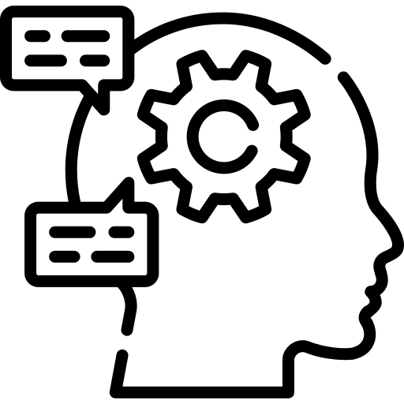
3 Days Workshop on AI, NLP and LLMs

Slide 2
Day 2: NLP with DL & LLMs
01
02
03
04
NLP with Deep Learning
Text Embeddings
Basic introduction to DL and how it made NLP powerful.
Representing text into numbers in better way and finalizing recommandation project.
Introduction to LLM
RAG & Vector Database
What is LLM, How do they work, How are they trained, How to use them ?
What is RAG ? What is vector databse ? How to use them (Hands on)

Slide 3
01. NLP with DL
What is deep learning? How DL made NLP powerful?

Slide 4
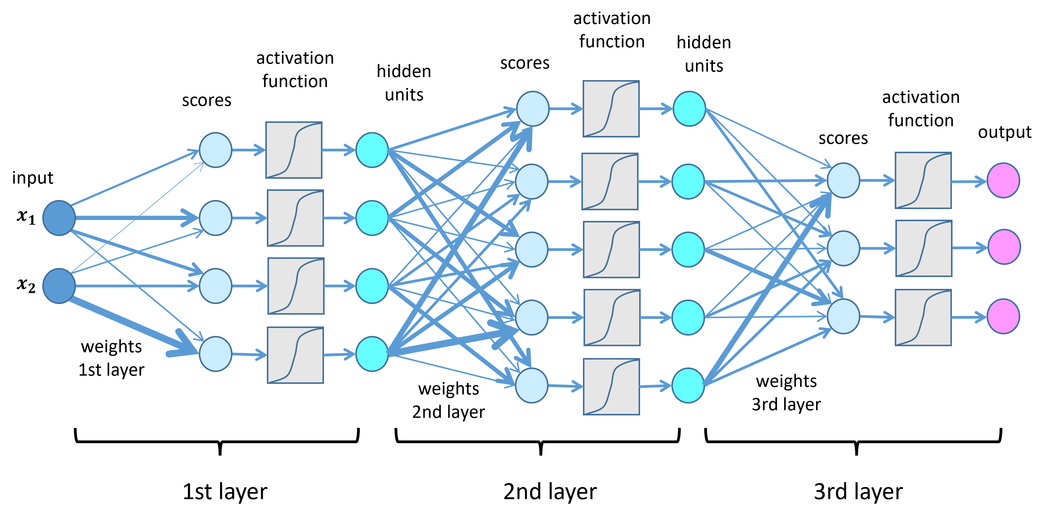
What is Neural Network ?
A neural network is a model that learns patterns from data
It has layers of "neurons" connected by adjustable weights
Learns by adjusting these weights from examples

Slide 5
Limitation of basic NN
They expect fixed-size input
They don’t understand order or context in sentences

Slide 6
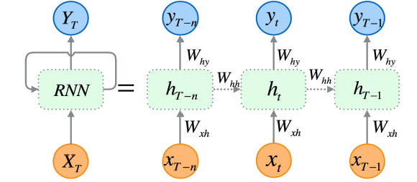
What is RNN ?
Designed to handle sequential data like text
Remembers previous words while processing the next one
Good for short sequences like simple sentences

Slide 7
Limitation of RNN
Hard to remember long-term context
Slow training and prone to forgetting
Struggles with long or complex sentences

Slide 8
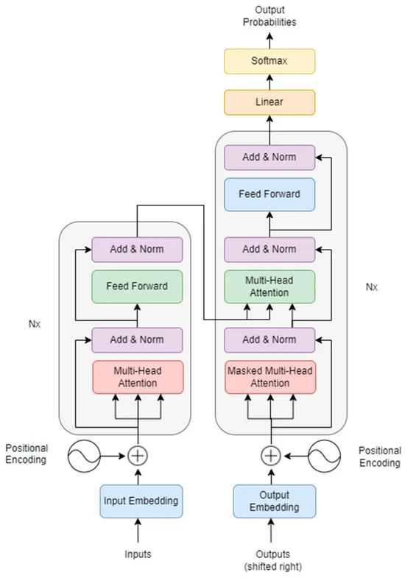
What is Transformer ?
Looks at the entire sentence at once
Uses attention to focus on important words
Fast, scalable, and works well with long texts

Slide 9
Why Transformers Made NLP So Powerful
Understands meaning in context
Learns relationships between all words, not just neighbors
Powers models like BERT and GPT

Slide 10
02. Text Embeddings
Representing text into numbers in better way and finalizing recommandation project.

Slide 11
What are embeddings ?
Traditional vectors don’t capture meaning, context or word order.
We want numbers that represent semantic meaning, not just position.
Embeddings turn text into dense vectors while capturing meaning behind word.
Word with similar meaning have similar embeddings.

Slide 12
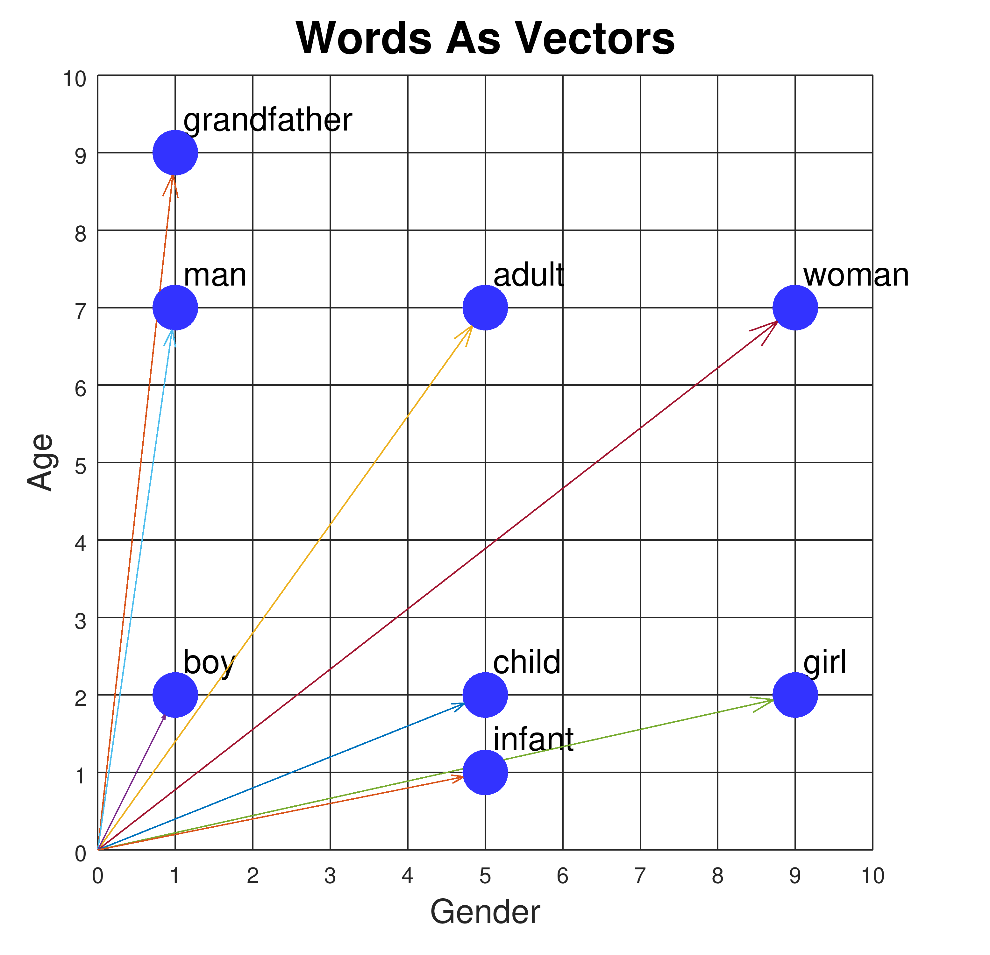
Word2Vec and GloVe
It is the first context based word embedding.
Word2Vec learns word meaning from surrounding words.
GloVe Combines word co-occurrence with neural embeddings and improves quality by looking at entire corpus statistics
BUT 1 vector per word, Apple has same vector for both fruit and company.

Slide 13
ELMo – Embeddings Of Language Models
First contexutal embedding.
Uses deep bi directional LSTM (Improved version of RNN)
Bank gets different embedding in “river bank” and “money bank”
Slow and not great for sentence level task.

Slide 14
BERT – Deep Transformer Embeddings
Uses Transformers to get deep, bidirectional context
Outputs embeddings for each words.
Pretrained on massive corpora (e.g., Wikipedia)
Great for downstream tasks (search, Q&A, etc.)
But it’s a bit heavy to run and isn’t designed to return a single vector for a sentence, which we often need.

Slide 15
Sentence Transformers
Built on top of BERT.
Returns a single vector for a full sentence
Trained for similarity/search directly
Perfect for semantic search, clustering, recommendations

Slide 16
Morden Embeddings & Beyond
Trained on huge datasets with powerful transformer models.
Capture deep semantic relationships.
Work across languages, topics, tasks.
Used in ChatGPT, semantic search, LLM agents.
Are extremely rich, general-purpose.
BUT usually paid APIs, not open-source.
E.g. OpenAI, Cohere, or Google Embeddings.

Slide 17
“Continue From Jupyter Notebook...”

Slide 18
03. Introduction to LLM
What is LLM, How do they work, How are they trained, How to use them ?

Slide 19
What are LLMs ?
Deep learning models trained on massive text datasets.
Learn to predict the next word in a sentence.
Can generate, summarize, translate, and answer questions.
Examples: GPT, LLaMA, Claude, Gemini.

Slide 20
How LLMs work ?
Given: “The cat sat on the…” → model predicts: “mat”
Do this billions of times across internet-scale data. Eventually they learn grammer, logic, factual knowledge, style and tone.
It’s not memorizing, it’s learning patterns.
Given text is converted into tokens, each token is converted into vectors, LLM uses attention to process all token at once and predics the next token one at a time.
Predicting next word is powerful, because it requires understanding the topic, maintains tone and structure and handles logic reasoning and even some math.
So bacically Super AutoComplete.

Slide 21
Prompt Engineering
Prompt is just text input to guide the AI's response.
Clear, specific prompts give better and more accurate results.
Adding context like role, goal, or examples helps AI understand intent.
Breaking tasks into steps improves reasoning and output quality.
Good prompting is trial and error — refine until it works well.
Explore more at promptingguide.ai

Slide 22
“Continue From Jupyter Notebook...”

Slide 23
04. RAG and Vector DB
What is LLM, How do they work, How are they trained, How to use them ?

Slide 24
Problems with LLMs
LLMs can’t access your private, recent, or external data.
They often make up facts or hallucinate confidently.
Updating their knowledge requires costly retraining or fine-tuning.
They struggle with long documents or large context windows.
Answers are not grounded — you don’t know where the info came from.

Slide 25
RAG: Retrieval-Augmented Generation
RAG is a method that combines LLMs with external data sources.
It retrieves relevant info from documents before generating an answer.
Uses embeddings to semantically match your question with stored chunks.
The LLM then uses both the prompt and retrieved data to respond.
Great for building “Chat with your data” apps using PDFs, wikis, etc.

Slide 26
Vector Database
A vector DB stores your document chunks as embeddings (vectors).
It enables fast similarity search based on meaning, not exact text.
Embeddings are generated using models like OpenAI, BERT, or SentenceTransformers.
Popular vector DBs: FAISS, Chroma, Pinecone etc.
It’s the key component that helps RAG find the right info efficiently.

Slide 27
“Continue From Jupyter Notebook...”

Slide 28
Thank You !

