Slide 1

ASM

Slide 2
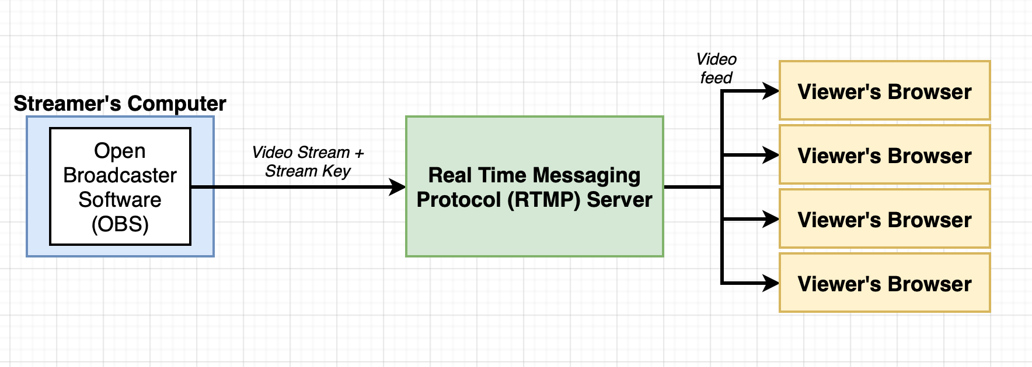
App Overview

Slide 3
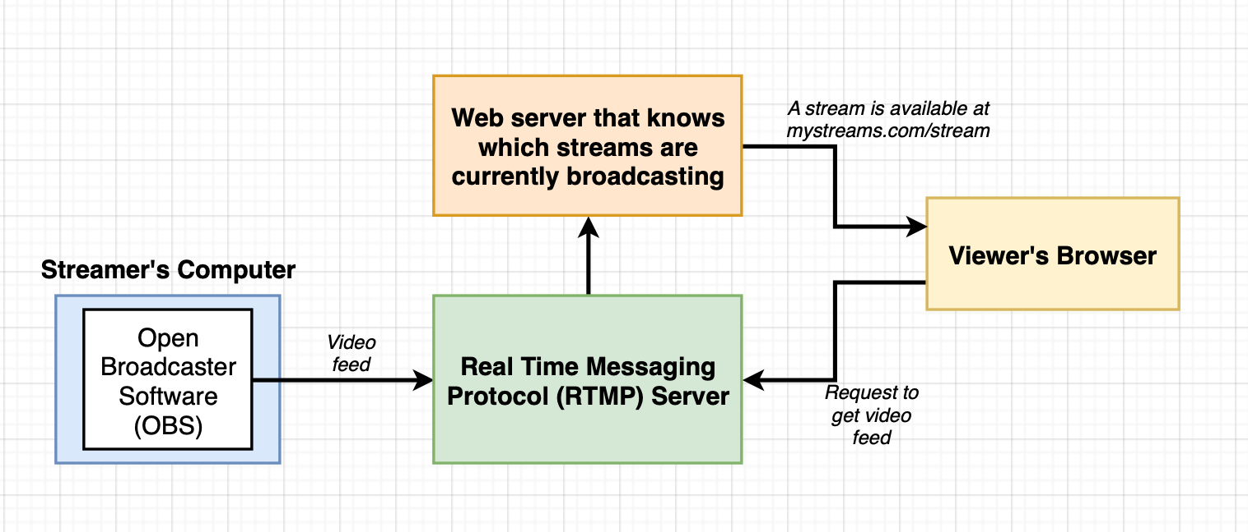
App overview

Slide 4
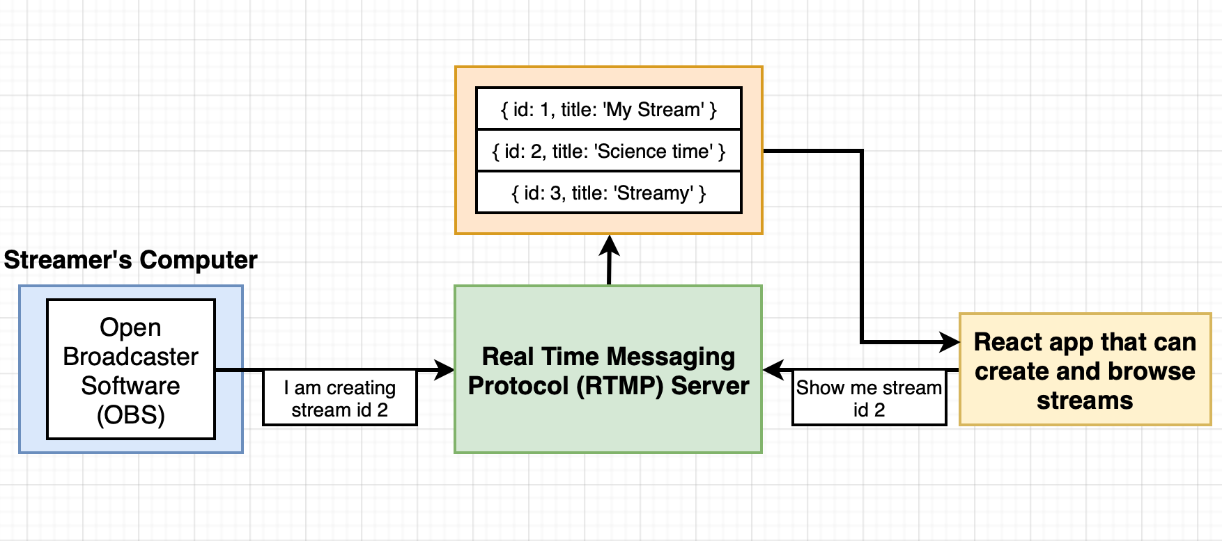
App Overview

Slide 5
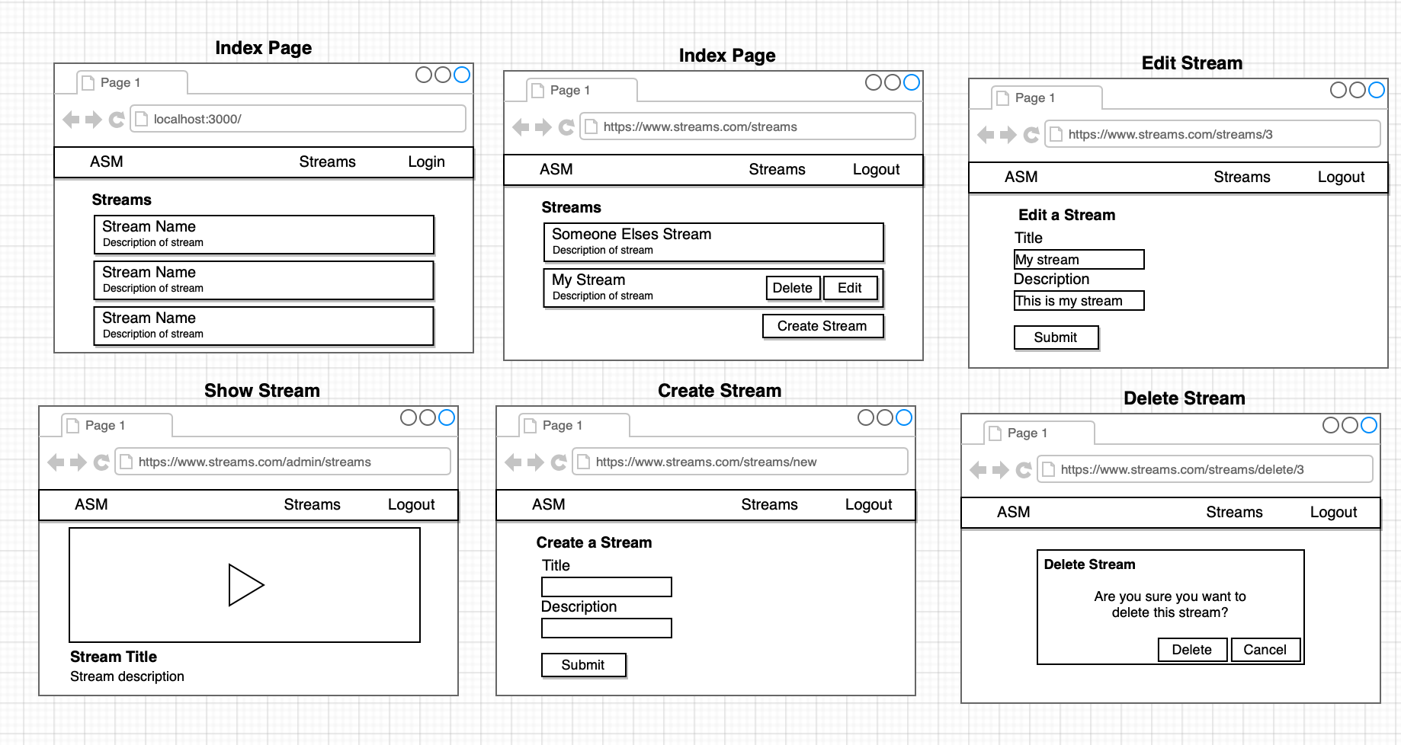
App Mockup

Slide 6
Project Challenges
Need to be able to navigate to separate pages in the app
Need to allow users to Login/Logout
Need to handle forms in Redux
Error Handling

Slide 7
Navigation - <a> tags
Can’t use conventional HTML anchor tags in a React app
Browser would make a request to the server (localhost:3000)
The development server responds with an index.html file
Browser receives the index.html file, dumps the old index.html file it was showing (including all of the React/Redux State data!; javascript variables/data)
App starts up for the second time without any data previously entered by a user
Use Links!

Slide 8
Navigation - Links
User clicks on a <Link>
React Router prevents the browser from navigating to the new page and fetching new Index.html file
URL still changes
Browser Router takes care of this.
This is why React apps are Single Page Applications.

Slide 9
User Authentication using google O-Auth USER’S BROWSER
User clicks on ‘Login with Google’
I use Google’s JS library (gapi) to initiate the O-Auth process
Jump to Point 1 in the GOOGLE SERVERS
Google’s JS library invokes a callback in the React App
Callback is provided with an authorization token and user information

Slide 10
User Authentication GOOGLE SERVERS
Google’s JS library makes authentication request to Google
Google Displays confirmation screen to user in a popup window
User Accepts & popup window closes
Jump to point 3 in USER’S BROWSER

Slide 11
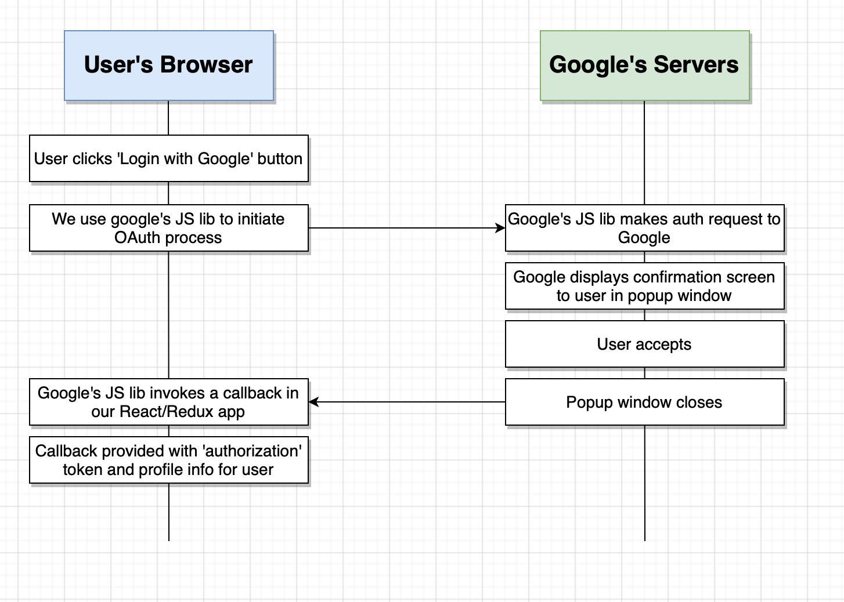
Authentication

Slide 12
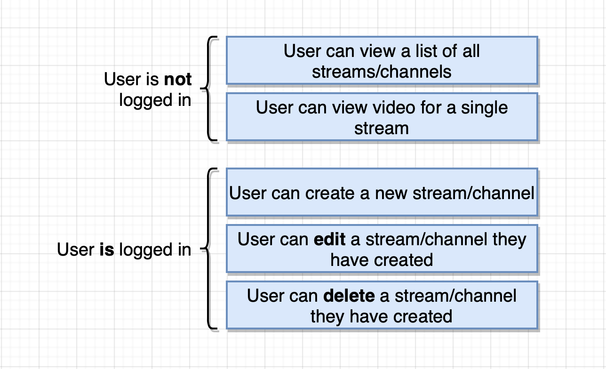

Slide 13
A little about gapi
The gapi library is extensively used all over the internet
When you first load up gapi, it simply has one method tied to it – the ‘load’ function
You then literally have to load up any other functionality you require using this load function.
This extra functionality is then added to the gapi library
Gapi.load(‘client:auth2’)

Slide 14
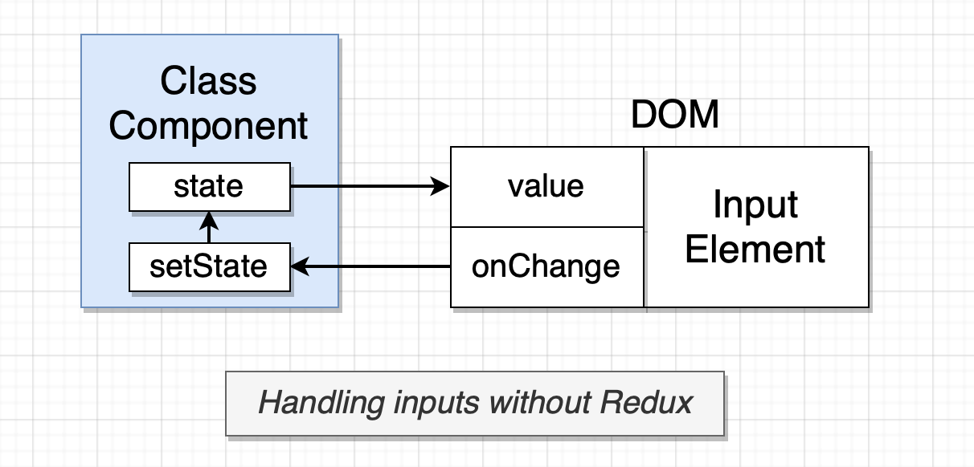
Handling inputs without redux

Slide 15
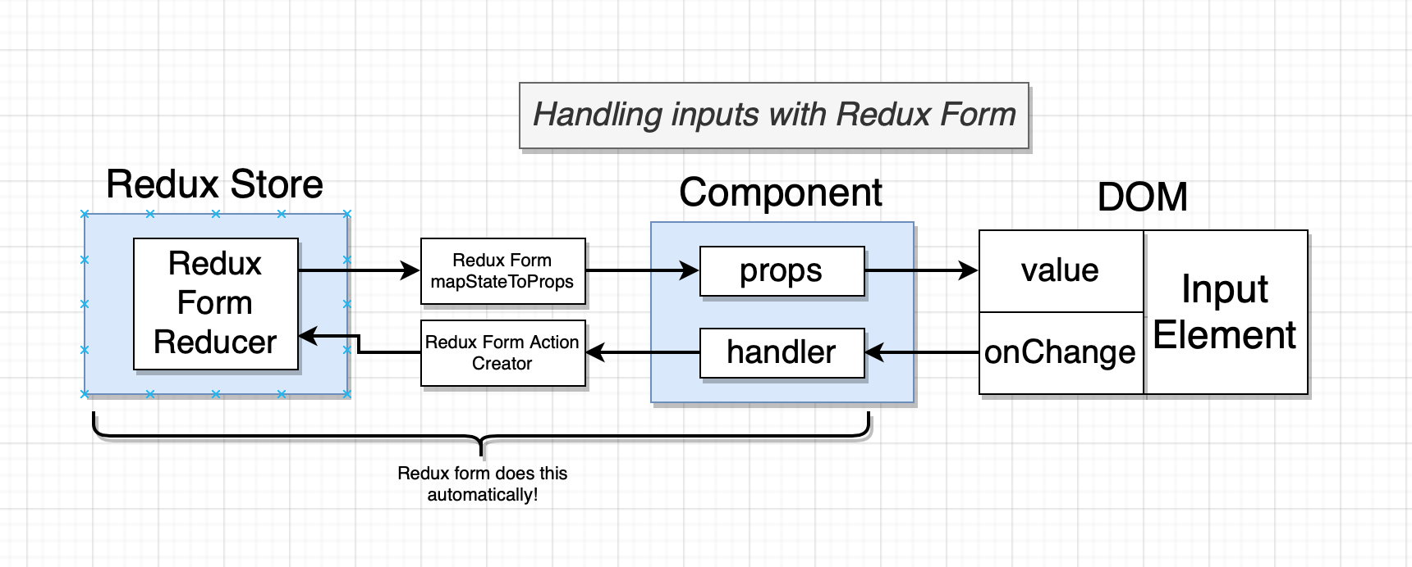
Handling input with redux-form

Slide 16
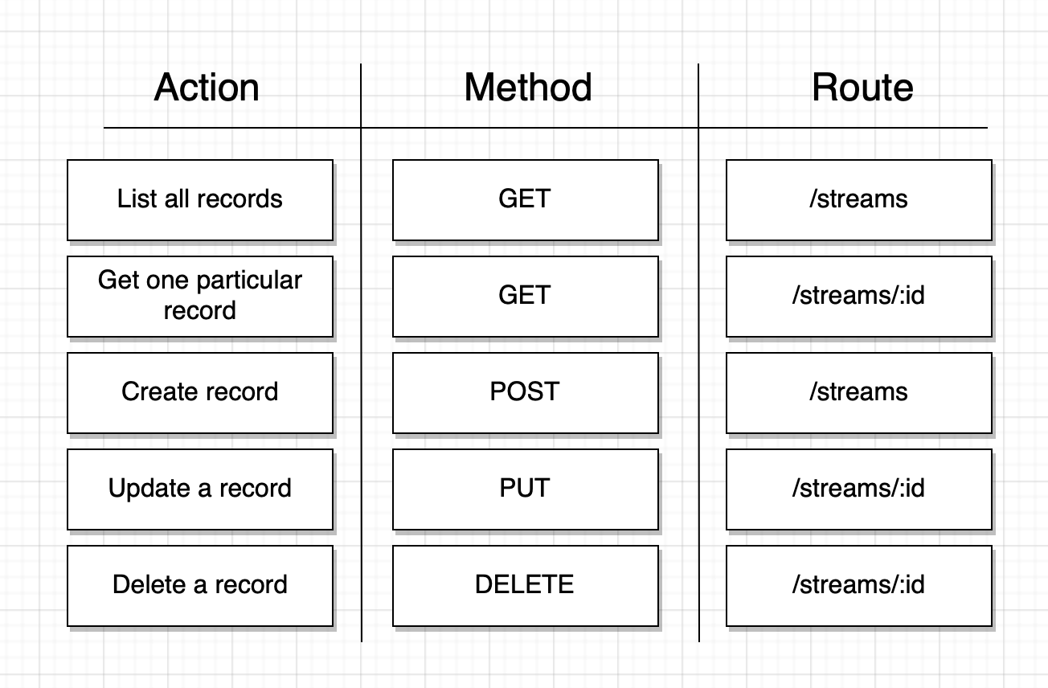
Using JSON server for implementing RESTful API

Slide 17
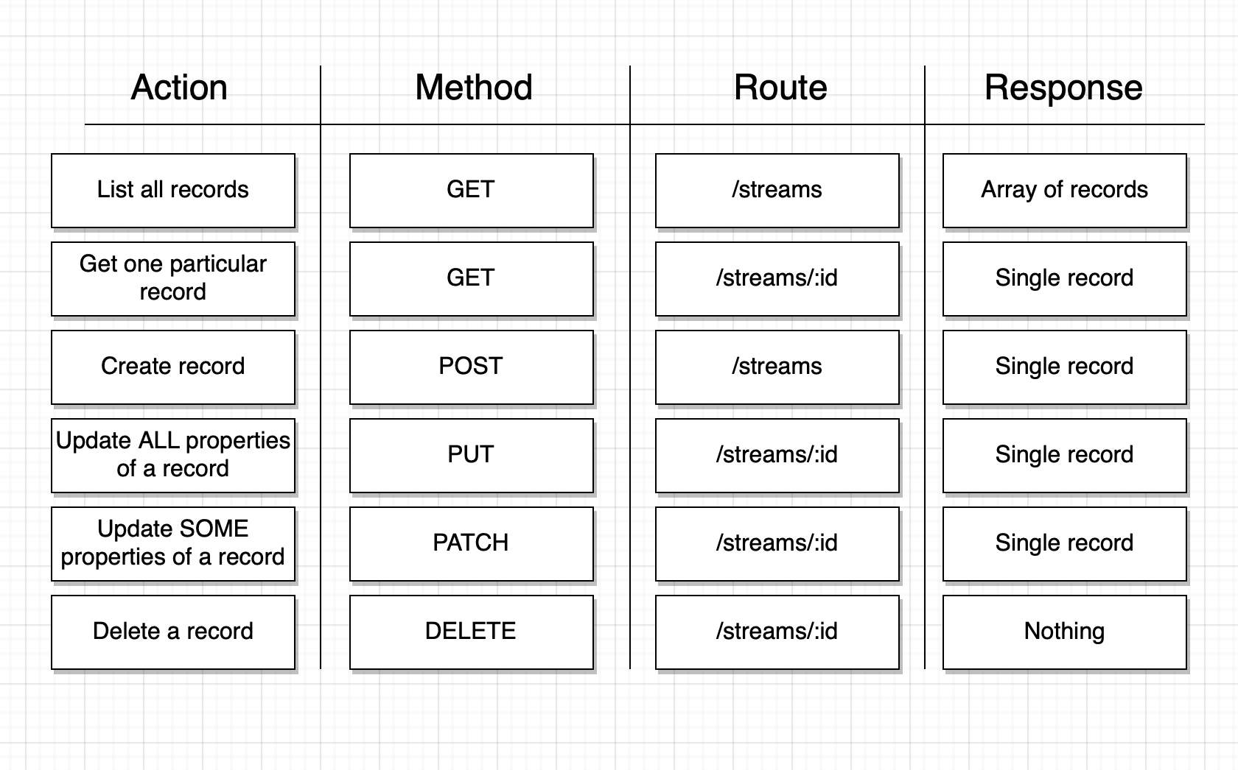
Response from the api server

