Slide 1


Bank Customer Churn Analysis
Leveraging Data to Drive Customer Retention Strategies
Presented by:
U.Sudarshan
P.Sai Teja

Slide 2
Problem Statement
The bank is experiencing a high customer churn, which is significantly impacting its revenue and customer acquisition costs. The lack of a data-driven approach to understanding the underlying factors contributing to customer attrition has resulted in ineffective retention strategies. This problem is further expanded by the inability to identify high-risk customer segments and implement targeted interventions. As a result, the bank is losing valuable customers, particularly in key demographics such as older customers, inactive members, and those with higher balances. Addressing this issue is critical to improving customer retention, reducing acquisition costs, and enhancing overall business profitability.

Slide 3
Objective of the Project
This project analyzes bank customer churn using a dataset sourced from Public Repositories to identify the key factors influencing customer attrition. The main goals are:
Understanding Customer Churn Patterns
Developing Data-Driven Insights
Applying Machine Learning Models
Providing Actionable Business Recommendations
Enhancing Business Profitability
By achieving these objectives, the bank can implement effective strategies to retain valuable customers and optimize business growth.

Slide 4
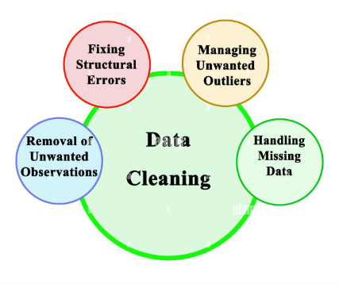
Dataset Overview
Dataset contains 10,000 rows and 14 Columns
Target Variable : Exited (1=churned, 0=not churned
Categorical Variable: Geography, Gender
Numerical Variable : Credit Score, Age, Balance, Tenure, Estimated Salary, etc
No missing values detected.
Data Cleaning
Dropped unnecessary columns : (Row Number, Customer Id, Surname)
Encoded categorical variables:
Gender: Male → 1, Female → 0.
Geography: One-hot encoded (Geography Germany, Geography Spain)
No duplicate records found.
Outliers are present in the following columns: ['Age', 'Credit Score', ‘Num Of Products’] & Outliers have been transformed by capping them within the valid range.

Slide 5
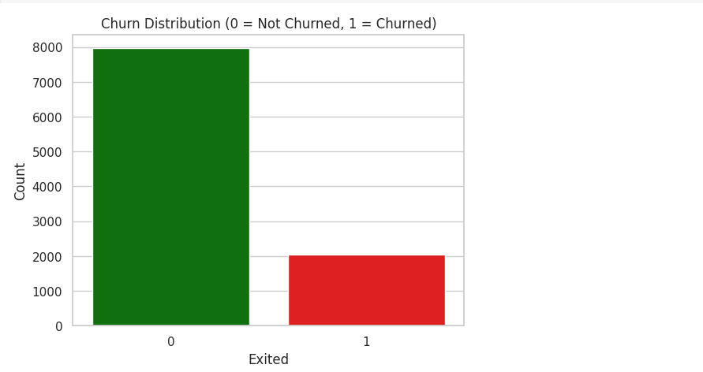
Target Variable Distribution
Exited = 0 (Not Churned): The majority of customers have stayed with the bank, as indicated by the large green bar.
Exited = 1 (Churned): A smaller proportion of customers have left the bank, represented by the red bar.
Key Observations:
Customer churn is significantly lower compared to customers who stayed, indicating an
imbalance in the dataset.
This imbalance might require special consideration (e.g., resampling techniques) during model development to ensure accurate predictions.

Slide 6
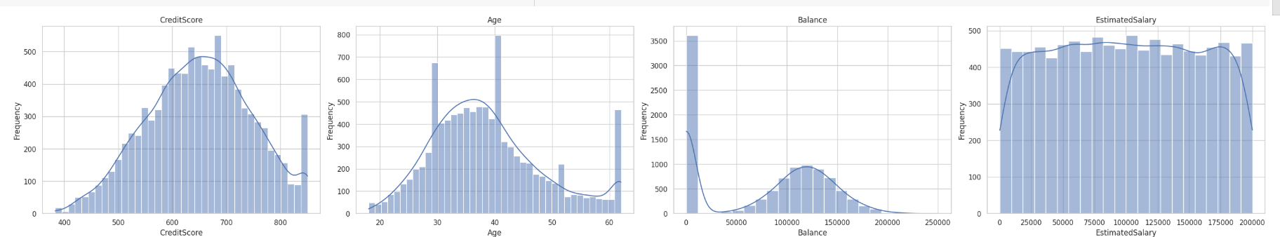
Data Distribution for numerical features
Credit Score and Age: These may correlate with churn, as customers with lower credit scores and older ages might be more prone to leaving.
Balance: The high number of customers with zero balances could signify disengaged customers, which might increase the risk of churn.
Estimated Salary: Salary does not seem to be a strong predictor of churn due to its uniform distribution.
v

Slide 7
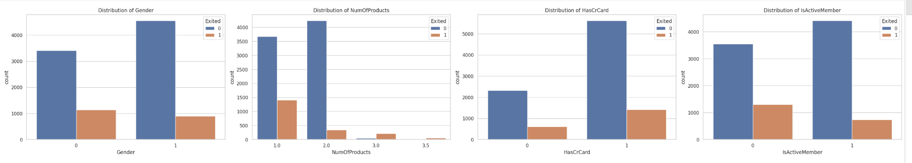
Data Distribution for Categorical features vs Target Variable
Gender:
The proportion of exited customers (Exited = 1) seems higher for female (0) compared to males (1).
Females are more likely to exit compared to males in this dataset.
Num Of Products:
Customers with 1 product are more likely to have exited than those with 2 products.
Very few customers with 3 or 4 products exited, indicating customer retention might improve with higher product engagement.
Has CrCard:
The presence or absence of a credit card does not appear to significantly impact customer exit rates. Both groups have similar proportions.

Slide 8
IsActiveMember:
Inactive members (IsActiveMember = 0) are less likely to exit compared to active members (IsActiveMember = 1).
Inactivity seems strongly correlated with customer churn.
Insights:
Focus retention efforts on inactive members and encourage them to increase product usage.
Investigate why females have a higher churn rate and address their concerns.
Credit card ownership might not be a strong indicator of customer churn in this dataset.

Slide 9
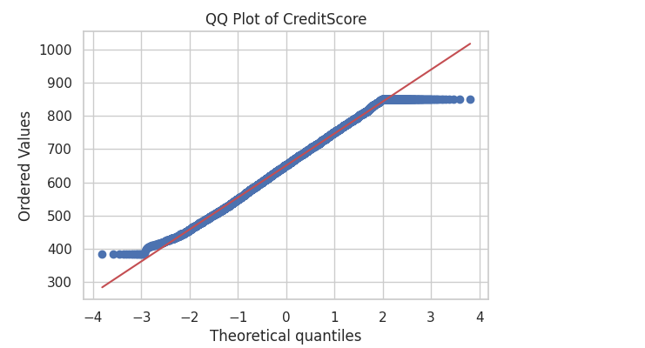
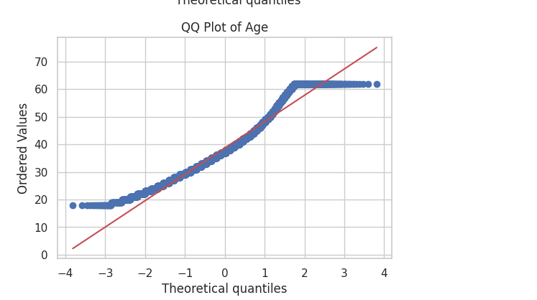
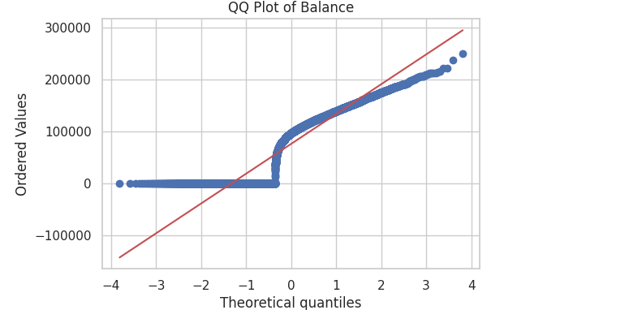
Statistical Test
Chi-Square test.
Gender vs. Churn p-value=0.0024 (p < 0.05) → Significant relationship (Gender impacts churn).
Geography vs. Churn p-value=0.0036 (p < 0.05) → Significant relationship (Geography impacts churn).
Mann-Whitney U Test:
Balance vs. Churn p-value=0.0043 (p < 0.05) → Significant difference (Balance influences churn).
QQ Plots:
Age & Credit Score show some deviation from normality.
Balance highly skewed (suggesting transformation or non-parametric models).

Slide 10
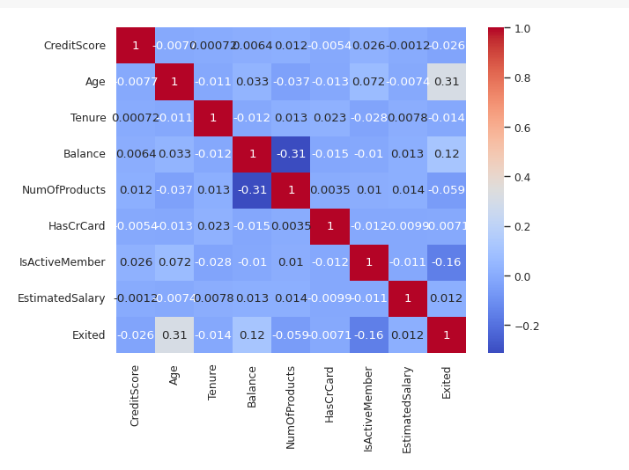
Key Observations
Age and Exited:
Balance and Exited:
Positive but weak correlation (0.12), suggesting that higher balance might be slightly related to churn.
3. Is Active Member and Exited:
Negative correlation (-0.16), meaning less active members are more likely to churn.
4. Other Features:
Moderate positive correlation (0.31), meaning older customers are more likely to churn.
Most features have very weak correlations with Exited, indicating that they might not individually
explain much of the churn.
Actionable Insights
Focus on features with stronger correlations to Exited (ex: Age, is active member, Balance)
Weakly correlated features might still contribute when combined in a multivariate model.
(
Check pairs like Balance and Num Of Products with moderate negative correlation (-0.31). If both are included in a model, they might cause multicollinearity issues.

Slide 11
Model Building
Advanced Feature Selection Methods
Variance Threshold
Select K – Best (Chi Square Based)
Mutual Information
Recursive Feature Elimination
Feature Scaling (Standardization)
Train-Test Split
Train the model Classification models like Logistic Regression, Decision Tree, Random Forest
Evaluate Performance (Accuracy, Precision, Recall, F1-score)
Hyperparameter Tuning using GridSearchCV

Slide 12
Business Conclusion
The analysis of customer churn data has provided valuable insights into the key factors driving customer attrition. By leveraging these insights, the bank can implement targeted retention strategies that address the specific needs of high-risk customer segments. This data-driven approach will not only reduce the churn rate but also improve customer satisfaction and loyalty, leading to long-term business growth and increased profitability. The problem statement is validated by the high churn rate and the identified factors, proving the need for immediate action to mitigate customer attrition.

Slide 13

THANK YOU

