Slide 1


Data Analysis of Flipkart Mobile Sales
Team Members
Suraj Japthi (Batch 318)
Sudarshan Usa (Batch 318)
Ganesh Puvvala(Batch 318)

Slide 2
Problem Statement
Many travel companies and tourism agencies aim to understand customer preferences for vacation destinations—mountains or beaches. By analyzing customer data, we can predict whether an individual is more likely to prefer a mountain or beach vacation.
This prediction helps businesses personalize travel recommendations, optimize marketing strategies, and improve customer satisfaction.

Slide 3
Objective: Predicting Vacation Preferences
📌 Understand Customer Preferences
Identify patterns in vacation choices (Mountains vs. Beaches).
Analyze demographic and behavioral factors influencing decisions.
📌 Enhance Business Decision-Making
Personalize vacation recommendations for customers.
Optimize marketing strategies based on predicted preferences.
📌 Build an Accurate Prediction Model
Train and evaluate machine learning models.
Select the best-performing model for accurate predictions
.
📌 Improve Customer Experience
Provide tailored travel packages.
Boost engagement and customer satisfaction.

Slide 4
Summary of the Data
Dataset Size: 52,444 rows × 14 columns
Key Features:
Age, Gender, Education Level, Location, Income, Vacation Budget, Travel Frequency, Preferred Activities, Favorite Season, Pets, Environmental Concerns, Proximity_to_Mountains, Proximity_to_Beaches
Target Variable: Preference
No Missing Values: All columns have complete data (52,444 non-null values).
Feature Types:
Categorical: Gender, Education Level, Location, Preferred Activities, Favorite Season,
Numerical: Age, Income, Vacation Budget, Travel Frequency, Pets, Environmental Concerns, Proximity_to_Mountains, Proximity_to_Beaches

Slide 5
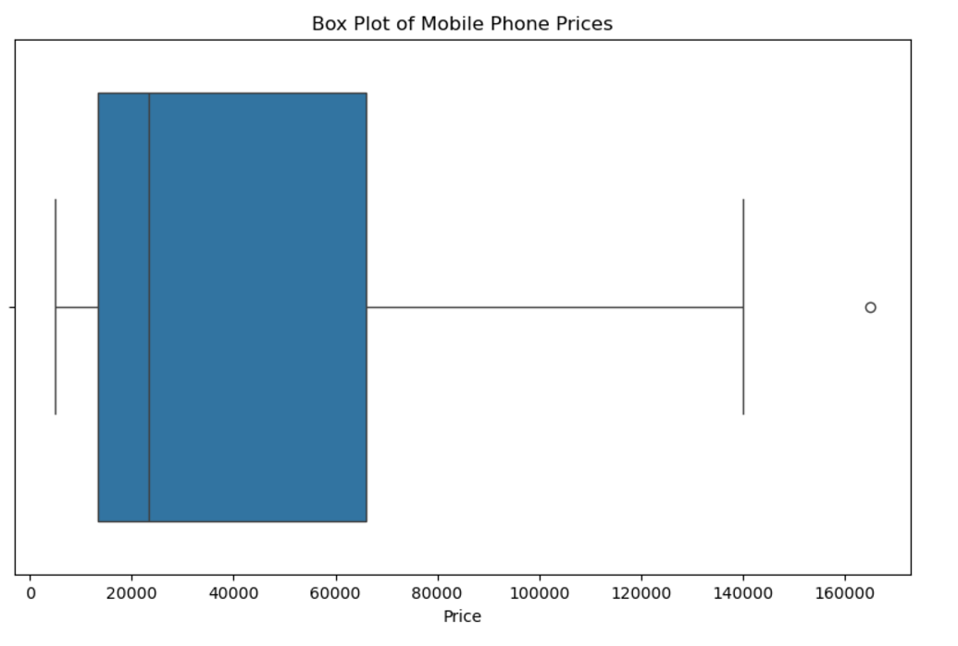
Price Distribution
The box plot visualizes the distribution of the Price column in the dataset. The box represents the interquartile range (IQR), which spans from the 25th percentile (₹13,452.5) to the 75th percentile (₹65,999.0).

Slide 6
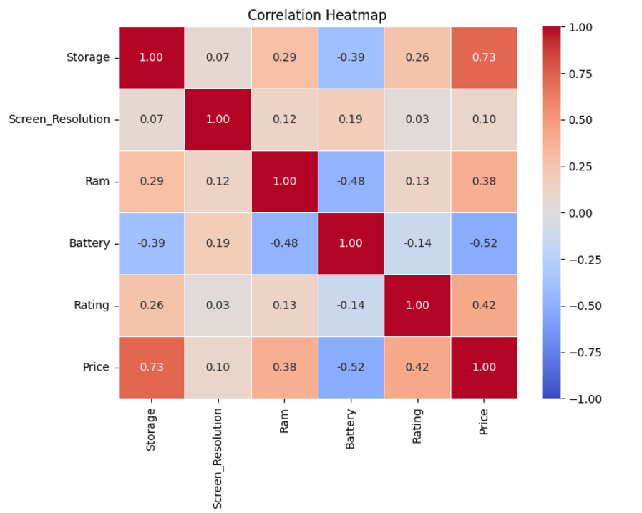
Based on the correlation heatmap
Price has the strongest positive correlation with Storage (correlation = 0.73). This indicates that as storage increases, price tends to increase significantly.
It also has a moderate positive correlation with Rating (correlation = 0.42) and RAM (correlation = 0.38), suggesting a weaker but still positive relationship.

Slide 7
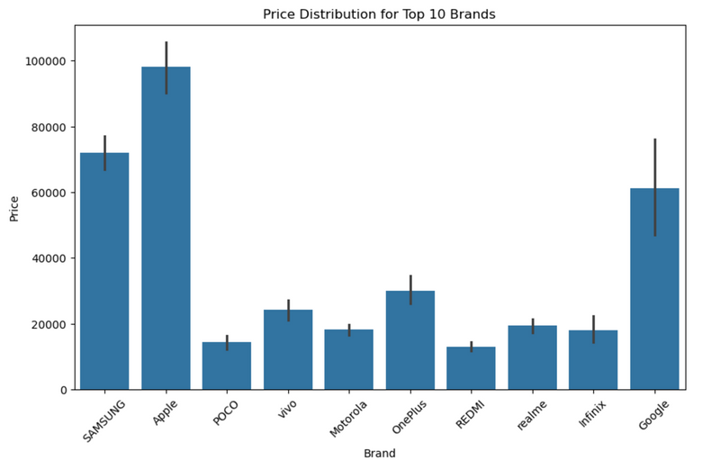
Price Distribution for Top 10 Brands
Observations:
Samsung and Apple Have the widest price ranges among all brands.
Google shows a wide price range, similar to Samsung and Apple, though with fewer models compared to these brands.
POCO, Redmi, and Realme represents brands with budget-friendly devices.

Slide 8
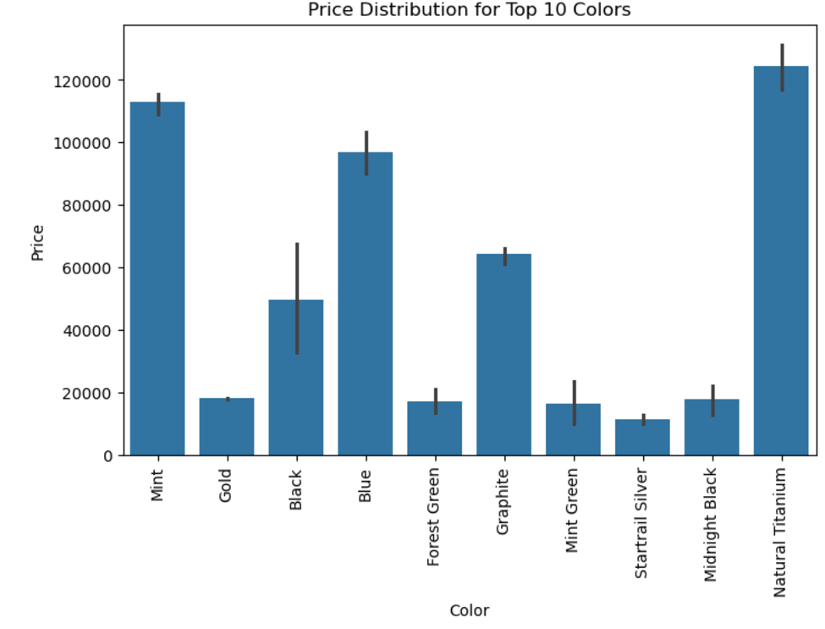
Price Distribution for Top 10 Colors
Insights:
Natural Titanium stands out as the most expensive, with an average price above 120,000, and relatively small variation in prices. Mint is also among the high-end colors, with prices nearing 100,000.

Slide 9
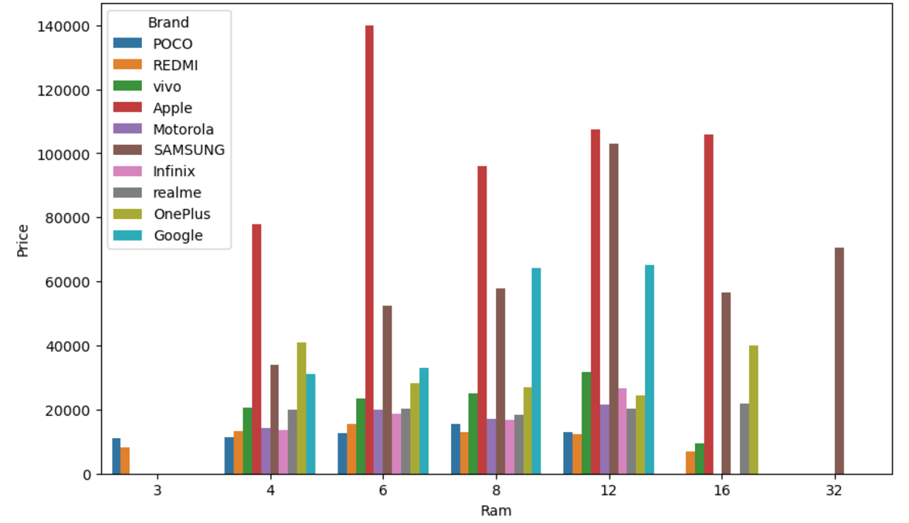
Average RAM size (in GB) and Price across different Brands
Phones with larger RAM (e.g., 12GB, 16GB, or 32GB) tend to have significantly higher average prices than those with smaller RAM (e.g., 3GB or 4GB)
Brands like Samsung, Google, and OnePlus generally occupy mid-to-high price ranges for larger RAM sizes.

Slide 10
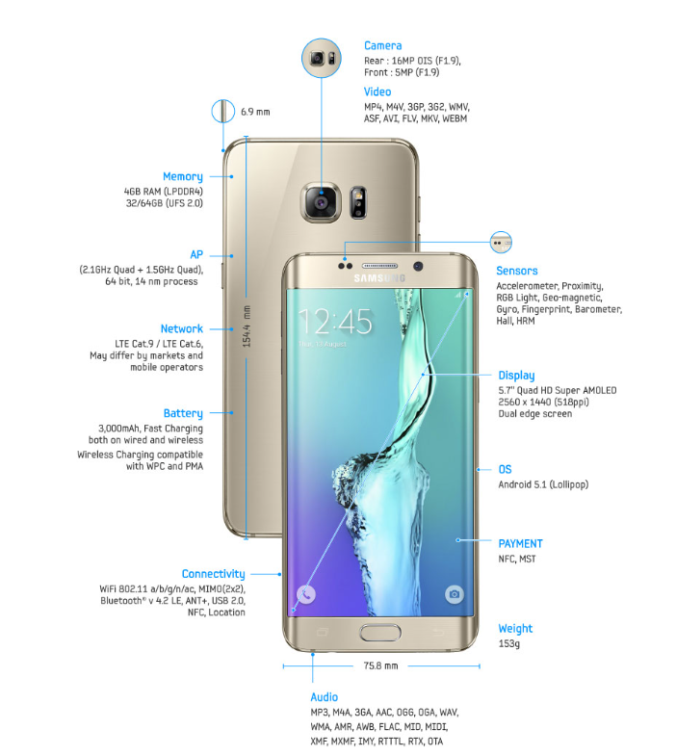
Conclusion
Features Impacting Mobile Prices
RAM (Random Access Memory):
Higher RAM directly correlates with higher prices.
Premium brands typically offer larger RAM options.
Storage Capacity:
Devices with higher storage options (e.g., 128GB, 256GB) are priced higher.
Battery Capacity:
Larger batteries (e.g., 5000mAh) generally lead to higher costs.
Price impact varies across brands.
Brand Value:
Premium brands (e.g., Apple, Samsung) charge significantly more.
Brand reputation plays a crucial role.
Screen Resolution & Display Technology:
Higher resolutions (e.g., Full HD, AMOLED) are priced at a premium.
Ratings and Reviews:
Higher-rated products often command better prices, reflecting customer trust.

Slide 11

THANK YOU

