Slide 1

Hypothesis of ROOF PAINT

Slide 2
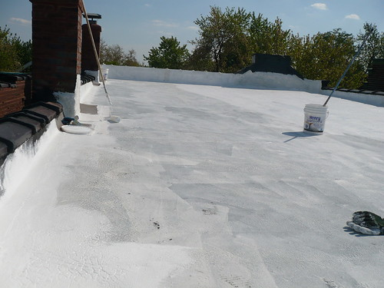
Advertisement from the indigo
Roof paint reduces 5 % of heat of day today life
now we are going to find whether it is true

Slide 3
Data
Which colour choosing for an roof painting
white green yellow pink black light blue
mon 1 28 c’ 32 c’ 30 c’ 31 c’ 45 c’ 29 c ‘
mon 2 30 c’ 35 c ‘ 32c’ 34c ‘ 46 c’ 30 c’
mon 3 27 c’ 32 c’ 29 c’ 31 c’ 45 c’ 27 c’

Slide 4
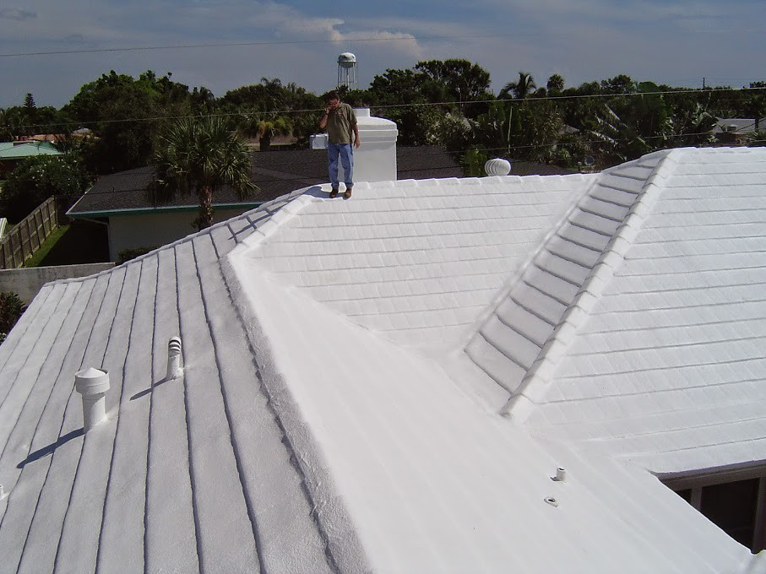
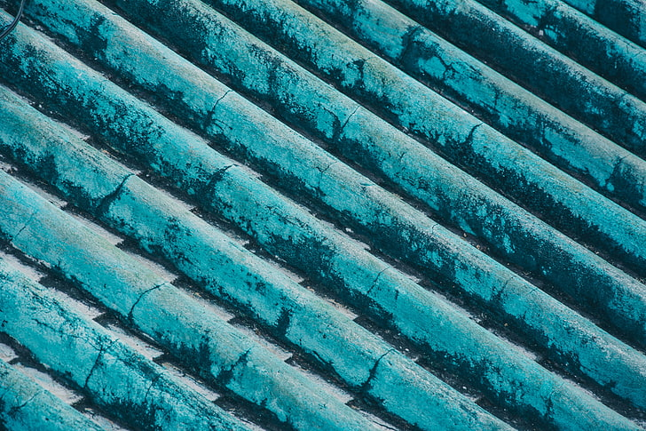
DATA
Data by two set of house
With roof paint without roof paint
mon 1 35 c’ 46 c’
mon 2 30 c’ 39 c’
mon 3 40 c’ 48 c’
mon 4 28 c’ 36c’
mon 5 32 c’ 37 c’

Slide 5
Hypothesis
Hypothesis for an with roofing paint and without roofing paint is
p=0.03417
which is less than 0.05 that is alpha

Slide 6
They claims it reduce 5%
From test p=0.03417
Alpha=0.05
Percentage=(8.2/100 )*100
Equals to % 8.2

Slide 7
conclusion
It is true ,room temperature reduced when we use roof paint of white in color

