Slide 1
Testing AJAX Web Applications with Selenium WebDriver in Java

Slide 2
Overview
WebDriver API
Simple Examples
Criticisms and Common Pitfalls
Patterns
Better Examples
Debugging
Our Process
Q&A

Slide 3
WebDriver API

Slide 4
WebDriver
Webdriver makes direct calls to the browser to drive actions the same way a user would
WebDriver is the interface that you code to, and each browser has an implementation.
For example, “new FirefoxDriver()”

Slide 5
Driver Implementations
AndroidDriver*
ChromeDriver*
FirefoxDriver
InternetExplorerDriver
IPhoneDriver*
OperaDriver*
PhantomJSDriver
SafariDriver
* Requires additional setup

Slide 6
Open A Page
Driver driver = new FirefoxDriver();
driver.get(“http://google.com”);

Slide 7
Finding Stuff
WebElement el = driver.findElement(By);
List<WebElement> els = driver.findElements(By)
or
WebElement child = el.findElement(By)
List<WebElement> els = el.findElements(By)

Slide 8
The Bys
By.id
By.name
By.xpath ← This is most common
By.tagName
By.cssSelector
By.className
By.linkText
new ByJavascript(“$(‘li:nth-child(2)’)[0]”);

Slide 9
Working With Elements
WebElement el = driver.find(By);
//interaction
el.click();
el.sendKeys(“Input value”);
//information
el.getAttribute(“name”);
el.isDisplayed();

Slide 10
Simple Example
Google search for PDX Selenium

Slide 11
A Note About Examples
I’ll try to mention all the “best practice” tidbits I’ve learned.
If I miss something you’d like to hear more about, just ask or yell “Hey Sean!”

Slide 12
Better Example
Check my RSVP status of next meetup

Slide 13
Avoiding Pitfalls
Especially relevant for AJAX applications

Slide 14
Get Good At Waiting
new WebDriverWait(driver, seconds).until(condition);
Predefined Waits:
ExpectedConditions.presenceOfElement
ExpectedConditions.elementToBeClickable
ExpectedConditions.alertIsPresent
More…
Make Your Own!
JxWaitUntil.javascriptEvaluatesToTrue
JxWaitUntil.nothingIsLoading
JxWaitUntil.activeElementHasProperty
More…

Slide 15
Stay In Scope
WebElement child = el.findElement(By…)
By.xpath
Must start with “.”
child = el.find(By.xpath(“.//button[text()=‘Add’]”)
ByJavascript
Pass element into script
child = (WebElement) JxActions.execute( “return $(arguments[0]).find(‘a:odd’)[2]”, el);

Slide 16
Wrap Page Interactions
With your AJAX application, helpful to wrap all actions and perform some common checks
Any unexpected modals on the screen?
Ext.Msg.isVisible() or .ext-el-mask-msg
Any outstanding requests?
jQuery.active === 0?
Anything else that would mean the user should wait?
CKEditor.isReady

Slide 17


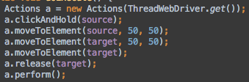
Easier To Read
JxActions.focus(el) JxActions.hover(el, ms)
JxActions.dragAndDrop(source, target)
JxActions.executeScript(js, args…)

Slide 18
Use Good Selectors
Scope your selector to logical areas of the page
Avoid selecting with common words like “Add” or “Edit”, unless properly scoped
It’s okay to add a class to your codebase
Jama uses a tool called Recess to enforce developers to NOT style ids or classes that begin with “js-”.
Learn XPATH

Slide 19
Completely Bypass RTEs!
Don’t bother with trying to “type” into rich text fields
It works, but not always!
Use JavaScript to just set the value
We hid this behind methods, in case we want to try again later

Slide 20
Patterns and Tips
Geared towards AJAX applications, but apply to all.

Slide 21
Common Criticisms
Fragile Tests
Tests fail whenever anything changes
Too many false test failures
Tests fail sometimes, but pass other times
Too hard to update tests with changes
Change a CSS class, need tons of test updates

Slide 22
Why AJAX applications are hard
Tests keep running while page changes asynchonously
Need to figure out what to wait for
Lots of DOM on the screen
Need well-scoped selectors
Browser performance can change results

Slide 23
Design To Protect Your Code
Tests should interact with objects, not the page
Avoid any selectors in your tests
Keep logic hidden under your API
Reuse code as much as possible
Write your API so that it can be reused in other tests
Assert the state of the page regularly

Slide 24
PageObject Pattern
Pages may know how to get to themselves
Provides an API to interact with the page
Hides the underlying HTML details
Can make assertions about the state before returning from any given method
Methods can return other Page Objects, modeling the user navigating through the application

Slide 25
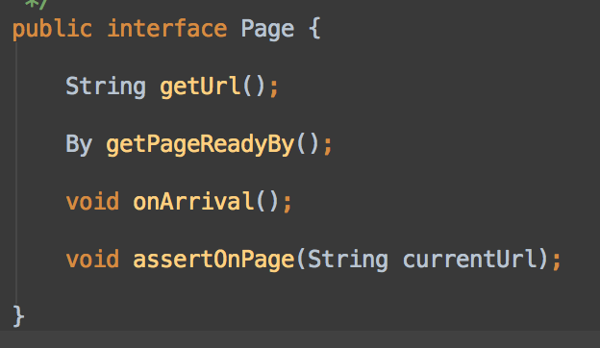
Page Interface

Slide 26
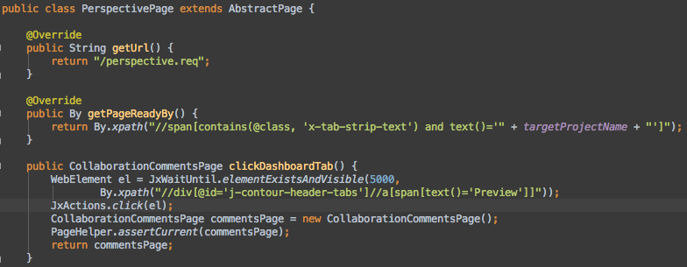
Real PageObject from Jama

Slide 27
PageElement Pattern
PageElements are like PageObjects, hiding implementation details and providing an API to interact with the element
The only contract is that they have a root element
For complex pages, divide logical areas into PageElement classes
“Navigate” to PageElements like you would a PageObject
page.getLeftNav()

Slide 28
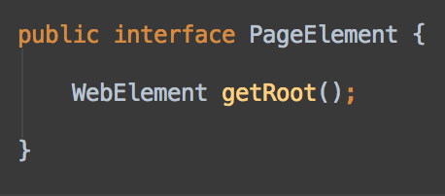
PageElement Interface

Slide 29
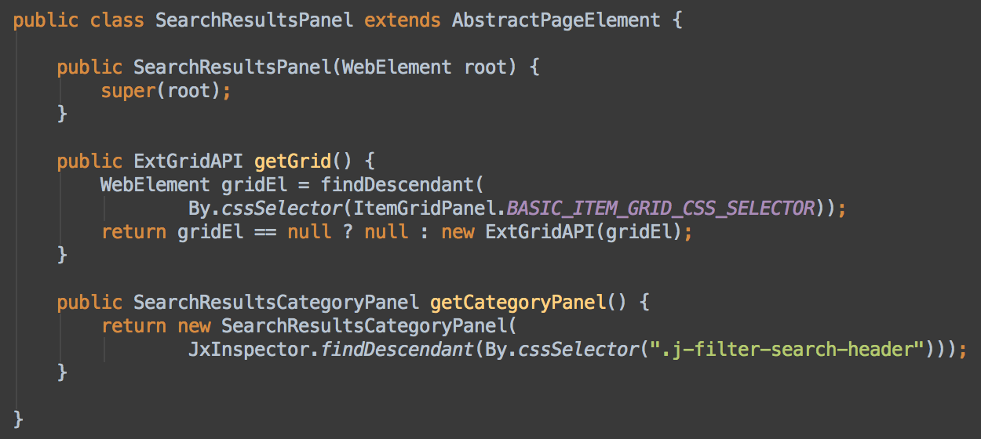
Real PageElement in Jama

Slide 30
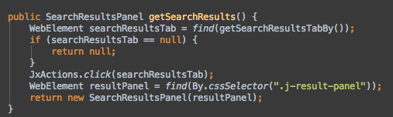
Example PageElement Retrieval

Slide 31
Meetup Example - Better
Meetup example with PageObjects!

Slide 32
Real Example Test
How we are using WebDriver to test creation of a List

Slide 33
Is It Really That Easy?

Slide 34
No, Not Always!
Debugging can be painful
You WILL write tests that pass sometimes and fail other times
Give yourself the tools to diagnose and fix
Keep getting better
“Don’t write code today that you can’t debug tomorrow!”

Slide 35
Some Things We Do
Known dataset to test against
Easier to create complex scenarios
Using Chef, a server is completely wiped and re-installed before tests begin
CI runs WebDriver on a VNC display
Maybe we can see one right now
Tests are recorded using vnc2flv
Actions can be written to the VNC display using osd_cat
We tried SauceLabs, but weren’t successful

Slide 36
Our FirefoxDriver
Check out the Firefox Preferences
app.update.enabled = false
never auto-update
browser.startup.page = 0
open at about:blank
browser.shell.checkDefaultBrowser = false
Don’t check default browser
Extensions
Firebug support
FirefoxProfile p = new FirefoxProfile();
p.setPreference(key, value);

Slide 37
Other Minor Things
ThreadWebDriver makes it so you can get the WebDriver instance anywhere in code
Less code to write
Restart browser before every test
Firefox can hang
Time limit for tests runs
Test can hang

Slide 38
Key Takeaways

Slide 39
Main Things To Remember
Create PageElements for logical areas of the application
Be sure to scope selections inside root el
No selectors in the test
Everything should be done in PageObjects or PageElements
Wait, don’t Sleep
Even if an element is already there, sometimes I’ll use JxWaitUntil.elementIsVisible just to future-proof
Avoid CKEditor!

Slide 40
Our Process

Slide 41
Who Writes Tests
Right now, developers are responsible for writing WebDriver tests
Sometimes CSS classes need to be added to the codebase
These are basically the Integration Tests for the front-end

Slide 42
When Do We Write Tests
We try to have a test for each Acceptance Criteria for any new features/stories
Any regression bug is exposed with a test first

Slide 43
When Are Tests Run
Right now, the entire test suite is run on every check-in
We develop on Git branches, and only after build is green do we merge to master
Tests can take awhile, but Git makes it easy to just Push and work on something else until the tests finish
We are looking into running a subset of tests for every commit, and the full suite on master

Slide 44
Q&A
Sean Adkinson
sadkinson@jamasoftware.com
@seanadkinson
https://github.com/seanadkinson/webdriver-examples

