Slide 1
Administrative
RUTGERS UNIVERSITY Computer Sciences Department
CS 416 Operating Systems Design
Sudarsun Kannan
HW-0 Self Assessment Released
Exokernel paper review – Due Tuesday before the class
Also read book chapters 1-24 if you would like refresh concepts
HW-1 (Measuring system call cost will be announced next week)

Slide 2
Traditional OS services – Management and Protection
Provides a set of abstractions
Processes, Threads, Virtual Memory, Files, IPC
APIs, e.g.,: POSIX
Resource Allocation and Management
E.g., Memory Management
Protection and Security
Concurrent execution
Notes:
Why resource management?
- resource are shared for efficiency
- fairness
- Scheduling, VM

Slide 3
Memory Management in Linux - Quick Recap
Q: What is a virtual memory?
Q: What is virtual address translation?
Q: How virtual address translation work?
Q: Is malloc() a system call?
Q: When does a OS allocate memory
Q: What is a page fault?
Q: What is a TLB?
Refer to book chapters 12– 24
Also refer to supporting virtual memory slides that will be added in a day

Slide 4
Paging
Goal: Eliminate requirement that address space is contiguous
Eliminate external fragmentation
Grow segments as needed
Idea: Divide address spaces and physical memory into fixed-sized pages
Size: 2^{n}, Example: 4KB
Physical page: page frame
Code
Physical View
Heap
Stack
Heap
Heap
Process 1
Process 3
Process 2
Logical View

Slide 5
Translation of Page Addresses
How to translate logical address to physical address?
High-order bits of address designate page number
Low-order bits of address designate offset within page
20 bits
12 bits
32 bits
page number
page offset
Logical address
translate
frame number
page offset
Physical address
No addition needed; just append bits correctly…
How does format of address space determine number of pages and size of pages?

Slide 6
Multilevel Page Tables
Goal: Allow each page tables to be allocated non-contiguously
Idea: Page the page tables
Creates multiple levels of page tables; outer level “page directory”
Only allocate page tables for pages in use
Used in x86 architectures (hardware can walk known structure)
30-bit address:
outer page (8 bits)
inner page (10 bits)
page offset (12 bits)
base of page directory

Slide 7
Multilevel Page Tables
Q: Assume a system with 48-bit virtual memory address. How many levels of pages table is required?
Q: What is the number of levels supported in current processors?

Slide 8
TLB
Q: What is a TLB?
TLB is a cache for address translation
Hardware and OS cooperate to translate addresses
First, hardware checks TLB for virtual address
if TLB hit, address translation is done; page in physical memory
If TLB miss...
Hardware or OS walk page tables
If PTE designates page is present, then page in physical memory
Cost of TLB translation vs. Page table translation?

Slide 9
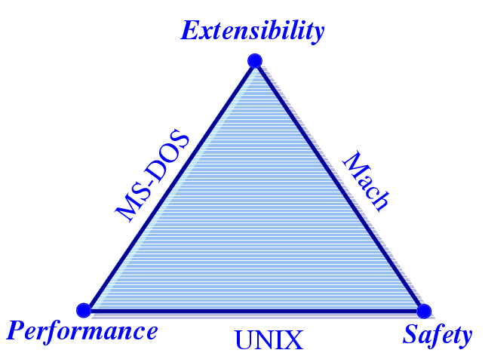
Challenges
Extensibility
Security
Performance
From Stefan Savage’s SOSP 95 presentation
Can we have all 3 in a single OS?
Notes:
Extensibility
Ability to use application specific knowledge
Security
Extensions should not compromise security. Applications should still be able to share resourses
Performance

Slide 10
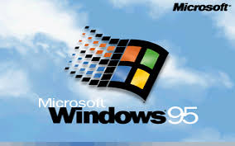
Context for These Papers (1990s)
Windows was dominating the market
Mac OS downward trend (few percents)
Unix market highly fragmented (few percents)
OS research limited impact
Vast majority of OSes proprietary
“Is OS research dead?”, popular panel topic at systems conferences of the era
An effort to reboot the OS research, in particular, and OS architecture, in general

Slide 11
Context for these papers
1990’s
Researchers (mostly) were doing special purpose OS hacks
Commercial market complaining that OS imposed big overheads on them
OS research community began to ask what the best way to facilitate customization might be. In the spirit of the Flux OS toolkit…
2010’s
containers: single-purpose appliances
Unikernels: (“sealable”) single-address space
Compile time specialized

Slide 12
Motivation
1988-1995: lots of innovation in OS development
Mach 3, the first “true” microkernel
SPIN, Exokernel, Nemesis, Scout, SPACE, Chorus, Vino,
Amoeba, etc...
And even more design papers

Slide 13
Context for these papers
1990’s
Researchers (mostly) were doing special purpose OS hacks
Commercial market complaining that OS imposed big overheads on them
OS research community began to ask what the best way to facilitate customization might be. In the spirit of the Flux OS toolkit…
2010’s
containers: single-purpose appliances
Unikernels: (“sealable”) single-address space
Compile time specialized

Slide 14
Motivation
1988-1995: lots of innovation in OS development
Mach 3, the first “true” microkernel
SPIN, Exokernel, Nemesis, Scout, SPACE, Chorus, Vino,
Amoeba, etc...
And even more design papers

Slide 15
Motivation
Exploring new spaces
Distributed computing
Secure computing
Extensible kernels (exokernel, unikernel)
Virtual machines (exokernel)
New languages (spin)
New memory management (exokernel, unikernel)

Slide 16
Problems (examples coming-up)
Extensibility
Abstractions overly general
Apps cannot dictate management
Implementations are fixed
Performance
Crossing over into the kernel is expensive
Generalizations and hiding information affect performance
Protection and Management offered with loss in Extensibility and Performance
Notes:
Microkernels (replaceable trusted servers, fault isolation)
- Process, address space, IPC
- same abstraction to all processes (even with trusted servers)
- is there a need to cross the protection boundary often?
Virtual Machines (multiple VMs on the same host OS)
- virtualization of hardware expensive
- virtualization can be counter-productive (apps LRU pager Vs VMM pager)

Slide 17
Exokernel
Dawson R. Engler, M. Frans Kaashoek and James O’Toole Jr.
Engler’s Master’s Thesis.
Follow-up publications on 1997 and 2002.
Kaashoek later worked on Corey.

Slide 18
Exokernels - Motivation
Existing Systems offer fixed high-level abstractions which is bad
Hurt app performance (generalization – eg: LRU)
Hide information (eg: page fault)
Limit functionality (infrequent changes – cool ideas don’t make it through)

Slide 19
Motivation (cont.)
Separate protection from management, mgmt in user space
Apps should use domain specific knowledge to influence OS services
Small and simple kernel – adaptable and maintainable

Slide 20
Exokernel
Kernel only multiplexes hardware resources (Aegis)
Higher-level abstractions in Library OS (ExOS)
Secure binding, Visible resource revocation, Abort
Apps link with the LibOS of their choice
Notes:
Extensibility, Safety and Performance

Slide 21
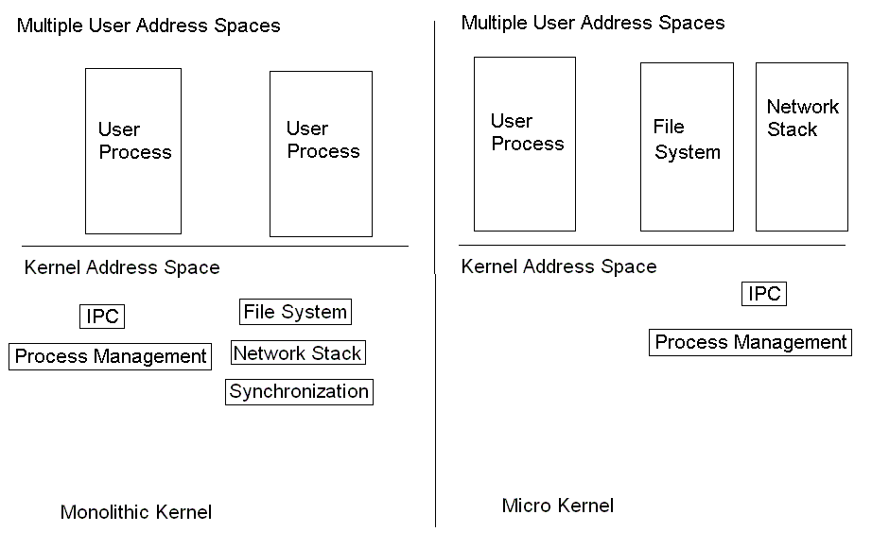
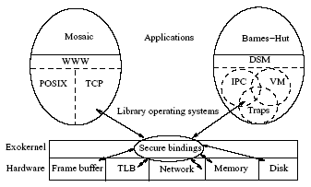
OS Component Layout
Exokernel

Slide 22
Exokernel main ideas
Kernel
Resource sharing, not policies
Library Operating System
Responsible for the abstractions
IPC
VM
Scheduling
Networking

Slide 23
Lib OS and the Exokernel
Lib OS (untrusted) can implement traditional OS abstractions (compatibility)
Efficient (Lib OS in user space)
Apps link with Lib OS of their choice
Kernel allows LibOS to manage resources, protects LibOss

Slide 24
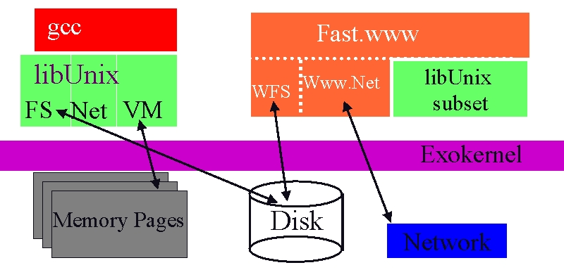
Exokernel Architecture
Exokernels. MIT CSAIL, 1998

Slide 25
Exokernel vs Microkenels vs VM
Exokernel defines only a low-level interface.
A microkernel also runs almost everything on user-level, but has fixed abstractions.
A VM emulates the whole machine, doesn’t provide direct access.

Slide 26
Design
Application-level resource management
Exports hardware resources
Multiplexes access between processes
Separates policy from management
avoid resource management!

Slide 27
What problems do we solve?
High-level abstractions
hurt application performance
Hide information
An application can get only a fraction of total available memory
Current OSes such as Linux or Windows don’t tell you that
Limit functionality
Application cannot decide how to manage the memory
Existing monolithic kernels
Encourage stable (archaic) interfaces
Application might want to write and encrypt data to disk
Difficult to extend with modern techniques

Slide 28
How do we solve them: Design
Secure bindings
Downloading code
Visible resource revocation
The abort protocol

Slide 29
How do we solve them: Design
Secure bindings
Downloading code
Visible resource revocation
The abort protocol

Slide 30
Secure bindings
Decouples authorization from use
Authorize once, at “bind time”
Use transferable “capabilities” to check access
Cache bindings in-kernel to decrease binding frequency
Example: huge software-based TLB

Slide 31
Secure Bindings - Virtual Memory
Virtual to Physical mapping done by the Library
Binding (i.e., a security token) along with the translation presented to the Exokernel
Exokernel puts into the the hardware TLB
Use transferable “capabilities” to check access
Cache bindings in-kernel to decrease binding frequency
Example: huge software-based TLB

Slide 32
How do we solve them: Design
Secure bindings
Downloading code
Visible resource revocation
The abort protocol

Slide 33
Downloading code
Userspace application produces kernel space code
Access checks at download time
Code is verified before being run, with JIT for speed

Slide 34
How do we solve them: Design
Secure bindings
Downloading code
Visible resource revocation
The abort protocol

Slide 35
Visible resource revocation
Revocation traditionally invisible (or transparent)
Expensive: have to save entire state
E.g., Admin changes a files permission from read-write to ready-only
Memory protection?
Try visible instead!
Save only the state you need
Kernel gives you a few microseconds to do it

Slide 36
How do we solve them: Design
Secure bindings
Downloading code
Visible resource revocation
The abort protocol

Slide 37
Abort
Revocation: kernel asks process for resource
“relinquish page 5 please”
Process tracks state and returns resource
Abort: kernel demands resource
“page 5 in 50 microseconds”
Takes resource “by force”
Invalidates credentials and bindings.
Notifies library operating system

Slide 38
Exokernel
DEC MIPS
Aegis: actual exokernel
Processor
Physical memory
TLB
Exceptions, Interrupts
ExOS: library operating system
Processes, IPC, Virtual Memory, Network protocols

Slide 39
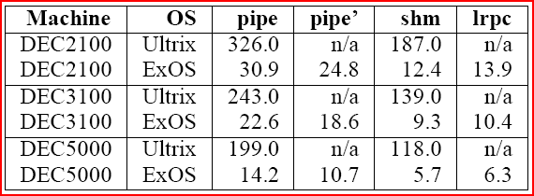
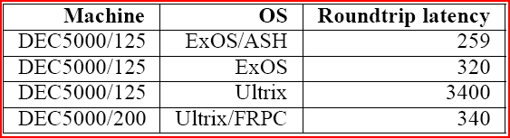
Microbenchmark results

Slide 40
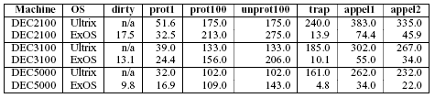
ExOS Virtual Memory
+ Fast Sys call.
- Half the time in look-up (vector).
Repeated access to Aegis STLB and ExOS PageTable
Notes:
Dirty – query if the page is dirty (user level)
Prot1 – change the protection of 1 page
100 – read [un]protect 100 pages
Trap – time to handle page-protection trap
Appel1 – access random protected page – prot (some other) + trap + unprot (faulting page)
Appel2 – prot100 + trap + unprot

Slide 41
Perspective
Extensible kernels are actually fast.
End-to-end arguments.
Efficient implementations.
Extensibility without loss of security or performance
Exokernels
Safely export machine resources
Decouple protection from management

Slide 42
Containers
Grouping of processes
Provide isolation between groups
Containers cannot customize operating systems
Isn’t this similar to the problem exokernels tried to solve?
Container
Container
Container
MySQL
Web Server
MySQL
Web Server
Web Server
OS
Hypervisor
Notes:
Operating system may not be good for all groupings.

