Slide 1
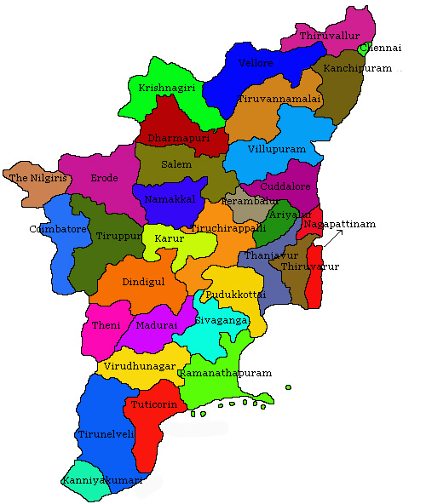
AIR QUALITY ANALYSIS IN TAMILNADU
Phase 2: Innovation

Slide 2
INTRODUCTION
The main purpose of the air quality analysis is to demonstrate that new emissions emitted from a proposed major stationary source or major modification, in conjunction with other applicable emissions increases and decreases from existing sources, will not cause or contribute to a violation of any applicable NAAQS or PSD increment.
Air quality is measured with the Air Quality Index, or AQI. The AQI works sort of like a thermometer that runs from 0 to 500 degrees. However, instead of showing changes in the temperature, the AQI is a way of showing changes in the amount of pollution in the air.

Slide 3
INNOVATIONS
1. Air Quality Sensor Network:
Design: Develop a network of low-cost, high-accuracy air quality sensors to be strategically placed across Tamil Nadu.
Innovation: These sensors will not only measure common pollutants but also use innovative sensor technology capable of detecting emerging pollutants and particulate matter with high precision.
2. Data Integration and AI Analysis:
Design: Create a centralized data platform that aggregates information from the sensor network, satellite data, and weather sources.
Innovation: Implement advanced AI and machine learning algorithms to analyze the data, providing real-time and predictive insights into air quality trends.

Slide 4
3. Mobile App and Public Engagement:
Design: Develop a user-friendly mobile app, "CleanAir Tamil Nadu," for citizens to access air quality information, report pollution sources, and receive personalized recommendations.
Innovation: Integrate augmented reality features into the app, allowing users to visualize air quality in their immediate surroundings using their smartphone's camera.
4. Drone Surveillance:
Design: Utilize drones equipped with specialized air quality sensors to monitor hard-to-reach or critical areas.
Innovation: Employ AI for autonomous flight planning and route optimization to maximize data collection efficiency.

Slide 5
5. Community Participation and Reporting:
Design: Create a citizen science program to involve the public in monitoring air quality and reporting pollution incidents.
Innovation: Implement a blockchain-based system to incentivize and reward citizen contributions to air quality data collection.
6. Early Warning System:
Design: Develop an early warning system integrated with the mobile app to notify users of deteriorating air quality conditions.
Innovation: Incorporate an SMS-based alert system for users without smartphones.

Slide 6
7. Policy and Regulation Support:
Design: Collaborate with government agencies to facilitate the enforcement of air quality regulations.
Innovation: Use blockchain technology for transparent tracking and verification of emissions reductions by industries and other stakeholders.
8. Green Infrastructure and Urban Planning:
Design: Promote urban planning that includes green spaces, pedestrian-friendly areas, and better traffic management.
Innovation: Implement a GIS-based tool to help urban planners visualize the impact of green infrastructure on air quality.

Slide 7
9. International Collaboration:
Design: Foster collaborations with neighboring states and countries to address cross-border pollution.
Innovation: Develop a regional air quality data-sharing platform to promote information exchange and coordinated response to transboundary pollution.
10. Air Quality Index Enhancement:
Design: Enhance the existing Air Quality Index (AQI) system.
Innovation: Customize the AQI system to reflect the unique pollution sources and health risks relevant to Tamil Nadu, and ensure this information is readily accessible through the app.

Slide 8
CONCLUSION
This innovative solution combines the power of technology, data, community engagement, and policy support to comprehensively address air quality issues in Tamil Nadu. It creates a sustainable, data-driven system that empowers both the government and the public to take informed actions to improve air quality and protect public health.
Implementing these innovative approaches for air quality analysis in Tamil Nadu will require a combination of technological investments, policy changes, public engagement, and collaboration among various stakeholders, including government agencies, research institutions, and the general public.

