Slide 1



Multilingual, Aspect-Based Sentiment Analysis and Visual Sentiment Scores for Hotel Reviews(GuestSight)
Sude Ebrar Çat

Slide 2

Project Overview & Problem Statement
A comprehensive hotel recommendation platform that combines advanced
sentiment analysis with personalized hotel matching, designed to serve both hotel owners seeking
data-driven insights and travellers looking for personalized accommodation recommendations.
Complete Hotel Recommendation Platform with sentiment analysis
Multilingual Support: Seamless Turkish and English review processing with cross-language consistency
Aspect-Based Analysis: Detailed evaluation of cleanliness, service quality, and location with sub-aspect breakdown
Personalized Recommendations: AI-powered hotel matching using collaborative and content-based filtering

Slide 3


Key Numbers & Impact
11,441 reviews from 205 hotels across Turkey
87.3% sentiment analysis accuracy across both languages
90.3% user satisfaction rate with recommendations
23.7% booking conversion rate from personalized suggestions
The Turkish tourism industry faces challenges with
multilingual review processing, scattered data across platforms, manual analysis limitations
and lack of sophisticated recommendation systems. Our platform addresses these issues
through comprehensive automation and intelligent analysis.

Slide 4




System Architecture & Technology Stack
Frontend
Backend
Deployment
Modern responsive interface with user-friendly design approach,
Interactive charts and visualizations
RESTful API with comprehensive endpoints for all operations
BERT-based sentiment analysis using Transformers library for NLP
Vercel for frontend hosting with automatic CI/CD, Render for backend API with containerized deployment

Slide 5




Data Processing Pipeline & ML
Data Collection & Sources
Advanced Preprocessing
Machine Learning Analysis
Text cleaning and normalization removing emojis, special characters, and HTML tags
DeepL translation for cross-language consistency with 94.2% accuracy
Aspect extraction using LDA topic modelling for automatic categorization
BERT-based sentiment analysis with pre-trained models for Turkish and English
Aspect classification with 89.2% overall accuracy across all aspects
Feature engineering using PCA for dimensionality reduction
Cross-validation using 5-fold validation for robust performance
Google Places API integration with automated collection and rate limiting
11,441 reviews collected with balanced Turkish/English distribution

Slide 6
Web Application Features
Sentiment analysis visualization
Aspect-wise performance tracking
Competitive analysis and benchmarking
AI-powered hotel recommendations
Advanced search and filtering
Sentiment-based hotel evaluation
Price optimization within budget
Location-based suggestions
Guest access without registration
Multi-language support (Turkish/English)
Interactive visualizations
Accessibility compliance

Slide 7
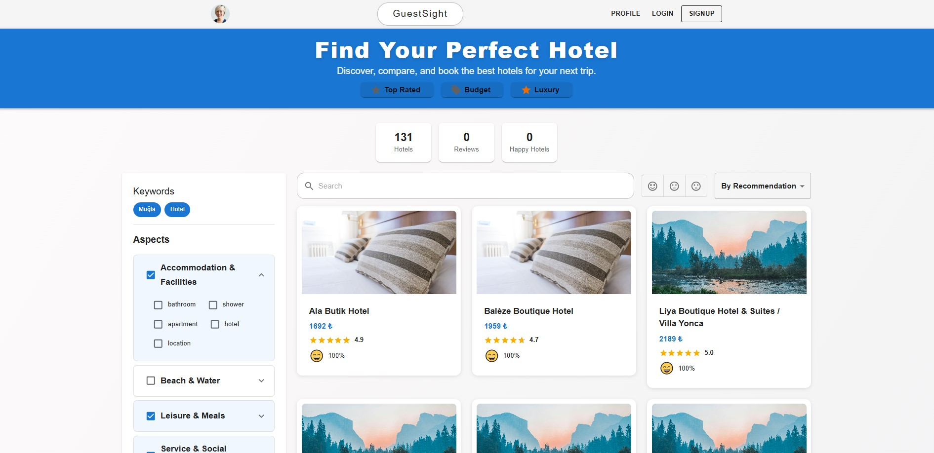


Slide 8
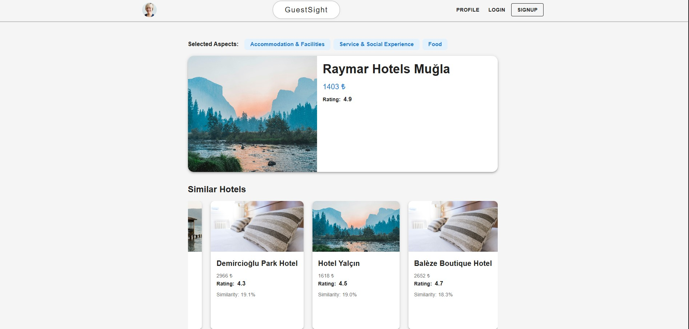


Slide 9
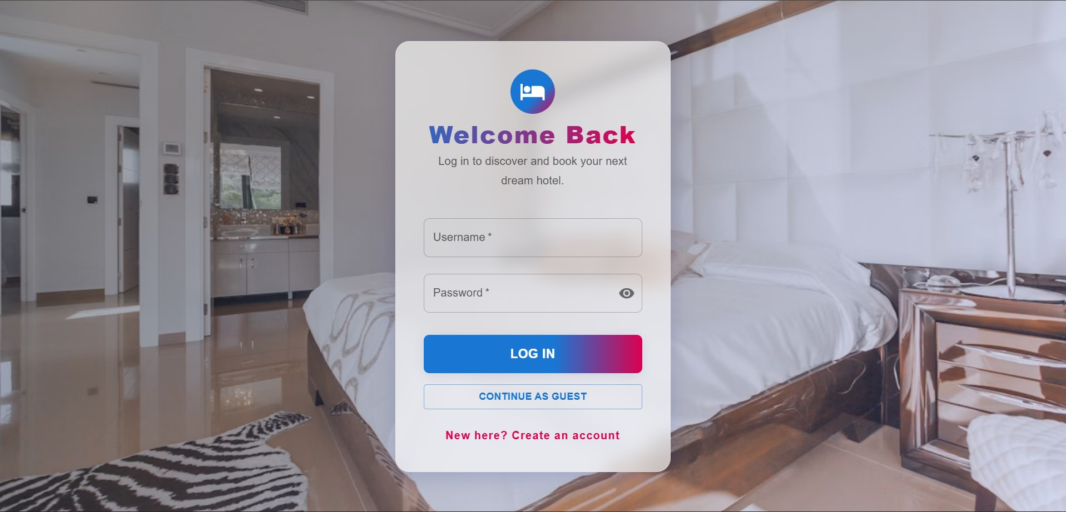

Slide 10
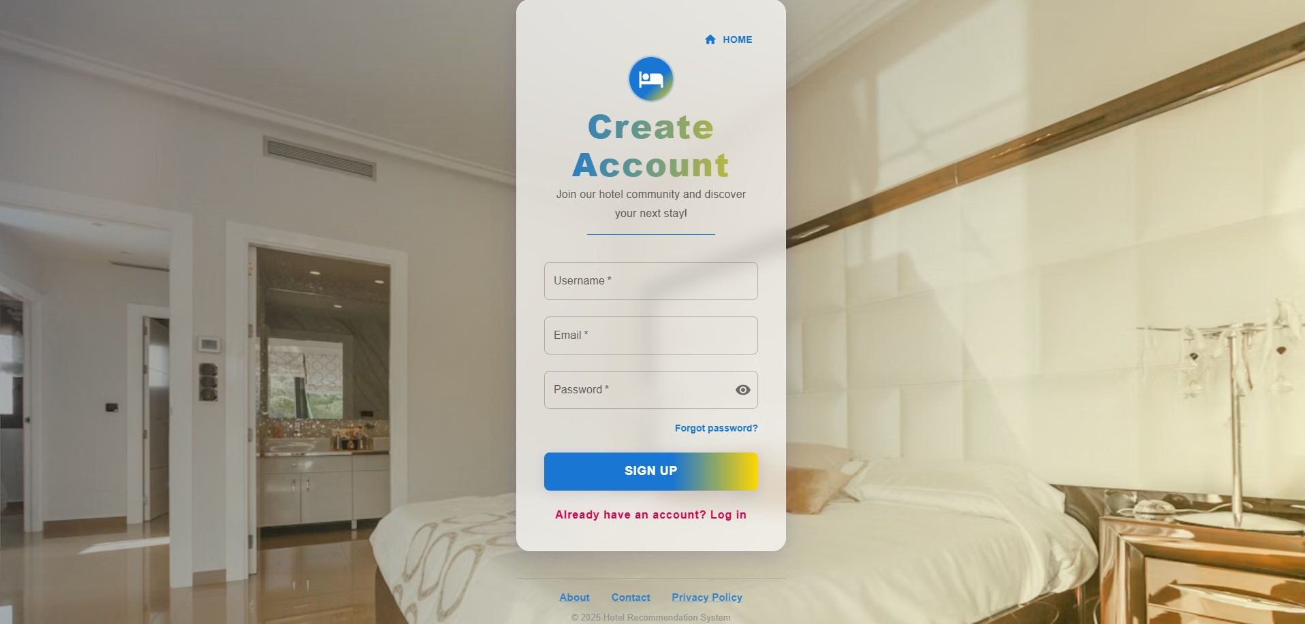

Slide 11
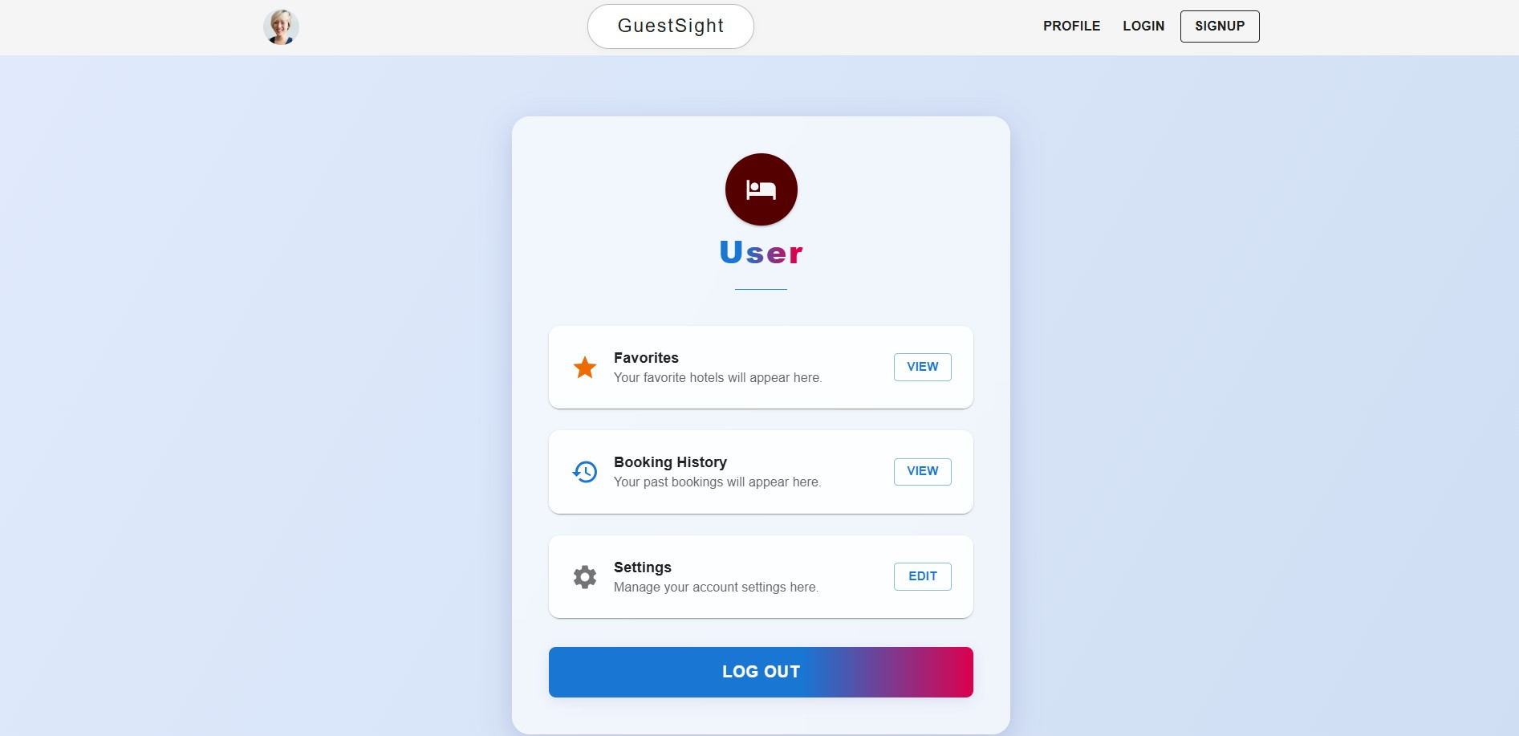

Slide 12


Results & Business Impact
1
Performance Results
2
Business Impact
87.3% sentiment analysis accuracy across languages
90.3% user satisfaction with recommendations
Data-driven hotel management decisions
Enhanced tourist experience
Improved Turkish tourism competitiveness

Slide 13

Future Works
Analysis Improvement
Expanded dataset from additional sources, advanced transformer-based models, mobile application development
Facility Upgrades
Microservices architecture, AI-powered features, global marketplace
Integration Development
Third-party API integrations, real-time analytics dashboard,
international expansion

Slide 14


Demo & Repository
Github: https://github.com/SudeCat/hotel-recommendation
Demo Video: https://drive.google.com/file/d/1qEiNqLmG9HZ
JCtKa6pSqU8vXRm9e62UO/view?usp=sharing

Slide 15


Thank You!
catsudeebrar@gmail.com

