Slide 1



Multilingual, Aspect-Based Sentiment Analysis and Visual Sentiment Scores for Hotel Reviews
Sude Ebrar Çat

Slide 2

Introduction: Leveraging customer feedback to drive hotel improvement
Customer reviews are a rich source of insights for hotels.
Analyzing sentiment can help identify strengths and weaknesses.

Slide 3




Importance of understanding customer sentiment in the Turkish hospitality industry
Growing Tourism
Competitive Market
Customer Expectations
Turkey is a popular tourist destination with diverse offerings.
Understanding customer preferences is crucial for success.
Reviews influence booking decisions, impacting hotel revenue.

Slide 4




TÜBİTAK–2209-A Project Overview
Multilingual sentiment analysis.
Utilizing Natural Language Processing (NLP) techniques.
Topic-based categorization (e.g., cleanliness, service, location).
Python, NLP Libraries (NLTK, SpaCy), Machine Learning (TensorFlow).
Visual sentiment scores for better decision-making.

Slide 5


Analyzing sentiment across key criteria: cleanliness, service, location
1
Cleanliness
2
Service
3
Location
Guest satisfaction with room cleanliness and hygiene.
Evaluates staff friendliness, helpfulness, and responsiveness.
Assesses proximity to attractions, transportation, and amenities.

Slide 6
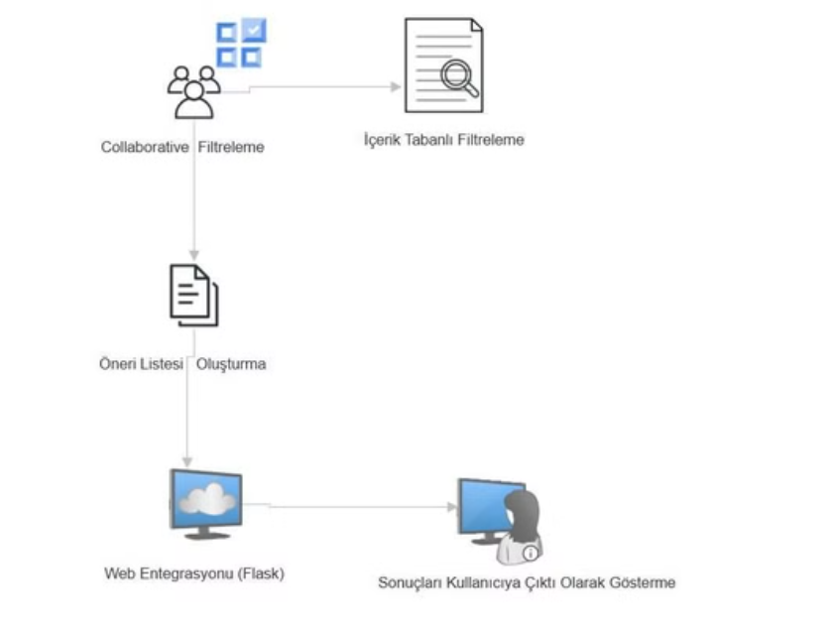
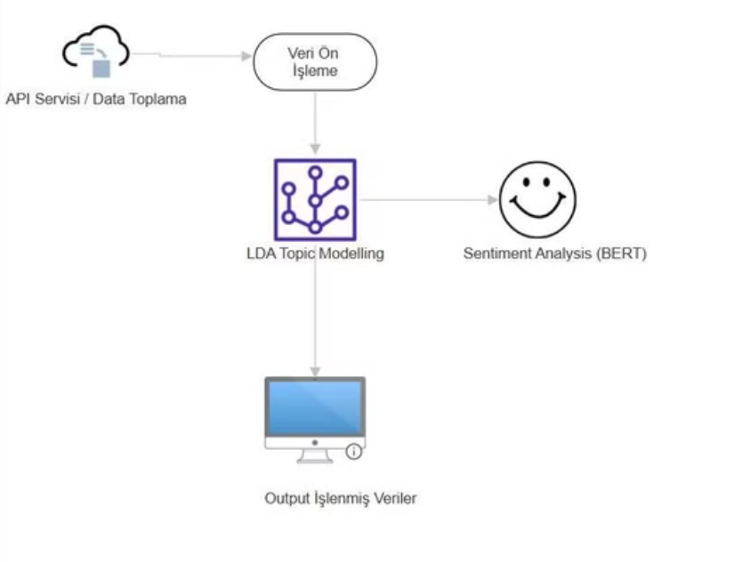



Slide 7
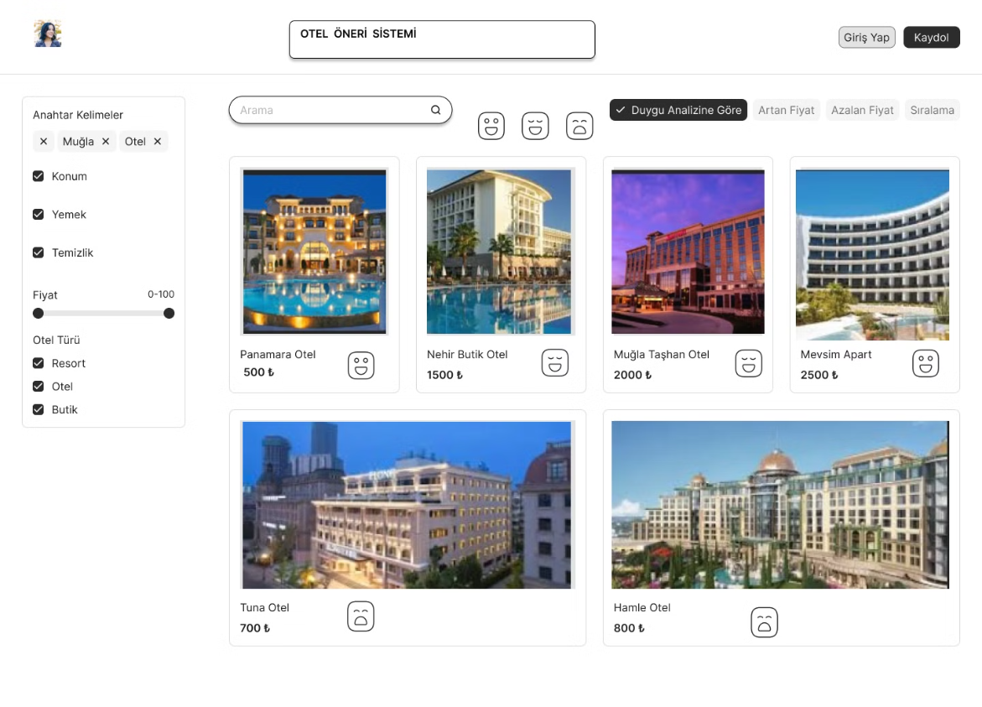


Slide 8


Current status and Accomplishments
Data Collection
Data Preprocessing
Aspect-Based Sentiment Analysis
Collected 2050 reviews from Google Places API
Cleaning and preprocessing text using NLTK and Pandas library, removing punctuation, converting to lowercase, and removing stop words
Basic understanding of NLP libraries (spaCy, NLTK), and exposure to topic modeling (LDA)

Slide 9
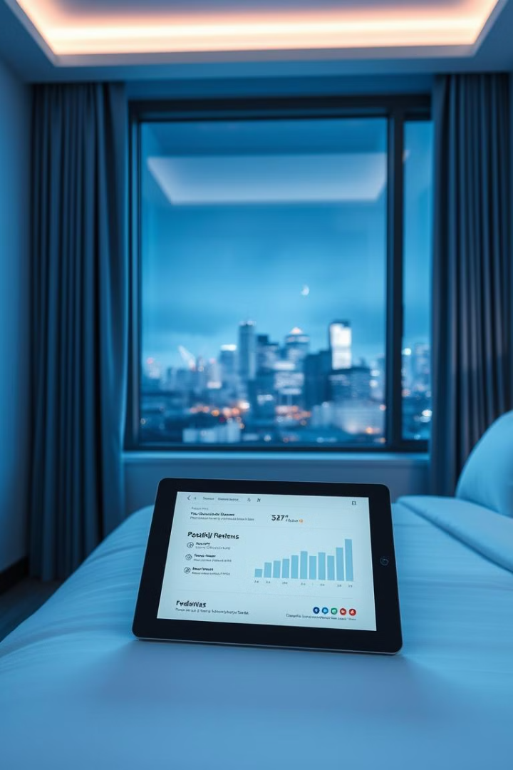
Future Works
Analysis Improvement
Complete and improve visual sentiment scores for hotels regarding topic categorization and sentiment scores
Facility Upgrades
Integrate collaborative filtering for personalized recommendations
Web Tool Status
Complete web platform development

Slide 10


Thank You!
catsudeebrar@gmail.com

