Slide 1





TBO Helm
Governed automation for TBO operations: one open core for travel ticketing and HR onboarding
→
→
→
→
Case
Rule
Human
Effect
Audit
Team of two · open-source · laptop-class hardware · free-tier hosting
Notes:
State the two briefs and the thesis in one breath: TBO's problem is not ticketing or HR software; it is that work is fragmented and every fix costs more. Helm is the shared core: agents do routine work, humans hold every reserved decision, and every action is auditable, idempotent and cost-metered.

Slide 2


The problem: fragmented work and a growing SaaS tax
$50
Travel operations (Zendesk)
HR services (Darwinbox)
per agent / month for Zendesk Copilot, plus per-resolution fees
Agencies repeat context on every contact
Linked tickets need a bolt-on app
Side conversations break on transfer
Urgency (check-in, LCD) not in the SLA clock
Events are recorded, but people move the work
HR emails IT, Admin and Finance, then chases
Policy lives in people’s heads
No safe stop before consequential decisions
$49
per 100 Freshdesk AI Agent email sessions
200–700
Zendesk API requests / min by plan; more only via paid add-on
Sources: Zendesk developer docs; Helply, Pluno and Macha pricing analyses (2026)
Notes:
Every improvement TBO wants is a metered add-on. Incumbents are moving too: Darwinbox launched Cortex in August 2026, so 'has AI' is table stakes. Governance and cost transparency are not.

Slide 3




What “must” means: users, guardrails, rubric
Users
Agents, agencies, escalation managers, HR ops, named approvers, employees, TBO developers
Non-negotiable
Agents never complete reserved decisions; retries never duplicate actions; HR can pause anything
Policy as config
DPDP principles and labour-law rules (e.g. two-working-day final settlement) live in versioned rules, not prompts
Our constraints
Team of two, consumer GPU, free-tier hosting
Notes:
Governance and extensibility together are 40% of the score, as much as automation and cost combined. Regulatory clock: Labour Codes in force since 21 Nov 2025 with a two-working-day final-settlement rule; DPDP substantive duties due May 2027. Rules must be effective-dated.

Slide 4




What research already tells us
Governed agents
Cost routing
AgentSpec (runtime rules), Progent (least privilege), CaMeL (untrusted data never drives control flow)
FrugalGPT cascades (up to 98% cost cut); RouteLLM routers (>2x)
Benchmarks
Reliability evidence
τ-bench pass^k; AgentDojo injection; ST-WebAgentBench Completion-under-Policy
MAST: multi-agent gains often minimal. Gemma 4 small models score 24–42% on τ²-bench
The gap: none of this is evaluated on governed HR or travel-ops workflows
Notes:
Thirty seconds: known patterns, unproven in our domain, and the models alone cannot be trusted with policy. That is why Helm is rules-first.

Slide 5
Existing tools and products
Tool / product | Licence / model | Role for Helm | Decision
llama.cpp, SetFit, Presidio, PostgreSQL | MIT / Apache-2.0 / PostgreSQL | Inference, intent, PII masking, storage | Reuse
Cerberus, SuperAgentX | Apache-2.0 / MIT | Generic tool-level policy gates with approvals | Learn
agent-ledger | Apache-2.0 | Idempotency and intent-bound approvals | Learn
Zammad, Frappe Helpdesk | AGPL-3.0 | Feature references for SLAs and queues | Avoid code
Zendesk, Freshdesk, Darwinbox Cortex | Proprietary | Price anchors; no public governance or per-task cost evidence | Benchmark
Pre-empting “isn’t this just X?”: we name the closest tools ourselves and show the difference next.
Notes:
Open tools give permissive building blocks; products give price anchors, not governance evidence. AGPL helpdesks are feature references only; we never copy their code.

Slide 6
The gap and our contribution
Gap 1
Gap 2
Gap 3
No system enforces an HR-editable reserved catalogue plus effective-dated statutory rules at one boundary
No benchmark measures duplicate side effects or statutory deadlines for governed workflows
Cost evidence is per query, not per completed workflow including GPU and hosting
Closest: Cerberus, agent-ledger, AgentSpec
Closest: ST-WebAgentBench (web agents only)
Closest: FrugalGPT, cascade literature
Potential contribution: the Governed Effect Boundary plus a Governed-Ops evaluation suite with workflow-level cost. An evaluated integration and an evaluation extension, not a new algorithm.
Notes:
Use the exact phrase 'potential contribution'. Say explicitly what we do not claim: not a new routing method, not a new human-in-the-loop concept, not the first enterprise policy benchmark.

Slide 7
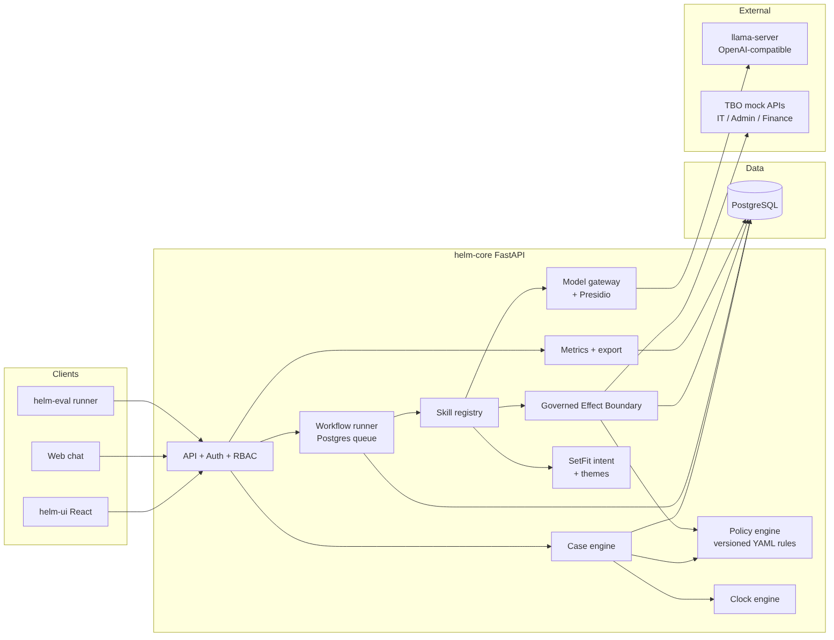
Architecture: one boundary for every side effect
Governed Effect Boundary
1. Policy check (versioned rule)
2. Reserved? → named human
3. Intent-bound approval
4. Idempotency ledger
5. Adapter call
6. Audit + cost row
Models only at the edges: intent (SetFit), themes, chat. Outputs are typed values, never tool calls.
Notes:
Point at the GEB: if it isn't logged here, it didn't happen. Deterministic core; FastAPI + PostgreSQL; versioned YAML rules; workflow runner; skill registry. Service lines are definitions, not code, which is where the live extension test is won.

Slide 8
Plan and prototype status
M0
M1
M2
M3
M4
Round 1
Weeks 1–2
Week 3
Week 4a
Week 4b
Skeleton, local model with JSON-schema output, free-tier deploy, stubs
MVP-0: core, GEB, onboarding, journeys A, B, D, hard-zero tests
Journeys A–E, chat, dashboard, 30 scenarios, B0/B1 baselines
Evaluation runs, licence audit, two extension drills
Demo rehearsal, hosted URL, README, backup video
Status today: design complete; licences verified; hosting limits confirmed; no code yet.
Cut list if we slip
BERTopic → chat beyond Q&A → 20 scenarios → DPDP case type → second drill
Notes:
Be candid about status. Two people, about 28 person-days each. MVP-0 is the thesis proof at the end of build week 2; the cut list absorbs slippage.

Slide 9
How we will prove it: metrics, baselines, targets
Metric | Target / plan | Measured
Reserved-decision violations | 0 | Pending (M2)
Duplicate side effects under faults | 0 | Pending (M2)
Unauthorised access | 0 | Pending (M2)
Statutory-deadline correctness | 100% | Pending (M2)
pass^k (k=5), Completion-under-Policy | Report with 95% CI | Pending (M2)
INR per completed workflow | Expected below B1 | Pending (M2)
Baselines
B0
FIFO + keyword triggers
B1
Single-LLM agent, same model
B2
Large model, projected only
150
runs per system: 30 scenarios × 5 repeats, with deterministic fault injection
Notes:
Say 'target' and 'expected' out loud: nothing is measured yet. Zero-failure metrics get a rule-of-three bound (about 2% with 150 runs). B2 is projected because we lack the VRAM for a large model, and it is labelled as such.

Slide 10
Limitations, risks and next steps
Limitations
Top risks
Next
Synthetic data and mock APIs
Small-model chat quality
B2 baseline not measured
Hosted tier is CPU-only
Scope for a team of two
Hosted memory limits
Unknown mock API semantics
The live extension test
Check GPU VRAM
Open Neon and Render accounts
Get starter kit and terms
Start M0
Judge us on the numbers the harness produces.
Notes:
Honest about synthetic data, small models and a two-person team. Restate the thesis: one governed core, measured. Close with the invitation to judge on the harness numbers.

