Slide 1

HACKZON
2023
New Horizon College Of Engineering

Slide 2

HACK O HOLICS
Sudeep M Arashinagodi
S Mahesh Kumar
S Tejas Mondeeri

Slide 3

New concept
“Corruption is cancer to the present society”
To cure this disease of corruption this project is a small contributory idea which can be bought in real-time use.
THEME

Slide 4
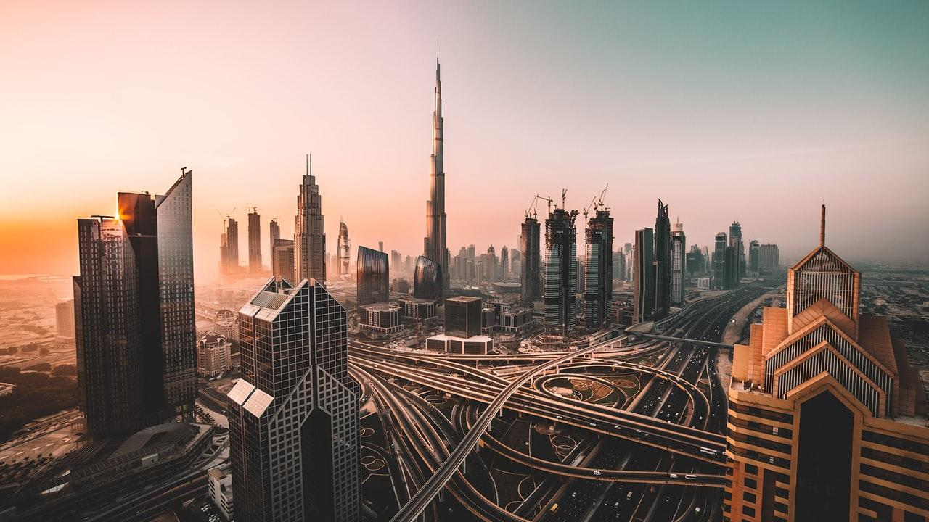
Jan Adhikar Voice Your Choice
जन अधिकार

Slide 5
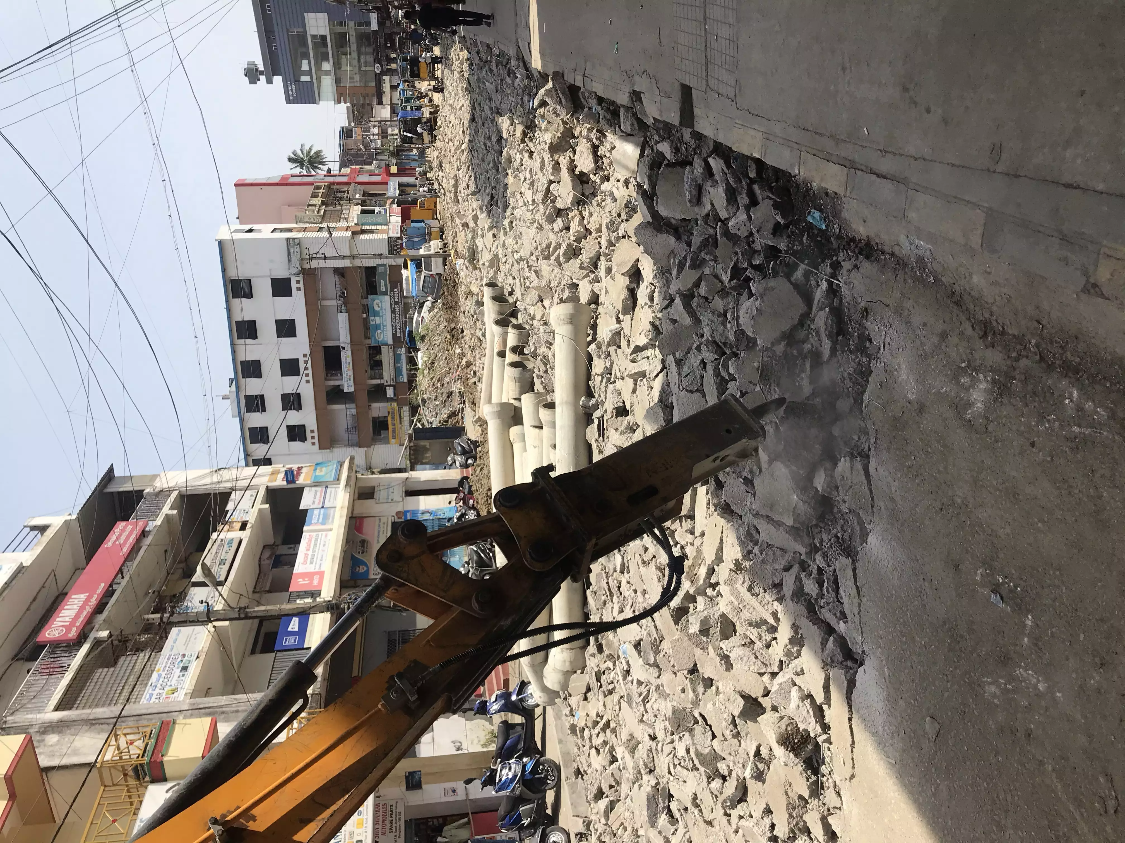
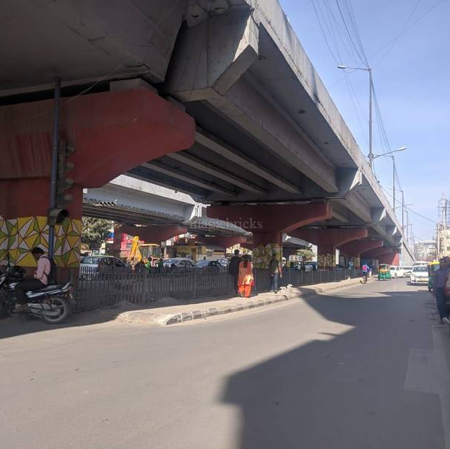
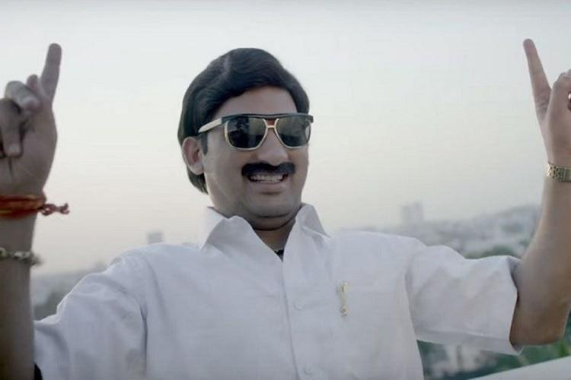
PROBLEM

Slide 6
CAUSE
Only MLA or DC sign grants a project
Residents opinions are not taken into consideration
MONEY == PERMISSION == PROJECT

Slide 7
PROBLEM STATEMENT
Whenever there is government project assigned to a particular part of country nowadays, most of them are un-necessary and some might even bring a new problem in locality.
Presently, a builder only needs a DC's signature and permission from some ministers to get a project worth crore of money. This indirectly leads them to bribe 5-10 officers for a large sum of money in order to obtain a project, even if it is unnecessary, such as the rebuilding of "good as new" roads.

Slide 8
SOLUTION (PROJECT IDEA)
This website registers users from across the nation and when a government project is assigned to a locality only those registered users get notification for voting the project’s necessity, downvote if it’s not really un-necessary or causing problem to public.
So, before a project is assigned 50% of decision is done by permission given by DC and other ministers incharge and the rest of the decision is dependent on voting of people.
The projects which have been approved will also have an additional bidding feature where bidders can voice their proposals giving a decent and reasonable rate for the project.

Slide 9
Our process is easy
ENTER YOUR ADHAR NUMBER
VOTE FOR PROJECTS IN YOUR AREA
BASED ON LIKES AND DISLIKES PROJECT VERIFIED
Verification Done through OTP
Locality Specific Projects
FINAL PROJECT APPORVED OR REJECTED
1
2
3

Slide 10
IMPLEMENTATION
FRONTEND:
HTML CSS JS
BACKEND:
Node.JS Express.JS

Slide 11
SECURITY
BLOCK CHAIN
Smart Contract Solidity Hardhat Library
CLOUD
MongoDB cloud

Slide 12
OVERALL REVIEW OF THE PROJECT
We tried or best to keep the project simple and understandable as the concept is unique and complicated
We are using block chain and cloud storage for security of voting
This project can be implemented in real time without any major issues
WE SELL THE IDEA NOT THE TECH
- Bill Gates
Place your screenshot here

Slide 13

Thanks!
Team
Hack O Holics

