Slide 1
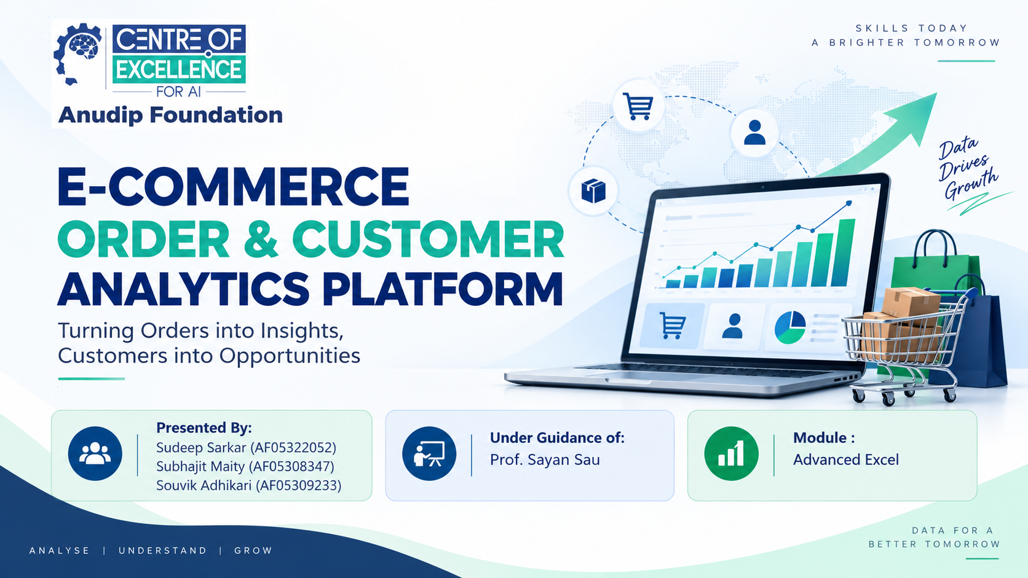

Notes:
• Welcome everyone to our presentation on the E-Commerce Order & Customer Analytics Platform • This project is brought to you by Sudeep Sarkar, Subhajit Maity, and Souvik Adhikari from Anudip Foundation • We're grateful for the guidance of Prof. Sayan Sau in the Advanced Excel module • Today we'll walk you through how we've built a comprehensive analytics solution to help e-commerce businesses understand their orders and customer behavior better

Slide 2
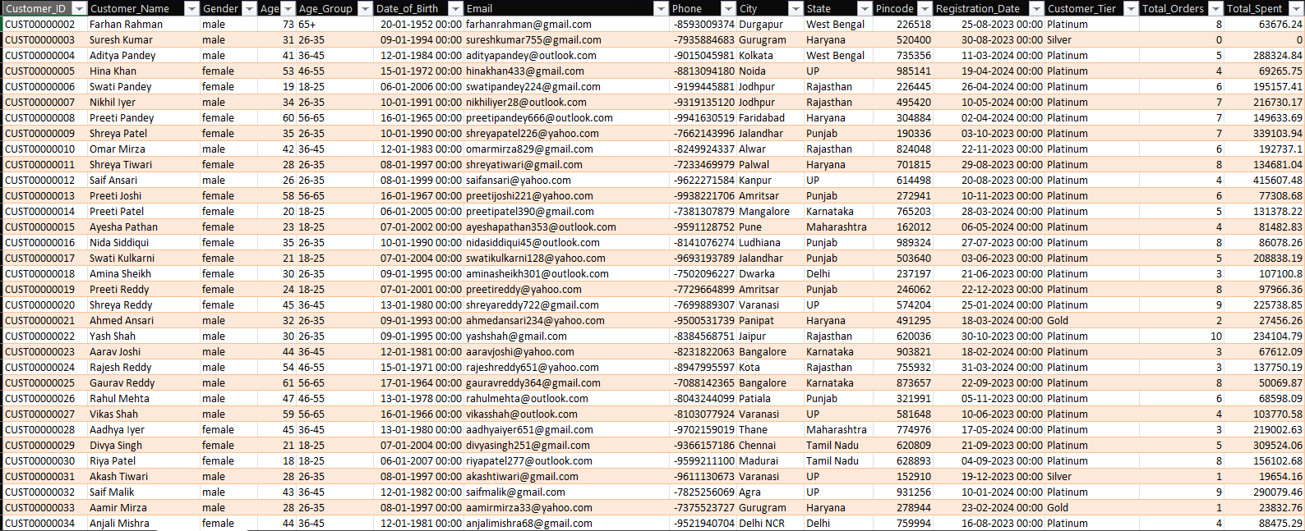
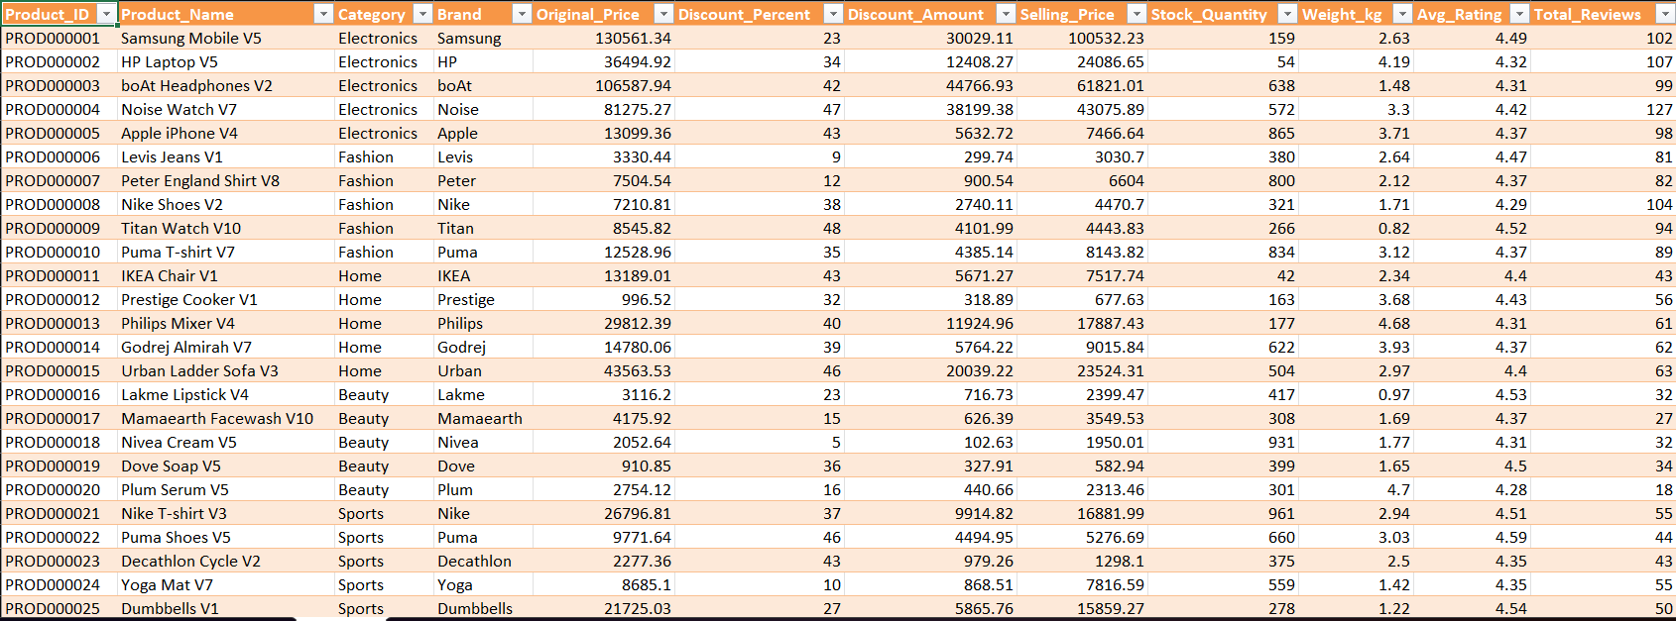
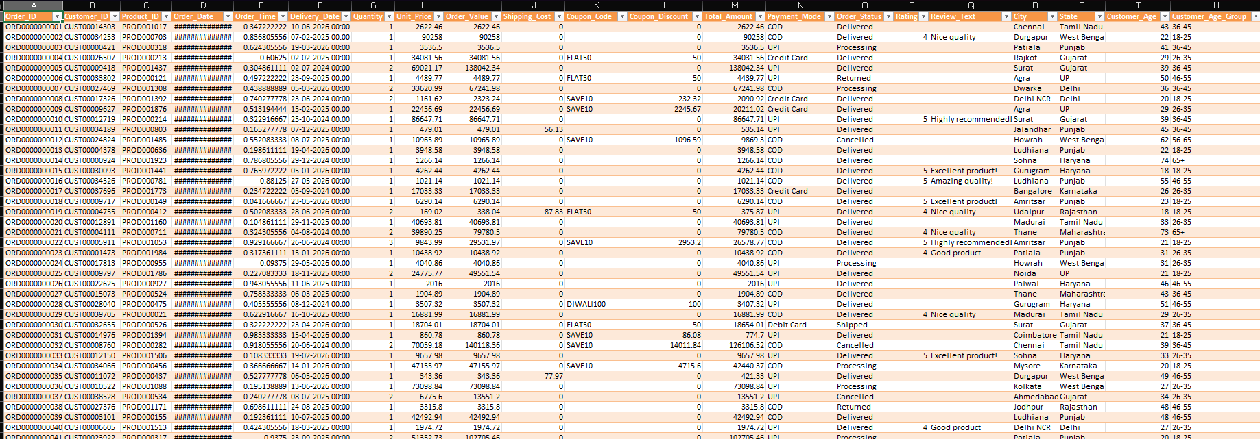
PROJECT OVERVIEW
Problem Statement
E-Commerce businesses generate large volumes of data scattered across disconnected raw files, but turning that data into clear, actionable insights can be challenging. This project aims to organize and visualize business data through an interactive Excel dashboard to support better understanding, monitoring, and decision-making.
Customer Segmentation
Profitability Analysis
Revenue Tracking
Organize customers into actionable groups.
Compare costs, margins, and outcomes in one model.
Unify sales data for reliable reporting.

Slide 3
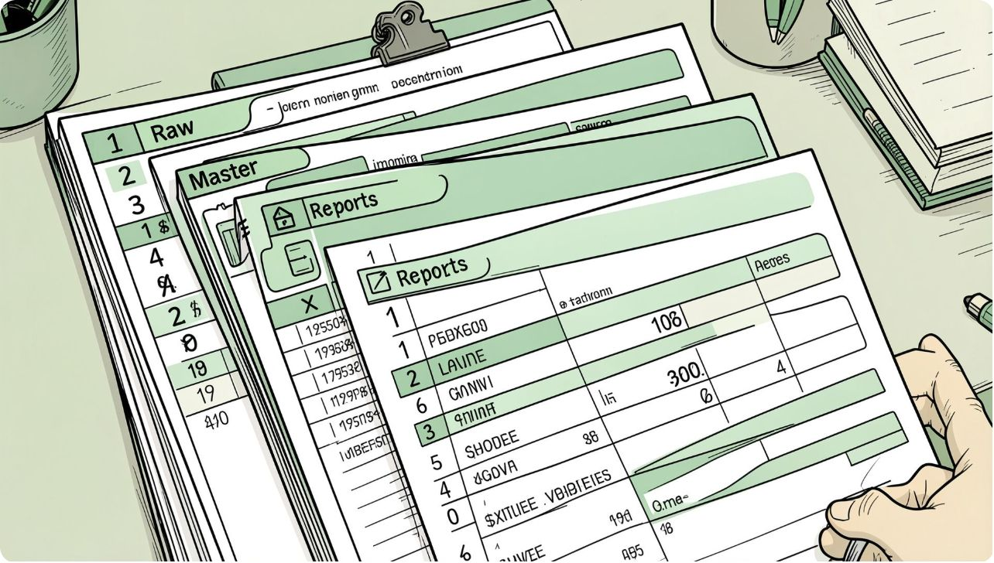
Objective & Design
Build a formula-driven Excel workbook that combines Customers, Products, and Sales data into a Master Data table, enabling refreshable, auditable reporting layers (KPIs & Dashboard).
01
02
03
Ingest
Merge
Report
Raw entity tables: Customers, Products, Sales
Master Data with cost and calculated profit per order
Pivot-driven KPIs and dashboard visuals

Slide 4
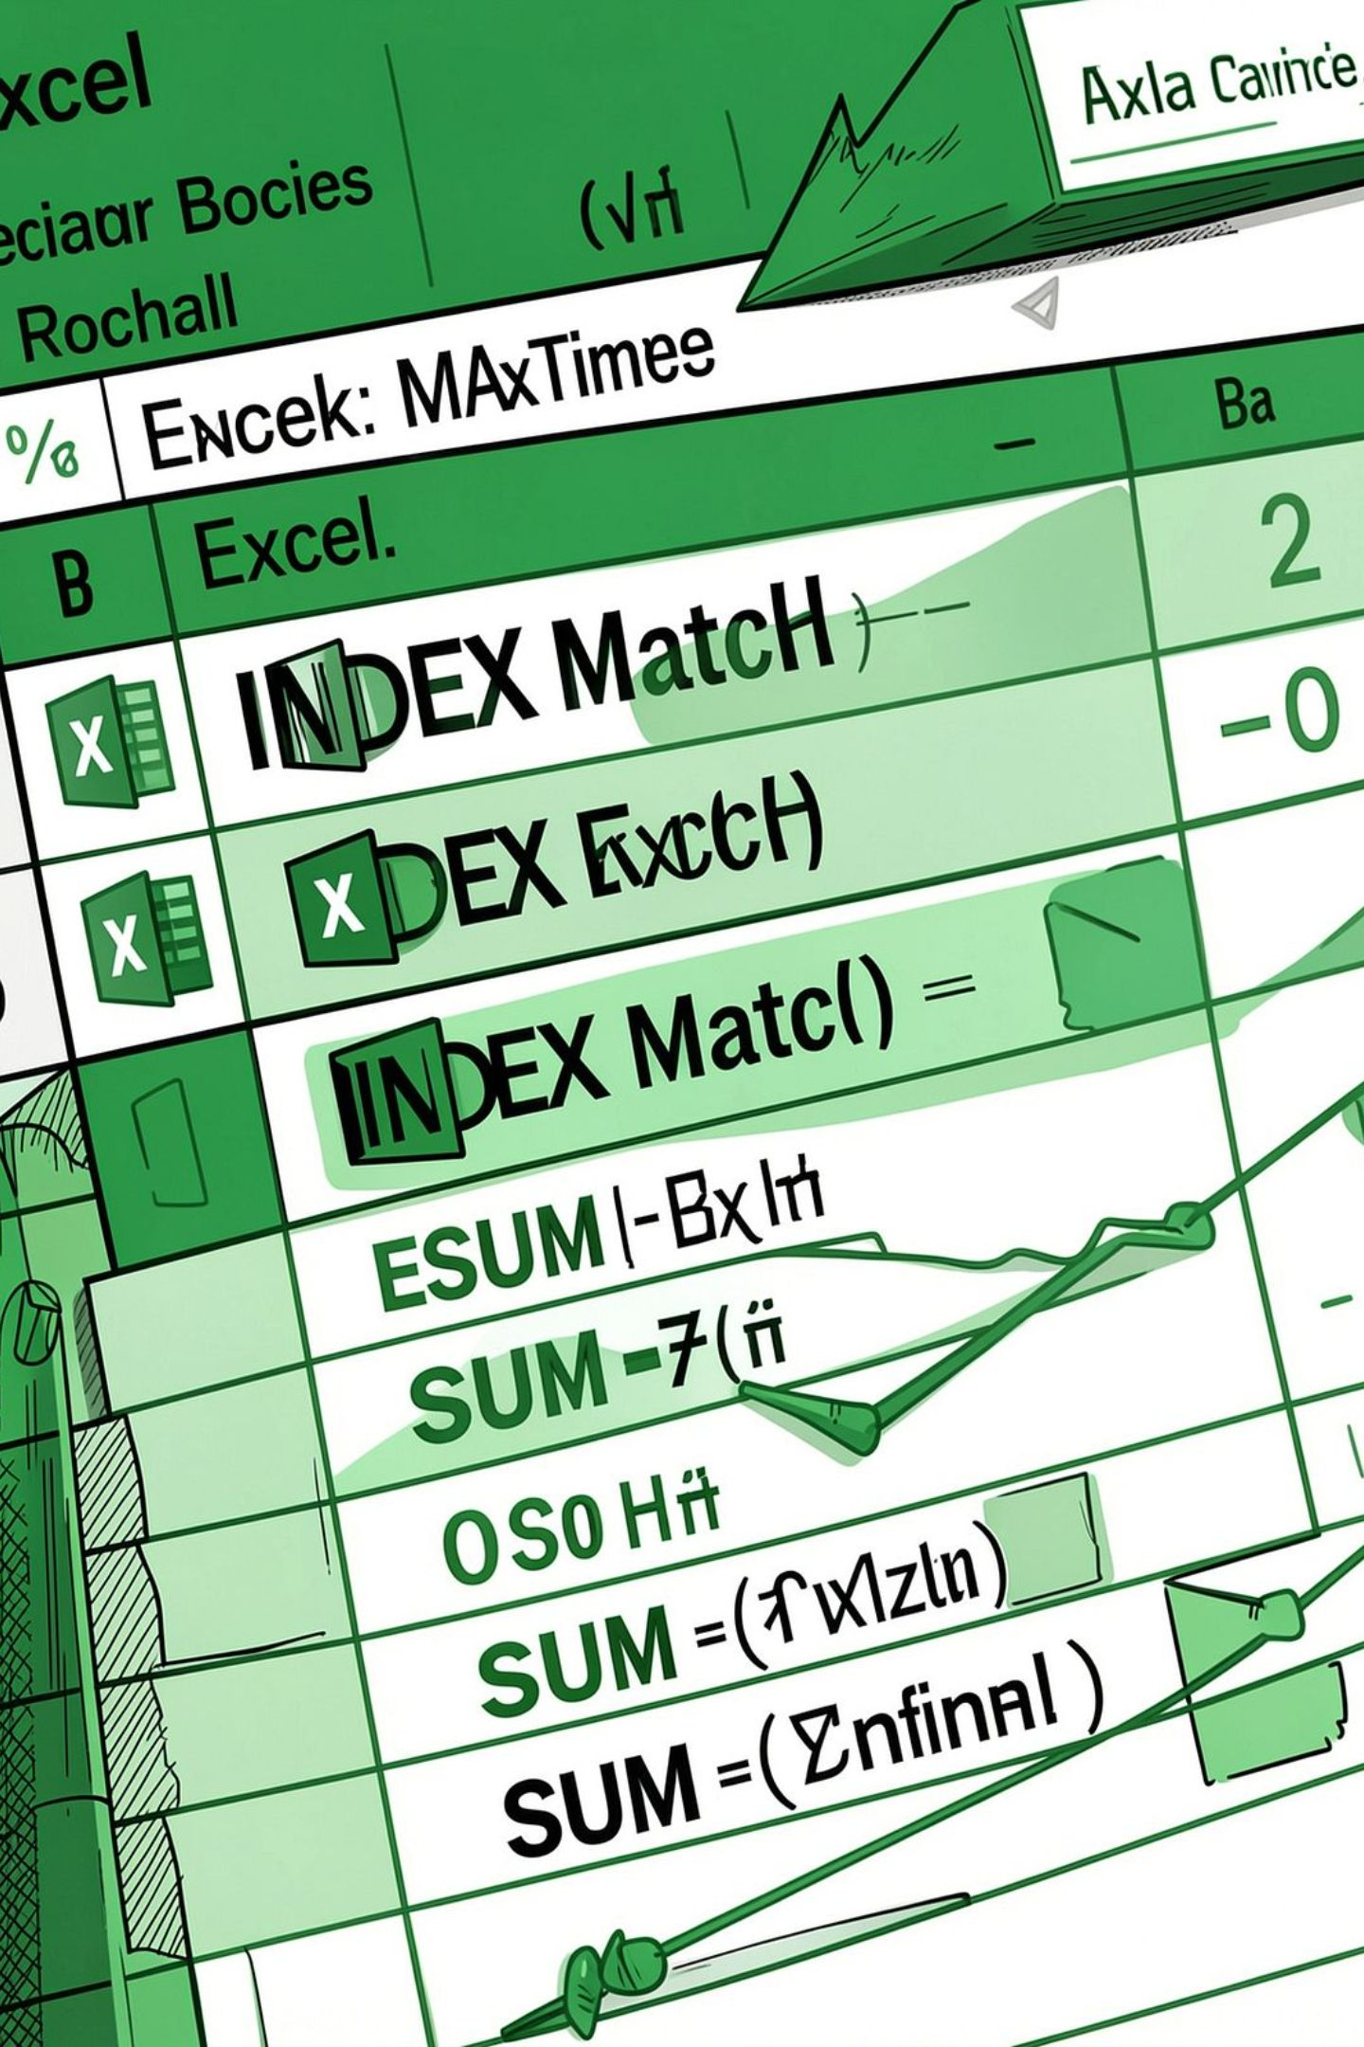
Tools & Techniques
Core Excel methods used to build a refreshable, auditable reporting model.
Microsoft Excel
Core workbook, formulas, calculated fields
Pivot Tables & Pivot Charts
KPI aggregation and dashboards
Join Techniques
Common columns to join different datasets

Slide 5
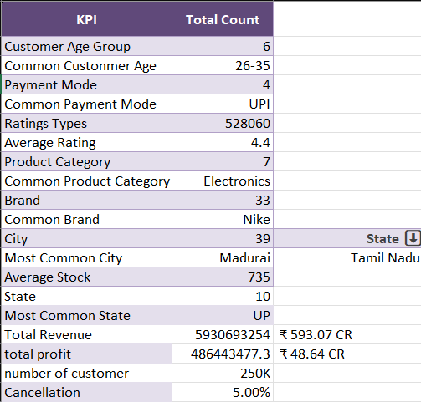




Dataset Overview
Range: June 2024 — June 2026
Includes 250,000 orders, 40,000 registered customers, and 2,000 products across 7 categories and 33 brands in 39 cities across 10 Indian states.
Orders
Customers
Products
250,000 order-level records
40,000 registered profiles
2,000 products, 7 categories, 33 brands

Slide 6
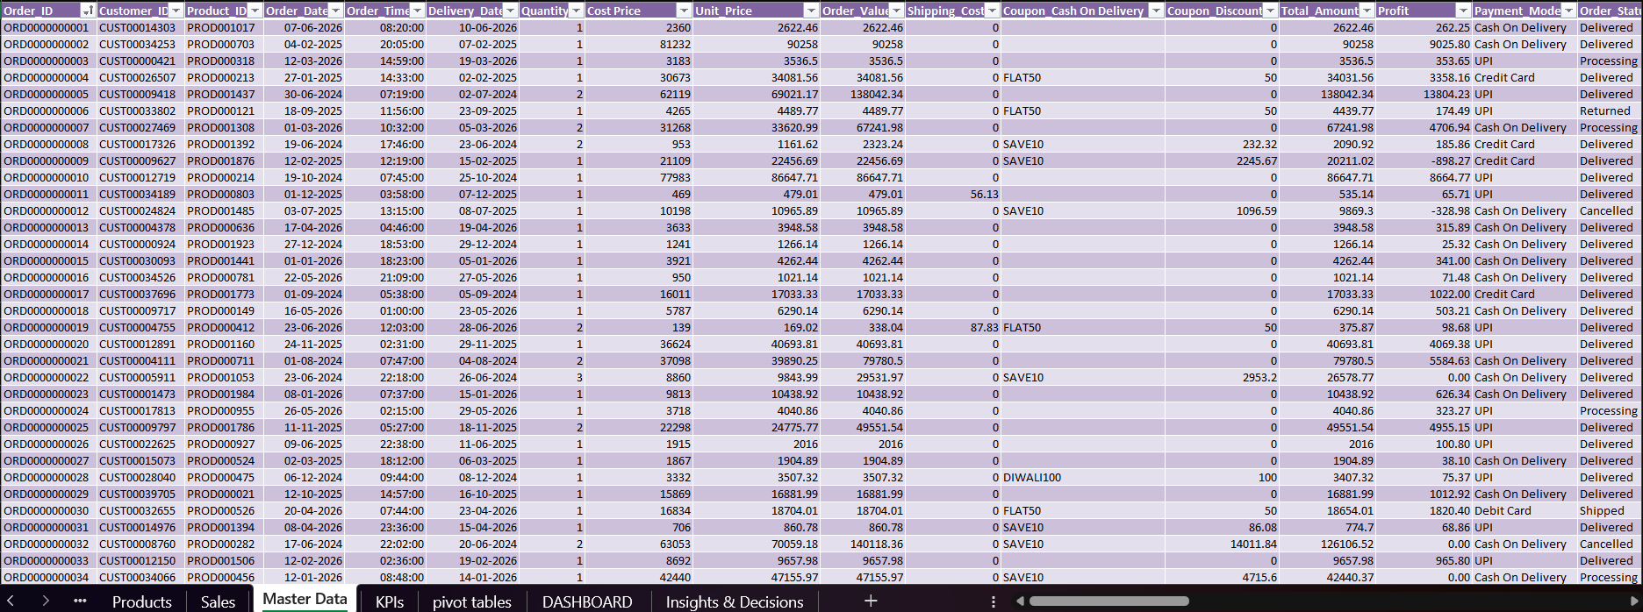
Master Data & Calculations
The Master Data table joins Customers, Products, and Sales, then adds cost price and an Order-level Profit field. This feeds KPI and dashboard layers for consistent reporting.
Calculated Fields
Enrichment
Profit = Revenue − Cost (order-level)
Customer tiers, age groups, geography for segmentation

Slide 7
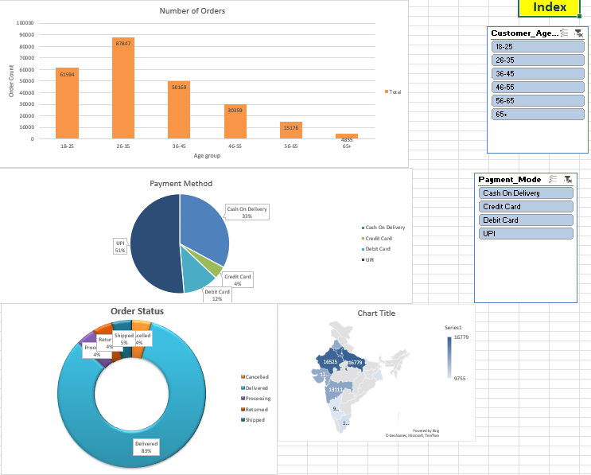
Key Features & Dashboards
Built for layered reporting from raw data to master tables to executive dashboards.
Charts
Slicers
Bar charts, Pie charts and maps for visual understanding
categorical slicers for more specific insights

Slide 8
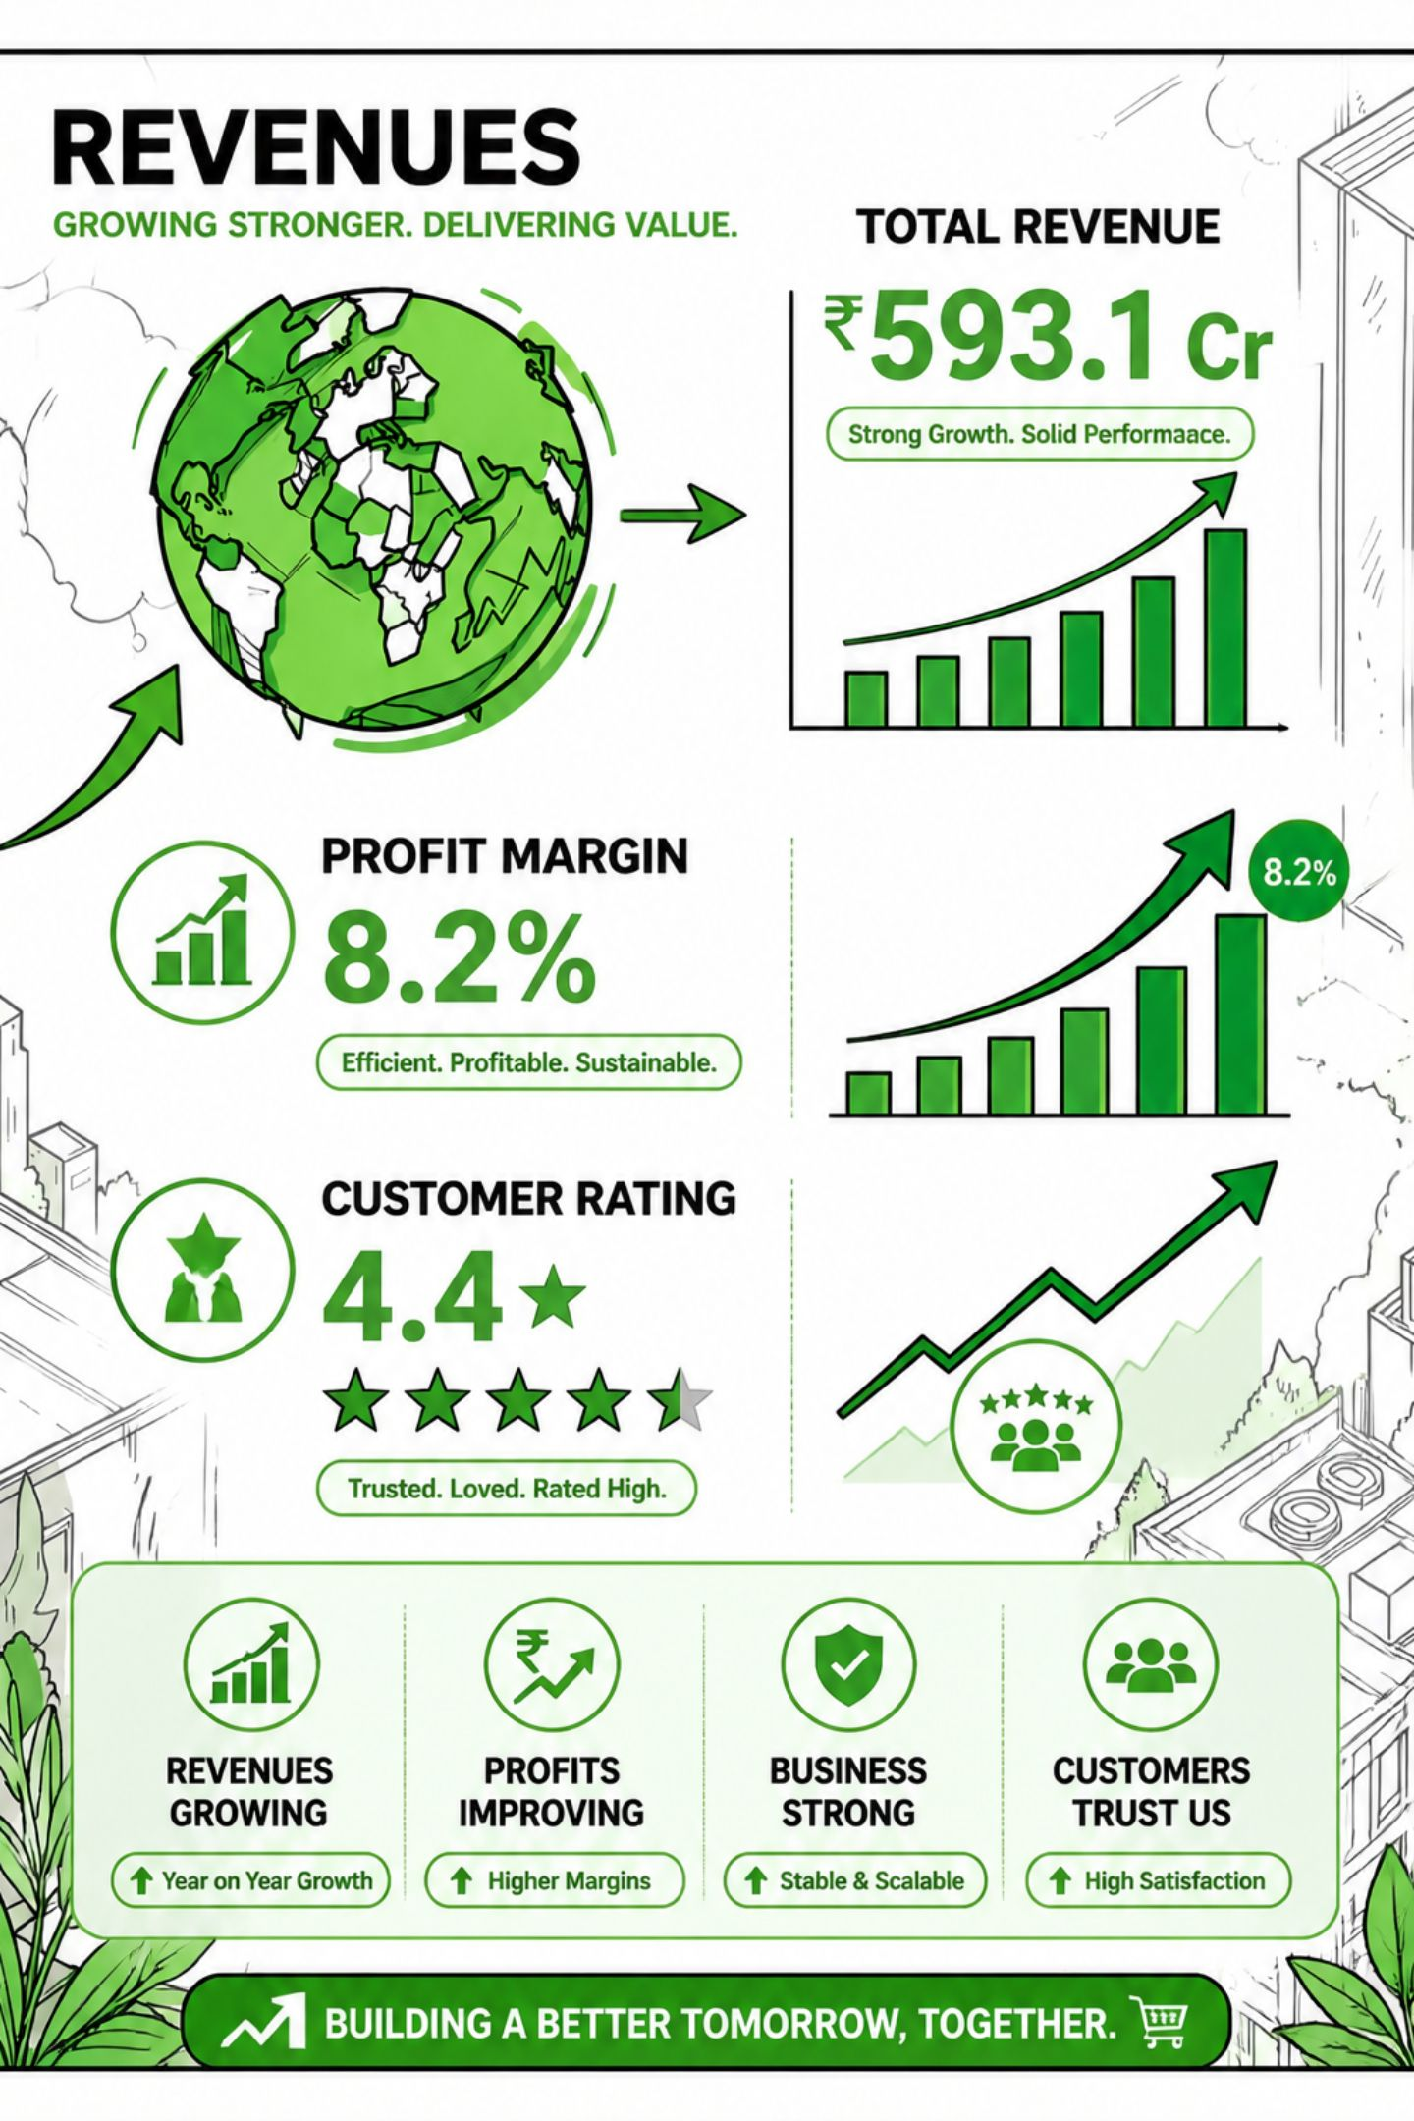
Business Summary
Aggregate results from the dataset: ₹593.1 crore in revenue with an 8.2% profit margin across 250,000 orders. The business appears healthy with clear improvement opportunities.
Strengths
Opportunities
High revenue scale and sustainable profit margin.
Expand beyond Electronics, provide UPI offers and cashbacks for greater sales.
Future Improvements
Prioritize marketing, inventory and delivery capacity in high-demand regions.

Slide 9
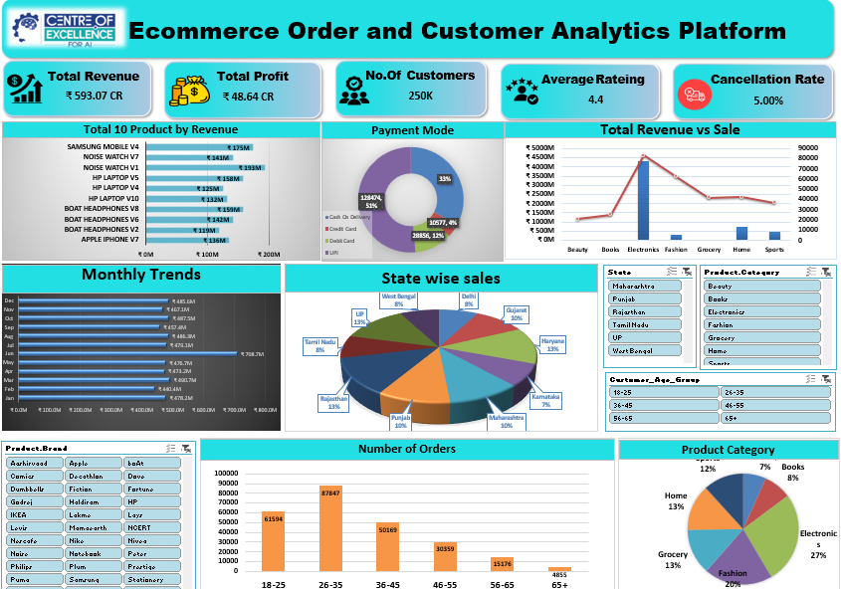
Final Dashboard

Slide 10
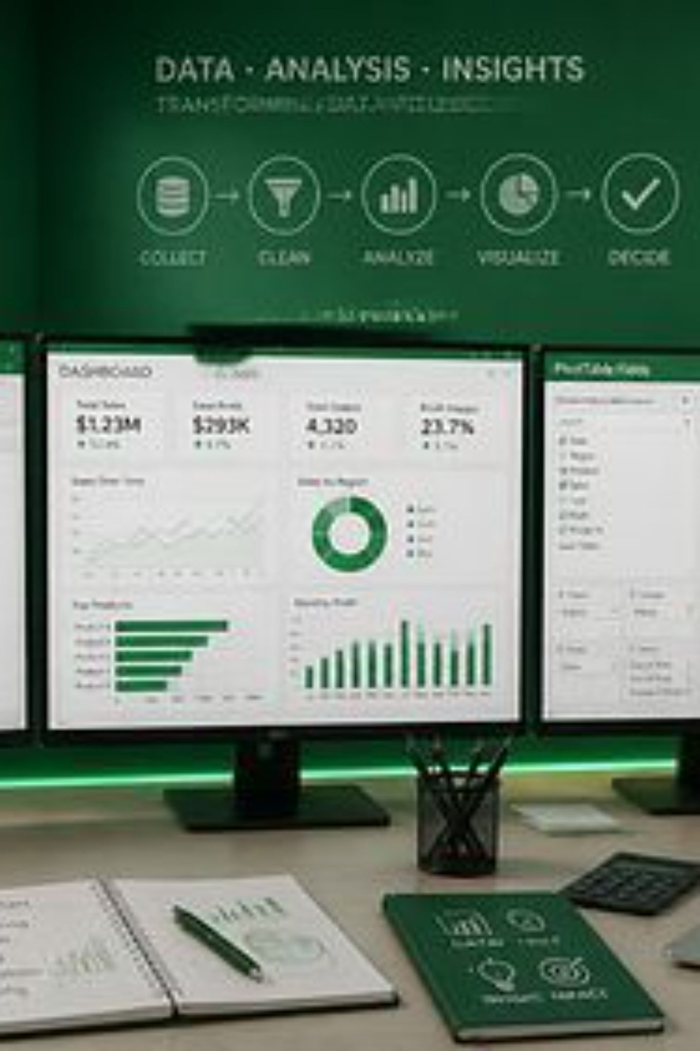
Conclusion & Learning
The project delivered a governed Excel model that unifies order, customer, and product data to answer revenue, profitability, customer value and operational questions. Learning: multi-table merges, calculating KPI fields, pivot-dashboard construction, and translating KPIs into actionable insights.

Slide 11

Thank You!
Questions are Welcome
We appreciate your time and interest in our E-Commerce Analytics Platform.

