Slide 1
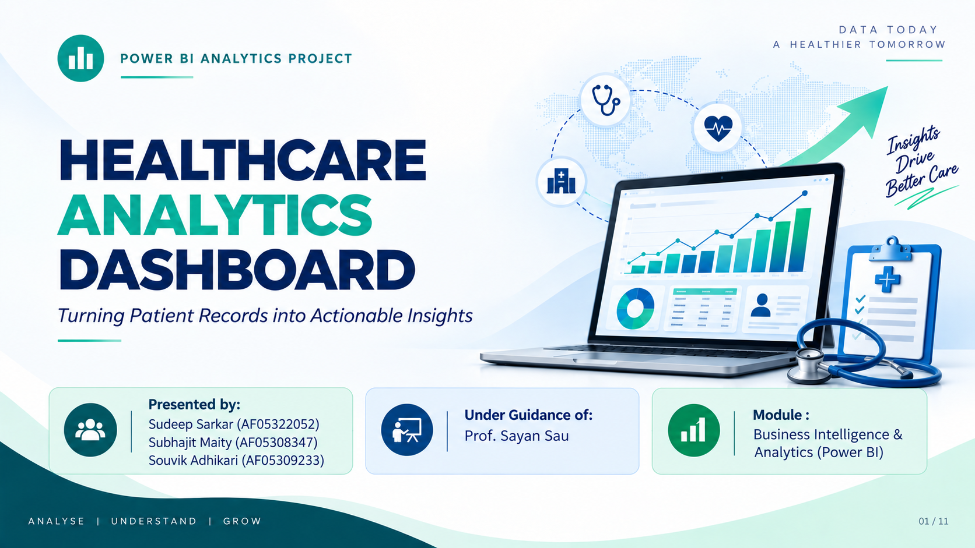


Slide 2
PROJECT OVERVIEW
Problem Statement
Hospitals and clinics generate patient, appointment, treatment and billing data across disconnected systems. Without a unified view, it's hard to spot operational issues — like rising no-shows or a billing shortfall — in time to act. This project consolidates five operational datasets into a single Power BI model to monitor patient flow, doctor performance, and revenue health.
Patient & Appointment
Tracking
Doctor Performance
Revenue & Billing
Health
Monitor visit volume, status, and no-show patterns across 200 appointments.
Compare caseload, specialization mix, and workload across 10 doctors.
Track billed vs. collected amounts and flag payment risk early.

Slide 3
OBJECTIVE & DESIGN
Objective & Design
Build a relational Power BI data model connecting Patients, Doctors, Appointments, Treatments and Billing into a single source of truth — enabling DAX-driven KPIs and a 3-page interactive dashboard.
01
Ingest
Imported 5 source tables — Patients, Doctors, Appointments, Treatments, Billing — covering 200 appointment records.
Ingest
02
Model
Connected the tables into a star schema via patient_id, doctor_id, appointment_id and treatment_id.
Model
03
Report
Built DAX measures and a 3-page report: Executive Dashboard, Doctors’ Performance, and Financials.
Report

Slide 4
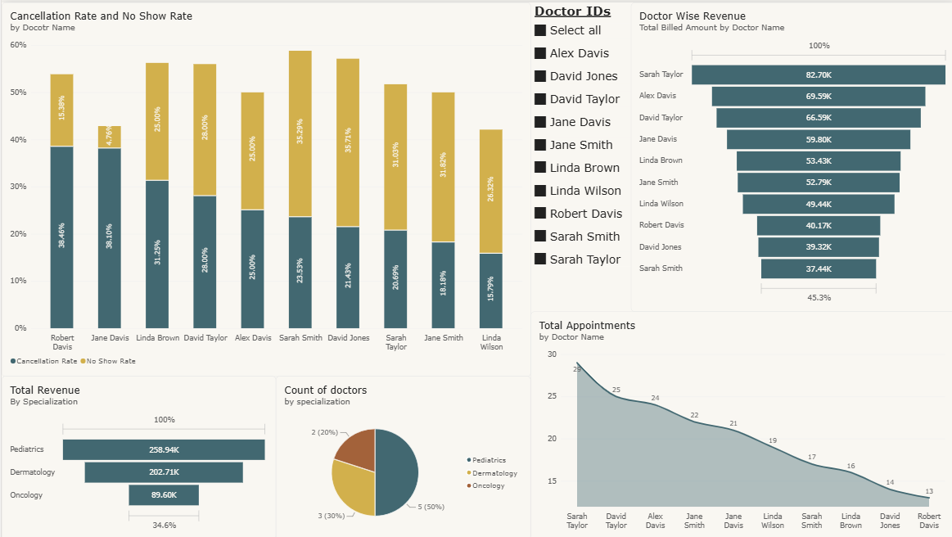
TOOLS & TECHNIQUES
Tools & Techniques
Core Power BI methods used to build a governed, interactive analytics model.
Power BI Desktop
Data modeling, table relationships, and multi-page report design.
DAX Measures & Calculated Columns
CALCULATE, DIVIDE and FILTER patterns for rate and retention KPIs.
Star Schema Modeling
Appointments fact table linked to Patient, Doctor, Treatment and Billing dimensions.
BUILT ENTIRELY
IN POWER BI

Slide 5
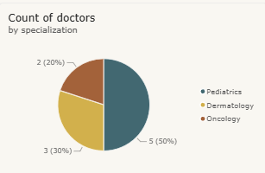
DATASET OVERVIEW
Dataset Overview
Range: January 2023 — December 2023
The model covers 200 appointments linked to 50 registered patients and 10 doctors across 3 hospital branches and 3 specializations, with matching treatment and billing records for every visit.
Doctors by Specialization
50
10
200
Patients
Doctors
Appointments
48 active in 2023
3 branches · 3 specializations
Jan – Dec 2023

Slide 6
DATA MODEL & RELATIONSHIPS
Data Model & Relationships
Appointments sits at the center as the fact table, linking Patient and Doctor dimensions and cascading into Treatments and Billing for a complete patient-to-payment view.
Calculated Fields (Measures)
Enrichment (Calculated Columns)
No-Show Rate, Cancellation Rate, Completion Rate, Patient Retention, Avg Treatment Cost, Total Billed vs Collected — built with CALCULATE + DIVIDE.
Age, Age Group, Appointment Month and Doctor Experience Band, added for segmentation and chronological sorting.
Star Schema Flow
Patients
Doctors
Appointments
Treatments
Billing
patient_id
doctor_id
appointment_id
treatment_id
Dimension
Fact Table

Slide 7
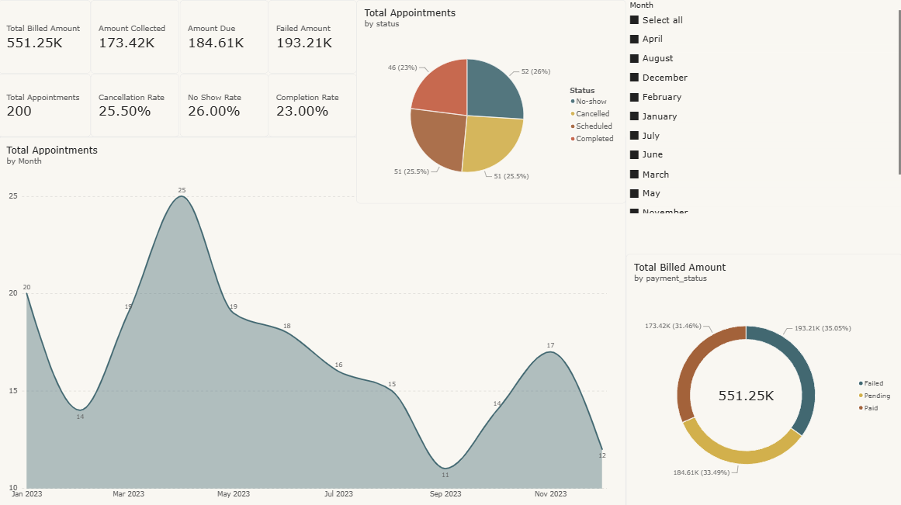

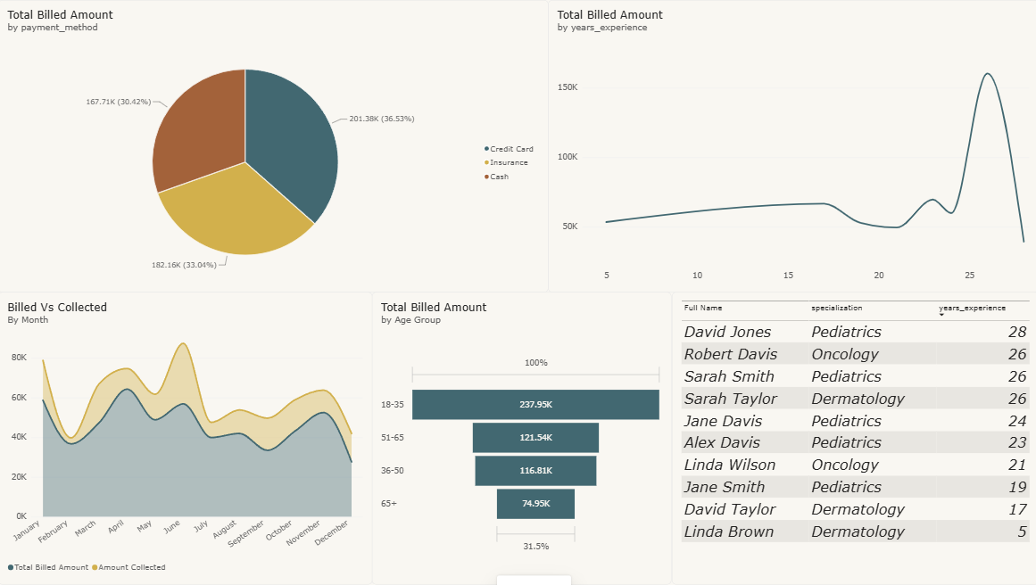
KEY FEATURES & DASHBOARDS
Key Features & Dashboards
Three report pages moving from patient-level detail to financial performance — 22 visuals in total.
Executive Dashboard
Doctors’ Performance
Financials
8 KPI cards, an appointment-trend area chart, status donut & pie, and a branch slicer.
Column chart of appointments by doctor, specialization funnels, trend area chart, and a patient slicer.
Payment-status pie, billed-vs-collected line chart, a billing detail table, and a payment funnel.
12 visuals
5 visuals
5 visuals

Slide 8
BUSINESS SUMMARY
Business Summary
₹5.51L billed across 200 appointments in 2023 — but only 31.5% has been collected, while no-shows and cancellations together account for over half of all bookings.
Appointments by Status
23%
26%
31.5%
100%
Completion
Rate
No-Show
Rate
Collection
Rate
Active Patient
Retention
Strengths
Opportunities
Future Improvements
Strong patient retention — every active patient returned for a repeat visit.
No-shows and cancellations together exceed completed visits — reminder workflows and advance charges could recover capacity.
Chase the 68.5% of billed revenue still pending or failed, starting with the largest balances.

Slide 9
CONCLUSION & LEARNING
Conclusion & Learning
This project delivered a governed Power BI model that unifies patient, doctor, treatment and billing data to answer questions about operational efficiency, doctor workload, and revenue collection. Building it strengthened skills in star-schema relationship design, DAX pattern-building (CALCULATE, DIVIDE, FILTER), and turning raw rates into decision-ready KPIs for a non-technical audience.
Data Modeling
DAX Measures
FROM RAW DATA
TO DECISIONS
KPI Storytelling
Dashboard Design

Slide 10
Thank You!
Questions are Welcome
We appreciate your time and interest in the Healthcare Analytics Dashboard.

