Slide 1



Dr. B. C. Roy Engineering College
Fuljhore, Jemua Road, Durgapur-713206
West Bengal, India
2024-2026
Plant Disease Detection using Machine Learning
MCA Major Project (CA - 481)
Members : Sudeep Sarkar (Roll: 120710242085)
Vishal Chandra (Roll: 120710242092)
Under the Guidance of : Prof. Biswesar Ghosh
Group Number : 9
SEMESTER: 4
BATCH: 2024-26

Slide 2
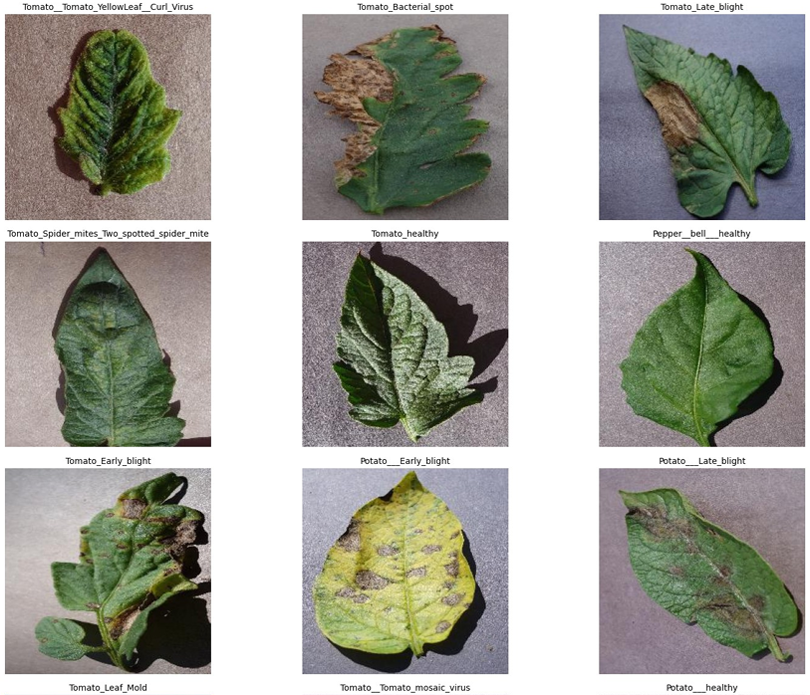
Abstract
This project builds an automated plant-leaf disease classifier using transfer learning (MobileNetV2). We processed the PlantVillage-derived dataset (15 classes, ~20.6K images), addressed class imbalance, trained with data augmentation and class weights, and deployed a prediction interface. Final fine-tuned model achieves ~94% validation accuracy with high per-class precision and recall.

Slide 3
Introduction
Early disease identification reduces crop loss and supports precision agriculture. Our Goal is to Create an accurate, lightweight model suitable for edge deployment and quick field diagnosis. The Dataset contains 15 disease classes from PlantVillage (~20,639 images). Input size: 224×224, batch size: 32.
Problem
Approach
Outcome
Manual diagnosis is slow and error-prone.
Transfer learning + augmentation + class-weighted training.
High-accuracy classifier and a Gradio interface for demo.

Slide 4
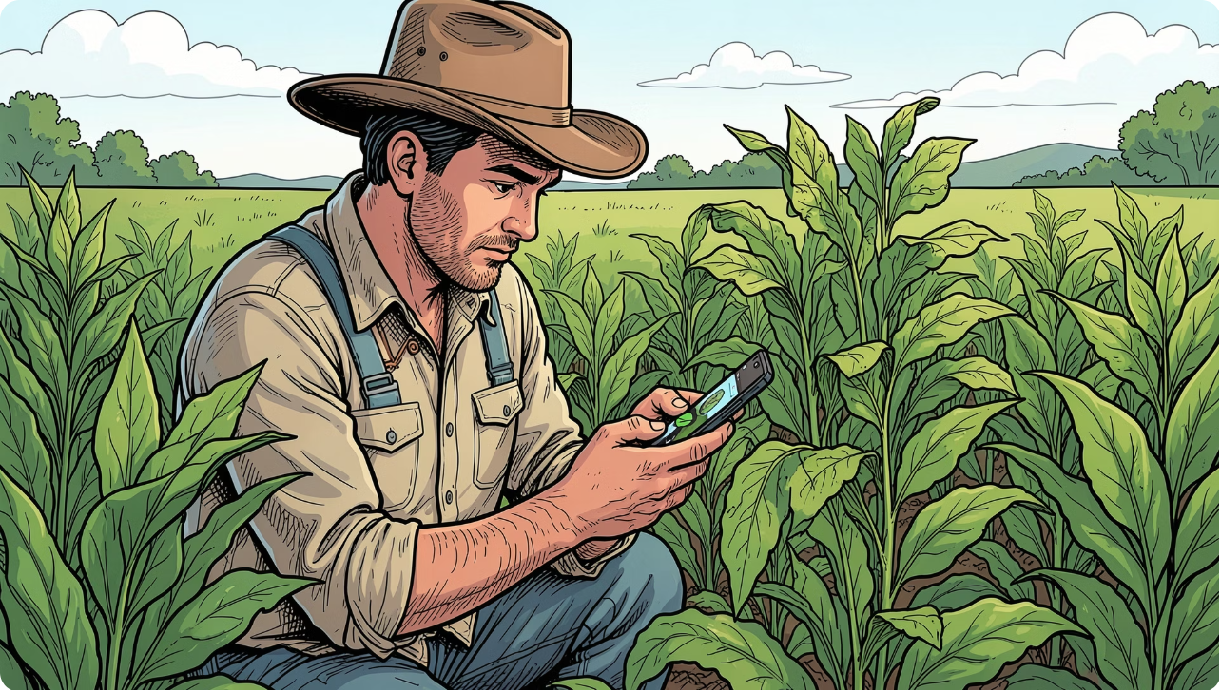
Scope
Project Boundaries & Deliverables
Classification of 15 common plant disease classes (tomato, potato, pepper variants)
Model training, fine-tuning, evaluation, and confusion analysis
Lightweight export (.keras) and a web demo via Gradio
Limitations: dataset bias, class imbalance, environmental variability

Slide 5
Key Technologies
Python
Matplotlib / Seaborn
Data processing, training scripts, inference utilities
EDA, class distribution bar chart, training plots, confusion heatmap
TensorFlow / Keras
Gradio
MobileNetV2 backbone, model.compile, training, checkpointing
Interactive demo for live image prediction and information display
Scikit-learn
Versioning & Export
Class-weight computation, metrics, confusion matrix
Model saved as plant_disease_model.keras; class_names.json for label mapping

Slide 6
Project Progress
Key milestones, status, and diagnostic notes.
01
02
Data Preparation
Modeling
Counted images per class (15 classes, 20.6K images). Visualized samples and distribution. Addressed imbalance with class weights.
Base: MobileNetV2 (imagenet weights, frozen). Added GAP, Dropout (0.2), Dense(15, softmax).
03
04
Training & Fine-tuning
Evaluation & Deployment
Initial training (15 epochs) → val_acc ~88%.
Fine-tuning (unfreeze after layer 100) improved val_acc to ~93–94%.
Computed classification report, confusion matrix, exported model, and built Gradio interface for predictions and remedial suggestions.

Slide 7
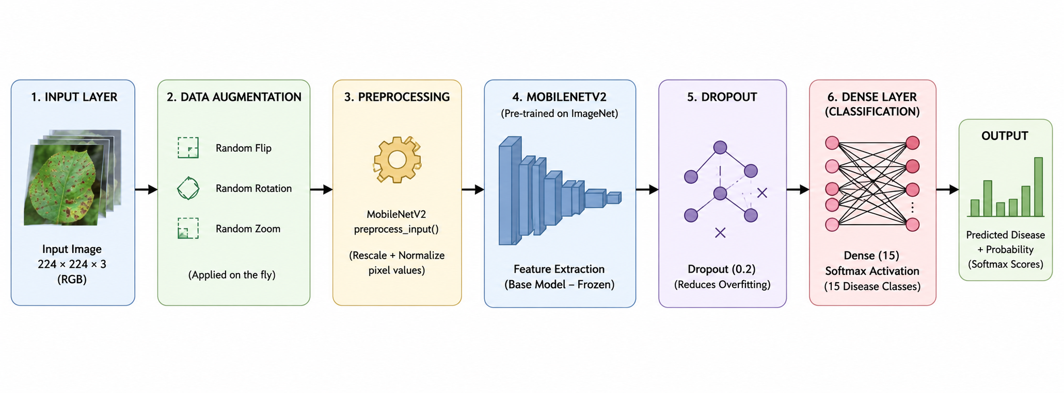
Layers

Slide 8
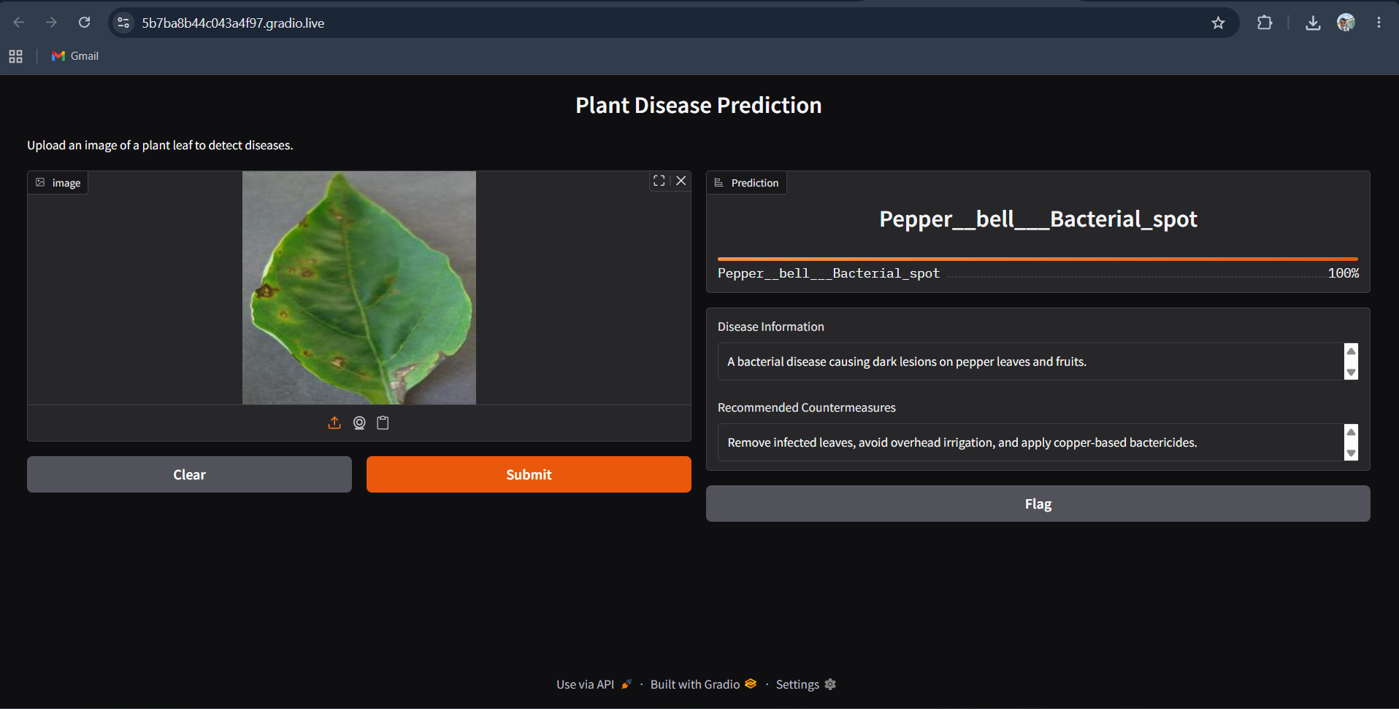
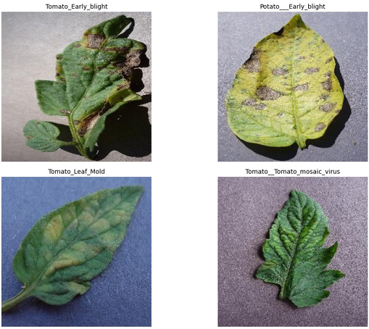
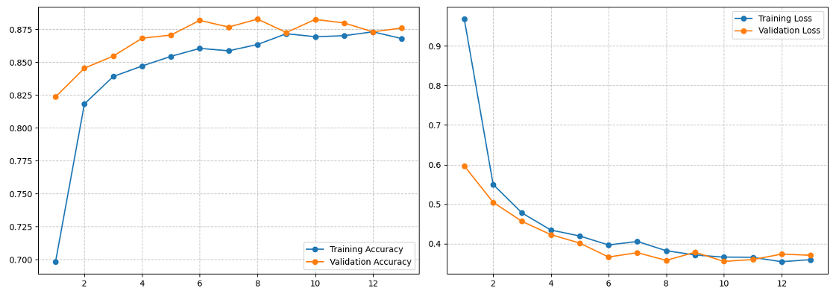
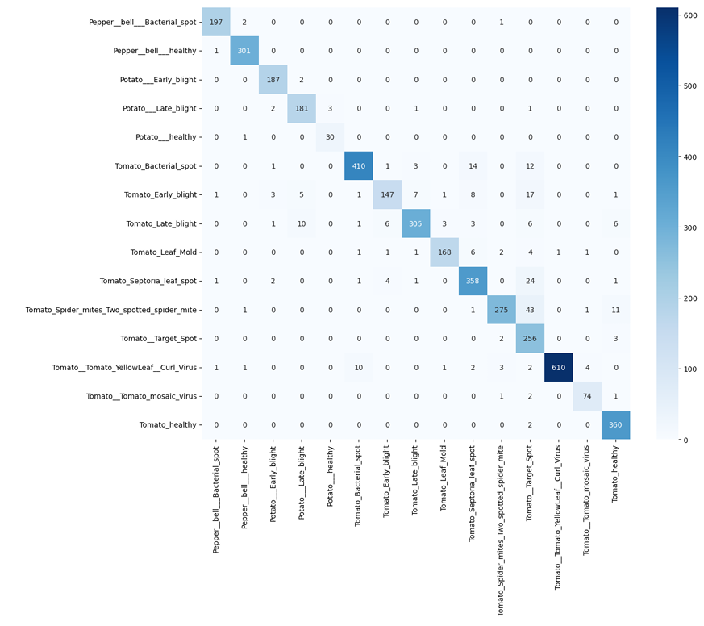
Screenshots & Visual Results
Representative visual outputs from the notebook: class distribution, sample images, training curves, and confusion matrix.
Notes: Training curves show convergence after augmentation and fine-tuning; confusion matrix highlights a few confusable tomato classes to target for future data collection.

Slide 9

Future Scope
Building on current achievements, our future work will focus on expanding the model's capabilities and practical utility.
Data Expansion
Edge Optimization
Advanced Vision
System Integration
Augment dataset with more plant species, varied disease stages, and diverse environmental conditions.
Implement object detection to localize diseased areas and explore disease progression tracking.
Optimize model for deployment on low-power edge devices through quantization and pruning.
Develop real-time feedback and integrate with precision agriculture platforms for actionable insights.

Slide 10

Bibliography
Key references and resources used during the project.
Using Deep Learning for Image-Based Plant Disease Detection - Sharada P. Mohanty, et al.
Survey of Accuracy Prediction on the PlantVillage Dataset Using Different ML Techniques - V. Pandey, et al.
Hughes, D. P., & Salathé, M. (2015). An open access repository of images for plant disease. arXiv.
TensorFlow Documentation — Transfer learning with tf.keras.
Chollet, F. (2017). Deep Learning with Python. Manning Publications.
For reproducibility: All code snippets referenced in the notebook (data loading, model definition, training loop, evaluation, and Gradio interface) were executed in the provided Jupyter notebook.

Slide 11

Thank You

