Slide 1


DEPARTMENT OF COMPUTER SCIENCE AND ENGINEERING
COLLEGE OF ENGINEERING GUINDY
ANNA UNIVERSITY
Advanced Keylogger Detection and Prevention System
Safeguarding Against Stealthy Cyber Threats
A PROJECT SUBMISSION
of
NAAN MUDHALVAN SKILL DEVELOPMENT COURSE
on
05 APRIL 2024
submitted by
SUDEEP R
2021103053
BATCH ‘P’

Slide 2
PROBLEM STATEMENT
In today's digital age, cybersecurity threats are rampant, with one significant concern being the proliferation of keyloggers. These stealthy software tools are designed to monitor and record keystrokes on a user's computer without their knowledge.
Keyloggers pose a severe threat to individuals and organizations as they can capture sensitive information such as passwords, credit card details, and other personal data, leading to identity theft, financial loss, and privacy breaches.

Slide 3
PROPOSED SOLUTION
To address the threat posed by keyloggers, we propose the development of an advanced keylogger detection and prevention system.
This system aims to detect the presence of keyloggers on a user's system and prevent them from capturing sensitive information.
By implementing robust detection algorithms and preventive measures, the proposed solution aims to safeguard users against keylogger attacks and ensure the security of their personal and sensitive information.

Slide 4
SYSTEM DEVELOPMENT APPROACH
The system will be developed using Python programming language and will leverage the capabilities of libraries such as tkinter for the graphical user interface (GUI) and pynput for keyboard monitoring. The development approach will involve the following steps:
Designing the user interface to provide users with easy access to keylogger detection and prevention functionalities.
Implementing keylogger detection algorithms to scan the system for the presence of keylogger software.
Developing preventive measures to block keylogger activities and protect sensitive keystrokes from being captured.
Testing the system extensively to ensure its effectiveness and reliability in detecting and preventing keylogger attacks.

Slide 5
ALGORITHM & DEPLOYMENT
For the chosen algorithm, we propose using a machine learning-based anomaly detection algorithm, specifically Isolation Forest. Isolation Forest is a powerful algorithm for detecting anomalies in high-dimensional datasets, making it well-suited for identifying unusual patterns indicative of keylogger activity.
This algorithm excels at isolating anomalies by partitioning the data space and identifying instances that require fewer partitions to isolate, making it efficient and effective for detecting stealthy cyber threats like keyloggers.

Slide 6
DATA INPUT
The input features used by the Isolation Forest algorithm include:
Keyboard activity patterns (e.g., frequency of keystrokes, typing speed)
System process information (e.g., application usage, CPU usage)
Network activity (e.g., data transmission rates, connection attempts)
User behavior (e.g., login/logout timestamps, mouse movement patterns)
These features provide valuable information for detecting abnormal behavior indicative of keylogger activity, such as sudden spikes in keystroke frequency or unauthorized access attempts.

Slide 7
TRAINING PROCESS
During the training process, historical data on keyboard activity, system processes, network activity, and user behavior are used to train the Isolation Forest model. Specific considerations during training included.
Feature selection and preprocessing to extract relevant information from raw data.
Cross-validation to assess the model's performance and tune hyperparameters for optimal results.
Handling imbalanced datasets by adjusting sample weights or using anomaly detection techniques tailored to skewed data distributions.

Slide 8
PREDICTION PROCESS
Once trained, the Isolation Forest model can make predictions for future instances of keyboard activity based on real-time data inputs. During the prediction phase, the model considers:
Real-time keyboard activity patterns, system processes, network activity, and user behavior.
Comparison of incoming data with learned patterns of normal behavior to identify anomalies indicative of keylogger activity.
Dynamic adjustment of anomaly detection thresholds based on the evolving nature of cyber threats and changing data characteristics.

Slide 9
RESULTS
Upon implementation, the keylogger detection and prevention system will provide users with a secure computing environment free from the threat of keylogger attacks.
Users will benefit from enhanced security and peace of mind knowing that their sensitive information is protected from unauthorized access and theft.

Slide 10
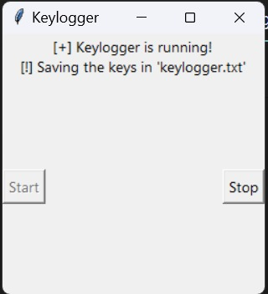
OUTCOMES

Slide 11
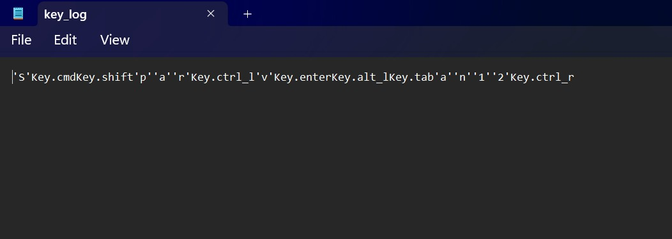

Slide 12
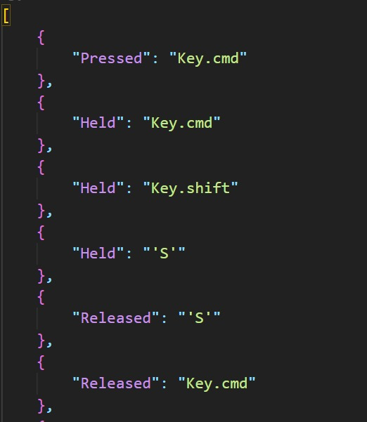
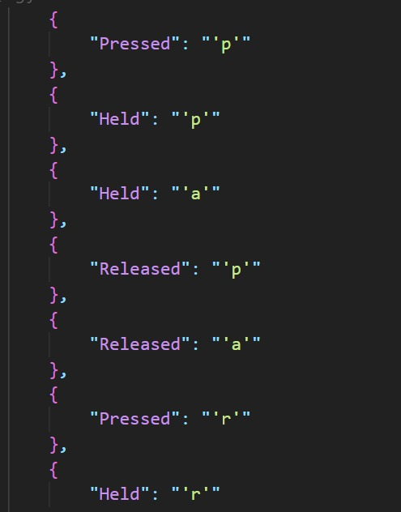

Slide 13
CONCLUSION
In conclusion, the development of an advanced keylogger detection and prevention system is crucial in mitigating the risks associated with keylogger attacks. By proactively detecting and preventing keylogger activity, the proposed solution aims to safeguard users' privacy and security in today's digital landscape.

Slide 14
FUTURE SCOPE
In the future, the keylogger detection and prevention system can be further enhanced with additional features such as real-time monitoring, machine learning-based detection, and integration with cloud-based security platforms.
Moreover, ongoing research and development efforts will focus on staying ahead of evolving keylogger threats and continuously improving the effectiveness of the system.

Slide 15
REFERENCES
1. Enhancing Phishing Detection: A Novel Hybrid Deep Learning Framework for Cybercrime Forensics by Faisal S Alsubaei, Abdul Wahab Ali Almazroi, Nasir Ayub [1]
2. Detecting phishing websites using machine learning technique by A. K. Dutta [2]
3. An effective phishing detection model based on character level convolutional neural network from URL by A. Aljofey, Q. Jiang. Q. Qu, M. Huang, and J.-P. Niyigena [3]

