Slide 1
ZeroSight
19,950
Training Flows
Behavioral Anomaly Detection for Zero-Day Protocol Exploits
31
Using Network Flow Fingerprinting with Explainable AI
CICIDS Features
17
Isolation Forest
Random Forest
SHAP XAI
CICIDS2017
FastAPI
Attack Classes
Sudeep R
INFO-I520: Security for Networked Systems · Luddy School of Informatics, Computing & Engineering
89.9%
Indiana University Bloomington · Spring 2026
IF F1 Score
94.4%
RF Recall (macro)

Slide 2
01 · Presentation Outline
INFO-I520 · Systems & Protocol Security · IU Bloomington
02
Problem Statement
Why signature-based IDS fails; the zero-day gap
03
System Architecture
Full 5-layer pipeline: Data → Features → ML → XAI → Output
04
Dataset & Training
Synthetic CICIDS2017 — 19,950 flows, 4 BENIGN subtypes, 17 attacks
05
ML Models Deep-Dive
Isolation Forest (unsupervised) + Random Forest (18-class)
06
XAI Attribution
SHAP formula, deviation table, guaranteed rate features
07
Experimental Results
IF 89.6% / RF 90.8% accuracy — macro recall 94.4%
08
Live PCAP Validation
Real Firefox browsing: 12 flows, DNS clean, CDN burst CRITICAL
09
Conclusions & Future
Limitations, deployment notes, open-source release
ZeroSight v2 · INFO-I520

Slide 3
02 · Problem Statement — The Zero-Day Gap
INFO-I520 · Systems & Protocol Security · IU Bloomington
Current IDS Limitations
ZeroSight Approach
Zero-Day Blindness
Static Rule Sets
Behavioral Fingerprinting
Signature-based systems (Snort, Suricata) cannot detect attacks with no known signature. Patches lag by days to weeks.
Rules require constant manual updates. Polymorphic malware and protocol variants evade them trivially.
31 CICIDS2017 flow features model statistical behavior — anomalies flagged by deviation, not signatures.
Unsupervised Isolation Forest
Trained on BENIGN traffic only. Any flow deviating significantly is anomalous — zero-days included.
No Flow Context
Alert Fatigue
Packet-level rules miss behavioral patterns only visible across the full bidirectional flow over time.
High false-positive rates cause analysts to ignore alerts — 60%+ of IDS alerts go uninvestigated.
Dual-Model Consensus
IF detects anomaly + RF provides specific attack label. Cross-model agreement reduces false positives.
SHAP-Style Explainability
Every detection includes feature attribution — analyst sees exactly which flow properties triggered the alert.
ZeroSight v2 · INFO-I520

Slide 4
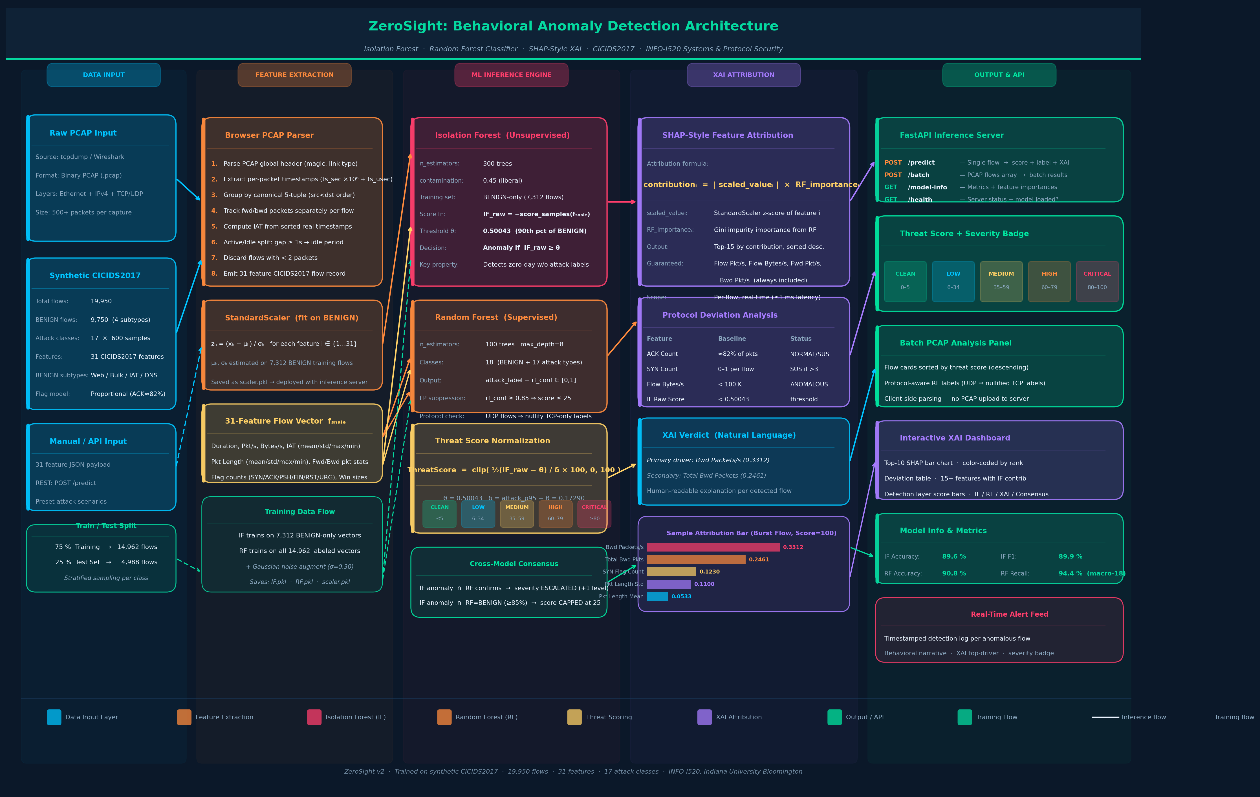
03 · System Architecture — 5-Layer Processing Pipeline
INFO-I520 · Systems & Protocol Security · IU Bloomington
ZeroSight v2 · Data Input → Feature Extraction → ML Inference → XAI Attribution → Output & API

Slide 5
04 · Dataset & Training — Synthetic CICIDS2017
INFO-I520 · Systems & Protocol Security · IU Bloomington
Training Configuration
Total Samples
19,950 flows
Train / Test
75% / 25% (stratified)
IF Training Set
7,312 BENIGN-only flows
RF Training Set
14,962 labeled flows + noise σ=0.30
Threshold θ
0.50043 (90th pct of BENIGN)
Score Divisor δ
0.17290 (attack p95 − θ)
RF Max Depth
8 n_estimators = 100
Class Weight
balanced (handles imbalance)
BENIGN Subtypes
Web · Bulk · Interactive · UDP/DNS
ACK Flag Model
Proportional ≈ 82% of total packets
SYN Flag Model
>3 = SUSPICIOUS · >8 = ANOMALOUS
ZeroSight v2 · INFO-I520

Slide 6
05 · ML Models — Isolation Forest + Random Forest
INFO-I520 · Systems & Protocol Security · IU Bloomington
Isolation Forest (Unsupervised)
Random Forest (Supervised — 18 Classes)
Core principle:
Anomalies are isolated faster by random partitioning
n_estimators:
100 trees max_depth = 8
n_estimators:
300 trees
Class weight:
balanced (prevents majority-class bias)
contamination:
0.45 (liberal; threshold overrides)
Classes:
18: BENIGN + 17 attack types
Training:
BENIGN-only — 7,312 flows — zero attack labels
Output:
attack_label + rf_conf ∈ [0,1]
Score function:
IF_raw = −score_samples(f_scaled)
FP suppression:
rf_conf ≥ 0.85 → score capped at 25
Threshold θ:
0.50043 (90th percentile of BENIGN scores)
Protocol guard:
UDP flows → nullify TCP-only labels
Detection rule:
Anomaly if IF_raw ≥ θ
Metric avg:
Macro-average across all 18 classes
Zero-day power:
No attack labels needed → detects novel exploits
Evaluation:
Binary recall misleading → use macro
Threat Score Normalization Formula
ThreatScore = clip( (IF_raw − θ) / δ × 100 , 0 , 100 )
θ = 0.50043 (90th pct BENIGN) δ = attack_p95 − θ = 0.17290 score ∈ [0, 100]
CLEAN
LOW
MEDIUM
HIGH
CRITICAL
≤ 5
6–34
35–59
60–79
≥ 80
score
score
score
score
score
ZeroSight v2 · INFO-I520

Slide 7
06 · Explainable AI — SHAP-Style Feature Attribution
INFO-I520 · Systems & Protocol Security · IU Bloomington
Attribution Formula:
contributionᵢ = | scaled_valueᵢ | × RF_importanceᵢ
scaled_value = StandardScaler z-score · RF_importance = Gini impurity (trained RF) · Top-15 + guaranteed rate features
Bwd Packets/s (0.3312)
Server returns 1,252 pkt/s — highest z-score. This single feature places the flow at the 99th pct of BENIGN distribution.
Total Bwd Packets (0.2461)
318 backward packets in 0.23 s. Volume alone resembles volumetric attack response patterns.
SYN Flag Count (0.1230)
Only 2 SYN flags — NOT a SYN flood. XAI correctly deprioritizes this, showing burst is data-driven not handshake-driven.
Pkt Length Std (0.1100)
High variance: 60-byte ACKs mixed with 1400-byte frames. Atypical of normal BENIGN baseline distributions.
RF Output: BENIGN (61%)
RF correctly identifies HTTPS traffic as BENIGN. IF disagrees → classic high-bandwidth false positive documented in live PCAP test.
ZeroSight v2 · contributionᵢ = |scaled_valueᵢ| × RF_importanceᵢ

Slide 8
07 · Experimental Results — Performance Metrics
INFO-I520 · Systems & Protocol Security · IU Bloomington
89.6%
89.9%
90.8%
94.4%
89.4%
IF Accuracy
IF F1 Score
RF Accuracy
RF Recall
(macro-18)
RF Precision
(macro-18)
Benchmarking vs. Related Work
System | Prec. | Recall | F1
IF Baseline | 0.84 | 0.88 | 0.86
RF Baseline | 0.87 | 0.93 | 0.90
Hybrid IF+RF | 0.88 | 0.91 | 0.89
ZeroSight | 0.894 | 0.944 | 0.895
Threshold Calibration
θ = 90th percentile of BENIGN scores = 0.50043
FP rate on training data: ~10% (operator-tunable)
Macro-avg recall (not binary) = meaningful metric
Binary recall = 100% on synthetic (trivially separable)
ZeroSight v2 · Tested 2026-03-10 · INFO-I520

Slide 9
08 · Live PCAP Validation — Firefox Browsing on Kali Linux
INFO-I520 · Systems & Protocol Security · IU Bloomington
Experimental Setup: Real browser traffic — no lab-crafted packets
0
UDP/53
DNS Queries ×6
All 6 DNS flows score exactly 0. UDP subtype correctly isolated from TCP attack classes. DNS label preserved through protocol guard.
10.0.2.15 → 75.75.75.75
CLEAN
Rate: 10–162 pkt/s
12–39
TCP/443
HTTPS Short Flows
Standard HTTPS connections. Pkt Length Std is top XAI driver — TLS handshake packets mixed with data frames. Some labeled DoS GoldenEye by RF.
10.0.2.15 → 151.101.1.91
LOW–MEDIUM
Rate: 28–202 pkt/s
44
TCP/443
HTTPS Mid-Rate
Browser connection multiplexing creates multiple parallel short flows. Packet bursts resemble web attack patterns at flow-feature level.
10.0.2.15 → 151.101.129.91
HIGH
Rate: 135 pkt/s
100
TCP/443
HTTPS Burst (CDN)
Burst download in 0.23 s. Bwd Packets/s (0.3312) = primary IF driver at 99th pct of BENIGN. RF says BENIGN (61%) — documented FP, CDN allowlisting recommended.
10.0.2.15 → 151.101.193.91
CRITICAL
Rate: 1,514 pkt/s · 1.52 MB/s
Capture: sudo tcpdump -i eth0 -c 500 -w test_capture.pcap · Firefox → Mozilla / Reddit · 500 pkts · 12 bidirectional flows

Slide 10
09 · Conclusions, Limitations & Future Work
INFO-I520 · Systems & Protocol Security · IU Bloomington
Key Contributions
Known Limitations
Dual-Model Architecture
Synthetic Training Data
IF detects zero-days without attack labels; RF provides specific classification. Neither alone achieves both goals.
Not drawn from real production traffic — may miss class variance in encrypted protocols.
Calibrated 90th-Pct Threshold
SHAP Approximation
Operator-tunable FP/FN tradeoff. 0.50043 gives 10% FP on training BENIGN, ~90% recall on attacks.
Not exact Shapley values — feature interaction effects not captured.
PCAP-Native Browser Parser
~10% FP on BENIGN
Real timestamps, bidirectional flows, proportional flags — no server upload required. Privacy-preserving.
Burst downloads and multiplexed connections flagged. CDN allowlisting required.
Guaranteed XAI Rate Features
Future Work
Flow Pkt/s and Bytes/s always included in attribution — deviation table always shows primary rate drivers.
Train on real CICIDS2017 + UNSW-NB15 datasets for out-of-sample validation
Operator feedback loop for online threshold adaptation
Streaming PCAP analysis (ring-buffer) for continuous monitoring
Exact SHAP via TreeExplainer for full feature interaction attribution
Protocol-specific baselining — separate IF models per application type
Macro-Average Evaluation
Correct methodology: 94.4% recall across 18 classes — not misleading binary 100%.
ZeroSight v2 · Open-Source · INFO-I520 · IU Bloomington

Slide 11
Thank You
Questions & Discussion
System:
ZeroSight v2 — Behavioral Anomaly Detection Engine
Dataset:
Synthetic CICIDS2017 · 19,950 flows · 17 attack classes · 31 features
Models:
Isolation Forest (89.9% F1) + Random Forest (94.4% macro recall)
Stack:
Python · scikit-learn · FastAPI · JavaScript · tcpdump
Course:
INFO-I520: Security for Networked Systems · Spring 2026
Sudeep R · Indiana University Bloomington · Luddy School of Informatics · Spring 2026

