Slide 1
Online Bus Booking

Slide 2
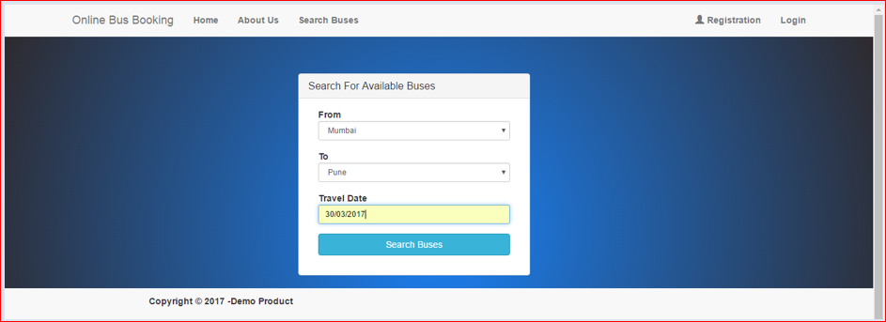
Home Page-> Search Bus
When website will run then Default page is Home Page and in the Home page there is the Search Bus Option. In Bus search bus option user can search their Origin and Designation.

Slide 3
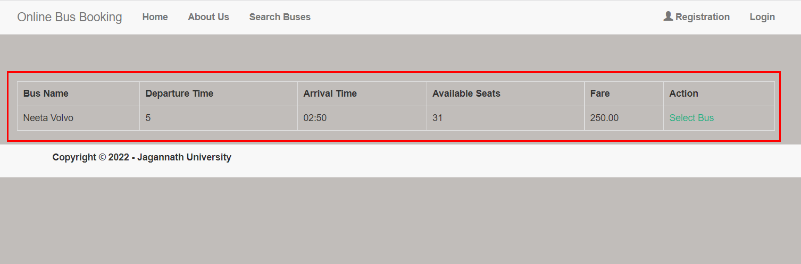
Available Bus Details
In this page user can see the available bus details

Slide 4
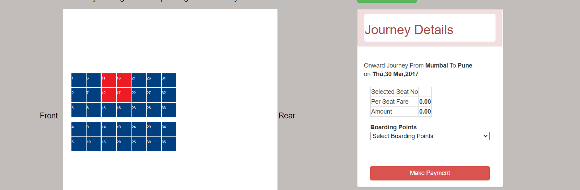
Seat Details and Make Payment
In this page user Can Book the Bus Ticket and Make payment but after that user need to login.

Slide 5
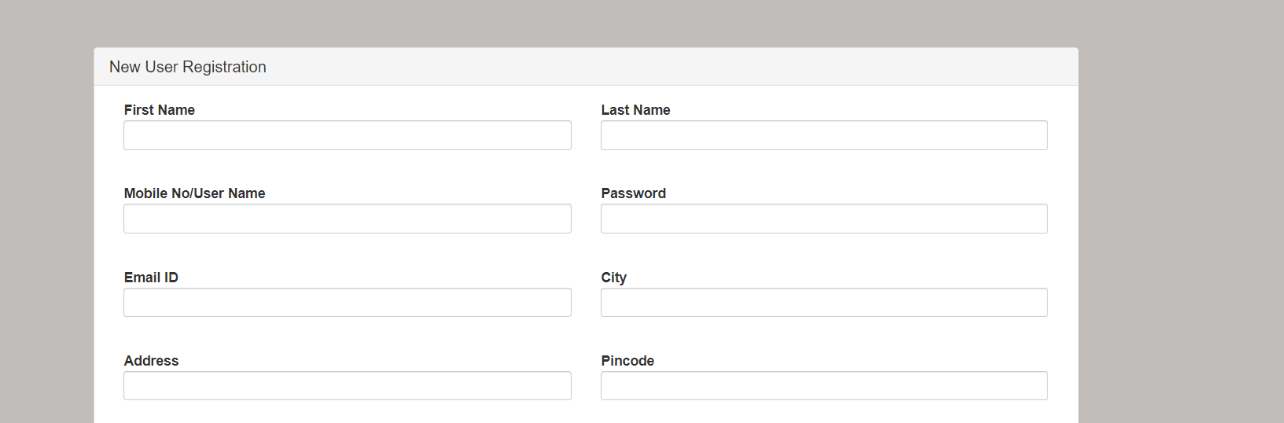
User Registration
In the User Registration page user can register itself for ticket booking without registration user can not book ticket.

Slide 6
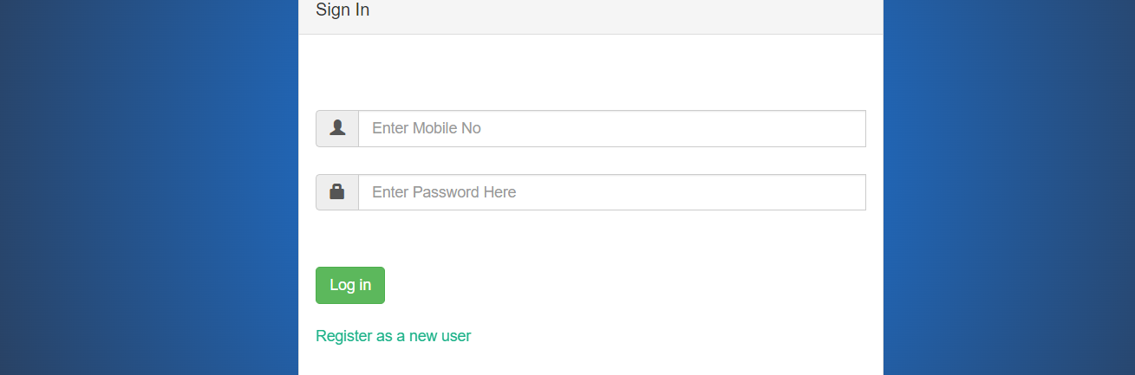
Login Page
For Ticket Booking and make payment user need to login first.

Slide 7
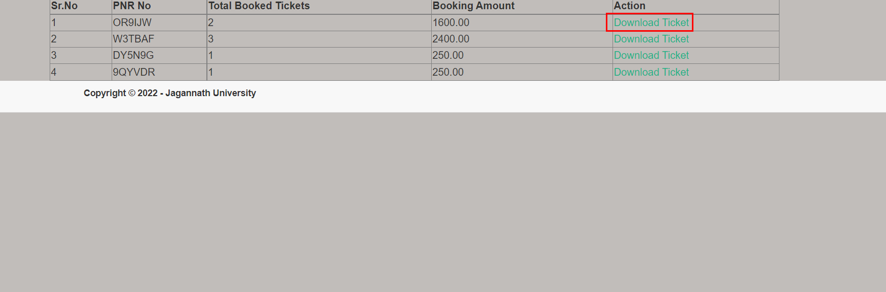
User Booked Ticket Details
After login user can see their Booked ticket history and also Download Ticket in Pdf format.

Slide 8
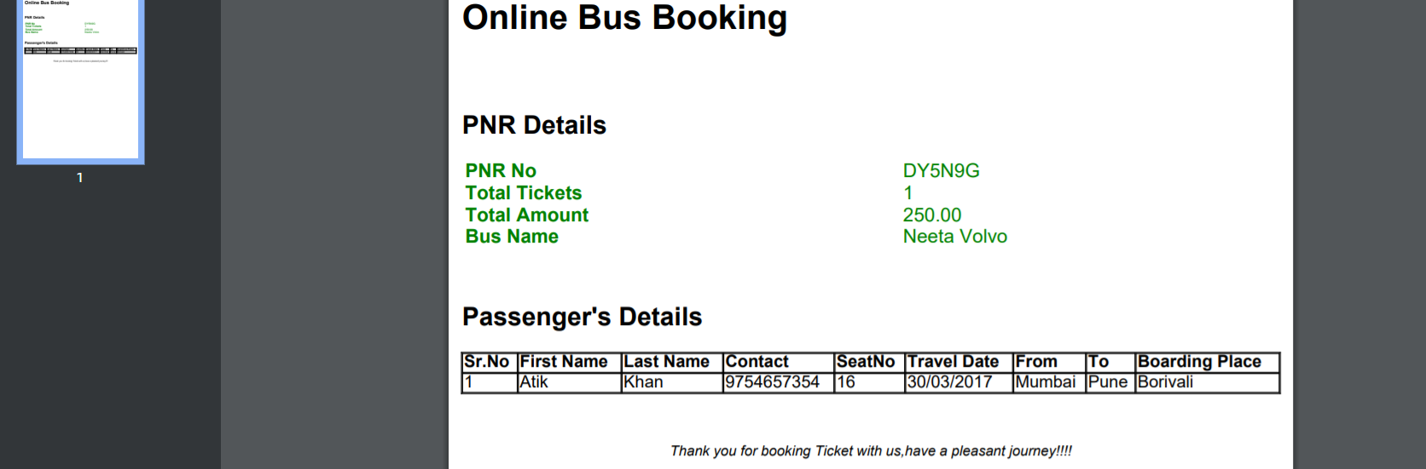
Ticket
User can see their booked ticket history and can download also.

Slide 9
Admin Panel

Slide 10
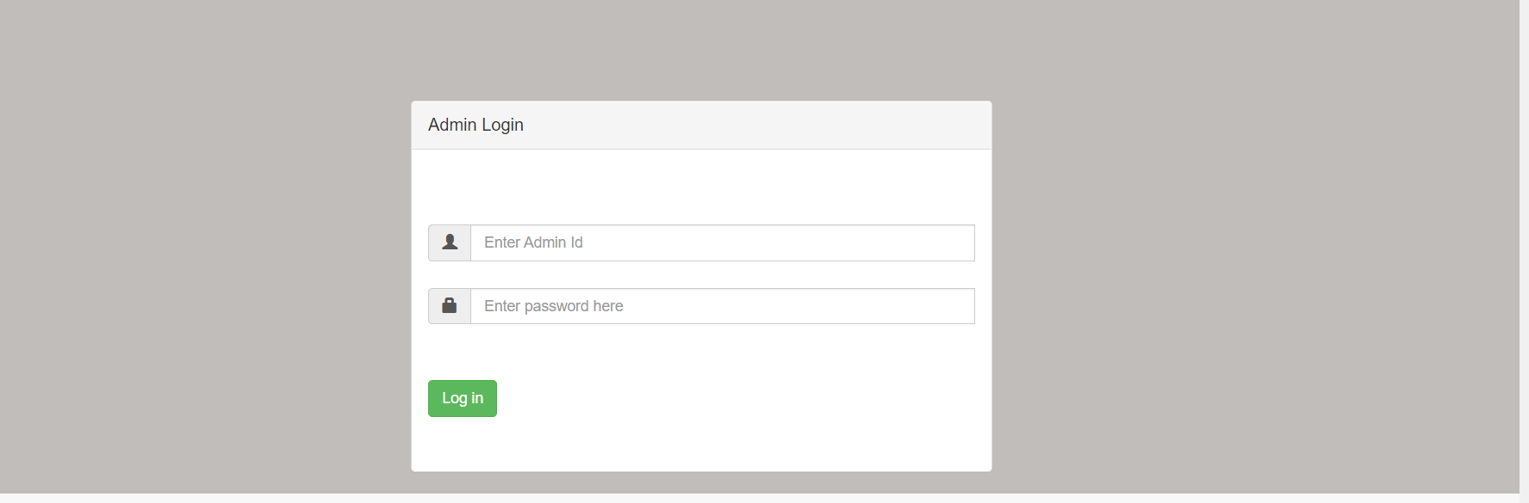
Admin Login
There is also a option so Admin can login and manage things like Bus Details , Ticket Booking Report , Route Details and Add Bus.

Slide 11
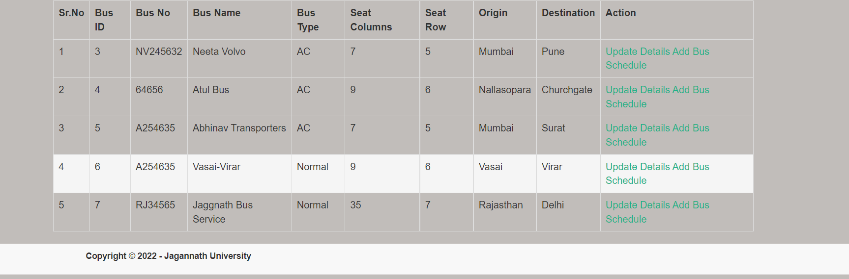
Bus Details
Admin can Update Bus Schedule and also Origin and Destination.

Slide 12
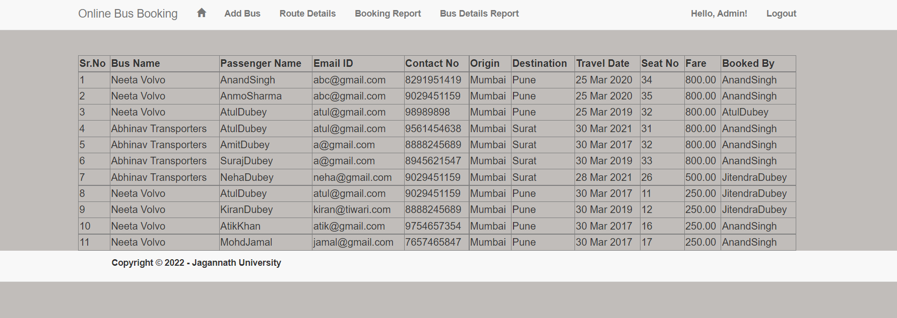
User Tickets
Admin can see the Booked ticket.

Slide 13
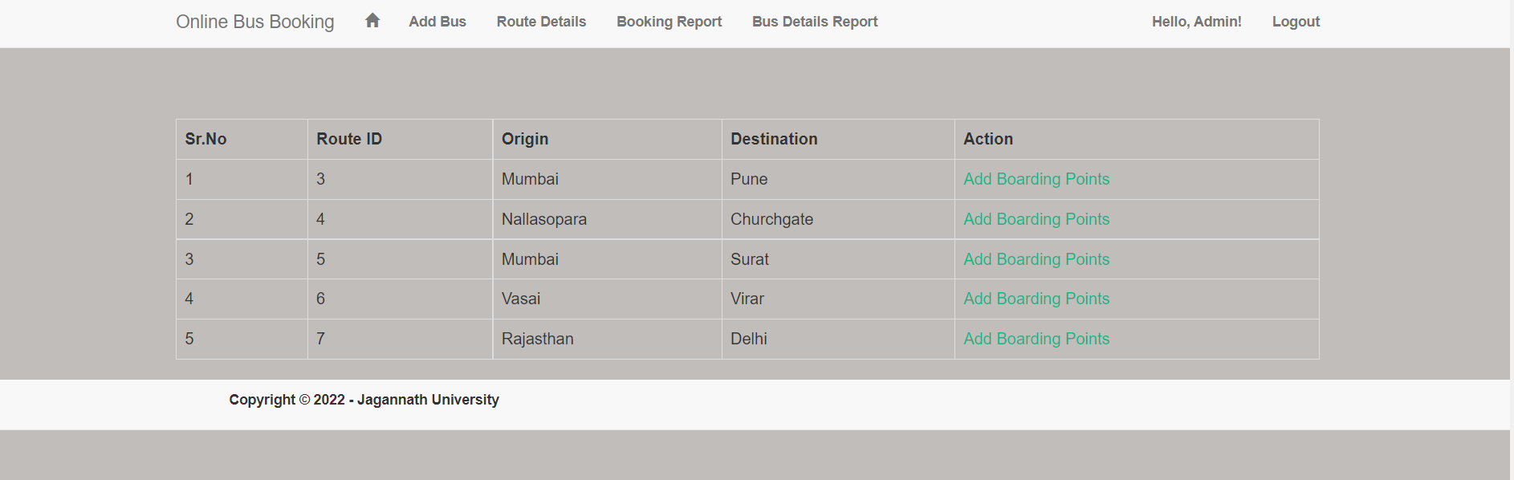
Route Details
Admin can add and Edit Bus Route Details.

Slide 14
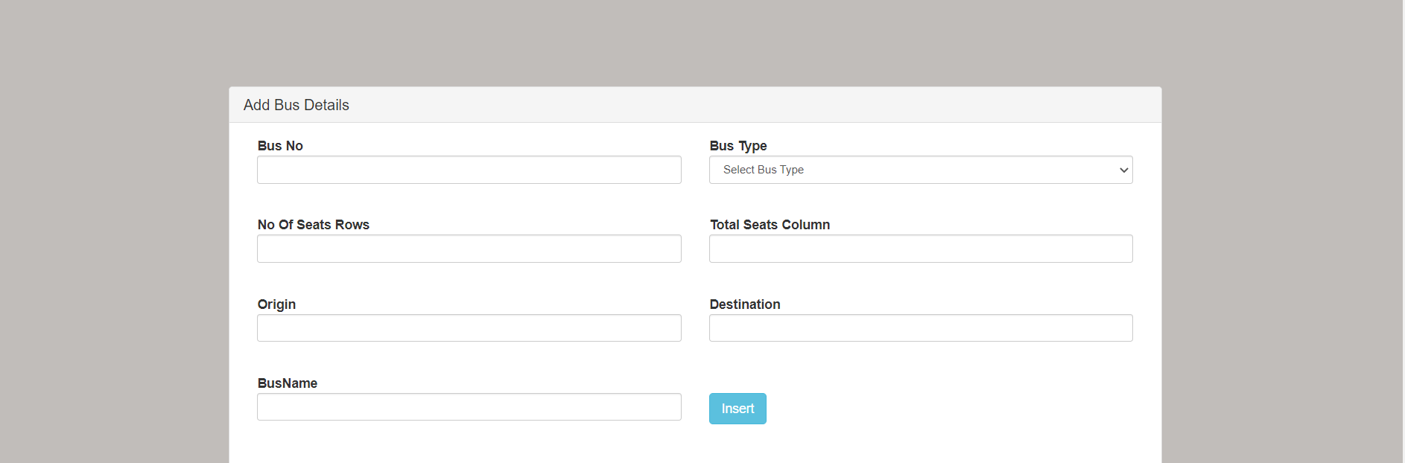
Add Bus
Admin Can add new Bus with these Details.

