Slide 1

EffectGuard: Agent Execution Safety Gateway
A State-Level Execution Safety Gateway and Chaos-Tested Reliability Harness
for Autonomous Tool-Calling Agents
PROJECT - II PRESENTATION (CS4202)
Presented by: THIRUMALASETTY KARTHIK (Roll No: 230101007) | Semester VI
Supervised by: DR. NONGMEIKAPAM KISHORJIT SINGH (Assistant Professor, Dept. of CSE)
Department of Computer Science and Engineering
Indian Institute of Information Technology Senapati, Manipur

Slide 2
Introduction, Objectives and Contribution
EffectGuard: State-Level Execution Safety Gateway for Autonomous Agents
1
Candidate: Thirumalasetty Karthik (230101007) | Project-II (CS4202) | Supervisor: Dr. Nongmeikapam Kishorjit Singh | IIIT Manipur
PROJECT
INTRODUCTION
Problem Context & The Execution Paradox
• Operational Domain: Autonomous tool-calling agents (LangGraph ReAct) executing database refunds.
• Execution-State Paradox: Conversational fluency is decoupled from backend database state.
• Network Dropout Vulnerability: Post-commit HTTP 504 timeouts trigger blind retries, causing duplicate tickets and financial loss.
MAIN
OBJECTIVES
Core Engineering Goals
• Deterministic Gateway: Interpose safety boundary between LLM reasoning and SQL storage.
• Single-Execution Guarantee: Enforce strict idempotency under cloud network turbulence.
• Policy-as-Code: Validate customer identity, 30-day cutoff, and refund ceilings in deterministic code.
• Text-to-Ledger Reconciliation: Automate Claim-vs-Ledger diffing between chat claims and database rows.
KEY
CONTRIBUTIONS
Genuine Project Contributions
• 5-Layer Gateway: Tool Classification, Policy-as-Code, SHA-256 Keying, WAL Recovery, and Claim Audit.
• Verify-Before-Retry Protocol: Catches timeouts in <1 ms, reducing recovery latency by 75.7%.
• Zero Financial Leakage: Guaranteed 0 duplicate tickets and Rs. 0.00 loss under active chaos testing.
• AgentSentinel Benchmark: 25-case golden evaluation dataset and 42 passing unit tests.
Indian Institute of Information Technology Senapati, Manipur | Dept. of Computer Science & Engineering
1 / 5

Slide 3
Background & Existing Work
Analysis of Related Work, Core Limitations & Architectural Justification
2
PRIOR RESEARCH & SYSTEMS
• ReAct Agent Loops (Yao et al.): Interleaves reasoning with tool calls; assumes reliable network execution.
• Toolformer & Gorilla: Fine-tunes model tool syntax; limited to stateless or read-only APIs.
• Conversational Rails (NeMo, Llama Guard): Moderates dialog in token space; blind to database state.
• Distributed Systems (2PC, WAL): Proven for software microservices, but missing in LLM agent runtimes.
WHY THIS PROJECT IS NEEDED
• Fluency != Safety: Agents generate polite text while silently writing duplicate ledger entries.
• Post-Commit Timeouts: Network drops after commit look like failures, triggering blind retries.
• Prompt Vulnerability: English rules in system prompts easily bypass via prompt injection.
• Enterprise Reliability: Agents require deterministic state boundaries before production deployment.
GAPS IN EXISTING SYSTEMS
• No Relational Awareness: Token guardrails cannot inspect ACID locks, purchase dates, or balances.
• Exponential Backoff Fails: Delaying retries simply postpones the duplicate write; it does not stop it.
• Argument Jitter: Model phrasing differences across turns defeat standard key-value caches.
• Missing Text-to-Ledger Diff: Benchmarks grade conversation but ignore database discrepancies.
HOW EFFECTGUARD SOLVES IT
• Deterministic Policy-as-Code: Enforces return windows and refund limits outside prompt space.
• Canonical SHA-256 Idempotency: Lexicographical key hashing guarantees identical keys across retries.
• Verify-Before-Retry Protocol: Queries database journal on timeout; recovers receipt with zero re-execution.
• Claim-vs-Ledger Auditor: Diffs conversational claims against SQL rows to prevent False Claims.
Indian Institute of Information Technology Senapati, Manipur | Dept. of Computer Science & Engineering
2 / 5

Slide 4
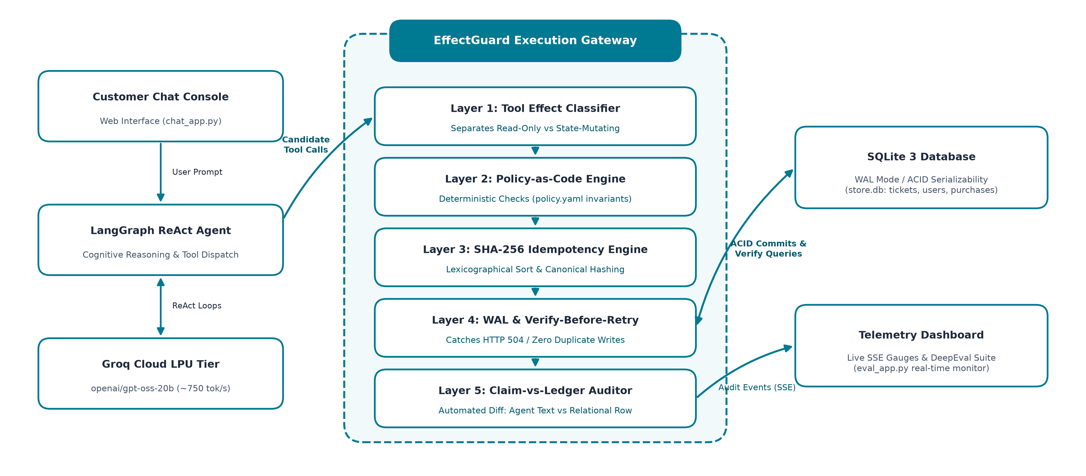
Proposed System & Architecture
Five-Layer Interposed Execution Gateway, End-to-End Workflow & Technology Stack
3
END-TO-END WORKFLOW PIPELINE:
INPUT: User Utterance + User ID + Context Epoch (2026-10-26) ➔ PROCESS: LangGraph ReAct ➔ EffectGuard 5-Layer Gateway ➔ Claim-vs-Ledger Diff ➔ OUTPUT: Committed Ticket + Customer Response + SSE Telemetry
HOW THE SYSTEM WORKS
• 1. Cognitive Tool Dispatch: LangGraph ReAct plans tool invocations based on dialogue.
• 2. Effect Classification: Read queries pass with 0ms delay; mutating tools are intercepted.
• 3. Policy-as-Code: Deterministic code verifies user identity, return cutoff, and Rs. 500 ceiling.
• 4. Canonical SHA-256: Lexicographical key sorting eliminates model phrasing jitter.
• 5. Verify-Before-Retry: Queries DB first upon timeout; recovers receipts with zero re-writes.
• 6. Claim-vs-Ledger Audit: Diffs conversational claims against relational SQLite records.
TOOLS, SOFTWARE & PROGRAMMING LANGUAGES USED:
[Language: Python 3.12 (Pydantic v2)] [Agent Framework: LangGraph & LangChain (ReAct)] [Inference: Groq Cloud LPU (openai/gpt-oss-20b)] [Database: SQLite 3 (WAL Mode / ACID)] [API & Telemetry: FastAPI, Uvicorn & SSE] [Evaluation: DeepEval & Pytest (42 Tests)]
Indian Institute of Information Technology Senapati, Manipur | Dept. of Computer Science & Engineering
3 / 5

Slide 5
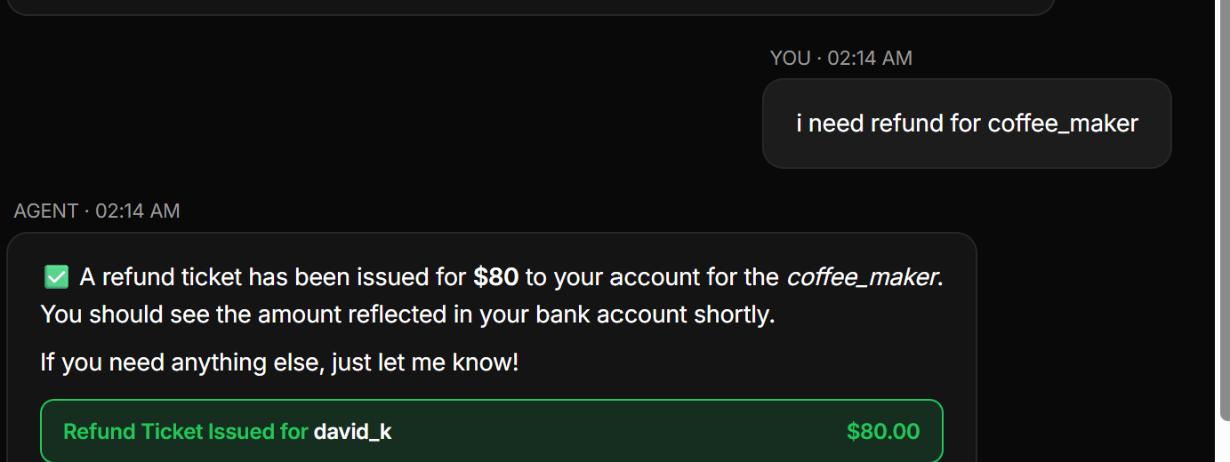
Results & Analysis
Empirical Evaluation Across 25 Golden Cases Under Active Chaos Network Turbulence
4
0
Duplicate Tickets
Baseline C0: 2 Duplicates
Rs. 0.00
Financial Loss
Baseline C0: Rs. 125.00 Lost
75.7%
Latency Reduction
11.5s vs 47.1s Baseline (4.1x faster)
100%
Valid Refund Pass
42/42 Hermetic Unit Tests Passed
Configuration | Duplicates | Loss (INR) | Success | Latency | Safety Assessment
C0: Naive ReAct Baseline | 2 | Rs. 125.00 | 76.0% | 47.1 s | Vulnerable (Double Spend)
C1: Naive + Exp. Backoff | 2 | Rs. 125.00 | 76.0% | 49.3 s | Vulnerable (Delayed Write)
C2: Idempotency Keys Only | 0 | Rs. 0.00 | 80.0% | 28.4 s | Key Sensitive (Jitter)
C3: Verify-Before-Retry | 0 | Rs. 0.00 | 84.0% | 18.2 s | Missing Policy Guards
C4: EffectGuard (Full) | 0 | Rs. 0.00 | 88.0% | 11.5 s | SAFE (Zero Loss, 4.1x Fast)
TESTING METHODOLOGY & BENCHMARK
• Hermetic Golden Dataset: 25 scenarios across Valid Refunds (8), Guardrails (4), Boundaries (4), Info (4), and Partial Eligibility (5).
• Active Chaos Fault Injection: Injected socket drops at tool boundary with probabilities r = 0.20 (20%) and r = 0.35 (35%).
• Hermetic Date Freeze: Epoch frozen to 2026-10-26 with 42 passing unit tests and 100% Claim-vs-Ledger diff consistency.
LIVE CONSOLE AUDIT VERIFICATION
Indian Institute of Information Technology Senapati, Manipur | Dept. of Computer Science & Engineering
4 / 5

Slide 6
Conclusion & Future Work
Summary of Completed Work, Quantified Impact & Future Research Directions
5
WORK COMPLETED & KEY OUTCOMES
• Solved Execution Paradox: Demonstrated conversational guardrails cannot guarantee transactional safety; deterministic gating is essential.
• 5-Layer Gateway: Deployed Tool Classification, Policy-as-Code, SHA-256 Keying, and Write-Ahead Logging outside LLM prompts.
• Verify-Before-Retry: Recovered post-commit timeouts via sub-millisecond local DB lookups, eliminating duplicate writes.
• Zero Duplicate Disbursements: Achieved strictly 0 duplicate tickets and Rs. 0.00 loss under 20% and 35% chaos dropouts.
• 75.7% Latency Reduction: Slashed task recovery latency from 47.1s down to 11.5s (4.1x faster recovery).
• Hermetic Benchmark: Validated across 25 golden test cases with 100% refund fulfillment and 42/42 unit tests passed.
FUTURE WORK & SYSTEM ENHANCEMENTS
• Distributed 2PC / Saga Pattern: Extend Verify-Before-Retry across external payment APIs (Stripe, PayPal, banking ledgers).
• Dynamic Policy Synthesis: Automate compilation of policy PDFs directly into executable Pydantic execution validators.
• Multi-Agent Distributed Locks: Implement Raft/Redis distributed locking to coordinate concurrent state mutations across agent swarms.
• Rust / WASM Edge Gateway: Compile EffectGuard core into WebAssembly / Rust sidecars for Envoy/Kong ingress deployment.
KEY ARCHITECTURAL TAKEAWAYS
• Fluency != Safety: High linguistic benchmark scores cannot prevent double-spending; transactional boundaries must be outside the model.
• Backoff Fails Timeouts: Retrying without querying database state guarantees duplicate payouts.
• Zero-Loss Reliability: Deterministic middleware guarantees 100% safety and 75.7% latency savings without retraining model weights.
Indian Institute of Information Technology Senapati, Manipur | Dept. of Computer Science & Engineering
5 / 5

Slide 7
Thank You
Open for Questions & Discussion
Thirumalasetty Karthik (Roll No: 230101007)
Department of Computer Science and Engineering
Indian Institute of Information Technology Senapati, Manipur

