Slide 1


Consumer Goods Ad-hoc Insights
SQL Project Challenge
Atliq Hardwares
Presented by M R Sudeep

Slide 2
AGENDA
01
02
03
04
ABOUT PROJECT
ABOUT COMPANY
INPUT DATASET
RESULTS

Slide 3
About
Project
01

Slide 4
About Project
Introduction
Atliq Hardwares (imaginary company) is one of the leading computer hardware producers in India and other countries too.
Problem Statement
The management noticed that they do not get enough insights to make quick and smart data-informed decisions.
Tasks
There are 10 ad-hoc requests for which the company needs insights.
You need to run a SQL query to answer these requests.
Convert it into visualizations and present the insights to the top-level management.

Slide 5
About
Company
02

Slide 6
Atliq's Products
PC
P&A
N&S
Desktop
Business laptop
Personal laptop
Notebook
Business laptop
Gaming laptop
Personal laptop
Accessories
Batteries
Keyboard
Mouse
Peripherals
Graphic card
Internal HDD
Motherboard
Processors
Networking
Wifi Extender
Storage
External SSD
USB Flash drivers

Slide 7
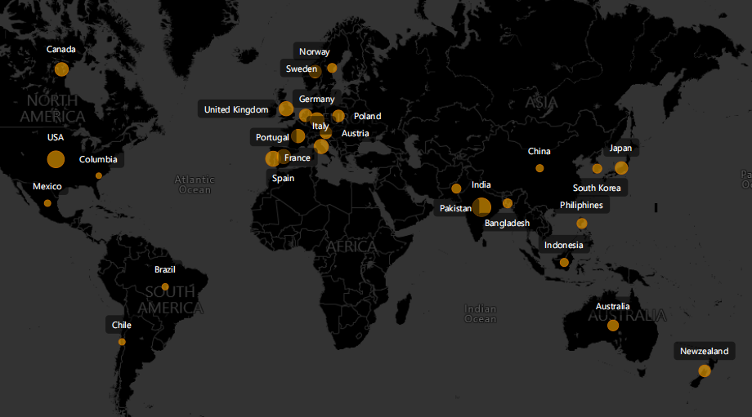
Atliq’s Network

Slide 8
Input
Dataset
03

Slide 9
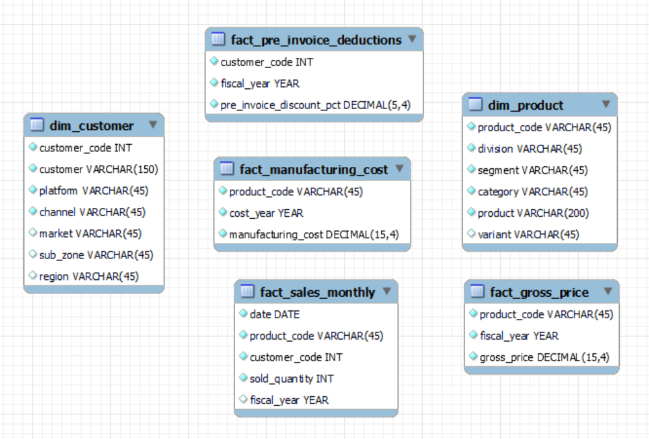
Input Dataset

Slide 10
Results
04

Slide 11
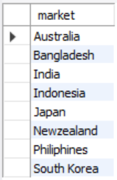
Request 1:
Output
Provide the list of markets in which customer "Atliq Exclusive" operates its business in the APAC region.

Slide 12
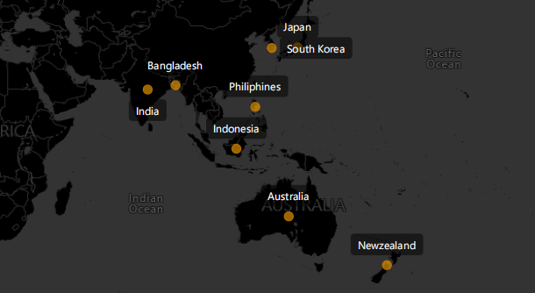
Insights
In the APAC region, Atliq Exclusive operates its business in eight major markets.

Slide 13

Request 2:
Output
What is the percentage of unique product increase in 2021 vs. 2020? The final output contains these fields,
unique_products_2020
unique_products_2021
percentage_chg

Slide 14
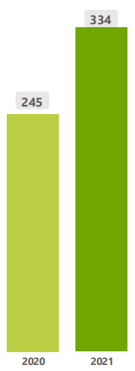
Insights
36.32%
The company had 245 products in FY 2020, which increased to 334 products (36% increase) in FY 2021.

Slide 15
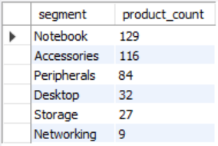
Request 3:
Output
Provide a report with all the unique product counts for each segment and sort them in descending order of product counts. The final output contains 2 fields,
segment
product_count

Slide 16
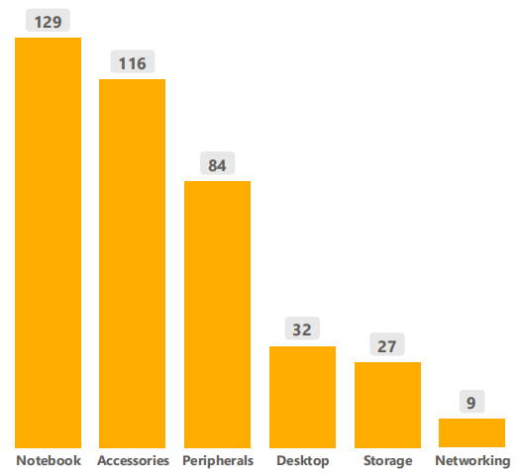
Insights
There are more unique products in the Notebook, Accessories, and Peripherals segments than in the Desktop, Storage and Networking segments.

Slide 17
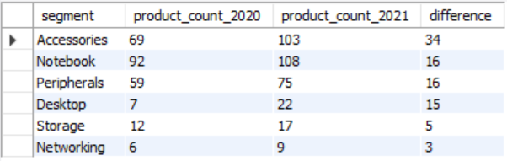
Request 4:
Output
Follow-up: Which segment had the most increase in unique products in 2021 vs 2020? The final output contains these fields,
segment
product_count_2020
product_count_2021
difference

Slide 18
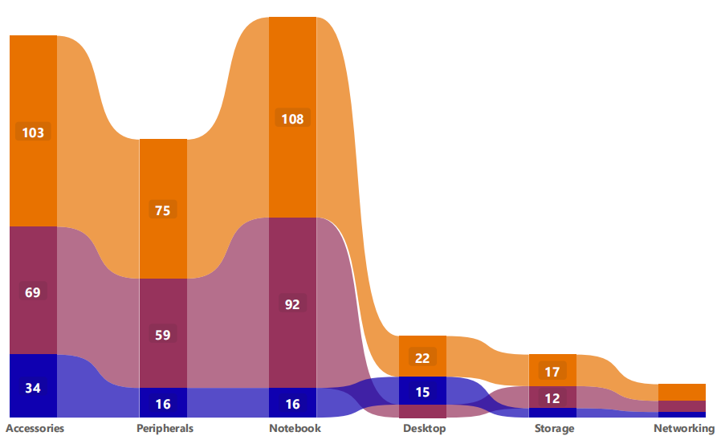
Insights
The Accessories segment introduced 34 new products. Notebook, peripherals, and desktop segments introduced an average of 16 new products.

Slide 19

Request 5:
Output
Get the products that have the highest and lowest manufacturing costs. The final output should contain these fields,
product_code
product
manufacturing_cost

Slide 20

Insights
The product with the highest manufacturing cost
The product with the lowest manufacturing cost
$240.53
$0.89
AQ HOME Allin1 Gen 2 (Plus 3)
AQ Master wired x1 Ms (Standard 1)
Personal Desktop
Mouse

Slide 21
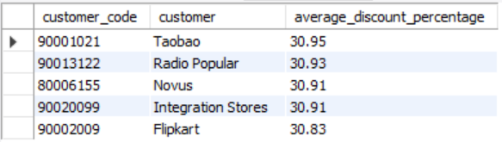
Request 6:
Output
Generate a report which contains the top 5 customers who received an average high pre_invoice_discount_pct for the fiscal year 2021 and in the Indian market. The final output contains these fields,
customer_code
customer
average_discount_percentage

Slide 22
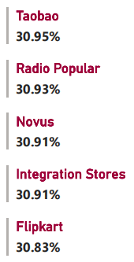
Insights
In 2021, the company offered nearly equal pre-invoice discounts to each of its top 5 customers. and Taobao is the most discounted customer in the Indian market, which equals 30.95%.

Slide 23
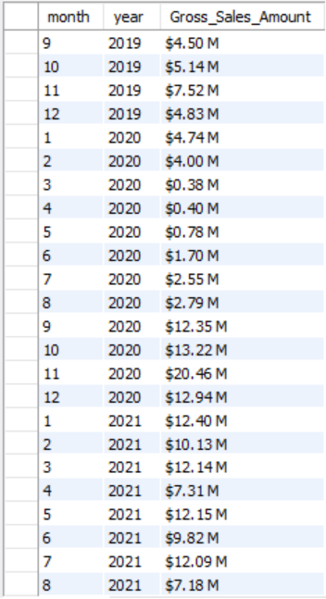
Request 7:
Output
Get the complete report of the Gross sales amount for the customer “Atliq Exclusive” for each month. This analysis helps to get an idea of low and high-performing months and take strategic decisions.
The final report contains these columns:
Month
Year
Gross sales Amount

Slide 24
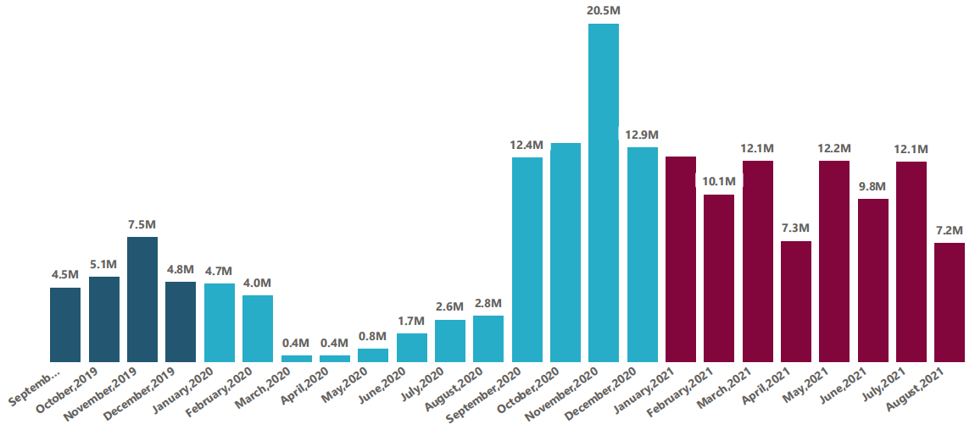

Insights
The Atliq Exclusive made its highest gross sales in November 2020 and its lowest gross sales in March 2020. Sales are balanced in 2021.

Slide 25
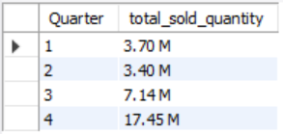
Request 8:
Output
In which quarter of 2020, got the maximum total_sold_quantity? The final output contains these fields sorted by the total_sold_quantity,
Quarter
total_sold_quantity

Slide 26
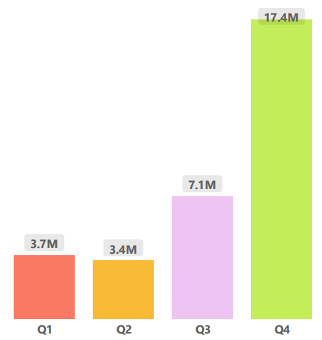
Insights
The Quarter 4 sold the maximum quantities, which is about 17.4 millions. Quarters 1 and 2 both sold the minimum quantities of 3.7 million and 3.4 million, respectively.

Slide 27
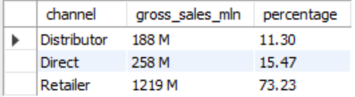
Request 9:
Output
Which channel helped to bring more gross sales in the fiscal year 2021 and the percentage of contribution? The final output contains these fields,
channel
gross_sales_mln
percentage

Slide 28
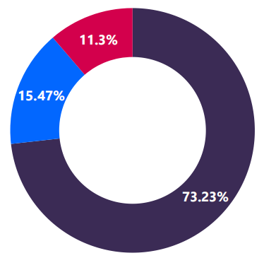
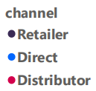
Insights
The majority of the sales were made through retailers, which is 73.23% of the total sales. Direct channels accounted for 15.47% of total sales. 11.3% of sales were made through distributor channels.

Slide 29
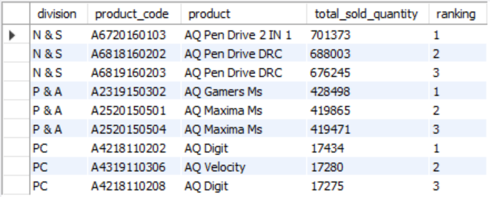
Request 10:
Output
Get the Top 3 products in each division that have a high total_sold_quantity in the fiscal_year 2021? The final output contains these fields,
division
product_code

Slide 30
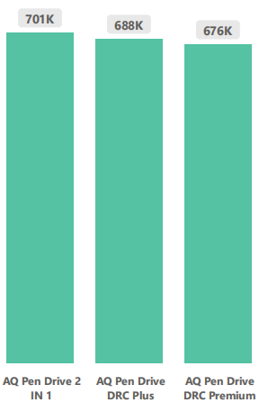
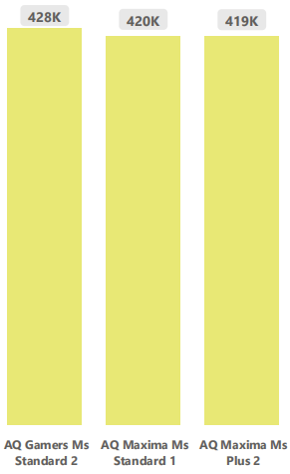
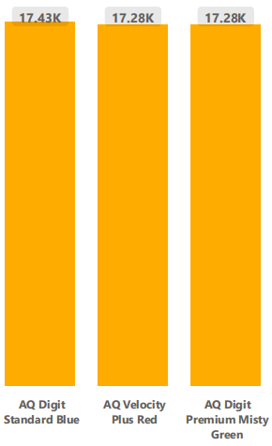
Insights
Pen drives are the top three selling products in N&S, with approximately 7 lakh units sold.
Mouse are the top three selling products in P&A, with approximately 4 lakh units sold.
Personal laptops are the top three selling products in PC, with approximately 7 lakh units sold.
N&S
P&A
PC

Slide 31
Thank You

