Slide 1
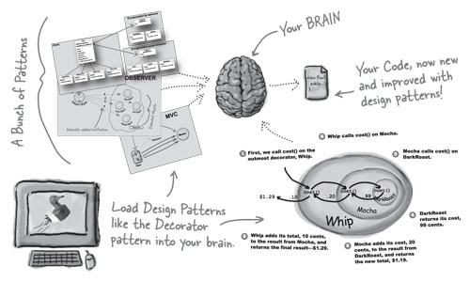
Cs 525 - ASD Project presentation Framework and Application
Presented by:
Sudeep Pradhan
Bishal Nepal
Ulugbek

Slide 2
Content
Motivation
Framework
Application
Design patterns
Conclusion

Slide 3
Motivation
We created the framework that deals with user management, checkin and checkout operations of products as its main business process. And, we aim to use it to develop any application that shares similar purposes, such as Library Management System, Car Rental System and etc, .
We chose to develop Library Management System (LibrarySystem) using the framework’s all functionalities as much as possible.

Slide 4
Framework
The framework has following main use cases that will clearly explain its objectives:
- User login/logout;
- CRUD operations on Product
- Customer/member management
- Checkin/Checkout products
- Circulation

Slide 5
Application
In the application, we extended the framework entities and functionalities by following the basic OOP principles and design patterns we learned in this course. As an example we extended the followings:
From [Product] to [Publication: Book, Journal]
From [Customer] to [LibraryMember]
From [User] to [User: ADMIN, LIBRARIAN, BOTH]
And, we provided additional functionalities like Validation, Logging, Secure Login and notification.

Slide 6
Design Patterns
Singleton: provides the presence of only single user during the sessions and having the single reference to Database connection.
Facade: framework provides Database interface for its controllers to do persistance operations and also for applications to implement it.
Strategy: password hashing mechanism uses several algorithms to encode password, so strategy faclitated the choosing right algorithm at right time dynamically.

Slide 7
Design Patterns
Decorator: allowed us to add new functionalities to an existing Product and Customer objects, as a result we easily had Book, Journal and LibraryMember.
Proxy: we applied protection proxy to limit the client to have reference to page controllers without checking their access type.
Bridge: framework provides its own Database interface which can be seen as an Implementer and in application layer DataManager interface serve Abstraction, all concrete implementation are done in Application layer using DB access tools.

Slide 8
Design Patterns
Composite: Our application has printing feature to print checkout record which has parent-child relationship with checkoutrecord entries.
Visitor: Our application has validation functionality that serves to validate all types of objects in application and visitor handled the problem.
Factory: application contains logging trace in debug mode that writes either into file or command line, so Factories job to initiantiate needed type of writing logging information.

Slide 9
Design Patterns
Observer pattern is used when there is one-to-many relationship between objects such as if one object is modified, its dependent objects are to be notified automatically. It is used in Application for sending notification for member when new book is available in library.
Chain of Responsibilities: This is one of the behavioral design pattern that is used when there is one-to-many relationship between objects such as if one object is modified, its dependent objects are to be notified automatically. In our application it is used to handle the IO exception that is used to read or write file.

Slide 10
Conclusion
From this project we learned the differences between developing a framework and application, and a long the way how and where to apply right design patterns for creating objects dynamically, building the right structure between sub-systems and objects and providing behaviors to objects.
The most importantly we were able to feel how framework developer’s and application developer’s mindset differ from each other towards building the project.

