Slide 1

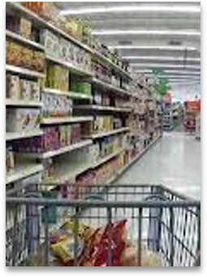
Sales Data Analysis of Uttam mart Indore​
About The Data And How The Data
got Collected
The Data is collected from a local market mart of Indore and the name of the shop is Uttam mega mart, which sells all type of grocery and house hold appliances
Uttam mega mart have 5 franchise all over Indore and in this project the sales data analysis of all the 5 franchises had been done
The data had been collected over a year so that proper analysis on sales and conclusion on profit and loss can be made accurately

Slide 2


Aim & References for The Data Analysis
In this project what we have done is we have taken the data from all the 5 franchises of the mart and had compared the sales via following parameters 1. Store Wise Sales Analysis of the Data 2. Monthly Sales Analysis of the Data 3. Effect of Holidays on Sales 4. Weekly Sales Analysis of the Data
The Data have been Collected from 5 stores across Indore over a year, below the no of store with their names and locations were given Store 1 :- Uttam Mega Mart Rani Sati Gate Store 2 :- Uttam Mega Mart South Tukoganj Store 3 :- Uttam Mega Mart Jain Shwetamber Mandir Store 4 :- Uttam Mega Mart Dewas naka Store 5 :- Uttam Mega Mart New Palasia

Slide 3
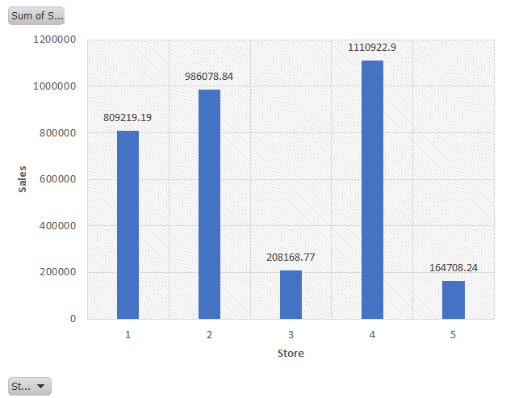
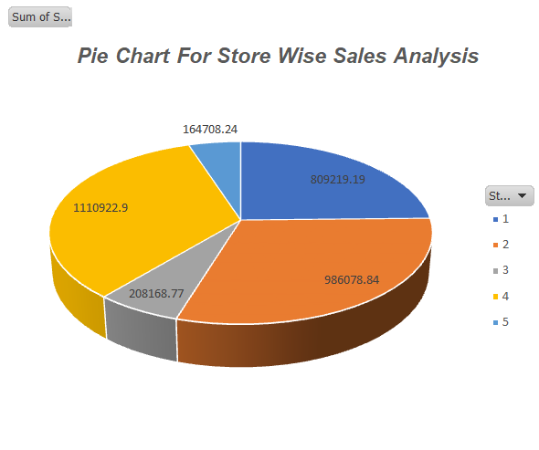
Store Wise Sales Analysis
Stores | Sales (lacs) | Percentage of sales
1 | 8 | 24.68
2 | 9.8 | 30.07
3 | 2 | 6.35
4 | 11.1 | 33.88
5 | 1.6 | 5.02
From the above analysis via Charts and table we can conclude that the store 4 makes the maximum profit and store 5 makes the least profit
so to increase the profit the owner can discontinue the store no 5 and instead of that use the resources for other 4 stores to increase the sales

Slide 4
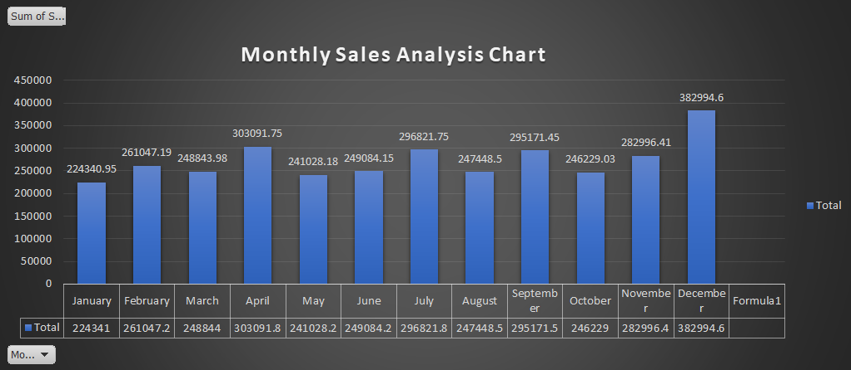
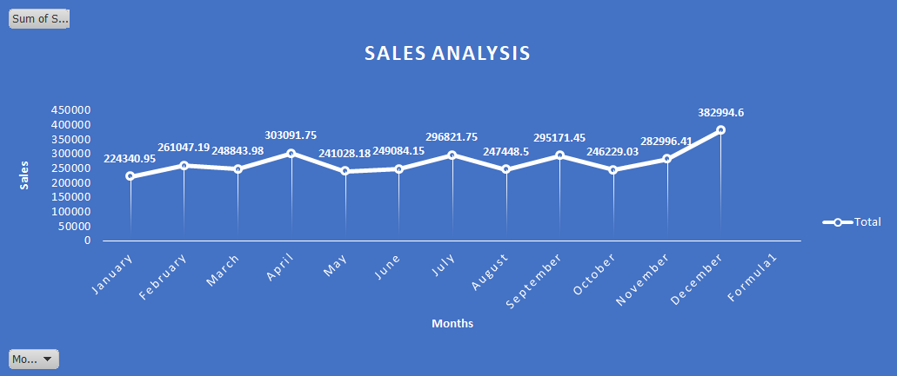
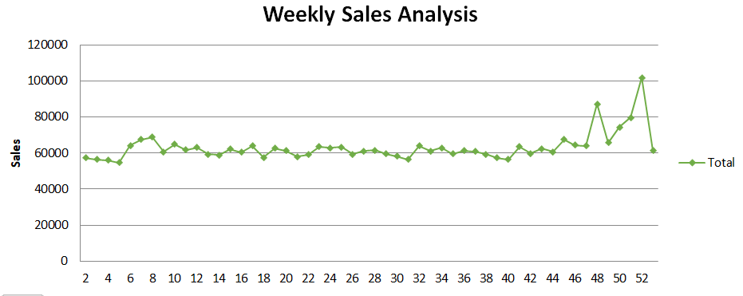
Monthly Sales Analysis
<- Weekly Sales Analysis
Week 52 have the Highest Sales
Week 5 have the Lowest Sales

Slide 5
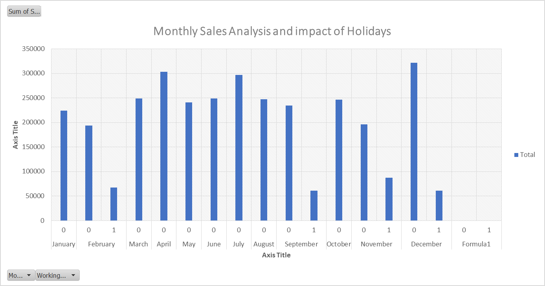
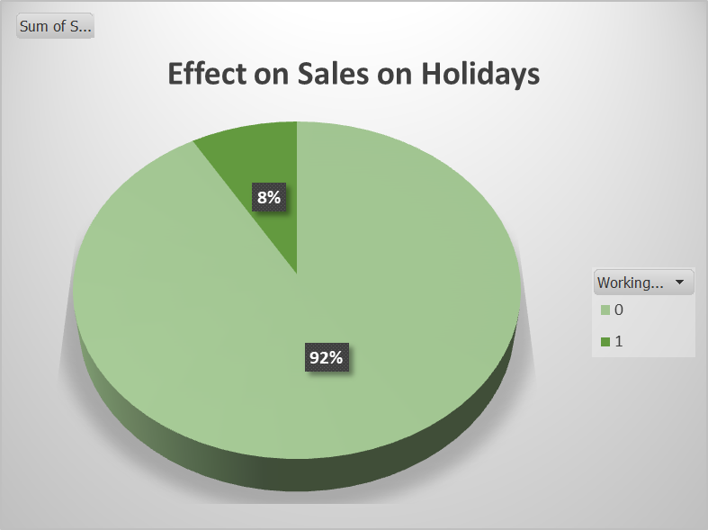

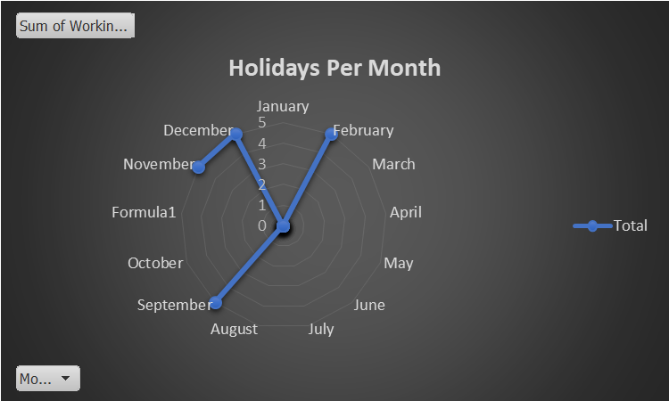
Sales analysis on Holidays
From the analysis we know that the month which have less holidays will generate greater profit as the working day profit percentage is 91% approx.
There are 20 holidays in total, out of which 5 holidays are in the month of February, September, November and December which means month of January, March, April, May, June, July, August, and October Will Generate more revenue as compared to February, September, November and December

