Slide 1
SMILES (Serving Multiple Individual Lives with Effective Solutions) -Beyond Miles
- CODE ARMY
ABHILASH KOSARAJU
JAI SONI
SUDEEP GUPTA S

Slide 2
Introduction
The purpose of this undertaking is to overcome geographical barriers by providing help for those who need it while notifying others who are willing to help.
A centralized system overcomes the problems by allowing the people to help as a volunteer and get recognized for their contributions.
An individual can easily reach out in any network to ask for any kind of help.
A Team Event initiator can create an event for a cause in which others can join as volunteers and get it accomplished.
Funds requests for events could be made to the welfare groups by the company organizations.

Slide 3
Use Cases
Application Design and secure login.
Sending and receiving requests over networks.
Creating a Team Initiative for a cause and take part in an initiative posted.
Earning Smiles and analyzing the activity.
Sending fund requests to the company fund provider(financier).
Financier requesting funds from the welfare groups.

Slide 4
Actors
System Admin
Enterprise Admins (Community/Individual Member, Company, Welfare Groups)
Community Member
Company Employee
Company Event Initiator
Financier
Fund Provider from Welfare Fund Dispenser Organization
Fund Supplier from Welfare Organization

Slide 5
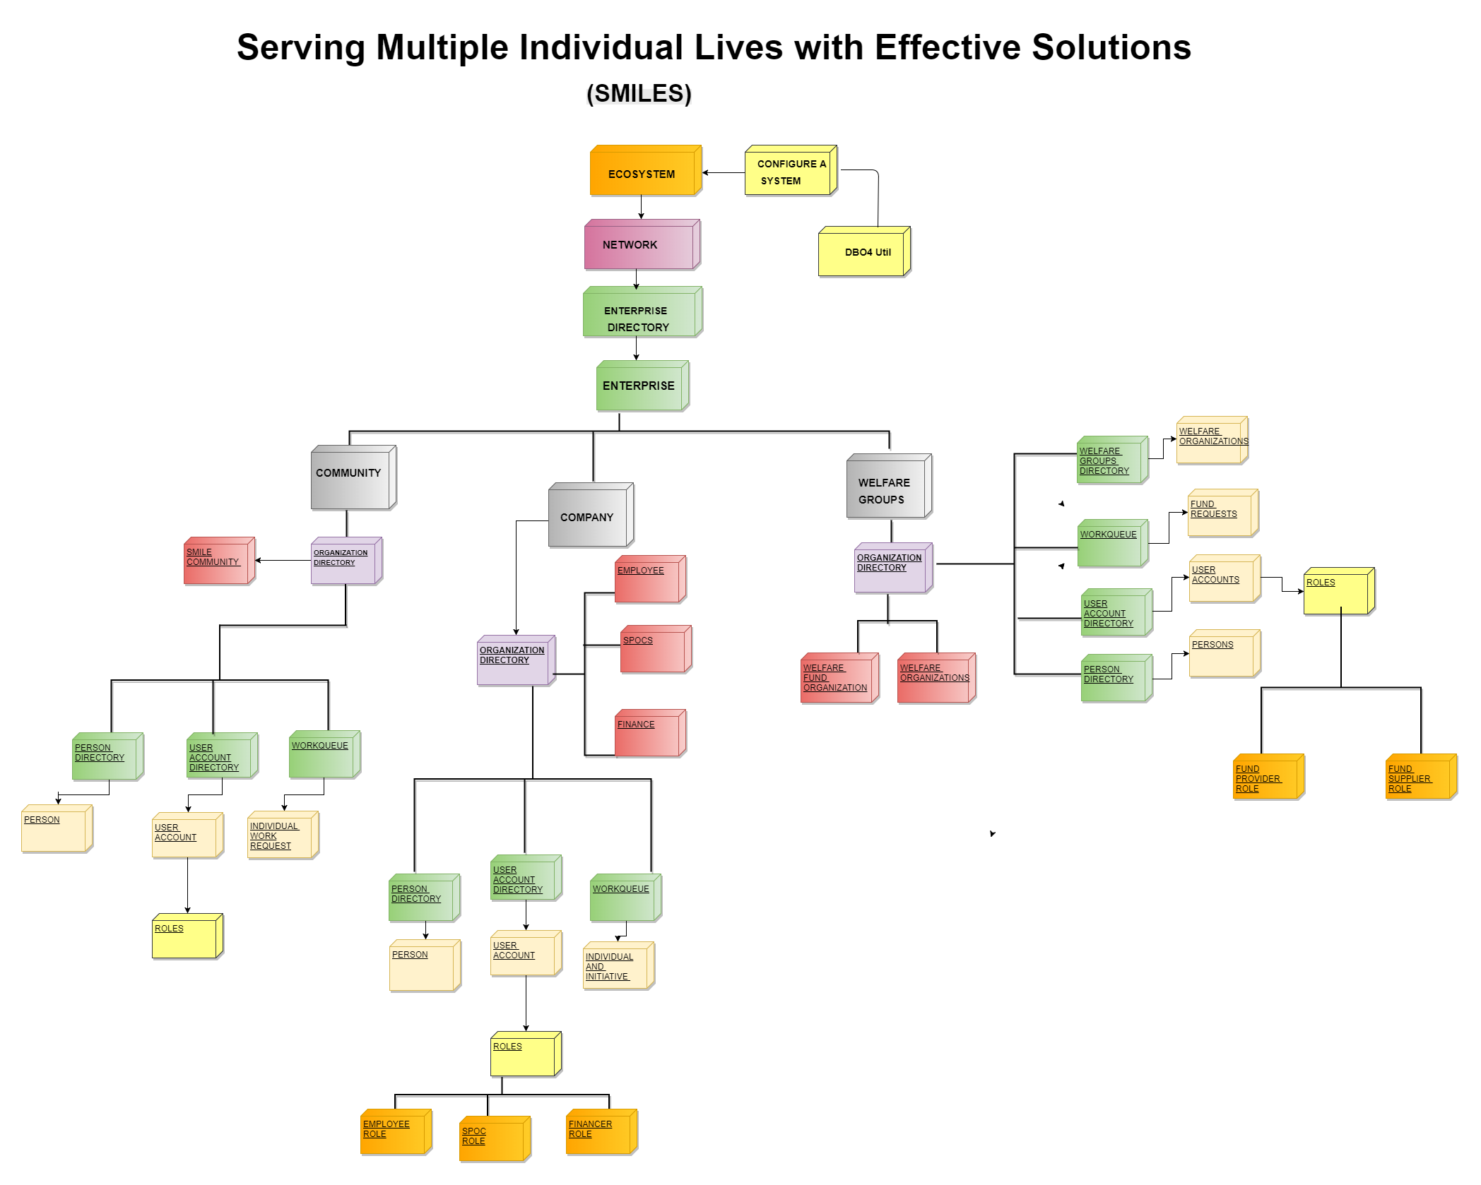

Slide 6
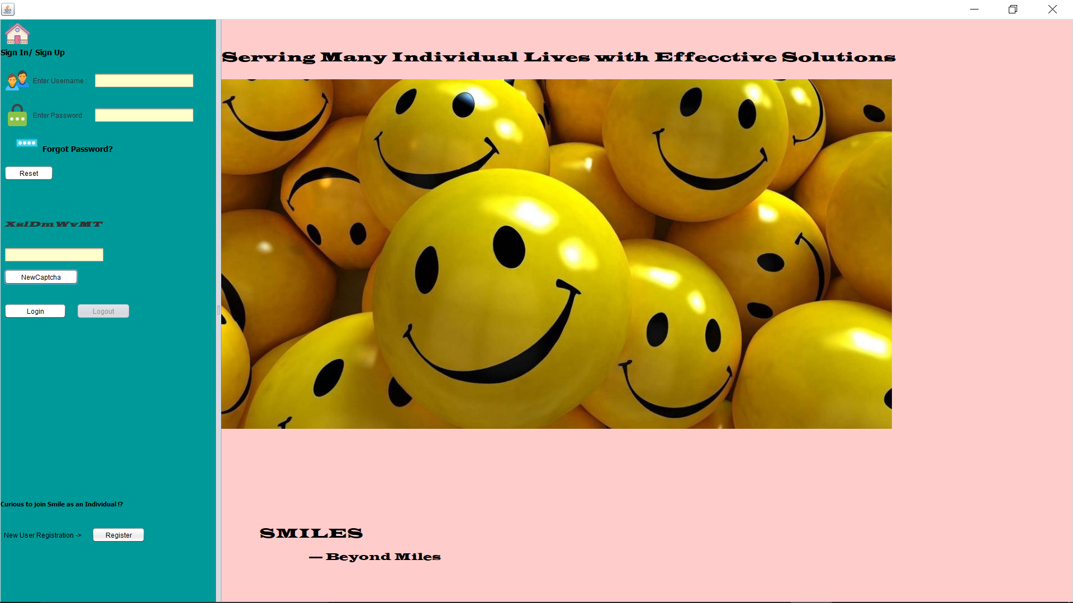
Important Use Cases Login

Slide 7
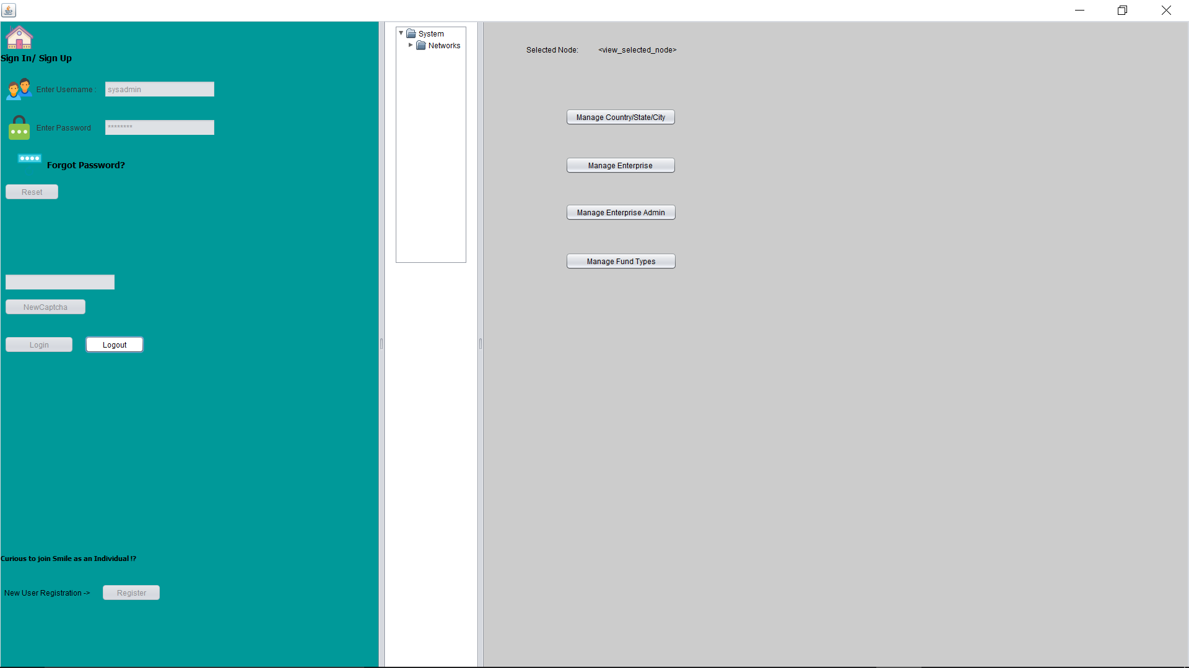
System Admin

Slide 8
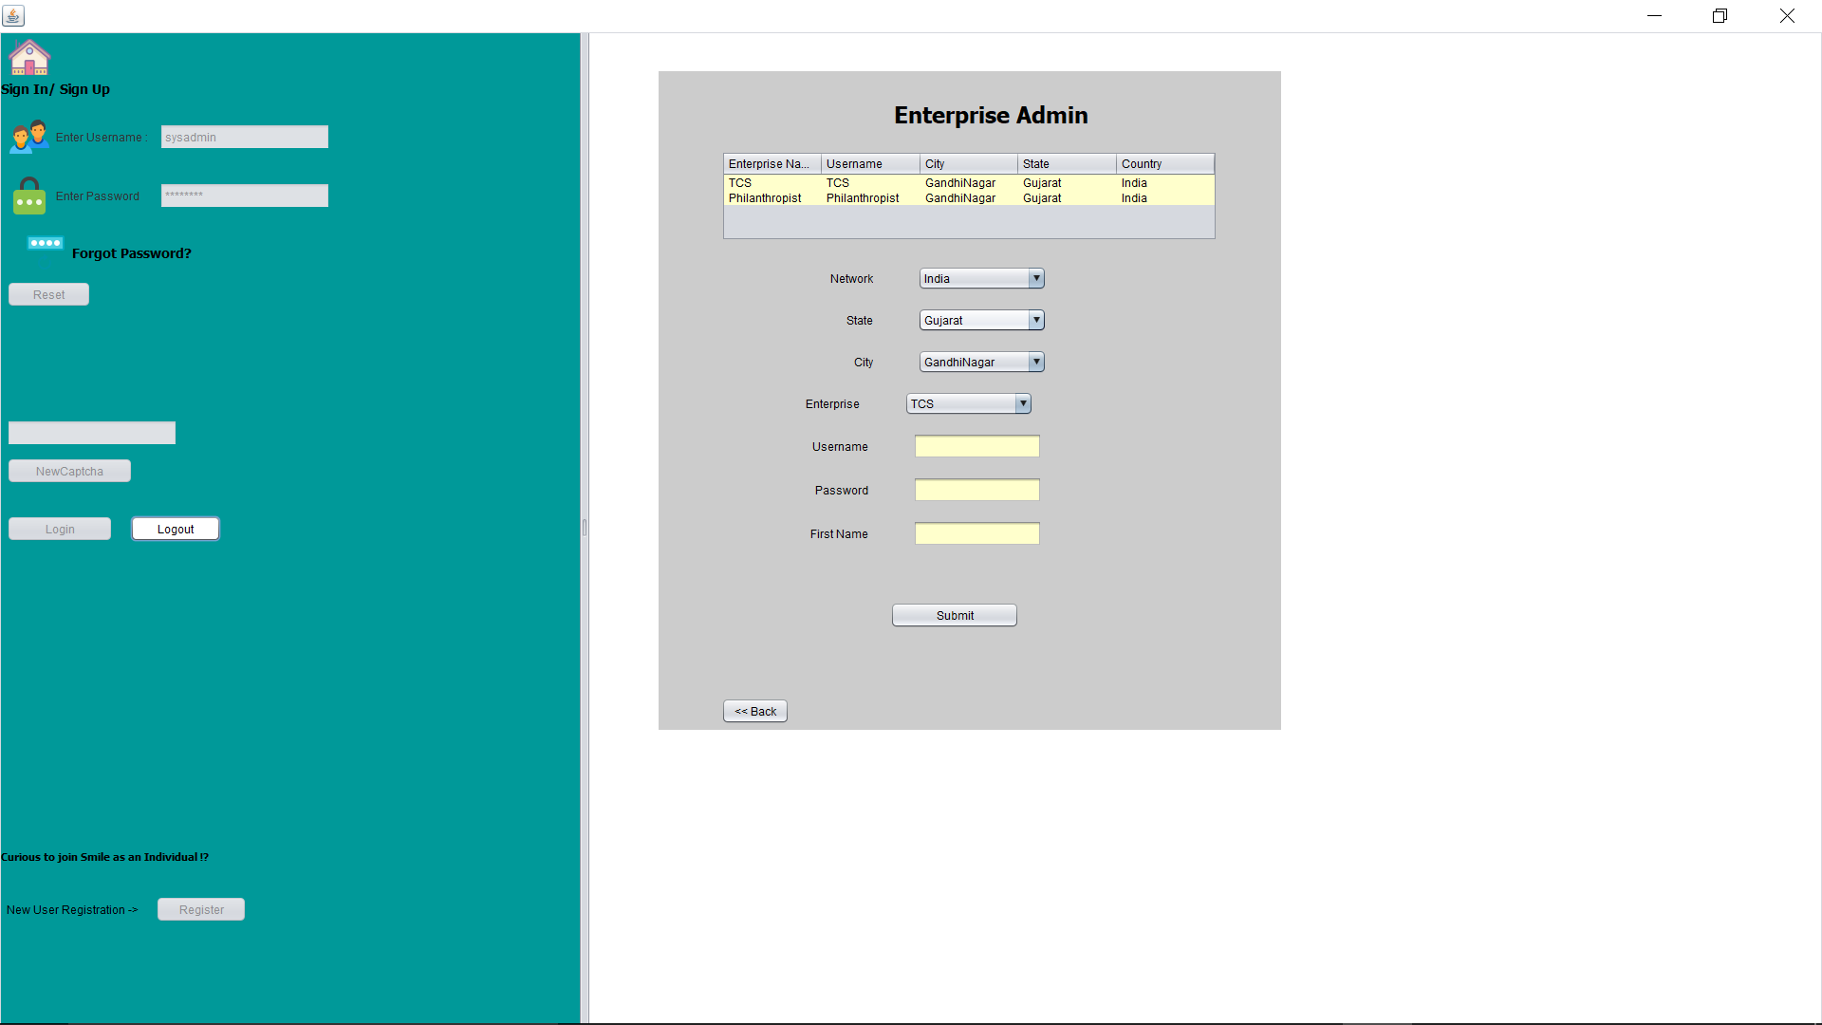
Manage Enterprise Admin

Slide 9
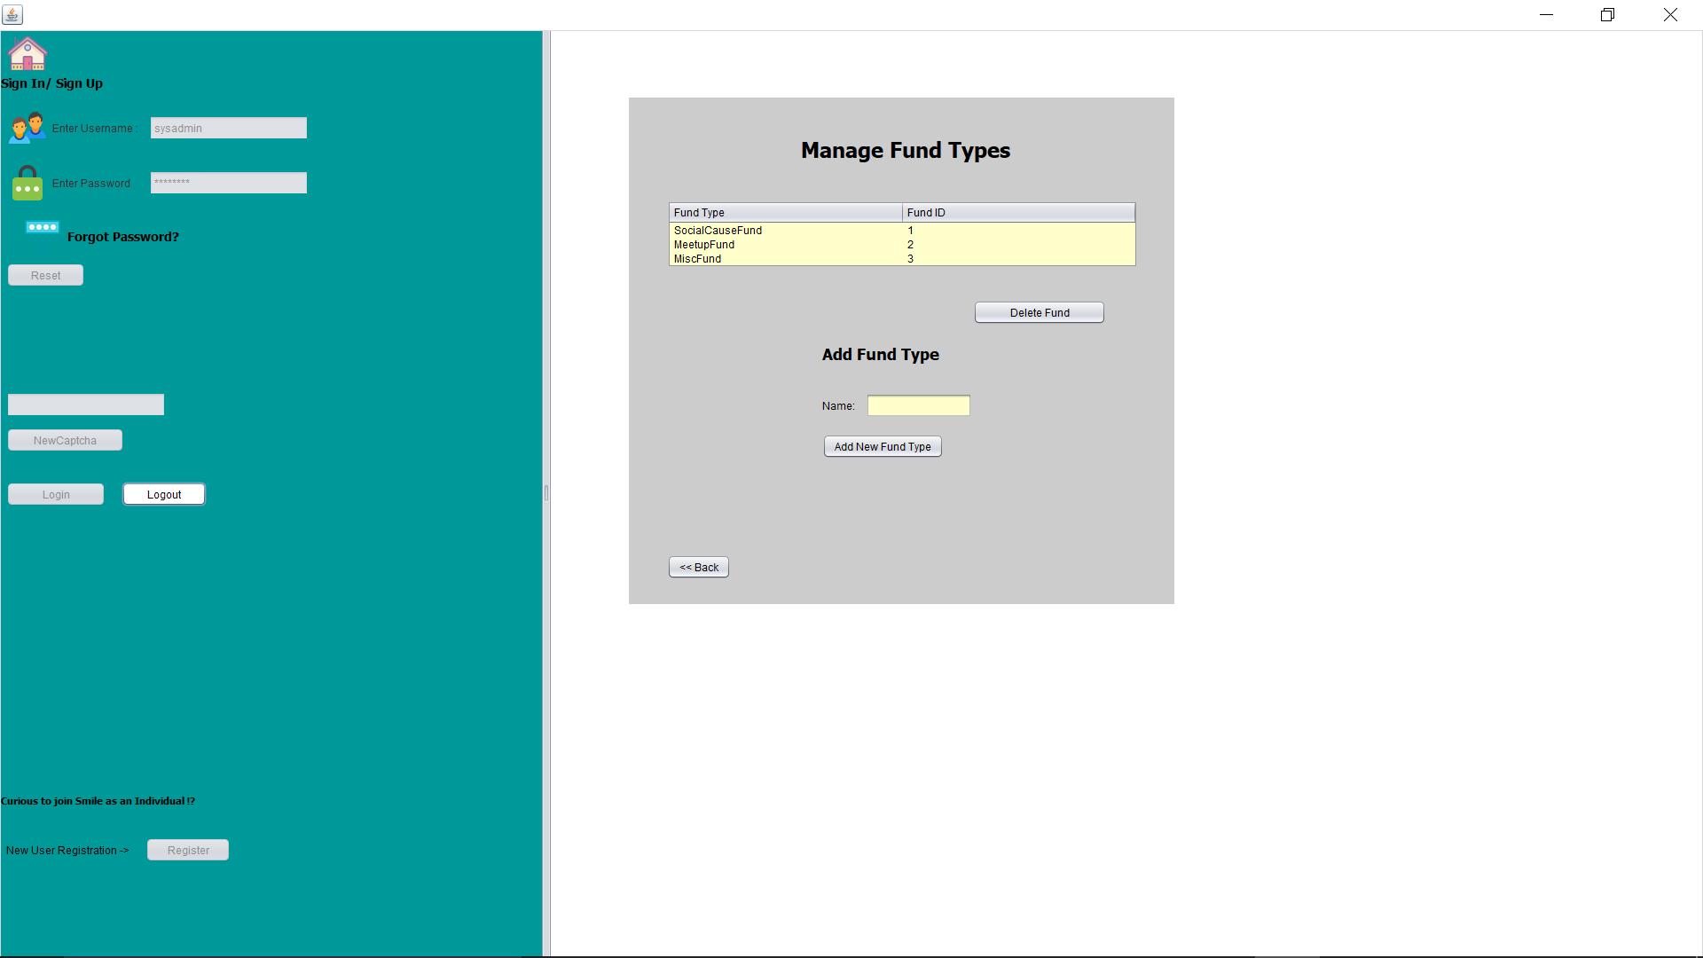
Manage Fund Types

Slide 10
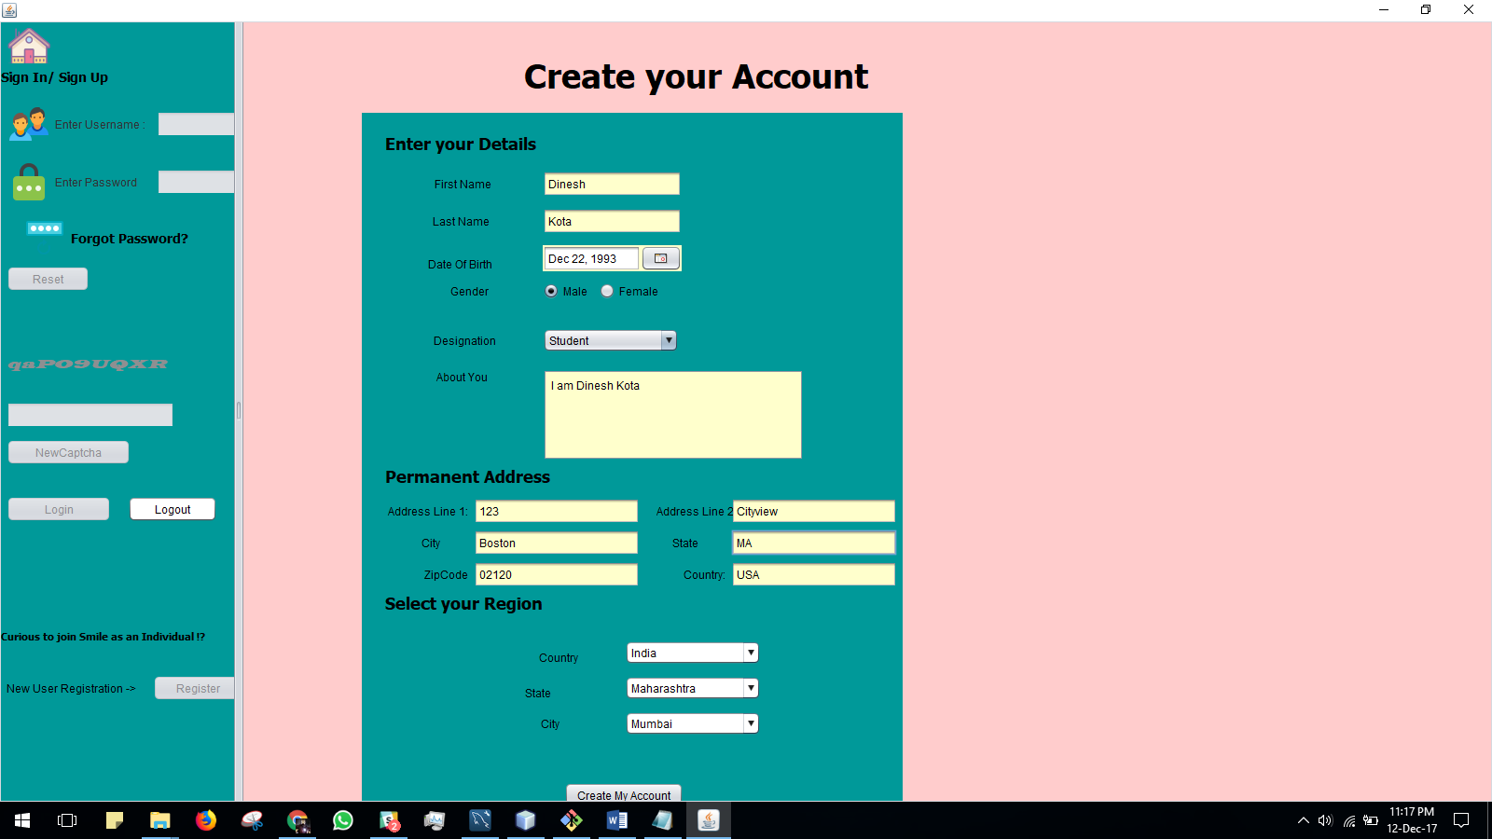
Self Registration

Slide 11
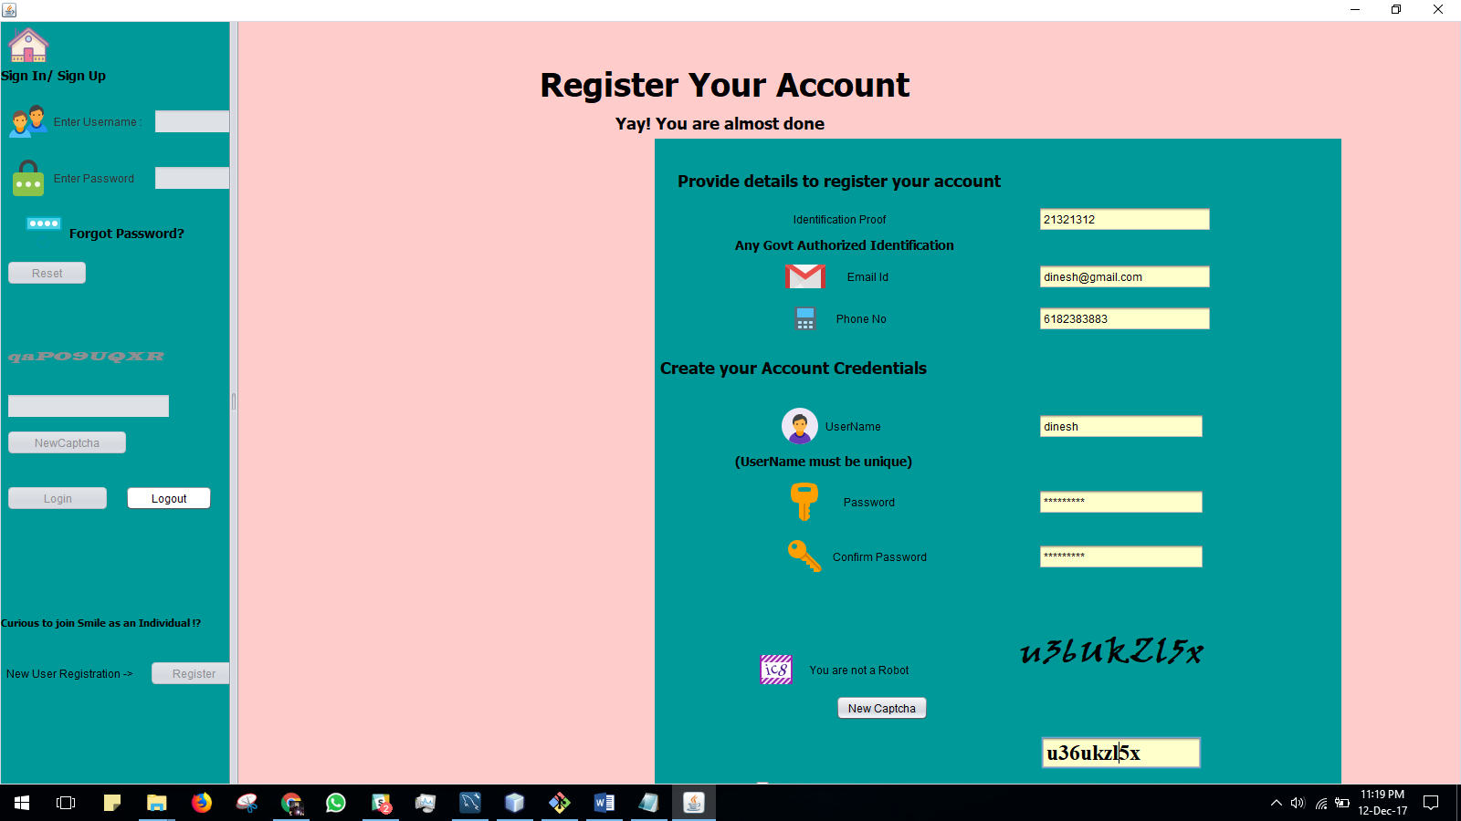

Slide 12
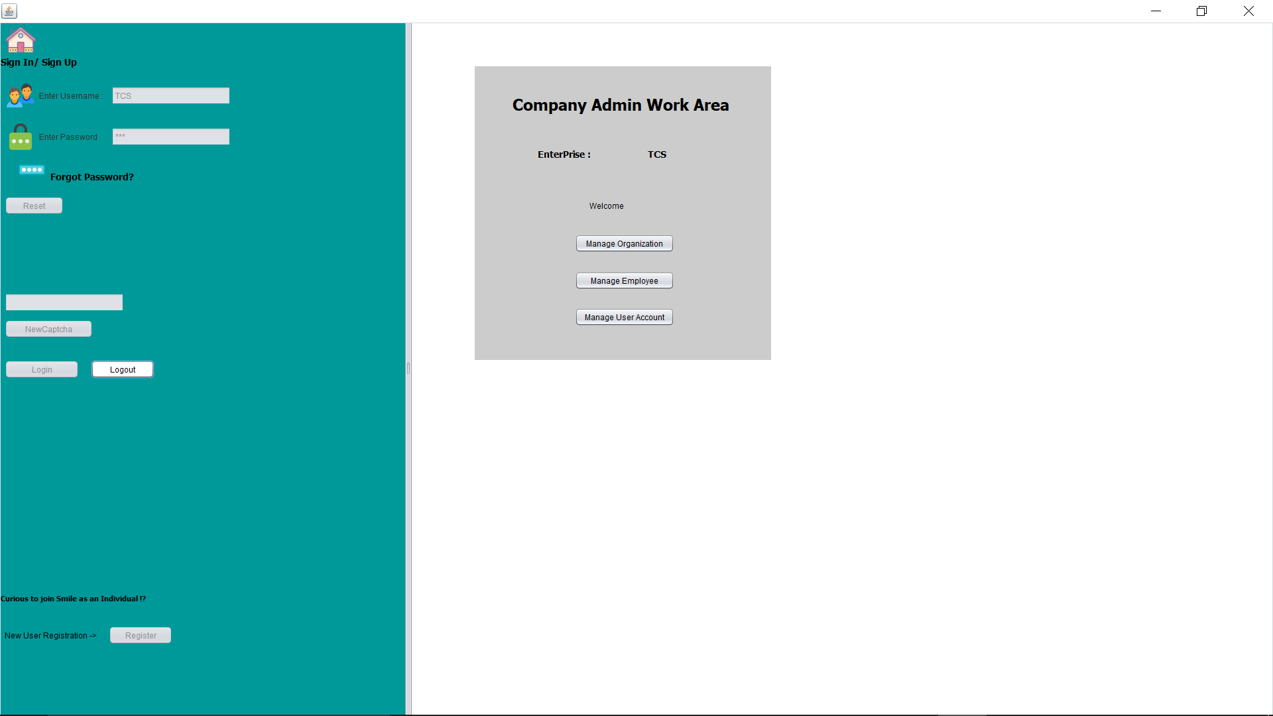
Company Admin Work Area

Slide 13
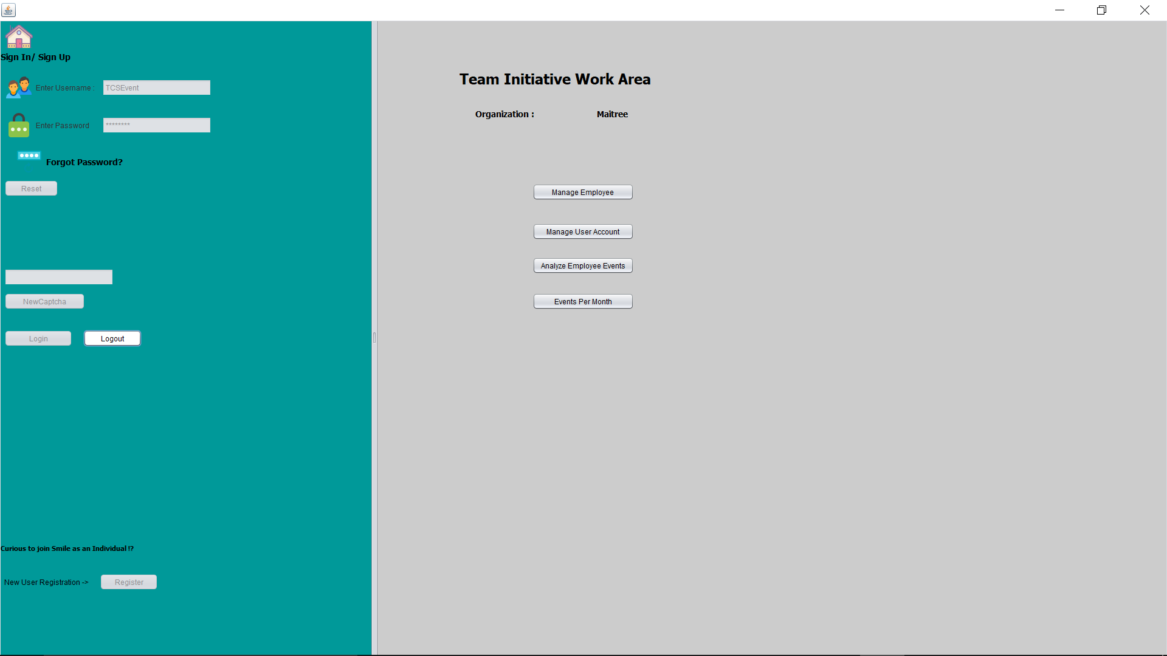
Team Event Organization

Slide 14
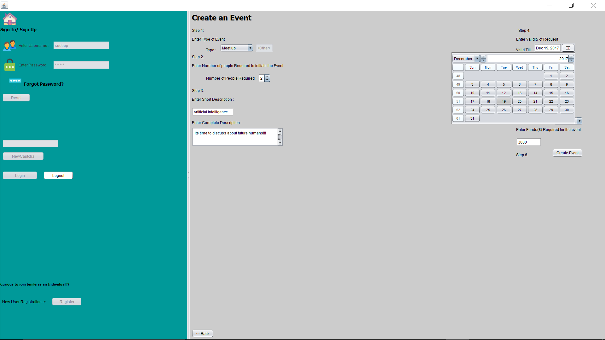
Creating Event

Slide 15
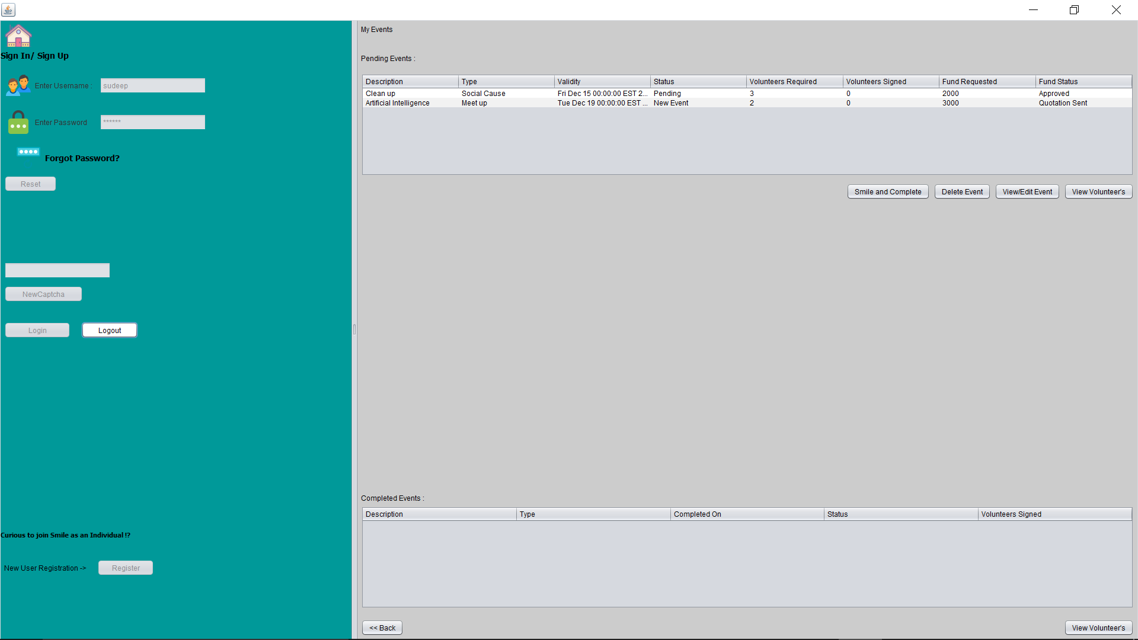
Listing Team Events

Slide 16

Event Fund Approved

Slide 17
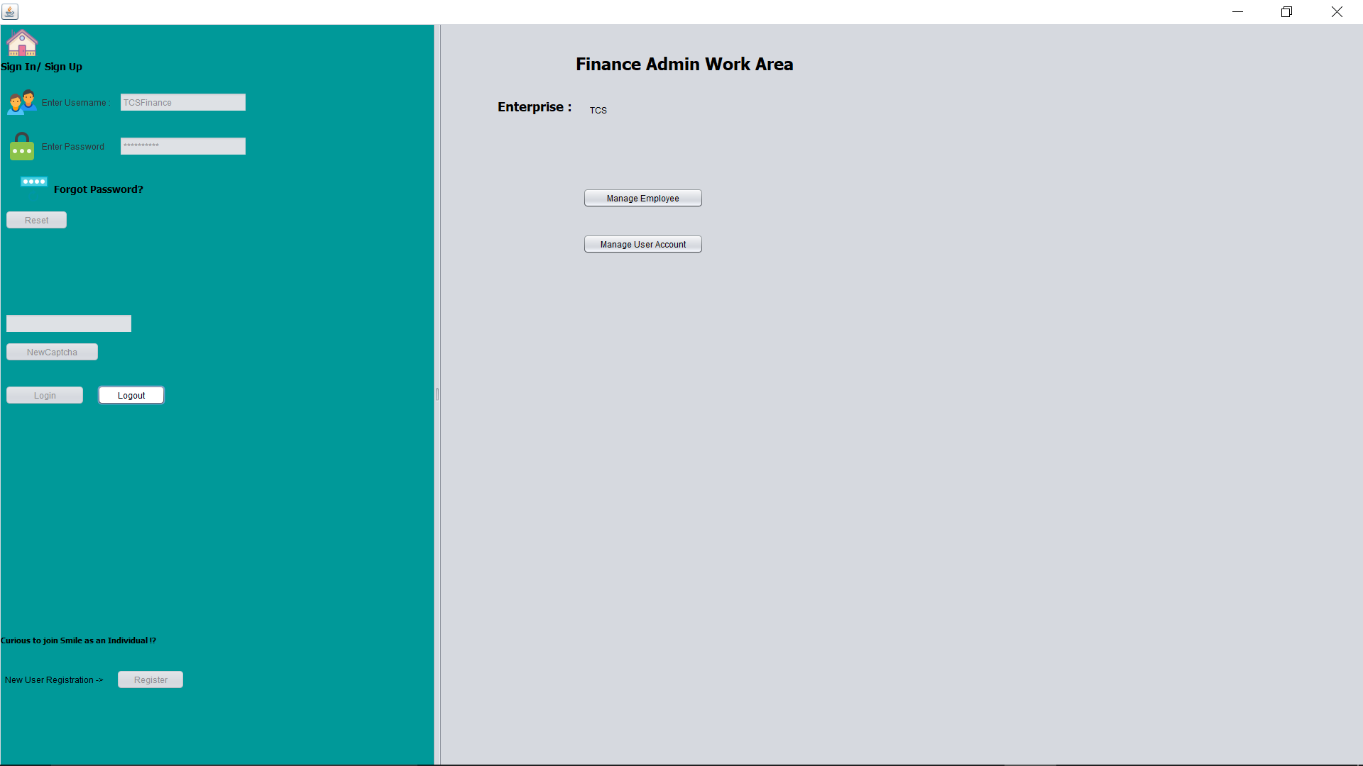
Company Finance Admin

Slide 18
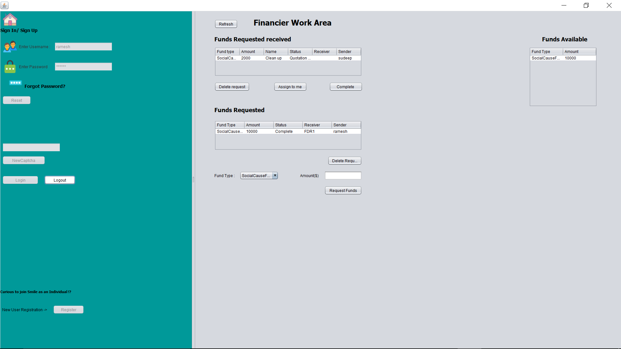
Financier Role

Slide 19

Financier had sent funds

Slide 20
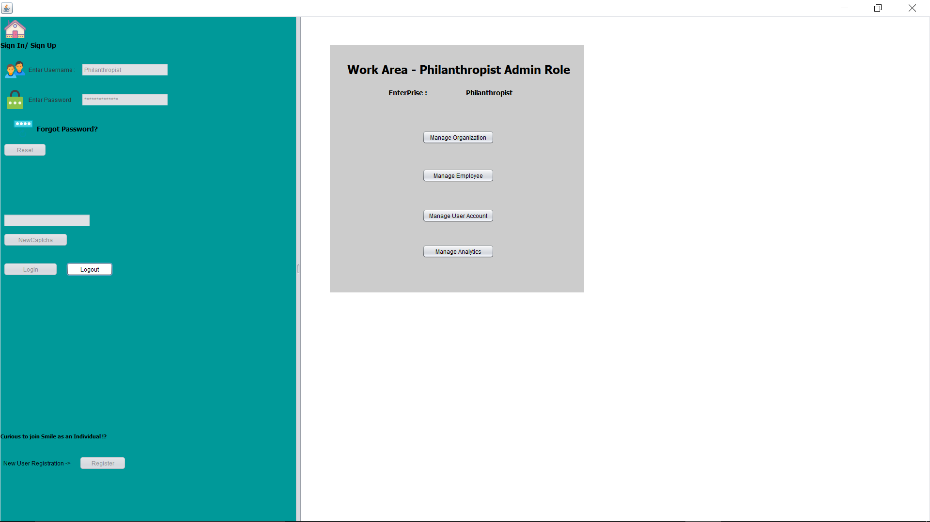
Philanthropist Work Area

Slide 21

Welfare Organization member

Slide 22

Welfare Fund Dispenser Organization

Slide 23
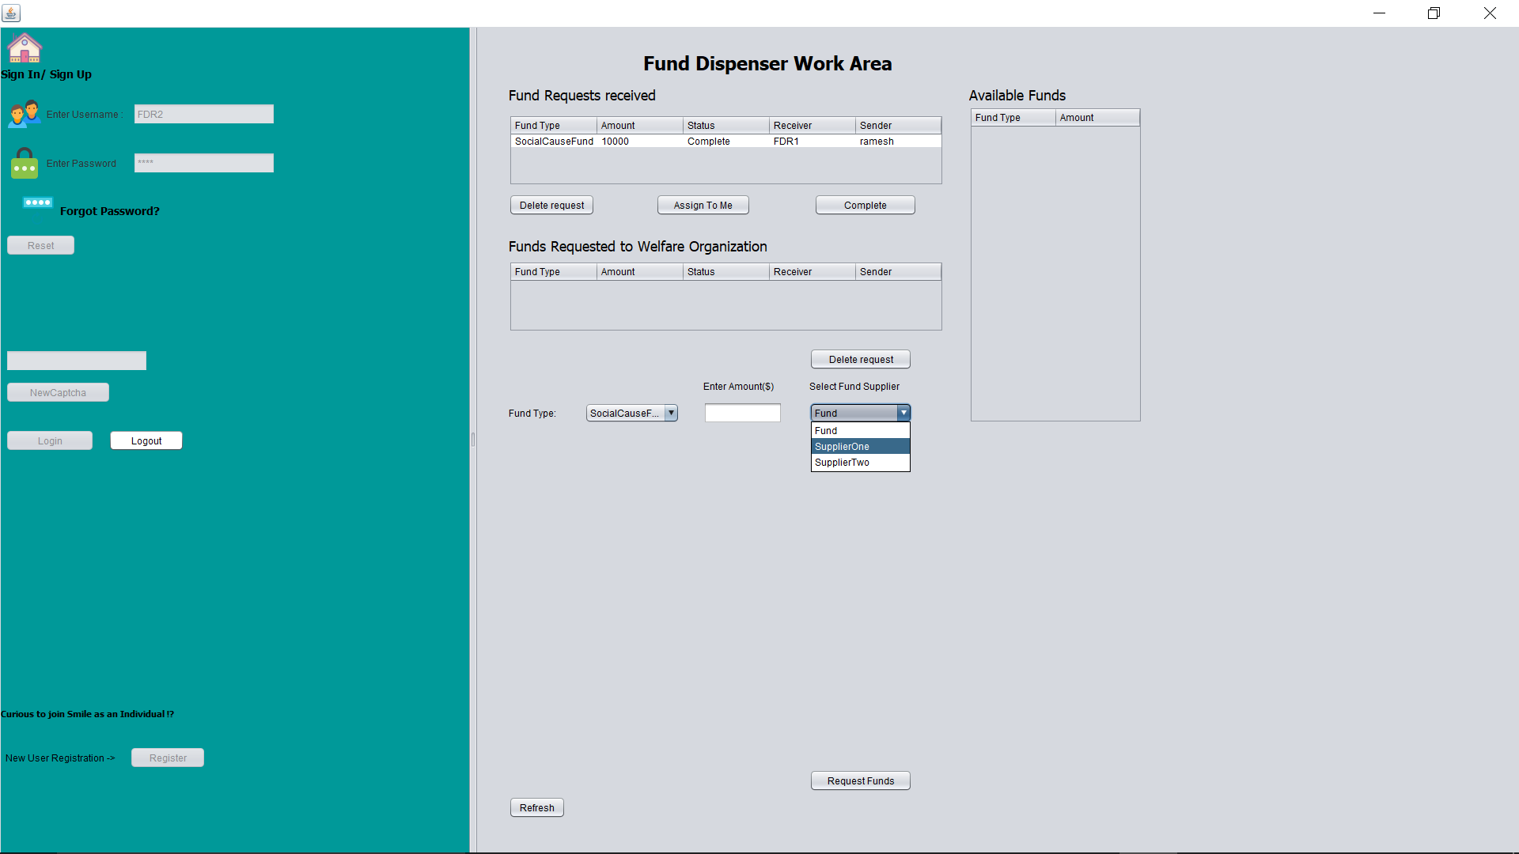
FDR Requesting Funds to specific Supplier

Slide 24
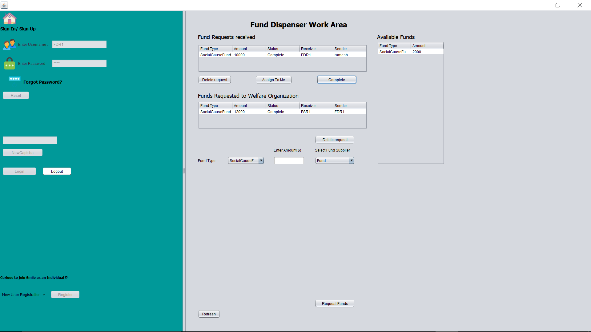

Slide 25
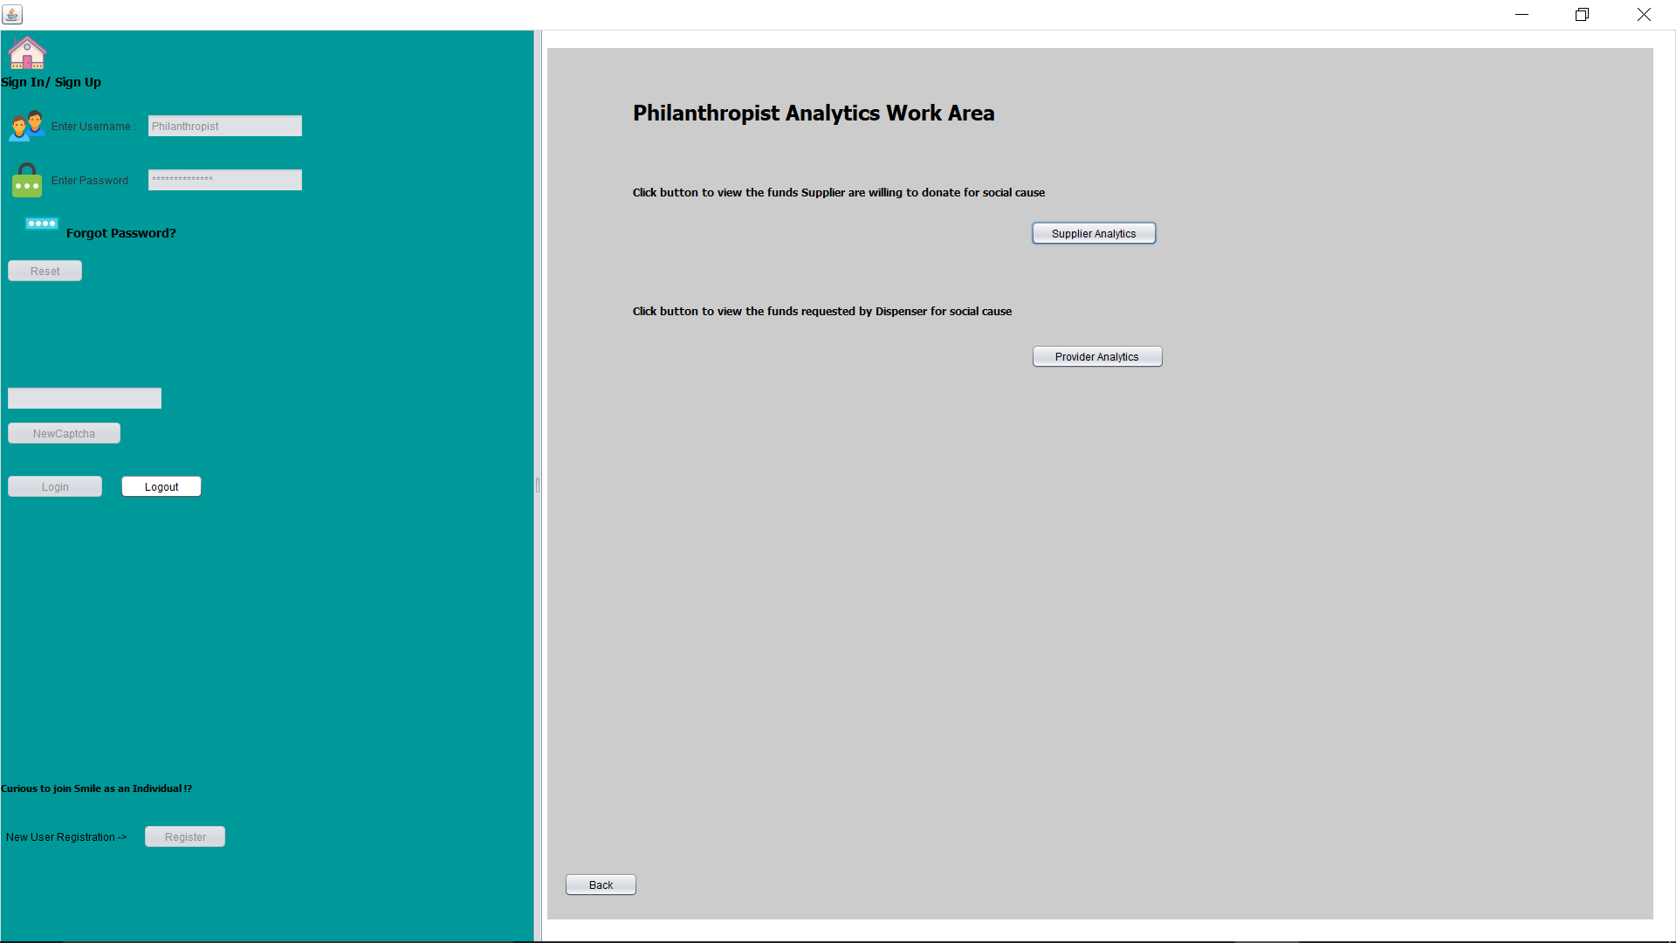
Philanthropist Analytics

Slide 26
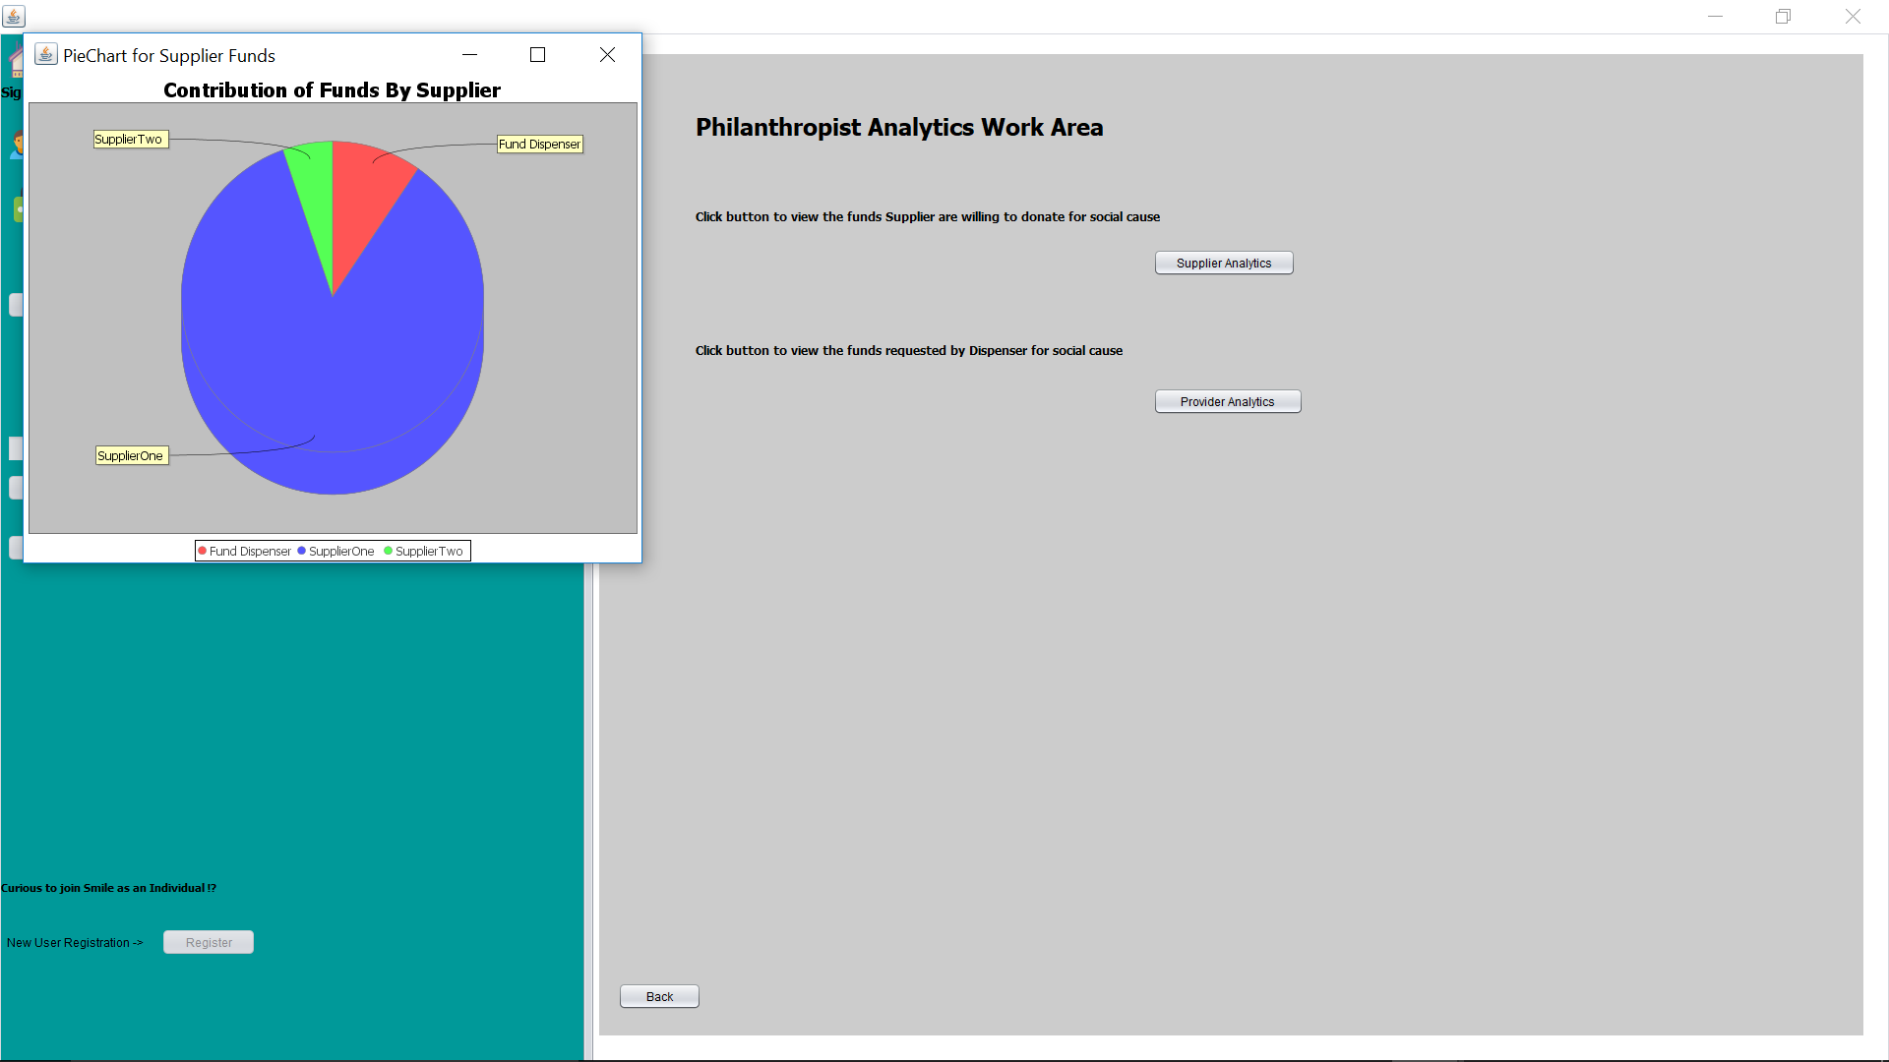
Supplier Analytics

Slide 27
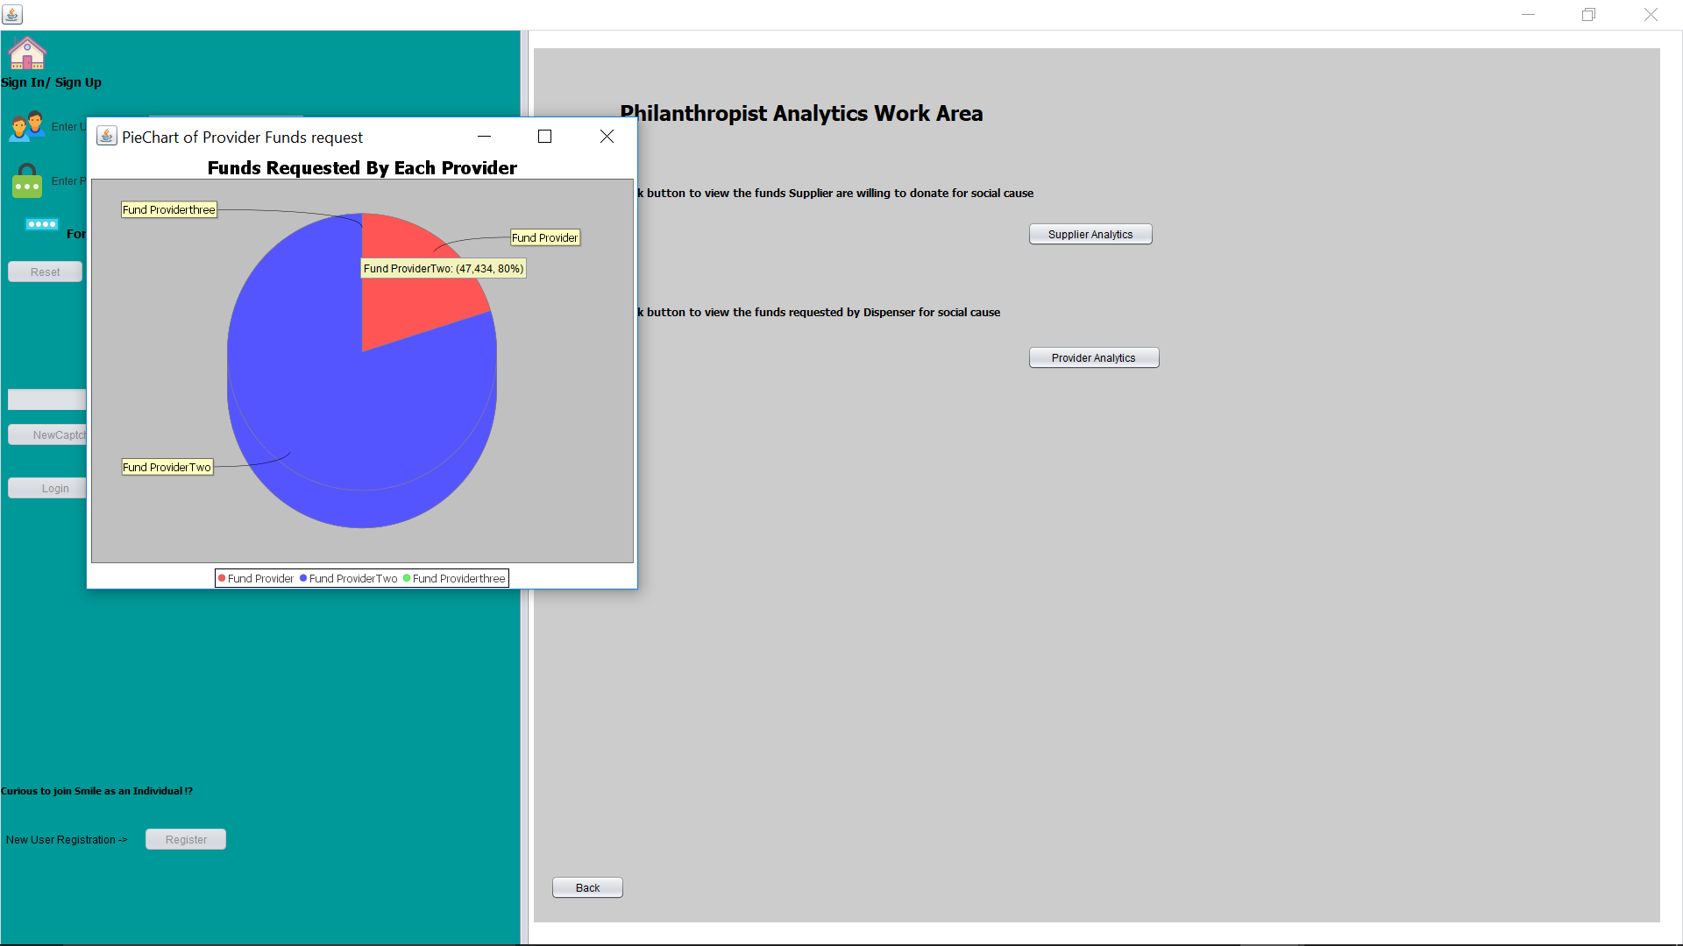
Dispenser Analytics

Slide 28
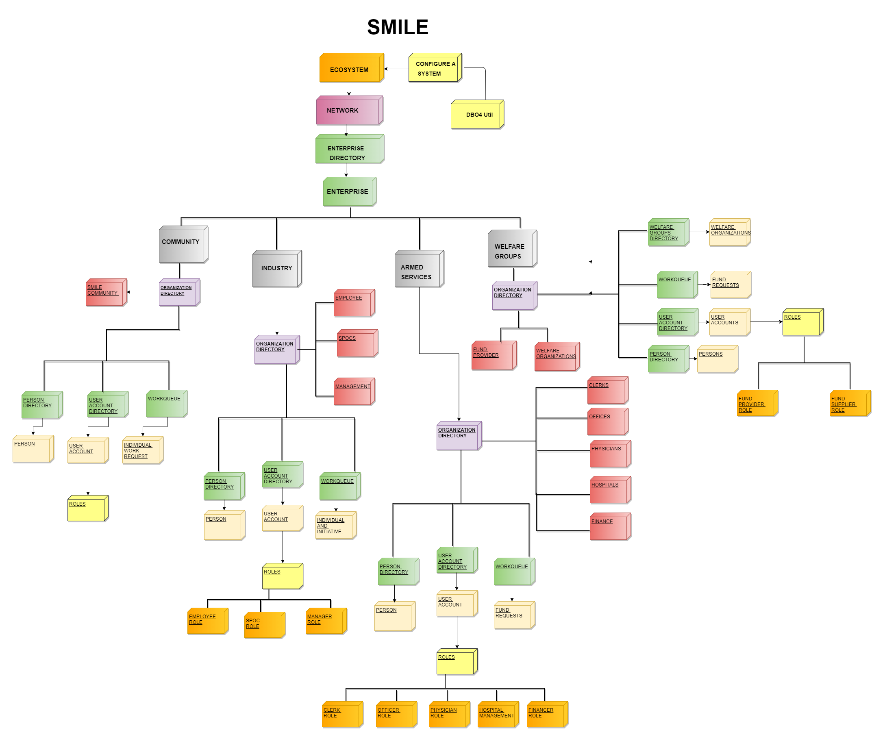

Slide 29
Thank You

