Slide 1


Week 01 · What generative AI does
OPEN / WEEK 01
The late-bus refund
A confident assistant says a late bus ticket is reimbursed. Policy P1 says student travel is not reimbursed. Would you trust the answer?
GENERATIVE AI 2027 • WEEK 01 • 01 / 40
Notes:
TEACHER SCRIPT — OPEN. Show the visual for ten seconds, then ask for an initial decision. Do not reveal the answer yet. Ask a student to name the source or measurement that would change their mind. This week’s case is: A student asks whether a fictional college reimburses a late bus ticket. The visible slide states: The late-bus refund
A confident assistant says a late bus ticket is reimbursed. Policy P1 says student travel is not reimbursed. Would you trust the answer? Reveal that the case will be revisited after four short concept cycles. The target is: Separate a model from the application that checks and delivers its output. Listen for an explanation of the actual arrow or calculation, not just a repeated label. If the answer is unsupported, mark that uncertainty and return to the source. Before moving on, ask for the main idea and one concrete change to the worked example.

Slide 2

First vote: what would you do?
QUESTION / WEEK 01
A confident assistant says a late bus ticket is reimbursed. Policy P1 says student travel is not reimbursed. Would you trust the answer?
Choose an initial answer and name one piece of evidence you need.
GENERATIVE AI 2027 • WEEK 01 • 02 / 40
Notes:
TEACHER SCRIPT — QUESTION. Take a show of hands for each choice before showing the mechanism. Ask pairs to defend a choice with evidence. Save the strongest wrong reason for the reveal later in this cycle. This week’s case is: A student asks whether a fictional college reimburses a late bus ticket. The visible slide states: A confident assistant says a late bus ticket is reimbursed. Policy P1 says student travel is not reimbursed. Would you trust the answer?
Choose an initial answer and name one piece of evidence you need. Accept reasonable uncertainty; record the initial votes to revisit at the end. The target is: Separate a model from the application that checks and delivers its output. Listen for an explanation of the actual arrow or calculation, not just a repeated label. If the answer is unsupported, mark that uncertainty and return to the source. Before moving on, ask for the main idea and one concrete change to the worked example.

Slide 3
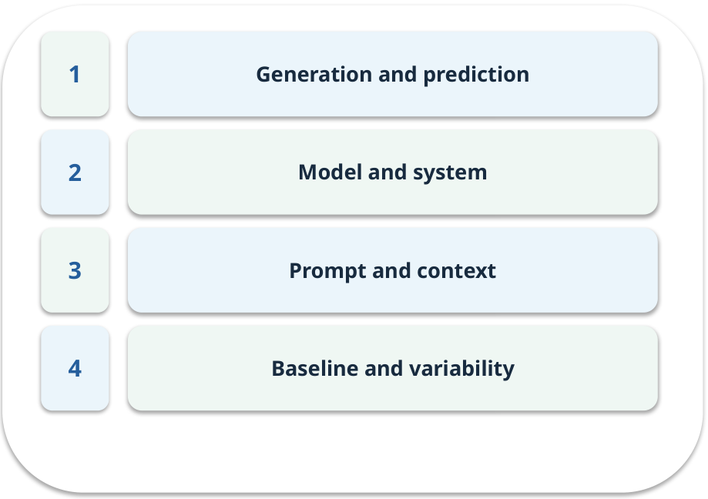
The journey through today’s case
OPEN / WEEK 01
We will predict, connect an analogy, trace a mechanism, work an example, then explain a decision.
GENERATIVE AI 2027 • WEEK 01 • 03 / 40
Notes:
TEACHER SCRIPT — OPEN. Show the visual for ten seconds, then ask for an initial decision. Do not reveal the answer yet. Ask a student to name the source or measurement that would change their mind. This week’s case is: A student asks whether a fictional college reimburses a late bus ticket. The visible slide states: We will predict, connect an analogy, trace a mechanism, work an example, then explain a decision. Point to the four named ideas, then show where the notebook experiment fits. The target is: Separate a model from the application that checks and delivers its output. Listen for an explanation of the actual arrow or calculation, not just a repeated label. If the answer is unsupported, mark that uncertainty and return to the source. Before moving on, ask for the main idea and one concrete change to the worked example.

Slide 4
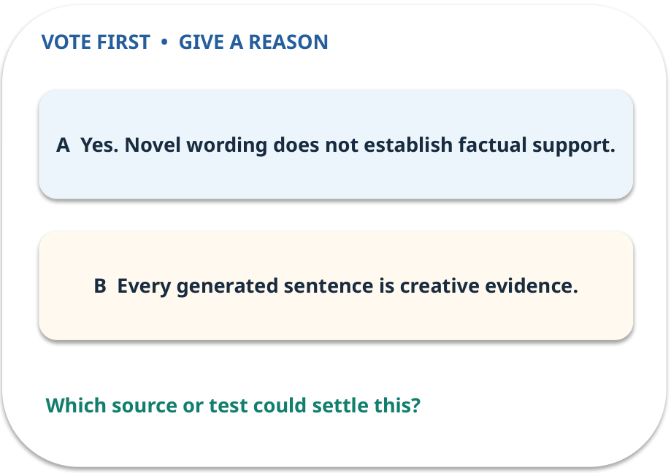
1. Predict · Generation and prediction
QUESTION / WEEK 01
Can a newly worded answer still be false?
Make a choice before we explain the diagram.
GENERATIVE AI 2027 • WEEK 01 • 04 / 40
Notes:
TEACHER SCRIPT — QUESTION. Take a show of hands for each choice before showing the mechanism. Ask pairs to defend a choice with evidence. Save the strongest wrong reason for the reveal later in this cycle. This week’s case is: A student asks whether a fictional college reimburses a late bus ticket. The visible slide states: Can a newly worded answer still be false?
Make a choice before we explain the diagram. The intended answer is Yes. Novel wording does not establish factual support. The tempting claim is Every generated sentence is creative evidence. Do not show which card is correct until the reveal. The target is: Separate a model from the application that checks and delivers its output. Listen for an explanation of the actual arrow or calculation, not just a repeated label. If the answer is unsupported, mark that uncertainty and return to the source. Before moving on, ask for the main idea and one concrete change to the worked example.

Slide 5
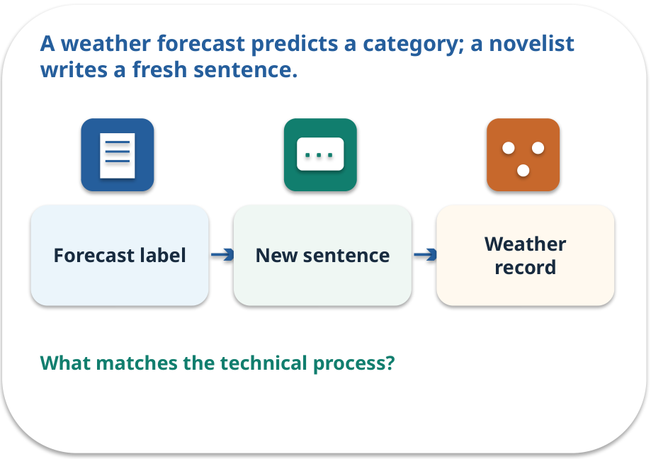
Generation and prediction · a familiar picture
ANALOGY / WEEK 01
A weather forecast predicts a category; a novelist writes a fresh sentence.
What matches our case, and where does the analogy stop?
GENERATIVE AI 2027 • WEEK 01 • 05 / 40
Notes:
TEACHER SCRIPT — ANALOGY. Begin with the familiar scene. Invite learners to describe each part in everyday language. Then ask where the comparison might fail before introducing the technical vocabulary. This week’s case is: A student asks whether a fictional college reimburses a late bus ticket. The visible slide states: A weather forecast predicts a category; a novelist writes a fresh sentence.
What matches our case, and where does the analogy stop? The boundary is: A generative model also predicts the next token internally; the distinction concerns the output task. The target is: Separate a model from the application that checks and delivers its output. Listen for an explanation of the actual arrow or calculation, not just a repeated label. If the answer is unsupported, mark that uncertainty and return to the source. Before moving on, ask for the main idea and one concrete change to the worked example.

Slide 6
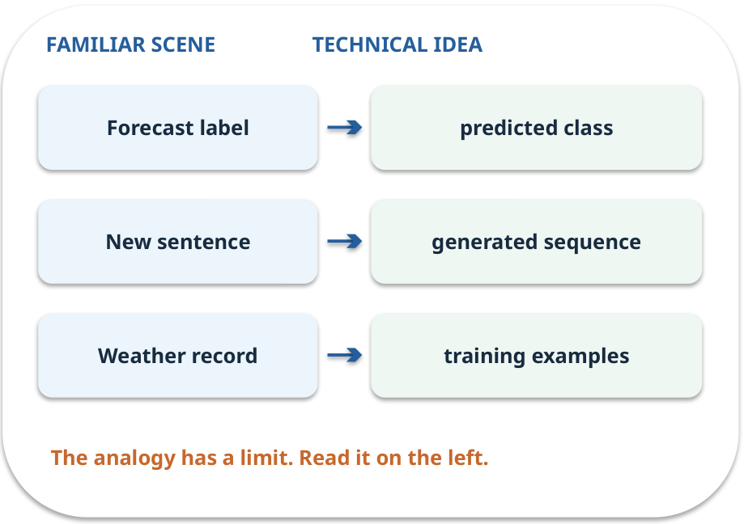
Generation and prediction · map the parts
MAPPING / WEEK 01
Match each everyday part to the technical part.
Analogy limit: A generative model also predicts the next token internally; the distinction concerns the output task.
GENERATIVE AI 2027 • WEEK 01 • 06 / 40
Notes:
TEACHER SCRIPT — MAPPING. Point from each familiar element to the corresponding technical element. Have students cover the right column and reconstruct the three matches. Read the limitation aloud. This week’s case is: A student asks whether a fictional college reimburses a late bus ticket. The visible slide states: Match each everyday part to the technical part.
Analogy limit: A generative model also predicts the next token internally; the distinction concerns the output task. The three precise mappings are [['Forecast label', 'predicted class'], ['New sentence', 'generated sequence'], ['Weather record', 'training examples']]. The target is: Separate a model from the application that checks and delivers its output. Listen for an explanation of the actual arrow or calculation, not just a repeated label. If the answer is unsupported, mark that uncertainty and return to the source. Before moving on, ask for the main idea and one concrete change to the worked example.

Slide 7
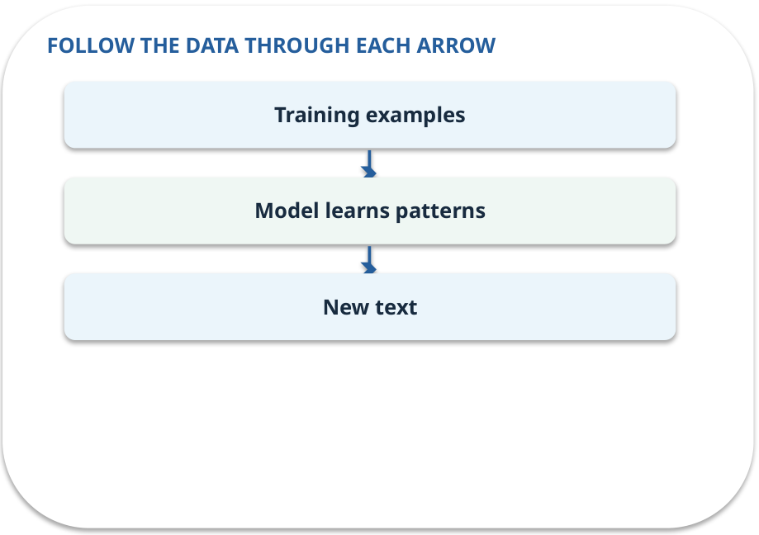
Generation and prediction · how it works
MECHANISM / WEEK 01
A predictor assigns a label or value. A generator creates a new sequence or image. Both can make errors.
Trace the arrows from left to right.
GENERATIVE AI 2027 • WEEK 01 • 07 / 40
Notes:
TEACHER SCRIPT — MECHANISM. Trace every arrow slowly from the input to the output. Ask what information crosses the boundary at each arrow. Pause if students confuse a simplified notebook with a trained model. This week’s case is: A student asks whether a fictional college reimburses a late bus ticket. The visible slide states: A predictor assigns a label or value. A generator creates a new sequence or image. Both can make errors.
Trace the arrows from left to right. The weekly example is: Given “Is travel reimbursed?”, a classifier could output NO; a generator could write “No, under P1.” State what the analogy does not explain: A generative model also predicts the next token internally; the distinction concerns the output task. The target is: Separate a model from the application that checks and delivers its output. Listen for an explanation of the actual arrow or calculation, not just a repeated label. If the answer is unsupported, mark that uncertainty and return to the source. Before moving on, ask for the main idea and one concrete change to the worked example.

Slide 8
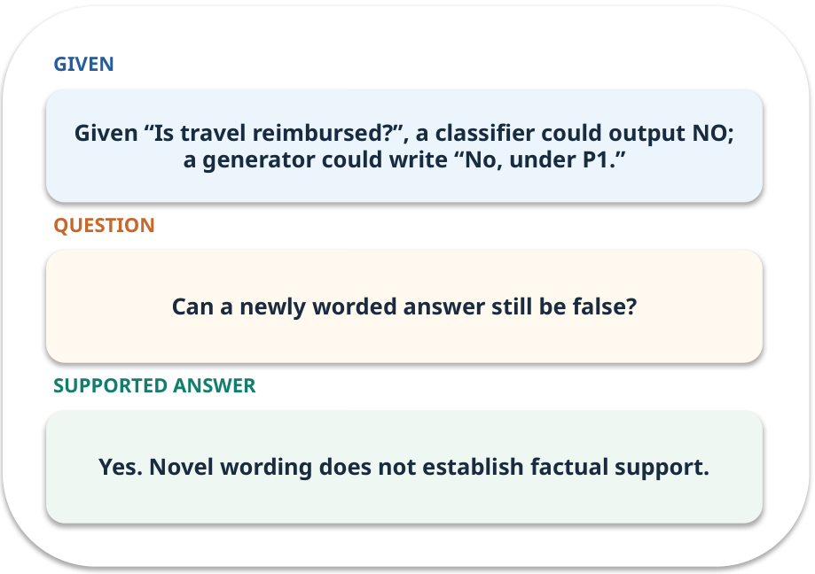
Generation and prediction · work one case
WORKED / WEEK 01
Given “Is travel reimbursed?”, a classifier could output NO; a generator could write “No, under P1.”
Point to the evidence before giving your conclusion.
GENERATIVE AI 2027 • WEEK 01 • 08 / 40
Notes:
TEACHER SCRIPT — WORKED. Work the specific numbers or source wording aloud. Give students thirty seconds to write a conclusion, then ask which source line or calculation supports it. This week’s case is: A student asks whether a fictional college reimburses a late bus ticket. The visible slide states: Given “Is travel reimbursed?”, a classifier could output NO; a generator could write “No, under P1.”
Point to the evidence before giving your conclusion. The expected reasoning concludes: Yes. Novel wording does not establish factual support. Distinguish measured results from illustrative numbers. The target is: Separate a model from the application that checks and delivers its output. Listen for an explanation of the actual arrow or calculation, not just a repeated label. If the answer is unsupported, mark that uncertainty and return to the source. Before moving on, ask for the main idea and one concrete change to the worked example.

Slide 9
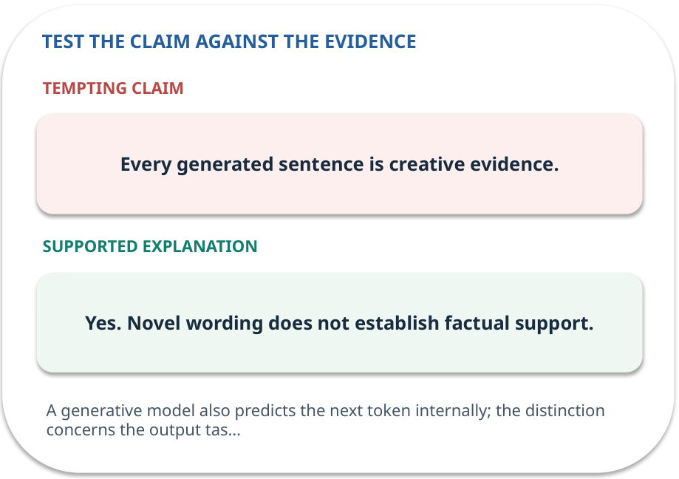
Generation and prediction · answer and explain
REVEAL / WEEK 01
Yes. Novel wording does not establish factual support.
Tempting mistake: Every generated sentence is creative evidence.
GENERATIVE AI 2027 • WEEK 01 • 09 / 40
Notes:
TEACHER SCRIPT — REVEAL. Return to the earlier choice. Explain the correct answer and why the tempting claim fails. Ask one learner to say the answer in a single sentence without reading it. This week’s case is: A student asks whether a fictional college reimburses a late bus ticket. The visible slide states: Yes. Novel wording does not establish factual support.
Tempting mistake: Every generated sentence is creative evidence. The earlier question was Can a newly worded answer still be false? Ask how this differs from the wrong claim. The target is: Separate a model from the application that checks and delivers its output. Listen for an explanation of the actual arrow or calculation, not just a repeated label. If the answer is unsupported, mark that uncertainty and return to the source. Before moving on, ask for the main idea and one concrete change to the worked example.

Slide 10
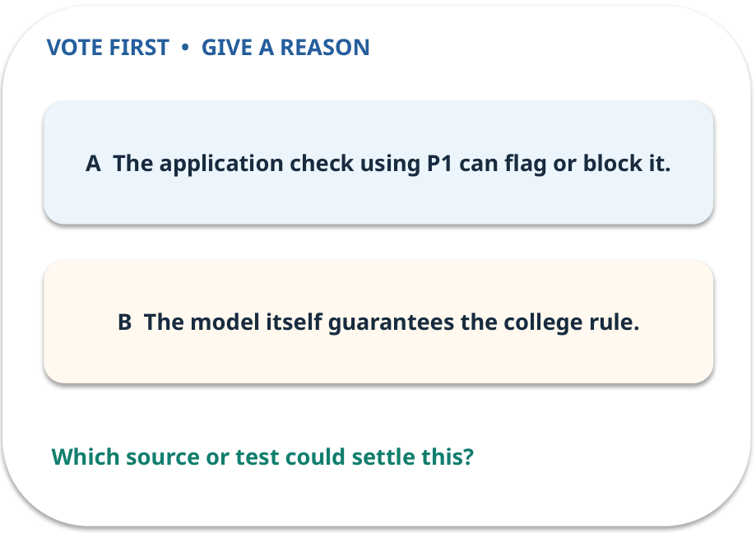
2. Predict · Model and system
QUESTION / WEEK 01
Which component can stop an unsupported answer reaching the student?
Make a choice before we explain the diagram.
GENERATIVE AI 2027 • WEEK 01 • 10 / 40
Notes:
TEACHER SCRIPT — QUESTION. Take a show of hands for each choice before showing the mechanism. Ask pairs to defend a choice with evidence. Save the strongest wrong reason for the reveal later in this cycle. This week’s case is: A student asks whether a fictional college reimburses a late bus ticket. The visible slide states: Which component can stop an unsupported answer reaching the student?
Make a choice before we explain the diagram. The intended answer is The application check using P1 can flag or block it. The tempting claim is The model itself guarantees the college rule. Do not show which card is correct until the reveal. The target is: Separate a model from the application that checks and delivers its output. Listen for an explanation of the actual arrow or calculation, not just a repeated label. If the answer is unsupported, mark that uncertainty and return to the source. Before moving on, ask for the main idea and one concrete change to the worked example.

Slide 11
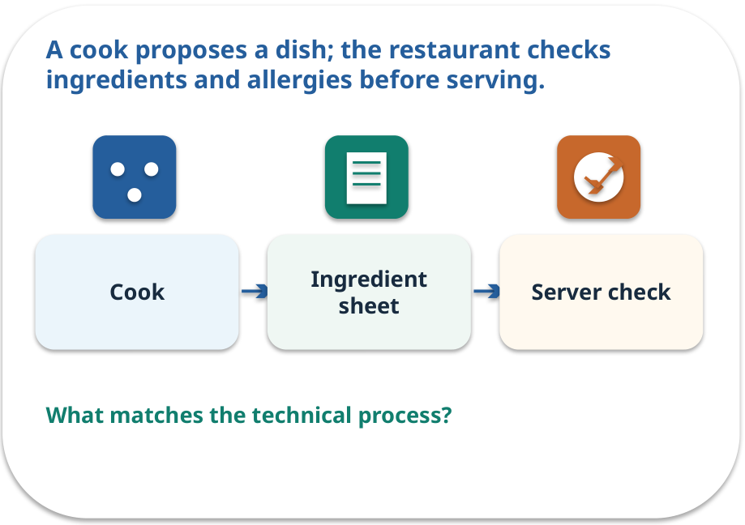
Model and system · a familiar picture
ANALOGY / WEEK 01
A cook proposes a dish; the restaurant checks ingredients and allergies before serving.
What matches our case, and where does the analogy stop?
GENERATIVE AI 2027 • WEEK 01 • 11 / 40
Notes:
TEACHER SCRIPT — ANALOGY. Begin with the familiar scene. Invite learners to describe each part in everyday language. Then ask where the comparison might fail before introducing the technical vocabulary. This week’s case is: A student asks whether a fictional college reimburses a late bus ticket. The visible slide states: A cook proposes a dish; the restaurant checks ingredients and allergies before serving.
What matches our case, and where does the analogy stop? The boundary is: A restaurant check is a deliberate rule; a model does not automatically enforce permissions. The target is: Separate a model from the application that checks and delivers its output. Listen for an explanation of the actual arrow or calculation, not just a repeated label. If the answer is unsupported, mark that uncertainty and return to the source. Before moving on, ask for the main idea and one concrete change to the worked example.

Slide 12
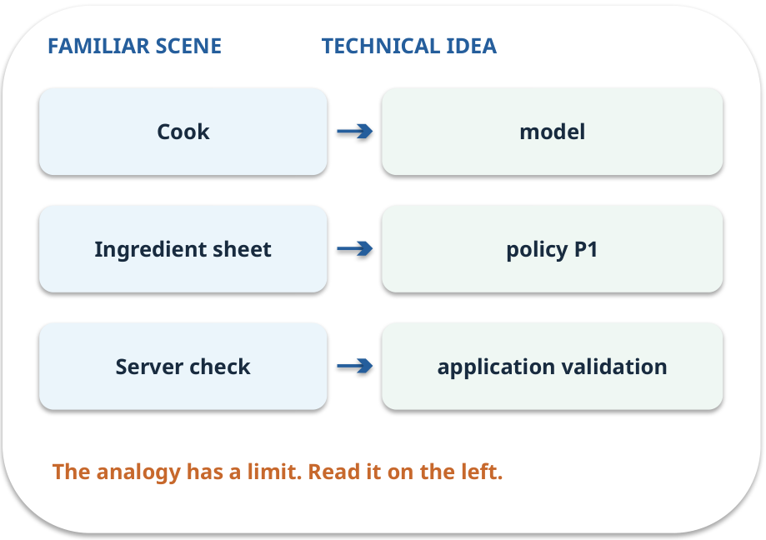
Model and system · map the parts
MAPPING / WEEK 01
Match each everyday part to the technical part.
Analogy limit: A restaurant check is a deliberate rule; a model does not automatically enforce permissions.
GENERATIVE AI 2027 • WEEK 01 • 12 / 40
Notes:
TEACHER SCRIPT — MAPPING. Point from each familiar element to the corresponding technical element. Have students cover the right column and reconstruct the three matches. Read the limitation aloud. This week’s case is: A student asks whether a fictional college reimburses a late bus ticket. The visible slide states: Match each everyday part to the technical part.
Analogy limit: A restaurant check is a deliberate rule; a model does not automatically enforce permissions. The three precise mappings are [['Cook', 'model'], ['Ingredient sheet', 'policy P1'], ['Server check', 'application validation']]. The target is: Separate a model from the application that checks and delivers its output. Listen for an explanation of the actual arrow or calculation, not just a repeated label. If the answer is unsupported, mark that uncertainty and return to the source. Before moving on, ask for the main idea and one concrete change to the worked example.

Slide 13
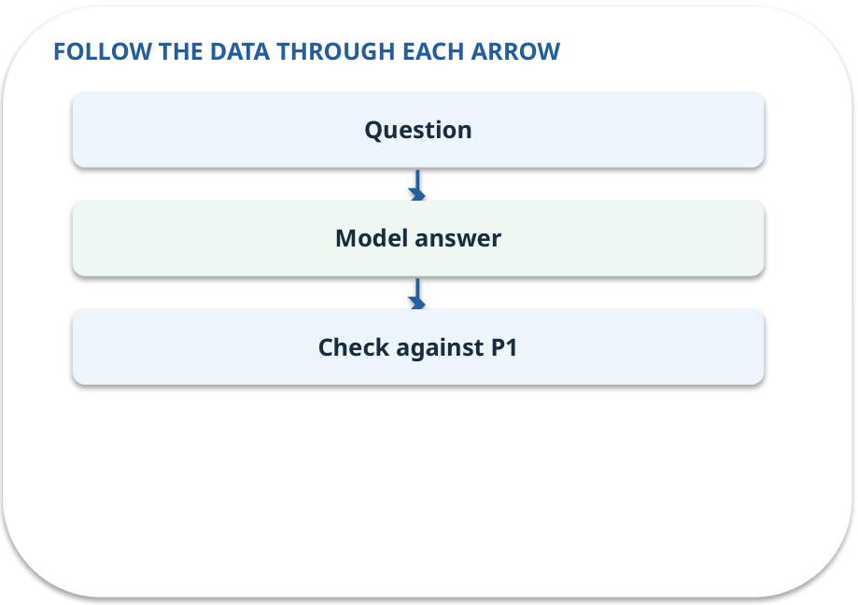
Model and system · how it works
MECHANISM / WEEK 01
The model proposes words. Retrieval, permissions, validation and people decide what the application may present.
Trace the arrows from left to right.
GENERATIVE AI 2027 • WEEK 01 • 13 / 40
Notes:
TEACHER SCRIPT — MECHANISM. Trace every arrow slowly from the input to the output. Ask what information crosses the boundary at each arrow. Pause if students confuse a simplified notebook with a trained model. This week’s case is: A student asks whether a fictional college reimburses a late bus ticket. The visible slide states: The model proposes words. Retrieval, permissions, validation and people decide what the application may present.
Trace the arrows from left to right. The weekly example is: The model proposes “Yes”; the application compares the claim with P1 and flags it. State what the analogy does not explain: A restaurant check is a deliberate rule; a model does not automatically enforce permissions. The target is: Separate a model from the application that checks and delivers its output. Listen for an explanation of the actual arrow or calculation, not just a repeated label. If the answer is unsupported, mark that uncertainty and return to the source. Before moving on, ask for the main idea and one concrete change to the worked example.

Slide 14
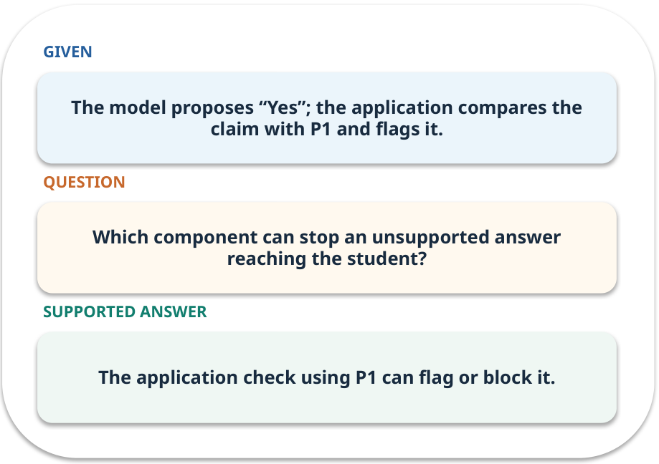
Model and system · work one case
WORKED / WEEK 01
The model proposes “Yes”; the application compares the claim with P1 and flags it.
Point to the evidence before giving your conclusion.
GENERATIVE AI 2027 • WEEK 01 • 14 / 40
Notes:
TEACHER SCRIPT — WORKED. Work the specific numbers or source wording aloud. Give students thirty seconds to write a conclusion, then ask which source line or calculation supports it. This week’s case is: A student asks whether a fictional college reimburses a late bus ticket. The visible slide states: The model proposes “Yes”; the application compares the claim with P1 and flags it.
Point to the evidence before giving your conclusion. The expected reasoning concludes: The application check using P1 can flag or block it. Distinguish measured results from illustrative numbers. The target is: Separate a model from the application that checks and delivers its output. Listen for an explanation of the actual arrow or calculation, not just a repeated label. If the answer is unsupported, mark that uncertainty and return to the source. Before moving on, ask for the main idea and one concrete change to the worked example.

Slide 15
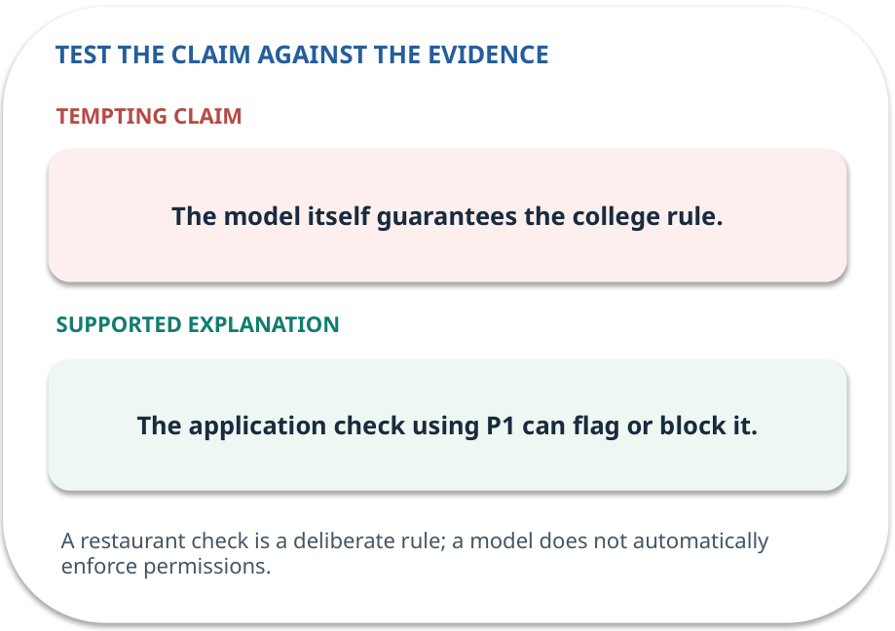
Model and system · answer and explain
REVEAL / WEEK 01
The application check using P1 can flag or block it.
Tempting mistake: The model itself guarantees the college rule.
GENERATIVE AI 2027 • WEEK 01 • 15 / 40
Notes:
TEACHER SCRIPT — REVEAL. Return to the earlier choice. Explain the correct answer and why the tempting claim fails. Ask one learner to say the answer in a single sentence without reading it. This week’s case is: A student asks whether a fictional college reimburses a late bus ticket. The visible slide states: The application check using P1 can flag or block it.
Tempting mistake: The model itself guarantees the college rule. The earlier question was Which component can stop an unsupported answer reaching the student? Ask how this differs from the wrong claim. The target is: Separate a model from the application that checks and delivers its output. Listen for an explanation of the actual arrow or calculation, not just a repeated label. If the answer is unsupported, mark that uncertainty and return to the source. Before moving on, ask for the main idea and one concrete change to the worked example.

Slide 16
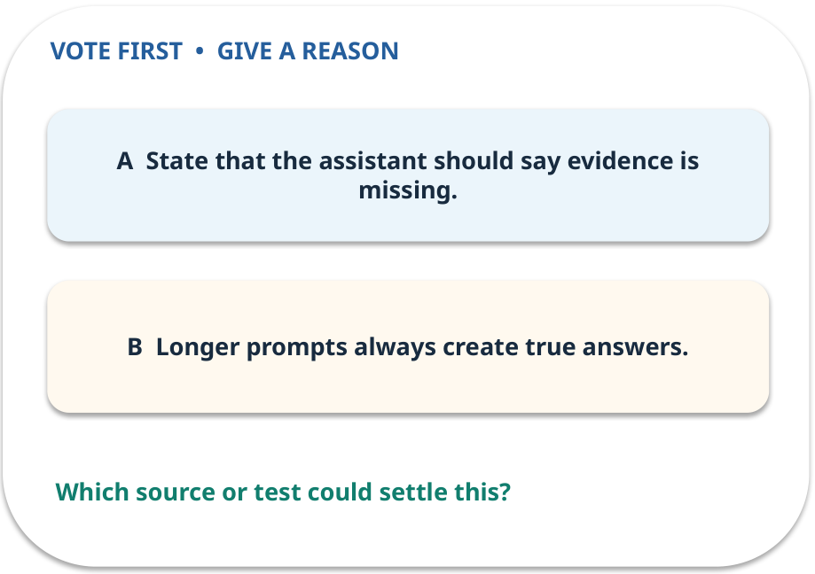
3. Predict · Prompt and context
QUESTION / WEEK 01
What should the prompt say when P1 lacks the answer?
Make a choice before we explain the diagram.
GENERATIVE AI 2027 • WEEK 01 • 16 / 40
Notes:
TEACHER SCRIPT — QUESTION. Take a show of hands for each choice before showing the mechanism. Ask pairs to defend a choice with evidence. Save the strongest wrong reason for the reveal later in this cycle. This week’s case is: A student asks whether a fictional college reimburses a late bus ticket. The visible slide states: What should the prompt say when P1 lacks the answer?
Make a choice before we explain the diagram. The intended answer is State that the assistant should say evidence is missing. The tempting claim is Longer prompts always create true answers. Do not show which card is correct until the reveal. The target is: Separate a model from the application that checks and delivers its output. Listen for an explanation of the actual arrow or calculation, not just a repeated label. If the answer is unsupported, mark that uncertainty and return to the source. Before moving on, ask for the main idea and one concrete change to the worked example.

Slide 17
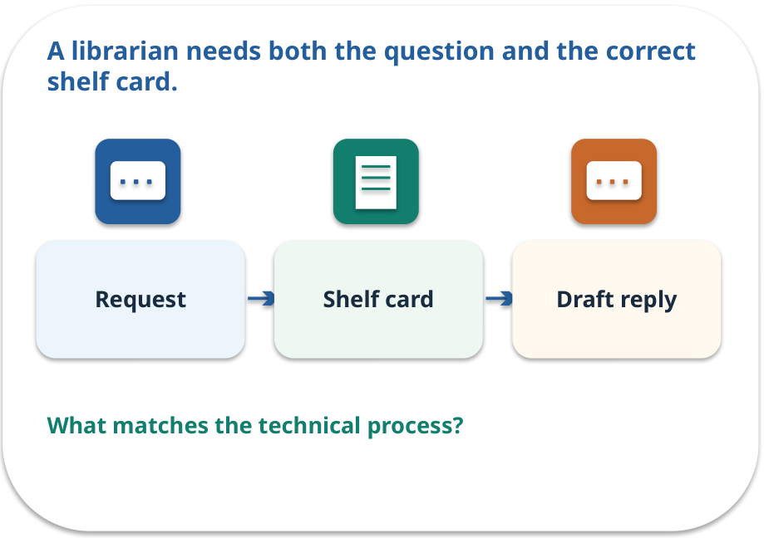
Prompt and context · a familiar picture
ANALOGY / WEEK 01
A librarian needs both the question and the correct shelf card.
What matches our case, and where does the analogy stop?
GENERATIVE AI 2027 • WEEK 01 • 17 / 40
Notes:
TEACHER SCRIPT — ANALOGY. Begin with the familiar scene. Invite learners to describe each part in everyday language. Then ask where the comparison might fail before introducing the technical vocabulary. This week’s case is: A student asks whether a fictional college reimburses a late bus ticket. The visible slide states: A librarian needs both the question and the correct shelf card.
What matches our case, and where does the analogy stop? The boundary is: The shelf card helps only if it is relevant, current and actually used. The target is: Separate a model from the application that checks and delivers its output. Listen for an explanation of the actual arrow or calculation, not just a repeated label. If the answer is unsupported, mark that uncertainty and return to the source. Before moving on, ask for the main idea and one concrete change to the worked example.

Slide 18
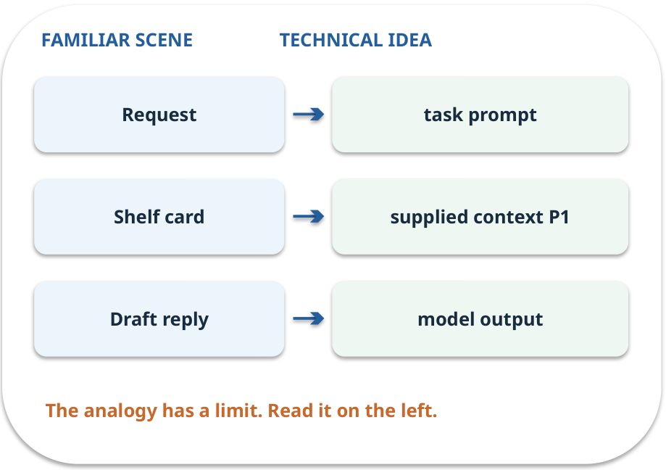
Prompt and context · map the parts
MAPPING / WEEK 01
Match each everyday part to the technical part.
Analogy limit: The shelf card helps only if it is relevant, current and actually used.
GENERATIVE AI 2027 • WEEK 01 • 18 / 40
Notes:
TEACHER SCRIPT — MAPPING. Point from each familiar element to the corresponding technical element. Have students cover the right column and reconstruct the three matches. Read the limitation aloud. This week’s case is: A student asks whether a fictional college reimburses a late bus ticket. The visible slide states: Match each everyday part to the technical part.
Analogy limit: The shelf card helps only if it is relevant, current and actually used. The three precise mappings are [['Request', 'task prompt'], ['Shelf card', 'supplied context P1'], ['Draft reply', 'model output']]. The target is: Separate a model from the application that checks and delivers its output. Listen for an explanation of the actual arrow or calculation, not just a repeated label. If the answer is unsupported, mark that uncertainty and return to the source. Before moving on, ask for the main idea and one concrete change to the worked example.

Slide 19

Prompt and context · how it works
MECHANISM / WEEK 01
A prompt states the task; context contains the supplied evidence. The model cannot reliably invent a missing policy.
Trace the arrows from left to right.
GENERATIVE AI 2027 • WEEK 01 • 19 / 40
Notes:
TEACHER SCRIPT — MECHANISM. Trace every arrow slowly from the input to the output. Ask what information crosses the boundary at each arrow. Pause if students confuse a simplified notebook with a trained model. This week’s case is: A student asks whether a fictional college reimburses a late bus ticket. The visible slide states: A prompt states the task; context contains the supplied evidence. The model cannot reliably invent a missing policy.
Trace the arrows from left to right. The weekly example is: “Answer using P1 and cite it” includes a task and source; “help me” does not. State what the analogy does not explain: The shelf card helps only if it is relevant, current and actually used. The target is: Separate a model from the application that checks and delivers its output. Listen for an explanation of the actual arrow or calculation, not just a repeated label. If the answer is unsupported, mark that uncertainty and return to the source. Before moving on, ask for the main idea and one concrete change to the worked example.

Slide 20
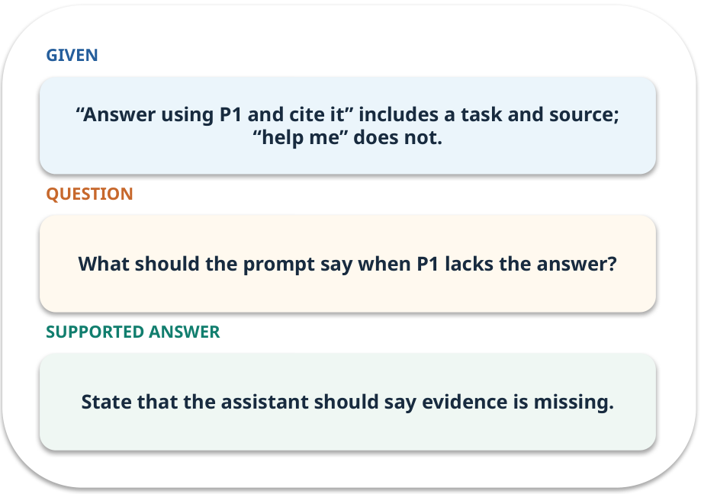
Prompt and context · work one case
WORKED / WEEK 01
“Answer using P1 and cite it” includes a task and source; “help me” does not.
Point to the evidence before giving your conclusion.
GENERATIVE AI 2027 • WEEK 01 • 20 / 40
Notes:
TEACHER SCRIPT — WORKED. Work the specific numbers or source wording aloud. Give students thirty seconds to write a conclusion, then ask which source line or calculation supports it. This week’s case is: A student asks whether a fictional college reimburses a late bus ticket. The visible slide states: “Answer using P1 and cite it” includes a task and source; “help me” does not.
Point to the evidence before giving your conclusion. The expected reasoning concludes: State that the assistant should say evidence is missing. Distinguish measured results from illustrative numbers. The target is: Separate a model from the application that checks and delivers its output. Listen for an explanation of the actual arrow or calculation, not just a repeated label. If the answer is unsupported, mark that uncertainty and return to the source. Before moving on, ask for the main idea and one concrete change to the worked example.

Slide 21
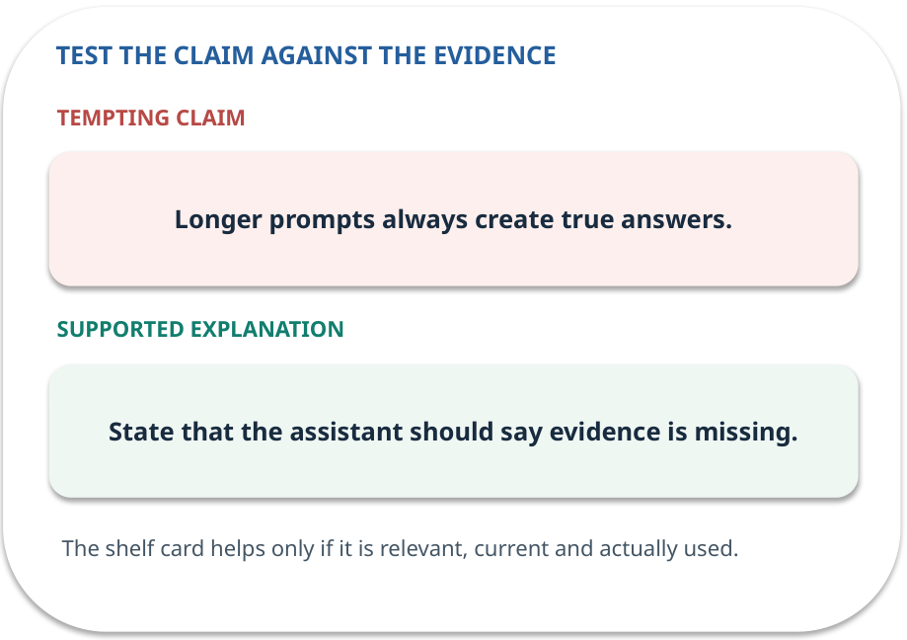
Prompt and context · answer and explain
REVEAL / WEEK 01
State that the assistant should say evidence is missing.
Tempting mistake: Longer prompts always create true answers.
GENERATIVE AI 2027 • WEEK 01 • 21 / 40
Notes:
TEACHER SCRIPT — REVEAL. Return to the earlier choice. Explain the correct answer and why the tempting claim fails. Ask one learner to say the answer in a single sentence without reading it. This week’s case is: A student asks whether a fictional college reimburses a late bus ticket. The visible slide states: State that the assistant should say evidence is missing.
Tempting mistake: Longer prompts always create true answers. The earlier question was What should the prompt say when P1 lacks the answer? Ask how this differs from the wrong claim. The target is: Separate a model from the application that checks and delivers its output. Listen for an explanation of the actual arrow or calculation, not just a repeated label. If the answer is unsupported, mark that uncertainty and return to the source. Before moving on, ask for the main idea and one concrete change to the worked example.

Slide 22
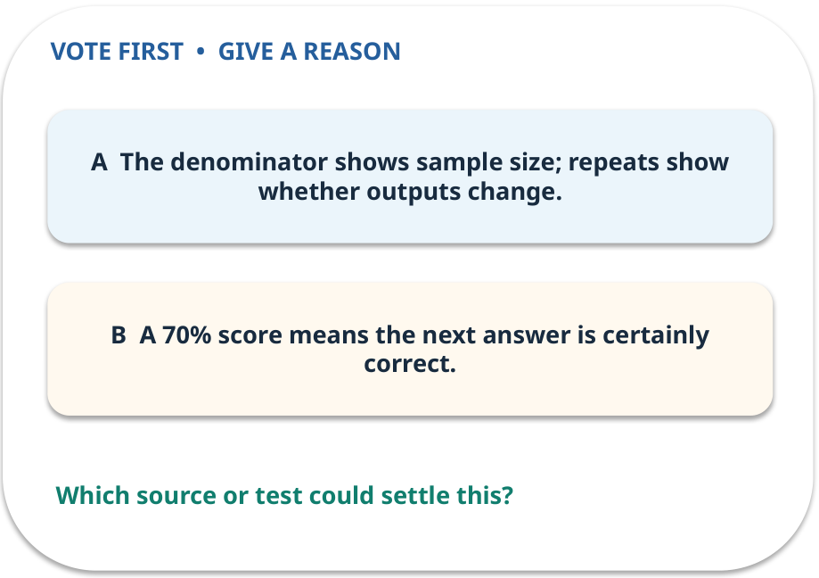
4. Predict · Baseline and variability
QUESTION / WEEK 01
Why record the denominator and repeats?
Make a choice before we explain the diagram.
GENERATIVE AI 2027 • WEEK 01 • 22 / 40
Notes:
TEACHER SCRIPT — QUESTION. Take a show of hands for each choice before showing the mechanism. Ask pairs to defend a choice with evidence. Save the strongest wrong reason for the reveal later in this cycle. This week’s case is: A student asks whether a fictional college reimburses a late bus ticket. The visible slide states: Why record the denominator and repeats?
Make a choice before we explain the diagram. The intended answer is The denominator shows sample size; repeats show whether outputs change. The tempting claim is A 70% score means the next answer is certainly correct. Do not show which card is correct until the reveal. The target is: Separate a model from the application that checks and delivers its output. Listen for an explanation of the actual arrow or calculation, not just a repeated label. If the answer is unsupported, mark that uncertainty and return to the source. Before moving on, ask for the main idea and one concrete change to the worked example.

Slide 23
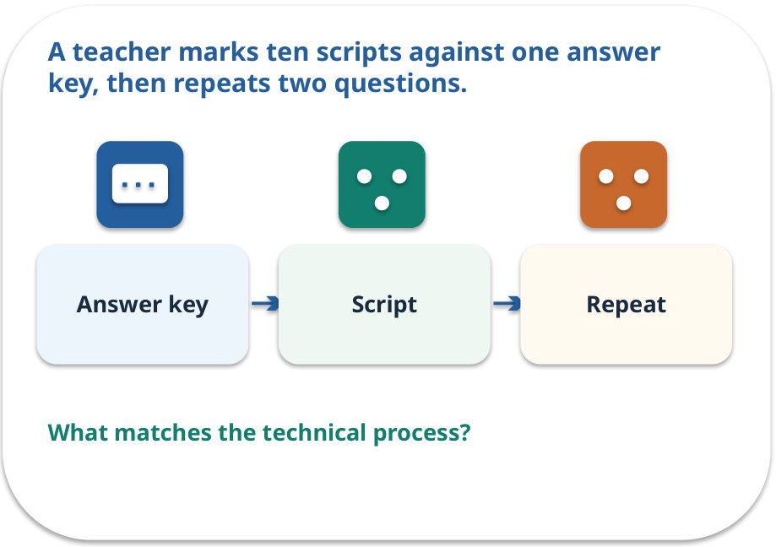
Baseline and variability · a familiar picture
ANALOGY / WEEK 01
A teacher marks ten scripts against one answer key, then repeats two questions.
What matches our case, and where does the analogy stop?
GENERATIVE AI 2027 • WEEK 01 • 23 / 40
Notes:
TEACHER SCRIPT — ANALOGY. Begin with the familiar scene. Invite learners to describe each part in everyday language. Then ask where the comparison might fail before introducing the technical vocabulary. This week’s case is: A student asks whether a fictional college reimburses a late bus ticket. The visible slide states: A teacher marks ten scripts against one answer key, then repeats two questions.
What matches our case, and where does the analogy stop? The boundary is: One short sample cannot estimate performance in all future situations. The target is: Separate a model from the application that checks and delivers its output. Listen for an explanation of the actual arrow or calculation, not just a repeated label. If the answer is unsupported, mark that uncertainty and return to the source. Before moving on, ask for the main idea and one concrete change to the worked example.

Slide 24
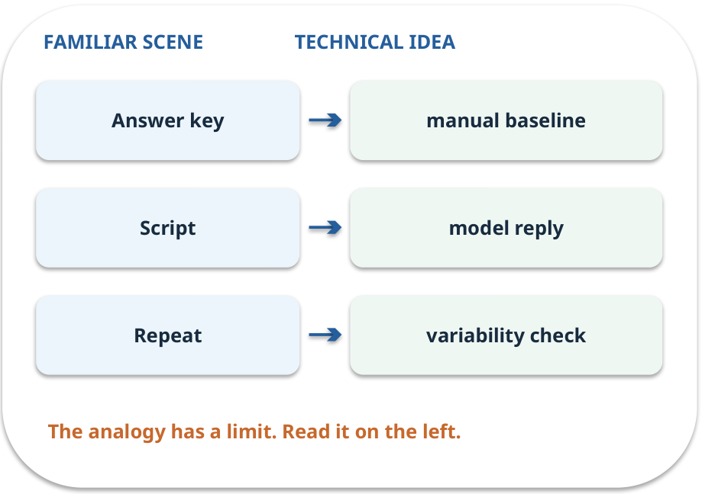
Baseline and variability · map the parts
MAPPING / WEEK 01
Match each everyday part to the technical part.
Analogy limit: One short sample cannot estimate performance in all future situations.
GENERATIVE AI 2027 • WEEK 01 • 24 / 40
Notes:
TEACHER SCRIPT — MAPPING. Point from each familiar element to the corresponding technical element. Have students cover the right column and reconstruct the three matches. Read the limitation aloud. This week’s case is: A student asks whether a fictional college reimburses a late bus ticket. The visible slide states: Match each everyday part to the technical part.
Analogy limit: One short sample cannot estimate performance in all future situations. The three precise mappings are [['Answer key', 'manual baseline'], ['Script', 'model reply'], ['Repeat', 'variability check']]. The target is: Separate a model from the application that checks and delivers its output. Listen for an explanation of the actual arrow or calculation, not just a repeated label. If the answer is unsupported, mark that uncertainty and return to the source. Before moving on, ask for the main idea and one concrete change to the worked example.

Slide 25
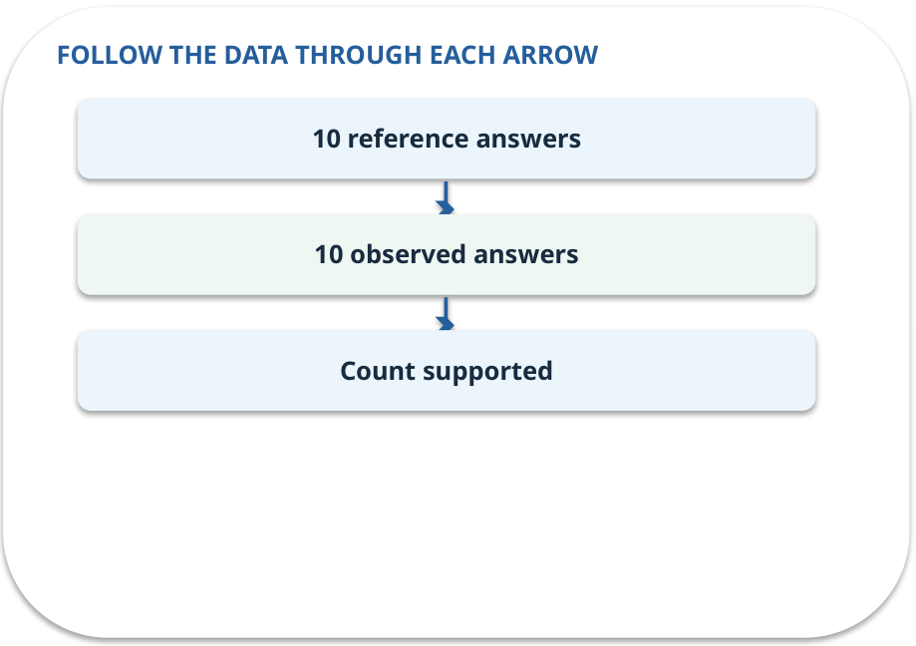
Baseline and variability · how it works
MECHANISM / WEEK 01
A manual answer sheet gives us a reference. Repeated responses can vary, so record both correctness and changes.
Trace the arrows from left to right.
GENERATIVE AI 2027 • WEEK 01 • 25 / 40
Notes:
TEACHER SCRIPT — MECHANISM. Trace every arrow slowly from the input to the output. Ask what information crosses the boundary at each arrow. Pause if students confuse a simplified notebook with a trained model. This week’s case is: A student asks whether a fictional college reimburses a late bus ticket. The visible slide states: A manual answer sheet gives us a reference. Repeated responses can vary, so record both correctness and changes.
Trace the arrows from left to right. The weekly example is: Seven of ten replies are supported: 7/10 = 70%; log the three failures and two repeats. State what the analogy does not explain: One short sample cannot estimate performance in all future situations. The target is: Separate a model from the application that checks and delivers its output. Listen for an explanation of the actual arrow or calculation, not just a repeated label. If the answer is unsupported, mark that uncertainty and return to the source. Before moving on, ask for the main idea and one concrete change to the worked example.

Slide 26
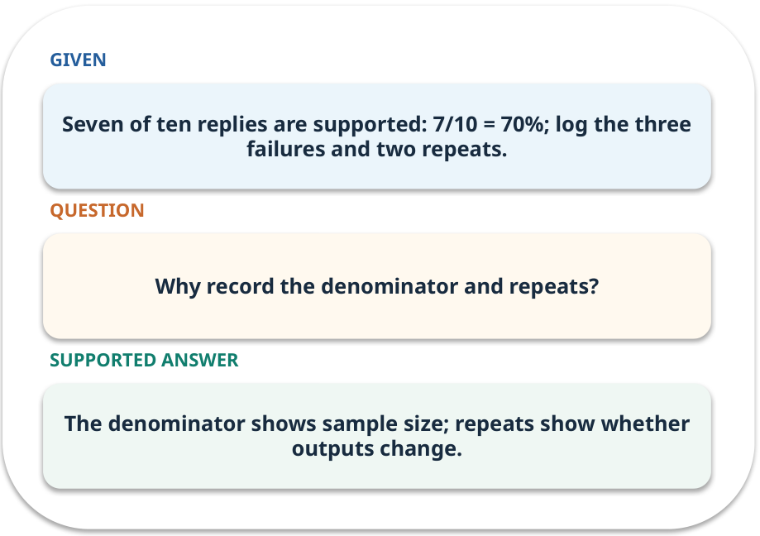
Baseline and variability · work one case
WORKED / WEEK 01
Seven of ten replies are supported: 7/10 = 70%; log the three failures and two repeats.
Point to the evidence before giving your conclusion.
GENERATIVE AI 2027 • WEEK 01 • 26 / 40
Notes:
TEACHER SCRIPT — WORKED. Work the specific numbers or source wording aloud. Give students thirty seconds to write a conclusion, then ask which source line or calculation supports it. This week’s case is: A student asks whether a fictional college reimburses a late bus ticket. The visible slide states: Seven of ten replies are supported: 7/10 = 70%; log the three failures and two repeats.
Point to the evidence before giving your conclusion. The expected reasoning concludes: The denominator shows sample size; repeats show whether outputs change. Distinguish measured results from illustrative numbers. The target is: Separate a model from the application that checks and delivers its output. Listen for an explanation of the actual arrow or calculation, not just a repeated label. If the answer is unsupported, mark that uncertainty and return to the source. Before moving on, ask for the main idea and one concrete change to the worked example.

Slide 27
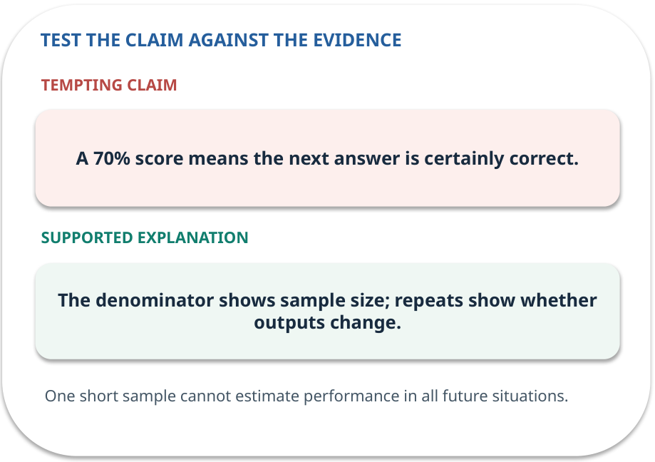
Baseline and variability · answer and explain
REVEAL / WEEK 01
The denominator shows sample size; repeats show whether outputs change.
Tempting mistake: A 70% score means the next answer is certainly correct.
GENERATIVE AI 2027 • WEEK 01 • 27 / 40
Notes:
TEACHER SCRIPT — REVEAL. Return to the earlier choice. Explain the correct answer and why the tempting claim fails. Ask one learner to say the answer in a single sentence without reading it. This week’s case is: A student asks whether a fictional college reimburses a late bus ticket. The visible slide states: The denominator shows sample size; repeats show whether outputs change.
Tempting mistake: A 70% score means the next answer is certainly correct. The earlier question was Why record the denominator and repeats? Ask how this differs from the wrong claim. The target is: Separate a model from the application that checks and delivers its output. Listen for an explanation of the actual arrow or calculation, not just a repeated label. If the answer is unsupported, mark that uncertainty and return to the source. Before moving on, ask for the main idea and one concrete change to the worked example.

Slide 28
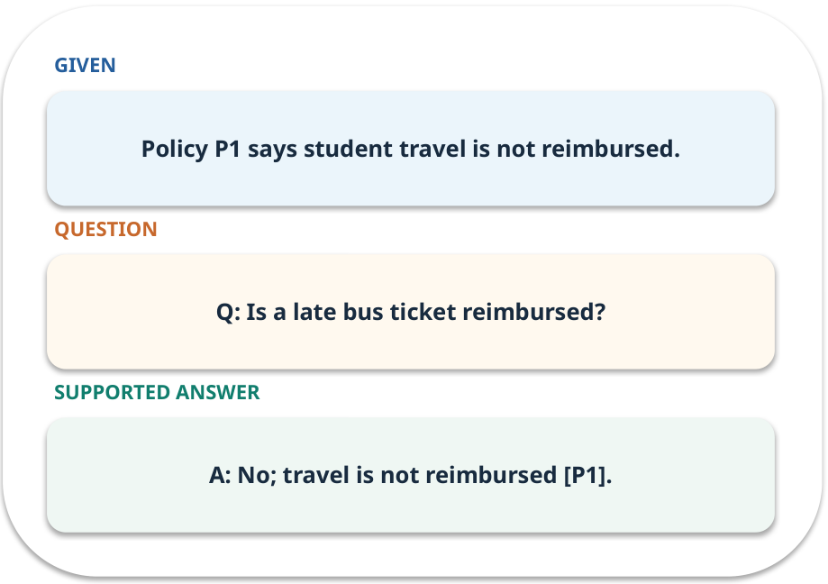
Evidence trail: input → result
WORKED / WEEK 01
Q: Is a late bus ticket reimbursed?
A: No; travel is not reimbursed [P1].
GENERATIVE AI 2027 • WEEK 01 • 28 / 40
Notes:
TEACHER SCRIPT — WORKED. Work the specific numbers or source wording aloud. Give students thirty seconds to write a conclusion, then ask which source line or calculation supports it. This week’s case is: A student asks whether a fictional college reimburses a late bus ticket. The visible slide states: Q: Is a late bus ticket reimbursed?
A: No; travel is not reimbursed [P1]. Have one student point to an exact source word or number for each conclusion. The target is: Separate a model from the application that checks and delivers its output. Listen for an explanation of the actual arrow or calculation, not just a repeated label. If the answer is unsupported, mark that uncertainty and return to the source. Before moving on, ask for the main idea and one concrete change to the worked example.

Slide 29
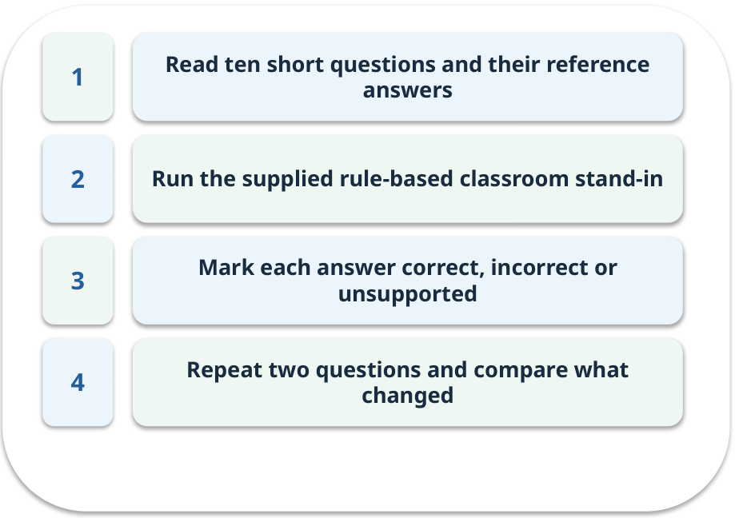
Notebook: run the prepared example
PRACTICE / WEEK 01
Run the ten-case baseline and change a single answer.
Read the original output before editing.
GENERATIVE AI 2027 • WEEK 01 • 29 / 40
Notes:
TEACHER SCRIPT — PRACTICE. Open the matching notebook and demonstrate the first run. Have learners predict one change, run only that change, and record input, setting, output and an error explanation. This week’s case is: A student asks whether a fictional college reimburses a late bus ticket. The visible slide states: Run the ten-case baseline and change a single answer.
Read the original output before editing. Use Week_01_Lab.ipynb. This lab is a prepared classroom demonstration with its limitations documented. The target is: Separate a model from the application that checks and delivers its output. Listen for an explanation of the actual arrow or calculation, not just a repeated label. If the answer is unsupported, mark that uncertainty and return to the source. Before moving on, ask for the main idea and one concrete change to the worked example.

Slide 30

Find the input and check in Python
PRACTICE / WEEK 01
Locate the supplied input, the transformation, the checking line and the printed result.
GENERATIVE AI 2027 • WEEK 01 • 30 / 40
Notes:
TEACHER SCRIPT — PRACTICE. Open the matching notebook and demonstrate the first run. Have learners predict one change, run only that change, and record input, setting, output and an error explanation. This week’s case is: A student asks whether a fictional college reimburses a late bus ticket. The visible slide states: Locate the supplied input, the transformation, the checking line and the printed result. The weekly lab change is: Change one answer to an unsupported claim and measure the score again. The target is: Separate a model from the application that checks and delivers its output. Listen for an explanation of the actual arrow or calculation, not just a repeated label. If the answer is unsupported, mark that uncertainty and return to the source. Before moving on, ask for the main idea and one concrete change to the worked example.

Slide 31

Predict one controlled change
PRACTICE / WEEK 01
Change one answer to an unsupported claim and measure the score again.
What should change in the result? What stays fixed?
GENERATIVE AI 2027 • WEEK 01 • 31 / 40
Notes:
TEACHER SCRIPT — PRACTICE. Open the matching notebook and demonstrate the first run. Have learners predict one change, run only that change, and record input, setting, output and an error explanation. This week’s case is: A student asks whether a fictional college reimburses a late bus ticket. The visible slide states: Change one answer to an unsupported claim and measure the score again.
What should change in the result? What stays fixed? Ask learners to write their prediction before rerunning the cell. The target is: Separate a model from the application that checks and delivers its output. Listen for an explanation of the actual arrow or calculation, not just a repeated label. If the answer is unsupported, mark that uncertainty and return to the source. Before moving on, ask for the main idea and one concrete change to the worked example.

Slide 32

Run, compare and record
PRACTICE / WEEK 01
Record the input, the one changed setting, the observed result and a reason for any difference.
GENERATIVE AI 2027 • WEEK 01 • 32 / 40
Notes:
TEACHER SCRIPT — PRACTICE. Open the matching notebook and demonstrate the first run. Have learners predict one change, run only that change, and record input, setting, output and an error explanation. This week’s case is: A student asks whether a fictional college reimburses a late bus ticket. The visible slide states: Record the input, the one changed setting, the observed result and a reason for any difference. The required evidence is: Ten-case answer table with one error analysis. The target is: Separate a model from the application that checks and delivers its output. Listen for an explanation of the actual arrow or calculation, not just a repeated label. If the answer is unsupported, mark that uncertainty and return to the source. Before moving on, ask for the main idea and one concrete change to the worked example.

Slide 33

Measure without hiding the denominator
CHECK / WEEK 01
Correct supported answers / 10 questions
Write the numerator, denominator and one failure case.
GENERATIVE AI 2027 • WEEK 01 • 33 / 40
Notes:
TEACHER SCRIPT — CHECK. Use this as a brief formative check. Ask for the conclusion, the evidence and one limitation. Revisit disagreements in the review session and offer an extension only after the core task. This week’s case is: A student asks whether a fictional college reimburses a late bus ticket. The visible slide states: Correct supported answers / 10 questions
Write the numerator, denominator and one failure case. Where a measure is qualitative, show the concrete source comparison. Example: A: No; travel is not reimbursed [P1]. The target is: Separate a model from the application that checks and delivers its output. Listen for an explanation of the actual arrow or calculation, not just a repeated label. If the answer is unsupported, mark that uncertainty and return to the source. Before moving on, ask for the main idea and one concrete change to the worked example.

Slide 34
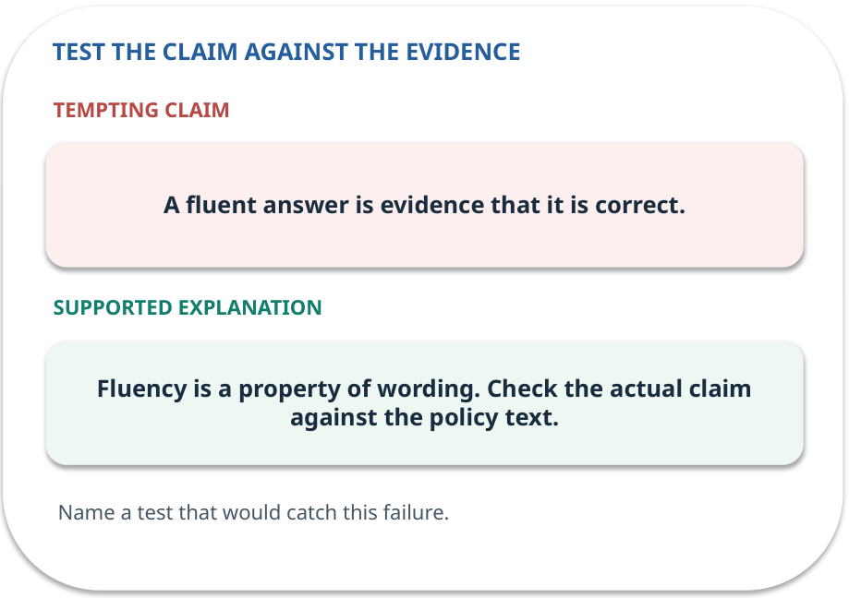
Error detective: find the layer
CHECK / WEEK 01
Plausible wrong claim: A fluent answer is evidence that it is correct.
Correct it using the case evidence.
GENERATIVE AI 2027 • WEEK 01 • 34 / 40
Notes:
TEACHER SCRIPT — CHECK. Use this as a brief formative check. Ask for the conclusion, the evidence and one limitation. Revisit disagreements in the review session and offer an extension only after the core task. This week’s case is: A student asks whether a fictional college reimburses a late bus ticket. The visible slide states: Plausible wrong claim: A fluent answer is evidence that it is correct.
Correct it using the case evidence. The correction is Fluency is a property of wording. Check the actual claim against the policy text. The target is: Separate a model from the application that checks and delivers its output. Listen for an explanation of the actual arrow or calculation, not just a repeated label. If the answer is unsupported, mark that uncertainty and return to the source. Before moving on, ask for the main idea and one concrete change to the worked example.

Slide 35

Transfer to a new situation
CHECK / WEEK 01
The assistant repeats the answer twice, but one version invents an exception. Which answer belongs in the ten-case baseline?
Explain which source or test would settle it.
GENERATIVE AI 2027 • WEEK 01 • 35 / 40
Notes:
TEACHER SCRIPT — CHECK. Use this as a brief formative check. Ask for the conclusion, the evidence and one limitation. Revisit disagreements in the review session and offer an extension only after the core task. This week’s case is: A student asks whether a fictional college reimburses a late bus ticket. The visible slide states: The assistant repeats the answer twice, but one version invents an exception. Which answer belongs in the ten-case baseline?
Explain which source or test would settle it. This is a fresh scenario, so ask for a reason before accepting either short answer. The target is: Separate a model from the application that checks and delivers its output. Listen for an explanation of the actual arrow or calculation, not just a repeated label. If the answer is unsupported, mark that uncertainty and return to the source. Before moving on, ask for the main idea and one concrete change to the worked example.

Slide 36

Explain it to a partner
CHECK / WEEK 01
Without reading the slide, name the input, one processing step and the check. Your partner should ask “How do you know?”
GENERATIVE AI 2027 • WEEK 01 • 36 / 40
Notes:
TEACHER SCRIPT — CHECK. Use this as a brief formative check. Ask for the conclusion, the evidence and one limitation. Revisit disagreements in the review session and offer an extension only after the core task. This week’s case is: A student asks whether a fictional college reimburses a late bus ticket. The visible slide states: Without reading the slide, name the input, one processing step and the check. Your partner should ask “How do you know?” Listen for a causal explanation and one limitation, then revisit a difficult arrow on the board. The target is: Separate a model from the application that checks and delivers its output. Listen for an explanation of the actual arrow or calculation, not just a repeated label. If the answer is unsupported, mark that uncertainty and return to the source. Before moving on, ask for the main idea and one concrete change to the worked example.

Slide 37

Exam rehearsal · explain and apply
CHECK / WEEK 01
Explain generation versus prediction with one example of each.
Write a short answer, then compare with the guide.
GENERATIVE AI 2027 • WEEK 01 • 37 / 40
Notes:
TEACHER SCRIPT — CHECK. Use this as a brief formative check. Ask for the conclusion, the evidence and one limitation. Revisit disagreements in the review session and offer an extension only after the core task. This week’s case is: A student asks whether a fictional college reimburses a late bus ticket. The visible slide states: Explain generation versus prediction with one example of each.
Write a short answer, then compare with the guide. Model answer after discussion: Predict whether an email is spam: a label. Generate a reply: new text. Both use learned patterns and both can be wrong. Practice marks: 4. The target is: Separate a model from the application that checks and delivers its output. Listen for an explanation of the actual arrow or calculation, not just a repeated label. If the answer is unsupported, mark that uncertainty and return to the source. Before moving on, ask for the main idea and one concrete change to the worked example.

Slide 38
Exam rehearsal · explain and apply
CHECK / WEEK 01
Seven of ten answers are correct and supported. Calculate accuracy and name a missing check.
Write a short answer, then compare with the guide.
GENERATIVE AI 2027 • WEEK 01 • 38 / 40
Notes:
TEACHER SCRIPT — CHECK. Use this as a brief formative check. Ask for the conclusion, the evidence and one limitation. Revisit disagreements in the review session and offer an extension only after the core task. This week’s case is: A student asks whether a fictional college reimburses a late bus ticket. The visible slide states: Seven of ten answers are correct and supported. Calculate accuracy and name a missing check.
Write a short answer, then compare with the guide. Model answer after discussion: 7/10 = 70%. Also check permissions, unsupported claims or repeated-run variation. Practice marks: 4. The target is: Separate a model from the application that checks and delivers its output. Listen for an explanation of the actual arrow or calculation, not just a repeated label. If the answer is unsupported, mark that uncertainty and return to the source. Before moving on, ask for the main idea and one concrete change to the worked example.

Slide 39

What to hand in
PRACTICE / WEEK 01
Ten-case answer table with one error analysis.
Include the one changed input and an error explanation.
GENERATIVE AI 2027 • WEEK 01 • 39 / 40
Notes:
TEACHER SCRIPT — PRACTICE. Open the matching notebook and demonstrate the first run. Have learners predict one change, run only that change, and record input, setting, output and an error explanation. This week’s case is: A student asks whether a fictional college reimburses a late bus ticket. The visible slide states: Ten-case answer table with one error analysis.
Include the one changed input and an error explanation. This weekly evidence receives formative feedback according to the module sequence; refer to the assessment brief for graded work. The target is: Separate a model from the application that checks and delivers its output. Listen for an explanation of the actual arrow or calculation, not just a repeated label. If the answer is unsupported, mark that uncertainty and return to the source. Before moving on, ask for the main idea and one concrete change to the worked example.

Slide 40
Three ideas to recall next week
CHECK / WEEK 01
A polished reply is a draft; trace its claim back to P1.
Read the linked official sources in the Word guide and redraw one diagram from memory.
GENERATIVE AI 2027 • WEEK 01 • 40 / 40
Notes:
TEACHER SCRIPT — CHECK. Use this as a brief formative check. Ask for the conclusion, the evidence and one limitation. Revisit disagreements in the review session and offer an extension only after the core task. This week’s case is: A student asks whether a fictional college reimburses a late bus ticket. The visible slide states: A polished reply is a draft; trace its claim back to P1.
Read the linked official sources in the Word guide and redraw one diagram from memory. Return to the opening vote and ask whether the evidence changed anyone’s mind. The next week builds on this outcome: Separate a model from the application that checks and delivers its output. The target is: Separate a model from the application that checks and delivers its output. Listen for an explanation of the actual arrow or calculation, not just a repeated label. If the answer is unsupported, mark that uncertainty and return to the source. Before moving on, ask for the main idea and one concrete change to the worked example.

