Slide 1
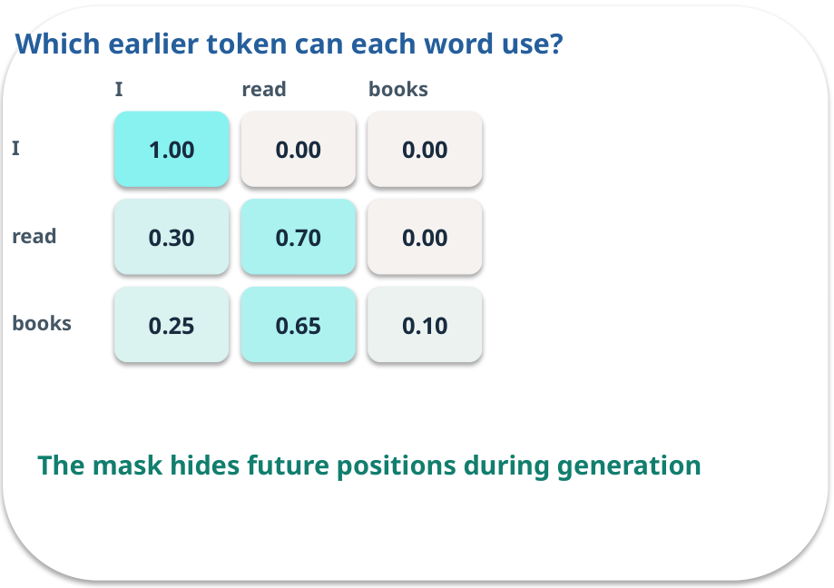
Week 04 · Transformers without heavy mathematics
OPEN / WEEK 04
The confusing sentence
In “Ava told Bea that she won,” which earlier word does “she” refer to? A model must use context, yet ambiguity can remain.
GENERATIVE AI 2027 • WEEK 04 • 01 / 40
Notes:
TEACHER SCRIPT — OPEN. Show the visual for ten seconds, then ask for an initial decision. Do not reveal the answer yet. Ask a student to name the source or measurement that would change their mind. This week’s case is: A document assistant must choose what earlier words matter when drafting a sentence. The visible slide states: The confusing sentence
In “Ava told Bea that she won,” which earlier word does “she” refer to? A model must use context, yet ambiguity can remain. Reveal that the case will be revisited after four short concept cycles. The target is: Explain tokens, attention weights, masking and model roles. Listen for an explanation of the actual arrow or calculation, not just a repeated label. If the answer is unsupported, mark that uncertainty and return to the source. Before moving on, ask for the main idea and one concrete change to the worked example.

Slide 2

First vote: what would you do?
QUESTION / WEEK 04
In “Ava told Bea that she won,” which earlier word does “she” refer to? A model must use context, yet ambiguity can remain.
Choose an initial answer and name one piece of evidence you need.
GENERATIVE AI 2027 • WEEK 04 • 02 / 40
Notes:
TEACHER SCRIPT — QUESTION. Take a show of hands for each choice before showing the mechanism. Ask pairs to defend a choice with evidence. Save the strongest wrong reason for the reveal later in this cycle. This week’s case is: A document assistant must choose what earlier words matter when drafting a sentence. The visible slide states: In “Ava told Bea that she won,” which earlier word does “she” refer to? A model must use context, yet ambiguity can remain.
Choose an initial answer and name one piece of evidence you need. Accept reasonable uncertainty; record the initial votes to revisit at the end. The target is: Explain tokens, attention weights, masking and model roles. Listen for an explanation of the actual arrow or calculation, not just a repeated label. If the answer is unsupported, mark that uncertainty and return to the source. Before moving on, ask for the main idea and one concrete change to the worked example.

Slide 3
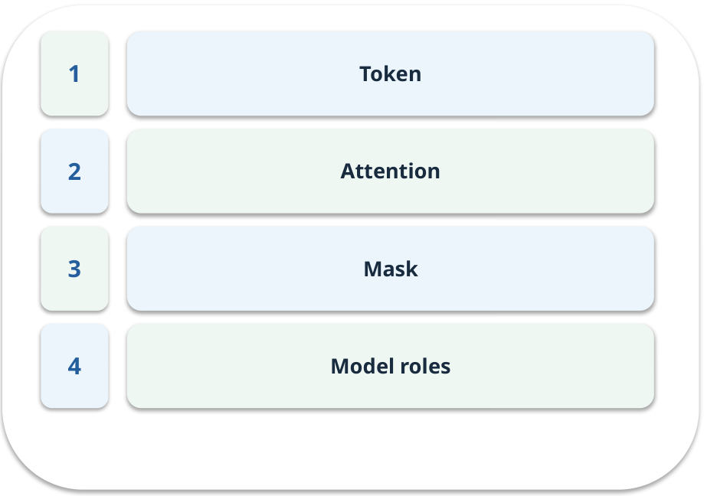
The journey through today’s case
OPEN / WEEK 04
We will predict, connect an analogy, trace a mechanism, work an example, then explain a decision.
GENERATIVE AI 2027 • WEEK 04 • 03 / 40
Notes:
TEACHER SCRIPT — OPEN. Show the visual for ten seconds, then ask for an initial decision. Do not reveal the answer yet. Ask a student to name the source or measurement that would change their mind. This week’s case is: A document assistant must choose what earlier words matter when drafting a sentence. The visible slide states: We will predict, connect an analogy, trace a mechanism, work an example, then explain a decision. Point to the four named ideas, then show where the notebook experiment fits. The target is: Explain tokens, attention weights, masking and model roles. Listen for an explanation of the actual arrow or calculation, not just a repeated label. If the answer is unsupported, mark that uncertainty and return to the source. Before moving on, ask for the main idea and one concrete change to the worked example.

Slide 4
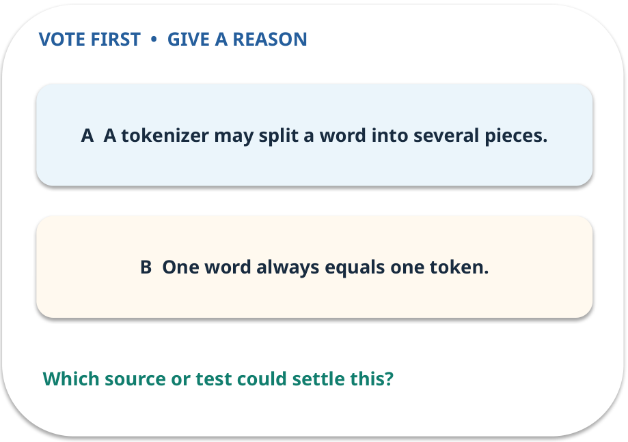
1. Predict · Token
QUESTION / WEEK 04
Why can word count differ from token count?
Make a choice before we explain the diagram.
GENERATIVE AI 2027 • WEEK 04 • 04 / 40
Notes:
TEACHER SCRIPT — QUESTION. Take a show of hands for each choice before showing the mechanism. Ask pairs to defend a choice with evidence. Save the strongest wrong reason for the reveal later in this cycle. This week’s case is: A document assistant must choose what earlier words matter when drafting a sentence. The visible slide states: Why can word count differ from token count?
Make a choice before we explain the diagram. The intended answer is A tokenizer may split a word into several pieces. The tempting claim is One word always equals one token. Do not show which card is correct until the reveal. The target is: Explain tokens, attention weights, masking and model roles. Listen for an explanation of the actual arrow or calculation, not just a repeated label. If the answer is unsupported, mark that uncertainty and return to the source. Before moving on, ask for the main idea and one concrete change to the worked example.

Slide 5
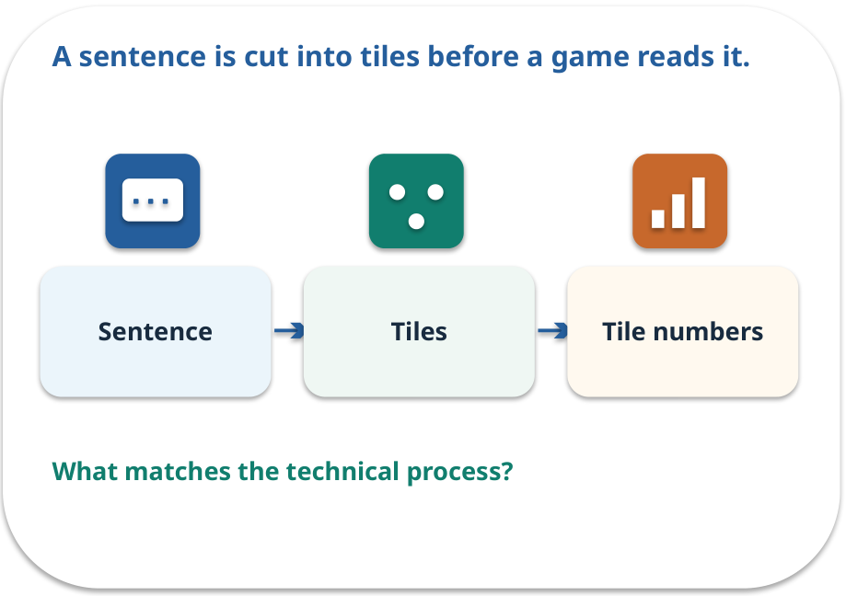
Token · a familiar picture
ANALOGY / WEEK 04
A sentence is cut into tiles before a game reads it.
What matches our case, and where does the analogy stop?
GENERATIVE AI 2027 • WEEK 04 • 05 / 40
Notes:
TEACHER SCRIPT — ANALOGY. Begin with the familiar scene. Invite learners to describe each part in everyday language. Then ask where the comparison might fail before introducing the technical vocabulary. This week’s case is: A document assistant must choose what earlier words matter when drafting a sentence. The visible slide states: A sentence is cut into tiles before a game reads it.
What matches our case, and where does the analogy stop? The boundary is: Token pieces need not be complete words; the vocabulary is model-specific. The target is: Explain tokens, attention weights, masking and model roles. Listen for an explanation of the actual arrow or calculation, not just a repeated label. If the answer is unsupported, mark that uncertainty and return to the source. Before moving on, ask for the main idea and one concrete change to the worked example.

Slide 6
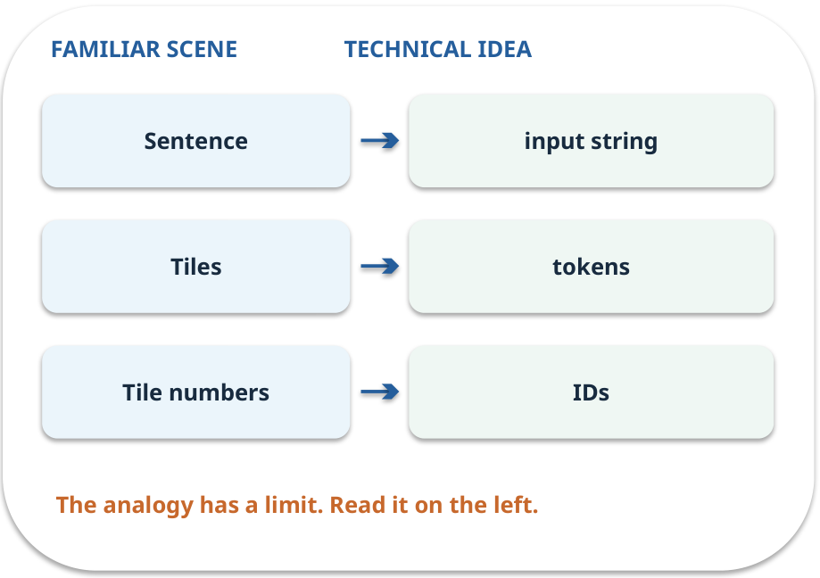
Token · map the parts
MAPPING / WEEK 04
Match each everyday part to the technical part.
Analogy limit: Token pieces need not be complete words; the vocabulary is model-specific.
GENERATIVE AI 2027 • WEEK 04 • 06 / 40
Notes:
TEACHER SCRIPT — MAPPING. Point from each familiar element to the corresponding technical element. Have students cover the right column and reconstruct the three matches. Read the limitation aloud. This week’s case is: A document assistant must choose what earlier words matter when drafting a sentence. The visible slide states: Match each everyday part to the technical part.
Analogy limit: Token pieces need not be complete words; the vocabulary is model-specific. The three precise mappings are [['Sentence', 'input string'], ['Tiles', 'tokens'], ['Tile numbers', 'IDs']]. The target is: Explain tokens, attention weights, masking and model roles. Listen for an explanation of the actual arrow or calculation, not just a repeated label. If the answer is unsupported, mark that uncertainty and return to the source. Before moving on, ask for the main idea and one concrete change to the worked example.

Slide 7
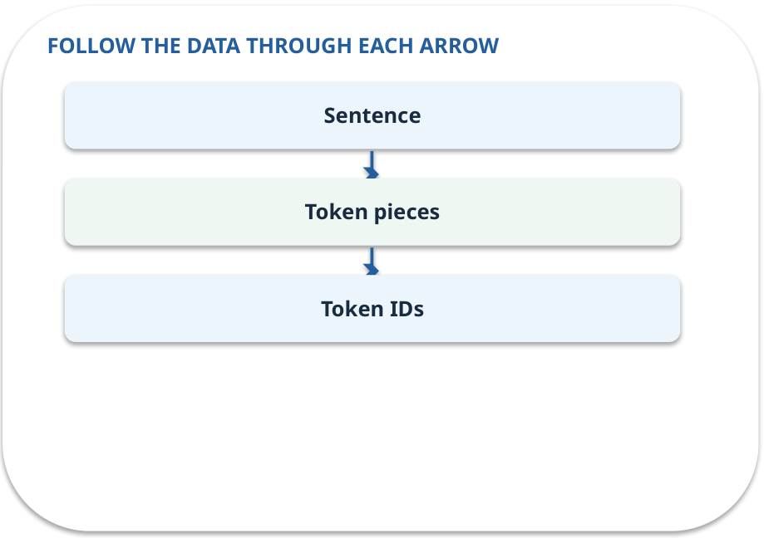
Token · how it works
MECHANISM / WEEK 04
A model processes pieces of text represented as IDs. A word may use more than one token.
Trace the arrows from left to right.
GENERATIVE AI 2027 • WEEK 04 • 07 / 40
Notes:
TEACHER SCRIPT — MECHANISM. Trace every arrow slowly from the input to the output. Ask what information crosses the boundary at each arrow. Pause if students confuse a simplified notebook with a trained model. This week’s case is: A document assistant must choose what earlier words matter when drafting a sentence. The visible slide states: A model processes pieces of text represented as IDs. A word may use more than one token.
Trace the arrows from left to right. The weekly example is: “unbelievable” might be one piece or several; record the tokenizer used before counting. State what the analogy does not explain: Token pieces need not be complete words; the vocabulary is model-specific. The target is: Explain tokens, attention weights, masking and model roles. Listen for an explanation of the actual arrow or calculation, not just a repeated label. If the answer is unsupported, mark that uncertainty and return to the source. Before moving on, ask for the main idea and one concrete change to the worked example.

Slide 8
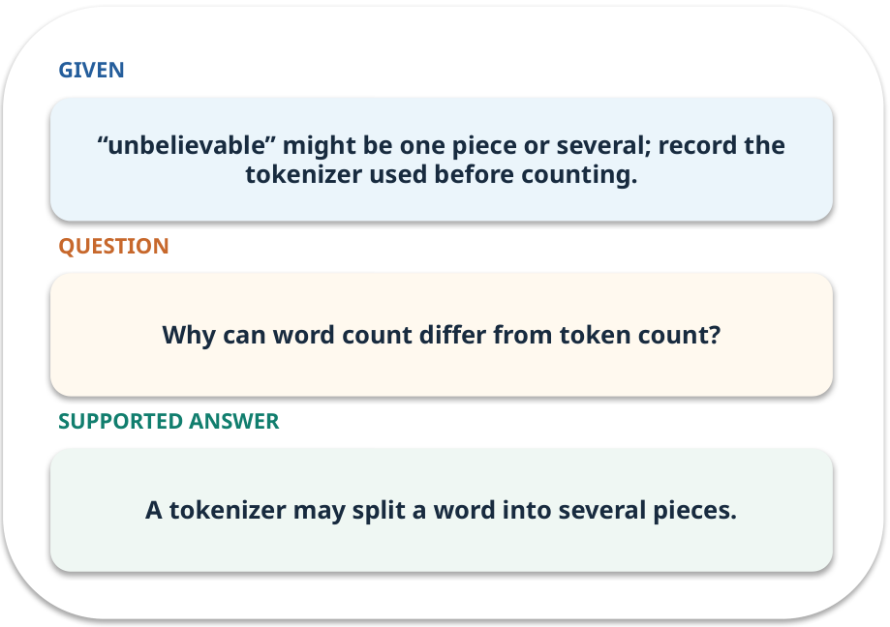
Token · work one case
WORKED / WEEK 04
“unbelievable” might be one piece or several; record the tokenizer used before counting.
Point to the evidence before giving your conclusion.
GENERATIVE AI 2027 • WEEK 04 • 08 / 40
Notes:
TEACHER SCRIPT — WORKED. Work the specific numbers or source wording aloud. Give students thirty seconds to write a conclusion, then ask which source line or calculation supports it. This week’s case is: A document assistant must choose what earlier words matter when drafting a sentence. The visible slide states: “unbelievable” might be one piece or several; record the tokenizer used before counting.
Point to the evidence before giving your conclusion. The expected reasoning concludes: A tokenizer may split a word into several pieces. Distinguish measured results from illustrative numbers. The target is: Explain tokens, attention weights, masking and model roles. Listen for an explanation of the actual arrow or calculation, not just a repeated label. If the answer is unsupported, mark that uncertainty and return to the source. Before moving on, ask for the main idea and one concrete change to the worked example.

Slide 9
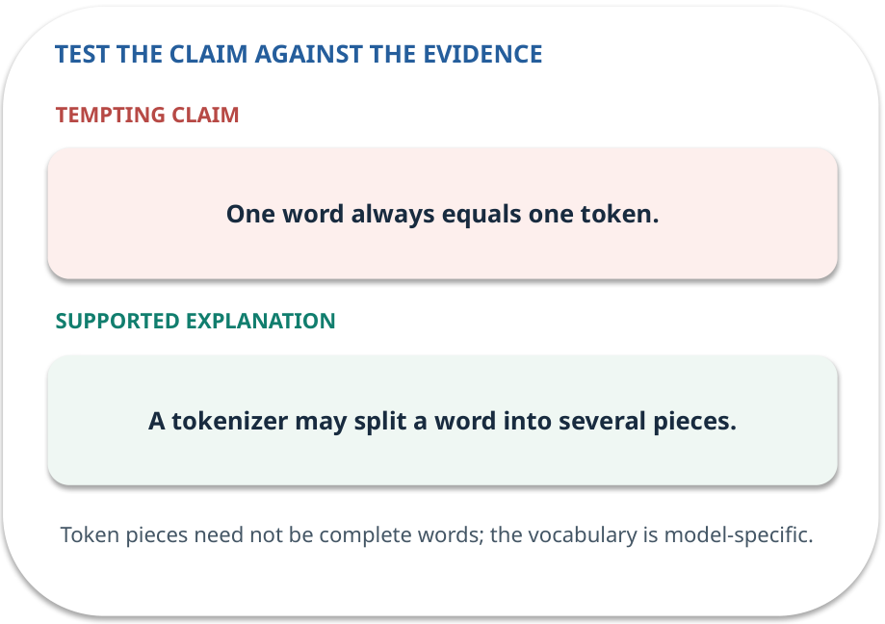
Token · answer and explain
REVEAL / WEEK 04
A tokenizer may split a word into several pieces.
Tempting mistake: One word always equals one token.
GENERATIVE AI 2027 • WEEK 04 • 09 / 40
Notes:
TEACHER SCRIPT — REVEAL. Return to the earlier choice. Explain the correct answer and why the tempting claim fails. Ask one learner to say the answer in a single sentence without reading it. This week’s case is: A document assistant must choose what earlier words matter when drafting a sentence. The visible slide states: A tokenizer may split a word into several pieces.
Tempting mistake: One word always equals one token. The earlier question was Why can word count differ from token count? Ask how this differs from the wrong claim. The target is: Explain tokens, attention weights, masking and model roles. Listen for an explanation of the actual arrow or calculation, not just a repeated label. If the answer is unsupported, mark that uncertainty and return to the source. Before moving on, ask for the main idea and one concrete change to the worked example.

Slide 10
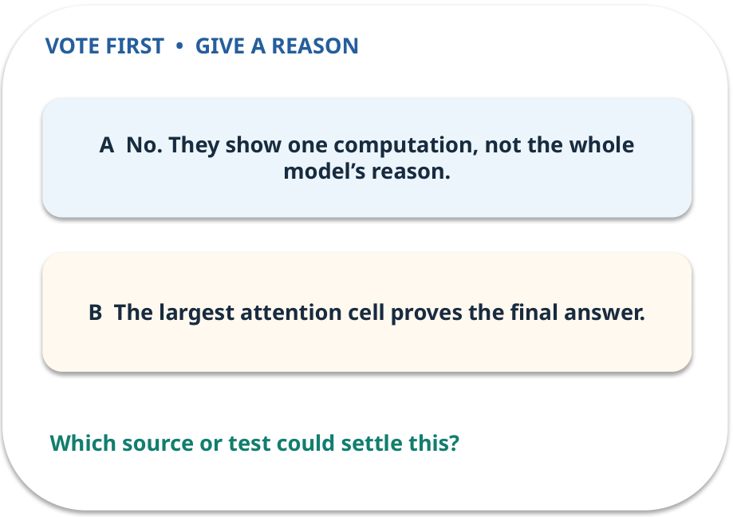
2. Predict · Attention
QUESTION / WEEK 04
Do weights identify a proven causal explanation?
Make a choice before we explain the diagram.
GENERATIVE AI 2027 • WEEK 04 • 10 / 40
Notes:
TEACHER SCRIPT — QUESTION. Take a show of hands for each choice before showing the mechanism. Ask pairs to defend a choice with evidence. Save the strongest wrong reason for the reveal later in this cycle. This week’s case is: A document assistant must choose what earlier words matter when drafting a sentence. The visible slide states: Do weights identify a proven causal explanation?
Make a choice before we explain the diagram. The intended answer is No. They show one computation, not the whole model’s reason. The tempting claim is The largest attention cell proves the final answer. Do not show which card is correct until the reveal. The target is: Explain tokens, attention weights, masking and model roles. Listen for an explanation of the actual arrow or calculation, not just a repeated label. If the answer is unsupported, mark that uncertainty and return to the source. Before moving on, ask for the main idea and one concrete change to the worked example.

Slide 11
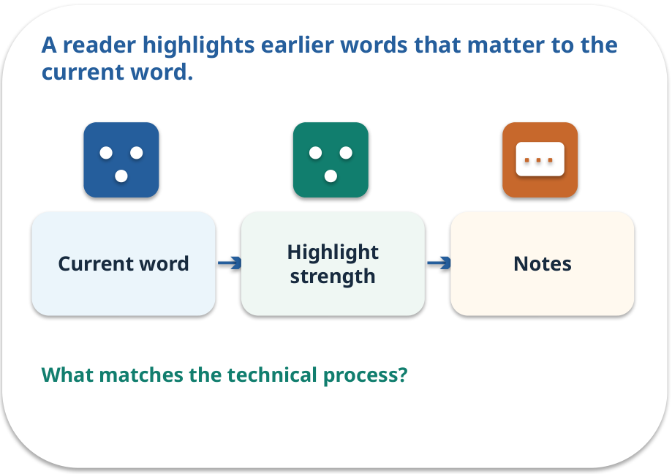
Attention · a familiar picture
ANALOGY / WEEK 04
A reader highlights earlier words that matter to the current word.
What matches our case, and where does the analogy stop?
GENERATIVE AI 2027 • WEEK 04 • 11 / 40
Notes:
TEACHER SCRIPT — ANALOGY. Begin with the familiar scene. Invite learners to describe each part in everyday language. Then ask where the comparison might fail before introducing the technical vocabulary. This week’s case is: A document assistant must choose what earlier words matter when drafting a sentence. The visible slide states: A reader highlights earlier words that matter to the current word.
What matches our case, and where does the analogy stop? The boundary is: Attention weights alone are not a complete explanation of model decisions. The target is: Explain tokens, attention weights, masking and model roles. Listen for an explanation of the actual arrow or calculation, not just a repeated label. If the answer is unsupported, mark that uncertainty and return to the source. Before moving on, ask for the main idea and one concrete change to the worked example.

Slide 12
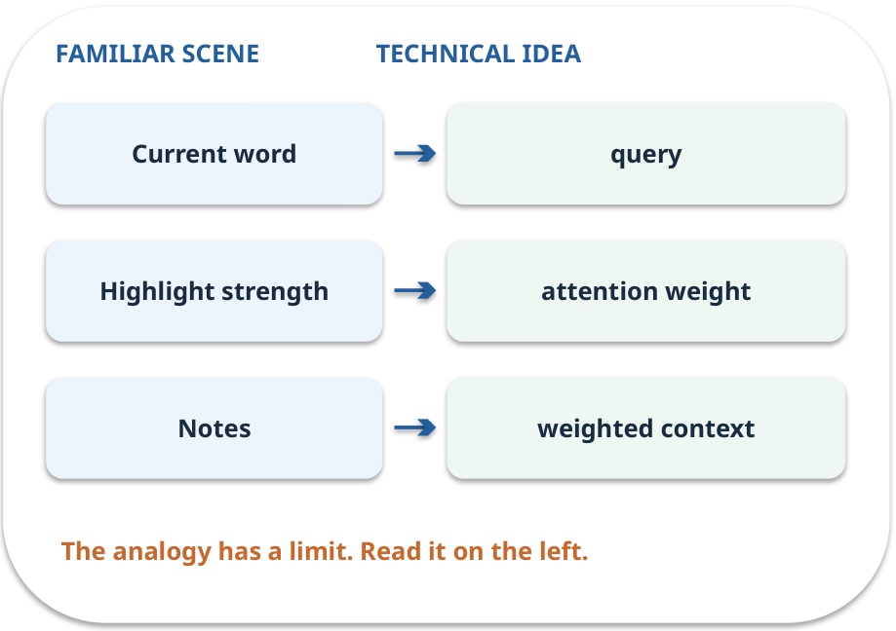
Attention · map the parts
MAPPING / WEEK 04
Match each everyday part to the technical part.
Analogy limit: Attention weights alone are not a complete explanation of model decisions.
GENERATIVE AI 2027 • WEEK 04 • 12 / 40
Notes:
TEACHER SCRIPT — MAPPING. Point from each familiar element to the corresponding technical element. Have students cover the right column and reconstruct the three matches. Read the limitation aloud. This week’s case is: A document assistant must choose what earlier words matter when drafting a sentence. The visible slide states: Match each everyday part to the technical part.
Analogy limit: Attention weights alone are not a complete explanation of model decisions. The three precise mappings are [['Current word', 'query'], ['Highlight strength', 'attention weight'], ['Notes', 'weighted context']]. The target is: Explain tokens, attention weights, masking and model roles. Listen for an explanation of the actual arrow or calculation, not just a repeated label. If the answer is unsupported, mark that uncertainty and return to the source. Before moving on, ask for the main idea and one concrete change to the worked example.

Slide 13
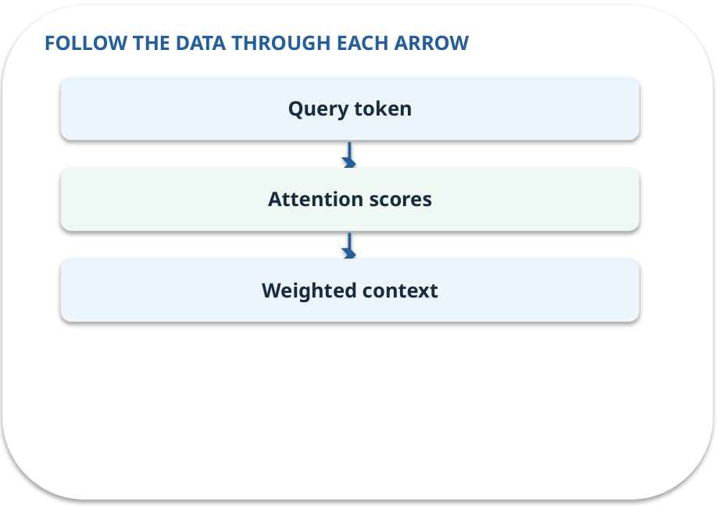
Attention · how it works
MECHANISM / WEEK 04
Each query uses scores to weight available tokens; the weighted combination carries contextual information.
Trace the arrows from left to right.
GENERATIVE AI 2027 • WEEK 04 • 13 / 40
Notes:
TEACHER SCRIPT — MECHANISM. Trace every arrow slowly from the input to the output. Ask what information crosses the boundary at each arrow. Pause if students confuse a simplified notebook with a trained model. This week’s case is: A document assistant must choose what earlier words matter when drafting a sentence. The visible slide states: Each query uses scores to weight available tokens; the weighted combination carries contextual information.
Trace the arrows from left to right. The weekly example is: Scores [1,2,0] yield about [0.245,0.665,0.090]; the middle token gets most weight. State what the analogy does not explain: Attention weights alone are not a complete explanation of model decisions. The target is: Explain tokens, attention weights, masking and model roles. Listen for an explanation of the actual arrow or calculation, not just a repeated label. If the answer is unsupported, mark that uncertainty and return to the source. Before moving on, ask for the main idea and one concrete change to the worked example.

Slide 14
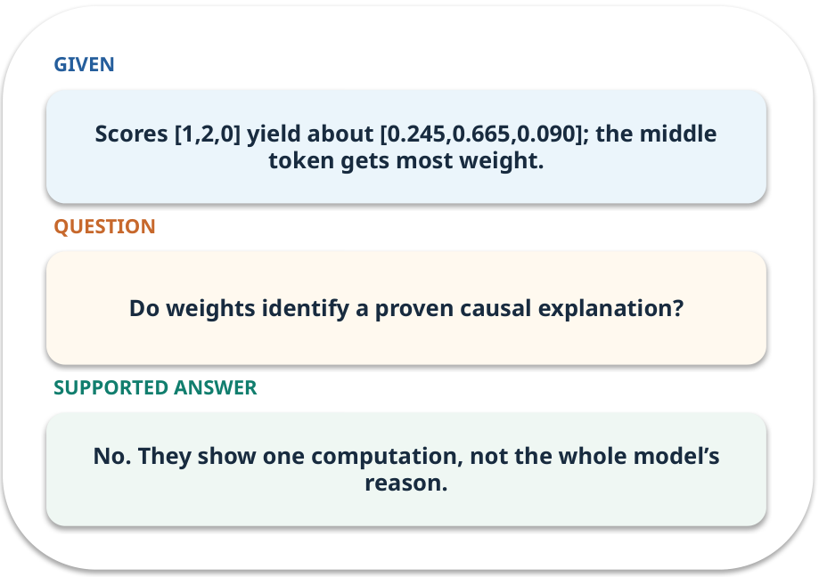
Attention · work one case
WORKED / WEEK 04
Scores [1,2,0] yield about [0.245,0.665,0.090]; the middle token gets most weight.
Point to the evidence before giving your conclusion.
GENERATIVE AI 2027 • WEEK 04 • 14 / 40
Notes:
TEACHER SCRIPT — WORKED. Work the specific numbers or source wording aloud. Give students thirty seconds to write a conclusion, then ask which source line or calculation supports it. This week’s case is: A document assistant must choose what earlier words matter when drafting a sentence. The visible slide states: Scores [1,2,0] yield about [0.245,0.665,0.090]; the middle token gets most weight.
Point to the evidence before giving your conclusion. The expected reasoning concludes: No. They show one computation, not the whole model’s reason. Distinguish measured results from illustrative numbers. The target is: Explain tokens, attention weights, masking and model roles. Listen for an explanation of the actual arrow or calculation, not just a repeated label. If the answer is unsupported, mark that uncertainty and return to the source. Before moving on, ask for the main idea and one concrete change to the worked example.

Slide 15
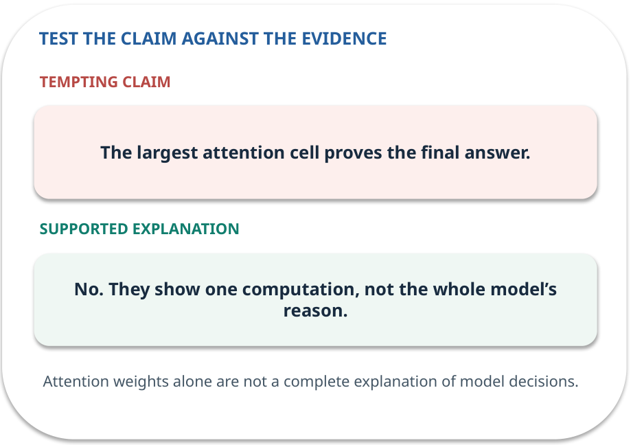
Attention · answer and explain
REVEAL / WEEK 04
No. They show one computation, not the whole model’s reason.
Tempting mistake: The largest attention cell proves the final answer.
GENERATIVE AI 2027 • WEEK 04 • 15 / 40
Notes:
TEACHER SCRIPT — REVEAL. Return to the earlier choice. Explain the correct answer and why the tempting claim fails. Ask one learner to say the answer in a single sentence without reading it. This week’s case is: A document assistant must choose what earlier words matter when drafting a sentence. The visible slide states: No. They show one computation, not the whole model’s reason.
Tempting mistake: The largest attention cell proves the final answer. The earlier question was Do weights identify a proven causal explanation? Ask how this differs from the wrong claim. The target is: Explain tokens, attention weights, masking and model roles. Listen for an explanation of the actual arrow or calculation, not just a repeated label. If the answer is unsupported, mark that uncertainty and return to the source. Before moving on, ask for the main idea and one concrete change to the worked example.

Slide 16
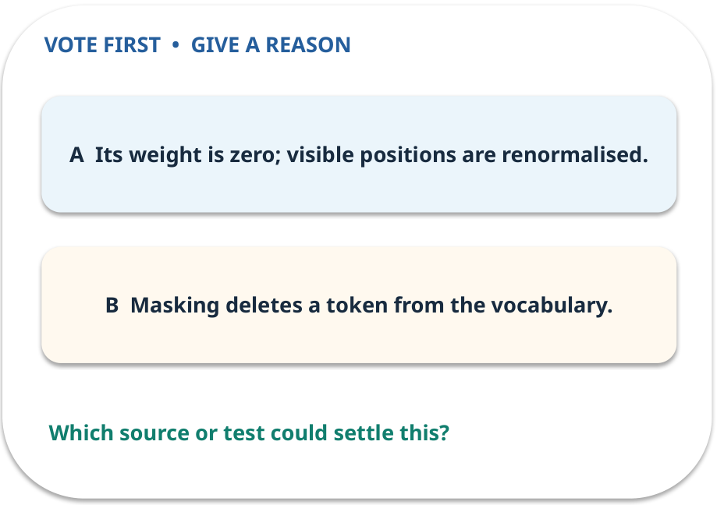
3. Predict · Mask
QUESTION / WEEK 04
What happens to the forbidden position?
Make a choice before we explain the diagram.
GENERATIVE AI 2027 • WEEK 04 • 16 / 40
Notes:
TEACHER SCRIPT — QUESTION. Take a show of hands for each choice before showing the mechanism. Ask pairs to defend a choice with evidence. Save the strongest wrong reason for the reveal later in this cycle. This week’s case is: A document assistant must choose what earlier words matter when drafting a sentence. The visible slide states: What happens to the forbidden position?
Make a choice before we explain the diagram. The intended answer is Its weight is zero; visible positions are renormalised. The tempting claim is Masking deletes a token from the vocabulary. Do not show which card is correct until the reveal. The target is: Explain tokens, attention weights, masking and model roles. Listen for an explanation of the actual arrow or calculation, not just a repeated label. If the answer is unsupported, mark that uncertainty and return to the source. Before moving on, ask for the main idea and one concrete change to the worked example.

Slide 17
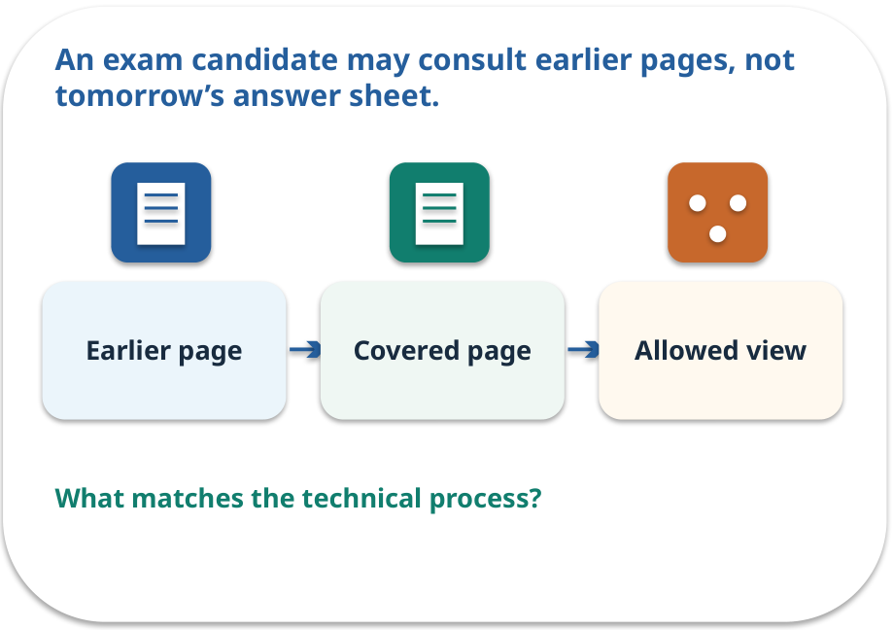
Mask · a familiar picture
ANALOGY / WEEK 04
An exam candidate may consult earlier pages, not tomorrow’s answer sheet.
What matches our case, and where does the analogy stop?
GENERATIVE AI 2027 • WEEK 04 • 17 / 40
Notes:
TEACHER SCRIPT — ANALOGY. Begin with the familiar scene. Invite learners to describe each part in everyday language. Then ask where the comparison might fail before introducing the technical vocabulary. This week’s case is: A document assistant must choose what earlier words matter when drafting a sentence. The visible slide states: An exam candidate may consult earlier pages, not tomorrow’s answer sheet.
What matches our case, and where does the analogy stop? The boundary is: A mask is an enforced attention constraint; it does not ensure factual accuracy. The target is: Explain tokens, attention weights, masking and model roles. Listen for an explanation of the actual arrow or calculation, not just a repeated label. If the answer is unsupported, mark that uncertainty and return to the source. Before moving on, ask for the main idea and one concrete change to the worked example.

Slide 18
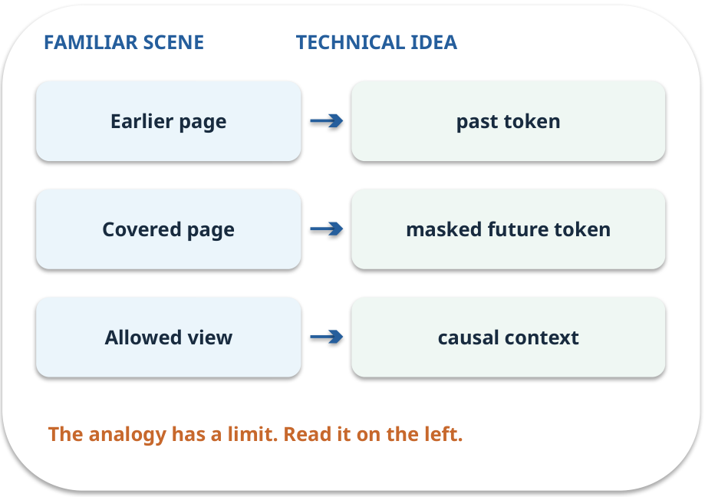
Mask · map the parts
MAPPING / WEEK 04
Match each everyday part to the technical part.
Analogy limit: A mask is an enforced attention constraint; it does not ensure factual accuracy.
GENERATIVE AI 2027 • WEEK 04 • 18 / 40
Notes:
TEACHER SCRIPT — MAPPING. Point from each familiar element to the corresponding technical element. Have students cover the right column and reconstruct the three matches. Read the limitation aloud. This week’s case is: A document assistant must choose what earlier words matter when drafting a sentence. The visible slide states: Match each everyday part to the technical part.
Analogy limit: A mask is an enforced attention constraint; it does not ensure factual accuracy. The three precise mappings are [['Earlier page', 'past token'], ['Covered page', 'masked future token'], ['Allowed view', 'causal context']]. The target is: Explain tokens, attention weights, masking and model roles. Listen for an explanation of the actual arrow or calculation, not just a repeated label. If the answer is unsupported, mark that uncertainty and return to the source. Before moving on, ask for the main idea and one concrete change to the worked example.

Slide 19
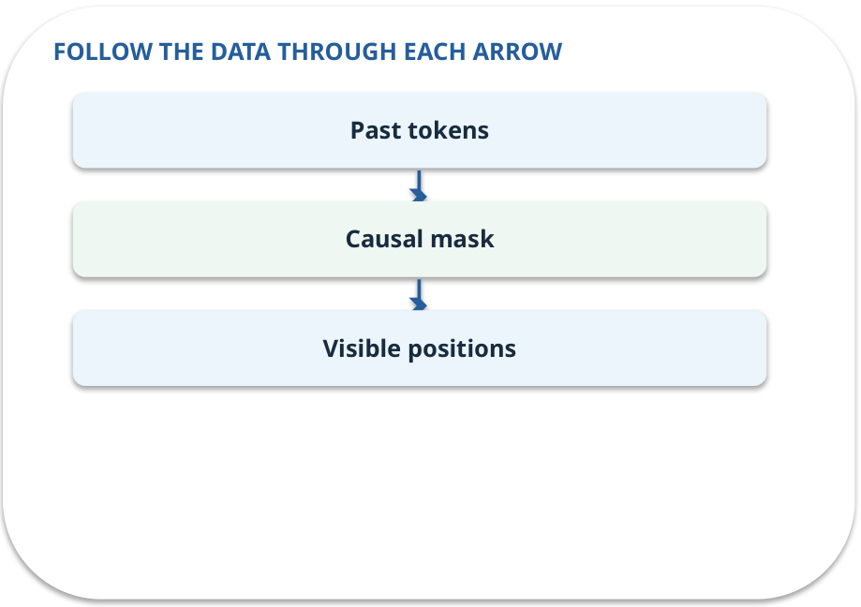
Mask · how it works
MECHANISM / WEEK 04
A decoder mask prevents a token from using future tokens while generating left to right.
Trace the arrows from left to right.
GENERATIVE AI 2027 • WEEK 04 • 19 / 40
Notes:
TEACHER SCRIPT — MECHANISM. Trace every arrow slowly from the input to the output. Ask what information crosses the boundary at each arrow. Pause if students confuse a simplified notebook with a trained model. This week’s case is: A document assistant must choose what earlier words matter when drafting a sentence. The visible slide states: A decoder mask prevents a token from using future tokens while generating left to right.
Trace the arrows from left to right. The weekly example is: Mask the third of three scores [1,2,0]; renormalised weights are about [0.269,0.731,0]. State what the analogy does not explain: A mask is an enforced attention constraint; it does not ensure factual accuracy. The target is: Explain tokens, attention weights, masking and model roles. Listen for an explanation of the actual arrow or calculation, not just a repeated label. If the answer is unsupported, mark that uncertainty and return to the source. Before moving on, ask for the main idea and one concrete change to the worked example.

Slide 20
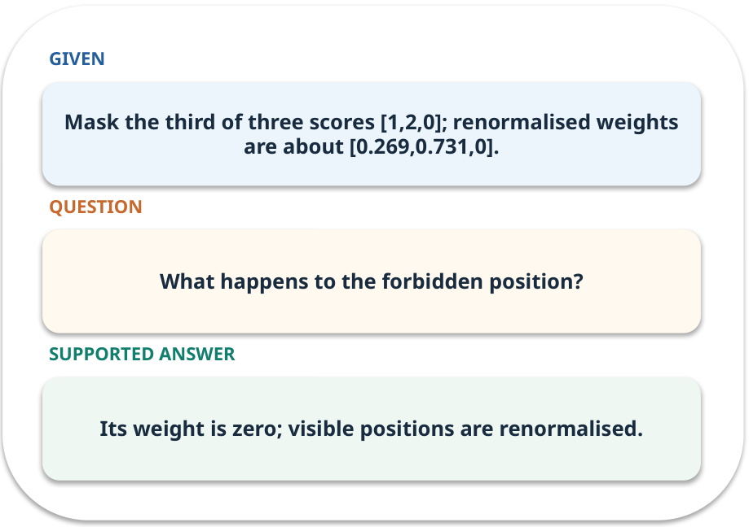
Mask · work one case
WORKED / WEEK 04
Mask the third of three scores [1,2,0]; renormalised weights are about [0.269,0.731,0].
Point to the evidence before giving your conclusion.
GENERATIVE AI 2027 • WEEK 04 • 20 / 40
Notes:
TEACHER SCRIPT — WORKED. Work the specific numbers or source wording aloud. Give students thirty seconds to write a conclusion, then ask which source line or calculation supports it. This week’s case is: A document assistant must choose what earlier words matter when drafting a sentence. The visible slide states: Mask the third of three scores [1,2,0]; renormalised weights are about [0.269,0.731,0].
Point to the evidence before giving your conclusion. The expected reasoning concludes: Its weight is zero; visible positions are renormalised. Distinguish measured results from illustrative numbers. The target is: Explain tokens, attention weights, masking and model roles. Listen for an explanation of the actual arrow or calculation, not just a repeated label. If the answer is unsupported, mark that uncertainty and return to the source. Before moving on, ask for the main idea and one concrete change to the worked example.

Slide 21
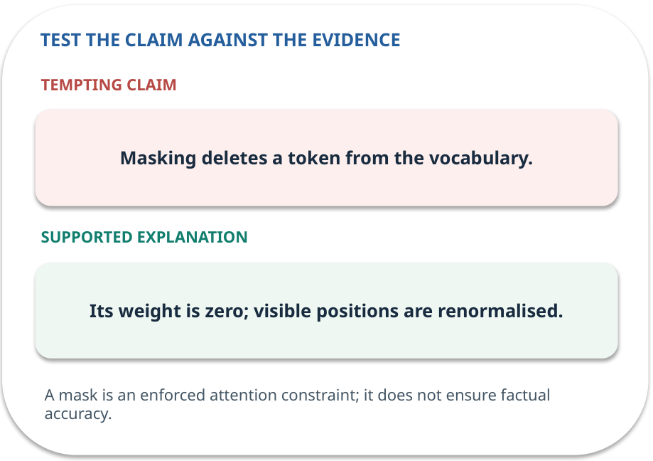
Mask · answer and explain
REVEAL / WEEK 04
Its weight is zero; visible positions are renormalised.
Tempting mistake: Masking deletes a token from the vocabulary.
GENERATIVE AI 2027 • WEEK 04 • 21 / 40
Notes:
TEACHER SCRIPT — REVEAL. Return to the earlier choice. Explain the correct answer and why the tempting claim fails. Ask one learner to say the answer in a single sentence without reading it. This week’s case is: A document assistant must choose what earlier words matter when drafting a sentence. The visible slide states: Its weight is zero; visible positions are renormalised.
Tempting mistake: Masking deletes a token from the vocabulary. The earlier question was What happens to the forbidden position? Ask how this differs from the wrong claim. The target is: Explain tokens, attention weights, masking and model roles. Listen for an explanation of the actual arrow or calculation, not just a repeated label. If the answer is unsupported, mark that uncertainty and return to the source. Before moving on, ask for the main idea and one concrete change to the worked example.

Slide 22
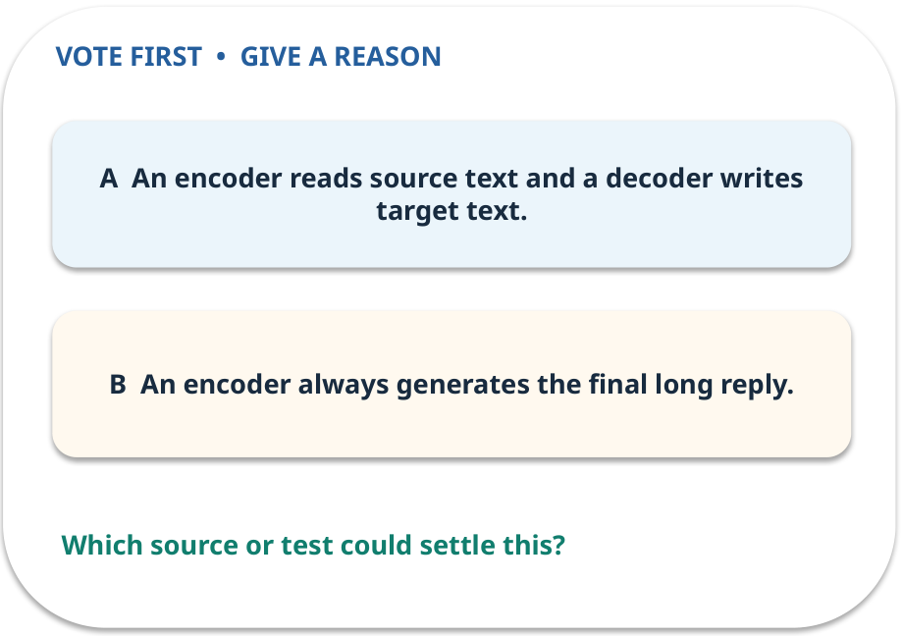
4. Predict · Model roles
QUESTION / WEEK 04
Which role suits translation in this simplified comparison?
Make a choice before we explain the diagram.
GENERATIVE AI 2027 • WEEK 04 • 22 / 40
Notes:
TEACHER SCRIPT — QUESTION. Take a show of hands for each choice before showing the mechanism. Ask pairs to defend a choice with evidence. Save the strongest wrong reason for the reveal later in this cycle. This week’s case is: A document assistant must choose what earlier words matter when drafting a sentence. The visible slide states: Which role suits translation in this simplified comparison?
Make a choice before we explain the diagram. The intended answer is An encoder reads source text and a decoder writes target text. The tempting claim is An encoder always generates the final long reply. Do not show which card is correct until the reveal. The target is: Explain tokens, attention weights, masking and model roles. Listen for an explanation of the actual arrow or calculation, not just a repeated label. If the answer is unsupported, mark that uncertainty and return to the source. Before moving on, ask for the main idea and one concrete change to the worked example.

Slide 23
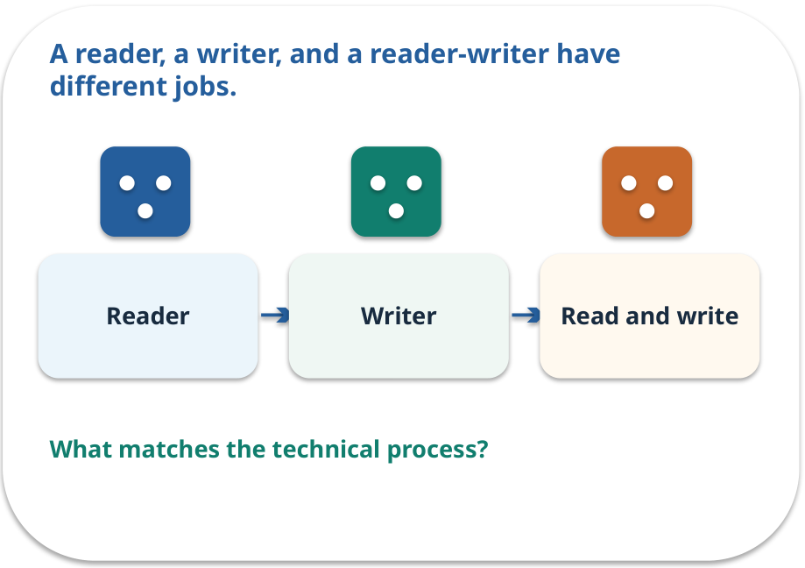
Model roles · a familiar picture
ANALOGY / WEEK 04
A reader, a writer, and a reader-writer have different jobs.
What matches our case, and where does the analogy stop?
GENERATIVE AI 2027 • WEEK 04 • 23 / 40
Notes:
TEACHER SCRIPT — ANALOGY. Begin with the familiar scene. Invite learners to describe each part in everyday language. Then ask where the comparison might fail before introducing the technical vocabulary. This week’s case is: A document assistant must choose what earlier words matter when drafting a sentence. The visible slide states: A reader, a writer, and a reader-writer have different jobs.
What matches our case, and where does the analogy stop? The boundary is: Many current systems combine components; this is a useful role sketch, not a full taxonomy. The target is: Explain tokens, attention weights, masking and model roles. Listen for an explanation of the actual arrow or calculation, not just a repeated label. If the answer is unsupported, mark that uncertainty and return to the source. Before moving on, ask for the main idea and one concrete change to the worked example.

Slide 24
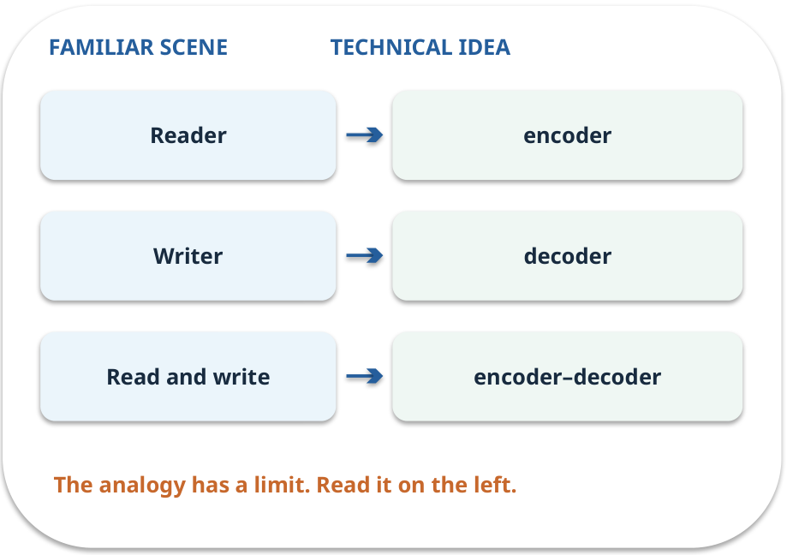
Model roles · map the parts
MAPPING / WEEK 04
Match each everyday part to the technical part.
Analogy limit: Many current systems combine components; this is a useful role sketch, not a full taxonomy.
GENERATIVE AI 2027 • WEEK 04 • 24 / 40
Notes:
TEACHER SCRIPT — MAPPING. Point from each familiar element to the corresponding technical element. Have students cover the right column and reconstruct the three matches. Read the limitation aloud. This week’s case is: A document assistant must choose what earlier words matter when drafting a sentence. The visible slide states: Match each everyday part to the technical part.
Analogy limit: Many current systems combine components; this is a useful role sketch, not a full taxonomy. The three precise mappings are [['Reader', 'encoder'], ['Writer', 'decoder'], ['Read and write', 'encoder–decoder']]. The target is: Explain tokens, attention weights, masking and model roles. Listen for an explanation of the actual arrow or calculation, not just a repeated label. If the answer is unsupported, mark that uncertainty and return to the source. Before moving on, ask for the main idea and one concrete change to the worked example.

Slide 25
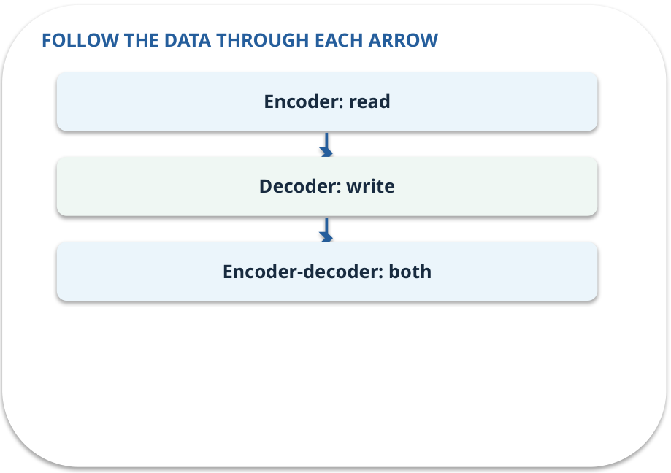
Model roles · how it works
MECHANISM / WEEK 04
Encoders read inputs; decoders generate; encoder-decoder models read then generate from a separate component.
Trace the arrows from left to right.
GENERATIVE AI 2027 • WEEK 04 • 25 / 40
Notes:
TEACHER SCRIPT — MECHANISM. Trace every arrow slowly from the input to the output. Ask what information crosses the boundary at each arrow. Pause if students confuse a simplified notebook with a trained model. This week’s case is: A document assistant must choose what earlier words matter when drafting a sentence. The visible slide states: Encoders read inputs; decoders generate; encoder-decoder models read then generate from a separate component.
Trace the arrows from left to right. The weekly example is: Classify a sentence: encoder. Continue it: decoder. Translate it: encoder–decoder. State what the analogy does not explain: Many current systems combine components; this is a useful role sketch, not a full taxonomy. The target is: Explain tokens, attention weights, masking and model roles. Listen for an explanation of the actual arrow or calculation, not just a repeated label. If the answer is unsupported, mark that uncertainty and return to the source. Before moving on, ask for the main idea and one concrete change to the worked example.

Slide 26
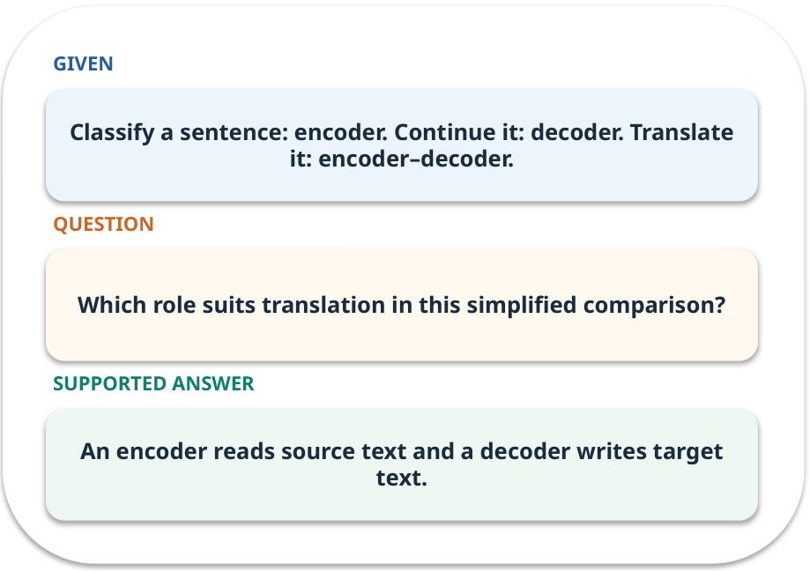
Model roles · work one case
WORKED / WEEK 04
Classify a sentence: encoder. Continue it: decoder. Translate it: encoder–decoder.
Point to the evidence before giving your conclusion.
GENERATIVE AI 2027 • WEEK 04 • 26 / 40
Notes:
TEACHER SCRIPT — WORKED. Work the specific numbers or source wording aloud. Give students thirty seconds to write a conclusion, then ask which source line or calculation supports it. This week’s case is: A document assistant must choose what earlier words matter when drafting a sentence. The visible slide states: Classify a sentence: encoder. Continue it: decoder. Translate it: encoder–decoder.
Point to the evidence before giving your conclusion. The expected reasoning concludes: An encoder reads source text and a decoder writes target text. Distinguish measured results from illustrative numbers. The target is: Explain tokens, attention weights, masking and model roles. Listen for an explanation of the actual arrow or calculation, not just a repeated label. If the answer is unsupported, mark that uncertainty and return to the source. Before moving on, ask for the main idea and one concrete change to the worked example.

Slide 27
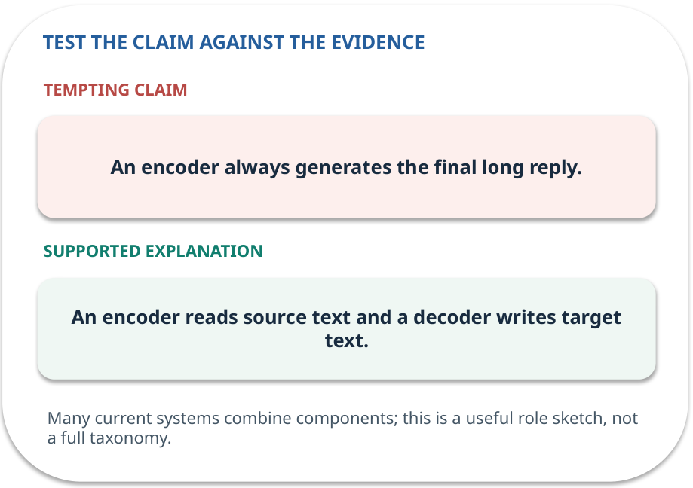
Model roles · answer and explain
REVEAL / WEEK 04
An encoder reads source text and a decoder writes target text.
Tempting mistake: An encoder always generates the final long reply.
GENERATIVE AI 2027 • WEEK 04 • 27 / 40
Notes:
TEACHER SCRIPT — REVEAL. Return to the earlier choice. Explain the correct answer and why the tempting claim fails. Ask one learner to say the answer in a single sentence without reading it. This week’s case is: A document assistant must choose what earlier words matter when drafting a sentence. The visible slide states: An encoder reads source text and a decoder writes target text.
Tempting mistake: An encoder always generates the final long reply. The earlier question was Which role suits translation in this simplified comparison? Ask how this differs from the wrong claim. The target is: Explain tokens, attention weights, masking and model roles. Listen for an explanation of the actual arrow or calculation, not just a repeated label. If the answer is unsupported, mark that uncertainty and return to the source. Before moving on, ask for the main idea and one concrete change to the worked example.

Slide 28
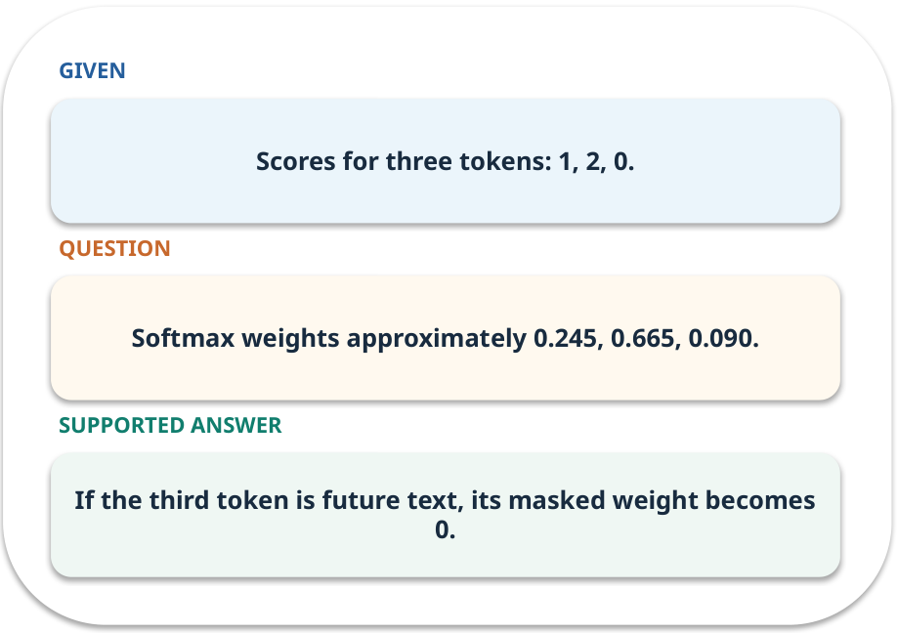
Evidence trail: input → result
WORKED / WEEK 04
Softmax weights approximately 0.245, 0.665, 0.090.
If the third token is future text, its masked weight becomes 0.
GENERATIVE AI 2027 • WEEK 04 • 28 / 40
Notes:
TEACHER SCRIPT — WORKED. Work the specific numbers or source wording aloud. Give students thirty seconds to write a conclusion, then ask which source line or calculation supports it. This week’s case is: A document assistant must choose what earlier words matter when drafting a sentence. The visible slide states: Softmax weights approximately 0.245, 0.665, 0.090.
If the third token is future text, its masked weight becomes 0. Have one student point to an exact source word or number for each conclusion. The target is: Explain tokens, attention weights, masking and model roles. Listen for an explanation of the actual arrow or calculation, not just a repeated label. If the answer is unsupported, mark that uncertainty and return to the source. Before moving on, ask for the main idea and one concrete change to the worked example.

Slide 29
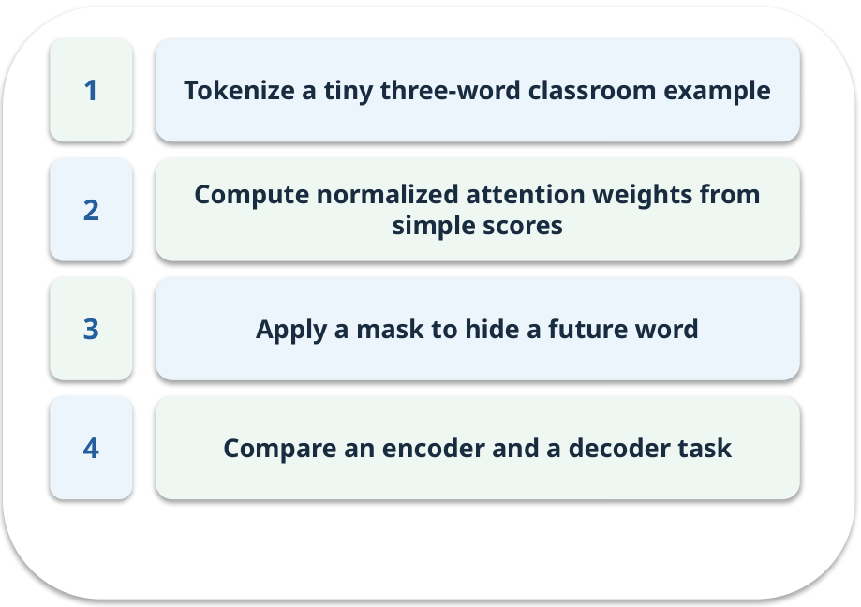
Notebook: run the prepared example
PRACTICE / WEEK 04
Compute attention for three tokens and explain one mask.
Read the original output before editing.
GENERATIVE AI 2027 • WEEK 04 • 29 / 40
Notes:
TEACHER SCRIPT — PRACTICE. Open the matching notebook and demonstrate the first run. Have learners predict one change, run only that change, and record input, setting, output and an error explanation. This week’s case is: A document assistant must choose what earlier words matter when drafting a sentence. The visible slide states: Compute attention for three tokens and explain one mask.
Read the original output before editing. Use Week_04_Lab.ipynb. This lab is a prepared classroom demonstration with its limitations documented. The target is: Explain tokens, attention weights, masking and model roles. Listen for an explanation of the actual arrow or calculation, not just a repeated label. If the answer is unsupported, mark that uncertainty and return to the source. Before moving on, ask for the main idea and one concrete change to the worked example.

Slide 30

Find the input and check in Python
PRACTICE / WEEK 04
Locate the supplied input, the transformation, the checking line and the printed result.
GENERATIVE AI 2027 • WEEK 04 • 30 / 40
Notes:
TEACHER SCRIPT — PRACTICE. Open the matching notebook and demonstrate the first run. Have learners predict one change, run only that change, and record input, setting, output and an error explanation. This week’s case is: A document assistant must choose what earlier words matter when drafting a sentence. The visible slide states: Locate the supplied input, the transformation, the checking line and the printed result. The weekly lab change is: Mask the last token and recompute the weights. The target is: Explain tokens, attention weights, masking and model roles. Listen for an explanation of the actual arrow or calculation, not just a repeated label. If the answer is unsupported, mark that uncertainty and return to the source. Before moving on, ask for the main idea and one concrete change to the worked example.

Slide 31

Predict one controlled change
PRACTICE / WEEK 04
Mask the last token and recompute the weights.
What should change in the result? What stays fixed?
GENERATIVE AI 2027 • WEEK 04 • 31 / 40
Notes:
TEACHER SCRIPT — PRACTICE. Open the matching notebook and demonstrate the first run. Have learners predict one change, run only that change, and record input, setting, output and an error explanation. This week’s case is: A document assistant must choose what earlier words matter when drafting a sentence. The visible slide states: Mask the last token and recompute the weights.
What should change in the result? What stays fixed? Ask learners to write their prediction before rerunning the cell. The target is: Explain tokens, attention weights, masking and model roles. Listen for an explanation of the actual arrow or calculation, not just a repeated label. If the answer is unsupported, mark that uncertainty and return to the source. Before moving on, ask for the main idea and one concrete change to the worked example.

Slide 32

Run, compare and record
PRACTICE / WEEK 04
Record the input, the one changed setting, the observed result and a reason for any difference.
GENERATIVE AI 2027 • WEEK 04 • 32 / 40
Notes:
TEACHER SCRIPT — PRACTICE. Open the matching notebook and demonstrate the first run. Have learners predict one change, run only that change, and record input, setting, output and an error explanation. This week’s case is: A document assistant must choose what earlier words matter when drafting a sentence. The visible slide states: Record the input, the one changed setting, the observed result and a reason for any difference. The required evidence is: Annotated attention table and one model-role choice. The target is: Explain tokens, attention weights, masking and model roles. Listen for an explanation of the actual arrow or calculation, not just a repeated label. If the answer is unsupported, mark that uncertainty and return to the source. Before moving on, ask for the main idea and one concrete change to the worked example.

Slide 33

Measure without hiding the denominator
CHECK / WEEK 04
Weights sum to one over visible tokens
Write the numerator, denominator and one failure case.
GENERATIVE AI 2027 • WEEK 04 • 33 / 40
Notes:
TEACHER SCRIPT — CHECK. Use this as a brief formative check. Ask for the conclusion, the evidence and one limitation. Revisit disagreements in the review session and offer an extension only after the core task. This week’s case is: A document assistant must choose what earlier words matter when drafting a sentence. The visible slide states: Weights sum to one over visible tokens
Write the numerator, denominator and one failure case. Where a measure is qualitative, show the concrete source comparison. Example: If the third token is future text, its masked weight becomes 0. The target is: Explain tokens, attention weights, masking and model roles. Listen for an explanation of the actual arrow or calculation, not just a repeated label. If the answer is unsupported, mark that uncertainty and return to the source. Before moving on, ask for the main idea and one concrete change to the worked example.

Slide 34
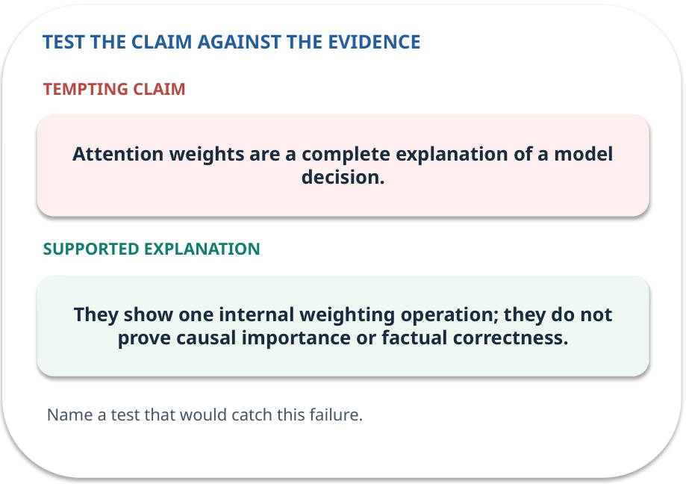
Error detective: find the layer
CHECK / WEEK 04
Plausible wrong claim: Attention weights are a complete explanation of a model decision.
Correct it using the case evidence.
GENERATIVE AI 2027 • WEEK 04 • 34 / 40
Notes:
TEACHER SCRIPT — CHECK. Use this as a brief formative check. Ask for the conclusion, the evidence and one limitation. Revisit disagreements in the review session and offer an extension only after the core task. This week’s case is: A document assistant must choose what earlier words matter when drafting a sentence. The visible slide states: Plausible wrong claim: Attention weights are a complete explanation of a model decision.
Correct it using the case evidence. The correction is They show one internal weighting operation; they do not prove causal importance or factual correctness. The target is: Explain tokens, attention weights, masking and model roles. Listen for an explanation of the actual arrow or calculation, not just a repeated label. If the answer is unsupported, mark that uncertainty and return to the source. Before moving on, ask for the main idea and one concrete change to the worked example.

Slide 35

Transfer to a new situation
CHECK / WEEK 04
A drafting decoder has the next word hidden. What happens to that column in its attention grid?
Explain which source or test would settle it.
GENERATIVE AI 2027 • WEEK 04 • 35 / 40
Notes:
TEACHER SCRIPT — CHECK. Use this as a brief formative check. Ask for the conclusion, the evidence and one limitation. Revisit disagreements in the review session and offer an extension only after the core task. This week’s case is: A document assistant must choose what earlier words matter when drafting a sentence. The visible slide states: A drafting decoder has the next word hidden. What happens to that column in its attention grid?
Explain which source or test would settle it. This is a fresh scenario, so ask for a reason before accepting either short answer. The target is: Explain tokens, attention weights, masking and model roles. Listen for an explanation of the actual arrow or calculation, not just a repeated label. If the answer is unsupported, mark that uncertainty and return to the source. Before moving on, ask for the main idea and one concrete change to the worked example.

Slide 36
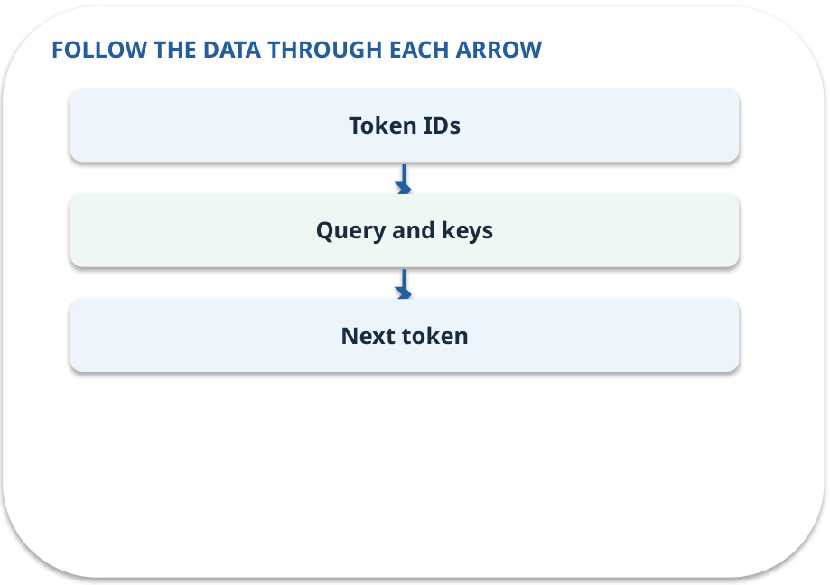
Explain it to a partner
CHECK / WEEK 04
Without reading the slide, name the input, one processing step and the check. Your partner should ask “How do you know?”
GENERATIVE AI 2027 • WEEK 04 • 36 / 40
Notes:
TEACHER SCRIPT — CHECK. Use this as a brief formative check. Ask for the conclusion, the evidence and one limitation. Revisit disagreements in the review session and offer an extension only after the core task. This week’s case is: A document assistant must choose what earlier words matter when drafting a sentence. The visible slide states: Without reading the slide, name the input, one processing step and the check. Your partner should ask “How do you know?” Listen for a causal explanation and one limitation, then revisit a difficult arrow on the board. The target is: Explain tokens, attention weights, masking and model roles. Listen for an explanation of the actual arrow or calculation, not just a repeated label. If the answer is unsupported, mark that uncertainty and return to the source. Before moving on, ask for the main idea and one concrete change to the worked example.

Slide 37

Exam rehearsal · explain and apply
CHECK / WEEK 04
Why does a decoder use a causal mask?
Write a short answer, then compare with the guide.
GENERATIVE AI 2027 • WEEK 04 • 37 / 40
Notes:
TEACHER SCRIPT — CHECK. Use this as a brief formative check. Ask for the conclusion, the evidence and one limitation. Revisit disagreements in the review session and offer an extension only after the core task. This week’s case is: A document assistant must choose what earlier words matter when drafting a sentence. The visible slide states: Why does a decoder use a causal mask?
Write a short answer, then compare with the guide. Model answer after discussion: To ensure generation at a position depends only on permitted earlier/current positions, not future target tokens. Practice marks: 4. The target is: Explain tokens, attention weights, masking and model roles. Listen for an explanation of the actual arrow or calculation, not just a repeated label. If the answer is unsupported, mark that uncertainty and return to the source. Before moving on, ask for the main idea and one concrete change to the worked example.

Slide 38
Exam rehearsal · explain and apply
CHECK / WEEK 04
For weights 0.25, 0.65, 0.10, which input receives most weight?
Write a short answer, then compare with the guide.
GENERATIVE AI 2027 • WEEK 04 • 38 / 40
Notes:
TEACHER SCRIPT — CHECK. Use this as a brief formative check. Ask for the conclusion, the evidence and one limitation. Revisit disagreements in the review session and offer an extension only after the core task. This week’s case is: A document assistant must choose what earlier words matter when drafting a sentence. The visible slide states: For weights 0.25, 0.65, 0.10, which input receives most weight?
Write a short answer, then compare with the guide. Model answer after discussion: The second input, with 0.65. The three weights sum to 1. Practice marks: 4. The target is: Explain tokens, attention weights, masking and model roles. Listen for an explanation of the actual arrow or calculation, not just a repeated label. If the answer is unsupported, mark that uncertainty and return to the source. Before moving on, ask for the main idea and one concrete change to the worked example.

Slide 39

What to hand in
PRACTICE / WEEK 04
Annotated attention table and one model-role choice.
Include the one changed input and an error explanation.
GENERATIVE AI 2027 • WEEK 04 • 39 / 40
Notes:
TEACHER SCRIPT — PRACTICE. Open the matching notebook and demonstrate the first run. Have learners predict one change, run only that change, and record input, setting, output and an error explanation. This week’s case is: A document assistant must choose what earlier words matter when drafting a sentence. The visible slide states: Annotated attention table and one model-role choice.
Include the one changed input and an error explanation. This weekly evidence receives formative feedback according to the module sequence; refer to the assessment brief for graded work. The target is: Explain tokens, attention weights, masking and model roles. Listen for an explanation of the actual arrow or calculation, not just a repeated label. If the answer is unsupported, mark that uncertainty and return to the source. Before moving on, ask for the main idea and one concrete change to the worked example.

Slide 40
Three ideas to recall next week
CHECK / WEEK 04
Tokenise, score visible context, and choose the model role for reading or writing.
Read the linked official sources in the Word guide and redraw one diagram from memory.
GENERATIVE AI 2027 • WEEK 04 • 40 / 40
Notes:
TEACHER SCRIPT — CHECK. Use this as a brief formative check. Ask for the conclusion, the evidence and one limitation. Revisit disagreements in the review session and offer an extension only after the core task. This week’s case is: A document assistant must choose what earlier words matter when drafting a sentence. The visible slide states: Tokenise, score visible context, and choose the model role for reading or writing.
Read the linked official sources in the Word guide and redraw one diagram from memory. Return to the opening vote and ask whether the evidence changed anyone’s mind. The next week builds on this outcome: Explain tokens, attention weights, masking and model roles. The target is: Explain tokens, attention weights, masking and model roles. Listen for an explanation of the actual arrow or calculation, not just a repeated label. If the answer is unsupported, mark that uncertainty and return to the source. Before moving on, ask for the main idea and one concrete change to the worked example.

