Slide 1
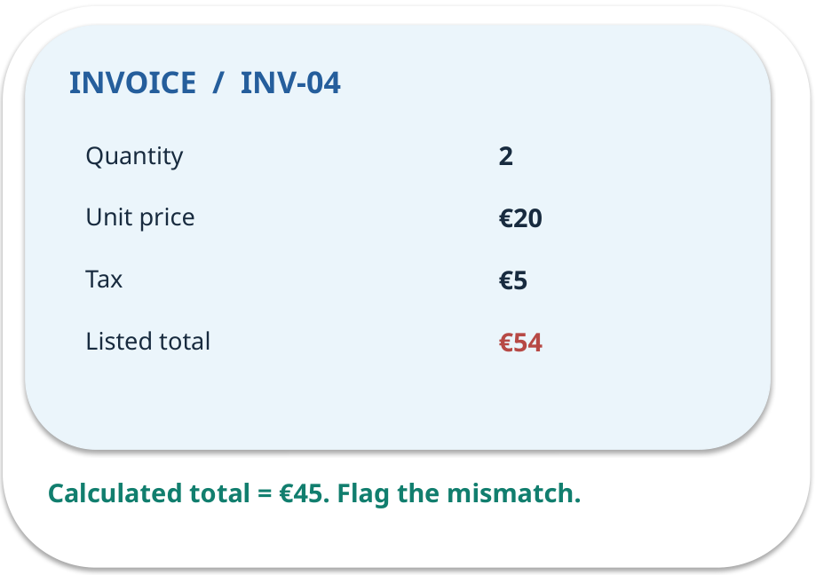
Week 05 · Clear prompts and output checks
OPEN / WEEK 05
The missing invoice total
An invoice has quantity 3 and price €12, but no printed total. Should the assistant fill €36 into the extracted total field?
GENERATIVE AI 2027 • WEEK 05 • 01 / 40
Notes:
TEACHER SCRIPT — OPEN. Show the visual for ten seconds, then ask for an initial decision. Do not reveal the answer yet. Ask a student to name the source or measurement that would change their mind. This week’s case is: An office extracts amounts and invoice identifiers from synthetic invoices. The visible slide states: The missing invoice total
An invoice has quantity 3 and price €12, but no printed total. Should the assistant fill €36 into the extracted total field? Reveal that the case will be revisited after four short concept cycles. The target is: Specify a task and validate an answer before using it. Listen for an explanation of the actual arrow or calculation, not just a repeated label. If the answer is unsupported, mark that uncertainty and return to the source. Before moving on, ask for the main idea and one concrete change to the worked example.

Slide 2

First vote: what would you do?
QUESTION / WEEK 05
An invoice has quantity 3 and price €12, but no printed total. Should the assistant fill €36 into the extracted total field?
Choose an initial answer and name one piece of evidence you need.
GENERATIVE AI 2027 • WEEK 05 • 02 / 40
Notes:
TEACHER SCRIPT — QUESTION. Take a show of hands for each choice before showing the mechanism. Ask pairs to defend a choice with evidence. Save the strongest wrong reason for the reveal later in this cycle. This week’s case is: An office extracts amounts and invoice identifiers from synthetic invoices. The visible slide states: An invoice has quantity 3 and price €12, but no printed total. Should the assistant fill €36 into the extracted total field?
Choose an initial answer and name one piece of evidence you need. Accept reasonable uncertainty; record the initial votes to revisit at the end. The target is: Specify a task and validate an answer before using it. Listen for an explanation of the actual arrow or calculation, not just a repeated label. If the answer is unsupported, mark that uncertainty and return to the source. Before moving on, ask for the main idea and one concrete change to the worked example.

Slide 3
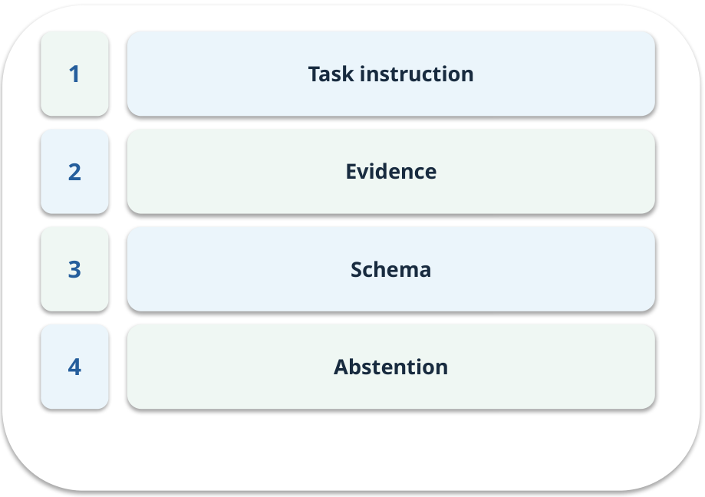
The journey through today’s case
OPEN / WEEK 05
We will predict, connect an analogy, trace a mechanism, work an example, then explain a decision.
GENERATIVE AI 2027 • WEEK 05 • 03 / 40
Notes:
TEACHER SCRIPT — OPEN. Show the visual for ten seconds, then ask for an initial decision. Do not reveal the answer yet. Ask a student to name the source or measurement that would change their mind. This week’s case is: An office extracts amounts and invoice identifiers from synthetic invoices. The visible slide states: We will predict, connect an analogy, trace a mechanism, work an example, then explain a decision. Point to the four named ideas, then show where the notebook experiment fits. The target is: Specify a task and validate an answer before using it. Listen for an explanation of the actual arrow or calculation, not just a repeated label. If the answer is unsupported, mark that uncertainty and return to the source. Before moving on, ask for the main idea and one concrete change to the worked example.

Slide 4
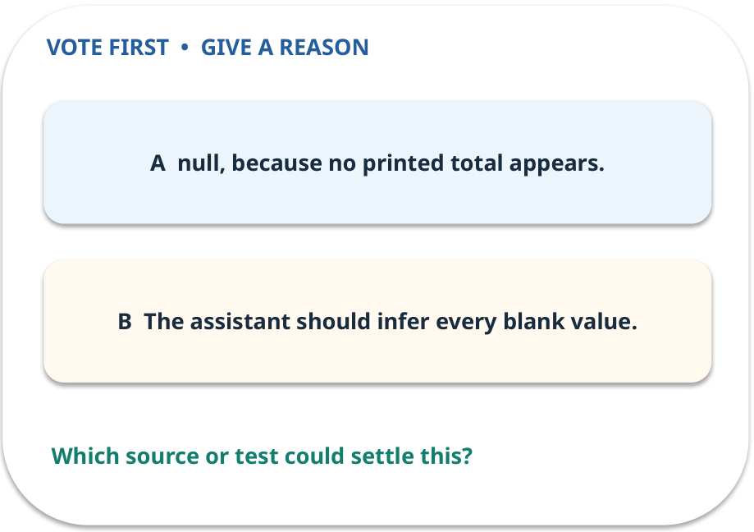
1. Predict · Task instruction
QUESTION / WEEK 05
What should the output contain for this invoice’s listed total?
Make a choice before we explain the diagram.
GENERATIVE AI 2027 • WEEK 05 • 04 / 40
Notes:
TEACHER SCRIPT — QUESTION. Take a show of hands for each choice before showing the mechanism. Ask pairs to defend a choice with evidence. Save the strongest wrong reason for the reveal later in this cycle. This week’s case is: An office extracts amounts and invoice identifiers from synthetic invoices. The visible slide states: What should the output contain for this invoice’s listed total?
Make a choice before we explain the diagram. The intended answer is null, because no printed total appears. The tempting claim is The assistant should infer every blank value. Do not show which card is correct until the reveal. The target is: Specify a task and validate an answer before using it. Listen for an explanation of the actual arrow or calculation, not just a repeated label. If the answer is unsupported, mark that uncertainty and return to the source. Before moving on, ask for the main idea and one concrete change to the worked example.

Slide 5
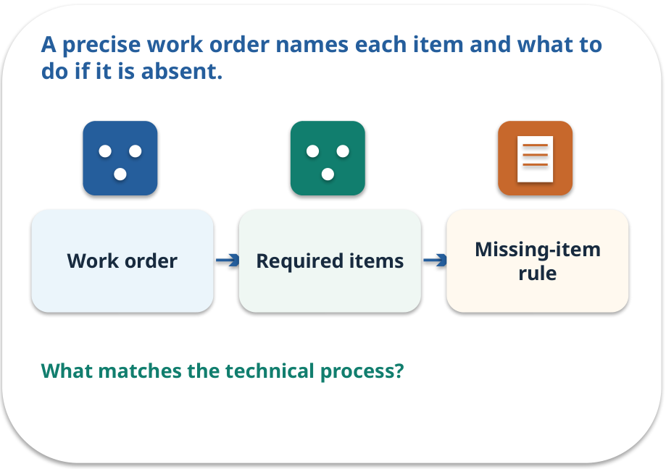
Task instruction · a familiar picture
ANALOGY / WEEK 05
A precise work order names each item and what to do if it is absent.
What matches our case, and where does the analogy stop?
GENERATIVE AI 2027 • WEEK 05 • 05 / 40
Notes:
TEACHER SCRIPT — ANALOGY. Begin with the familiar scene. Invite learners to describe each part in everyday language. Then ask where the comparison might fail before introducing the technical vocabulary. This week’s case is: An office extracts amounts and invoice identifiers from synthetic invoices. The visible slide states: A precise work order names each item and what to do if it is absent.
What matches our case, and where does the analogy stop? The boundary is: A prompt guides behaviour but does not enforce correctness by itself. The target is: Specify a task and validate an answer before using it. Listen for an explanation of the actual arrow or calculation, not just a repeated label. If the answer is unsupported, mark that uncertainty and return to the source. Before moving on, ask for the main idea and one concrete change to the worked example.

Slide 6
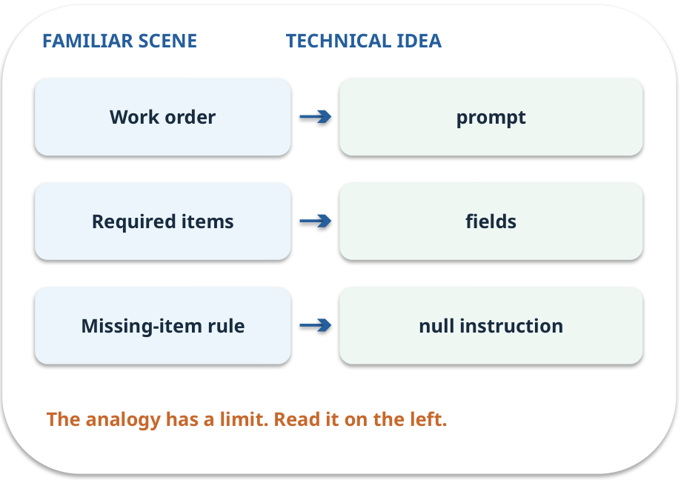
Task instruction · map the parts
MAPPING / WEEK 05
Match each everyday part to the technical part.
Analogy limit: A prompt guides behaviour but does not enforce correctness by itself.
GENERATIVE AI 2027 • WEEK 05 • 06 / 40
Notes:
TEACHER SCRIPT — MAPPING. Point from each familiar element to the corresponding technical element. Have students cover the right column and reconstruct the three matches. Read the limitation aloud. This week’s case is: An office extracts amounts and invoice identifiers from synthetic invoices. The visible slide states: Match each everyday part to the technical part.
Analogy limit: A prompt guides behaviour but does not enforce correctness by itself. The three precise mappings are [['Work order', 'prompt'], ['Required items', 'fields'], ['Missing-item rule', 'null instruction']]. The target is: Specify a task and validate an answer before using it. Listen for an explanation of the actual arrow or calculation, not just a repeated label. If the answer is unsupported, mark that uncertainty and return to the source. Before moving on, ask for the main idea and one concrete change to the worked example.

Slide 7

Task instruction · how it works
MECHANISM / WEEK 05
State exactly which fields to extract and how to handle missing entries.
Trace the arrows from left to right.
GENERATIVE AI 2027 • WEEK 05 • 07 / 40
Notes:
TEACHER SCRIPT — MECHANISM. Trace every arrow slowly from the input to the output. Ask what information crosses the boundary at each arrow. Pause if students confuse a simplified notebook with a trained model. This week’s case is: An office extracts amounts and invoice identifiers from synthetic invoices. The visible slide states: State exactly which fields to extract and how to handle missing entries.
Trace the arrows from left to right. The weekly example is: Request invoice_id and listed_total; say “use null if the total is not printed.” State what the analogy does not explain: A prompt guides behaviour but does not enforce correctness by itself. The target is: Specify a task and validate an answer before using it. Listen for an explanation of the actual arrow or calculation, not just a repeated label. If the answer is unsupported, mark that uncertainty and return to the source. Before moving on, ask for the main idea and one concrete change to the worked example.

Slide 8
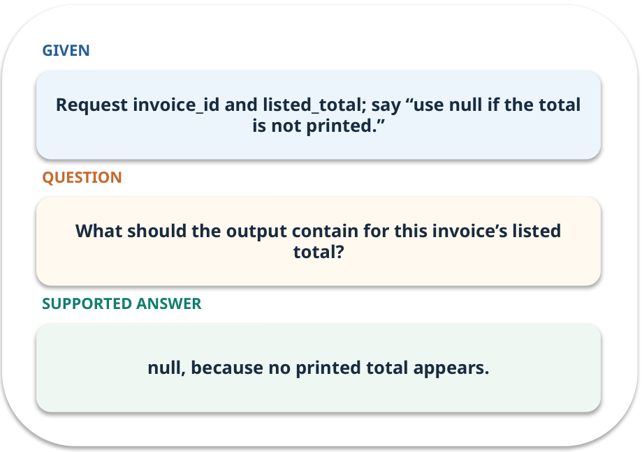
Task instruction · work one case
WORKED / WEEK 05
Request invoice_id and listed_total; say “use null if the total is not printed.”
Point to the evidence before giving your conclusion.
GENERATIVE AI 2027 • WEEK 05 • 08 / 40
Notes:
TEACHER SCRIPT — WORKED. Work the specific numbers or source wording aloud. Give students thirty seconds to write a conclusion, then ask which source line or calculation supports it. This week’s case is: An office extracts amounts and invoice identifiers from synthetic invoices. The visible slide states: Request invoice_id and listed_total; say “use null if the total is not printed.”
Point to the evidence before giving your conclusion. The expected reasoning concludes: null, because no printed total appears. Distinguish measured results from illustrative numbers. The target is: Specify a task and validate an answer before using it. Listen for an explanation of the actual arrow or calculation, not just a repeated label. If the answer is unsupported, mark that uncertainty and return to the source. Before moving on, ask for the main idea and one concrete change to the worked example.

Slide 9
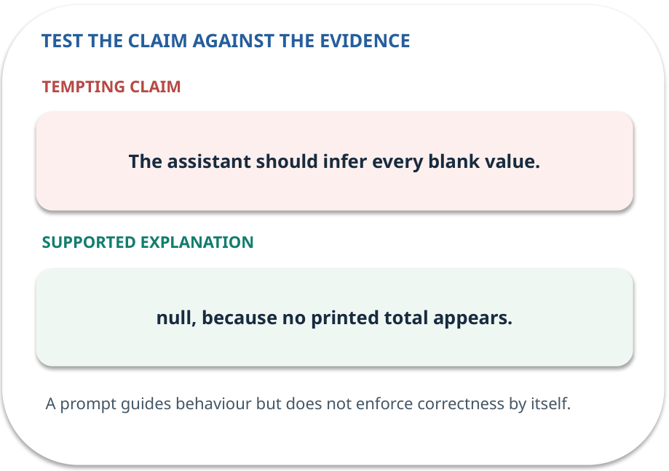
Task instruction · answer and explain
REVEAL / WEEK 05
null, because no printed total appears.
Tempting mistake: The assistant should infer every blank value.
GENERATIVE AI 2027 • WEEK 05 • 09 / 40
Notes:
TEACHER SCRIPT — REVEAL. Return to the earlier choice. Explain the correct answer and why the tempting claim fails. Ask one learner to say the answer in a single sentence without reading it. This week’s case is: An office extracts amounts and invoice identifiers from synthetic invoices. The visible slide states: null, because no printed total appears.
Tempting mistake: The assistant should infer every blank value. The earlier question was What should the output contain for this invoice’s listed total? Ask how this differs from the wrong claim. The target is: Specify a task and validate an answer before using it. Listen for an explanation of the actual arrow or calculation, not just a repeated label. If the answer is unsupported, mark that uncertainty and return to the source. Before moving on, ask for the main idea and one concrete change to the worked example.

Slide 10
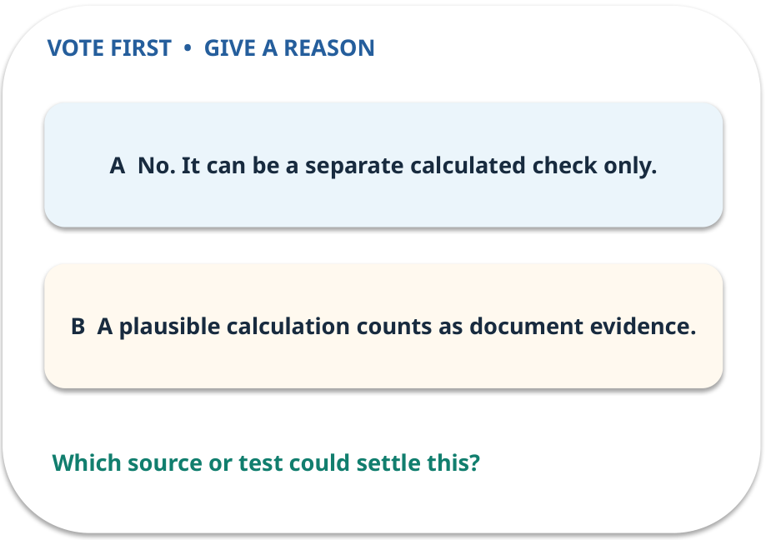
2. Predict · Evidence
QUESTION / WEEK 05
Can €36 be labelled “extracted listed total”?
Make a choice before we explain the diagram.
GENERATIVE AI 2027 • WEEK 05 • 10 / 40
Notes:
TEACHER SCRIPT — QUESTION. Take a show of hands for each choice before showing the mechanism. Ask pairs to defend a choice with evidence. Save the strongest wrong reason for the reveal later in this cycle. This week’s case is: An office extracts amounts and invoice identifiers from synthetic invoices. The visible slide states: Can €36 be labelled “extracted listed total”?
Make a choice before we explain the diagram. The intended answer is No. It can be a separate calculated check only. The tempting claim is A plausible calculation counts as document evidence. Do not show which card is correct until the reveal. The target is: Specify a task and validate an answer before using it. Listen for an explanation of the actual arrow or calculation, not just a repeated label. If the answer is unsupported, mark that uncertainty and return to the source. Before moving on, ask for the main idea and one concrete change to the worked example.

Slide 11
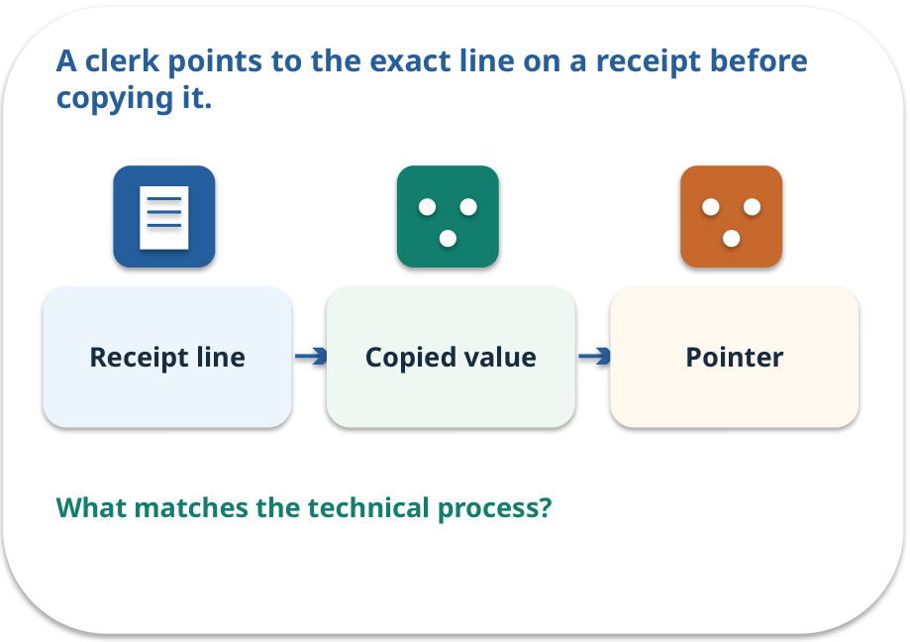
Evidence · a familiar picture
ANALOGY / WEEK 05
A clerk points to the exact line on a receipt before copying it.
What matches our case, and where does the analogy stop?
GENERATIVE AI 2027 • WEEK 05 • 11 / 40
Notes:
TEACHER SCRIPT — ANALOGY. Begin with the familiar scene. Invite learners to describe each part in everyday language. Then ask where the comparison might fail before introducing the technical vocabulary. This week’s case is: An office extracts amounts and invoice identifiers from synthetic invoices. The visible slide states: A clerk points to the exact line on a receipt before copying it.
What matches our case, and where does the analogy stop? The boundary is: A source pointer may still point to the wrong line; verify the match. The target is: Specify a task and validate an answer before using it. Listen for an explanation of the actual arrow or calculation, not just a repeated label. If the answer is unsupported, mark that uncertainty and return to the source. Before moving on, ask for the main idea and one concrete change to the worked example.

Slide 12
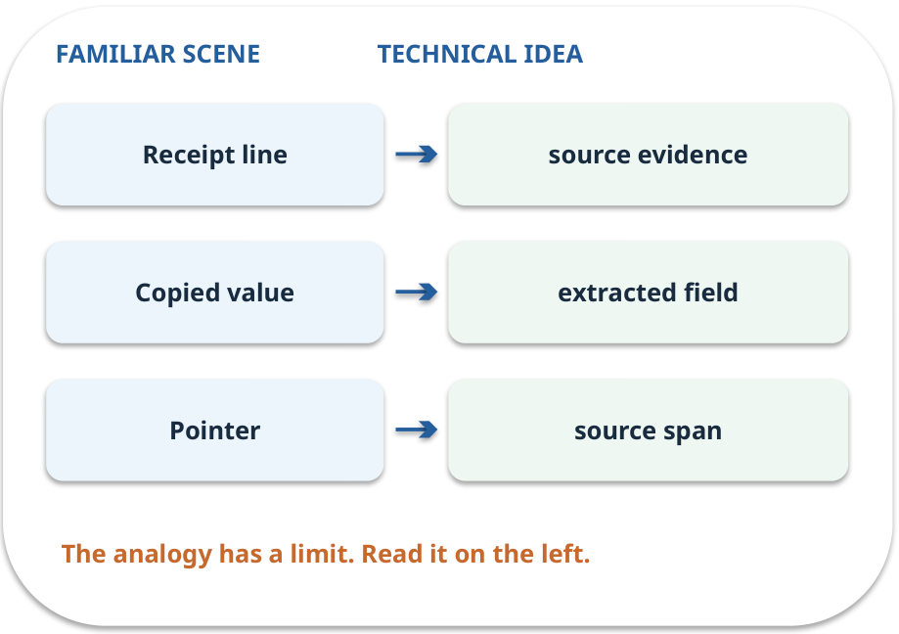
Evidence · map the parts
MAPPING / WEEK 05
Match each everyday part to the technical part.
Analogy limit: A source pointer may still point to the wrong line; verify the match.
GENERATIVE AI 2027 • WEEK 05 • 12 / 40
Notes:
TEACHER SCRIPT — MAPPING. Point from each familiar element to the corresponding technical element. Have students cover the right column and reconstruct the three matches. Read the limitation aloud. This week’s case is: An office extracts amounts and invoice identifiers from synthetic invoices. The visible slide states: Match each everyday part to the technical part.
Analogy limit: A source pointer may still point to the wrong line; verify the match. The three precise mappings are [['Receipt line', 'source evidence'], ['Copied value', 'extracted field'], ['Pointer', 'source span']]. The target is: Specify a task and validate an answer before using it. Listen for an explanation of the actual arrow or calculation, not just a repeated label. If the answer is unsupported, mark that uncertainty and return to the source. Before moving on, ask for the main idea and one concrete change to the worked example.

Slide 13
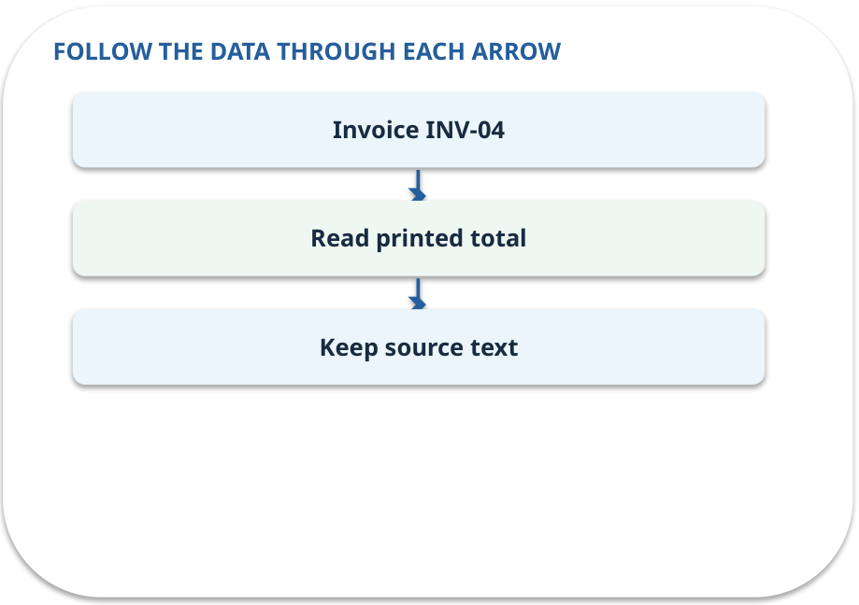
Evidence · how it works
MECHANISM / WEEK 05
Use only the supplied invoice text; do not infer a value that is absent.
Trace the arrows from left to right.
GENERATIVE AI 2027 • WEEK 05 • 13 / 40
Notes:
TEACHER SCRIPT — MECHANISM. Trace every arrow slowly from the input to the output. Ask what information crosses the boundary at each arrow. Pause if students confuse a simplified notebook with a trained model. This week’s case is: An office extracts amounts and invoice identifiers from synthetic invoices. The visible slide states: Use only the supplied invoice text; do not infer a value that is absent.
Trace the arrows from left to right. The weekly example is: Quantity 3 and unit price €12 are visible. €36 is a calculation, not a printed total. State what the analogy does not explain: A source pointer may still point to the wrong line; verify the match. The target is: Specify a task and validate an answer before using it. Listen for an explanation of the actual arrow or calculation, not just a repeated label. If the answer is unsupported, mark that uncertainty and return to the source. Before moving on, ask for the main idea and one concrete change to the worked example.

Slide 14
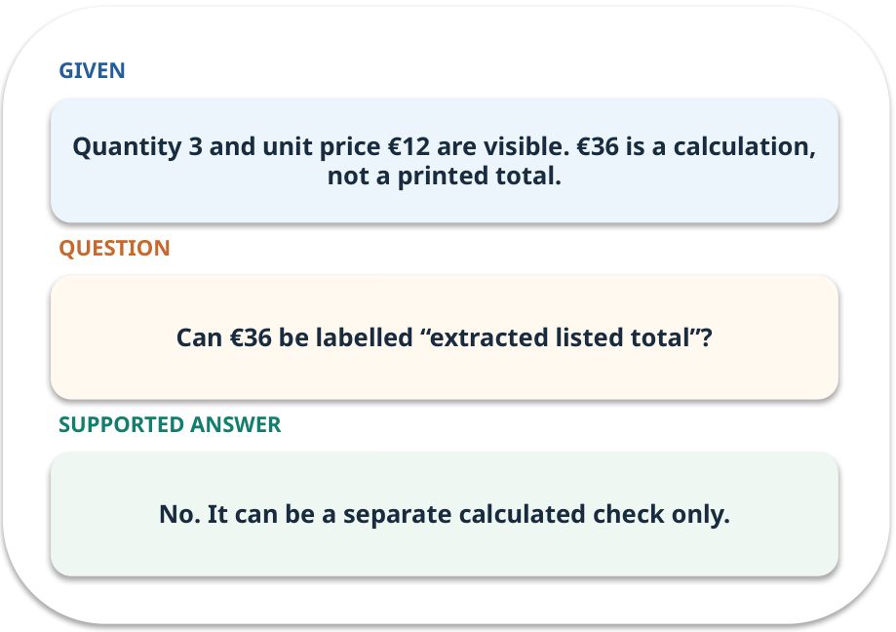
Evidence · work one case
WORKED / WEEK 05
Quantity 3 and unit price €12 are visible. €36 is a calculation, not a printed total.
Point to the evidence before giving your conclusion.
GENERATIVE AI 2027 • WEEK 05 • 14 / 40
Notes:
TEACHER SCRIPT — WORKED. Work the specific numbers or source wording aloud. Give students thirty seconds to write a conclusion, then ask which source line or calculation supports it. This week’s case is: An office extracts amounts and invoice identifiers from synthetic invoices. The visible slide states: Quantity 3 and unit price €12 are visible. €36 is a calculation, not a printed total.
Point to the evidence before giving your conclusion. The expected reasoning concludes: No. It can be a separate calculated check only. Distinguish measured results from illustrative numbers. The target is: Specify a task and validate an answer before using it. Listen for an explanation of the actual arrow or calculation, not just a repeated label. If the answer is unsupported, mark that uncertainty and return to the source. Before moving on, ask for the main idea and one concrete change to the worked example.

Slide 15
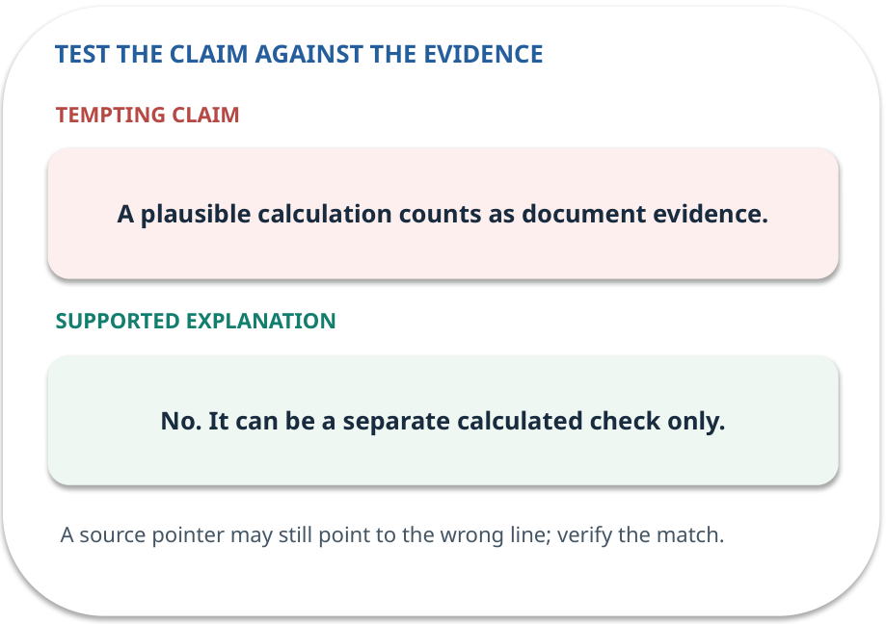
Evidence · answer and explain
REVEAL / WEEK 05
No. It can be a separate calculated check only.
Tempting mistake: A plausible calculation counts as document evidence.
GENERATIVE AI 2027 • WEEK 05 • 15 / 40
Notes:
TEACHER SCRIPT — REVEAL. Return to the earlier choice. Explain the correct answer and why the tempting claim fails. Ask one learner to say the answer in a single sentence without reading it. This week’s case is: An office extracts amounts and invoice identifiers from synthetic invoices. The visible slide states: No. It can be a separate calculated check only.
Tempting mistake: A plausible calculation counts as document evidence. The earlier question was Can €36 be labelled “extracted listed total”? Ask how this differs from the wrong claim. The target is: Specify a task and validate an answer before using it. Listen for an explanation of the actual arrow or calculation, not just a repeated label. If the answer is unsupported, mark that uncertainty and return to the source. Before moving on, ask for the main idea and one concrete change to the worked example.

Slide 16
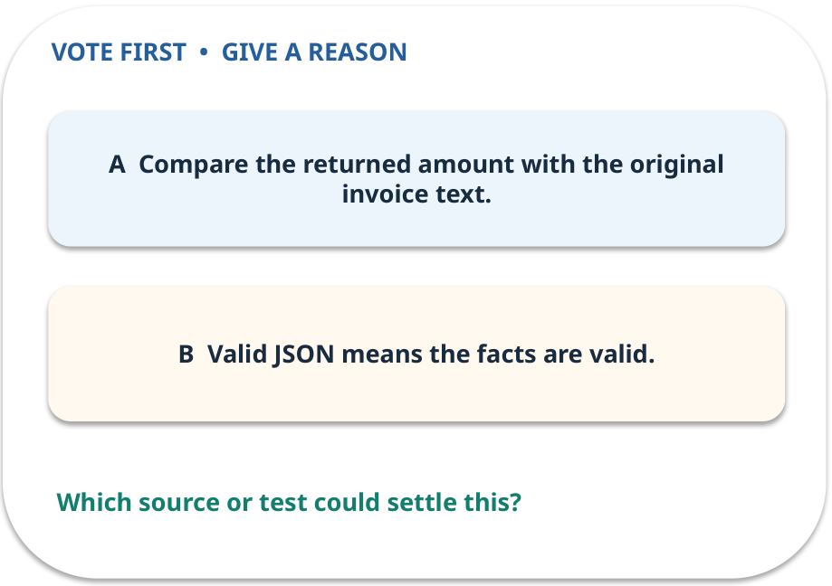
3. Predict · Schema
QUESTION / WEEK 05
Which test detects a wrong but well-typed amount?
Make a choice before we explain the diagram.
GENERATIVE AI 2027 • WEEK 05 • 16 / 40
Notes:
TEACHER SCRIPT — QUESTION. Take a show of hands for each choice before showing the mechanism. Ask pairs to defend a choice with evidence. Save the strongest wrong reason for the reveal later in this cycle. This week’s case is: An office extracts amounts and invoice identifiers from synthetic invoices. The visible slide states: Which test detects a wrong but well-typed amount?
Make a choice before we explain the diagram. The intended answer is Compare the returned amount with the original invoice text. The tempting claim is Valid JSON means the facts are valid. Do not show which card is correct until the reveal. The target is: Specify a task and validate an answer before using it. Listen for an explanation of the actual arrow or calculation, not just a repeated label. If the answer is unsupported, mark that uncertainty and return to the source. Before moving on, ask for the main idea and one concrete change to the worked example.

Slide 17
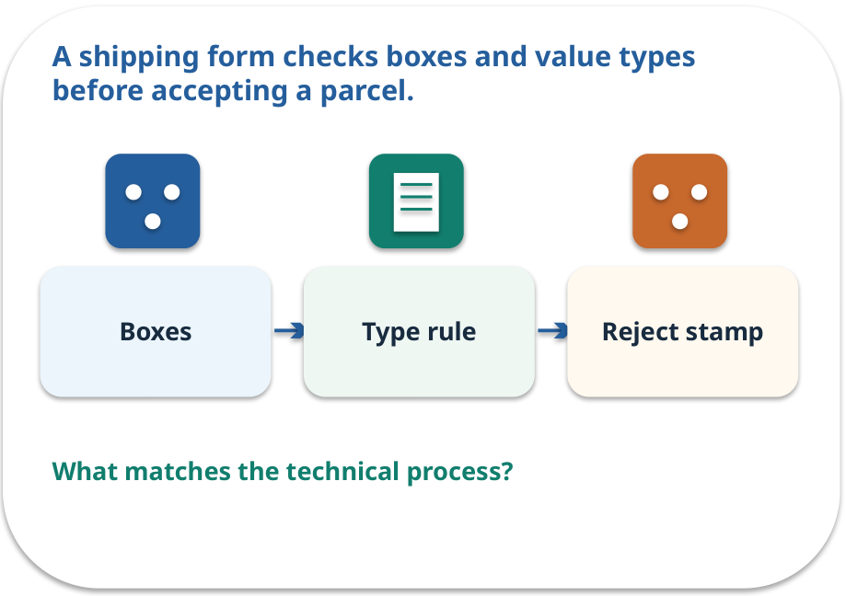
Schema · a familiar picture
ANALOGY / WEEK 05
A shipping form checks boxes and value types before accepting a parcel.
What matches our case, and where does the analogy stop?
GENERATIVE AI 2027 • WEEK 05 • 17 / 40
Notes:
TEACHER SCRIPT — ANALOGY. Begin with the familiar scene. Invite learners to describe each part in everyday language. Then ask where the comparison might fail before introducing the technical vocabulary. This week’s case is: An office extracts amounts and invoice identifiers from synthetic invoices. The visible slide states: A shipping form checks boxes and value types before accepting a parcel.
What matches our case, and where does the analogy stop? The boundary is: A correct shape does not prove the value came from the document. The target is: Specify a task and validate an answer before using it. Listen for an explanation of the actual arrow or calculation, not just a repeated label. If the answer is unsupported, mark that uncertainty and return to the source. Before moving on, ask for the main idea and one concrete change to the worked example.

Slide 18
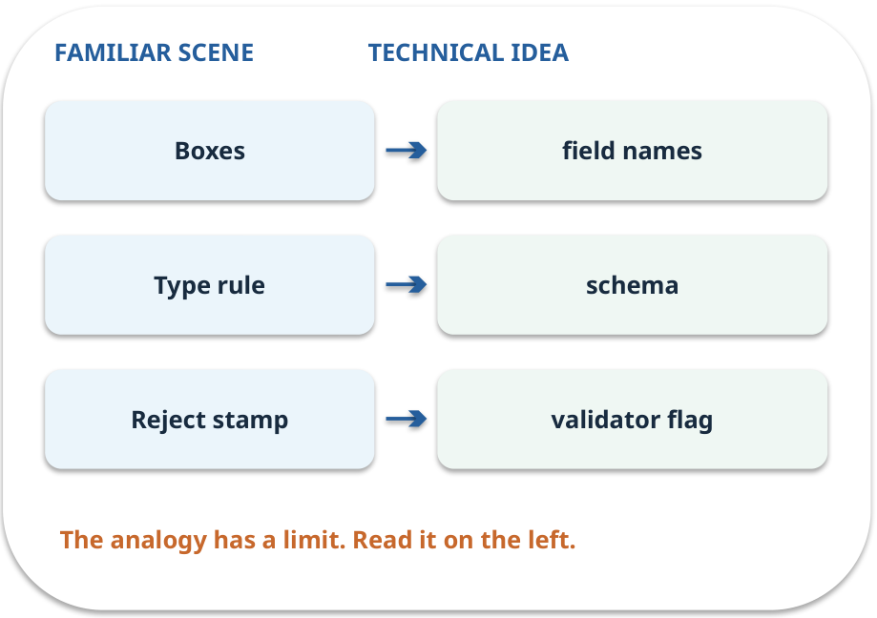
Schema · map the parts
MAPPING / WEEK 05
Match each everyday part to the technical part.
Analogy limit: A correct shape does not prove the value came from the document.
GENERATIVE AI 2027 • WEEK 05 • 18 / 40
Notes:
TEACHER SCRIPT — MAPPING. Point from each familiar element to the corresponding technical element. Have students cover the right column and reconstruct the three matches. Read the limitation aloud. This week’s case is: An office extracts amounts and invoice identifiers from synthetic invoices. The visible slide states: Match each everyday part to the technical part.
Analogy limit: A correct shape does not prove the value came from the document. The three precise mappings are [['Boxes', 'field names'], ['Type rule', 'schema'], ['Reject stamp', 'validator flag']]. The target is: Specify a task and validate an answer before using it. Listen for an explanation of the actual arrow or calculation, not just a repeated label. If the answer is unsupported, mark that uncertainty and return to the source. Before moving on, ask for the main idea and one concrete change to the worked example.

Slide 19
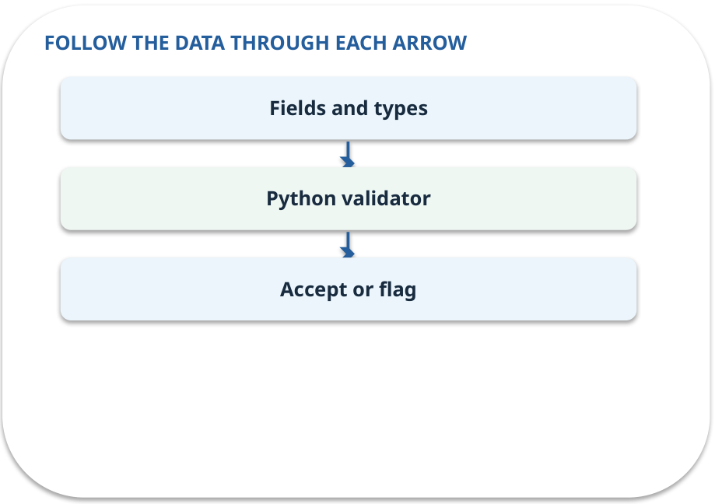
Schema · how it works
MECHANISM / WEEK 05
Validate names and types of returned fields with Python.
Trace the arrows from left to right.
GENERATIVE AI 2027 • WEEK 05 • 19 / 40
Notes:
TEACHER SCRIPT — MECHANISM. Trace every arrow slowly from the input to the output. Ask what information crosses the boundary at each arrow. Pause if students confuse a simplified notebook with a trained model. This week’s case is: An office extracts amounts and invoice identifiers from synthetic invoices. The visible slide states: Validate names and types of returned fields with Python.
Trace the arrows from left to right. The weekly example is: An ID of INV-04 and a listed total of €36 can pass type checks but fail a source check. State what the analogy does not explain: A correct shape does not prove the value came from the document. The target is: Specify a task and validate an answer before using it. Listen for an explanation of the actual arrow or calculation, not just a repeated label. If the answer is unsupported, mark that uncertainty and return to the source. Before moving on, ask for the main idea and one concrete change to the worked example.

Slide 20
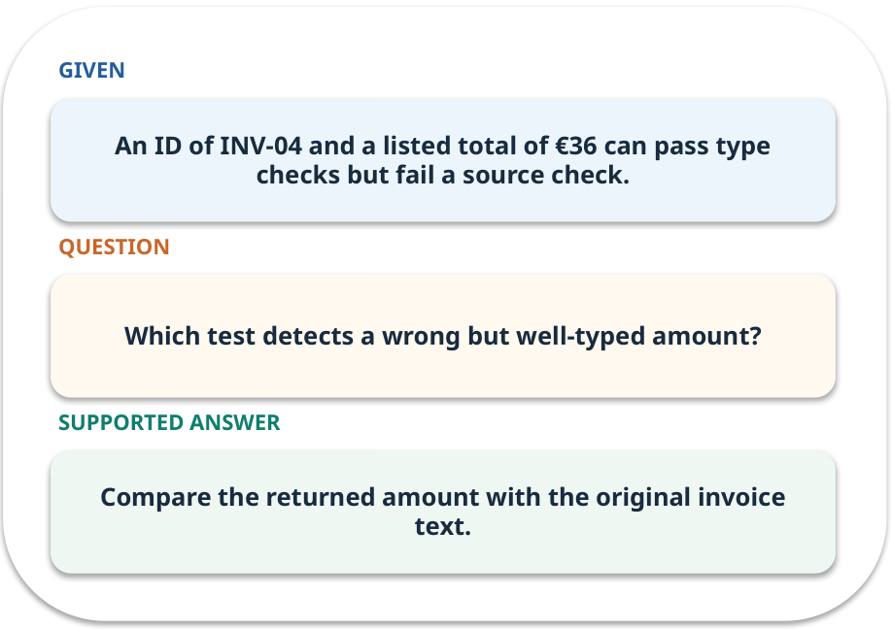
Schema · work one case
WORKED / WEEK 05
An ID of INV-04 and a listed total of €36 can pass type checks but fail a source check.
Point to the evidence before giving your conclusion.
GENERATIVE AI 2027 • WEEK 05 • 20 / 40
Notes:
TEACHER SCRIPT — WORKED. Work the specific numbers or source wording aloud. Give students thirty seconds to write a conclusion, then ask which source line or calculation supports it. This week’s case is: An office extracts amounts and invoice identifiers from synthetic invoices. The visible slide states: An ID of INV-04 and a listed total of €36 can pass type checks but fail a source check.
Point to the evidence before giving your conclusion. The expected reasoning concludes: Compare the returned amount with the original invoice text. Distinguish measured results from illustrative numbers. The target is: Specify a task and validate an answer before using it. Listen for an explanation of the actual arrow or calculation, not just a repeated label. If the answer is unsupported, mark that uncertainty and return to the source. Before moving on, ask for the main idea and one concrete change to the worked example.

Slide 21
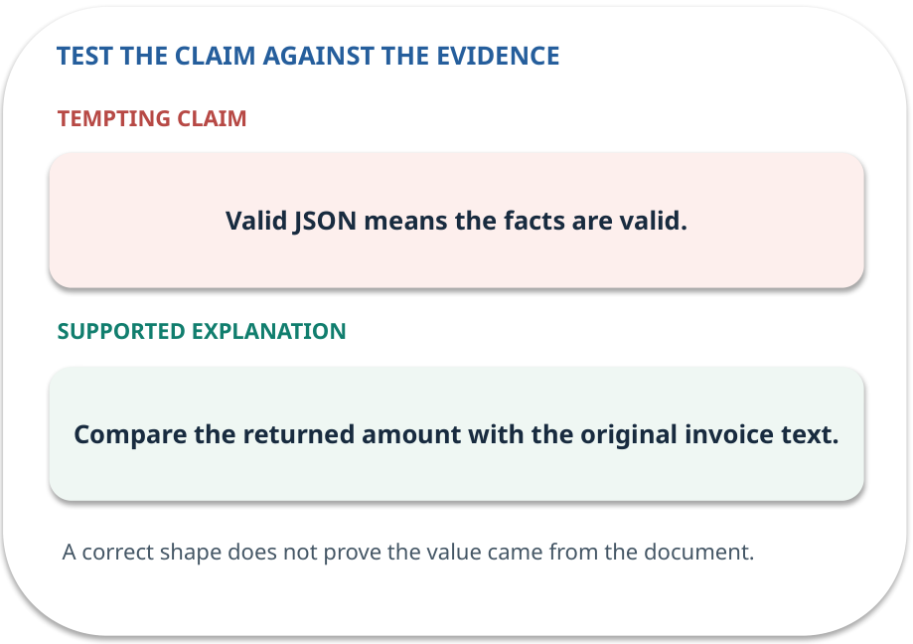
Schema · answer and explain
REVEAL / WEEK 05
Compare the returned amount with the original invoice text.
Tempting mistake: Valid JSON means the facts are valid.
GENERATIVE AI 2027 • WEEK 05 • 21 / 40
Notes:
TEACHER SCRIPT — REVEAL. Return to the earlier choice. Explain the correct answer and why the tempting claim fails. Ask one learner to say the answer in a single sentence without reading it. This week’s case is: An office extracts amounts and invoice identifiers from synthetic invoices. The visible slide states: Compare the returned amount with the original invoice text.
Tempting mistake: Valid JSON means the facts are valid. The earlier question was Which test detects a wrong but well-typed amount? Ask how this differs from the wrong claim. The target is: Specify a task and validate an answer before using it. Listen for an explanation of the actual arrow or calculation, not just a repeated label. If the answer is unsupported, mark that uncertainty and return to the source. Before moving on, ask for the main idea and one concrete change to the worked example.

Slide 22
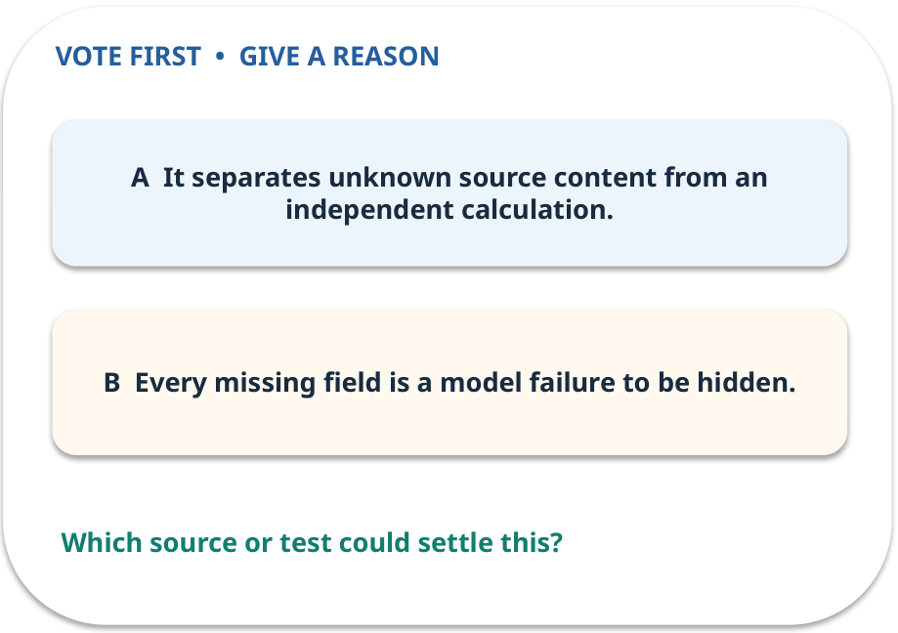
4. Predict · Abstention
QUESTION / WEEK 05
Why preserve a missing value?
Make a choice before we explain the diagram.
GENERATIVE AI 2027 • WEEK 05 • 22 / 40
Notes:
TEACHER SCRIPT — QUESTION. Take a show of hands for each choice before showing the mechanism. Ask pairs to defend a choice with evidence. Save the strongest wrong reason for the reveal later in this cycle. This week’s case is: An office extracts amounts and invoice identifiers from synthetic invoices. The visible slide states: Why preserve a missing value?
Make a choice before we explain the diagram. The intended answer is It separates unknown source content from an independent calculation. The tempting claim is Every missing field is a model failure to be hidden. Do not show which card is correct until the reveal. The target is: Specify a task and validate an answer before using it. Listen for an explanation of the actual arrow or calculation, not just a repeated label. If the answer is unsupported, mark that uncertainty and return to the source. Before moving on, ask for the main idea and one concrete change to the worked example.

Slide 23
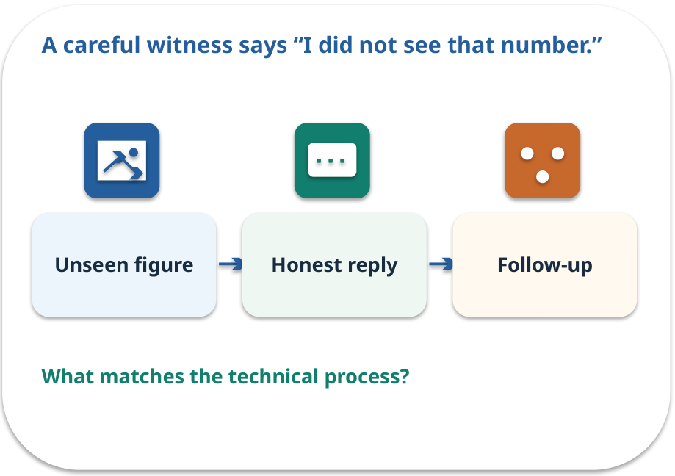
Abstention · a familiar picture
ANALOGY / WEEK 05
A careful witness says “I did not see that number.”
What matches our case, and where does the analogy stop?
GENERATIVE AI 2027 • WEEK 05 • 23 / 40
Notes:
TEACHER SCRIPT — ANALOGY. Begin with the familiar scene. Invite learners to describe each part in everyday language. Then ask where the comparison might fail before introducing the technical vocabulary. This week’s case is: An office extracts amounts and invoice identifiers from synthetic invoices. The visible slide states: A careful witness says “I did not see that number.”
What matches our case, and where does the analogy stop? The boundary is: Abstention can be too cautious; measure missing and falsely missing fields. The target is: Specify a task and validate an answer before using it. Listen for an explanation of the actual arrow or calculation, not just a repeated label. If the answer is unsupported, mark that uncertainty and return to the source. Before moving on, ask for the main idea and one concrete change to the worked example.

Slide 24
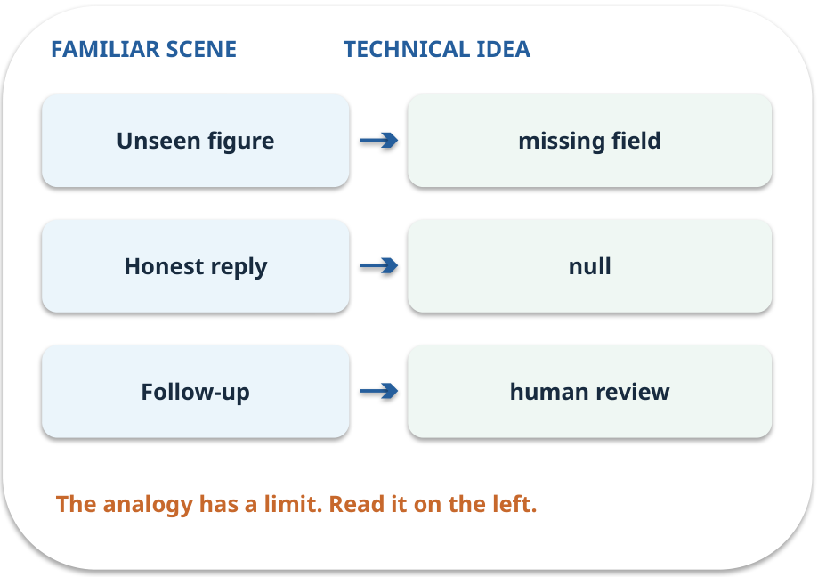
Abstention · map the parts
MAPPING / WEEK 05
Match each everyday part to the technical part.
Analogy limit: Abstention can be too cautious; measure missing and falsely missing fields.
GENERATIVE AI 2027 • WEEK 05 • 24 / 40
Notes:
TEACHER SCRIPT — MAPPING. Point from each familiar element to the corresponding technical element. Have students cover the right column and reconstruct the three matches. Read the limitation aloud. This week’s case is: An office extracts amounts and invoice identifiers from synthetic invoices. The visible slide states: Match each everyday part to the technical part.
Analogy limit: Abstention can be too cautious; measure missing and falsely missing fields. The three precise mappings are [['Unseen figure', 'missing field'], ['Honest reply', 'null'], ['Follow-up', 'human review']]. The target is: Specify a task and validate an answer before using it. Listen for an explanation of the actual arrow or calculation, not just a repeated label. If the answer is unsupported, mark that uncertainty and return to the source. Before moving on, ask for the main idea and one concrete change to the worked example.

Slide 25
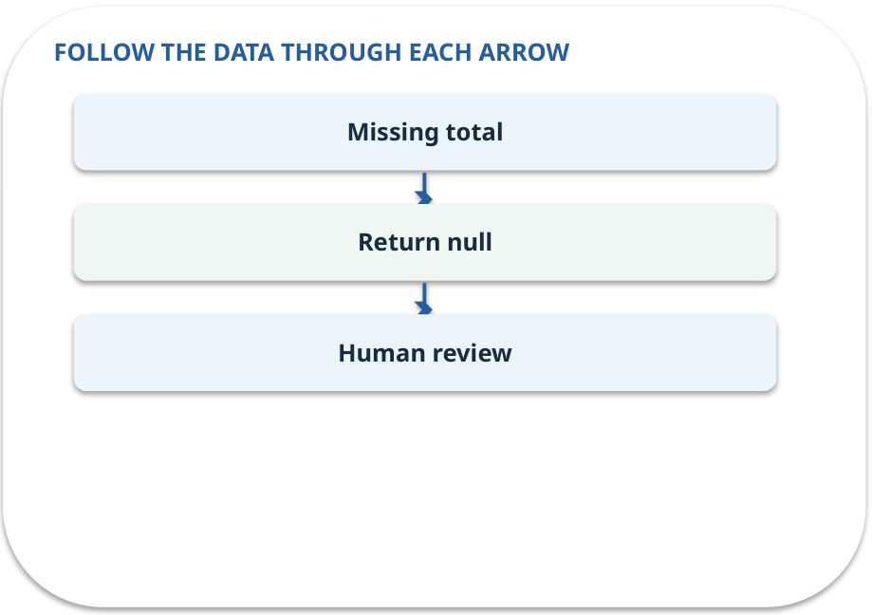
Abstention · how it works
MECHANISM / WEEK 05
A missing value should stay null or cause a review flag, rather than be guessed.
Trace the arrows from left to right.
GENERATIVE AI 2027 • WEEK 05 • 25 / 40
Notes:
TEACHER SCRIPT — MECHANISM. Trace every arrow slowly from the input to the output. Ask what information crosses the boundary at each arrow. Pause if students confuse a simplified notebook with a trained model. This week’s case is: An office extracts amounts and invoice identifiers from synthetic invoices. The visible slide states: A missing value should stay null or cause a review flag, rather than be guessed.
Trace the arrows from left to right. The weekly example is: When the total is absent, the validator flags null for review without inventing a figure. State what the analogy does not explain: Abstention can be too cautious; measure missing and falsely missing fields. The target is: Specify a task and validate an answer before using it. Listen for an explanation of the actual arrow or calculation, not just a repeated label. If the answer is unsupported, mark that uncertainty and return to the source. Before moving on, ask for the main idea and one concrete change to the worked example.

Slide 26
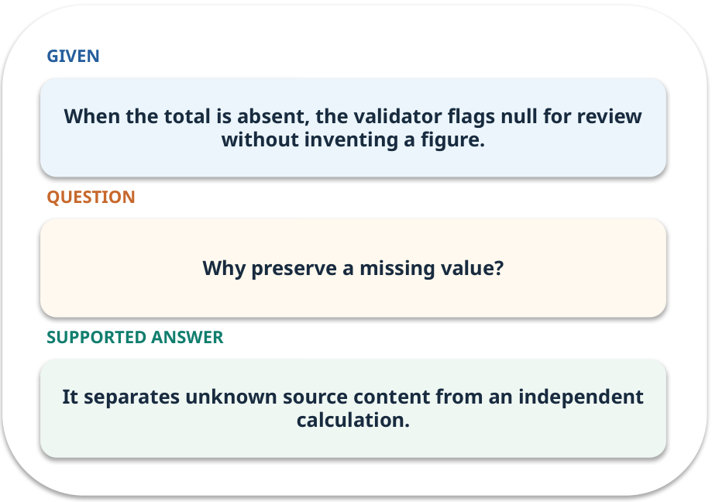
Abstention · work one case
WORKED / WEEK 05
When the total is absent, the validator flags null for review without inventing a figure.
Point to the evidence before giving your conclusion.
GENERATIVE AI 2027 • WEEK 05 • 26 / 40
Notes:
TEACHER SCRIPT — WORKED. Work the specific numbers or source wording aloud. Give students thirty seconds to write a conclusion, then ask which source line or calculation supports it. This week’s case is: An office extracts amounts and invoice identifiers from synthetic invoices. The visible slide states: When the total is absent, the validator flags null for review without inventing a figure.
Point to the evidence before giving your conclusion. The expected reasoning concludes: It separates unknown source content from an independent calculation. Distinguish measured results from illustrative numbers. The target is: Specify a task and validate an answer before using it. Listen for an explanation of the actual arrow or calculation, not just a repeated label. If the answer is unsupported, mark that uncertainty and return to the source. Before moving on, ask for the main idea and one concrete change to the worked example.

Slide 27
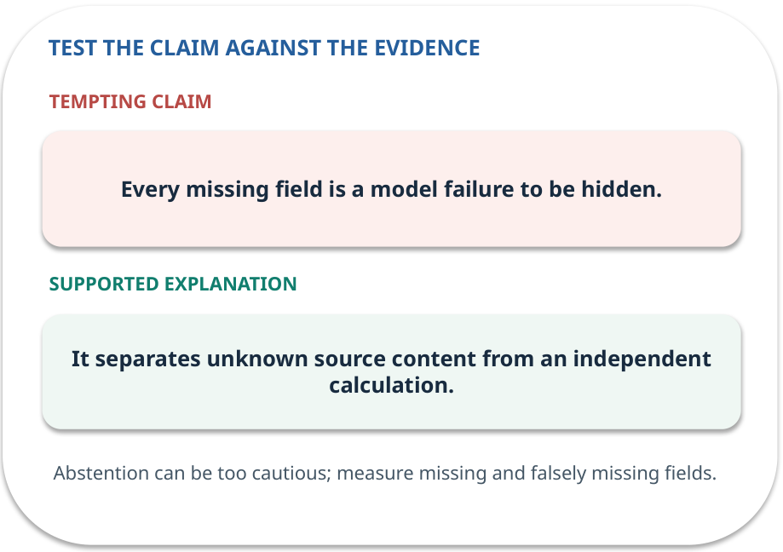
Abstention · answer and explain
REVEAL / WEEK 05
It separates unknown source content from an independent calculation.
Tempting mistake: Every missing field is a model failure to be hidden.
GENERATIVE AI 2027 • WEEK 05 • 27 / 40
Notes:
TEACHER SCRIPT — REVEAL. Return to the earlier choice. Explain the correct answer and why the tempting claim fails. Ask one learner to say the answer in a single sentence without reading it. This week’s case is: An office extracts amounts and invoice identifiers from synthetic invoices. The visible slide states: It separates unknown source content from an independent calculation.
Tempting mistake: Every missing field is a model failure to be hidden. The earlier question was Why preserve a missing value? Ask how this differs from the wrong claim. The target is: Specify a task and validate an answer before using it. Listen for an explanation of the actual arrow or calculation, not just a repeated label. If the answer is unsupported, mark that uncertainty and return to the source. Before moving on, ask for the main idea and one concrete change to the worked example.

Slide 28
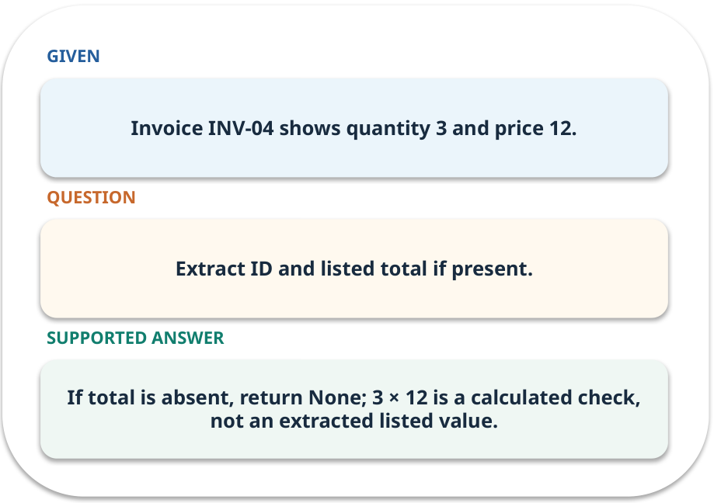
Evidence trail: input → result
WORKED / WEEK 05
Extract ID and listed total if present.
If total is absent, return None; 3 × 12 is a calculated check, not an extracted listed value.
GENERATIVE AI 2027 • WEEK 05 • 28 / 40
Notes:
TEACHER SCRIPT — WORKED. Work the specific numbers or source wording aloud. Give students thirty seconds to write a conclusion, then ask which source line or calculation supports it. This week’s case is: An office extracts amounts and invoice identifiers from synthetic invoices. The visible slide states: Extract ID and listed total if present.
If total is absent, return None; 3 × 12 is a calculated check, not an extracted listed value. Have one student point to an exact source word or number for each conclusion. The target is: Specify a task and validate an answer before using it. Listen for an explanation of the actual arrow or calculation, not just a repeated label. If the answer is unsupported, mark that uncertainty and return to the source. Before moving on, ask for the main idea and one concrete change to the worked example.

Slide 29
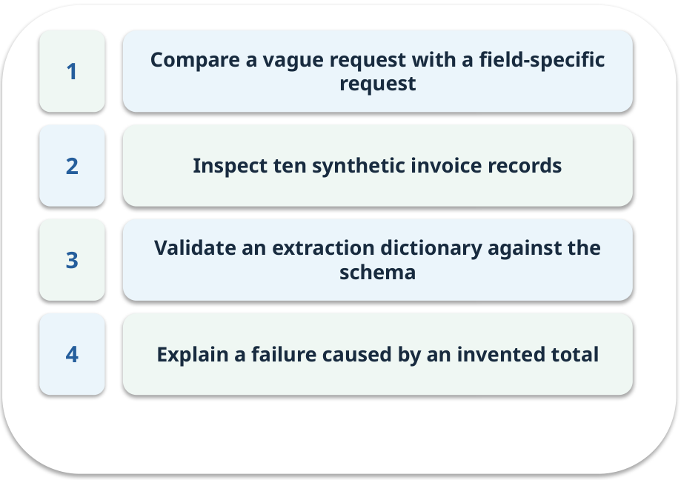
Notebook: run the prepared example
PRACTICE / WEEK 05
Run extraction validation on ten synthetic records.
Read the original output before editing.
GENERATIVE AI 2027 • WEEK 05 • 29 / 40
Notes:
TEACHER SCRIPT — PRACTICE. Open the matching notebook and demonstrate the first run. Have learners predict one change, run only that change, and record input, setting, output and an error explanation. This week’s case is: An office extracts amounts and invoice identifiers from synthetic invoices. The visible slide states: Run extraction validation on ten synthetic records.
Read the original output before editing. Use Week_05_Lab.ipynb. This lab is a prepared classroom demonstration with its limitations documented. The target is: Specify a task and validate an answer before using it. Listen for an explanation of the actual arrow or calculation, not just a repeated label. If the answer is unsupported, mark that uncertainty and return to the source. Before moving on, ask for the main idea and one concrete change to the worked example.

Slide 30

Find the input and check in Python
PRACTICE / WEEK 05
Locate the supplied input, the transformation, the checking line and the printed result.
GENERATIVE AI 2027 • WEEK 05 • 30 / 40
Notes:
TEACHER SCRIPT — PRACTICE. Open the matching notebook and demonstrate the first run. Have learners predict one change, run only that change, and record input, setting, output and an error explanation. This week’s case is: An office extracts amounts and invoice identifiers from synthetic invoices. The visible slide states: Locate the supplied input, the transformation, the checking line and the printed result. The weekly lab change is: Delete one total and confirm the missing-field review flag fires. The target is: Specify a task and validate an answer before using it. Listen for an explanation of the actual arrow or calculation, not just a repeated label. If the answer is unsupported, mark that uncertainty and return to the source. Before moving on, ask for the main idea and one concrete change to the worked example.

Slide 31

Predict one controlled change
PRACTICE / WEEK 05
Delete one total and confirm the missing-field review flag fires.
What should change in the result? What stays fixed?
GENERATIVE AI 2027 • WEEK 05 • 31 / 40
Notes:
TEACHER SCRIPT — PRACTICE. Open the matching notebook and demonstrate the first run. Have learners predict one change, run only that change, and record input, setting, output and an error explanation. This week’s case is: An office extracts amounts and invoice identifiers from synthetic invoices. The visible slide states: Delete one total and confirm the missing-field review flag fires.
What should change in the result? What stays fixed? Ask learners to write their prediction before rerunning the cell. The target is: Specify a task and validate an answer before using it. Listen for an explanation of the actual arrow or calculation, not just a repeated label. If the answer is unsupported, mark that uncertainty and return to the source. Before moving on, ask for the main idea and one concrete change to the worked example.

Slide 32

Run, compare and record
PRACTICE / WEEK 05
Record the input, the one changed setting, the observed result and a reason for any difference.
GENERATIVE AI 2027 • WEEK 05 • 32 / 40
Notes:
TEACHER SCRIPT — PRACTICE. Open the matching notebook and demonstrate the first run. Have learners predict one change, run only that change, and record input, setting, output and an error explanation. This week’s case is: An office extracts amounts and invoice identifiers from synthetic invoices. The visible slide states: Record the input, the one changed setting, the observed result and a reason for any difference. The required evidence is: Prompt revision and before/after field-check table. The target is: Specify a task and validate an answer before using it. Listen for an explanation of the actual arrow or calculation, not just a repeated label. If the answer is unsupported, mark that uncertainty and return to the source. Before moving on, ask for the main idea and one concrete change to the worked example.

Slide 33

Measure without hiding the denominator
CHECK / WEEK 05
Fields correct / fields checked; report missing fields separately
Write the numerator, denominator and one failure case.
GENERATIVE AI 2027 • WEEK 05 • 33 / 40
Notes:
TEACHER SCRIPT — CHECK. Use this as a brief formative check. Ask for the conclusion, the evidence and one limitation. Revisit disagreements in the review session and offer an extension only after the core task. This week’s case is: An office extracts amounts and invoice identifiers from synthetic invoices. The visible slide states: Fields correct / fields checked; report missing fields separately
Write the numerator, denominator and one failure case. Where a measure is qualitative, show the concrete source comparison. Example: If total is absent, return None; 3 × 12 is a calculated check, not an extracted listed value. The target is: Specify a task and validate an answer before using it. Listen for an explanation of the actual arrow or calculation, not just a repeated label. If the answer is unsupported, mark that uncertainty and return to the source. Before moving on, ask for the main idea and one concrete change to the worked example.

Slide 34
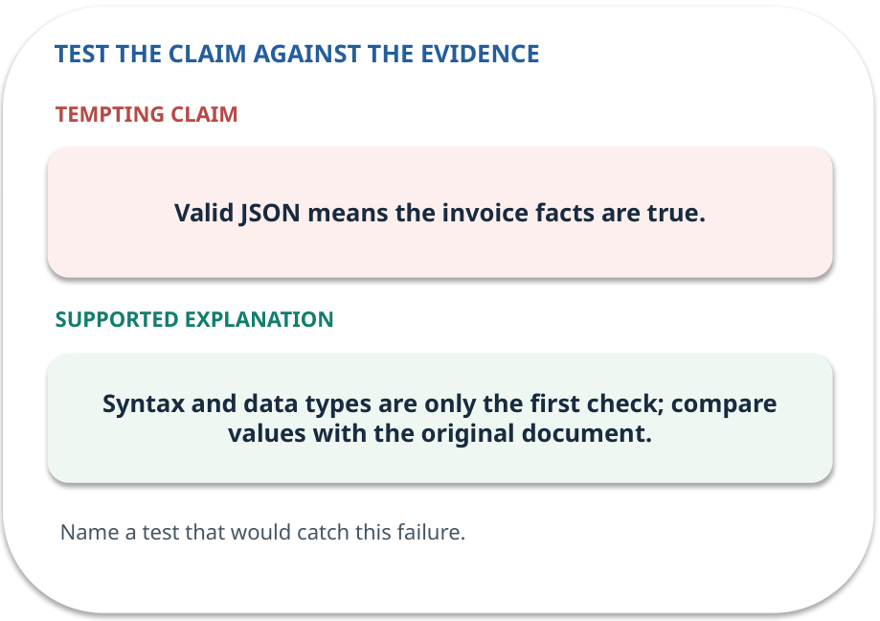
Error detective: find the layer
CHECK / WEEK 05
Plausible wrong claim: Valid JSON means the invoice facts are true.
Correct it using the case evidence.
GENERATIVE AI 2027 • WEEK 05 • 34 / 40
Notes:
TEACHER SCRIPT — CHECK. Use this as a brief formative check. Ask for the conclusion, the evidence and one limitation. Revisit disagreements in the review session and offer an extension only after the core task. This week’s case is: An office extracts amounts and invoice identifiers from synthetic invoices. The visible slide states: Plausible wrong claim: Valid JSON means the invoice facts are true.
Correct it using the case evidence. The correction is Syntax and data types are only the first check; compare values with the original document. The target is: Specify a task and validate an answer before using it. Listen for an explanation of the actual arrow or calculation, not just a repeated label. If the answer is unsupported, mark that uncertainty and return to the source. Before moving on, ask for the main idea and one concrete change to the worked example.

Slide 35

Transfer to a new situation
CHECK / WEEK 05
A syntactically valid JSON reply lists total €36. Which two checks disagree?
Explain which source or test would settle it.
GENERATIVE AI 2027 • WEEK 05 • 35 / 40
Notes:
TEACHER SCRIPT — CHECK. Use this as a brief formative check. Ask for the conclusion, the evidence and one limitation. Revisit disagreements in the review session and offer an extension only after the core task. This week’s case is: An office extracts amounts and invoice identifiers from synthetic invoices. The visible slide states: A syntactically valid JSON reply lists total €36. Which two checks disagree?
Explain which source or test would settle it. This is a fresh scenario, so ask for a reason before accepting either short answer. The target is: Specify a task and validate an answer before using it. Listen for an explanation of the actual arrow or calculation, not just a repeated label. If the answer is unsupported, mark that uncertainty and return to the source. Before moving on, ask for the main idea and one concrete change to the worked example.

Slide 36

Explain it to a partner
CHECK / WEEK 05
Without reading the slide, name the input, one processing step and the check. Your partner should ask “How do you know?”
GENERATIVE AI 2027 • WEEK 05 • 36 / 40
Notes:
TEACHER SCRIPT — CHECK. Use this as a brief formative check. Ask for the conclusion, the evidence and one limitation. Revisit disagreements in the review session and offer an extension only after the core task. This week’s case is: An office extracts amounts and invoice identifiers from synthetic invoices. The visible slide states: Without reading the slide, name the input, one processing step and the check. Your partner should ask “How do you know?” Listen for a causal explanation and one limitation, then revisit a difficult arrow on the board. The target is: Specify a task and validate an answer before using it. Listen for an explanation of the actual arrow or calculation, not just a repeated label. If the answer is unsupported, mark that uncertainty and return to the source. Before moving on, ask for the main idea and one concrete change to the worked example.

Slide 37

Exam rehearsal · explain and apply
CHECK / WEEK 05
Write a missing-value instruction for invoice extraction.
Write a short answer, then compare with the guide.
GENERATIVE AI 2027 • WEEK 05 • 37 / 40
Notes:
TEACHER SCRIPT — CHECK. Use this as a brief formative check. Ask for the conclusion, the evidence and one limitation. Revisit disagreements in the review session and offer an extension only after the core task. This week’s case is: An office extracts amounts and invoice identifiers from synthetic invoices. The visible slide states: Write a missing-value instruction for invoice extraction.
Write a short answer, then compare with the guide. Model answer after discussion: Use only the provided invoice. Return null for an absent field and do not infer or invent the printed total. Practice marks: 4. The target is: Specify a task and validate an answer before using it. Listen for an explanation of the actual arrow or calculation, not just a repeated label. If the answer is unsupported, mark that uncertainty and return to the source. Before moving on, ask for the main idea and one concrete change to the worked example.

Slide 38
Exam rehearsal · explain and apply
CHECK / WEEK 05
A JSON response contains a valid number for an absent total. Does it pass?
Write a short answer, then compare with the guide.
GENERATIVE AI 2027 • WEEK 05 • 38 / 40
Notes:
TEACHER SCRIPT — CHECK. Use this as a brief formative check. Ask for the conclusion, the evidence and one limitation. Revisit disagreements in the review session and offer an extension only after the core task. This week’s case is: An office extracts amounts and invoice identifiers from synthetic invoices. The visible slide states: A JSON response contains a valid number for an absent total. Does it pass?
Write a short answer, then compare with the guide. Model answer after discussion: It may pass schema validation but fails evidence validation. Practice marks: 4. The target is: Specify a task and validate an answer before using it. Listen for an explanation of the actual arrow or calculation, not just a repeated label. If the answer is unsupported, mark that uncertainty and return to the source. Before moving on, ask for the main idea and one concrete change to the worked example.

Slide 39

What to hand in
PRACTICE / WEEK 05
Prompt revision and before/after field-check table.
Include the one changed input and an error explanation.
GENERATIVE AI 2027 • WEEK 05 • 39 / 40
Notes:
TEACHER SCRIPT — PRACTICE. Open the matching notebook and demonstrate the first run. Have learners predict one change, run only that change, and record input, setting, output and an error explanation. This week’s case is: An office extracts amounts and invoice identifiers from synthetic invoices. The visible slide states: Prompt revision and before/after field-check table.
Include the one changed input and an error explanation. This weekly evidence receives formative feedback according to the module sequence; refer to the assessment brief for graded work. The target is: Specify a task and validate an answer before using it. Listen for an explanation of the actual arrow or calculation, not just a repeated label. If the answer is unsupported, mark that uncertainty and return to the source. Before moving on, ask for the main idea and one concrete change to the worked example.

Slide 40
Three ideas to recall next week
CHECK / WEEK 05
Specify the task, keep missing fields missing, then check structure and source.
Read the linked official sources in the Word guide and redraw one diagram from memory.
GENERATIVE AI 2027 • WEEK 05 • 40 / 40
Notes:
TEACHER SCRIPT — CHECK. Use this as a brief formative check. Ask for the conclusion, the evidence and one limitation. Revisit disagreements in the review session and offer an extension only after the core task. This week’s case is: An office extracts amounts and invoice identifiers from synthetic invoices. The visible slide states: Specify the task, keep missing fields missing, then check structure and source.
Read the linked official sources in the Word guide and redraw one diagram from memory. Return to the opening vote and ask whether the evidence changed anyone’s mind. The next week builds on this outcome: Specify a task and validate an answer before using it. The target is: Specify a task and validate an answer before using it. Listen for an explanation of the actual arrow or calculation, not just a repeated label. If the answer is unsupported, mark that uncertainty and return to the source. Before moving on, ask for the main idea and one concrete change to the worked example.

