Slide 1
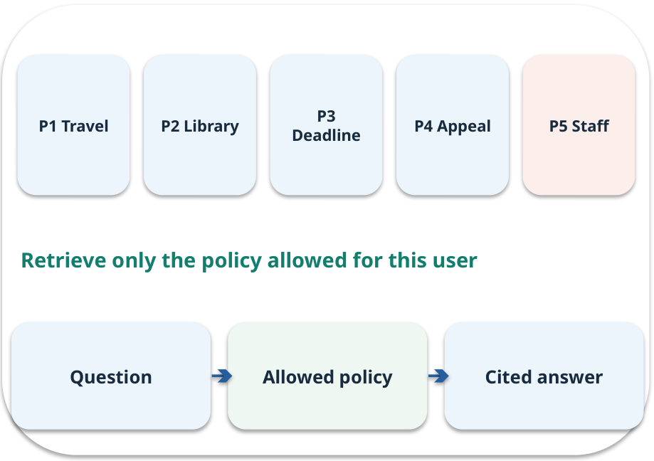
Week 07 · Building and checking RAG
OPEN / WEEK 07
The cited deadline answer
The assistant cites P3 for “two extensions,” but P3 permits one. A citation is present. Is the answer supported?
GENERATIVE AI 2027 • WEEK 07 • 01 / 40
Notes:
TEACHER SCRIPT — OPEN. Show the visual for ten seconds, then ask for an initial decision. Do not reveal the answer yet. Ask a student to name the source or measurement that would change their mind. This week’s case is: The college-policy assistant answers questions with policy IDs. The visible slide states: The cited deadline answer
The assistant cites P3 for “two extensions,” but P3 permits one. A citation is present. Is the answer supported? Reveal that the case will be revisited after four short concept cycles. The target is: Connect retrieved evidence to an answer and abstain when support is absent. Listen for an explanation of the actual arrow or calculation, not just a repeated label. If the answer is unsupported, mark that uncertainty and return to the source. Before moving on, ask for the main idea and one concrete change to the worked example.

Slide 2

First vote: what would you do?
QUESTION / WEEK 07
The assistant cites P3 for “two extensions,” but P3 permits one. A citation is present. Is the answer supported?
Choose an initial answer and name one piece of evidence you need.
GENERATIVE AI 2027 • WEEK 07 • 02 / 40
Notes:
TEACHER SCRIPT — QUESTION. Take a show of hands for each choice before showing the mechanism. Ask pairs to defend a choice with evidence. Save the strongest wrong reason for the reveal later in this cycle. This week’s case is: The college-policy assistant answers questions with policy IDs. The visible slide states: The assistant cites P3 for “two extensions,” but P3 permits one. A citation is present. Is the answer supported?
Choose an initial answer and name one piece of evidence you need. Accept reasonable uncertainty; record the initial votes to revisit at the end. The target is: Connect retrieved evidence to an answer and abstain when support is absent. Listen for an explanation of the actual arrow or calculation, not just a repeated label. If the answer is unsupported, mark that uncertainty and return to the source. Before moving on, ask for the main idea and one concrete change to the worked example.

Slide 3
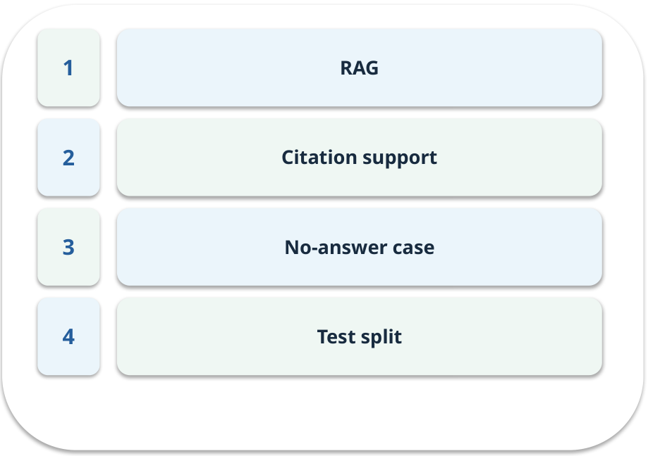
The journey through today’s case
OPEN / WEEK 07
We will predict, connect an analogy, trace a mechanism, work an example, then explain a decision.
GENERATIVE AI 2027 • WEEK 07 • 03 / 40
Notes:
TEACHER SCRIPT — OPEN. Show the visual for ten seconds, then ask for an initial decision. Do not reveal the answer yet. Ask a student to name the source or measurement that would change their mind. This week’s case is: The college-policy assistant answers questions with policy IDs. The visible slide states: We will predict, connect an analogy, trace a mechanism, work an example, then explain a decision. Point to the four named ideas, then show where the notebook experiment fits. The target is: Connect retrieved evidence to an answer and abstain when support is absent. Listen for an explanation of the actual arrow or calculation, not just a repeated label. If the answer is unsupported, mark that uncertainty and return to the source. Before moving on, ask for the main idea and one concrete change to the worked example.

Slide 4
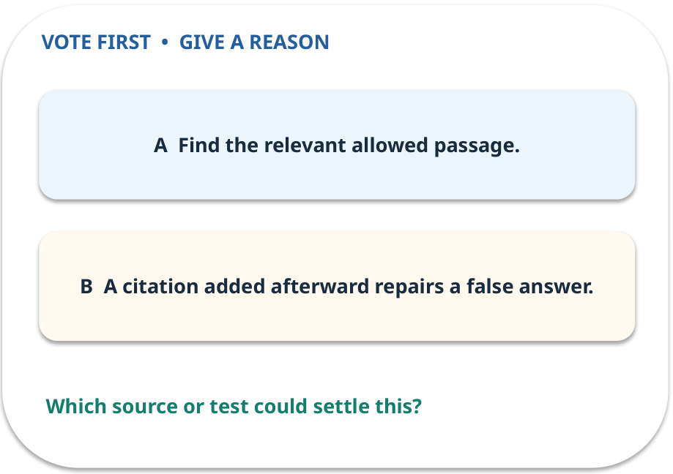
1. Predict · RAG
QUESTION / WEEK 07
Which step happens before drafting?
Make a choice before we explain the diagram.
GENERATIVE AI 2027 • WEEK 07 • 04 / 40
Notes:
TEACHER SCRIPT — QUESTION. Take a show of hands for each choice before showing the mechanism. Ask pairs to defend a choice with evidence. Save the strongest wrong reason for the reveal later in this cycle. This week’s case is: The college-policy assistant answers questions with policy IDs. The visible slide states: Which step happens before drafting?
Make a choice before we explain the diagram. The intended answer is Find the relevant allowed passage. The tempting claim is A citation added afterward repairs a false answer. Do not show which card is correct until the reveal. The target is: Connect retrieved evidence to an answer and abstain when support is absent. Listen for an explanation of the actual arrow or calculation, not just a repeated label. If the answer is unsupported, mark that uncertainty and return to the source. Before moving on, ask for the main idea and one concrete change to the worked example.

Slide 5
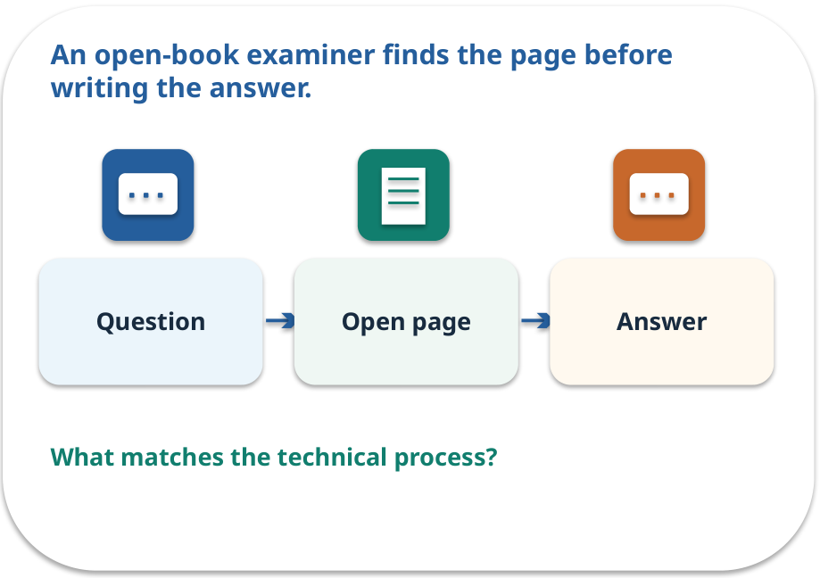
RAG · a familiar picture
ANALOGY / WEEK 07
An open-book examiner finds the page before writing the answer.
What matches our case, and where does the analogy stop?
GENERATIVE AI 2027 • WEEK 07 • 05 / 40
Notes:
TEACHER SCRIPT — ANALOGY. Begin with the familiar scene. Invite learners to describe each part in everyday language. Then ask where the comparison might fail before introducing the technical vocabulary. This week’s case is: The college-policy assistant answers questions with policy IDs. The visible slide states: An open-book examiner finds the page before writing the answer.
What matches our case, and where does the analogy stop? The boundary is: Retrieval can pick an irrelevant page; answer quality depends on what was found. The target is: Connect retrieved evidence to an answer and abstain when support is absent. Listen for an explanation of the actual arrow or calculation, not just a repeated label. If the answer is unsupported, mark that uncertainty and return to the source. Before moving on, ask for the main idea and one concrete change to the worked example.

Slide 6
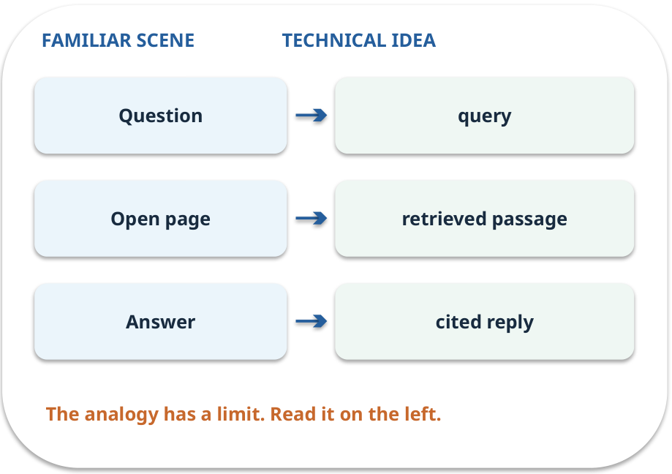
RAG · map the parts
MAPPING / WEEK 07
Match each everyday part to the technical part.
Analogy limit: Retrieval can pick an irrelevant page; answer quality depends on what was found.
GENERATIVE AI 2027 • WEEK 07 • 06 / 40
Notes:
TEACHER SCRIPT — MAPPING. Point from each familiar element to the corresponding technical element. Have students cover the right column and reconstruct the three matches. Read the limitation aloud. This week’s case is: The college-policy assistant answers questions with policy IDs. The visible slide states: Match each everyday part to the technical part.
Analogy limit: Retrieval can pick an irrelevant page; answer quality depends on what was found. The three precise mappings are [['Question', 'query'], ['Open page', 'retrieved passage'], ['Answer', 'cited reply']]. The target is: Connect retrieved evidence to an answer and abstain when support is absent. Listen for an explanation of the actual arrow or calculation, not just a repeated label. If the answer is unsupported, mark that uncertainty and return to the source. Before moving on, ask for the main idea and one concrete change to the worked example.

Slide 7
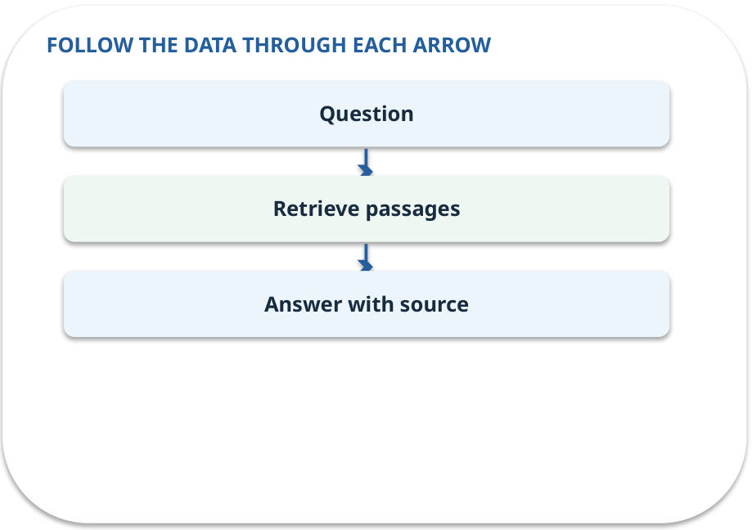
RAG · how it works
MECHANISM / WEEK 07
Retrieve relevant text for the current request, then draft an answer bounded by that text.
Trace the arrows from left to right.
GENERATIVE AI 2027 • WEEK 07 • 07 / 40
Notes:
TEACHER SCRIPT — MECHANISM. Trace every arrow slowly from the input to the output. Ask what information crosses the boundary at each arrow. Pause if students confuse a simplified notebook with a trained model. This week’s case is: The college-policy assistant answers questions with policy IDs. The visible slide states: Retrieve relevant text for the current request, then draft an answer bounded by that text.
Trace the arrows from left to right. The weekly example is: P3 states one extension in seven days; answer “one [P3]” after retrieving P3. State what the analogy does not explain: Retrieval can pick an irrelevant page; answer quality depends on what was found. The target is: Connect retrieved evidence to an answer and abstain when support is absent. Listen for an explanation of the actual arrow or calculation, not just a repeated label. If the answer is unsupported, mark that uncertainty and return to the source. Before moving on, ask for the main idea and one concrete change to the worked example.

Slide 8
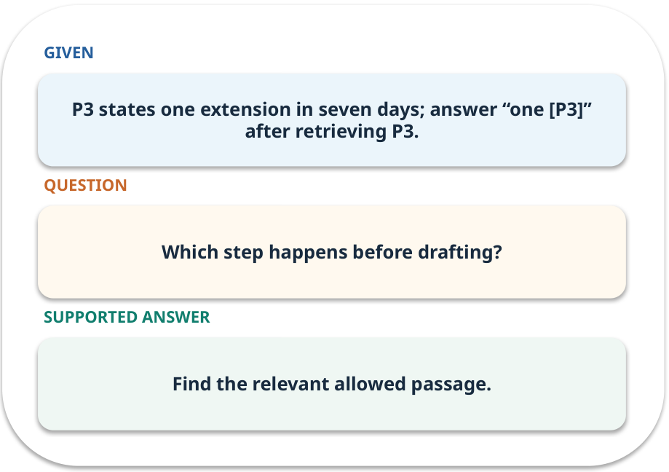
RAG · work one case
WORKED / WEEK 07
P3 states one extension in seven days; answer “one [P3]” after retrieving P3.
Point to the evidence before giving your conclusion.
GENERATIVE AI 2027 • WEEK 07 • 08 / 40
Notes:
TEACHER SCRIPT — WORKED. Work the specific numbers or source wording aloud. Give students thirty seconds to write a conclusion, then ask which source line or calculation supports it. This week’s case is: The college-policy assistant answers questions with policy IDs. The visible slide states: P3 states one extension in seven days; answer “one [P3]” after retrieving P3.
Point to the evidence before giving your conclusion. The expected reasoning concludes: Find the relevant allowed passage. Distinguish measured results from illustrative numbers. The target is: Connect retrieved evidence to an answer and abstain when support is absent. Listen for an explanation of the actual arrow or calculation, not just a repeated label. If the answer is unsupported, mark that uncertainty and return to the source. Before moving on, ask for the main idea and one concrete change to the worked example.

Slide 9
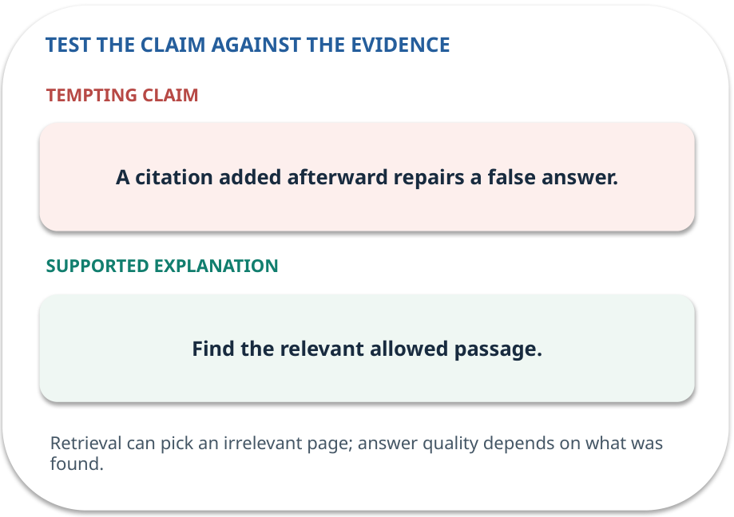
RAG · answer and explain
REVEAL / WEEK 07
Find the relevant allowed passage.
Tempting mistake: A citation added afterward repairs a false answer.
GENERATIVE AI 2027 • WEEK 07 • 09 / 40
Notes:
TEACHER SCRIPT — REVEAL. Return to the earlier choice. Explain the correct answer and why the tempting claim fails. Ask one learner to say the answer in a single sentence without reading it. This week’s case is: The college-policy assistant answers questions with policy IDs. The visible slide states: Find the relevant allowed passage.
Tempting mistake: A citation added afterward repairs a false answer. The earlier question was Which step happens before drafting? Ask how this differs from the wrong claim. The target is: Connect retrieved evidence to an answer and abstain when support is absent. Listen for an explanation of the actual arrow or calculation, not just a repeated label. If the answer is unsupported, mark that uncertainty and return to the source. Before moving on, ask for the main idea and one concrete change to the worked example.

Slide 10
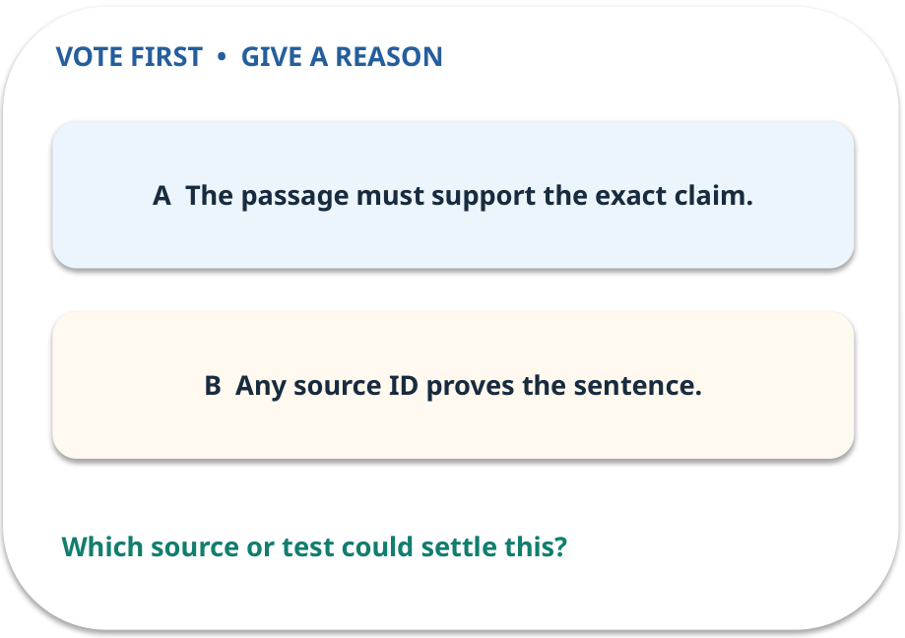
2. Predict · Citation support
QUESTION / WEEK 07
What must be checked beyond the presence of a citation?
Make a choice before we explain the diagram.
GENERATIVE AI 2027 • WEEK 07 • 10 / 40
Notes:
TEACHER SCRIPT — QUESTION. Take a show of hands for each choice before showing the mechanism. Ask pairs to defend a choice with evidence. Save the strongest wrong reason for the reveal later in this cycle. This week’s case is: The college-policy assistant answers questions with policy IDs. The visible slide states: What must be checked beyond the presence of a citation?
Make a choice before we explain the diagram. The intended answer is The passage must support the exact claim. The tempting claim is Any source ID proves the sentence. Do not show which card is correct until the reveal. The target is: Connect retrieved evidence to an answer and abstain when support is absent. Listen for an explanation of the actual arrow or calculation, not just a repeated label. If the answer is unsupported, mark that uncertainty and return to the source. Before moving on, ask for the main idea and one concrete change to the worked example.

Slide 11
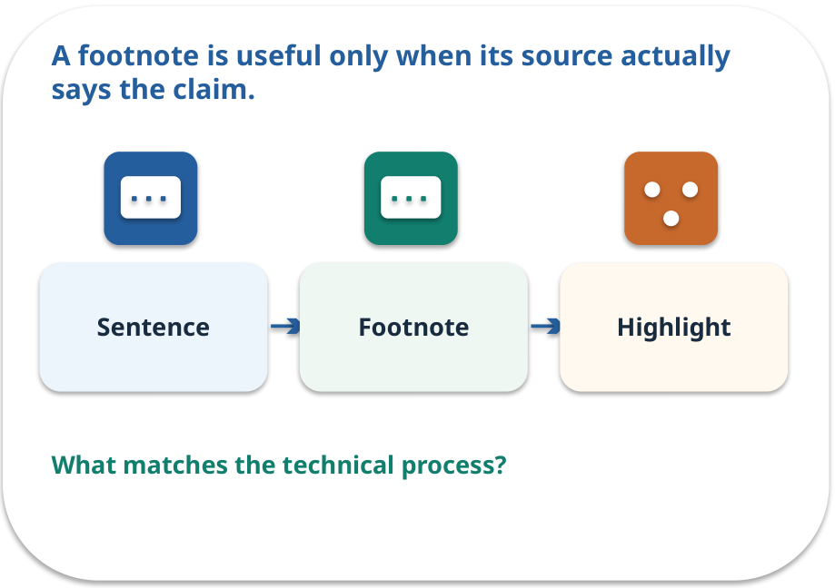
Citation support · a familiar picture
ANALOGY / WEEK 07
A footnote is useful only when its source actually says the claim.
What matches our case, and where does the analogy stop?
GENERATIVE AI 2027 • WEEK 07 • 11 / 40
Notes:
TEACHER SCRIPT — ANALOGY. Begin with the familiar scene. Invite learners to describe each part in everyday language. Then ask where the comparison might fail before introducing the technical vocabulary. This week’s case is: The college-policy assistant answers questions with policy IDs. The visible slide states: A footnote is useful only when its source actually says the claim.
What matches our case, and where does the analogy stop? The boundary is: Checking entailment can involve nuance; use a human for disputed cases. The target is: Connect retrieved evidence to an answer and abstain when support is absent. Listen for an explanation of the actual arrow or calculation, not just a repeated label. If the answer is unsupported, mark that uncertainty and return to the source. Before moving on, ask for the main idea and one concrete change to the worked example.

Slide 12
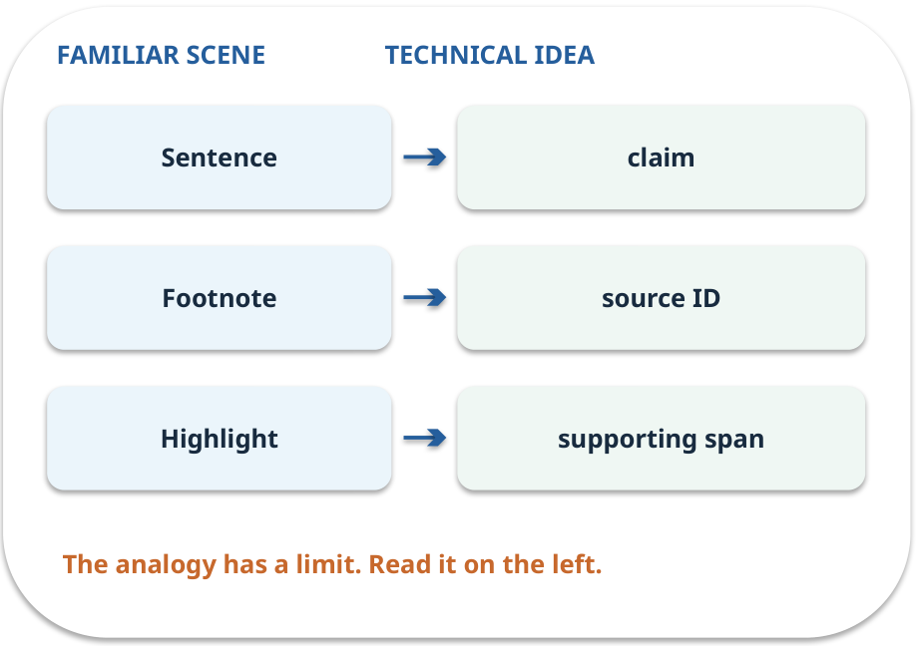
Citation support · map the parts
MAPPING / WEEK 07
Match each everyday part to the technical part.
Analogy limit: Checking entailment can involve nuance; use a human for disputed cases.
GENERATIVE AI 2027 • WEEK 07 • 12 / 40
Notes:
TEACHER SCRIPT — MAPPING. Point from each familiar element to the corresponding technical element. Have students cover the right column and reconstruct the three matches. Read the limitation aloud. This week’s case is: The college-policy assistant answers questions with policy IDs. The visible slide states: Match each everyday part to the technical part.
Analogy limit: Checking entailment can involve nuance; use a human for disputed cases. The three precise mappings are [['Sentence', 'claim'], ['Footnote', 'source ID'], ['Highlight', 'supporting span']]. The target is: Connect retrieved evidence to an answer and abstain when support is absent. Listen for an explanation of the actual arrow or calculation, not just a repeated label. If the answer is unsupported, mark that uncertainty and return to the source. Before moving on, ask for the main idea and one concrete change to the worked example.

Slide 13

Citation support · how it works
MECHANISM / WEEK 07
Check every material claim against the cited passage.
Trace the arrows from left to right.
GENERATIVE AI 2027 • WEEK 07 • 13 / 40
Notes:
TEACHER SCRIPT — MECHANISM. Trace every arrow slowly from the input to the output. Ask what information crosses the boundary at each arrow. Pause if students confuse a simplified notebook with a trained model. This week’s case is: The college-policy assistant answers questions with policy IDs. The visible slide states: Check every material claim against the cited passage.
Trace the arrows from left to right. The weekly example is: “Two extensions [P3]” is unsupported because P3 says one, even though the ID exists. State what the analogy does not explain: Checking entailment can involve nuance; use a human for disputed cases. The target is: Connect retrieved evidence to an answer and abstain when support is absent. Listen for an explanation of the actual arrow or calculation, not just a repeated label. If the answer is unsupported, mark that uncertainty and return to the source. Before moving on, ask for the main idea and one concrete change to the worked example.

Slide 14
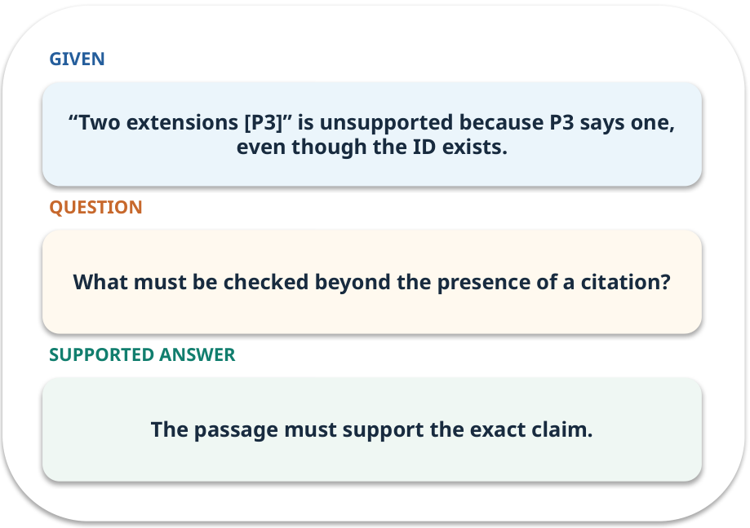
Citation support · work one case
WORKED / WEEK 07
“Two extensions [P3]” is unsupported because P3 says one, even though the ID exists.
Point to the evidence before giving your conclusion.
GENERATIVE AI 2027 • WEEK 07 • 14 / 40
Notes:
TEACHER SCRIPT — WORKED. Work the specific numbers or source wording aloud. Give students thirty seconds to write a conclusion, then ask which source line or calculation supports it. This week’s case is: The college-policy assistant answers questions with policy IDs. The visible slide states: “Two extensions [P3]” is unsupported because P3 says one, even though the ID exists.
Point to the evidence before giving your conclusion. The expected reasoning concludes: The passage must support the exact claim. Distinguish measured results from illustrative numbers. The target is: Connect retrieved evidence to an answer and abstain when support is absent. Listen for an explanation of the actual arrow or calculation, not just a repeated label. If the answer is unsupported, mark that uncertainty and return to the source. Before moving on, ask for the main idea and one concrete change to the worked example.

Slide 15
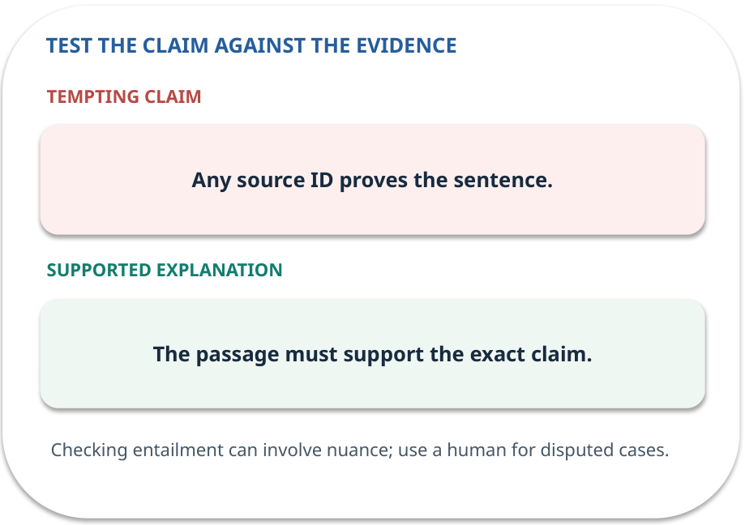
Citation support · answer and explain
REVEAL / WEEK 07
The passage must support the exact claim.
Tempting mistake: Any source ID proves the sentence.
GENERATIVE AI 2027 • WEEK 07 • 15 / 40
Notes:
TEACHER SCRIPT — REVEAL. Return to the earlier choice. Explain the correct answer and why the tempting claim fails. Ask one learner to say the answer in a single sentence without reading it. This week’s case is: The college-policy assistant answers questions with policy IDs. The visible slide states: The passage must support the exact claim.
Tempting mistake: Any source ID proves the sentence. The earlier question was What must be checked beyond the presence of a citation? Ask how this differs from the wrong claim. The target is: Connect retrieved evidence to an answer and abstain when support is absent. Listen for an explanation of the actual arrow or calculation, not just a repeated label. If the answer is unsupported, mark that uncertainty and return to the source. Before moving on, ask for the main idea and one concrete change to the worked example.

Slide 16
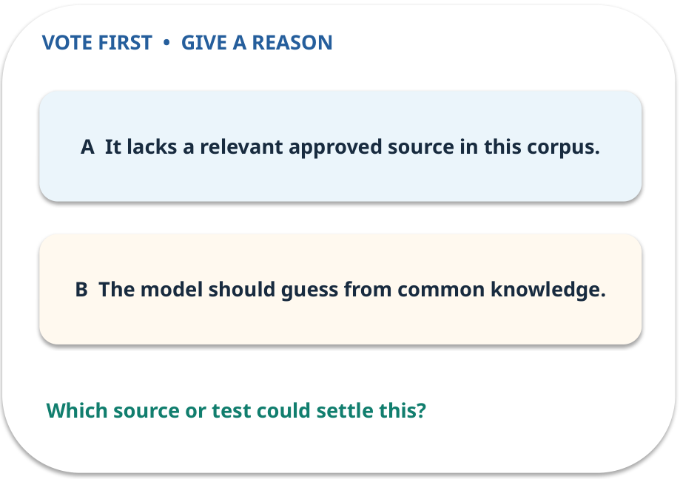
3. Predict · No-answer case
QUESTION / WEEK 07
What should the system say?
Make a choice before we explain the diagram.
GENERATIVE AI 2027 • WEEK 07 • 16 / 40
Notes:
TEACHER SCRIPT — QUESTION. Take a show of hands for each choice before showing the mechanism. Ask pairs to defend a choice with evidence. Save the strongest wrong reason for the reveal later in this cycle. This week’s case is: The college-policy assistant answers questions with policy IDs. The visible slide states: What should the system say?
Make a choice before we explain the diagram. The intended answer is It lacks a relevant approved source in this corpus. The tempting claim is The model should guess from common knowledge. Do not show which card is correct until the reveal. The target is: Connect retrieved evidence to an answer and abstain when support is absent. Listen for an explanation of the actual arrow or calculation, not just a repeated label. If the answer is unsupported, mark that uncertainty and return to the source. Before moving on, ask for the main idea and one concrete change to the worked example.

Slide 17
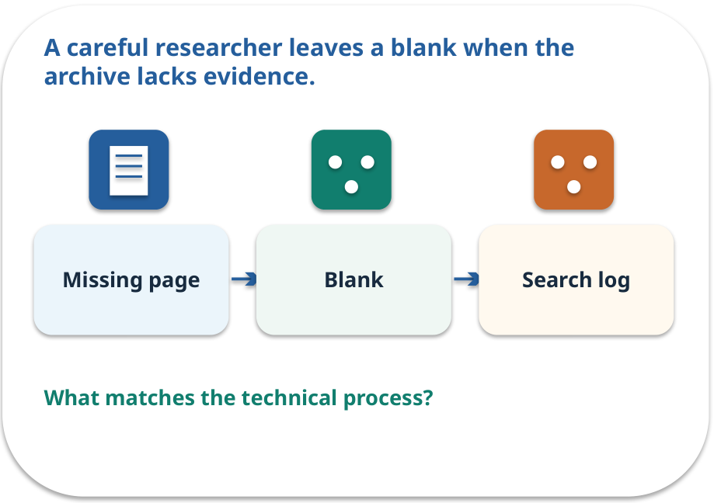
No-answer case · a familiar picture
ANALOGY / WEEK 07
A careful researcher leaves a blank when the archive lacks evidence.
What matches our case, and where does the analogy stop?
GENERATIVE AI 2027 • WEEK 07 • 17 / 40
Notes:
TEACHER SCRIPT — ANALOGY. Begin with the familiar scene. Invite learners to describe each part in everyday language. Then ask where the comparison might fail before introducing the technical vocabulary. This week’s case is: The college-policy assistant answers questions with policy IDs. The visible slide states: A careful researcher leaves a blank when the archive lacks evidence.
What matches our case, and where does the analogy stop? The boundary is: A retrieval miss may hide a real answer elsewhere; report the search limit. The target is: Connect retrieved evidence to an answer and abstain when support is absent. Listen for an explanation of the actual arrow or calculation, not just a repeated label. If the answer is unsupported, mark that uncertainty and return to the source. Before moving on, ask for the main idea and one concrete change to the worked example.

Slide 18
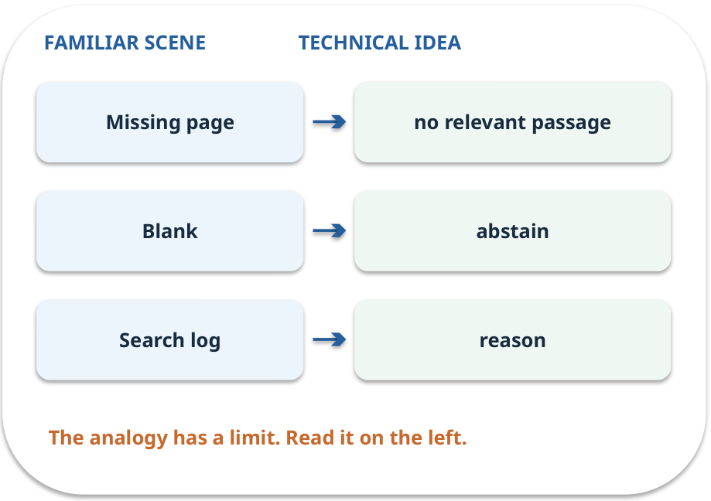
No-answer case · map the parts
MAPPING / WEEK 07
Match each everyday part to the technical part.
Analogy limit: A retrieval miss may hide a real answer elsewhere; report the search limit.
GENERATIVE AI 2027 • WEEK 07 • 18 / 40
Notes:
TEACHER SCRIPT — MAPPING. Point from each familiar element to the corresponding technical element. Have students cover the right column and reconstruct the three matches. Read the limitation aloud. This week’s case is: The college-policy assistant answers questions with policy IDs. The visible slide states: Match each everyday part to the technical part.
Analogy limit: A retrieval miss may hide a real answer elsewhere; report the search limit. The three precise mappings are [['Missing page', 'no relevant passage'], ['Blank', 'abstain'], ['Search log', 'reason']]. The target is: Connect retrieved evidence to an answer and abstain when support is absent. Listen for an explanation of the actual arrow or calculation, not just a repeated label. If the answer is unsupported, mark that uncertainty and return to the source. Before moving on, ask for the main idea and one concrete change to the worked example.

Slide 19
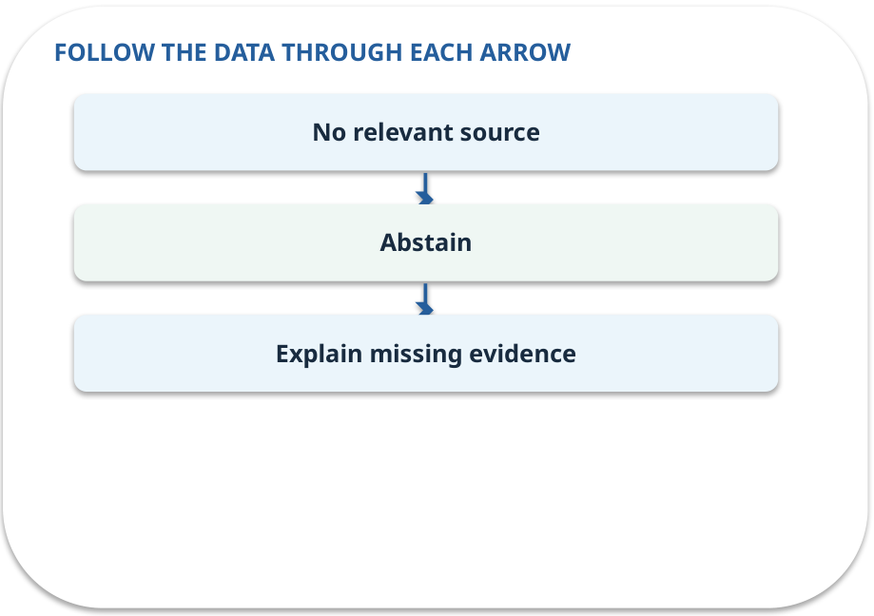
No-answer case · how it works
MECHANISM / WEEK 07
If approved sources lack an answer, return a clear unsupported status.
Trace the arrows from left to right.
GENERATIVE AI 2027 • WEEK 07 • 19 / 40
Notes:
TEACHER SCRIPT — MECHANISM. Trace every arrow slowly from the input to the output. Ask what information crosses the boundary at each arrow. Pause if students confuse a simplified notebook with a trained model. This week’s case is: The college-policy assistant answers questions with policy IDs. The visible slide states: If approved sources lack an answer, return a clear unsupported status.
Trace the arrows from left to right. The weekly example is: Ask about parking permits; none of five policies covers it, so say evidence is unavailable. State what the analogy does not explain: A retrieval miss may hide a real answer elsewhere; report the search limit. The target is: Connect retrieved evidence to an answer and abstain when support is absent. Listen for an explanation of the actual arrow or calculation, not just a repeated label. If the answer is unsupported, mark that uncertainty and return to the source. Before moving on, ask for the main idea and one concrete change to the worked example.

Slide 20
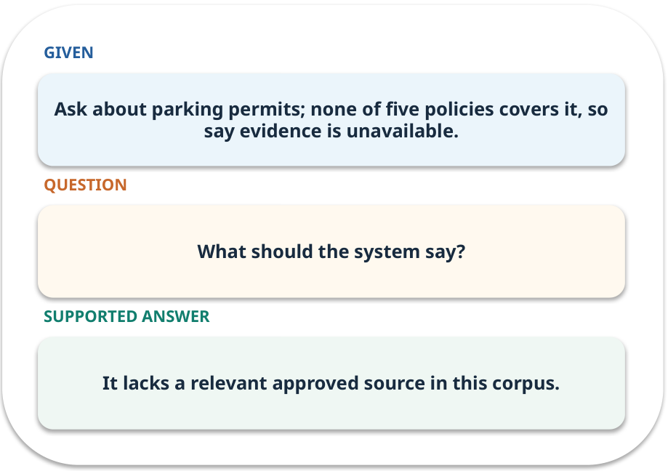
No-answer case · work one case
WORKED / WEEK 07
Ask about parking permits; none of five policies covers it, so say evidence is unavailable.
Point to the evidence before giving your conclusion.
GENERATIVE AI 2027 • WEEK 07 • 20 / 40
Notes:
TEACHER SCRIPT — WORKED. Work the specific numbers or source wording aloud. Give students thirty seconds to write a conclusion, then ask which source line or calculation supports it. This week’s case is: The college-policy assistant answers questions with policy IDs. The visible slide states: Ask about parking permits; none of five policies covers it, so say evidence is unavailable.
Point to the evidence before giving your conclusion. The expected reasoning concludes: It lacks a relevant approved source in this corpus. Distinguish measured results from illustrative numbers. The target is: Connect retrieved evidence to an answer and abstain when support is absent. Listen for an explanation of the actual arrow or calculation, not just a repeated label. If the answer is unsupported, mark that uncertainty and return to the source. Before moving on, ask for the main idea and one concrete change to the worked example.

Slide 21
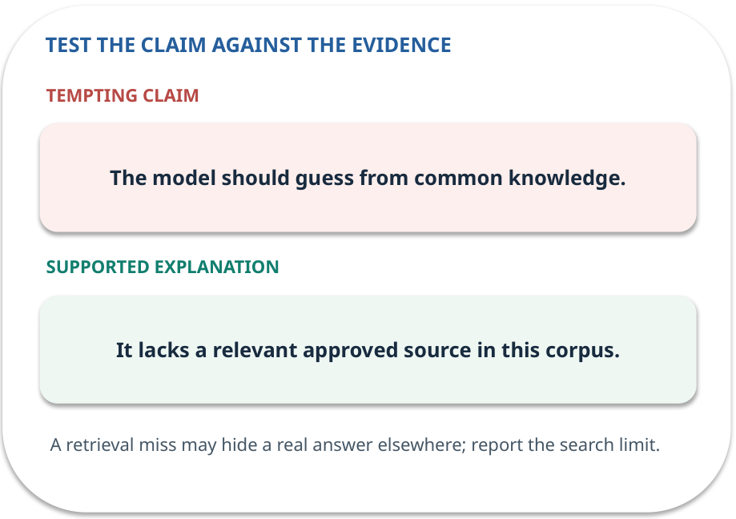
No-answer case · answer and explain
REVEAL / WEEK 07
It lacks a relevant approved source in this corpus.
Tempting mistake: The model should guess from common knowledge.
GENERATIVE AI 2027 • WEEK 07 • 21 / 40
Notes:
TEACHER SCRIPT — REVEAL. Return to the earlier choice. Explain the correct answer and why the tempting claim fails. Ask one learner to say the answer in a single sentence without reading it. This week’s case is: The college-policy assistant answers questions with policy IDs. The visible slide states: It lacks a relevant approved source in this corpus.
Tempting mistake: The model should guess from common knowledge. The earlier question was What should the system say? Ask how this differs from the wrong claim. The target is: Connect retrieved evidence to an answer and abstain when support is absent. Listen for an explanation of the actual arrow or calculation, not just a repeated label. If the answer is unsupported, mark that uncertainty and return to the source. Before moving on, ask for the main idea and one concrete change to the worked example.

Slide 22
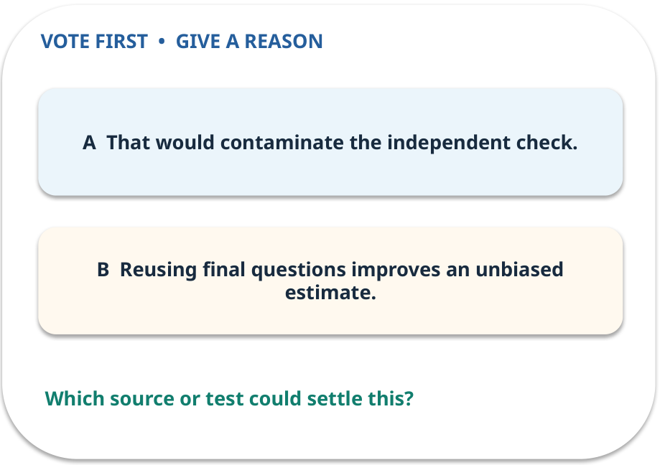
4. Predict · Test split
QUESTION / WEEK 07
Why not tune again after seeing the ten final answers?
Make a choice before we explain the diagram.
GENERATIVE AI 2027 • WEEK 07 • 22 / 40
Notes:
TEACHER SCRIPT — QUESTION. Take a show of hands for each choice before showing the mechanism. Ask pairs to defend a choice with evidence. Save the strongest wrong reason for the reveal later in this cycle. This week’s case is: The college-policy assistant answers questions with policy IDs. The visible slide states: Why not tune again after seeing the ten final answers?
Make a choice before we explain the diagram. The intended answer is That would contaminate the independent check. The tempting claim is Reusing final questions improves an unbiased estimate. Do not show which card is correct until the reveal. The target is: Connect retrieved evidence to an answer and abstain when support is absent. Listen for an explanation of the actual arrow or calculation, not just a repeated label. If the answer is unsupported, mark that uncertainty and return to the source. Before moving on, ask for the main idea and one concrete change to the worked example.

Slide 23
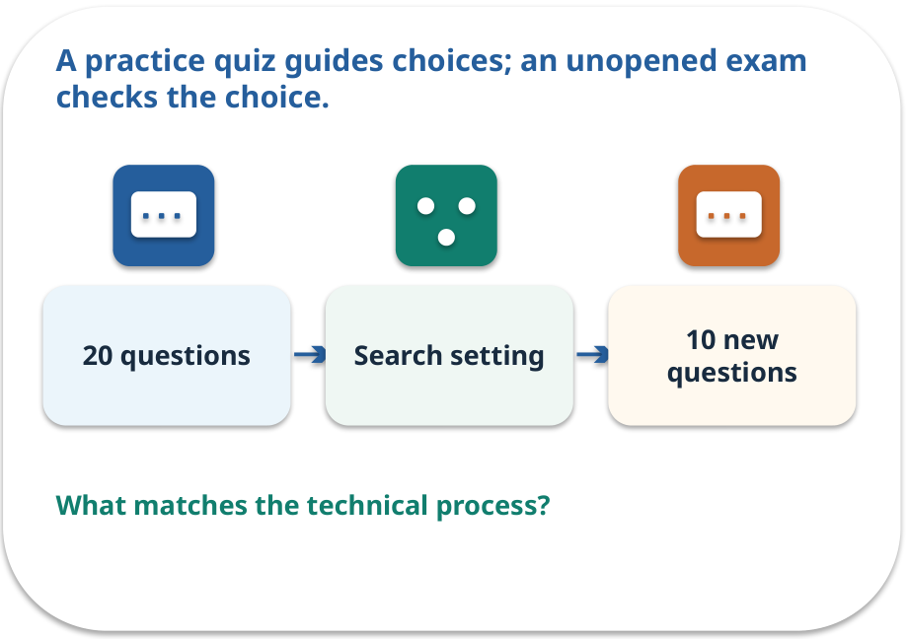
Test split · a familiar picture
ANALOGY / WEEK 07
A practice quiz guides choices; an unopened exam checks the choice.
What matches our case, and where does the analogy stop?
GENERATIVE AI 2027 • WEEK 07 • 23 / 40
Notes:
TEACHER SCRIPT — ANALOGY. Begin with the familiar scene. Invite learners to describe each part in everyday language. Then ask where the comparison might fail before introducing the technical vocabulary. This week’s case is: The college-policy assistant answers questions with policy IDs. The visible slide states: A practice quiz guides choices; an unopened exam checks the choice.
What matches our case, and where does the analogy stop? The boundary is: Ten final cases are still a small sample; report each failure and denominator. The target is: Connect retrieved evidence to an answer and abstain when support is absent. Listen for an explanation of the actual arrow or calculation, not just a repeated label. If the answer is unsupported, mark that uncertainty and return to the source. Before moving on, ask for the main idea and one concrete change to the worked example.

Slide 24
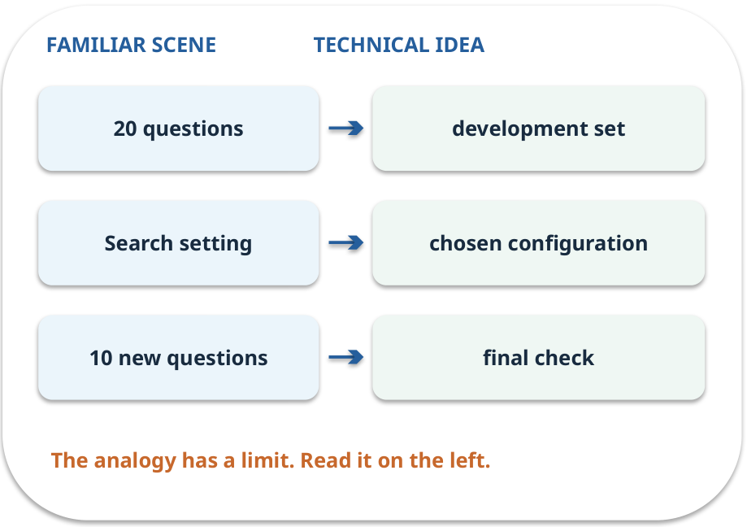
Test split · map the parts
MAPPING / WEEK 07
Match each everyday part to the technical part.
Analogy limit: Ten final cases are still a small sample; report each failure and denominator.
GENERATIVE AI 2027 • WEEK 07 • 24 / 40
Notes:
TEACHER SCRIPT — MAPPING. Point from each familiar element to the corresponding technical element. Have students cover the right column and reconstruct the three matches. Read the limitation aloud. This week’s case is: The college-policy assistant answers questions with policy IDs. The visible slide states: Match each everyday part to the technical part.
Analogy limit: Ten final cases are still a small sample; report each failure and denominator. The three precise mappings are [['20 questions', 'development set'], ['Search setting', 'chosen configuration'], ['10 new questions', 'final check']]. The target is: Connect retrieved evidence to an answer and abstain when support is absent. Listen for an explanation of the actual arrow or calculation, not just a repeated label. If the answer is unsupported, mark that uncertainty and return to the source. Before moving on, ask for the main idea and one concrete change to the worked example.

Slide 25
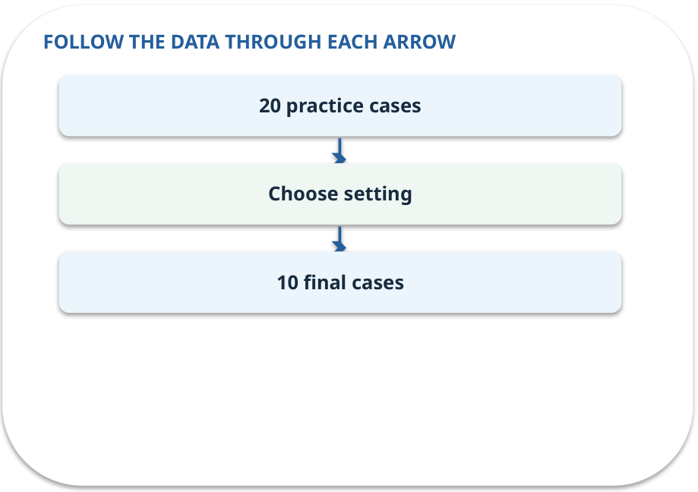
Test split · how it works
MECHANISM / WEEK 07
Use 20 practice questions for improvements and keep ten separate questions for final checking.
Trace the arrows from left to right.
GENERATIVE AI 2027 • WEEK 07 • 25 / 40
Notes:
TEACHER SCRIPT — MECHANISM. Trace every arrow slowly from the input to the output. Ask what information crosses the boundary at each arrow. Pause if students confuse a simplified notebook with a trained model. This week’s case is: The college-policy assistant answers questions with policy IDs. The visible slide states: Use 20 practice questions for improvements and keep ten separate questions for final checking.
Trace the arrows from left to right. The weekly example is: Compare top-k 1 and 2 on 20 practice questions, freeze the choice, then open ten final cases. State what the analogy does not explain: Ten final cases are still a small sample; report each failure and denominator. The target is: Connect retrieved evidence to an answer and abstain when support is absent. Listen for an explanation of the actual arrow or calculation, not just a repeated label. If the answer is unsupported, mark that uncertainty and return to the source. Before moving on, ask for the main idea and one concrete change to the worked example.

Slide 26
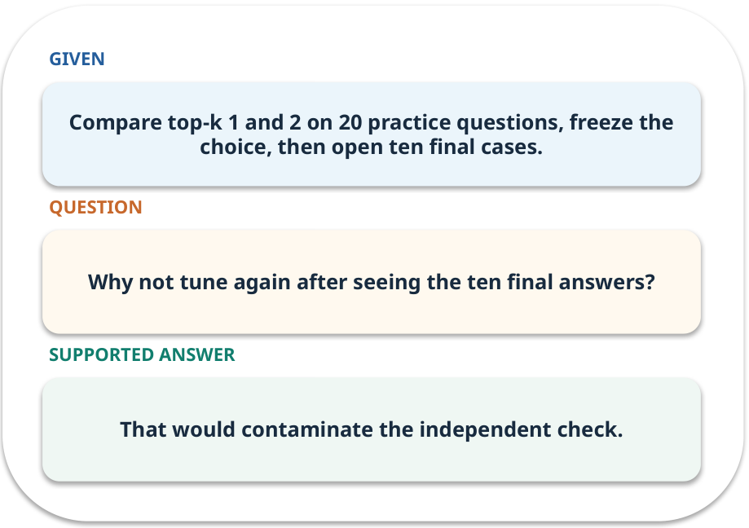
Test split · work one case
WORKED / WEEK 07
Compare top-k 1 and 2 on 20 practice questions, freeze the choice, then open ten final cases.
Point to the evidence before giving your conclusion.
GENERATIVE AI 2027 • WEEK 07 • 26 / 40
Notes:
TEACHER SCRIPT — WORKED. Work the specific numbers or source wording aloud. Give students thirty seconds to write a conclusion, then ask which source line or calculation supports it. This week’s case is: The college-policy assistant answers questions with policy IDs. The visible slide states: Compare top-k 1 and 2 on 20 practice questions, freeze the choice, then open ten final cases.
Point to the evidence before giving your conclusion. The expected reasoning concludes: That would contaminate the independent check. Distinguish measured results from illustrative numbers. The target is: Connect retrieved evidence to an answer and abstain when support is absent. Listen for an explanation of the actual arrow or calculation, not just a repeated label. If the answer is unsupported, mark that uncertainty and return to the source. Before moving on, ask for the main idea and one concrete change to the worked example.

Slide 27
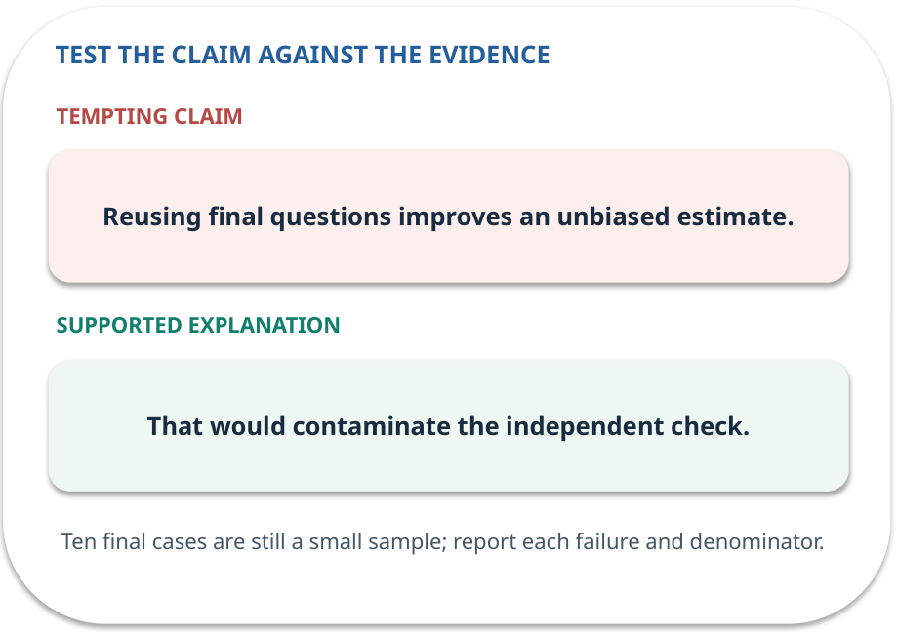
Test split · answer and explain
REVEAL / WEEK 07
That would contaminate the independent check.
Tempting mistake: Reusing final questions improves an unbiased estimate.
GENERATIVE AI 2027 • WEEK 07 • 27 / 40
Notes:
TEACHER SCRIPT — REVEAL. Return to the earlier choice. Explain the correct answer and why the tempting claim fails. Ask one learner to say the answer in a single sentence without reading it. This week’s case is: The college-policy assistant answers questions with policy IDs. The visible slide states: That would contaminate the independent check.
Tempting mistake: Reusing final questions improves an unbiased estimate. The earlier question was Why not tune again after seeing the ten final answers? Ask how this differs from the wrong claim. The target is: Connect retrieved evidence to an answer and abstain when support is absent. Listen for an explanation of the actual arrow or calculation, not just a repeated label. If the answer is unsupported, mark that uncertainty and return to the source. Before moving on, ask for the main idea and one concrete change to the worked example.

Slide 28
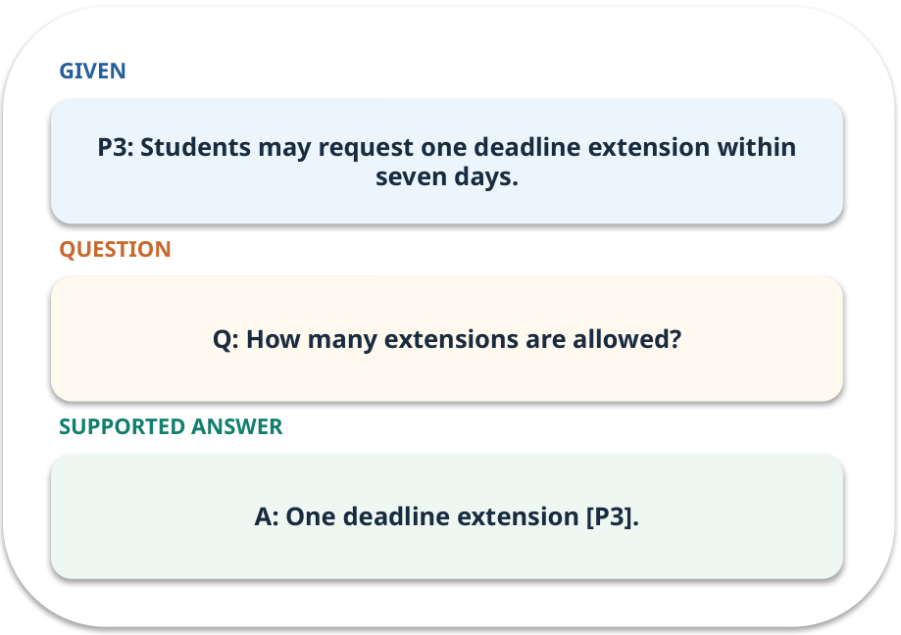
Evidence trail: input → result
WORKED / WEEK 07
Q: How many extensions are allowed?
A: One deadline extension [P3].
GENERATIVE AI 2027 • WEEK 07 • 28 / 40
Notes:
TEACHER SCRIPT — WORKED. Work the specific numbers or source wording aloud. Give students thirty seconds to write a conclusion, then ask which source line or calculation supports it. This week’s case is: The college-policy assistant answers questions with policy IDs. The visible slide states: Q: How many extensions are allowed?
A: One deadline extension [P3]. Have one student point to an exact source word or number for each conclusion. The target is: Connect retrieved evidence to an answer and abstain when support is absent. Listen for an explanation of the actual arrow or calculation, not just a repeated label. If the answer is unsupported, mark that uncertainty and return to the source. Before moving on, ask for the main idea and one concrete change to the worked example.

Slide 29
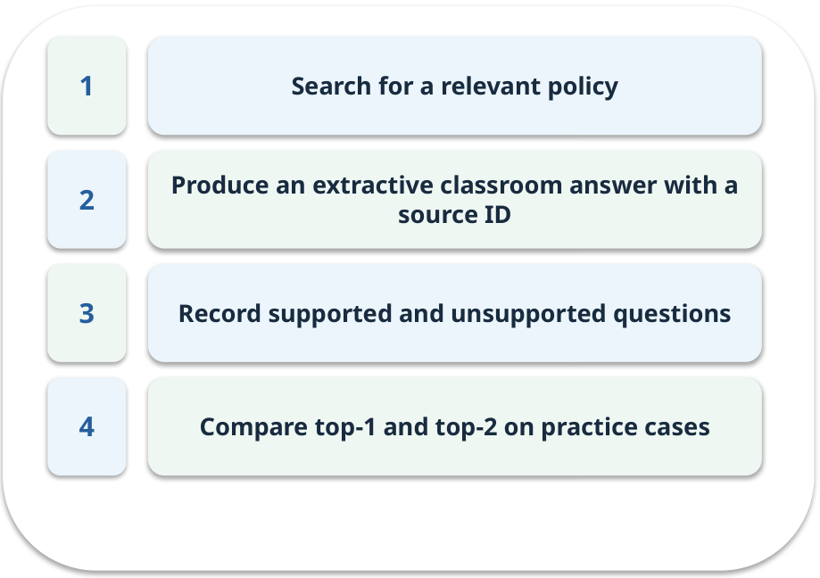
Notebook: run the prepared example
PRACTICE / WEEK 07
Run a small extractive retrieval and answer pipeline.
Read the original output before editing.
GENERATIVE AI 2027 • WEEK 07 • 29 / 40
Notes:
TEACHER SCRIPT — PRACTICE. Open the matching notebook and demonstrate the first run. Have learners predict one change, run only that change, and record input, setting, output and an error explanation. This week’s case is: The college-policy assistant answers questions with policy IDs. The visible slide states: Run a small extractive retrieval and answer pipeline.
Read the original output before editing. Use Week_07_Lab.ipynb. This lab is a prepared classroom demonstration with its limitations documented. The target is: Connect retrieved evidence to an answer and abstain when support is absent. Listen for an explanation of the actual arrow or calculation, not just a repeated label. If the answer is unsupported, mark that uncertainty and return to the source. Before moving on, ask for the main idea and one concrete change to the worked example.

Slide 30

Find the input and check in Python
PRACTICE / WEEK 07
Locate the supplied input, the transformation, the checking line and the printed result.
GENERATIVE AI 2027 • WEEK 07 • 30 / 40
Notes:
TEACHER SCRIPT — PRACTICE. Open the matching notebook and demonstrate the first run. Have learners predict one change, run only that change, and record input, setting, output and an error explanation. This week’s case is: The college-policy assistant answers questions with policy IDs. The visible slide states: Locate the supplied input, the transformation, the checking line and the printed result. The weekly lab change is: Replace a relevant passage with an irrelevant one and observe abstention. The target is: Connect retrieved evidence to an answer and abstain when support is absent. Listen for an explanation of the actual arrow or calculation, not just a repeated label. If the answer is unsupported, mark that uncertainty and return to the source. Before moving on, ask for the main idea and one concrete change to the worked example.

Slide 31

Predict one controlled change
PRACTICE / WEEK 07
Replace a relevant passage with an irrelevant one and observe abstention.
What should change in the result? What stays fixed?
GENERATIVE AI 2027 • WEEK 07 • 31 / 40
Notes:
TEACHER SCRIPT — PRACTICE. Open the matching notebook and demonstrate the first run. Have learners predict one change, run only that change, and record input, setting, output and an error explanation. This week’s case is: The college-policy assistant answers questions with policy IDs. The visible slide states: Replace a relevant passage with an irrelevant one and observe abstention.
What should change in the result? What stays fixed? Ask learners to write their prediction before rerunning the cell. The target is: Connect retrieved evidence to an answer and abstain when support is absent. Listen for an explanation of the actual arrow or calculation, not just a repeated label. If the answer is unsupported, mark that uncertainty and return to the source. Before moving on, ask for the main idea and one concrete change to the worked example.

Slide 32

Run, compare and record
PRACTICE / WEEK 07
Record the input, the one changed setting, the observed result and a reason for any difference.
GENERATIVE AI 2027 • WEEK 07 • 32 / 40
Notes:
TEACHER SCRIPT — PRACTICE. Open the matching notebook and demonstrate the first run. Have learners predict one change, run only that change, and record input, setting, output and an error explanation. This week’s case is: The college-policy assistant answers questions with policy IDs. The visible slide states: Record the input, the one changed setting, the observed result and a reason for any difference. The required evidence is: Twenty-case practice table; ten final questions remain sealed for assessment. The target is: Connect retrieved evidence to an answer and abstain when support is absent. Listen for an explanation of the actual arrow or calculation, not just a repeated label. If the answer is unsupported, mark that uncertainty and return to the source. Before moving on, ask for the main idea and one concrete change to the worked example.

Slide 33

Measure without hiding the denominator
CHECK / WEEK 07
Supported claims / checked claims and no-answer accuracy
Write the numerator, denominator and one failure case.
GENERATIVE AI 2027 • WEEK 07 • 33 / 40
Notes:
TEACHER SCRIPT — CHECK. Use this as a brief formative check. Ask for the conclusion, the evidence and one limitation. Revisit disagreements in the review session and offer an extension only after the core task. This week’s case is: The college-policy assistant answers questions with policy IDs. The visible slide states: Supported claims / checked claims and no-answer accuracy
Write the numerator, denominator and one failure case. Where a measure is qualitative, show the concrete source comparison. Example: A: One deadline extension [P3]. The target is: Connect retrieved evidence to an answer and abstain when support is absent. Listen for an explanation of the actual arrow or calculation, not just a repeated label. If the answer is unsupported, mark that uncertainty and return to the source. Before moving on, ask for the main idea and one concrete change to the worked example.

Slide 34
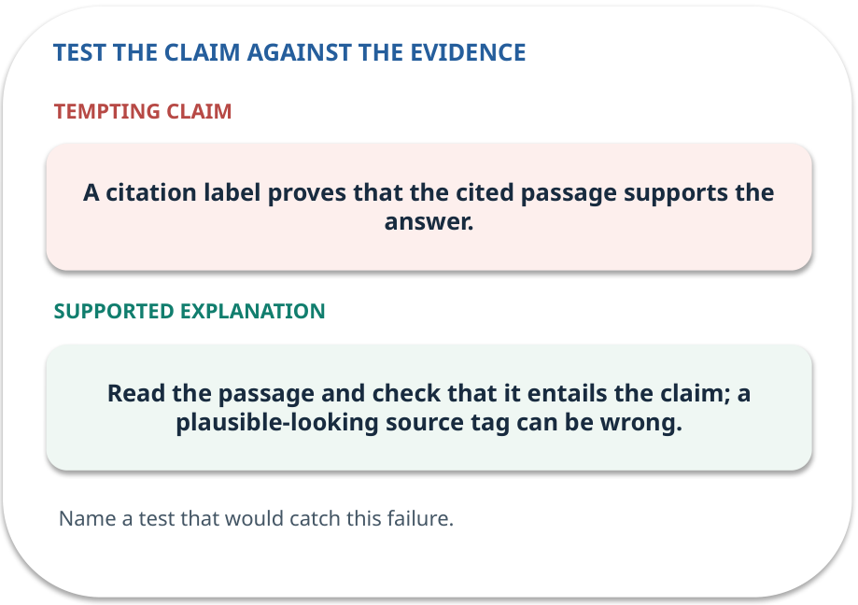
Error detective: find the layer
CHECK / WEEK 07
Plausible wrong claim: A citation label proves that the cited passage supports the answer.
Correct it using the case evidence.
GENERATIVE AI 2027 • WEEK 07 • 34 / 40
Notes:
TEACHER SCRIPT — CHECK. Use this as a brief formative check. Ask for the conclusion, the evidence and one limitation. Revisit disagreements in the review session and offer an extension only after the core task. This week’s case is: The college-policy assistant answers questions with policy IDs. The visible slide states: Plausible wrong claim: A citation label proves that the cited passage supports the answer.
Correct it using the case evidence. The correction is Read the passage and check that it entails the claim; a plausible-looking source tag can be wrong. The target is: Connect retrieved evidence to an answer and abstain when support is absent. Listen for an explanation of the actual arrow or calculation, not just a repeated label. If the answer is unsupported, mark that uncertainty and return to the source. Before moving on, ask for the main idea and one concrete change to the worked example.

Slide 35

Transfer to a new situation
CHECK / WEEK 07
A fresh question asks about a rule absent from all five policies. What should the assistant do?
Explain which source or test would settle it.
GENERATIVE AI 2027 • WEEK 07 • 35 / 40
Notes:
TEACHER SCRIPT — CHECK. Use this as a brief formative check. Ask for the conclusion, the evidence and one limitation. Revisit disagreements in the review session and offer an extension only after the core task. This week’s case is: The college-policy assistant answers questions with policy IDs. The visible slide states: A fresh question asks about a rule absent from all five policies. What should the assistant do?
Explain which source or test would settle it. This is a fresh scenario, so ask for a reason before accepting either short answer. The target is: Connect retrieved evidence to an answer and abstain when support is absent. Listen for an explanation of the actual arrow or calculation, not just a repeated label. If the answer is unsupported, mark that uncertainty and return to the source. Before moving on, ask for the main idea and one concrete change to the worked example.

Slide 36
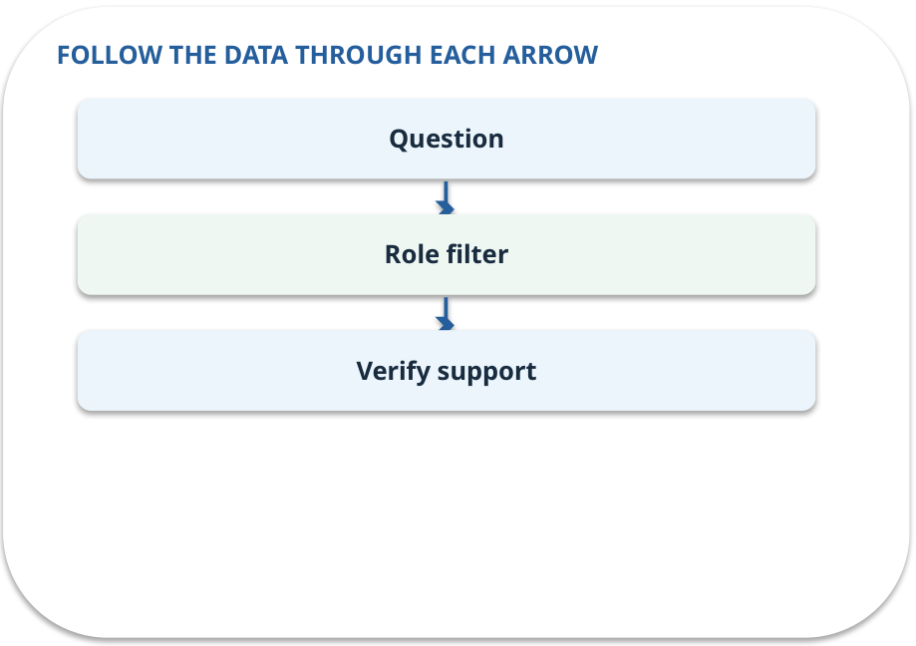
Explain it to a partner
CHECK / WEEK 07
Without reading the slide, name the input, one processing step and the check. Your partner should ask “How do you know?”
GENERATIVE AI 2027 • WEEK 07 • 36 / 40
Notes:
TEACHER SCRIPT — CHECK. Use this as a brief formative check. Ask for the conclusion, the evidence and one limitation. Revisit disagreements in the review session and offer an extension only after the core task. This week’s case is: The college-policy assistant answers questions with policy IDs. The visible slide states: Without reading the slide, name the input, one processing step and the check. Your partner should ask “How do you know?” Listen for a causal explanation and one limitation, then revisit a difficult arrow on the board. The target is: Connect retrieved evidence to an answer and abstain when support is absent. Listen for an explanation of the actual arrow or calculation, not just a repeated label. If the answer is unsupported, mark that uncertainty and return to the source. Before moving on, ask for the main idea and one concrete change to the worked example.

Slide 37

Exam rehearsal · explain and apply
CHECK / WEEK 07
Why reserve final questions?
Write a short answer, then compare with the guide.
GENERATIVE AI 2027 • WEEK 07 • 37 / 40
Notes:
TEACHER SCRIPT — CHECK. Use this as a brief formative check. Ask for the conclusion, the evidence and one limitation. Revisit disagreements in the review session and offer an extension only after the core task. This week’s case is: The college-policy assistant answers questions with policy IDs. The visible slide states: Why reserve final questions?
Write a short answer, then compare with the guide. Model answer after discussion: They estimate performance on cases that did not guide tuning. Repeated tuning on them leaks evaluation information. Practice marks: 4. The target is: Connect retrieved evidence to an answer and abstain when support is absent. Listen for an explanation of the actual arrow or calculation, not just a repeated label. If the answer is unsupported, mark that uncertainty and return to the source. Before moving on, ask for the main idea and one concrete change to the worked example.

Slide 38
Exam rehearsal · explain and apply
CHECK / WEEK 07
Two of four material claims are supported. What is citation support?
Write a short answer, then compare with the guide.
GENERATIVE AI 2027 • WEEK 07 • 38 / 40
Notes:
TEACHER SCRIPT — CHECK. Use this as a brief formative check. Ask for the conclusion, the evidence and one limitation. Revisit disagreements in the review session and offer an extension only after the core task. This week’s case is: The college-policy assistant answers questions with policy IDs. The visible slide states: Two of four material claims are supported. What is citation support?
Write a short answer, then compare with the guide. Model answer after discussion: 2/4 = 50%. Check each claim against its cited evidence. Practice marks: 4. The target is: Connect retrieved evidence to an answer and abstain when support is absent. Listen for an explanation of the actual arrow or calculation, not just a repeated label. If the answer is unsupported, mark that uncertainty and return to the source. Before moving on, ask for the main idea and one concrete change to the worked example.

Slide 39

What to hand in
PRACTICE / WEEK 07
Twenty-case practice table; ten final questions remain sealed for assessment.
Include the one changed input and an error explanation.
GENERATIVE AI 2027 • WEEK 07 • 39 / 40
Notes:
TEACHER SCRIPT — PRACTICE. Open the matching notebook and demonstrate the first run. Have learners predict one change, run only that change, and record input, setting, output and an error explanation. This week’s case is: The college-policy assistant answers questions with policy IDs. The visible slide states: Twenty-case practice table; ten final questions remain sealed for assessment.
Include the one changed input and an error explanation. This weekly evidence receives formative feedback according to the module sequence; refer to the assessment brief for graded work. The target is: Connect retrieved evidence to an answer and abstain when support is absent. Listen for an explanation of the actual arrow or calculation, not just a repeated label. If the answer is unsupported, mark that uncertainty and return to the source. Before moving on, ask for the main idea and one concrete change to the worked example.

Slide 40
Three ideas to recall next week
CHECK / WEEK 07
Retrieve, answer, check each claim, and abstain without evidence.
Read the linked official sources in the Word guide and redraw one diagram from memory.
GENERATIVE AI 2027 • WEEK 07 • 40 / 40
Notes:
TEACHER SCRIPT — CHECK. Use this as a brief formative check. Ask for the conclusion, the evidence and one limitation. Revisit disagreements in the review session and offer an extension only after the core task. This week’s case is: The college-policy assistant answers questions with policy IDs. The visible slide states: Retrieve, answer, check each claim, and abstain without evidence.
Read the linked official sources in the Word guide and redraw one diagram from memory. Return to the opening vote and ask whether the evidence changed anyone’s mind. The next week builds on this outcome: Connect retrieved evidence to an answer and abstain when support is absent. The target is: Connect retrieved evidence to an answer and abstain when support is absent. Listen for an explanation of the actual arrow or calculation, not just a repeated label. If the answer is unsupported, mark that uncertainty and return to the source. Before moving on, ask for the main idea and one concrete change to the worked example.

