Slide 1
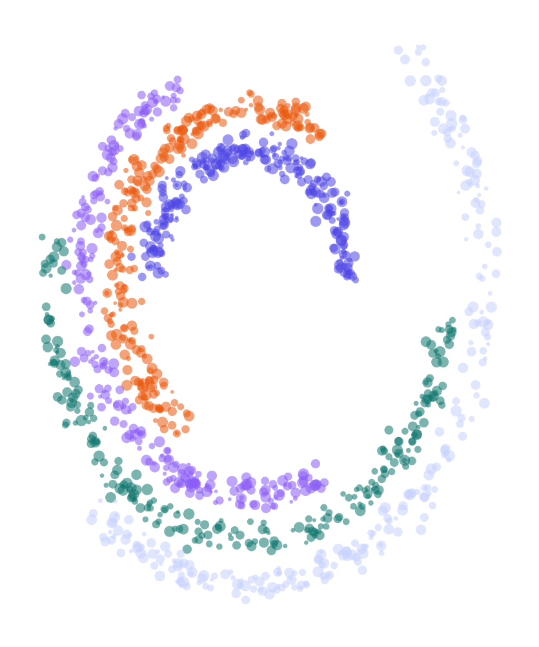
WEEK 01
Introduction to Generative & Responsible AI
What generative models are, how they turn probability into content, and how to use AI tools responsibly
MSc in Artificial Intelligence · Generative AI · 2-hour lecture
Notes:
Welcome everyone to Generative AI. This module runs for twelve weeks: each week has a two-hour lecture like this one and a two-hour lab where you build and test real models. Today is the map for the whole journey. We will see what generative AI is, the vocabulary we will use every week, the probability ideas that sit underneath every generative model, and the habits of responsible use that we expect from day one. There is no heavy mathematics today; the equations we meet are short and every symbol will be explained. Ask questions at any time.

Slide 2
WEEK 01 · INTRODUCTION TO GENERATIVE & RESPONSIBLE AI
By the end of this week you can…
1
Describe the generative AI landscape: foundation models, proprietary vs. open-weight families, and the difference between a model, an application and an AI tool.
Module learning outcomes (MIMLOs) practised
MIMLO 1
2
Explain core concepts: data, parameters, tokens, training vs. inference, pre-training vs. post-training.
Explain core concepts, maths and model families
3
Use probability to explain generation: distributions, likelihood, maximum likelihood, sampling and temperature.
MIMLO 4
4
Distinguish generative from discriminative models and explain what a latent variable is.
Critically evaluate outputs: metrics, humans, ethics
5
Compare the four main generative model families: autoregressive, VAE, GAN and diffusion.
6
Identify key responsible-AI risks and apply a five-step checklist whenever you use an AI tool.
Generative AI · MSc in Artificial Intelligence
2
Notes:
Read the six outcomes aloud and point out the bold words: these are the terms students must be able to define and use in the exam. On the right are the module learning outcomes this week practises. MIMLO 1 is about explaining concepts and the mathematics behind generative models; today we lay the foundations with probability. MIMLO 4 is about critically evaluating outputs, including bias and hallucination, which we start today with the responsible-use checklist. Tell students that every week opens with a slide like this, and the practice questions in the lab map to these outcomes.

Slide 3

WEEK 01 · INTRODUCTION TO GENERATIVE & RESPONSIBLE AI
Today's plan
1
Warm-up: how do you use AI today?
8 min
2
1 · The generative AI landscape
22 min
3
2 · Core concepts: data, parameters, tokens
18 min
4
3 · Probabilistic foundations
35 min
5
Model families and the course map
10 min
6
4 · Responsible AI from day one
17 min
7
Lab preview and wrap-up
10 min
Generative AI · MSc in Artificial Intelligence
3
Notes:
This is the plan for the two hours, with approximate timings. The longest block is probabilistic foundations, because the whole module builds on it: every model we meet, from VAEs to diffusion to large language models, is a way of learning a probability distribution and sampling from it. We take a short break after section 2. Keep an eye on time during the warm-up discussion: it is easy to spend twenty minutes on it. If you are running late, the model-families table can be covered quickly because weeks 2 to 6 revisit each family in depth.

Slide 4
WEEK 01 · INTRODUCTION TO GENERATIVE & RESPONSIBLE AI
Starting vocabulary
Term | Plain meaning
Probability | A number from 0 to 1 describing how likely an outcome is.
Array index | A numbered position used to select an item or a matrix row.
Loop | Code that repeats a task for several items or steps.
Generative AI · MSc in Artificial Intelligence
4
Notes:
Introduce these terms before the main theory. Probability: A number from 0 to 1 describing how likely an outcome is. Ask: If two possible outcomes have probabilities 0.7 and 0.3, what is their sum? Array index: A numbered position used to select an item or a matrix row. Ask: In N[i, j], which index selects the row? Loop: Code that repeats a task for several items or steps. Ask: How many adjacent pairs are in the sequence . e m m a .? Let students explain one example aloud, then connect their example to the next flow diagram. Use the numbered blocks to name the inputs and outputs before introducing notation.

Slide 5

WEEK 01 · INTRODUCTION TO GENERATIVE & RESPONSIBLE AI
Warm-up
Which AI tools did you use this week, and did any of them get something wrong?
Turn to a neighbour: name one task where an AI tool helped you and one where it failed.
Was the failure a wrong fact, a misunderstood request, or a made-up source?
How did you notice? Would a less expert user have noticed?
Generative AI · MSc in Artificial Intelligence
5
Notes:
Give two minutes for pair discussion, then take three or four examples from the room. Write them on the board in two columns, helped and failed. You will usually hear coding help, summarising, email drafting and translation on the helped side, and invented references, wrong numbers and outdated information on the failed side. Keep this list: we come back to it in section 4 on hallucination. Ask how they noticed each failure; the key point is that detecting errors needs expertise or checking, which is why verification is part of responsible use.

Slide 6

01
The generative AI landscape
What exactly is 'generative', and what is the difference between a model and a product?
Notes:
Section one gives us the big picture. We will define generative AI precisely, look at how the field developed from 2013 to today, and separate three things people often confuse: a model, an application and a tool. We also compare proprietary models that you reach through an API with open-weight models that you can download and run yourself. By the end of this section students should be able to place any AI product they meet onto this map. Allow about twenty minutes.

Slide 7
WEEK 01 · INTRODUCTION TO GENERATIVE & RESPONSIBLE AI
Learn a name model, then generate
Training stores transition probabilities; generation repeatedly uses them.
1. Read names
2. Count pairs
3. Make probabilities
Add '.' before and after each name.
Record previous-character to next-character transitions.
Smooth counts and make each row sum to one.
words
N
P
Pass: character pairs
Pass: count matrix
Pass: probability table + current character
5. Build a name
4. Choose next character
Append letters; stop at '.' or the length limit.
Read the current row, adjust temperature, and sample.
sample_name
sample_name
Pass: sampled character
Repeat: For a sampled letter, use that letter as the previous character and repeat.
Generative AI · MSc in Artificial Intelligence
7
Notes:
A generative model describes possible data so that we can draw new examples. This first model learns from counts instead of a neural network. A bigram is a pair of neighbouring characters. The matrix N stores how often each pair occurs; its row identifies the previous character and its column identifies the next character. Adding one to every count prevents unseen pairs from receiving zero probability. Dividing by each row's total creates P, a conditional distribution: probabilities for the next character given the previous one. Generation begins with the special start marker '.'. The sampler chooses a character from the corresponding row, moves to that character's row, and repeats. A sampled '.' ends the name. Temperature changes the choices during sampling, while the learned counts remain fixed. This model remembers one previous character, so locally plausible pairs can still produce unusual names.
Worked example:
The training name emma gives five pairs: .→e, e→m, m→m, m→a, a→..
Each pair increases one cell of N; the row for e counts letters after e.
P turns each smoothed count row into probabilities that sum to 1.
A possible generation path samples e, m, m, a, then '.'; other paths are possible.
avg_nll scores a supplied name; sample_name creates a new one using the same P.
Check: After generating e, which row of P supplies the next-character probabilities?
Answer: The row indexed by stoi['e']; the model conditions on the most recently generated character.

Slide 8

WEEK 01 · INTRODUCTION TO GENERATIVE & RESPONSIBLE AI
What is generative AI?
A generative model learns the probability distribution of its training data, so it can sample new examples that look like that data.
Outputs: text, code, images, audio, speech, music, video, 3-D shapes, molecules…
Contrast: a classifier answers which label?; a generator answers what could a new example look like?
Modern systems are foundation models: trained once on broad data, then adapted to many tasks.
  The same model can summarise, translate, write code and answer questions.
Key idea: Generating = sampling from a learned probability distribution. Everything this term builds on that idea.
Generative AI · MSc in Artificial Intelligence
8
Notes:
Give the definition slowly: a generative model learns the distribution of the data and can draw new samples from it. Contrast with the classifiers students know from machine learning, which map an input to a label. A spam filter is discriminative; a model that writes a new email is generative. The term foundation model comes from a 2021 Stanford report and means a large model trained on broad data that many applications are built on. Ask the class: is a translation system generative? Yes, because it produces a new sequence of text, even though the task is well defined.

Slide 9
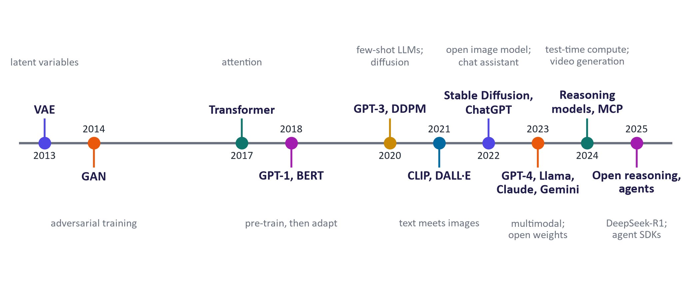
WEEK 01 · INTRODUCTION TO GENERATIVE & RESPONSIBLE AI
A short history: from VAEs to agents
Key milestones. Model names change monthly; the underlying ideas in this module are the ones on this line.
Generative AI · MSc in Artificial Intelligence
9
Notes:
Walk left to right. 2013 and 2014 brought the two deep generative families we study in weeks 2 and 3: variational autoencoders and GANs. 2017 introduced the transformer, the architecture behind almost every modern language model. 2018 showed that pre-training and then adapting works: GPT-1 and BERT. 2020 showed few-shot learning at scale with GPT-3, and diffusion models appeared. 2021 connected text and images with CLIP. 2022 made the technology public: Stable Diffusion released open weights and ChatGPT reached a mass audience. Since 2023 we see multimodal and open-weight models, then reasoning models, video, and agents. Stress that products change monthly while these ideas stay.

Slide 10




WEEK 01 · INTRODUCTION TO GENERATIVE & RESPONSIBLE AI
Foundation models come in several kinds
Language models
Image & video generators
Text and code in, text and code out. Families: GPT, Claude, Gemini, Llama, Qwen, Mistral, DeepSeek.
Text or images in, images or video out. Mostly diffusion or flow models (week 4).
Speech & audio models
Multimodal assistants
Speech recognition, text-to-speech, voice conversion and music generation (weeks 9–10).
One model that reads and writes text, images, audio and video, and can call tools (weeks 10–12).
Generative AI · MSc in Artificial Intelligence
10
Notes:
These are the four kinds of foundation model students will meet. Language models are the most widely used; we name families rather than versions because versions change every few months. Image and video generators are mostly diffusion or flow-matching models, covered in week 4. Speech and audio models include recognisers like Whisper and speech synthesisers. The newest category is natively multimodal assistants that handle several modalities in one model. Ask: which category does a tool that turns a sketch into a photo belong to? Image generator, conditioned on an image.

Slide 11
WEEK 01 · INTRODUCTION TO GENERATIVE & RESPONSIBLE AI
Model, application, tool: three layers people confuse
Layer | What it is | Example
Model | Trained weights that map inputs to a probability distribution over outputs | An LLM family such as GPT, Llama or Gemini
Application | Model + system instructions + memory + retrieval + tools + safety filters + user interface | A chat assistant app, a coding assistant in an editor
Tool / workflow | An application used for a specific task, often inside other software | Meeting summaries in a video call, AI search in a library catalogue
Key idea: When a product 'gets smarter overnight', the model, the instructions, the tools or the retrieval may have changed. Always ask which layer changed.
Generative AI · MSc in Artificial Intelligence
11
Notes:
This distinction prevents many misunderstandings. The model is only the trained weights. A chat assistant is an application that wraps the model with hidden system instructions, conversation memory, sometimes web search or document retrieval, tools such as code execution, safety filters and a user interface. When two apps use the same model they can still behave differently because those other layers differ. In the exam, students lose marks for calling a chat app a model. Ask: if a chat assistant can quote today's news, is that the model knowing it? No, it is usually a search tool added by the application.

Slide 12


WEEK 01 · INTRODUCTION TO GENERATIVE & RESPONSIBLE AI
Proprietary vs. open-weight models
Proprietary (closed-weight)
Open-weight
Accessed through an app or API (e.g. GPT, Claude, Gemini families)
Often the strongest general capability
No hardware needed; pay per token
Your data goes to the provider: check terms and retention
Provider controls updates and retirements
Weights downloadable (e.g. Llama, Qwen, Mistral, Gemma, DeepSeek families)
Run locally or on your own cloud: privacy and control
Can be fine-tuned (week 8) and inspected
You manage hardware, updates and safety
Licences vary; 'open-weight' ≠ 'open-source'
Key idea: Choosing between them is a trade-off between capability, cost, privacy and control, which we revisit in week 11 (deployment).
Generative AI · MSc in Artificial Intelligence
12
Notes:
Proprietary models are used through a provider's interface and you never see the weights. Open-weight models publish the trained parameters, so anyone can run and fine-tune them, subject to the licence. Emphasise the nuance that open weights are not the same as open source: training data and training code are often not released, and some licences restrict commercial use. In practice organisations use both: a hosted frontier model for difficult reasoning and a small open model for private or high-volume tasks. Ask students which option a hospital processing patient notes might prefer, and why.

Slide 13






WEEK 01 · INTRODUCTION TO GENERATIVE & RESPONSIBLE AI
Everyday AI tools you will meet
Chat assistants
Coding assistants
Research & study
ChatGPT, Gemini, Claude, Microsoft Copilot, Le Chat: general writing, analysis and Q&A.
GitHub Copilot, Cursor, Claude Code, Gemini Code Assist: complete, explain and edit code.
NotebookLM, deep-research modes, AI search engines: work over sources you supply or search.
Image & design
Video & audio
Open models you run
Image generators and editors inside design tools, e.g. Adobe Firefly, Midjourney, Imagen.
Text-to-video, voice and music tools, e.g. Veo, Sora, ElevenLabs, Suno.
Hugging Face and Ollama let you run open-weight models on your own machine (weeks 6 and 11).
Key idea: Products change monthly. Judge any tool with the same questions: which model, what data, which tools, how verified?
Generative AI · MSc in Artificial Intelligence
13
Notes:
This is a quick tour, not an endorsement. The point is that students already use several of these and will meet more at work. Each is an application built on one or more models. Research tools like NotebookLM are interesting because they answer from sources you upload, which reduces but does not remove hallucination; we will build our own version of this idea, retrieval-augmented generation, in week 12. Encourage students to try at least two chat assistants in the lab on the same prompt and compare. Remind them of the institution's policy on using AI tools for assessed work.

Slide 14

WEEK 01 · INTRODUCTION TO GENERATIVE & RESPONSIBLE AI
Quick check
ChatGPT, the Gemini app and Claude.ai are best described as…
Three large language models
Applications that wrap model families with instructions, tools, memory and safety layers
A
B
Search engines that look up stored answers
Open-weight models you can download
C
D
Vote, then convince your neighbour (1 minute).
Generative AI · MSc in Artificial Intelligence
14
Notes:
Answer: B. These are applications. Each is built on a model family, GPT, Gemini and Claude respectively, but the product adds hidden system instructions, memory, tools such as web search and code execution, safety filters and an interface. A is the most common wrong answer and is worth discussing: the model name and the product name are often similar, which causes the confusion. C is wrong because the model generates text token by token rather than retrieving stored answers, although some apps add a search tool. D is wrong: these are proprietary and their weights are not published.

Slide 15

02
Core concepts: data, parameters, tokens
How is a model built, and what happens when you press Enter?
Notes:
Section two introduces the vocabulary we will use every single week: data, parameters, tokens, training, inference, pre-training and post-training. These words appear in every model card, research paper and job advert in this field, so students need to be fluent with them. We finish the section with a few numbers that show the scale of modern models. Allow about eighteen minutes, then take a short break before the probability section.

Slide 16
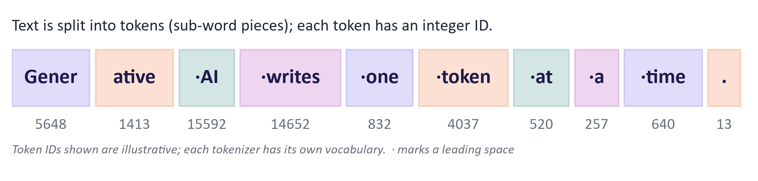
WEEK 01 · INTRODUCTION TO GENERATIVE & RESPONSIBLE AI
Tokens: how models see text
A token is a sub-word piece; common words are one token, rare words are split.
Rule of thumb for English: about ¾ of a word per token.
Context window, pricing and speed are all measured in tokens.
Images and audio are also turned into tokens (weeks 9–10).
Generative AI · MSc in Artificial Intelligence
16
Notes:
Models do not read characters or words directly. A tokenizer splits text into sub-word pieces and maps each to an integer ID from a fixed vocabulary, typically tens of thousands to a couple of hundred thousand entries. Common words become one token; rare words, names and many non-English words are split into several, which is one reason models can be weaker and more expensive in some languages. Everything is counted in tokens: how much text fits in the context window, how much an API call costs, how long generation takes. In the lab students will tokenize their own sentences and count tokens.

Slide 17


WEEK 01 · INTRODUCTION TO GENERATIVE & RESPONSIBLE AI
Training vs. inference
Training
Inference
Learn the parameters (weights) from data
Minimise a loss by gradient descent over many passes
Very expensive: large GPU clusters, weeks to months
Done rarely by the model provider
Use the fixed parameters to produce an output
One forward pass per generated token for an LLM
Cheap per request, but adds up at scale
Happens every time you send a prompt
Key idea: Chatting with a model does not train it. Your prompt changes the input, not the weights, unless the provider later uses your data for training.
Generative AI · MSc in Artificial Intelligence
17
Notes:
Parameters are the numbers inside the network, often billions of them. Training searches for parameter values that make the training data likely, by repeatedly computing a loss and nudging parameters with gradient descent. Inference is using those fixed parameters to answer a new input. A very common misconception is that a chatbot learns from your conversation in real time. It does not: within a conversation it only sees more context. Some providers may later use conversations to train future versions, which is a privacy issue and why data settings matter. Ask: when you fine-tune in week 8, is that training or inference? Training.

Slide 18
WEEK 01 · INTRODUCTION TO GENERATIVE & RESPONSIBLE AI
From raw data to an assistant: pre-training, post-training, application
1
2
3
4
5
Data
Pre-training
Post-training
Assistant model
Application
Web text, books, code, images; filtered and deduplicated
Predict the next token over trillions of tokens → base model
Instruction tuning, preference tuning (RLHF/DPO), RL for reasoning
Follows instructions, refuses unsafe requests, reasons step by step
System prompt, tools, retrieval, guardrails, interface
A base model only continues text; post-training turns it into a helpful assistant (details in week 8).
Most of the knowledge comes from pre-training; most of the behaviour comes from post-training.
Generative AI · MSc in Artificial Intelligence
18
Notes:
This pipeline is the backbone of the module. Pre-training teaches a model to predict the next token on a huge corpus; the result is a base model that is knowledgeable but only continues text. Post-training shapes behaviour: supervised instruction tuning on example conversations, preference tuning such as reinforcement learning from human feedback or direct preference optimisation, and more recently reinforcement learning on problems with checkable answers to improve reasoning. The application layer then adds instructions, tools and guardrails. Weeks 5 and 6 cover pre-training, week 8 post-training, and weeks 11 and 12 the application layer.

Slide 19
WEEK 01 · INTRODUCTION TO GENERATIVE & RESPONSIBLE AI
The scale of modern models
175 B
15 T+
2 M
800 M
parameters in GPT-3 (2020), once considered huge
tokens used to pre-train Llama 3 (Meta, 2024)
tokens in the largest context windows (Gemini 1.5 Pro, 2024), up from 2 K in 2020
weekly ChatGPT users reported by OpenAI (Oct 2025)
Figures are as reported by the developers at the time; they illustrate orders of magnitude, not current records.
Generative AI · MSc in Artificial Intelligence
19
Notes:
These numbers give a sense of scale. GPT-3 had 175 billion parameters in 2020. Meta reported pre-training Llama 3 on more than fifteen trillion tokens. Context windows grew from about two thousand tokens in GPT-3 to around two million tokens in some 2024 models, enough for several books at once. OpenAI reported eight hundred million weekly ChatGPT users in October 2025. Be careful with numbers: always say who reported them and when, and remember that bigger is not automatically better. Smaller, well-trained models now match much larger older ones, which we discuss in week 6.

Slide 20

03
Probabilistic foundations
How does a probability distribution become a sentence, an image or a song?
Notes:
Welcome back from the break. This is the most important section of today and the longest. Every generative model in this module is a way of representing a probability distribution and drawing samples from it. We will look at next-token distributions, the chain rule that lets language models generate one token at a time, likelihood and maximum likelihood training, temperature and sampling strategies, the difference between generative and discriminative models, and latent variables. Students who are rusty on probability should revisit these slides and the teaching notes after class.

Slide 21
WEEK 01 · INTRODUCTION TO GENERATIVE & RESPONSIBLE AI
One language-model generation step
A text prompt becomes scores, probabilities, and one more token.
1. Provide context
2. Encode tokens
3. Predict scores
Start with text such as 'The cat sat on the'.
Map text pieces to integer vocabulary IDs.
Use fixed weights to score every possible next token.
prompt
tok
model
Pass: prompt text
Pass: token IDs
Pass: next-token logits
6. Extend context
5. Select a token
4. Make probabilities
Append the token; repeat until stopping, then decode text.
Sample with decoding settings, or choose the highest-scoring token.
Temperature and softmax turn scores into a distribution.
chat
chat
next_token_probs
Pass: selected token ID
Pass: next-token probabilities
Repeat: The extended token sequence becomes the model's input for the next prediction.
Generative AI · MSc in Artificial Intelligence
21
Notes:
A token is a text piece from a fixed vocabulary, represented by an integer ID. It can be a word, part of a word, or punctuation. The tokenizer maps the prompt into these IDs. The language model uses learned parameters, also called weights, to assign a logit to every possible next token. A logit is an unnormalised score, not a probability. For positive temperature T, dividing scores by T and applying softmax creates probabilities that sum to one. Lower T concentrates probability on stronger candidates; higher T spreads it more widely. In the lab, next_token_probs exposes this distribution but does not generate an answer. The chat function calls model.generate, which repeatedly selects tokens and extends the context. Its top-p setting limits the candidates used in sampling. This is inference: the input grows, but model weights do not change. Fluent output still needs checking against evidence.
Worked example:
tok maps 'The cat sat on the' to IDs; exact pieces depend on the tokenizer.
model returns logits for all positions; [0, -1] selects next-token scores for this prompt.
next_token_probs shows the top five candidates at T = 0.5, 1.0, and 1.5.
chat uses model.generate to select and append tokens repeatedly, then decodes the new tokens.
Check: Does changing temperature from 0.5 to 1.5 retrain the model?
Answer: No. It changes how the fixed next-token scores become sampling probabilities.

Slide 22
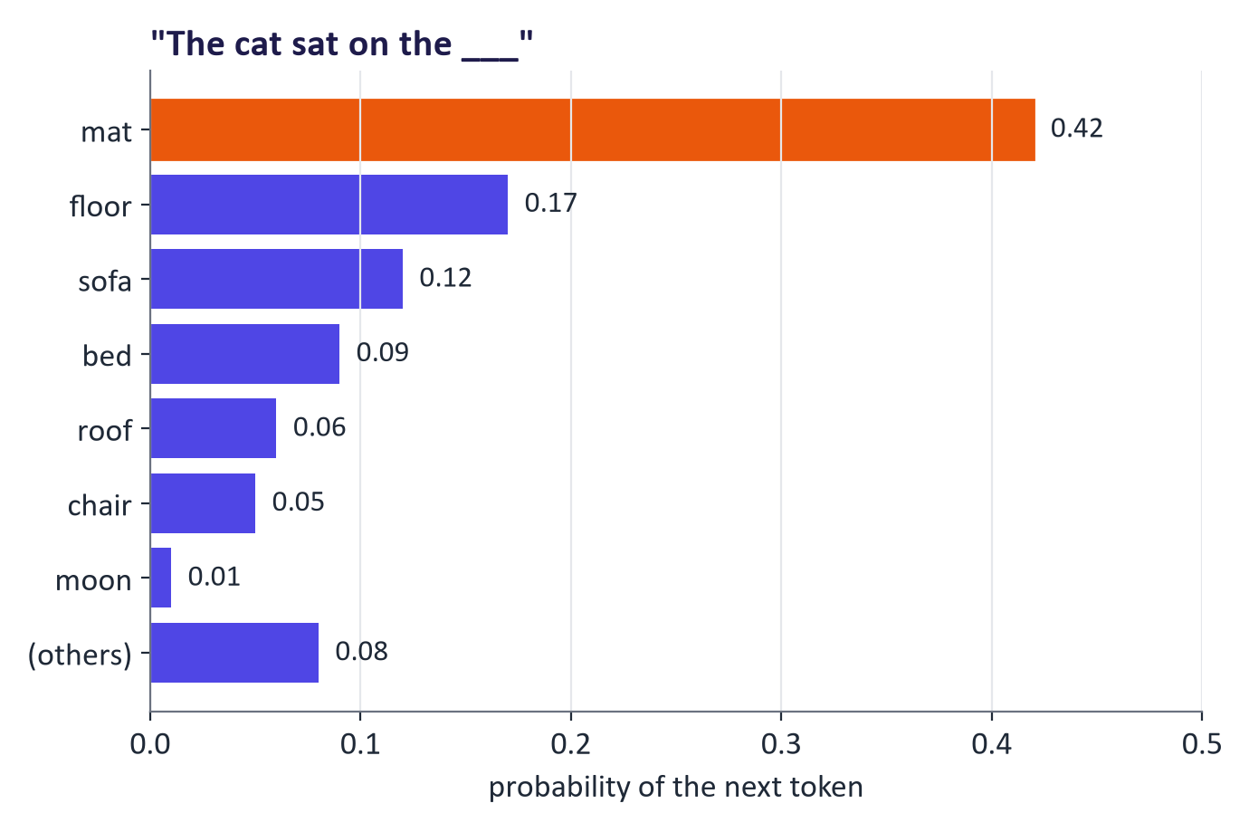
WEEK 01 · INTRODUCTION TO GENERATIVE & RESPONSIBLE AI
An LLM outputs a probability distribution over the next token
Given the context, the model assigns a probability to every token in its vocabulary.
Probabilities sum to 1; most tokens get almost zero.
Generating = sampling one token, appending it, and repeating.
Different samples from the same distribution give different, equally 'valid' outputs.
Generative AI · MSc in Artificial Intelligence
22
Notes:
Here is the key picture. For the context, the cat sat on the, the model outputs a probability for every token in its vocabulary; we show the top few. Mat is most likely, but floor, sofa and bed are plausible. The model then samples one token, appends it, and asks for the next distribution. This is why the same prompt can give different answers: each answer is one sample from a distribution. Ask: if the model always picked mat, what would happen to creative writing? It would become repetitive, which is why we sample rather than always taking the maximum.

Slide 23
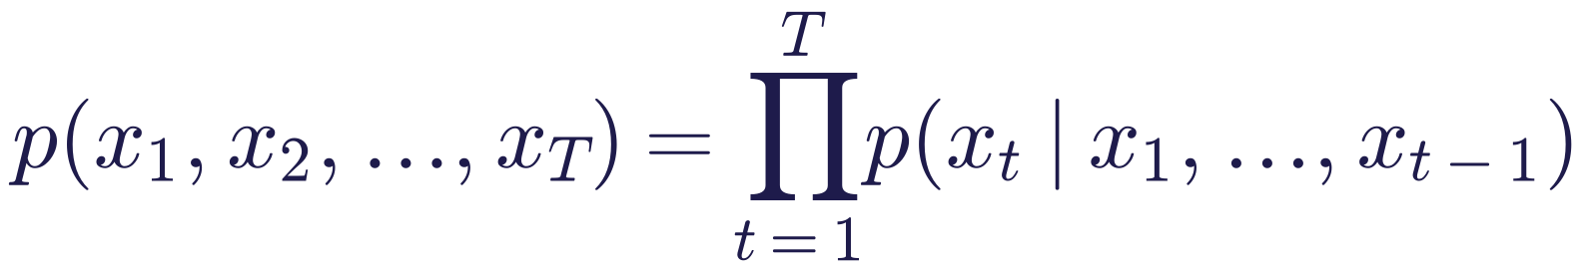
WEEK 01 · INTRODUCTION TO GENERATIVE & RESPONSIBLE AI
The chain rule: generating one token at a time
Read it as
Symbols
The probability of a whole sequence is the product of next-token probabilities.
This factorisation is exact: no approximation is made.
A model that predicts the next token therefore defines a probability for any sequence. This is an autoregressive model.
xₜ
the token at position t
T
length of the sequence
∏
product over positions
|
'given'
Generative AI · MSc in Artificial Intelligence
23
Notes:
This is the chain rule of probability, which students met in statistics. Any joint distribution over a sequence can be written as a product of conditionals, each token given all previous tokens. Autoregressive models such as GPT learn each conditional with one neural network shared across positions. The consequence is powerful: if you can predict the next token well, you have a model of the whole sequence, and you can both score sequences and generate them. Image generators do not usually use this factorisation, which is one reason they need different families, covered in weeks 2 to 4.

Slide 24
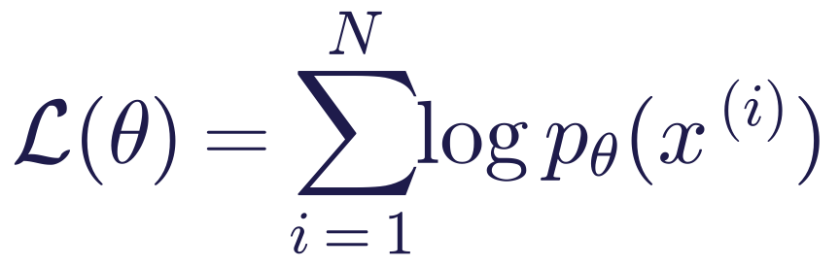
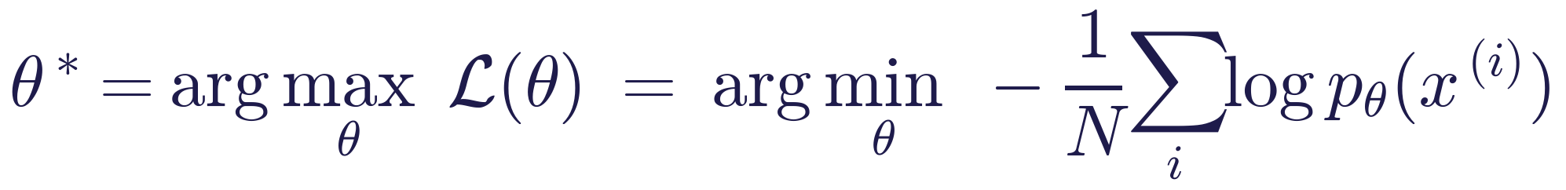
WEEK 01 · INTRODUCTION TO GENERATIVE & RESPONSIBLE AI
Likelihood and maximum likelihood training
Read it as
Symbols
Likelihood: how probable the model says the real training data is.
Maximum likelihood: choose parameters that make the training data as probable as possible.
Maximising log-likelihood = minimising negative log-likelihood (cross-entropy), the loss used to train LLMs.
θ
model parameters
x⁽ⁱ⁾
the i-th training example
N
number of examples
log
natural log (turns products into sums)
Generative AI · MSc in Artificial Intelligence
24
Notes:
Likelihood is the probability the model assigns to the observed data, viewed as a function of the parameters. Maximum likelihood estimation picks the parameters that make the data most probable. We use logarithms because products of many small probabilities underflow, while sums of logs are stable, and because the log is monotonic the maximiser is unchanged. Minimising the average negative log-likelihood is the same as minimising cross-entropy, the loss students will see printed during training in the labs. Important: VAEs, autoregressive models and diffusion models are all trained with likelihood or a bound on it; GANs are the exception, as we see in week 3.

Slide 25
WEEK 01 · INTRODUCTION TO GENERATIVE & RESPONSIBLE AI
Worked example: the likelihood of a short sentence
Step | Next-token probability | log p (natural)
p(the) | 0.06 | −2.81
p(cat | the) | 0.01 | −4.61
p(sat | the cat) | 0.20 | −1.61
p(on | the cat sat) | 0.55 | −0.60
Sequence | 0.06 × 0.01 × 0.20 × 0.55 = 6.6 × 10⁻⁵ | sum = −9.63
Key idea: Average negative log-likelihood = 9.63 / 4 ≈ 2.41 nats per token. Perplexity = e^2.41 ≈ 11: the model is as uncertain as choosing among ~11 equally likely tokens.
Generative AI · MSc in Artificial Intelligence
25
Notes:
Work through this on the board. Multiply the four conditional probabilities to get the joint probability, about 6.6 times ten to the minus five. Summing logs gives the same result as the log of the product, minus 9.63. Dividing by four tokens gives the average negative log-likelihood, 2.41 nats per token, which is exactly the loss a language model reports. Exponentiate it to get perplexity, about 11: lower is better. Ask students which single step contributes most to the loss: cat given the, because the model found it surprising. Training would push that probability up if the sentence is common in real data.

Slide 26
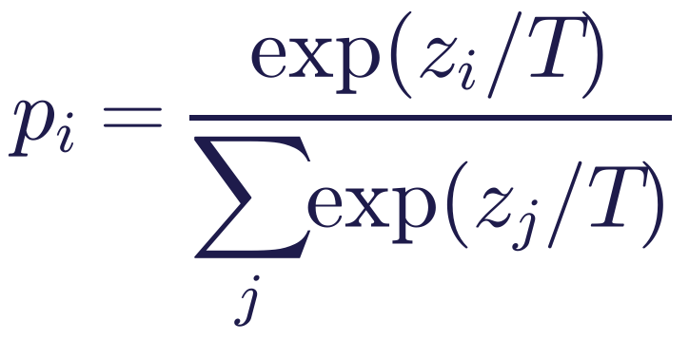
WEEK 01 · INTRODUCTION TO GENERATIVE & RESPONSIBLE AI
Temperature reshapes the distribution before sampling
Read it as
Symbols
The network outputs scores (logits) z; softmax turns them into probabilities.
Dividing by temperature T < 1 sharpens the distribution; T > 1 flattens it; T → 0 is greedy.
Example, logits [2, 1, 0]: T = 1 gives [0.67, 0.24, 0.09]; T = 0.5 gives [0.87, 0.12, 0.02]; T = 2 gives [0.51, 0.31, 0.19].
zᵢ
logit (raw score) of token i
T
temperature (> 0)
pᵢ
probability used for sampling
Generative AI · MSc in Artificial Intelligence
26
Notes:
Softmax converts logits into probabilities that are positive and sum to one. Temperature divides the logits before the softmax. Low temperature exaggerates differences, so the top token dominates and outputs become more predictable; high temperature shrinks differences so less likely tokens are sampled more often, increasing variety and also errors. Check the worked numbers with the class using a calculator: exp of 2 is 7.39, exp of 1 is 2.72, exp of 0 is 1, sum 11.11, giving 0.67, 0.24 and 0.09. Temperature changes sampling only; it does not change what the model knows.

Slide 27
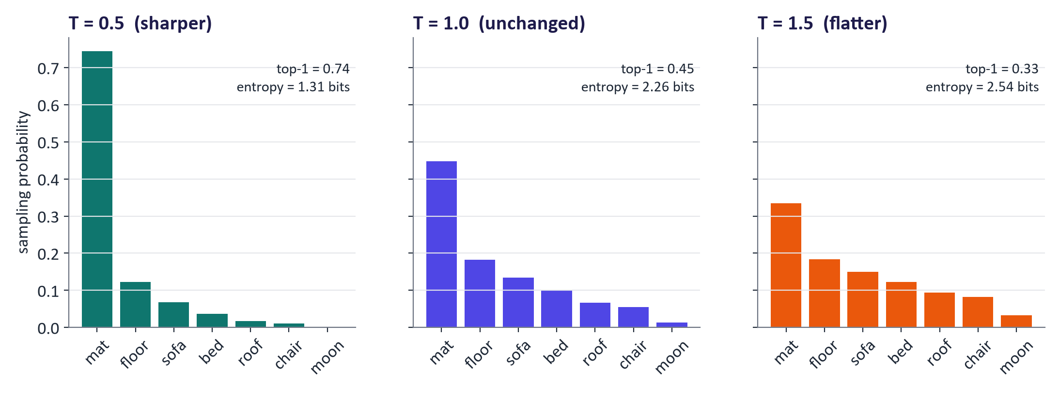
WEEK 01 · INTRODUCTION TO GENERATIVE & RESPONSIBLE AI
Temperature in pictures
The same logits sampled at three temperatures. Lower entropy = more predictable output.
Key idea: Use low temperature for factual extraction, code and grading; higher temperature for brainstorming and creative writing.
Generative AI · MSc in Artificial Intelligence
27
Notes:
These three charts use the same logits. At temperature 0.5 almost all the probability goes to mat, so outputs are nearly deterministic. At 1.0 we sample from the model's own distribution. At 1.5 the distribution flattens, so even moon gets a noticeable chance. Entropy, shown in bits, measures that spread. The practical guidance is on the callout. In the lab students will sample names from their own character model at these three temperatures and see the same effect: sensible but repetitive names at low temperature, creative but sometimes unpronounceable names at high temperature.

Slide 28

WEEK 01 · INTRODUCTION TO GENERATIVE & RESPONSIBLE AI
Decoding strategies: how we pick the next token
Greedy: always take the most likely token. Deterministic, but can loop and sound flat.
Temperature sampling: sample from the (re-scaled) distribution.
Top-k: sample only among the k most likely tokens.
Top-p (nucleus): sample among the smallest set of tokens whose probabilities add up to p (e.g. 0.9).
Seeds: fix the random seed to make sampling reproducible for experiments.
Key idea: Decoding settings are part of your experimental method: always report them, like the random seed and the model version.
Generative AI · MSc in Artificial Intelligence
28
Notes:
These are the controls exposed by almost every API and library, so students need to recognise them. Greedy decoding is equivalent to temperature zero. Top-k cuts off the long tail of unlikely tokens at a fixed count; top-p adapts the cut-off to how confident the model is, which is why it is popular. Some reasoning models fix these values or ignore them, so always check the documentation. For evaluation work later in the module, we will insist that students report model, version, temperature, top-p, seed and date, because without them a result cannot be reproduced.

Slide 29
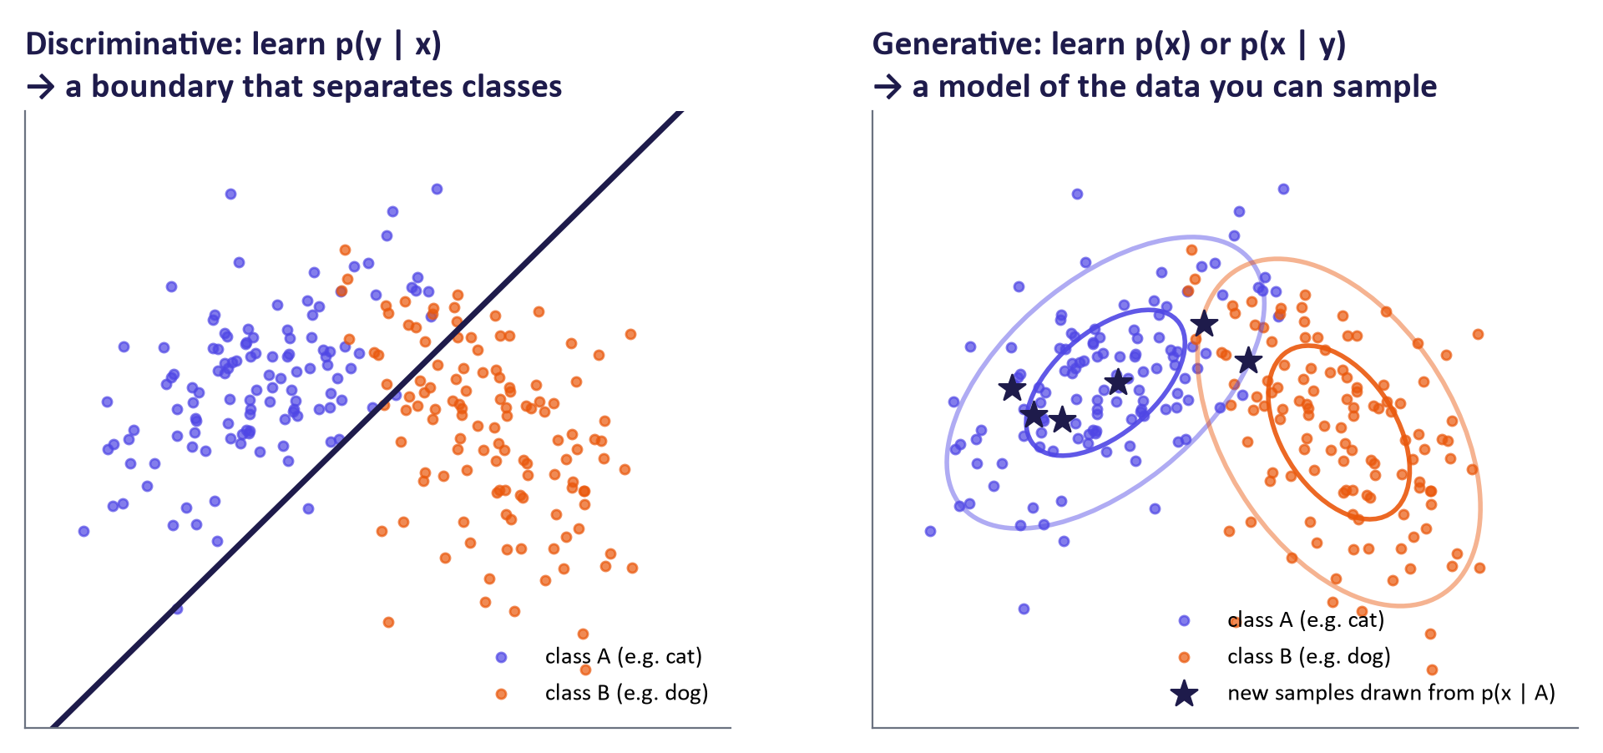
WEEK 01 · INTRODUCTION TO GENERATIVE & RESPONSIBLE AI
Generative vs. discriminative models
Left: a discriminative model only needs the boundary. Right: a generative model describes where the data lives, so it can also create new points (stars).
Generative AI · MSc in Artificial Intelligence
29
Notes:
On the left, a discriminative model such as logistic regression learns only the probability of the label given the input, which amounts to a boundary between cats and dogs. It cannot tell you what a typical cat looks like. On the right, a generative model learns the distribution of the inputs themselves, here one Gaussian per class. That is more work, but it lets us sample new examples, the stars, detect unusual inputs that have low probability, and even classify using Bayes' rule on the next slide. In the lab students fit both kinds on the same 2-D data and sample from the generative one.

Slide 30
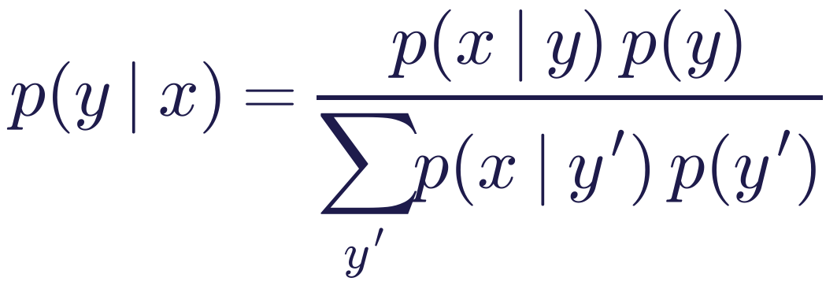
WEEK 01 · INTRODUCTION TO GENERATIVE & RESPONSIBLE AI
Connecting the two views with Bayes' rule
Read it as
Symbols
A generative classifier learns p(x | y) and p(y), then uses Bayes' rule to classify.
A discriminative classifier learns p(y | x) directly and skips modelling x.
Only the generative model can produce new x; the discriminative one is usually better at pure classification.
x
input (image, text, …)
y
label or class
p(x | y)
what inputs of class y look like
p(y)
how common each class is
Key idea: Modern generative AI learns p(x) (unconditional) or p(x | condition), where the condition can be a label, a prompt or an image.
Generative AI · MSc in Artificial Intelligence
30
Notes:
Bayes' rule links the two approaches. Naive Bayes and Gaussian discriminant analysis are classic generative classifiers: they model how each class generates inputs and then invert with Bayes' rule. Logistic regression and most neural classifiers model the label given the input directly. The callout is the bridge to modern generative AI: text-to-image models learn p of an image given a prompt, and language models learn p of a response given the conversation so far. The condition is whatever we control. Ask: which is harder to learn, p of x or p of y given x, for a 512 by 512 image? p of x, by far.

Slide 31
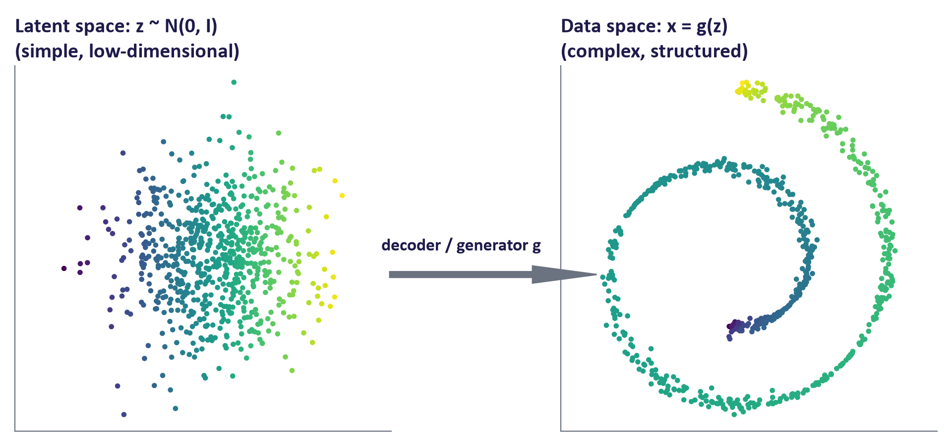
WEEK 01 · INTRODUCTION TO GENERATIVE & RESPONSIBLE AI
Latent variables: simple hidden causes, complex data
A latent variable z is an unobserved cause of the data (e.g. style, pose, lighting).
Sample a simple z, then map it through a network g to get a complex x.
p(x) = ∫ p(x | z) p(z) dz: the data distribution is a mixture over latent causes.
VAEs, GANs and diffusion all use this idea (weeks 2–4).
Generative AI · MSc in Artificial Intelligence
31
Notes:
Latent means hidden. The idea is to explain complicated data using a few hidden factors that follow a simple distribution, usually a standard Gaussian. A neural network, called a decoder or generator, maps each latent point to a data point. Here a two-dimensional Gaussian is bent into a spiral; in real models the latent space might be a few hundred dimensions and the output a face or a sentence. Moving smoothly in latent space changes the output smoothly, which is why latent interpolations are a favourite lab exercise in weeks 2 and 3. The integral says we average over all possible hidden causes.

Slide 32
WEEK 01 · INTRODUCTION TO GENERATIVE & RESPONSIBLE AI
Quick check
You raise the sampling temperature from 0.7 to 1.5. What happens?
The model learns new facts from the higher temperature
Outputs become more deterministic and repetitive
A
B
Probability mass spreads to less likely tokens, so outputs become more varied and more error-prone
The model's parameters are updated
C
D
Vote, then convince your neighbour (1 minute).
Generative AI · MSc in Artificial Intelligence
32
Notes:
Answer: C. A higher temperature flattens the distribution, so tokens that were unlikely get sampled more often. That makes outputs more diverse and often more creative, but also more likely to contain mistakes or nonsense. A and D are both wrong for the same reason: temperature is a decoding setting applied at inference time, and nothing changes in the parameters. B describes the opposite effect, lowering temperature. If students chose B, redraw the three charts from the previous slides and ask which one has the flattest bars.

Slide 33
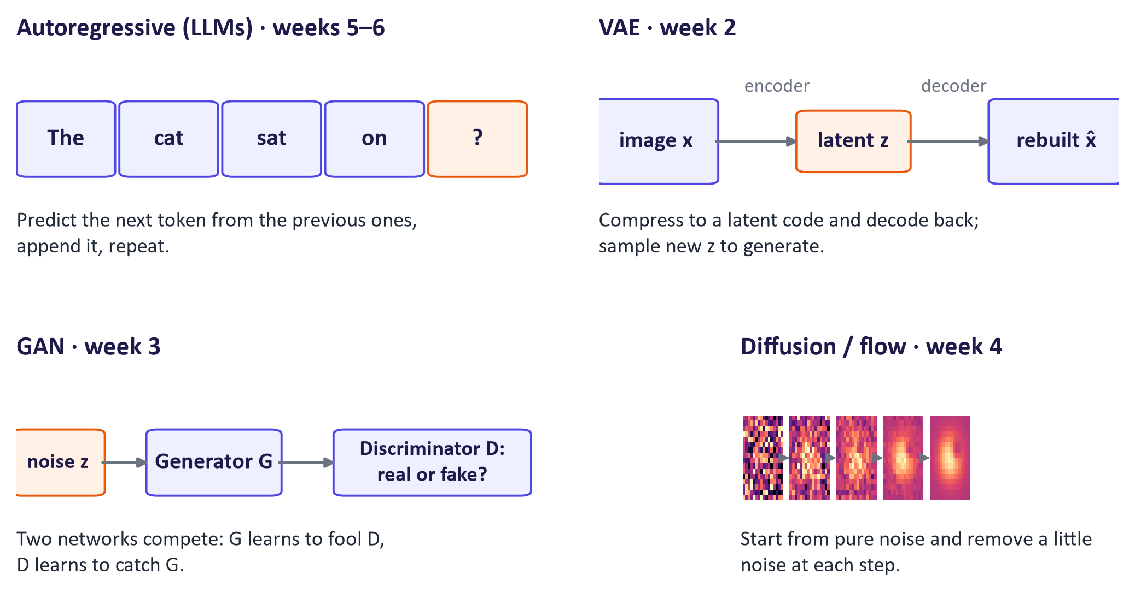
WEEK 01 · INTRODUCTION TO GENERATIVE & RESPONSIBLE AI
Four ways to generate: the model families of this module
Autoregressive models (weeks 5–6), VAEs (week 2), GANs (week 3) and diffusion / flow models (week 4).
Generative AI · MSc in Artificial Intelligence
33
Notes:
Now we connect probability to the model families we study. Autoregressive models use the chain rule and generate one token at a time; they dominate text and code. VAEs learn an encoder to a latent space and a decoder back, trained with a bound on the likelihood. GANs train a generator against a discriminator in a two-player game, without an explicit likelihood. Diffusion and flow models learn to turn noise into data step by step; they dominate images, video and audio today. Many real systems combine families: Stable Diffusion uses a VAE plus a diffusion model plus a transformer text encoder.

Slide 34
WEEK 01 · INTRODUCTION TO GENERATIVE & RESPONSIBLE AI
Comparing the four families
Family | How it generates | Strengths | Weaknesses | Where used today
Autoregressive | Next token given previous tokens | Exact likelihood; excellent for text and code | Slow, sequential generation | LLMs, code models, speech tokens
VAE | Decode a sample from a latent space | Smooth latent space; stable training | Samples can be blurry | Compression inside latent diffusion; anomaly detection
GAN | Generator fools a discriminator | Sharp images; one-step, fast | Unstable training; mode collapse | Super-resolution; fast distilled generators
Diffusion / flow | Remove noise step by step | Highest quality and diversity | Many steps (being reduced) | Image, video and audio generation
Generative AI · MSc in Artificial Intelligence
34
Notes:
Students should be able to reproduce this table by week 6; it is a classic exam question. Explain the trade-off triangle between quality, diversity and speed: GANs are fast and sharp but can miss parts of the data distribution; VAEs cover the data well but samples are blurrier; diffusion models achieve quality and diversity at the cost of many steps, and much current research reduces the number of steps. Autoregressive models give exact likelihoods, which is valuable for evaluation. Note that the boundaries blur: transformers are used inside diffusion models, and images can be generated autoregressively.

Slide 35
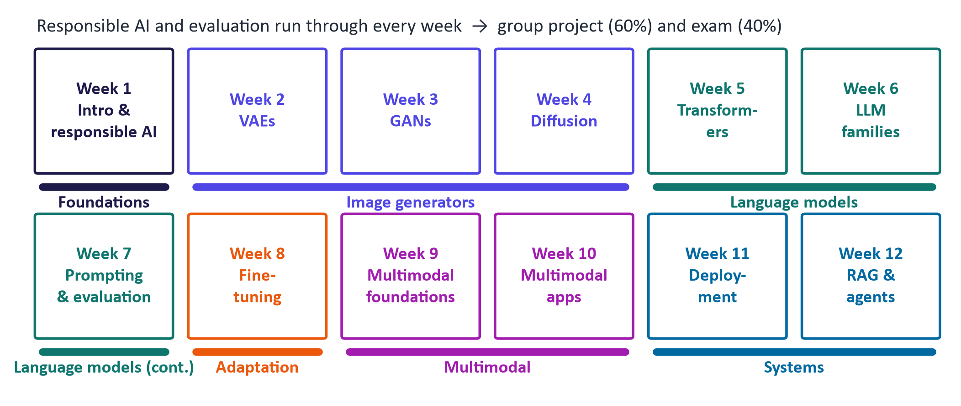
WEEK 01 · INTRODUCTION TO GENERATIVE & RESPONSIBLE AI
Where we are going: the 12-week map
Foundations → image generators → language models → adaptation → multimodal → deployed systems, with evaluation and responsible AI every week.
Generative AI · MSc in Artificial Intelligence
35
Notes:
Here is the structure of the module. Weeks 2 to 4 cover the image generator families. Weeks 5 to 7 cover transformers, large language models and prompting. Week 8 is fine-tuning, including parameter-efficient methods like LoRA. Weeks 9 and 10 are multimodal. Weeks 11 and 12 turn models into systems: deployment, retrieval-augmented generation and agents. The group project, worth 60 percent, asks students to build and evaluate a generative AI application, so every lab produces something reusable. The exam, worth 40 percent, tests concepts, mathematics and interpretation. Encourage students to form project groups by week 4.

Slide 36

04
Responsible AI from day one
What can go wrong, and what habits keep you, your users and your data safe?
Notes:
The final section is responsible AI. It is not a separate topic added at the end of the module; every week includes a responsible-AI lens, and the project is assessed partly on it. Today we cover hallucination, the main risk categories, and a practical five-step checklist that students should use every time they use an AI tool, including for their studies. Other modules in the programme cover regulation and explainability in depth; here we focus on the risks specific to generative models and how to test for them.

Slide 37
WEEK 01 · INTRODUCTION TO GENERATIVE & RESPONSIBLE AI
Hallucination: fluent but false
Models are trained to produce plausible continuations, not verified facts.
Hallucination = output that is fluent and confident but false or unsupported: invented citations, wrong numbers, fake quotes.
More likely for rare facts, recent events, exact figures, long chains of reasoning, and questions with false premises.
Reduce it:
  ground answers in sources (RAG, week 12) and check the citations
  use tools such as calculators, code and search
  lower temperature for factual tasks; ask the model to say when it is unsure
  keep a human reviewer for anything that matters
Remember: Fluency is not evidence. A confident tone tells you nothing about correctness.
Generative AI · MSc in Artificial Intelligence
37
Notes:
Return to the warm-up board: most of the failures students listed are hallucinations. Explain the mechanism in one sentence: a language model maximises the likelihood of text that looks like its training data, and a plausible-looking reference is highly likely text even when the paper does not exist. Hallucination rates have fallen as models improved and gained tools, but they are not zero, and they rise for obscure topics. The mitigations preview later weeks. In the lab students will deliberately probe a small model with a question about a fictional paper and watch it invent details.

Slide 38






WEEK 01 · INTRODUCTION TO GENERATIVE & RESPONSIBLE AI
Six risks to check with any generative AI system
Bias & fairness
Privacy
Intellectual property
Outputs reflect patterns and gaps in training data, e.g. stereotyped images of professions. Test across groups.
Do not paste personal or confidential data into tools without approval. Check retention and training settings.
Training-data copyright is contested; check output licences and attribute your sources.
Transparency & law
Academic integrity
Security & misuse
EU AI Act Art. 50 (from 2 Aug 2026): disclose AI interaction and label AI-generated or manipulated content.
Follow the module's AI-use policy, disclose use, and remember you are accountable for what you submit.
Prompt injection, deepfakes and harmful content: safety filters reduce but do not remove risk.
Generative AI · MSc in Artificial Intelligence
38
Notes:
Go through each card with a concrete example. Bias: image generators asked for a CEO historically over-produced one demographic. Privacy: pasting a customer list into a public chatbot may breach GDPR. Intellectual property: several lawsuits about training data are ongoing, and output ownership depends on terms and jurisdiction. Transparency: since 2 August 2026, Article 50 of the EU AI Act requires telling people when they interact with an AI system and marking AI-generated or manipulated content, with a short grace period for the machine-readable marking of systems already on the market. Academic integrity: point to the local policy. Security: prompt injection is covered in weeks 7 and 12.

Slide 39
WEEK 01 · INTRODUCTION TO GENERATIVE & RESPONSIBLE AI
A five-step checklist for using AI tools
1
2
3
4
5
Purpose
Protect data
Prompt clearly
Verify
Disclose & record
Is AI appropriate and allowed for this task?
No personal or confidential data without approval
Task, context, format, constraints (week 7)
Check facts, numbers, citations, code; test edge cases
Say how AI was used; keep prompts and model versions
Key idea: Use this checklist in every lab and in your group project. It is also a good exam answer structure.
Generative AI · MSc in Artificial Intelligence
39
Notes:
This is the habit we want students to form. Purpose: some tasks, such as assessed individual reflections, may not permit AI at all. Protect data: think before pasting. Prompt clearly: we spend all of week 7 on this. Verify is highlighted because it is the step most often skipped: check every fact and citation, run the code, and test unusual inputs. Disclose and record: say how AI was used and keep enough detail, such as prompts, model and date, for someone else to reproduce the work. Each lab notebook ends with a short evidence table built on these five steps.

Slide 40

WEEK 01 · INTRODUCTION TO GENERATIVE & RESPONSIBLE AI
Case discussion
A student asks a chat assistant for five references on diffusion models for a literature review. Two of the references do not exist.
What mechanism produced the fake references?
Who is responsible for the error in the submitted review?
Which checklist step failed, and what process would have prevented it?
Would a research tool that answers only from uploaded papers remove the risk entirely?
Generative AI · MSc in Artificial Intelligence
40
Notes:
Give three minutes in groups, then discuss. Mechanism: the model generated plausible author names, titles and venues because they are likely text, not because it looked them up. Responsibility: the student, who submitted unverified work; tools are not authors. The failed step is verify: every reference should be opened and checked, for example on Google Scholar or the publisher's site. The last question tests nuance: grounding in uploaded sources greatly reduces invented references, but the model can still misquote or misattribute a source, so checking remains necessary. This case links directly to retrieval-augmented generation in week 12.

Slide 41
WEEK 01 · INTRODUCTION TO GENERATIVE & RESPONSIBLE AI
Follow the Week 1 experiments
Connect probability, generation, classification, and verification to actual code.
1. Build the table
2. Score and sample
3. Compare classifiers
Load names, count pairs, and normalise rows.
Compare name likelihoods and temperature-controlled samples.
Classify points, then sample the generative class distribution.
N / P
avg_nll / sample_name
disc / genm
Pass: learned P
Pass: probability ideas
Pass: generative versus discriminative distinction
6. Verify and record
5. Inspect generation
4. Inspect tokens
Test a fictional paper prompt and record checking evidence.
Compare next-token probabilities and generated answers.
Load the language model and print token pieces.
fake / chat
next_token_probs / chat
tok / model
Pass: answers to check
Pass: token IDs and model
Check: Which operation creates a new name: avg_nll or sample_name?
Generative AI · MSc in Artificial Intelligence
41
Notes:
The lab uses three small systems to make the same distinction visible: learning a distribution, using it, and checking the result. First, N and P form a character model. avg_nll measures how surprising a supplied name is under that model; sample_name draws a new name. Second, logistic regression predicts a class from a point, while QDA also describes the point distribution within each class. That learned distribution lets QDA produce new class-0 points. Third, a pretrained language model provides next-token scores and generated text. You inspect the tokenizer and probabilities before comparing complete answers. The fictional paper prompt is a controlled verification test: a plausible summary is not evidence that the paper exists. Keep the model, settings, observations, and verification method together in the evidence table. Compare actual runs, because random sampling and different model configurations can change the outputs.
Worked example:
Check that every row of P sums to 1 before interpreting any sampled names.
Use avg_nll on emma and xqzz; inspect scores without assuming a particular result.
QDA stores a mean and covariance for each class; compare new_points with the real scatter plot.
Print tokenizer pieces and the top-five candidates before using chat on a full question.
The deliberately fictional paper prompt tests unsupported claims; record what you actually observed.
Check: Which operation creates a new name: avg_nll or sample_name?
Answer: sample_name creates a name; avg_nll scores a name supplied to it.

Slide 42



WEEK 01 · INTRODUCTION TO GENERATIVE & RESPONSIBLE AI
Lab 1: probability, sampling and a first look at an LLM
1
Set up Google Colab (T4 GPU), a Hugging Face account and safe storage for API keys.
Runtime
Google Colab (T4 GPU) or local Jupyter; everything also runs on a CPU
2
Build a character-level bigram model of names; compute likelihood and negative log-likelihood.
3
Sample new names at temperatures 0.5, 1.0 and 1.5; explain the differences.
Time
2-hour lab
4
Fit a generative and a discriminative classifier on 2-D data; sample from the generative one.
5
Run a small open LLM: inspect its next-token probabilities; vary temperature and top-p.
Hand in
Completed notebook: code TODOs, three short written answers and the evidence table
6
Probe hallucination and compare with a hosted assistant; complete the evidence table.
Generative AI · MSc in Artificial Intelligence
42
Notes:
Preview the lab so students arrive ready. Part one builds a tiny generative model from counts, which makes likelihood and temperature concrete. Part two contrasts generative and discriminative classifiers on the same data. Part three loads a small open-weight language model from Hugging Face; it runs even on a laptop CPU. The last part asks students to probe hallucination and compare the small model with a large hosted assistant. The optional API cell uses a free Google AI Studio key; students without a key simply use the chat interface instead. Remind them never to paste keys into shared notebooks.

Slide 43

WEEK 01 · INTRODUCTION TO GENERATIVE & RESPONSIBLE AI
Key takeaways
Generative models learn a probability distribution over data and sample new content.
Temperature, top-k and top-p change how we sample, not what the model knows.
A model (weights) is not an application (model + instructions + tools + retrieval + safety + UI).
Generative models learn p(x) or p(x | condition); discriminative models learn p(y | x).
Pre-training gives knowledge; post-training gives behaviour; inference uses fixed weights.
Latent variables are simple hidden causes mapped to complex data (weeks 2–4).
LLMs use the chain rule and are trained by maximum likelihood (minimising negative log-likelihood).
Fluency is not evidence: purpose, protect, prompt, verify, disclose.
Generative AI · MSc in Artificial Intelligence
43
Notes:
Recap each point in one sentence and ask the class to complete the sentence before you reveal it, if you have time. These eight points are the minimum students should retain. Next week we build the first of our model families, the variational autoencoder, which uses latent variables and a bound on the likelihood that we derived from today's ideas. Ask students to review the probability section of the teaching notes, especially likelihood and the chain rule, and to watch the three-minute and eight-minute videos on the next slide before the lab.

Slide 44



WEEK 01 · INTRODUCTION TO GENERATIVE & RESPONSIBLE AI
Read, watch, practise
Foster (2023) Generative Deep Learning, 2nd ed., ch. 1 'Generative Modeling'
Core module text (descriptor 7.9)
Microsoft Learn: Introduction to generative AI and agents
Free module with a knowledge check
3Blue1Brown: Large Language Models explained briefly
8-minute visual overview
Microsoft: Generative AI for Beginners, lessons 1–3
Includes 'Using generative AI responsibly'
Google Cloud Tech: Introduction to Generative AI
Short introduction from Google
EU AI Act, Article 50: transparency obligations
Applies from 2 August 2026
Andrej Karpathy: Intro to Large Language Models
1-hour talk: pre-training, post-training, risks
NIST AI 600-1: Generative AI risk profile
Risk categories and mitigations
Generative AI · MSc in Artificial Intelligence
44
Notes:
These resources are chosen to be short, reliable and free, apart from the core textbook, which the library provides. The 3Blue1Brown video is the best visual introduction to next-token prediction. The Google video is an accessible overview for students new to the area. Karpathy's talk is longer and excellent on pre-training and post-training. The Microsoft materials include a responsible-AI lesson with practical guidance. The EU AI Act article and the NIST profile are primary sources for the risk discussion. All links were checked in September 2026; product-specific pages change, so recheck before teaching.

