Slide 1
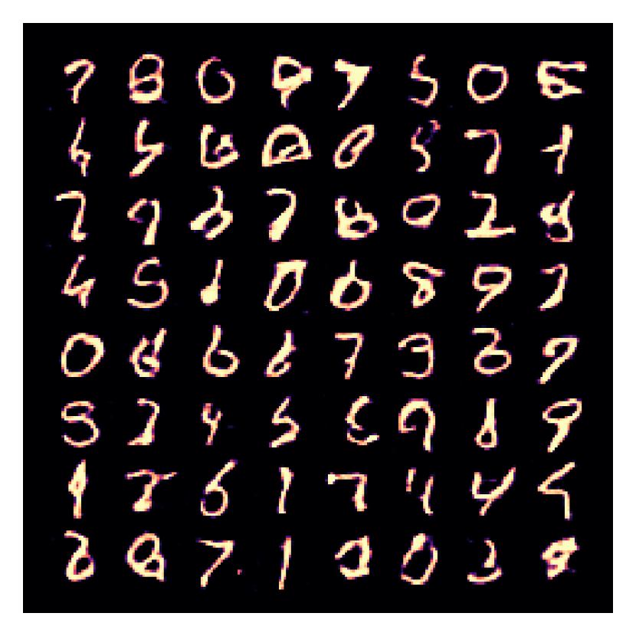
WEEK 03
Generative Adversarial Networks (GANs)
Learning to generate by competition: the adversarial game, its training challenges, variants and evaluation
MSc in Artificial Intelligence · Generative AI · 2-hour lecture
Notes:
Welcome to week 3. Last week's VAEs gave us a principled likelihood-based model with a smooth latent space, but blurry samples. Today we meet the model family that was designed to produce sharp, realistic images: generative adversarial networks, or GANs, introduced by Ian Goodfellow and colleagues in 2014. The digits on this slide were produced by a small GAN trained on a laptop for these slides; you will train the same model in the lab. GANs dominated image generation from about 2016 to 2021 and their ideas are still inside many modern systems.

Slide 2
WEEK 03 · GENERATIVE ADVERSARIAL NETWORKS (GANS)
By the end of this week you can…
1
Explain the motivation for adversarial learning and the roles of the generator and discriminator.
Module learning outcomes (MIMLOs) practised
2
Write the GAN minimax objective, derive the optimal discriminator, and explain the non-saturating generator loss.
MIMLO 1
Explain core concepts, maths and model families
3
Diagnose training problems (mode collapse, instability, vanishing gradients) and choose stabilisation techniques.
MIMLO 3
4
Describe key variants: DCGAN, conditional GAN, pix2pix, CycleGAN, StyleGAN.
Design, implement and fine-tune models
5
Evaluate GANs with FID, Inception Score, precision/recall and human judgement.
MIMLO 4
Critically evaluate outputs: metrics, humans, ethics
6
Implement and train a DCGAN in PyTorch, and discuss GANs' role today and the risks of deepfakes.
Generative AI · MSc in Artificial Intelligence
2
Notes:
Six outcomes. The first two are about the game itself and its mathematics: students should be able to write the minimax objective, state the optimal discriminator and explain why we use the non-saturating loss. The third is practical diagnosis, a favourite exam topic because GAN training fails in characteristic ways. The fourth covers variants they will meet in papers and industry, the fifth evaluation metrics, especially FID which is also used for diffusion next week, and the sixth combines implementation with a responsible-AI discussion of deepfakes. This week practises MIMLO 1, 3 and 4.

Slide 3

WEEK 03 · GENERATIVE ADVERSARIAL NETWORKS (GANS)
Today's plan
1
Warm-up: training a forger
6 min
2
1 · Why adversarial learning?
15 min
3
2 · The GAN objective
30 min
4
3 · Training challenges and fixes
22 min
5
4 · Variants: DCGAN to StyleGAN
22 min
6
5 · Evaluation, applications and risks
18 min
7
Lab preview and wrap-up
7 min
Generative AI · MSc in Artificial Intelligence
3
Notes:
The plan follows the descriptor's topics for this week: motivation, architecture, objective, training challenges, variants, evaluation and applications. Section two contains the mathematics; take the break after it. Section three uses real training runs, including a small experiment that shows mode collapse happening. If short of time, compress the variants section, but keep the evaluation slides because FID returns next week for diffusion models and in the project.

Slide 4
WEEK 03 · GENERATIVE ADVERSARIAL NETWORKS (GANS)
Starting vocabulary
Term | Plain meaning
Neural-network weights | Learned numbers used to transform an input into a prediction.
Binary classification | Predicting between two labels, here real and generated.
Gradient | A measure of how changing a quantity would change a loss.
Generative AI · MSc in Artificial Intelligence
4
Notes:
Introduce these terms before the main theory. Neural-network weights: Learned numbers used to transform an input into a prediction. Ask: Which operation changes weights: opt.step or plotting a sample? Binary classification: Predicting between two labels, here real and generated. Ask: In this lab, is label 1 used for real or generated images during the discriminator update? Gradient: A measure of how changing a quantity would change a loss. Ask: Why must a generator receive feedback about its output to improve? Let students explain one example aloud, then connect their example to the next flow diagram. Use the numbered blocks to name the inputs and outputs before introducing notation.

Slide 5
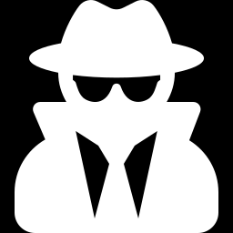
WEEK 03 · GENERATIVE ADVERSARIAL NETWORKS (GANS)
Warm-up
How would you train an art forger if you had no rulebook for 'realistic', only a detective who compares fakes with real paintings?
What feedback would the forger need from the detective?
What happens if the detective becomes perfect very quickly?
What if the forger finds one painting that always fools the detective?
Generative AI · MSc in Artificial Intelligence
5
Notes:
Give two minutes. The analogy maps directly onto a GAN: the forger is the generator, the detective is the discriminator. Useful answers: the forger needs to know how to change a fake to make it more convincing, which is the gradient. If the detective becomes perfect too fast, the forger gets no useful signal, which is the vanishing-gradient problem. If the forger finds one trick that always works and keeps repeating it, that is mode collapse. Keep these three answers on the board; each becomes a slide later. Note the limit of the analogy: in a GAN both players are trained together from scratch.

Slide 6
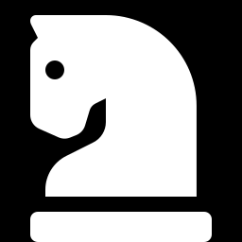
01
Why adversarial learning?
Can we learn the loss function itself?
Notes:
Section one motivates GANs. The key idea is that instead of writing down a loss that measures realism, such as pixel-wise error, which caused blur in VAEs, we train a second network whose job is to measure realism, and we use its judgement as the loss for the generator. We look at the architecture and the roles of the two networks. This section takes about fifteen minutes.

Slide 7
WEEK 03 · GENERATIVE ADVERSARIAL NETWORKS (GANS)
A GAN learns from a discriminator
Two networks learn different tasks; only the generator creates new images.
1. Draw inputs
2. Generate images
3. Score real and fake
Sample noise; load real digits on a parallel data path.
Map each 64-number noise code into one digit image.
The discriminator reads both real and generated images.
train_dl / Z_DIM
Generator / G
Discriminator / D
Pass: noise codes; real images bypass G
Pass: fake images; real images join D
Pass: real/fake logits
6. Inspect progress
5. Alternate updates
4. Form two losses
Compare fixed-noise images, class coverage, and feature distance.
Update D first, then update G through the new D.
D separates sources; G wants its fakes accepted as real.
snapshots / frechet_distance
opt_D / opt_G
d_loss_fn / g_loss_fn
Pass: trained G and recorded samples
Pass: losses and gradients
Repeat: Repeat generation and alternating updates on new batches using the updated G and D.
Generative AI · MSc in Artificial Intelligence
7
Notes:
A generative adversarial network, or GAN, contains two networks with different jobs. The generator G transforms a random latent code into an image. The discriminator D judges whether an image came from the dataset or the generator. Real images follow a separate path into D; they do not pass through G. Training alternates two updates. The discriminator learns to assign real labels to dataset images and fake labels to generated ones. The generator then learns to make its images receive the real label from the updated discriminator. Gradients from D guide G even though G never receives a matching target digit for each noise code. This creates a moving learning problem: improving either network changes the other network's task. Loss curves alone cannot show success. The lab compares fixed-code snapshots, predicted digit coverage, and a custom feature distance. Generation after training needs G and a fresh code, without D.
Worked example:
A real MNIST batch is scaled to [-1, 1]; G receives separate Gaussian codes of length 64.
G upsamples each code through 7×7, 14×14, and 28×28 feature grids.
D scores real images and detached fake images; opt_D updates D using source labels.
The original connected fakes pass through updated D; opt_G improves their real-labelled score.
After training, draw new codes and use G alone; inspect both image quality and diversity.
Check: Which networks must run to generate a new digit after training?
Answer: Only G is needed. D supplied training feedback but is not part of the generation path.

Slide 8

WEEK 03 · GENERATIVE ADVERSARIAL NETWORKS (GANS)
The motivation: a learned loss for realism
VAEs use pixel-wise likelihoods, which reward the average of plausible images, and averages look blurry.
Realism is hard to write as a formula, but a classifier can learn to tell real from fake.
GANs train a discriminator to spot fakes and a generator to fool it; the discriminator acts as a learned, adaptive loss.
GANs are implicit models: they can sample, but give no likelihood p(x).
Key idea: Instead of 'be close to the data pixel by pixel', the generator's goal is 'be indistinguishable from the data'.
Generative AI · MSc in Artificial Intelligence
8
Notes:
Connect to last week. A pixel-wise loss says a slightly shifted sharp edge is as bad as a blurred edge, so under uncertainty the model predicts the blur. A discriminator judges the whole image: a blurry digit is easy to spot as fake, so the generator is pushed towards sharp outputs. The price is that GANs are implicit generative models: you can draw samples, but you cannot compute the probability of an image, so you cannot use likelihood for evaluation or anomaly detection. That is why evaluation later in the lecture needs sample-based metrics.

Slide 9
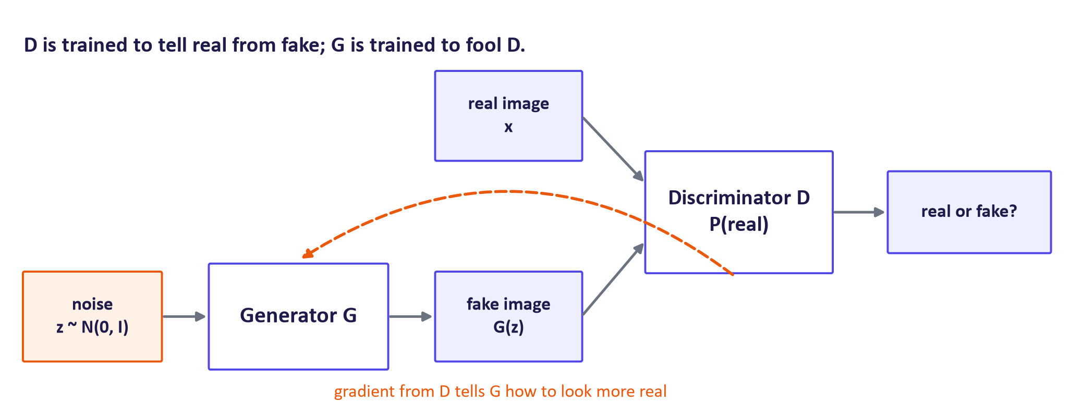
WEEK 03 · GENERATIVE ADVERSARIAL NETWORKS (GANS)
GAN architecture: two networks, one game
Generative AI · MSc in Artificial Intelligence
9
Notes:
Walk through the diagram. The generator takes a random noise vector, typically sixty-four to five hundred and twelve numbers from a standard Gaussian, and outputs an image. The discriminator is a binary classifier that takes an image, real or generated, and outputs the probability that it is real. The dashed arrow is the crucial part: the generator never sees real images directly. It only receives gradients that flow back through the discriminator, telling it how to change its output to be judged more real. Ask: where is the latent variable from week 1? It is z, the noise input.

Slide 10
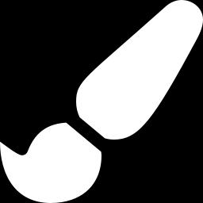

WEEK 03 · GENERATIVE ADVERSARIAL NETWORKS (GANS)
Generator vs. discriminator
Generator G
Discriminator D
Input: noise z (and optionally a condition)
Output: a sample, e.g. a 28 × 28 image
Goal: make D(G(z)) close to 1
Architecture: upsampling (transposed convolutions)
Kept after training: this is the model you use
Input: a real or generated sample
Output: probability (or score) that it is real
Goal: D(x) → 1 for real, D(G(z)) → 0 for fakes
Architecture: a CNN classifier (downsampling)
Usually discarded after training
Key idea: Neither network is trained on its own: each one's loss depends on the other, which makes GAN training a game, not a plain optimisation.
Generative AI · MSc in Artificial Intelligence
10
Notes:
Summarise the roles. The generator is an upsampling network; the discriminator is an ordinary image classifier. After training we keep the generator and usually throw the discriminator away, although discriminators are sometimes reused as feature extractors. The key difference from every model students have trained before is in the callout: the loss of each network depends on the parameters of the other, so we are looking for an equilibrium of a two-player game rather than a minimum of a fixed function. That single fact explains most of the training difficulties in section three.

Slide 11
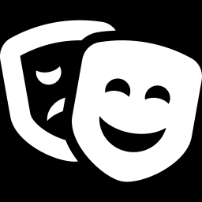
WEEK 03 · GENERATIVE ADVERSARIAL NETWORKS (GANS)
ANALOGY AND ITS LIMITS
Forger and detective improve together, until the detective can do no better than a coin flip.
Limits: the 'forger' never sees a real painting, only the detective's gradients; and the players can also chase each other in circles instead of converging.
Generative AI · MSc in Artificial Intelligence
11
Notes:
The forger and detective analogy is useful, but state its limits clearly, since the course asks students to explain analogies critically. At the ideal end point the generator's samples are indistinguishable from real data, so the best the discriminator can do is output one half everywhere, a coin flip. But unlike a human forger, the generator never looks at real examples, only at the discriminator's feedback. And real training does not always converge: the two networks can oscillate, each one's improvement undoing the other's. We see both in section three.

Slide 12
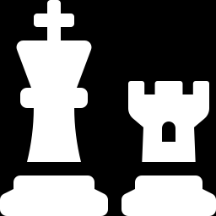
02
The GAN objective
What game are the networks playing, and where does it end?
Notes:
Section two gives the mathematics. We write the minimax value function from the original paper, derive the optimal discriminator for a fixed generator, show what the generator then minimises, and explain why the loss used in practice differs from the textbook one. Then we look at the training loop in code. This is the core exam material for the week; go at a steady pace and work through the optimal-discriminator derivation on the board.

Slide 13
WEEK 03 · GENERATIVE ADVERSARIAL NETWORKS (GANS)
The minimax game (Goodfellow et al., 2014)
Read it as
Symbols
D maximises V: output high D(x) for real data and low D(G(z)) for fakes. This is just binary cross-entropy with labels 1 and 0.
G minimises V: it can only affect the second term, by making D(G(z)) large.
Training alternates: a few gradient steps for D, then one for G.
D(x)
probability D assigns to x being real
G(z)
sample generated from noise z
p_data
distribution of real data
p(z)
noise prior, e.g. N(0, I)
Generative AI · MSc in Artificial Intelligence
13
Notes:
Read the equation as two expectations. The first is over real data: the discriminator wants log D of x to be high, meaning D of x near one. The second is over noise: the discriminator wants one minus D of G of z to be high, meaning fakes get low scores. So the discriminator maximises exactly the negative binary cross-entropy of a real-versus-fake classifier. The generator appears only in the second term and wants to make it small, pushing D of G of z up. In practice we alternate gradient ascent steps for D and descent steps for G on mini-batches.

Slide 14
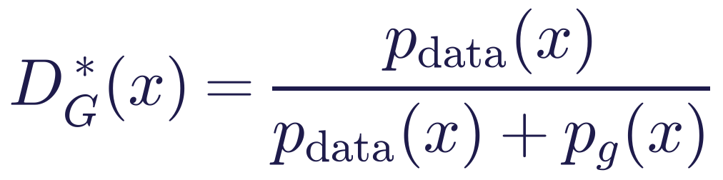
WEEK 03 · GENERATIVE ADVERSARIAL NETWORKS (GANS)
The optimal discriminator and what G really minimises
Read it as
Symbols
For a fixed G, the best D compares the two densities point by point.
Plugging D* in, G minimises the Jensen–Shannon divergence between data and generator distributions.
Global optimum: p_g = p_data, where D* = ½ everywhere and V = −log 4.
p_g
distribution of G(z)
JSD
Jensen–Shannon divergence (≥ 0, symmetric)
D* = ½
D can do no better than a coin flip
Generative AI · MSc in Artificial Intelligence
14
Notes:
Derive the first line on the board: for each x, D maximises p data times log D plus p g times log of one minus D, and setting the derivative to zero gives p data over p data plus p g. Substituting back gives minus log four plus twice the Jensen-Shannon divergence, a symmetric measure of the difference between two distributions. So, in the idealised setting with an optimal discriminator and infinite capacity, training the generator minimises a proper divergence, and the unique optimum is when the generator's distribution equals the data distribution. Real training never reaches this ideal, but it explains what the game is aiming for.

Slide 15
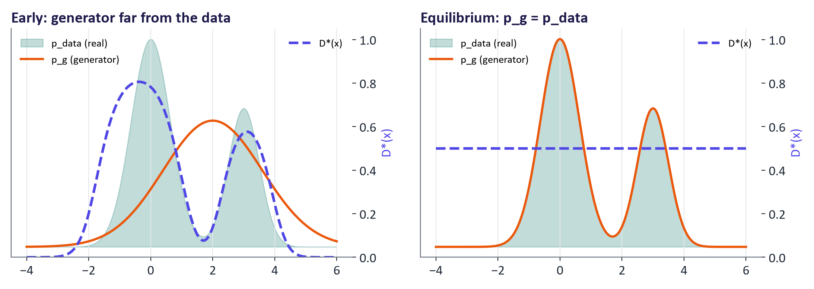
WEEK 03 · GENERATIVE ADVERSARIAL NETWORKS (GANS)
The optimal discriminator in pictures
Generative AI · MSc in Artificial Intelligence
15
Notes:
A one-dimensional illustration. The teal area is the data distribution, the orange curve the generator's distribution, and the dashed purple line the optimal discriminator. On the left, early in training, the discriminator is close to one where only real data lives and close to zero where only fakes live, and its slope tells the generator which way to move its samples. On the right, at equilibrium, the two distributions coincide and the discriminator is flat at one half: it carries no information, and the generator receives no further push. Ask: what does a flat D look like in the lab's plots? D of real and D of fake both near one half.

Slide 16
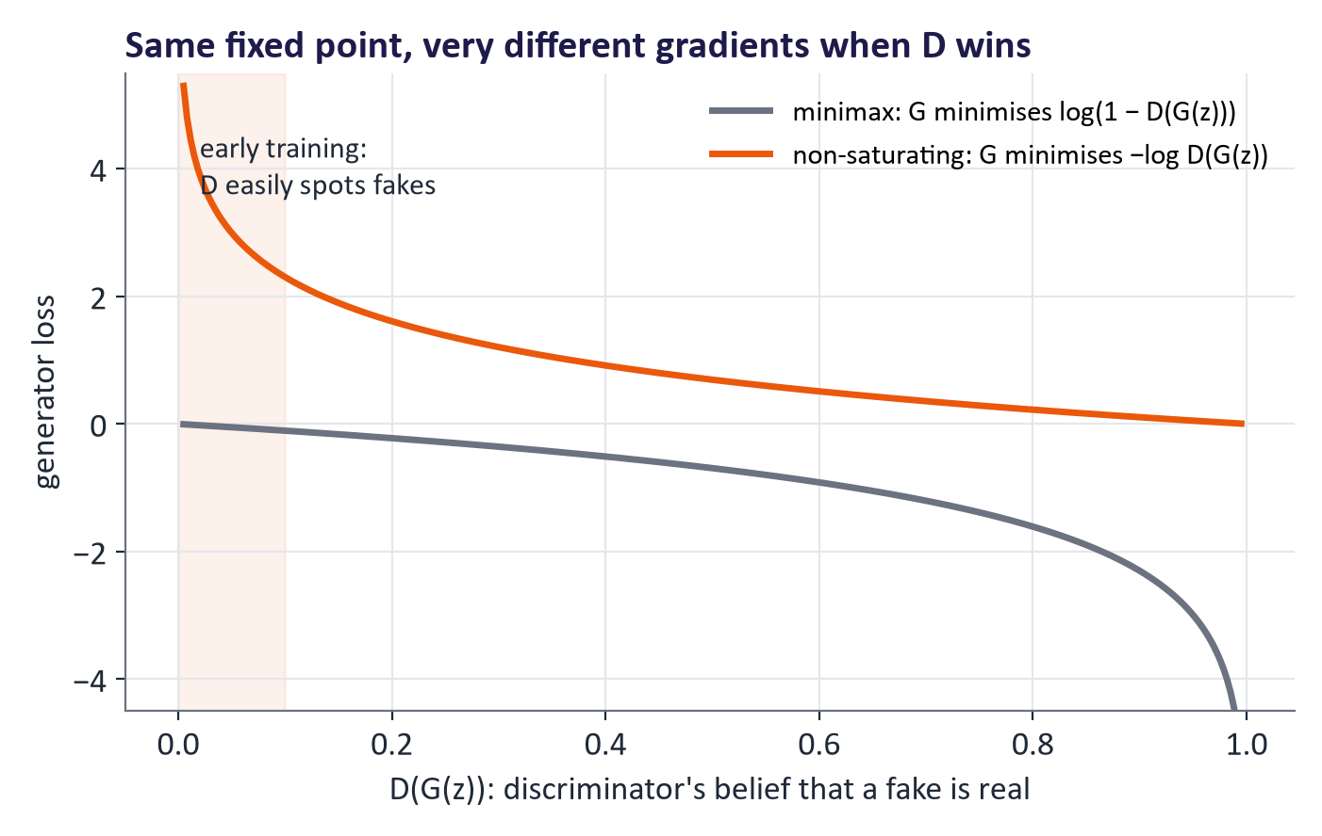
WEEK 03 · GENERATIVE ADVERSARIAL NETWORKS (GANS)
Why practitioners use the non-saturating generator loss
Early on, D easily rejects fakes: D(G(z)) ≈ 0.
Minimax loss log(1 − D(G(z))) is flat there, giving tiny gradients for G.
Non-saturating loss −log D(G(z)) is steep there: strong gradients when G is worst.
Same fixed point, much better learning; used in almost all implementations.
Generative AI · MSc in Artificial Intelligence
16
Notes:
This is a practical detail with a big effect, also from the original paper. At the start of training the generator's samples are obviously fake, so D of G of z is near zero. The minimax generator loss, log of one minus D, is almost flat near zero, so the generator gets almost no gradient exactly when it most needs one: the curve saturates. The fix is to have the generator maximise log D of G of z instead, which is steep near zero. Both losses are optimised by the same equilibrium. In code, the non-saturating loss is simply binary cross-entropy with the fake samples labelled as real.

Slide 17
WEEK 03 · GENERATIVE ADVERSARIAL NETWORKS (GANS)
One alternating GAN update
Detach fakes for the D update; keep G connected for its own update.
1. Make connected fakes
2. Detach for D
3. Update D
G creates images with a gradient path to its weights.
Give D real images and a disconnected view of fakes.
Train D with real targets 1 and fake targets 0.
G / fake
d_loss_fn
opt_D
Pass: fake images with graph
Pass: real/fake D loss
Pass: updated D; original fake tensor
5. Update G
4. Score original fakes
Backpropagate the real-target loss; step only G's optimiser.
Use updated D; original fakes still connect to G.
opt_G
g_loss_fn
Pass: generator loss and gradient path
Repeat: Updated G produces the fakes for the next batch's discriminator and generator updates.
Generative AI · MSc in Artificial Intelligence
17
Notes:
The important distinction is between a tensor's values and its gradient connection. fake.detach supplies the same image values to D while cutting the route back to G for that operation. This lets the discriminator learn from generated images without updating the generator from the discriminator's loss. The original fake tensor remains connected to G. After opt_D changes D's weights, g_loss_fn sends that original tensor through D and asks for the real label. This non-saturating generator objective rewards fakes that D accepts. Backpropagation follows the chain from the loss through D's operations, through the fake image, and into G's weights. The optimiser step then changes only the parameters registered with opt_G. The labels therefore serve different purposes in the two updates: fake means 0 when training D, but G's desired target is 1. Repeat this sequence for each training batch.
Worked example:
Suppose D confidently rejects a generated digit; that creates a large real-target generator cost.
During the D step, fake.detach blocks gradients from reaching G through that loss.
During the G step, g_loss_fn uses the original fake so gradients can travel through D to G.
opt_G steps G's parameters; the discriminator is a scoring route rather than the optimiser target.
Check: Why would detaching fake inside g_loss_fn stop the generator from learning?
Answer: It would cut the gradient path from the generator loss back to G's weights.

Slide 18
WEEK 03 · GENERATIVE ADVERSARIAL NETWORKS (GANS)
One training step in PyTorch
# --- 1. discriminator step: real -> 1, fake -> 0
fake = G(torch.randn(b, z_dim))
loss_D = bce(D(x_real), ones) + bce(D(fake.detach()), zeros)
opt_D.zero_grad(); loss_D.backward(); opt_D.step()
# --- 2. generator step (non-saturating): make D call the fakes real
loss_G = bce(D(fake), ones)
opt_G.zero_grad(); loss_G.backward(); opt_G.step()
bce = BCEWithLogitsLoss; D outputs a logit.
.detach() stops the D step from updating G.
The G step labels fakes as real: that is the non-saturating loss.
DCGAN settings: Adam, lr 2 × 10⁻⁴, β₁ = 0.5.
Generative AI · MSc in Artificial Intelligence
18
Notes:
This is the complete core of GAN training, and it is what students write in the lab. First update the discriminator on a real batch labelled one and a fake batch labelled zero; the detach call is essential, otherwise the discriminator's loss would also change the generator. Then update the generator by passing the same fakes through the discriminator, this time with the label one, and backpropagating through the discriminator into the generator. Only the generator's optimiser steps in the second update. The Adam settings come from the DCGAN paper and are still a sensible default.

Slide 19

WEEK 03 · GENERATIVE ADVERSARIAL NETWORKS (GANS)
Quick check
At the theoretical equilibrium of a GAN, what does the optimal discriminator output for any input?
1 for real images and 0 for fakes
0.5 everywhere, because real and generated data are indistinguishable
A
B
The class label of the image
log 4
C
D
Vote, then convince your neighbour (1 minute).
Generative AI · MSc in Artificial Intelligence
19
Notes:
Answer: B. When the generator's distribution equals the data distribution, the optimal discriminator is p data divided by twice p data, which is one half everywhere. A describes a discriminator that is winning, which happens early in training or when the generator fails. C confuses the discriminator with a classifier of digit classes; a standard GAN discriminator only judges real versus fake. D is the value of the objective at equilibrium, minus log four, not the discriminator's output. In practice you rarely see exactly one half, but D values drifting towards it suggest the game is balanced.

Slide 20
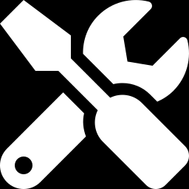
03
Training challenges and fixes
Why are GANs notoriously hard to train, and what helps?
Notes:
Welcome back from the break. Section three is about what goes wrong. We look at real loss curves from the DCGAN trained for these slides, see mode collapse happen in a small experiment, summarise the failure modes and their symptoms, and then cover the main stabilisation techniques, including the Wasserstein loss. This is highly practical: students will meet these problems in the lab and possibly in the project.

Slide 21
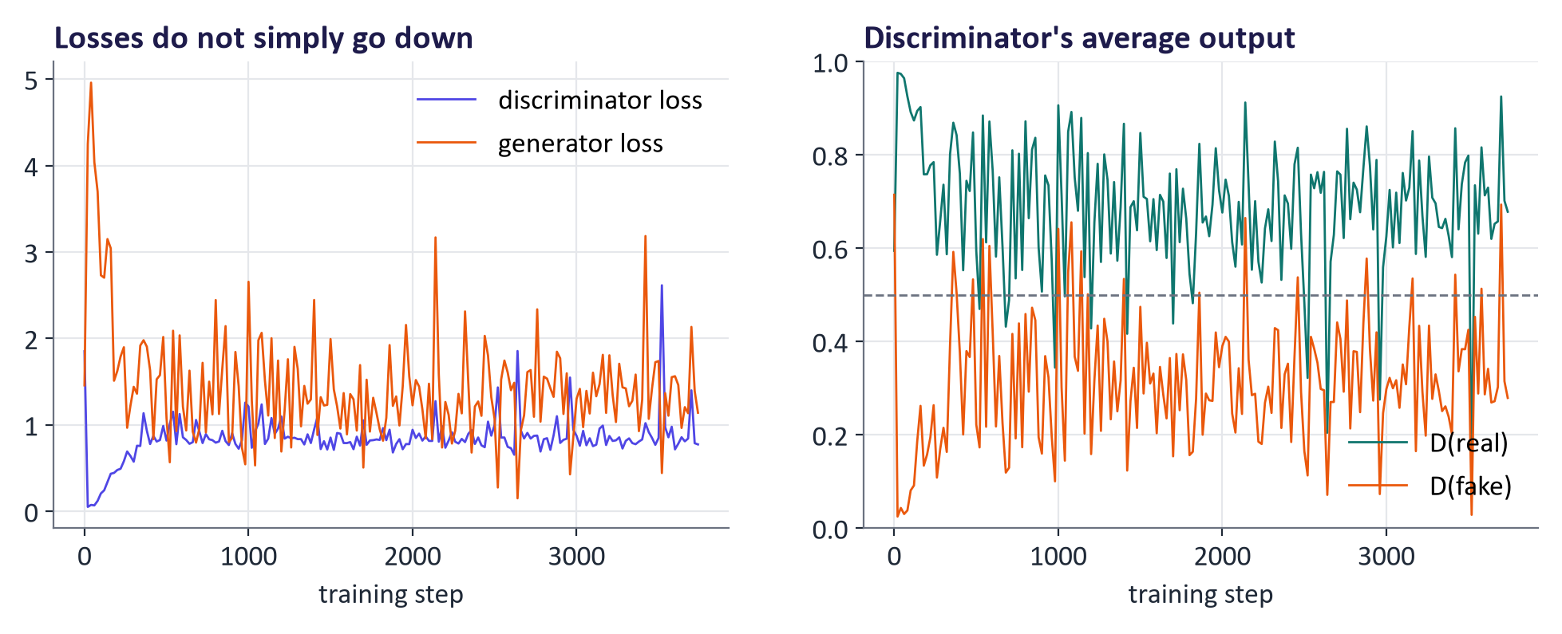
WEEK 03 · GENERATIVE ADVERSARIAL NETWORKS (GANS)
Real training curves: losses do not tell you quality
Losses oscillate instead of decreasing: each player's gain is the other's loss.
D(real) stays above D(fake): the discriminator keeps an edge; neither saturates at 0 or 1.
Judge progress by looking at samples and by metrics such as FID, not by the loss.
Generative AI · MSc in Artificial Intelligence
21
Notes:
These curves come from the DCGAN trained for today. Unlike every supervised model students have trained, the losses do not steadily fall; they fluctuate, because each update of one network changes the other's objective. A healthy run keeps the discriminator's average output on real images above its output on fakes without either collapsing to zero or one. If D of fake goes to zero and stays there, the discriminator has won and the generator's gradients vanish. The practical lesson is to monitor samples at fixed noise vectors every epoch and to compute a quality metric, which the lab does.

Slide 22
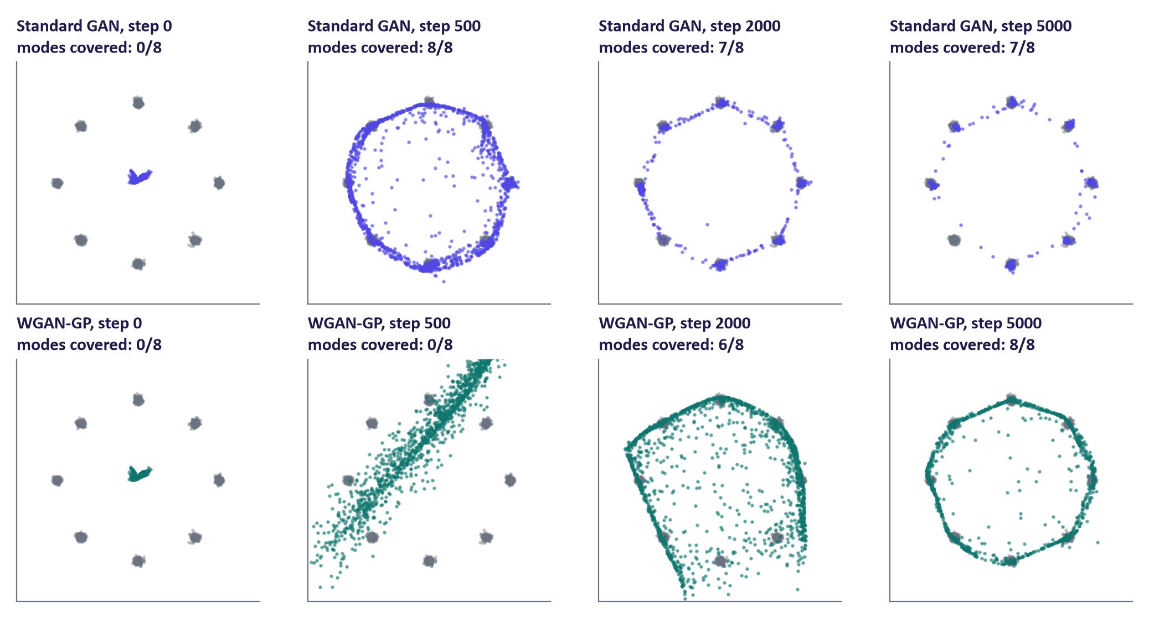
WEEK 03 · GENERATIVE ADVERSARIAL NETWORKS (GANS)
Mode collapse, seen in a real experiment
Target: 8 Gaussian clusters on a ring (grey). Blue/green: 1,500 generated points at each training step, same network sizes.
Generative AI · MSc in Artificial Intelligence
22
Notes:
This is a real experiment on a toy problem where we can see the whole distribution. The data are eight small clusters on a ring. The top row is a standard GAN; the bottom row uses the Wasserstein loss with gradient penalty. Mode collapse means the generator covers only some of the modes, producing plausible but repetitive samples. In this run the standard GAN quickly produces tight, sharp clusters, but by step 2,000 it has dropped the bottom-left cluster entirely and never recovers it: 7 of 8 modes. The Wasserstein GAN with gradient penalty learns more slowly, sweeping across the plane at first, but covers all 8 by the end. Other seeds drop more or fewer modes, which is itself a lesson: always report seeds and repeat runs. In image terms, mode collapse is a digit generator that never draws, say, a two.

Slide 23
WEEK 03 · GENERATIVE ADVERSARIAL NETWORKS (GANS)
Failure modes: symptoms and remedies
Problem | Symptom | Common remedies
Mode collapse | Samples look alike; some classes never appear | Wasserstein loss, minibatch statistics in D, unrolled or ensembled D, more diverse data
Vanishing gradients | D(fake) ≈ 0, G stops improving | Non-saturating loss, weaker or regularised D, Wasserstein loss
Non-convergence | Samples keep changing style; losses oscillate wildly | Lower learning rates, TTUR, spectral normalisation, EMA of G weights
D overfits (small data) | D(real) → 1 on training data only | Data augmentation applied to both real and fake images (e.g. ADA)
Artefacts | Checkerboard patterns, texture sticking | Resize-then-convolve upsampling; improved architectures (StyleGAN2/3)
Generative AI · MSc in Artificial Intelligence
23
Notes:
This table is a practical checklist and a good exam answer structure. Link each row to the warm-up: the forger who repeats one trick is mode collapse; the detective who wins too fast gives vanishing gradients; the endless chase is non-convergence. Two remedies deserve mention by name. TTUR, the two time-scale update rule, simply uses a larger learning rate for the discriminator and comes from the same paper that introduced FID. ADA, adaptive discriminator augmentation from the StyleGAN team, lets GANs train on a few thousand images by augmenting what the discriminator sees. Checkerboard artefacts come from transposed convolutions.

Slide 24
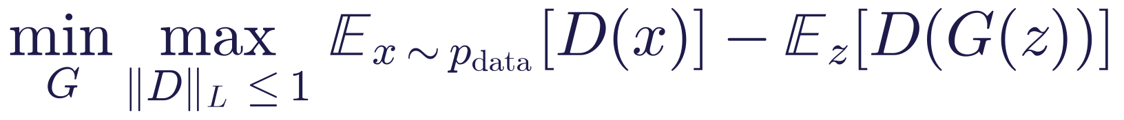
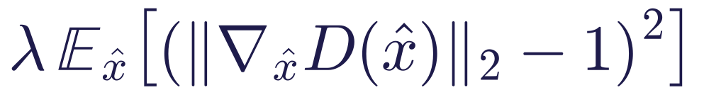
WEEK 03 · GENERATIVE ADVERSARIAL NETWORKS (GANS)
The Wasserstein GAN with gradient penalty (WGAN-GP)
Read it as
Symbols
The critic D outputs an unbounded score, not a probability; the gap in average scores estimates the Wasserstein (earth-mover) distance.
It gives useful gradients even when the two distributions do not overlap, which is where JSD saturates.
The second term (added to the critic's loss, λ = 10) keeps D smooth (1-Lipschitz) on points x̂ between real and fake samples.
Lipschitz
D is 1-Lipschitz: its slope is at most 1
x̂
random mix of a real and a fake sample
λ
penalty weight, typically 10
Generative AI · MSc in Artificial Intelligence
24
Notes:
The Wasserstein distance, or earth mover's distance, measures how much probability mass must be moved, and how far, to turn one distribution into another. Unlike the Jensen-Shannon divergence it changes smoothly even when the distributions do not overlap, which is typical early in training on high-dimensional images. The critic must be Lipschitz, meaning its slope is bounded; the original WGAN clipped weights, which works poorly, and WGAN-GP instead penalises gradient norms different from one at random interpolates between real and fake samples. The critic is usually updated five times per generator step. This is what the bottom row of the mode-collapse experiment used.

Slide 25
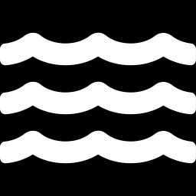
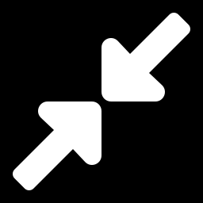
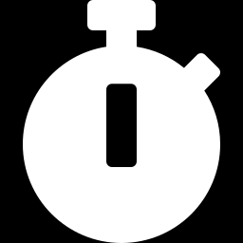
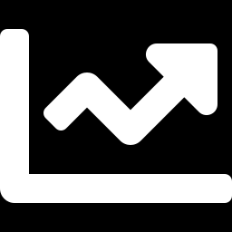
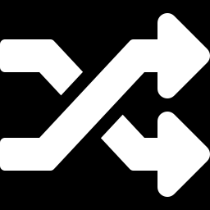
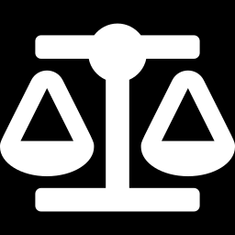
WEEK 03 · GENERATIVE ADVERSARIAL NETWORKS (GANS)
Stabilisation techniques you will meet
Wasserstein loss + GP
Spectral normalisation
TTUR
Smooth distance with useful gradients; reduces mode collapse (Gulrajani et al., 2017).
Divide each D layer's weights by their largest singular value: a cheap way to keep D Lipschitz.
Different learning rates for D and G; provably converges under assumptions (Heusel et al., 2017).
EMA of G weights
Augmentation (ADA)
R1 penalty
Generate with a moving average of generator weights: smoother, better samples at no training cost.
Augment real and fake images seen by D, so it cannot memorise a small dataset.
Penalise D's gradient on real data; the default regulariser in StyleGAN2.
Generative AI · MSc in Artificial Intelligence
25
Notes:
These six techniques cover most of what modern GAN code uses. Students do not need to derive them, but should know what problem each addresses. Spectral normalisation is a one-line change in PyTorch, torch dot nn dot utils dot spectral norm, and is one of the most effective. EMA, the exponential moving average of generator weights, is also used in diffusion model training. R1 regularisation penalises the discriminator's gradient on real data and is the default in StyleGAN2. A good lab extension is to add spectral normalisation to the discriminator and compare sample quality and stability.

Slide 26
WEEK 03 · GENERATIVE ADVERSARIAL NETWORKS (GANS)
Quick check
Your MNIST GAN produces sharp digits, but almost all of them are 1s and 7s. What is the most appropriate first step?
Train for many more epochs with the same settings
Diagnose mode collapse (class histogram of samples), then try a Wasserstein loss with gradient penalty or spectral normalisation
A
B
Remove the discriminator and train the generator with pixel-wise MSE
Raise the sampling temperature
C
D
Vote, then convince your neighbour (1 minute).
Generative AI · MSc in Artificial Intelligence
26
Notes:
Answer: B. Sharp but repetitive samples are the signature of mode collapse. The first step is to measure it, for example by classifying generated digits and plotting the class histogram, which students do in the lab; then apply a remedy aimed at coverage, such as the Wasserstein loss with gradient penalty, spectral normalisation or minibatch statistics. A rarely helps, since a collapsed generator often stays collapsed or hops between modes. C would produce a blurry average, essentially giving up on the adversarial idea. D confuses GANs with language models: a GAN has no temperature; the related idea is the truncation trick, which trades diversity for quality.

Slide 27
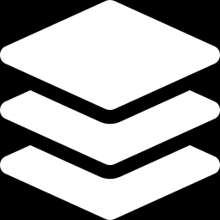
04
Variants: from DCGAN to StyleGAN
How did GANs go from blurry digits to photorealistic faces?
Notes:
Section four surveys the variants named in the descriptor: DCGAN, which made GANs work with convolutions; conditional GANs, which let us choose what to generate; pix2pix and CycleGAN, which translate images from one domain to another; and StyleGAN, which produced the photorealistic faces that made deepfakes a public concern. We also look at real samples from the DCGAN trained for these slides and at latent interpolation.

Slide 28
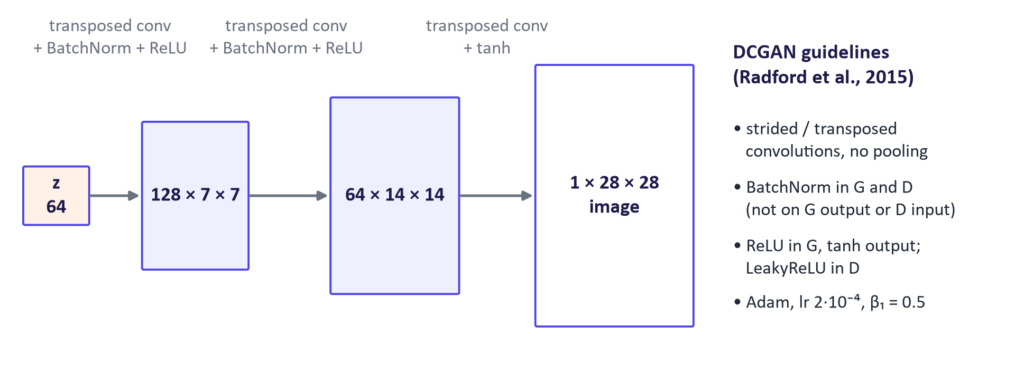
WEEK 03 · GENERATIVE ADVERSARIAL NETWORKS (GANS)
DCGAN: the architecture that made GANs work on images
Generative AI · MSc in Artificial Intelligence
28
Notes:
The deep convolutional GAN paper by Radford, Metz and Chintala in 2015 established a set of architecture guidelines that made GAN training reliable enough to use widely. The generator starts from the noise vector, projects it to a small spatial grid, and doubles the resolution with each transposed convolution, using batch normalisation and ReLU, finishing with tanh so that pixels lie between minus one and one. The discriminator mirrors this with strided convolutions and leaky ReLU. Our lab model is exactly this architecture for 28 by 28 images, with about a million parameters in total.

Slide 29
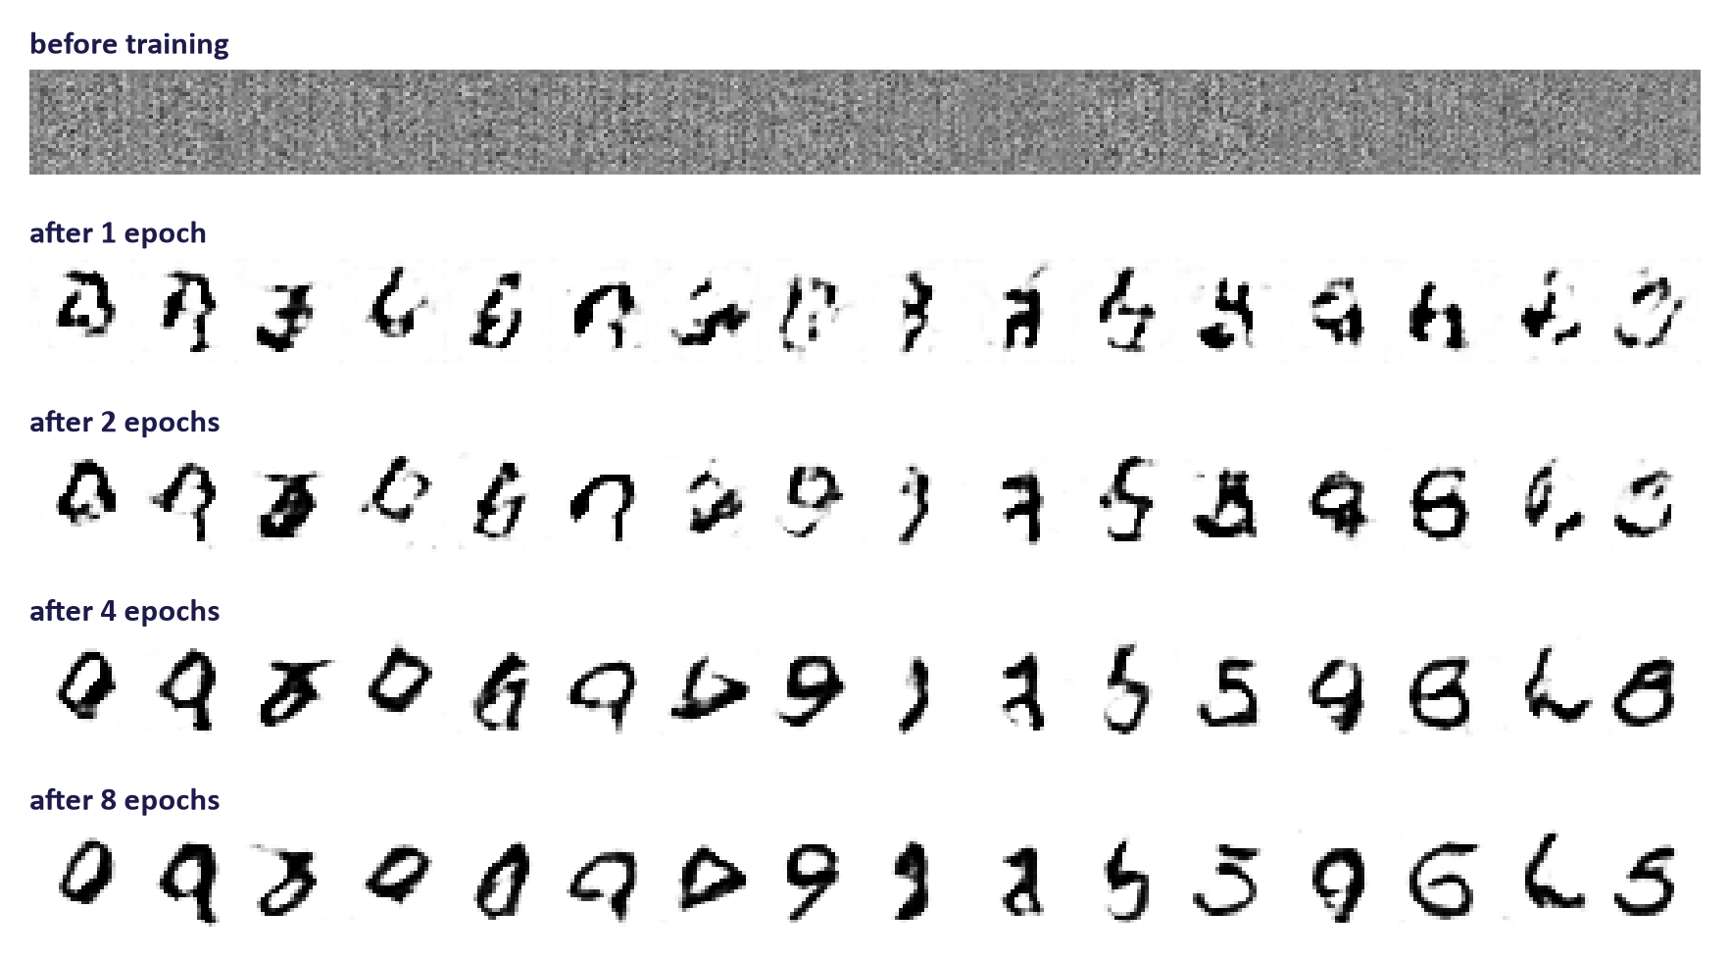
WEEK 03 · GENERATIVE ADVERSARIAL NETWORKS (GANS)
Real DCGAN samples across training epochs
The same 16 noise vectors decoded after each epoch (MNIST, CPU training).
Generative AI · MSc in Artificial Intelligence
29
Notes:
These samples use fixed noise vectors, so each column shows how one generated digit evolves. Before training the output is noise. After one epoch rough strokes appear. After two to four epochs digits become recognisable and sharper than last week's VAE samples, although some are malformed. By eight epochs most samples are convincing. Notice that the same noise vector can change digit identity between epochs, a sign that the generator's mapping is still moving as the game continues. In the lab students produce this figure themselves, and on a Colab GPU each epoch takes seconds.

Slide 30
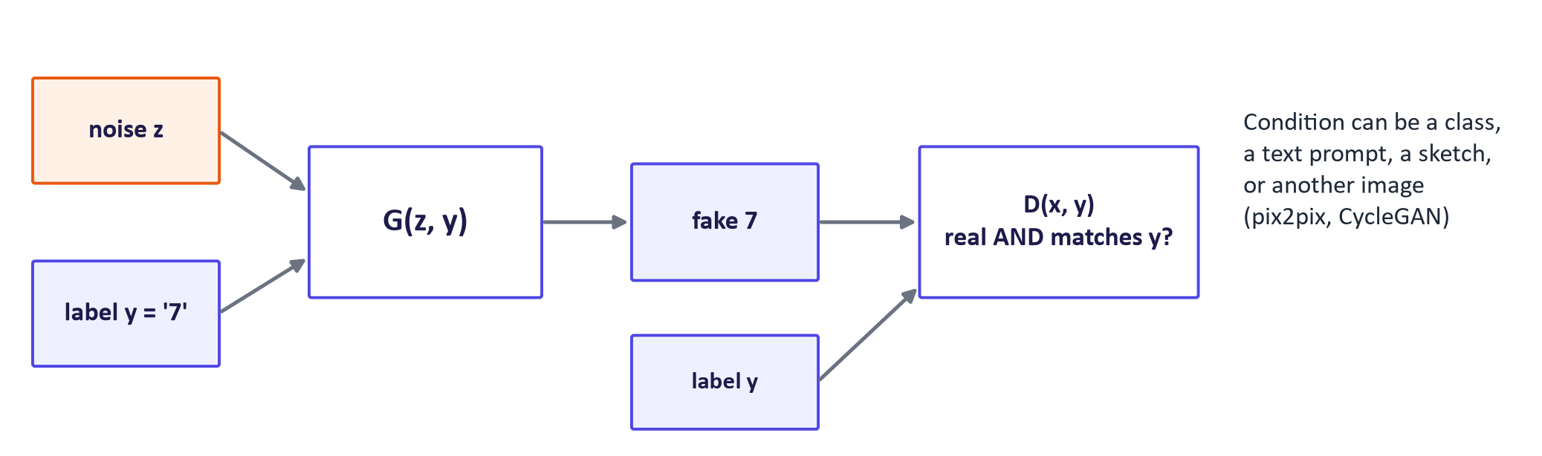
WEEK 03 · GENERATIVE ADVERSARIAL NETWORKS (GANS)
Conditional GANs: choose what to generate
Feed a condition y to both networks: G(z, y) and D(x, y).
D must check that x is real and matches y, so G learns to respect the condition.
Conditions: class labels, text, sketches, segmentation maps, other images.
Generative AI · MSc in Artificial Intelligence
30
Notes:
A conditional GAN, from Mirza and Osindero in 2014, adds information to both players. The generator receives the noise and the condition, for example the label seven, and the discriminator receives an image together with a label. A real seven paired with the label three should be rejected, so the generator is forced to produce images that match their condition. The same principle extends to any kind of condition: text for text-to-image GANs, a semantic map for image synthesis, or an entire image for image-to-image translation, which is the next slide.

Slide 31
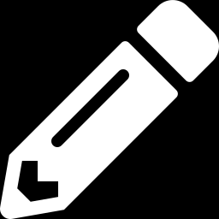
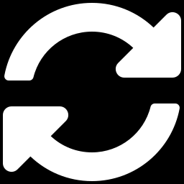
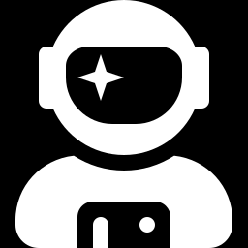
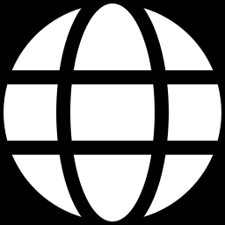
WEEK 03 · GENERATIVE ADVERSARIAL NETWORKS (GANS)
Landmark GAN variants
pix2pix (2017)
CycleGAN (2017)
Paired image-to-image translation: sketch → photo, map → aerial. Conditional GAN + L1 loss.
Unpaired translation (horse ↔ zebra, summer ↔ winter) using a cycle-consistency loss.
StyleGAN (2019–21)
BigGAN (2018)
Mapping network + style injection per layer: photorealistic faces, controllable coarse-to-fine styles.
Class-conditional ImageNet generation at scale: large batches, truncation trick for quality vs. diversity.
Generative AI · MSc in Artificial Intelligence
31
Notes:
Four landmark variants. Pix2pix needs paired examples and combines the adversarial loss with an L1 pixel loss, so outputs are both realistic and faithful to the input. CycleGAN removes the need for pairs by training two translators and requiring that translating there and back returns the original image. StyleGAN, from NVIDIA, maps noise through a mapping network into a style vector that controls each resolution of the generator separately, which gives photorealistic faces and control over coarse features like pose and fine features like hair texture. BigGAN showed that scaling up batch size and model size gives high-fidelity ImageNet samples, and popularised the truncation trick.

Slide 32
WEEK 03 · GENERATIVE ADVERSARIAL NETWORKS (GANS)
CycleGAN's key idea: cycle consistency
Read it as
Symbols
G translates domain X → Y (horse → zebra); F translates Y → X.
Going there and back should return the original image; this stops G from ignoring the input.
Total loss = two adversarial losses (one per domain) + λ · cycle loss.
G, F
the two translators
‖·‖₁
sum of absolute pixel differences
Generative AI · MSc in Artificial Intelligence
32
Notes:
Without paired data, an adversarial loss alone would let the generator output any realistic zebra, unrelated to the input horse. The cycle-consistency loss fixes this: translating a horse to a zebra and back must reproduce the original horse, and vice versa. This is a general idea worth remembering, using round-trip consistency as supervision when direct labels are missing; it appears again in unsupervised translation of text. Point out the limitation: cycle consistency encourages, but does not guarantee, that semantic content is preserved, and CycleGAN can hide information in imperceptible patterns to pass the cycle test.

Slide 33
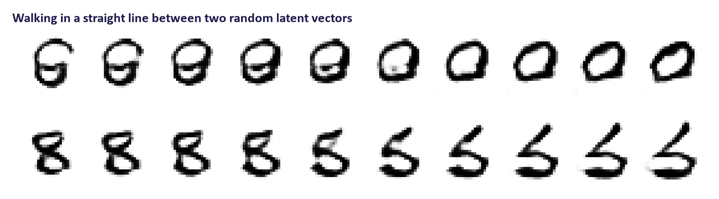
WEEK 03 · GENERATIVE ADVERSARIAL NETWORKS (GANS)
Latent interpolation in a GAN
Straight lines between random noise vectors give smooth transitions, as in the VAE.
GANs have no encoder: to edit a real image you must first find its z (GAN inversion).
StyleGAN's style space made interpolation and attribute editing (age, smile, pose) practical.
Generative AI · MSc in Artificial Intelligence
33
Notes:
As with VAEs, walking between two latent vectors gives smooth, plausible transitions, which shows the generator has learned a continuous mapping rather than memorising examples. A key difference from VAEs is that a standard GAN has no encoder, so we cannot directly find the latent code of a real image. GAN inversion methods optimise a latent vector to reproduce a given image, which enables editing real photos. StyleGAN's intermediate style space turned out to be particularly well organised, with directions for age, smile or pose, and this powered a wave of face-editing tools, with obvious misuse potential.

Slide 34
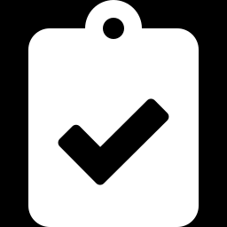
05
Evaluation, applications and risks
How good is a generator, and where are GANs used in 2026?
Notes:
The final section covers evaluation, which is required by the descriptor and by MIMLO 4, then where GANs are used today, and a responsible AI discussion of deepfakes. Because GANs have no likelihood, evaluation relies on comparing samples with real data, and the Fréchet Inception Distance is the standard. The same metrics are used for diffusion models next week and for image generation in the project, so this section has lasting value.

Slide 35
WEEK 03 · GENERATIVE ADVERSARIAL NETWORKS (GANS)
Fréchet Inception Distance (FID)
Read it as
Symbols
Embed real and generated images with a pretrained network (Inception-v3, 2048 features).
Fit a Gaussian to each set; FID is the Fréchet distance between the two Gaussians. Lower is better; 0 means identical statistics.
Captures quality (means) and diversity (covariances); needs thousands of samples; depends on the feature network.
μ (r, g)
mean feature vectors, real and generated
Σ (r, g)
feature covariance matrices
Tr
trace (sum of the diagonal)
Generative AI · MSc in Artificial Intelligence
35
Notes:
FID, introduced by Heusel and colleagues in 2017, is the most widely reported metric for image generators. Both sets of images are passed through an Inception network trained on ImageNet, and the two sets of feature vectors are summarised by their means and covariances. The formula is the Fréchet or Wasserstein-2 distance between two Gaussians. A generator whose samples are good but all alike will have a small covariance, so FID also penalises low diversity. Limitations: it assumes Gaussian features, is biased with small samples, and uses features learned on ImageNet, which may not suit medical images or digits. In the lab students compute FID with features from a small digit classifier.

Slide 36
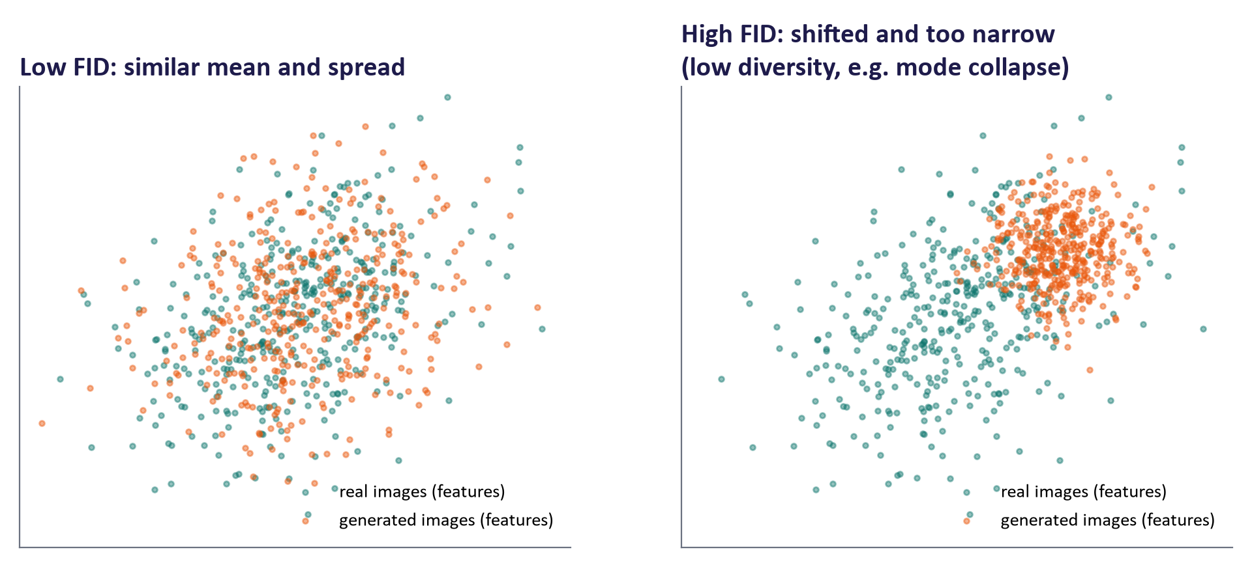
WEEK 03 · GENERATIVE ADVERSARIAL NETWORKS (GANS)
What FID measures, in feature space
Generative AI · MSc in Artificial Intelligence
36
Notes:
A two-dimensional illustration of what happens in the two-thousand-dimensional feature space. On the left the generated features have a similar centre and spread to the real ones, giving a low FID. On the right they are shifted, meaning the average generated image differs from the average real image, and narrow, meaning low diversity, which is exactly what mode collapse produces; both effects increase FID. Remind students that FID values are only comparable when computed with the same feature network, the same number of samples, and the same image preprocessing.

Slide 37
WEEK 03 · GENERATIVE ADVERSARIAL NETWORKS (GANS)
Evaluating GANs: the main tools
Metric | What it captures | Limitations
FID (lower is better) | Quality and diversity via feature statistics | Needs ~10k samples; ImageNet features; one number mixes two aspects
Inception Score (higher) | Confident and varied class predictions | Ignores real data; fooled by class-diverse but unrealistic images
Precision & recall | Separately: fidelity (precision) and coverage (recall) | Depends on feature space and neighbourhood size
KID | Like FID but unbiased for small sample sizes | Less widely reported
Human evaluation | Realism, preference, task fit (e.g. 2-alternative choice) | Costly; needs a rubric, several raters and agreement statistics
Generative AI · MSc in Artificial Intelligence
37
Notes:
No single metric is sufficient, so reports should combine them. Inception Score rewards images that a classifier labels confidently and a set of images covering many classes, but it never compares with real data. Precision and recall for generative models, from 2019, separate the two things FID mixes: are samples realistic, and do they cover the data distribution. For small sample sizes KID is preferable to FID. Human evaluation remains the gold standard for realism and usefulness and must be designed properly: several raters, a clear rubric, and agreement statistics. This table maps directly onto MIMLO 4 and the project's evaluation section.

Slide 38
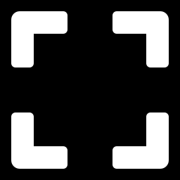
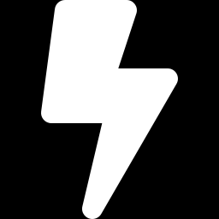
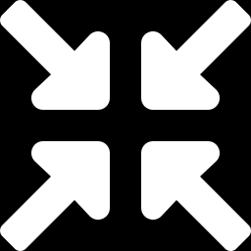
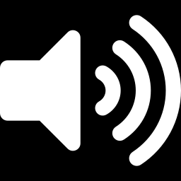
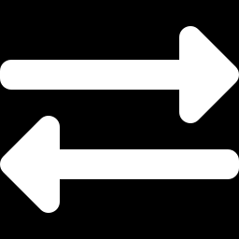
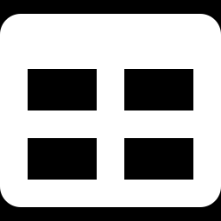
WEEK 03 · GENERATIVE ADVERSARIAL NETWORKS (GANS)
Where GANs are used in 2026
Super-resolution
Fast diffusion
Sharper autoencoders
Upscaling and restoring photos and video (e.g. Real-ESRGAN): one fast forward pass.
Adversarial diffusion distillation turns 50-step diffusion into 1–4-step generators (e.g. SDXL-Turbo).
Adversarial losses keep the VAE/VQ decoders inside latent diffusion and image tokenizers sharp.
Audio vocoders
Image translation
Synthetic data
GAN vocoders (e.g. HiFi-GAN) turn spectrograms into natural speech in real time.
Domain adaptation, style transfer and simulation-to-real for robotics and medical imaging.
Augmenting rare classes; tabular data generators, with privacy checks.
Generative AI · MSc in Artificial Intelligence
38
Notes:
Diffusion models have replaced GANs as the main text-to-image generators, but GANs are far from gone. They excel where speed matters: a GAN produces an image in one forward pass, while diffusion needs many steps. So GAN-based upscalers are everywhere, and adversarial distillation, as in Stability AI's SDXL-Turbo, uses a discriminator to compress a diffusion model into one to four steps. Adversarial losses also keep the decoders of latent-diffusion autoencoders and image tokenizers sharp, and GAN vocoders are standard in speech synthesis. Point out the link to last week: the VAE inside Stable Diffusion was trained with a GAN loss.

Slide 39

WEEK 03 · GENERATIVE ADVERSARIAL NETWORKS (GANS)
Responsible AI lens: deepfakes and synthetic media
StyleGAN-quality faces (2019) made fake profile photos trivial; face-swap and voice-cloning tools followed.
Harms: fraud, harassment and non-consensual imagery, political disinformation, and the liar's dividend (real evidence dismissed as fake).
Detection is an arms race: detectors trained on one generator often fail on the next.
Provenance and labelling: content credentials (C2PA), watermarking, and EU AI Act Art. 50 duties to disclose deepfakes (since 2 Aug 2026).
Data: FFHQ-style face datasets raise consent and demographic-balance questions.
Generative AI · MSc in Artificial Intelligence
39
Notes:
Adversarial training is, by design, optimised to fool a detector, so it is no surprise that GAN outputs raised the first wave of deepfake concerns. Discuss the harms concretely, including the liar's dividend, where genuine recordings are dismissed as fakes. Explain why detection alone is insufficient: detectors generalise poorly to new generators. The policy response combines provenance, meaning signed content credentials such as C2PA, watermarks, and legal duties: under Article 50 of the EU AI Act, deployers must disclose deepfakes. Week 10 returns to watermarking in detail. Ask students where their project could create synthetic media and how they would label it.

Slide 40
WEEK 03 · GENERATIVE ADVERSARIAL NETWORKS (GANS)
VAE vs. GAN: a summary for the exam
 | VAE (week 2) | GAN (week 3)
Training signal | Maximise ELBO (likelihood bound) | Two-player game with a learned discriminator
Likelihood p(x) | Lower bound available | None (implicit model)
Encoder | Yes: images → latent codes | No (needs GAN inversion)
Sample quality | Smooth, often blurry | Sharp, realistic
Diversity | Good coverage of the data | Risk of mode collapse
Training | Stable, simple loss | Unstable; needs tricks and monitoring
Typical use today | Autoencoder in latent diffusion; anomaly detection | Super-resolution, fast distillation, vocoders
Generative AI · MSc in Artificial Intelligence
40
Notes:
This comparison appears frequently in exams, so present it as a revision tool. VAEs optimise a bound on likelihood, have an encoder and train stably, but their samples blur. GANs produce sharper samples through a learned critic, but have no likelihood, no encoder, and can collapse. The two families are complementary, and modern systems combine them: VAE-GAN hybrids and autoencoders trained with adversarial losses. Next week, diffusion models achieve the quality of GANs with the stability and coverage of likelihood-based models, at the cost of many sampling steps.

Slide 41
WEEK 03 · GENERATIVE ADVERSARIAL NETWORKS (GANS)
Train, inspect, and evaluate a GAN
Check visual quality and coverage with evidence beyond the training loss.
1. Prepare and build
2. Alternate training
3. Explore codes
Scale digits and connect noise-to-image and image-to-score networks.
Record losses, discriminator probabilities, and fixed-code snapshots.
Compare straight and spherical paths between noise codes.
Generator / Discriminator
d_loss_fn / g_loss_fn / log
lerp / slerp
Pass: G, D, and real batches
Pass: trained G + snapshots
Pass: generated images
6. Test collapse
5. Compare features
4. Check class coverage
Compare standard GAN and WGAN-GP on eight toy clusters.
Compare real and fake feature means and covariances.
Train a digit classifier and count predicted generated classes.
train_toy / modes_covered
feats / frechet_distance
DigitCNN / counts
Pass: quality and coverage questions
Pass: classifier feature extractor
Check: Can a low feature distance alone prove that every digit class is represented?
Generative AI · MSc in Artificial Intelligence
41
Notes:
The lab asks two separate evaluation questions: do the images resemble digits, and does the generator cover varied digits? Fixed-noise snapshots answer a visual progress question because each epoch uses the same input codes. The digit classifier estimates class coverage, but its mistakes can distort the histogram, so first check its test accuracy and inspect samples. Its hidden features also define a custom Fréchet distance. This compares two sets of feature vectors through their means and covariance matrices; it is not the standard Inception-based FID. Real-versus-real features provide a reference for finite-sample differences. Keep the feature network, preprocessing, and sample count fixed when comparing generators. The toy ring makes missing modes easy to see. WGAN-GP changes the scoring objective and adds a gradient penalty, so its training feedback differs from ordinary real/fake classification. Better toy coverage is evidence for that experiment, not a guarantee for every dataset.
Worked example:
Reuse z_fixed across epoch snapshots so image changes reflect training rather than new noise inputs.
Compare lerp and slerp images and midpoint norms; neither path guarantees valid digits.
Check the classifier's test accuracy before trusting its histogram of 2,000 generated digits.
Compare real-versus-real, epoch-1, final, and uniform-noise feature distances using the same clf.
On the eight-cluster ring, inspect both the scatter plots and modes_covered for each trained system.
Check: Can a low feature distance alone prove that every digit class is represented?
Answer: No. Inspect the coverage histogram and samples as well; the feature statistic summarises only some aspects of the distribution.

Slide 42
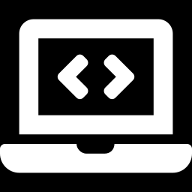
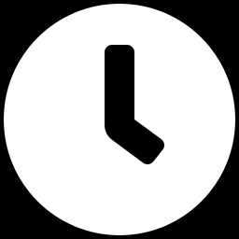
WEEK 03 · GENERATIVE ADVERSARIAL NETWORKS (GANS)
Lab 3: train and diagnose a DCGAN
1
Build the DCGAN generator and discriminator for 28 × 28 images.
Runtime
Google Colab T4 GPU (about 15 s per epoch) or CPU (about 1–2 min per epoch)
2
Implement the discriminator loss and the non-saturating generator loss (TODOs).
3
Train for several epochs; save samples from fixed noise after each epoch; plot losses, D(real) and D(fake).
Time
2-hour lab
4
Interpolate between noise vectors; look for signs of mode collapse.
5
Evaluate: class histogram and a custom feature Fréchet distance using a small digit classifier you train.
Hand in
Notebook with samples per epoch, diagnostics, custom feature Fréchet distance and class histogram, ring experiment and written answers
6
Run the 2-D ring experiment: standard GAN vs. WGAN-GP; count covered modes.
Generative AI · MSc in Artificial Intelligence
42
Notes:
The lab mirrors the lecture. Students first implement the two losses, especially the detached path for the discriminator update. They then train and inspect fixed-noise samples. Evaluation uses a small digit classifier: its predictions estimate class coverage, and its features supply a custom Fréchet distance. This uses the FID formula with a different feature network, so its values cannot be compared directly with standard Inception FID. Check classifier accuracy before interpreting either result. Finally the ring experiment makes missing modes visible and lets students test the Wasserstein objective with gradient penalty. The trained generator and evaluation code can be reused in the project.

Slide 43

WEEK 03 · GENERATIVE ADVERSARIAL NETWORKS (GANS)
Key takeaways
A GAN trains a generator to fool a discriminator that learns to tell real from fake.
Stabilise with WGAN-GP, spectral normalisation, TTUR, EMA, augmentation.
Minimax objective; the optimal D compares densities, and G then minimises the JSD.
Variants: DCGAN, cGAN, pix2pix, CycleGAN, StyleGAN.
Use the non-saturating loss −log D(G(z)) to avoid vanishing gradients early on.
Evaluate with FID (lower is better), precision/recall and humans.
Training is a game: monitor samples, not losses; watch for mode collapse and oscillation.
Today GANs power super-resolution, fast diffusion, vocoders; deepfakes demand provenance and disclosure.
Generative AI · MSc in Artificial Intelligence
43
Notes:
Recap the eight points. The essential equations are the minimax objective and the optimal discriminator; the essential practical knowledge is the non-saturating loss, the failure modes, and FID. Next week we meet diffusion models, which learn to reverse a gradual noising process. They combine the sample quality of GANs with the stable, likelihood-based training of VAEs, and they power today's image and video generators. Ask students to finish the lab, read Foster chapter 4 and, if they want the history, chapter 10 on advanced GANs including StyleGAN.

Slide 44
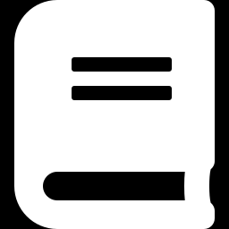
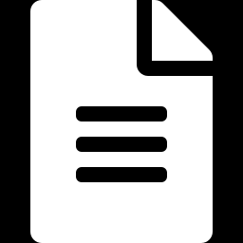
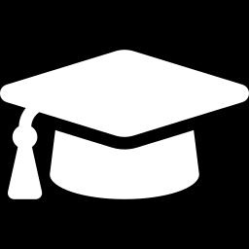
WEEK 03 · GENERATIVE ADVERSARIAL NETWORKS (GANS)
Read, watch, practise
Foster (2023) Generative Deep Learning, 2nd ed., ch. 4 'GANs' and ch. 10 'Advanced GANs'
Core module text
Arjovsky et al. (2017) Wasserstein GAN
Why the Wasserstein distance helps
Goodfellow et al. (2014) Generative Adversarial Networks
The original paper
Karras et al. (2019) StyleGAN
Style-based generator
PyTorch tutorial: DCGAN
Official step-by-step implementation
Heusel et al. (2017) TTUR and FID
Defines the Fréchet Inception Distance
Google for Developers: GAN course
Short free course with exercises
Generative AI · MSc in Artificial Intelligence
44
Notes:
Foster chapter 4 introduces GANs with Keras code and chapter 10 covers ProGAN, StyleGAN and related work. The original Goodfellow paper is short and contains the optimal-discriminator derivation. The PyTorch DCGAN tutorial is the official reference implementation and trains on faces. Google's short GAN course has clear explanations of loss functions and common problems. The WGAN, StyleGAN and FID papers are for deeper reading. All links were checked in September 2026.

