Slide 1

WEEK 05
Transformers & Attention
Attention is how modern AI reads: queries, keys and values, multi-head attention, and the transformer block behind every LLM
MSc in Artificial Intelligence · Generative AI · 2-hour lecture
Notes:
Welcome to week 5. Every system we will study for the rest of the module, large language models, the text encoders inside image generators, diffusion transformers, multimodal models and agents, is built from one component: the transformer and its attention mechanism. The image on the title slide is an attention matrix, a table of how strongly each word looks at every other word. Today we will build that table by hand, understand every part of a transformer block, and in the lab implement attention and train a small transformer that writes Shakespeare-like text.

Slide 2
WEEK 05 · TRANSFORMERS & ATTENTION
By the end of this week you can…
1
Explain the limitations of recurrent networks (long-range dependencies, sequential computation) that transformers address.
Module learning outcomes (MIMLOs) practised
2
Describe tokenisation, embeddings and why transformers need positional encoding (sinusoidal, rotary).
MIMLO 1
Explain core concepts, maths and model families
3
Compute scaled dot-product self-attention with queries, keys and values, and explain the √d_k scaling.
MIMLO 3
4
Explain multi-head, cross-attention and causal masking, and interpret attention maps critically.
Design, implement and fine-tune models
5
Describe the transformer block and the encoder-only, decoder-only and encoder–decoder families.
6
Explain training objectives, perplexity, efficiency variants (KV cache, efficient attention, mixture-of-experts, long context) and applications beyond text; implement attention in PyTorch.
Generative AI · MSc in Artificial Intelligence
2
Notes:
Six outcomes. The first motivates transformers by the problems of recurrent networks. The second covers the input side: tokens, embeddings and positional encodings. The third and fourth are the heart of the week: the attention equation, which students must be able to compute by hand in the exam, and its variants, multi-head, cross-attention and causal masking. The fifth assembles the full block and the three architecture families. The sixth covers training, evaluation with perplexity and the efficiency techniques that make modern models possible. This week practises MIMLO 1 on concepts and maths, and MIMLO 3 through implementation.

Slide 3

WEEK 05 · TRANSFORMERS & ATTENTION
Today's plan
1
Warm-up: what does 'it' refer to?
5 min
2
1 · Why transformers?
10 min
3
2 · Tokens, embeddings and position
12 min
4
3 · Attention
38 min
5
4 · The transformer architecture
22 min
6
5 · Training, efficiency and applications
25 min
7
Lab preview and wrap-up
8 min
Generative AI · MSc in Artificial Intelligence
3
Notes:
The structure follows the descriptor: motivation and the limitations of recurrent architectures, attention in its variants, the transformer architecture and components, training, evaluation, variants and applications. The attention section is the longest; take the break after it. Section five includes a real small transformer trained for this lecture and real attention maps from BERT and GPT-2, so students see both the mechanism and what trained models do with it. If short of time, compress the efficiency slides, since week 6 and week 11 return to them.

Slide 4
WEEK 05 · TRANSFORMERS & ATTENTION
Starting vocabulary
Term | Plain meaning
Vector | An ordered list of numbers representing one item, such as a token.
Matrix shape | The number of rows and columns in a table of numbers.
Training target | The known answer used to measure a model's prediction error.
Generative AI · MSc in Artificial Intelligence
4
Notes:
Introduce these terms before the main theory. Vector: An ordered list of numbers representing one item, such as a token. Ask: How many entries are in the vector [1, 0, 1]? Matrix shape: The number of rows and columns in a table of numbers. Ask: What does shape [3, 2] tell you about three token vectors? Training target: The known answer used to measure a model's prediction error. Ask: For input characters 'cat', which characters follow them in 'cats'? Let students explain one example aloud, then connect their example to the next flow diagram. Use the numbered blocks to name the inputs and outputs before introducing notation.

Slide 5

WEEK 05 · TRANSFORMERS & ATTENTION
Warm-up
'The animal didn't cross the street because it was too tired.' What does 'it' refer to? What if 'tired' becomes 'wide'?
How did you decide? Which words did you look at?
How far back in the sentence did you need to look?
Could a model that reads one word at a time, keeping only a short memory, do the same?
Generative AI · MSc in Artificial Intelligence
5
Notes:
This is a classic Winograd-style example. With tired, it refers to the animal; with wide, it refers to the street. People use the candidate nouns and the later adjective to decide. Bidirectional attention in BERT allows the representation of it to use both earlier nouns and the later adjective. In a causal decoder, the representation at it cannot yet use that adjective; a later position can use the whole sentence. Keep the sentence on the board: we will inspect a real BERT attention head later today, while keeping information routing separate from proof of coreference reasoning.

Slide 6

01
Why transformers?
What was wrong with reading one word at a time?
Notes:
Section one explains the motivation. Before 2017 the standard sequence models were recurrent neural networks, especially LSTMs, often with an attention layer added on top for translation. Vaswani and colleagues' paper, Attention Is All You Need, showed that attention alone, without recurrence, gave better translation and trained far faster. We look at why, in two slides.

Slide 7
WEEK 05 · TRANSFORMERS & ATTENTION
Text to the next character
Follow the small decoder built in this week's lab
1. Text
2. Character IDs
3. Token + position
Characters from the Tiny Shakespeare training text
Each character receives one vocabulary number
Look up character vectors and add position vectors
text
stoi
CharGPT.tok / CharGPT.pos
Pass: raw characters
Pass: integer IDs
Pass: position-aware vectors
6. New character
5. Vocabulary scores
4. Causal blocks
Choose an ID and decode it back to text
One score for every possible next character
Mix allowed earlier information, then transform each position
CharGPT.generate / itos
CharGPT.head
Block.forward
Pass: logits
Pass: contextual vectors
Repeat: Append the chosen ID; predict again from the current context
Generative AI · MSc in Artificial Intelligence
7
Notes:
A token is the unit the model reads. This lab deliberately uses one character per token, although larger language models often use word pieces. The dictionary stoi maps characters to integer IDs; an embedding table maps those IDs to vectors. A separate table adds where each character occurs. Transformer blocks then build contextual vectors: the same character can carry different information in different prefixes. The causal mask prevents a position from using later characters. The output layer produces logits, which are scores rather than probabilities. Generation converts the final position's scores into probabilities, samples one character ID, and repeats. Training instead compares every position with its known next character. The model learns patterns in text; fluent-looking output alone does not establish factual knowledge or coherent reasoning.
Worked example:
The prefix 'ROMEO:' becomes a sequence of IDs using stoi.
CharGPT adds a learned position vector to each character vector.
Causal blocks let each position use itself and earlier positions.
The final position's scores become probabilities for the next character.
A sampled ID is appended; repeated predictions form a continuation.
Check: When predicting the character after 'ROMEO:', can the model use characters from the continuation that have not been generated?
Answer: No. Its prediction uses the existing prefix; the continuation is generated one character at a time.

Slide 8
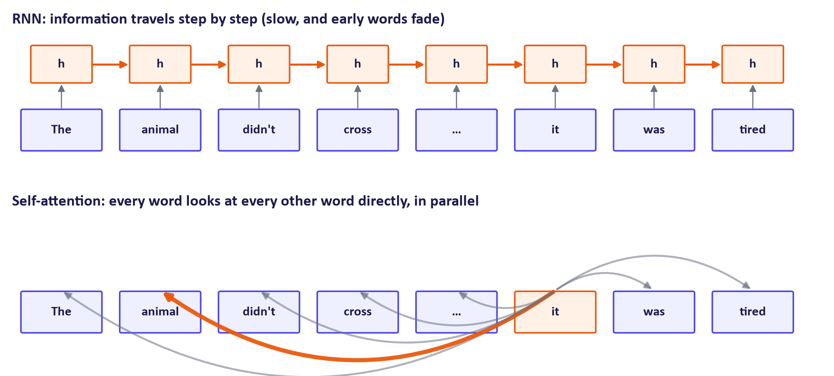
WEEK 05 · TRANSFORMERS & ATTENTION
Recurrence vs. attention
Generative AI · MSc in Artificial Intelligence
8
Notes:
The top row is a recurrent network. It reads one token at a time and passes a hidden state forward, so information about the animal must survive many steps to reach it; in practice early information fades, the long-range dependency problem. It also cannot be parallelised across the sequence during training, since step t needs step t minus one. The bottom row is self-attention: the representation of it is computed by looking at all tokens directly, with weights, and all positions are computed at once. Thick arrows show high attention to animal.

Slide 9


WEEK 05 · TRANSFORMERS & ATTENTION
RNN / LSTM vs. transformer
Recurrent (RNN, LSTM)
Transformer
Processes tokens sequentially
Path between distant tokens grows with distance: long-term dependencies are hard
Vanishing / exploding gradients over long sequences
Cannot parallelise over time: slow to train on GPUs
Memory per step is constant
Processes all tokens in parallel
Any token can attend to any other in one step
Stable training with residuals and normalisation
Scales to billions of parameters and trillions of tokens
Cost grows as n² with sequence length (section 5)
Key idea: Parallel training on GPUs, not just accuracy, is why transformers took over: they turned more compute and data directly into better models.
Generative AI · MSc in Artificial Intelligence
9
Notes:
Summarise the comparison. The decisive practical advantage is parallelism: during training, a transformer processes all positions of a sequence at once, which uses GPUs efficiently, whereas an RNN has to loop. That is what allowed scaling to the enormous datasets of week 6. Transformers also connect distant tokens directly, easing long-range dependencies. The cost, which we return to later, is that attention compares every token with every other, so memory and compute grow with the square of the sequence length. Recent recurrent-style models, such as state-space models, try to recover linear cost; they are an active research area.

Slide 10

02
Tokens, embeddings and position
How does text become numbers that attention can work with?
Notes:
Section two covers the input to a transformer. We recap tokenisation from week 1, introduce the embedding table that turns token IDs into vectors, and explain why the model needs to be told the position of each token, with the two main solutions: the original sinusoidal encoding and the rotary encoding used by most current language models.

Slide 11

WEEK 05 · TRANSFORMERS & ATTENTION
From text to vectors
Tokenise: split text into sub-word tokens (byte-pair encoding and similar); each gets an integer ID (week 1).
Embed: look up each ID in a learned table of size vocabulary × d (e.g. 50,000 × 768). Similar tokens end up with similar vectors.
Attention ignores order: shuffle the tokens and self-attention produces the same outputs, shuffled (permutation-equivariant).
So we must add positional information: 'dog bites man' ≠ 'man bites dog'.
Key idea: Everything a transformer knows about a token at the input is its embedding plus its position.
Generative AI · MSc in Artificial Intelligence
11
Notes:
The embedding layer is simply a learned lookup table: one vector per token in the vocabulary, typically of dimension 512 to a few thousand. These vectors are learned during training, and tokens used in similar contexts end up close together, which students will explore in week 12 for retrieval. The key point for today is that the attention operation itself has no notion of order: it compares every token with every other using dot products, so permuting the input simply permutes the output. Without positional information, dog bites man and man bites dog would look identical. In the lab students verify this permutation property numerically.

Slide 12
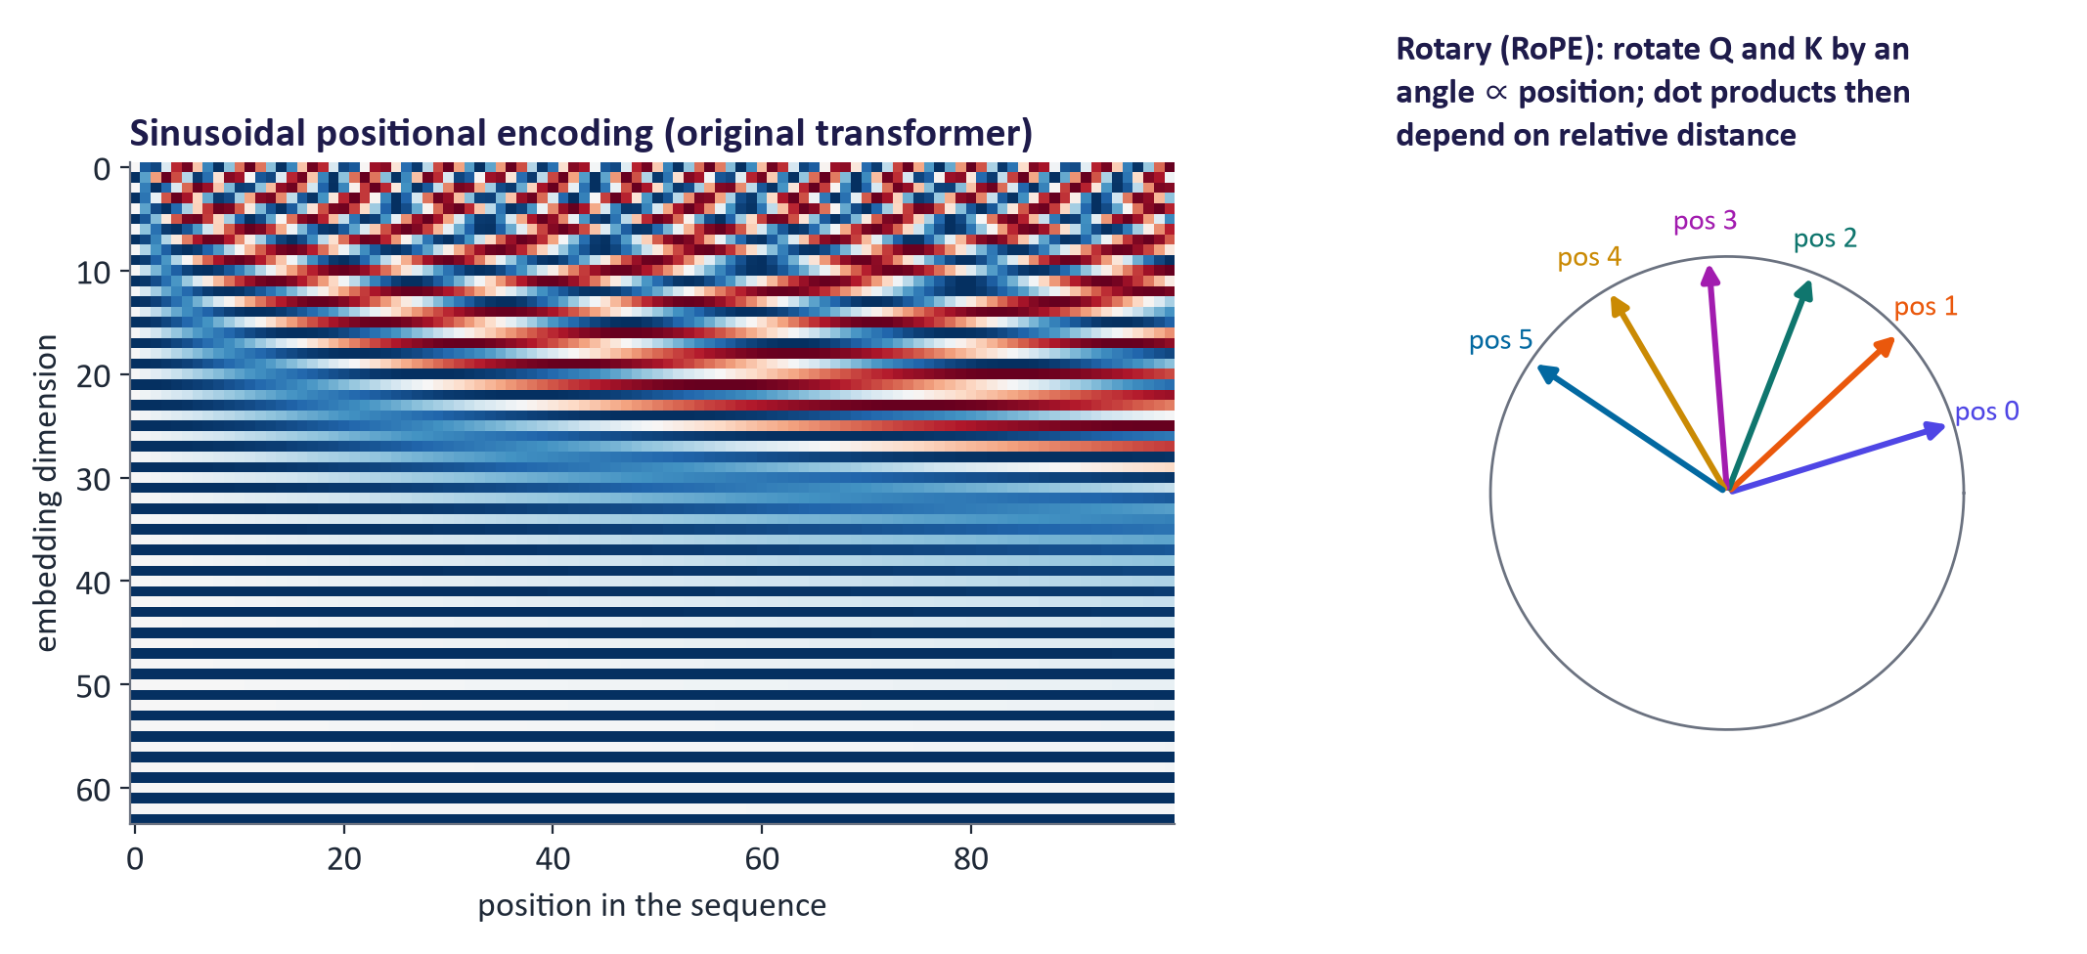
WEEK 05 · TRANSFORMERS & ATTENTION
Positional encoding: sinusoidal and rotary
Sinusoidal (2017): add sine/cosine waves of different frequencies; each position gets a unique pattern.
Learned absolute positions (BERT, GPT-2): a trainable vector per position, up to a fixed maximum.
Rotary (RoPE) (Su et al., 2021): rotate query and key vectors by position-dependent angles; attention then depends on relative distance. Used by most current open LLMs and extendable to long context.
Generative AI · MSc in Artificial Intelligence
12
Notes:
The original transformer adds a fixed pattern of sine and cosine waves to each embedding; the heatmap shows it, with position along the horizontal axis. Low dimensions change quickly, high dimensions slowly, so each position gets a unique signature, like the hands of a clock. BERT and GPT-2 instead learned one vector per position, which limits the context to the trained maximum. Rotary position embedding, used by the LLaMA, Qwen and Mistral families among others, rotates each query and key by an angle proportional to its position, so the dot product between two tokens depends on how far apart they are. Rescaling these rotations is one of the main tricks for extending context length.

Slide 13

03
Attention
How does a token decide which other tokens matter?
Notes:
Section three is the core of the week. We define queries, keys and values, write the scaled dot-product attention equation, compute a small example by hand, explain why we divide by the square root of the key dimension, extend to multiple heads, add the causal mask used by generative models, contrast self-attention with cross-attention, and finally look at attention maps from real pretrained models, with a warning about how to interpret them. Allow about thirty-five minutes, then take the break.

Slide 14
WEEK 05 · TRANSFORMERS & ATTENTION
Inside one attention head
Turn comparisons between tokens into a mixture of information
1. Input vectors
2. Q, K and V
3. Scaled scores
One vector for each token position
Learned projections form queries, keys and values
Compare each query with keys; control score magnitude
MultiHeadAttention.forward
MultiHeadAttention.qkv
attention
Pass: token vectors
Pass: query/key/value tensors
Pass: score table
6. Weighted values
5. Row weights
4. Allowed positions
Mix value vectors using each query's row weights
Softmax gives nonnegative weights summing to one
Optional mask blocks future tokens before probability calculation
attention
attention
causal_mask
Pass: attention weights
Pass: masked score table
Check: Do attention weights mix the key vectors or the value vectors to form the output?
Generative AI · MSc in Artificial Intelligence
14
Notes:
A query describes the information a token seeks; a key supplies features for matching; a value carries the information passed onward. These are learned numerical projections, rather than literal questions or words. A dot product compares each query with every key. Dividing by the square root of the key dimension controls the scale of those comparisons. A causal mask, when used, removes future positions before softmax turns each row into weights. Multiplying those weights by the values gives one new vector per query. Multi-head attention performs this process in several smaller vector spaces, then joins their outputs. Printing shapes helps: the score table is token positions by token positions, while the output still has one vector per position. A bright attention cell describes information routing and does not by itself explain a prediction.
Worked example:
In the lecture example, cat's query is [1, 0].
Its scaled scores for cat, sat and mat are about [0.71, 0, 0.71].
Without a mask, its weights are about [0.40, 0.20, 0.40].
Mixing the three value vectors produces cat's output [0.60, 0.40].
With a causal mask at the first position, later tokens receive zero weight.
Check: Do attention weights mix the key vectors or the value vectors to form the output?
Answer: They mix the value vectors. Keys are used to calculate the matching scores.

Slide 15
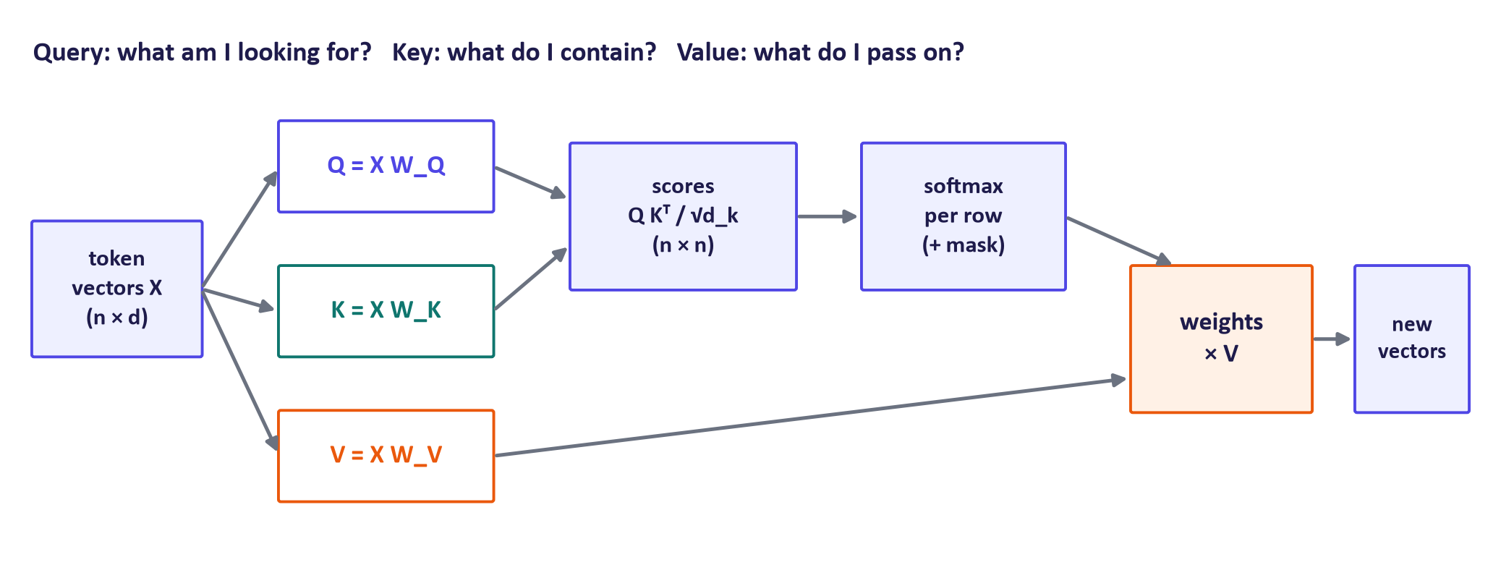
WEEK 05 · TRANSFORMERS & ATTENTION
Queries, keys and values
Generative AI · MSc in Artificial Intelligence
15
Notes:
Each token vector is projected three times with learned matrices. The query represents what this token is looking for, the key represents what it offers for matching, and the value is the information it passes on if selected. An analogy is a library search: your query is compared with the keys, such as titles and keywords, of every book, and you take home a weighted mixture of the contents, the values, of the best matches. Scores are dot products of queries with keys, scaled; softmax turns each row of scores into weights; and the output for each token is the weighted average of the values.

Slide 16
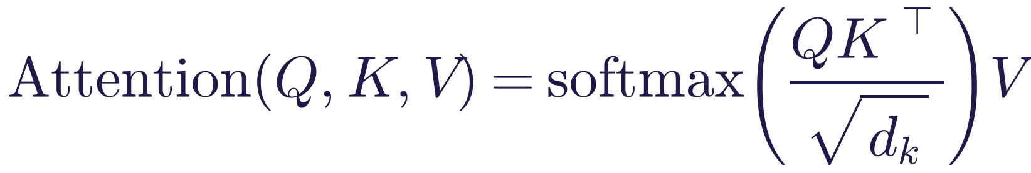
WEEK 05 · TRANSFORMERS & ATTENTION
Scaled dot-product attention
Read it as
Symbols
QKᵀ: every query dotted with every key gives an n × n table of compatibility scores.
Divide by √d_k, apply softmax to each row: each token's weights over all tokens sum to 1.
Multiply by V: each output is a weighted average of value vectors.
Q, K
queries and keys, n × d_k
V
values, n × d_v
n
number of tokens
d_k
key dimension, e.g. 64
Generative AI · MSc in Artificial Intelligence
16
Notes:
This equation is the single most important formula of the second half of the module. Read it from the inside out. The product of Q and K transposed is a table: row i, column j holds the dot product between token i's query and token j's key, a measure of how relevant token j is to token i. Dividing by the square root of the key dimension keeps the numbers in a sensible range. The softmax is applied to each row, turning scores into positive weights that sum to one. Finally, multiplying by V mixes the value vectors according to those weights, giving a new, context-aware vector for every token.

Slide 17
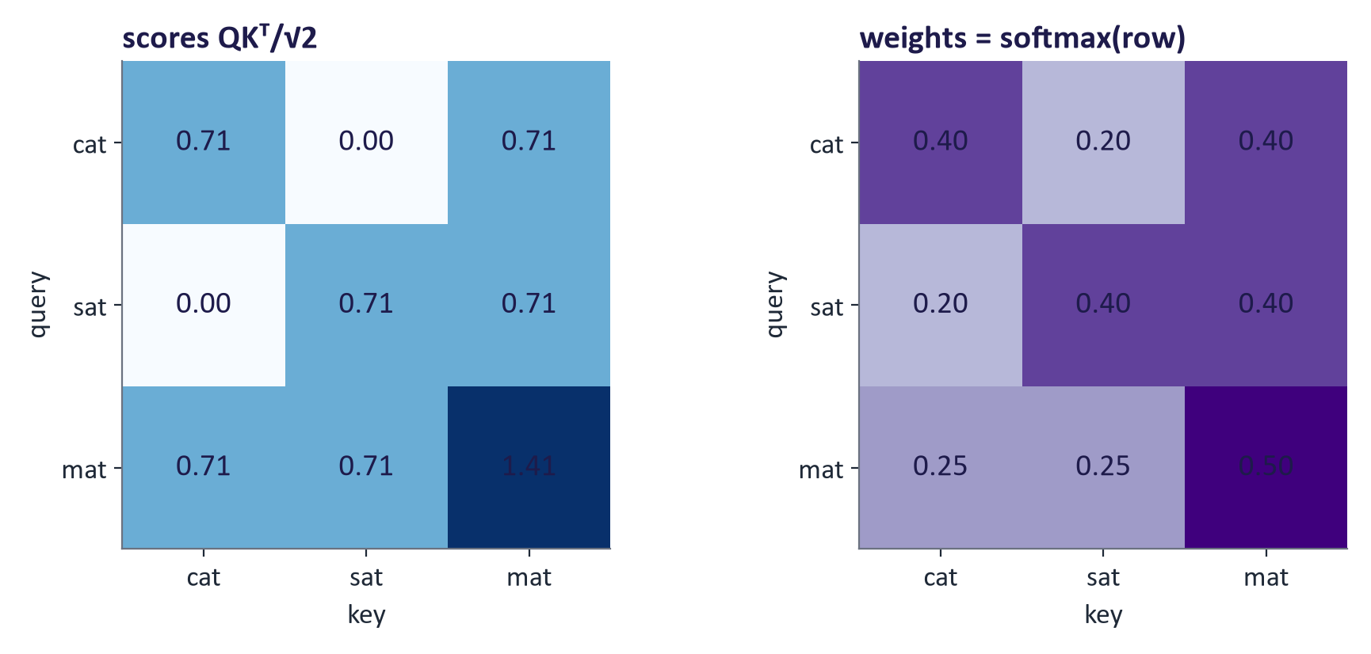
WEEK 05 · TRANSFORMERS & ATTENTION
Worked example: three tokens, d_k = 2
Q = K = [[1,0],[0,1],[1,1]] for 'cat', 'sat', 'mat'. Score cat·mat = (1·1 + 0·1)/√2 = 0.71.
Row 'mat': softmax([0.71, 0.71, 1.41]) = [0.25, 0.25, 0.50]: 'mat' attends most to itself.
With V = [[1,0],[0,1],[0.5,0.5]], output for 'cat' = 0.40·[1,0] + 0.20·[0,1] + 0.40·[0.5,0.5] = [0.60, 0.40].
Generative AI · MSc in Artificial Intelligence
17
Notes:
Work through this on the board. The dot product of cat's query with mat's key is one, divided by root two gives 0.71. The dot product of cat with sat is zero. For the mat row, exponentiate 0.71, 0.71 and 1.41, giving about 2.03, 2.03 and 4.11, which sum to 8.17, so the weights are 0.25, 0.25 and 0.50. For the cat row the weights are 0.40, 0.20, 0.40. Multiplying by the value vectors gives cat's new representation, 0.60 and 0.40. Exam questions often give small matrices like this; students should practise until it is routine.

Slide 18

WEEK 05 · TRANSFORMERS & ATTENTION
Why divide by √d_k?
If query and key entries have mean 0 and variance 1, their dot product has variance d_k.
With d_k = 64 the scores have standard deviation 8: softmax becomes almost one-hot.
Saturated softmax has near-zero gradients, so learning stalls.
Dividing by √d_k restores variance 1: soft, trainable attention.
Key idea: The scaling is not cosmetic: without it, large models train poorly. It is the 'scaled' in scaled dot-product attention.
Generative AI · MSc in Artificial Intelligence
18
Notes:
This is a favourite exam question. A dot product sums d k products of random numbers, so its variance grows linearly with d k, and its standard deviation with the square root. For a typical head dimension of sixty-four, raw scores have a standard deviation of about eight, and a softmax over numbers that far apart puts nearly all weight on the largest, like temperature close to zero in week 1. A saturated softmax has tiny gradients. Dividing by the square root of d k brings the variance back to about one. Link to week 1: this is exactly the temperature idea, applied inside the network.

Slide 19
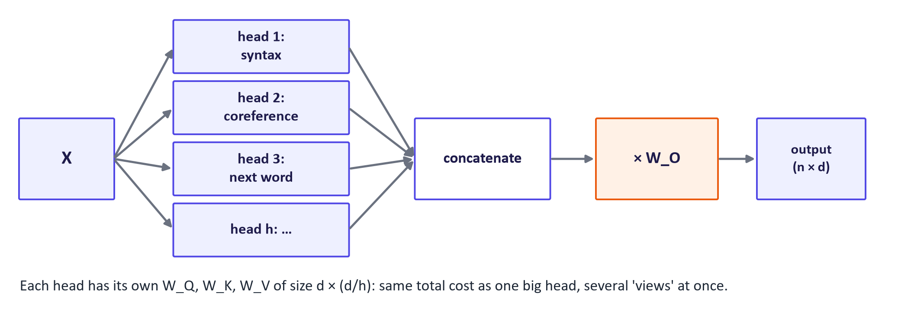
WEEK 05 · TRANSFORMERS & ATTENTION
Multi-head attention: several views at once
Generative AI · MSc in Artificial Intelligence
19
Notes:
A single attention head produces one weighted average per token, which can only capture one kind of relationship at a time. Multi-head attention runs several heads in parallel, each with its own smaller projection matrices, so one head can track syntactic relations, another coreference, another the previous token. The head outputs are concatenated and mixed by an output matrix. Because each head works in dimension d divided by h, the total cost is the same as one full-size head. The original transformer used eight heads; large models use dozens. The head labels here are illustrative: real heads often have mixed or unclear roles.

Slide 20
WEEK 05 · TRANSFORMERS & ATTENTION
Multi-head attention, formally
Read it as
Symbols
Each head has its own projections of size d × (d/h).
Heads are computed in parallel as one batched tensor operation (reshape to [batch, heads, n, d/h]).
W_O (d × d) mixes the heads back into the model dimension.
h
number of heads, e.g. 8–128
d
model dimension, e.g. 512–8192
W_O
output projection
Generative AI · MSc in Artificial Intelligence
20
Notes:
The formal definition is compact. Each head applies attention to its own projections of the same input. In code, we do not loop over heads: we compute one big projection, reshape the result so that heads become a separate tensor dimension, run attention once in batch, and reshape back before the output projection. Students implement exactly this reshape in the lab, and it is the most common source of bugs, so encourage them to print tensor shapes at every step. Modern large models also use grouped-query attention, where several query heads share one key-value head to save memory.

Slide 21
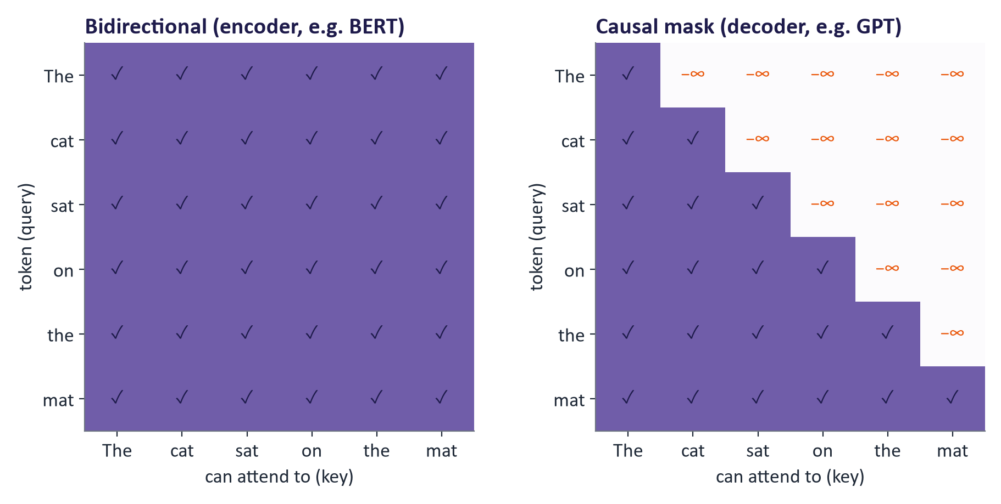
WEEK 05 · TRANSFORMERS & ATTENTION
Causal masking: no peeking at the future
Generative (decoder) models must predict token t using only tokens before t.
Set scores for future positions to −∞ before the softmax, so their weight is exactly 0.
One forward pass then trains every position's next-token prediction at once.
Generative AI · MSc in Artificial Intelligence
21
Notes:
In an encoder such as BERT every token may attend to every other, left and right. In a decoder such as GPT, which generates text left to right, a token must not see the tokens it is trying to predict. The causal mask enforces this by adding minus infinity to all scores above the diagonal before the softmax, so those weights become zero. A beautiful side effect is training efficiency: in a single forward pass over a sequence of n tokens, the model makes n next-token predictions, each using only the correct past, so every token in the training data provides a learning signal.

Slide 22


WEEK 05 · TRANSFORMERS & ATTENTION
Self-attention vs. cross-attention
Self-attention
Cross-attention
Q, K and V all come from the same sequence
Tokens exchange information with each other
Used in every encoder and decoder layer
Q from one sequence; K and V from another
Translation: decoder words attend to the source sentence
Stable Diffusion: image latents attend to prompt tokens (week 4)
Multimodal models: text attends to image features (weeks 9–10)
Key idea: Cross-attention is the standard way to condition one modality on another.
Generative AI · MSc in Artificial Intelligence
22
Notes:
Cross-attention uses exactly the same equation; only the sources differ. The queries come from the sequence being generated, and the keys and values from a second sequence. In the original encoder-decoder transformer for translation, each decoder layer has a cross-attention sublayer in which the partially generated translation attends to the encoded source sentence. Last week we saw the same mechanism in Stable Diffusion, where image latents attend to the prompt tokens. In weeks 9 and 10, cross-attention is one of the main ways to fuse images, audio and text. Ask students to name the queries, keys and values in the Stable Diffusion case.

Slide 23
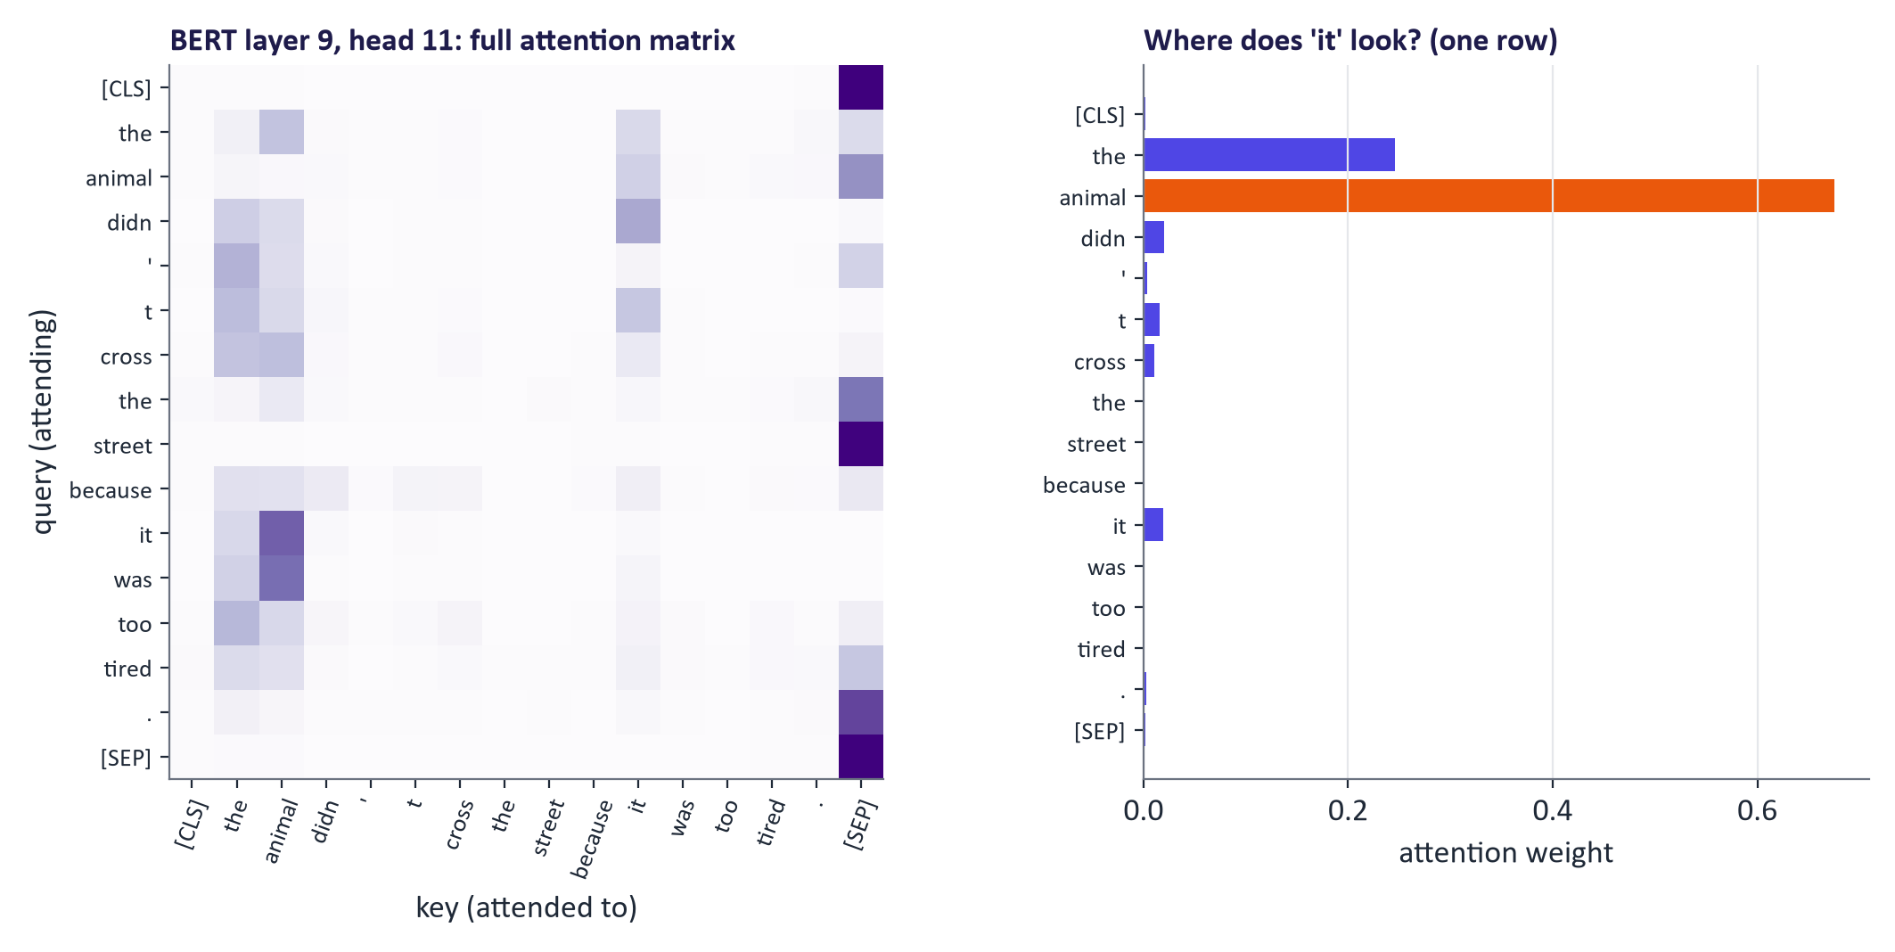
WEEK 05 · TRANSFORMERS & ATTENTION
A real attention head: BERT resolving 'it'
Pretrained BERT-base on the warm-up sentence. The head shown is the one (layers 5–10) where 'it' attends most strongly to 'animal'.
Generative AI · MSc in Artificial Intelligence
23
Notes:
Here is a real pretrained model. We fed the warm-up sentence to BERT base and looked for a head in its middle layers where the token it attends strongly to animal; the chosen layer and head, and the weight, are recorded in the teaching notes. On the left is that head's full attention matrix; on the right, the row for it. Several heads in BERT's middle layers track coreference like this. Be careful, though: we selected this head because it shows the pattern, which is a form of cherry-picking, and other heads attend to punctuation or the separator token. That leads to the caution on the next slide.

Slide 24
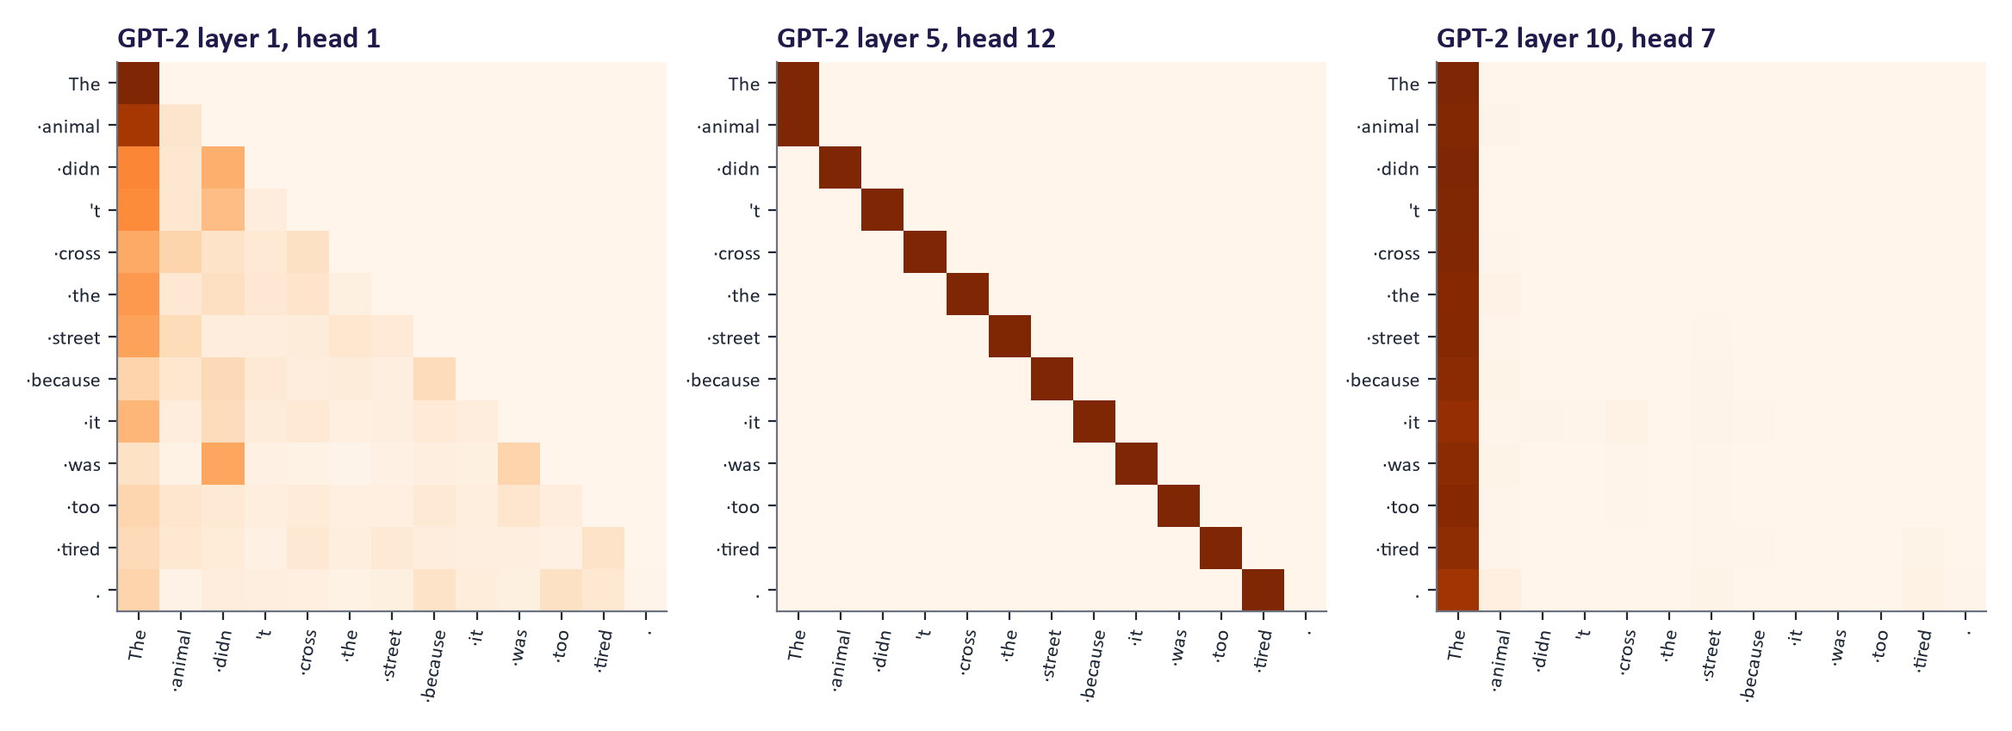
WEEK 05 · TRANSFORMERS & ATTENTION
Real GPT-2 heads: causal patterns
All weights lie on or below the diagonal: the causal mask at work.
Common patterns: attend to the previous token, to the first token (an 'attention sink'), or to related earlier words.
Caution: attention weights show where information flows, not why the model decided something. Attention is not a complete explanation.
Generative AI · MSc in Artificial Intelligence
24
Notes:
Three heads from GPT-2 on the same sentence. Every matrix is lower triangular because of the causal mask. Different heads have recognisable habits: one attends to the previous token, another places much of its weight on the first token, and another links related earlier words. In the lab, replacing tired with wide should not change attention at it, because both adjectives are later tokens hidden from that position by the causal mask. This is expected causality, not evidence of failed full-sentence reasoning; a later position can use the adjective. The caution matters for responsible AI and for the exam: attention weights alone do not establish why a prediction was made. Interpretability research uses controlled interventions and other evidence.

Slide 25

WEEK 05 · TRANSFORMERS & ATTENTION
Quick check
For one query, the scaled scores against three keys are [2, 0, 0]. What are the attention weights (to two decimals)?
[1.00, 0.00, 0.00]
[0.79, 0.11, 0.11]
A
B
[0.50, 0.25, 0.25]
[0.67, 0.17, 0.17]
C
D
Vote, then convince your neighbour (1 minute).
Generative AI · MSc in Artificial Intelligence
25
Notes:
Answer: B. Exponentiate: e squared is 7.39, e to the zero is one, and one again; the sum is 9.39; so the weights are 0.79, 0.11 and 0.11. A is what a hard maximum would give; softmax is soft. C is what you get by dividing the raw scores naively. D corresponds to scores of about 1.39. If students got it wrong, redo it on the board and connect it to the softmax slide of week 1. This is exactly the kind of calculation that appears in the exam.

Slide 26

04
The transformer architecture
How are attention layers assembled into a model?
Notes:
Welcome back. Section four assembles attention into complete models. We look at one transformer block, with its residual connections, normalisation and feed-forward network; the three architecture families, encoder-only, decoder-only and encoder-decoder, which week 6 builds on; how big real models are; and the whole attention computation in a few lines of PyTorch.

Slide 27
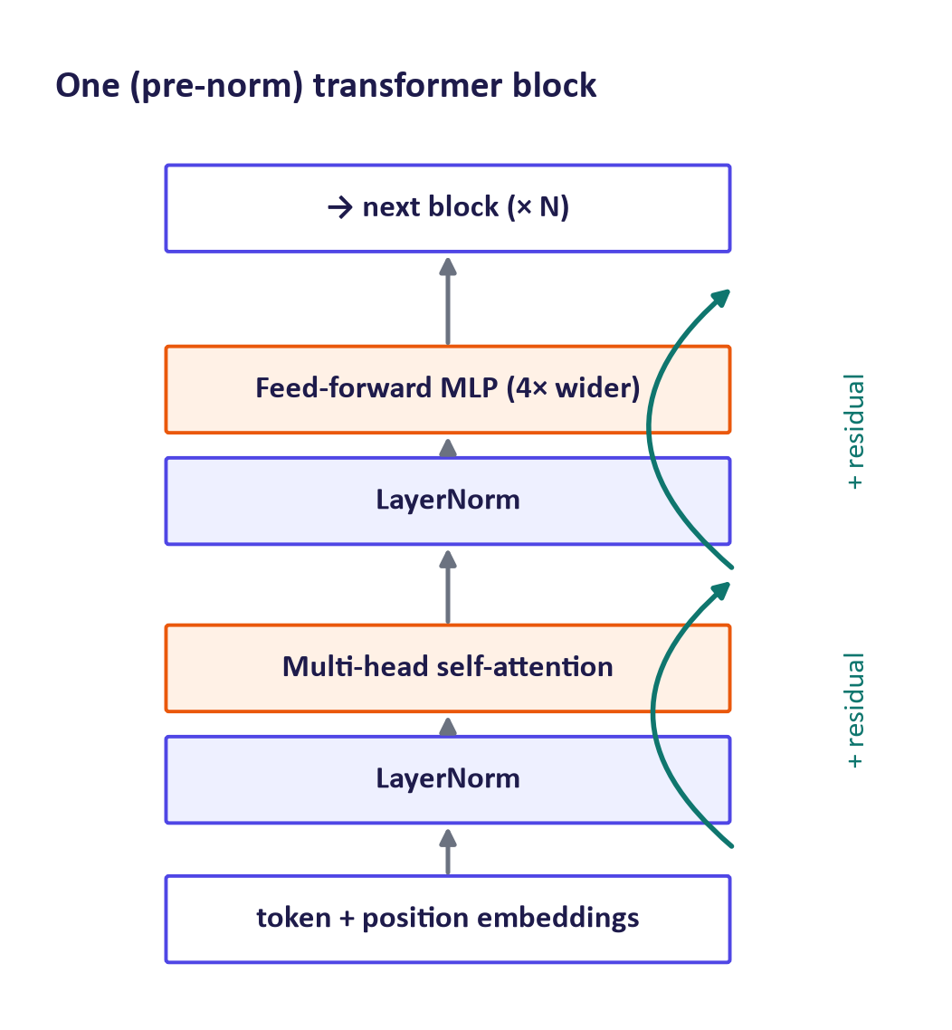
WEEK 05 · TRANSFORMERS & ATTENTION
Inside one transformer block
Attention lets tokens exchange information; the feed-forward MLP (applied to each token separately) processes it and stores much of the model's knowledge.
Residual connections add each sublayer's output to its input: gradients flow through very deep stacks.
Layer normalisation keeps activations well scaled; modern models normalise before each sublayer (pre-norm), often with RMSNorm.
Stack N identical blocks (12 in BERT-base, 32 in an 8B-parameter LLM, 96 in GPT-3).
Generative AI · MSc in Artificial Intelligence
27
Notes:
A transformer is a stack of identical blocks. Each block has two sublayers. The attention sublayer mixes information across tokens. The feed-forward sublayer is a two-layer MLP, usually four times wider than the model dimension, applied to each token independently; interpretability studies suggest that much factual knowledge is stored in these MLP weights. Each sublayer is wrapped in a residual connection, so the block learns a correction to its input, which is what allows stacks of dozens of blocks to train. Normalisation keeps activation scales stable; modern models use pre-norm and often RMSNorm, and activations such as GELU or SwiGLU.

Slide 28
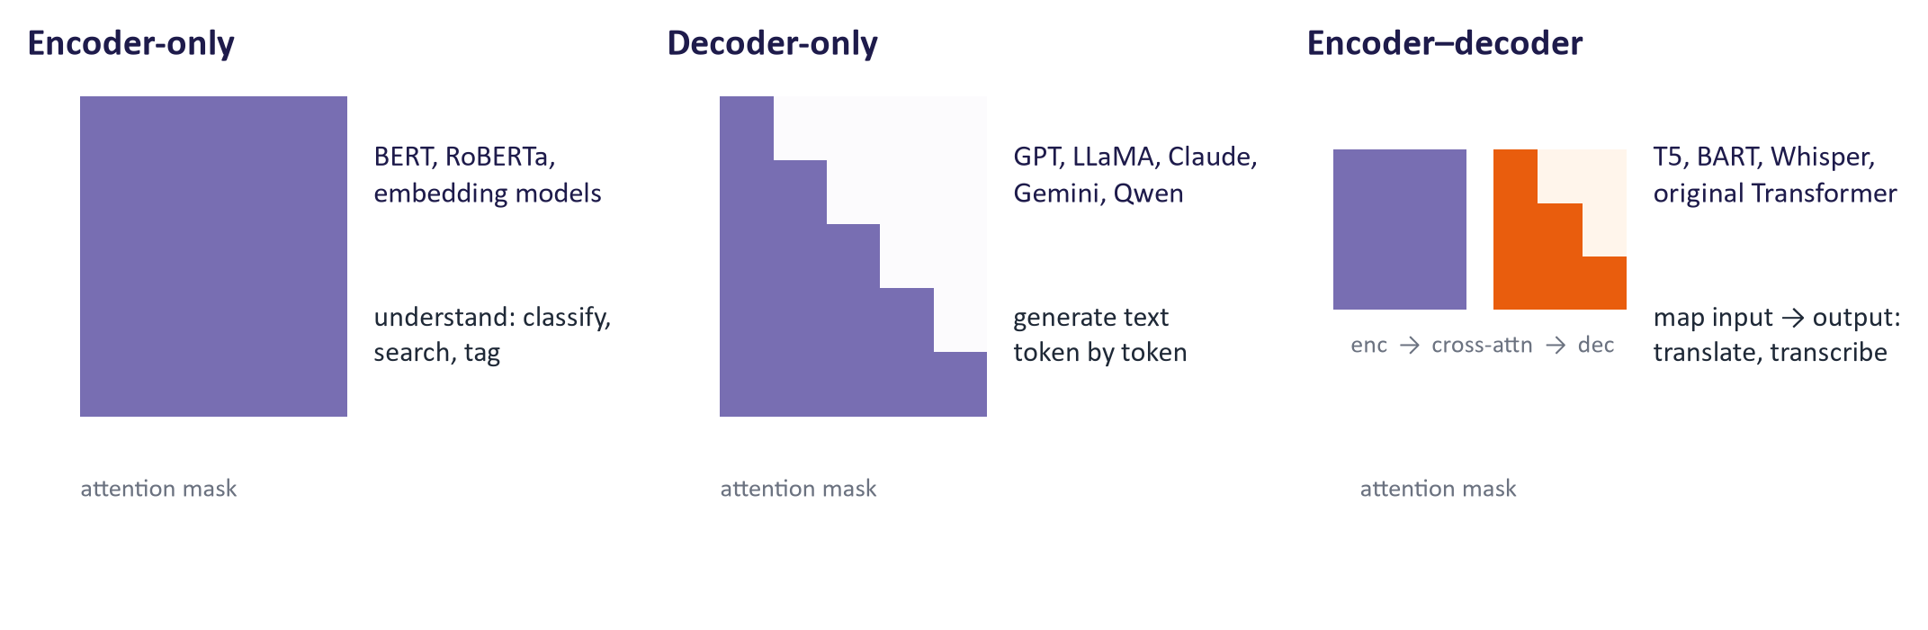
WEEK 05 · TRANSFORMERS & ATTENTION
Three families of transformers
Encoder-only: bidirectional attention; best for understanding tasks and embeddings.
Decoder-only: causal attention; generates text; the design of almost all current LLMs.
Encoder–decoder: encoder reads the input, decoder generates with cross-attention; translation, summarisation, speech recognition.
Generative AI · MSc in Artificial Intelligence
28
Notes:
These three families organise everything in week 6. Encoder-only models such as BERT see the whole input at once, which makes them excellent for classification, tagging and producing embeddings for search, but they do not generate text left to right. Decoder-only models such as GPT, LLaMA, Claude, Gemini and Qwen use the causal mask and generate text; nearly all modern chat models are decoder-only. Encoder-decoder models such as T5, BART and Whisper encode an input and generate an output conditioned on it through cross-attention. A common misconception is that BERT is a chatbot; it is not a text generator in this sense.

Slide 29
WEEK 05 · TRANSFORMERS & ATTENTION
How big are real transformers?
Model (year) | Type | Layers | d_model | Heads | Parameters | Context
Transformer base (2017) | Enc–dec | 6 + 6 | 512 | 8 | 65 M | ~512
BERT-base (2018) | Encoder | 12 | 768 | 12 | 110 M | 512
GPT-2 small (2019) | Decoder | 12 | 768 | 12 | 124 M | 1,024
GPT-3 (2020) | Decoder | 96 | 12,288 | 96 | 175 B | 2,048
Llama 3 8B (2024) | Decoder | 32 | 4,096 | 32 (8 KV) | 8 B | 8K (128K in 3.1)
Generative AI · MSc in Artificial Intelligence
29
Notes:
These published figures show how the same architecture scales. The original transformer had sixty-five million parameters; GPT-3 had one hundred and seventy-five billion, with ninety-six layers and a model dimension over twelve thousand, but the block is recognisably the same. The Llama 3 row shows modern details: eight key-value heads shared by thirty-two query heads, which is grouped-query attention, and a context extended to one hundred and twenty-eight thousand tokens in version 3.1 using rotary scaling. Proprietary frontier models do not publish these numbers, so do not quote guesses about them.

Slide 30
WEEK 05 · TRANSFORMERS & ATTENTION
Quick check
You need (a) vectors for semantic search over course documents and (b) a chatbot that writes answers. Which architectures fit best?
(a) decoder-only, (b) encoder-only
(a) encoder-only (embedding model), (b) decoder-only LLM
A
B
Both encoder-only, because BERT can chat
Both encoder–decoder, because only they use attention
C
D
Vote, then convince your neighbour (1 minute).
Generative AI · MSc in Artificial Intelligence
30
Notes:
Answer: B. Encoder-only models see the whole text bidirectionally and are the basis of most embedding models used for search and retrieval, which we build in week 12. Chatbots are decoder-only LLMs that generate text token by token with a causal mask. A reverses the roles. C repeats the common misconception that BERT is a chat model; it is not designed to generate free text. D is wrong because all three families use attention; encoder-decoders are good for input-to-output tasks such as translation or speech recognition. In practice, retrieval-augmented systems combine an encoder for search with a decoder for answering.

Slide 31
WEEK 05 · TRANSFORMERS & ATTENTION
Attention in PyTorch (what you write in the lab)
def attention(q, k, v, causal=False):
# q, k, v: [batch, heads, n, d_k]
d_k = q.size(-1)
scores = q @ k.transpose(-2, -1) / d_k**0.5
if causal:
n = q.size(-2)
mask = torch.triu(torch.ones(n, n, dtype=torch.bool), 1)
scores = scores.masked_fill(mask, float("-inf"))
weights = scores.softmax(dim=-1)
return weights @ v, weights
# multi-head: project, split heads, attend, merge
q = (x @ W_q).view(b, n, h, d // h).transpose(1, 2)
Matrix products compute all n × n scores at once.
masked_fill with −∞ implements the causal mask.
PyTorch's F.scaled_dot_product_attention does the same, using fast kernels (FlashAttention) when available.
Generative AI · MSc in Artificial Intelligence
31
Notes:
The whole attention mechanism is about ten lines. Point out the transpose of the last two dimensions of k, the division by the square root of d k, the mask created with torch dot triu and applied with masked fill, and the softmax over the last dimension, the keys. For multi-head attention the input is projected, reshaped to separate heads and transposed so that heads act like a batch dimension. In the lab students check their implementation against PyTorch's built-in scaled dot product attention, which dispatches to optimised kernels such as FlashAttention on GPUs.

Slide 32

05
Training, efficiency and applications
How are transformers trained and evaluated, and how are they made fast?
Notes:
The final section covers how transformers are trained, with the main objectives; how language models are evaluated with perplexity, using a real small transformer trained for this lecture; the quadratic cost of attention and the techniques that reduce it, including the KV cache and mixture-of-experts; and applications beyond text, ending with a responsible-AI note on interpretation and cost.

Slide 33


WEEK 05 · TRANSFORMERS & ATTENTION
Training objectives
Masked LM (BERT)
Next-token / causal LM (GPT)
Sequence-to-sequence (T5)
Hide ~15% of tokens; predict them from both sides
Encoder-only; bidirectional context
Good representations, not free-running generation
Predict every next token (causal mask)
Decoder-only; the objective of LLM pre-training
Loss = cross-entropy = negative log-likelihood (week 1)
Corrupt spans of the input; generate the missing text
Encoder–decoder
Every task framed as text-to-text
Generative AI · MSc in Artificial Intelligence
33
Notes:
Three training objectives match the three families. BERT's masked language modelling hides about fifteen percent of the tokens and predicts them using context on both sides, which yields strong representations. GPT-style next-token prediction trains a decoder to predict every token from its past, exactly the chain-rule likelihood from week 1. T5's span corruption removes spans of text and trains the decoder to generate them, which suits a text-to-text framing of every task. All three are self-supervised: the labels come from the text itself, which is why transformers can be trained on trillions of tokens without human annotation.

Slide 34
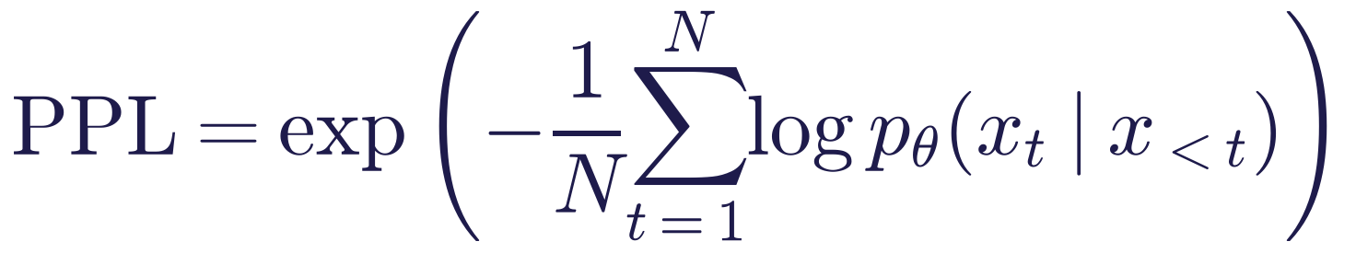
WEEK 05 · TRANSFORMERS & ATTENTION
Evaluating language models: perplexity
Read it as
Symbols
Exponentiated average negative log-likelihood on held-out text (week 1).
Interpretation: the model is as uncertain as choosing among PPL equally likely tokens.
Only comparable between models with the same tokeniser and test text; low perplexity ≠ helpful, truthful or safe.
N
number of tokens in the test text
x_{<t}
the tokens before position t
Generative AI · MSc in Artificial Intelligence
34
Notes:
Perplexity is the standard intrinsic metric for language models and was introduced numerically in week 1. It is the exponential of the average negative log-likelihood per token on held-out text. A perplexity of ten means the model is, on average, as uncertain as if it were choosing uniformly among ten tokens. Two important caveats: perplexities depend on the tokeniser, so a model with a character vocabulary and one with a sub-word vocabulary cannot be compared directly; and perplexity measures fit to text, not usefulness, truthfulness or safety, which need the task-based and human evaluations of week 7.

Slide 35
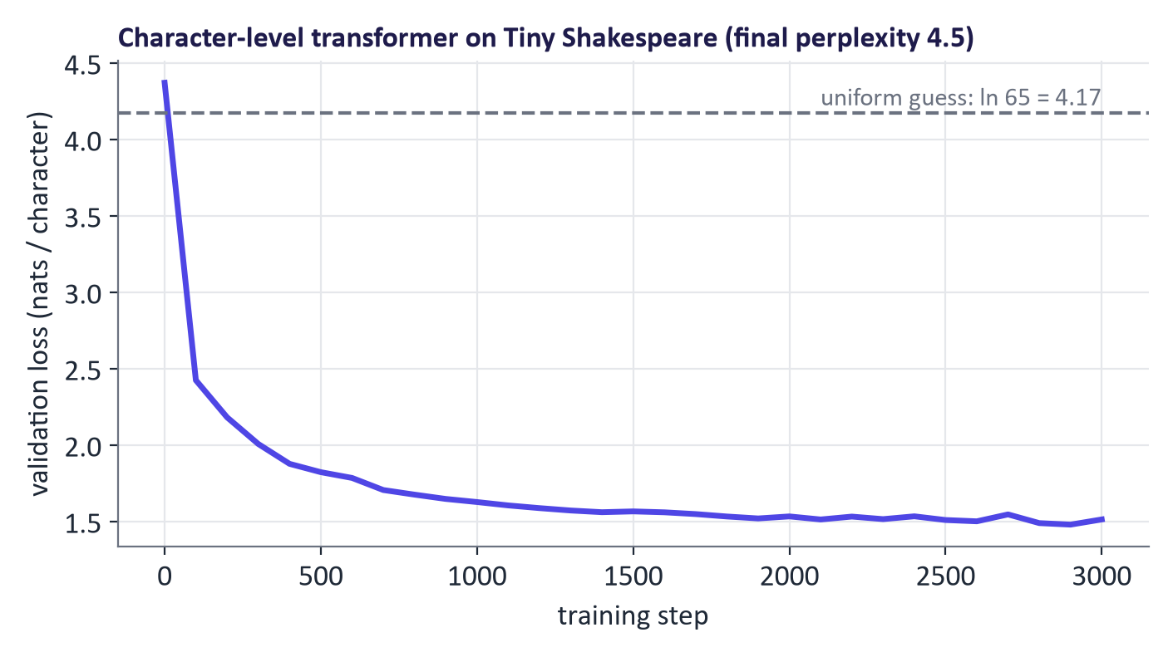
WEEK 05 · TRANSFORMERS & ATTENTION
A real small transformer, trained for this lecture
1.8 M-parameter model, 3000 steps (9 min on a laptop GPU): validation loss 4.37 → 1.51 nats/char, perplexity 4.5 (uniform: 65).
Step 0: dJU;gf:MizAhT,lXeibxua: J$:H;xdyStqR!jCtHxhKTRMCNogCWu&FXYbX…
Step 300: I thy and whe, the hum fousing fore the hen. / MENRONTIO: / You wese and bestay sor? om then…
End: I think my heart is uncle. / MENENIUS: / My lord, I would leave you me for grace. / CORIO…
Generative AI · MSc in Artificial Intelligence
35
Notes:
This is a small character-level transformer trained on the complete works of Shakespeare collected in the Tiny Shakespeare dataset, the same model students build in the lab. The dashed line is the loss of uniform guessing over the character vocabulary. The validation loss falls quickly, and the samples show the progression: random characters at the start, word-like chunks and line structure after a few hundred steps, and plausible if meaningless Shakespearean dialogue at the end, with speaker names, line breaks and archaic words. It knows spelling and style, not meaning. The exact numbers are in the teaching notes.

Slide 36
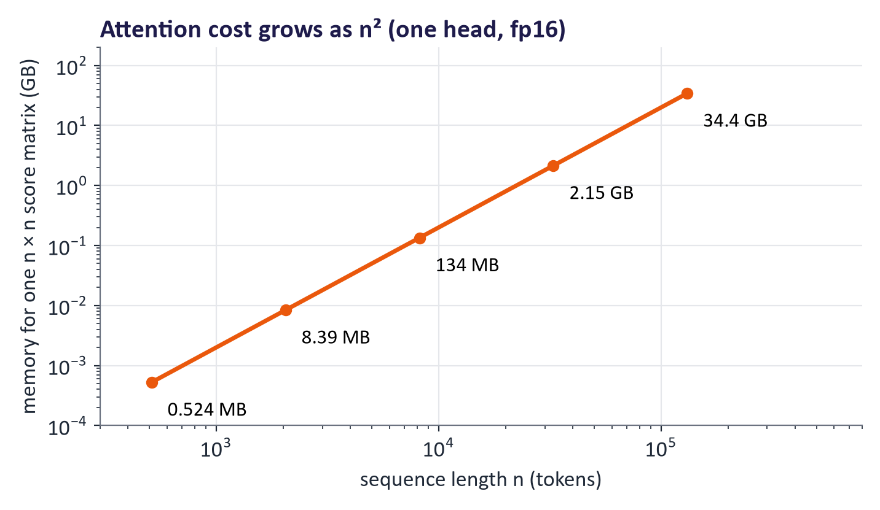
WEEK 05 · TRANSFORMERS & ATTENTION
The cost of attention grows as n²
Every token attends to every token: n² scores per head per layer.
FlashAttention computes exact attention without storing the n × n matrix (memory-aware GPU kernels).
Sparse / sliding-window attention, grouped-query attention and alternatives (state-space models) cut cost further.
Generative AI · MSc in Artificial Intelligence
36
Notes:
The quadratic cost is the main weakness of attention. A single score matrix for one head at one hundred and thirty-one thousand tokens would need tens of gigabytes if stored naively. FlashAttention, by Dao and colleagues in 2022, reorganises the computation into tiles that fit in fast on-chip GPU memory, computing exact attention without ever storing the full matrix; it is now standard. Other approaches restrict which tokens attend to which, such as sliding windows, reduce the number of key-value heads, or replace attention with recurrent state-space layers in some hybrid models. Long context remains expensive, which matters for retrieval design in week 12.

Slide 37
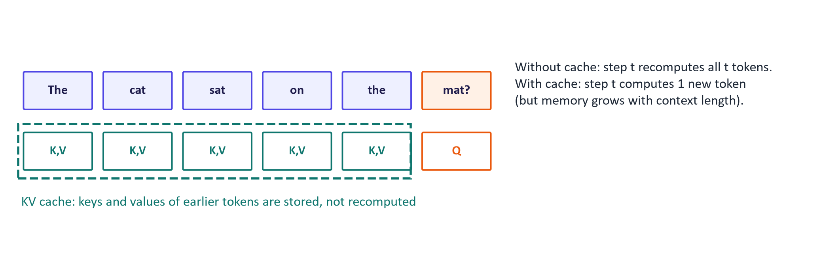
WEEK 05 · TRANSFORMERS & ATTENTION
Faster generation: the KV cache
Generating token t needs keys and values of all earlier tokens; store them instead of recomputing.
Turns generation from quadratic recomputation into one new token's work per step.
Cache memory grows with context length × layers × KV heads: the main memory cost when serving LLMs (week 11).
Generative AI · MSc in Artificial Intelligence
37
Notes:
During generation, the model produces one token at a time. Without a cache, generating token t would recompute the keys and values of all previous tokens at every layer, wasting enormous work. The KV cache stores them, so each new step only computes the new token's query, key and value and attends to the cache. Every production LLM server uses it. The trade-off is memory: the cache grows with context length, number of layers and number of key-value heads, which is exactly why grouped-query attention reduces key-value heads. In week 11 we will see that serving systems such as vLLM are largely about managing this cache efficiently.

Slide 38
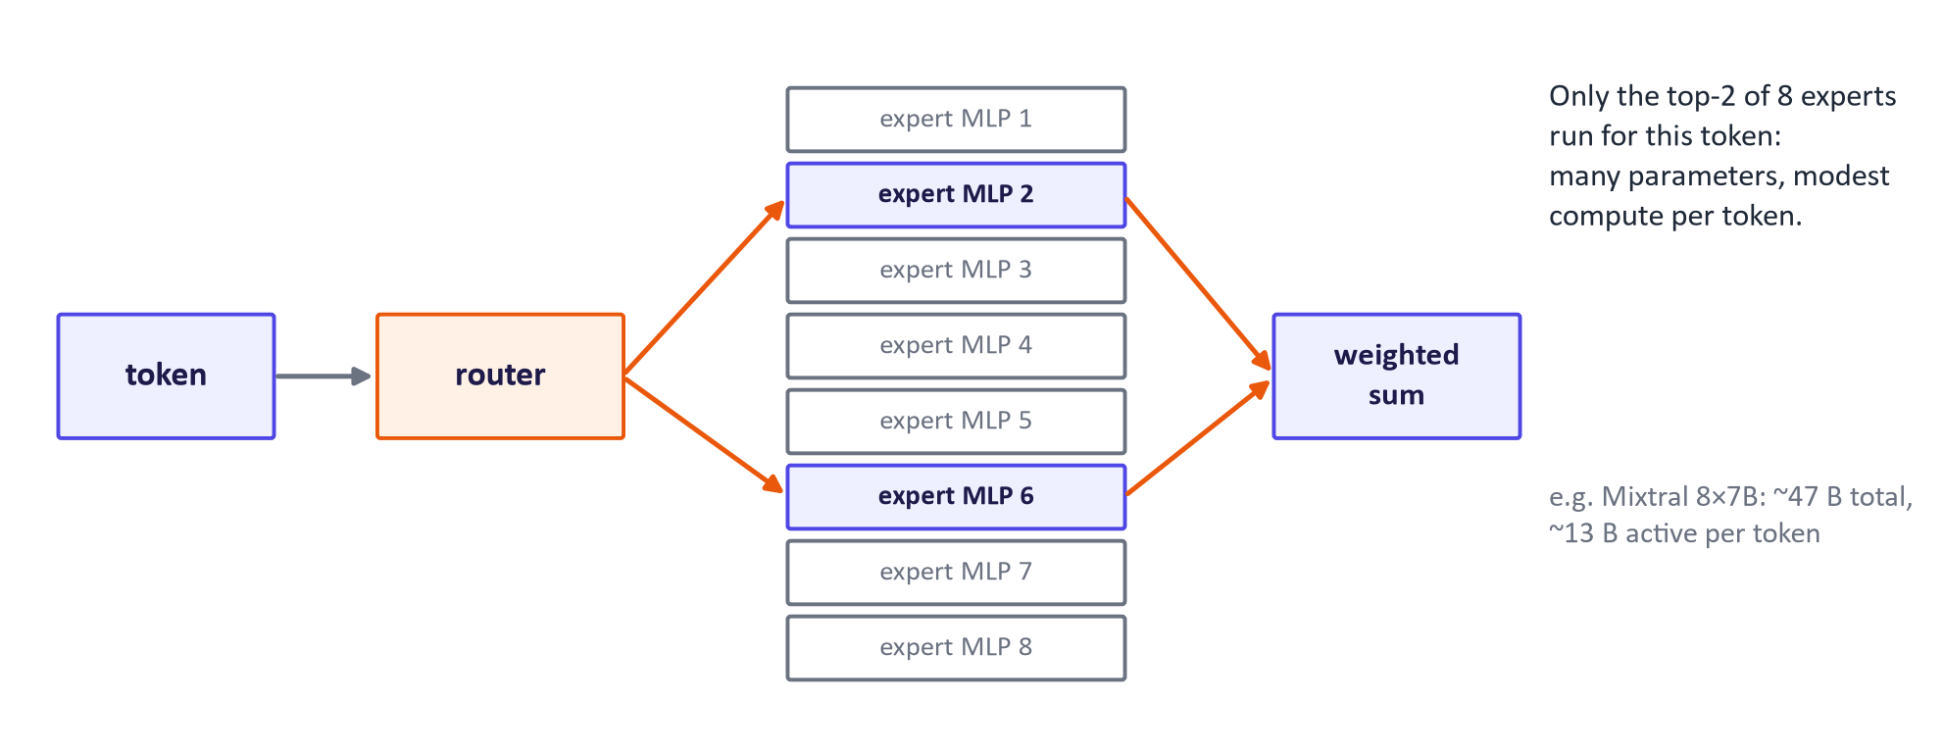
WEEK 05 · TRANSFORMERS & ATTENTION
Mixture-of-experts: more parameters, same compute
Replace the feed-forward MLP with many expert MLPs and a learned router.
Each token uses only the top-k experts (e.g. 2 of 8), so compute per token stays low.
Used in several large open and proprietary model families (e.g. Mixtral, DeepSeek-V3); memory still holds all experts.
Generative AI · MSc in Artificial Intelligence
38
Notes:
Mixture-of-experts replaces the single feed-forward network in some or all blocks with many expert networks and a small router that sends each token to the top few experts. The model can therefore have a very large number of parameters, and hence capacity, while each token uses only a fraction of them. Mixtral 8x7B, released in December 2023, has about forty-seven billion parameters in total but about thirteen billion active per token; DeepSeek-V3 has six hundred and seventy-one billion total and thirty-seven billion active. The catch is memory: all experts must be loaded, and training needs care to balance the load across experts.

Slide 39
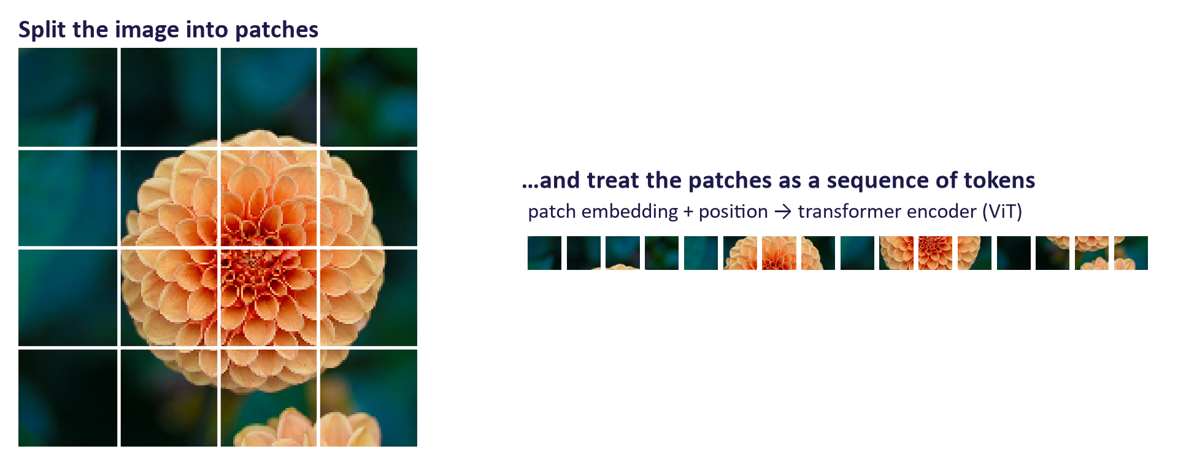
WEEK 05 · TRANSFORMERS & ATTENTION
Beyond text: transformers for images, audio and more
Vision Transformer (ViT): image patches as tokens; basis of CLIP's image encoder (week 9).
Speech: Whisper is an encoder–decoder transformer from audio spectrograms to text.
Generation: diffusion transformers (week 4); protein structure, time series, robotics, code.
Generative AI · MSc in Artificial Intelligence
39
Notes:
Once text is a sequence of token vectors, any data that can be cut into pieces can be processed the same way. The Vision Transformer, from Dosovitskiy and colleagues in 2020, splits an image into sixteen by sixteen pixel patches, embeds each patch like a word and adds positional information; it now underpins CLIP and most multimodal models. Whisper encodes audio spectrogram frames and decodes text. Diffusion transformers treat latent patches as tokens. Attention also appears in protein structure prediction, weather models and robotics. This universality is why the transformer is the common language of the rest of the module.

Slide 40

WEEK 05 · TRANSFORMERS & ATTENTION
Responsible AI lens: attention, interpretability and cost
Attention ≠ explanation: weights show information flow, not reasons; do not present attention maps as proof of why a model decided something.
Interpretability research (probing, mechanistic analysis) aims for faithful explanations; it is still maturing.
Compute and energy: quadratic attention and scale make training and long-context use costly; report compute and prefer efficient models when they suffice.
Tokenisation fairness: some languages need 3–5× more tokens (week 1 lab), raising cost and reducing quality for their speakers.
Generative AI · MSc in Artificial Intelligence
40
Notes:
Three points for this week's responsible-AI lens. First, attention maps are attractive visualisations, and students will be tempted to use them as explanations in reports and projects; research such as Jain and Wallace's has shown that different attention patterns can give the same prediction, so they must be presented as evidence of information flow at most. Second, compute and energy: the scale of transformer training has real environmental and financial costs, so choose the smallest model that meets the requirement. Third, the tokenisation inequality measured in the week 1 lab is a fairness issue for multilingual applications.

Slide 41
WEEK 05 · TRANSFORMERS & ATTENTION
Build, train and inspect
Connect each experiment to the function that performs it
1. Check attention
2. Assemble blocks
3. Prepare batches
Compare numerical outputs with the example and PyTorch
Split heads, mix information, preserve residual paths
Input characters pair with one-position-shifted target characters
attention / causal_mask
MultiHeadAttention / Block
get_batch
Pass: checked attention operation
Pass: complete model components
Pass: input/target batches
6. Inspect real heads
5. Validate and sample
4. Train CharGPT
Separate BERT and GPT-2 experiments plot pretrained attention
Measure unseen-text loss, then generate continuations
Prediction error adjusts model parameters
bert_att / att
val_loss / CharGPT.generate
gpt / opt
Pass: samples and measured loss
Pass: trained parameters
Check: Which function supplies the known next characters during training, and which evaluates separate text?
Generative AI · MSc in Artificial Intelligence
41
Notes:
The lab begins with a small numerical operation and builds upward. First, attention is checked against a worked example and PyTorch. Next, MultiHeadAttention handles parallel heads, while Block adds normalisation, a per-position feed-forward network and residual additions. get_batch returns input characters and targets shifted one position ahead. The training loop computes cross-entropy, a measure of prediction error, and the optimizer updates parameters using gradients. val_loss measures error on the separate validation text. Perplexity summarises that uncertainty, but character perplexity cannot be compared directly with word-piece perplexity. The final inspection is a separate experiment with pretrained BERT and GPT-2. GPT-2's representation at 'it' cannot depend on 'tired' or 'wide' occurring later; unchanged attention there is the expected consequence of causality.
Worked example:
First verify that future positions get zero weight in a masked test.
For a short chunk 'ROM', the next-character targets start 'OME'.
Cross-entropy measures how much probability the model assigns to the known next characters.
Validation uses the separate val_data portion rather than the training batches.
Finally, inspect separate pretrained models; their weights were not trained by CharGPT.
Check: Which function supplies the known next characters during training, and which evaluates separate text?
Answer: get_batch supplies shifted targets; val_loss evaluates batches drawn from val_data.

Slide 42



WEEK 05 · TRANSFORMERS & ATTENTION
Lab 5: build attention and a small GPT
1
Implement scaled dot-product attention; check it against the worked example and PyTorch's built-in function.
Runtime
Google Colab T4 GPU (training ≈ 3–5 min) or CPU (fewer steps)
2
Add the causal mask; verify future tokens get zero weight; show attention without positions is order-blind.
3
Implement multi-head attention (split heads, attend, merge) and a pre-norm transformer block.
Time
2-hour lab
4
Train a character-level GPT on Tiny Shakespeare; plot validation loss and perplexity; sample at different temperatures.
5
Interrogate pretrained BERT and GPT-2: plot attention for the 'it' sentence; discuss whether it explains the model.
Hand in
Notebook with passing checks, loss curve, perplexity, samples, attention plots and written answers
6
Optional: time GPT-2 generation with and without the KV cache.
Generative AI · MSc in Artificial Intelligence
42
Notes:
The lab builds the transformer from the bottom up, following the descriptor's intention that students both build simple transformer models and interrogate how transformers use attention in practice. Automated checks tell students immediately whether their attention and multi-head implementations match PyTorch's. The small GPT trains in a few minutes on a Colab GPU. The interrogation part asks students to plot attention for the warm-up sentence in BERT and GPT-2 and to argue critically about what the plots show. The optional KV-cache timing connects to deployment in week 11.

Slide 43

WEEK 05 · TRANSFORMERS & ATTENTION
Key takeaways
Transformers replaced RNNs because they parallelise and connect distant tokens directly.
A block = attention + feed-forward MLP, each with residual + normalisation; stack N blocks.
Tokens → embeddings + positional encoding (sinusoidal, learned or rotary).
Encoder-only (BERT), decoder-only (GPT, LLaMA), encoder–decoder (T5, Whisper).
Attention = softmax(QKᵀ/√d_k)V: each token takes a weighted average of values.
Train with masked, next-token or span objectives; evaluate with perplexity (same tokeniser only).
√d_k keeps scores in range; multi-head gives several views; causal masks block the future; cross-attention links sequences.
Efficiency: KV cache, FlashAttention, grouped-query attention, mixture-of-experts, long context.
Generative AI · MSc in Artificial Intelligence
43
Notes:
Recap the eight points, and make sure students can write the attention equation from memory. Next week we scale this architecture up: large language models, their training on trillions of tokens, scaling laws, decoding strategies, the model families and how to choose among them, including reasoning models. Ask students to finish the lab and to watch the two 3Blue1Brown videos on transformers and attention, which visualise exactly what we did today.

Slide 44





WEEK 05 · TRANSFORMERS & ATTENTION
Read, watch, practise
3Blue1Brown: Transformers, the tech behind LLMs (Deep Learning ch. 5)
Visual overview
Vaswani et al. (2017) Attention Is All You Need
The original paper
3Blue1Brown: Attention in transformers, step-by-step (ch. 6)
Queries, keys, values visualised
Tunstall et al. (2022) NLP with Transformers, ch. 3 'Transformer Anatomy'
Descriptor 7.9 reading
Andrej Karpathy: Let's build GPT from scratch, in code
2-hour build of the lab model
Foster (2023) Generative Deep Learning, ch. 9 'Transformers'
Core module text
Jay Alammar: The Illustrated Transformer
Classic visual explanation
Hugging Face LLM Course, chapter 1
How transformers work, with code
Generative AI · MSc in Artificial Intelligence
44
Notes:
The two 3Blue1Brown videos are the best visual reinforcement of today's lecture. Karpathy's two-hour video builds essentially the lab model, step by step, and is ideal for students who want to go deeper. Jay Alammar's illustrated transformer is a classic. The original paper is readable after today. Tunstall and colleagues' chapter 3 and Foster's chapter 9 are the descriptor's reading-list chapters for this topic. All links were checked in September 2026.

