Slide 1
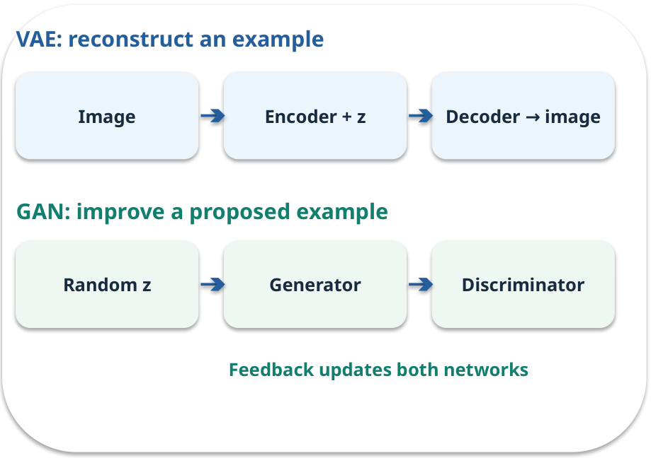
Week 02 · VAE and GAN model ideas
OPEN / WEEK 02
The icon studio
A designer wants varied icons that resemble a style without copying one example. How could two training ideas approach this?
GENERATIVE AI 2027 • WEEK 02 • 01 / 40
Notes:
TEACHER SCRIPT — OPEN. Show the visual for ten seconds, then ask for an initial decision. Do not reveal the answer yet. Ask a student to name the source or measurement that would change their mind. This week’s case is: A designer wants new simple icons similar to examples, without copying an exact icon. The visible slide states: The icon studio
A designer wants varied icons that resemble a style without copying one example. How could two training ideas approach this? Reveal that the case will be revisited after four short concept cycles. The target is: Explain how reconstruction differs from adversarial generation. Listen for an explanation of the actual arrow or calculation, not just a repeated label. If the answer is unsupported, mark that uncertainty and return to the source. Before moving on, ask for the main idea and one concrete change to the worked example.

Slide 2

First vote: what would you do?
QUESTION / WEEK 02
A designer wants varied icons that resemble a style without copying one example. How could two training ideas approach this?
Choose an initial answer and name one piece of evidence you need.
GENERATIVE AI 2027 • WEEK 02 • 02 / 40
Notes:
TEACHER SCRIPT — QUESTION. Take a show of hands for each choice before showing the mechanism. Ask pairs to defend a choice with evidence. Save the strongest wrong reason for the reveal later in this cycle. This week’s case is: A designer wants new simple icons similar to examples, without copying an exact icon. The visible slide states: A designer wants varied icons that resemble a style without copying one example. How could two training ideas approach this?
Choose an initial answer and name one piece of evidence you need. Accept reasonable uncertainty; record the initial votes to revisit at the end. The target is: Explain how reconstruction differs from adversarial generation. Listen for an explanation of the actual arrow or calculation, not just a repeated label. If the answer is unsupported, mark that uncertainty and return to the source. Before moving on, ask for the main idea and one concrete change to the worked example.

Slide 3
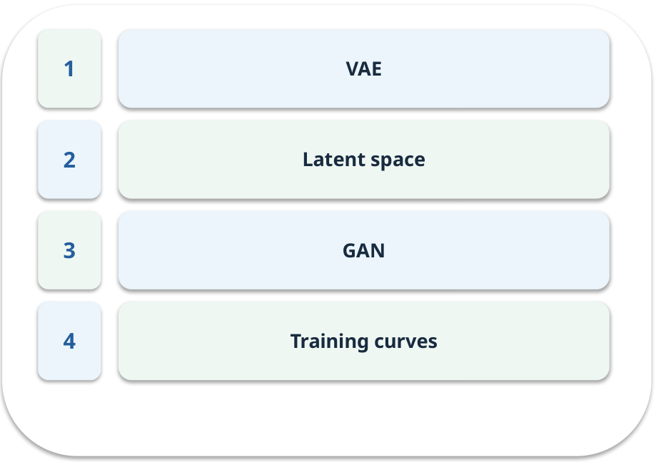
The journey through today’s case
OPEN / WEEK 02
We will predict, connect an analogy, trace a mechanism, work an example, then explain a decision.
GENERATIVE AI 2027 • WEEK 02 • 03 / 40
Notes:
TEACHER SCRIPT — OPEN. Show the visual for ten seconds, then ask for an initial decision. Do not reveal the answer yet. Ask a student to name the source or measurement that would change their mind. This week’s case is: A designer wants new simple icons similar to examples, without copying an exact icon. The visible slide states: We will predict, connect an analogy, trace a mechanism, work an example, then explain a decision. Point to the four named ideas, then show where the notebook experiment fits. The target is: Explain how reconstruction differs from adversarial generation. Listen for an explanation of the actual arrow or calculation, not just a repeated label. If the answer is unsupported, mark that uncertainty and return to the source. Before moving on, ask for the main idea and one concrete change to the worked example.

Slide 4
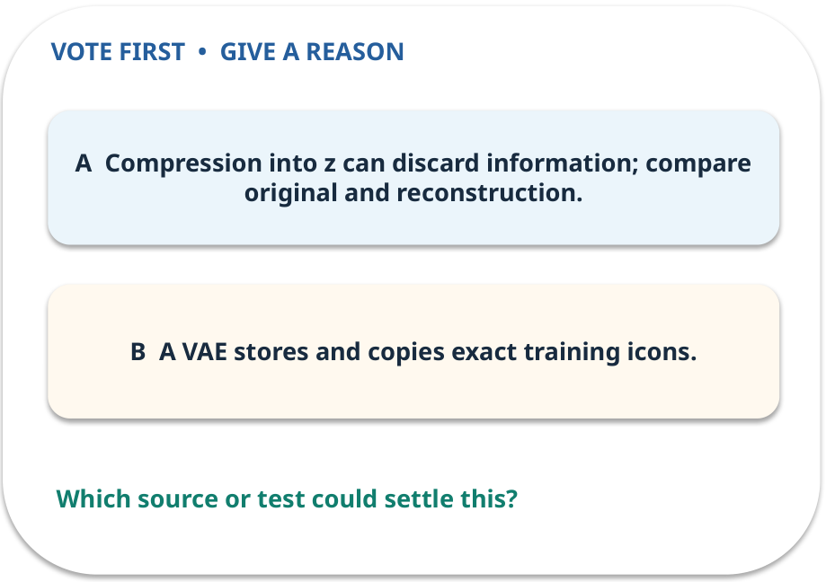
1. Predict · VAE
QUESTION / WEEK 02
Which arrow could lose a fine detail?
Make a choice before we explain the diagram.
GENERATIVE AI 2027 • WEEK 02 • 04 / 40
Notes:
TEACHER SCRIPT — QUESTION. Take a show of hands for each choice before showing the mechanism. Ask pairs to defend a choice with evidence. Save the strongest wrong reason for the reveal later in this cycle. This week’s case is: A designer wants new simple icons similar to examples, without copying an exact icon. The visible slide states: Which arrow could lose a fine detail?
Make a choice before we explain the diagram. The intended answer is Compression into z can discard information; compare original and reconstruction. The tempting claim is A VAE stores and copies exact training icons. Do not show which card is correct until the reveal. The target is: Explain how reconstruction differs from adversarial generation. Listen for an explanation of the actual arrow or calculation, not just a repeated label. If the answer is unsupported, mark that uncertainty and return to the source. Before moving on, ask for the main idea and one concrete change to the worked example.

Slide 5
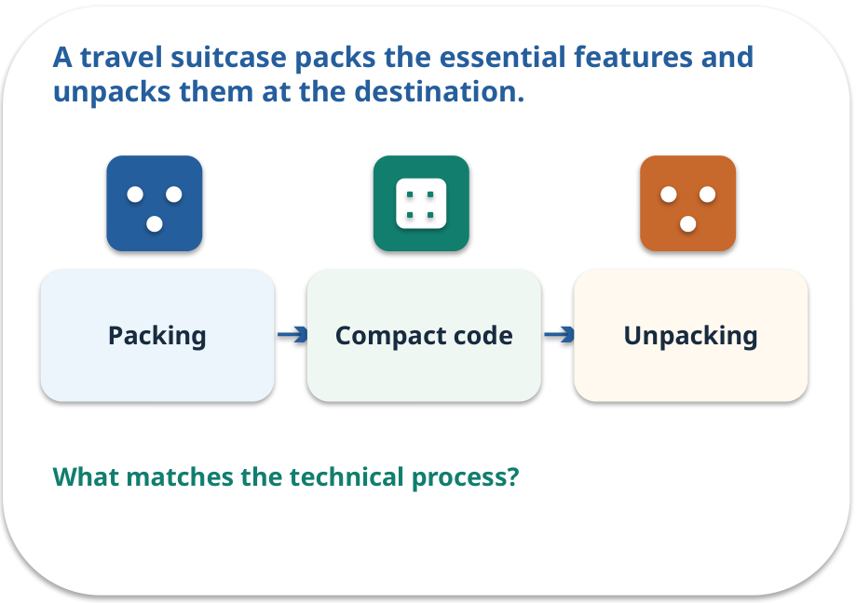
VAE · a familiar picture
ANALOGY / WEEK 02
A travel suitcase packs the essential features and unpacks them at the destination.
What matches our case, and where does the analogy stop?
GENERATIVE AI 2027 • WEEK 02 • 05 / 40
Notes:
TEACHER SCRIPT — ANALOGY. Begin with the familiar scene. Invite learners to describe each part in everyday language. Then ask where the comparison might fail before introducing the technical vocabulary. This week’s case is: A designer wants new simple icons similar to examples, without copying an exact icon. The visible slide states: A travel suitcase packs the essential features and unpacks them at the destination.
What matches our case, and where does the analogy stop? The boundary is: A VAE learns a distribution and reconstruction objective; a suitcase is not a probabilistic model. The target is: Explain how reconstruction differs from adversarial generation. Listen for an explanation of the actual arrow or calculation, not just a repeated label. If the answer is unsupported, mark that uncertainty and return to the source. Before moving on, ask for the main idea and one concrete change to the worked example.

Slide 6
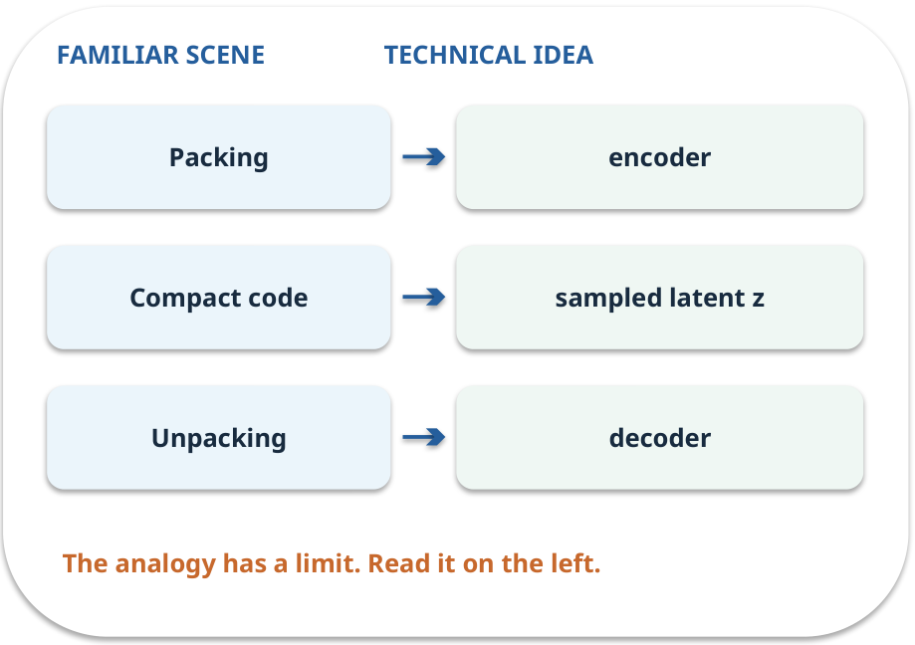
VAE · map the parts
MAPPING / WEEK 02
Match each everyday part to the technical part.
Analogy limit: A VAE learns a distribution and reconstruction objective; a suitcase is not a probabilistic model.
GENERATIVE AI 2027 • WEEK 02 • 06 / 40
Notes:
TEACHER SCRIPT — MAPPING. Point from each familiar element to the corresponding technical element. Have students cover the right column and reconstruct the three matches. Read the limitation aloud. This week’s case is: A designer wants new simple icons similar to examples, without copying an exact icon. The visible slide states: Match each everyday part to the technical part.
Analogy limit: A VAE learns a distribution and reconstruction objective; a suitcase is not a probabilistic model. The three precise mappings are [['Packing', 'encoder'], ['Compact code', 'sampled latent z'], ['Unpacking', 'decoder']]. The target is: Explain how reconstruction differs from adversarial generation. Listen for an explanation of the actual arrow or calculation, not just a repeated label. If the answer is unsupported, mark that uncertainty and return to the source. Before moving on, ask for the main idea and one concrete change to the worked example.

Slide 7
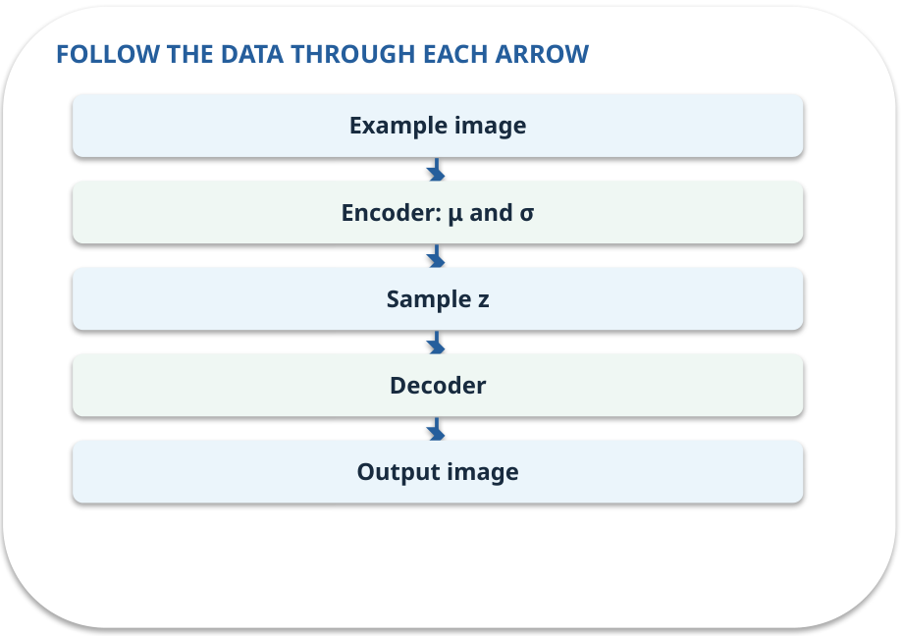
VAE · how it works
MECHANISM / WEEK 02
An encoder predicts the centre (μ) and spread (σ) of a small latent distribution. We sample a code z from it. A decoder uses z to reconstruct the image.
Trace the arrows from left to right.
GENERATIVE AI 2027 • WEEK 02 • 07 / 40
Notes:
TEACHER SCRIPT — MECHANISM. Trace every arrow slowly from the input to the output. Ask what information crosses the boundary at each arrow. Pause if students confuse a simplified notebook with a trained model. This week’s case is: A designer wants new simple icons similar to examples, without copying an exact icon. The visible slide states: An encoder predicts the centre (μ) and spread (σ) of a small latent distribution. We sample a code z from it. A decoder uses z to reconstruct the image.
Trace the arrows from left to right. The weekly example is: A 2-value icon [0.2, 0.8] enters an encoder; a sampled z is decoded into a reconstructed icon. State what the analogy does not explain: A VAE learns a distribution and reconstruction objective; a suitcase is not a probabilistic model. The target is: Explain how reconstruction differs from adversarial generation. Listen for an explanation of the actual arrow or calculation, not just a repeated label. If the answer is unsupported, mark that uncertainty and return to the source. Before moving on, ask for the main idea and one concrete change to the worked example.

Slide 8
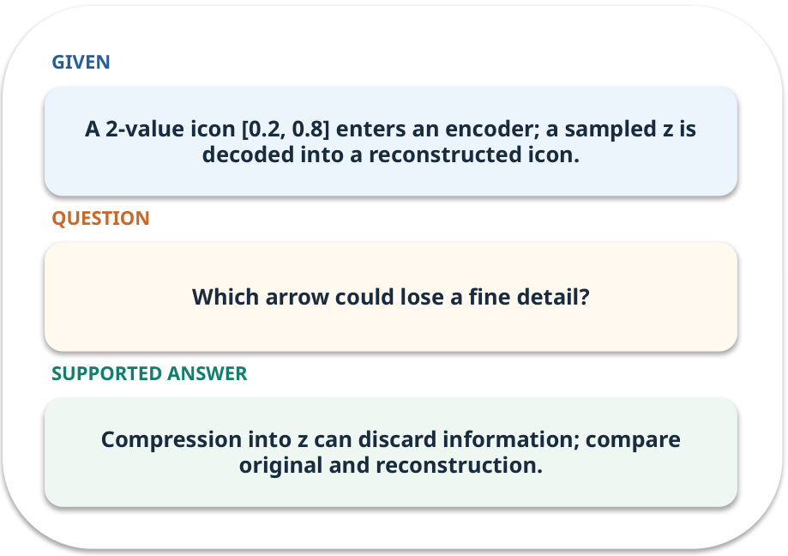
VAE · work one case
WORKED / WEEK 02
A 2-value icon [0.2, 0.8] enters an encoder; a sampled z is decoded into a reconstructed icon.
Point to the evidence before giving your conclusion.
GENERATIVE AI 2027 • WEEK 02 • 08 / 40
Notes:
TEACHER SCRIPT — WORKED. Work the specific numbers or source wording aloud. Give students thirty seconds to write a conclusion, then ask which source line or calculation supports it. This week’s case is: A designer wants new simple icons similar to examples, without copying an exact icon. The visible slide states: A 2-value icon [0.2, 0.8] enters an encoder; a sampled z is decoded into a reconstructed icon.
Point to the evidence before giving your conclusion. The expected reasoning concludes: Compression into z can discard information; compare original and reconstruction. Distinguish measured results from illustrative numbers. The target is: Explain how reconstruction differs from adversarial generation. Listen for an explanation of the actual arrow or calculation, not just a repeated label. If the answer is unsupported, mark that uncertainty and return to the source. Before moving on, ask for the main idea and one concrete change to the worked example.

Slide 9
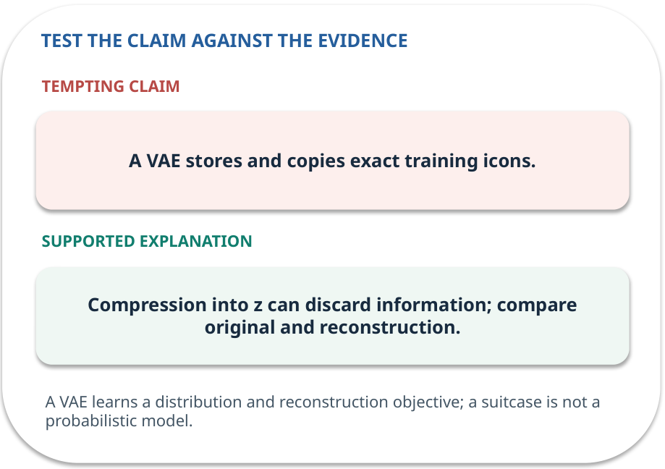
VAE · answer and explain
REVEAL / WEEK 02
Compression into z can discard information; compare original and reconstruction.
Tempting mistake: A VAE stores and copies exact training icons.
GENERATIVE AI 2027 • WEEK 02 • 09 / 40
Notes:
TEACHER SCRIPT — REVEAL. Return to the earlier choice. Explain the correct answer and why the tempting claim fails. Ask one learner to say the answer in a single sentence without reading it. This week’s case is: A designer wants new simple icons similar to examples, without copying an exact icon. The visible slide states: Compression into z can discard information; compare original and reconstruction.
Tempting mistake: A VAE stores and copies exact training icons. The earlier question was Which arrow could lose a fine detail? Ask how this differs from the wrong claim. The target is: Explain how reconstruction differs from adversarial generation. Listen for an explanation of the actual arrow or calculation, not just a repeated label. If the answer is unsupported, mark that uncertainty and return to the source. Before moving on, ask for the main idea and one concrete change to the worked example.

Slide 10
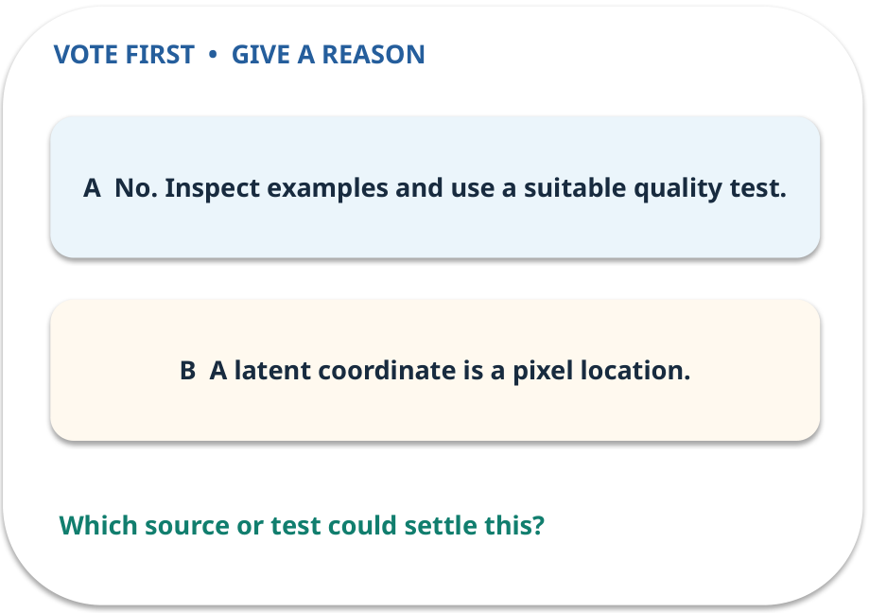
2. Predict · Latent space
QUESTION / WEEK 02
Does a smoother output prove realism?
Make a choice before we explain the diagram.
GENERATIVE AI 2027 • WEEK 02 • 10 / 40
Notes:
TEACHER SCRIPT — QUESTION. Take a show of hands for each choice before showing the mechanism. Ask pairs to defend a choice with evidence. Save the strongest wrong reason for the reveal later in this cycle. This week’s case is: A designer wants new simple icons similar to examples, without copying an exact icon. The visible slide states: Does a smoother output prove realism?
Make a choice before we explain the diagram. The intended answer is No. Inspect examples and use a suitable quality test. The tempting claim is A latent coordinate is a pixel location. Do not show which card is correct until the reveal. The target is: Explain how reconstruction differs from adversarial generation. Listen for an explanation of the actual arrow or calculation, not just a repeated label. If the answer is unsupported, mark that uncertainty and return to the source. Before moving on, ask for the main idea and one concrete change to the worked example.

Slide 11
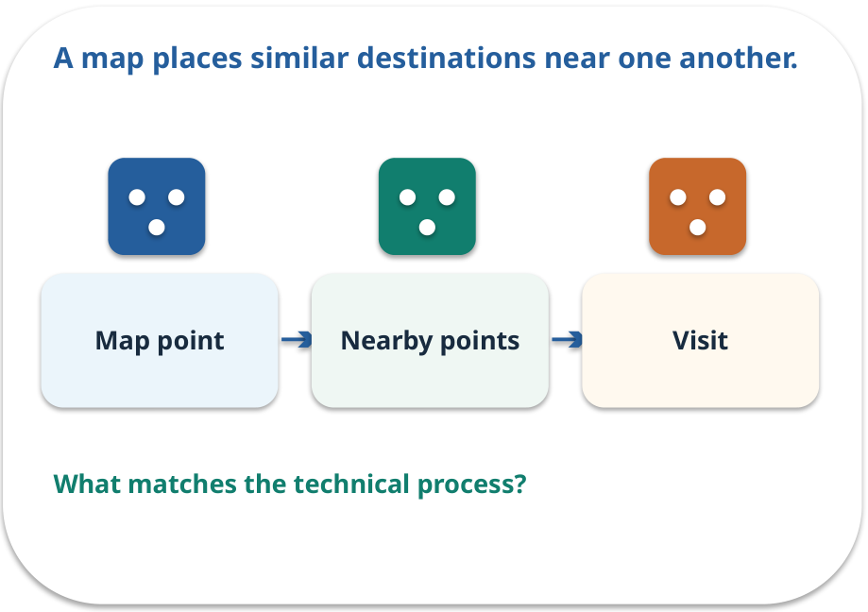
Latent space · a familiar picture
ANALOGY / WEEK 02
A map places similar destinations near one another.
What matches our case, and where does the analogy stop?
GENERATIVE AI 2027 • WEEK 02 • 11 / 40
Notes:
TEACHER SCRIPT — ANALOGY. Begin with the familiar scene. Invite learners to describe each part in everyday language. Then ask where the comparison might fail before introducing the technical vocabulary. This week’s case is: A designer wants new simple icons similar to examples, without copying an exact icon. The visible slide states: A map places similar destinations near one another.
What matches our case, and where does the analogy stop? The boundary is: Closeness in a toy plot does not guarantee human-perceived similarity. The target is: Explain how reconstruction differs from adversarial generation. Listen for an explanation of the actual arrow or calculation, not just a repeated label. If the answer is unsupported, mark that uncertainty and return to the source. Before moving on, ask for the main idea and one concrete change to the worked example.

Slide 12
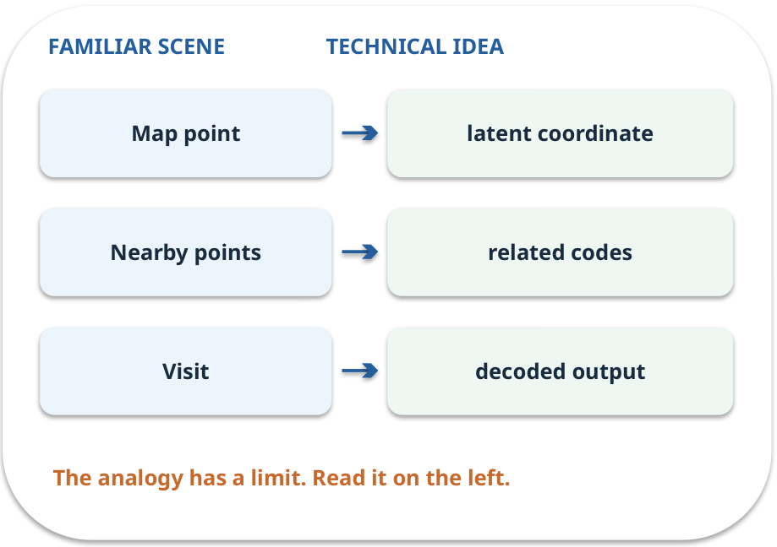
Latent space · map the parts
MAPPING / WEEK 02
Match each everyday part to the technical part.
Analogy limit: Closeness in a toy plot does not guarantee human-perceived similarity.
GENERATIVE AI 2027 • WEEK 02 • 12 / 40
Notes:
TEACHER SCRIPT — MAPPING. Point from each familiar element to the corresponding technical element. Have students cover the right column and reconstruct the three matches. Read the limitation aloud. This week’s case is: A designer wants new simple icons similar to examples, without copying an exact icon. The visible slide states: Match each everyday part to the technical part.
Analogy limit: Closeness in a toy plot does not guarantee human-perceived similarity. The three precise mappings are [['Map point', 'latent coordinate'], ['Nearby points', 'related codes'], ['Visit', 'decoded output']]. The target is: Explain how reconstruction differs from adversarial generation. Listen for an explanation of the actual arrow or calculation, not just a repeated label. If the answer is unsupported, mark that uncertainty and return to the source. Before moving on, ask for the main idea and one concrete change to the worked example.

Slide 13
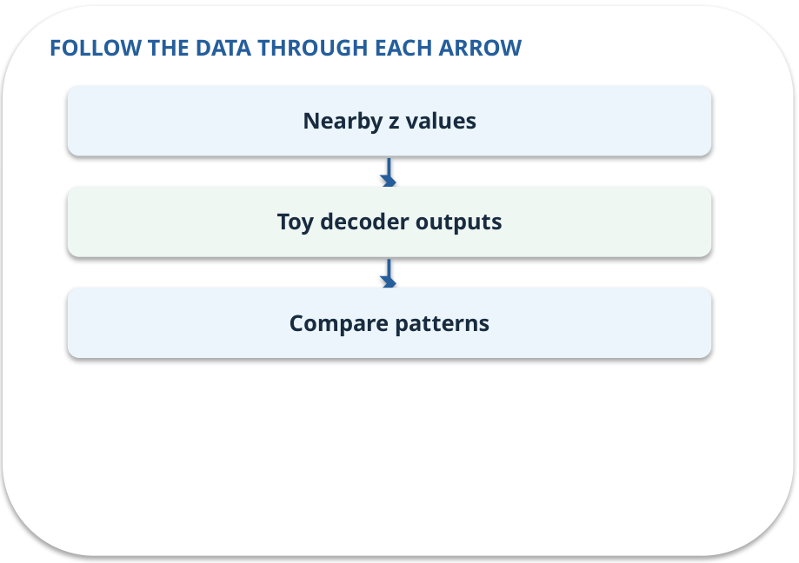
Latent space · how it works
MECHANISM / WEEK 02
Nearby latent values often produce related outputs, though this is learned rather than guaranteed.
Trace the arrows from left to right.
GENERATIVE AI 2027 • WEEK 02 • 13 / 40
Notes:
TEACHER SCRIPT — MECHANISM. Trace every arrow slowly from the input to the output. Ask what information crosses the boundary at each arrow. Pause if students confuse a simplified notebook with a trained model. This week’s case is: A designer wants new simple icons similar to examples, without copying an exact icon. The visible slide states: Nearby latent values often produce related outputs, though this is learned rather than guaranteed.
Trace the arrows from left to right. The weekly example is: Change toy z from 0.3 to 0.7; compare the output pattern while keeping the decoder fixed. State what the analogy does not explain: Closeness in a toy plot does not guarantee human-perceived similarity. The target is: Explain how reconstruction differs from adversarial generation. Listen for an explanation of the actual arrow or calculation, not just a repeated label. If the answer is unsupported, mark that uncertainty and return to the source. Before moving on, ask for the main idea and one concrete change to the worked example.

Slide 14
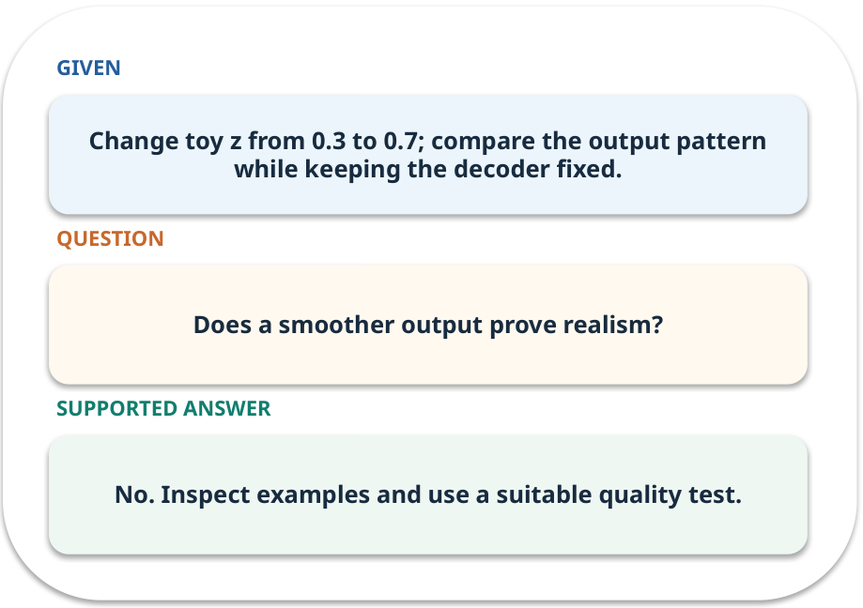
Latent space · work one case
WORKED / WEEK 02
Change toy z from 0.3 to 0.7; compare the output pattern while keeping the decoder fixed.
Point to the evidence before giving your conclusion.
GENERATIVE AI 2027 • WEEK 02 • 14 / 40
Notes:
TEACHER SCRIPT — WORKED. Work the specific numbers or source wording aloud. Give students thirty seconds to write a conclusion, then ask which source line or calculation supports it. This week’s case is: A designer wants new simple icons similar to examples, without copying an exact icon. The visible slide states: Change toy z from 0.3 to 0.7; compare the output pattern while keeping the decoder fixed.
Point to the evidence before giving your conclusion. The expected reasoning concludes: No. Inspect examples and use a suitable quality test. Distinguish measured results from illustrative numbers. The target is: Explain how reconstruction differs from adversarial generation. Listen for an explanation of the actual arrow or calculation, not just a repeated label. If the answer is unsupported, mark that uncertainty and return to the source. Before moving on, ask for the main idea and one concrete change to the worked example.

Slide 15
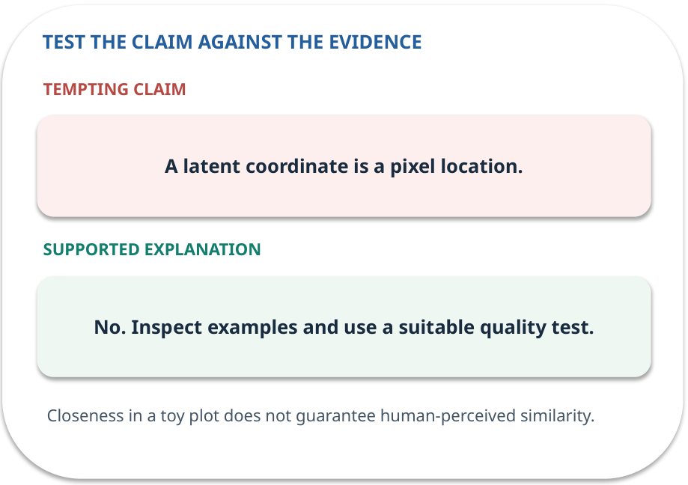
Latent space · answer and explain
REVEAL / WEEK 02
No. Inspect examples and use a suitable quality test.
Tempting mistake: A latent coordinate is a pixel location.
GENERATIVE AI 2027 • WEEK 02 • 15 / 40
Notes:
TEACHER SCRIPT — REVEAL. Return to the earlier choice. Explain the correct answer and why the tempting claim fails. Ask one learner to say the answer in a single sentence without reading it. This week’s case is: A designer wants new simple icons similar to examples, without copying an exact icon. The visible slide states: No. Inspect examples and use a suitable quality test.
Tempting mistake: A latent coordinate is a pixel location. The earlier question was Does a smoother output prove realism? Ask how this differs from the wrong claim. The target is: Explain how reconstruction differs from adversarial generation. Listen for an explanation of the actual arrow or calculation, not just a repeated label. If the answer is unsupported, mark that uncertainty and return to the source. Before moving on, ask for the main idea and one concrete change to the worked example.

Slide 16
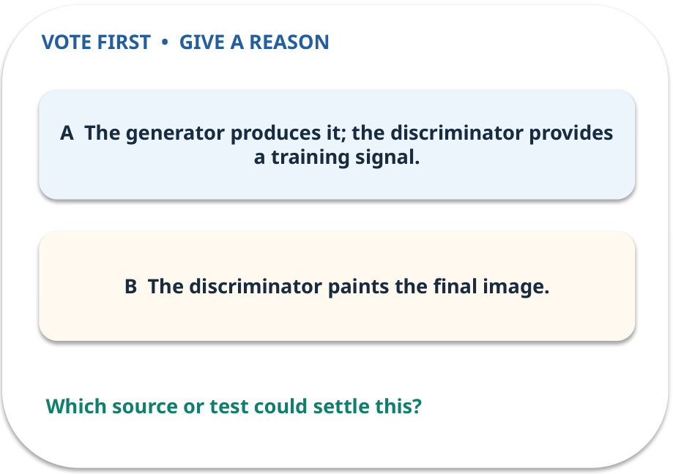
3. Predict · GAN
QUESTION / WEEK 02
Which part produces the new image?
Make a choice before we explain the diagram.
GENERATIVE AI 2027 • WEEK 02 • 16 / 40
Notes:
TEACHER SCRIPT — QUESTION. Take a show of hands for each choice before showing the mechanism. Ask pairs to defend a choice with evidence. Save the strongest wrong reason for the reveal later in this cycle. This week’s case is: A designer wants new simple icons similar to examples, without copying an exact icon. The visible slide states: Which part produces the new image?
Make a choice before we explain the diagram. The intended answer is The generator produces it; the discriminator provides a training signal. The tempting claim is The discriminator paints the final image. Do not show which card is correct until the reveal. The target is: Explain how reconstruction differs from adversarial generation. Listen for an explanation of the actual arrow or calculation, not just a repeated label. If the answer is unsupported, mark that uncertainty and return to the source. Before moving on, ask for the main idea and one concrete change to the worked example.

Slide 17
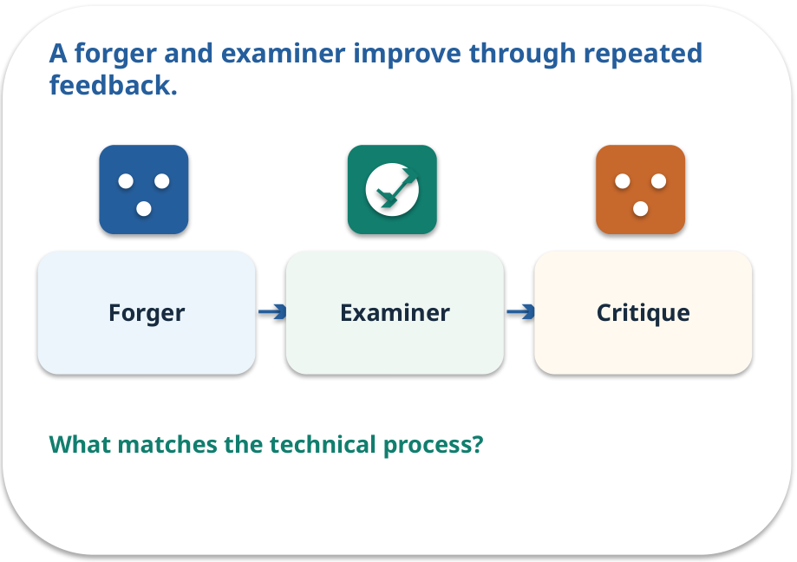
GAN · a familiar picture
ANALOGY / WEEK 02
A forger and examiner improve through repeated feedback.
What matches our case, and where does the analogy stop?
GENERATIVE AI 2027 • WEEK 02 • 17 / 40
Notes:
TEACHER SCRIPT — ANALOGY. Begin with the familiar scene. Invite learners to describe each part in everyday language. Then ask where the comparison might fail before introducing the technical vocabulary. This week’s case is: A designer wants new simple icons similar to examples, without copying an exact icon. The visible slide states: A forger and examiner improve through repeated feedback.
What matches our case, and where does the analogy stop? The boundary is: The analogy can imply a human examiner; the discriminator is a learned network and may be fooled. The target is: Explain how reconstruction differs from adversarial generation. Listen for an explanation of the actual arrow or calculation, not just a repeated label. If the answer is unsupported, mark that uncertainty and return to the source. Before moving on, ask for the main idea and one concrete change to the worked example.

Slide 18
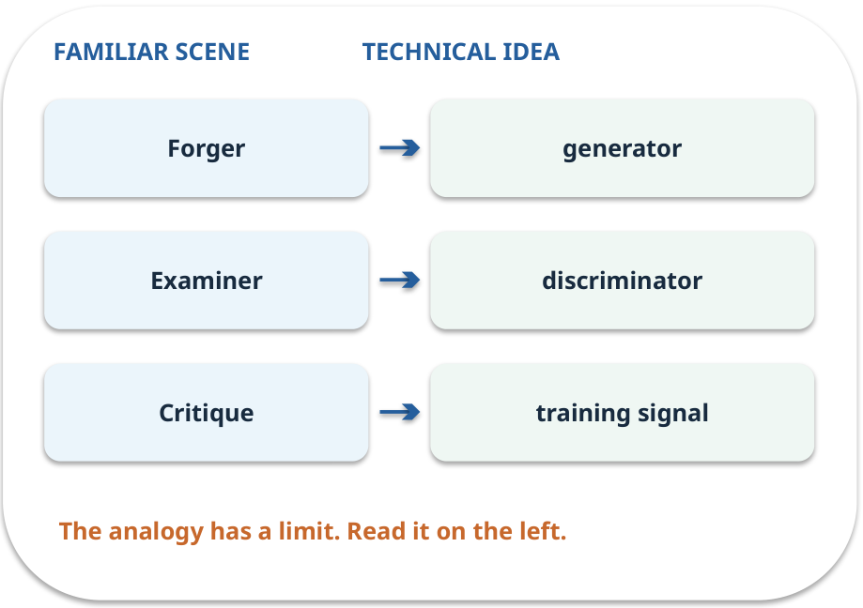
GAN · map the parts
MAPPING / WEEK 02
Match each everyday part to the technical part.
Analogy limit: The analogy can imply a human examiner; the discriminator is a learned network and may be fooled.
GENERATIVE AI 2027 • WEEK 02 • 18 / 40
Notes:
TEACHER SCRIPT — MAPPING. Point from each familiar element to the corresponding technical element. Have students cover the right column and reconstruct the three matches. Read the limitation aloud. This week’s case is: A designer wants new simple icons similar to examples, without copying an exact icon. The visible slide states: Match each everyday part to the technical part.
Analogy limit: The analogy can imply a human examiner; the discriminator is a learned network and may be fooled. The three precise mappings are [['Forger', 'generator'], ['Examiner', 'discriminator'], ['Critique', 'training signal']]. The target is: Explain how reconstruction differs from adversarial generation. Listen for an explanation of the actual arrow or calculation, not just a repeated label. If the answer is unsupported, mark that uncertainty and return to the source. Before moving on, ask for the main idea and one concrete change to the worked example.

Slide 19
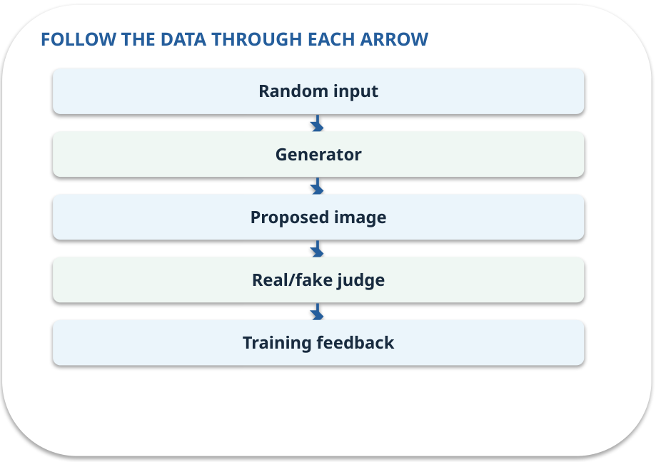
GAN · how it works
MECHANISM / WEEK 02
A generator proposes samples. A discriminator learns to distinguish generated and real samples; both change during training.
Trace the arrows from left to right.
GENERATIVE AI 2027 • WEEK 02 • 19 / 40
Notes:
TEACHER SCRIPT — MECHANISM. Trace every arrow slowly from the input to the output. Ask what information crosses the boundary at each arrow. Pause if students confuse a simplified notebook with a trained model. This week’s case is: A designer wants new simple icons similar to examples, without copying an exact icon. The visible slide states: A generator proposes samples. A discriminator learns to distinguish generated and real samples; both change during training.
Trace the arrows from left to right. The weekly example is: A generator proposes an icon; the discriminator scores real versus generated examples; both update. State what the analogy does not explain: The analogy can imply a human examiner; the discriminator is a learned network and may be fooled. The target is: Explain how reconstruction differs from adversarial generation. Listen for an explanation of the actual arrow or calculation, not just a repeated label. If the answer is unsupported, mark that uncertainty and return to the source. Before moving on, ask for the main idea and one concrete change to the worked example.

Slide 20
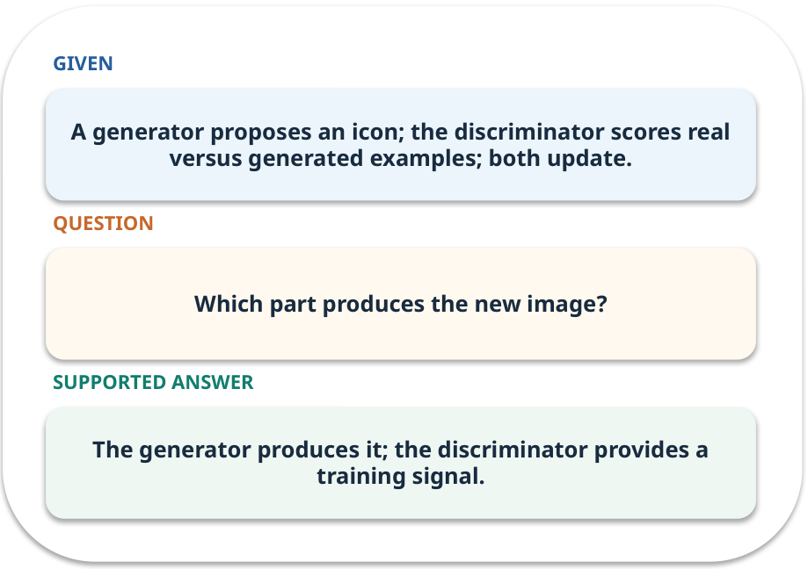
GAN · work one case
WORKED / WEEK 02
A generator proposes an icon; the discriminator scores real versus generated examples; both update.
Point to the evidence before giving your conclusion.
GENERATIVE AI 2027 • WEEK 02 • 20 / 40
Notes:
TEACHER SCRIPT — WORKED. Work the specific numbers or source wording aloud. Give students thirty seconds to write a conclusion, then ask which source line or calculation supports it. This week’s case is: A designer wants new simple icons similar to examples, without copying an exact icon. The visible slide states: A generator proposes an icon; the discriminator scores real versus generated examples; both update.
Point to the evidence before giving your conclusion. The expected reasoning concludes: The generator produces it; the discriminator provides a training signal. Distinguish measured results from illustrative numbers. The target is: Explain how reconstruction differs from adversarial generation. Listen for an explanation of the actual arrow or calculation, not just a repeated label. If the answer is unsupported, mark that uncertainty and return to the source. Before moving on, ask for the main idea and one concrete change to the worked example.

Slide 21
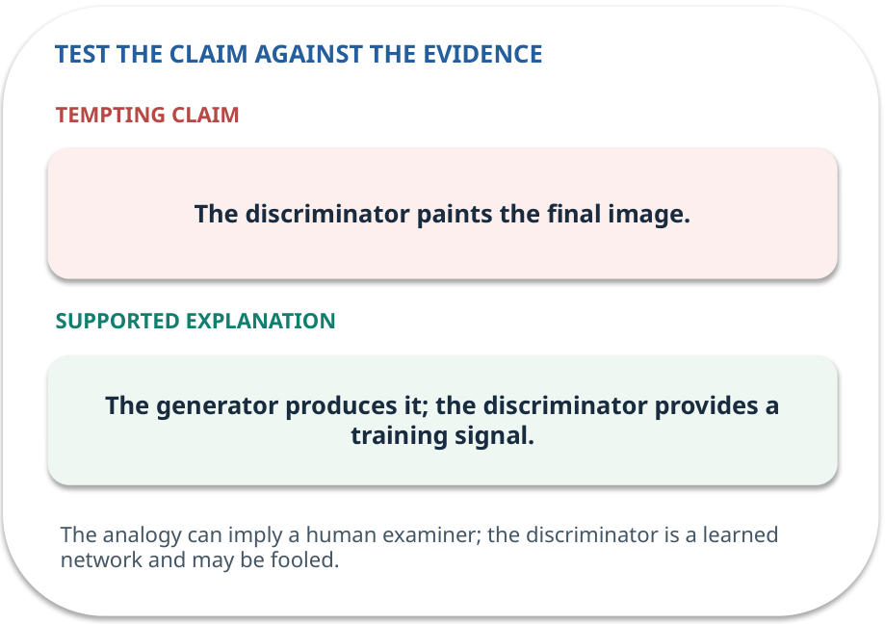
GAN · answer and explain
REVEAL / WEEK 02
The generator produces it; the discriminator provides a training signal.
Tempting mistake: The discriminator paints the final image.
GENERATIVE AI 2027 • WEEK 02 • 21 / 40
Notes:
TEACHER SCRIPT — REVEAL. Return to the earlier choice. Explain the correct answer and why the tempting claim fails. Ask one learner to say the answer in a single sentence without reading it. This week’s case is: A designer wants new simple icons similar to examples, without copying an exact icon. The visible slide states: The generator produces it; the discriminator provides a training signal.
Tempting mistake: The discriminator paints the final image. The earlier question was Which part produces the new image? Ask how this differs from the wrong claim. The target is: Explain how reconstruction differs from adversarial generation. Listen for an explanation of the actual arrow or calculation, not just a repeated label. If the answer is unsupported, mark that uncertainty and return to the source. Before moving on, ask for the main idea and one concrete change to the worked example.

Slide 22
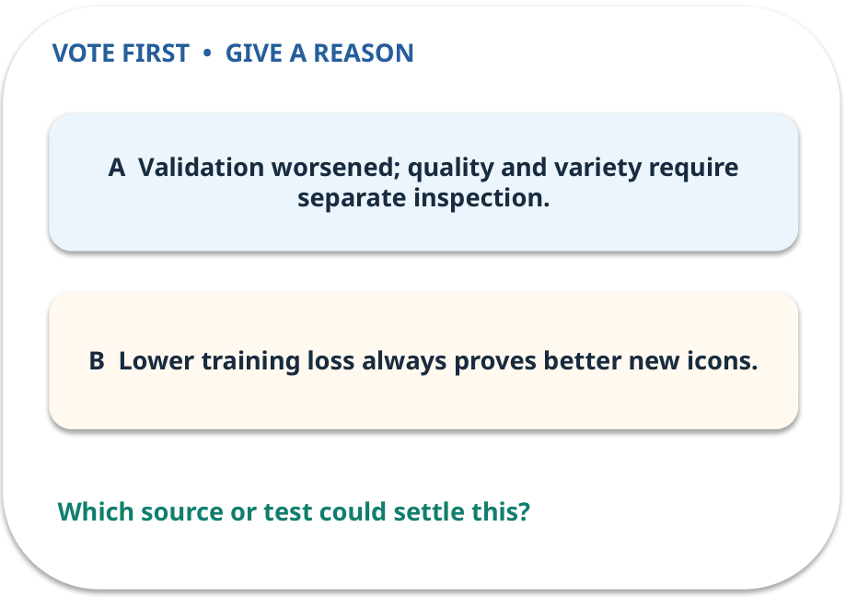
4. Predict · Training curves
QUESTION / WEEK 02
Why is the final training number insufficient?
Make a choice before we explain the diagram.
GENERATIVE AI 2027 • WEEK 02 • 22 / 40
Notes:
TEACHER SCRIPT — QUESTION. Take a show of hands for each choice before showing the mechanism. Ask pairs to defend a choice with evidence. Save the strongest wrong reason for the reveal later in this cycle. This week’s case is: A designer wants new simple icons similar to examples, without copying an exact icon. The visible slide states: Why is the final training number insufficient?
Make a choice before we explain the diagram. The intended answer is Validation worsened; quality and variety require separate inspection. The tempting claim is Lower training loss always proves better new icons. Do not show which card is correct until the reveal. The target is: Explain how reconstruction differs from adversarial generation. Listen for an explanation of the actual arrow or calculation, not just a repeated label. If the answer is unsupported, mark that uncertainty and return to the source. Before moving on, ask for the main idea and one concrete change to the worked example.

Slide 23
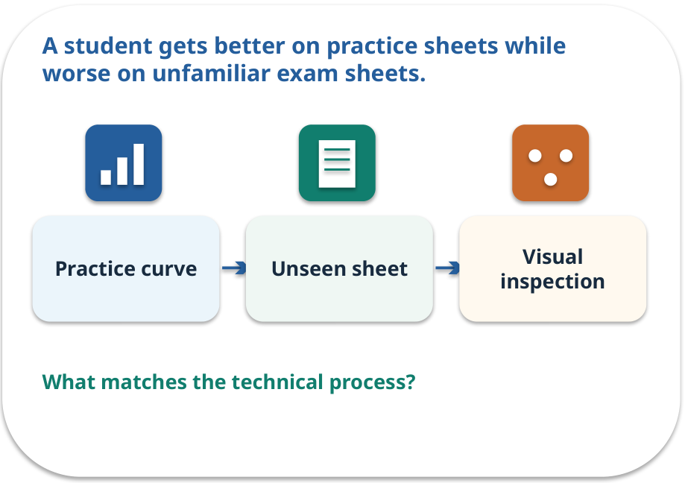
Training curves · a familiar picture
ANALOGY / WEEK 02
A student gets better on practice sheets while worse on unfamiliar exam sheets.
What matches our case, and where does the analogy stop?
GENERATIVE AI 2027 • WEEK 02 • 23 / 40
Notes:
TEACHER SCRIPT — ANALOGY. Begin with the familiar scene. Invite learners to describe each part in everyday language. Then ask where the comparison might fail before introducing the technical vocabulary. This week’s case is: A designer wants new simple icons similar to examples, without copying an exact icon. The visible slide states: A student gets better on practice sheets while worse on unfamiliar exam sheets.
What matches our case, and where does the analogy stop? The boundary is: GAN losses are not simple universal quality scores; compare held-out samples too. The target is: Explain how reconstruction differs from adversarial generation. Listen for an explanation of the actual arrow or calculation, not just a repeated label. If the answer is unsupported, mark that uncertainty and return to the source. Before moving on, ask for the main idea and one concrete change to the worked example.

Slide 24
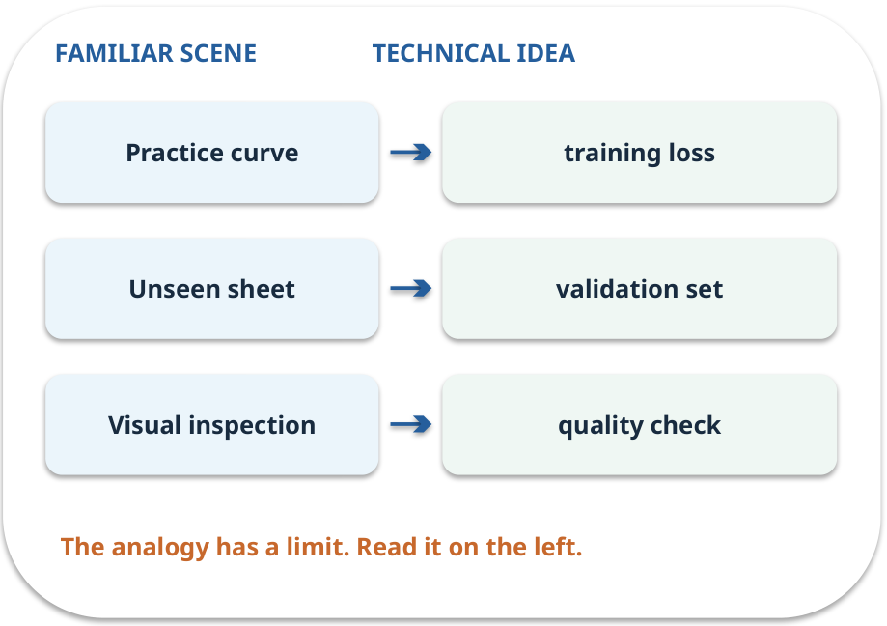
Training curves · map the parts
MAPPING / WEEK 02
Match each everyday part to the technical part.
Analogy limit: GAN losses are not simple universal quality scores; compare held-out samples too.
GENERATIVE AI 2027 • WEEK 02 • 24 / 40
Notes:
TEACHER SCRIPT — MAPPING. Point from each familiar element to the corresponding technical element. Have students cover the right column and reconstruct the three matches. Read the limitation aloud. This week’s case is: A designer wants new simple icons similar to examples, without copying an exact icon. The visible slide states: Match each everyday part to the technical part.
Analogy limit: GAN losses are not simple universal quality scores; compare held-out samples too. The three precise mappings are [['Practice curve', 'training loss'], ['Unseen sheet', 'validation set'], ['Visual inspection', 'quality check']]. The target is: Explain how reconstruction differs from adversarial generation. Listen for an explanation of the actual arrow or calculation, not just a repeated label. If the answer is unsupported, mark that uncertainty and return to the source. Before moving on, ask for the main idea and one concrete change to the worked example.

Slide 25
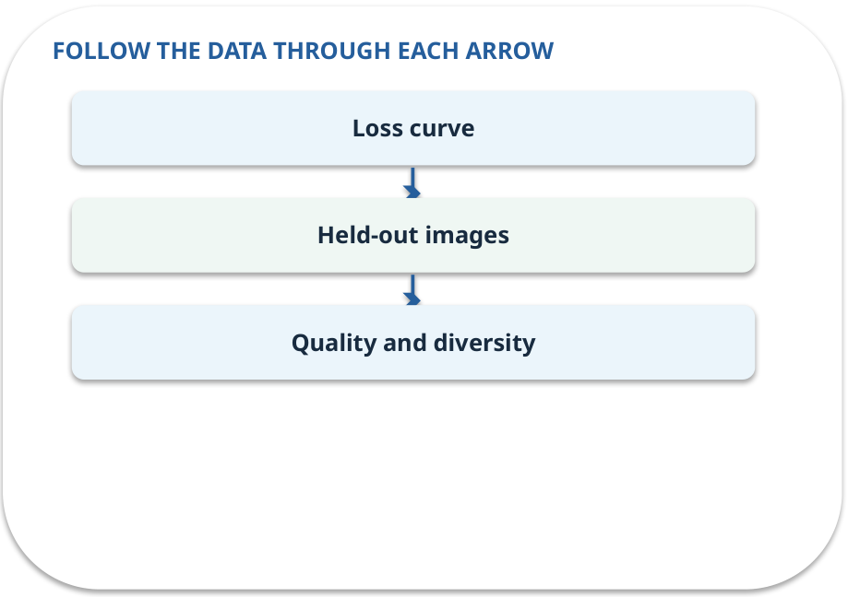
Training curves · how it works
MECHANISM / WEEK 02
A lower loss alone does not certify useful images; inspect quality, diversity and a held-out sample.
Trace the arrows from left to right.
GENERATIVE AI 2027 • WEEK 02 • 25 / 40
Notes:
TEACHER SCRIPT — MECHANISM. Trace every arrow slowly from the input to the output. Ask what information crosses the boundary at each arrow. Pause if students confuse a simplified notebook with a trained model. This week’s case is: A designer wants new simple icons similar to examples, without copying an exact icon. The visible slide states: A lower loss alone does not certify useful images; inspect quality, diversity and a held-out sample.
Trace the arrows from left to right. The weekly example is: Training error 0.30→0.18→0.12; validation 0.32→0.20→0.26. Inspect epoch 3. State what the analogy does not explain: GAN losses are not simple universal quality scores; compare held-out samples too. The target is: Explain how reconstruction differs from adversarial generation. Listen for an explanation of the actual arrow or calculation, not just a repeated label. If the answer is unsupported, mark that uncertainty and return to the source. Before moving on, ask for the main idea and one concrete change to the worked example.

Slide 26
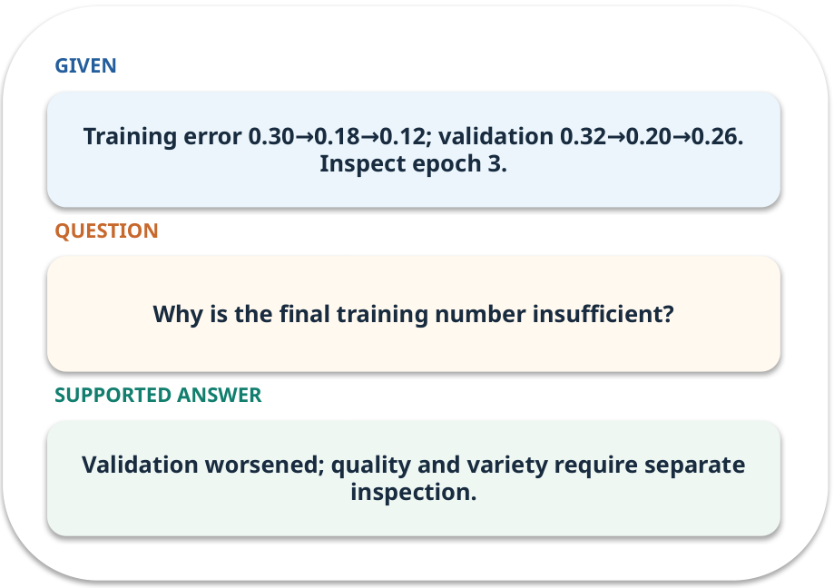
Training curves · work one case
WORKED / WEEK 02
Training error 0.30→0.18→0.12; validation 0.32→0.20→0.26. Inspect epoch 3.
Point to the evidence before giving your conclusion.
GENERATIVE AI 2027 • WEEK 02 • 26 / 40
Notes:
TEACHER SCRIPT — WORKED. Work the specific numbers or source wording aloud. Give students thirty seconds to write a conclusion, then ask which source line or calculation supports it. This week’s case is: A designer wants new simple icons similar to examples, without copying an exact icon. The visible slide states: Training error 0.30→0.18→0.12; validation 0.32→0.20→0.26. Inspect epoch 3.
Point to the evidence before giving your conclusion. The expected reasoning concludes: Validation worsened; quality and variety require separate inspection. Distinguish measured results from illustrative numbers. The target is: Explain how reconstruction differs from adversarial generation. Listen for an explanation of the actual arrow or calculation, not just a repeated label. If the answer is unsupported, mark that uncertainty and return to the source. Before moving on, ask for the main idea and one concrete change to the worked example.

Slide 27
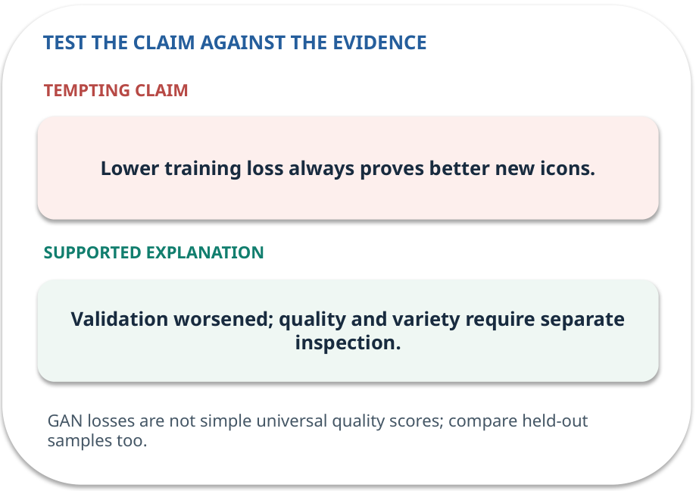
Training curves · answer and explain
REVEAL / WEEK 02
Validation worsened; quality and variety require separate inspection.
Tempting mistake: Lower training loss always proves better new icons.
GENERATIVE AI 2027 • WEEK 02 • 27 / 40
Notes:
TEACHER SCRIPT — REVEAL. Return to the earlier choice. Explain the correct answer and why the tempting claim fails. Ask one learner to say the answer in a single sentence without reading it. This week’s case is: A designer wants new simple icons similar to examples, without copying an exact icon. The visible slide states: Validation worsened; quality and variety require separate inspection.
Tempting mistake: Lower training loss always proves better new icons. The earlier question was Why is the final training number insufficient? Ask how this differs from the wrong claim. The target is: Explain how reconstruction differs from adversarial generation. Listen for an explanation of the actual arrow or calculation, not just a repeated label. If the answer is unsupported, mark that uncertainty and return to the source. Before moving on, ask for the main idea and one concrete change to the worked example.

Slide 28
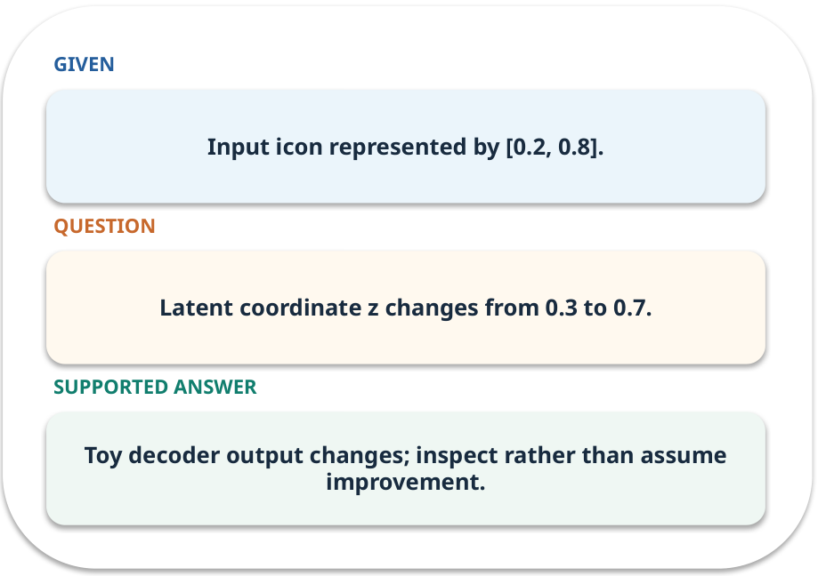
Evidence trail: input → result
WORKED / WEEK 02
Latent coordinate z changes from 0.3 to 0.7.
Toy decoder output changes; inspect rather than assume improvement.
GENERATIVE AI 2027 • WEEK 02 • 28 / 40
Notes:
TEACHER SCRIPT — WORKED. Work the specific numbers or source wording aloud. Give students thirty seconds to write a conclusion, then ask which source line or calculation supports it. This week’s case is: A designer wants new simple icons similar to examples, without copying an exact icon. The visible slide states: Latent coordinate z changes from 0.3 to 0.7.
Toy decoder output changes; inspect rather than assume improvement. Have one student point to an exact source word or number for each conclusion. The target is: Explain how reconstruction differs from adversarial generation. Listen for an explanation of the actual arrow or calculation, not just a repeated label. If the answer is unsupported, mark that uncertainty and return to the source. Before moving on, ask for the main idea and one concrete change to the worked example.

Slide 29
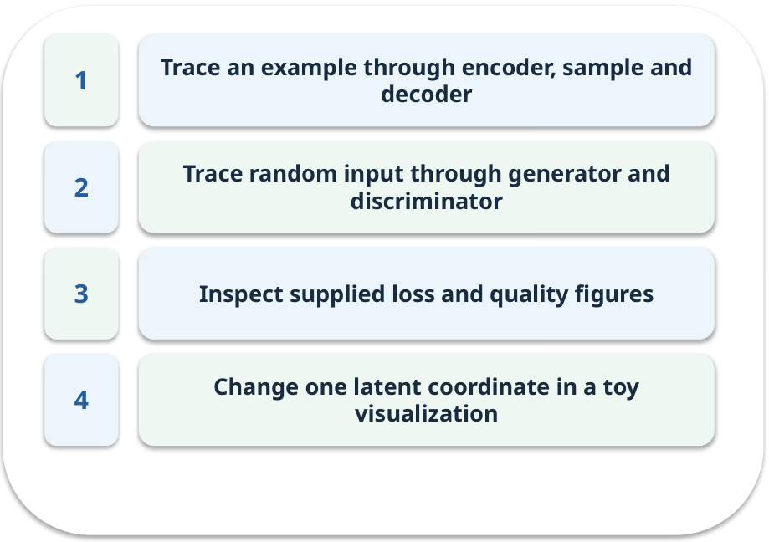
Notebook: run the prepared example
PRACTICE / WEEK 02
Annotate model paths and explore a toy latent coordinate.
Read the original output before editing.
GENERATIVE AI 2027 • WEEK 02 • 29 / 40
Notes:
TEACHER SCRIPT — PRACTICE. Open the matching notebook and demonstrate the first run. Have learners predict one change, run only that change, and record input, setting, output and an error explanation. This week’s case is: A designer wants new simple icons similar to examples, without copying an exact icon. The visible slide states: Annotate model paths and explore a toy latent coordinate.
Read the original output before editing. Use Week_02_Lab.ipynb. This lab is a prepared classroom demonstration with its limitations documented. The target is: Explain how reconstruction differs from adversarial generation. Listen for an explanation of the actual arrow or calculation, not just a repeated label. If the answer is unsupported, mark that uncertainty and return to the source. Before moving on, ask for the main idea and one concrete change to the worked example.

Slide 30

Find the input and check in Python
PRACTICE / WEEK 02
Locate the supplied input, the transformation, the checking line and the printed result.
GENERATIVE AI 2027 • WEEK 02 • 30 / 40
Notes:
TEACHER SCRIPT — PRACTICE. Open the matching notebook and demonstrate the first run. Have learners predict one change, run only that change, and record input, setting, output and an error explanation. This week’s case is: A designer wants new simple icons similar to examples, without copying an exact icon. The visible slide states: Locate the supplied input, the transformation, the checking line and the printed result. The weekly lab change is: Change z and compare output difference; explain that the toy cannot establish realism. The target is: Explain how reconstruction differs from adversarial generation. Listen for an explanation of the actual arrow or calculation, not just a repeated label. If the answer is unsupported, mark that uncertainty and return to the source. Before moving on, ask for the main idea and one concrete change to the worked example.

Slide 31

Predict one controlled change
PRACTICE / WEEK 02
Change z and compare output difference; explain that the toy cannot establish realism.
What should change in the result? What stays fixed?
GENERATIVE AI 2027 • WEEK 02 • 31 / 40
Notes:
TEACHER SCRIPT — PRACTICE. Open the matching notebook and demonstrate the first run. Have learners predict one change, run only that change, and record input, setting, output and an error explanation. This week’s case is: A designer wants new simple icons similar to examples, without copying an exact icon. The visible slide states: Change z and compare output difference; explain that the toy cannot establish realism.
What should change in the result? What stays fixed? Ask learners to write their prediction before rerunning the cell. The target is: Explain how reconstruction differs from adversarial generation. Listen for an explanation of the actual arrow or calculation, not just a repeated label. If the answer is unsupported, mark that uncertainty and return to the source. Before moving on, ask for the main idea and one concrete change to the worked example.

Slide 32

Run, compare and record
PRACTICE / WEEK 02
Record the input, the one changed setting, the observed result and a reason for any difference.
GENERATIVE AI 2027 • WEEK 02 • 32 / 40
Notes:
TEACHER SCRIPT — PRACTICE. Open the matching notebook and demonstrate the first run. Have learners predict one change, run only that change, and record input, setting, output and an error explanation. This week’s case is: A designer wants new simple icons similar to examples, without copying an exact icon. The visible slide states: Record the input, the one changed setting, the observed result and a reason for any difference. The required evidence is: Two labelled model diagrams and a reconstruction comparison. The target is: Explain how reconstruction differs from adversarial generation. Listen for an explanation of the actual arrow or calculation, not just a repeated label. If the answer is unsupported, mark that uncertainty and return to the source. Before moving on, ask for the main idea and one concrete change to the worked example.

Slide 33

Measure without hiding the denominator
CHECK / WEEK 02
Mean absolute reconstruction error on supplied example pairs
Write the numerator, denominator and one failure case.
GENERATIVE AI 2027 • WEEK 02 • 33 / 40
Notes:
TEACHER SCRIPT — CHECK. Use this as a brief formative check. Ask for the conclusion, the evidence and one limitation. Revisit disagreements in the review session and offer an extension only after the core task. This week’s case is: A designer wants new simple icons similar to examples, without copying an exact icon. The visible slide states: Mean absolute reconstruction error on supplied example pairs
Write the numerator, denominator and one failure case. Where a measure is qualitative, show the concrete source comparison. Example: Toy decoder output changes; inspect rather than assume improvement. The target is: Explain how reconstruction differs from adversarial generation. Listen for an explanation of the actual arrow or calculation, not just a repeated label. If the answer is unsupported, mark that uncertainty and return to the source. Before moving on, ask for the main idea and one concrete change to the worked example.

Slide 34
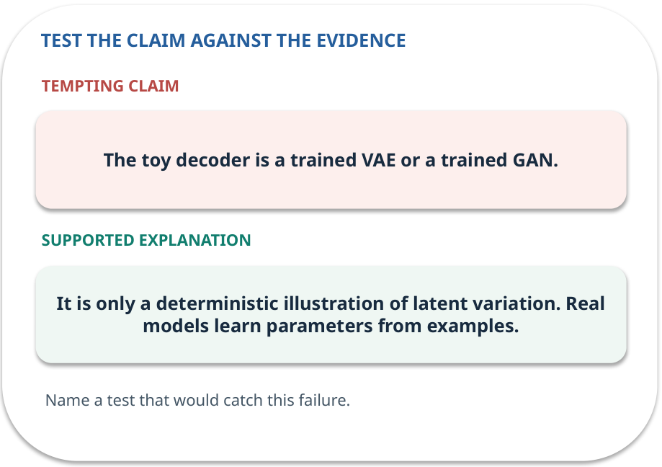
Error detective: find the layer
CHECK / WEEK 02
Plausible wrong claim: The toy decoder is a trained VAE or a trained GAN.
Correct it using the case evidence.
GENERATIVE AI 2027 • WEEK 02 • 34 / 40
Notes:
TEACHER SCRIPT — CHECK. Use this as a brief formative check. Ask for the conclusion, the evidence and one limitation. Revisit disagreements in the review session and offer an extension only after the core task. This week’s case is: A designer wants new simple icons similar to examples, without copying an exact icon. The visible slide states: Plausible wrong claim: The toy decoder is a trained VAE or a trained GAN.
Correct it using the case evidence. The correction is It is only a deterministic illustration of latent variation. Real models learn parameters from examples. The target is: Explain how reconstruction differs from adversarial generation. Listen for an explanation of the actual arrow or calculation, not just a repeated label. If the answer is unsupported, mark that uncertainty and return to the source. Before moving on, ask for the main idea and one concrete change to the worked example.

Slide 35

Transfer to a new situation
CHECK / WEEK 02
The generated icon looks sharp but repeats one shape. Which additional check would reveal lack of diversity?
Explain which source or test would settle it.
GENERATIVE AI 2027 • WEEK 02 • 35 / 40
Notes:
TEACHER SCRIPT — CHECK. Use this as a brief formative check. Ask for the conclusion, the evidence and one limitation. Revisit disagreements in the review session and offer an extension only after the core task. This week’s case is: A designer wants new simple icons similar to examples, without copying an exact icon. The visible slide states: The generated icon looks sharp but repeats one shape. Which additional check would reveal lack of diversity?
Explain which source or test would settle it. This is a fresh scenario, so ask for a reason before accepting either short answer. The target is: Explain how reconstruction differs from adversarial generation. Listen for an explanation of the actual arrow or calculation, not just a repeated label. If the answer is unsupported, mark that uncertainty and return to the source. Before moving on, ask for the main idea and one concrete change to the worked example.

Slide 36
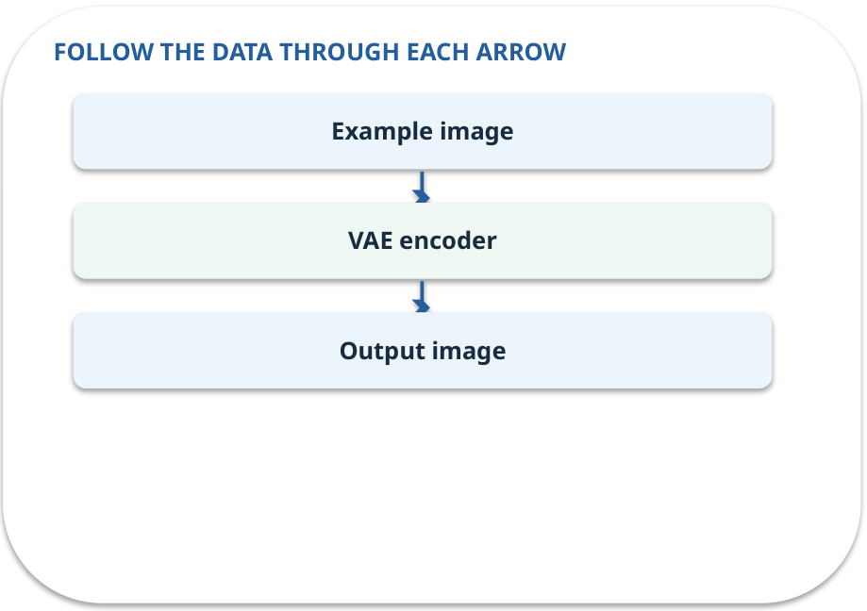
Explain it to a partner
CHECK / WEEK 02
Without reading the slide, name the input, one processing step and the check. Your partner should ask “How do you know?”
GENERATIVE AI 2027 • WEEK 02 • 36 / 40
Notes:
TEACHER SCRIPT — CHECK. Use this as a brief formative check. Ask for the conclusion, the evidence and one limitation. Revisit disagreements in the review session and offer an extension only after the core task. This week’s case is: A designer wants new simple icons similar to examples, without copying an exact icon. The visible slide states: Without reading the slide, name the input, one processing step and the check. Your partner should ask “How do you know?” Listen for a causal explanation and one limitation, then revisit a difficult arrow on the board. The target is: Explain how reconstruction differs from adversarial generation. Listen for an explanation of the actual arrow or calculation, not just a repeated label. If the answer is unsupported, mark that uncertainty and return to the source. Before moving on, ask for the main idea and one concrete change to the worked example.

Slide 37

Exam rehearsal · explain and apply
CHECK / WEEK 02
Label input, encoder, latent sample and decoder in a VAE.
Write a short answer, then compare with the guide.
GENERATIVE AI 2027 • WEEK 02 • 37 / 40
Notes:
TEACHER SCRIPT — CHECK. Use this as a brief formative check. Ask for the conclusion, the evidence and one limitation. Revisit disagreements in the review session and offer an extension only after the core task. This week’s case is: A designer wants new simple icons similar to examples, without copying an exact icon. The visible slide states: Label input, encoder, latent sample and decoder in a VAE.
Write a short answer, then compare with the guide. Model answer after discussion: Input enters encoder. Encoder predicts a latent distribution. Sample z from that distribution. Decoder reconstructs the input from z. Practice marks: 4. The target is: Explain how reconstruction differs from adversarial generation. Listen for an explanation of the actual arrow or calculation, not just a repeated label. If the answer is unsupported, mark that uncertainty and return to the source. Before moving on, ask for the main idea and one concrete change to the worked example.

Slide 38
Exam rehearsal · explain and apply
CHECK / WEEK 02
Training error falls but validation error rises. What should you inspect?
Write a short answer, then compare with the guide.
GENERATIVE AI 2027 • WEEK 02 • 38 / 40
Notes:
TEACHER SCRIPT — CHECK. Use this as a brief formative check. Ask for the conclusion, the evidence and one limitation. Revisit disagreements in the review session and offer an extension only after the core task. This week’s case is: A designer wants new simple icons similar to examples, without copying an exact icon. The visible slide states: Training error falls but validation error rises. What should you inspect?
Write a short answer, then compare with the guide. Model answer after discussion: Inspect held-out examples and overfitting; compare checkpoints and avoid claiming progress from training error alone. Practice marks: 4. The target is: Explain how reconstruction differs from adversarial generation. Listen for an explanation of the actual arrow or calculation, not just a repeated label. If the answer is unsupported, mark that uncertainty and return to the source. Before moving on, ask for the main idea and one concrete change to the worked example.

Slide 39

What to hand in
PRACTICE / WEEK 02
Two labelled model diagrams and a reconstruction comparison.
Include the one changed input and an error explanation.
GENERATIVE AI 2027 • WEEK 02 • 39 / 40
Notes:
TEACHER SCRIPT — PRACTICE. Open the matching notebook and demonstrate the first run. Have learners predict one change, run only that change, and record input, setting, output and an error explanation. This week’s case is: A designer wants new simple icons similar to examples, without copying an exact icon. The visible slide states: Two labelled model diagrams and a reconstruction comparison.
Include the one changed input and an error explanation. This weekly evidence receives formative feedback according to the module sequence; refer to the assessment brief for graded work. The target is: Explain how reconstruction differs from adversarial generation. Listen for an explanation of the actual arrow or calculation, not just a repeated label. If the answer is unsupported, mark that uncertainty and return to the source. Before moving on, ask for the main idea and one concrete change to the worked example.

Slide 40
Three ideas to recall next week
CHECK / WEEK 02
VAE: compress and reconstruct. GAN: propose and critique.
Read the linked official sources in the Word guide and redraw one diagram from memory.
GENERATIVE AI 2027 • WEEK 02 • 40 / 40
Notes:
TEACHER SCRIPT — CHECK. Use this as a brief formative check. Ask for the conclusion, the evidence and one limitation. Revisit disagreements in the review session and offer an extension only after the core task. This week’s case is: A designer wants new simple icons similar to examples, without copying an exact icon. The visible slide states: VAE: compress and reconstruct. GAN: propose and critique.
Read the linked official sources in the Word guide and redraw one diagram from memory. Return to the opening vote and ask whether the evidence changed anyone’s mind. The next week builds on this outcome: Explain how reconstruction differs from adversarial generation. The target is: Explain how reconstruction differs from adversarial generation. Listen for an explanation of the actual arrow or calculation, not just a repeated label. If the answer is unsupported, mark that uncertainty and return to the source. Before moving on, ask for the main idea and one concrete change to the worked example.

