Slide 1
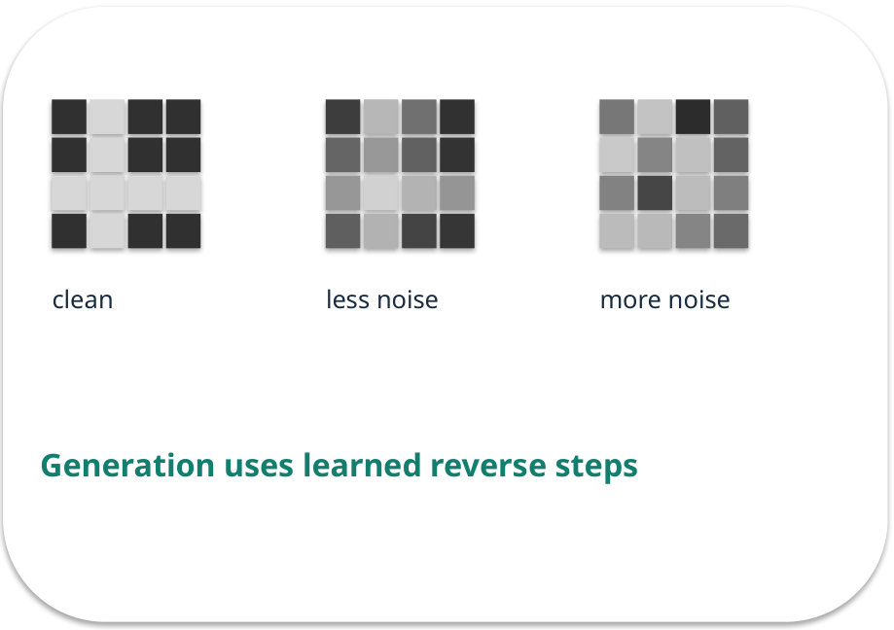
Week 03 · Diffusion and generated media
OPEN / WEEK 03
The consent-safe poster
A team requests a synthetic poster. The output looks vivid but may show a recognisable person. How do generation and review interact?
GENERATIVE AI 2027 • WEEK 03 • 01 / 40
Notes:
TEACHER SCRIPT — OPEN. Show the visual for ten seconds, then ask for an initial decision. Do not reveal the answer yet. Ask a student to name the source or measurement that would change their mind. This week’s case is: A college needs a synthetic poster image while respecting consent and image rights. The visible slide states: The consent-safe poster
A team requests a synthetic poster. The output looks vivid but may show a recognisable person. How do generation and review interact? Reveal that the case will be revisited after four short concept cycles. The target is: Explain the denoising idea and judge an image with a consistent checklist. Listen for an explanation of the actual arrow or calculation, not just a repeated label. If the answer is unsupported, mark that uncertainty and return to the source. Before moving on, ask for the main idea and one concrete change to the worked example.

Slide 2

First vote: what would you do?
QUESTION / WEEK 03
A team requests a synthetic poster. The output looks vivid but may show a recognisable person. How do generation and review interact?
Choose an initial answer and name one piece of evidence you need.
GENERATIVE AI 2027 • WEEK 03 • 02 / 40
Notes:
TEACHER SCRIPT — QUESTION. Take a show of hands for each choice before showing the mechanism. Ask pairs to defend a choice with evidence. Save the strongest wrong reason for the reveal later in this cycle. This week’s case is: A college needs a synthetic poster image while respecting consent and image rights. The visible slide states: A team requests a synthetic poster. The output looks vivid but may show a recognisable person. How do generation and review interact?
Choose an initial answer and name one piece of evidence you need. Accept reasonable uncertainty; record the initial votes to revisit at the end. The target is: Explain the denoising idea and judge an image with a consistent checklist. Listen for an explanation of the actual arrow or calculation, not just a repeated label. If the answer is unsupported, mark that uncertainty and return to the source. Before moving on, ask for the main idea and one concrete change to the worked example.

Slide 3
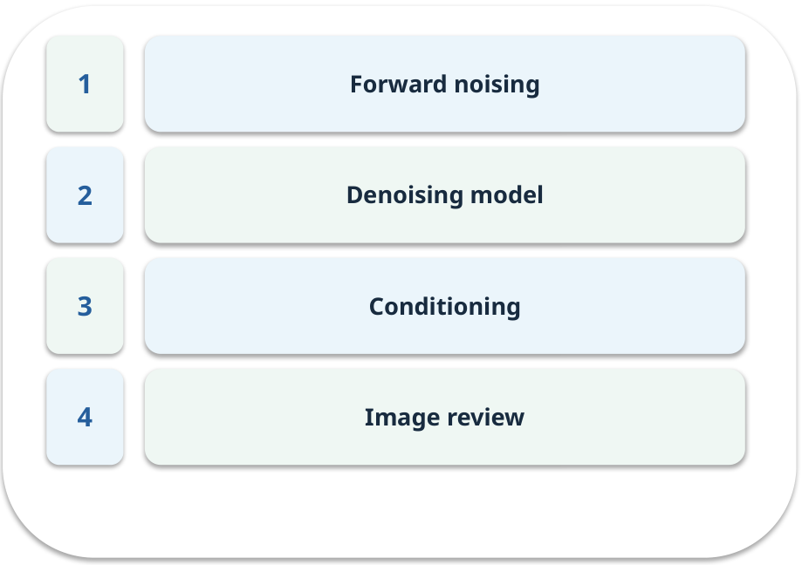
The journey through today’s case
OPEN / WEEK 03
We will predict, connect an analogy, trace a mechanism, work an example, then explain a decision.
GENERATIVE AI 2027 • WEEK 03 • 03 / 40
Notes:
TEACHER SCRIPT — OPEN. Show the visual for ten seconds, then ask for an initial decision. Do not reveal the answer yet. Ask a student to name the source or measurement that would change their mind. This week’s case is: A college needs a synthetic poster image while respecting consent and image rights. The visible slide states: We will predict, connect an analogy, trace a mechanism, work an example, then explain a decision. Point to the four named ideas, then show where the notebook experiment fits. The target is: Explain the denoising idea and judge an image with a consistent checklist. Listen for an explanation of the actual arrow or calculation, not just a repeated label. If the answer is unsupported, mark that uncertainty and return to the source. Before moving on, ask for the main idea and one concrete change to the worked example.

Slide 4
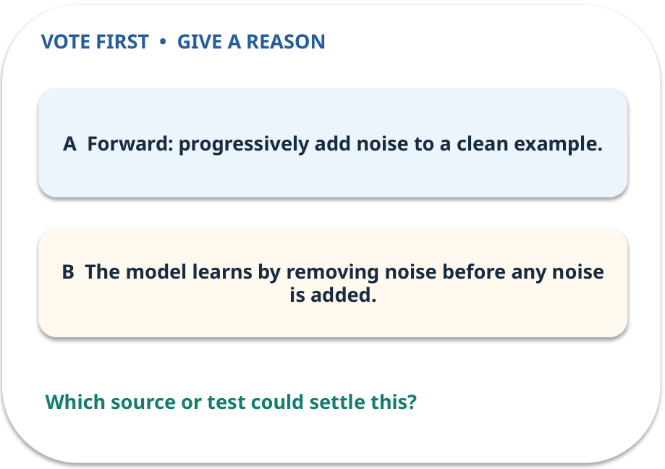
1. Predict · Forward noising
QUESTION / WEEK 03
Which direction is used while preparing training pairs?
Make a choice before we explain the diagram.
GENERATIVE AI 2027 • WEEK 03 • 04 / 40
Notes:
TEACHER SCRIPT — QUESTION. Take a show of hands for each choice before showing the mechanism. Ask pairs to defend a choice with evidence. Save the strongest wrong reason for the reveal later in this cycle. This week’s case is: A college needs a synthetic poster image while respecting consent and image rights. The visible slide states: Which direction is used while preparing training pairs?
Make a choice before we explain the diagram. The intended answer is Forward: progressively add noise to a clean example. The tempting claim is The model learns by removing noise before any noise is added. Do not show which card is correct until the reveal. The target is: Explain the denoising idea and judge an image with a consistent checklist. Listen for an explanation of the actual arrow or calculation, not just a repeated label. If the answer is unsupported, mark that uncertainty and return to the source. Before moving on, ask for the main idea and one concrete change to the worked example.

Slide 5
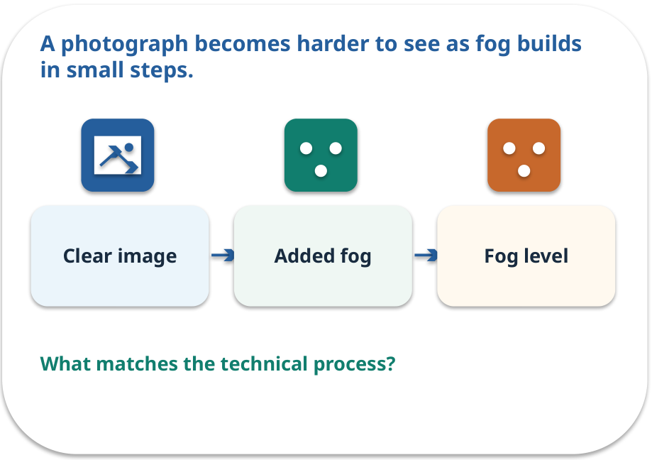
Forward noising · a familiar picture
ANALOGY / WEEK 03
A photograph becomes harder to see as fog builds in small steps.
What matches our case, and where does the analogy stop?
GENERATIVE AI 2027 • WEEK 03 • 05 / 40
Notes:
TEACHER SCRIPT — ANALOGY. Begin with the familiar scene. Invite learners to describe each part in everyday language. Then ask where the comparison might fail before introducing the technical vocabulary. This week’s case is: A college needs a synthetic poster image while respecting consent and image rights. The visible slide states: A photograph becomes harder to see as fog builds in small steps.
What matches our case, and where does the analogy stop? The boundary is: Noise is mathematically sampled; real fog is not the model’s training process. The target is: Explain the denoising idea and judge an image with a consistent checklist. Listen for an explanation of the actual arrow or calculation, not just a repeated label. If the answer is unsupported, mark that uncertainty and return to the source. Before moving on, ask for the main idea and one concrete change to the worked example.

Slide 6
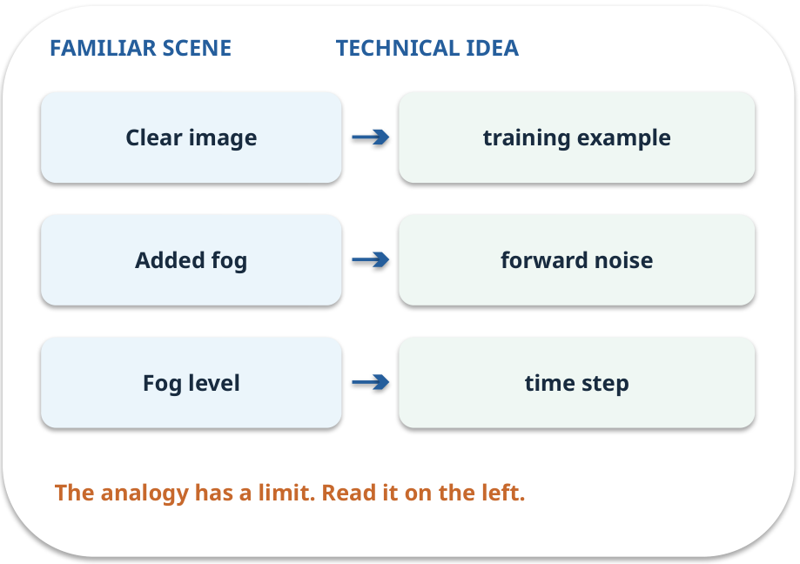
Forward noising · map the parts
MAPPING / WEEK 03
Match each everyday part to the technical part.
Analogy limit: Noise is mathematically sampled; real fog is not the model’s training process.
GENERATIVE AI 2027 • WEEK 03 • 06 / 40
Notes:
TEACHER SCRIPT — MAPPING. Point from each familiar element to the corresponding technical element. Have students cover the right column and reconstruct the three matches. Read the limitation aloud. This week’s case is: A college needs a synthetic poster image while respecting consent and image rights. The visible slide states: Match each everyday part to the technical part.
Analogy limit: Noise is mathematically sampled; real fog is not the model’s training process. The three precise mappings are [['Clear image', 'training example'], ['Added fog', 'forward noise'], ['Fog level', 'time step']]. The target is: Explain the denoising idea and judge an image with a consistent checklist. Listen for an explanation of the actual arrow or calculation, not just a repeated label. If the answer is unsupported, mark that uncertainty and return to the source. Before moving on, ask for the main idea and one concrete change to the worked example.

Slide 7
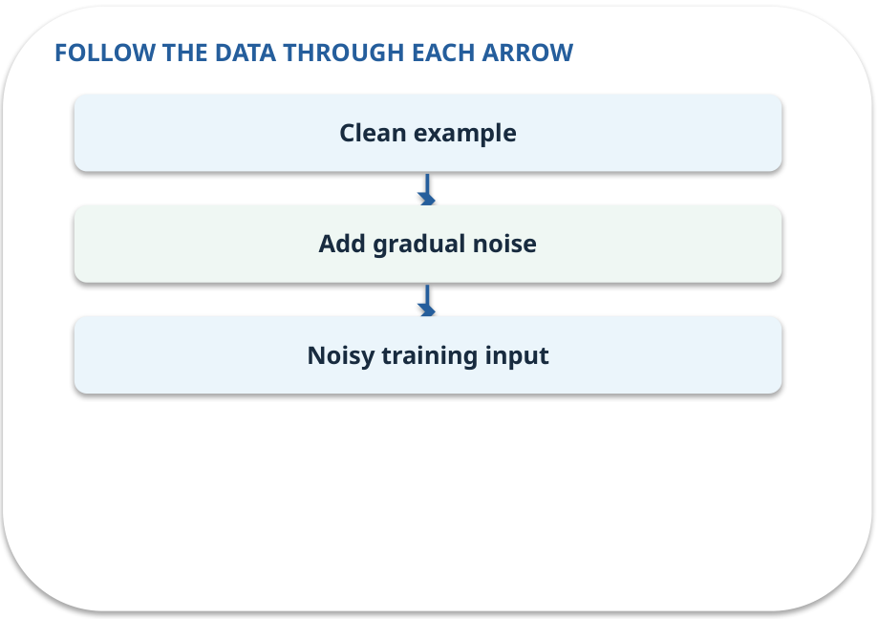
Forward noising · how it works
MECHANISM / WEEK 03
In a common training setup, progressively add noise to a clean image.
Trace the arrows from left to right.
GENERATIVE AI 2027 • WEEK 03 • 07 / 40
Notes:
TEACHER SCRIPT — MECHANISM. Trace every arrow slowly from the input to the output. Ask what information crosses the boundary at each arrow. Pause if students confuse a simplified notebook with a trained model. This week’s case is: A college needs a synthetic poster image while respecting consent and image rights. The visible slide states: In a common training setup, progressively add noise to a clean image.
Trace the arrows from left to right. The weekly example is: At low noise the L-shaped grid remains visible; at high noise most cells are obscured. State what the analogy does not explain: Noise is mathematically sampled; real fog is not the model’s training process. The target is: Explain the denoising idea and judge an image with a consistent checklist. Listen for an explanation of the actual arrow or calculation, not just a repeated label. If the answer is unsupported, mark that uncertainty and return to the source. Before moving on, ask for the main idea and one concrete change to the worked example.

Slide 8
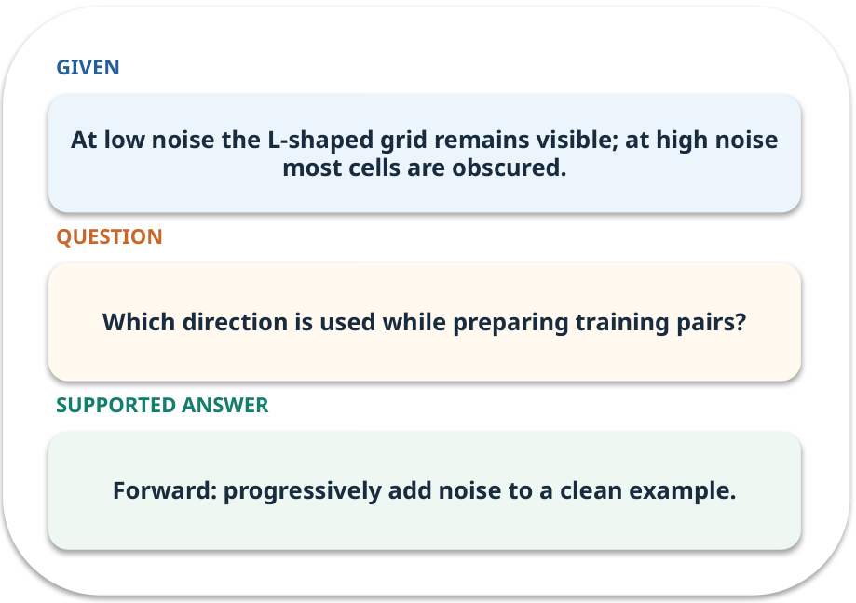
Forward noising · work one case
WORKED / WEEK 03
At low noise the L-shaped grid remains visible; at high noise most cells are obscured.
Point to the evidence before giving your conclusion.
GENERATIVE AI 2027 • WEEK 03 • 08 / 40
Notes:
TEACHER SCRIPT — WORKED. Work the specific numbers or source wording aloud. Give students thirty seconds to write a conclusion, then ask which source line or calculation supports it. This week’s case is: A college needs a synthetic poster image while respecting consent and image rights. The visible slide states: At low noise the L-shaped grid remains visible; at high noise most cells are obscured.
Point to the evidence before giving your conclusion. The expected reasoning concludes: Forward: progressively add noise to a clean example. Distinguish measured results from illustrative numbers. The target is: Explain the denoising idea and judge an image with a consistent checklist. Listen for an explanation of the actual arrow or calculation, not just a repeated label. If the answer is unsupported, mark that uncertainty and return to the source. Before moving on, ask for the main idea and one concrete change to the worked example.

Slide 9
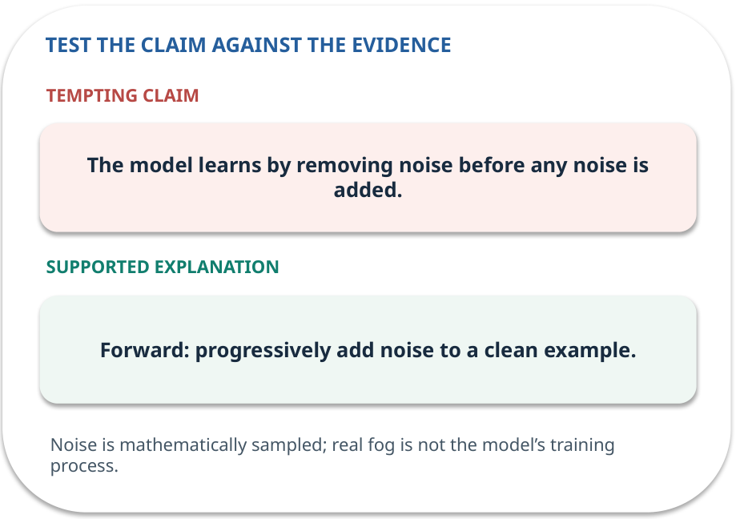
Forward noising · answer and explain
REVEAL / WEEK 03
Forward: progressively add noise to a clean example.
Tempting mistake: The model learns by removing noise before any noise is added.
GENERATIVE AI 2027 • WEEK 03 • 09 / 40
Notes:
TEACHER SCRIPT — REVEAL. Return to the earlier choice. Explain the correct answer and why the tempting claim fails. Ask one learner to say the answer in a single sentence without reading it. This week’s case is: A college needs a synthetic poster image while respecting consent and image rights. The visible slide states: Forward: progressively add noise to a clean example.
Tempting mistake: The model learns by removing noise before any noise is added. The earlier question was Which direction is used while preparing training pairs? Ask how this differs from the wrong claim. The target is: Explain the denoising idea and judge an image with a consistent checklist. Listen for an explanation of the actual arrow or calculation, not just a repeated label. If the answer is unsupported, mark that uncertainty and return to the source. Before moving on, ask for the main idea and one concrete change to the worked example.

Slide 10
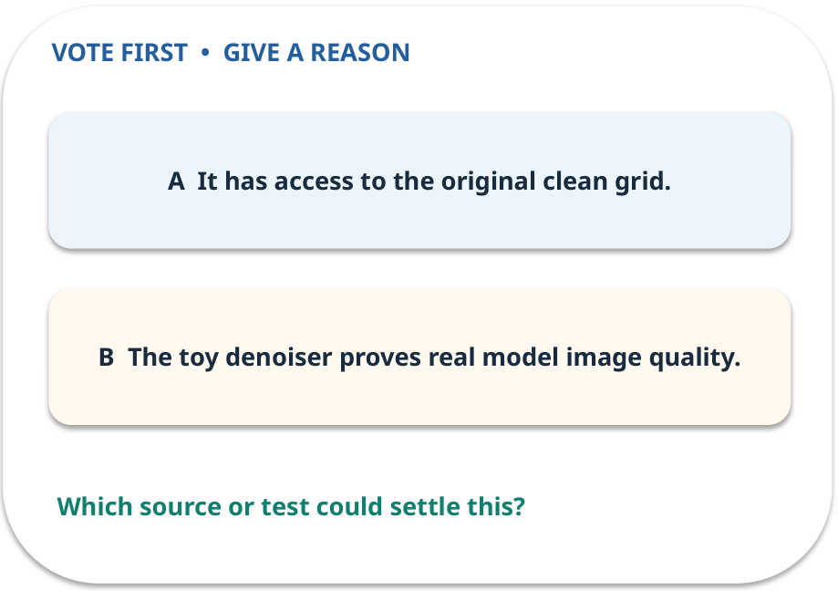
2. Predict · Denoising model
QUESTION / WEEK 03
What extra information makes the toy restoration easier?
Make a choice before we explain the diagram.
GENERATIVE AI 2027 • WEEK 03 • 10 / 40
Notes:
TEACHER SCRIPT — QUESTION. Take a show of hands for each choice before showing the mechanism. Ask pairs to defend a choice with evidence. Save the strongest wrong reason for the reveal later in this cycle. This week’s case is: A college needs a synthetic poster image while respecting consent and image rights. The visible slide states: What extra information makes the toy restoration easier?
Make a choice before we explain the diagram. The intended answer is It has access to the original clean grid. The tempting claim is The toy denoiser proves real model image quality. Do not show which card is correct until the reveal. The target is: Explain the denoising idea and judge an image with a consistent checklist. Listen for an explanation of the actual arrow or calculation, not just a repeated label. If the answer is unsupported, mark that uncertainty and return to the source. Before moving on, ask for the main idea and one concrete change to the worked example.

Slide 11
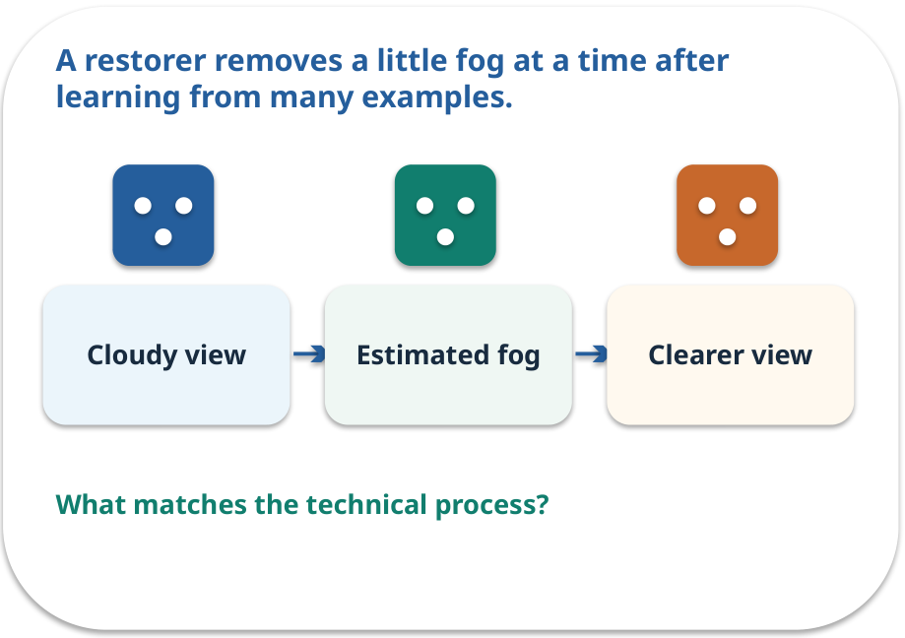
Denoising model · a familiar picture
ANALOGY / WEEK 03
A restorer removes a little fog at a time after learning from many examples.
What matches our case, and where does the analogy stop?
GENERATIVE AI 2027 • WEEK 03 • 11 / 40
Notes:
TEACHER SCRIPT — ANALOGY. Begin with the familiar scene. Invite learners to describe each part in everyday language. Then ask where the comparison might fail before introducing the technical vocabulary. This week’s case is: A college needs a synthetic poster image while respecting consent and image rights. The visible slide states: A restorer removes a little fog at a time after learning from many examples.
What matches our case, and where does the analogy stop? The boundary is: A real model does not secretly have the exact clean target at generation time. The target is: Explain the denoising idea and judge an image with a consistent checklist. Listen for an explanation of the actual arrow or calculation, not just a repeated label. If the answer is unsupported, mark that uncertainty and return to the source. Before moving on, ask for the main idea and one concrete change to the worked example.

Slide 12
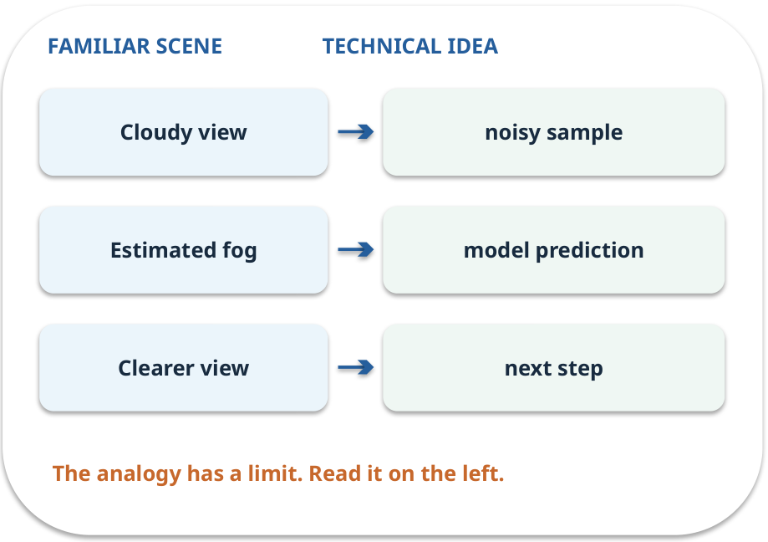
Denoising model · map the parts
MAPPING / WEEK 03
Match each everyday part to the technical part.
Analogy limit: A real model does not secretly have the exact clean target at generation time.
GENERATIVE AI 2027 • WEEK 03 • 12 / 40
Notes:
TEACHER SCRIPT — MAPPING. Point from each familiar element to the corresponding technical element. Have students cover the right column and reconstruct the three matches. Read the limitation aloud. This week’s case is: A college needs a synthetic poster image while respecting consent and image rights. The visible slide states: Match each everyday part to the technical part.
Analogy limit: A real model does not secretly have the exact clean target at generation time. The three precise mappings are [['Cloudy view', 'noisy sample'], ['Estimated fog', 'model prediction'], ['Clearer view', 'next step']]. The target is: Explain the denoising idea and judge an image with a consistent checklist. Listen for an explanation of the actual arrow or calculation, not just a repeated label. If the answer is unsupported, mark that uncertainty and return to the source. Before moving on, ask for the main idea and one concrete change to the worked example.

Slide 13
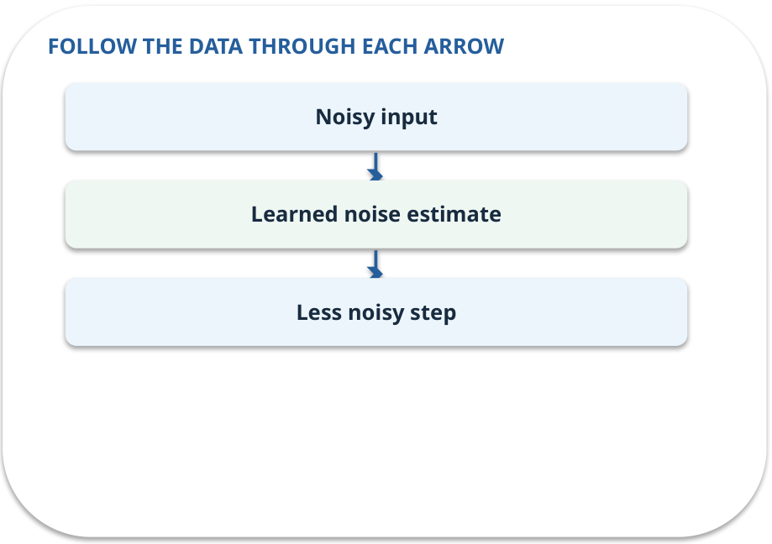
Denoising model · how it works
MECHANISM / WEEK 03
A learned model estimates how to remove noise at each step; the course simulation uses the known clean target.
Trace the arrows from left to right.
GENERATIVE AI 2027 • WEEK 03 • 13 / 40
Notes:
TEACHER SCRIPT — MECHANISM. Trace every arrow slowly from the input to the output. Ask what information crosses the boundary at each arrow. Pause if students confuse a simplified notebook with a trained model. This week’s case is: A college needs a synthetic poster image while respecting consent and image rights. The visible slide states: A learned model estimates how to remove noise at each step; the course simulation uses the known clean target.
Trace the arrows from left to right. The weekly example is: The prepared notebook’s toy restorer uses a clean target to illustrate steps; label that shortcut. State what the analogy does not explain: A real model does not secretly have the exact clean target at generation time. The target is: Explain the denoising idea and judge an image with a consistent checklist. Listen for an explanation of the actual arrow or calculation, not just a repeated label. If the answer is unsupported, mark that uncertainty and return to the source. Before moving on, ask for the main idea and one concrete change to the worked example.

Slide 14
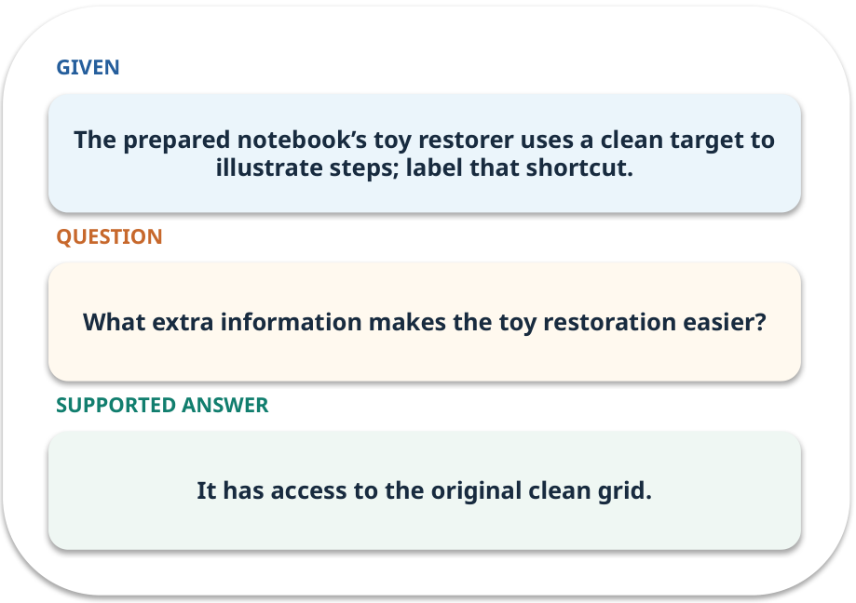
Denoising model · work one case
WORKED / WEEK 03
The prepared notebook’s toy restorer uses a clean target to illustrate steps; label that shortcut.
Point to the evidence before giving your conclusion.
GENERATIVE AI 2027 • WEEK 03 • 14 / 40
Notes:
TEACHER SCRIPT — WORKED. Work the specific numbers or source wording aloud. Give students thirty seconds to write a conclusion, then ask which source line or calculation supports it. This week’s case is: A college needs a synthetic poster image while respecting consent and image rights. The visible slide states: The prepared notebook’s toy restorer uses a clean target to illustrate steps; label that shortcut.
Point to the evidence before giving your conclusion. The expected reasoning concludes: It has access to the original clean grid. Distinguish measured results from illustrative numbers. The target is: Explain the denoising idea and judge an image with a consistent checklist. Listen for an explanation of the actual arrow or calculation, not just a repeated label. If the answer is unsupported, mark that uncertainty and return to the source. Before moving on, ask for the main idea and one concrete change to the worked example.

Slide 15
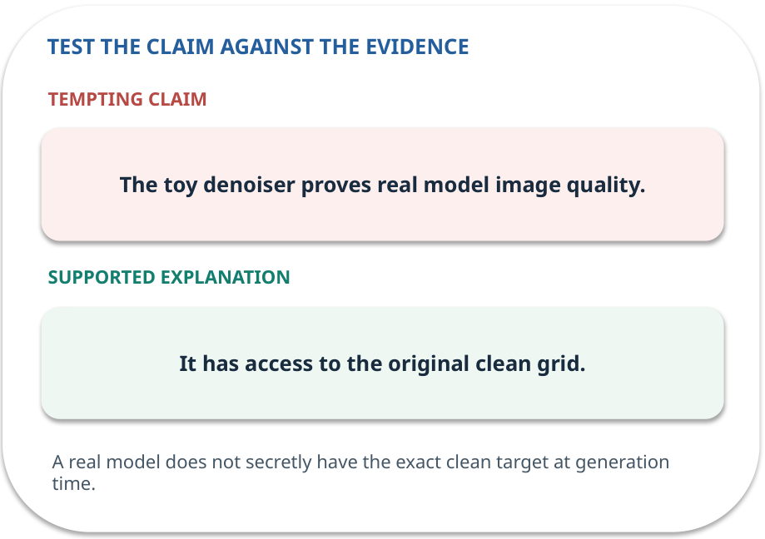
Denoising model · answer and explain
REVEAL / WEEK 03
It has access to the original clean grid.
Tempting mistake: The toy denoiser proves real model image quality.
GENERATIVE AI 2027 • WEEK 03 • 15 / 40
Notes:
TEACHER SCRIPT — REVEAL. Return to the earlier choice. Explain the correct answer and why the tempting claim fails. Ask one learner to say the answer in a single sentence without reading it. This week’s case is: A college needs a synthetic poster image while respecting consent and image rights. The visible slide states: It has access to the original clean grid.
Tempting mistake: The toy denoiser proves real model image quality. The earlier question was What extra information makes the toy restoration easier? Ask how this differs from the wrong claim. The target is: Explain the denoising idea and judge an image with a consistent checklist. Listen for an explanation of the actual arrow or calculation, not just a repeated label. If the answer is unsupported, mark that uncertainty and return to the source. Before moving on, ask for the main idea and one concrete change to the worked example.

Slide 16
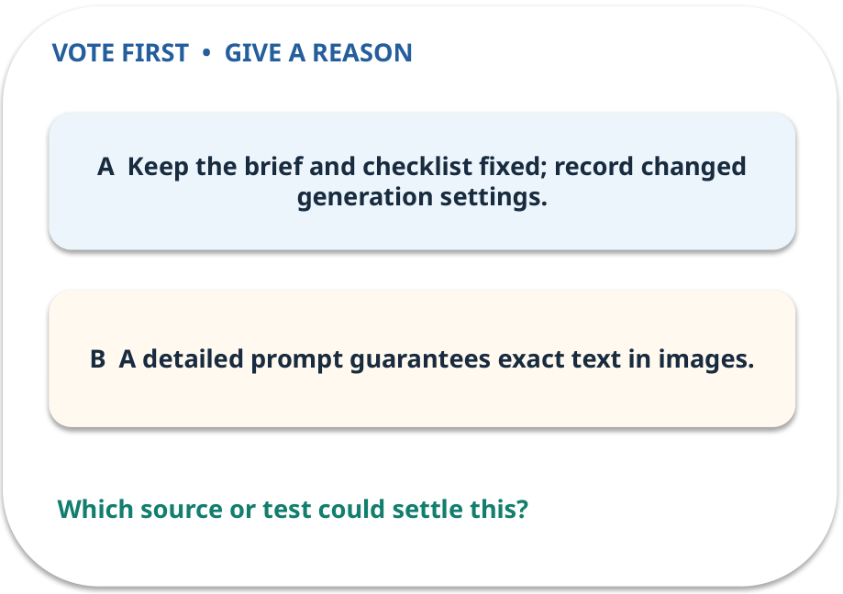
3. Predict · Conditioning
QUESTION / WEEK 03
What stays fixed in a fair output comparison?
Make a choice before we explain the diagram.
GENERATIVE AI 2027 • WEEK 03 • 16 / 40
Notes:
TEACHER SCRIPT — QUESTION. Take a show of hands for each choice before showing the mechanism. Ask pairs to defend a choice with evidence. Save the strongest wrong reason for the reveal later in this cycle. This week’s case is: A college needs a synthetic poster image while respecting consent and image rights. The visible slide states: What stays fixed in a fair output comparison?
Make a choice before we explain the diagram. The intended answer is Keep the brief and checklist fixed; record changed generation settings. The tempting claim is A detailed prompt guarantees exact text in images. Do not show which card is correct until the reveal. The target is: Explain the denoising idea and judge an image with a consistent checklist. Listen for an explanation of the actual arrow or calculation, not just a repeated label. If the answer is unsupported, mark that uncertainty and return to the source. Before moving on, ask for the main idea and one concrete change to the worked example.

Slide 17
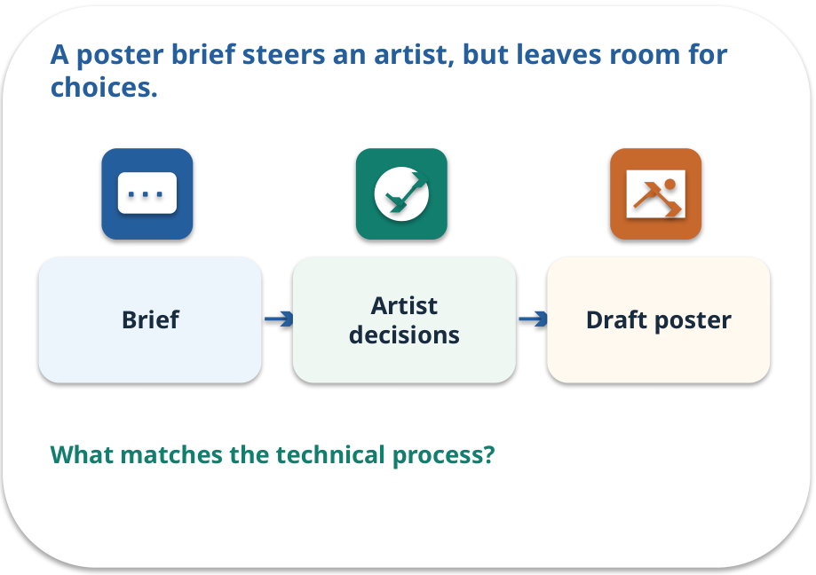
Conditioning · a familiar picture
ANALOGY / WEEK 03
A poster brief steers an artist, but leaves room for choices.
What matches our case, and where does the analogy stop?
GENERATIVE AI 2027 • WEEK 03 • 17 / 40
Notes:
TEACHER SCRIPT — ANALOGY. Begin with the familiar scene. Invite learners to describe each part in everyday language. Then ask where the comparison might fail before introducing the technical vocabulary. This week’s case is: A college needs a synthetic poster image while respecting consent and image rights. The visible slide states: A poster brief steers an artist, but leaves room for choices.
What matches our case, and where does the analogy stop? The boundary is: The brief does not guarantee that every requested detail appears correctly. The target is: Explain the denoising idea and judge an image with a consistent checklist. Listen for an explanation of the actual arrow or calculation, not just a repeated label. If the answer is unsupported, mark that uncertainty and return to the source. Before moving on, ask for the main idea and one concrete change to the worked example.

Slide 18
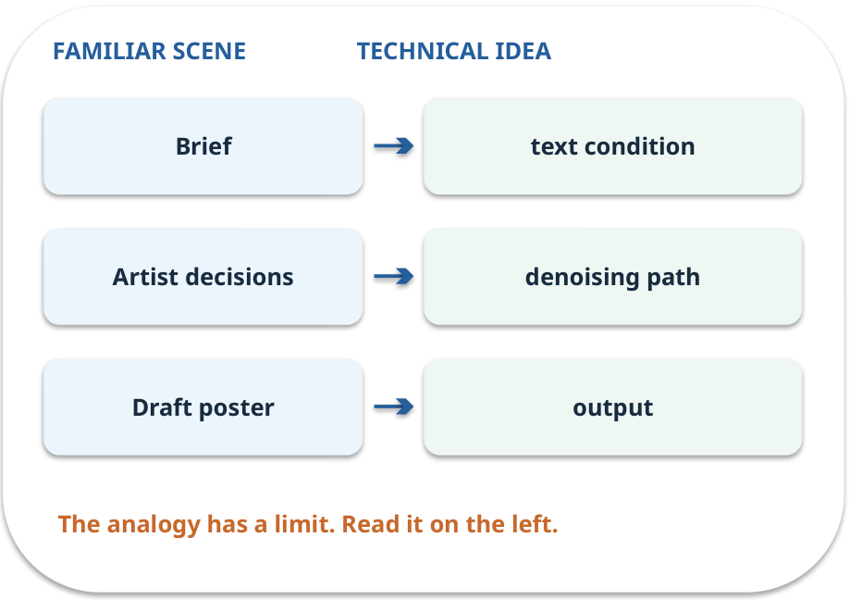
Conditioning · map the parts
MAPPING / WEEK 03
Match each everyday part to the technical part.
Analogy limit: The brief does not guarantee that every requested detail appears correctly.
GENERATIVE AI 2027 • WEEK 03 • 18 / 40
Notes:
TEACHER SCRIPT — MAPPING. Point from each familiar element to the corresponding technical element. Have students cover the right column and reconstruct the three matches. Read the limitation aloud. This week’s case is: A college needs a synthetic poster image while respecting consent and image rights. The visible slide states: Match each everyday part to the technical part.
Analogy limit: The brief does not guarantee that every requested detail appears correctly. The three precise mappings are [['Brief', 'text condition'], ['Artist decisions', 'denoising path'], ['Draft poster', 'output']]. The target is: Explain the denoising idea and judge an image with a consistent checklist. Listen for an explanation of the actual arrow or calculation, not just a repeated label. If the answer is unsupported, mark that uncertainty and return to the source. Before moving on, ask for the main idea and one concrete change to the worked example.

Slide 19
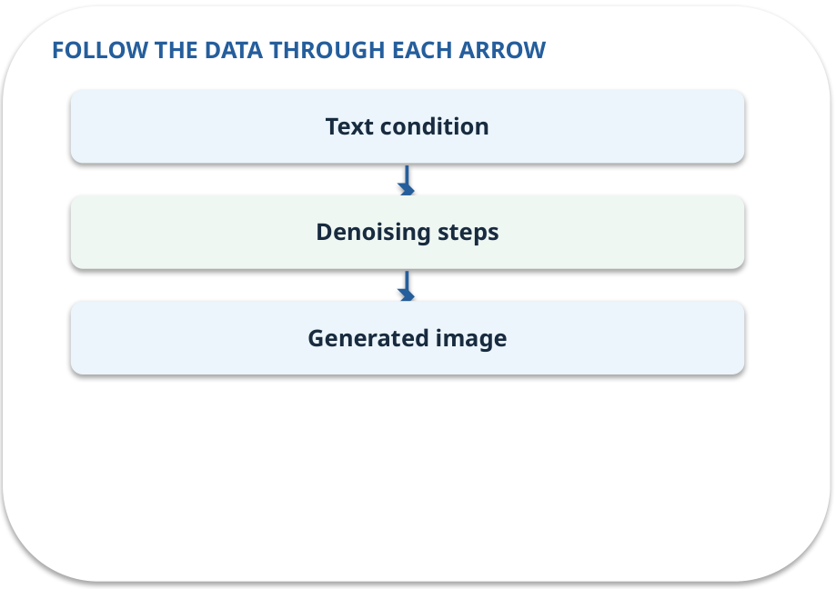
Conditioning · how it works
MECHANISM / WEEK 03
Text or other inputs can guide generation. The condition does not guarantee accurate details.
Trace the arrows from left to right.
GENERATIVE AI 2027 • WEEK 03 • 19 / 40
Notes:
TEACHER SCRIPT — MECHANISM. Trace every arrow slowly from the input to the output. Ask what information crosses the boundary at each arrow. Pause if students confuse a simplified notebook with a trained model. This week’s case is: A college needs a synthetic poster image while respecting consent and image rights. The visible slide states: Text or other inputs can guide generation. The condition does not guarantee accurate details.
Trace the arrows from left to right. The weekly example is: Use “blue campus poster” for both trials; compare date lettering and layout separately. State what the analogy does not explain: The brief does not guarantee that every requested detail appears correctly. The target is: Explain the denoising idea and judge an image with a consistent checklist. Listen for an explanation of the actual arrow or calculation, not just a repeated label. If the answer is unsupported, mark that uncertainty and return to the source. Before moving on, ask for the main idea and one concrete change to the worked example.

Slide 20
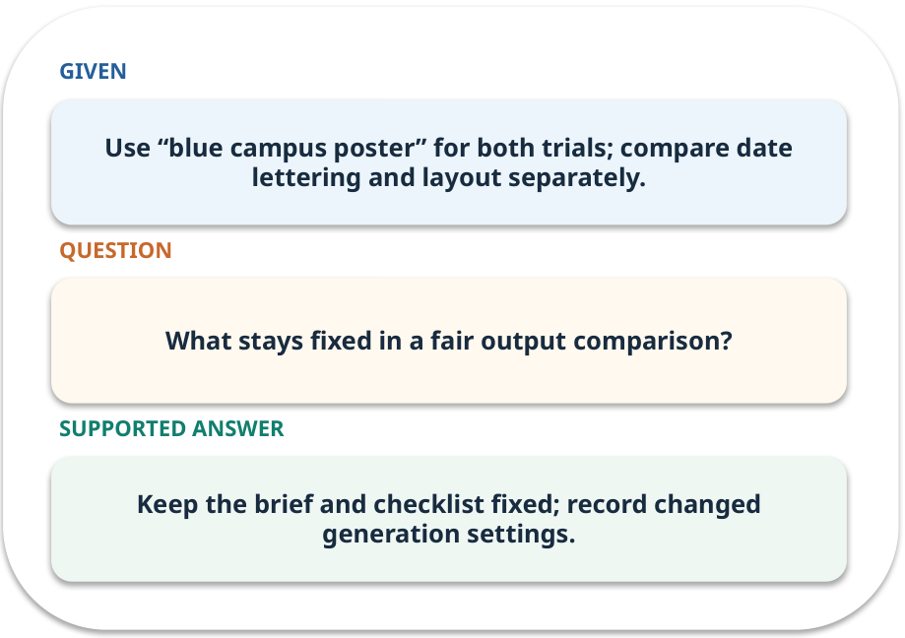
Conditioning · work one case
WORKED / WEEK 03
Use “blue campus poster” for both trials; compare date lettering and layout separately.
Point to the evidence before giving your conclusion.
GENERATIVE AI 2027 • WEEK 03 • 20 / 40
Notes:
TEACHER SCRIPT — WORKED. Work the specific numbers or source wording aloud. Give students thirty seconds to write a conclusion, then ask which source line or calculation supports it. This week’s case is: A college needs a synthetic poster image while respecting consent and image rights. The visible slide states: Use “blue campus poster” for both trials; compare date lettering and layout separately.
Point to the evidence before giving your conclusion. The expected reasoning concludes: Keep the brief and checklist fixed; record changed generation settings. Distinguish measured results from illustrative numbers. The target is: Explain the denoising idea and judge an image with a consistent checklist. Listen for an explanation of the actual arrow or calculation, not just a repeated label. If the answer is unsupported, mark that uncertainty and return to the source. Before moving on, ask for the main idea and one concrete change to the worked example.

Slide 21
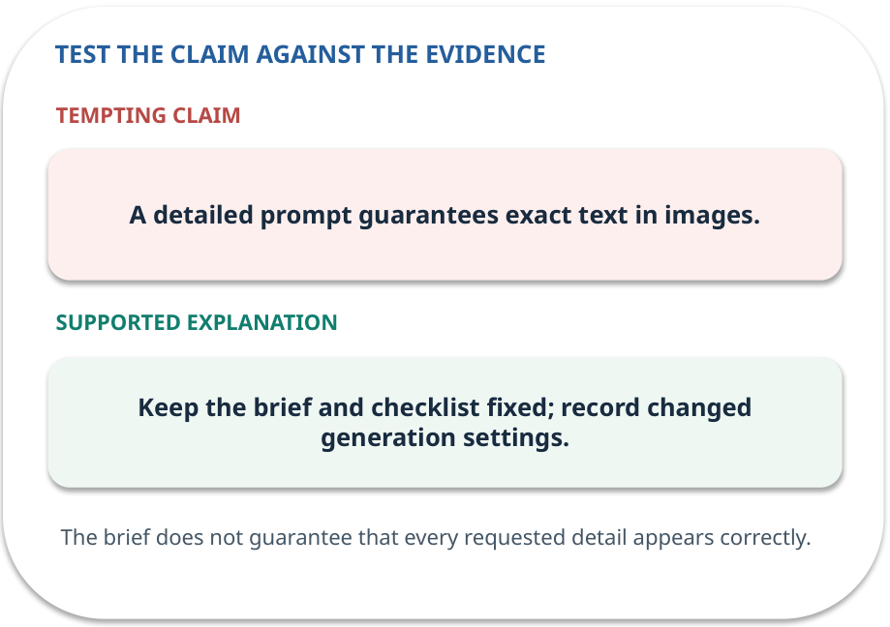
Conditioning · answer and explain
REVEAL / WEEK 03
Keep the brief and checklist fixed; record changed generation settings.
Tempting mistake: A detailed prompt guarantees exact text in images.
GENERATIVE AI 2027 • WEEK 03 • 21 / 40
Notes:
TEACHER SCRIPT — REVEAL. Return to the earlier choice. Explain the correct answer and why the tempting claim fails. Ask one learner to say the answer in a single sentence without reading it. This week’s case is: A college needs a synthetic poster image while respecting consent and image rights. The visible slide states: Keep the brief and checklist fixed; record changed generation settings.
Tempting mistake: A detailed prompt guarantees exact text in images. The earlier question was What stays fixed in a fair output comparison? Ask how this differs from the wrong claim. The target is: Explain the denoising idea and judge an image with a consistent checklist. Listen for an explanation of the actual arrow or calculation, not just a repeated label. If the answer is unsupported, mark that uncertainty and return to the source. Before moving on, ask for the main idea and one concrete change to the worked example.

Slide 22
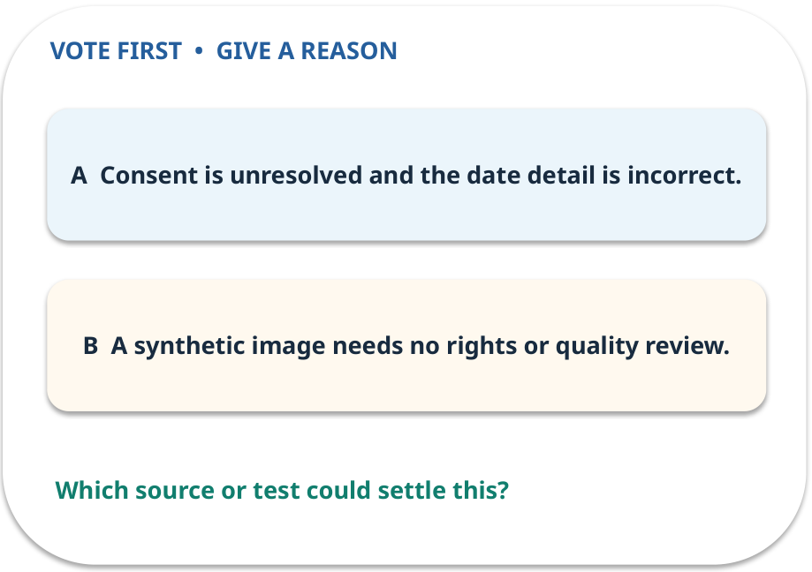
4. Predict · Image review
QUESTION / WEEK 03
What two reasons justify holding this image?
Make a choice before we explain the diagram.
GENERATIVE AI 2027 • WEEK 03 • 22 / 40
Notes:
TEACHER SCRIPT — QUESTION. Take a show of hands for each choice before showing the mechanism. Ask pairs to defend a choice with evidence. Save the strongest wrong reason for the reveal later in this cycle. This week’s case is: A college needs a synthetic poster image while respecting consent and image rights. The visible slide states: What two reasons justify holding this image?
Make a choice before we explain the diagram. The intended answer is Consent is unresolved and the date detail is incorrect. The tempting claim is A synthetic image needs no rights or quality review. Do not show which card is correct until the reveal. The target is: Explain the denoising idea and judge an image with a consistent checklist. Listen for an explanation of the actual arrow or calculation, not just a repeated label. If the answer is unsupported, mark that uncertainty and return to the source. Before moving on, ask for the main idea and one concrete change to the worked example.

Slide 23
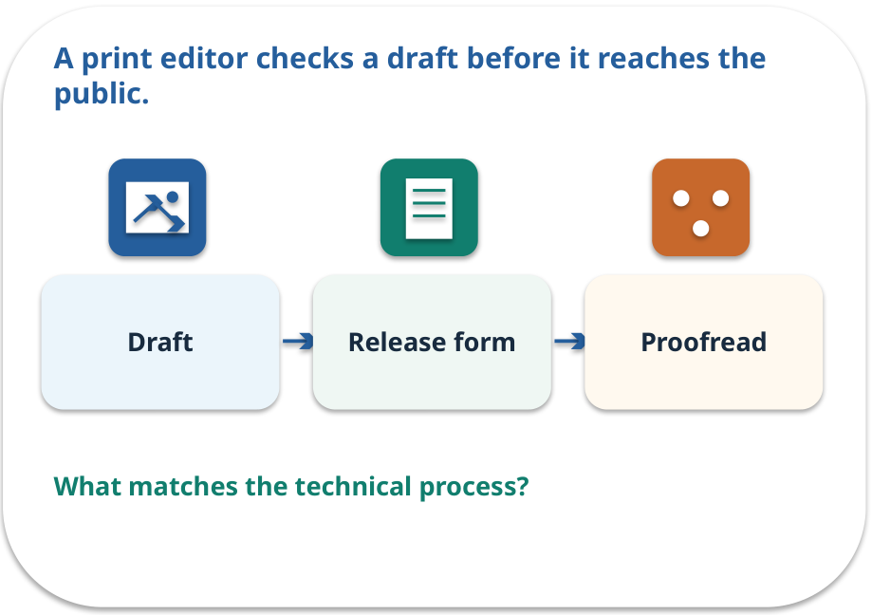
Image review · a familiar picture
ANALOGY / WEEK 03
A print editor checks a draft before it reaches the public.
What matches our case, and where does the analogy stop?
GENERATIVE AI 2027 • WEEK 03 • 23 / 40
Notes:
TEACHER SCRIPT — ANALOGY. Begin with the familiar scene. Invite learners to describe each part in everyday language. Then ask where the comparison might fail before introducing the technical vocabulary. This week’s case is: A college needs a synthetic poster image while respecting consent and image rights. The visible slide states: A print editor checks a draft before it reaches the public.
What matches our case, and where does the analogy stop? The boundary is: A release form cannot be inferred from pixels; ask for documented permission. The target is: Explain the denoising idea and judge an image with a consistent checklist. Listen for an explanation of the actual arrow or calculation, not just a repeated label. If the answer is unsupported, mark that uncertainty and return to the source. Before moving on, ask for the main idea and one concrete change to the worked example.

Slide 24
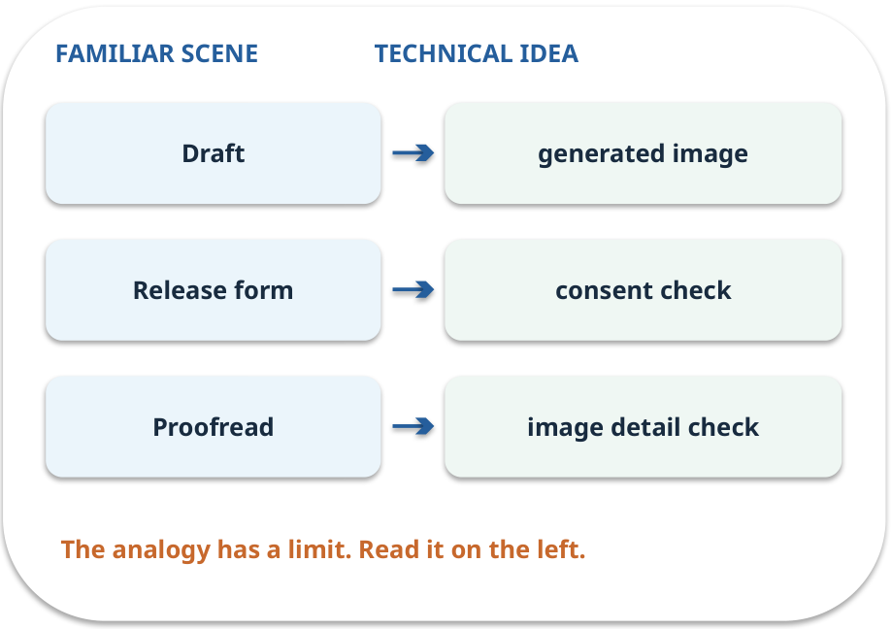
Image review · map the parts
MAPPING / WEEK 03
Match each everyday part to the technical part.
Analogy limit: A release form cannot be inferred from pixels; ask for documented permission.
GENERATIVE AI 2027 • WEEK 03 • 24 / 40
Notes:
TEACHER SCRIPT — MAPPING. Point from each familiar element to the corresponding technical element. Have students cover the right column and reconstruct the three matches. Read the limitation aloud. This week’s case is: A college needs a synthetic poster image while respecting consent and image rights. The visible slide states: Match each everyday part to the technical part.
Analogy limit: A release form cannot be inferred from pixels; ask for documented permission. The three precise mappings are [['Draft', 'generated image'], ['Release form', 'consent check'], ['Proofread', 'image detail check']]. The target is: Explain the denoising idea and judge an image with a consistent checklist. Listen for an explanation of the actual arrow or calculation, not just a repeated label. If the answer is unsupported, mark that uncertainty and return to the source. Before moving on, ask for the main idea and one concrete change to the worked example.

Slide 25
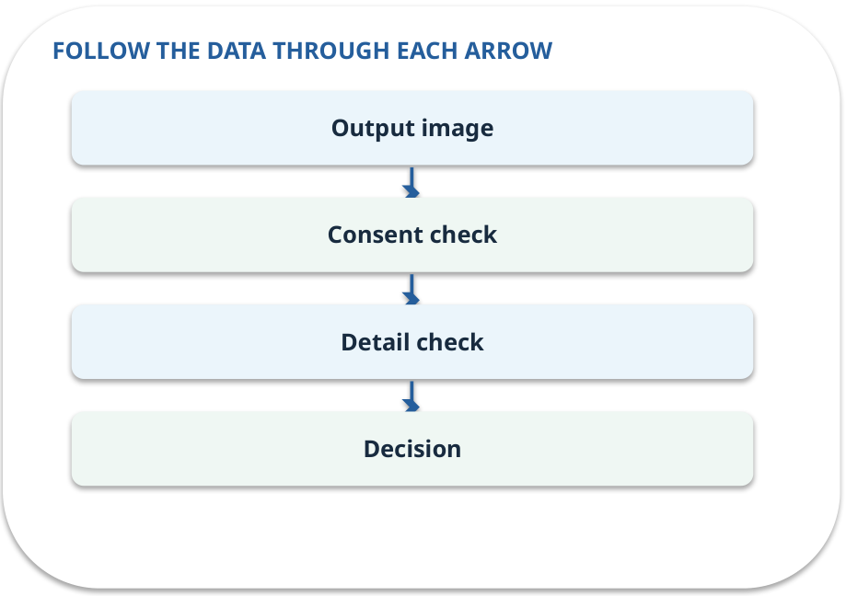
Image review · how it works
MECHANISM / WEEK 03
Check whether text, people, permissions and task-specific details meet the brief.
Trace the arrows from left to right.
GENERATIVE AI 2027 • WEEK 03 • 25 / 40
Notes:
TEACHER SCRIPT — MECHANISM. Trace every arrow slowly from the input to the output. Ask what information crosses the boundary at each arrow. Pause if students confuse a simplified notebook with a trained model. This week’s case is: A college needs a synthetic poster image while respecting consent and image rights. The visible slide states: Check whether text, people, permissions and task-specific details meet the brief.
Trace the arrows from left to right. The weekly example is: The poster is attractive, but a face resembles a classmate and the date is wrong: hold publication. State what the analogy does not explain: A release form cannot be inferred from pixels; ask for documented permission. The target is: Explain the denoising idea and judge an image with a consistent checklist. Listen for an explanation of the actual arrow or calculation, not just a repeated label. If the answer is unsupported, mark that uncertainty and return to the source. Before moving on, ask for the main idea and one concrete change to the worked example.

Slide 26
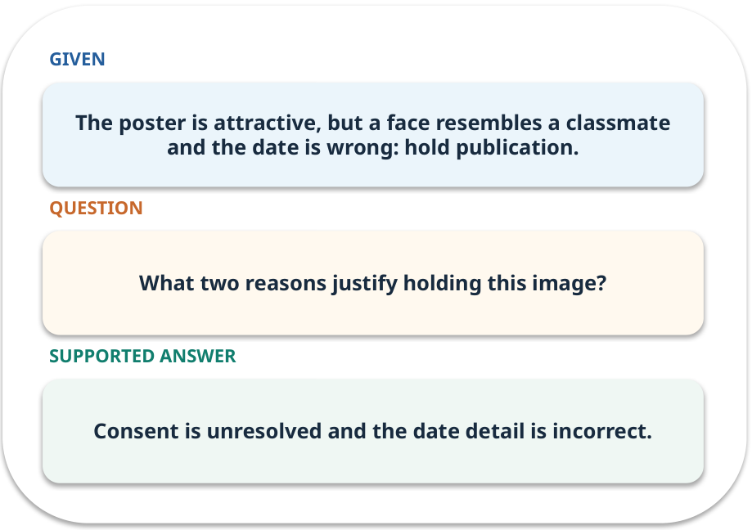
Image review · work one case
WORKED / WEEK 03
The poster is attractive, but a face resembles a classmate and the date is wrong: hold publication.
Point to the evidence before giving your conclusion.
GENERATIVE AI 2027 • WEEK 03 • 26 / 40
Notes:
TEACHER SCRIPT — WORKED. Work the specific numbers or source wording aloud. Give students thirty seconds to write a conclusion, then ask which source line or calculation supports it. This week’s case is: A college needs a synthetic poster image while respecting consent and image rights. The visible slide states: The poster is attractive, but a face resembles a classmate and the date is wrong: hold publication.
Point to the evidence before giving your conclusion. The expected reasoning concludes: Consent is unresolved and the date detail is incorrect. Distinguish measured results from illustrative numbers. The target is: Explain the denoising idea and judge an image with a consistent checklist. Listen for an explanation of the actual arrow or calculation, not just a repeated label. If the answer is unsupported, mark that uncertainty and return to the source. Before moving on, ask for the main idea and one concrete change to the worked example.

Slide 27
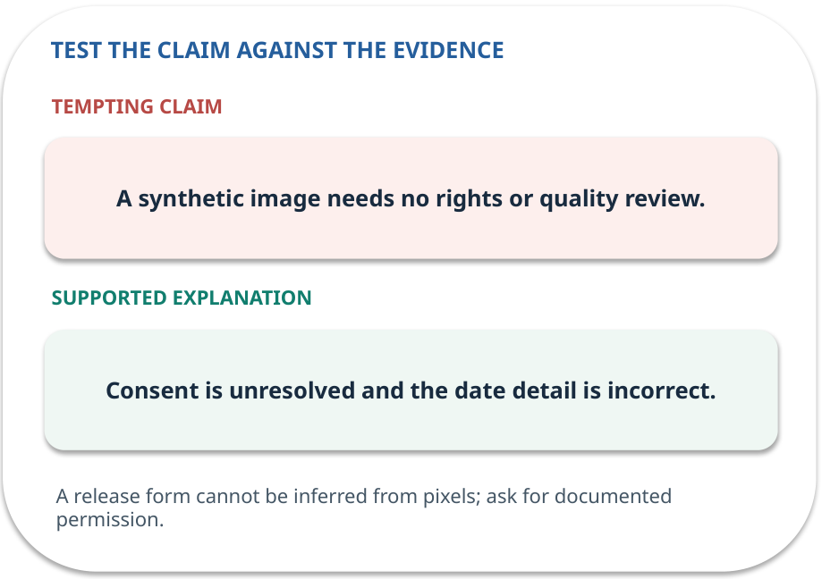
Image review · answer and explain
REVEAL / WEEK 03
Consent is unresolved and the date detail is incorrect.
Tempting mistake: A synthetic image needs no rights or quality review.
GENERATIVE AI 2027 • WEEK 03 • 27 / 40
Notes:
TEACHER SCRIPT — REVEAL. Return to the earlier choice. Explain the correct answer and why the tempting claim fails. Ask one learner to say the answer in a single sentence without reading it. This week’s case is: A college needs a synthetic poster image while respecting consent and image rights. The visible slide states: Consent is unresolved and the date detail is incorrect.
Tempting mistake: A synthetic image needs no rights or quality review. The earlier question was What two reasons justify holding this image? Ask how this differs from the wrong claim. The target is: Explain the denoising idea and judge an image with a consistent checklist. Listen for an explanation of the actual arrow or calculation, not just a repeated label. If the answer is unsupported, mark that uncertainty and return to the source. Before moving on, ask for the main idea and one concrete change to the worked example.

Slide 28
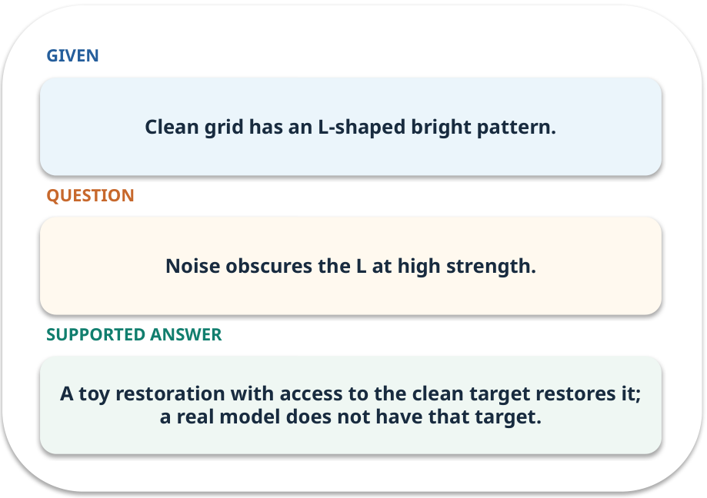
Evidence trail: input → result
WORKED / WEEK 03
Noise obscures the L at high strength.
A toy restoration with access to the clean target restores it; a real model does not have that target.
GENERATIVE AI 2027 • WEEK 03 • 28 / 40
Notes:
TEACHER SCRIPT — WORKED. Work the specific numbers or source wording aloud. Give students thirty seconds to write a conclusion, then ask which source line or calculation supports it. This week’s case is: A college needs a synthetic poster image while respecting consent and image rights. The visible slide states: Noise obscures the L at high strength.
A toy restoration with access to the clean target restores it; a real model does not have that target. Have one student point to an exact source word or number for each conclusion. The target is: Explain the denoising idea and judge an image with a consistent checklist. Listen for an explanation of the actual arrow or calculation, not just a repeated label. If the answer is unsupported, mark that uncertainty and return to the source. Before moving on, ask for the main idea and one concrete change to the worked example.

Slide 29
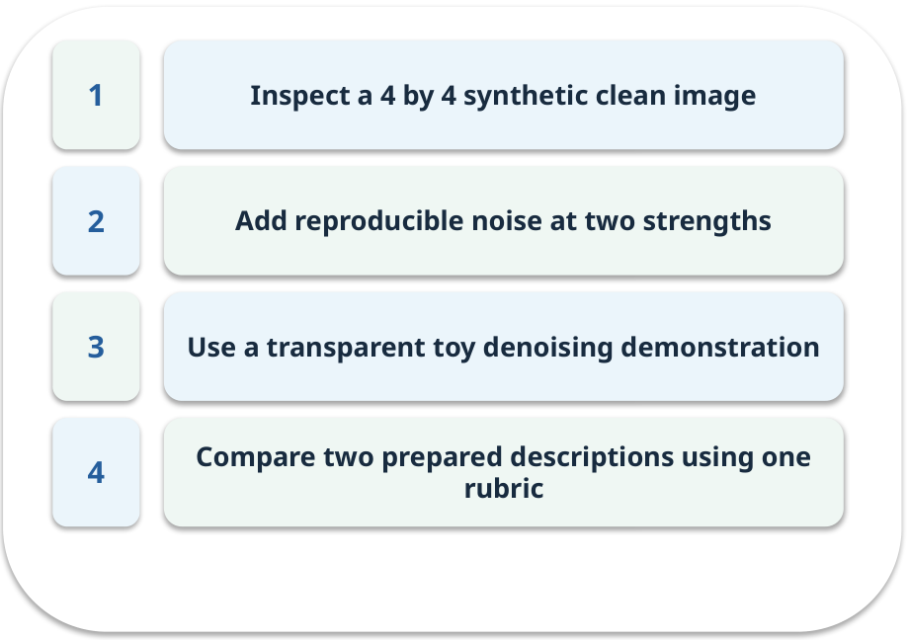
Notebook: run the prepared example
PRACTICE / WEEK 03
Run a denoising illustration and a consent checklist.
Read the original output before editing.
GENERATIVE AI 2027 • WEEK 03 • 29 / 40
Notes:
TEACHER SCRIPT — PRACTICE. Open the matching notebook and demonstrate the first run. Have learners predict one change, run only that change, and record input, setting, output and an error explanation. This week’s case is: A college needs a synthetic poster image while respecting consent and image rights. The visible slide states: Run a denoising illustration and a consent checklist.
Read the original output before editing. Use Week_03_Lab.ipynb. This lab is a prepared classroom demonstration with its limitations documented. The target is: Explain the denoising idea and judge an image with a consistent checklist. Listen for an explanation of the actual arrow or calculation, not just a repeated label. If the answer is unsupported, mark that uncertainty and return to the source. Before moving on, ask for the main idea and one concrete change to the worked example.

Slide 30

Find the input and check in Python
PRACTICE / WEEK 03
Locate the supplied input, the transformation, the checking line and the printed result.
GENERATIVE AI 2027 • WEEK 03 • 30 / 40
Notes:
TEACHER SCRIPT — PRACTICE. Open the matching notebook and demonstrate the first run. Have learners predict one change, run only that change, and record input, setting, output and an error explanation. This week’s case is: A college needs a synthetic poster image while respecting consent and image rights. The visible slide states: Locate the supplied input, the transformation, the checking line and the printed result. The weekly lab change is: Increase noise strength from 0.15 to 0.45 and compare measured error. The target is: Explain the denoising idea and judge an image with a consistent checklist. Listen for an explanation of the actual arrow or calculation, not just a repeated label. If the answer is unsupported, mark that uncertainty and return to the source. Before moving on, ask for the main idea and one concrete change to the worked example.

Slide 31

Predict one controlled change
PRACTICE / WEEK 03
Increase noise strength from 0.15 to 0.45 and compare measured error.
What should change in the result? What stays fixed?
GENERATIVE AI 2027 • WEEK 03 • 31 / 40
Notes:
TEACHER SCRIPT — PRACTICE. Open the matching notebook and demonstrate the first run. Have learners predict one change, run only that change, and record input, setting, output and an error explanation. This week’s case is: A college needs a synthetic poster image while respecting consent and image rights. The visible slide states: Increase noise strength from 0.15 to 0.45 and compare measured error.
What should change in the result? What stays fixed? Ask learners to write their prediction before rerunning the cell. The target is: Explain the denoising idea and judge an image with a consistent checklist. Listen for an explanation of the actual arrow or calculation, not just a repeated label. If the answer is unsupported, mark that uncertainty and return to the source. Before moving on, ask for the main idea and one concrete change to the worked example.

Slide 32

Run, compare and record
PRACTICE / WEEK 03
Record the input, the one changed setting, the observed result and a reason for any difference.
GENERATIVE AI 2027 • WEEK 03 • 32 / 40
Notes:
TEACHER SCRIPT — PRACTICE. Open the matching notebook and demonstrate the first run. Have learners predict one change, run only that change, and record input, setting, output and an error explanation. This week’s case is: A college needs a synthetic poster image while respecting consent and image rights. The visible slide states: Record the input, the one changed setting, the observed result and a reason for any difference. The required evidence is: Step comparison and three task-specific image observations. The target is: Explain the denoising idea and judge an image with a consistent checklist. Listen for an explanation of the actual arrow or calculation, not just a repeated label. If the answer is unsupported, mark that uncertainty and return to the source. Before moving on, ask for the main idea and one concrete change to the worked example.

Slide 33

Measure without hiding the denominator
CHECK / WEEK 03
Mean absolute pixel error; plus a human quality checklist
Write the numerator, denominator and one failure case.
GENERATIVE AI 2027 • WEEK 03 • 33 / 40
Notes:
TEACHER SCRIPT — CHECK. Use this as a brief formative check. Ask for the conclusion, the evidence and one limitation. Revisit disagreements in the review session and offer an extension only after the core task. This week’s case is: A college needs a synthetic poster image while respecting consent and image rights. The visible slide states: Mean absolute pixel error; plus a human quality checklist
Write the numerator, denominator and one failure case. Where a measure is qualitative, show the concrete source comparison. Example: A toy restoration with access to the clean target restores it; a real model does not have that target. The target is: Explain the denoising idea and judge an image with a consistent checklist. Listen for an explanation of the actual arrow or calculation, not just a repeated label. If the answer is unsupported, mark that uncertainty and return to the source. Before moving on, ask for the main idea and one concrete change to the worked example.

Slide 34
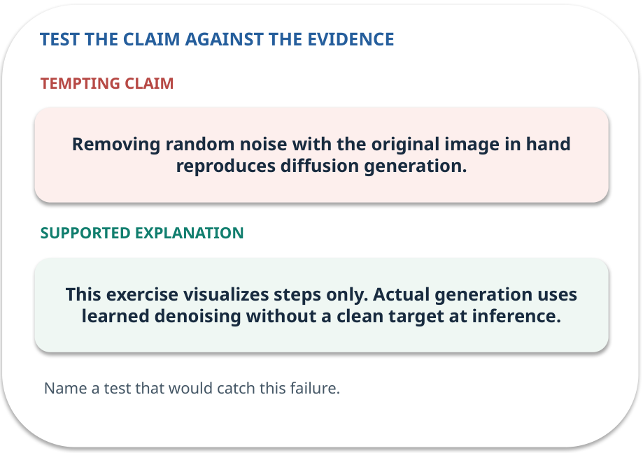
Error detective: find the layer
CHECK / WEEK 03
Plausible wrong claim: Removing random noise with the original image in hand reproduces diffusion generation.
Correct it using the case evidence.
GENERATIVE AI 2027 • WEEK 03 • 34 / 40
Notes:
TEACHER SCRIPT — CHECK. Use this as a brief formative check. Ask for the conclusion, the evidence and one limitation. Revisit disagreements in the review session and offer an extension only after the core task. This week’s case is: A college needs a synthetic poster image while respecting consent and image rights. The visible slide states: Plausible wrong claim: Removing random noise with the original image in hand reproduces diffusion generation.
Correct it using the case evidence. The correction is This exercise visualizes steps only. Actual generation uses learned denoising without a clean target at inference. The target is: Explain the denoising idea and judge an image with a consistent checklist. Listen for an explanation of the actual arrow or calculation, not just a repeated label. If the answer is unsupported, mark that uncertainty and return to the source. Before moving on, ask for the main idea and one concrete change to the worked example.

Slide 35

Transfer to a new situation
CHECK / WEEK 03
A poster has readable-looking text that spells the event date incorrectly. Which check catches the error?
Explain which source or test would settle it.
GENERATIVE AI 2027 • WEEK 03 • 35 / 40
Notes:
TEACHER SCRIPT — CHECK. Use this as a brief formative check. Ask for the conclusion, the evidence and one limitation. Revisit disagreements in the review session and offer an extension only after the core task. This week’s case is: A college needs a synthetic poster image while respecting consent and image rights. The visible slide states: A poster has readable-looking text that spells the event date incorrectly. Which check catches the error?
Explain which source or test would settle it. This is a fresh scenario, so ask for a reason before accepting either short answer. The target is: Explain the denoising idea and judge an image with a consistent checklist. Listen for an explanation of the actual arrow or calculation, not just a repeated label. If the answer is unsupported, mark that uncertainty and return to the source. Before moving on, ask for the main idea and one concrete change to the worked example.

Slide 36
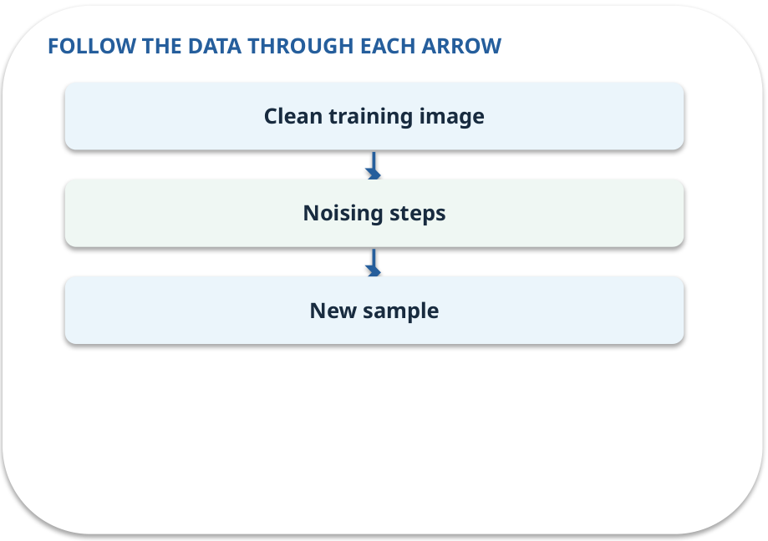
Explain it to a partner
CHECK / WEEK 03
Without reading the slide, name the input, one processing step and the check. Your partner should ask “How do you know?”
GENERATIVE AI 2027 • WEEK 03 • 36 / 40
Notes:
TEACHER SCRIPT — CHECK. Use this as a brief formative check. Ask for the conclusion, the evidence and one limitation. Revisit disagreements in the review session and offer an extension only after the core task. This week’s case is: A college needs a synthetic poster image while respecting consent and image rights. The visible slide states: Without reading the slide, name the input, one processing step and the check. Your partner should ask “How do you know?” Listen for a causal explanation and one limitation, then revisit a difficult arrow on the board. The target is: Explain the denoising idea and judge an image with a consistent checklist. Listen for an explanation of the actual arrow or calculation, not just a repeated label. If the answer is unsupported, mark that uncertainty and return to the source. Before moving on, ask for the main idea and one concrete change to the worked example.

Slide 37

Exam rehearsal · explain and apply
CHECK / WEEK 03
Distinguish noising during training from denoising during generation.
Write a short answer, then compare with the guide.
GENERATIVE AI 2027 • WEEK 03 • 37 / 40
Notes:
TEACHER SCRIPT — CHECK. Use this as a brief formative check. Ask for the conclusion, the evidence and one limitation. Revisit disagreements in the review session and offer an extension only after the core task. This week’s case is: A college needs a synthetic poster image while respecting consent and image rights. The visible slide states: Distinguish noising during training from denoising during generation.
Write a short answer, then compare with the guide. Model answer after discussion: Training creates corrupted examples and learns a reverse prediction. Generation applies learned reverse steps to a noise sample. Practice marks: 4. The target is: Explain the denoising idea and judge an image with a consistent checklist. Listen for an explanation of the actual arrow or calculation, not just a repeated label. If the answer is unsupported, mark that uncertainty and return to the source. Before moving on, ask for the main idea and one concrete change to the worked example.

Slide 38
Exam rehearsal · explain and apply
CHECK / WEEK 03
Does conditioning guarantee the requested text will be correct?
Write a short answer, then compare with the guide.
GENERATIVE AI 2027 • WEEK 03 • 38 / 40
Notes:
TEACHER SCRIPT — CHECK. Use this as a brief formative check. Ask for the conclusion, the evidence and one limitation. Revisit disagreements in the review session and offer an extension only after the core task. This week’s case is: A college needs a synthetic poster image while respecting consent and image rights. The visible slide states: Does conditioning guarantee the requested text will be correct?
Write a short answer, then compare with the guide. Model answer after discussion: No. The condition guides generation; the resulting image still needs inspection. Practice marks: 4. The target is: Explain the denoising idea and judge an image with a consistent checklist. Listen for an explanation of the actual arrow or calculation, not just a repeated label. If the answer is unsupported, mark that uncertainty and return to the source. Before moving on, ask for the main idea and one concrete change to the worked example.

Slide 39

What to hand in
PRACTICE / WEEK 03
Step comparison and three task-specific image observations.
Include the one changed input and an error explanation.
GENERATIVE AI 2027 • WEEK 03 • 39 / 40
Notes:
TEACHER SCRIPT — PRACTICE. Open the matching notebook and demonstrate the first run. Have learners predict one change, run only that change, and record input, setting, output and an error explanation. This week’s case is: A college needs a synthetic poster image while respecting consent and image rights. The visible slide states: Step comparison and three task-specific image observations.
Include the one changed input and an error explanation. This weekly evidence receives formative feedback according to the module sequence; refer to the assessment brief for graded work. The target is: Explain the denoising idea and judge an image with a consistent checklist. Listen for an explanation of the actual arrow or calculation, not just a repeated label. If the answer is unsupported, mark that uncertainty and return to the source. Before moving on, ask for the main idea and one concrete change to the worked example.

Slide 40
Three ideas to recall next week
CHECK / WEEK 03
Noise becomes an image through repeated learned denoising; check consent and details.
Read the linked official sources in the Word guide and redraw one diagram from memory.
GENERATIVE AI 2027 • WEEK 03 • 40 / 40
Notes:
TEACHER SCRIPT — CHECK. Use this as a brief formative check. Ask for the conclusion, the evidence and one limitation. Revisit disagreements in the review session and offer an extension only after the core task. This week’s case is: A college needs a synthetic poster image while respecting consent and image rights. The visible slide states: Noise becomes an image through repeated learned denoising; check consent and details.
Read the linked official sources in the Word guide and redraw one diagram from memory. Return to the opening vote and ask whether the evidence changed anyone’s mind. The next week builds on this outcome: Explain the denoising idea and judge an image with a consistent checklist. The target is: Explain the denoising idea and judge an image with a consistent checklist. Listen for an explanation of the actual arrow or calculation, not just a repeated label. If the answer is unsupported, mark that uncertainty and return to the source. Before moving on, ask for the main idea and one concrete change to the worked example.

