Slide 1
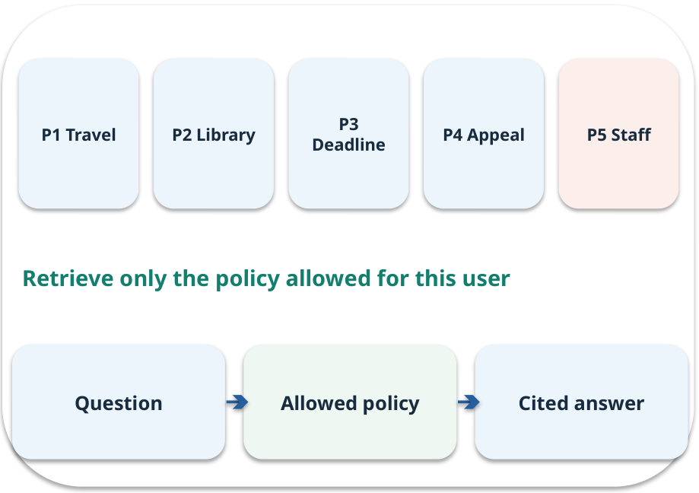
Week 06 · Finding useful information
OPEN / WEEK 06
The library-renewal search
A learner asks “Can I renew my book?” Policy P2 says “library loans may be extended once.” Which passage should search find?
GENERATIVE AI 2027 • WEEK 06 • 01 / 40
Notes:
TEACHER SCRIPT — OPEN. Show the visual for ten seconds, then ask for an initial decision. Do not reveal the answer yet. Ask a student to name the source or measurement that would change their mind. This week’s case is: Five fictional college policies must answer student questions. The visible slide states: The library-renewal search
A learner asks “Can I renew my book?” Policy P2 says “library loans may be extended once.” Which passage should search find? Reveal that the case will be revisited after four short concept cycles. The target is: Compare search strategies while preserving source and access information. Listen for an explanation of the actual arrow or calculation, not just a repeated label. If the answer is unsupported, mark that uncertainty and return to the source. Before moving on, ask for the main idea and one concrete change to the worked example.

Slide 2

First vote: what would you do?
QUESTION / WEEK 06
A learner asks “Can I renew my book?” Policy P2 says “library loans may be extended once.” Which passage should search find?
Choose an initial answer and name one piece of evidence you need.
GENERATIVE AI 2027 • WEEK 06 • 02 / 40
Notes:
TEACHER SCRIPT — QUESTION. Take a show of hands for each choice before showing the mechanism. Ask pairs to defend a choice with evidence. Save the strongest wrong reason for the reveal later in this cycle. This week’s case is: Five fictional college policies must answer student questions. The visible slide states: A learner asks “Can I renew my book?” Policy P2 says “library loans may be extended once.” Which passage should search find?
Choose an initial answer and name one piece of evidence you need. Accept reasonable uncertainty; record the initial votes to revisit at the end. The target is: Compare search strategies while preserving source and access information. Listen for an explanation of the actual arrow or calculation, not just a repeated label. If the answer is unsupported, mark that uncertainty and return to the source. Before moving on, ask for the main idea and one concrete change to the worked example.

Slide 3
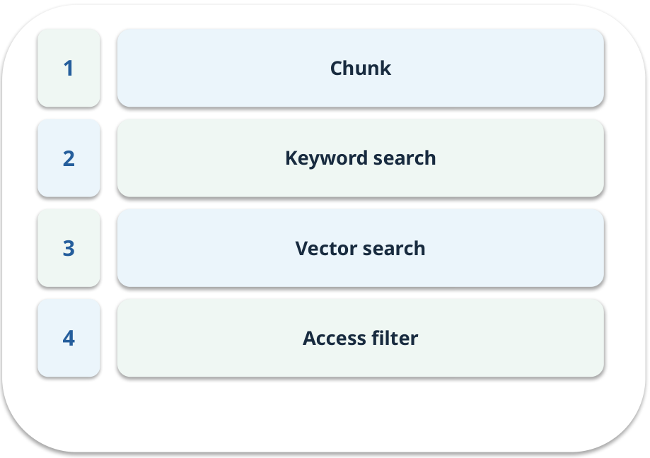
The journey through today’s case
OPEN / WEEK 06
We will predict, connect an analogy, trace a mechanism, work an example, then explain a decision.
GENERATIVE AI 2027 • WEEK 06 • 03 / 40
Notes:
TEACHER SCRIPT — OPEN. Show the visual for ten seconds, then ask for an initial decision. Do not reveal the answer yet. Ask a student to name the source or measurement that would change their mind. This week’s case is: Five fictional college policies must answer student questions. The visible slide states: We will predict, connect an analogy, trace a mechanism, work an example, then explain a decision. Point to the four named ideas, then show where the notebook experiment fits. The target is: Compare search strategies while preserving source and access information. Listen for an explanation of the actual arrow or calculation, not just a repeated label. If the answer is unsupported, mark that uncertainty and return to the source. Before moving on, ask for the main idea and one concrete change to the worked example.

Slide 4
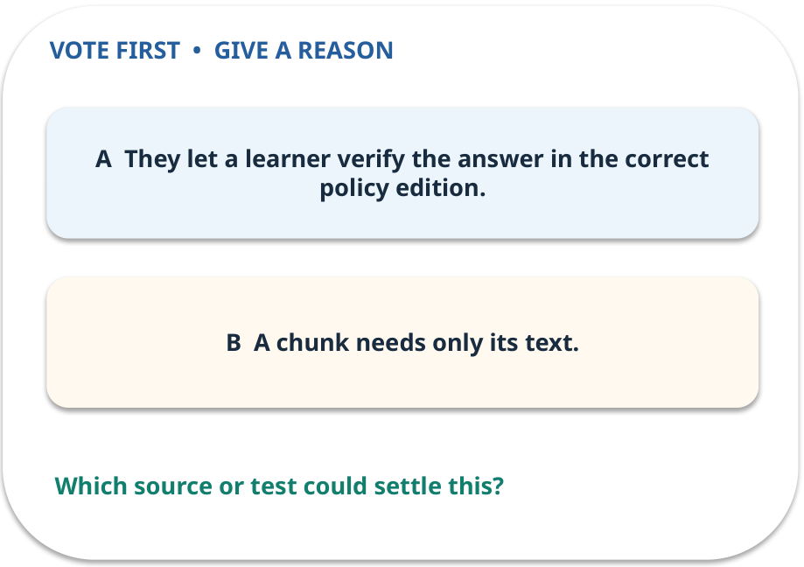
1. Predict · Chunk
QUESTION / WEEK 06
Why preserve the source ID and version?
Make a choice before we explain the diagram.
GENERATIVE AI 2027 • WEEK 06 • 04 / 40
Notes:
TEACHER SCRIPT — QUESTION. Take a show of hands for each choice before showing the mechanism. Ask pairs to defend a choice with evidence. Save the strongest wrong reason for the reveal later in this cycle. This week’s case is: Five fictional college policies must answer student questions. The visible slide states: Why preserve the source ID and version?
Make a choice before we explain the diagram. The intended answer is They let a learner verify the answer in the correct policy edition. The tempting claim is A chunk needs only its text. Do not show which card is correct until the reveal. The target is: Compare search strategies while preserving source and access information. Listen for an explanation of the actual arrow or calculation, not just a repeated label. If the answer is unsupported, mark that uncertainty and return to the source. Before moving on, ask for the main idea and one concrete change to the worked example.

Slide 5
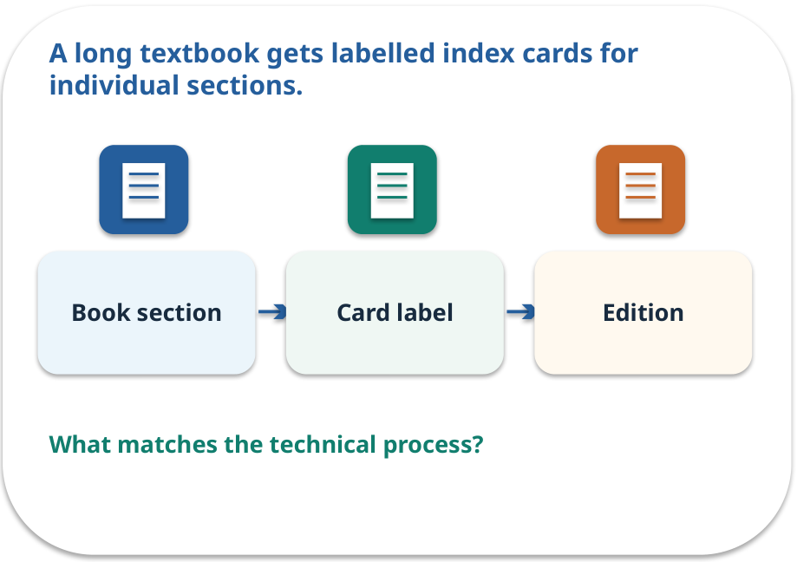
Chunk · a familiar picture
ANALOGY / WEEK 06
A long textbook gets labelled index cards for individual sections.
What matches our case, and where does the analogy stop?
GENERATIVE AI 2027 • WEEK 06 • 05 / 40
Notes:
TEACHER SCRIPT — ANALOGY. Begin with the familiar scene. Invite learners to describe each part in everyday language. Then ask where the comparison might fail before introducing the technical vocabulary. This week’s case is: Five fictional college policies must answer student questions. The visible slide states: A long textbook gets labelled index cards for individual sections.
What matches our case, and where does the analogy stop? The boundary is: Cutting at arbitrary length can separate a condition from its rule. The target is: Compare search strategies while preserving source and access information. Listen for an explanation of the actual arrow or calculation, not just a repeated label. If the answer is unsupported, mark that uncertainty and return to the source. Before moving on, ask for the main idea and one concrete change to the worked example.

Slide 6
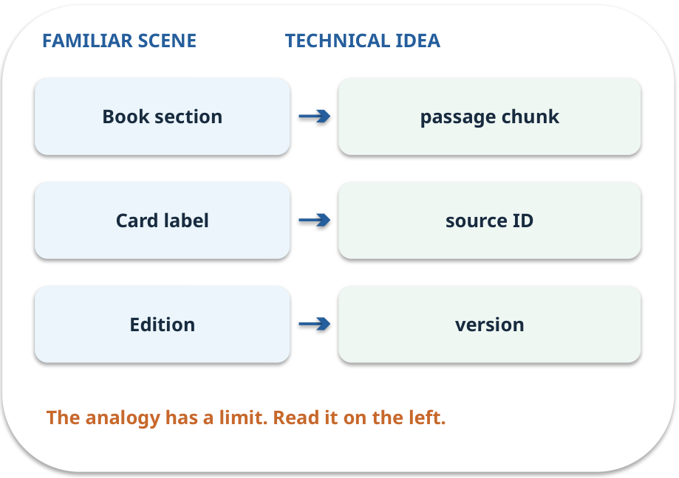
Chunk · map the parts
MAPPING / WEEK 06
Match each everyday part to the technical part.
Analogy limit: Cutting at arbitrary length can separate a condition from its rule.
GENERATIVE AI 2027 • WEEK 06 • 06 / 40
Notes:
TEACHER SCRIPT — MAPPING. Point from each familiar element to the corresponding technical element. Have students cover the right column and reconstruct the three matches. Read the limitation aloud. This week’s case is: Five fictional college policies must answer student questions. The visible slide states: Match each everyday part to the technical part.
Analogy limit: Cutting at arbitrary length can separate a condition from its rule. The three precise mappings are [['Book section', 'passage chunk'], ['Card label', 'source ID'], ['Edition', 'version']]. The target is: Compare search strategies while preserving source and access information. Listen for an explanation of the actual arrow or calculation, not just a repeated label. If the answer is unsupported, mark that uncertainty and return to the source. Before moving on, ask for the main idea and one concrete change to the worked example.

Slide 7
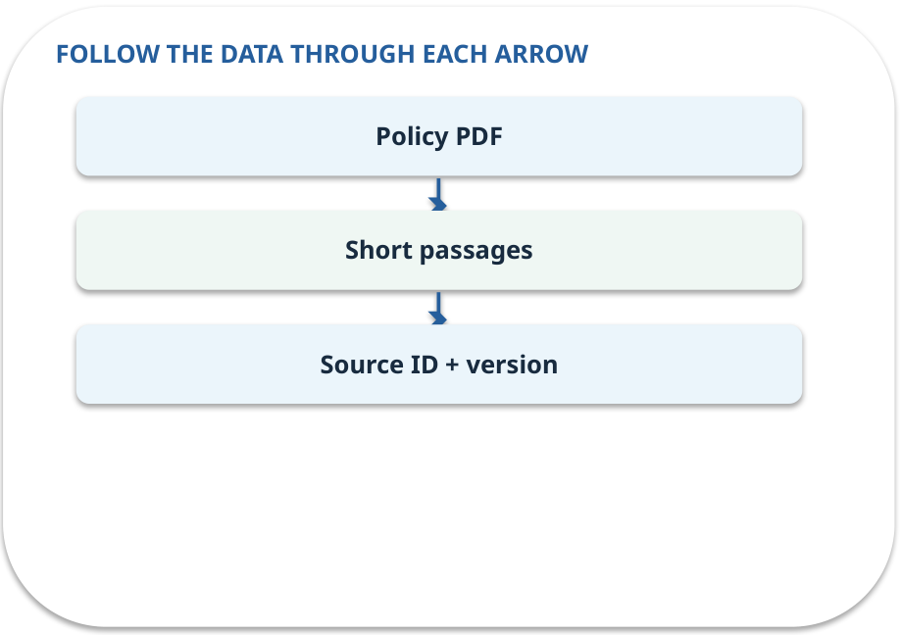
Chunk · how it works
MECHANISM / WEEK 06
A short passage from a larger source; keep its document ID and version.
Trace the arrows from left to right.
GENERATIVE AI 2027 • WEEK 06 • 07 / 40
Notes:
TEACHER SCRIPT — MECHANISM. Trace every arrow slowly from the input to the output. Ask what information crosses the boundary at each arrow. Pause if students confuse a simplified notebook with a trained model. This week’s case is: Five fictional college policies must answer student questions. The visible slide states: A short passage from a larger source; keep its document ID and version.
Trace the arrows from left to right. The weekly example is: P2 becomes a short passage with ID P2 and version; keep “once” in the same passage. State what the analogy does not explain: Cutting at arbitrary length can separate a condition from its rule. The target is: Compare search strategies while preserving source and access information. Listen for an explanation of the actual arrow or calculation, not just a repeated label. If the answer is unsupported, mark that uncertainty and return to the source. Before moving on, ask for the main idea and one concrete change to the worked example.

Slide 8
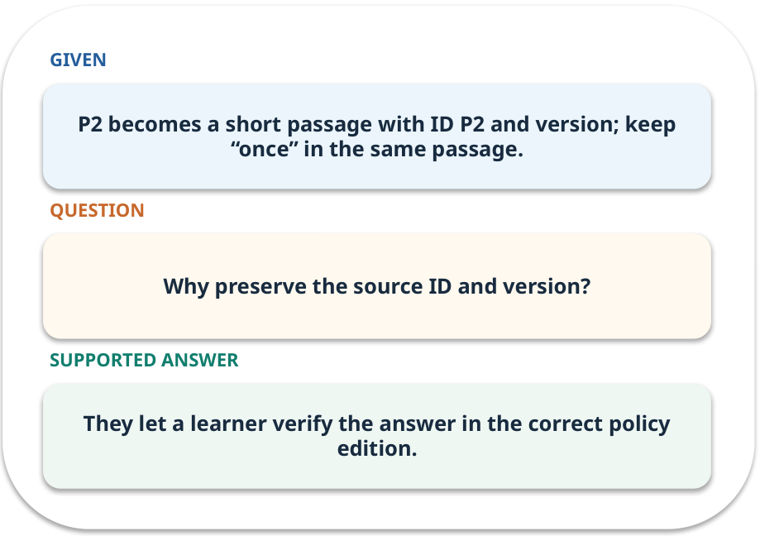
Chunk · work one case
WORKED / WEEK 06
P2 becomes a short passage with ID P2 and version; keep “once” in the same passage.
Point to the evidence before giving your conclusion.
GENERATIVE AI 2027 • WEEK 06 • 08 / 40
Notes:
TEACHER SCRIPT — WORKED. Work the specific numbers or source wording aloud. Give students thirty seconds to write a conclusion, then ask which source line or calculation supports it. This week’s case is: Five fictional college policies must answer student questions. The visible slide states: P2 becomes a short passage with ID P2 and version; keep “once” in the same passage.
Point to the evidence before giving your conclusion. The expected reasoning concludes: They let a learner verify the answer in the correct policy edition. Distinguish measured results from illustrative numbers. The target is: Compare search strategies while preserving source and access information. Listen for an explanation of the actual arrow or calculation, not just a repeated label. If the answer is unsupported, mark that uncertainty and return to the source. Before moving on, ask for the main idea and one concrete change to the worked example.

Slide 9
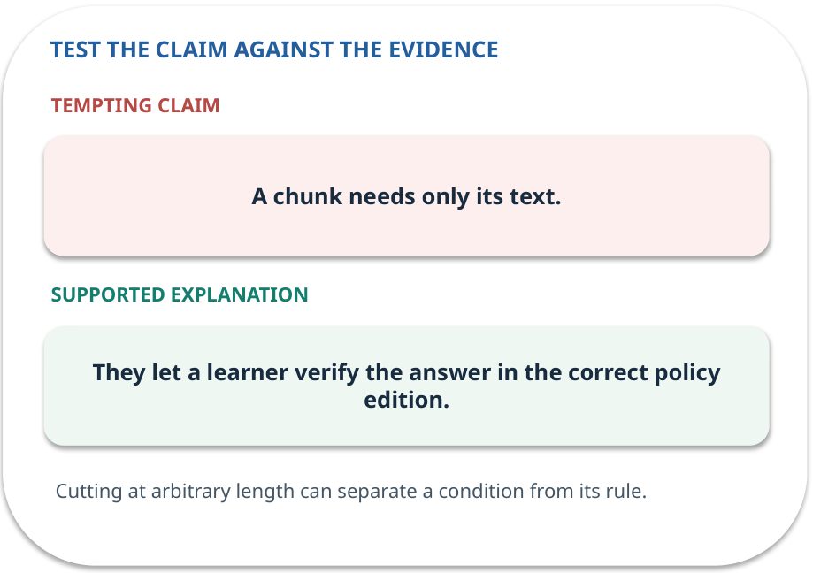
Chunk · answer and explain
REVEAL / WEEK 06
They let a learner verify the answer in the correct policy edition.
Tempting mistake: A chunk needs only its text.
GENERATIVE AI 2027 • WEEK 06 • 09 / 40
Notes:
TEACHER SCRIPT — REVEAL. Return to the earlier choice. Explain the correct answer and why the tempting claim fails. Ask one learner to say the answer in a single sentence without reading it. This week’s case is: Five fictional college policies must answer student questions. The visible slide states: They let a learner verify the answer in the correct policy edition.
Tempting mistake: A chunk needs only its text. The earlier question was Why preserve the source ID and version? Ask how this differs from the wrong claim. The target is: Compare search strategies while preserving source and access information. Listen for an explanation of the actual arrow or calculation, not just a repeated label. If the answer is unsupported, mark that uncertainty and return to the source. Before moving on, ask for the main idea and one concrete change to the worked example.

Slide 10
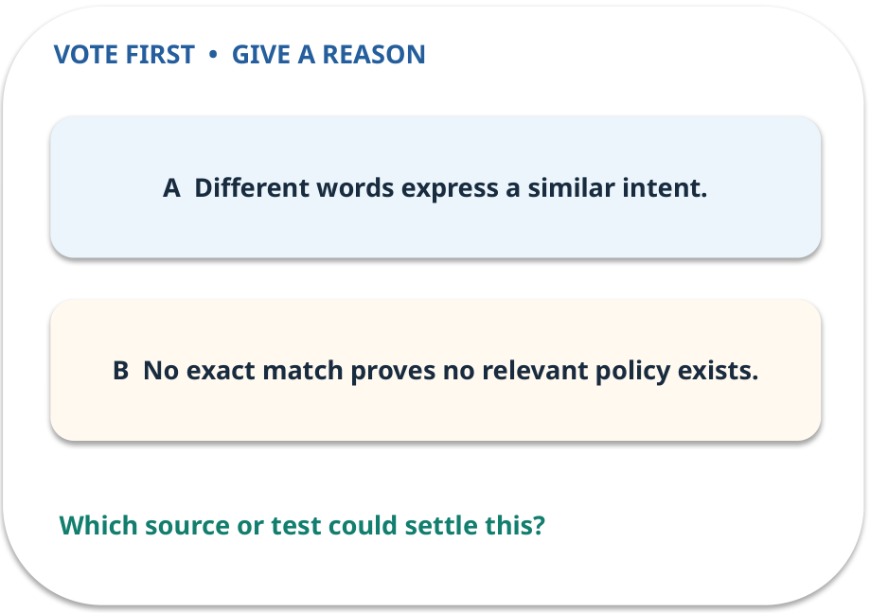
2. Predict · Keyword search
QUESTION / WEEK 06
What explains this miss?
Make a choice before we explain the diagram.
GENERATIVE AI 2027 • WEEK 06 • 10 / 40
Notes:
TEACHER SCRIPT — QUESTION. Take a show of hands for each choice before showing the mechanism. Ask pairs to defend a choice with evidence. Save the strongest wrong reason for the reveal later in this cycle. This week’s case is: Five fictional college policies must answer student questions. The visible slide states: What explains this miss?
Make a choice before we explain the diagram. The intended answer is Different words express a similar intent. The tempting claim is No exact match proves no relevant policy exists. Do not show which card is correct until the reveal. The target is: Compare search strategies while preserving source and access information. Listen for an explanation of the actual arrow or calculation, not just a repeated label. If the answer is unsupported, mark that uncertainty and return to the source. Before moving on, ask for the main idea and one concrete change to the worked example.

Slide 11
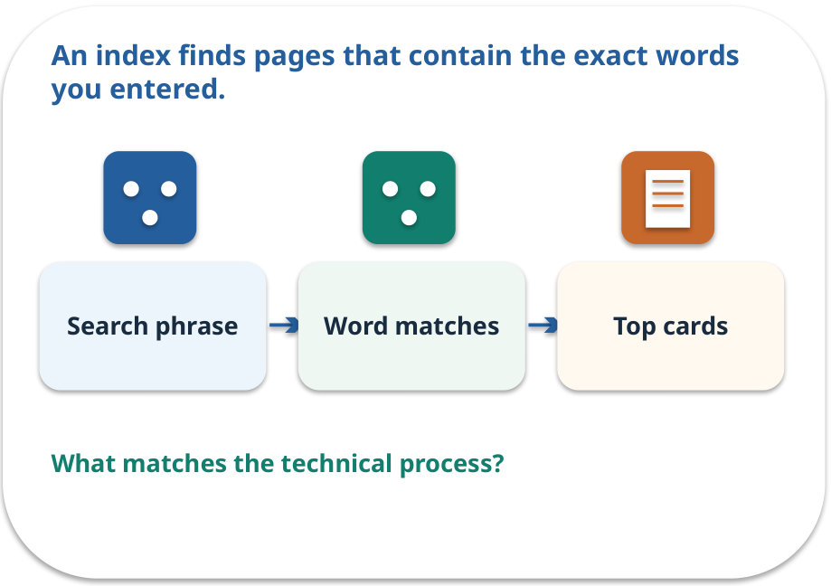
Keyword search · a familiar picture
ANALOGY / WEEK 06
An index finds pages that contain the exact words you entered.
What matches our case, and where does the analogy stop?
GENERATIVE AI 2027 • WEEK 06 • 11 / 40
Notes:
TEACHER SCRIPT — ANALOGY. Begin with the familiar scene. Invite learners to describe each part in everyday language. Then ask where the comparison might fail before introducing the technical vocabulary. This week’s case is: Five fictional college policies must answer student questions. The visible slide states: An index finds pages that contain the exact words you entered.
What matches our case, and where does the analogy stop? The boundary is: Synonyms can make a relevant passage score poorly. The target is: Compare search strategies while preserving source and access information. Listen for an explanation of the actual arrow or calculation, not just a repeated label. If the answer is unsupported, mark that uncertainty and return to the source. Before moving on, ask for the main idea and one concrete change to the worked example.

Slide 12
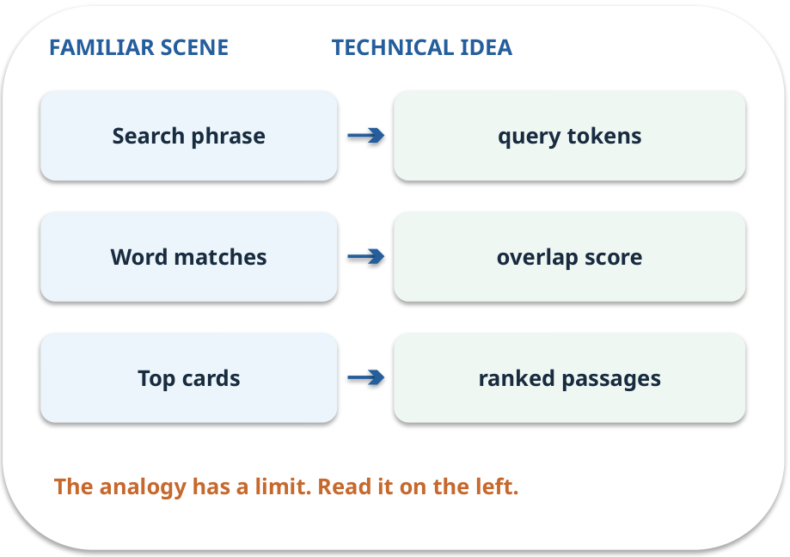
Keyword search · map the parts
MAPPING / WEEK 06
Match each everyday part to the technical part.
Analogy limit: Synonyms can make a relevant passage score poorly.
GENERATIVE AI 2027 • WEEK 06 • 12 / 40
Notes:
TEACHER SCRIPT — MAPPING. Point from each familiar element to the corresponding technical element. Have students cover the right column and reconstruct the three matches. Read the limitation aloud. This week’s case is: Five fictional college policies must answer student questions. The visible slide states: Match each everyday part to the technical part.
Analogy limit: Synonyms can make a relevant passage score poorly. The three precise mappings are [['Search phrase', 'query tokens'], ['Word matches', 'overlap score'], ['Top cards', 'ranked passages']]. The target is: Compare search strategies while preserving source and access information. Listen for an explanation of the actual arrow or calculation, not just a repeated label. If the answer is unsupported, mark that uncertainty and return to the source. Before moving on, ask for the main idea and one concrete change to the worked example.

Slide 13
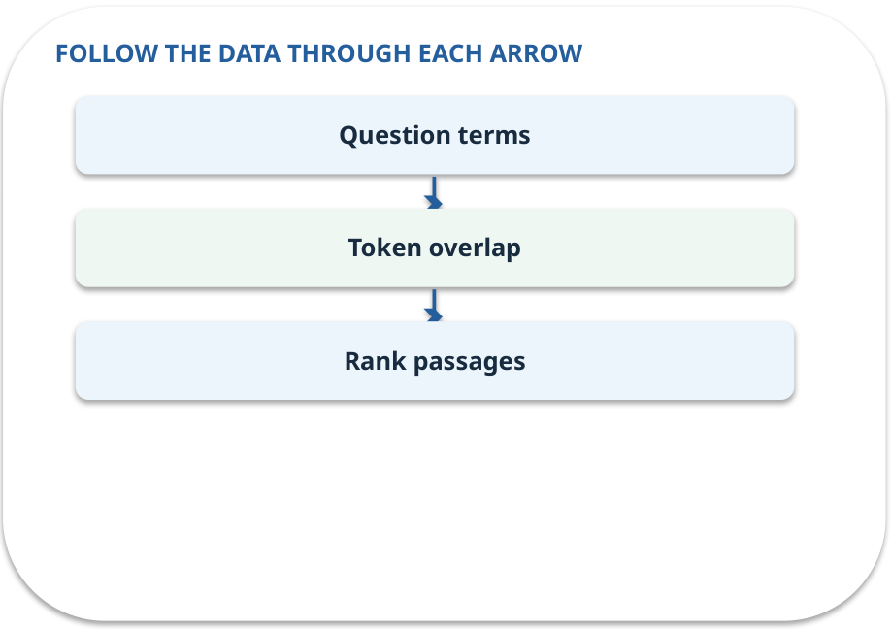
Keyword search · how it works
MECHANISM / WEEK 06
Matches terms in a query and passage; useful when wording overlaps.
Trace the arrows from left to right.
GENERATIVE AI 2027 • WEEK 06 • 13 / 40
Notes:
TEACHER SCRIPT — MECHANISM. Trace every arrow slowly from the input to the output. Ask what information crosses the boundary at each arrow. Pause if students confuse a simplified notebook with a trained model. This week’s case is: Five fictional college policies must answer student questions. The visible slide states: Matches terms in a query and passage; useful when wording overlaps.
Trace the arrows from left to right. The weekly example is: “renew” does not exactly match P2’s “extend”; a keyword-only search may miss it. State what the analogy does not explain: Synonyms can make a relevant passage score poorly. The target is: Compare search strategies while preserving source and access information. Listen for an explanation of the actual arrow or calculation, not just a repeated label. If the answer is unsupported, mark that uncertainty and return to the source. Before moving on, ask for the main idea and one concrete change to the worked example.

Slide 14
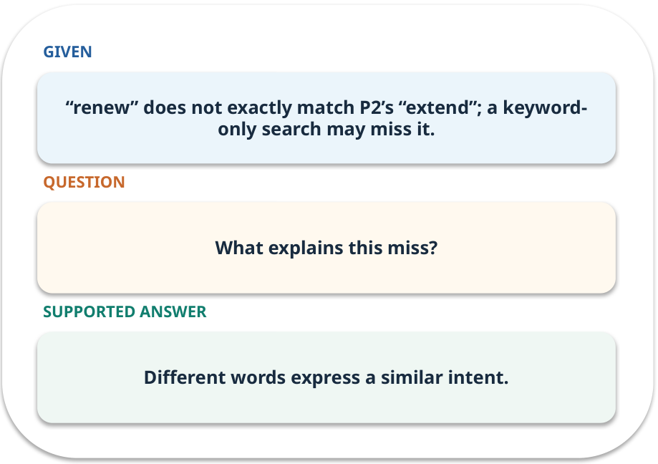
Keyword search · work one case
WORKED / WEEK 06
“renew” does not exactly match P2’s “extend”; a keyword-only search may miss it.
Point to the evidence before giving your conclusion.
GENERATIVE AI 2027 • WEEK 06 • 14 / 40
Notes:
TEACHER SCRIPT — WORKED. Work the specific numbers or source wording aloud. Give students thirty seconds to write a conclusion, then ask which source line or calculation supports it. This week’s case is: Five fictional college policies must answer student questions. The visible slide states: “renew” does not exactly match P2’s “extend”; a keyword-only search may miss it.
Point to the evidence before giving your conclusion. The expected reasoning concludes: Different words express a similar intent. Distinguish measured results from illustrative numbers. The target is: Compare search strategies while preserving source and access information. Listen for an explanation of the actual arrow or calculation, not just a repeated label. If the answer is unsupported, mark that uncertainty and return to the source. Before moving on, ask for the main idea and one concrete change to the worked example.

Slide 15
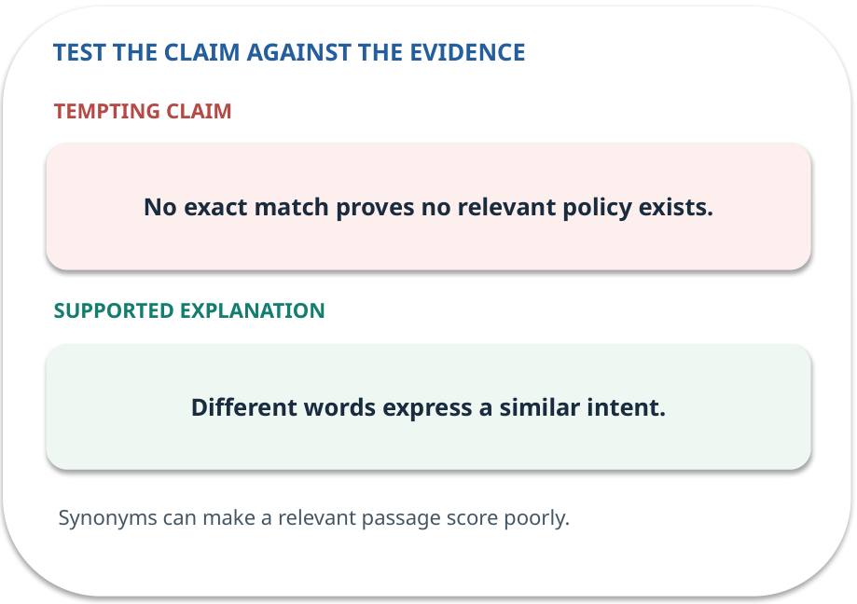
Keyword search · answer and explain
REVEAL / WEEK 06
Different words express a similar intent.
Tempting mistake: No exact match proves no relevant policy exists.
GENERATIVE AI 2027 • WEEK 06 • 15 / 40
Notes:
TEACHER SCRIPT — REVEAL. Return to the earlier choice. Explain the correct answer and why the tempting claim fails. Ask one learner to say the answer in a single sentence without reading it. This week’s case is: Five fictional college policies must answer student questions. The visible slide states: Different words express a similar intent.
Tempting mistake: No exact match proves no relevant policy exists. The earlier question was What explains this miss? Ask how this differs from the wrong claim. The target is: Compare search strategies while preserving source and access information. Listen for an explanation of the actual arrow or calculation, not just a repeated label. If the answer is unsupported, mark that uncertainty and return to the source. Before moving on, ask for the main idea and one concrete change to the worked example.

Slide 16
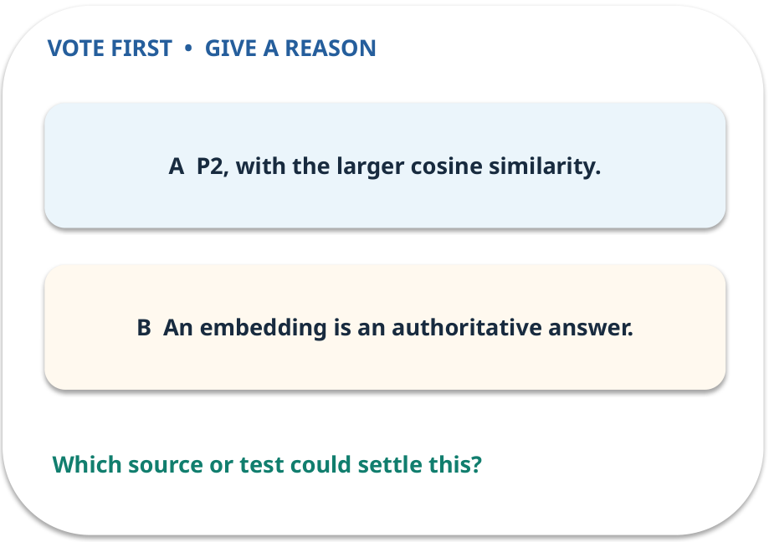
3. Predict · Vector search
QUESTION / WEEK 06
Which passage ranks nearer to q in this toy calculation?
Make a choice before we explain the diagram.
GENERATIVE AI 2027 • WEEK 06 • 16 / 40
Notes:
TEACHER SCRIPT — QUESTION. Take a show of hands for each choice before showing the mechanism. Ask pairs to defend a choice with evidence. Save the strongest wrong reason for the reveal later in this cycle. This week’s case is: Five fictional college policies must answer student questions. The visible slide states: Which passage ranks nearer to q in this toy calculation?
Make a choice before we explain the diagram. The intended answer is P2, with the larger cosine similarity. The tempting claim is An embedding is an authoritative answer. Do not show which card is correct until the reveal. The target is: Compare search strategies while preserving source and access information. Listen for an explanation of the actual arrow or calculation, not just a repeated label. If the answer is unsupported, mark that uncertainty and return to the source. Before moving on, ask for the main idea and one concrete change to the worked example.

Slide 17
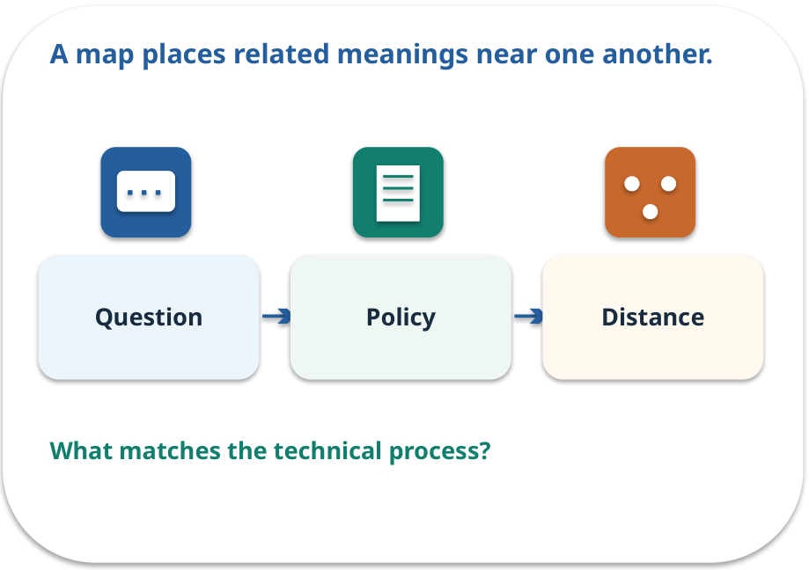
Vector search · a familiar picture
ANALOGY / WEEK 06
A map places related meanings near one another.
What matches our case, and where does the analogy stop?
GENERATIVE AI 2027 • WEEK 06 • 17 / 40
Notes:
TEACHER SCRIPT — ANALOGY. Begin with the familiar scene. Invite learners to describe each part in everyday language. Then ask where the comparison might fail before introducing the technical vocabulary. This week’s case is: Five fictional college policies must answer student questions. The visible slide states: A map places related meanings near one another.
What matches our case, and where does the analogy stop? The boundary is: Similar vectors can retrieve the wrong passage; check text and permissions. The target is: Compare search strategies while preserving source and access information. Listen for an explanation of the actual arrow or calculation, not just a repeated label. If the answer is unsupported, mark that uncertainty and return to the source. Before moving on, ask for the main idea and one concrete change to the worked example.

Slide 18
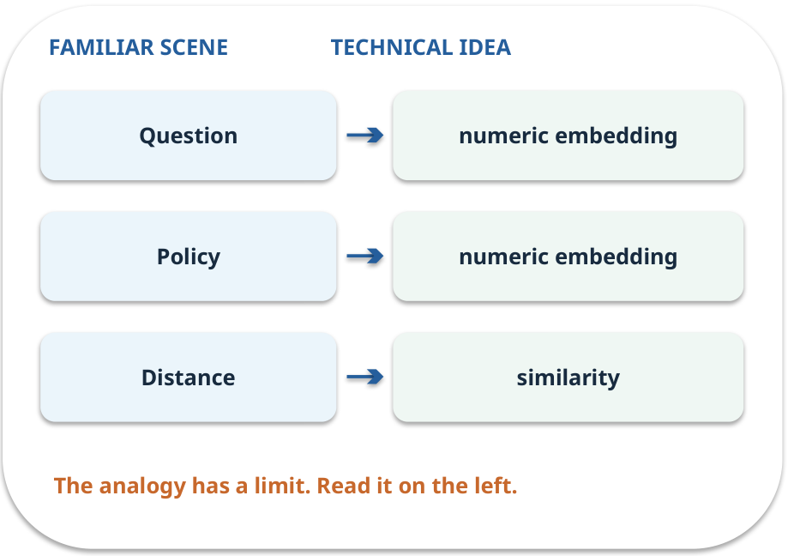
Vector search · map the parts
MAPPING / WEEK 06
Match each everyday part to the technical part.
Analogy limit: Similar vectors can retrieve the wrong passage; check text and permissions.
GENERATIVE AI 2027 • WEEK 06 • 18 / 40
Notes:
TEACHER SCRIPT — MAPPING. Point from each familiar element to the corresponding technical element. Have students cover the right column and reconstruct the three matches. Read the limitation aloud. This week’s case is: Five fictional college policies must answer student questions. The visible slide states: Match each everyday part to the technical part.
Analogy limit: Similar vectors can retrieve the wrong passage; check text and permissions. The three precise mappings are [['Question', 'numeric embedding'], ['Policy', 'numeric embedding'], ['Distance', 'similarity']]. The target is: Compare search strategies while preserving source and access information. Listen for an explanation of the actual arrow or calculation, not just a repeated label. If the answer is unsupported, mark that uncertainty and return to the source. Before moving on, ask for the main idea and one concrete change to the worked example.

Slide 19
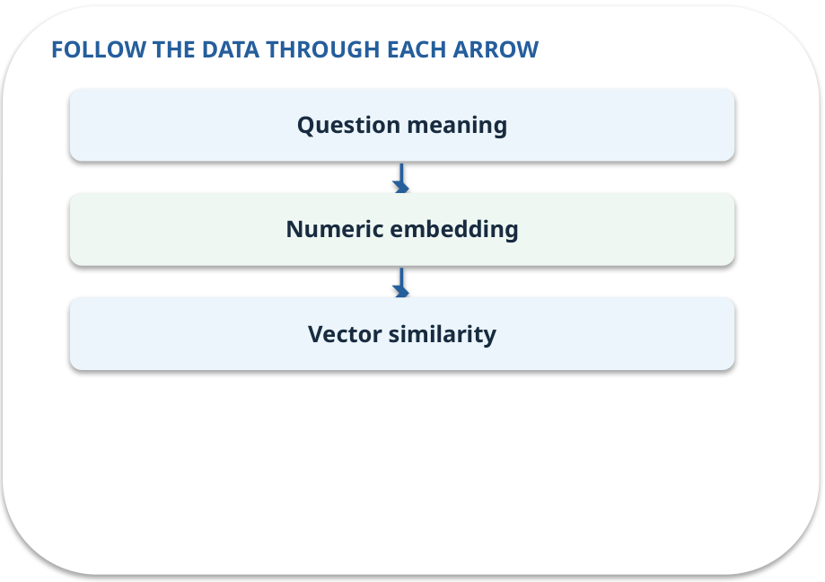
Vector search · how it works
MECHANISM / WEEK 06
Compares numerical representations of text; a production embedding model can capture semantic similarity.
Trace the arrows from left to right.
GENERATIVE AI 2027 • WEEK 06 • 19 / 40
Notes:
TEACHER SCRIPT — MECHANISM. Trace every arrow slowly from the input to the output. Ask what information crosses the boundary at each arrow. Pause if students confuse a simplified notebook with a trained model. This week’s case is: Five fictional college policies must answer student questions. The visible slide states: Compares numerical representations of text; a production embedding model can capture semantic similarity.
Trace the arrows from left to right. The weekly example is: Toy vectors q=[1,0], P2=[1,1], P3=[0,1]: cosine scores about .707 and 0. State what the analogy does not explain: Similar vectors can retrieve the wrong passage; check text and permissions. The target is: Compare search strategies while preserving source and access information. Listen for an explanation of the actual arrow or calculation, not just a repeated label. If the answer is unsupported, mark that uncertainty and return to the source. Before moving on, ask for the main idea and one concrete change to the worked example.

Slide 20
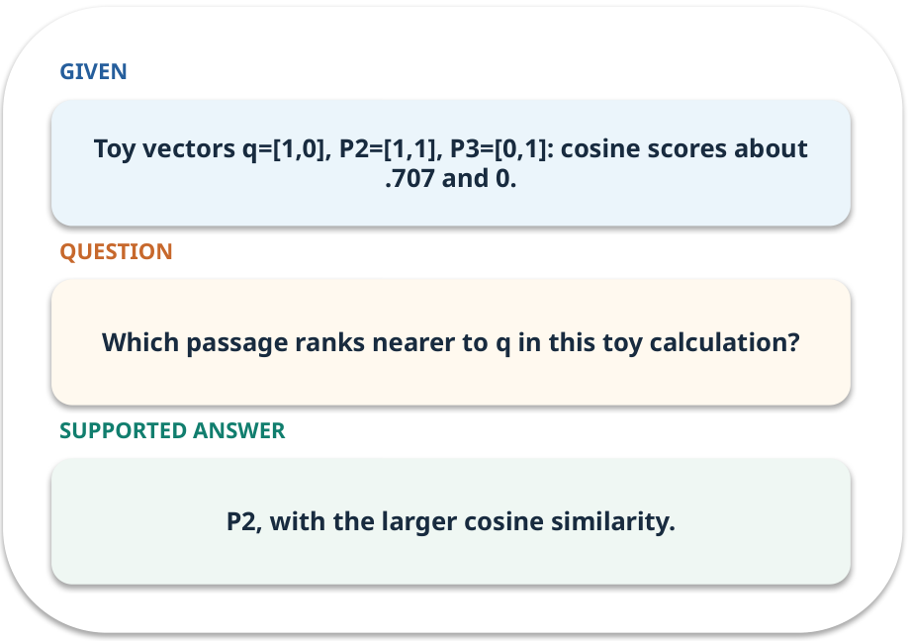
Vector search · work one case
WORKED / WEEK 06
Toy vectors q=[1,0], P2=[1,1], P3=[0,1]: cosine scores about .707 and 0.
Point to the evidence before giving your conclusion.
GENERATIVE AI 2027 • WEEK 06 • 20 / 40
Notes:
TEACHER SCRIPT — WORKED. Work the specific numbers or source wording aloud. Give students thirty seconds to write a conclusion, then ask which source line or calculation supports it. This week’s case is: Five fictional college policies must answer student questions. The visible slide states: Toy vectors q=[1,0], P2=[1,1], P3=[0,1]: cosine scores about .707 and 0.
Point to the evidence before giving your conclusion. The expected reasoning concludes: P2, with the larger cosine similarity. Distinguish measured results from illustrative numbers. The target is: Compare search strategies while preserving source and access information. Listen for an explanation of the actual arrow or calculation, not just a repeated label. If the answer is unsupported, mark that uncertainty and return to the source. Before moving on, ask for the main idea and one concrete change to the worked example.

Slide 21
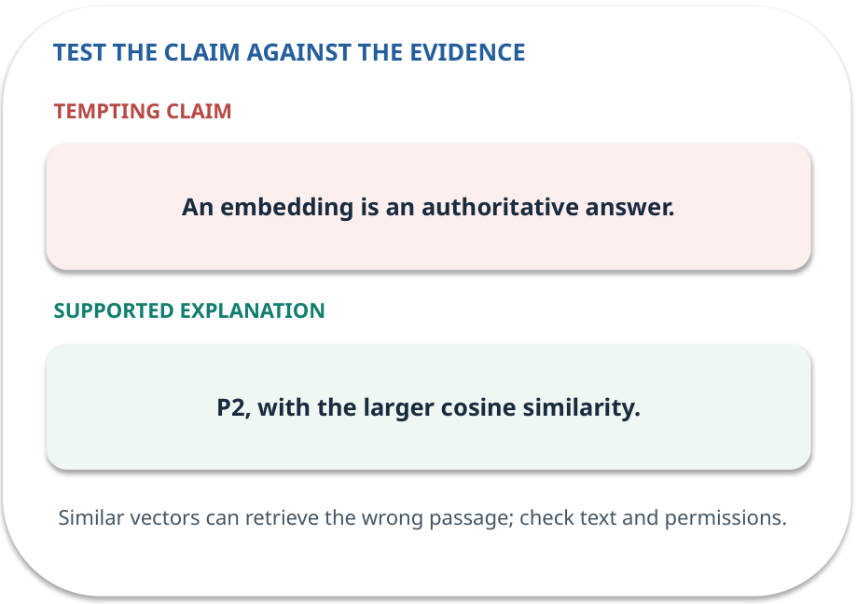
Vector search · answer and explain
REVEAL / WEEK 06
P2, with the larger cosine similarity.
Tempting mistake: An embedding is an authoritative answer.
GENERATIVE AI 2027 • WEEK 06 • 21 / 40
Notes:
TEACHER SCRIPT — REVEAL. Return to the earlier choice. Explain the correct answer and why the tempting claim fails. Ask one learner to say the answer in a single sentence without reading it. This week’s case is: Five fictional college policies must answer student questions. The visible slide states: P2, with the larger cosine similarity.
Tempting mistake: An embedding is an authoritative answer. The earlier question was Which passage ranks nearer to q in this toy calculation? Ask how this differs from the wrong claim. The target is: Compare search strategies while preserving source and access information. Listen for an explanation of the actual arrow or calculation, not just a repeated label. If the answer is unsupported, mark that uncertainty and return to the source. Before moving on, ask for the main idea and one concrete change to the worked example.

Slide 22
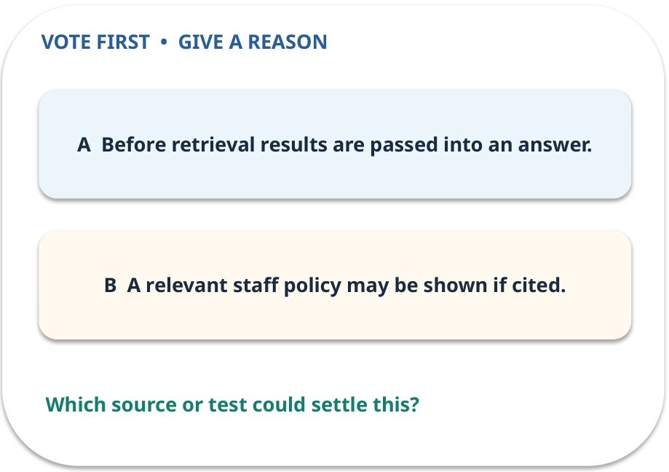
4. Predict · Access filter
QUESTION / WEEK 06
When must the access filter apply?
Make a choice before we explain the diagram.
GENERATIVE AI 2027 • WEEK 06 • 22 / 40
Notes:
TEACHER SCRIPT — QUESTION. Take a show of hands for each choice before showing the mechanism. Ask pairs to defend a choice with evidence. Save the strongest wrong reason for the reveal later in this cycle. This week’s case is: Five fictional college policies must answer student questions. The visible slide states: When must the access filter apply?
Make a choice before we explain the diagram. The intended answer is Before retrieval results are passed into an answer. The tempting claim is A relevant staff policy may be shown if cited. Do not show which card is correct until the reveal. The target is: Compare search strategies while preserving source and access information. Listen for an explanation of the actual arrow or calculation, not just a repeated label. If the answer is unsupported, mark that uncertainty and return to the source. Before moving on, ask for the main idea and one concrete change to the worked example.

Slide 23
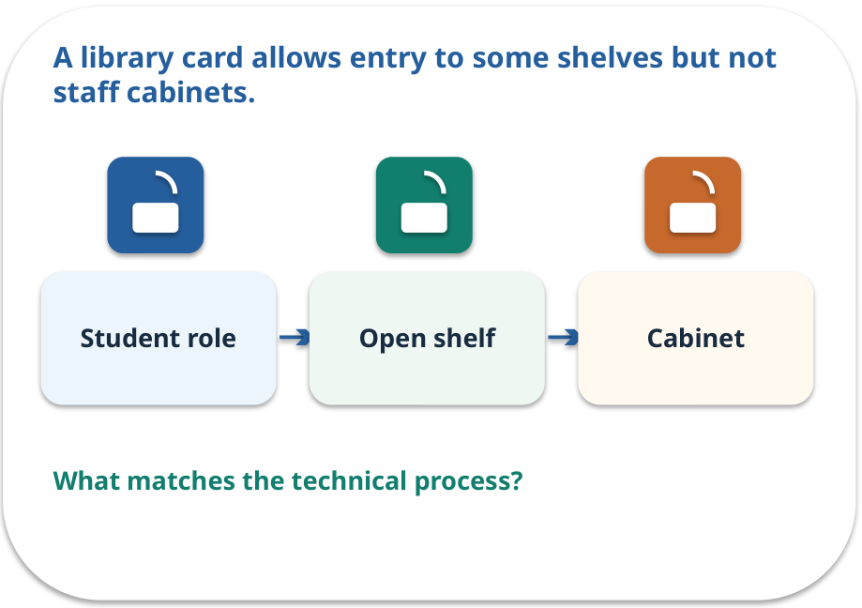
Access filter · a familiar picture
ANALOGY / WEEK 06
A library card allows entry to some shelves but not staff cabinets.
What matches our case, and where does the analogy stop?
GENERATIVE AI 2027 • WEEK 06 • 23 / 40
Notes:
TEACHER SCRIPT — ANALOGY. Begin with the familiar scene. Invite learners to describe each part in everyday language. Then ask where the comparison might fail before introducing the technical vocabulary. This week’s case is: Five fictional college policies must answer student questions. The visible slide states: A library card allows entry to some shelves but not staff cabinets.
What matches our case, and where does the analogy stop? The boundary is: Filtering after generation may leak details already inserted into context. The target is: Compare search strategies while preserving source and access information. Listen for an explanation of the actual arrow or calculation, not just a repeated label. If the answer is unsupported, mark that uncertainty and return to the source. Before moving on, ask for the main idea and one concrete change to the worked example.

Slide 24
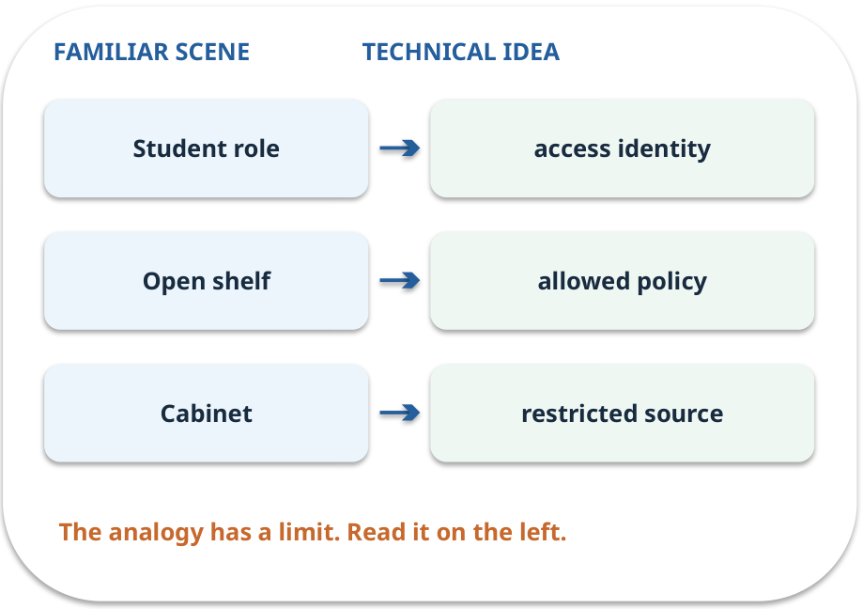
Access filter · map the parts
MAPPING / WEEK 06
Match each everyday part to the technical part.
Analogy limit: Filtering after generation may leak details already inserted into context.
GENERATIVE AI 2027 • WEEK 06 • 24 / 40
Notes:
TEACHER SCRIPT — MAPPING. Point from each familiar element to the corresponding technical element. Have students cover the right column and reconstruct the three matches. Read the limitation aloud. This week’s case is: Five fictional college policies must answer student questions. The visible slide states: Match each everyday part to the technical part.
Analogy limit: Filtering after generation may leak details already inserted into context. The three precise mappings are [['Student role', 'access identity'], ['Open shelf', 'allowed policy'], ['Cabinet', 'restricted source']]. The target is: Compare search strategies while preserving source and access information. Listen for an explanation of the actual arrow or calculation, not just a repeated label. If the answer is unsupported, mark that uncertainty and return to the source. Before moving on, ask for the main idea and one concrete change to the worked example.

Slide 25
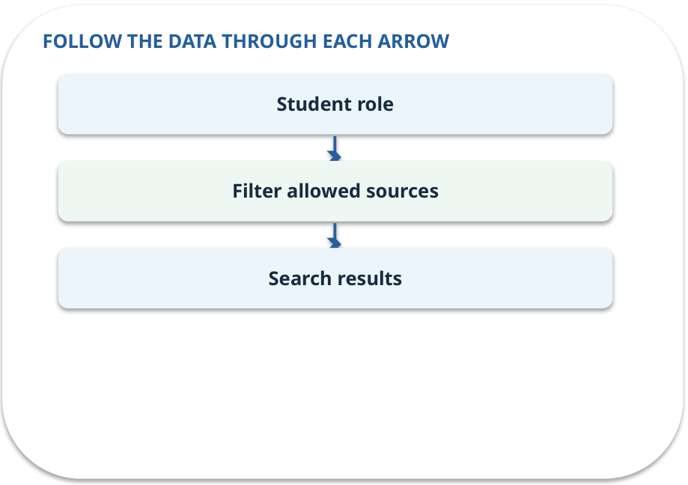
Access filter · how it works
MECHANISM / WEEK 06
Only retrieve passages that the current role is allowed to read.
Trace the arrows from left to right.
GENERATIVE AI 2027 • WEEK 06 • 25 / 40
Notes:
TEACHER SCRIPT — MECHANISM. Trace every arrow slowly from the input to the output. Ask what information crosses the boundary at each arrow. Pause if students confuse a simplified notebook with a trained model. This week’s case is: Five fictional college policies must answer student questions. The visible slide states: Only retrieve passages that the current role is allowed to read.
Trace the arrows from left to right. The weekly example is: Filter staff-only P5 before ranking; never supply it to the student answer stage. State what the analogy does not explain: Filtering after generation may leak details already inserted into context. The target is: Compare search strategies while preserving source and access information. Listen for an explanation of the actual arrow or calculation, not just a repeated label. If the answer is unsupported, mark that uncertainty and return to the source. Before moving on, ask for the main idea and one concrete change to the worked example.

Slide 26
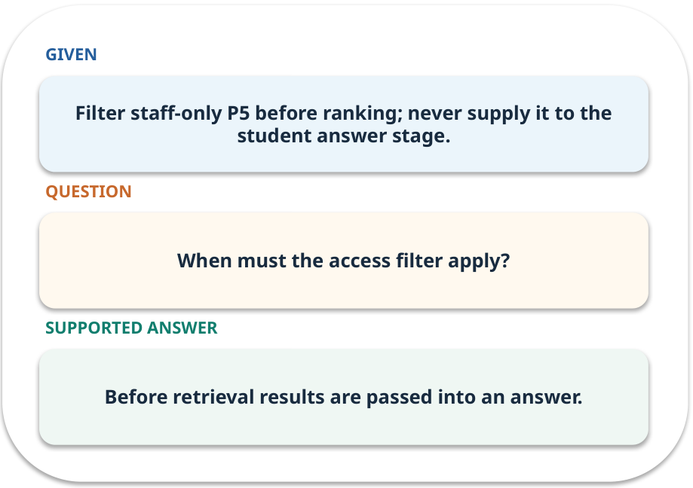
Access filter · work one case
WORKED / WEEK 06
Filter staff-only P5 before ranking; never supply it to the student answer stage.
Point to the evidence before giving your conclusion.
GENERATIVE AI 2027 • WEEK 06 • 26 / 40
Notes:
TEACHER SCRIPT — WORKED. Work the specific numbers or source wording aloud. Give students thirty seconds to write a conclusion, then ask which source line or calculation supports it. This week’s case is: Five fictional college policies must answer student questions. The visible slide states: Filter staff-only P5 before ranking; never supply it to the student answer stage.
Point to the evidence before giving your conclusion. The expected reasoning concludes: Before retrieval results are passed into an answer. Distinguish measured results from illustrative numbers. The target is: Compare search strategies while preserving source and access information. Listen for an explanation of the actual arrow or calculation, not just a repeated label. If the answer is unsupported, mark that uncertainty and return to the source. Before moving on, ask for the main idea and one concrete change to the worked example.

Slide 27
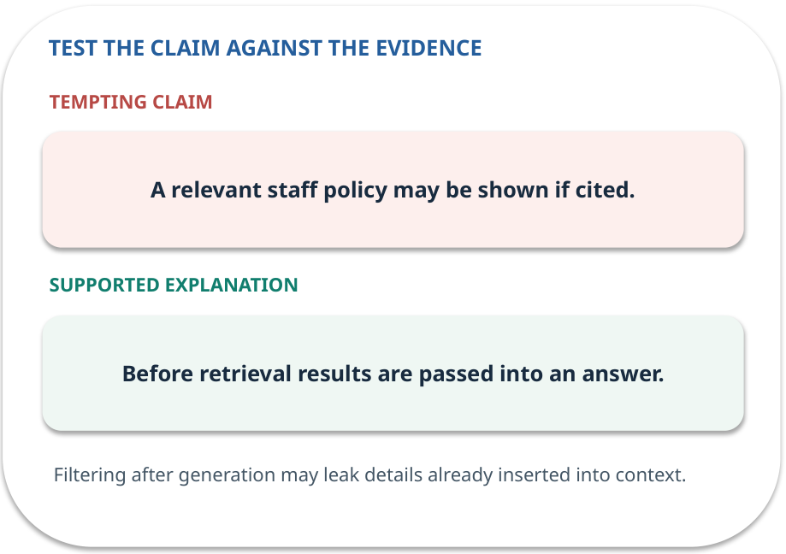
Access filter · answer and explain
REVEAL / WEEK 06
Before retrieval results are passed into an answer.
Tempting mistake: A relevant staff policy may be shown if cited.
GENERATIVE AI 2027 • WEEK 06 • 27 / 40
Notes:
TEACHER SCRIPT — REVEAL. Return to the earlier choice. Explain the correct answer and why the tempting claim fails. Ask one learner to say the answer in a single sentence without reading it. This week’s case is: Five fictional college policies must answer student questions. The visible slide states: Before retrieval results are passed into an answer.
Tempting mistake: A relevant staff policy may be shown if cited. The earlier question was When must the access filter apply? Ask how this differs from the wrong claim. The target is: Compare search strategies while preserving source and access information. Listen for an explanation of the actual arrow or calculation, not just a repeated label. If the answer is unsupported, mark that uncertainty and return to the source. Before moving on, ask for the main idea and one concrete change to the worked example.

Slide 28
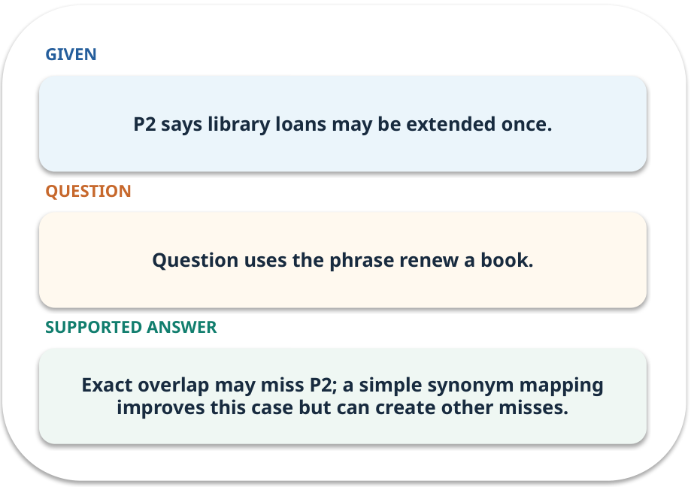
Evidence trail: input → result
WORKED / WEEK 06
Question uses the phrase renew a book.
Exact overlap may miss P2; a simple synonym mapping improves this case but can create other misses.
GENERATIVE AI 2027 • WEEK 06 • 28 / 40
Notes:
TEACHER SCRIPT — WORKED. Work the specific numbers or source wording aloud. Give students thirty seconds to write a conclusion, then ask which source line or calculation supports it. This week’s case is: Five fictional college policies must answer student questions. The visible slide states: Question uses the phrase renew a book.
Exact overlap may miss P2; a simple synonym mapping improves this case but can create other misses. Have one student point to an exact source word or number for each conclusion. The target is: Compare search strategies while preserving source and access information. Listen for an explanation of the actual arrow or calculation, not just a repeated label. If the answer is unsupported, mark that uncertainty and return to the source. Before moving on, ask for the main idea and one concrete change to the worked example.

Slide 29
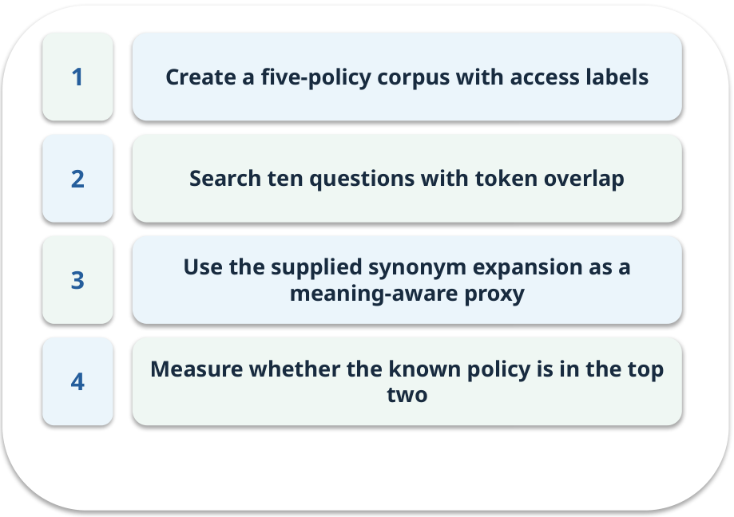
Notebook: run the prepared example
PRACTICE / WEEK 06
Compare token overlap and the synonym proxy on a fixed corpus.
Read the original output before editing.
GENERATIVE AI 2027 • WEEK 06 • 29 / 40
Notes:
TEACHER SCRIPT — PRACTICE. Open the matching notebook and demonstrate the first run. Have learners predict one change, run only that change, and record input, setting, output and an error explanation. This week’s case is: Five fictional college policies must answer student questions. The visible slide states: Compare token overlap and the synonym proxy on a fixed corpus.
Read the original output before editing. Use Week_06_Lab.ipynb. This lab is a prepared classroom demonstration with its limitations documented. The target is: Compare search strategies while preserving source and access information. Listen for an explanation of the actual arrow or calculation, not just a repeated label. If the answer is unsupported, mark that uncertainty and return to the source. Before moving on, ask for the main idea and one concrete change to the worked example.

Slide 30

Find the input and check in Python
PRACTICE / WEEK 06
Locate the supplied input, the transformation, the checking line and the printed result.
GENERATIVE AI 2027 • WEEK 06 • 30 / 40
Notes:
TEACHER SCRIPT — PRACTICE. Open the matching notebook and demonstrate the first run. Have learners predict one change, run only that change, and record input, setting, output and an error explanation. This week’s case is: Five fictional college policies must answer student questions. The visible slide states: Locate the supplied input, the transformation, the checking line and the printed result. The weekly lab change is: Remove a synonym or lower top-k from 2 to 1 and compare recall. The target is: Compare search strategies while preserving source and access information. Listen for an explanation of the actual arrow or calculation, not just a repeated label. If the answer is unsupported, mark that uncertainty and return to the source. Before moving on, ask for the main idea and one concrete change to the worked example.

Slide 31

Predict one controlled change
PRACTICE / WEEK 06
Remove a synonym or lower top-k from 2 to 1 and compare recall.
What should change in the result? What stays fixed?
GENERATIVE AI 2027 • WEEK 06 • 31 / 40
Notes:
TEACHER SCRIPT — PRACTICE. Open the matching notebook and demonstrate the first run. Have learners predict one change, run only that change, and record input, setting, output and an error explanation. This week’s case is: Five fictional college policies must answer student questions. The visible slide states: Remove a synonym or lower top-k from 2 to 1 and compare recall.
What should change in the result? What stays fixed? Ask learners to write their prediction before rerunning the cell. The target is: Compare search strategies while preserving source and access information. Listen for an explanation of the actual arrow or calculation, not just a repeated label. If the answer is unsupported, mark that uncertainty and return to the source. Before moving on, ask for the main idea and one concrete change to the worked example.

Slide 32

Run, compare and record
PRACTICE / WEEK 06
Record the input, the one changed setting, the observed result and a reason for any difference.
GENERATIVE AI 2027 • WEEK 06 • 32 / 40
Notes:
TEACHER SCRIPT — PRACTICE. Open the matching notebook and demonstrate the first run. Have learners predict one change, run only that change, and record input, setting, output and an error explanation. This week’s case is: Five fictional college policies must answer student questions. The visible slide states: Record the input, the one changed setting, the observed result and a reason for any difference. The required evidence is: Corpus manifest and retrieval misses with evidence IDs. The target is: Compare search strategies while preserving source and access information. Listen for an explanation of the actual arrow or calculation, not just a repeated label. If the answer is unsupported, mark that uncertainty and return to the source. Before moving on, ask for the main idea and one concrete change to the worked example.

Slide 33

Measure without hiding the denominator
CHECK / WEEK 06
Recall@2 on ten labelled questions
Write the numerator, denominator and one failure case.
GENERATIVE AI 2027 • WEEK 06 • 33 / 40
Notes:
TEACHER SCRIPT — CHECK. Use this as a brief formative check. Ask for the conclusion, the evidence and one limitation. Revisit disagreements in the review session and offer an extension only after the core task. This week’s case is: Five fictional college policies must answer student questions. The visible slide states: Recall@2 on ten labelled questions
Write the numerator, denominator and one failure case. Where a measure is qualitative, show the concrete source comparison. Example: Exact overlap may miss P2; a simple synonym mapping improves this case but can create other misses. The target is: Compare search strategies while preserving source and access information. Listen for an explanation of the actual arrow or calculation, not just a repeated label. If the answer is unsupported, mark that uncertainty and return to the source. Before moving on, ask for the main idea and one concrete change to the worked example.

Slide 34
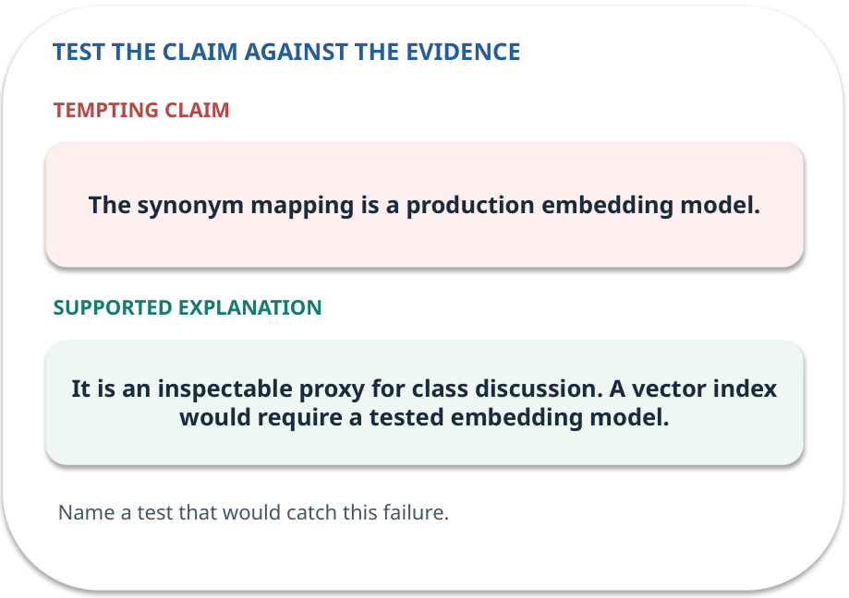
Error detective: find the layer
CHECK / WEEK 06
Plausible wrong claim: The synonym mapping is a production embedding model.
Correct it using the case evidence.
GENERATIVE AI 2027 • WEEK 06 • 34 / 40
Notes:
TEACHER SCRIPT — CHECK. Use this as a brief formative check. Ask for the conclusion, the evidence and one limitation. Revisit disagreements in the review session and offer an extension only after the core task. This week’s case is: Five fictional college policies must answer student questions. The visible slide states: Plausible wrong claim: The synonym mapping is a production embedding model.
Correct it using the case evidence. The correction is It is an inspectable proxy for class discussion. A vector index would require a tested embedding model. The target is: Compare search strategies while preserving source and access information. Listen for an explanation of the actual arrow or calculation, not just a repeated label. If the answer is unsupported, mark that uncertainty and return to the source. Before moving on, ask for the main idea and one concrete change to the worked example.

Slide 35

Transfer to a new situation
CHECK / WEEK 06
A staff-only policy has a perfect keyword match. Should the student see it?
Explain which source or test would settle it.
GENERATIVE AI 2027 • WEEK 06 • 35 / 40
Notes:
TEACHER SCRIPT — CHECK. Use this as a brief formative check. Ask for the conclusion, the evidence and one limitation. Revisit disagreements in the review session and offer an extension only after the core task. This week’s case is: Five fictional college policies must answer student questions. The visible slide states: A staff-only policy has a perfect keyword match. Should the student see it?
Explain which source or test would settle it. This is a fresh scenario, so ask for a reason before accepting either short answer. The target is: Compare search strategies while preserving source and access information. Listen for an explanation of the actual arrow or calculation, not just a repeated label. If the answer is unsupported, mark that uncertainty and return to the source. Before moving on, ask for the main idea and one concrete change to the worked example.

Slide 36

Explain it to a partner
CHECK / WEEK 06
Without reading the slide, name the input, one processing step and the check. Your partner should ask “How do you know?”
GENERATIVE AI 2027 • WEEK 06 • 36 / 40
Notes:
TEACHER SCRIPT — CHECK. Use this as a brief formative check. Ask for the conclusion, the evidence and one limitation. Revisit disagreements in the review session and offer an extension only after the core task. This week’s case is: Five fictional college policies must answer student questions. The visible slide states: Without reading the slide, name the input, one processing step and the check. Your partner should ask “How do you know?” Listen for a causal explanation and one limitation, then revisit a difficult arrow on the board. The target is: Compare search strategies while preserving source and access information. Listen for an explanation of the actual arrow or calculation, not just a repeated label. If the answer is unsupported, mark that uncertainty and return to the source. Before moving on, ask for the main idea and one concrete change to the worked example.

Slide 37

Exam rehearsal · explain and apply
CHECK / WEEK 06
Why keep source IDs and versions with chunks?
Write a short answer, then compare with the guide.
GENERATIVE AI 2027 • WEEK 06 • 37 / 40
Notes:
TEACHER SCRIPT — CHECK. Use this as a brief formative check. Ask for the conclusion, the evidence and one limitation. Revisit disagreements in the review session and offer an extension only after the core task. This week’s case is: Five fictional college policies must answer student questions. The visible slide states: Why keep source IDs and versions with chunks?
Write a short answer, then compare with the guide. Model answer after discussion: To trace an answer to the right document and identify stale evidence. Practice marks: 4. The target is: Compare search strategies while preserving source and access information. Listen for an explanation of the actual arrow or calculation, not just a repeated label. If the answer is unsupported, mark that uncertainty and return to the source. Before moving on, ask for the main idea and one concrete change to the worked example.

Slide 38
Exam rehearsal · explain and apply
CHECK / WEEK 06
One relevant passage exists and appears in the top two. What is recall@2?
Write a short answer, then compare with the guide.
GENERATIVE AI 2027 • WEEK 06 • 38 / 40
Notes:
TEACHER SCRIPT — CHECK. Use this as a brief formative check. Ask for the conclusion, the evidence and one limitation. Revisit disagreements in the review session and offer an extension only after the core task. This week’s case is: Five fictional college policies must answer student questions. The visible slide states: One relevant passage exists and appears in the top two. What is recall@2?
Write a short answer, then compare with the guide. Model answer after discussion: 1/1 = 1 for that query. Average across queries with relevant evidence; handle no-answer cases separately. Practice marks: 4. The target is: Compare search strategies while preserving source and access information. Listen for an explanation of the actual arrow or calculation, not just a repeated label. If the answer is unsupported, mark that uncertainty and return to the source. Before moving on, ask for the main idea and one concrete change to the worked example.

Slide 39

What to hand in
PRACTICE / WEEK 06
Corpus manifest and retrieval misses with evidence IDs.
Include the one changed input and an error explanation.
GENERATIVE AI 2027 • WEEK 06 • 39 / 40
Notes:
TEACHER SCRIPT — PRACTICE. Open the matching notebook and demonstrate the first run. Have learners predict one change, run only that change, and record input, setting, output and an error explanation. This week’s case is: Five fictional college policies must answer student questions. The visible slide states: Corpus manifest and retrieval misses with evidence IDs.
Include the one changed input and an error explanation. This weekly evidence receives formative feedback according to the module sequence; refer to the assessment brief for graded work. The target is: Compare search strategies while preserving source and access information. Listen for an explanation of the actual arrow or calculation, not just a repeated label. If the answer is unsupported, mark that uncertainty and return to the source. Before moving on, ask for the main idea and one concrete change to the worked example.

Slide 40
Three ideas to recall next week
CHECK / WEEK 06
Split with source IDs, compare retrieval methods, and filter permissions first.
Read the linked official sources in the Word guide and redraw one diagram from memory.
GENERATIVE AI 2027 • WEEK 06 • 40 / 40
Notes:
TEACHER SCRIPT — CHECK. Use this as a brief formative check. Ask for the conclusion, the evidence and one limitation. Revisit disagreements in the review session and offer an extension only after the core task. This week’s case is: Five fictional college policies must answer student questions. The visible slide states: Split with source IDs, compare retrieval methods, and filter permissions first.
Read the linked official sources in the Word guide and redraw one diagram from memory. Return to the opening vote and ask whether the evidence changed anyone’s mind. The next week builds on this outcome: Compare search strategies while preserving source and access information. The target is: Compare search strategies while preserving source and access information. Listen for an explanation of the actual arrow or calculation, not just a repeated label. If the answer is unsupported, mark that uncertainty and return to the source. Before moving on, ask for the main idea and one concrete change to the worked example.

