Slide 1
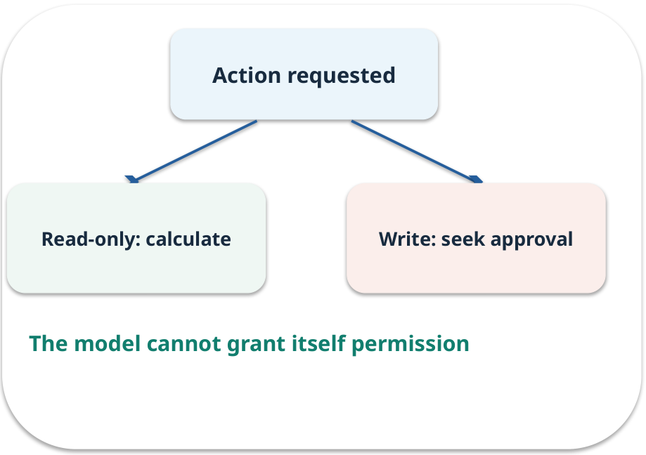
Week 08 · Tools and controlled actions
OPEN / WEEK 08
The reimbursement cap tool
A €55 claim has a €40 cap. The assistant may calculate the payable amount. A separate request asks it to change the cap. Which path needs approval?
GENERATIVE AI 2027 • WEEK 08 • 01 / 40
Notes:
TEACHER SCRIPT — OPEN. Show the visual for ten seconds, then ask for an initial decision. Do not reveal the answer yet. Ask a student to name the source or measurement that would change their mind. This week’s case is: The assistant calculates a permitted reimbursement cap; a request to update a record needs approval. The visible slide states: The reimbursement cap tool
A €55 claim has a €40 cap. The assistant may calculate the payable amount. A separate request asks it to change the cap. Which path needs approval? Reveal that the case will be revisited after four short concept cycles. The target is: Implement a bounded read-only tool and reason about approval for actions. Listen for an explanation of the actual arrow or calculation, not just a repeated label. If the answer is unsupported, mark that uncertainty and return to the source. Before moving on, ask for the main idea and one concrete change to the worked example.

Slide 2

First vote: what would you do?
QUESTION / WEEK 08
A €55 claim has a €40 cap. The assistant may calculate the payable amount. A separate request asks it to change the cap. Which path needs approval?
Choose an initial answer and name one piece of evidence you need.
GENERATIVE AI 2027 • WEEK 08 • 02 / 40
Notes:
TEACHER SCRIPT — QUESTION. Take a show of hands for each choice before showing the mechanism. Ask pairs to defend a choice with evidence. Save the strongest wrong reason for the reveal later in this cycle. This week’s case is: The assistant calculates a permitted reimbursement cap; a request to update a record needs approval. The visible slide states: A €55 claim has a €40 cap. The assistant may calculate the payable amount. A separate request asks it to change the cap. Which path needs approval?
Choose an initial answer and name one piece of evidence you need. Accept reasonable uncertainty; record the initial votes to revisit at the end. The target is: Implement a bounded read-only tool and reason about approval for actions. Listen for an explanation of the actual arrow or calculation, not just a repeated label. If the answer is unsupported, mark that uncertainty and return to the source. Before moving on, ask for the main idea and one concrete change to the worked example.

Slide 3
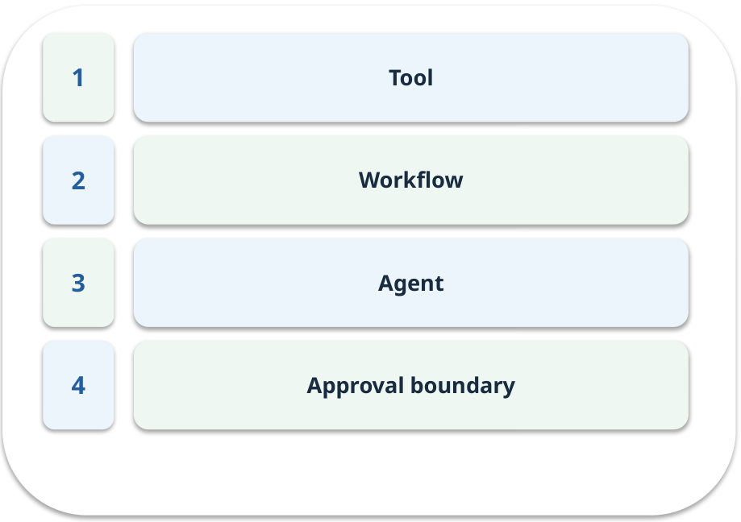
The journey through today’s case
OPEN / WEEK 08
We will predict, connect an analogy, trace a mechanism, work an example, then explain a decision.
GENERATIVE AI 2027 • WEEK 08 • 03 / 40
Notes:
TEACHER SCRIPT — OPEN. Show the visual for ten seconds, then ask for an initial decision. Do not reveal the answer yet. Ask a student to name the source or measurement that would change their mind. This week’s case is: The assistant calculates a permitted reimbursement cap; a request to update a record needs approval. The visible slide states: We will predict, connect an analogy, trace a mechanism, work an example, then explain a decision. Point to the four named ideas, then show where the notebook experiment fits. The target is: Implement a bounded read-only tool and reason about approval for actions. Listen for an explanation of the actual arrow or calculation, not just a repeated label. If the answer is unsupported, mark that uncertainty and return to the source. Before moving on, ask for the main idea and one concrete change to the worked example.

Slide 4
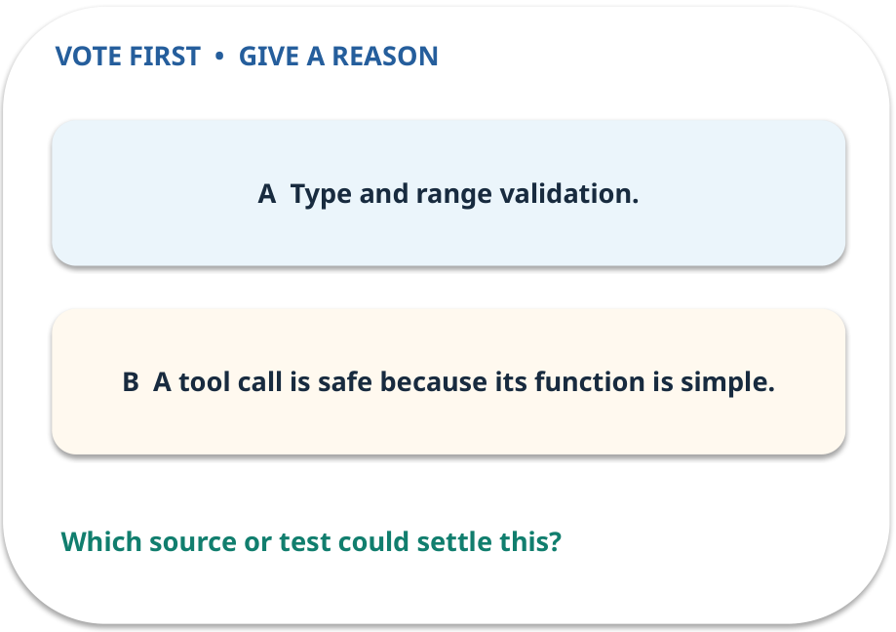
1. Predict · Tool
QUESTION / WEEK 08
What should run before the arithmetic?
Make a choice before we explain the diagram.
GENERATIVE AI 2027 • WEEK 08 • 04 / 40
Notes:
TEACHER SCRIPT — QUESTION. Take a show of hands for each choice before showing the mechanism. Ask pairs to defend a choice with evidence. Save the strongest wrong reason for the reveal later in this cycle. This week’s case is: The assistant calculates a permitted reimbursement cap; a request to update a record needs approval. The visible slide states: What should run before the arithmetic?
Make a choice before we explain the diagram. The intended answer is Type and range validation. The tempting claim is A tool call is safe because its function is simple. Do not show which card is correct until the reveal. The target is: Implement a bounded read-only tool and reason about approval for actions. Listen for an explanation of the actual arrow or calculation, not just a repeated label. If the answer is unsupported, mark that uncertainty and return to the source. Before moving on, ask for the main idea and one concrete change to the worked example.

Slide 5
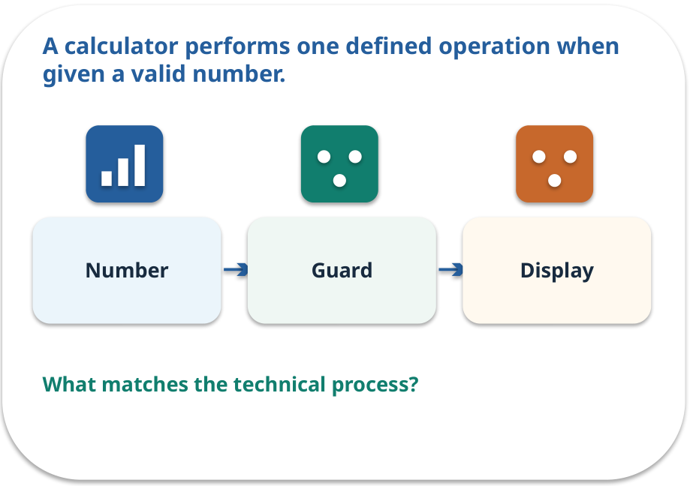
Tool · a familiar picture
ANALOGY / WEEK 08
A calculator performs one defined operation when given a valid number.
What matches our case, and where does the analogy stop?
GENERATIVE AI 2027 • WEEK 08 • 05 / 40
Notes:
TEACHER SCRIPT — ANALOGY. Begin with the familiar scene. Invite learners to describe each part in everyday language. Then ask where the comparison might fail before introducing the technical vocabulary. This week’s case is: The assistant calculates a permitted reimbursement cap; a request to update a record needs approval. The visible slide states: A calculator performs one defined operation when given a valid number.
What matches our case, and where does the analogy stop? The boundary is: The model may choose the wrong tool or arguments; inspect the call. The target is: Implement a bounded read-only tool and reason about approval for actions. Listen for an explanation of the actual arrow or calculation, not just a repeated label. If the answer is unsupported, mark that uncertainty and return to the source. Before moving on, ask for the main idea and one concrete change to the worked example.

Slide 6
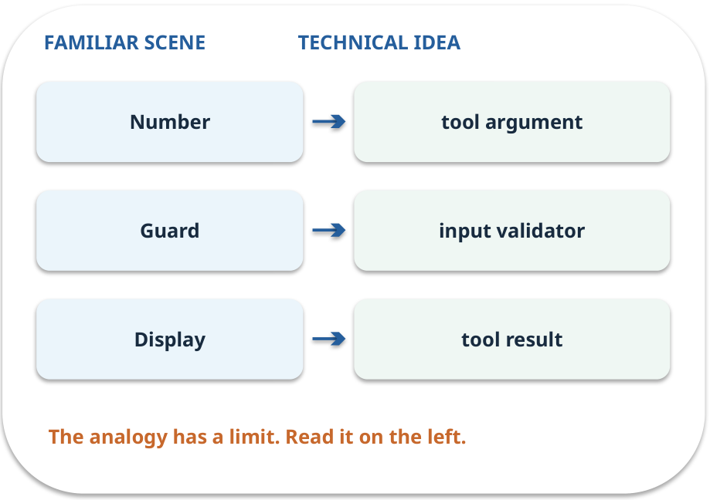
Tool · map the parts
MAPPING / WEEK 08
Match each everyday part to the technical part.
Analogy limit: The model may choose the wrong tool or arguments; inspect the call.
GENERATIVE AI 2027 • WEEK 08 • 06 / 40
Notes:
TEACHER SCRIPT — MAPPING. Point from each familiar element to the corresponding technical element. Have students cover the right column and reconstruct the three matches. Read the limitation aloud. This week’s case is: The assistant calculates a permitted reimbursement cap; a request to update a record needs approval. The visible slide states: Match each everyday part to the technical part.
Analogy limit: The model may choose the wrong tool or arguments; inspect the call. The three precise mappings are [['Number', 'tool argument'], ['Guard', 'input validator'], ['Display', 'tool result']]. The target is: Implement a bounded read-only tool and reason about approval for actions. Listen for an explanation of the actual arrow or calculation, not just a repeated label. If the answer is unsupported, mark that uncertainty and return to the source. Before moving on, ask for the main idea and one concrete change to the worked example.

Slide 7
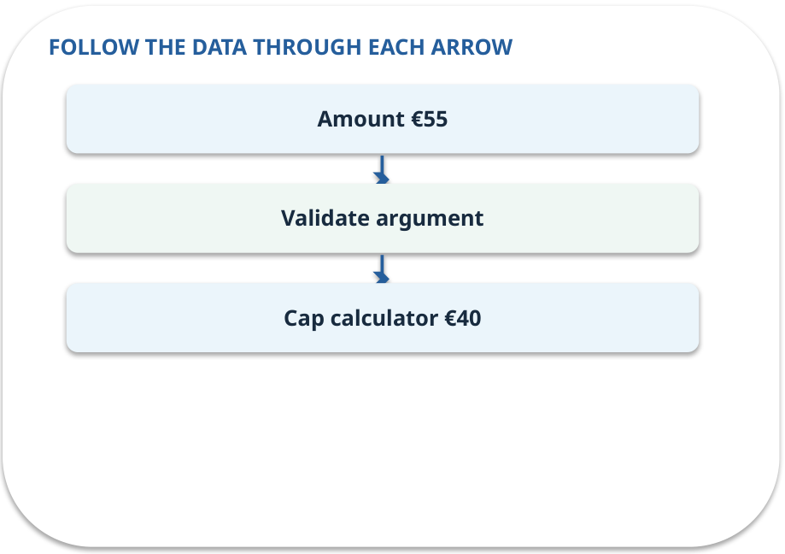
Tool · how it works
MECHANISM / WEEK 08
A named operation with validated arguments, permissions and a defined result.
Trace the arrows from left to right.
GENERATIVE AI 2027 • WEEK 08 • 07 / 40
Notes:
TEACHER SCRIPT — MECHANISM. Trace every arrow slowly from the input to the output. Ask what information crosses the boundary at each arrow. Pause if students confuse a simplified notebook with a trained model. This week’s case is: The assistant calculates a permitted reimbursement cap; a request to update a record needs approval. The visible slide states: A named operation with validated arguments, permissions and a defined result.
Trace the arrows from left to right. The weekly example is: cap(55,40) returns €40; cap(−5,40) is rejected as invalid input. State what the analogy does not explain: The model may choose the wrong tool or arguments; inspect the call. The target is: Implement a bounded read-only tool and reason about approval for actions. Listen for an explanation of the actual arrow or calculation, not just a repeated label. If the answer is unsupported, mark that uncertainty and return to the source. Before moving on, ask for the main idea and one concrete change to the worked example.

Slide 8
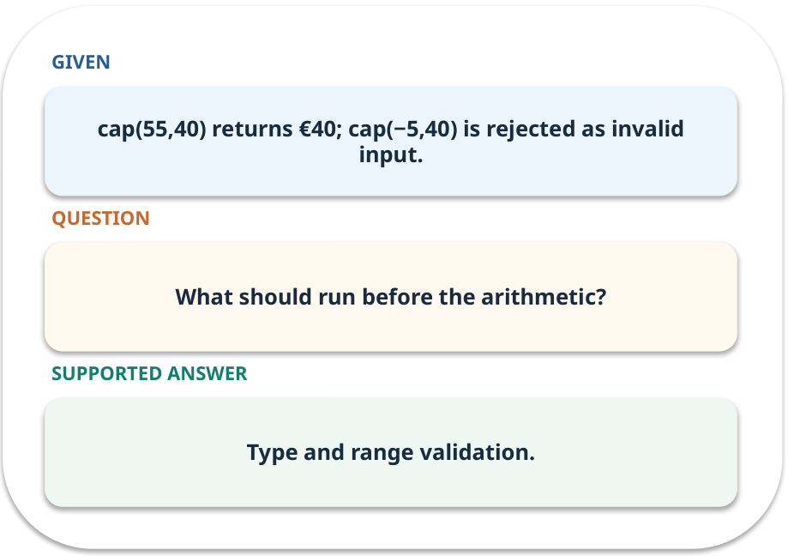
Tool · work one case
WORKED / WEEK 08
cap(55,40) returns €40; cap(−5,40) is rejected as invalid input.
Point to the evidence before giving your conclusion.
GENERATIVE AI 2027 • WEEK 08 • 08 / 40
Notes:
TEACHER SCRIPT — WORKED. Work the specific numbers or source wording aloud. Give students thirty seconds to write a conclusion, then ask which source line or calculation supports it. This week’s case is: The assistant calculates a permitted reimbursement cap; a request to update a record needs approval. The visible slide states: cap(55,40) returns €40; cap(−5,40) is rejected as invalid input.
Point to the evidence before giving your conclusion. The expected reasoning concludes: Type and range validation. Distinguish measured results from illustrative numbers. The target is: Implement a bounded read-only tool and reason about approval for actions. Listen for an explanation of the actual arrow or calculation, not just a repeated label. If the answer is unsupported, mark that uncertainty and return to the source. Before moving on, ask for the main idea and one concrete change to the worked example.

Slide 9
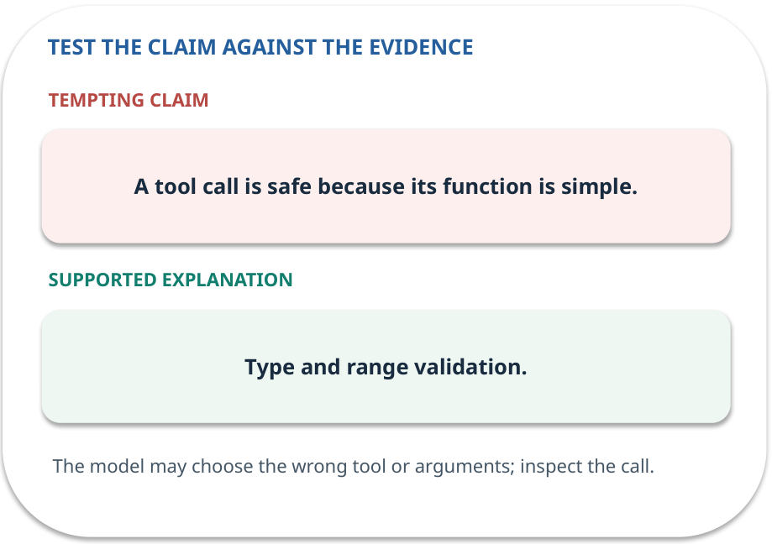
Tool · answer and explain
REVEAL / WEEK 08
Type and range validation.
Tempting mistake: A tool call is safe because its function is simple.
GENERATIVE AI 2027 • WEEK 08 • 09 / 40
Notes:
TEACHER SCRIPT — REVEAL. Return to the earlier choice. Explain the correct answer and why the tempting claim fails. Ask one learner to say the answer in a single sentence without reading it. This week’s case is: The assistant calculates a permitted reimbursement cap; a request to update a record needs approval. The visible slide states: Type and range validation.
Tempting mistake: A tool call is safe because its function is simple. The earlier question was What should run before the arithmetic? Ask how this differs from the wrong claim. The target is: Implement a bounded read-only tool and reason about approval for actions. Listen for an explanation of the actual arrow or calculation, not just a repeated label. If the answer is unsupported, mark that uncertainty and return to the source. Before moving on, ask for the main idea and one concrete change to the worked example.

Slide 10
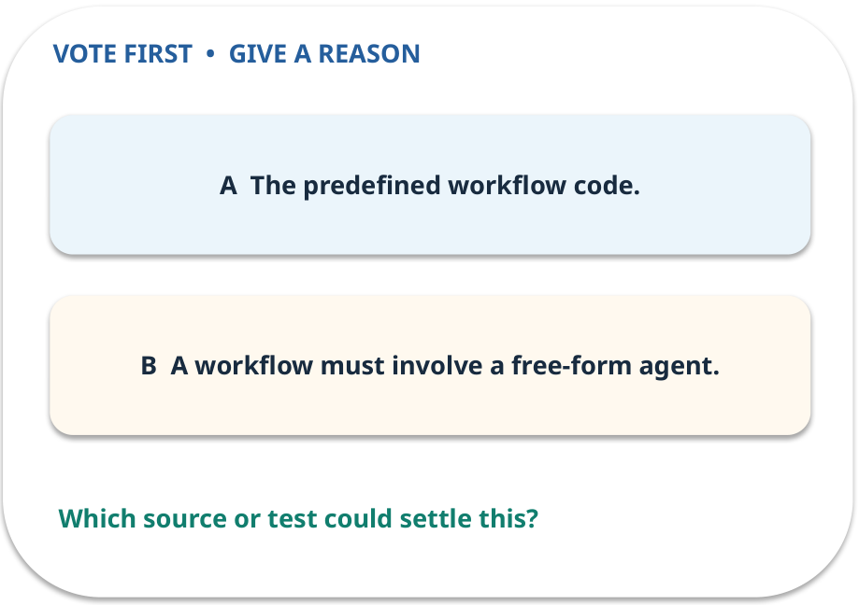
2. Predict · Workflow
QUESTION / WEEK 08
Who chooses the next station in this version?
Make a choice before we explain the diagram.
GENERATIVE AI 2027 • WEEK 08 • 10 / 40
Notes:
TEACHER SCRIPT — QUESTION. Take a show of hands for each choice before showing the mechanism. Ask pairs to defend a choice with evidence. Save the strongest wrong reason for the reveal later in this cycle. This week’s case is: The assistant calculates a permitted reimbursement cap; a request to update a record needs approval. The visible slide states: Who chooses the next station in this version?
Make a choice before we explain the diagram. The intended answer is The predefined workflow code. The tempting claim is A workflow must involve a free-form agent. Do not show which card is correct until the reveal. The target is: Implement a bounded read-only tool and reason about approval for actions. Listen for an explanation of the actual arrow or calculation, not just a repeated label. If the answer is unsupported, mark that uncertainty and return to the source. Before moving on, ask for the main idea and one concrete change to the worked example.

Slide 11
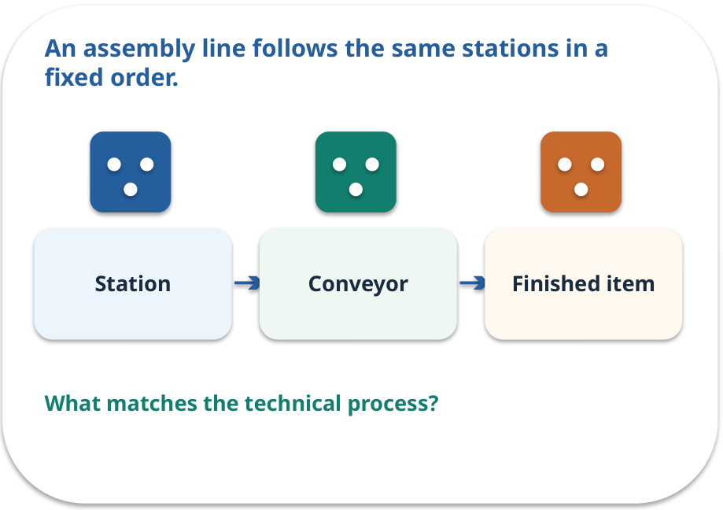
Workflow · a familiar picture
ANALOGY / WEEK 08
An assembly line follows the same stations in a fixed order.
What matches our case, and where does the analogy stop?
GENERATIVE AI 2027 • WEEK 08 • 11 / 40
Notes:
TEACHER SCRIPT — ANALOGY. Begin with the familiar scene. Invite learners to describe each part in everyday language. Then ask where the comparison might fail before introducing the technical vocabulary. This week’s case is: The assistant calculates a permitted reimbursement cap; a request to update a record needs approval. The visible slide states: An assembly line follows the same stations in a fixed order.
What matches our case, and where does the analogy stop? The boundary is: Real workflows can branch on validated conditions, while remaining predefined. The target is: Implement a bounded read-only tool and reason about approval for actions. Listen for an explanation of the actual arrow or calculation, not just a repeated label. If the answer is unsupported, mark that uncertainty and return to the source. Before moving on, ask for the main idea and one concrete change to the worked example.

Slide 12
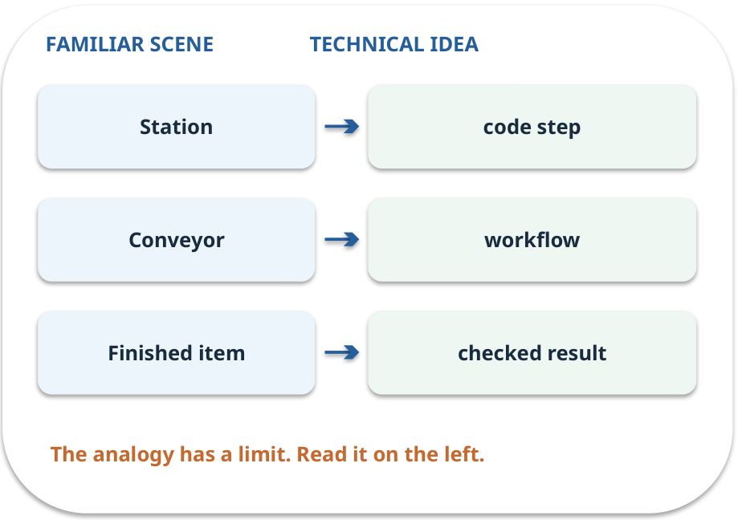
Workflow · map the parts
MAPPING / WEEK 08
Match each everyday part to the technical part.
Analogy limit: Real workflows can branch on validated conditions, while remaining predefined.
GENERATIVE AI 2027 • WEEK 08 • 12 / 40
Notes:
TEACHER SCRIPT — MAPPING. Point from each familiar element to the corresponding technical element. Have students cover the right column and reconstruct the three matches. Read the limitation aloud. This week’s case is: The assistant calculates a permitted reimbursement cap; a request to update a record needs approval. The visible slide states: Match each everyday part to the technical part.
Analogy limit: Real workflows can branch on validated conditions, while remaining predefined. The three precise mappings are [['Station', 'code step'], ['Conveyor', 'workflow'], ['Finished item', 'checked result']]. The target is: Implement a bounded read-only tool and reason about approval for actions. Listen for an explanation of the actual arrow or calculation, not just a repeated label. If the answer is unsupported, mark that uncertainty and return to the source. Before moving on, ask for the main idea and one concrete change to the worked example.

Slide 13
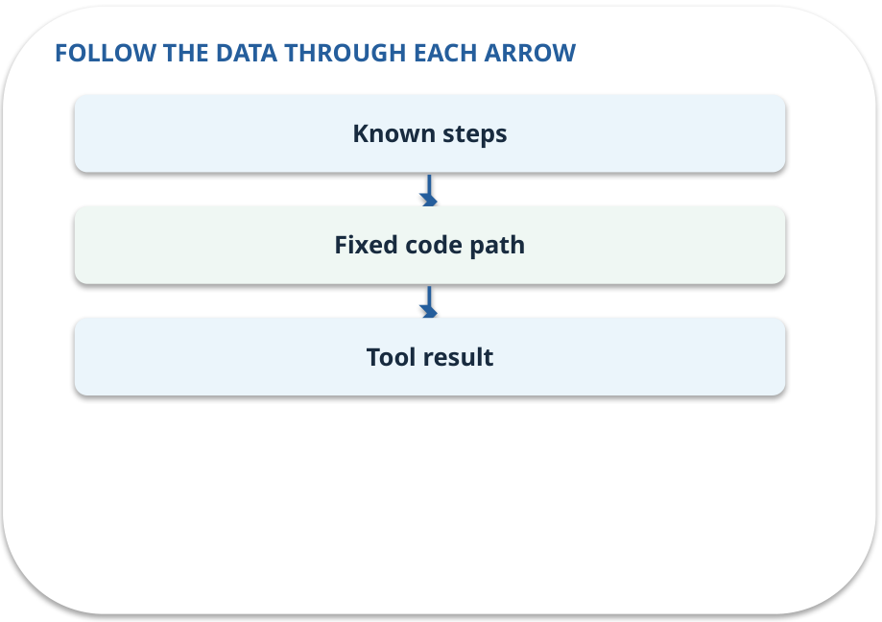
Workflow · how it works
MECHANISM / WEEK 08
Code chooses the next step by a fixed rule.
Trace the arrows from left to right.
GENERATIVE AI 2027 • WEEK 08 • 13 / 40
Notes:
TEACHER SCRIPT — MECHANISM. Trace every arrow slowly from the input to the output. Ask what information crosses the boundary at each arrow. Pause if students confuse a simplified notebook with a trained model. This week’s case is: The assistant calculates a permitted reimbursement cap; a request to update a record needs approval. The visible slide states: Code chooses the next step by a fixed rule.
Trace the arrows from left to right. The weekly example is: Validate amount → calculate cap → format reply; a negative amount stops at validation. State what the analogy does not explain: Real workflows can branch on validated conditions, while remaining predefined. The target is: Implement a bounded read-only tool and reason about approval for actions. Listen for an explanation of the actual arrow or calculation, not just a repeated label. If the answer is unsupported, mark that uncertainty and return to the source. Before moving on, ask for the main idea and one concrete change to the worked example.

Slide 14
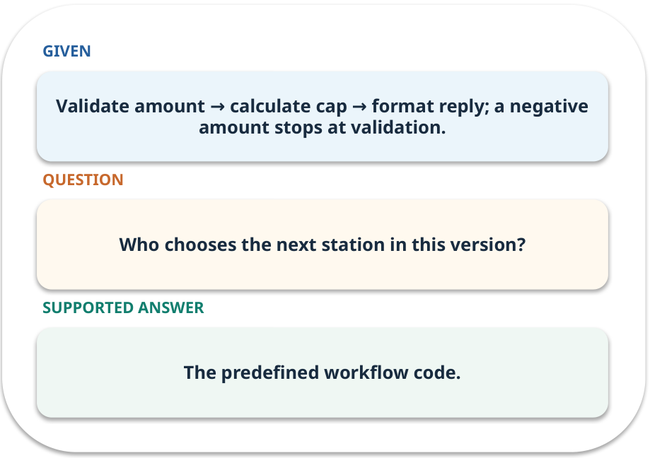
Workflow · work one case
WORKED / WEEK 08
Validate amount → calculate cap → format reply; a negative amount stops at validation.
Point to the evidence before giving your conclusion.
GENERATIVE AI 2027 • WEEK 08 • 14 / 40
Notes:
TEACHER SCRIPT — WORKED. Work the specific numbers or source wording aloud. Give students thirty seconds to write a conclusion, then ask which source line or calculation supports it. This week’s case is: The assistant calculates a permitted reimbursement cap; a request to update a record needs approval. The visible slide states: Validate amount → calculate cap → format reply; a negative amount stops at validation.
Point to the evidence before giving your conclusion. The expected reasoning concludes: The predefined workflow code. Distinguish measured results from illustrative numbers. The target is: Implement a bounded read-only tool and reason about approval for actions. Listen for an explanation of the actual arrow or calculation, not just a repeated label. If the answer is unsupported, mark that uncertainty and return to the source. Before moving on, ask for the main idea and one concrete change to the worked example.

Slide 15
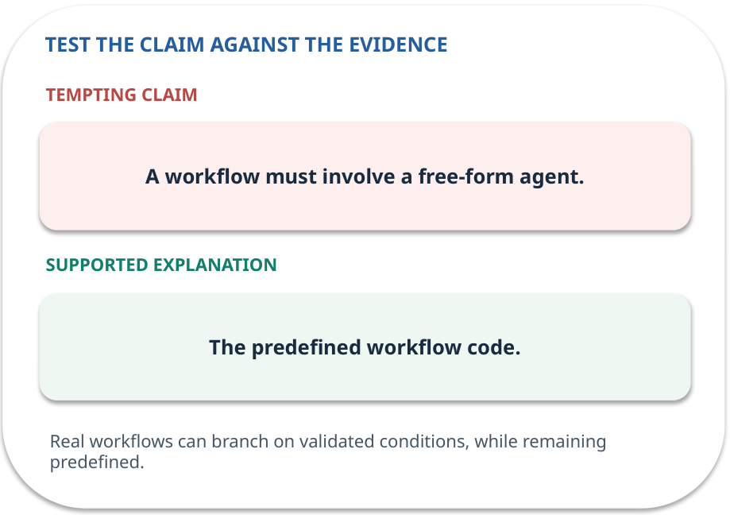
Workflow · answer and explain
REVEAL / WEEK 08
The predefined workflow code.
Tempting mistake: A workflow must involve a free-form agent.
GENERATIVE AI 2027 • WEEK 08 • 15 / 40
Notes:
TEACHER SCRIPT — REVEAL. Return to the earlier choice. Explain the correct answer and why the tempting claim fails. Ask one learner to say the answer in a single sentence without reading it. This week’s case is: The assistant calculates a permitted reimbursement cap; a request to update a record needs approval. The visible slide states: The predefined workflow code.
Tempting mistake: A workflow must involve a free-form agent. The earlier question was Who chooses the next station in this version? Ask how this differs from the wrong claim. The target is: Implement a bounded read-only tool and reason about approval for actions. Listen for an explanation of the actual arrow or calculation, not just a repeated label. If the answer is unsupported, mark that uncertainty and return to the source. Before moving on, ask for the main idea and one concrete change to the worked example.

Slide 16
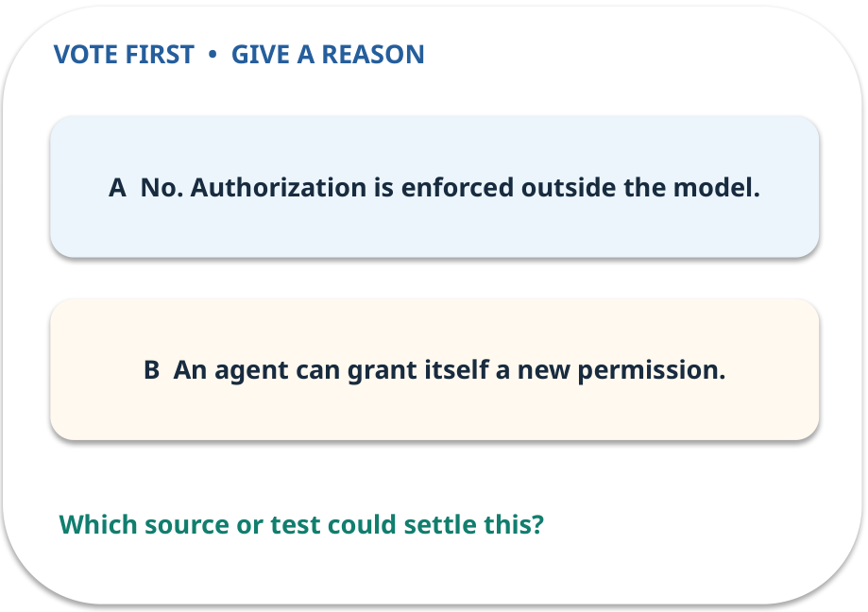
3. Predict · Agent
QUESTION / WEEK 08
Can the model authorize a write by choosing a tool?
Make a choice before we explain the diagram.
GENERATIVE AI 2027 • WEEK 08 • 16 / 40
Notes:
TEACHER SCRIPT — QUESTION. Take a show of hands for each choice before showing the mechanism. Ask pairs to defend a choice with evidence. Save the strongest wrong reason for the reveal later in this cycle. This week’s case is: The assistant calculates a permitted reimbursement cap; a request to update a record needs approval. The visible slide states: Can the model authorize a write by choosing a tool?
Make a choice before we explain the diagram. The intended answer is No. Authorization is enforced outside the model. The tempting claim is An agent can grant itself a new permission. Do not show which card is correct until the reveal. The target is: Implement a bounded read-only tool and reason about approval for actions. Listen for an explanation of the actual arrow or calculation, not just a repeated label. If the answer is unsupported, mark that uncertainty and return to the source. Before moving on, ask for the main idea and one concrete change to the worked example.

Slide 17
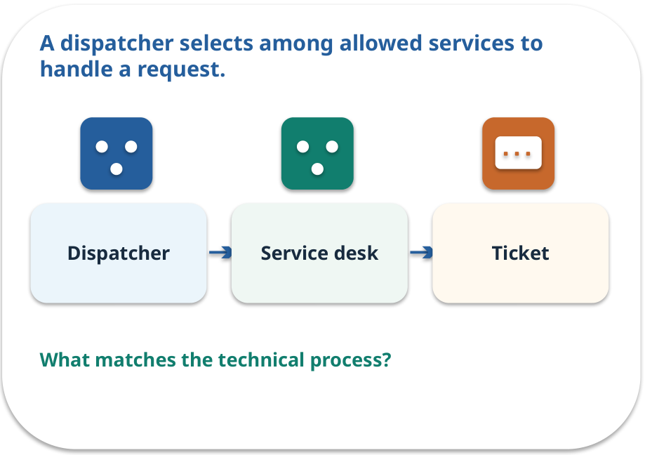
Agent · a familiar picture
ANALOGY / WEEK 08
A dispatcher selects among allowed services to handle a request.
What matches our case, and where does the analogy stop?
GENERATIVE AI 2027 • WEEK 08 • 17 / 40
Notes:
TEACHER SCRIPT — ANALOGY. Begin with the familiar scene. Invite learners to describe each part in everyday language. Then ask where the comparison might fail before introducing the technical vocabulary. This week’s case is: The assistant calculates a permitted reimbursement cap; a request to update a record needs approval. The visible slide states: A dispatcher selects among allowed services to handle a request.
What matches our case, and where does the analogy stop? The boundary is: Agent choice is bounded by available tools and permissions; autonomy is limited. The target is: Implement a bounded read-only tool and reason about approval for actions. Listen for an explanation of the actual arrow or calculation, not just a repeated label. If the answer is unsupported, mark that uncertainty and return to the source. Before moving on, ask for the main idea and one concrete change to the worked example.

Slide 18
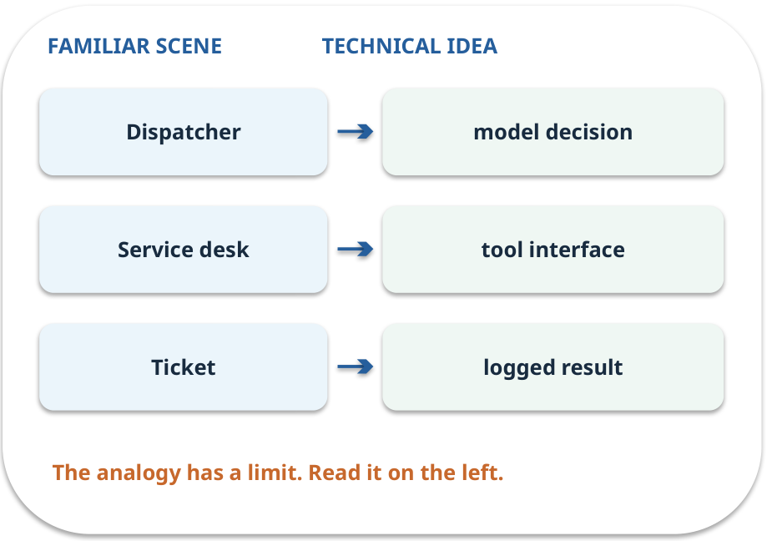
Agent · map the parts
MAPPING / WEEK 08
Match each everyday part to the technical part.
Analogy limit: Agent choice is bounded by available tools and permissions; autonomy is limited.
GENERATIVE AI 2027 • WEEK 08 • 18 / 40
Notes:
TEACHER SCRIPT — MAPPING. Point from each familiar element to the corresponding technical element. Have students cover the right column and reconstruct the three matches. Read the limitation aloud. This week’s case is: The assistant calculates a permitted reimbursement cap; a request to update a record needs approval. The visible slide states: Match each everyday part to the technical part.
Analogy limit: Agent choice is bounded by available tools and permissions; autonomy is limited. The three precise mappings are [['Dispatcher', 'model decision'], ['Service desk', 'tool interface'], ['Ticket', 'logged result']]. The target is: Implement a bounded read-only tool and reason about approval for actions. Listen for an explanation of the actual arrow or calculation, not just a repeated label. If the answer is unsupported, mark that uncertainty and return to the source. Before moving on, ask for the main idea and one concrete change to the worked example.

Slide 19
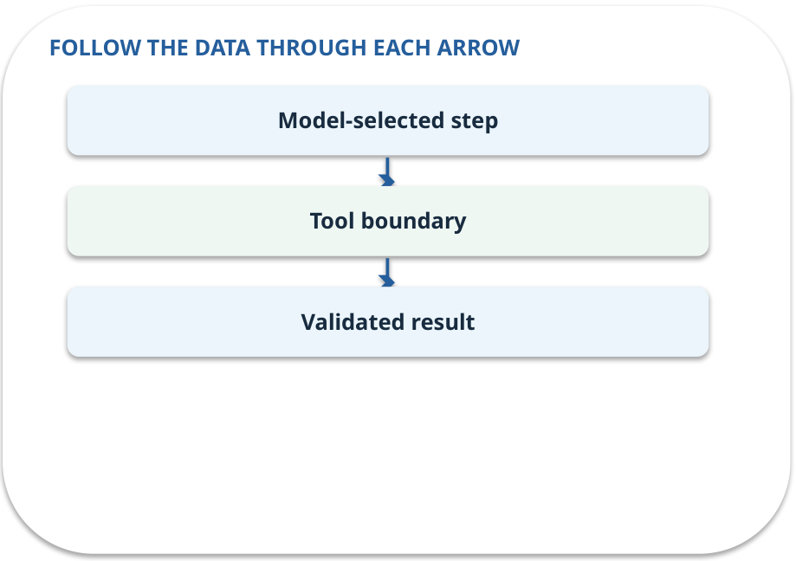
Agent · how it works
MECHANISM / WEEK 08
A model may choose a next action, within the permissions and limits supplied by the application.
Trace the arrows from left to right.
GENERATIVE AI 2027 • WEEK 08 • 19 / 40
Notes:
TEACHER SCRIPT — MECHANISM. Trace every arrow slowly from the input to the output. Ask what information crosses the boundary at each arrow. Pause if students confuse a simplified notebook with a trained model. This week’s case is: The assistant calculates a permitted reimbursement cap; a request to update a record needs approval. The visible slide states: A model may choose a next action, within the permissions and limits supplied by the application.
Trace the arrows from left to right. The weekly example is: The model proposes calculator; the interface validates €55 before executing it. State what the analogy does not explain: Agent choice is bounded by available tools and permissions; autonomy is limited. The target is: Implement a bounded read-only tool and reason about approval for actions. Listen for an explanation of the actual arrow or calculation, not just a repeated label. If the answer is unsupported, mark that uncertainty and return to the source. Before moving on, ask for the main idea and one concrete change to the worked example.

Slide 20
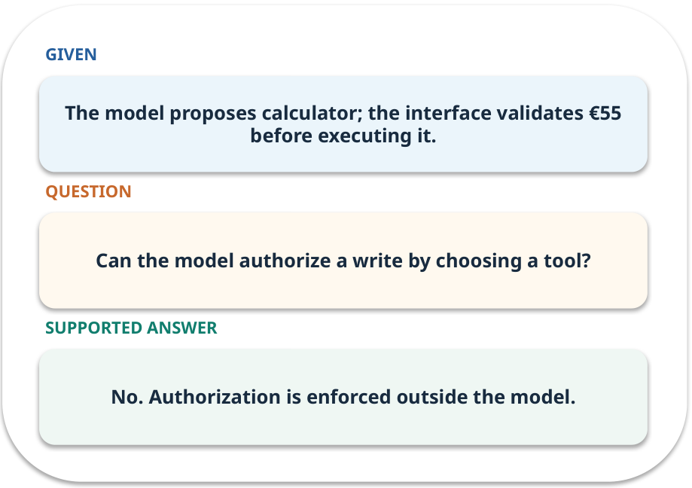
Agent · work one case
WORKED / WEEK 08
The model proposes calculator; the interface validates €55 before executing it.
Point to the evidence before giving your conclusion.
GENERATIVE AI 2027 • WEEK 08 • 20 / 40
Notes:
TEACHER SCRIPT — WORKED. Work the specific numbers or source wording aloud. Give students thirty seconds to write a conclusion, then ask which source line or calculation supports it. This week’s case is: The assistant calculates a permitted reimbursement cap; a request to update a record needs approval. The visible slide states: The model proposes calculator; the interface validates €55 before executing it.
Point to the evidence before giving your conclusion. The expected reasoning concludes: No. Authorization is enforced outside the model. Distinguish measured results from illustrative numbers. The target is: Implement a bounded read-only tool and reason about approval for actions. Listen for an explanation of the actual arrow or calculation, not just a repeated label. If the answer is unsupported, mark that uncertainty and return to the source. Before moving on, ask for the main idea and one concrete change to the worked example.

Slide 21
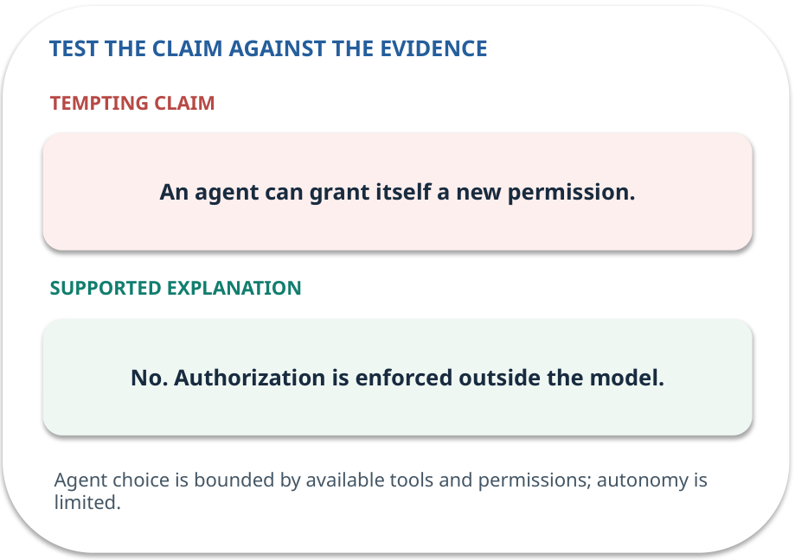
Agent · answer and explain
REVEAL / WEEK 08
No. Authorization is enforced outside the model.
Tempting mistake: An agent can grant itself a new permission.
GENERATIVE AI 2027 • WEEK 08 • 21 / 40
Notes:
TEACHER SCRIPT — REVEAL. Return to the earlier choice. Explain the correct answer and why the tempting claim fails. Ask one learner to say the answer in a single sentence without reading it. This week’s case is: The assistant calculates a permitted reimbursement cap; a request to update a record needs approval. The visible slide states: No. Authorization is enforced outside the model.
Tempting mistake: An agent can grant itself a new permission. The earlier question was Can the model authorize a write by choosing a tool? Ask how this differs from the wrong claim. The target is: Implement a bounded read-only tool and reason about approval for actions. Listen for an explanation of the actual arrow or calculation, not just a repeated label. If the answer is unsupported, mark that uncertainty and return to the source. Before moving on, ask for the main idea and one concrete change to the worked example.

Slide 22
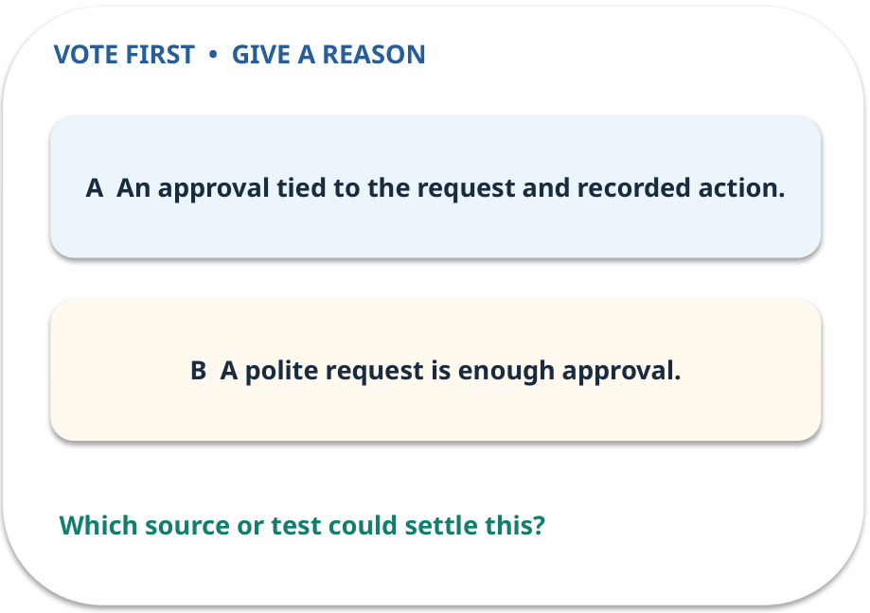
4. Predict · Approval boundary
QUESTION / WEEK 08
What evidence shows a write was authorized?
Make a choice before we explain the diagram.
GENERATIVE AI 2027 • WEEK 08 • 22 / 40
Notes:
TEACHER SCRIPT — QUESTION. Take a show of hands for each choice before showing the mechanism. Ask pairs to defend a choice with evidence. Save the strongest wrong reason for the reveal later in this cycle. This week’s case is: The assistant calculates a permitted reimbursement cap; a request to update a record needs approval. The visible slide states: What evidence shows a write was authorized?
Make a choice before we explain the diagram. The intended answer is An approval tied to the request and recorded action. The tempting claim is A polite request is enough approval. Do not show which card is correct until the reveal. The target is: Implement a bounded read-only tool and reason about approval for actions. Listen for an explanation of the actual arrow or calculation, not just a repeated label. If the answer is unsupported, mark that uncertainty and return to the source. Before moving on, ask for the main idea and one concrete change to the worked example.

Slide 23
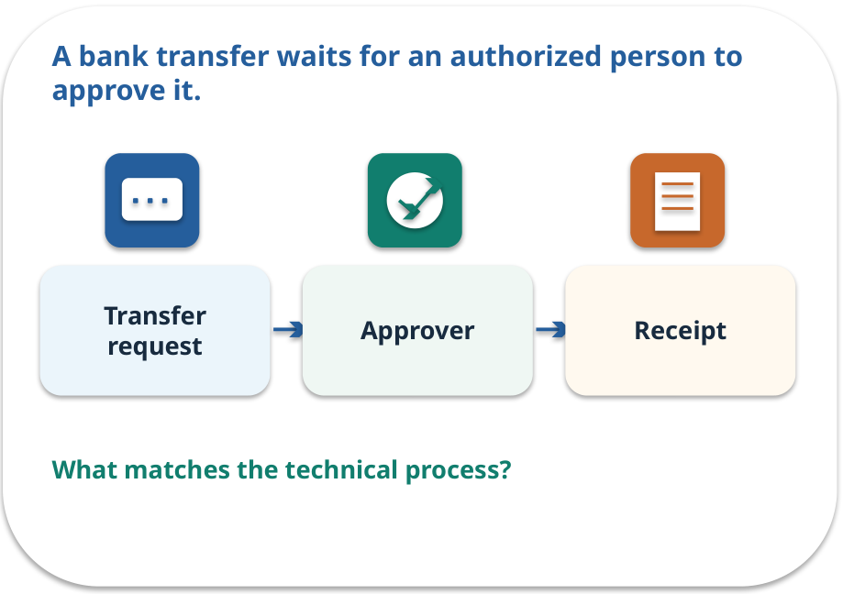
Approval boundary · a familiar picture
ANALOGY / WEEK 08
A bank transfer waits for an authorized person to approve it.
What matches our case, and where does the analogy stop?
GENERATIVE AI 2027 • WEEK 08 • 23 / 40
Notes:
TEACHER SCRIPT — ANALOGY. Begin with the familiar scene. Invite learners to describe each part in everyday language. Then ask where the comparison might fail before introducing the technical vocabulary. This week’s case is: The assistant calculates a permitted reimbursement cap; a request to update a record needs approval. The visible slide states: A bank transfer waits for an authorized person to approve it.
What matches our case, and where does the analogy stop? The boundary is: Some read-only actions also need controls when they reveal restricted information. The target is: Implement a bounded read-only tool and reason about approval for actions. Listen for an explanation of the actual arrow or calculation, not just a repeated label. If the answer is unsupported, mark that uncertainty and return to the source. Before moving on, ask for the main idea and one concrete change to the worked example.

Slide 24
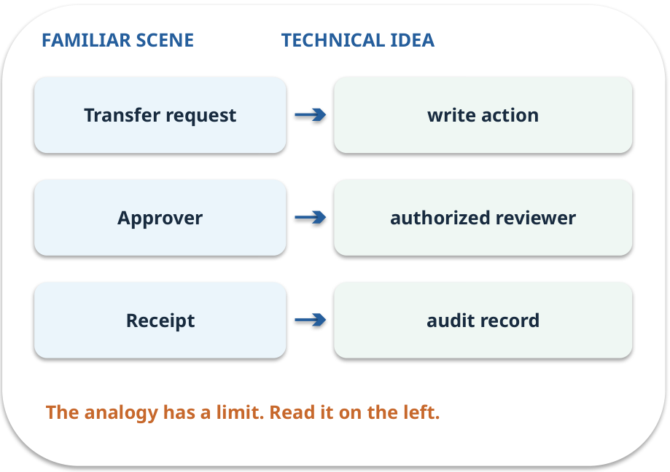
Approval boundary · map the parts
MAPPING / WEEK 08
Match each everyday part to the technical part.
Analogy limit: Some read-only actions also need controls when they reveal restricted information.
GENERATIVE AI 2027 • WEEK 08 • 24 / 40
Notes:
TEACHER SCRIPT — MAPPING. Point from each familiar element to the corresponding technical element. Have students cover the right column and reconstruct the three matches. Read the limitation aloud. This week’s case is: The assistant calculates a permitted reimbursement cap; a request to update a record needs approval. The visible slide states: Match each everyday part to the technical part.
Analogy limit: Some read-only actions also need controls when they reveal restricted information. The three precise mappings are [['Transfer request', 'write action'], ['Approver', 'authorized reviewer'], ['Receipt', 'audit record']]. The target is: Implement a bounded read-only tool and reason about approval for actions. Listen for an explanation of the actual arrow or calculation, not just a repeated label. If the answer is unsupported, mark that uncertainty and return to the source. Before moving on, ask for the main idea and one concrete change to the worked example.

Slide 25
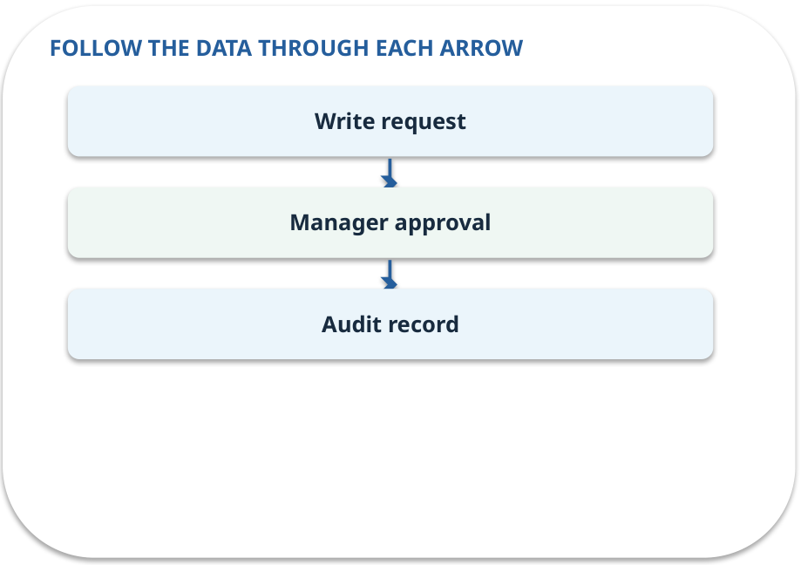
Approval boundary · how it works
MECHANISM / WEEK 08
A consequential write needs explicit review before execution and an audit record.
Trace the arrows from left to right.
GENERATIVE AI 2027 • WEEK 08 • 25 / 40
Notes:
TEACHER SCRIPT — MECHANISM. Trace every arrow slowly from the input to the output. Ask what information crosses the boundary at each arrow. Pause if students confuse a simplified notebook with a trained model. This week’s case is: The assistant calculates a permitted reimbursement cap; a request to update a record needs approval. The visible slide states: A consequential write needs explicit review before execution and an audit record.
Trace the arrows from left to right. The weekly example is: Changing the cap requires an approval record; calculation of €40 does not change the record. State what the analogy does not explain: Some read-only actions also need controls when they reveal restricted information. The target is: Implement a bounded read-only tool and reason about approval for actions. Listen for an explanation of the actual arrow or calculation, not just a repeated label. If the answer is unsupported, mark that uncertainty and return to the source. Before moving on, ask for the main idea and one concrete change to the worked example.

Slide 26
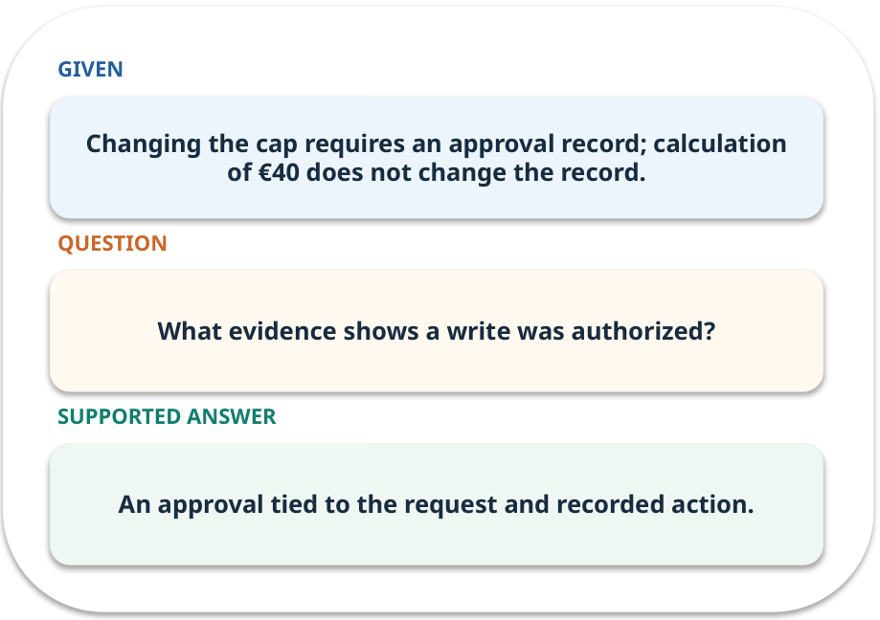
Approval boundary · work one case
WORKED / WEEK 08
Changing the cap requires an approval record; calculation of €40 does not change the record.
Point to the evidence before giving your conclusion.
GENERATIVE AI 2027 • WEEK 08 • 26 / 40
Notes:
TEACHER SCRIPT — WORKED. Work the specific numbers or source wording aloud. Give students thirty seconds to write a conclusion, then ask which source line or calculation supports it. This week’s case is: The assistant calculates a permitted reimbursement cap; a request to update a record needs approval. The visible slide states: Changing the cap requires an approval record; calculation of €40 does not change the record.
Point to the evidence before giving your conclusion. The expected reasoning concludes: An approval tied to the request and recorded action. Distinguish measured results from illustrative numbers. The target is: Implement a bounded read-only tool and reason about approval for actions. Listen for an explanation of the actual arrow or calculation, not just a repeated label. If the answer is unsupported, mark that uncertainty and return to the source. Before moving on, ask for the main idea and one concrete change to the worked example.

Slide 27
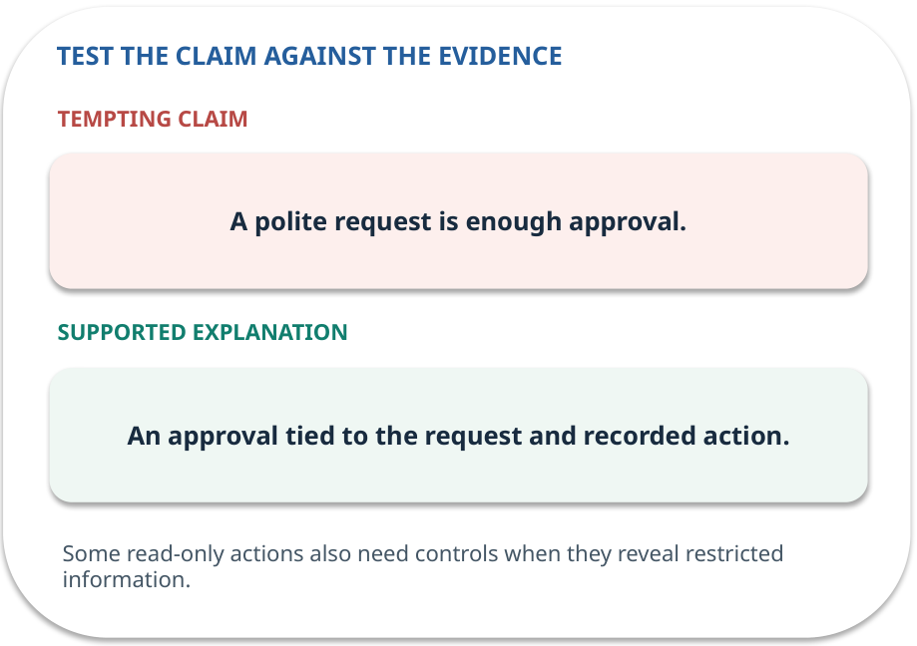
Approval boundary · answer and explain
REVEAL / WEEK 08
An approval tied to the request and recorded action.
Tempting mistake: A polite request is enough approval.
GENERATIVE AI 2027 • WEEK 08 • 27 / 40
Notes:
TEACHER SCRIPT — REVEAL. Return to the earlier choice. Explain the correct answer and why the tempting claim fails. Ask one learner to say the answer in a single sentence without reading it. This week’s case is: The assistant calculates a permitted reimbursement cap; a request to update a record needs approval. The visible slide states: An approval tied to the request and recorded action.
Tempting mistake: A polite request is enough approval. The earlier question was What evidence shows a write was authorized? Ask how this differs from the wrong claim. The target is: Implement a bounded read-only tool and reason about approval for actions. Listen for an explanation of the actual arrow or calculation, not just a repeated label. If the answer is unsupported, mark that uncertainty and return to the source. Before moving on, ask for the main idea and one concrete change to the worked example.

Slide 28
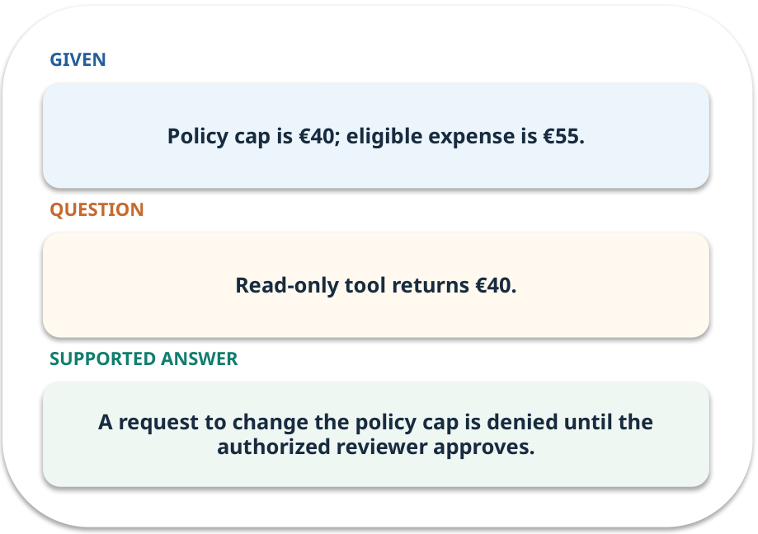
Evidence trail: input → result
WORKED / WEEK 08
Read-only tool returns €40.
A request to change the policy cap is denied until the authorized reviewer approves.
GENERATIVE AI 2027 • WEEK 08 • 28 / 40
Notes:
TEACHER SCRIPT — WORKED. Work the specific numbers or source wording aloud. Give students thirty seconds to write a conclusion, then ask which source line or calculation supports it. This week’s case is: The assistant calculates a permitted reimbursement cap; a request to update a record needs approval. The visible slide states: Read-only tool returns €40.
A request to change the policy cap is denied until the authorized reviewer approves. Have one student point to an exact source word or number for each conclusion. The target is: Implement a bounded read-only tool and reason about approval for actions. Listen for an explanation of the actual arrow or calculation, not just a repeated label. If the answer is unsupported, mark that uncertainty and return to the source. Before moving on, ask for the main idea and one concrete change to the worked example.

Slide 29
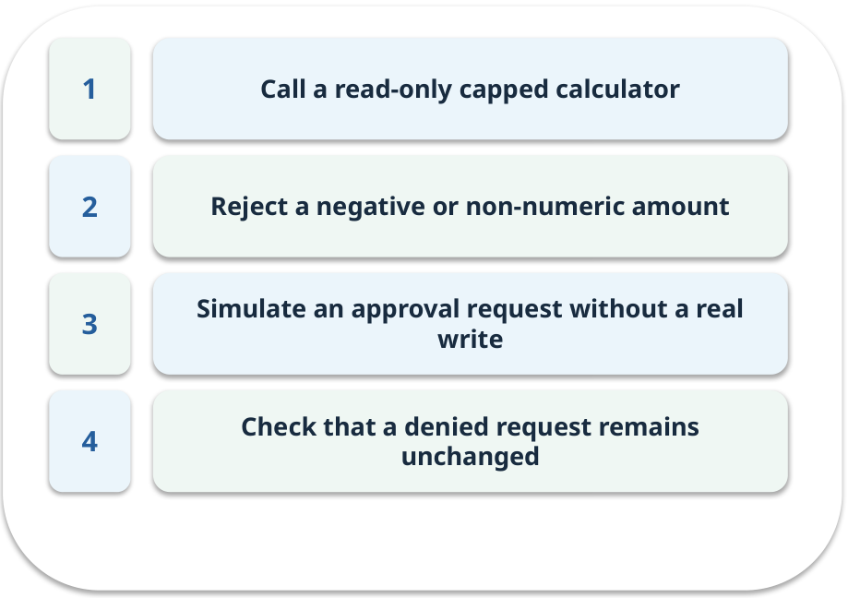
Notebook: run the prepared example
PRACTICE / WEEK 08
Implement a calculator and approval gate simulation.
Read the original output before editing.
GENERATIVE AI 2027 • WEEK 08 • 29 / 40
Notes:
TEACHER SCRIPT — PRACTICE. Open the matching notebook and demonstrate the first run. Have learners predict one change, run only that change, and record input, setting, output and an error explanation. This week’s case is: The assistant calculates a permitted reimbursement cap; a request to update a record needs approval. The visible slide states: Implement a calculator and approval gate simulation.
Read the original output before editing. Use Week_08_Lab.ipynb. This lab is a prepared classroom demonstration with its limitations documented. The target is: Implement a bounded read-only tool and reason about approval for actions. Listen for an explanation of the actual arrow or calculation, not just a repeated label. If the answer is unsupported, mark that uncertainty and return to the source. Before moving on, ask for the main idea and one concrete change to the worked example.

Slide 30

Find the input and check in Python
PRACTICE / WEEK 08
Locate the supplied input, the transformation, the checking line and the printed result.
GENERATIVE AI 2027 • WEEK 08 • 30 / 40
Notes:
TEACHER SCRIPT — PRACTICE. Open the matching notebook and demonstrate the first run. Have learners predict one change, run only that change, and record input, setting, output and an error explanation. This week’s case is: The assistant calculates a permitted reimbursement cap; a request to update a record needs approval. The visible slide states: Locate the supplied input, the transformation, the checking line and the printed result. The weekly lab change is: Try a negative amount and confirm the validator blocks it. The target is: Implement a bounded read-only tool and reason about approval for actions. Listen for an explanation of the actual arrow or calculation, not just a repeated label. If the answer is unsupported, mark that uncertainty and return to the source. Before moving on, ask for the main idea and one concrete change to the worked example.

Slide 31

Predict one controlled change
PRACTICE / WEEK 08
Try a negative amount and confirm the validator blocks it.
What should change in the result? What stays fixed?
GENERATIVE AI 2027 • WEEK 08 • 31 / 40
Notes:
TEACHER SCRIPT — PRACTICE. Open the matching notebook and demonstrate the first run. Have learners predict one change, run only that change, and record input, setting, output and an error explanation. This week’s case is: The assistant calculates a permitted reimbursement cap; a request to update a record needs approval. The visible slide states: Try a negative amount and confirm the validator blocks it.
What should change in the result? What stays fixed? Ask learners to write their prediction before rerunning the cell. The target is: Implement a bounded read-only tool and reason about approval for actions. Listen for an explanation of the actual arrow or calculation, not just a repeated label. If the answer is unsupported, mark that uncertainty and return to the source. Before moving on, ask for the main idea and one concrete change to the worked example.

Slide 32

Run, compare and record
PRACTICE / WEEK 08
Record the input, the one changed setting, the observed result and a reason for any difference.
GENERATIVE AI 2027 • WEEK 08 • 32 / 40
Notes:
TEACHER SCRIPT — PRACTICE. Open the matching notebook and demonstrate the first run. Have learners predict one change, run only that change, and record input, setting, output and an error explanation. This week’s case is: The assistant calculates a permitted reimbursement cap; a request to update a record needs approval. The visible slide states: Record the input, the one changed setting, the observed result and a reason for any difference. The required evidence is: Tool result, blocked-request trace and approval explanation. The target is: Implement a bounded read-only tool and reason about approval for actions. Listen for an explanation of the actual arrow or calculation, not just a repeated label. If the answer is unsupported, mark that uncertainty and return to the source. Before moving on, ask for the main idea and one concrete change to the worked example.

Slide 33

Measure without hiding the denominator
CHECK / WEEK 08
Unauthorized successful actions / attempted unauthorized actions (target zero)
Write the numerator, denominator and one failure case.
GENERATIVE AI 2027 • WEEK 08 • 33 / 40
Notes:
TEACHER SCRIPT — CHECK. Use this as a brief formative check. Ask for the conclusion, the evidence and one limitation. Revisit disagreements in the review session and offer an extension only after the core task. This week’s case is: The assistant calculates a permitted reimbursement cap; a request to update a record needs approval. The visible slide states: Unauthorized successful actions / attempted unauthorized actions (target zero)
Write the numerator, denominator and one failure case. Where a measure is qualitative, show the concrete source comparison. Example: A request to change the policy cap is denied until the authorized reviewer approves. The target is: Implement a bounded read-only tool and reason about approval for actions. Listen for an explanation of the actual arrow or calculation, not just a repeated label. If the answer is unsupported, mark that uncertainty and return to the source. Before moving on, ask for the main idea and one concrete change to the worked example.

Slide 34
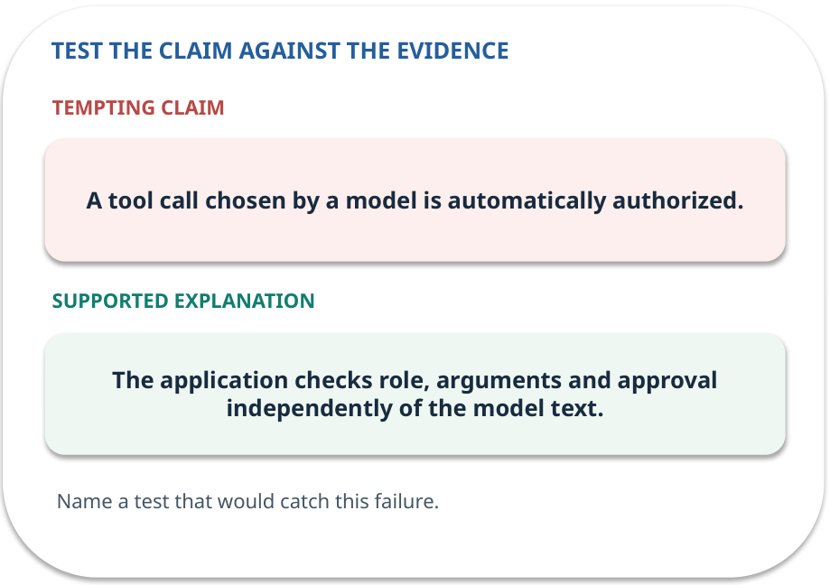
Error detective: find the layer
CHECK / WEEK 08
Plausible wrong claim: A tool call chosen by a model is automatically authorized.
Correct it using the case evidence.
GENERATIVE AI 2027 • WEEK 08 • 34 / 40
Notes:
TEACHER SCRIPT — CHECK. Use this as a brief formative check. Ask for the conclusion, the evidence and one limitation. Revisit disagreements in the review session and offer an extension only after the core task. This week’s case is: The assistant calculates a permitted reimbursement cap; a request to update a record needs approval. The visible slide states: Plausible wrong claim: A tool call chosen by a model is automatically authorized.
Correct it using the case evidence. The correction is The application checks role, arguments and approval independently of the model text. The target is: Implement a bounded read-only tool and reason about approval for actions. Listen for an explanation of the actual arrow or calculation, not just a repeated label. If the answer is unsupported, mark that uncertainty and return to the source. Before moving on, ask for the main idea and one concrete change to the worked example.

Slide 35

Transfer to a new situation
CHECK / WEEK 08
A tool receives amount −€5. What should happen before any calculation?
Explain which source or test would settle it.
GENERATIVE AI 2027 • WEEK 08 • 35 / 40
Notes:
TEACHER SCRIPT — CHECK. Use this as a brief formative check. Ask for the conclusion, the evidence and one limitation. Revisit disagreements in the review session and offer an extension only after the core task. This week’s case is: The assistant calculates a permitted reimbursement cap; a request to update a record needs approval. The visible slide states: A tool receives amount −€5. What should happen before any calculation?
Explain which source or test would settle it. This is a fresh scenario, so ask for a reason before accepting either short answer. The target is: Implement a bounded read-only tool and reason about approval for actions. Listen for an explanation of the actual arrow or calculation, not just a repeated label. If the answer is unsupported, mark that uncertainty and return to the source. Before moving on, ask for the main idea and one concrete change to the worked example.

Slide 36

Explain it to a partner
CHECK / WEEK 08
Without reading the slide, name the input, one processing step and the check. Your partner should ask “How do you know?”
GENERATIVE AI 2027 • WEEK 08 • 36 / 40
Notes:
TEACHER SCRIPT — CHECK. Use this as a brief formative check. Ask for the conclusion, the evidence and one limitation. Revisit disagreements in the review session and offer an extension only after the core task. This week’s case is: The assistant calculates a permitted reimbursement cap; a request to update a record needs approval. The visible slide states: Without reading the slide, name the input, one processing step and the check. Your partner should ask “How do you know?” Listen for a causal explanation and one limitation, then revisit a difficult arrow on the board. The target is: Implement a bounded read-only tool and reason about approval for actions. Listen for an explanation of the actual arrow or calculation, not just a repeated label. If the answer is unsupported, mark that uncertainty and return to the source. Before moving on, ask for the main idea and one concrete change to the worked example.

Slide 37

Exam rehearsal · explain and apply
CHECK / WEEK 08
What distinguishes a workflow from an agent?
Write a short answer, then compare with the guide.
GENERATIVE AI 2027 • WEEK 08 • 37 / 40
Notes:
TEACHER SCRIPT — CHECK. Use this as a brief formative check. Ask for the conclusion, the evidence and one limitation. Revisit disagreements in the review session and offer an extension only after the core task. This week’s case is: The assistant calculates a permitted reimbursement cap; a request to update a record needs approval. The visible slide states: What distinguishes a workflow from an agent?
Write a short answer, then compare with the guide. Model answer after discussion: A workflow follows predefined steps; an agent can select subsequent actions within allowed boundaries. Practice marks: 4. The target is: Implement a bounded read-only tool and reason about approval for actions. Listen for an explanation of the actual arrow or calculation, not just a repeated label. If the answer is unsupported, mark that uncertainty and return to the source. Before moving on, ask for the main idea and one concrete change to the worked example.

Slide 38
Exam rehearsal · explain and apply
CHECK / WEEK 08
Calculate a reimbursement with eligible expense 55 and cap 40.
Write a short answer, then compare with the guide.
GENERATIVE AI 2027 • WEEK 08 • 38 / 40
Notes:
TEACHER SCRIPT — CHECK. Use this as a brief formative check. Ask for the conclusion, the evidence and one limitation. Revisit disagreements in the review session and offer an extension only after the core task. This week’s case is: The assistant calculates a permitted reimbursement cap; a request to update a record needs approval. The visible slide states: Calculate a reimbursement with eligible expense 55 and cap 40.
Write a short answer, then compare with the guide. Model answer after discussion: min(55,40)=40. Eligibility must already be established; the calculator does not decide it. Practice marks: 4. The target is: Implement a bounded read-only tool and reason about approval for actions. Listen for an explanation of the actual arrow or calculation, not just a repeated label. If the answer is unsupported, mark that uncertainty and return to the source. Before moving on, ask for the main idea and one concrete change to the worked example.

Slide 39

What to hand in
PRACTICE / WEEK 08
Tool result, blocked-request trace and approval explanation.
Include the one changed input and an error explanation.
GENERATIVE AI 2027 • WEEK 08 • 39 / 40
Notes:
TEACHER SCRIPT — PRACTICE. Open the matching notebook and demonstrate the first run. Have learners predict one change, run only that change, and record input, setting, output and an error explanation. This week’s case is: The assistant calculates a permitted reimbursement cap; a request to update a record needs approval. The visible slide states: Tool result, blocked-request trace and approval explanation.
Include the one changed input and an error explanation. This weekly evidence receives formative feedback according to the module sequence; refer to the assessment brief for graded work. The target is: Implement a bounded read-only tool and reason about approval for actions. Listen for an explanation of the actual arrow or calculation, not just a repeated label. If the answer is unsupported, mark that uncertainty and return to the source. Before moving on, ask for the main idea and one concrete change to the worked example.

Slide 40
Three ideas to recall next week
CHECK / WEEK 08
Validate a read-only tool; route write actions through human approval.
Read the linked official sources in the Word guide and redraw one diagram from memory.
GENERATIVE AI 2027 • WEEK 08 • 40 / 40
Notes:
TEACHER SCRIPT — CHECK. Use this as a brief formative check. Ask for the conclusion, the evidence and one limitation. Revisit disagreements in the review session and offer an extension only after the core task. This week’s case is: The assistant calculates a permitted reimbursement cap; a request to update a record needs approval. The visible slide states: Validate a read-only tool; route write actions through human approval.
Read the linked official sources in the Word guide and redraw one diagram from memory. Return to the opening vote and ask whether the evidence changed anyone’s mind. The next week builds on this outcome: Implement a bounded read-only tool and reason about approval for actions. The target is: Implement a bounded read-only tool and reason about approval for actions. Listen for an explanation of the actual arrow or calculation, not just a repeated label. If the answer is unsupported, mark that uncertainty and return to the source. Before moving on, ask for the main idea and one concrete change to the worked example.

