Slide 1
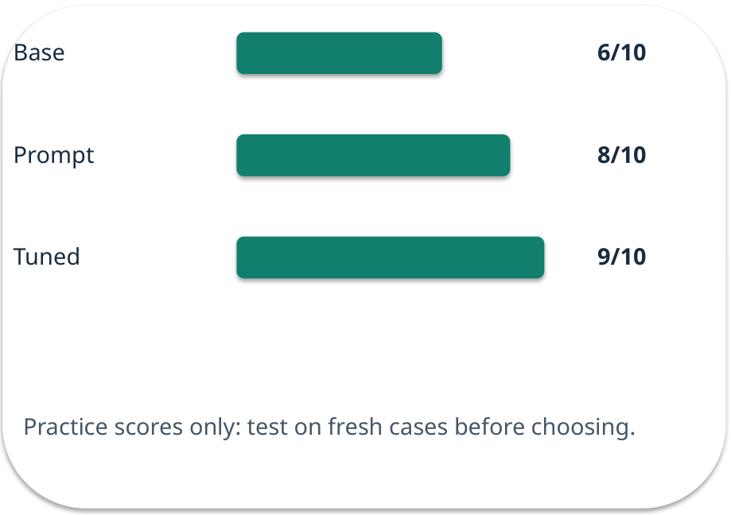
Week 09 · When fine-tuning helps
OPEN / WEEK 09
The revised policy problem
Practice results say a tuned model wins 9/10, but a revised policy arrived yesterday and final cases show 6/10. What should change first?
GENERATIVE AI 2027 • WEEK 09 • 01 / 40
Notes:
TEACHER SCRIPT — OPEN. Show the visual for ten seconds, then ask for an initial decision. Do not reveal the answer yet. Ask a student to name the source or measurement that would change their mind. This week’s case is: A college assistant uses the correct format but misses a revised policy. The visible slide states: The revised policy problem
Practice results say a tuned model wins 9/10, but a revised policy arrived yesterday and final cases show 6/10. What should change first? Reveal that the case will be revisited after four short concept cycles. The target is: Choose among a clearer prompt, current evidence and model adaptation. Listen for an explanation of the actual arrow or calculation, not just a repeated label. If the answer is unsupported, mark that uncertainty and return to the source. Before moving on, ask for the main idea and one concrete change to the worked example.

Slide 2

First vote: what would you do?
QUESTION / WEEK 09
Practice results say a tuned model wins 9/10, but a revised policy arrived yesterday and final cases show 6/10. What should change first?
Choose an initial answer and name one piece of evidence you need.
GENERATIVE AI 2027 • WEEK 09 • 02 / 40
Notes:
TEACHER SCRIPT — QUESTION. Take a show of hands for each choice before showing the mechanism. Ask pairs to defend a choice with evidence. Save the strongest wrong reason for the reveal later in this cycle. This week’s case is: A college assistant uses the correct format but misses a revised policy. The visible slide states: Practice results say a tuned model wins 9/10, but a revised policy arrived yesterday and final cases show 6/10. What should change first?
Choose an initial answer and name one piece of evidence you need. Accept reasonable uncertainty; record the initial votes to revisit at the end. The target is: Choose among a clearer prompt, current evidence and model adaptation. Listen for an explanation of the actual arrow or calculation, not just a repeated label. If the answer is unsupported, mark that uncertainty and return to the source. Before moving on, ask for the main idea and one concrete change to the worked example.

Slide 3
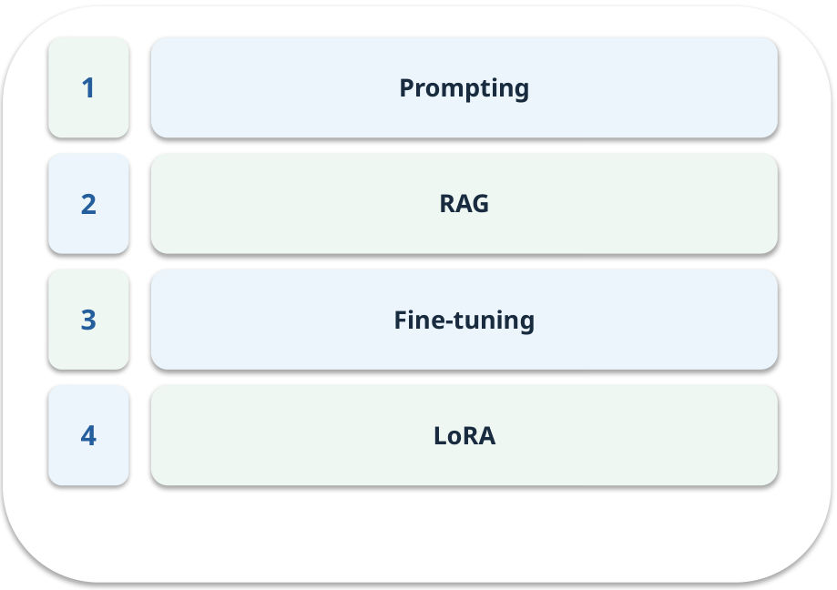
The journey through today’s case
OPEN / WEEK 09
We will predict, connect an analogy, trace a mechanism, work an example, then explain a decision.
GENERATIVE AI 2027 • WEEK 09 • 03 / 40
Notes:
TEACHER SCRIPT — OPEN. Show the visual for ten seconds, then ask for an initial decision. Do not reveal the answer yet. Ask a student to name the source or measurement that would change their mind. This week’s case is: A college assistant uses the correct format but misses a revised policy. The visible slide states: We will predict, connect an analogy, trace a mechanism, work an example, then explain a decision. Point to the four named ideas, then show where the notebook experiment fits. The target is: Choose among a clearer prompt, current evidence and model adaptation. Listen for an explanation of the actual arrow or calculation, not just a repeated label. If the answer is unsupported, mark that uncertainty and return to the source. Before moving on, ask for the main idea and one concrete change to the worked example.

Slide 4
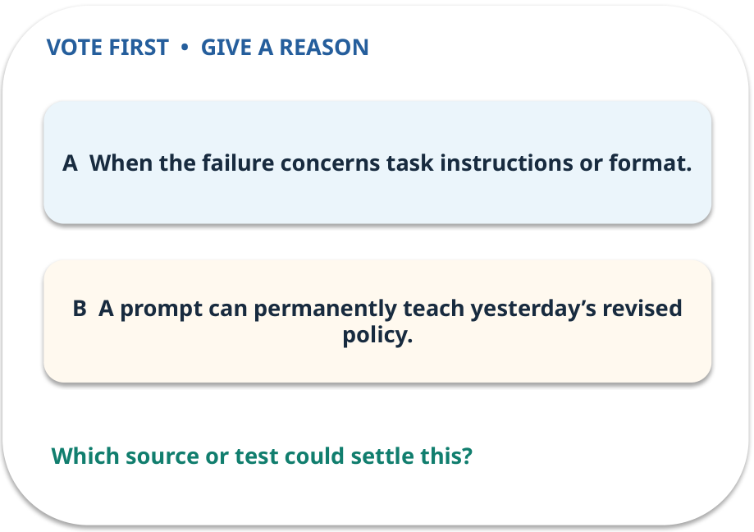
1. Predict · Prompting
QUESTION / WEEK 09
When is this an inexpensive first trial?
Make a choice before we explain the diagram.
GENERATIVE AI 2027 • WEEK 09 • 04 / 40
Notes:
TEACHER SCRIPT — QUESTION. Take a show of hands for each choice before showing the mechanism. Ask pairs to defend a choice with evidence. Save the strongest wrong reason for the reveal later in this cycle. This week’s case is: A college assistant uses the correct format but misses a revised policy. The visible slide states: When is this an inexpensive first trial?
Make a choice before we explain the diagram. The intended answer is When the failure concerns task instructions or format. The tempting claim is A prompt can permanently teach yesterday’s revised policy. Do not show which card is correct until the reveal. The target is: Choose among a clearer prompt, current evidence and model adaptation. Listen for an explanation of the actual arrow or calculation, not just a repeated label. If the answer is unsupported, mark that uncertainty and return to the source. Before moving on, ask for the main idea and one concrete change to the worked example.

Slide 5
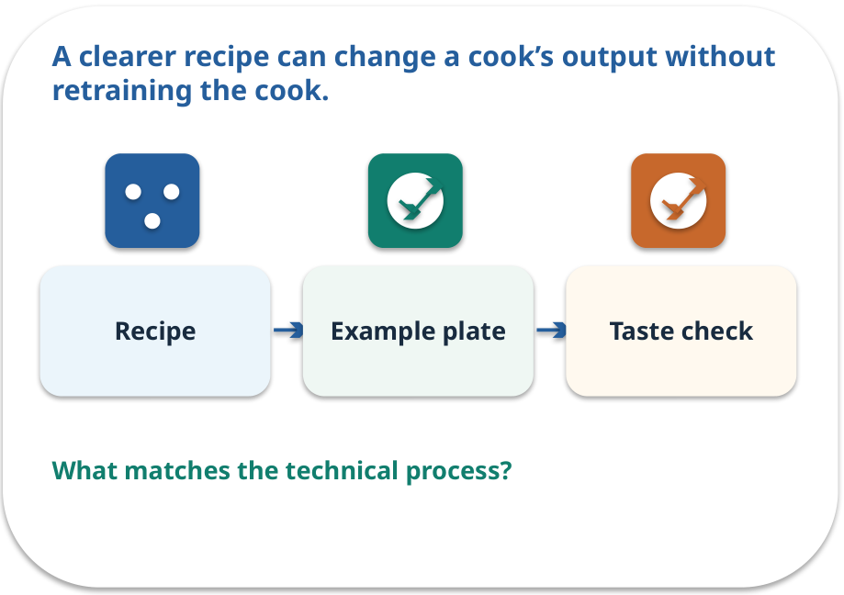
Prompting · a familiar picture
ANALOGY / WEEK 09
A clearer recipe can change a cook’s output without retraining the cook.
What matches our case, and where does the analogy stop?
GENERATIVE AI 2027 • WEEK 09 • 05 / 40
Notes:
TEACHER SCRIPT — ANALOGY. Begin with the familiar scene. Invite learners to describe each part in everyday language. Then ask where the comparison might fail before introducing the technical vocabulary. This week’s case is: A college assistant uses the correct format but misses a revised policy. The visible slide states: A clearer recipe can change a cook’s output without retraining the cook.
What matches our case, and where does the analogy stop? The boundary is: Instructions can fail; a prompt does not update facts or guarantee conformance. The target is: Choose among a clearer prompt, current evidence and model adaptation. Listen for an explanation of the actual arrow or calculation, not just a repeated label. If the answer is unsupported, mark that uncertainty and return to the source. Before moving on, ask for the main idea and one concrete change to the worked example.

Slide 6
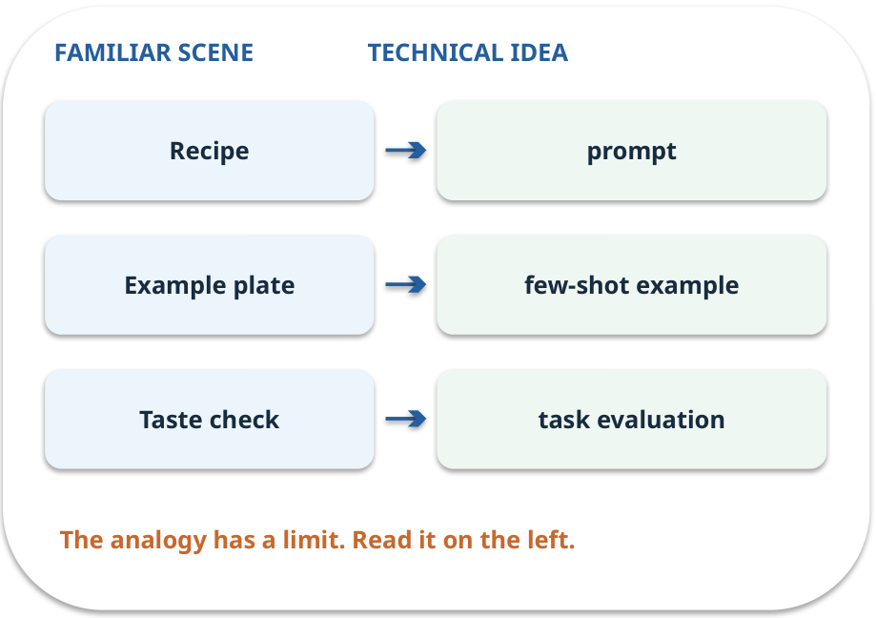
Prompting · map the parts
MAPPING / WEEK 09
Match each everyday part to the technical part.
Analogy limit: Instructions can fail; a prompt does not update facts or guarantee conformance.
GENERATIVE AI 2027 • WEEK 09 • 06 / 40
Notes:
TEACHER SCRIPT — MAPPING. Point from each familiar element to the corresponding technical element. Have students cover the right column and reconstruct the three matches. Read the limitation aloud. This week’s case is: A college assistant uses the correct format but misses a revised policy. The visible slide states: Match each everyday part to the technical part.
Analogy limit: Instructions can fail; a prompt does not update facts or guarantee conformance. The three precise mappings are [['Recipe', 'prompt'], ['Example plate', 'few-shot example'], ['Taste check', 'task evaluation']]. The target is: Choose among a clearer prompt, current evidence and model adaptation. Listen for an explanation of the actual arrow or calculation, not just a repeated label. If the answer is unsupported, mark that uncertainty and return to the source. Before moving on, ask for the main idea and one concrete change to the worked example.

Slide 7

Prompting · how it works
MECHANISM / WEEK 09
Change instructions or examples for the task without changing weights.
Trace the arrows from left to right.
GENERATIVE AI 2027 • WEEK 09 • 07 / 40
Notes:
TEACHER SCRIPT — MECHANISM. Trace every arrow slowly from the input to the output. Ask what information crosses the boundary at each arrow. Pause if students confuse a simplified notebook with a trained model. This week’s case is: A college assistant uses the correct format but misses a revised policy. The visible slide states: Change instructions or examples for the task without changing weights.
Trace the arrows from left to right. The weekly example is: On ten practice cases, a clarified prompt improves 6/10 to 8/10; record the cases. State what the analogy does not explain: Instructions can fail; a prompt does not update facts or guarantee conformance. The target is: Choose among a clearer prompt, current evidence and model adaptation. Listen for an explanation of the actual arrow or calculation, not just a repeated label. If the answer is unsupported, mark that uncertainty and return to the source. Before moving on, ask for the main idea and one concrete change to the worked example.

Slide 8
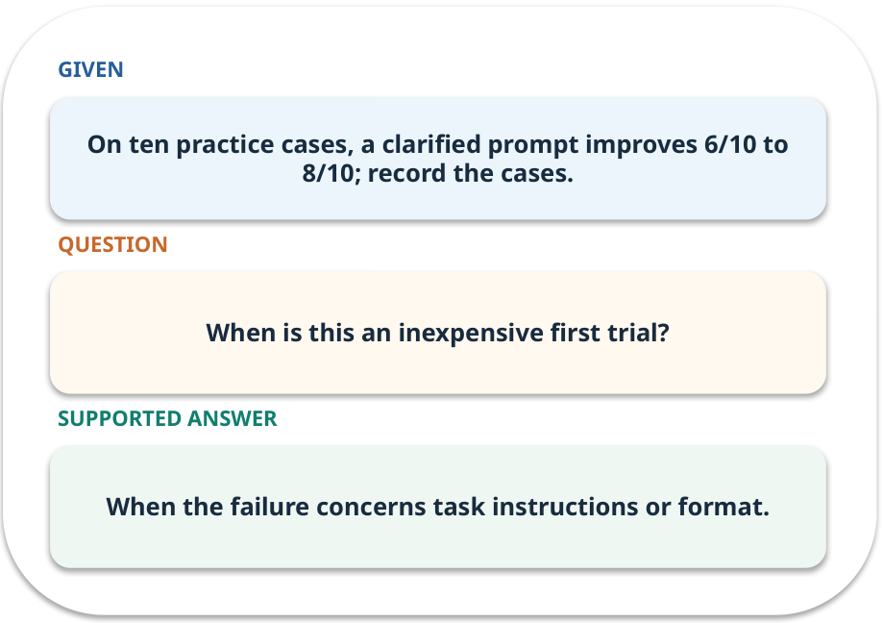
Prompting · work one case
WORKED / WEEK 09
On ten practice cases, a clarified prompt improves 6/10 to 8/10; record the cases.
Point to the evidence before giving your conclusion.
GENERATIVE AI 2027 • WEEK 09 • 08 / 40
Notes:
TEACHER SCRIPT — WORKED. Work the specific numbers or source wording aloud. Give students thirty seconds to write a conclusion, then ask which source line or calculation supports it. This week’s case is: A college assistant uses the correct format but misses a revised policy. The visible slide states: On ten practice cases, a clarified prompt improves 6/10 to 8/10; record the cases.
Point to the evidence before giving your conclusion. The expected reasoning concludes: When the failure concerns task instructions or format. Distinguish measured results from illustrative numbers. The target is: Choose among a clearer prompt, current evidence and model adaptation. Listen for an explanation of the actual arrow or calculation, not just a repeated label. If the answer is unsupported, mark that uncertainty and return to the source. Before moving on, ask for the main idea and one concrete change to the worked example.

Slide 9
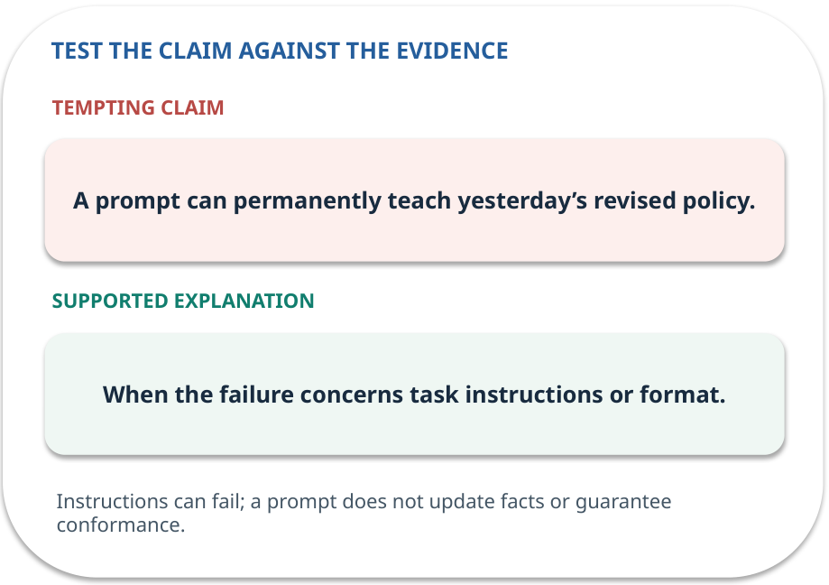
Prompting · answer and explain
REVEAL / WEEK 09
When the failure concerns task instructions or format.
Tempting mistake: A prompt can permanently teach yesterday’s revised policy.
GENERATIVE AI 2027 • WEEK 09 • 09 / 40
Notes:
TEACHER SCRIPT — REVEAL. Return to the earlier choice. Explain the correct answer and why the tempting claim fails. Ask one learner to say the answer in a single sentence without reading it. This week’s case is: A college assistant uses the correct format but misses a revised policy. The visible slide states: When the failure concerns task instructions or format.
Tempting mistake: A prompt can permanently teach yesterday’s revised policy. The earlier question was When is this an inexpensive first trial? Ask how this differs from the wrong claim. The target is: Choose among a clearer prompt, current evidence and model adaptation. Listen for an explanation of the actual arrow or calculation, not just a repeated label. If the answer is unsupported, mark that uncertainty and return to the source. Before moving on, ask for the main idea and one concrete change to the worked example.

Slide 10
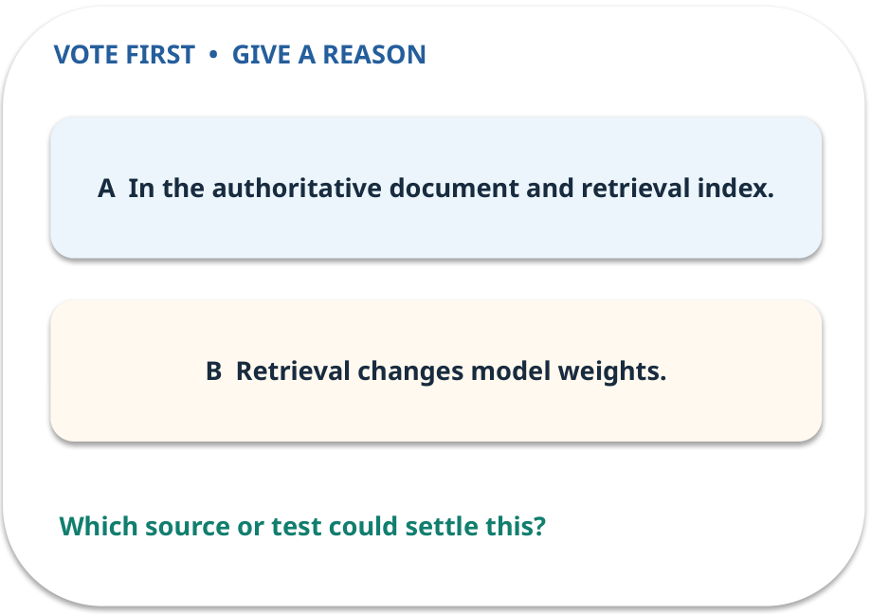
2. Predict · RAG
QUESTION / WEEK 09
Where should a changed policy be updated first?
Make a choice before we explain the diagram.
GENERATIVE AI 2027 • WEEK 09 • 10 / 40
Notes:
TEACHER SCRIPT — QUESTION. Take a show of hands for each choice before showing the mechanism. Ask pairs to defend a choice with evidence. Save the strongest wrong reason for the reveal later in this cycle. This week’s case is: A college assistant uses the correct format but misses a revised policy. The visible slide states: Where should a changed policy be updated first?
Make a choice before we explain the diagram. The intended answer is In the authoritative document and retrieval index. The tempting claim is Retrieval changes model weights. Do not show which card is correct until the reveal. The target is: Choose among a clearer prompt, current evidence and model adaptation. Listen for an explanation of the actual arrow or calculation, not just a repeated label. If the answer is unsupported, mark that uncertainty and return to the source. Before moving on, ask for the main idea and one concrete change to the worked example.

Slide 11
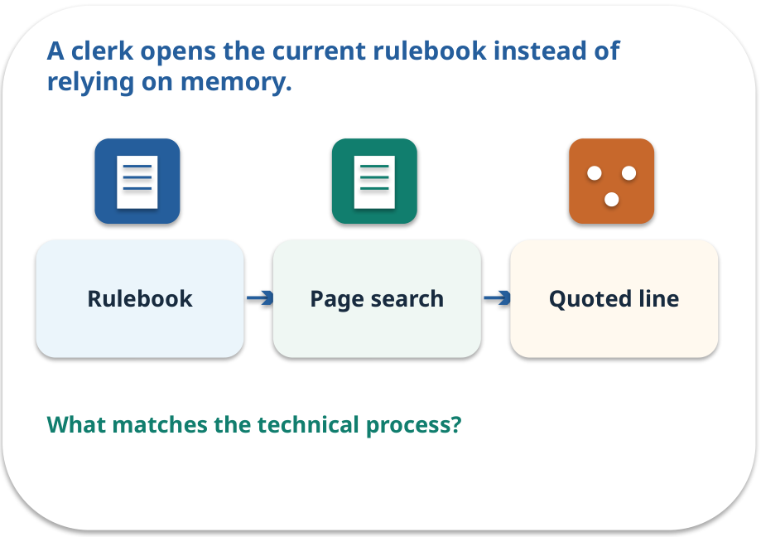
RAG · a familiar picture
ANALOGY / WEEK 09
A clerk opens the current rulebook instead of relying on memory.
What matches our case, and where does the analogy stop?
GENERATIVE AI 2027 • WEEK 09 • 11 / 40
Notes:
TEACHER SCRIPT — ANALOGY. Begin with the familiar scene. Invite learners to describe each part in everyday language. Then ask where the comparison might fail before introducing the technical vocabulary. This week’s case is: A college assistant uses the correct format but misses a revised policy. The visible slide states: A clerk opens the current rulebook instead of relying on memory.
What matches our case, and where does the analogy stop? The boundary is: Retrieved text still needs access, relevance and claim checks. The target is: Choose among a clearer prompt, current evidence and model adaptation. Listen for an explanation of the actual arrow or calculation, not just a repeated label. If the answer is unsupported, mark that uncertainty and return to the source. Before moving on, ask for the main idea and one concrete change to the worked example.

Slide 12
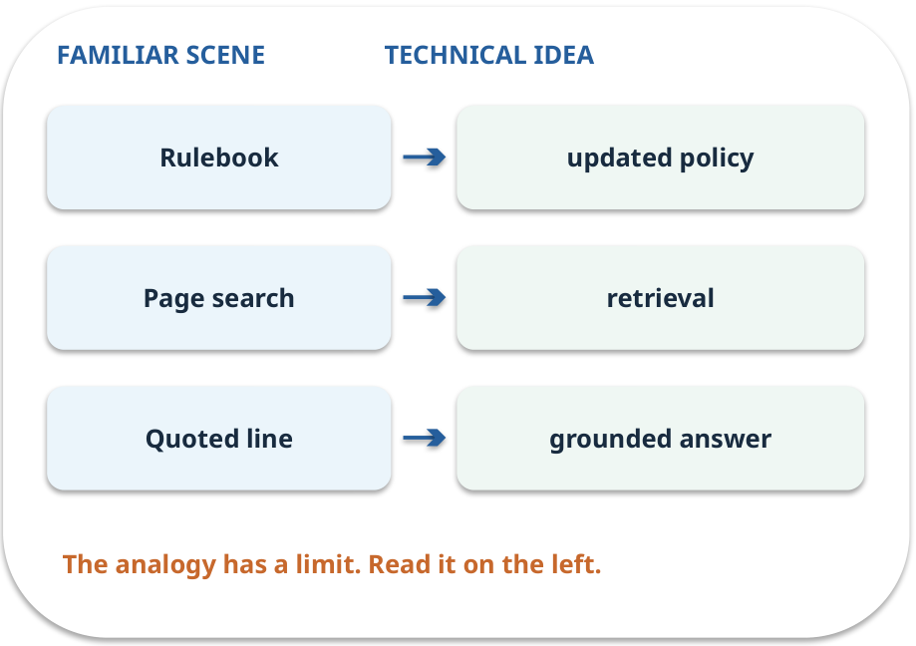
RAG · map the parts
MAPPING / WEEK 09
Match each everyday part to the technical part.
Analogy limit: Retrieved text still needs access, relevance and claim checks.
GENERATIVE AI 2027 • WEEK 09 • 12 / 40
Notes:
TEACHER SCRIPT — MAPPING. Point from each familiar element to the corresponding technical element. Have students cover the right column and reconstruct the three matches. Read the limitation aloud. This week’s case is: A college assistant uses the correct format but misses a revised policy. The visible slide states: Match each everyday part to the technical part.
Analogy limit: Retrieved text still needs access, relevance and claim checks. The three precise mappings are [['Rulebook', 'updated policy'], ['Page search', 'retrieval'], ['Quoted line', 'grounded answer']]. The target is: Choose among a clearer prompt, current evidence and model adaptation. Listen for an explanation of the actual arrow or calculation, not just a repeated label. If the answer is unsupported, mark that uncertainty and return to the source. Before moving on, ask for the main idea and one concrete change to the worked example.

Slide 13
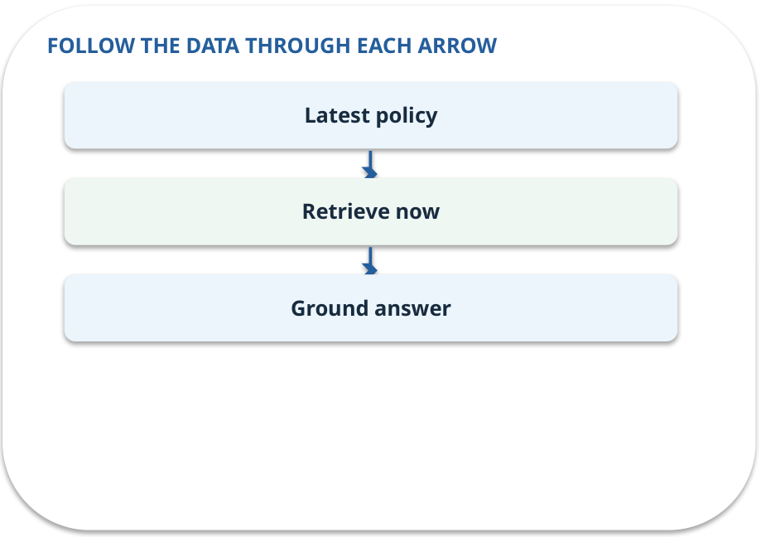
RAG · how it works
MECHANISM / WEEK 09
Supply up-to-date evidence at inference time; useful for changing facts and traceable answers.
Trace the arrows from left to right.
GENERATIVE AI 2027 • WEEK 09 • 13 / 40
Notes:
TEACHER SCRIPT — MECHANISM. Trace every arrow slowly from the input to the output. Ask what information crosses the boundary at each arrow. Pause if students confuse a simplified notebook with a trained model. This week’s case is: A college assistant uses the correct format but misses a revised policy. The visible slide states: Supply up-to-date evidence at inference time; useful for changing facts and traceable answers.
Trace the arrows from left to right. The weekly example is: Replace P3 with its approved revised version, reindex and retrieve it for the question. State what the analogy does not explain: Retrieved text still needs access, relevance and claim checks. The target is: Choose among a clearer prompt, current evidence and model adaptation. Listen for an explanation of the actual arrow or calculation, not just a repeated label. If the answer is unsupported, mark that uncertainty and return to the source. Before moving on, ask for the main idea and one concrete change to the worked example.

Slide 14
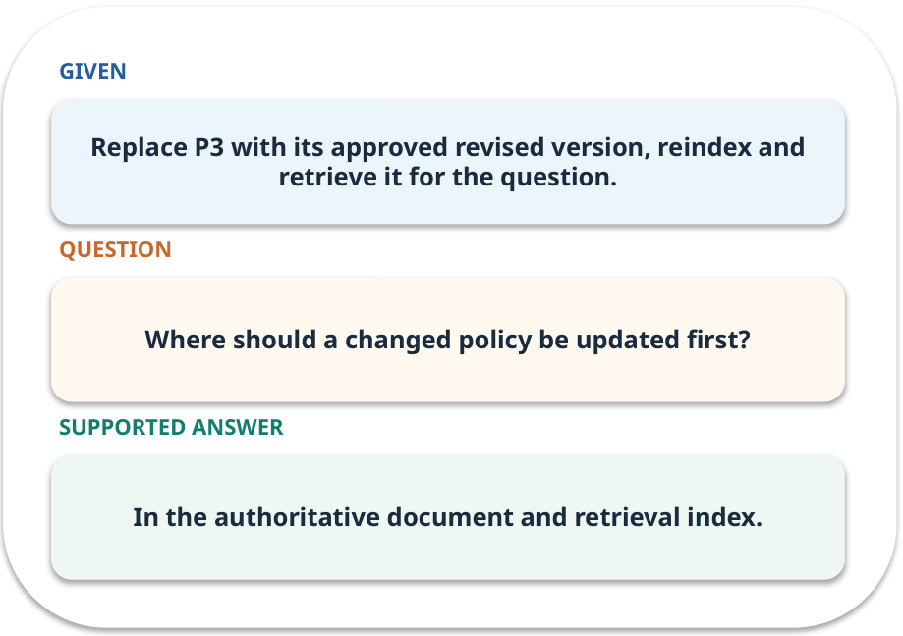
RAG · work one case
WORKED / WEEK 09
Replace P3 with its approved revised version, reindex and retrieve it for the question.
Point to the evidence before giving your conclusion.
GENERATIVE AI 2027 • WEEK 09 • 14 / 40
Notes:
TEACHER SCRIPT — WORKED. Work the specific numbers or source wording aloud. Give students thirty seconds to write a conclusion, then ask which source line or calculation supports it. This week’s case is: A college assistant uses the correct format but misses a revised policy. The visible slide states: Replace P3 with its approved revised version, reindex and retrieve it for the question.
Point to the evidence before giving your conclusion. The expected reasoning concludes: In the authoritative document and retrieval index. Distinguish measured results from illustrative numbers. The target is: Choose among a clearer prompt, current evidence and model adaptation. Listen for an explanation of the actual arrow or calculation, not just a repeated label. If the answer is unsupported, mark that uncertainty and return to the source. Before moving on, ask for the main idea and one concrete change to the worked example.

Slide 15
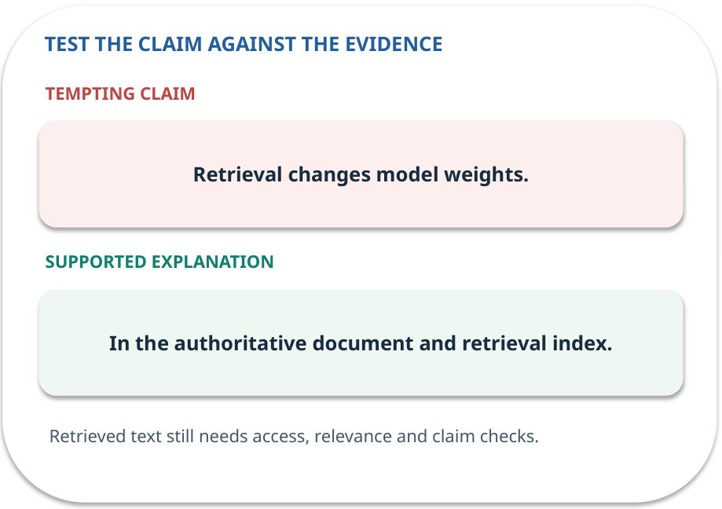
RAG · answer and explain
REVEAL / WEEK 09
In the authoritative document and retrieval index.
Tempting mistake: Retrieval changes model weights.
GENERATIVE AI 2027 • WEEK 09 • 15 / 40
Notes:
TEACHER SCRIPT — REVEAL. Return to the earlier choice. Explain the correct answer and why the tempting claim fails. Ask one learner to say the answer in a single sentence without reading it. This week’s case is: A college assistant uses the correct format but misses a revised policy. The visible slide states: In the authoritative document and retrieval index.
Tempting mistake: Retrieval changes model weights. The earlier question was Where should a changed policy be updated first? Ask how this differs from the wrong claim. The target is: Choose among a clearer prompt, current evidence and model adaptation. Listen for an explanation of the actual arrow or calculation, not just a repeated label. If the answer is unsupported, mark that uncertainty and return to the source. Before moving on, ask for the main idea and one concrete change to the worked example.

Slide 16
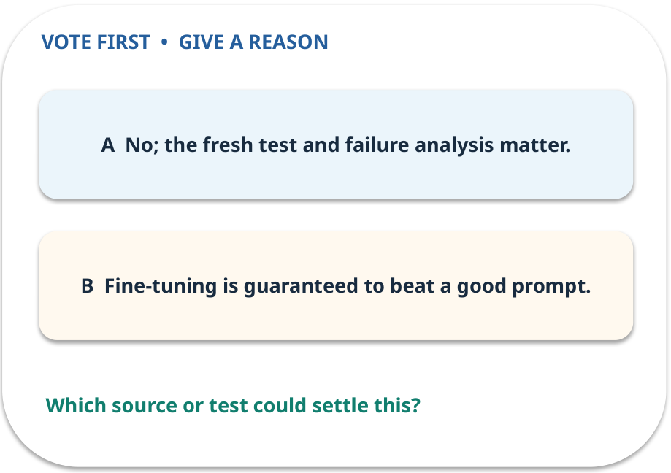
3. Predict · Fine-tuning
QUESTION / WEEK 09
Does the practice result prove tuning should ship?
Make a choice before we explain the diagram.
GENERATIVE AI 2027 • WEEK 09 • 16 / 40
Notes:
TEACHER SCRIPT — QUESTION. Take a show of hands for each choice before showing the mechanism. Ask pairs to defend a choice with evidence. Save the strongest wrong reason for the reveal later in this cycle. This week’s case is: A college assistant uses the correct format but misses a revised policy. The visible slide states: Does the practice result prove tuning should ship?
Make a choice before we explain the diagram. The intended answer is No; the fresh test and failure analysis matter. The tempting claim is Fine-tuning is guaranteed to beat a good prompt. Do not show which card is correct until the reveal. The target is: Choose among a clearer prompt, current evidence and model adaptation. Listen for an explanation of the actual arrow or calculation, not just a repeated label. If the answer is unsupported, mark that uncertainty and return to the source. Before moving on, ask for the main idea and one concrete change to the worked example.

Slide 17
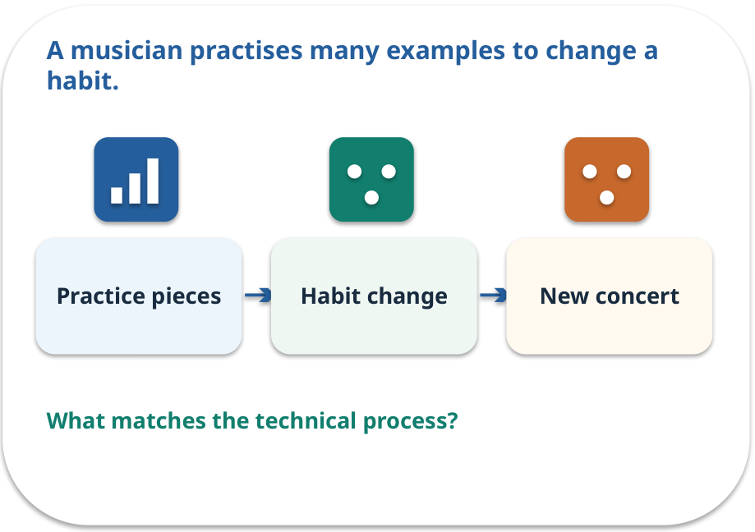
Fine-tuning · a familiar picture
ANALOGY / WEEK 09
A musician practises many examples to change a habit.
What matches our case, and where does the analogy stop?
GENERATIVE AI 2027 • WEEK 09 • 17 / 40
Notes:
TEACHER SCRIPT — ANALOGY. Begin with the familiar scene. Invite learners to describe each part in everyday language. Then ask where the comparison might fail before introducing the technical vocabulary. This week’s case is: A college assistant uses the correct format but misses a revised policy. The visible slide states: A musician practises many examples to change a habit.
What matches our case, and where does the analogy stop? The boundary is: Small practice gains can reflect overfitting; tuning is not a live fact store. The target is: Choose among a clearer prompt, current evidence and model adaptation. Listen for an explanation of the actual arrow or calculation, not just a repeated label. If the answer is unsupported, mark that uncertainty and return to the source. Before moving on, ask for the main idea and one concrete change to the worked example.

Slide 18
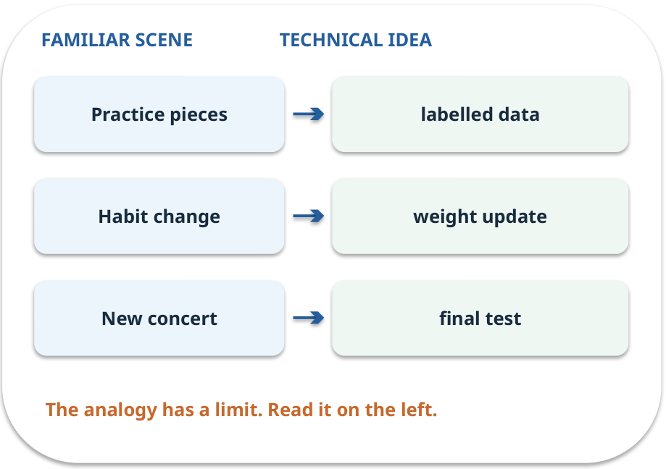
Fine-tuning · map the parts
MAPPING / WEEK 09
Match each everyday part to the technical part.
Analogy limit: Small practice gains can reflect overfitting; tuning is not a live fact store.
GENERATIVE AI 2027 • WEEK 09 • 18 / 40
Notes:
TEACHER SCRIPT — MAPPING. Point from each familiar element to the corresponding technical element. Have students cover the right column and reconstruct the three matches. Read the limitation aloud. This week’s case is: A college assistant uses the correct format but misses a revised policy. The visible slide states: Match each everyday part to the technical part.
Analogy limit: Small practice gains can reflect overfitting; tuning is not a live fact store. The three precise mappings are [['Practice pieces', 'labelled data'], ['Habit change', 'weight update'], ['New concert', 'final test']]. The target is: Choose among a clearer prompt, current evidence and model adaptation. Listen for an explanation of the actual arrow or calculation, not just a repeated label. If the answer is unsupported, mark that uncertainty and return to the source. Before moving on, ask for the main idea and one concrete change to the worked example.

Slide 19
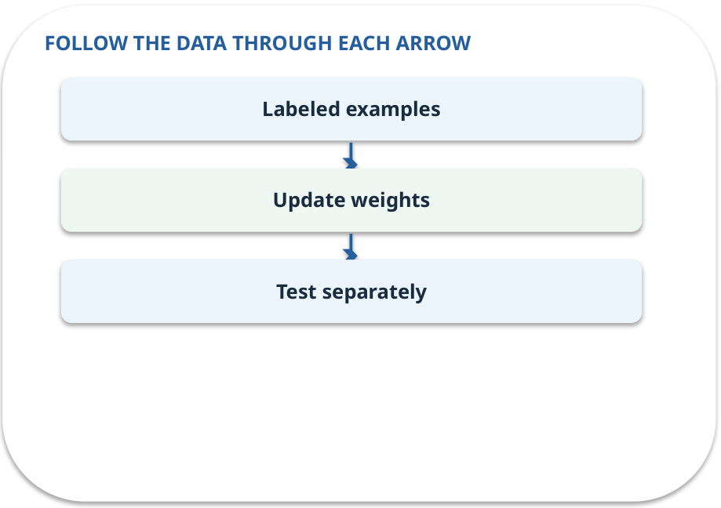
Fine-tuning · how it works
MECHANISM / WEEK 09
Train on examples to change learned behaviour; separate development from final test cases.
Trace the arrows from left to right.
GENERATIVE AI 2027 • WEEK 09 • 19 / 40
Notes:
TEACHER SCRIPT — MECHANISM. Trace every arrow slowly from the input to the output. Ask what information crosses the boundary at each arrow. Pause if students confuse a simplified notebook with a trained model. This week’s case is: A college assistant uses the correct format but misses a revised policy. The visible slide states: Train on examples to change learned behaviour; separate development from final test cases.
Trace the arrows from left to right. The weekly example is: Base 6/10, prompted 8/10, tuned 9/10 in practice; final tuned 6/10. Investigate. State what the analogy does not explain: Small practice gains can reflect overfitting; tuning is not a live fact store. The target is: Choose among a clearer prompt, current evidence and model adaptation. Listen for an explanation of the actual arrow or calculation, not just a repeated label. If the answer is unsupported, mark that uncertainty and return to the source. Before moving on, ask for the main idea and one concrete change to the worked example.

Slide 20
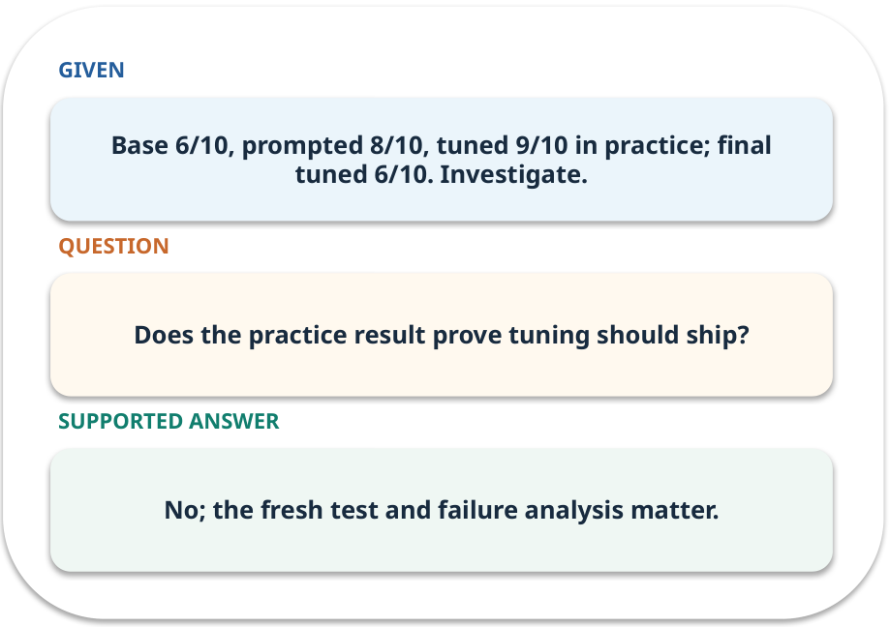
Fine-tuning · work one case
WORKED / WEEK 09
Base 6/10, prompted 8/10, tuned 9/10 in practice; final tuned 6/10. Investigate.
Point to the evidence before giving your conclusion.
GENERATIVE AI 2027 • WEEK 09 • 20 / 40
Notes:
TEACHER SCRIPT — WORKED. Work the specific numbers or source wording aloud. Give students thirty seconds to write a conclusion, then ask which source line or calculation supports it. This week’s case is: A college assistant uses the correct format but misses a revised policy. The visible slide states: Base 6/10, prompted 8/10, tuned 9/10 in practice; final tuned 6/10. Investigate.
Point to the evidence before giving your conclusion. The expected reasoning concludes: No; the fresh test and failure analysis matter. Distinguish measured results from illustrative numbers. The target is: Choose among a clearer prompt, current evidence and model adaptation. Listen for an explanation of the actual arrow or calculation, not just a repeated label. If the answer is unsupported, mark that uncertainty and return to the source. Before moving on, ask for the main idea and one concrete change to the worked example.

Slide 21
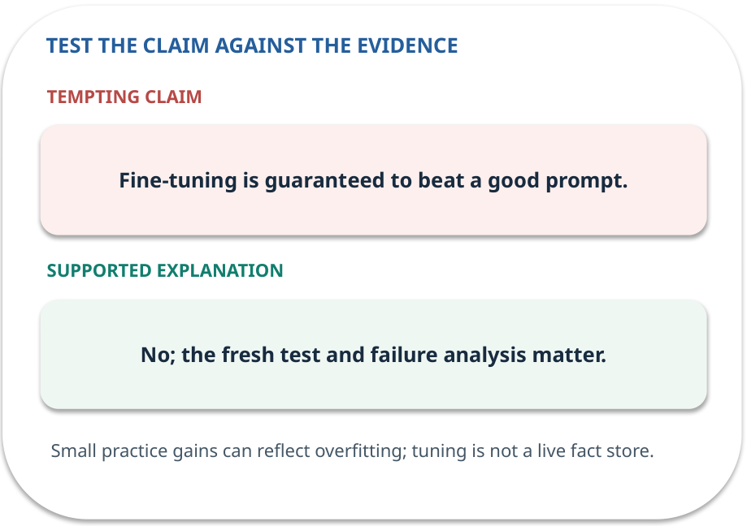
Fine-tuning · answer and explain
REVEAL / WEEK 09
No; the fresh test and failure analysis matter.
Tempting mistake: Fine-tuning is guaranteed to beat a good prompt.
GENERATIVE AI 2027 • WEEK 09 • 21 / 40
Notes:
TEACHER SCRIPT — REVEAL. Return to the earlier choice. Explain the correct answer and why the tempting claim fails. Ask one learner to say the answer in a single sentence without reading it. This week’s case is: A college assistant uses the correct format but misses a revised policy. The visible slide states: No; the fresh test and failure analysis matter.
Tempting mistake: Fine-tuning is guaranteed to beat a good prompt. The earlier question was Does the practice result prove tuning should ship? Ask how this differs from the wrong claim. The target is: Choose among a clearer prompt, current evidence and model adaptation. Listen for an explanation of the actual arrow or calculation, not just a repeated label. If the answer is unsupported, mark that uncertainty and return to the source. Before moving on, ask for the main idea and one concrete change to the worked example.

Slide 22
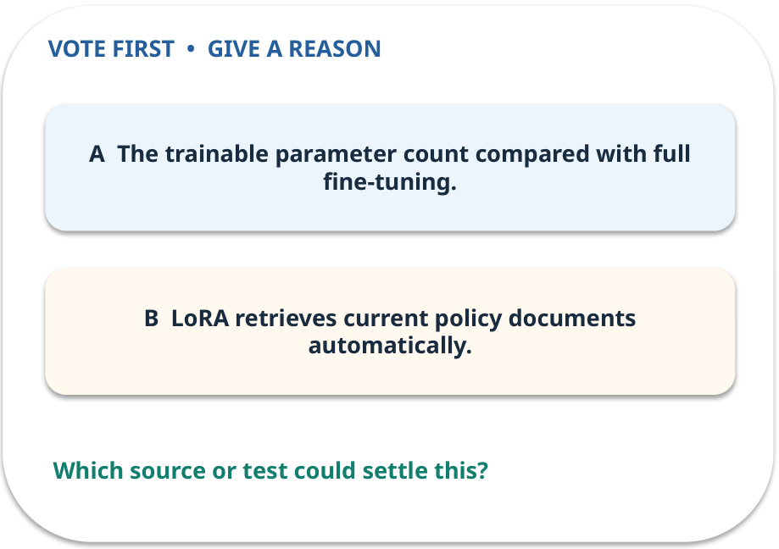
4. Predict · LoRA
QUESTION / WEEK 09
What does LoRA reduce?
Make a choice before we explain the diagram.
GENERATIVE AI 2027 • WEEK 09 • 22 / 40
Notes:
TEACHER SCRIPT — QUESTION. Take a show of hands for each choice before showing the mechanism. Ask pairs to defend a choice with evidence. Save the strongest wrong reason for the reveal later in this cycle. This week’s case is: A college assistant uses the correct format but misses a revised policy. The visible slide states: What does LoRA reduce?
Make a choice before we explain the diagram. The intended answer is The trainable parameter count compared with full fine-tuning. The tempting claim is LoRA retrieves current policy documents automatically. Do not show which card is correct until the reveal. The target is: Choose among a clearer prompt, current evidence and model adaptation. Listen for an explanation of the actual arrow or calculation, not just a repeated label. If the answer is unsupported, mark that uncertainty and return to the source. Before moving on, ask for the main idea and one concrete change to the worked example.

Slide 23
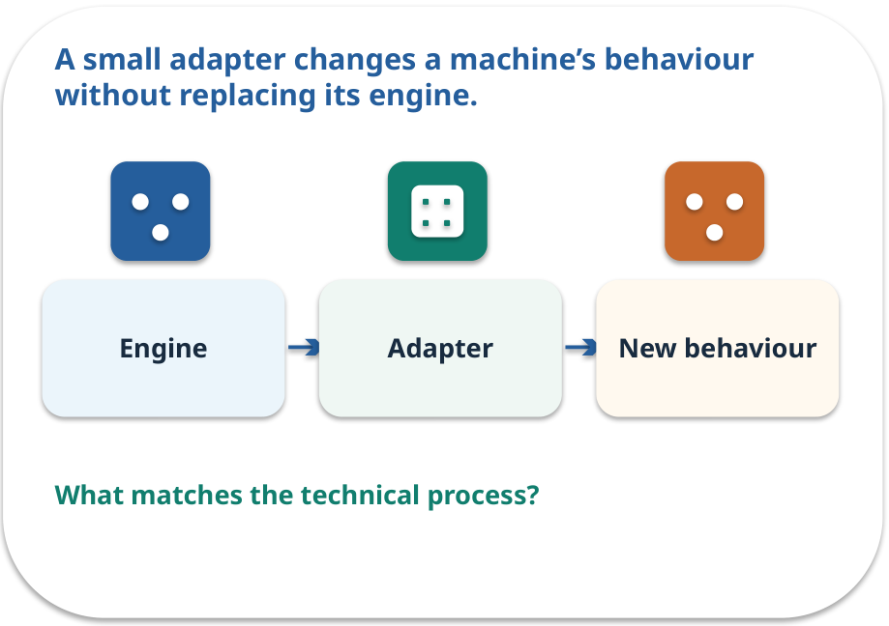
LoRA · a familiar picture
ANALOGY / WEEK 09
A small adapter changes a machine’s behaviour without replacing its engine.
What matches our case, and where does the analogy stop?
GENERATIVE AI 2027 • WEEK 09 • 23 / 40
Notes:
TEACHER SCRIPT — ANALOGY. Begin with the familiar scene. Invite learners to describe each part in everyday language. Then ask where the comparison might fail before introducing the technical vocabulary. This week’s case is: A college assistant uses the correct format but misses a revised policy. The visible slide states: A small adapter changes a machine’s behaviour without replacing its engine.
What matches our case, and where does the analogy stop? The boundary is: Low trainable parameter count does not remove data, compute or evaluation needs. The target is: Choose among a clearer prompt, current evidence and model adaptation. Listen for an explanation of the actual arrow or calculation, not just a repeated label. If the answer is unsupported, mark that uncertainty and return to the source. Before moving on, ask for the main idea and one concrete change to the worked example.

Slide 24
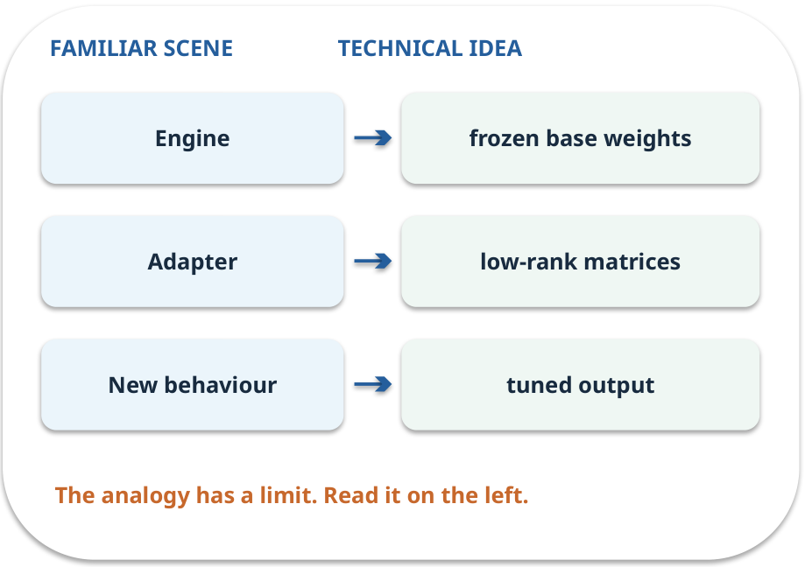
LoRA · map the parts
MAPPING / WEEK 09
Match each everyday part to the technical part.
Analogy limit: Low trainable parameter count does not remove data, compute or evaluation needs.
GENERATIVE AI 2027 • WEEK 09 • 24 / 40
Notes:
TEACHER SCRIPT — MAPPING. Point from each familiar element to the corresponding technical element. Have students cover the right column and reconstruct the three matches. Read the limitation aloud. This week’s case is: A college assistant uses the correct format but misses a revised policy. The visible slide states: Match each everyday part to the technical part.
Analogy limit: Low trainable parameter count does not remove data, compute or evaluation needs. The three precise mappings are [['Engine', 'frozen base weights'], ['Adapter', 'low-rank matrices'], ['New behaviour', 'tuned output']]. The target is: Choose among a clearer prompt, current evidence and model adaptation. Listen for an explanation of the actual arrow or calculation, not just a repeated label. If the answer is unsupported, mark that uncertainty and return to the source. Before moving on, ask for the main idea and one concrete change to the worked example.

Slide 25
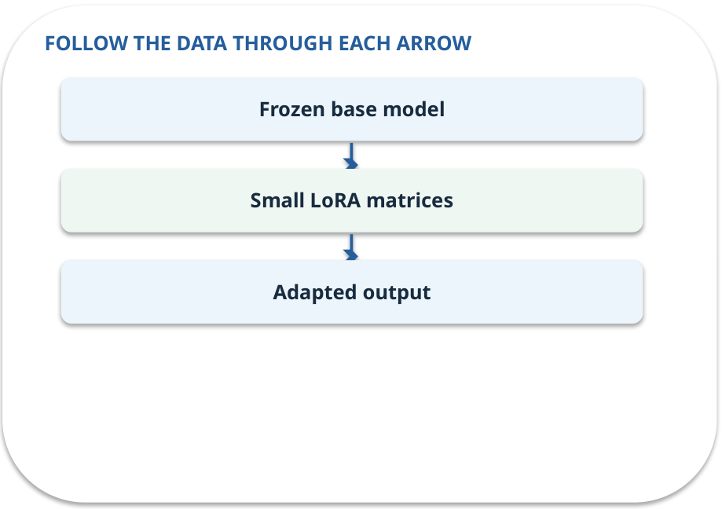
LoRA · how it works
MECHANISM / WEEK 09
Update a small trainable low-rank component instead of all model weights.
Trace the arrows from left to right.
GENERATIVE AI 2027 • WEEK 09 • 25 / 40
Notes:
TEACHER SCRIPT — MECHANISM. Trace every arrow slowly from the input to the output. Ask what information crosses the boundary at each arrow. Pause if students confuse a simplified notebook with a trained model. This week’s case is: A college assistant uses the correct format but misses a revised policy. The visible slide states: Update a small trainable low-rank component instead of all model weights.
Trace the arrows from left to right. The weekly example is: LoRA trains small matrices while freezing most base weights; no live tuning is required in this lab. State what the analogy does not explain: Low trainable parameter count does not remove data, compute or evaluation needs. The target is: Choose among a clearer prompt, current evidence and model adaptation. Listen for an explanation of the actual arrow or calculation, not just a repeated label. If the answer is unsupported, mark that uncertainty and return to the source. Before moving on, ask for the main idea and one concrete change to the worked example.

Slide 26
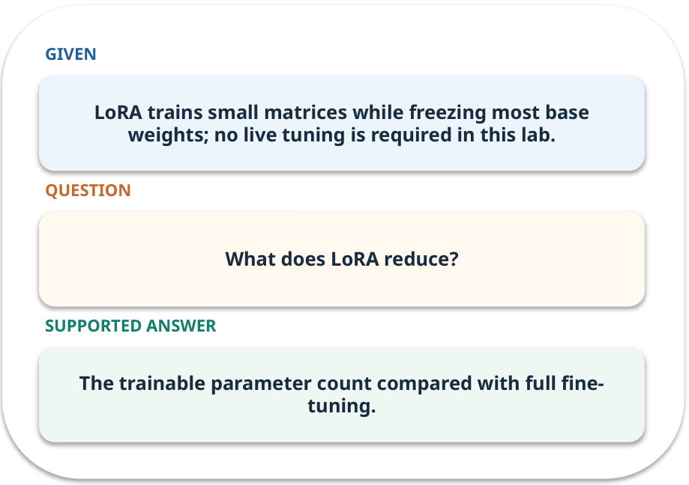
LoRA · work one case
WORKED / WEEK 09
LoRA trains small matrices while freezing most base weights; no live tuning is required in this lab.
Point to the evidence before giving your conclusion.
GENERATIVE AI 2027 • WEEK 09 • 26 / 40
Notes:
TEACHER SCRIPT — WORKED. Work the specific numbers or source wording aloud. Give students thirty seconds to write a conclusion, then ask which source line or calculation supports it. This week’s case is: A college assistant uses the correct format but misses a revised policy. The visible slide states: LoRA trains small matrices while freezing most base weights; no live tuning is required in this lab.
Point to the evidence before giving your conclusion. The expected reasoning concludes: The trainable parameter count compared with full fine-tuning. Distinguish measured results from illustrative numbers. The target is: Choose among a clearer prompt, current evidence and model adaptation. Listen for an explanation of the actual arrow or calculation, not just a repeated label. If the answer is unsupported, mark that uncertainty and return to the source. Before moving on, ask for the main idea and one concrete change to the worked example.

Slide 27
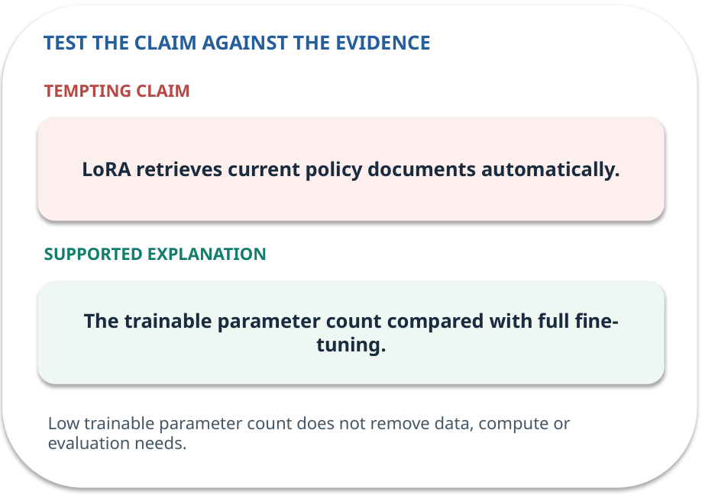
LoRA · answer and explain
REVEAL / WEEK 09
The trainable parameter count compared with full fine-tuning.
Tempting mistake: LoRA retrieves current policy documents automatically.
GENERATIVE AI 2027 • WEEK 09 • 27 / 40
Notes:
TEACHER SCRIPT — REVEAL. Return to the earlier choice. Explain the correct answer and why the tempting claim fails. Ask one learner to say the answer in a single sentence without reading it. This week’s case is: A college assistant uses the correct format but misses a revised policy. The visible slide states: The trainable parameter count compared with full fine-tuning.
Tempting mistake: LoRA retrieves current policy documents automatically. The earlier question was What does LoRA reduce? Ask how this differs from the wrong claim. The target is: Choose among a clearer prompt, current evidence and model adaptation. Listen for an explanation of the actual arrow or calculation, not just a repeated label. If the answer is unsupported, mark that uncertainty and return to the source. Before moving on, ask for the main idea and one concrete change to the worked example.

Slide 28
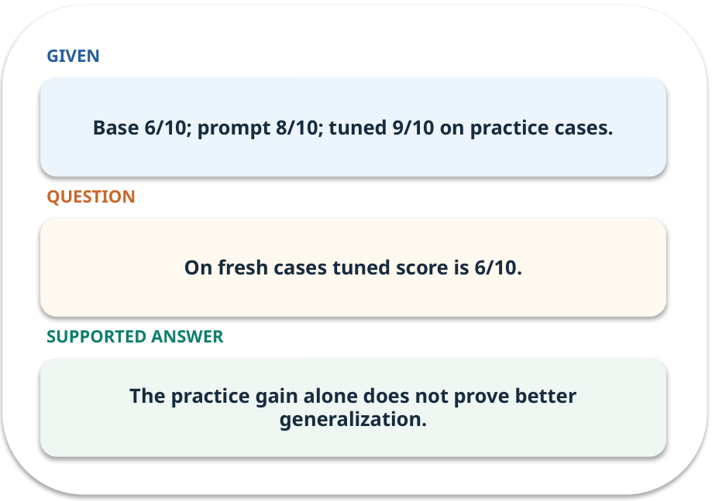
Evidence trail: input → result
WORKED / WEEK 09
On fresh cases tuned score is 6/10.
The practice gain alone does not prove better generalization.
GENERATIVE AI 2027 • WEEK 09 • 28 / 40
Notes:
TEACHER SCRIPT — WORKED. Work the specific numbers or source wording aloud. Give students thirty seconds to write a conclusion, then ask which source line or calculation supports it. This week’s case is: A college assistant uses the correct format but misses a revised policy. The visible slide states: On fresh cases tuned score is 6/10.
The practice gain alone does not prove better generalization. Have one student point to an exact source word or number for each conclusion. The target is: Choose among a clearer prompt, current evidence and model adaptation. Listen for an explanation of the actual arrow or calculation, not just a repeated label. If the answer is unsupported, mark that uncertainty and return to the source. Before moving on, ask for the main idea and one concrete change to the worked example.

Slide 29
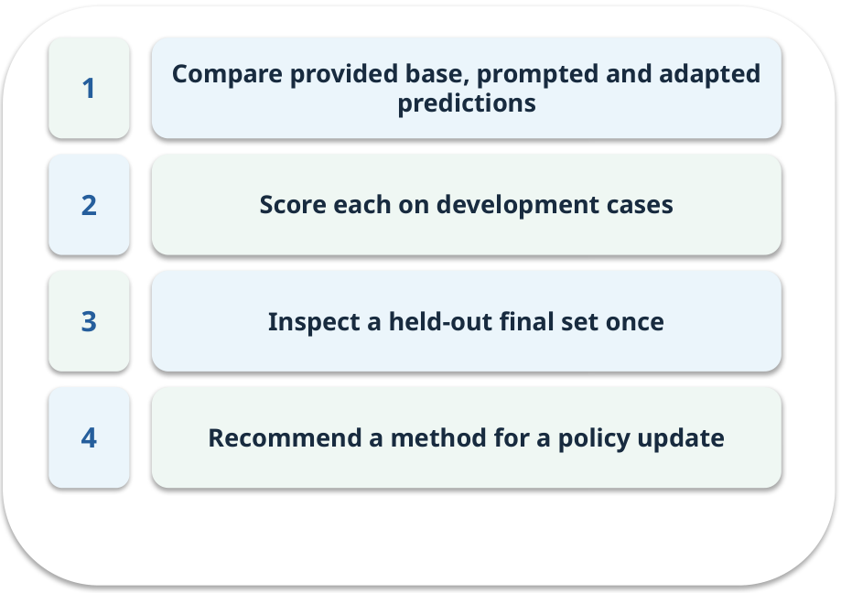
Notebook: run the prepared example
PRACTICE / WEEK 09
Analyze a supplied results pack without training a model.
Read the original output before editing.
GENERATIVE AI 2027 • WEEK 09 • 29 / 40
Notes:
TEACHER SCRIPT — PRACTICE. Open the matching notebook and demonstrate the first run. Have learners predict one change, run only that change, and record input, setting, output and an error explanation. This week’s case is: A college assistant uses the correct format but misses a revised policy. The visible slide states: Analyze a supplied results pack without training a model.
Read the original output before editing. Use Week_09_Lab.ipynb. This lab is a prepared classroom demonstration with its limitations documented. The target is: Choose among a clearer prompt, current evidence and model adaptation. Listen for an explanation of the actual arrow or calculation, not just a repeated label. If the answer is unsupported, mark that uncertainty and return to the source. Before moving on, ask for the main idea and one concrete change to the worked example.

Slide 30

Find the input and check in Python
PRACTICE / WEEK 09
Locate the supplied input, the transformation, the checking line and the printed result.
GENERATIVE AI 2027 • WEEK 09 • 30 / 40
Notes:
TEACHER SCRIPT — PRACTICE. Open the matching notebook and demonstrate the first run. Have learners predict one change, run only that change, and record input, setting, output and an error explanation. This week’s case is: A college assistant uses the correct format but misses a revised policy. The visible slide states: Locate the supplied input, the transformation, the checking line and the printed result. The weekly lab change is: Change one threshold and note why the final set must remain untouched. The target is: Choose among a clearer prompt, current evidence and model adaptation. Listen for an explanation of the actual arrow or calculation, not just a repeated label. If the answer is unsupported, mark that uncertainty and return to the source. Before moving on, ask for the main idea and one concrete change to the worked example.

Slide 31

Predict one controlled change
PRACTICE / WEEK 09
Change one threshold and note why the final set must remain untouched.
What should change in the result? What stays fixed?
GENERATIVE AI 2027 • WEEK 09 • 31 / 40
Notes:
TEACHER SCRIPT — PRACTICE. Open the matching notebook and demonstrate the first run. Have learners predict one change, run only that change, and record input, setting, output and an error explanation. This week’s case is: A college assistant uses the correct format but misses a revised policy. The visible slide states: Change one threshold and note why the final set must remain untouched.
What should change in the result? What stays fixed? Ask learners to write their prediction before rerunning the cell. The target is: Choose among a clearer prompt, current evidence and model adaptation. Listen for an explanation of the actual arrow or calculation, not just a repeated label. If the answer is unsupported, mark that uncertainty and return to the source. Before moving on, ask for the main idea and one concrete change to the worked example.

Slide 32

Run, compare and record
PRACTICE / WEEK 09
Record the input, the one changed setting, the observed result and a reason for any difference.
GENERATIVE AI 2027 • WEEK 09 • 32 / 40
Notes:
TEACHER SCRIPT — PRACTICE. Open the matching notebook and demonstrate the first run. Have learners predict one change, run only that change, and record input, setting, output and an error explanation. This week’s case is: A college assistant uses the correct format but misses a revised policy. The visible slide states: Record the input, the one changed setting, the observed result and a reason for any difference. The required evidence is: Comparison table with recommendation and uncertainty. The target is: Choose among a clearer prompt, current evidence and model adaptation. Listen for an explanation of the actual arrow or calculation, not just a repeated label. If the answer is unsupported, mark that uncertainty and return to the source. Before moving on, ask for the main idea and one concrete change to the worked example.

Slide 33

Measure without hiding the denominator
CHECK / WEEK 09
Accuracy with numerator and denominator on separate cases
Write the numerator, denominator and one failure case.
GENERATIVE AI 2027 • WEEK 09 • 33 / 40
Notes:
TEACHER SCRIPT — CHECK. Use this as a brief formative check. Ask for the conclusion, the evidence and one limitation. Revisit disagreements in the review session and offer an extension only after the core task. This week’s case is: A college assistant uses the correct format but misses a revised policy. The visible slide states: Accuracy with numerator and denominator on separate cases
Write the numerator, denominator and one failure case. Where a measure is qualitative, show the concrete source comparison. Example: The practice gain alone does not prove better generalization. The target is: Choose among a clearer prompt, current evidence and model adaptation. Listen for an explanation of the actual arrow or calculation, not just a repeated label. If the answer is unsupported, mark that uncertainty and return to the source. Before moving on, ask for the main idea and one concrete change to the worked example.

Slide 34
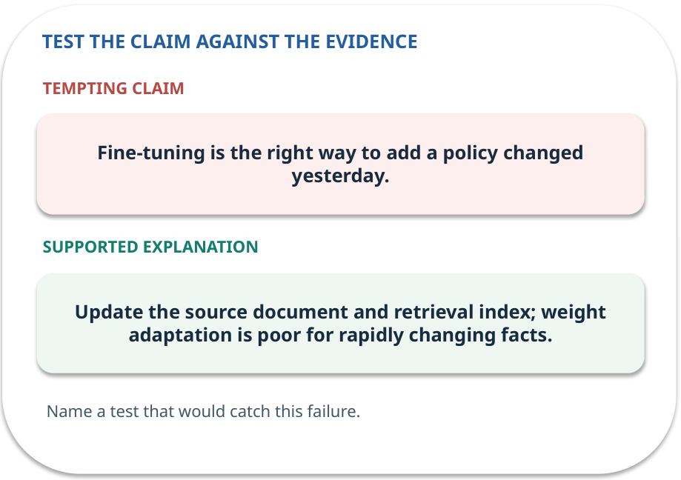
Error detective: find the layer
CHECK / WEEK 09
Plausible wrong claim: Fine-tuning is the right way to add a policy changed yesterday.
Correct it using the case evidence.
GENERATIVE AI 2027 • WEEK 09 • 34 / 40
Notes:
TEACHER SCRIPT — CHECK. Use this as a brief formative check. Ask for the conclusion, the evidence and one limitation. Revisit disagreements in the review session and offer an extension only after the core task. This week’s case is: A college assistant uses the correct format but misses a revised policy. The visible slide states: Plausible wrong claim: Fine-tuning is the right way to add a policy changed yesterday.
Correct it using the case evidence. The correction is Update the source document and retrieval index; weight adaptation is poor for rapidly changing facts. The target is: Choose among a clearer prompt, current evidence and model adaptation. Listen for an explanation of the actual arrow or calculation, not just a repeated label. If the answer is unsupported, mark that uncertainty and return to the source. Before moving on, ask for the main idea and one concrete change to the worked example.

Slide 35

Transfer to a new situation
CHECK / WEEK 09
The system returns the right fact but the wrong JSON field names. Which adaptation is the simplest first trial?
Explain which source or test would settle it.
GENERATIVE AI 2027 • WEEK 09 • 35 / 40
Notes:
TEACHER SCRIPT — CHECK. Use this as a brief formative check. Ask for the conclusion, the evidence and one limitation. Revisit disagreements in the review session and offer an extension only after the core task. This week’s case is: A college assistant uses the correct format but misses a revised policy. The visible slide states: The system returns the right fact but the wrong JSON field names. Which adaptation is the simplest first trial?
Explain which source or test would settle it. This is a fresh scenario, so ask for a reason before accepting either short answer. The target is: Choose among a clearer prompt, current evidence and model adaptation. Listen for an explanation of the actual arrow or calculation, not just a repeated label. If the answer is unsupported, mark that uncertainty and return to the source. Before moving on, ask for the main idea and one concrete change to the worked example.

Slide 36
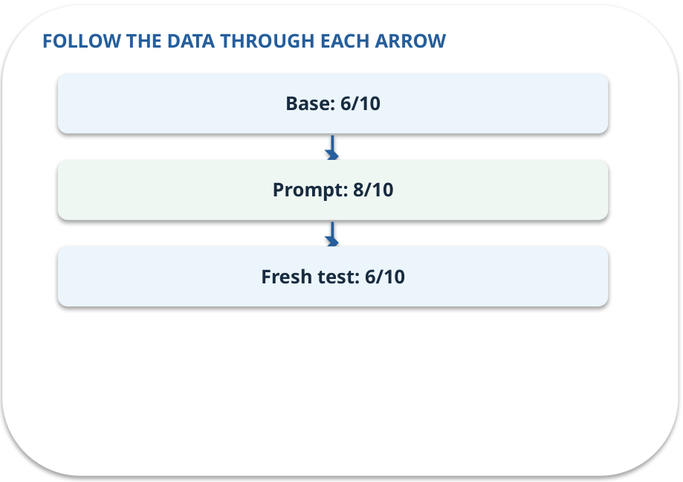
Explain it to a partner
CHECK / WEEK 09
Without reading the slide, name the input, one processing step and the check. Your partner should ask “How do you know?”
GENERATIVE AI 2027 • WEEK 09 • 36 / 40
Notes:
TEACHER SCRIPT — CHECK. Use this as a brief formative check. Ask for the conclusion, the evidence and one limitation. Revisit disagreements in the review session and offer an extension only after the core task. This week’s case is: A college assistant uses the correct format but misses a revised policy. The visible slide states: Without reading the slide, name the input, one processing step and the check. Your partner should ask “How do you know?” Listen for a causal explanation and one limitation, then revisit a difficult arrow on the board. The target is: Choose among a clearer prompt, current evidence and model adaptation. Listen for an explanation of the actual arrow or calculation, not just a repeated label. If the answer is unsupported, mark that uncertainty and return to the source. Before moving on, ask for the main idea and one concrete change to the worked example.

Slide 37

Exam rehearsal · explain and apply
CHECK / WEEK 09
Which method suits a policy that changed yesterday?
Write a short answer, then compare with the guide.
GENERATIVE AI 2027 • WEEK 09 • 37 / 40
Notes:
TEACHER SCRIPT — CHECK. Use this as a brief formative check. Ask for the conclusion, the evidence and one limitation. Revisit disagreements in the review session and offer an extension only after the core task. This week’s case is: A college assistant uses the correct format but misses a revised policy. The visible slide states: Which method suits a policy that changed yesterday?
Write a short answer, then compare with the guide. Model answer after discussion: Update the authoritative document and retrieval data. Fine-tuning is not a dependable store for rapidly changing facts. Practice marks: 4. The target is: Choose among a clearer prompt, current evidence and model adaptation. Listen for an explanation of the actual arrow or calculation, not just a repeated label. If the answer is unsupported, mark that uncertainty and return to the source. Before moving on, ask for the main idea and one concrete change to the worked example.

Slide 38
Exam rehearsal · explain and apply
CHECK / WEEK 09
What does LoRA reduce compared with full fine-tuning?
Write a short answer, then compare with the guide.
GENERATIVE AI 2027 • WEEK 09 • 38 / 40
Notes:
TEACHER SCRIPT — CHECK. Use this as a brief formative check. Ask for the conclusion, the evidence and one limitation. Revisit disagreements in the review session and offer an extension only after the core task. This week’s case is: A college assistant uses the correct format but misses a revised policy. The visible slide states: What does LoRA reduce compared with full fine-tuning?
Write a short answer, then compare with the guide. Model answer after discussion: The number of trainable parameters by using low-rank updates. It does not remove the need for data quality or evaluation. Practice marks: 4. The target is: Choose among a clearer prompt, current evidence and model adaptation. Listen for an explanation of the actual arrow or calculation, not just a repeated label. If the answer is unsupported, mark that uncertainty and return to the source. Before moving on, ask for the main idea and one concrete change to the worked example.

Slide 39

What to hand in
PRACTICE / WEEK 09
Comparison table with recommendation and uncertainty.
Include the one changed input and an error explanation.
GENERATIVE AI 2027 • WEEK 09 • 39 / 40
Notes:
TEACHER SCRIPT — PRACTICE. Open the matching notebook and demonstrate the first run. Have learners predict one change, run only that change, and record input, setting, output and an error explanation. This week’s case is: A college assistant uses the correct format but misses a revised policy. The visible slide states: Comparison table with recommendation and uncertainty.
Include the one changed input and an error explanation. This weekly evidence receives formative feedback according to the module sequence; refer to the assessment brief for graded work. The target is: Choose among a clearer prompt, current evidence and model adaptation. Listen for an explanation of the actual arrow or calculation, not just a repeated label. If the answer is unsupported, mark that uncertainty and return to the source. Before moving on, ask for the main idea and one concrete change to the worked example.

Slide 40
Three ideas to recall next week
CHECK / WEEK 09
Diagnose the failure, choose prompt or RAG or tuning, and test fresh cases.
Read the linked official sources in the Word guide and redraw one diagram from memory.
GENERATIVE AI 2027 • WEEK 09 • 40 / 40
Notes:
TEACHER SCRIPT — CHECK. Use this as a brief formative check. Ask for the conclusion, the evidence and one limitation. Revisit disagreements in the review session and offer an extension only after the core task. This week’s case is: A college assistant uses the correct format but misses a revised policy. The visible slide states: Diagnose the failure, choose prompt or RAG or tuning, and test fresh cases.
Read the linked official sources in the Word guide and redraw one diagram from memory. Return to the opening vote and ask whether the evidence changed anyone’s mind. The next week builds on this outcome: Choose among a clearer prompt, current evidence and model adaptation. The target is: Choose among a clearer prompt, current evidence and model adaptation. Listen for an explanation of the actual arrow or calculation, not just a repeated label. If the answer is unsupported, mark that uncertainty and return to the source. Before moving on, ask for the main idea and one concrete change to the worked example.

