Slide 1
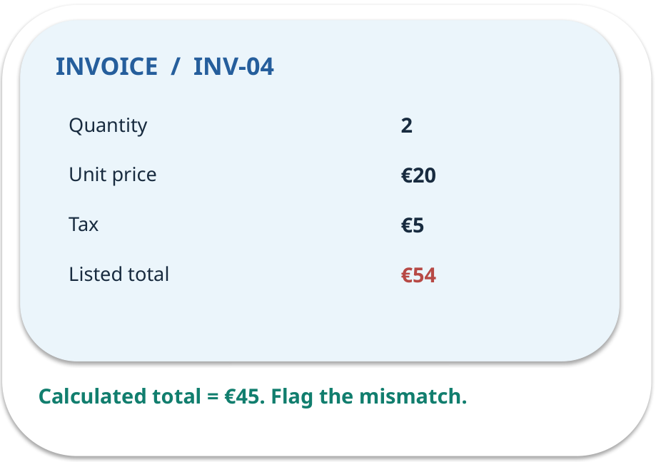
Week 10 · Working with an image or document
OPEN / WEEK 10
The €54 invoice
An invoice image lists two items at €20 and €5 tax, yet displays €54 total. A model reads €54 correctly. Should the payment pass?
GENERATIVE AI 2027 • WEEK 10 • 01 / 40
Notes:
TEACHER SCRIPT — OPEN. Show the visual for ten seconds, then ask for an initial decision. Do not reveal the answer yet. Ask a student to name the source or measurement that would change their mind. This week’s case is: A synthetic invoice image has fields supplied by a prepared transcription. The visible slide states: The €54 invoice
An invoice image lists two items at €20 and €5 tax, yet displays €54 total. A model reads €54 correctly. Should the payment pass? Reveal that the case will be revisited after four short concept cycles. The target is: Distinguish reading from independently checking a document value. Listen for an explanation of the actual arrow or calculation, not just a repeated label. If the answer is unsupported, mark that uncertainty and return to the source. Before moving on, ask for the main idea and one concrete change to the worked example.

Slide 2

First vote: what would you do?
QUESTION / WEEK 10
An invoice image lists two items at €20 and €5 tax, yet displays €54 total. A model reads €54 correctly. Should the payment pass?
Choose an initial answer and name one piece of evidence you need.
GENERATIVE AI 2027 • WEEK 10 • 02 / 40
Notes:
TEACHER SCRIPT — QUESTION. Take a show of hands for each choice before showing the mechanism. Ask pairs to defend a choice with evidence. Save the strongest wrong reason for the reveal later in this cycle. This week’s case is: A synthetic invoice image has fields supplied by a prepared transcription. The visible slide states: An invoice image lists two items at €20 and €5 tax, yet displays €54 total. A model reads €54 correctly. Should the payment pass?
Choose an initial answer and name one piece of evidence you need. Accept reasonable uncertainty; record the initial votes to revisit at the end. The target is: Distinguish reading from independently checking a document value. Listen for an explanation of the actual arrow or calculation, not just a repeated label. If the answer is unsupported, mark that uncertainty and return to the source. Before moving on, ask for the main idea and one concrete change to the worked example.

Slide 3
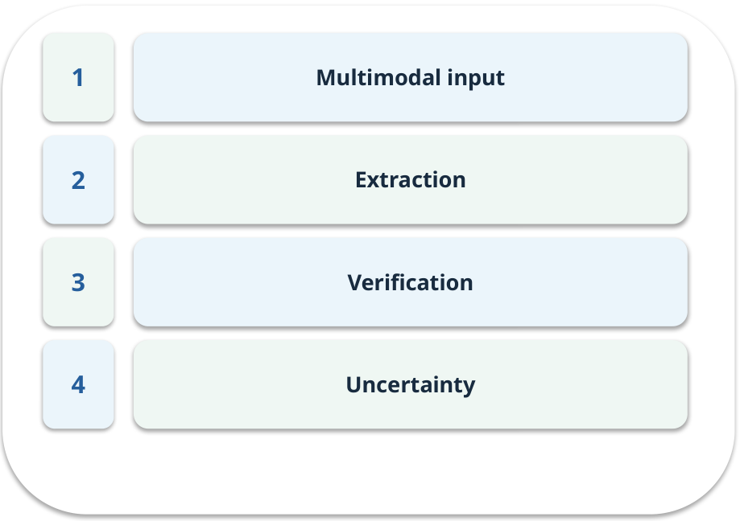
The journey through today’s case
OPEN / WEEK 10
We will predict, connect an analogy, trace a mechanism, work an example, then explain a decision.
GENERATIVE AI 2027 • WEEK 10 • 03 / 40
Notes:
TEACHER SCRIPT — OPEN. Show the visual for ten seconds, then ask for an initial decision. Do not reveal the answer yet. Ask a student to name the source or measurement that would change their mind. This week’s case is: A synthetic invoice image has fields supplied by a prepared transcription. The visible slide states: We will predict, connect an analogy, trace a mechanism, work an example, then explain a decision. Point to the four named ideas, then show where the notebook experiment fits. The target is: Distinguish reading from independently checking a document value. Listen for an explanation of the actual arrow or calculation, not just a repeated label. If the answer is unsupported, mark that uncertainty and return to the source. Before moving on, ask for the main idea and one concrete change to the worked example.

Slide 4
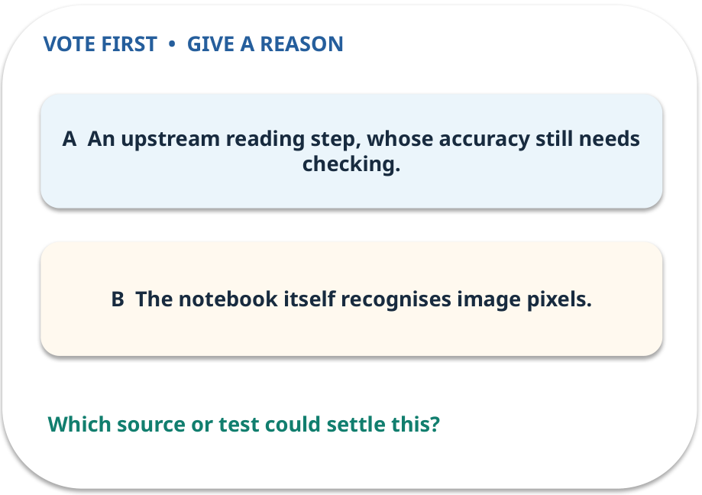
1. Predict · Multimodal input
QUESTION / WEEK 10
What capability is represented by the supplied transcription?
Make a choice before we explain the diagram.
GENERATIVE AI 2027 • WEEK 10 • 04 / 40
Notes:
TEACHER SCRIPT — QUESTION. Take a show of hands for each choice before showing the mechanism. Ask pairs to defend a choice with evidence. Save the strongest wrong reason for the reveal later in this cycle. This week’s case is: A synthetic invoice image has fields supplied by a prepared transcription. The visible slide states: What capability is represented by the supplied transcription?
Make a choice before we explain the diagram. The intended answer is An upstream reading step, whose accuracy still needs checking. The tempting claim is The notebook itself recognises image pixels. Do not show which card is correct until the reveal. The target is: Distinguish reading from independently checking a document value. Listen for an explanation of the actual arrow or calculation, not just a repeated label. If the answer is unsupported, mark that uncertainty and return to the source. Before moving on, ask for the main idea and one concrete change to the worked example.

Slide 5
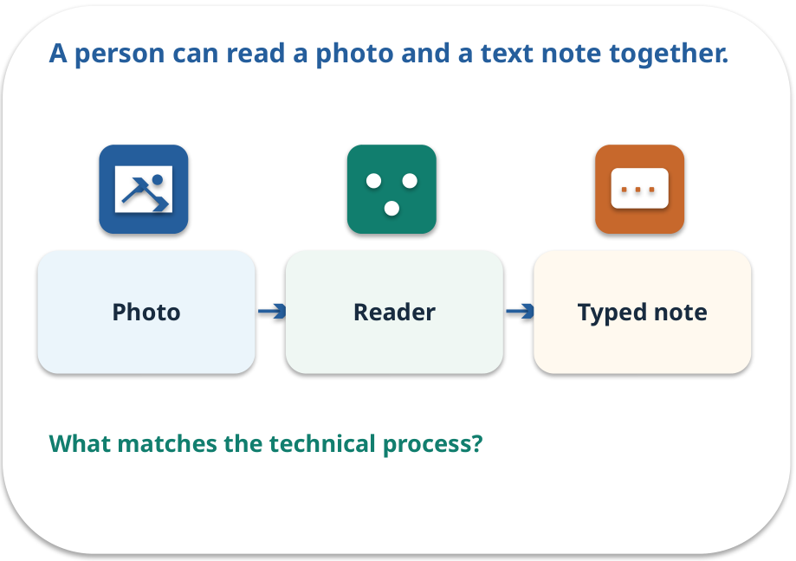
Multimodal input · a familiar picture
ANALOGY / WEEK 10
A person can read a photo and a text note together.
What matches our case, and where does the analogy stop?
GENERATIVE AI 2027 • WEEK 10 • 05 / 40
Notes:
TEACHER SCRIPT — ANALOGY. Begin with the familiar scene. Invite learners to describe each part in everyday language. Then ask where the comparison might fail before introducing the technical vocabulary. This week’s case is: A synthetic invoice image has fields supplied by a prepared transcription. The visible slide states: A person can read a photo and a text note together.
What matches our case, and where does the analogy stop? The boundary is: This notebook uses a prepared transcription; it does not run OCR or test a vision model. The target is: Distinguish reading from independently checking a document value. Listen for an explanation of the actual arrow or calculation, not just a repeated label. If the answer is unsupported, mark that uncertainty and return to the source. Before moving on, ask for the main idea and one concrete change to the worked example.

Slide 6
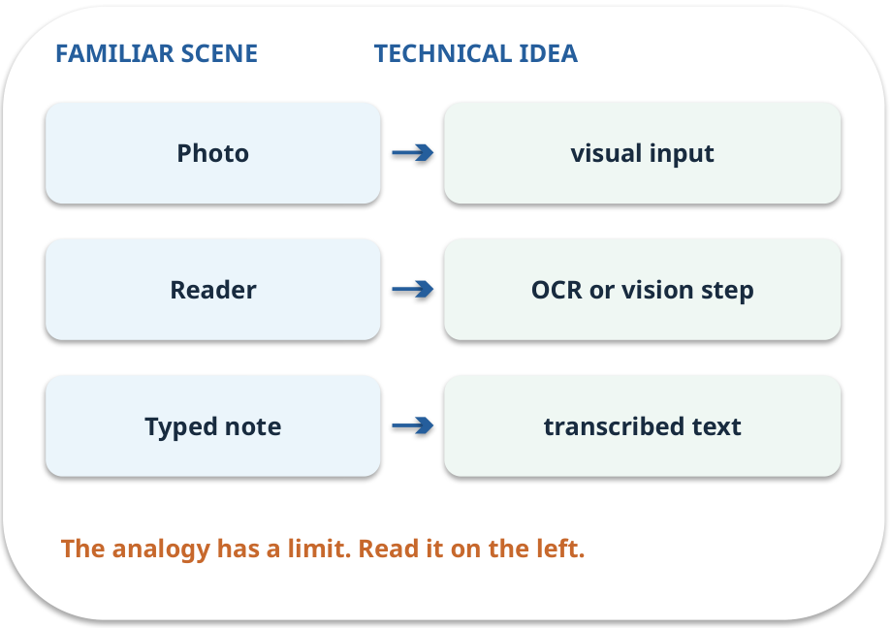
Multimodal input · map the parts
MAPPING / WEEK 10
Match each everyday part to the technical part.
Analogy limit: This notebook uses a prepared transcription; it does not run OCR or test a vision model.
GENERATIVE AI 2027 • WEEK 10 • 06 / 40
Notes:
TEACHER SCRIPT — MAPPING. Point from each familiar element to the corresponding technical element. Have students cover the right column and reconstruct the three matches. Read the limitation aloud. This week’s case is: A synthetic invoice image has fields supplied by a prepared transcription. The visible slide states: Match each everyday part to the technical part.
Analogy limit: This notebook uses a prepared transcription; it does not run OCR or test a vision model. The three precise mappings are [['Photo', 'visual input'], ['Reader', 'OCR or vision step'], ['Typed note', 'transcribed text']]. The target is: Distinguish reading from independently checking a document value. Listen for an explanation of the actual arrow or calculation, not just a repeated label. If the answer is unsupported, mark that uncertainty and return to the source. Before moving on, ask for the main idea and one concrete change to the worked example.

Slide 7

Multimodal input · how it works
MECHANISM / WEEK 10
A system may process text, images or other signals. Here the transcription stands in for an image reader.
Trace the arrows from left to right.
GENERATIVE AI 2027 • WEEK 10 • 07 / 40
Notes:
TEACHER SCRIPT — MECHANISM. Trace every arrow slowly from the input to the output. Ask what information crosses the boundary at each arrow. Pause if students confuse a simplified notebook with a trained model. This week’s case is: A synthetic invoice image has fields supplied by a prepared transcription. The visible slide states: A system may process text, images or other signals. Here the transcription stands in for an image reader.
Trace the arrows from left to right. The weekly example is: The prepared text records quantity 2, unit price €20, tax €5 and listed total €54. State what the analogy does not explain: This notebook uses a prepared transcription; it does not run OCR or test a vision model. The target is: Distinguish reading from independently checking a document value. Listen for an explanation of the actual arrow or calculation, not just a repeated label. If the answer is unsupported, mark that uncertainty and return to the source. Before moving on, ask for the main idea and one concrete change to the worked example.

Slide 8
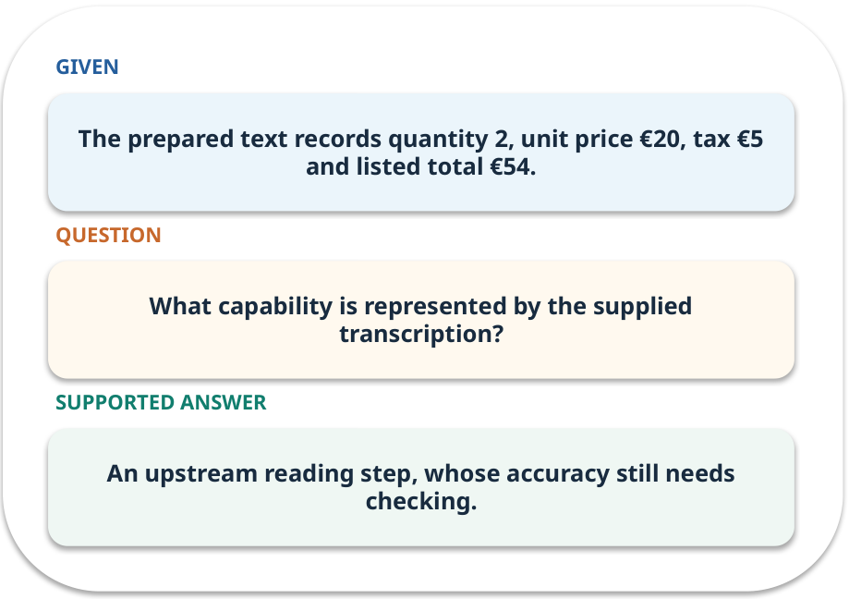
Multimodal input · work one case
WORKED / WEEK 10
The prepared text records quantity 2, unit price €20, tax €5 and listed total €54.
Point to the evidence before giving your conclusion.
GENERATIVE AI 2027 • WEEK 10 • 08 / 40
Notes:
TEACHER SCRIPT — WORKED. Work the specific numbers or source wording aloud. Give students thirty seconds to write a conclusion, then ask which source line or calculation supports it. This week’s case is: A synthetic invoice image has fields supplied by a prepared transcription. The visible slide states: The prepared text records quantity 2, unit price €20, tax €5 and listed total €54.
Point to the evidence before giving your conclusion. The expected reasoning concludes: An upstream reading step, whose accuracy still needs checking. Distinguish measured results from illustrative numbers. The target is: Distinguish reading from independently checking a document value. Listen for an explanation of the actual arrow or calculation, not just a repeated label. If the answer is unsupported, mark that uncertainty and return to the source. Before moving on, ask for the main idea and one concrete change to the worked example.

Slide 9
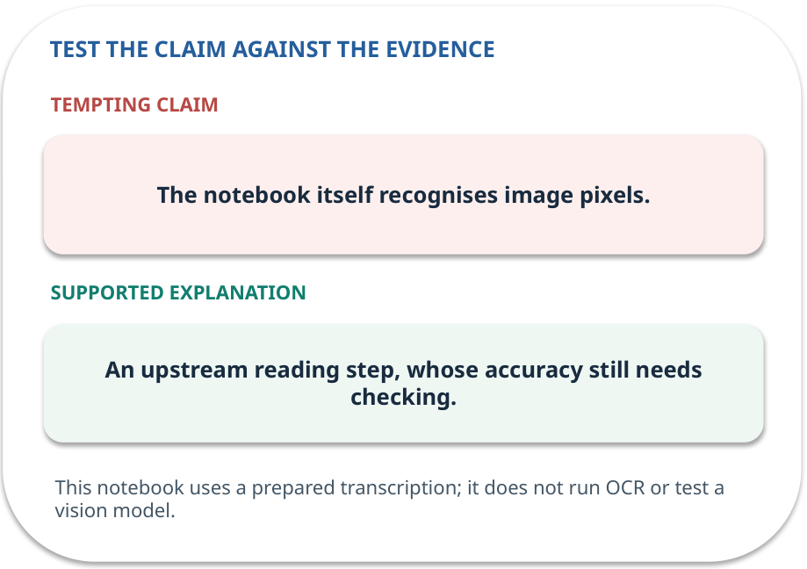
Multimodal input · answer and explain
REVEAL / WEEK 10
An upstream reading step, whose accuracy still needs checking.
Tempting mistake: The notebook itself recognises image pixels.
GENERATIVE AI 2027 • WEEK 10 • 09 / 40
Notes:
TEACHER SCRIPT — REVEAL. Return to the earlier choice. Explain the correct answer and why the tempting claim fails. Ask one learner to say the answer in a single sentence without reading it. This week’s case is: A synthetic invoice image has fields supplied by a prepared transcription. The visible slide states: An upstream reading step, whose accuracy still needs checking.
Tempting mistake: The notebook itself recognises image pixels. The earlier question was What capability is represented by the supplied transcription? Ask how this differs from the wrong claim. The target is: Distinguish reading from independently checking a document value. Listen for an explanation of the actual arrow or calculation, not just a repeated label. If the answer is unsupported, mark that uncertainty and return to the source. Before moving on, ask for the main idea and one concrete change to the worked example.

Slide 10
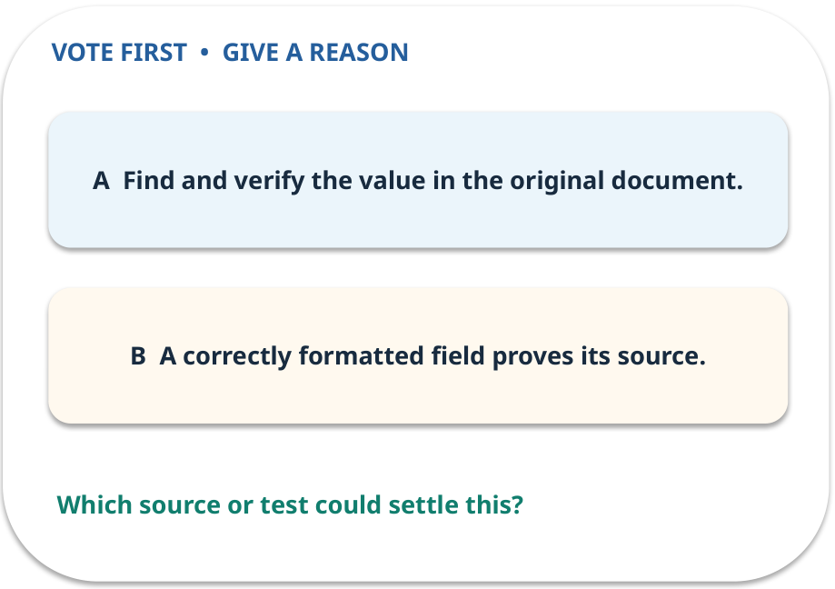
2. Predict · Extraction
QUESTION / WEEK 10
What does a source pointer let another person do?
Make a choice before we explain the diagram.
GENERATIVE AI 2027 • WEEK 10 • 10 / 40
Notes:
TEACHER SCRIPT — QUESTION. Take a show of hands for each choice before showing the mechanism. Ask pairs to defend a choice with evidence. Save the strongest wrong reason for the reveal later in this cycle. This week’s case is: A synthetic invoice image has fields supplied by a prepared transcription. The visible slide states: What does a source pointer let another person do?
Make a choice before we explain the diagram. The intended answer is Find and verify the value in the original document. The tempting claim is A correctly formatted field proves its source. Do not show which card is correct until the reveal. The target is: Distinguish reading from independently checking a document value. Listen for an explanation of the actual arrow or calculation, not just a repeated label. If the answer is unsupported, mark that uncertainty and return to the source. Before moving on, ask for the main idea and one concrete change to the worked example.

Slide 11
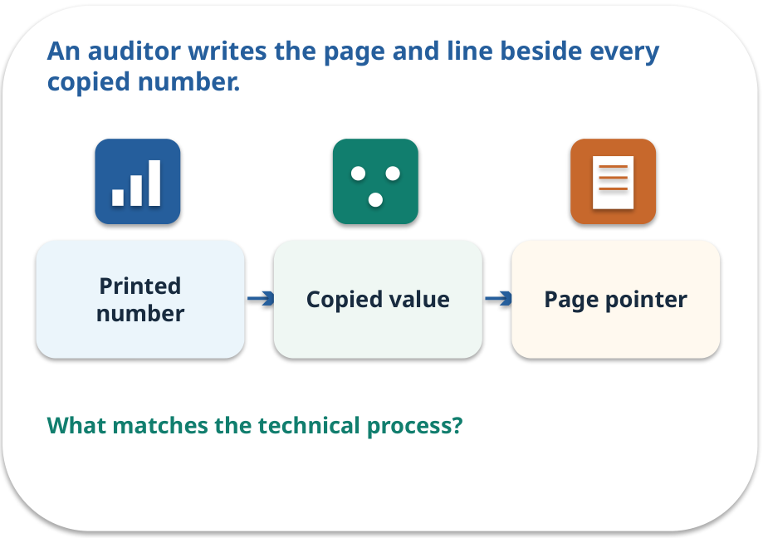
Extraction · a familiar picture
ANALOGY / WEEK 10
An auditor writes the page and line beside every copied number.
What matches our case, and where does the analogy stop?
GENERATIVE AI 2027 • WEEK 10 • 11 / 40
Notes:
TEACHER SCRIPT — ANALOGY. Begin with the familiar scene. Invite learners to describe each part in everyday language. Then ask where the comparison might fail before introducing the technical vocabulary. This week’s case is: A synthetic invoice image has fields supplied by a prepared transcription. The visible slide states: An auditor writes the page and line beside every copied number.
What matches our case, and where does the analogy stop? The boundary is: A pointer can be wrong or ambiguous, especially with poor image quality. The target is: Distinguish reading from independently checking a document value. Listen for an explanation of the actual arrow or calculation, not just a repeated label. If the answer is unsupported, mark that uncertainty and return to the source. Before moving on, ask for the main idea and one concrete change to the worked example.

Slide 12
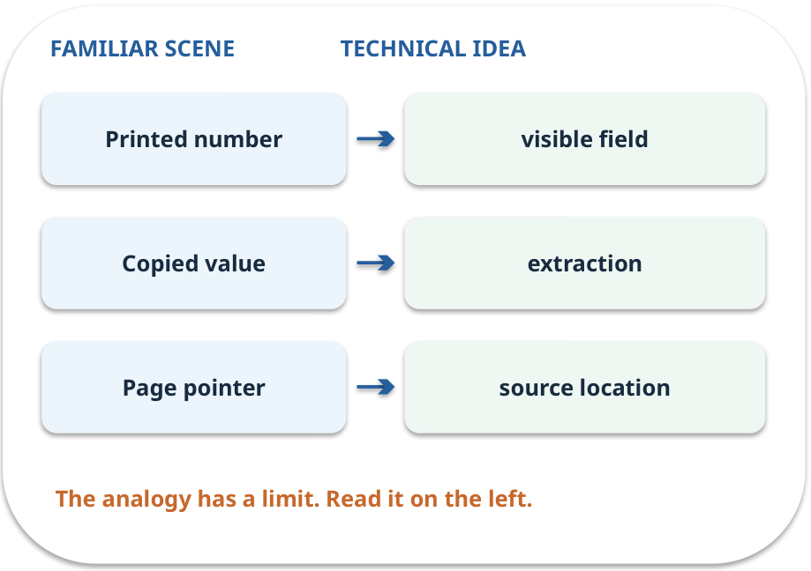
Extraction · map the parts
MAPPING / WEEK 10
Match each everyday part to the technical part.
Analogy limit: A pointer can be wrong or ambiguous, especially with poor image quality.
GENERATIVE AI 2027 • WEEK 10 • 12 / 40
Notes:
TEACHER SCRIPT — MAPPING. Point from each familiar element to the corresponding technical element. Have students cover the right column and reconstruct the three matches. Read the limitation aloud. This week’s case is: A synthetic invoice image has fields supplied by a prepared transcription. The visible slide states: Match each everyday part to the technical part.
Analogy limit: A pointer can be wrong or ambiguous, especially with poor image quality. The three precise mappings are [['Printed number', 'visible field'], ['Copied value', 'extraction'], ['Page pointer', 'source location']]. The target is: Distinguish reading from independently checking a document value. Listen for an explanation of the actual arrow or calculation, not just a repeated label. If the answer is unsupported, mark that uncertainty and return to the source. Before moving on, ask for the main idea and one concrete change to the worked example.

Slide 13

Extraction · how it works
MECHANISM / WEEK 10
Read fields present in the document and retain a pointer to the source.
Trace the arrows from left to right.
GENERATIVE AI 2027 • WEEK 10 • 13 / 40
Notes:
TEACHER SCRIPT — MECHANISM. Trace every arrow slowly from the input to the output. Ask what information crosses the boundary at each arrow. Pause if students confuse a simplified notebook with a trained model. This week’s case is: A synthetic invoice image has fields supplied by a prepared transcription. The visible slide states: Read fields present in the document and retain a pointer to the source.
Trace the arrows from left to right. The weekly example is: Record “listed_total = €54” with the invoice field location; keep calculation separate. State what the analogy does not explain: A pointer can be wrong or ambiguous, especially with poor image quality. The target is: Distinguish reading from independently checking a document value. Listen for an explanation of the actual arrow or calculation, not just a repeated label. If the answer is unsupported, mark that uncertainty and return to the source. Before moving on, ask for the main idea and one concrete change to the worked example.

Slide 14
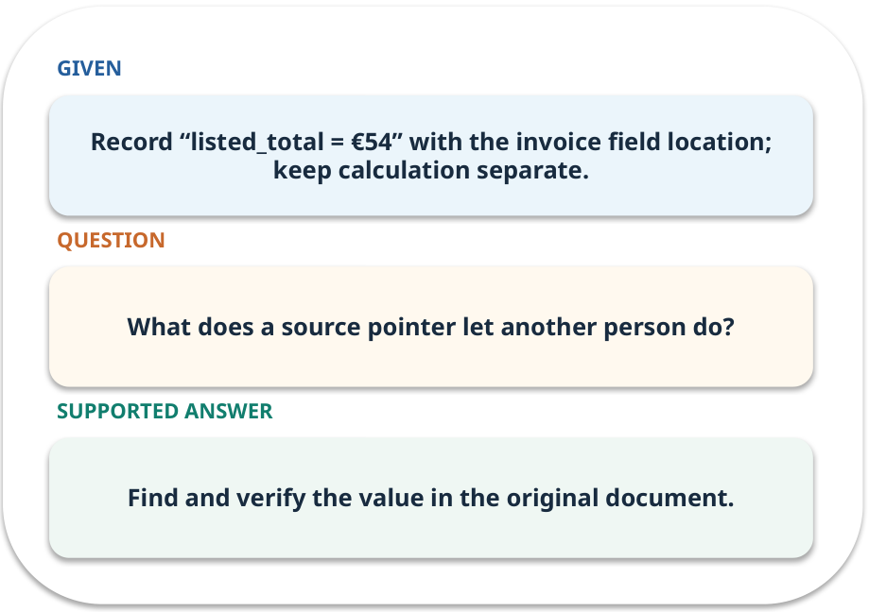
Extraction · work one case
WORKED / WEEK 10
Record “listed_total = €54” with the invoice field location; keep calculation separate.
Point to the evidence before giving your conclusion.
GENERATIVE AI 2027 • WEEK 10 • 14 / 40
Notes:
TEACHER SCRIPT — WORKED. Work the specific numbers or source wording aloud. Give students thirty seconds to write a conclusion, then ask which source line or calculation supports it. This week’s case is: A synthetic invoice image has fields supplied by a prepared transcription. The visible slide states: Record “listed_total = €54” with the invoice field location; keep calculation separate.
Point to the evidence before giving your conclusion. The expected reasoning concludes: Find and verify the value in the original document. Distinguish measured results from illustrative numbers. The target is: Distinguish reading from independently checking a document value. Listen for an explanation of the actual arrow or calculation, not just a repeated label. If the answer is unsupported, mark that uncertainty and return to the source. Before moving on, ask for the main idea and one concrete change to the worked example.

Slide 15
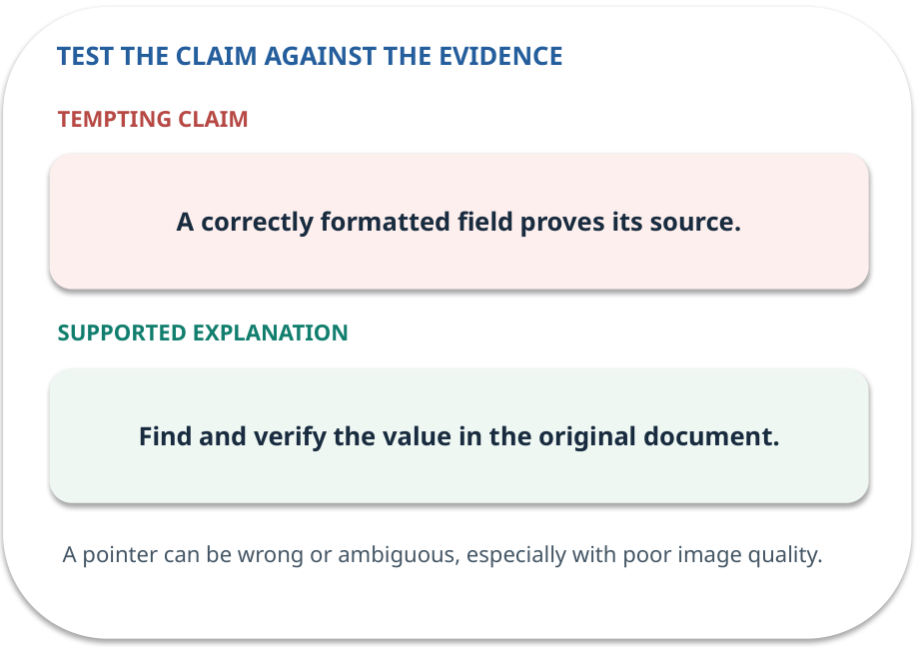
Extraction · answer and explain
REVEAL / WEEK 10
Find and verify the value in the original document.
Tempting mistake: A correctly formatted field proves its source.
GENERATIVE AI 2027 • WEEK 10 • 15 / 40
Notes:
TEACHER SCRIPT — REVEAL. Return to the earlier choice. Explain the correct answer and why the tempting claim fails. Ask one learner to say the answer in a single sentence without reading it. This week’s case is: A synthetic invoice image has fields supplied by a prepared transcription. The visible slide states: Find and verify the value in the original document.
Tempting mistake: A correctly formatted field proves its source. The earlier question was What does a source pointer let another person do? Ask how this differs from the wrong claim. The target is: Distinguish reading from independently checking a document value. Listen for an explanation of the actual arrow or calculation, not just a repeated label. If the answer is unsupported, mark that uncertainty and return to the source. Before moving on, ask for the main idea and one concrete change to the worked example.

Slide 16
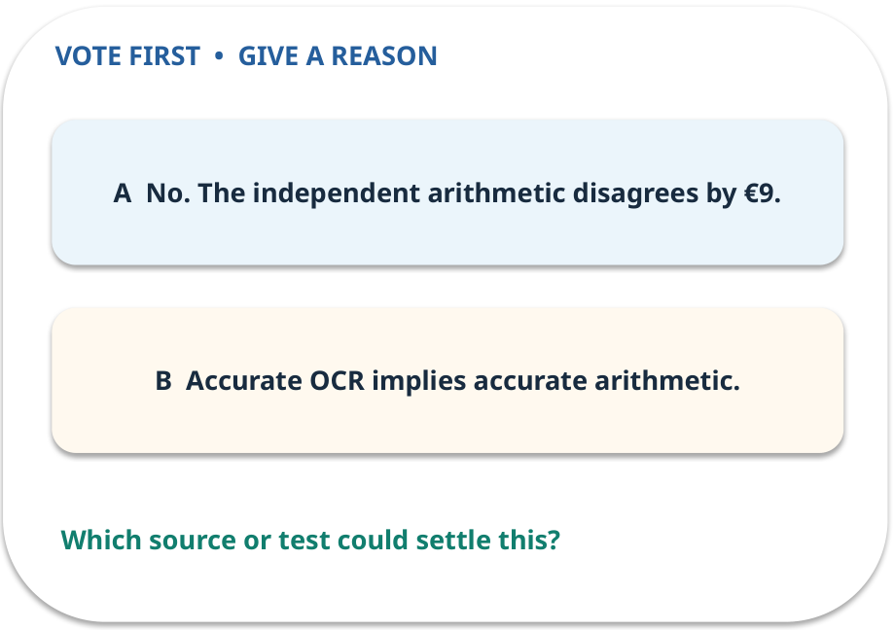
3. Predict · Verification
QUESTION / WEEK 10
Does reading €54 correctly make it a correct payable total?
Make a choice before we explain the diagram.
GENERATIVE AI 2027 • WEEK 10 • 16 / 40
Notes:
TEACHER SCRIPT — QUESTION. Take a show of hands for each choice before showing the mechanism. Ask pairs to defend a choice with evidence. Save the strongest wrong reason for the reveal later in this cycle. This week’s case is: A synthetic invoice image has fields supplied by a prepared transcription. The visible slide states: Does reading €54 correctly make it a correct payable total?
Make a choice before we explain the diagram. The intended answer is No. The independent arithmetic disagrees by €9. The tempting claim is Accurate OCR implies accurate arithmetic. Do not show which card is correct until the reveal. The target is: Distinguish reading from independently checking a document value. Listen for an explanation of the actual arrow or calculation, not just a repeated label. If the answer is unsupported, mark that uncertainty and return to the source. Before moving on, ask for the main idea and one concrete change to the worked example.

Slide 17
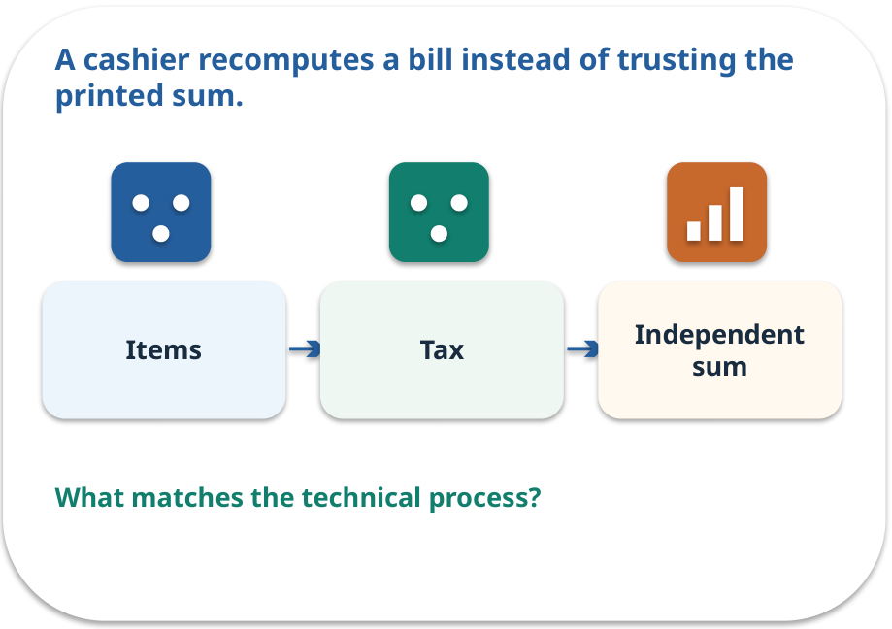
Verification · a familiar picture
ANALOGY / WEEK 10
A cashier recomputes a bill instead of trusting the printed sum.
What matches our case, and where does the analogy stop?
GENERATIVE AI 2027 • WEEK 10 • 17 / 40
Notes:
TEACHER SCRIPT — ANALOGY. Begin with the familiar scene. Invite learners to describe each part in everyday language. Then ask where the comparison might fail before introducing the technical vocabulary. This week’s case is: A synthetic invoice image has fields supplied by a prepared transcription. The visible slide states: A cashier recomputes a bill instead of trusting the printed sum.
What matches our case, and where does the analogy stop? The boundary is: Real invoices may have discounts and other rules; specify the case assumptions. The target is: Distinguish reading from independently checking a document value. Listen for an explanation of the actual arrow or calculation, not just a repeated label. If the answer is unsupported, mark that uncertainty and return to the source. Before moving on, ask for the main idea and one concrete change to the worked example.

Slide 18
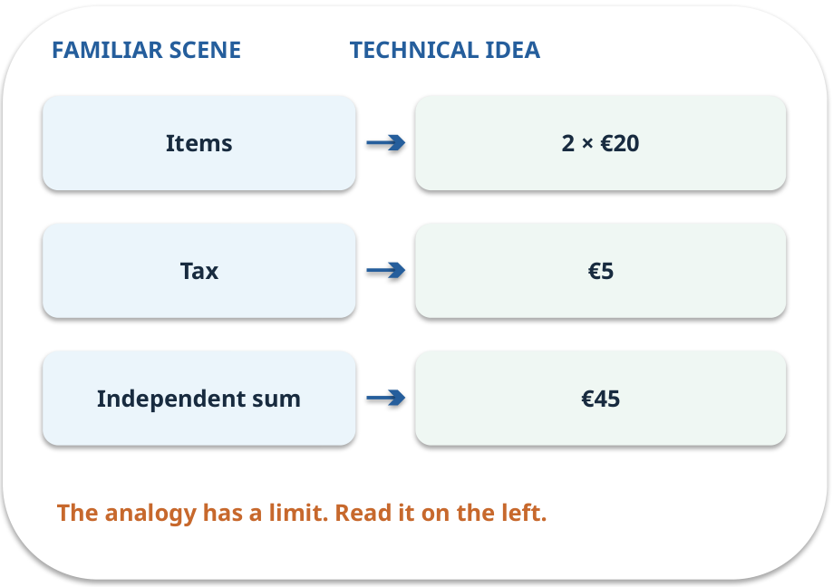
Verification · map the parts
MAPPING / WEEK 10
Match each everyday part to the technical part.
Analogy limit: Real invoices may have discounts and other rules; specify the case assumptions.
GENERATIVE AI 2027 • WEEK 10 • 18 / 40
Notes:
TEACHER SCRIPT — MAPPING. Point from each familiar element to the corresponding technical element. Have students cover the right column and reconstruct the three matches. Read the limitation aloud. This week’s case is: A synthetic invoice image has fields supplied by a prepared transcription. The visible slide states: Match each everyday part to the technical part.
Analogy limit: Real invoices may have discounts and other rules; specify the case assumptions. The three precise mappings are [['Items', '2 × €20'], ['Tax', '€5'], ['Independent sum', '€45']]. The target is: Distinguish reading from independently checking a document value. Listen for an explanation of the actual arrow or calculation, not just a repeated label. If the answer is unsupported, mark that uncertainty and return to the source. Before moving on, ask for the main idea and one concrete change to the worked example.

Slide 19
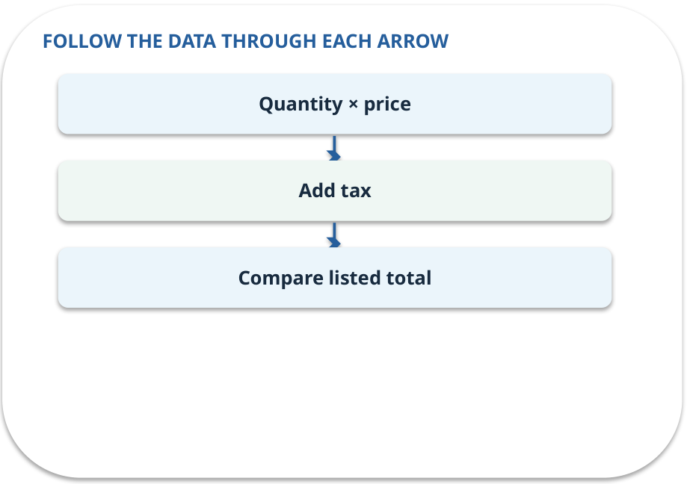
Verification · how it works
MECHANISM / WEEK 10
Recalculate totals and compare against the listed values.
Trace the arrows from left to right.
GENERATIVE AI 2027 • WEEK 10 • 19 / 40
Notes:
TEACHER SCRIPT — MECHANISM. Trace every arrow slowly from the input to the output. Ask what information crosses the boundary at each arrow. Pause if students confuse a simplified notebook with a trained model. This week’s case is: A synthetic invoice image has fields supplied by a prepared transcription. The visible slide states: Recalculate totals and compare against the listed values.
Trace the arrows from left to right. The weekly example is: 2 × €20 + €5 = €45; listed total €54, a €9 discrepancy. State what the analogy does not explain: Real invoices may have discounts and other rules; specify the case assumptions. The target is: Distinguish reading from independently checking a document value. Listen for an explanation of the actual arrow or calculation, not just a repeated label. If the answer is unsupported, mark that uncertainty and return to the source. Before moving on, ask for the main idea and one concrete change to the worked example.

Slide 20
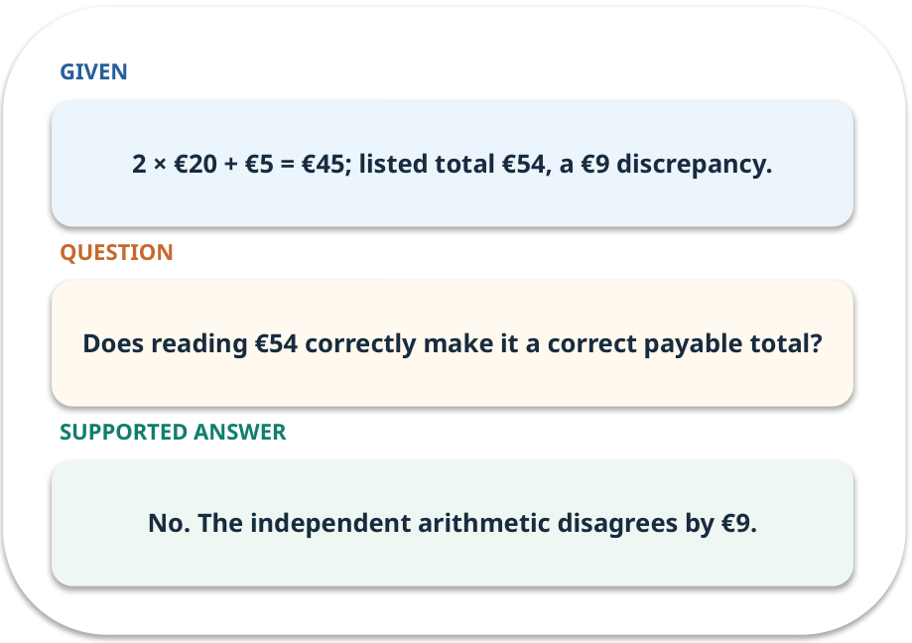
Verification · work one case
WORKED / WEEK 10
2 × €20 + €5 = €45; listed total €54, a €9 discrepancy.
Point to the evidence before giving your conclusion.
GENERATIVE AI 2027 • WEEK 10 • 20 / 40
Notes:
TEACHER SCRIPT — WORKED. Work the specific numbers or source wording aloud. Give students thirty seconds to write a conclusion, then ask which source line or calculation supports it. This week’s case is: A synthetic invoice image has fields supplied by a prepared transcription. The visible slide states: 2 × €20 + €5 = €45; listed total €54, a €9 discrepancy.
Point to the evidence before giving your conclusion. The expected reasoning concludes: No. The independent arithmetic disagrees by €9. Distinguish measured results from illustrative numbers. The target is: Distinguish reading from independently checking a document value. Listen for an explanation of the actual arrow or calculation, not just a repeated label. If the answer is unsupported, mark that uncertainty and return to the source. Before moving on, ask for the main idea and one concrete change to the worked example.

Slide 21
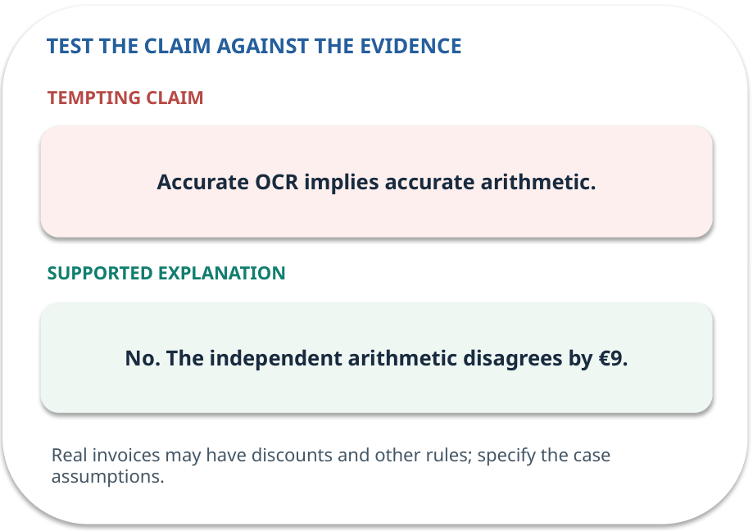
Verification · answer and explain
REVEAL / WEEK 10
No. The independent arithmetic disagrees by €9.
Tempting mistake: Accurate OCR implies accurate arithmetic.
GENERATIVE AI 2027 • WEEK 10 • 21 / 40
Notes:
TEACHER SCRIPT — REVEAL. Return to the earlier choice. Explain the correct answer and why the tempting claim fails. Ask one learner to say the answer in a single sentence without reading it. This week’s case is: A synthetic invoice image has fields supplied by a prepared transcription. The visible slide states: No. The independent arithmetic disagrees by €9.
Tempting mistake: Accurate OCR implies accurate arithmetic. The earlier question was Does reading €54 correctly make it a correct payable total? Ask how this differs from the wrong claim. The target is: Distinguish reading from independently checking a document value. Listen for an explanation of the actual arrow or calculation, not just a repeated label. If the answer is unsupported, mark that uncertainty and return to the source. Before moving on, ask for the main idea and one concrete change to the worked example.

Slide 22
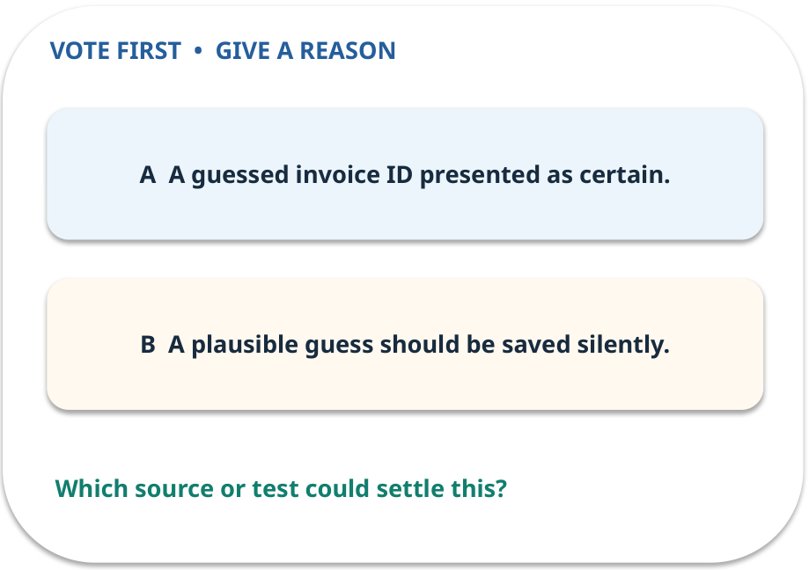
4. Predict · Uncertainty
QUESTION / WEEK 10
What would be unsafe to store?
Make a choice before we explain the diagram.
GENERATIVE AI 2027 • WEEK 10 • 22 / 40
Notes:
TEACHER SCRIPT — QUESTION. Take a show of hands for each choice before showing the mechanism. Ask pairs to defend a choice with evidence. Save the strongest wrong reason for the reveal later in this cycle. This week’s case is: A synthetic invoice image has fields supplied by a prepared transcription. The visible slide states: What would be unsafe to store?
Make a choice before we explain the diagram. The intended answer is A guessed invoice ID presented as certain. The tempting claim is A plausible guess should be saved silently. Do not show which card is correct until the reveal. The target is: Distinguish reading from independently checking a document value. Listen for an explanation of the actual arrow or calculation, not just a repeated label. If the answer is unsupported, mark that uncertainty and return to the source. Before moving on, ask for the main idea and one concrete change to the worked example.

Slide 23
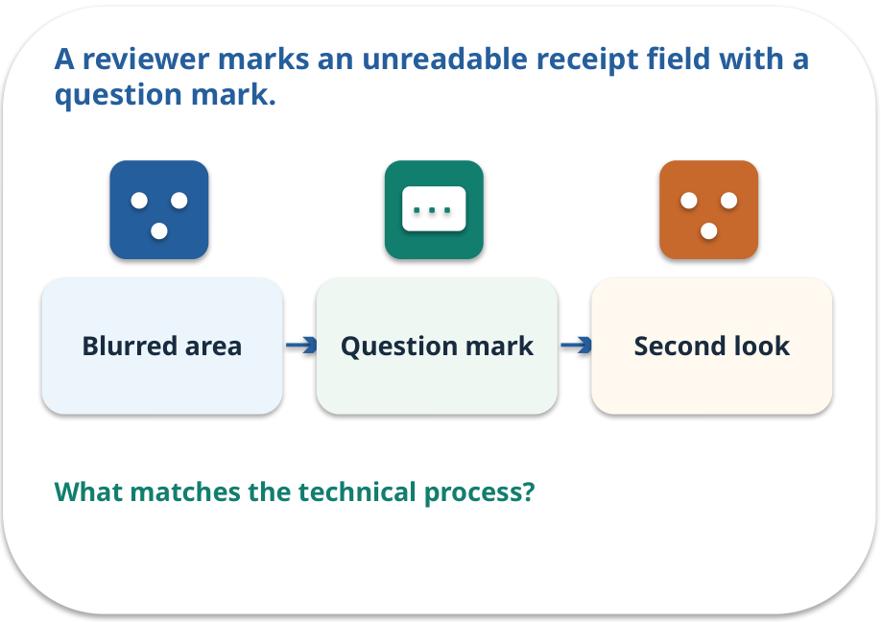
Uncertainty · a familiar picture
ANALOGY / WEEK 10
A reviewer marks an unreadable receipt field with a question mark.
What matches our case, and where does the analogy stop?
GENERATIVE AI 2027 • WEEK 10 • 23 / 40
Notes:
TEACHER SCRIPT — ANALOGY. Begin with the familiar scene. Invite learners to describe each part in everyday language. Then ask where the comparison might fail before introducing the technical vocabulary. This week’s case is: A synthetic invoice image has fields supplied by a prepared transcription. The visible slide states: A reviewer marks an unreadable receipt field with a question mark.
What matches our case, and where does the analogy stop? The boundary is: Uncertainty needs a clear workflow; marking everything uncertain is unhelpful. The target is: Distinguish reading from independently checking a document value. Listen for an explanation of the actual arrow or calculation, not just a repeated label. If the answer is unsupported, mark that uncertainty and return to the source. Before moving on, ask for the main idea and one concrete change to the worked example.

Slide 24
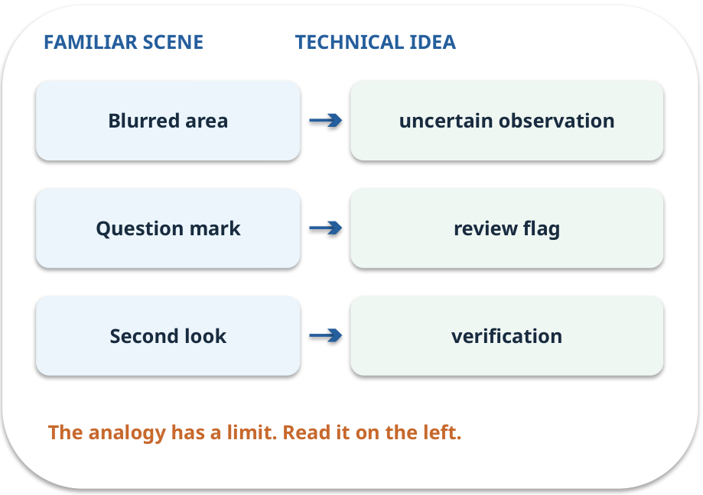
Uncertainty · map the parts
MAPPING / WEEK 10
Match each everyday part to the technical part.
Analogy limit: Uncertainty needs a clear workflow; marking everything uncertain is unhelpful.
GENERATIVE AI 2027 • WEEK 10 • 24 / 40
Notes:
TEACHER SCRIPT — MAPPING. Point from each familiar element to the corresponding technical element. Have students cover the right column and reconstruct the three matches. Read the limitation aloud. This week’s case is: A synthetic invoice image has fields supplied by a prepared transcription. The visible slide states: Match each everyday part to the technical part.
Analogy limit: Uncertainty needs a clear workflow; marking everything uncertain is unhelpful. The three precise mappings are [['Blurred area', 'uncertain observation'], ['Question mark', 'review flag'], ['Second look', 'verification']]. The target is: Distinguish reading from independently checking a document value. Listen for an explanation of the actual arrow or calculation, not just a repeated label. If the answer is unsupported, mark that uncertainty and return to the source. Before moving on, ask for the main idea and one concrete change to the worked example.

Slide 25
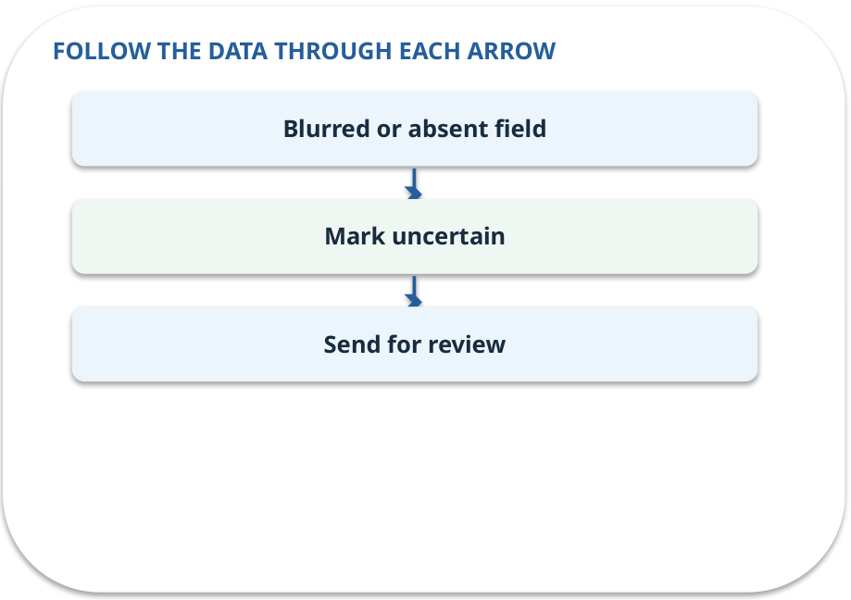
Uncertainty · how it works
MECHANISM / WEEK 10
Mark unreadable or absent fields for review rather than inventing a value.
Trace the arrows from left to right.
GENERATIVE AI 2027 • WEEK 10 • 25 / 40
Notes:
TEACHER SCRIPT — MECHANISM. Trace every arrow slowly from the input to the output. Ask what information crosses the boundary at each arrow. Pause if students confuse a simplified notebook with a trained model. This week’s case is: A synthetic invoice image has fields supplied by a prepared transcription. The visible slide states: Mark unreadable or absent fields for review rather than inventing a value.
Trace the arrows from left to right. The weekly example is: If INV-08/INV-03 cannot be distinguished, store an uncertain ID and request review. State what the analogy does not explain: Uncertainty needs a clear workflow; marking everything uncertain is unhelpful. The target is: Distinguish reading from independently checking a document value. Listen for an explanation of the actual arrow or calculation, not just a repeated label. If the answer is unsupported, mark that uncertainty and return to the source. Before moving on, ask for the main idea and one concrete change to the worked example.

Slide 26
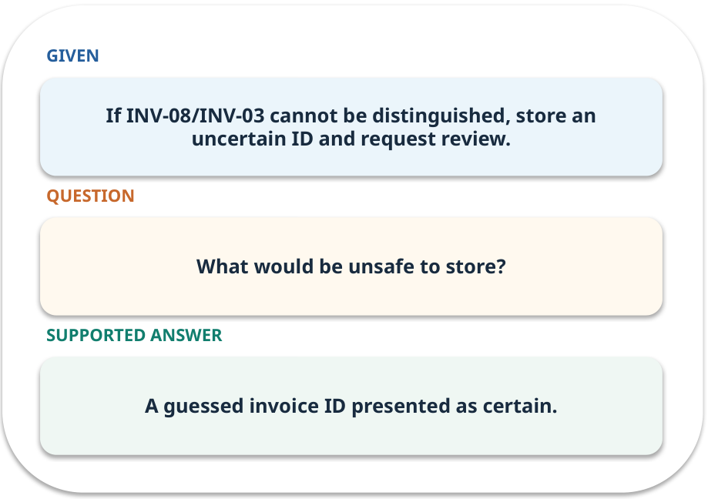
Uncertainty · work one case
WORKED / WEEK 10
If INV-08/INV-03 cannot be distinguished, store an uncertain ID and request review.
Point to the evidence before giving your conclusion.
GENERATIVE AI 2027 • WEEK 10 • 26 / 40
Notes:
TEACHER SCRIPT — WORKED. Work the specific numbers or source wording aloud. Give students thirty seconds to write a conclusion, then ask which source line or calculation supports it. This week’s case is: A synthetic invoice image has fields supplied by a prepared transcription. The visible slide states: If INV-08/INV-03 cannot be distinguished, store an uncertain ID and request review.
Point to the evidence before giving your conclusion. The expected reasoning concludes: A guessed invoice ID presented as certain. Distinguish measured results from illustrative numbers. The target is: Distinguish reading from independently checking a document value. Listen for an explanation of the actual arrow or calculation, not just a repeated label. If the answer is unsupported, mark that uncertainty and return to the source. Before moving on, ask for the main idea and one concrete change to the worked example.

Slide 27
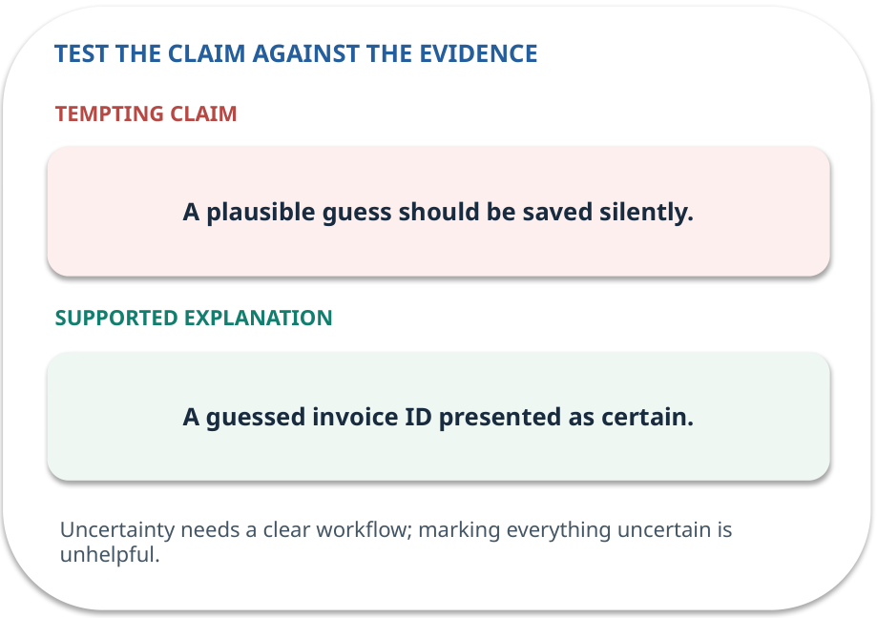
Uncertainty · answer and explain
REVEAL / WEEK 10
A guessed invoice ID presented as certain.
Tempting mistake: A plausible guess should be saved silently.
GENERATIVE AI 2027 • WEEK 10 • 27 / 40
Notes:
TEACHER SCRIPT — REVEAL. Return to the earlier choice. Explain the correct answer and why the tempting claim fails. Ask one learner to say the answer in a single sentence without reading it. This week’s case is: A synthetic invoice image has fields supplied by a prepared transcription. The visible slide states: A guessed invoice ID presented as certain.
Tempting mistake: A plausible guess should be saved silently. The earlier question was What would be unsafe to store? Ask how this differs from the wrong claim. The target is: Distinguish reading from independently checking a document value. Listen for an explanation of the actual arrow or calculation, not just a repeated label. If the answer is unsupported, mark that uncertainty and return to the source. Before moving on, ask for the main idea and one concrete change to the worked example.

Slide 28
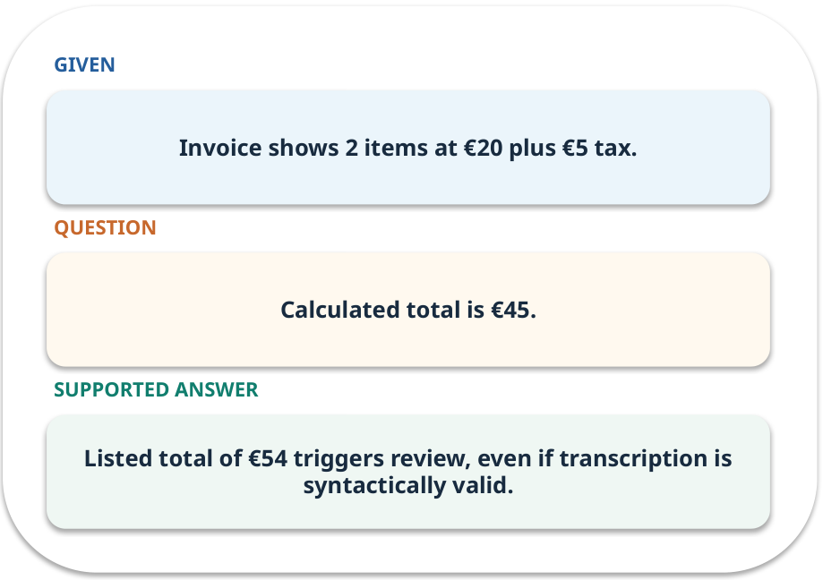
Evidence trail: input → result
WORKED / WEEK 10
Calculated total is €45.
Listed total of €54 triggers review, even if transcription is syntactically valid.
GENERATIVE AI 2027 • WEEK 10 • 28 / 40
Notes:
TEACHER SCRIPT — WORKED. Work the specific numbers or source wording aloud. Give students thirty seconds to write a conclusion, then ask which source line or calculation supports it. This week’s case is: A synthetic invoice image has fields supplied by a prepared transcription. The visible slide states: Calculated total is €45.
Listed total of €54 triggers review, even if transcription is syntactically valid. Have one student point to an exact source word or number for each conclusion. The target is: Distinguish reading from independently checking a document value. Listen for an explanation of the actual arrow or calculation, not just a repeated label. If the answer is unsupported, mark that uncertainty and return to the source. Before moving on, ask for the main idea and one concrete change to the worked example.

Slide 29
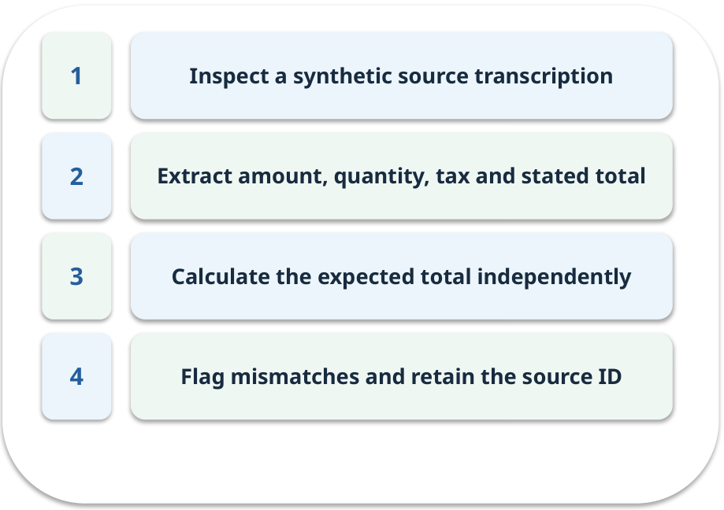
Notebook: run the prepared example
PRACTICE / WEEK 10
Check two synthetic invoices, including a mismatched total.
Read the original output before editing.
GENERATIVE AI 2027 • WEEK 10 • 29 / 40
Notes:
TEACHER SCRIPT — PRACTICE. Open the matching notebook and demonstrate the first run. Have learners predict one change, run only that change, and record input, setting, output and an error explanation. This week’s case is: A synthetic invoice image has fields supplied by a prepared transcription. The visible slide states: Check two synthetic invoices, including a mismatched total.
Read the original output before editing. Use Week_10_Lab.ipynb. This lab is a prepared classroom demonstration with its limitations documented. The target is: Distinguish reading from independently checking a document value. Listen for an explanation of the actual arrow or calculation, not just a repeated label. If the answer is unsupported, mark that uncertainty and return to the source. Before moving on, ask for the main idea and one concrete change to the worked example.

Slide 30

Find the input and check in Python
PRACTICE / WEEK 10
Locate the supplied input, the transformation, the checking line and the printed result.
GENERATIVE AI 2027 • WEEK 10 • 30 / 40
Notes:
TEACHER SCRIPT — PRACTICE. Open the matching notebook and demonstrate the first run. Have learners predict one change, run only that change, and record input, setting, output and an error explanation. This week’s case is: A synthetic invoice image has fields supplied by a prepared transcription. The visible slide states: Locate the supplied input, the transformation, the checking line and the printed result. The weekly lab change is: Correct the listed total and rerun the checker. The target is: Distinguish reading from independently checking a document value. Listen for an explanation of the actual arrow or calculation, not just a repeated label. If the answer is unsupported, mark that uncertainty and return to the source. Before moving on, ask for the main idea and one concrete change to the worked example.

Slide 31

Predict one controlled change
PRACTICE / WEEK 10
Correct the listed total and rerun the checker.
What should change in the result? What stays fixed?
GENERATIVE AI 2027 • WEEK 10 • 31 / 40
Notes:
TEACHER SCRIPT — PRACTICE. Open the matching notebook and demonstrate the first run. Have learners predict one change, run only that change, and record input, setting, output and an error explanation. This week’s case is: A synthetic invoice image has fields supplied by a prepared transcription. The visible slide states: Correct the listed total and rerun the checker.
What should change in the result? What stays fixed? Ask learners to write their prediction before rerunning the cell. The target is: Distinguish reading from independently checking a document value. Listen for an explanation of the actual arrow or calculation, not just a repeated label. If the answer is unsupported, mark that uncertainty and return to the source. Before moving on, ask for the main idea and one concrete change to the worked example.

Slide 32

Run, compare and record
PRACTICE / WEEK 10
Record the input, the one changed setting, the observed result and a reason for any difference.
GENERATIVE AI 2027 • WEEK 10 • 32 / 40
Notes:
TEACHER SCRIPT — PRACTICE. Open the matching notebook and demonstrate the first run. Have learners predict one change, run only that change, and record input, setting, output and an error explanation. This week’s case is: A synthetic invoice image has fields supplied by a prepared transcription. The visible slide states: Record the input, the one changed setting, the observed result and a reason for any difference. The required evidence is: Source-linked field table and calculation. The target is: Distinguish reading from independently checking a document value. Listen for an explanation of the actual arrow or calculation, not just a repeated label. If the answer is unsupported, mark that uncertainty and return to the source. Before moving on, ask for the main idea and one concrete change to the worked example.

Slide 33

Measure without hiding the denominator
CHECK / WEEK 10
Number of correctly checked fields / fields reviewed
Write the numerator, denominator and one failure case.
GENERATIVE AI 2027 • WEEK 10 • 33 / 40
Notes:
TEACHER SCRIPT — CHECK. Use this as a brief formative check. Ask for the conclusion, the evidence and one limitation. Revisit disagreements in the review session and offer an extension only after the core task. This week’s case is: A synthetic invoice image has fields supplied by a prepared transcription. The visible slide states: Number of correctly checked fields / fields reviewed
Write the numerator, denominator and one failure case. Where a measure is qualitative, show the concrete source comparison. Example: Listed total of €54 triggers review, even if transcription is syntactically valid. The target is: Distinguish reading from independently checking a document value. Listen for an explanation of the actual arrow or calculation, not just a repeated label. If the answer is unsupported, mark that uncertainty and return to the source. Before moving on, ask for the main idea and one concrete change to the worked example.

Slide 34
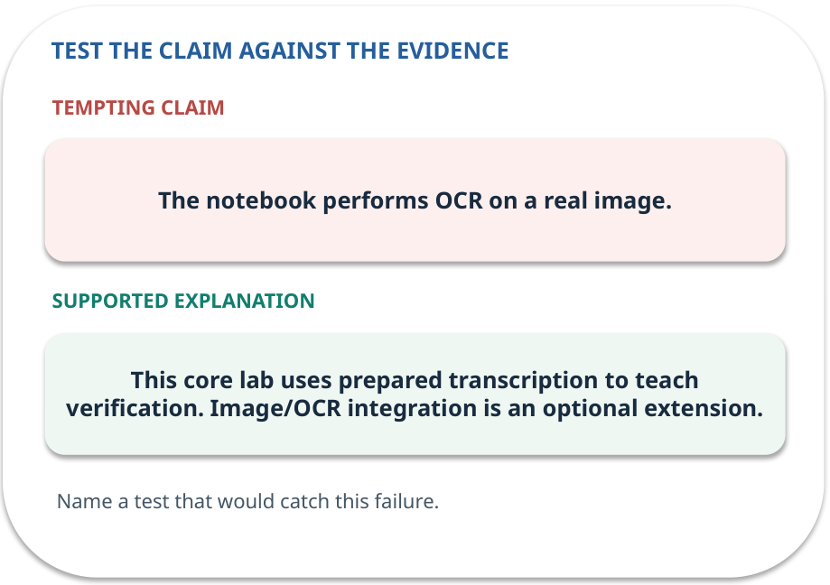
Error detective: find the layer
CHECK / WEEK 10
Plausible wrong claim: The notebook performs OCR on a real image.
Correct it using the case evidence.
GENERATIVE AI 2027 • WEEK 10 • 34 / 40
Notes:
TEACHER SCRIPT — CHECK. Use this as a brief formative check. Ask for the conclusion, the evidence and one limitation. Revisit disagreements in the review session and offer an extension only after the core task. This week’s case is: A synthetic invoice image has fields supplied by a prepared transcription. The visible slide states: Plausible wrong claim: The notebook performs OCR on a real image.
Correct it using the case evidence. The correction is This core lab uses prepared transcription to teach verification. Image/OCR integration is an optional extension. The target is: Distinguish reading from independently checking a document value. Listen for an explanation of the actual arrow or calculation, not just a repeated label. If the answer is unsupported, mark that uncertainty and return to the source. Before moving on, ask for the main idea and one concrete change to the worked example.

Slide 35

Transfer to a new situation
CHECK / WEEK 10
A blurred invoice number looks like INV-08 or INV-03. Which field should be marked uncertain?
Explain which source or test would settle it.
GENERATIVE AI 2027 • WEEK 10 • 35 / 40
Notes:
TEACHER SCRIPT — CHECK. Use this as a brief formative check. Ask for the conclusion, the evidence and one limitation. Revisit disagreements in the review session and offer an extension only after the core task. This week’s case is: A synthetic invoice image has fields supplied by a prepared transcription. The visible slide states: A blurred invoice number looks like INV-08 or INV-03. Which field should be marked uncertain?
Explain which source or test would settle it. This is a fresh scenario, so ask for a reason before accepting either short answer. The target is: Distinguish reading from independently checking a document value. Listen for an explanation of the actual arrow or calculation, not just a repeated label. If the answer is unsupported, mark that uncertainty and return to the source. Before moving on, ask for the main idea and one concrete change to the worked example.

Slide 36
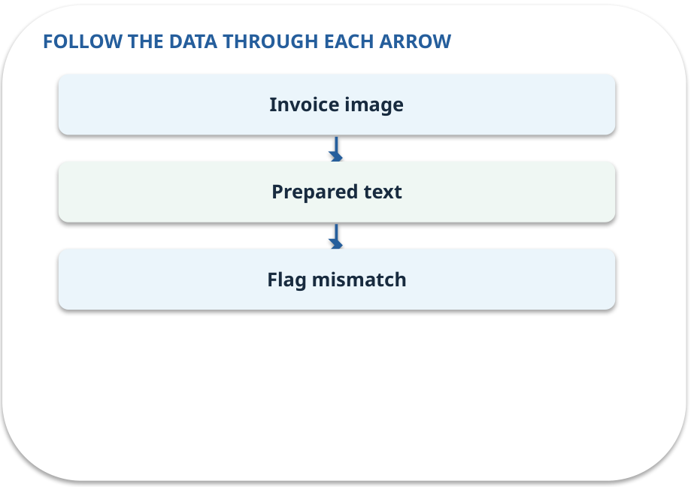
Explain it to a partner
CHECK / WEEK 10
Without reading the slide, name the input, one processing step and the check. Your partner should ask “How do you know?”
GENERATIVE AI 2027 • WEEK 10 • 36 / 40
Notes:
TEACHER SCRIPT — CHECK. Use this as a brief formative check. Ask for the conclusion, the evidence and one limitation. Revisit disagreements in the review session and offer an extension only after the core task. This week’s case is: A synthetic invoice image has fields supplied by a prepared transcription. The visible slide states: Without reading the slide, name the input, one processing step and the check. Your partner should ask “How do you know?” Listen for a causal explanation and one limitation, then revisit a difficult arrow on the board. The target is: Distinguish reading from independently checking a document value. Listen for an explanation of the actual arrow or calculation, not just a repeated label. If the answer is unsupported, mark that uncertainty and return to the source. Before moving on, ask for the main idea and one concrete change to the worked example.

Slide 37

Exam rehearsal · explain and apply
CHECK / WEEK 10
What is the difference between extraction and verification?
Write a short answer, then compare with the guide.
GENERATIVE AI 2027 • WEEK 10 • 37 / 40
Notes:
TEACHER SCRIPT — CHECK. Use this as a brief formative check. Ask for the conclusion, the evidence and one limitation. Revisit disagreements in the review session and offer an extension only after the core task. This week’s case is: A synthetic invoice image has fields supplied by a prepared transcription. The visible slide states: What is the difference between extraction and verification?
Write a short answer, then compare with the guide. Model answer after discussion: Extraction records the visible value. Verification checks it against arithmetic, evidence or rules. Practice marks: 4. The target is: Distinguish reading from independently checking a document value. Listen for an explanation of the actual arrow or calculation, not just a repeated label. If the answer is unsupported, mark that uncertainty and return to the source. Before moving on, ask for the main idea and one concrete change to the worked example.

Slide 38
Exam rehearsal · explain and apply
CHECK / WEEK 10
Calculate the total for 2 × 20 plus 5 tax.
Write a short answer, then compare with the guide.
GENERATIVE AI 2027 • WEEK 10 • 38 / 40
Notes:
TEACHER SCRIPT — CHECK. Use this as a brief formative check. Ask for the conclusion, the evidence and one limitation. Revisit disagreements in the review session and offer an extension only after the core task. This week’s case is: A synthetic invoice image has fields supplied by a prepared transcription. The visible slide states: Calculate the total for 2 × 20 plus 5 tax.
Write a short answer, then compare with the guide. Model answer after discussion: 45. A listed value of 54 differs by 9 and should be reviewed. Practice marks: 4. The target is: Distinguish reading from independently checking a document value. Listen for an explanation of the actual arrow or calculation, not just a repeated label. If the answer is unsupported, mark that uncertainty and return to the source. Before moving on, ask for the main idea and one concrete change to the worked example.

Slide 39

What to hand in
PRACTICE / WEEK 10
Source-linked field table and calculation.
Include the one changed input and an error explanation.
GENERATIVE AI 2027 • WEEK 10 • 39 / 40
Notes:
TEACHER SCRIPT — PRACTICE. Open the matching notebook and demonstrate the first run. Have learners predict one change, run only that change, and record input, setting, output and an error explanation. This week’s case is: A synthetic invoice image has fields supplied by a prepared transcription. The visible slide states: Source-linked field table and calculation.
Include the one changed input and an error explanation. This weekly evidence receives formative feedback according to the module sequence; refer to the assessment brief for graded work. The target is: Distinguish reading from independently checking a document value. Listen for an explanation of the actual arrow or calculation, not just a repeated label. If the answer is unsupported, mark that uncertainty and return to the source. Before moving on, ask for the main idea and one concrete change to the worked example.

Slide 40
Three ideas to recall next week
CHECK / WEEK 10
Read the source, preserve field pointers, calculate independently, and flag discrepancies.
Read the linked official sources in the Word guide and redraw one diagram from memory.
GENERATIVE AI 2027 • WEEK 10 • 40 / 40
Notes:
TEACHER SCRIPT — CHECK. Use this as a brief formative check. Ask for the conclusion, the evidence and one limitation. Revisit disagreements in the review session and offer an extension only after the core task. This week’s case is: A synthetic invoice image has fields supplied by a prepared transcription. The visible slide states: Read the source, preserve field pointers, calculate independently, and flag discrepancies.
Read the linked official sources in the Word guide and redraw one diagram from memory. Return to the opening vote and ask whether the evidence changed anyone’s mind. The next week builds on this outcome: Distinguish reading from independently checking a document value. The target is: Distinguish reading from independently checking a document value. Listen for an explanation of the actual arrow or calculation, not just a repeated label. If the answer is unsupported, mark that uncertainty and return to the source. Before moving on, ask for the main idea and one concrete change to the worked example.

