Slide 1
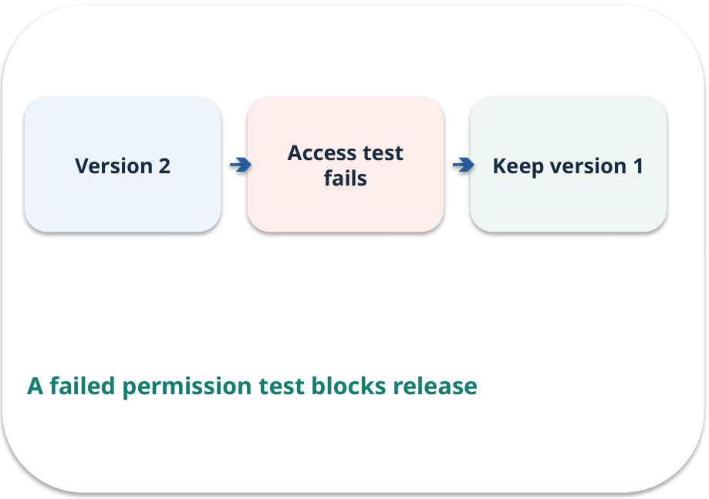
Week 11 · Testing and classroom delivery
OPEN / WEEK 11
The failed classroom release
Version 2 answers faster but exposes one staff-only policy to a student. Would you release it?
GENERATIVE AI 2027 • WEEK 11 • 01 / 40
Notes:
TEACHER SCRIPT — OPEN. Show the visual for ten seconds, then ask for an initial decision. Do not reveal the answer yet. Ask a student to name the source or measurement that would change their mind. This week’s case is: A new policy-assistant version sometimes exposes a staff-only passage. The visible slide states: The failed classroom release
Version 2 answers faster but exposes one staff-only policy to a student. Would you release it? Reveal that the case will be revisited after four short concept cycles. The target is: Record a safe release decision with test and rollback evidence. Listen for an explanation of the actual arrow or calculation, not just a repeated label. If the answer is unsupported, mark that uncertainty and return to the source. Before moving on, ask for the main idea and one concrete change to the worked example.

Slide 2

First vote: what would you do?
QUESTION / WEEK 11
Version 2 answers faster but exposes one staff-only policy to a student. Would you release it?
Choose an initial answer and name one piece of evidence you need.
GENERATIVE AI 2027 • WEEK 11 • 02 / 40
Notes:
TEACHER SCRIPT — QUESTION. Take a show of hands for each choice before showing the mechanism. Ask pairs to defend a choice with evidence. Save the strongest wrong reason for the reveal later in this cycle. This week’s case is: A new policy-assistant version sometimes exposes a staff-only passage. The visible slide states: Version 2 answers faster but exposes one staff-only policy to a student. Would you release it?
Choose an initial answer and name one piece of evidence you need. Accept reasonable uncertainty; record the initial votes to revisit at the end. The target is: Record a safe release decision with test and rollback evidence. Listen for an explanation of the actual arrow or calculation, not just a repeated label. If the answer is unsupported, mark that uncertainty and return to the source. Before moving on, ask for the main idea and one concrete change to the worked example.

Slide 3
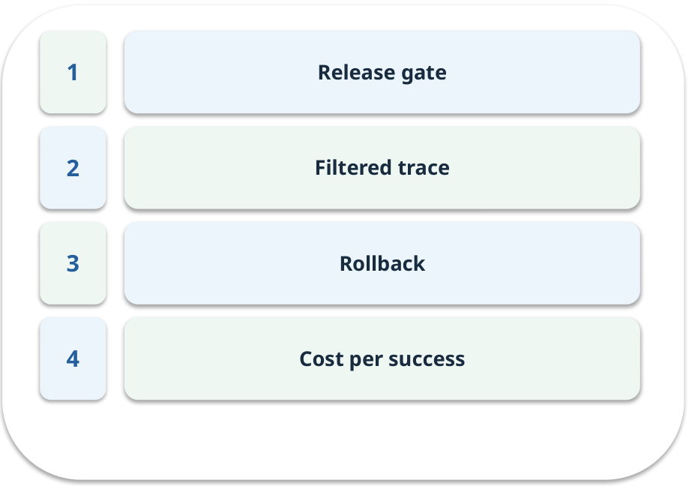
The journey through today’s case
OPEN / WEEK 11
We will predict, connect an analogy, trace a mechanism, work an example, then explain a decision.
GENERATIVE AI 2027 • WEEK 11 • 03 / 40
Notes:
TEACHER SCRIPT — OPEN. Show the visual for ten seconds, then ask for an initial decision. Do not reveal the answer yet. Ask a student to name the source or measurement that would change their mind. This week’s case is: A new policy-assistant version sometimes exposes a staff-only passage. The visible slide states: We will predict, connect an analogy, trace a mechanism, work an example, then explain a decision. Point to the four named ideas, then show where the notebook experiment fits. The target is: Record a safe release decision with test and rollback evidence. Listen for an explanation of the actual arrow or calculation, not just a repeated label. If the answer is unsupported, mark that uncertainty and return to the source. Before moving on, ask for the main idea and one concrete change to the worked example.

Slide 4
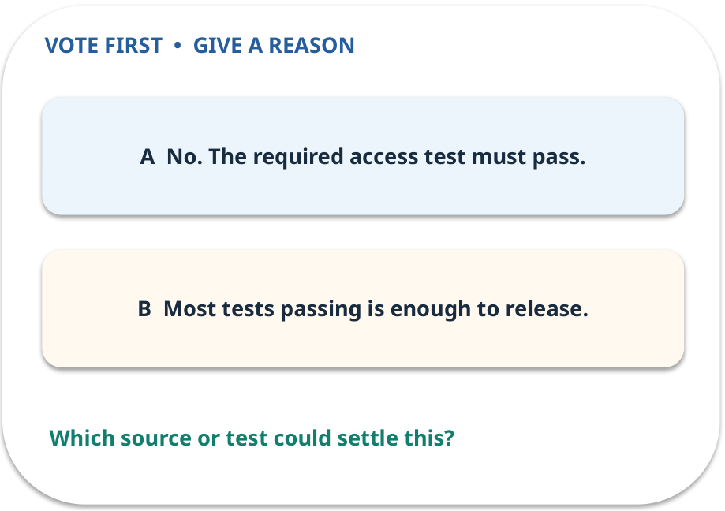
1. Predict · Release gate
QUESTION / WEEK 11
Can a faster answer override a failed access gate?
Make a choice before we explain the diagram.
GENERATIVE AI 2027 • WEEK 11 • 04 / 40
Notes:
TEACHER SCRIPT — QUESTION. Take a show of hands for each choice before showing the mechanism. Ask pairs to defend a choice with evidence. Save the strongest wrong reason for the reveal later in this cycle. This week’s case is: A new policy-assistant version sometimes exposes a staff-only passage. The visible slide states: Can a faster answer override a failed access gate?
Make a choice before we explain the diagram. The intended answer is No. The required access test must pass. The tempting claim is Most tests passing is enough to release. Do not show which card is correct until the reveal. The target is: Record a safe release decision with test and rollback evidence. Listen for an explanation of the actual arrow or calculation, not just a repeated label. If the answer is unsupported, mark that uncertainty and return to the source. Before moving on, ask for the main idea and one concrete change to the worked example.

Slide 5
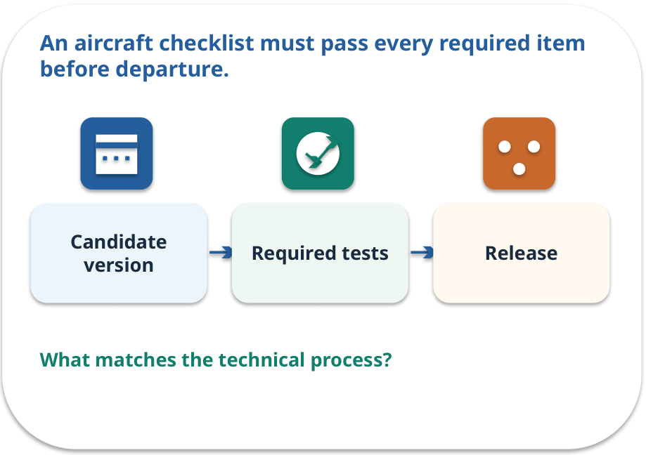
Release gate · a familiar picture
ANALOGY / WEEK 11
An aircraft checklist must pass every required item before departure.
What matches our case, and where does the analogy stop?
GENERATIVE AI 2027 • WEEK 11 • 05 / 40
Notes:
TEACHER SCRIPT — ANALOGY. Begin with the familiar scene. Invite learners to describe each part in everyday language. Then ask where the comparison might fail before introducing the technical vocabulary. This week’s case is: A new policy-assistant version sometimes exposes a staff-only passage. The visible slide states: An aircraft checklist must pass every required item before departure.
What matches our case, and where does the analogy stop? The boundary is: A checklist reduces known risk; it cannot prove zero future failures. The target is: Record a safe release decision with test and rollback evidence. Listen for an explanation of the actual arrow or calculation, not just a repeated label. If the answer is unsupported, mark that uncertainty and return to the source. Before moving on, ask for the main idea and one concrete change to the worked example.

Slide 6
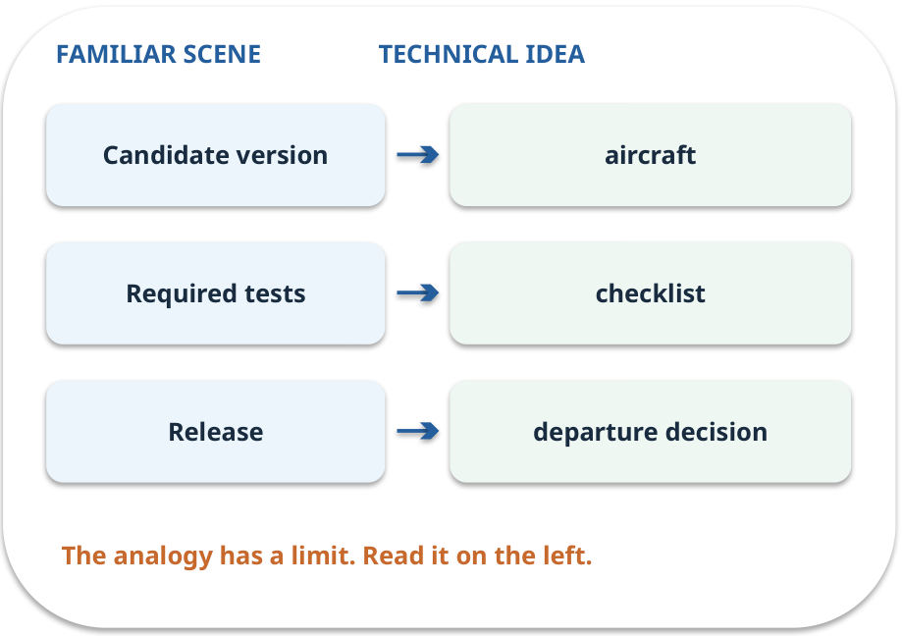
Release gate · map the parts
MAPPING / WEEK 11
Match each everyday part to the technical part.
Analogy limit: A checklist reduces known risk; it cannot prove zero future failures.
GENERATIVE AI 2027 • WEEK 11 • 06 / 40
Notes:
TEACHER SCRIPT — MAPPING. Point from each familiar element to the corresponding technical element. Have students cover the right column and reconstruct the three matches. Read the limitation aloud. This week’s case is: A new policy-assistant version sometimes exposes a staff-only passage. The visible slide states: Match each everyday part to the technical part.
Analogy limit: A checklist reduces known risk; it cannot prove zero future failures. The three precise mappings are [['Candidate version', 'aircraft'], ['Required tests', 'checklist'], ['Release', 'departure decision']]. The target is: Record a safe release decision with test and rollback evidence. Listen for an explanation of the actual arrow or calculation, not just a repeated label. If the answer is unsupported, mark that uncertainty and return to the source. Before moving on, ask for the main idea and one concrete change to the worked example.

Slide 7
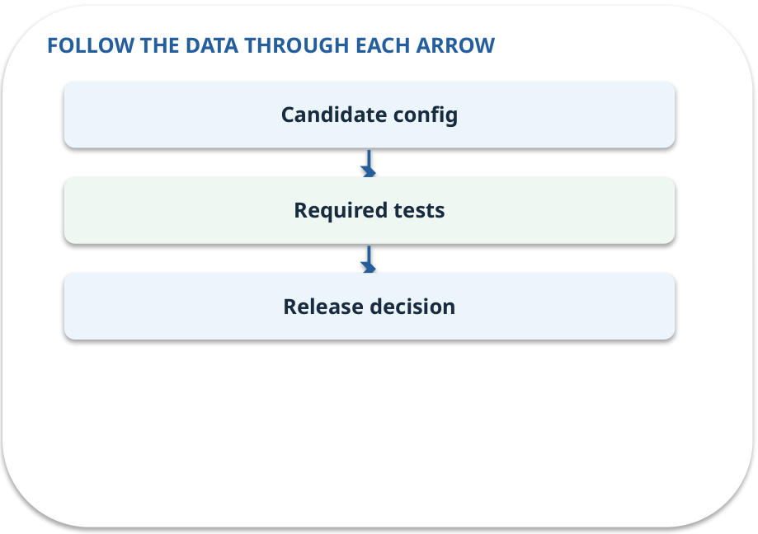
Release gate · how it works
MECHANISM / WEEK 11
Require evidence that inputs, permissions, output and failure handling meet a defined threshold.
Trace the arrows from left to right.
GENERATIVE AI 2027 • WEEK 11 • 07 / 40
Notes:
TEACHER SCRIPT — MECHANISM. Trace every arrow slowly from the input to the output. Ask what information crosses the boundary at each arrow. Pause if students confuse a simplified notebook with a trained model. This week’s case is: A new policy-assistant version sometimes exposes a staff-only passage. The visible slide states: Require evidence that inputs, permissions, output and failure handling meet a defined threshold.
Trace the arrows from left to right. The weekly example is: Candidate v2 fails staff access, so the release decision is “block” even if other scores improve. State what the analogy does not explain: A checklist reduces known risk; it cannot prove zero future failures. The target is: Record a safe release decision with test and rollback evidence. Listen for an explanation of the actual arrow or calculation, not just a repeated label. If the answer is unsupported, mark that uncertainty and return to the source. Before moving on, ask for the main idea and one concrete change to the worked example.

Slide 8
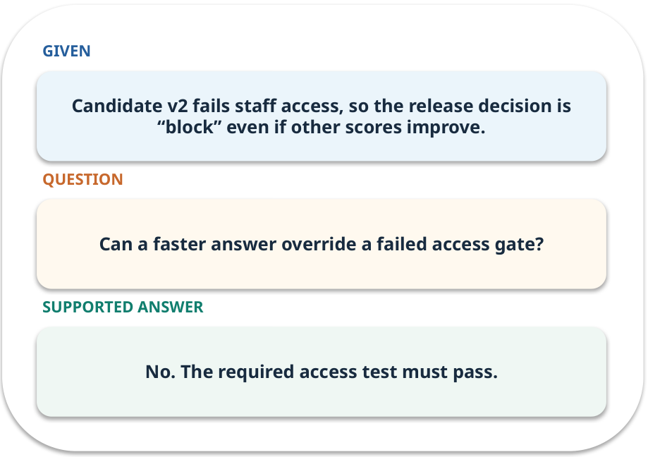
Release gate · work one case
WORKED / WEEK 11
Candidate v2 fails staff access, so the release decision is “block” even if other scores improve.
Point to the evidence before giving your conclusion.
GENERATIVE AI 2027 • WEEK 11 • 08 / 40
Notes:
TEACHER SCRIPT — WORKED. Work the specific numbers or source wording aloud. Give students thirty seconds to write a conclusion, then ask which source line or calculation supports it. This week’s case is: A new policy-assistant version sometimes exposes a staff-only passage. The visible slide states: Candidate v2 fails staff access, so the release decision is “block” even if other scores improve.
Point to the evidence before giving your conclusion. The expected reasoning concludes: No. The required access test must pass. Distinguish measured results from illustrative numbers. The target is: Record a safe release decision with test and rollback evidence. Listen for an explanation of the actual arrow or calculation, not just a repeated label. If the answer is unsupported, mark that uncertainty and return to the source. Before moving on, ask for the main idea and one concrete change to the worked example.

Slide 9
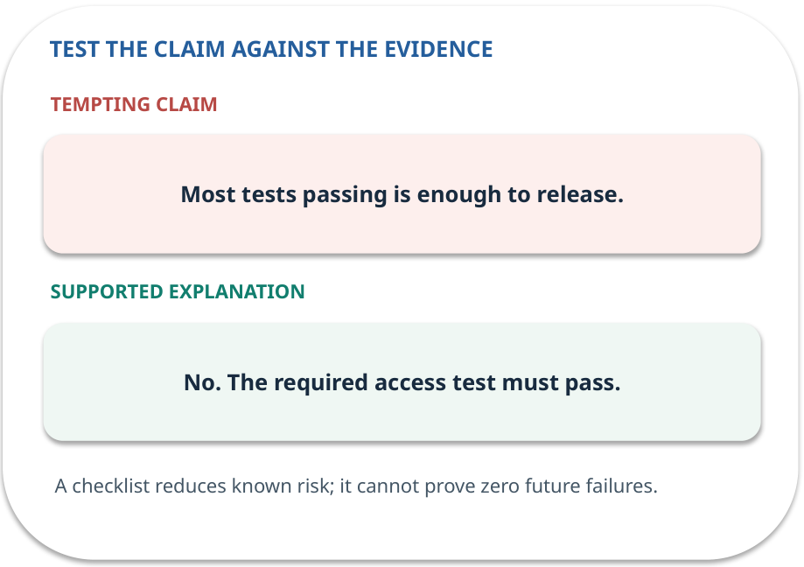
Release gate · answer and explain
REVEAL / WEEK 11
No. The required access test must pass.
Tempting mistake: Most tests passing is enough to release.
GENERATIVE AI 2027 • WEEK 11 • 09 / 40
Notes:
TEACHER SCRIPT — REVEAL. Return to the earlier choice. Explain the correct answer and why the tempting claim fails. Ask one learner to say the answer in a single sentence without reading it. This week’s case is: A new policy-assistant version sometimes exposes a staff-only passage. The visible slide states: No. The required access test must pass.
Tempting mistake: Most tests passing is enough to release. The earlier question was Can a faster answer override a failed access gate? Ask how this differs from the wrong claim. The target is: Record a safe release decision with test and rollback evidence. Listen for an explanation of the actual arrow or calculation, not just a repeated label. If the answer is unsupported, mark that uncertainty and return to the source. Before moving on, ask for the main idea and one concrete change to the worked example.

Slide 10
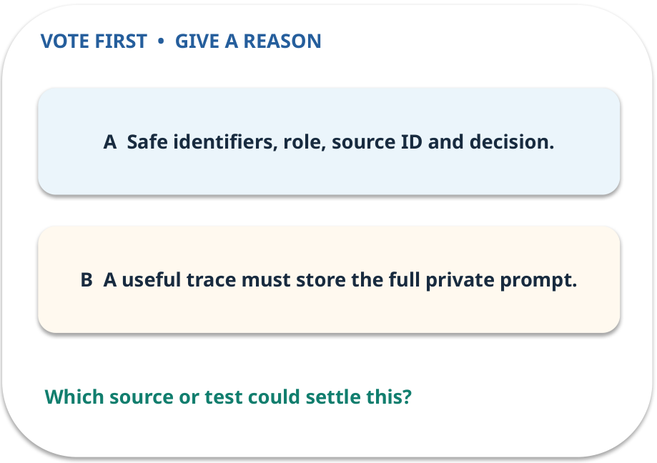
2. Predict · Filtered trace
QUESTION / WEEK 11
Which fields help investigate without exposing private text?
Make a choice before we explain the diagram.
GENERATIVE AI 2027 • WEEK 11 • 10 / 40
Notes:
TEACHER SCRIPT — QUESTION. Take a show of hands for each choice before showing the mechanism. Ask pairs to defend a choice with evidence. Save the strongest wrong reason for the reveal later in this cycle. This week’s case is: A new policy-assistant version sometimes exposes a staff-only passage. The visible slide states: Which fields help investigate without exposing private text?
Make a choice before we explain the diagram. The intended answer is Safe identifiers, role, source ID and decision. The tempting claim is A useful trace must store the full private prompt. Do not show which card is correct until the reveal. The target is: Record a safe release decision with test and rollback evidence. Listen for an explanation of the actual arrow or calculation, not just a repeated label. If the answer is unsupported, mark that uncertainty and return to the source. Before moving on, ask for the main idea and one concrete change to the worked example.

Slide 11
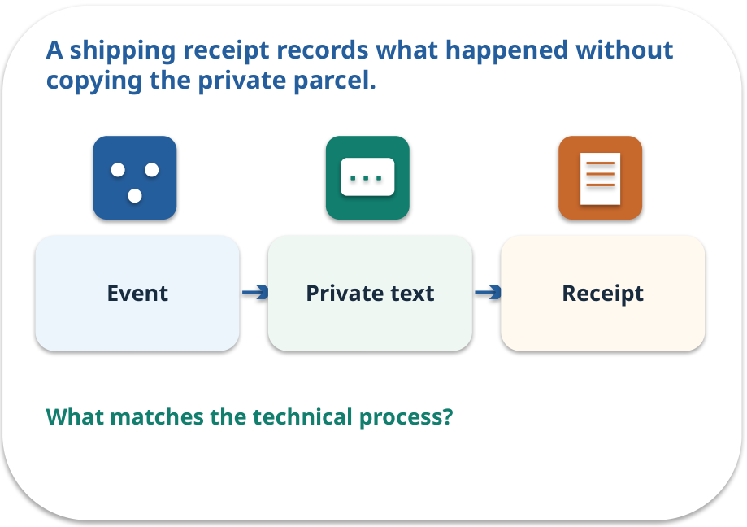
Filtered trace · a familiar picture
ANALOGY / WEEK 11
A shipping receipt records what happened without copying the private parcel.
What matches our case, and where does the analogy stop?
GENERATIVE AI 2027 • WEEK 11 • 11 / 40
Notes:
TEACHER SCRIPT — ANALOGY. Begin with the familiar scene. Invite learners to describe each part in everyday language. Then ask where the comparison might fail before introducing the technical vocabulary. This week’s case is: A new policy-assistant version sometimes exposes a staff-only passage. The visible slide states: A shipping receipt records what happened without copying the private parcel.
What matches our case, and where does the analogy stop? The boundary is: Aggressive filtering can hide useful debug details; keep safe IDs and event type. The target is: Record a safe release decision with test and rollback evidence. Listen for an explanation of the actual arrow or calculation, not just a repeated label. If the answer is unsupported, mark that uncertainty and return to the source. Before moving on, ask for the main idea and one concrete change to the worked example.

Slide 12
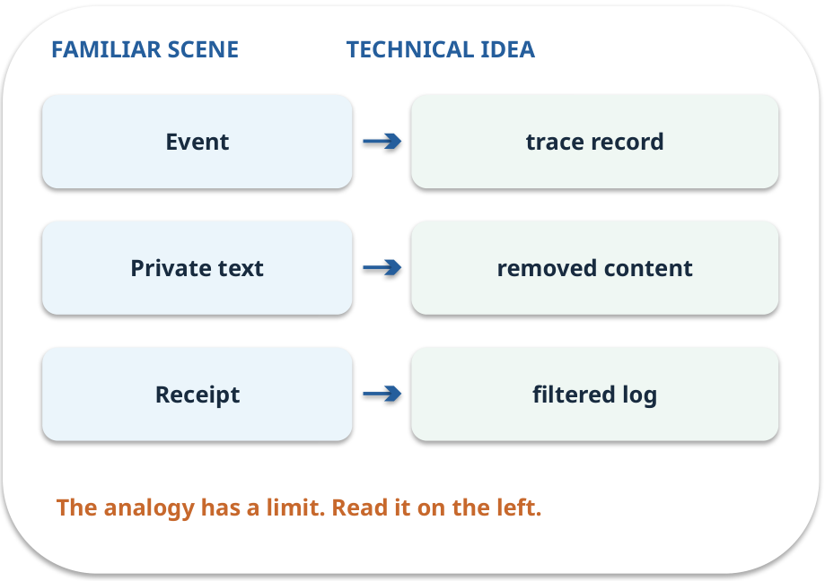
Filtered trace · map the parts
MAPPING / WEEK 11
Match each everyday part to the technical part.
Analogy limit: Aggressive filtering can hide useful debug details; keep safe IDs and event type.
GENERATIVE AI 2027 • WEEK 11 • 12 / 40
Notes:
TEACHER SCRIPT — MAPPING. Point from each familiar element to the corresponding technical element. Have students cover the right column and reconstruct the three matches. Read the limitation aloud. This week’s case is: A new policy-assistant version sometimes exposes a staff-only passage. The visible slide states: Match each everyday part to the technical part.
Analogy limit: Aggressive filtering can hide useful debug details; keep safe IDs and event type. The three precise mappings are [['Event', 'trace record'], ['Private text', 'removed content'], ['Receipt', 'filtered log']]. The target is: Record a safe release decision with test and rollback evidence. Listen for an explanation of the actual arrow or calculation, not just a repeated label. If the answer is unsupported, mark that uncertainty and return to the source. Before moving on, ask for the main idea and one concrete change to the worked example.

Slide 13
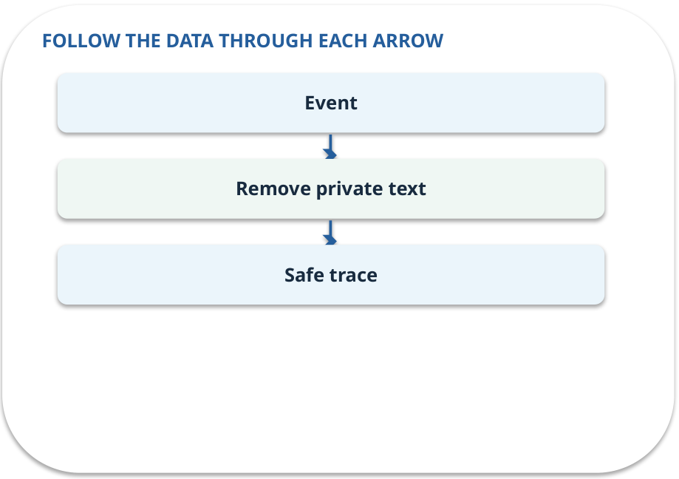
Filtered trace · how it works
MECHANISM / WEEK 11
Log enough to debug while omitting unnecessary personal data and credentials.
Trace the arrows from left to right.
GENERATIVE AI 2027 • WEEK 11 • 13 / 40
Notes:
TEACHER SCRIPT — MECHANISM. Trace every arrow slowly from the input to the output. Ask what information crosses the boundary at each arrow. Pause if students confuse a simplified notebook with a trained model. This week’s case is: A new policy-assistant version sometimes exposes a staff-only passage. The visible slide states: Log enough to debug while omitting unnecessary personal data and credentials.
Trace the arrows from left to right. The weekly example is: Log request ID, role, policy ID and outcome; omit student question text and secret key. State what the analogy does not explain: Aggressive filtering can hide useful debug details; keep safe IDs and event type. The target is: Record a safe release decision with test and rollback evidence. Listen for an explanation of the actual arrow or calculation, not just a repeated label. If the answer is unsupported, mark that uncertainty and return to the source. Before moving on, ask for the main idea and one concrete change to the worked example.

Slide 14
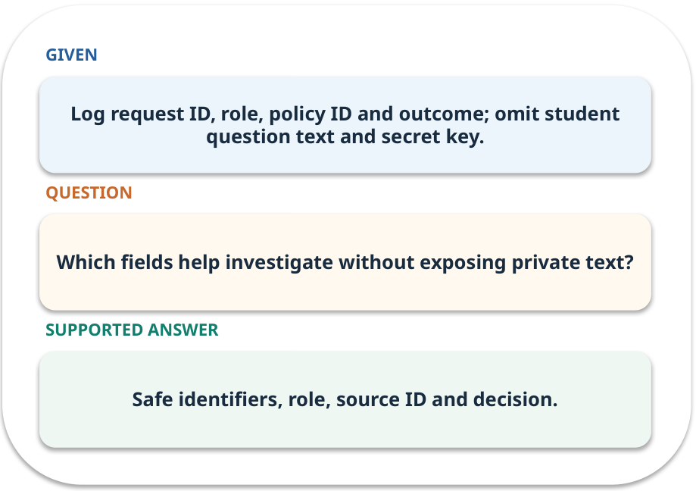
Filtered trace · work one case
WORKED / WEEK 11
Log request ID, role, policy ID and outcome; omit student question text and secret key.
Point to the evidence before giving your conclusion.
GENERATIVE AI 2027 • WEEK 11 • 14 / 40
Notes:
TEACHER SCRIPT — WORKED. Work the specific numbers or source wording aloud. Give students thirty seconds to write a conclusion, then ask which source line or calculation supports it. This week’s case is: A new policy-assistant version sometimes exposes a staff-only passage. The visible slide states: Log request ID, role, policy ID and outcome; omit student question text and secret key.
Point to the evidence before giving your conclusion. The expected reasoning concludes: Safe identifiers, role, source ID and decision. Distinguish measured results from illustrative numbers. The target is: Record a safe release decision with test and rollback evidence. Listen for an explanation of the actual arrow or calculation, not just a repeated label. If the answer is unsupported, mark that uncertainty and return to the source. Before moving on, ask for the main idea and one concrete change to the worked example.

Slide 15
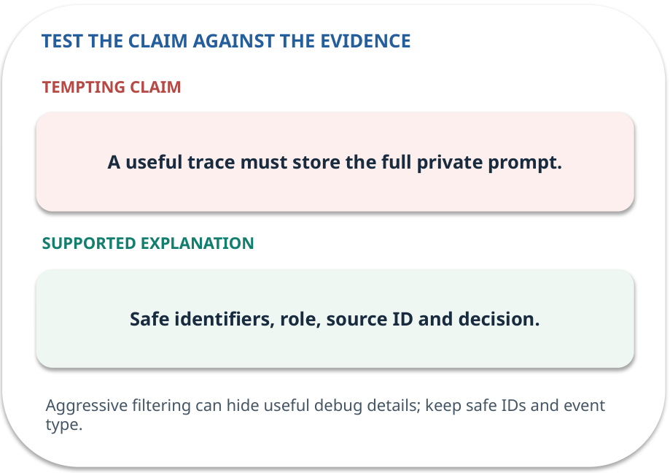
Filtered trace · answer and explain
REVEAL / WEEK 11
Safe identifiers, role, source ID and decision.
Tempting mistake: A useful trace must store the full private prompt.
GENERATIVE AI 2027 • WEEK 11 • 15 / 40
Notes:
TEACHER SCRIPT — REVEAL. Return to the earlier choice. Explain the correct answer and why the tempting claim fails. Ask one learner to say the answer in a single sentence without reading it. This week’s case is: A new policy-assistant version sometimes exposes a staff-only passage. The visible slide states: Safe identifiers, role, source ID and decision.
Tempting mistake: A useful trace must store the full private prompt. The earlier question was Which fields help investigate without exposing private text? Ask how this differs from the wrong claim. The target is: Record a safe release decision with test and rollback evidence. Listen for an explanation of the actual arrow or calculation, not just a repeated label. If the answer is unsupported, mark that uncertainty and return to the source. Before moving on, ask for the main idea and one concrete change to the worked example.

Slide 16
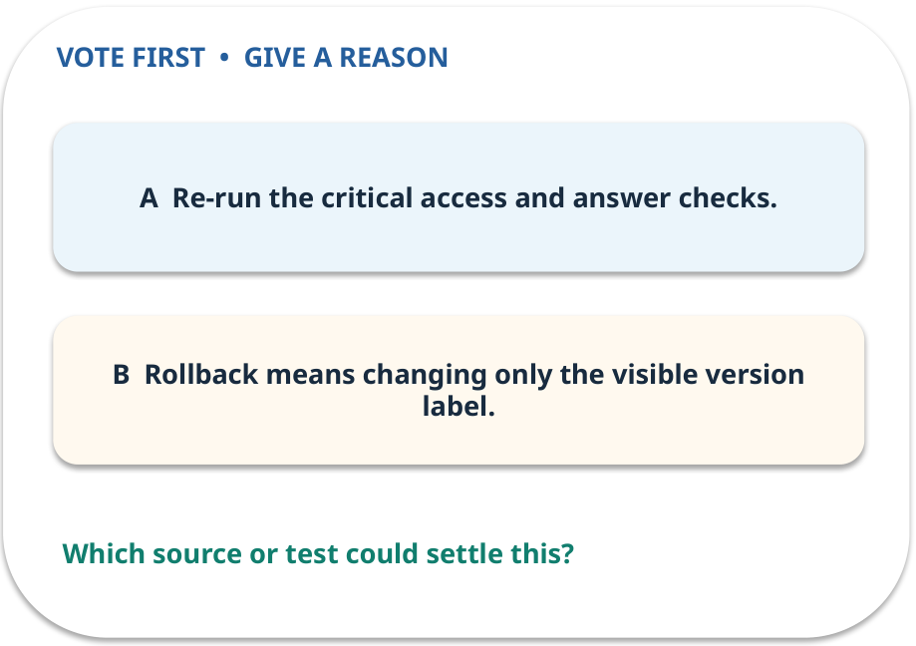
3. Predict · Rollback
QUESTION / WEEK 11
What must be checked after restoring v1?
Make a choice before we explain the diagram.
GENERATIVE AI 2027 • WEEK 11 • 16 / 40
Notes:
TEACHER SCRIPT — QUESTION. Take a show of hands for each choice before showing the mechanism. Ask pairs to defend a choice with evidence. Save the strongest wrong reason for the reveal later in this cycle. This week’s case is: A new policy-assistant version sometimes exposes a staff-only passage. The visible slide states: What must be checked after restoring v1?
Make a choice before we explain the diagram. The intended answer is Re-run the critical access and answer checks. The tempting claim is Rollback means changing only the visible version label. Do not show which card is correct until the reveal. The target is: Record a safe release decision with test and rollback evidence. Listen for an explanation of the actual arrow or calculation, not just a repeated label. If the answer is unsupported, mark that uncertainty and return to the source. Before moving on, ask for the main idea and one concrete change to the worked example.

Slide 17
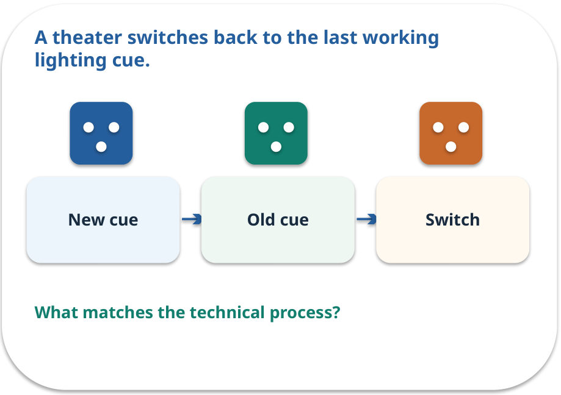
Rollback · a familiar picture
ANALOGY / WEEK 11
A theater switches back to the last working lighting cue.
What matches our case, and where does the analogy stop?
GENERATIVE AI 2027 • WEEK 11 • 17 / 40
Notes:
TEACHER SCRIPT — ANALOGY. Begin with the familiar scene. Invite learners to describe each part in everyday language. Then ask where the comparison might fail before introducing the technical vocabulary. This week’s case is: A new policy-assistant version sometimes exposes a staff-only passage. The visible slide states: A theater switches back to the last working lighting cue.
What matches our case, and where does the analogy stop? The boundary is: Rollback needs tested artifacts and compatible data; rehearsal matters. The target is: Record a safe release decision with test and rollback evidence. Listen for an explanation of the actual arrow or calculation, not just a repeated label. If the answer is unsupported, mark that uncertainty and return to the source. Before moving on, ask for the main idea and one concrete change to the worked example.

Slide 18
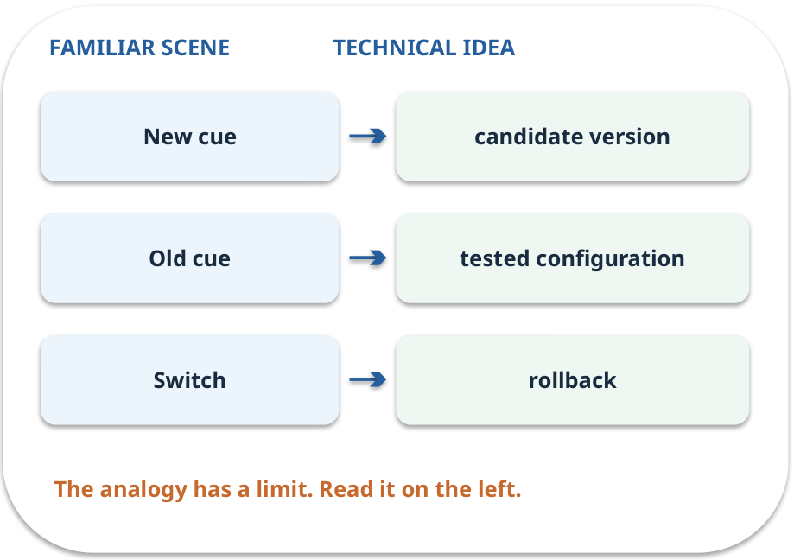
Rollback · map the parts
MAPPING / WEEK 11
Match each everyday part to the technical part.
Analogy limit: Rollback needs tested artifacts and compatible data; rehearsal matters.
GENERATIVE AI 2027 • WEEK 11 • 18 / 40
Notes:
TEACHER SCRIPT — MAPPING. Point from each familiar element to the corresponding technical element. Have students cover the right column and reconstruct the three matches. Read the limitation aloud. This week’s case is: A new policy-assistant version sometimes exposes a staff-only passage. The visible slide states: Match each everyday part to the technical part.
Analogy limit: Rollback needs tested artifacts and compatible data; rehearsal matters. The three precise mappings are [['New cue', 'candidate version'], ['Old cue', 'tested configuration'], ['Switch', 'rollback']]. The target is: Record a safe release decision with test and rollback evidence. Listen for an explanation of the actual arrow or calculation, not just a repeated label. If the answer is unsupported, mark that uncertainty and return to the source. Before moving on, ask for the main idea and one concrete change to the worked example.

Slide 19
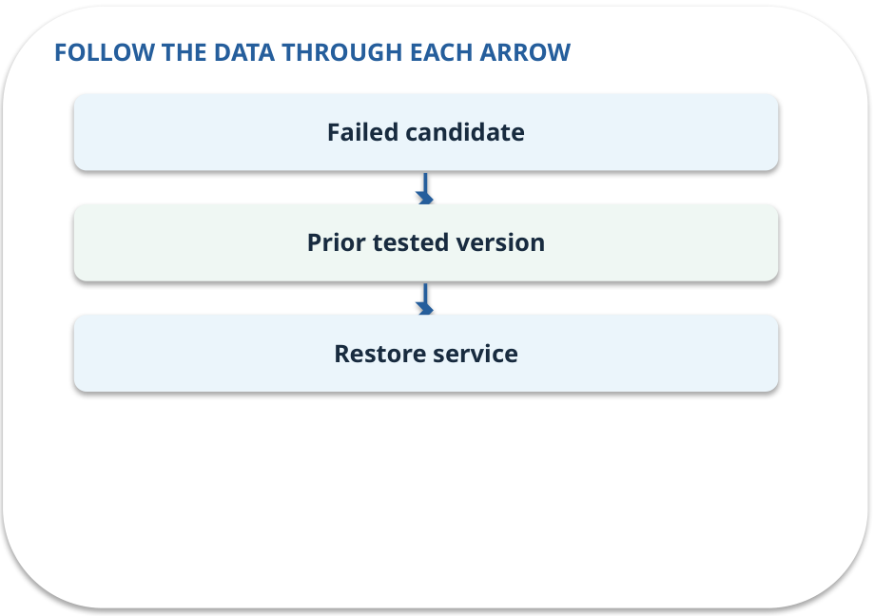
Rollback · how it works
MECHANISM / WEEK 11
Restore a previously tested configuration if a new version fails.
Trace the arrows from left to right.
GENERATIVE AI 2027 • WEEK 11 • 19 / 40
Notes:
TEACHER SCRIPT — MECHANISM. Trace every arrow slowly from the input to the output. Ask what information crosses the boundary at each arrow. Pause if students confuse a simplified notebook with a trained model. This week’s case is: A new policy-assistant version sometimes exposes a staff-only passage. The visible slide states: Restore a previously tested configuration if a new version fails.
Trace the arrows from left to right. The weekly example is: After v2 leaks P5, restore v1 with its policy index and confirm the student test passes. State what the analogy does not explain: Rollback needs tested artifacts and compatible data; rehearsal matters. The target is: Record a safe release decision with test and rollback evidence. Listen for an explanation of the actual arrow or calculation, not just a repeated label. If the answer is unsupported, mark that uncertainty and return to the source. Before moving on, ask for the main idea and one concrete change to the worked example.

Slide 20
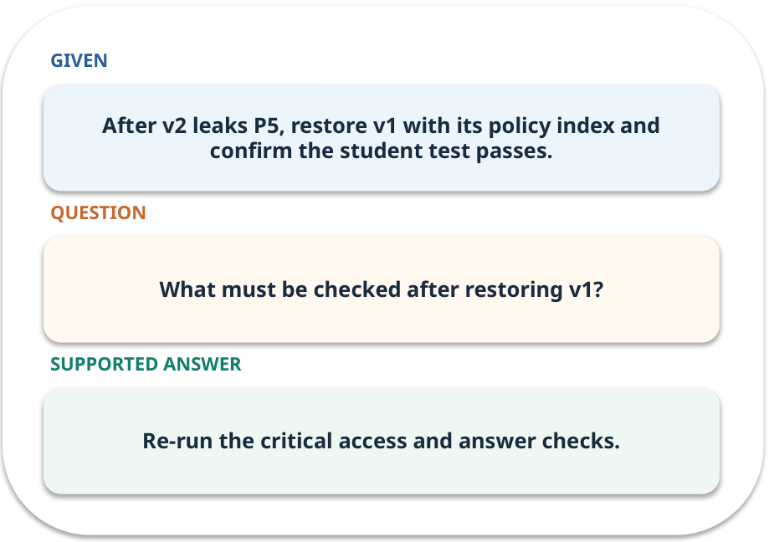
Rollback · work one case
WORKED / WEEK 11
After v2 leaks P5, restore v1 with its policy index and confirm the student test passes.
Point to the evidence before giving your conclusion.
GENERATIVE AI 2027 • WEEK 11 • 20 / 40
Notes:
TEACHER SCRIPT — WORKED. Work the specific numbers or source wording aloud. Give students thirty seconds to write a conclusion, then ask which source line or calculation supports it. This week’s case is: A new policy-assistant version sometimes exposes a staff-only passage. The visible slide states: After v2 leaks P5, restore v1 with its policy index and confirm the student test passes.
Point to the evidence before giving your conclusion. The expected reasoning concludes: Re-run the critical access and answer checks. Distinguish measured results from illustrative numbers. The target is: Record a safe release decision with test and rollback evidence. Listen for an explanation of the actual arrow or calculation, not just a repeated label. If the answer is unsupported, mark that uncertainty and return to the source. Before moving on, ask for the main idea and one concrete change to the worked example.

Slide 21
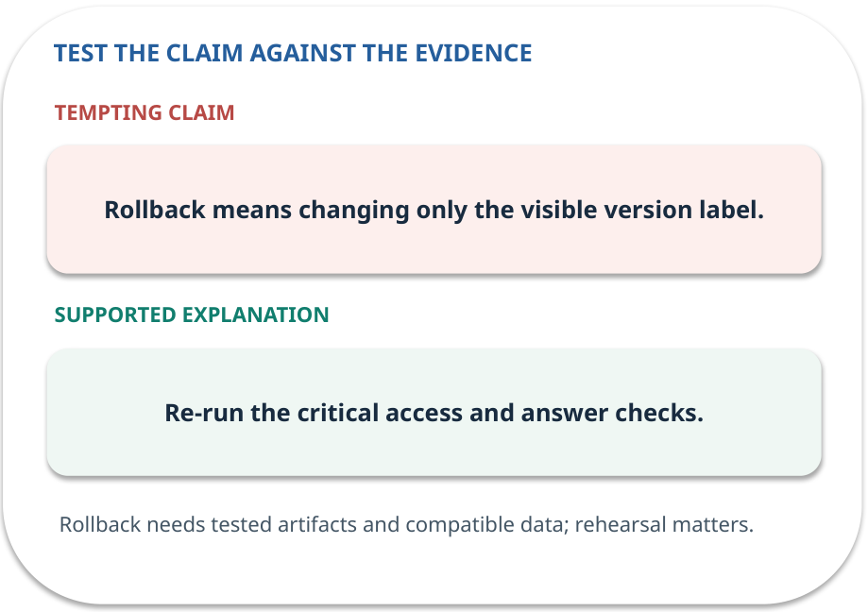
Rollback · answer and explain
REVEAL / WEEK 11
Re-run the critical access and answer checks.
Tempting mistake: Rollback means changing only the visible version label.
GENERATIVE AI 2027 • WEEK 11 • 21 / 40
Notes:
TEACHER SCRIPT — REVEAL. Return to the earlier choice. Explain the correct answer and why the tempting claim fails. Ask one learner to say the answer in a single sentence without reading it. This week’s case is: A new policy-assistant version sometimes exposes a staff-only passage. The visible slide states: Re-run the critical access and answer checks.
Tempting mistake: Rollback means changing only the visible version label. The earlier question was What must be checked after restoring v1? Ask how this differs from the wrong claim. The target is: Record a safe release decision with test and rollback evidence. Listen for an explanation of the actual arrow or calculation, not just a repeated label. If the answer is unsupported, mark that uncertainty and return to the source. Before moving on, ask for the main idea and one concrete change to the worked example.

Slide 22
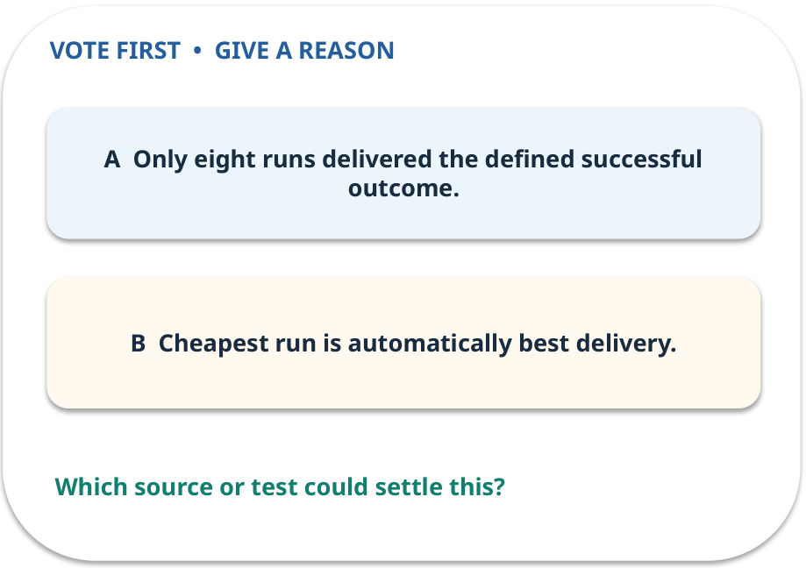
4. Predict · Cost per success
QUESTION / WEEK 11
Why divide by eight rather than ten?
Make a choice before we explain the diagram.
GENERATIVE AI 2027 • WEEK 11 • 22 / 40
Notes:
TEACHER SCRIPT — QUESTION. Take a show of hands for each choice before showing the mechanism. Ask pairs to defend a choice with evidence. Save the strongest wrong reason for the reveal later in this cycle. This week’s case is: A new policy-assistant version sometimes exposes a staff-only passage. The visible slide states: Why divide by eight rather than ten?
Make a choice before we explain the diagram. The intended answer is Only eight runs delivered the defined successful outcome. The tempting claim is Cheapest run is automatically best delivery. Do not show which card is correct until the reveal. The target is: Record a safe release decision with test and rollback evidence. Listen for an explanation of the actual arrow or calculation, not just a repeated label. If the answer is unsupported, mark that uncertainty and return to the source. Before moving on, ask for the main idea and one concrete change to the worked example.

Slide 23
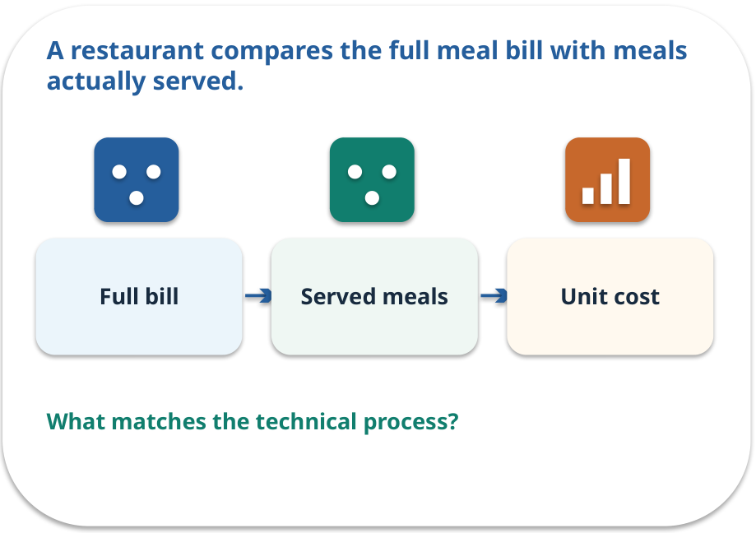
Cost per success · a familiar picture
ANALOGY / WEEK 11
A restaurant compares the full meal bill with meals actually served.
What matches our case, and where does the analogy stop?
GENERATIVE AI 2027 • WEEK 11 • 23 / 40
Notes:
TEACHER SCRIPT — ANALOGY. Begin with the familiar scene. Invite learners to describe each part in everyday language. Then ask where the comparison might fail before introducing the technical vocabulary. This week’s case is: A new policy-assistant version sometimes exposes a staff-only passage. The visible slide states: A restaurant compares the full meal bill with meals actually served.
What matches our case, and where does the analogy stop? The boundary is: A very small sample can make the estimate noisy; state the denominator. The target is: Record a safe release decision with test and rollback evidence. Listen for an explanation of the actual arrow or calculation, not just a repeated label. If the answer is unsupported, mark that uncertainty and return to the source. Before moving on, ask for the main idea and one concrete change to the worked example.

Slide 24
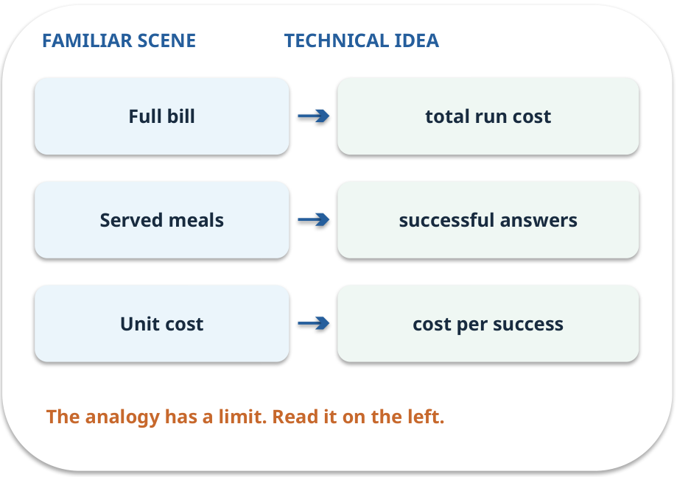
Cost per success · map the parts
MAPPING / WEEK 11
Match each everyday part to the technical part.
Analogy limit: A very small sample can make the estimate noisy; state the denominator.
GENERATIVE AI 2027 • WEEK 11 • 24 / 40
Notes:
TEACHER SCRIPT — MAPPING. Point from each familiar element to the corresponding technical element. Have students cover the right column and reconstruct the three matches. Read the limitation aloud. This week’s case is: A new policy-assistant version sometimes exposes a staff-only passage. The visible slide states: Match each everyday part to the technical part.
Analogy limit: A very small sample can make the estimate noisy; state the denominator. The three precise mappings are [['Full bill', 'total run cost'], ['Served meals', 'successful answers'], ['Unit cost', 'cost per success']]. The target is: Record a safe release decision with test and rollback evidence. Listen for an explanation of the actual arrow or calculation, not just a repeated label. If the answer is unsupported, mark that uncertainty and return to the source. Before moving on, ask for the main idea and one concrete change to the worked example.

Slide 25

Cost per success · how it works
MECHANISM / WEEK 11
All run costs including failed attempts divided by successful tasks; undefined at zero success.
Trace the arrows from left to right.
GENERATIVE AI 2027 • WEEK 11 • 25 / 40
Notes:
TEACHER SCRIPT — MECHANISM. Trace every arrow slowly from the input to the output. Ask what information crosses the boundary at each arrow. Pause if students confuse a simplified notebook with a trained model. This week’s case is: A new policy-assistant version sometimes exposes a staff-only passage. The visible slide states: All run costs including failed attempts divided by successful tasks; undefined at zero success.
Trace the arrows from left to right. The weekly example is: If ten runs cost €0.20 and eight meet criteria, cost per success = €0.025. State what the analogy does not explain: A very small sample can make the estimate noisy; state the denominator. The target is: Record a safe release decision with test and rollback evidence. Listen for an explanation of the actual arrow or calculation, not just a repeated label. If the answer is unsupported, mark that uncertainty and return to the source. Before moving on, ask for the main idea and one concrete change to the worked example.

Slide 26
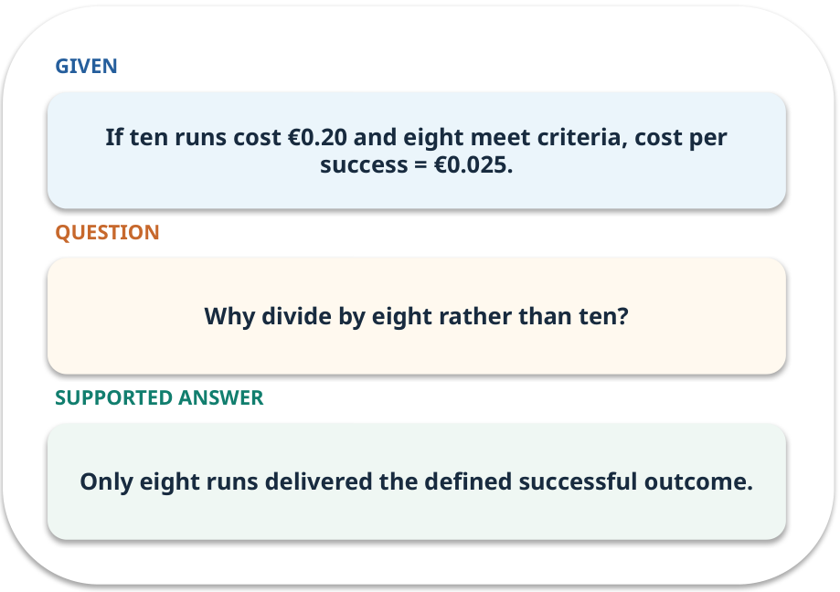
Cost per success · work one case
WORKED / WEEK 11
If ten runs cost €0.20 and eight meet criteria, cost per success = €0.025.
Point to the evidence before giving your conclusion.
GENERATIVE AI 2027 • WEEK 11 • 26 / 40
Notes:
TEACHER SCRIPT — WORKED. Work the specific numbers or source wording aloud. Give students thirty seconds to write a conclusion, then ask which source line or calculation supports it. This week’s case is: A new policy-assistant version sometimes exposes a staff-only passage. The visible slide states: If ten runs cost €0.20 and eight meet criteria, cost per success = €0.025.
Point to the evidence before giving your conclusion. The expected reasoning concludes: Only eight runs delivered the defined successful outcome. Distinguish measured results from illustrative numbers. The target is: Record a safe release decision with test and rollback evidence. Listen for an explanation of the actual arrow or calculation, not just a repeated label. If the answer is unsupported, mark that uncertainty and return to the source. Before moving on, ask for the main idea and one concrete change to the worked example.

Slide 27
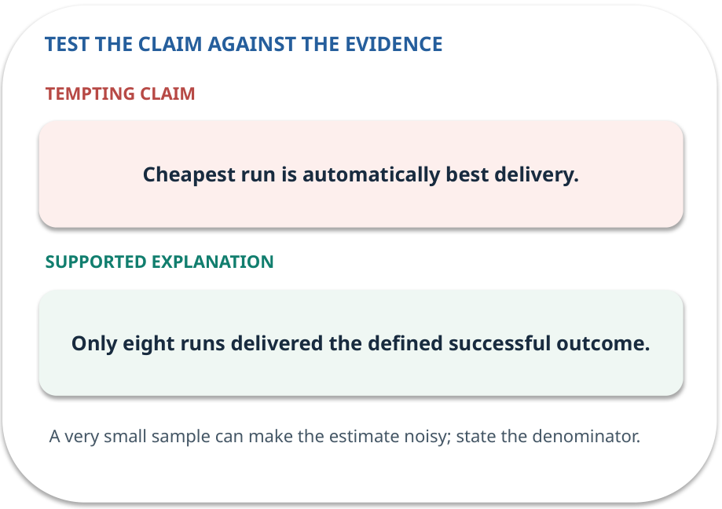
Cost per success · answer and explain
REVEAL / WEEK 11
Only eight runs delivered the defined successful outcome.
Tempting mistake: Cheapest run is automatically best delivery.
GENERATIVE AI 2027 • WEEK 11 • 27 / 40
Notes:
TEACHER SCRIPT — REVEAL. Return to the earlier choice. Explain the correct answer and why the tempting claim fails. Ask one learner to say the answer in a single sentence without reading it. This week’s case is: A new policy-assistant version sometimes exposes a staff-only passage. The visible slide states: Only eight runs delivered the defined successful outcome.
Tempting mistake: Cheapest run is automatically best delivery. The earlier question was Why divide by eight rather than ten? Ask how this differs from the wrong claim. The target is: Record a safe release decision with test and rollback evidence. Listen for an explanation of the actual arrow or calculation, not just a repeated label. If the answer is unsupported, mark that uncertainty and return to the source. Before moving on, ask for the main idea and one concrete change to the worked example.

Slide 28
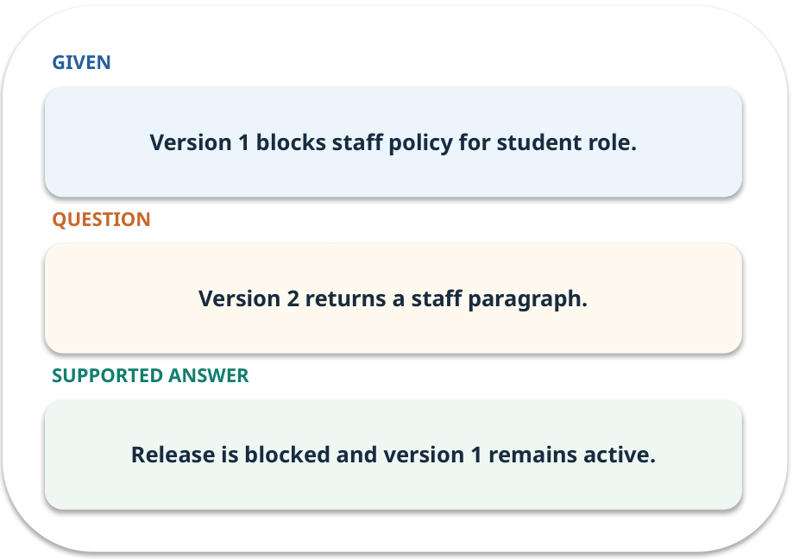
Evidence trail: input → result
WORKED / WEEK 11
Version 2 returns a staff paragraph.
Release is blocked and version 1 remains active.
GENERATIVE AI 2027 • WEEK 11 • 28 / 40
Notes:
TEACHER SCRIPT — WORKED. Work the specific numbers or source wording aloud. Give students thirty seconds to write a conclusion, then ask which source line or calculation supports it. This week’s case is: A new policy-assistant version sometimes exposes a staff-only passage. The visible slide states: Version 2 returns a staff paragraph.
Release is blocked and version 1 remains active. Have one student point to an exact source word or number for each conclusion. The target is: Record a safe release decision with test and rollback evidence. Listen for an explanation of the actual arrow or calculation, not just a repeated label. If the answer is unsupported, mark that uncertainty and return to the source. Before moving on, ask for the main idea and one concrete change to the worked example.

Slide 29
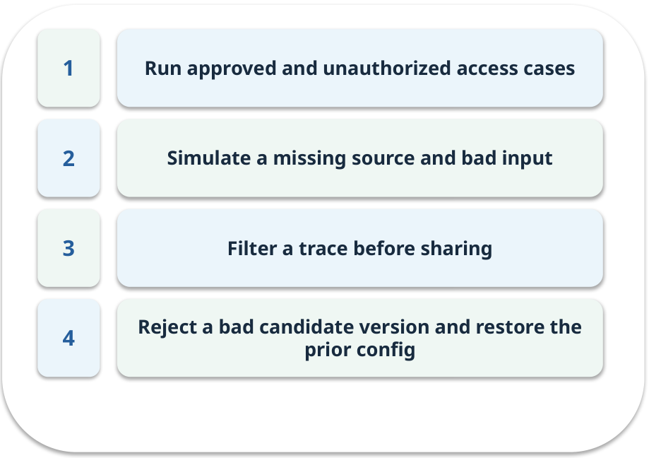
Notebook: run the prepared example
PRACTICE / WEEK 11
Run a local release-gate simulation and rollback.
Read the original output before editing.
GENERATIVE AI 2027 • WEEK 11 • 29 / 40
Notes:
TEACHER SCRIPT — PRACTICE. Open the matching notebook and demonstrate the first run. Have learners predict one change, run only that change, and record input, setting, output and an error explanation. This week’s case is: A new policy-assistant version sometimes exposes a staff-only passage. The visible slide states: Run a local release-gate simulation and rollback.
Read the original output before editing. Use Week_11_Lab.ipynb. This lab is a prepared classroom demonstration with its limitations documented. The target is: Record a safe release decision with test and rollback evidence. Listen for an explanation of the actual arrow or calculation, not just a repeated label. If the answer is unsupported, mark that uncertainty and return to the source. Before moving on, ask for the main idea and one concrete change to the worked example.

Slide 30

Find the input and check in Python
PRACTICE / WEEK 11
Locate the supplied input, the transformation, the checking line and the printed result.
GENERATIVE AI 2027 • WEEK 11 • 30 / 40
Notes:
TEACHER SCRIPT — PRACTICE. Open the matching notebook and demonstrate the first run. Have learners predict one change, run only that change, and record input, setting, output and an error explanation. This week’s case is: A new policy-assistant version sometimes exposes a staff-only passage. The visible slide states: Locate the supplied input, the transformation, the checking line and the printed result. The weekly lab change is: Flip the candidate role check and verify rollback happens. The target is: Record a safe release decision with test and rollback evidence. Listen for an explanation of the actual arrow or calculation, not just a repeated label. If the answer is unsupported, mark that uncertainty and return to the source. Before moving on, ask for the main idea and one concrete change to the worked example.

Slide 31

Predict one controlled change
PRACTICE / WEEK 11
Flip the candidate role check and verify rollback happens.
What should change in the result? What stays fixed?
GENERATIVE AI 2027 • WEEK 11 • 31 / 40
Notes:
TEACHER SCRIPT — PRACTICE. Open the matching notebook and demonstrate the first run. Have learners predict one change, run only that change, and record input, setting, output and an error explanation. This week’s case is: A new policy-assistant version sometimes exposes a staff-only passage. The visible slide states: Flip the candidate role check and verify rollback happens.
What should change in the result? What stays fixed? Ask learners to write their prediction before rerunning the cell. The target is: Record a safe release decision with test and rollback evidence. Listen for an explanation of the actual arrow or calculation, not just a repeated label. If the answer is unsupported, mark that uncertainty and return to the source. Before moving on, ask for the main idea and one concrete change to the worked example.

Slide 32

Run, compare and record
PRACTICE / WEEK 11
Record the input, the one changed setting, the observed result and a reason for any difference.
GENERATIVE AI 2027 • WEEK 11 • 32 / 40
Notes:
TEACHER SCRIPT — PRACTICE. Open the matching notebook and demonstrate the first run. Have learners predict one change, run only that change, and record input, setting, output and an error explanation. This week’s case is: A new policy-assistant version sometimes exposes a staff-only passage. The visible slide states: Record the input, the one changed setting, the observed result and a reason for any difference. The required evidence is: Filtered trace and classroom release checklist. The target is: Record a safe release decision with test and rollback evidence. Listen for an explanation of the actual arrow or calculation, not just a repeated label. If the answer is unsupported, mark that uncertainty and return to the source. Before moving on, ask for the main idea and one concrete change to the worked example.

Slide 33

Measure without hiding the denominator
CHECK / WEEK 11
Passed release gates / required gates; cost per successful task
Write the numerator, denominator and one failure case.
GENERATIVE AI 2027 • WEEK 11 • 33 / 40
Notes:
TEACHER SCRIPT — CHECK. Use this as a brief formative check. Ask for the conclusion, the evidence and one limitation. Revisit disagreements in the review session and offer an extension only after the core task. This week’s case is: A new policy-assistant version sometimes exposes a staff-only passage. The visible slide states: Passed release gates / required gates; cost per successful task
Write the numerator, denominator and one failure case. Where a measure is qualitative, show the concrete source comparison. Example: Release is blocked and version 1 remains active. The target is: Record a safe release decision with test and rollback evidence. Listen for an explanation of the actual arrow or calculation, not just a repeated label. If the answer is unsupported, mark that uncertainty and return to the source. Before moving on, ask for the main idea and one concrete change to the worked example.

Slide 34
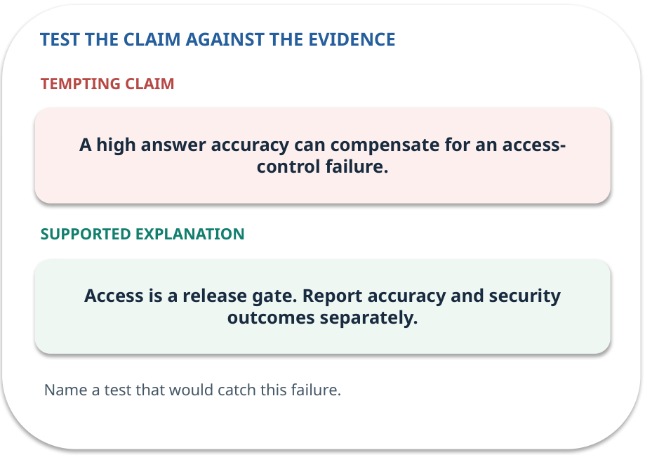
Error detective: find the layer
CHECK / WEEK 11
Plausible wrong claim: A high answer accuracy can compensate for an access-control failure.
Correct it using the case evidence.
GENERATIVE AI 2027 • WEEK 11 • 34 / 40
Notes:
TEACHER SCRIPT — CHECK. Use this as a brief formative check. Ask for the conclusion, the evidence and one limitation. Revisit disagreements in the review session and offer an extension only after the core task. This week’s case is: A new policy-assistant version sometimes exposes a staff-only passage. The visible slide states: Plausible wrong claim: A high answer accuracy can compensate for an access-control failure.
Correct it using the case evidence. The correction is Access is a release gate. Report accuracy and security outcomes separately. The target is: Record a safe release decision with test and rollback evidence. Listen for an explanation of the actual arrow or calculation, not just a repeated label. If the answer is unsupported, mark that uncertainty and return to the source. Before moving on, ask for the main idea and one concrete change to the worked example.

Slide 35

Transfer to a new situation
CHECK / WEEK 11
The new version passes answer checks but fails the missing-source test. What does the release gate decide?
Explain which source or test would settle it.
GENERATIVE AI 2027 • WEEK 11 • 35 / 40
Notes:
TEACHER SCRIPT — CHECK. Use this as a brief formative check. Ask for the conclusion, the evidence and one limitation. Revisit disagreements in the review session and offer an extension only after the core task. This week’s case is: A new policy-assistant version sometimes exposes a staff-only passage. The visible slide states: The new version passes answer checks but fails the missing-source test. What does the release gate decide?
Explain which source or test would settle it. This is a fresh scenario, so ask for a reason before accepting either short answer. The target is: Record a safe release decision with test and rollback evidence. Listen for an explanation of the actual arrow or calculation, not just a repeated label. If the answer is unsupported, mark that uncertainty and return to the source. Before moving on, ask for the main idea and one concrete change to the worked example.

Slide 36
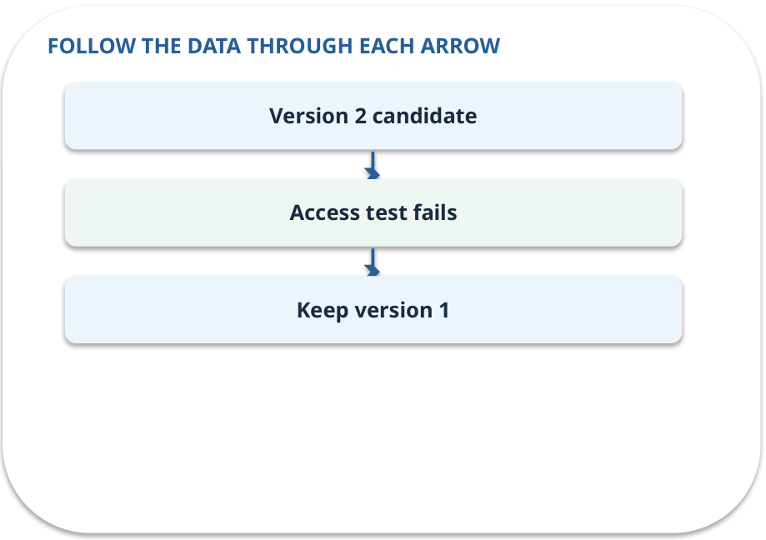
Explain it to a partner
CHECK / WEEK 11
Without reading the slide, name the input, one processing step and the check. Your partner should ask “How do you know?”
GENERATIVE AI 2027 • WEEK 11 • 36 / 40
Notes:
TEACHER SCRIPT — CHECK. Use this as a brief formative check. Ask for the conclusion, the evidence and one limitation. Revisit disagreements in the review session and offer an extension only after the core task. This week’s case is: A new policy-assistant version sometimes exposes a staff-only passage. The visible slide states: Without reading the slide, name the input, one processing step and the check. Your partner should ask “How do you know?” Listen for a causal explanation and one limitation, then revisit a difficult arrow on the board. The target is: Record a safe release decision with test and rollback evidence. Listen for an explanation of the actual arrow or calculation, not just a repeated label. If the answer is unsupported, mark that uncertainty and return to the source. Before moving on, ask for the main idea and one concrete change to the worked example.

Slide 37

Exam rehearsal · explain and apply
CHECK / WEEK 11
What happens to cost per success when successes equal zero?
Write a short answer, then compare with the guide.
GENERATIVE AI 2027 • WEEK 11 • 37 / 40
Notes:
TEACHER SCRIPT — CHECK. Use this as a brief formative check. Ask for the conclusion, the evidence and one limitation. Revisit disagreements in the review session and offer an extension only after the core task. This week’s case is: A new policy-assistant version sometimes exposes a staff-only passage. The visible slide states: What happens to cost per success when successes equal zero?
Write a short answer, then compare with the guide. Model answer after discussion: There is no finite value. Report undefined and investigate the failed workload. Practice marks: 4. The target is: Record a safe release decision with test and rollback evidence. Listen for an explanation of the actual arrow or calculation, not just a repeated label. If the answer is unsupported, mark that uncertainty and return to the source. Before moving on, ask for the main idea and one concrete change to the worked example.

Slide 38
Exam rehearsal · explain and apply
CHECK / WEEK 11
Why test a missing source before release?
Write a short answer, then compare with the guide.
GENERATIVE AI 2027 • WEEK 11 • 38 / 40
Notes:
TEACHER SCRIPT — CHECK. Use this as a brief formative check. Ask for the conclusion, the evidence and one limitation. Revisit disagreements in the review session and offer an extension only after the core task. This week’s case is: A new policy-assistant version sometimes exposes a staff-only passage. The visible slide states: Why test a missing source before release?
Write a short answer, then compare with the guide. Model answer after discussion: To verify the application abstains or recovers rather than inventing an answer. Practice marks: 4. The target is: Record a safe release decision with test and rollback evidence. Listen for an explanation of the actual arrow or calculation, not just a repeated label. If the answer is unsupported, mark that uncertainty and return to the source. Before moving on, ask for the main idea and one concrete change to the worked example.

Slide 39

What to hand in
PRACTICE / WEEK 11
Filtered trace and classroom release checklist.
Include the one changed input and an error explanation.
GENERATIVE AI 2027 • WEEK 11 • 39 / 40
Notes:
TEACHER SCRIPT — PRACTICE. Open the matching notebook and demonstrate the first run. Have learners predict one change, run only that change, and record input, setting, output and an error explanation. This week’s case is: A new policy-assistant version sometimes exposes a staff-only passage. The visible slide states: Filtered trace and classroom release checklist.
Include the one changed input and an error explanation. This weekly evidence receives formative feedback according to the module sequence; refer to the assessment brief for graded work. The target is: Record a safe release decision with test and rollback evidence. Listen for an explanation of the actual arrow or calculation, not just a repeated label. If the answer is unsupported, mark that uncertainty and return to the source. Before moving on, ask for the main idea and one concrete change to the worked example.

Slide 40
Three ideas to recall next week
CHECK / WEEK 11
A required access test blocks release; keep safe traces and a tested rollback.
Read the linked official sources in the Word guide and redraw one diagram from memory.
GENERATIVE AI 2027 • WEEK 11 • 40 / 40
Notes:
TEACHER SCRIPT — CHECK. Use this as a brief formative check. Ask for the conclusion, the evidence and one limitation. Revisit disagreements in the review session and offer an extension only after the core task. This week’s case is: A new policy-assistant version sometimes exposes a staff-only passage. The visible slide states: A required access test blocks release; keep safe traces and a tested rollback.
Read the linked official sources in the Word guide and redraw one diagram from memory. Return to the opening vote and ask whether the evidence changed anyone’s mind. The next week builds on this outcome: Record a safe release decision with test and rollback evidence. The target is: Record a safe release decision with test and rollback evidence. Listen for an explanation of the actual arrow or calculation, not just a repeated label. If the answer is unsupported, mark that uncertainty and return to the source. Before moving on, ask for the main idea and one concrete change to the worked example.

