Slide 1
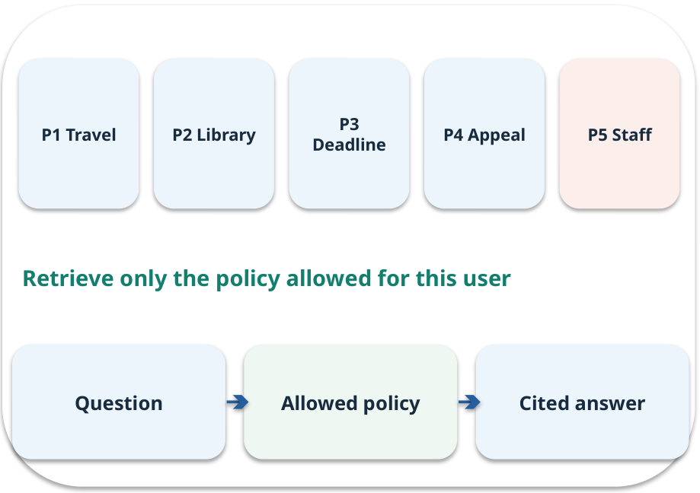
Week 12 · Final demonstration and explanation
OPEN / WEEK 12
The fresh policy question
A student appeals on day 12. P4 says appeals must be filed within ten days. The team must answer, cite, test and explain a fresh failure.
GENERATIVE AI 2027 • WEEK 12 • 01 / 40
Notes:
TEACHER SCRIPT — OPEN. Show the visual for ten seconds, then ask for an initial decision. Do not reveal the answer yet. Ask a student to name the source or measurement that would change their mind. This week’s case is: A fresh student question and a previously unseen failure are presented. The visible slide states: The fresh policy question
A student appeals on day 12. P4 says appeals must be filed within ten days. The team must answer, cite, test and explain a fresh failure. Reveal that the case will be revisited after four short concept cycles. The target is: Demonstrate the policy assistant and explain its limits with evidence. Listen for an explanation of the actual arrow or calculation, not just a repeated label. If the answer is unsupported, mark that uncertainty and return to the source. Before moving on, ask for the main idea and one concrete change to the worked example.

Slide 2

First vote: what would you do?
QUESTION / WEEK 12
A student appeals on day 12. P4 says appeals must be filed within ten days. The team must answer, cite, test and explain a fresh failure.
Choose an initial answer and name one piece of evidence you need.
GENERATIVE AI 2027 • WEEK 12 • 02 / 40
Notes:
TEACHER SCRIPT — QUESTION. Take a show of hands for each choice before showing the mechanism. Ask pairs to defend a choice with evidence. Save the strongest wrong reason for the reveal later in this cycle. This week’s case is: A fresh student question and a previously unseen failure are presented. The visible slide states: A student appeals on day 12. P4 says appeals must be filed within ten days. The team must answer, cite, test and explain a fresh failure.
Choose an initial answer and name one piece of evidence you need. Accept reasonable uncertainty; record the initial votes to revisit at the end. The target is: Demonstrate the policy assistant and explain its limits with evidence. Listen for an explanation of the actual arrow or calculation, not just a repeated label. If the answer is unsupported, mark that uncertainty and return to the source. Before moving on, ask for the main idea and one concrete change to the worked example.

Slide 3
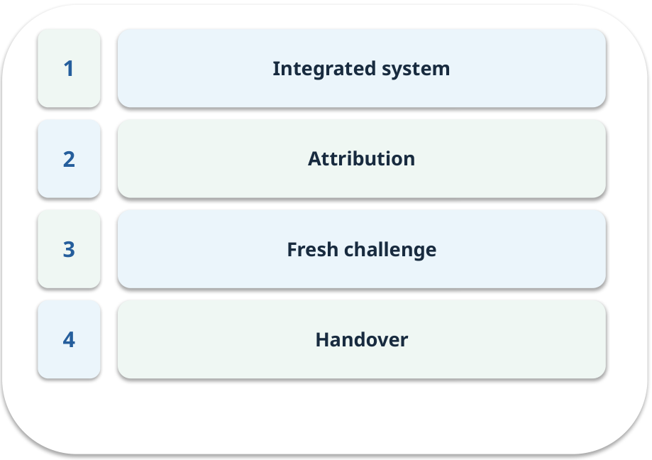
The journey through today’s case
OPEN / WEEK 12
We will predict, connect an analogy, trace a mechanism, work an example, then explain a decision.
GENERATIVE AI 2027 • WEEK 12 • 03 / 40
Notes:
TEACHER SCRIPT — OPEN. Show the visual for ten seconds, then ask for an initial decision. Do not reveal the answer yet. Ask a student to name the source or measurement that would change their mind. This week’s case is: A fresh student question and a previously unseen failure are presented. The visible slide states: We will predict, connect an analogy, trace a mechanism, work an example, then explain a decision. Point to the four named ideas, then show where the notebook experiment fits. The target is: Demonstrate the policy assistant and explain its limits with evidence. Listen for an explanation of the actual arrow or calculation, not just a repeated label. If the answer is unsupported, mark that uncertainty and return to the source. Before moving on, ask for the main idea and one concrete change to the worked example.

Slide 4
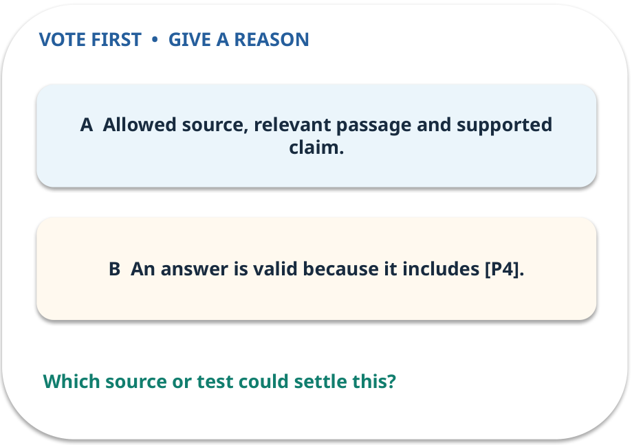
1. Predict · Integrated system
QUESTION / WEEK 12
Which three checks precede a confident reply?
Make a choice before we explain the diagram.
GENERATIVE AI 2027 • WEEK 12 • 04 / 40
Notes:
TEACHER SCRIPT — QUESTION. Take a show of hands for each choice before showing the mechanism. Ask pairs to defend a choice with evidence. Save the strongest wrong reason for the reveal later in this cycle. This week’s case is: A fresh student question and a previously unseen failure are presented. The visible slide states: Which three checks precede a confident reply?
Make a choice before we explain the diagram. The intended answer is Allowed source, relevant passage and supported claim. The tempting claim is An answer is valid because it includes [P4]. Do not show which card is correct until the reveal. The target is: Demonstrate the policy assistant and explain its limits with evidence. Listen for an explanation of the actual arrow or calculation, not just a repeated label. If the answer is unsupported, mark that uncertainty and return to the source. Before moving on, ask for the main idea and one concrete change to the worked example.

Slide 5
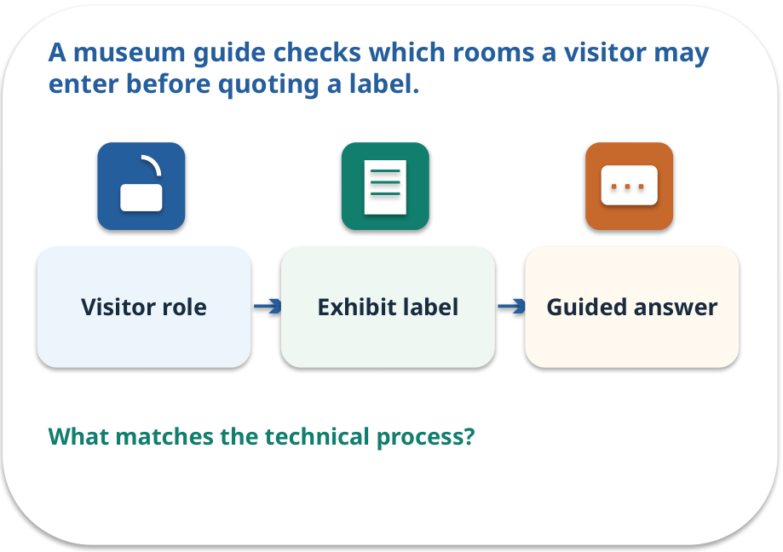
Integrated system · a familiar picture
ANALOGY / WEEK 12
A museum guide checks which rooms a visitor may enter before quoting a label.
What matches our case, and where does the analogy stop?
GENERATIVE AI 2027 • WEEK 12 • 05 / 40
Notes:
TEACHER SCRIPT — ANALOGY. Begin with the familiar scene. Invite learners to describe each part in everyday language. Then ask where the comparison might fail before introducing the technical vocabulary. This week’s case is: A fresh student question and a previously unseen failure are presented. The visible slide states: A museum guide checks which rooms a visitor may enter before quoting a label.
What matches our case, and where does the analogy stop? The boundary is: A citation needs to support the exact statement and the version in force. The target is: Demonstrate the policy assistant and explain its limits with evidence. Listen for an explanation of the actual arrow or calculation, not just a repeated label. If the answer is unsupported, mark that uncertainty and return to the source. Before moving on, ask for the main idea and one concrete change to the worked example.

Slide 6
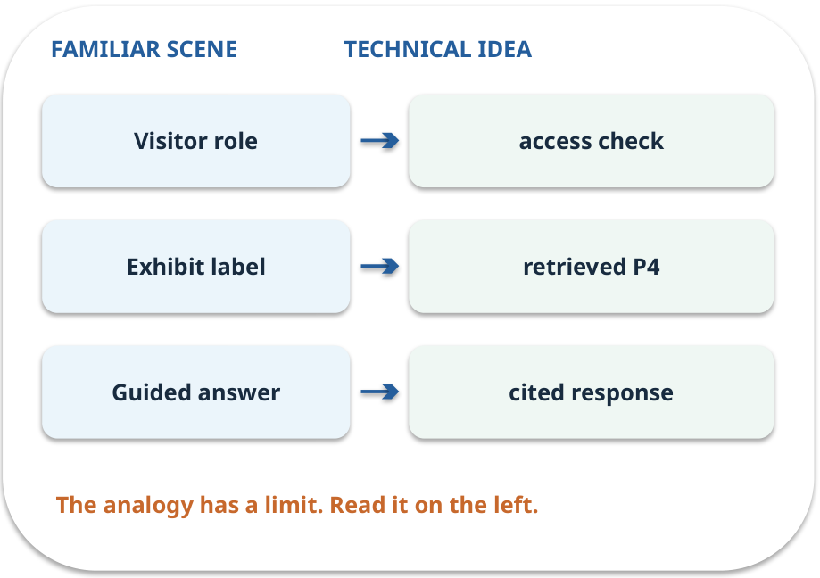
Integrated system · map the parts
MAPPING / WEEK 12
Match each everyday part to the technical part.
Analogy limit: A citation needs to support the exact statement and the version in force.
GENERATIVE AI 2027 • WEEK 12 • 06 / 40
Notes:
TEACHER SCRIPT — MAPPING. Point from each familiar element to the corresponding technical element. Have students cover the right column and reconstruct the three matches. Read the limitation aloud. This week’s case is: A fresh student question and a previously unseen failure are presented. The visible slide states: Match each everyday part to the technical part.
Analogy limit: A citation needs to support the exact statement and the version in force. The three precise mappings are [['Visitor role', 'access check'], ['Exhibit label', 'retrieved P4'], ['Guided answer', 'cited response']]. The target is: Demonstrate the policy assistant and explain its limits with evidence. Listen for an explanation of the actual arrow or calculation, not just a repeated label. If the answer is unsupported, mark that uncertainty and return to the source. Before moving on, ask for the main idea and one concrete change to the worked example.

Slide 7
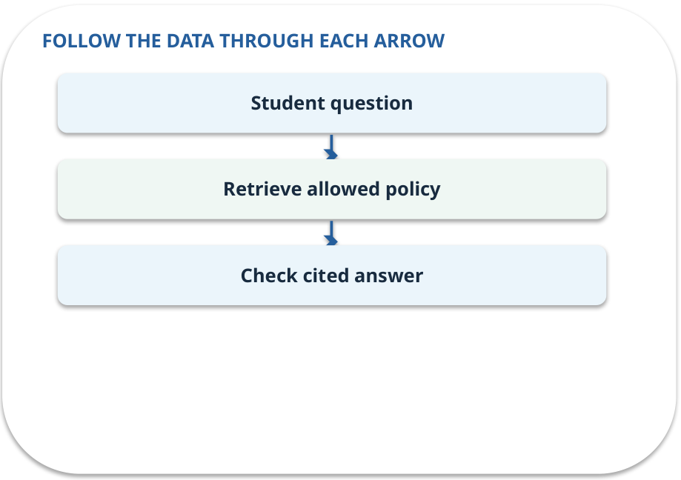
Integrated system · how it works
MECHANISM / WEEK 12
The student question enters retrieval, access checks, answer construction and evaluation.
Trace the arrows from left to right.
GENERATIVE AI 2027 • WEEK 12 • 07 / 40
Notes:
TEACHER SCRIPT — MECHANISM. Trace every arrow slowly from the input to the output. Ask what information crosses the boundary at each arrow. Pause if students confuse a simplified notebook with a trained model. This week’s case is: A fresh student question and a previously unseen failure are presented. The visible slide states: The student question enters retrieval, access checks, answer construction and evaluation.
Trace the arrows from left to right. The weekly example is: For day 12 under the supplied ten-day P4, answer no and cite P4 with the used version. State what the analogy does not explain: A citation needs to support the exact statement and the version in force. The target is: Demonstrate the policy assistant and explain its limits with evidence. Listen for an explanation of the actual arrow or calculation, not just a repeated label. If the answer is unsupported, mark that uncertainty and return to the source. Before moving on, ask for the main idea and one concrete change to the worked example.

Slide 8
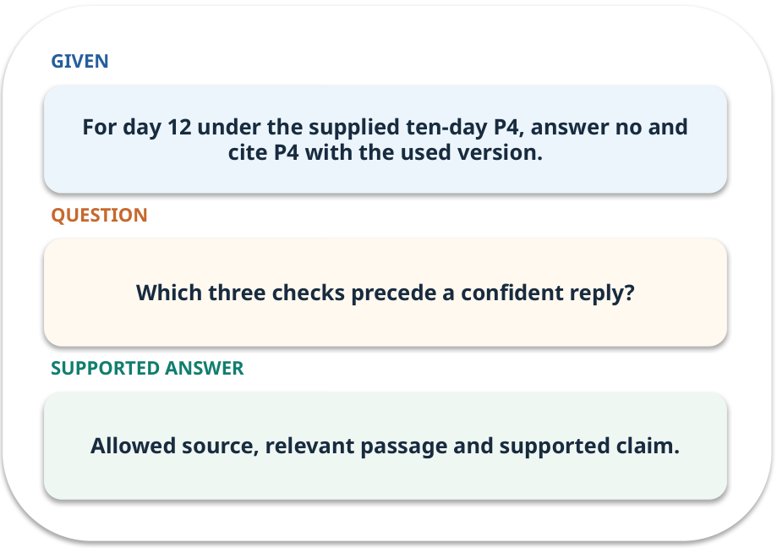
Integrated system · work one case
WORKED / WEEK 12
For day 12 under the supplied ten-day P4, answer no and cite P4 with the used version.
Point to the evidence before giving your conclusion.
GENERATIVE AI 2027 • WEEK 12 • 08 / 40
Notes:
TEACHER SCRIPT — WORKED. Work the specific numbers or source wording aloud. Give students thirty seconds to write a conclusion, then ask which source line or calculation supports it. This week’s case is: A fresh student question and a previously unseen failure are presented. The visible slide states: For day 12 under the supplied ten-day P4, answer no and cite P4 with the used version.
Point to the evidence before giving your conclusion. The expected reasoning concludes: Allowed source, relevant passage and supported claim. Distinguish measured results from illustrative numbers. The target is: Demonstrate the policy assistant and explain its limits with evidence. Listen for an explanation of the actual arrow or calculation, not just a repeated label. If the answer is unsupported, mark that uncertainty and return to the source. Before moving on, ask for the main idea and one concrete change to the worked example.

Slide 9
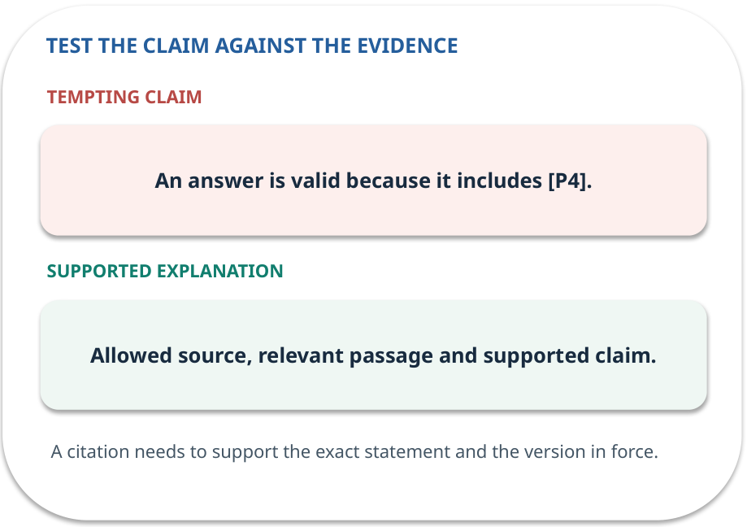
Integrated system · answer and explain
REVEAL / WEEK 12
Allowed source, relevant passage and supported claim.
Tempting mistake: An answer is valid because it includes [P4].
GENERATIVE AI 2027 • WEEK 12 • 09 / 40
Notes:
TEACHER SCRIPT — REVEAL. Return to the earlier choice. Explain the correct answer and why the tempting claim fails. Ask one learner to say the answer in a single sentence without reading it. This week’s case is: A fresh student question and a previously unseen failure are presented. The visible slide states: Allowed source, relevant passage and supported claim.
Tempting mistake: An answer is valid because it includes [P4]. The earlier question was Which three checks precede a confident reply? Ask how this differs from the wrong claim. The target is: Demonstrate the policy assistant and explain its limits with evidence. Listen for an explanation of the actual arrow or calculation, not just a repeated label. If the answer is unsupported, mark that uncertainty and return to the source. Before moving on, ask for the main idea and one concrete change to the worked example.

Slide 10
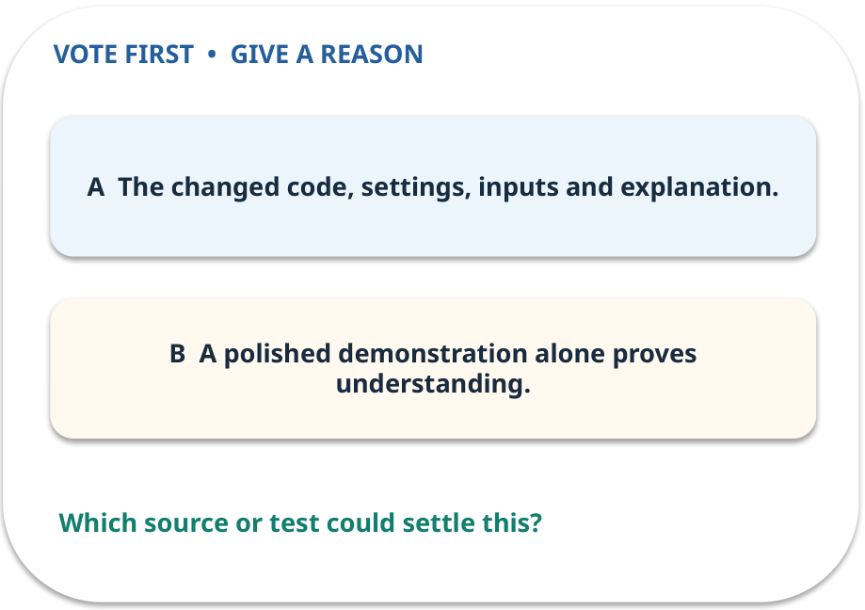
2. Predict · Attribution
QUESTION / WEEK 12
What proves the work is yours and reproducible?
Make a choice before we explain the diagram.
GENERATIVE AI 2027 • WEEK 12 • 10 / 40
Notes:
TEACHER SCRIPT — QUESTION. Take a show of hands for each choice before showing the mechanism. Ask pairs to defend a choice with evidence. Save the strongest wrong reason for the reveal later in this cycle. This week’s case is: A fresh student question and a previously unseen failure are presented. The visible slide states: What proves the work is yours and reproducible?
Make a choice before we explain the diagram. The intended answer is The changed code, settings, inputs and explanation. The tempting claim is A polished demonstration alone proves understanding. Do not show which card is correct until the reveal. The target is: Demonstrate the policy assistant and explain its limits with evidence. Listen for an explanation of the actual arrow or calculation, not just a repeated label. If the answer is unsupported, mark that uncertainty and return to the source. Before moving on, ask for the main idea and one concrete change to the worked example.

Slide 11
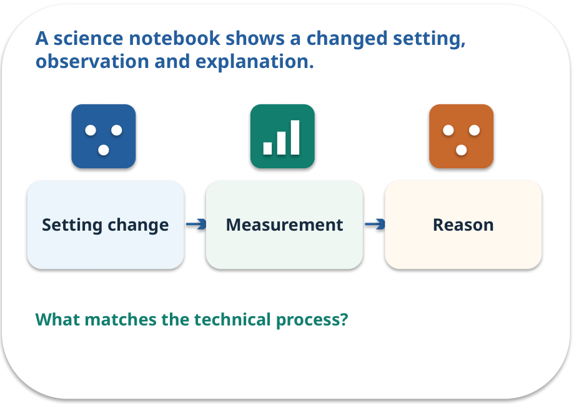
Attribution · a familiar picture
ANALOGY / WEEK 12
A science notebook shows a changed setting, observation and explanation.
What matches our case, and where does the analogy stop?
GENERATIVE AI 2027 • WEEK 12 • 11 / 40
Notes:
TEACHER SCRIPT — ANALOGY. Begin with the familiar scene. Invite learners to describe each part in everyday language. Then ask where the comparison might fail before introducing the technical vocabulary. This week’s case is: A fresh student question and a previously unseen failure are presented. The visible slide states: A science notebook shows a changed setting, observation and explanation.
What matches our case, and where does the analogy stop? The boundary is: A before/after result in one toy case cannot establish general reliability. The target is: Demonstrate the policy assistant and explain its limits with evidence. Listen for an explanation of the actual arrow or calculation, not just a repeated label. If the answer is unsupported, mark that uncertainty and return to the source. Before moving on, ask for the main idea and one concrete change to the worked example.

Slide 12
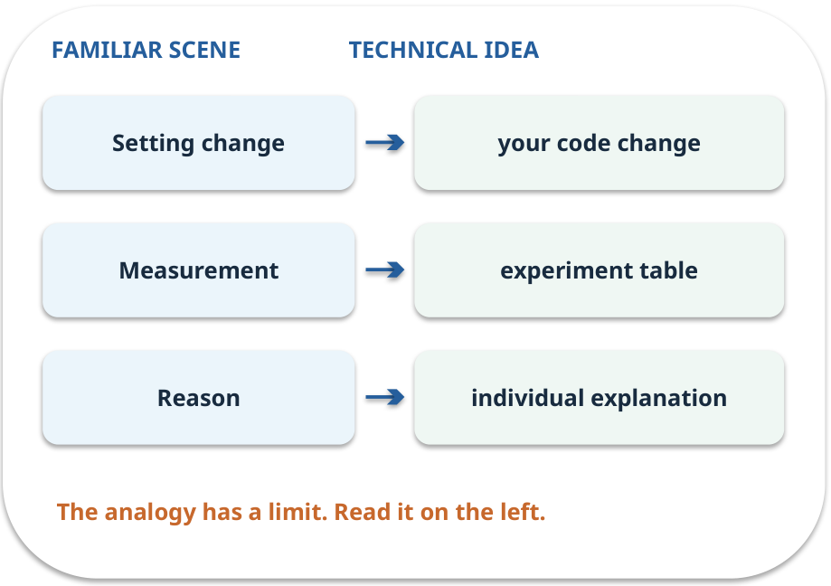
Attribution · map the parts
MAPPING / WEEK 12
Match each everyday part to the technical part.
Analogy limit: A before/after result in one toy case cannot establish general reliability.
GENERATIVE AI 2027 • WEEK 12 • 12 / 40
Notes:
TEACHER SCRIPT — MAPPING. Point from each familiar element to the corresponding technical element. Have students cover the right column and reconstruct the three matches. Read the limitation aloud. This week’s case is: A fresh student question and a previously unseen failure are presented. The visible slide states: Match each everyday part to the technical part.
Analogy limit: A before/after result in one toy case cannot establish general reliability. The three precise mappings are [['Setting change', 'your code change'], ['Measurement', 'experiment table'], ['Reason', 'individual explanation']]. The target is: Demonstrate the policy assistant and explain its limits with evidence. Listen for an explanation of the actual arrow or calculation, not just a repeated label. If the answer is unsupported, mark that uncertainty and return to the source. Before moving on, ask for the main idea and one concrete change to the worked example.

Slide 13
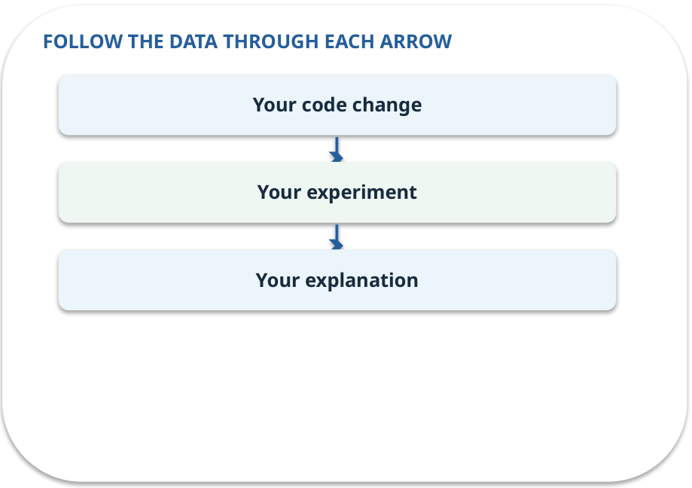
Attribution · how it works
MECHANISM / WEEK 12
Each learner shows the part they changed and explains the choice.
Trace the arrows from left to right.
GENERATIVE AI 2027 • WEEK 12 • 13 / 40
Notes:
TEACHER SCRIPT — MECHANISM. Trace every arrow slowly from the input to the output. Ask what information crosses the boundary at each arrow. Pause if students confuse a simplified notebook with a trained model. This week’s case is: A fresh student question and a previously unseen failure are presented. The visible slide states: Each learner shows the part they changed and explains the choice.
Trace the arrows from left to right. The weekly example is: Show baseline, chosen setting, case counts and one error that still remains. State what the analogy does not explain: A before/after result in one toy case cannot establish general reliability. The target is: Demonstrate the policy assistant and explain its limits with evidence. Listen for an explanation of the actual arrow or calculation, not just a repeated label. If the answer is unsupported, mark that uncertainty and return to the source. Before moving on, ask for the main idea and one concrete change to the worked example.

Slide 14
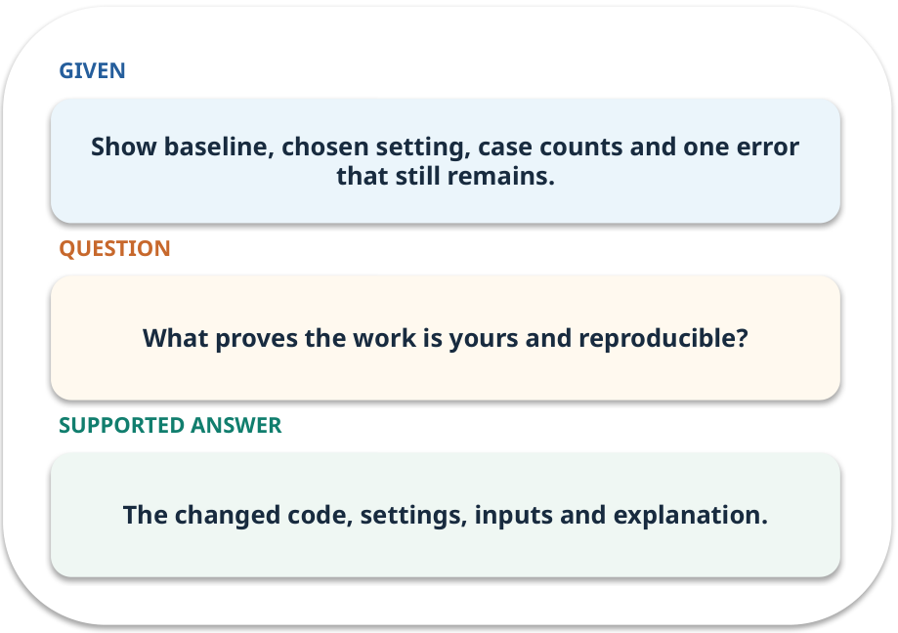
Attribution · work one case
WORKED / WEEK 12
Show baseline, chosen setting, case counts and one error that still remains.
Point to the evidence before giving your conclusion.
GENERATIVE AI 2027 • WEEK 12 • 14 / 40
Notes:
TEACHER SCRIPT — WORKED. Work the specific numbers or source wording aloud. Give students thirty seconds to write a conclusion, then ask which source line or calculation supports it. This week’s case is: A fresh student question and a previously unseen failure are presented. The visible slide states: Show baseline, chosen setting, case counts and one error that still remains.
Point to the evidence before giving your conclusion. The expected reasoning concludes: The changed code, settings, inputs and explanation. Distinguish measured results from illustrative numbers. The target is: Demonstrate the policy assistant and explain its limits with evidence. Listen for an explanation of the actual arrow or calculation, not just a repeated label. If the answer is unsupported, mark that uncertainty and return to the source. Before moving on, ask for the main idea and one concrete change to the worked example.

Slide 15
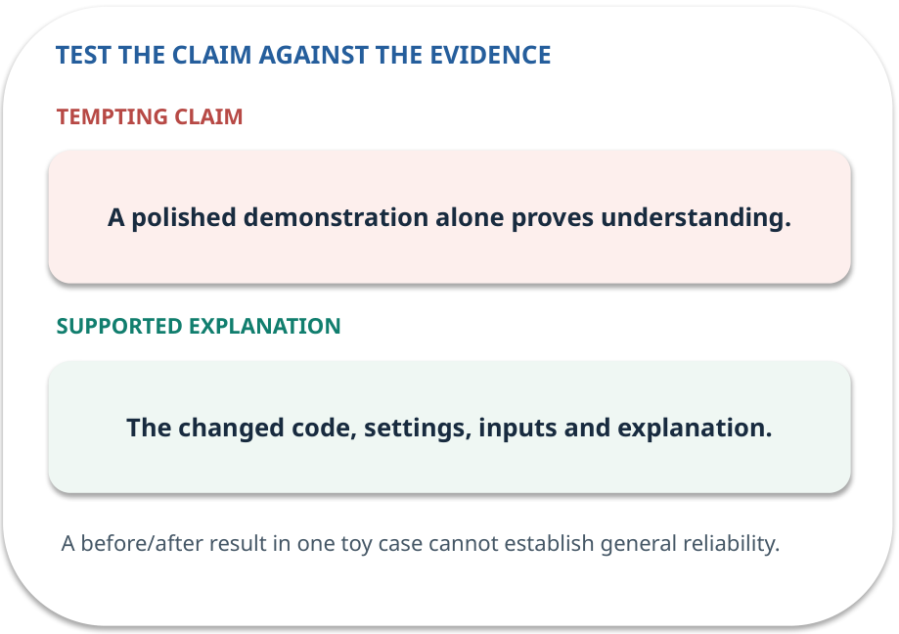
Attribution · answer and explain
REVEAL / WEEK 12
The changed code, settings, inputs and explanation.
Tempting mistake: A polished demonstration alone proves understanding.
GENERATIVE AI 2027 • WEEK 12 • 15 / 40
Notes:
TEACHER SCRIPT — REVEAL. Return to the earlier choice. Explain the correct answer and why the tempting claim fails. Ask one learner to say the answer in a single sentence without reading it. This week’s case is: A fresh student question and a previously unseen failure are presented. The visible slide states: The changed code, settings, inputs and explanation.
Tempting mistake: A polished demonstration alone proves understanding. The earlier question was What proves the work is yours and reproducible? Ask how this differs from the wrong claim. The target is: Demonstrate the policy assistant and explain its limits with evidence. Listen for an explanation of the actual arrow or calculation, not just a repeated label. If the answer is unsupported, mark that uncertainty and return to the source. Before moving on, ask for the main idea and one concrete change to the worked example.

Slide 16

3. Predict · Fresh challenge
QUESTION / WEEK 12
Which layer deserves the first test here?
Make a choice before we explain the diagram.
GENERATIVE AI 2027 • WEEK 12 • 16 / 40
Notes:
TEACHER SCRIPT — QUESTION. Take a show of hands for each choice before showing the mechanism. Ask pairs to defend a choice with evidence. Save the strongest wrong reason for the reveal later in this cycle. This week’s case is: A fresh student question and a previously unseen failure are presented. The visible slide states: Which layer deserves the first test here?
Make a choice before we explain the diagram. The intended answer is Answer support using the retrieved P4 passage. The tempting claim is Every wrong answer is a retrieval failure. Do not show which card is correct until the reveal. The target is: Demonstrate the policy assistant and explain its limits with evidence. Listen for an explanation of the actual arrow or calculation, not just a repeated label. If the answer is unsupported, mark that uncertainty and return to the source. Before moving on, ask for the main idea and one concrete change to the worked example.

Slide 17
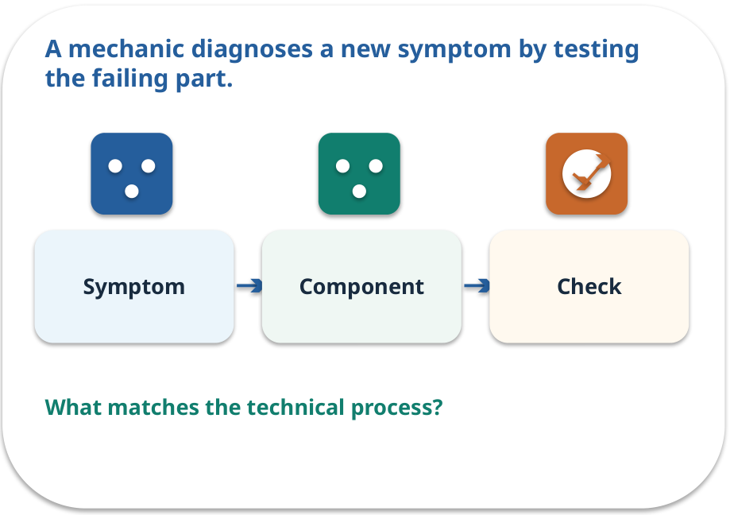
Fresh challenge · a familiar picture
ANALOGY / WEEK 12
A mechanic diagnoses a new symptom by testing the failing part.
What matches our case, and where does the analogy stop?
GENERATIVE AI 2027 • WEEK 12 • 17 / 40
Notes:
TEACHER SCRIPT — ANALOGY. Begin with the familiar scene. Invite learners to describe each part in everyday language. Then ask where the comparison might fail before introducing the technical vocabulary. This week’s case is: A fresh student question and a previously unseen failure are presented. The visible slide states: A mechanic diagnoses a new symptom by testing the failing part.
What matches our case, and where does the analogy stop? The boundary is: Some failures cross layers; record uncertainty and test competing causes. The target is: Demonstrate the policy assistant and explain its limits with evidence. Listen for an explanation of the actual arrow or calculation, not just a repeated label. If the answer is unsupported, mark that uncertainty and return to the source. Before moving on, ask for the main idea and one concrete change to the worked example.

Slide 18
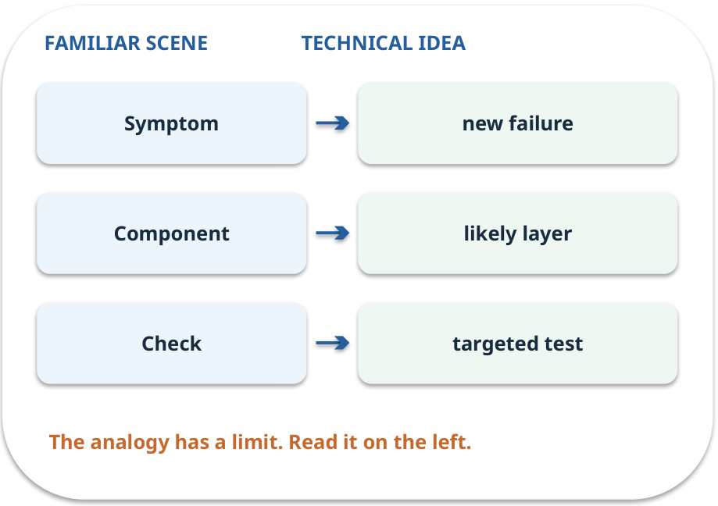
Fresh challenge · map the parts
MAPPING / WEEK 12
Match each everyday part to the technical part.
Analogy limit: Some failures cross layers; record uncertainty and test competing causes.
GENERATIVE AI 2027 • WEEK 12 • 18 / 40
Notes:
TEACHER SCRIPT — MAPPING. Point from each familiar element to the corresponding technical element. Have students cover the right column and reconstruct the three matches. Read the limitation aloud. This week’s case is: A fresh student question and a previously unseen failure are presented. The visible slide states: Match each everyday part to the technical part.
Analogy limit: Some failures cross layers; record uncertainty and test competing causes. The three precise mappings are [['Symptom', 'new failure'], ['Component', 'likely layer'], ['Check', 'targeted test']]. The target is: Demonstrate the policy assistant and explain its limits with evidence. Listen for an explanation of the actual arrow or calculation, not just a repeated label. If the answer is unsupported, mark that uncertainty and return to the source. Before moving on, ask for the main idea and one concrete change to the worked example.

Slide 19
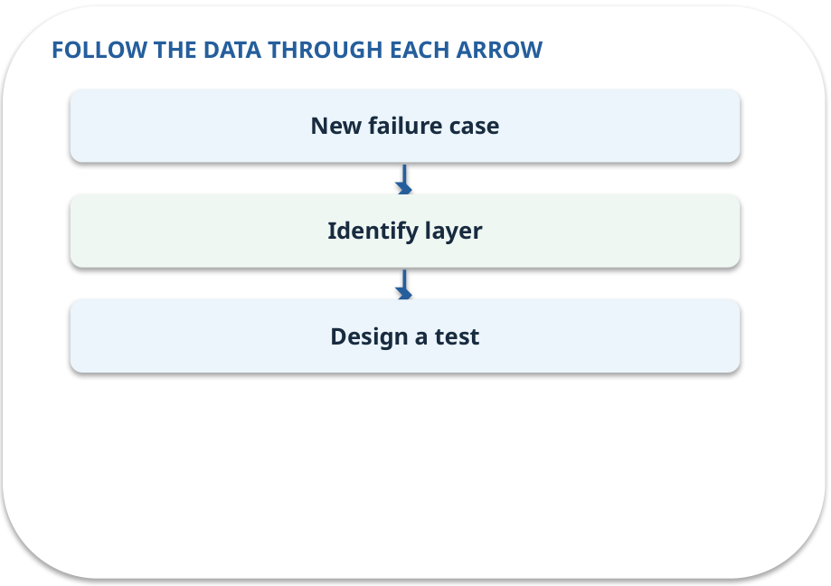
Fresh challenge · how it works
MECHANISM / WEEK 12
A new example of a practised failure tests understanding rather than memorization.
Trace the arrows from left to right.
GENERATIVE AI 2027 • WEEK 12 • 19 / 40
Notes:
TEACHER SCRIPT — MECHANISM. Trace every arrow slowly from the input to the output. Ask what information crosses the boundary at each arrow. Pause if students confuse a simplified notebook with a trained model. This week’s case is: A fresh student question and a previously unseen failure are presented. The visible slide states: A new example of a practised failure tests understanding rather than memorization.
Trace the arrows from left to right. The weekly example is: If P4 is retrieved but the answer says 12 days is allowed, test claim support before changing search. State what the analogy does not explain: Some failures cross layers; record uncertainty and test competing causes. The target is: Demonstrate the policy assistant and explain its limits with evidence. Listen for an explanation of the actual arrow or calculation, not just a repeated label. If the answer is unsupported, mark that uncertainty and return to the source. Before moving on, ask for the main idea and one concrete change to the worked example.

Slide 20
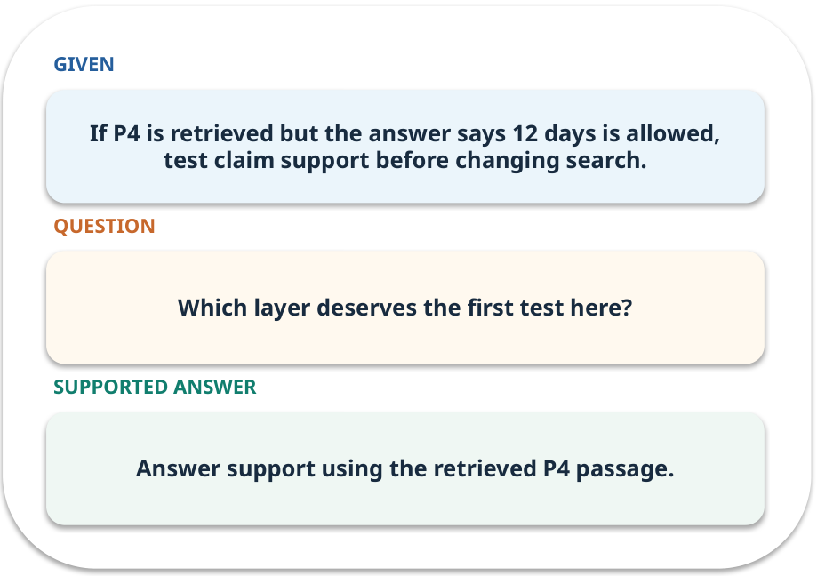
Fresh challenge · work one case
WORKED / WEEK 12
If P4 is retrieved but the answer says 12 days is allowed, test claim support before changing search.
Point to the evidence before giving your conclusion.
GENERATIVE AI 2027 • WEEK 12 • 20 / 40
Notes:
TEACHER SCRIPT — WORKED. Work the specific numbers or source wording aloud. Give students thirty seconds to write a conclusion, then ask which source line or calculation supports it. This week’s case is: A fresh student question and a previously unseen failure are presented. The visible slide states: If P4 is retrieved but the answer says 12 days is allowed, test claim support before changing search.
Point to the evidence before giving your conclusion. The expected reasoning concludes: Answer support using the retrieved P4 passage. Distinguish measured results from illustrative numbers. The target is: Demonstrate the policy assistant and explain its limits with evidence. Listen for an explanation of the actual arrow or calculation, not just a repeated label. If the answer is unsupported, mark that uncertainty and return to the source. Before moving on, ask for the main idea and one concrete change to the worked example.

Slide 21
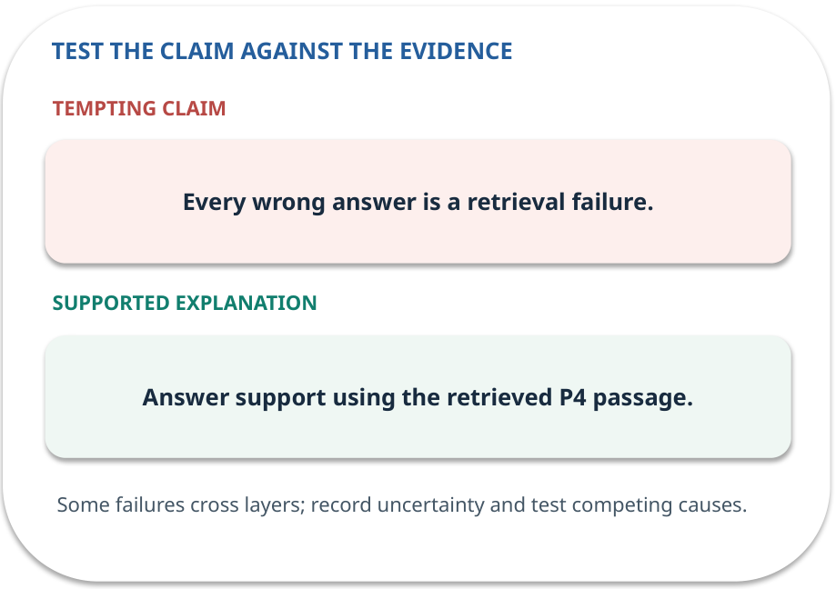
Fresh challenge · answer and explain
REVEAL / WEEK 12
Answer support using the retrieved P4 passage.
Tempting mistake: Every wrong answer is a retrieval failure.
GENERATIVE AI 2027 • WEEK 12 • 21 / 40
Notes:
TEACHER SCRIPT — REVEAL. Return to the earlier choice. Explain the correct answer and why the tempting claim fails. Ask one learner to say the answer in a single sentence without reading it. This week’s case is: A fresh student question and a previously unseen failure are presented. The visible slide states: Answer support using the retrieved P4 passage.
Tempting mistake: Every wrong answer is a retrieval failure. The earlier question was Which layer deserves the first test here? Ask how this differs from the wrong claim. The target is: Demonstrate the policy assistant and explain its limits with evidence. Listen for an explanation of the actual arrow or calculation, not just a repeated label. If the answer is unsupported, mark that uncertainty and return to the source. Before moving on, ask for the main idea and one concrete change to the worked example.

Slide 22
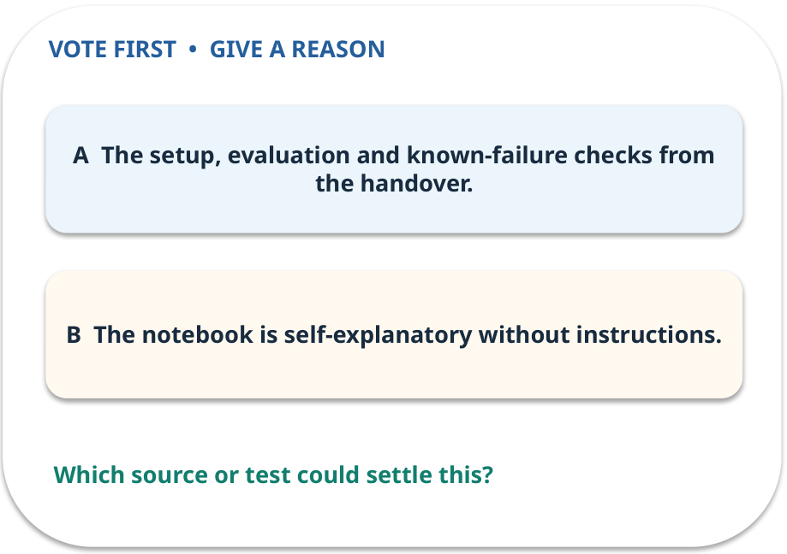
4. Predict · Handover
QUESTION / WEEK 12
What can the next maintainer reproduce?
Make a choice before we explain the diagram.
GENERATIVE AI 2027 • WEEK 12 • 22 / 40
Notes:
TEACHER SCRIPT — QUESTION. Take a show of hands for each choice before showing the mechanism. Ask pairs to defend a choice with evidence. Save the strongest wrong reason for the reveal later in this cycle. This week’s case is: A fresh student question and a previously unseen failure are presented. The visible slide states: What can the next maintainer reproduce?
Make a choice before we explain the diagram. The intended answer is The setup, evaluation and known-failure checks from the handover. The tempting claim is The notebook is self-explanatory without instructions. Do not show which card is correct until the reveal. The target is: Demonstrate the policy assistant and explain its limits with evidence. Listen for an explanation of the actual arrow or calculation, not just a repeated label. If the answer is unsupported, mark that uncertainty and return to the source. Before moving on, ask for the main idea and one concrete change to the worked example.

Slide 23
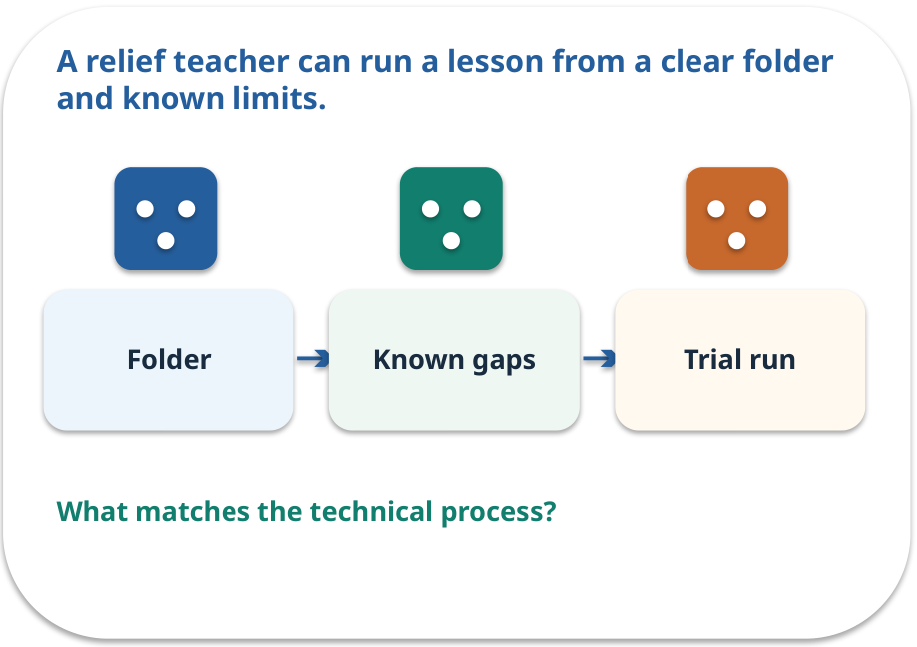
Handover · a familiar picture
ANALOGY / WEEK 12
A relief teacher can run a lesson from a clear folder and known limits.
What matches our case, and where does the analogy stop?
GENERATIVE AI 2027 • WEEK 12 • 23 / 40
Notes:
TEACHER SCRIPT — ANALOGY. Begin with the familiar scene. Invite learners to describe each part in everyday language. Then ask where the comparison might fail before introducing the technical vocabulary. This week’s case is: A fresh student question and a previously unseen failure are presented. The visible slide states: A relief teacher can run a lesson from a clear folder and known limits.
What matches our case, and where does the analogy stop? The boundary is: Documentation can go stale; date versions and rerun the checks. The target is: Demonstrate the policy assistant and explain its limits with evidence. Listen for an explanation of the actual arrow or calculation, not just a repeated label. If the answer is unsupported, mark that uncertainty and return to the source. Before moving on, ask for the main idea and one concrete change to the worked example.

Slide 24
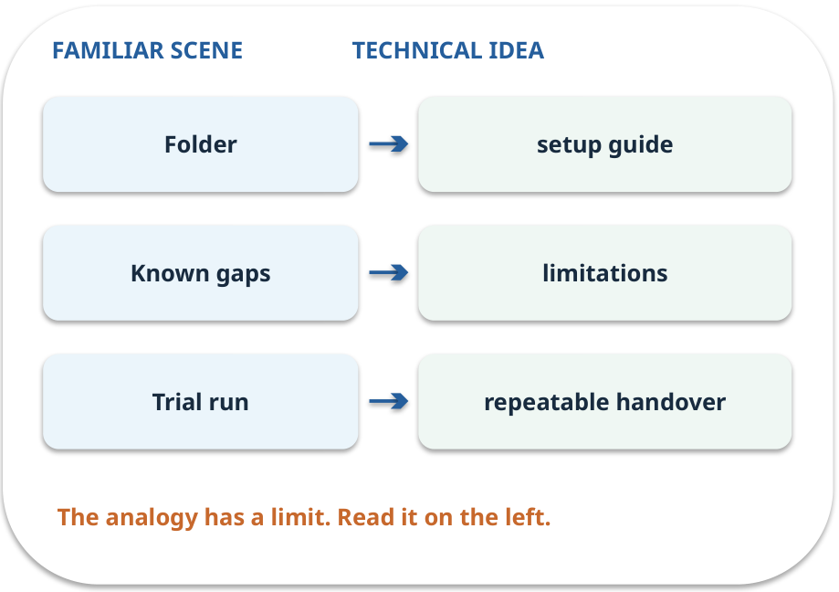
Handover · map the parts
MAPPING / WEEK 12
Match each everyday part to the technical part.
Analogy limit: Documentation can go stale; date versions and rerun the checks.
GENERATIVE AI 2027 • WEEK 12 • 24 / 40
Notes:
TEACHER SCRIPT — MAPPING. Point from each familiar element to the corresponding technical element. Have students cover the right column and reconstruct the three matches. Read the limitation aloud. This week’s case is: A fresh student question and a previously unseen failure are presented. The visible slide states: Match each everyday part to the technical part.
Analogy limit: Documentation can go stale; date versions and rerun the checks. The three precise mappings are [['Folder', 'setup guide'], ['Known gaps', 'limitations'], ['Trial run', 'repeatable handover']]. The target is: Demonstrate the policy assistant and explain its limits with evidence. Listen for an explanation of the actual arrow or calculation, not just a repeated label. If the answer is unsupported, mark that uncertainty and return to the source. Before moving on, ask for the main idea and one concrete change to the worked example.

Slide 25
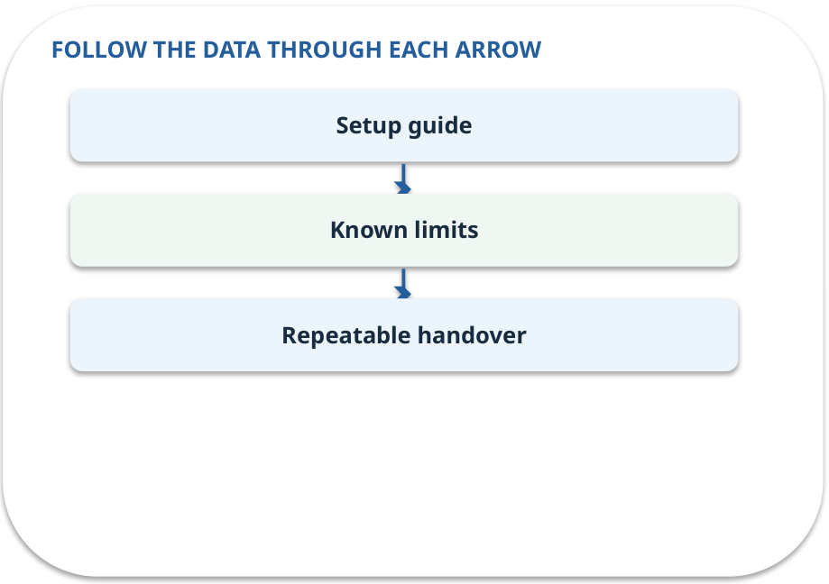
Handover · how it works
MECHANISM / WEEK 12
Another person can run, test and review the solution from written instructions.
Trace the arrows from left to right.
GENERATIVE AI 2027 • WEEK 12 • 25 / 40
Notes:
TEACHER SCRIPT — MECHANISM. Trace every arrow slowly from the input to the output. Ask what information crosses the boundary at each arrow. Pause if students confuse a simplified notebook with a trained model. This week’s case is: A fresh student question and a previously unseen failure are presented. The visible slide states: Another person can run, test and review the solution from written instructions.
Trace the arrows from left to right. The weekly example is: Give installation steps, source versions, test commands, role rules and rollback instructions. State what the analogy does not explain: Documentation can go stale; date versions and rerun the checks. The target is: Demonstrate the policy assistant and explain its limits with evidence. Listen for an explanation of the actual arrow or calculation, not just a repeated label. If the answer is unsupported, mark that uncertainty and return to the source. Before moving on, ask for the main idea and one concrete change to the worked example.

Slide 26
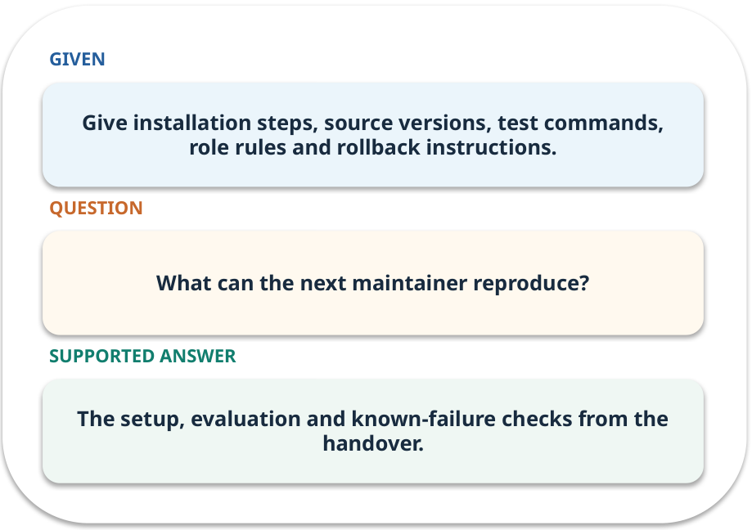
Handover · work one case
WORKED / WEEK 12
Give installation steps, source versions, test commands, role rules and rollback instructions.
Point to the evidence before giving your conclusion.
GENERATIVE AI 2027 • WEEK 12 • 26 / 40
Notes:
TEACHER SCRIPT — WORKED. Work the specific numbers or source wording aloud. Give students thirty seconds to write a conclusion, then ask which source line or calculation supports it. This week’s case is: A fresh student question and a previously unseen failure are presented. The visible slide states: Give installation steps, source versions, test commands, role rules and rollback instructions.
Point to the evidence before giving your conclusion. The expected reasoning concludes: The setup, evaluation and known-failure checks from the handover. Distinguish measured results from illustrative numbers. The target is: Demonstrate the policy assistant and explain its limits with evidence. Listen for an explanation of the actual arrow or calculation, not just a repeated label. If the answer is unsupported, mark that uncertainty and return to the source. Before moving on, ask for the main idea and one concrete change to the worked example.

Slide 27
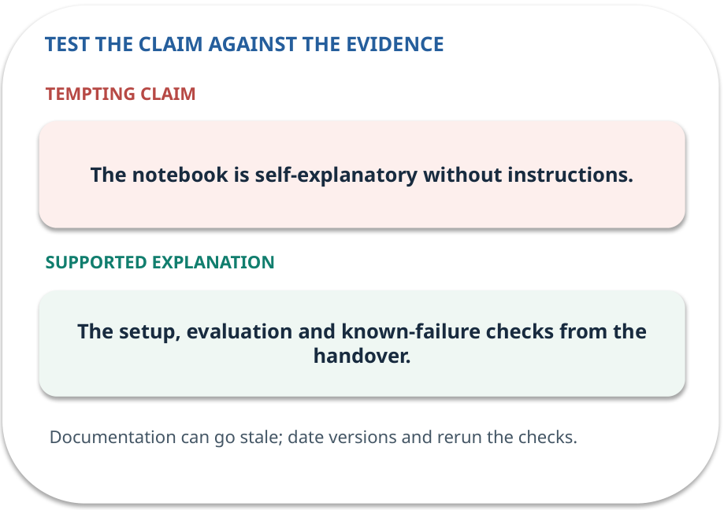
Handover · answer and explain
REVEAL / WEEK 12
The setup, evaluation and known-failure checks from the handover.
Tempting mistake: The notebook is self-explanatory without instructions.
GENERATIVE AI 2027 • WEEK 12 • 27 / 40
Notes:
TEACHER SCRIPT — REVEAL. Return to the earlier choice. Explain the correct answer and why the tempting claim fails. Ask one learner to say the answer in a single sentence without reading it. This week’s case is: A fresh student question and a previously unseen failure are presented. The visible slide states: The setup, evaluation and known-failure checks from the handover.
Tempting mistake: The notebook is self-explanatory without instructions. The earlier question was What can the next maintainer reproduce? Ask how this differs from the wrong claim. The target is: Demonstrate the policy assistant and explain its limits with evidence. Listen for an explanation of the actual arrow or calculation, not just a repeated label. If the answer is unsupported, mark that uncertainty and return to the source. Before moving on, ask for the main idea and one concrete change to the worked example.

Slide 28
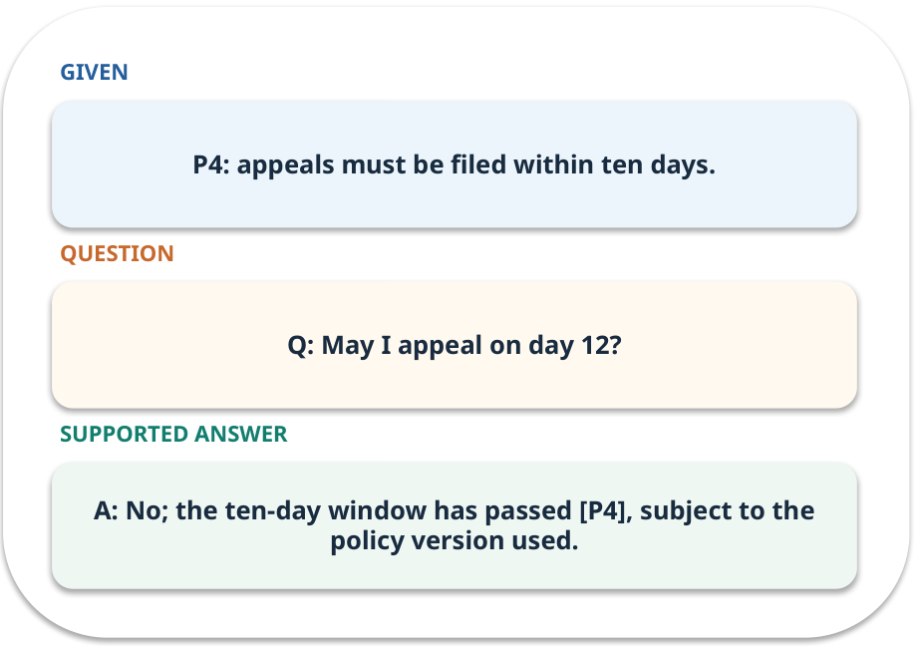
Evidence trail: input → result
WORKED / WEEK 12
Q: May I appeal on day 12?
A: No; the ten-day window has passed [P4], subject to the policy version used.
GENERATIVE AI 2027 • WEEK 12 • 28 / 40
Notes:
TEACHER SCRIPT — WORKED. Work the specific numbers or source wording aloud. Give students thirty seconds to write a conclusion, then ask which source line or calculation supports it. This week’s case is: A fresh student question and a previously unseen failure are presented. The visible slide states: Q: May I appeal on day 12?
A: No; the ten-day window has passed [P4], subject to the policy version used. Have one student point to an exact source word or number for each conclusion. The target is: Demonstrate the policy assistant and explain its limits with evidence. Listen for an explanation of the actual arrow or calculation, not just a repeated label. If the answer is unsupported, mark that uncertainty and return to the source. Before moving on, ask for the main idea and one concrete change to the worked example.

Slide 29
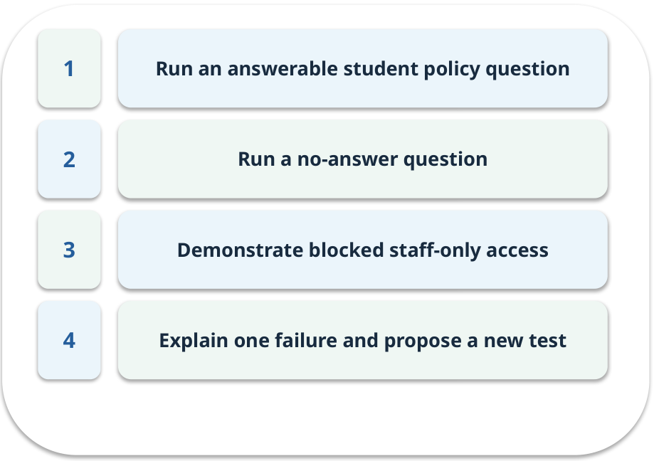
Notebook: run the prepared example
PRACTICE / WEEK 12
Present a self-contained end-to-end policy assistant.
Read the original output before editing.
GENERATIVE AI 2027 • WEEK 12 • 29 / 40
Notes:
TEACHER SCRIPT — PRACTICE. Open the matching notebook and demonstrate the first run. Have learners predict one change, run only that change, and record input, setting, output and an error explanation. This week’s case is: A fresh student question and a previously unseen failure are presented. The visible slide states: Present a self-contained end-to-end policy assistant.
Read the original output before editing. Use Week_12_Lab.ipynb. This lab is a prepared classroom demonstration with its limitations documented. The target is: Demonstrate the policy assistant and explain its limits with evidence. Listen for an explanation of the actual arrow or calculation, not just a repeated label. If the answer is unsupported, mark that uncertainty and return to the source. Before moving on, ask for the main idea and one concrete change to the worked example.

Slide 30

Find the input and check in Python
PRACTICE / WEEK 12
Locate the supplied input, the transformation, the checking line and the printed result.
GENERATIVE AI 2027 • WEEK 12 • 30 / 40
Notes:
TEACHER SCRIPT — PRACTICE. Open the matching notebook and demonstrate the first run. Have learners predict one change, run only that change, and record input, setting, output and an error explanation. This week’s case is: A fresh student question and a previously unseen failure are presented. The visible slide states: Locate the supplied input, the transformation, the checking line and the printed result. The weekly lab change is: Use a new policy version and explain which index and tests must change. The target is: Demonstrate the policy assistant and explain its limits with evidence. Listen for an explanation of the actual arrow or calculation, not just a repeated label. If the answer is unsupported, mark that uncertainty and return to the source. Before moving on, ask for the main idea and one concrete change to the worked example.

Slide 31

Predict one controlled change
PRACTICE / WEEK 12
Use a new policy version and explain which index and tests must change.
What should change in the result? What stays fixed?
GENERATIVE AI 2027 • WEEK 12 • 31 / 40
Notes:
TEACHER SCRIPT — PRACTICE. Open the matching notebook and demonstrate the first run. Have learners predict one change, run only that change, and record input, setting, output and an error explanation. This week’s case is: A fresh student question and a previously unseen failure are presented. The visible slide states: Use a new policy version and explain which index and tests must change.
What should change in the result? What stays fixed? Ask learners to write their prediction before rerunning the cell. The target is: Demonstrate the policy assistant and explain its limits with evidence. Listen for an explanation of the actual arrow or calculation, not just a repeated label. If the answer is unsupported, mark that uncertainty and return to the source. Before moving on, ask for the main idea and one concrete change to the worked example.

Slide 32

Run, compare and record
PRACTICE / WEEK 12
Record the input, the one changed setting, the observed result and a reason for any difference.
GENERATIVE AI 2027 • WEEK 12 • 32 / 40
Notes:
TEACHER SCRIPT — PRACTICE. Open the matching notebook and demonstrate the first run. Have learners predict one change, run only that change, and record input, setting, output and an error explanation. This week’s case is: A fresh student question and a previously unseen failure are presented. The visible slide states: Record the input, the one changed setting, the observed result and a reason for any difference. The required evidence is: Demo, test table, known limits and individual explanation. The target is: Demonstrate the policy assistant and explain its limits with evidence. Listen for an explanation of the actual arrow or calculation, not just a repeated label. If the answer is unsupported, mark that uncertainty and return to the source. Before moving on, ask for the main idea and one concrete change to the worked example.

Slide 33

Measure without hiding the denominator
CHECK / WEEK 12
Task success, citation support, no-answer accuracy and access gate
Write the numerator, denominator and one failure case.
GENERATIVE AI 2027 • WEEK 12 • 33 / 40
Notes:
TEACHER SCRIPT — CHECK. Use this as a brief formative check. Ask for the conclusion, the evidence and one limitation. Revisit disagreements in the review session and offer an extension only after the core task. This week’s case is: A fresh student question and a previously unseen failure are presented. The visible slide states: Task success, citation support, no-answer accuracy and access gate
Write the numerator, denominator and one failure case. Where a measure is qualitative, show the concrete source comparison. Example: A: No; the ten-day window has passed [P4], subject to the policy version used. The target is: Demonstrate the policy assistant and explain its limits with evidence. Listen for an explanation of the actual arrow or calculation, not just a repeated label. If the answer is unsupported, mark that uncertainty and return to the source. Before moving on, ask for the main idea and one concrete change to the worked example.

Slide 34
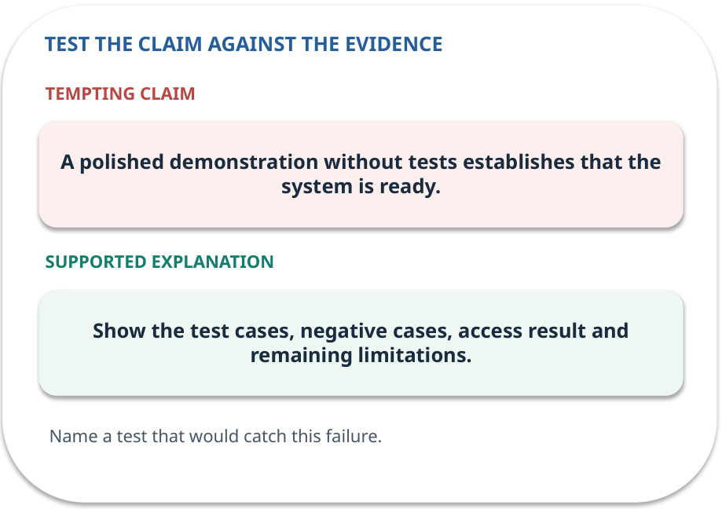
Error detective: find the layer
CHECK / WEEK 12
Plausible wrong claim: A polished demonstration without tests establishes that the system is ready.
Correct it using the case evidence.
GENERATIVE AI 2027 • WEEK 12 • 34 / 40
Notes:
TEACHER SCRIPT — CHECK. Use this as a brief formative check. Ask for the conclusion, the evidence and one limitation. Revisit disagreements in the review session and offer an extension only after the core task. This week’s case is: A fresh student question and a previously unseen failure are presented. The visible slide states: Plausible wrong claim: A polished demonstration without tests establishes that the system is ready.
Correct it using the case evidence. The correction is Show the test cases, negative cases, access result and remaining limitations. The target is: Demonstrate the policy assistant and explain its limits with evidence. Listen for an explanation of the actual arrow or calculation, not just a repeated label. If the answer is unsupported, mark that uncertainty and return to the source. Before moving on, ask for the main idea and one concrete change to the worked example.

Slide 35

Transfer to a new situation
CHECK / WEEK 12
A new policy edition changes the appeal window. What records, index and tests need updating?
Explain which source or test would settle it.
GENERATIVE AI 2027 • WEEK 12 • 35 / 40
Notes:
TEACHER SCRIPT — CHECK. Use this as a brief formative check. Ask for the conclusion, the evidence and one limitation. Revisit disagreements in the review session and offer an extension only after the core task. This week’s case is: A fresh student question and a previously unseen failure are presented. The visible slide states: A new policy edition changes the appeal window. What records, index and tests need updating?
Explain which source or test would settle it. This is a fresh scenario, so ask for a reason before accepting either short answer. The target is: Demonstrate the policy assistant and explain its limits with evidence. Listen for an explanation of the actual arrow or calculation, not just a repeated label. If the answer is unsupported, mark that uncertainty and return to the source. Before moving on, ask for the main idea and one concrete change to the worked example.

Slide 36
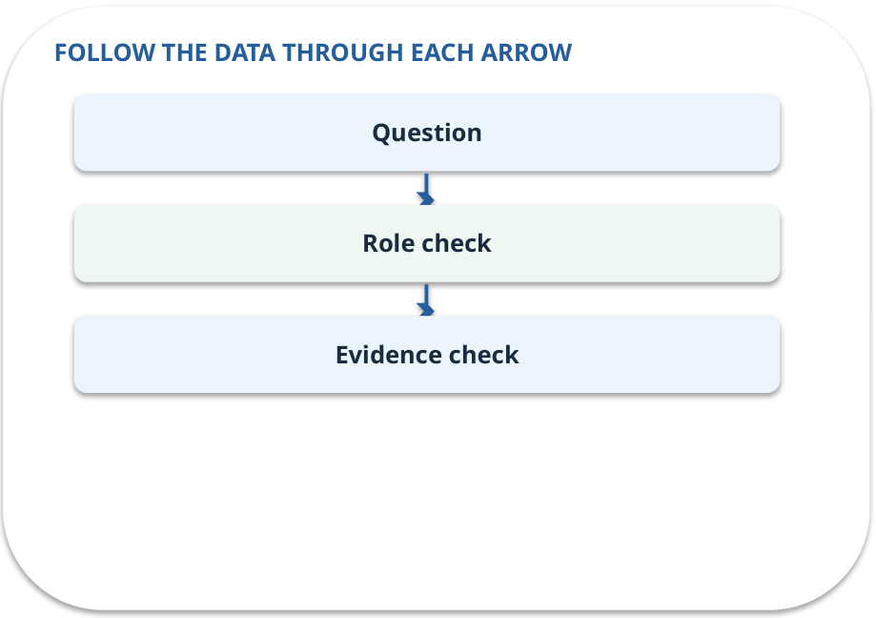
Explain it to a partner
CHECK / WEEK 12
Without reading the slide, name the input, one processing step and the check. Your partner should ask “How do you know?”
GENERATIVE AI 2027 • WEEK 12 • 36 / 40
Notes:
TEACHER SCRIPT — CHECK. Use this as a brief formative check. Ask for the conclusion, the evidence and one limitation. Revisit disagreements in the review session and offer an extension only after the core task. This week’s case is: A fresh student question and a previously unseen failure are presented. The visible slide states: Without reading the slide, name the input, one processing step and the check. Your partner should ask “How do you know?” Listen for a causal explanation and one limitation, then revisit a difficult arrow on the board. The target is: Demonstrate the policy assistant and explain its limits with evidence. Listen for an explanation of the actual arrow or calculation, not just a repeated label. If the answer is unsupported, mark that uncertainty and return to the source. Before moving on, ask for the main idea and one concrete change to the worked example.

Slide 37

Exam rehearsal · explain and apply
CHECK / WEEK 12
What makes a fair baseline comparison?
Write a short answer, then compare with the guide.
GENERATIVE AI 2027 • WEEK 12 • 37 / 40
Notes:
TEACHER SCRIPT — CHECK. Use this as a brief formative check. Ask for the conclusion, the evidence and one limitation. Revisit disagreements in the review session and offer an extension only after the core task. This week’s case is: A fresh student question and a previously unseen failure are presented. The visible slide states: What makes a fair baseline comparison?
Write a short answer, then compare with the guide. Model answer after discussion: Same task, matched cases, source version and scoring rubric, with changes and variability recorded. Practice marks: 4. The target is: Demonstrate the policy assistant and explain its limits with evidence. Listen for an explanation of the actual arrow or calculation, not just a repeated label. If the answer is unsupported, mark that uncertainty and return to the source. Before moving on, ask for the main idea and one concrete change to the worked example.

Slide 38
Exam rehearsal · explain and apply
CHECK / WEEK 12
Name the four demonstration cases.
Write a short answer, then compare with the guide.
GENERATIVE AI 2027 • WEEK 12 • 38 / 40
Notes:
TEACHER SCRIPT — CHECK. Use this as a brief formative check. Ask for the conclusion, the evidence and one limitation. Revisit disagreements in the review session and offer an extension only after the core task. This week’s case is: A fresh student question and a previously unseen failure are presented. The visible slide states: Name the four demonstration cases.
Write a short answer, then compare with the guide. Model answer after discussion: Answerable, unsupported, access denied, and failure recovery. Practice marks: 4. The target is: Demonstrate the policy assistant and explain its limits with evidence. Listen for an explanation of the actual arrow or calculation, not just a repeated label. If the answer is unsupported, mark that uncertainty and return to the source. Before moving on, ask for the main idea and one concrete change to the worked example.

Slide 39

What to hand in
PRACTICE / WEEK 12
Demo, test table, known limits and individual explanation.
Include the one changed input and an error explanation.
GENERATIVE AI 2027 • WEEK 12 • 39 / 40
Notes:
TEACHER SCRIPT — PRACTICE. Open the matching notebook and demonstrate the first run. Have learners predict one change, run only that change, and record input, setting, output and an error explanation. This week’s case is: A fresh student question and a previously unseen failure are presented. The visible slide states: Demo, test table, known limits and individual explanation.
Include the one changed input and an error explanation. This weekly evidence receives formative feedback according to the module sequence; refer to the assessment brief for graded work. The target is: Demonstrate the policy assistant and explain its limits with evidence. Listen for an explanation of the actual arrow or calculation, not just a repeated label. If the answer is unsupported, mark that uncertainty and return to the source. Before moving on, ask for the main idea and one concrete change to the worked example.

Slide 40
Three ideas to recall next week
CHECK / WEEK 12
Show the question-to-evidence path, your measured change and a repeatable handover.
Read the linked official sources in the Word guide and redraw one diagram from memory.
GENERATIVE AI 2027 • WEEK 12 • 40 / 40
Notes:
TEACHER SCRIPT — CHECK. Use this as a brief formative check. Ask for the conclusion, the evidence and one limitation. Revisit disagreements in the review session and offer an extension only after the core task. This week’s case is: A fresh student question and a previously unseen failure are presented. The visible slide states: Show the question-to-evidence path, your measured change and a repeatable handover.
Read the linked official sources in the Word guide and redraw one diagram from memory. Return to the opening vote and ask whether the evidence changed anyone’s mind. The next week builds on this outcome: Demonstrate the policy assistant and explain its limits with evidence. The target is: Demonstrate the policy assistant and explain its limits with evidence. Listen for an explanation of the actual arrow or calculation, not just a repeated label. If the answer is unsupported, mark that uncertainty and return to the source. Before moving on, ask for the main idea and one concrete change to the worked example.

