Slide 1
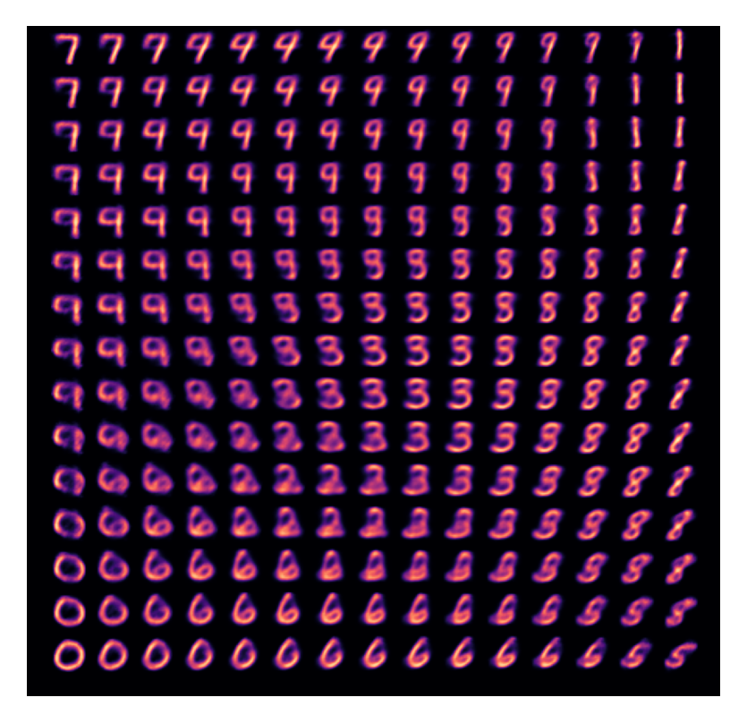
WEEK 02
Variational Autoencoders (VAEs)
How a VAE learns short hidden codes, rebuilds images and generates new digits
MSc in Artificial Intelligence · Generative AI · 2-hour lecture
Notes:
Welcome to week 2. Last week we said that every generative model learns a probability distribution and samples from it, and that latent variables let us generate complex data from simple hidden causes. Today we build the first deep generative model of the module that uses that idea directly: the variational autoencoder, or VAE. The image on this slide is not a drawing: it was produced by a small VAE trained on handwritten digits, decoding a grid of points from its two-dimensional latent space. By the end of today you will understand, and in the lab implement, every part of that model.

Slide 2
WEEK 02 · VARIATIONAL AUTOENCODERS (VAES)
By the end of this week you can…
1
Explain reconstruction and prior sampling.
Module learning outcomes (MIMLOs) practised
2
Trace encoder, sampled code and decoder.
MIMLO 1
Explain core concepts, maths and model families
3
Read reconstruction and KL in the ELBO.
MIMLO 3
4
Use reparameterisation to train the encoder.
Design, implement and fine-tune models
5
Build a VAE and compare beta settings.
MIMLO 4
Critically evaluate outputs: metrics, humans, ethics
6
Evaluate samples, anomalies and data risks.
Generative AI · MSc in Artificial Intelligence
2
Notes:
Six outcomes today. The first two are conceptual: why plain autoencoders fail as generators and what the three parts of a VAE are. The third is the mathematical core, the evidence lower bound or ELBO, which students must be able to write down and interpret for the exam. The fourth, the reparameterisation trick, is a small idea with huge influence; it appears again in diffusion models. The fifth is practical: in the lab you implement and train a VAE in PyTorch. This week practises MIMLO 1 on concepts and maths, MIMLO 3 on implementing a model, and MIMLO 4 on evaluating it.

Slide 3
WEEK 02 · VARIATIONAL AUTOENCODERS (VAES)
Where we are in the course
Foundations and image generators
Week 1
Week 2: you are here
Week 3
Week 4
Introduction and
Variational
Generative adversarial
Diffusion
responsible AI
autoencoders (VAEs)
networks (GANs)
models
Language models and adaptation
Week 5
Week 6
Week 7
Week 8
Transformers
Language models
Prompting
Fine-tuning
and attention
and families
and evaluation
and adaptation
Multimodal applications and deployed systems
Week 9
Week 10
Week 11
Week 12
Multimodal
Multimodal
Deployment
Retrieval (RAG)
foundations
applications
and frameworks
and agents
Responsible use and evaluation continue throughout the course.
Generative AI · MSc in Artificial Intelligence
3
Notes:
Here is the plan. Section two, the model and the ELBO, is the mathematical heart and takes the most time; take the break after it. Section four shows real results from VAEs trained for these slides, so students can see what the maths produces before they reproduce it in the lab. If you run short of time, shorten section five, since variants return in weeks 4 and 9: the VQ-VAE idea reappears when we discuss image and audio tokens, and the latent-diffusion autoencoder reappears next-but-one week.
Trace the highlighted week. Earlier concepts feed later systems. Ask which earlier idea today needs. Common mistake: treating each week as an unrelated tool.

Slide 4
WEEK 02 · VARIATIONAL AUTOENCODERS (VAES)
Starting vocabulary
Term | Plain meaning | Quick check
Image tensor | A numerical array holding a batch of images, their channels, rows, and columns. | How many pixels are in one 28 by 28 grayscale digit?
Mean and standard deviation | The centre of a distribution and a measure of its spread. | Does a larger standard deviation make samples more concentrated or more spread out?
Training loss | A number used to measure mistakes and guide weight updates. | Which changes model weights: an optimiser step or displaying an image?
Generative AI · MSc in Artificial Intelligence
4
Notes:
Introduce these terms before the main theory. Give pairs one minute to answer the quick checks, then take answers. Image tensor: A numerical array holding a batch of images, their channels, rows, and columns. Check: How many pixels are in one 28 by 28 grayscale digit? Answer: 784, because 28 × 28 = 784. Mean and standard deviation: The centre of a distribution and a measure of its spread. Check: Does a larger standard deviation make samples more concentrated or more spread out? Answer: More spread out. A larger standard deviation means a wider spread. Training loss: A number used to measure mistakes and guide weight updates. Check: Which changes model weights: an optimiser step or displaying an image? Answer: The optimiser step. Displaying an image changes nothing. Let students explain one example aloud, then connect their example to the next flow diagram. Use the blocks to name the inputs and outputs before introducing notation.

Slide 5
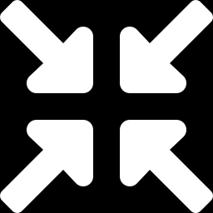
WEEK 02 · VARIATIONAL AUTOENCODERS (VAES)
Warm-up
Could you describe any face using just 32 numbers, and then redraw it from those numbers?
Which 32 properties would you choose? (age, hair length, smile, pose, lighting…)
Could you invent a new face by picking 32 new numbers?
What would go wrong if two very different faces got almost the same numbers, or if some combinations of numbers never appeared in your data?
Generative AI · MSc in Artificial Intelligence
5
Notes:
Give two minutes in pairs. Students will propose interpretable features such as age, pose, glasses and smile. Point out that this is exactly what an encoder does automatically, except that a neural network chooses the features, and they are usually not so interpretable. The second question leads to generation: if the numbers are a good description, choosing new numbers should give a new face. The third question previews the key problem of today: if some combinations of numbers were never seen in training, the decoder has no idea what to draw there. VAEs encourage a known sampling region; no loss guarantees every code gives a good image.

Slide 6
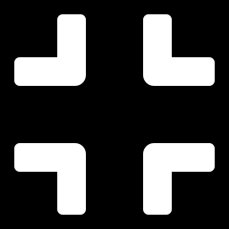
01
From autoencoders to VAEs
An autoencoder can compress and rebuild images. Why can random codes fail?
Notes:
Section one motivates the VAE. We start with the ordinary autoencoder, which students may have seen in a deep learning module: a network trained to reproduce its input through a narrow bottleneck. It is great at compression and denoising but poor at generation. We will see, using real models trained on handwritten digits, exactly why, and what change turns an autoencoder into a generative model. This section takes about twenty minutes.

Slide 7
WEEK 02 · VARIATIONAL AUTOENCODERS (VAES)
Train a VAE to rebuild digits
Learn a distribution of short codes and a decoder that turns codes into pixels.
Use updated encoder and decoder on the next batch.
image batch x
mu and logvar
latent code z
784 pixel logits
batch loss
Read digits
Encode
Sample a code
Decode pixels
Measure two
Update
distribution
costs
weights
28 × 28 pixels,
Predict mean
Centre + spread
Predict 784 pixel
Reconstruction +
Adam changes
values 0–1.
and log variance.
× noise.
logits.
β × KL.
both networks.
train_dl
VAE.encode
reparameterise
VAE.dec
vae_loss
train
mu, logvar for the KL cost
image x: the pixel targets
Input data
Model
Loss / update
data flow
feedback / repeat
Check: Does generating from a fresh prior code require an input digit?
Generative AI · MSc in Artificial Intelligence
7
Notes:
A variational autoencoder, or VAE, learns an encoder and a decoder. The encoder compresses an image into parameters of a distribution over a shorter hidden representation called a latent code. It produces two branches, mu and logvar, which describe the centre and spread; both branches meet at the sampling step. The decoder receives a sampled code and predicts pixel logits. Training compares those predictions with the original pixels using a reconstruction cost. A second cost, KL divergence, encourages each encoder distribution to stay close to the chosen prior, here a standard Gaussian. The β setting controls that pressure. Backpropagation computes how both costs depend on the weights, and Adam updates the encoder and decoder. To generate a new digit after training, bypass the encoder: draw a code from the prior and decode it. The lab displays sigmoid pixel probabilities rather than sampling individual binary pixels.
Worked example:
A batch of 128 digits has shape [128, 1, 28, 28]; flattening gives 784 values per image.
With zdim = 2, the encoder produces two means and two log-variances for each image.
A sampled two-number code becomes 784 decoder logits; the original image also enters the loss.
vae_loss adds reconstruction cost and a KL cost that compares the encoder distribution with N(0, I).
After training, torch.randn draws codes from the prior and VAE.decode displays new pixel probabilities.
Check: Does generating from a fresh prior code require an input digit?
Answer: No. The decoder can receive a code sampled from N(0, I) directly; reconstruction uses an input image and the encoder.

Slide 8
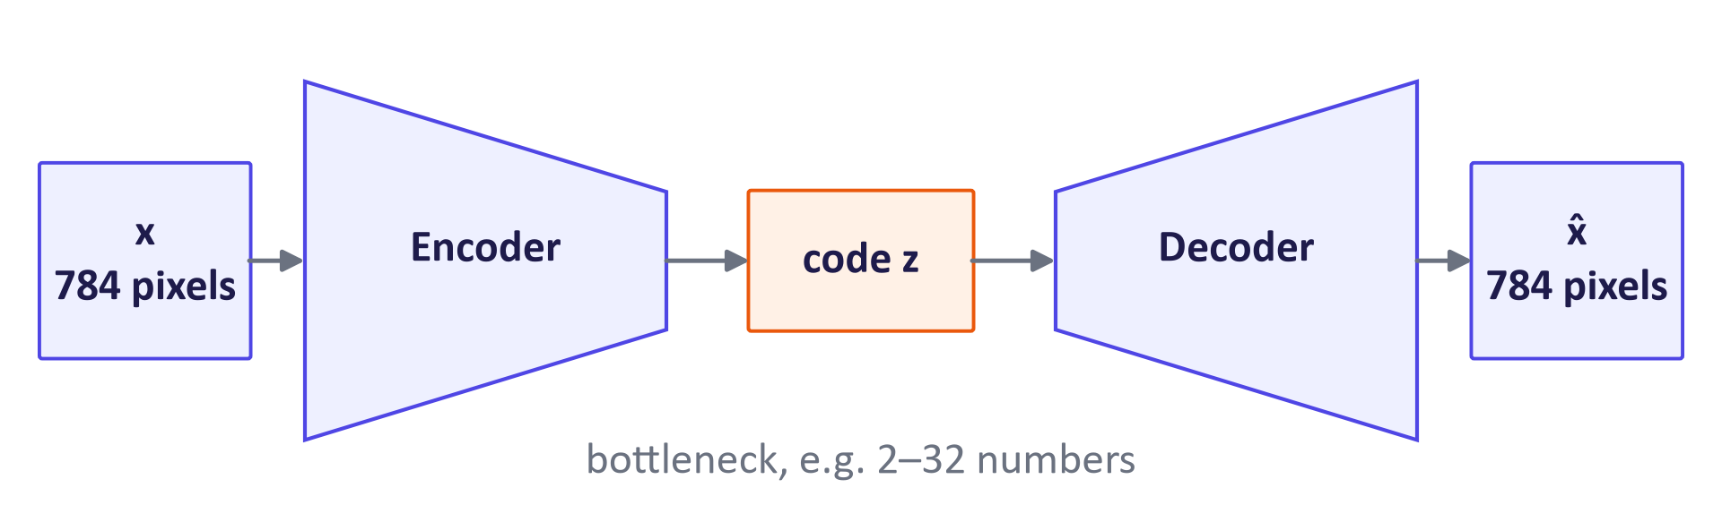
WEEK 02 · VARIATIONAL AUTOENCODERS (VAES)
An autoencoder: squeeze, then rebuild
Generative AI · MSc in Artificial Intelligence
8
Notes:
An autoencoder has two networks. The encoder maps a 784-pixel digit image to a code of perhaps two to thirty-two numbers; the decoder maps the code back to an image. Training minimises reconstruction error, so the code must keep the information needed to redraw the input. Because the bottleneck is narrow, the network is forced to learn structure rather than copy pixels. Autoencoders are useful for compression, removing noise, learning features for other tasks, and spotting unusual inputs that reconstruct badly. Ask: if the code were as large as the image, what would the autoencoder learn? Probably just to copy, which is useless.
Figure discussion prompts: Encoder: pixels → short code z. Decoder: code → reconstructed pixels. Train to reduce reconstruction error. Random-code generation needs extra structure.

Slide 9
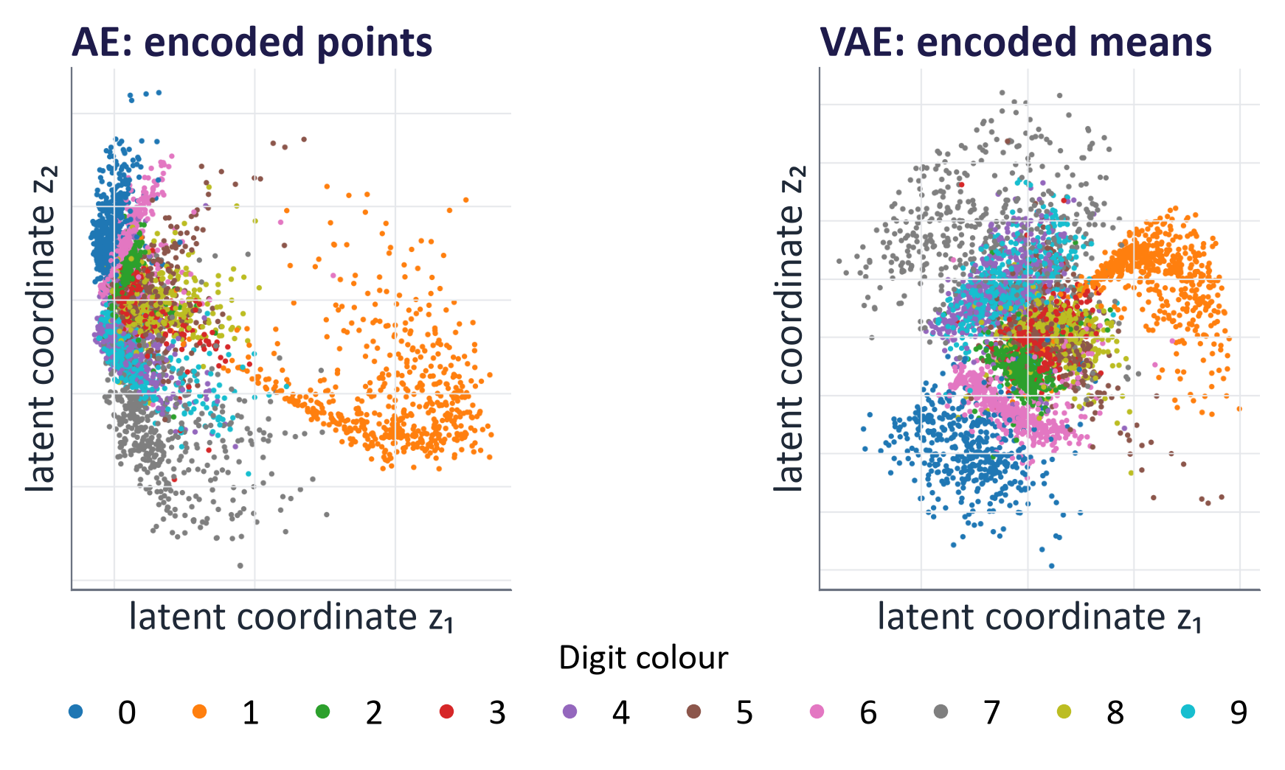
WEEK 02 · VARIATIONAL AUTOENCODERS (VAES)
The problem: an autoencoder's latent space has gaps
Real models trained on MNIST with a 2-D code. Each dot is a test image, coloured by digit.
Generative AI · MSc in Artificial Intelligence
9
Notes:
These are real results. Both models have a two-dimensional code so that we can plot it. On the left, the plain autoencoder places each digit class somewhere in the plane, but the clusters are irregular, stretched and separated by empty regions, and their scale is arbitrary. On the right, the VAE's codes are packed into a roughly circular region around zero, with classes touching each other. The VAE was told to keep its codes close to a standard Gaussian. Ask students: if you picked a random point in the left-hand plot, would you land on a digit? Often not.

Slide 10
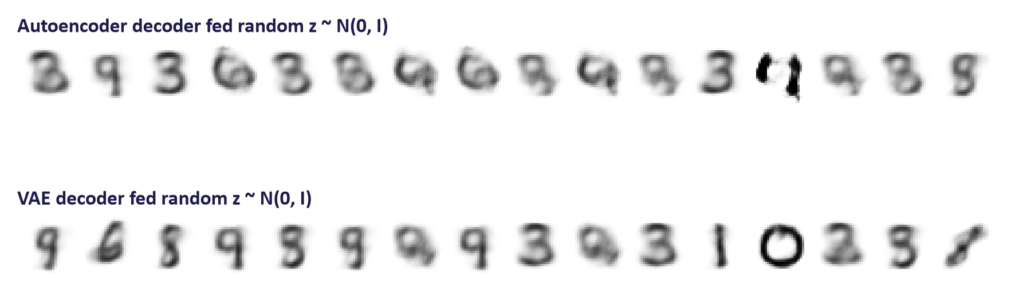
WEEK 02 · VARIATIONAL AUTOENCODERS (VAES)
Consequence: random codes decode to nonsense in an autoencoder
The same 16 random points z ~ N(0, I) decoded by each model.
Key idea: Prior codes must reach regions the decoder learned.
Generative AI · MSc in Artificial Intelligence
10
Notes:
The same random codes are decoded by both models. Ask students to count recognisable digits and identify a poor sample. Ordinary autoencoder training does not align codes with our Gaussian sampling rule. The VAE penalty encourages that alignment, making more random codes useful in this experiment. It does not guarantee a perfectly filled space or a realistic image at every possible code. Judge the measured samples rather than promising ideal behaviour.

Slide 11
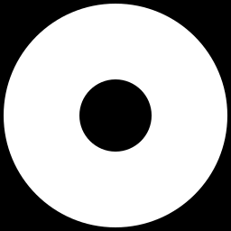

WEEK 02 · VARIATIONAL AUTOENCODERS (VAES)
Autoencoder vs. variational autoencoder
Autoencoder
Variational autoencoder
One exact code point per image.
Trained only to rebuild: reconstruction loss.
Codes can scatter, leaving gaps between groups.
Example: a random code in a gap decodes to a smudge.
A small cloud of codes per image (mean and spread).
Rebuild loss plus a KL penalty towards N(0, I).
Clouds overlap, so the space has fewer gaps.
Example: draw z from N(0, I), decode, get a digit.
Key idea: KL encourages useful codes. Inspect generation failures.
Generative AI · MSc in Artificial Intelligence
11
Notes:
This comparison is the one-slide summary of the section. Two changes turn an autoencoder into a VAE. First, the encoder outputs the mean and variance of a Gaussian instead of a single point, so each input maps to a small cloud of possible codes. Second, the loss adds a penalty, the KL divergence, that pulls every cloud towards a standard Gaussian prior. The KL penalty encourages overlap and prior-compatible codes. The decoder can still give poor outputs in some regions. The result is a proper probabilistic generative model with a principled training objective, which we derive next.

Slide 12

WEEK 02 · VARIATIONAL AUTOENCODERS (VAES)
Quick check
Why do random codes decode to nonsense in a plain autoencoder?
The decoder is too small to draw clear digits from any code it is given
The reconstruction loss compares the wrong pixels, so the decoder learns shifted images
A
B
Autoencoders cannot use more than two latent dimensions, too few to describe a digit
Training never makes the codes fill a known region, so random points fall in untrained gaps
C
D
Vote, then convince your neighbour (1 minute).
Generative AI · MSc in Artificial Intelligence
12
Notes:
Answer: D. The autoencoder is only trained to reconstruct training images, so it only ever sees codes produced by its encoder. Those codes can sit anywhere, at any scale, with gaps between clusters. A random point from a standard Gaussian often lands in a gap where the decoder's behaviour is undefined. A is wrong because the same decoder reconstructs real digits well. C is wrong: autoencoders can use any code size. B is a distractor. This answer sets up the KL term: it encourages code distributions towards a known prior, without guaranteeing complete coverage.

Slide 13
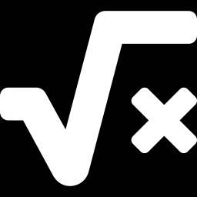
02
The VAE model and the ELBO
What exactly does a VAE maximise, and why a 'lower bound'?
Notes:
Section two is the mathematical core of the week. We write the VAE as a latent variable model, see why its likelihood cannot be computed directly, introduce the approximate posterior produced by the encoder, and derive the evidence lower bound. Then we read the bound term by term, compute the KL divergence for Gaussians with worked numbers, and connect the reconstruction term to familiar loss functions. Go slowly; students who follow this section will find diffusion models in week 4 much easier.

Slide 14
WEEK 02 · VARIATIONAL AUTOENCODERS (VAES)
The VAE as a probabilistic model
1
2
3
4
Prior
Decoder
Data
Encoder
Draw a code
Predict pixel distribution
Observe an image
Estimate useful codes
Generate with prior + decoder.
Train with encoder + decoder.
Generative AI · MSc in Artificial Intelligence
14
Notes:
Here is the probabilistic story. Nature, in our model, first draws a hidden code from a standard Gaussian, then the decoder turns it into an image. That is all we need to generate. To train, however, we need to know which codes are responsible for each real image, which is the posterior p of z given x. The true posterior is too difficult to calculate exactly, so we train a second network, the encoder, to approximate it. That is why it is called variational: variational inference approximates a hard distribution with a simpler, described by adjustable numbers one. Theta and phi are just the two networks' weights.

Slide 15
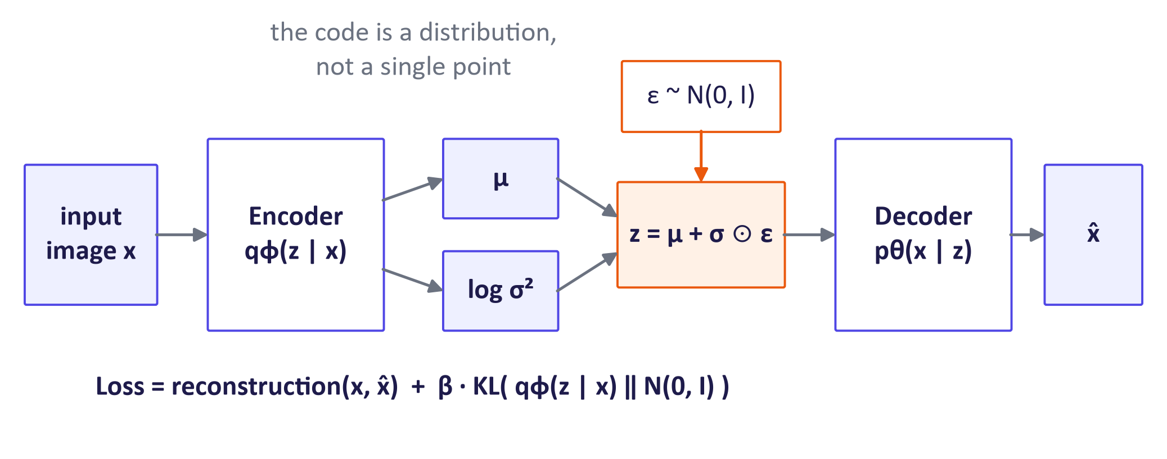
WEEK 02 · VARIATIONAL AUTOENCODERS (VAES)
VAE architecture in one picture
Generative AI · MSc in Artificial Intelligence
15
Notes:
Walk through the diagram from left to right. The encoder reads the image and outputs two vectors, the mean mu and the log-variance, one number per latent dimension. We use the log-variance because it can be any real number, while a variance must be positive. We then draw a code by adding scaled noise to the mean; this is the reparameterisation trick we meet in section three. The decoder turns the code into a reconstruction. The loss has two parts, written at the bottom: how well we rebuild the input, and how far each encoder distribution is from the prior. Students implement exactly this in the lab.

Slide 16
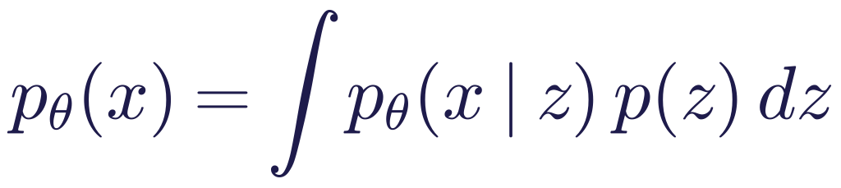
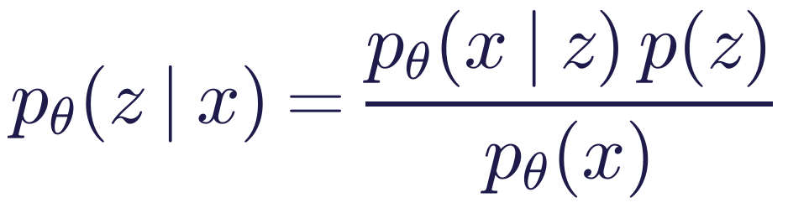
WEEK 02 · VARIATIONAL AUTOENCODERS (VAES)
Why we cannot maximise the likelihood directly
Read it as
Symbols
Combine predictions over possible codes.
The exact integral is difficult.
The encoder proposes a tractable approximation.
p(z)
prior over codes, N(0, I)
pθ(x | z)
decoder
pθ(z | x)
true posterior (too difficult to calculate exactly)
qφ(z | x)
encoder's approximation
Generative AI · MSc in Artificial Intelligence
16
Notes:
Last week we met the latent variable integral. For a VAE, the decoder is a neural network, so the integral over all codes has no formula, and estimating it by randomly sampling codes is hopelessly inefficient because almost all random codes explain a given image very poorly. Bayes' rule shows that the posterior has the same integral in the denominator. The variational idea is to stop trying to compute these exactly and instead introduce a flexible approximation, the encoder, and improve a quantity we can compute that is guaranteed to lie below the true log-likelihood.

Slide 17
WEEK 02 · VARIATIONAL AUTOENCODERS (VAES)
How the two VAE costs train the model
One image supplies both a reconstruction target and a code-distribution penalty.
Repeat with updated weights and the next batch.
batch-averaged
known x
sampled code z
784 pixel logits
loss
Read image batch
Encode and
Predict pixels
Update networks
sample
Add both costs
Known pixels are
Predict mu/logvar;
Decode to raw
Pixel cost + β × KL.
Backpropagate; step
targets.
draw z.
scores.
Adam.
train_dl
VAE.dec
vae_loss
train
VAE.forward
mu, logvar (KL cost)
known pixels x (target)
Input data
Model
Loss / update
data flow
feedback / repeat
Check: Does a low total loss by itself show why the model improved?
Generative AI · MSc in Artificial Intelligence
17
Notes:
The original image is the reconstruction target. The decoder produces raw pixel scores, called logits. Binary cross-entropy compares them with the known pixels. The other cost, KL, compares the encoder's code distribution with the chosen prior N(0, I). The vae_loss function adds reconstruction cost and β times KL, then averages over the batch. Backpropagation calculates how each learned number affected the loss. The optimiser changes both encoder and decoder weights. The code is sampled with the reparameterisation trick so reconstruction feedback can reach the encoder.
Worked example:
Suppose one image has reconstruction cost 120 and KL cost 3.
At β = 1, its combined cost is 123. At β = 4, it is 132.
For a batch, sum image costs and divide by the number of images.
The larger β increases pressure to match the prior, rather than changing the pixel target.
Check: Does a low total loss by itself show why the model improved?
Answer: No. Track reconstruction and KL separately to see which cost changed.

Slide 18
WEEK 02 · VARIATIONAL AUTOENCODERS (VAES)
The evidence lower bound (ELBO)
Read it as
Reconstruction: rebuild the known input.
KL: compare encoder distribution with prior.
Nonnegative posterior KL explains the lower-bound gap.
Generative AI · MSc in Artificial Intelligence
18
Notes:
This is the most important equation of the week. Evidence means p(x), the marginal likelihood. The ELBO is a lower bound on its logarithm, log p(x). The first term rewards good reconstructions of x from codes sampled from the encoder. The second term penalises encoder distributions that stray from the prior. The second line explains why it is a bound: the true log-likelihood equals the ELBO plus a KL divergence between the approximate and true posteriors, and KL divergences are never negative. Improving the ELBO improves our training bound. A particular joint update need not increase the exact likelihood or improve every posterior. We train by minimising the negative ELBO.

Slide 19
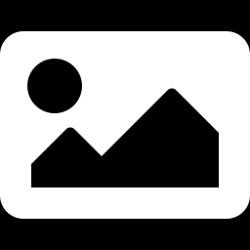
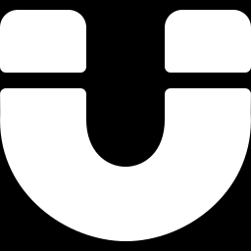
WEEK 02 · VARIATIONAL AUTOENCODERS (VAES)
Reading the ELBO: two forces in tension
Reconstruction term
KL term
Keep enough information in z to rebuild the image.
Lower when predicted pixels are closer to the real ones.
Alone, it pushes codes apart: sharp rebuilds, gappy space.
Pull each code cloud towards the prior N(0, I).
Lower when each cloud is centred near 0 with spread near 1.
Alone, it erases information: every image gets the same N(0, I) cloud.
Key idea: β weights KL; compare both costs.
Generative AI · MSc in Artificial Intelligence
19
Notes:
Present the two terms as forces pulling in opposite directions. The reconstruction term wants a precise, unique code for each image, which pushes variances towards zero and codes apart. The KL term wants every image's distribution to be the same standard Gaussian, which would destroy all information. The trained VAE is a compromise: codes carry enough information to reconstruct, but they overlap enough that the whole region is covered. This compromise is also why VAE samples tend to be slightly blurry: overlapping codes mean the decoder averages over similar images. We will see the effect of changing the balance with beta.

Slide 20
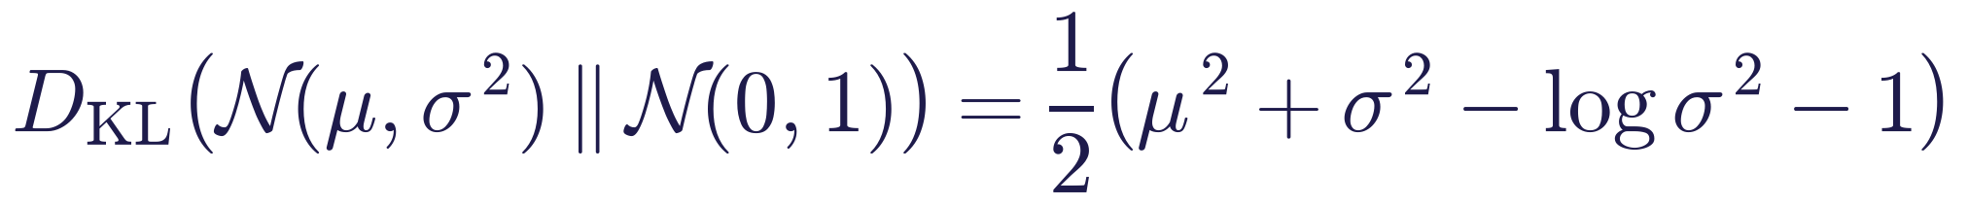
WEEK 02 · VARIATIONAL AUTOENCODERS (VAES)
KL divergence between two Gaussians has a closed form
Read it as
Symbols
Compute one cost per latent coordinate; add.
Mean 0, standard deviation 1 gives KL = 0.
logvar is log variance, not spread.
μ
encoder mean for one latent dimension
σ²
encoder variance
log σ²
what the network actually outputs
Generative AI · MSc in Artificial Intelligence
20
Notes:
KL divergence measures how different one distribution is from another; it is zero only when they are identical and it is not symmetric. For two Gaussians it has a formula, which is one reason VAEs use Gaussian encoders and priors: no sampling is needed for this term. Point out each part. Mu squared penalises codes whose mean is far from zero. Sigma squared minus log sigma squared minus one is zero at sigma equal to one and grows when the spread is either too small or too large. Show how the formula becomes the one line of PyTorch that students write in the lab.

Slide 21
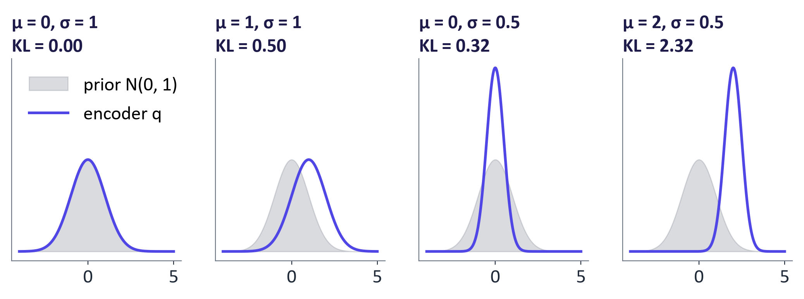
WEEK 02 · VARIATIONAL AUTOENCODERS (VAES)
Worked examples: how far is the encoder from the prior?
Generative AI · MSc in Artificial Intelligence
21
Notes:
Work these on the board. With mean zero and standard deviation one, the encoder equals the prior and the KL is zero. Shifting the mean to one costs half a nat. Shrinking the standard deviation to one half costs 0.32 nats, because the log of 0.25 is minus 1.39. Both together, a confident code far from zero, costs 2.32 nats. In a trained VAE each latent dimension pays a cost like this, and the total KL printed during training, typically a few nats per image for a small latent space, is the sum over dimensions averaged over images.
Figure discussion prompts: μ = 1, σ = 1: KL = 0.50. μ = 0, σ = 0.5: KL ≈ 0.32. μ = 2, σ = 0.5: KL ≈ 2.32.

Slide 22
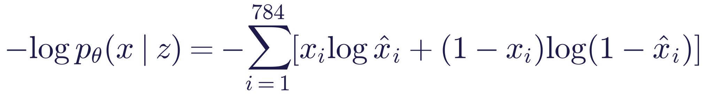
WEEK 02 · VARIATIONAL AUTOENCODERS (VAES)
The reconstruction term in practice
Read it as
Symbols
Sum pixel cross-entropy over the image.
Binary targets give a Bernoulli likelihood.
Greyscale targets use a conventional soft-target surrogate.
xᵢ
true intensity of pixel i
x̂ᵢ
decoder's predicted probability for pixel i
784
28 × 28 pixels
Generative AI · MSc in Artificial Intelligence
22
Notes:
The reconstruction term is just a familiar loss function once we choose the decoder's output distribution. For binary pixels a Bernoulli likelihood gives binary cross-entropy. The greyscale MNIST lab uses soft targets as a conventional surrogate, summed over pixels. For colour photographs a Gaussian decoder is common, giving squared error. The expectation over the encoder's distribution is estimated with a single sampled code per image in each training step; the noise averages out over many steps. Important implementation detail: sum over pixels rather than averaging, otherwise the KL term dominates and samples become very blurry.

Slide 23
WEEK 02 · VARIATIONAL AUTOENCODERS (VAES)
Quick check
Which loss term encourages encoder distributions towards the prior?
The KL divergence to the prior N(0, I)
The reconstruction (binary cross-entropy) term
A
B
The Adam optimiser's learning rate
The size of the decoder's hidden layer
C
D
Vote, then convince your neighbour (1 minute).
Generative AI · MSc in Artificial Intelligence
23
Notes:
Answer: A. KL pulls encoder code distributions towards the shared Gaussian prior. This encourages overlap and helps prior sampling. It does not guarantee there are no poorly learned regions. Reconstruction is the other pressure: keep enough input information to rebuild the image. Ask students to predict what happens when beta becomes very large, then compare the later measured results.

Slide 24
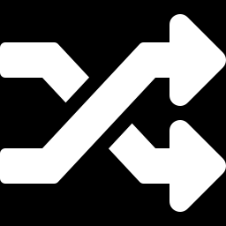
03
Training: the reparameterisation trick
How do we backpropagate through a random sample?
Notes:
Welcome back from the break. We know what to maximise; now we need to train it with gradient descent. The obstacle is that the loss depends on a random sample of the code, and you cannot differentiate a random draw. The reparameterisation trick removes that obstacle with one line of algebra. After that we look at the complete PyTorch model in about twenty lines, and at practical training details, including how to monitor the two loss terms and a failure mode called posterior collapse.

Slide 25
WEEK 02 · VARIATIONAL AUTOENCODERS (VAES)
Sample a latent code while training
Random noise enters from outside; the encoder learns only the centre and spread.
Gradients flow back through z to mu and std; the noise needs none.
mu and logvar
noise ε
sampled code z
Encode one
Find the spread
Draw noise
Decode and
image
Shift and scale
compare
std = exp(0.5 ×
ε from N(0, 1);
z = mu + std × ε.
Pixel cost depends
Get mu and logvar.
logvar).
nothing learned.
on z.
VAE.encode
reparameterise
torch.randn_like
reparameterise
VAE.forward
mu and std (learned)
Input data
Model
Loss / update
data flow
feedback / repeat
Check: If logvar is zero, is the standard deviation zero or one?
Generative AI · MSc in Artificial Intelligence
25
Notes:
The encoder predicts a distribution, so repeated passes can produce different latent codes for the same image. Reparameterisation expresses this sampling as three understandable parts: learn a centre, learn a spread, and draw independent noise. In this lab, logvar means the logarithm of the variance, not the variance itself. Converting it to a standard deviation uses exp(0.5 × logvar), which is always positive. Standard-normal noise has centre zero and standard deviation one. Scaling that noise by the predicted standard deviation and adding mu gives a sample from the encoder's Gaussian. The random draw does not depend on learned weights, while the shift and scale do. This allows the reconstruction cost to supply gradients to both encoder branches through the sampled code. The KL cost takes a separate path directly from mu and logvar. Neither path requires the latent dimensions to have predefined digit labels.
Worked example:
For one latent coordinate, suppose mu = 1 and logvar = 0, so standard deviation = 1.
With a drawn noise value ε = −0.5, the sampled code coordinate is 0.5.
With the same encoder output and ε = 0.5, that coordinate would instead be 1.5.
The decoder uses the sampled code; the KL term uses mu and logvar directly.
Check: If logvar is zero, is the standard deviation zero or one?
Answer: One: exp(0.5 × 0) = 1. A zero log-variance still describes a distribution with spread.

Slide 26
WEEK 02 · VARIATIONAL AUTOENCODERS (VAES)
The reparameterisation trick
Read it as
Symbols
Draw independent Gaussian noise ε.
Compute centre + spread × noise.
Gradients reach learned centre and spread.
ε
standard Gaussian noise
⊙
element-wise product
σ
exp(½ · log σ²)
Generative AI · MSc in Artificial Intelligence
26
Notes:
The trick rewrites a sample from a Gaussian with mean mu and standard deviation sigma as mu plus sigma times standard noise. Mathematically the distribution of z is identical. Computationally, the difference is decisive: the random part epsilon no longer depends on the network's parameters, so z is an ordinary function of mu and sigma and we can backpropagate through it. Kingma and Welling introduced this in the original 2013 VAE paper. The same idea, writing a noisy variable as a clean one plus scaled noise, is central to diffusion models in week 4, so it is worth making sure everyone understands it now.

Slide 27
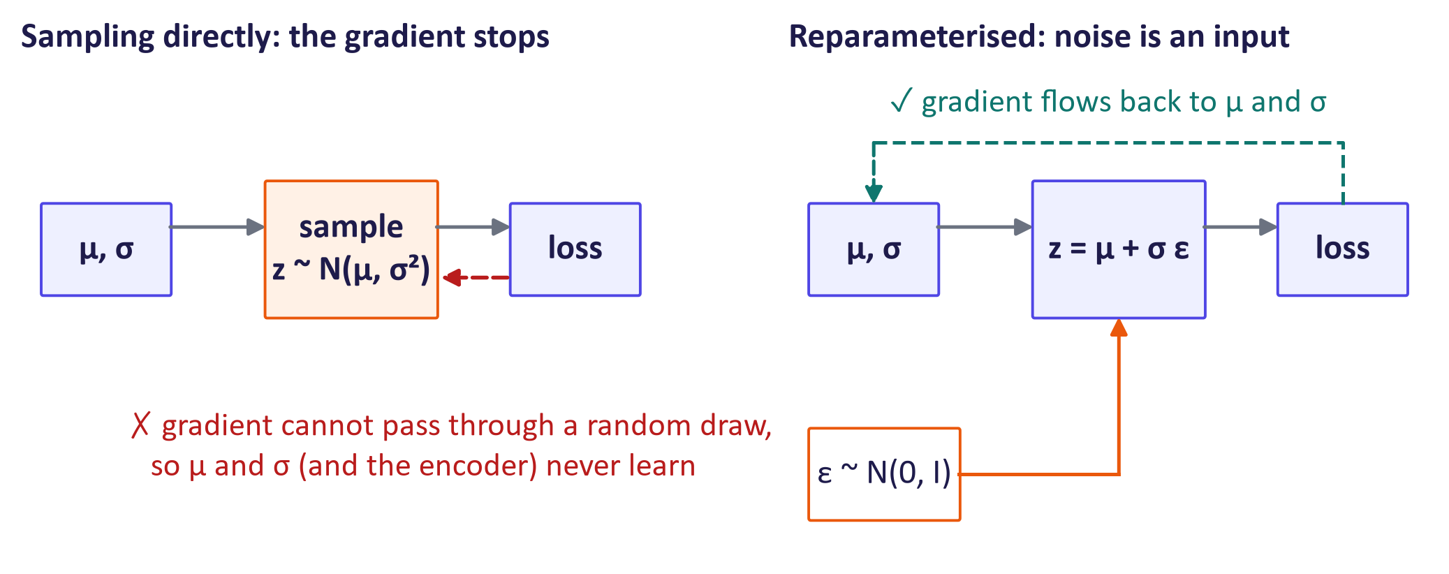
WEEK 02 · VARIATIONAL AUTOENCODERS (VAES)
Why the trick matters for backpropagation
Generative AI · MSc in Artificial Intelligence
27
Notes:
The left diagram shows the problem: a sampling node sits between the encoder's outputs and the loss, and a direct PyTorch sample() draw disconnects the pathwise autograd route. Reconstruction gradients then do not reach the encoder through that sample. The right diagram shows the fix: the noise is drawn outside the network and combined with mu and sigma by multiplication and addition, which are differentiable. Gradients now flow back to mu and sigma and into the encoder weights. An alternative, the score-function or REINFORCE estimator, can handle non-differentiable sampling but has much higher variance, which is why the reparameterisation trick made VAEs practical.

Slide 28
WEEK 02 · VARIATIONAL AUTOENCODERS (VAES)
A complete VAE in PyTorch
class VAE(nn.Module):
# Layers are created in __init__ (see the lab).
def encode(self, x):
h = self.enc(x)
return self.mu_head(h), self.logvar_head(h)
def reparameterise(self, mu, logvar):
std = torch.exp(0.5 * logvar)
eps = torch.randn_like(std)
return mu + std * eps
def forward(self, x):
mu, logvar = self.encode(x)
z = self.reparameterise(mu, logvar)
return self.dec(z), mu, logvar
encode: image → mu, logvar.
reparameterise: mu + std × noise → z.
forward: z → 784 pixel logits.
vae_loss (in the lab): pixel cost + β × KL.
Generative AI · MSc in Artificial Intelligence
28
Notes:
This projected fragment shows the three methods used in training; the layer definitions, decode and the loss are in the lab and the teaching notes. Walk through one tensor at a time. The enc layers produce features. The mu_head and logvar_head layers describe a Gaussian for each input. The expression exp(0.5 * logvar) converts log-variance into standard deviation. Fresh independent noise produces z, and dec gives pixel logits. Analogy: the two heads write the centre and spread of a cloud, and eps chooses a point within it. Ask: why do we halve logvar before exponentiating? Answer: we need standard deviation, not variance. Common mistake: treating pixel logits as probabilities; apply sigmoid when displaying decoded samples. Reconstruction and KL are computed by the separate vae_loss function.

Slide 29
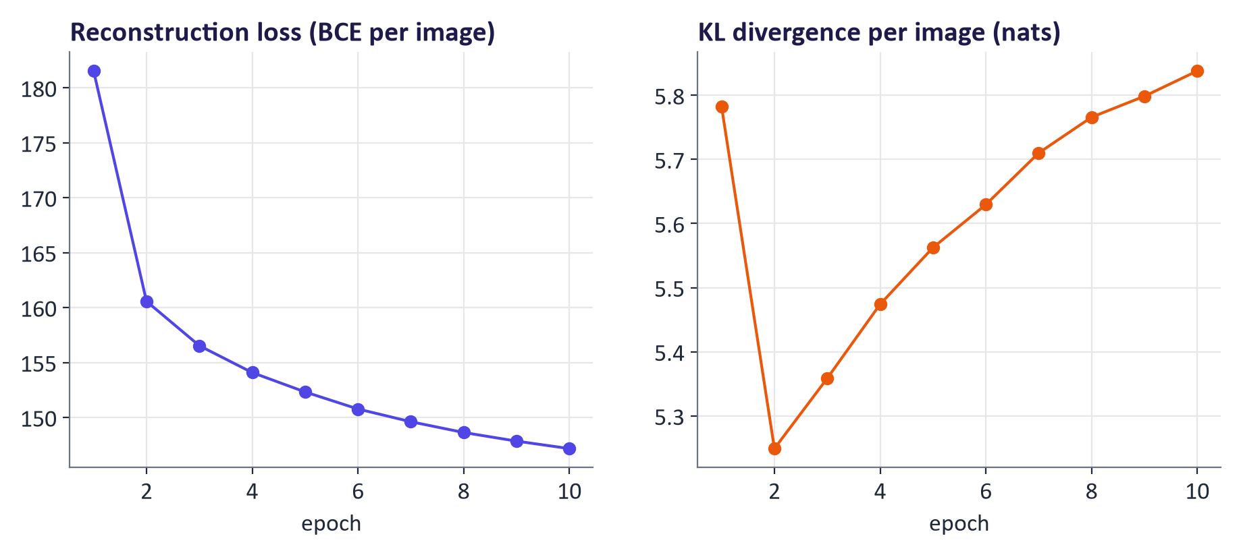
WEEK 02 · VARIATIONAL AUTOENCODERS (VAES)
Training in practice: watch both terms
Generative AI · MSc in Artificial Intelligence
29
Notes:
These curves come from the model that produced today's figures. Always log the two terms separately, never just the total. Reconstruction error falls quickly. In this run the KL term dips after the first epoch, as the encoder first pulls its codes towards the prior, and then rises steadily: as the model learns to use the code, each image's distribution moves away from the prior to carry more information. Both terms are still changing at epoch ten, which is normal for a short run. Persistently small KL can signal posterior collapse; inspect whether the decoder uses the code, a common problem with powerful autoregressive decoders. Remedies include gradually increasing beta from zero, called warm-up, or free bits, which removes the loss incentive to reduce KL further below a chosen allowance. Free bits does not guarantee the actual KL reaches that allowance.
Ask: why plot reconstruction and KL separately? Their sum can hide a change in latent use. Common mistake: diagnosing collapse from one low-KL observation without testing the decoder.
Figure discussion prompts: Track reconstruction and KL separately. Near-zero KL may indicate ignored codes. Try KL warm-up, free bits or a smaller decoder. Check samples as well as losses.

Slide 30

04
Exploring and evaluating the latent space
What has the model learned, and how do we measure it?
Notes:
Section four is visual. We look at reconstructions, decode a whole grid of latent points, interpolate between digits, and change beta to see the trade-off between sharpness and a well-behaved latent space. All images are from real models trained for these slides with the same code students use in the lab. Then we discuss how to evaluate a VAE properly, because pretty pictures are not enough evidence for a report or a project.

Slide 31
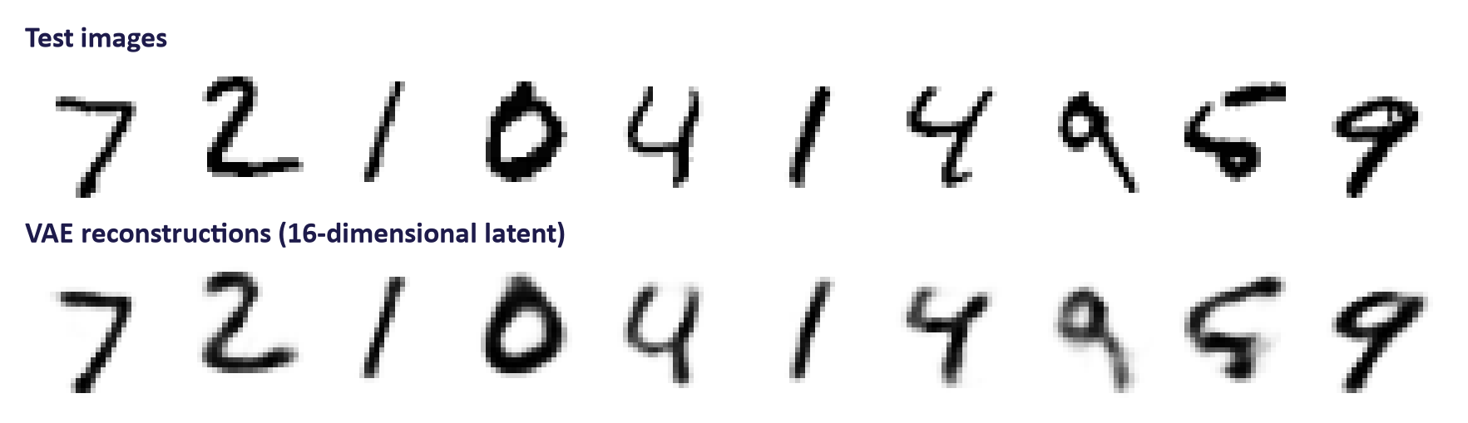
WEEK 02 · VARIATIONAL AUTOENCODERS (VAES)
Reconstructions: good, but a little blurry
Key idea: Basic VAEs often blur uncertain details. Pixel losses can reward average-looking pixels.
Generative AI · MSc in Artificial Intelligence
31
Notes:
The top row shows test images the model never saw during training; the bottom row shows the VAE's reconstructions from a sixteen-dimensional code. The digits are clearly recognisable, but edges are softer. Ask students why. Two reasons: the KL term forces overlapping codes, so a code is compatible with several slightly different images and the decoder outputs their average; and pixel-wise losses reward predicting the average intensity when uncertain, which looks blurry. GANs, next week, attack exactly this weakness, at the price of harder training. Diffusion models use a fixed noise-prediction target and can produce detailed samples, but optimisation and coverage still need testing.

Slide 32
WEEK 02 · VARIATIONAL AUTOENCODERS (VAES)
Generate a digit without an input image
Random codes come from the prior. Only the trained decoder is needed.
latent size
code z
784 logits
pixel intensities
Set code size
Draw random
Run decoder
Display pixels
Inspect samples
code
Match the trained
Sample the standard
Fixed weights predict
Sigmoid; reshape to
Check realism and
latent size.
prior.
logits.
28 × 28.
variety.
vae16
torch.randn
VAE.dec
VAE.decode
z_fixed
Input data
Model
Output
data flow
Check: Must the encoder run to generate a fresh prior sample?
Generative AI · MSc in Artificial Intelligence
32
Notes:
Generation differs from reconstruction. A reconstruction begins with an image and uses the encoder. A new sample starts with a code drawn from the prior, so no image or encoder is needed. The trained decoder turns that code into 784 pixel logits. VAE.decode applies sigmoid to put display intensities between zero and one, then reshapes them into a 28 by 28 image. In this lab we display the predicted pixel probabilities. We do not separately draw every pixel from a Bernoulli distribution. Keep fixed codes when comparing trained models.
Worked example:
For the two-dimensional model, a code might be [0.2, −0.7].
The decoder maps those two numbers to 784 raw pixel scores.
Sigmoid maps a score of 0 to intensity 0.5. The grid then displays the digit.
A different random code can give a different digit. Poor codes may still give poor samples.
Check: Must the encoder run to generate a fresh prior sample?
Answer: No. Use a prior code and the trained decoder. The encoder is needed when mapping an existing image to a code.

Slide 33
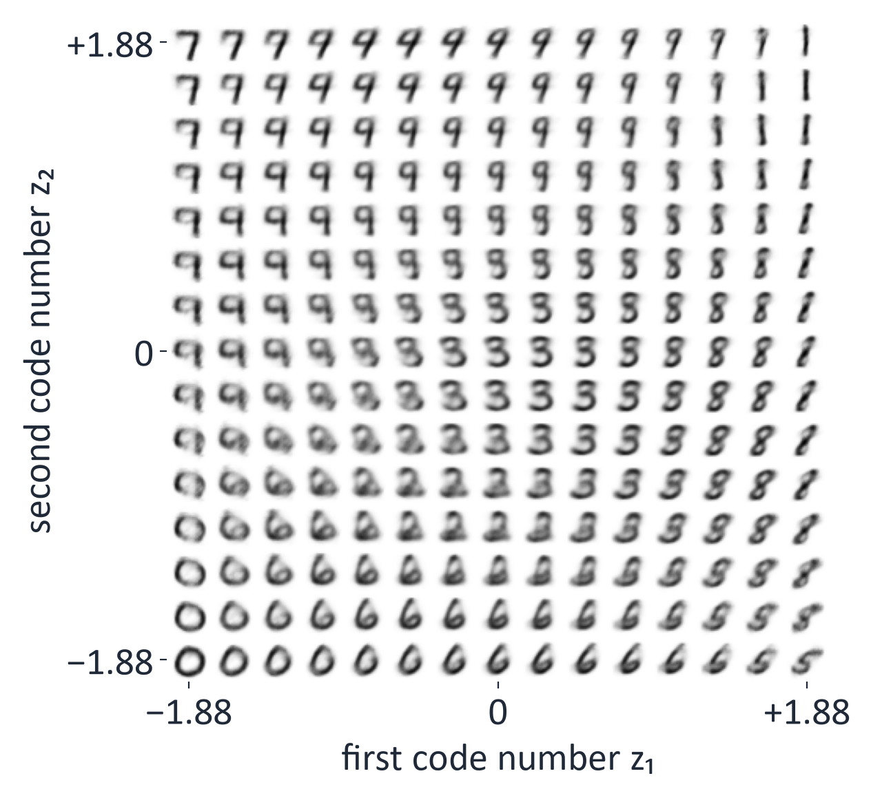
WEEK 02 · VARIATIONAL AUTOENCODERS (VAES)
Decoding a grid of latent points: a map of the learned space
Each cell is the decoder's drawing of one code (z₁, z₂).
15 × 15 codes cover the middle 94% of N(0, 1) on each axis.
Neighbours change gradually: the bottom row turns 0 into 6, then 5.
Some cells blend two digits, such as 9 and 3.
Generative AI · MSc in Artificial Intelligence
33
Notes:
Read one grid row slowly. Each cell decodes a different two-number code; the axes show the code values, from −1.88 to +1.88, which are the 3rd and 97th percentiles of the standard normal prior. Nearby cells often share strokes and change gradually: the bottom row turns a 0 into a 6 and then a 5, and the top row turns a 7 into a 9 and then a 1. Many points in this measured grid look digit-like, but some cells blend two digits, because two numbers are a very small summary of an image. This is evidence about the trained model, rather than proof that every code is realistic. In higher dimensions a grid is difficult to draw, so interpolate between two chosen codes and inspect the resulting sequence.
Figure discussion prompts: Each cell decodes one 2-D code. Compare neighbouring cells. Inspect unclear or malformed digits. A useful grid is no universal guarantee.

Slide 34
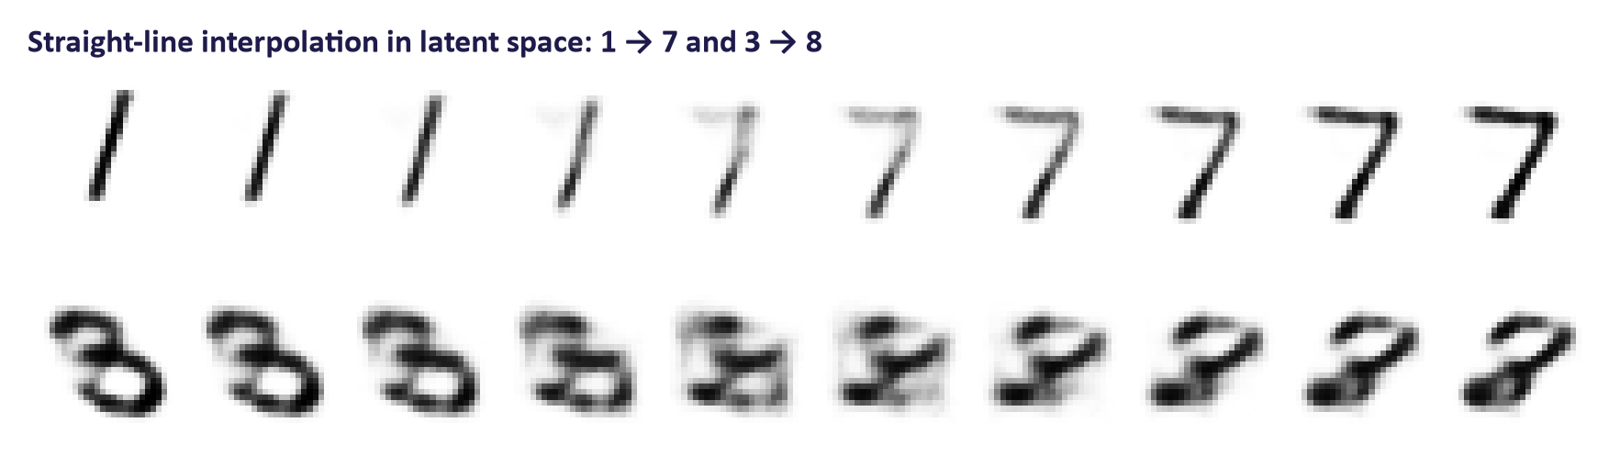
WEEK 02 · VARIATIONAL AUTOENCODERS (VAES)
Interpolation: walk in a straight line through latent space
Each row decodes 10 evenly spaced codes on the straight line between two test digits.
Top row: the 1 gains a bar and turns smoothly into a 7.
Bottom row: the middle of 3 → 8 is smudged, and the decoded 8 itself is unclear.
Generative AI · MSc in Artificial Intelligence
34
Notes:
Interpolation is the main tool for exploring higher-dimensional latent spaces. Encode two test images to their means, draw a straight line between them, and decode points along it. A latent path can show gradual changes, but intermediate images may be unclear or malformed: in this measured run the 1 to 7 path is smooth, while the 3 to 8 path passes through smudged shapes and even its 8 end point decodes poorly. Show both kinds of path in a report. Compare the observed path with pixel blending. Mention spherical interpolation: in high dimensions, samples from a Gaussian concentrate near a sphere, and the straight line between two such points passes through the lower-norm interior, so walking along the sphere often gives better images. Students implement interpolation in the lab as a TODO.
Figure discussion prompts: Encode two images as means z1 and z2. Decode (1 − t)z1 + t z2. At t = 0.5, use their midpoint. Inspect intermediate images.

Slide 35
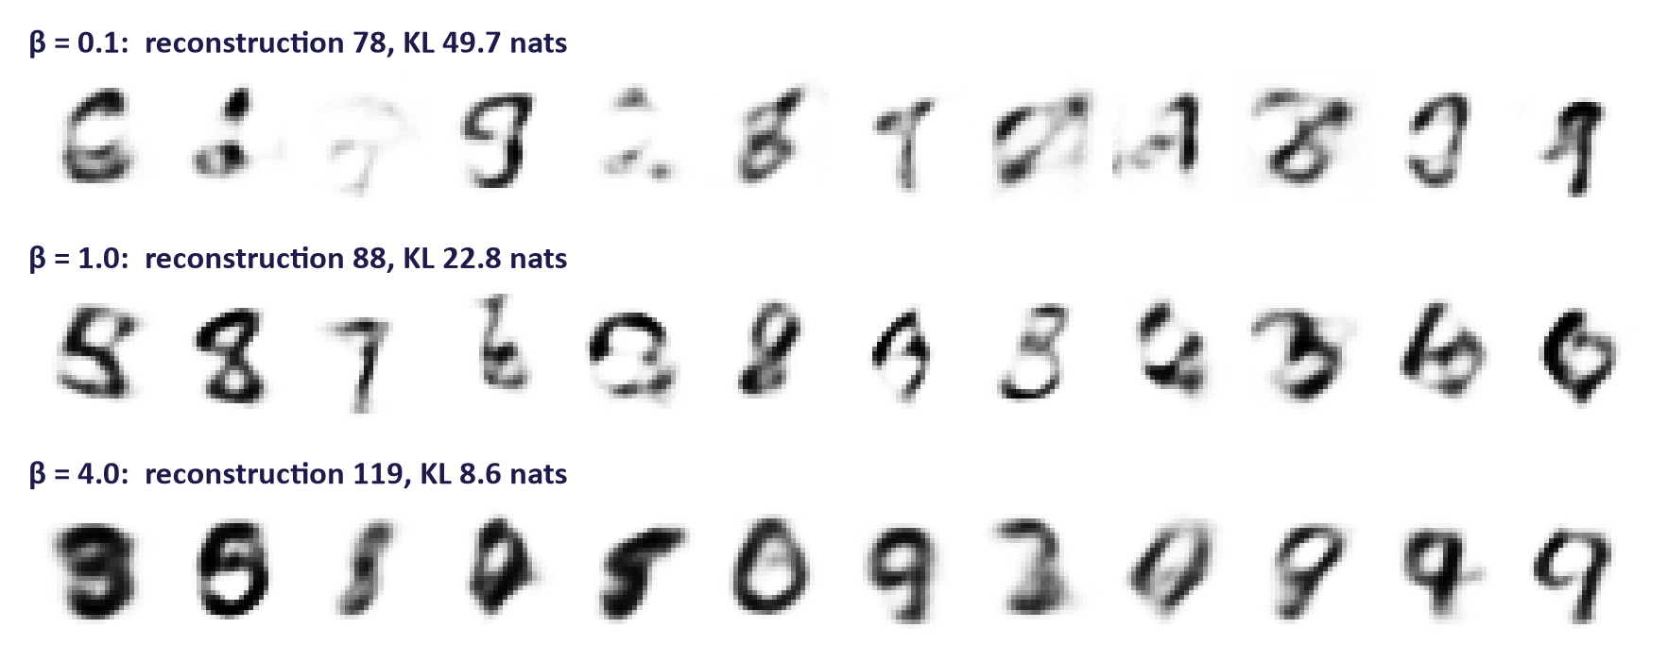
WEEK 02 · VARIATIONAL AUTOENCODERS (VAES)
β changes the balance between sharpness and structure
Generative AI · MSc in Artificial Intelligence
35
Notes:
Beta multiplies the KL term. With a small beta the model behaves more like an autoencoder: reconstructions are good but the aggregate distribution of codes does not match the prior, so sampling from the prior gives more broken digits. With a large beta the codes are forced very close to the prior; samples are well formed but blurrier and less varied, and reconstructions lose detail. Beta equal to one corresponds to the true ELBO. The numbers in each title are the measured reconstruction and KL terms. Beta-VAE, with beta larger than one, is also used to encourage disentangled latent dimensions. This is the rate-distortion trade-off: the KL is the rate, how many nats the code carries, and reconstruction error is the distortion; every nat saved costs detail.
Figure discussion prompts: Beta multiplies the KL term. Lower beta often improves reconstruction. Higher beta pressures codes towards the prior. Inspect prior samples and both costs.

Slide 36
WEEK 02 · VARIATIONAL AUTOENCODERS (VAES)
How to evaluate a VAE
What we check | How to measure it | Watch out for
Fit to new data | Negative ELBO on held-out images | It is a bound; compare models with the same pixel likelihood
Reconstruction | Pixel error (BCE or MSE) on test images | Good rebuilds do not prove good new samples
New samples | FID score plus people rating images | FID depends on its feature network; show the samples too
The codes | Interpolation paths and traversals | Show failures, not only the best paths
A real task | For example, anomaly ROC AUC | Test on realistic anomalies, not just easy ones
Generative AI · MSc in Artificial Intelligence
36
Notes:
A VAE is evaluated on several axes because no single number captures everything. The held-out negative ELBO is the principled measure of fit, but it is a bound, so comparisons are only fair across models with the same decoder likelihood. Reconstruction error and pictures show closeness to real examples. Sample quality needs a metric such as the Fréchet Inception Distance, which we define next week, or careful human evaluation. Latent-space quality is usually shown with traversals. Finally, if the VAE serves a task, measure the task. In the project, students must report at least one quantitative and one human-centred evaluation, which links to MIMLO 4.

Slide 37
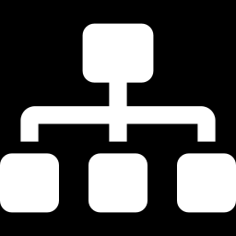
05
Variants and applications
Where are VAEs used in 2026?
Notes:
Section five looks beyond the basic model. Pure VAEs are rarely the image generator of choice today, because diffusion models produce sharper samples. But VAE ideas are everywhere: conditional generation, disentanglement, discrete image tokens with VQ-VAE, and most importantly the autoencoder that compresses images inside latent diffusion models such as Stable Diffusion and FLUX. We finish with applications and a responsible AI lens before the lab preview.

Slide 38
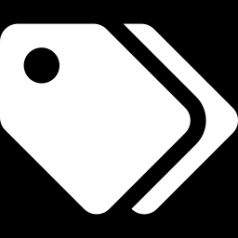
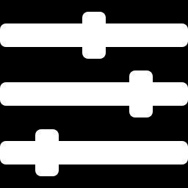
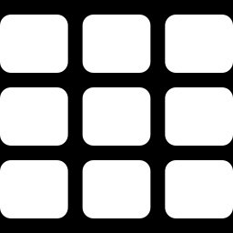
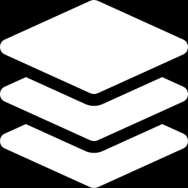
WEEK 02 · VARIATIONAL AUTOENCODERS (VAES)
Important VAE variants
Conditional VAE
β-VAE
Give both networks a label, such as “7”; then ask the decoder for a 7.
Set β above 1 so each code number tends to hold one factor, such as slant. Test it.
VQ-VAE
Hierarchical VAEs
Snap each code to the nearest entry of a learned codebook, so an image becomes a grid of tokens.
Stack several code levels, from overall layout to fine detail (for example NVAE).
Generative AI · MSc in Artificial Intelligence
38
Notes:
Four variants students should know by name. A conditional VAE feeds a label or other condition into both networks, so you can ask for a specific digit or attribute; students can try this as a lab extension. Beta-VAE uses beta greater than one to encourage each latent dimension to capture one factor of variation, useful for interpretability. VQ-VAE replaces the continuous Gaussian code with the nearest entry in a learned codebook, so an image becomes a grid of discrete tokens; this idea underlies image tokenizers used by autoregressive and multimodal models, and audio codecs. Hierarchical VAEs stack several latent layers and close much of the quality gap.

Slide 39
WEEK 02 · VARIATIONAL AUTOENCODERS (VAES)
Where you meet VAEs every day: inside latent diffusion
1
2
3
4
Random latent
Diffusion model
VAE decoder
Image
64 × 64 × 4 noise
Removes noise step by step, guided by the prompt
Turns the latent into pixels
512 × 512 × 3
The latent holds 48 times fewer numbers than the image.
The VAE encoder is used in training and for editing an existing photo.
Generative AI · MSc in Artificial Intelligence
39
Notes:
This is the most important modern application. Diffusion directly in pixel space is expensive for large images. Latent diffusion, introduced by Rombach and colleagues in 2022 and used in Stable Diffusion, first trains an autoencoder that compresses a 512 by 512 colour image into a 64 by 64 grid with four channels, forty-eight times fewer numbers, and then runs the diffusion process in that latent space. Read the flow from left to right as text-to-image generation: it starts from random noise in the small latent space, the diffusion model removes the noise step by step while following the prompt, and the VAE decoder turns the final latent into a full image. The encoder is not used in that path. It is used during training, to turn every training photo into a latent, and in image-to-image editing, where an existing picture is encoded first. These autoencoders use only a small KL penalty and add perceptual and adversarial losses so that reconstructions are sharp. Next week's GAN ideas therefore also reappear here.

Slide 40


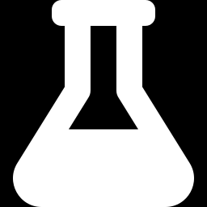
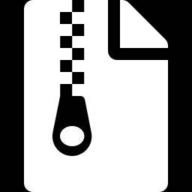
WEEK 02 · VARIATIONAL AUTOENCODERS (VAES)
Applications of VAEs
Anomaly detection
Synthetic data
Flag inputs that rebuild badly, such as a scratched part on a production line.
Sample extra training records for rare cases; check that no real record is copied.
Molecule and design search
Compression & tokens
Move through the code space towards better predicted properties, then decode new candidates.
Store images or audio as short codes, such as the image tokens used by multimodal models.
Generative AI · MSc in Artificial Intelligence
40
Notes:
Beyond latent diffusion, VAEs are used for anomaly detection in manufacturing, cybersecurity and medicine, because unusual inputs reconstruct poorly. They generate synthetic data to augment small datasets, although synthetic data can leak information about real records. In drug discovery, molecules are encoded into a continuous space where optimisation is easier, then decoded. Learned compression for images, audio and video relies on autoencoder ideas, and VQ-style codes turn images and sounds into tokens for multimodal transformers, which we meet in weeks 9 and 10.

Slide 41
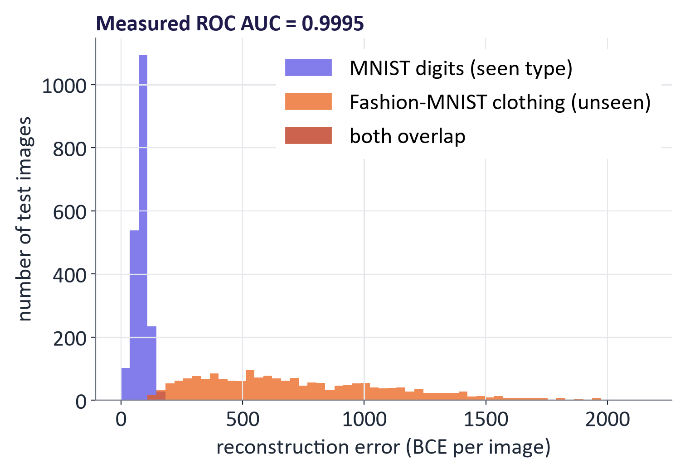
WEEK 02 · VARIATIONAL AUTOENCODERS (VAES)
Application demo: detecting unusual inputs
Trained only on digits; tested on new digits and on clothing.
Clothing rebuilds badly, so a high error means “unusual”.
A random clothing image scores higher than a random digit 99.95% of the time.
Easy test: real defects can look almost normal.
Generative AI · MSc in Artificial Intelligence
41
Notes:
This is a real result, and students reproduce it in the lab. We trained the VAE only on handwritten digits, then measured reconstruction error on 2,000 unseen digits and 2,000 clothing images from Fashion-MNIST. The two histograms barely overlap and the ROC area under the curve, shown in the title, is close to one: a randomly chosen clothing image has a higher error than a randomly chosen digit 99.95% of the time, so reconstruction error is an excellent anomaly score here. The small dark bars near an error of 150 are bins where both histograms overlap. Stress the limitation: clothing versus digits is an easy, artificial anomaly. A defect on a circuit board or an unusual heart rhythm is much subtler, and some anomalies can even reconstruct well. Evaluation must use realistic anomalies.
Figure discussion prompts: Train on digits. Test on unseen digits and on Fashion-MNIST clothing images. In this experiment, clothing tends to have higher reconstruction error. Choose and test a threshold. Real defects can be much harder to distinguish.

Slide 42

WEEK 02 · VARIATIONAL AUTOENCODERS (VAES)
Responsible AI lens: VAEs and synthetic data
Synthetic data may leak records.
Ask “normal for whom?” in anomaly detection.
Check consent, lawful basis and licences.
Show typical outputs and failures.
Generative AI · MSc in Artificial Intelligence
42
Notes:
Each week has a responsible AI lens tied to the model family. For VAEs, synthetic data is the headline risk: people often assume generated data is automatically anonymous, but models can memorise rare training examples. Anomaly detection raises fairness questions: if the training data under-represents a group, their normal inputs look anomalous, for example in fraud or medical screening. Data rights matter as soon as students move from MNIST to faces or health data. Finally, report honestly: carefully selected best interpolations are a common form of overclaiming, which the project marking scheme penalises.

Slide 43
WEEK 02 · VARIATIONAL AUTOENCODERS (VAES)
Build, train, then explore the VAE
Use reconstruction, generation, and anomaly tests for different questions.
normalised image
checked model
samples and latent
per-image
batches
and loss
trained VAE
paths
anomaly scores
Build and
Train and
Test unusual
Prepare digits
check
monitor
Explore codes
Compare β
inputs
Inspect shapes
Check tensors
Record
Plot means;
Keep sample
Rank clothing
and intensities.
and initial loss.
reconstruction
decode paths.
codes fixed.
against digits.
train_dl
and KL.
vae2 / vae16
results / z_fixed
VAE / vae_loss
train / hist
recon_error / auc
Input data
Model
Output
data flow
Check: Why does the β experiment reuse z_fixed instead of drawing new codes for each row?
Generative AI · MSc in Artificial Intelligence
43
Notes:
The lab separates several uses of the same model. First, a quick forward pass checks that the model produces the expected tensor shapes and sensible initial losses. Training then changes weights while recording reconstruction and KL costs separately. The two-dimensional VAE makes a map possible: each plotted point is an encoder mean for one test image. Labels only colour this map; the ordinary VAE learns without them. A sixteen-dimensional model supports interpolation and new generation. Interpolation joins two encoded means, while prior sampling chooses new codes without an input image. The β experiment trains separate models and decodes the same fixed codes, allowing a more useful visual comparison. Finally, reconstruction error becomes an anomaly score: clothing may be harder to rebuild than digits. A high score suggests an unusual input relative to this training set; it is not a guarantee of a real-world defect.
Worked example:
Start with the eight-image check: logits has shape [8, 784] and both costs are finite.
Train vae2 to plot latent means; digit labels colour the plot without entering VAE training.
Train vae16, interpolate between encoded means of a 1 and a 7, and compare with pixel blending.
Decode z_fixed for each β run to reduce randomness in the sample comparison.
Use per-image reconstruction costs for digits and clothing; judge separation without assuming a perfect detector.
Check: Why does the β experiment reuse z_fixed instead of drawing new codes for each row?
Answer: Keeping the input codes fixed helps distinguish changes in the trained decoder from changes caused by random input codes.

Slide 44
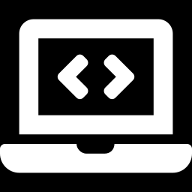
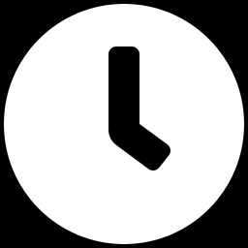
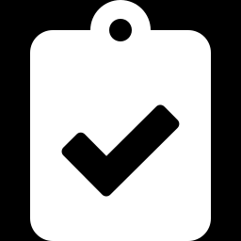
WEEK 02 · VARIATIONAL AUTOENCODERS (VAES)
Lab 2: implement and explore a VAE in PyTorch
1
Inspect images and tensor shapes.
Runtime
Colab or local CPU. About 9 min on a laptop CPU after downloads
2
Implement encoder, sampling and loss.
3
Train; log both costs.
Time
2-hour lab
4
Explore grids and paths.
5
Compare β values using fixed codes.
Hand in
Five TODOs, figures, β table, four answers
6
Evaluate digits versus clothing.
Generative AI · MSc in Artificial Intelligence
44
Notes:
The lab follows the lecture exactly. Students fill in the encoder output, the reparameterisation line and the loss, then train. With the two-dimensional model they reproduce the latent scatter and grid; with a sixteen-dimensional model they interpolate. The beta experiment asks them to connect numbers to pictures, and the anomaly detection part turns the model into a tool and asks for a proper metric, ROC AUC. The conditional VAE extension is for students who finish early. Remind them that the trained model and the evaluation code can be reused in the group project.

Slide 45
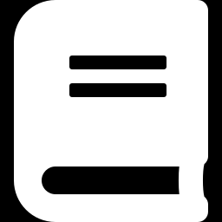
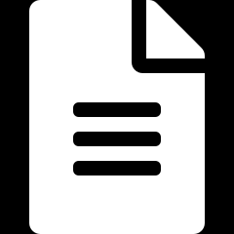
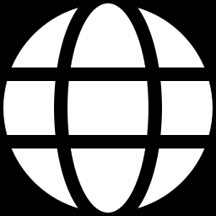
WEEK 02 · VARIATIONAL AUTOENCODERS (VAES)
Read, watch, practise
Foster (2023) Generative Deep Learning, 2nd ed., ch. 3 'Variational Autoencoders'
Core module text
Kingma & Welling (2013) Auto-Encoding Variational Bayes
The original VAE paper
Lilian Weng: From Autoencoder to Beta-VAE
Clear derivations and variants
TensorFlow tutorial: Convolutional VAE
Alternative implementation in TensorFlow
van den Oord et al. (2017) VQ-VAE
Discrete latent codes and tokens
Rombach et al. (2022) Latent Diffusion Models
The VAE inside Stable Diffusion (preview of week 4)
Generative AI · MSc in Artificial Intelligence
45
Notes:
Foster chapter 3 follows almost the same path as this lecture with Keras code, which is useful for students who prefer TensorFlow; the descriptor allows either framework. The original Kingma and Welling paper is short and readable after today. Lilian Weng's blog post is the best single written reference for the derivations and variants. The TensorFlow tutorial is a convolutional VAE students can compare with our PyTorch model. The VQ-VAE and latent diffusion papers are for students who want to look ahead. All links were checked in September 2026.

Slide 46
WEEK 02 · VARIATIONAL AUTOENCODERS (VAES)
Week 2: what we learned
Encode an image
Sample during training
Decode a code
The encoder predicts a mean and
z = centre + spread × fresh
The decoder turns a short code
log variance for each latent
Gaussian noise; gradients train
into pixel predictions.
coordinate.
the encoder.
Balance two costs
Generate a new image
Evaluate the result
Pixel cost preserves detail. KL
Draw a prior code and decode. No
Inspect samples and failures;
compares code distributions to the
input image or encoder is needed.
validate anomaly scores on
prior.
realistic data.
Example to explain aloud
Illustrative costs: reconstruction 120 + β × KL 3 gives 123 at β 1 and 132 at β 4.
Next: in Week 3 we train a realism checker instead of comparing only pixels.
Exit question: If logvar = 0, is the standard deviation 0 or 1?
Generative AI · MSc in Artificial Intelligence
46
Notes:
Start with a digit and ask students to trace its reconstruction through encoder, sampling and decoder. Then cover the image card and ask for the new-generation path: prior noise to decoder. Use the illustrative costs to test the meaning of β without claiming a measured result. Pause on the exit question; zero log variance is a frequent implementation mistake. Explain that the prior and the encoder distribution play different roles. Ask one student what a good reconstruction cannot prove: good random samples or reliable real-world anomaly detection. Finish by connecting the need for perceptual realism with the next week’s discriminator.
Exit question: If logvar = 0, is the standard deviation 0 or 1?
Answer: It is 1: exp(0.5 × 0) = 1. Zero log variance still has spread.
Recap the six points, ideally asking students to supply the key word before you reveal it. If they remember one equation, it should be the ELBO; if they remember one trick, the reparameterisation. Next week we meet the other classic answer to blurry samples: generative adversarial networks, which drop the likelihood altogether and train a generator against a critic. Ask students to finish the lab, read Foster chapter 3 and watch the suggested video before next week.

