Slide 1
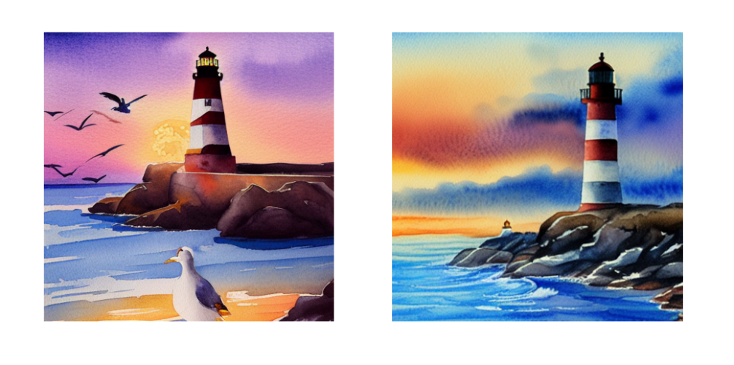
WEEK 04
Diffusion Models
How adding noise creates training examples, and how repeated denoising generates an image
MSc in Artificial Intelligence · Generative AI · 2-hour lecture
Notes:
Welcome to week 4, diffusion models. Almost every image and video generator you have used since 2022 is built on the ideas of today: Stable Diffusion, the image generators in chat assistants, Midjourney-style tools, and video models. The images on this slide were generated for this lecture by Stable Diffusion running on an ordinary laptop. Today we connect three threads: last week's GANs, whose sample quality diffusion matches; week 2's VAEs, whose latent space diffusion runs in; and week 1's probability, because diffusion is trained with a bound on the likelihood. The lab trains a small diffusion model and uses a pretrained one.

Slide 2
WEEK 04 · DIFFUSION MODELS
By the end of this week you can…
1
Compare generator quality, variety and cost.
Module learning outcomes (MIMLOs) practised
2
Separate fixed noising from learned denoising.
MIMLO 1
Explain core concepts, maths and model families
3
Train a network with known noise targets.
MIMLO 2
Analyse and apply multimodal generative AI
4
Trace latent diffusion components.
MIMLO 3
5
Test samplers, guidance, seeds and prompts.
Design, implement and fine-tune models
MIMLO 4
6
Explain flow matching and evaluate outputs.
Critically evaluate outputs: metrics, humans, ethics
Generative AI · MSc in Artificial Intelligence
2
Notes:
Six outcomes. The first sets up the motivation by comparing with the previous two weeks. Outcomes two and three are the theoretical core: the forward process with its closed form, the reverse process, and the remarkably simple training objective of predicting the noise. Outcome four covers the architecture used in practice, particularly latent diffusion, which explains how Stable Diffusion works. Outcome five is hands-on: in the lab students generate images and vary steps, guidance, seeds and negative prompts. Outcome six brings us to 2026: flow matching, few-step distillation, editing, video and audio, and how to evaluate generators. This week touches MIMLOs 1 to 4.

Slide 3
WEEK 04 · DIFFUSION MODELS
Where we are in the course
Foundations and image generators
Week 1
Week 2
Week 3
Week 4: you are here
Introduction and
Variational
Generative adversarial
Diffusion
responsible AI
autoencoders (VAEs)
networks (GANs)
models
Language models and adaptation
Week 5
Week 6
Week 7
Week 8
Transformers
Language models
Prompting
Fine-tuning
and attention
and families
and evaluation
and adaptation
Multimodal applications and deployed systems
Week 9
Week 10
Week 11
Week 12
Multimodal
Multimodal
Deployment
Retrieval (RAG)
foundations
applications
and frameworks
and agents
Responsible use and evaluation continue throughout the course.
Generative AI · MSc in Artificial Intelligence
3
Notes:
The plan follows the descriptor: motivation and limitations of GANs and VAEs, theoretical foundations, core architecture, the denoising process, variants, evaluation and applications, and a comparison with other generative models. Section two has the equations, so take the break after it. Section four shows real Stable Diffusion outputs generated for these slides, so students can see what each setting does before trying it themselves. If time is short, compress the variants cards; the video and audio models return in week 10.
Trace the highlighted week. Earlier concepts feed later systems. Ask which earlier idea today needs. Common mistake: treating each week as an unrelated tool.

Slide 4
WEEK 04 · DIFFUSION MODELS
Starting vocabulary
Term | Plain meaning | Quick check
Gaussian noise | Random numerical values drawn from a bell-shaped distribution. | Does standard Gaussian noise already contain a requested digit?
Regression | Learning to predict numerical values rather than selecting a class label. | Is predicting a noise value of −0.5 regression or classification?
Tensor shape | The number of entries along each dimension of an array. | Why should a pixel-noise predictor output the same shape as its noisy image input?
Generative AI · MSc in Artificial Intelligence
4
Notes:
Introduce these terms before the main theory. Give pairs one minute to answer the quick checks, then take answers. Gaussian noise: Random numerical values drawn from a bell-shaped distribution. Check: Does standard Gaussian noise already contain a requested digit? Answer: No. Pure noise contains no digit; the trained network removes noise step by step. Regression: Learning to predict numerical values rather than selecting a class label. Check: Is predicting a noise value of −0.5 regression or classification? Answer: Regression: the target is a number, not a class. Tensor shape: The number of entries along each dimension of an array. Check: Why should a pixel-noise predictor output the same shape as its noisy image input? Answer: The prediction is compared with the true noise pixel by pixel, so the shapes must match. Let students explain one example aloud, then connect their example to the next flow diagram. Use the blocks to name the inputs and outputs before introducing notation.

Slide 5

WEEK 04 · DIFFUSION MODELS
Warm-up
Could you restore a photo covered in light static? What if you had to start from pure static and remove a little at a time, a thousand times?
How would you learn which part is noise?
If you always start from different random static, will you get the same photo?
What information would help you decide what the final photo should show?
Generative AI · MSc in Artificial Intelligence
5
Notes:
Two minutes in pairs. A partly visible image provides clues, but the exact clean image is not uniquely recoverable. Analogy: restore a damaged sketch using patterns learned from other sketches. The model receives the noisy state and its noise level, not the clean original. Ask: where does the target noise come from during training? We add and record it. Common mistake: treating generation as recovering a hidden original from fresh random noise. Generation instead produces a new sample. Starting noise and optional conditions influence the result; inspect actual variety and prompt fit.

Slide 6

01
Why diffusion?
How does diffusion train and sample differently from VAEs and GANs?
Notes:
Section one motivates diffusion by comparison with the two families we have studied. We summarise their limitations, place the three families on a trade-off triangle of quality, diversity and speed, and state the core idea of diffusion in one slide. Ask students to recall one weakness of VAEs and one of GANs before you show the next slide. About twelve minutes.

Slide 7
WEEK 04 · DIFFUSION MODELS
Train a network to predict noise
The forward process is fixed; the denoiser is the part that learns.
Repeat with fresh data, timesteps and known noise.
clean x, t and
mean squared
noise
noisy x and t
predicted noise
error
Draw training data
Make noisy data
Predict noise
Compare noise
Update weights
Clean image, step t,
Mix signal and noise.
Network receives
Known noise is the
Backpropagate MSE;
known noise.
noisy x and t.
target.
step Adam.
diffusion_loss
q_sample
EpsMLP / TinyUNet
diffusion_loss
opt
known noise (the target)
Input data
Model
Loss / update
data flow
feedback / repeat
Check: Which quantity is the target in diffusion_loss: the clean input x₀ or the sampled noise ε?
Generative AI · MSc in Artificial Intelligence
7
Notes:
A diffusion model learns from examples whose corruption is known. The forward process uses a fixed noise schedule to mix clean data with Gaussian noise. The q_sample function can produce the noisy example for a selected timestep directly, without running every earlier noising step. The timestep tells the network how much corruption to expect. In this lab, the network predicts the noise that was added, rather than directly predicting a class or the clean image. Because the training code drew that noise, it has an exact numerical target for mean squared error. The target follows a separate path to the loss; it is not given to the denoiser. Backpropagation updates the denoiser weights, while the schedule remains fixed. Training samples many noise levels in random order. Generation is a different loop: start from new Gaussian noise and use the learned predictions to move through decreasing noise levels.
Worked example:
Take a clean pixel value x₀ = 0.8 and a timestep where ᾱₜ = 0.36.
For noise ε = −0.5, q_sample gives √0.36 × 0.8 + √0.64 × (−0.5) = 0.6 × 0.8 + 0.8 × (−0.5) = 0.08.
The denoiser sees the noisy input and timestep; it does not receive the true noise ε as input.
Compare its predicted noise with −0.5; the loss is aggregated across all entries.
Generation later starts from fresh noise and repeatedly calls the trained network through reverse_step.
Check: Which quantity is the target in diffusion_loss: the clean input x₀ or the sampled noise ε?
Answer: The sampled noise ε is the target. The clean input helps construct the noisy training example.

Slide 8
WEEK 04 · DIFFUSION MODELS
Limitations of VAEs and GANs that diffusion addresses
 | VAE (week 2) | GAN (week 3) | Diffusion (today)
Image quality | Often slightly blurry | Often sharp | Detailed with enough steps
Coverage of the data | Usually broad; still check | Can miss whole classes | Usually broad; still check
Training | One stable loss | Two networks in a moving game | One stable loss: predict the added noise
Following a prompt or label | Possible | Possible | Strong, with guidance
Generation cost | One network pass | One network pass | Many passes (fewer if distilled)
Generative AI · MSc in Artificial Intelligence
8
Notes:
Use this table to compare mechanisms and practical tendencies. A VAE has a reconstruction-and-KL objective; a GAN has two changing players; this diffusion model predicts known noise with a fixed regression target. None guarantees useful quality or complete coverage. Analogy: one learner practices against an answer sheet, while two players adapt to each other. Ask: which model needs repeated calls at generation time? Traditional diffusion does. Common mistake: reading a model family as a guarantee of sharpness, stability or diversity. Evaluate samples, failures, coverage and cost in the actual task.

Slide 9
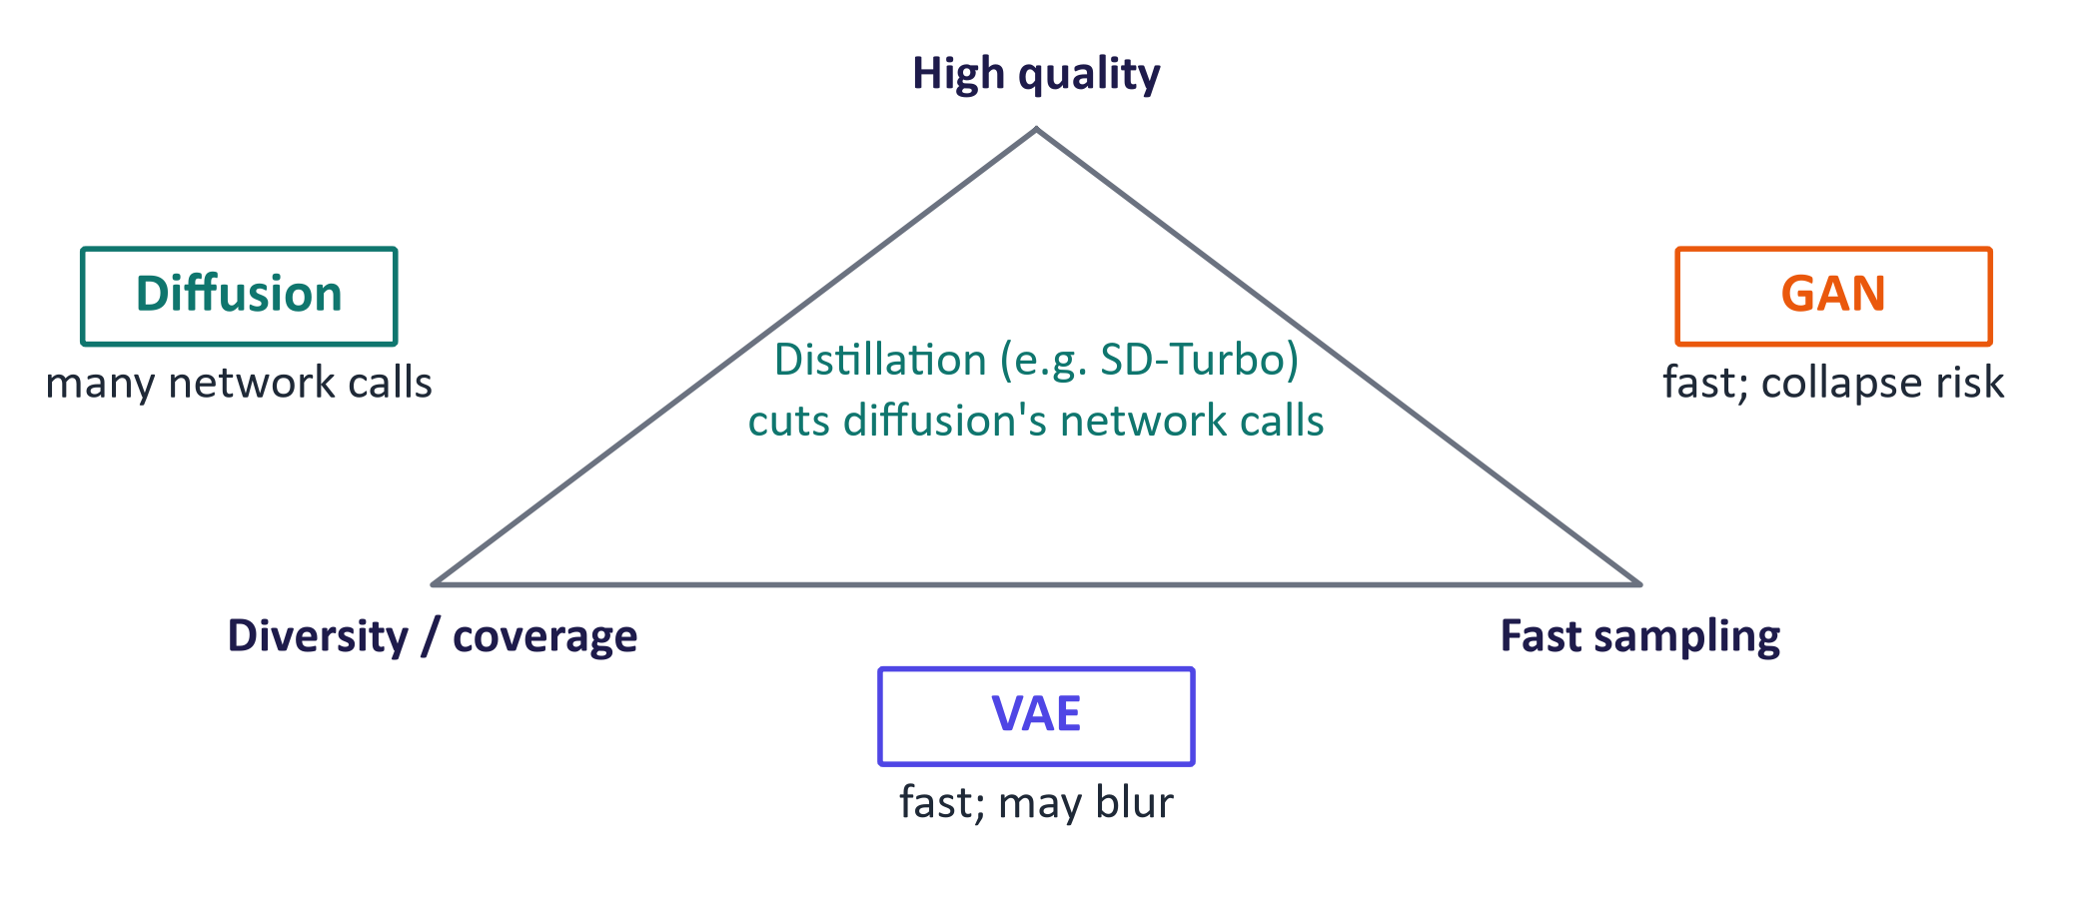
WEEK 04 · DIFFUSION MODELS
The generative trilemma: quality, diversity, speed
Generative AI · MSc in Artificial Intelligence
9
Notes:
The triangle organises three measurements: useful quality, varied coverage and generation speed. Positions are schematic tendencies, not numerical rankings. Analogy: compare vehicles by journey time, carrying capacity and running cost. Ask: what evidence would justify a model choice? Use matched tasks and settings, sampled outputs, coverage checks and recorded runtime. Common mistake: assuming diffusion automatically covers every mode or that flow matching always generates in one to four calls. Some distilled models need few calls after extra training; measure their quality and failures.
Figure discussion prompts: Measure useful quality, varied coverage and speed. Traditional diffusion uses many steps. Distillation can reduce network calls. No family guarantees success on every task.

Slide 10

WEEK 04 · DIFFUSION MODELS
The core idea in one slide
Training: take a real image and add noise that you drew yourself.
The network learns to predict exactly that noise.
Generation: start from fresh random noise; no real image exists.
Remove a little predicted noise at a time, many times.
Key idea: Training has a known answer (the added noise); generation does not.
Generative AI · MSc in Artificial Intelligence
10
Notes:
State the loop before the equations. A fixed rule adds sampled noise to known clean data. A network receives the noisy state and timestep and learns to predict that recorded noise. At generation time, fresh noise starts a repeated reverse update; there is no known original image. Analogy: practice restoring many damaged sketches, then use the learned patterns to build a new sketch from static. Ask: which values are known to the trainer? Clean data, timestep and sampled noise. Common mistake: feeding the target noise to the denoiser or promising that every local update is easy.

Slide 11

02
Forward and reverse processes
What exactly is added, what exactly is learned?
Notes:
Section two gives the theoretical foundations. We define the forward process and its very useful closed form, look at real images being noised and at noise schedules, define the reverse process, and derive the training objective that predicts the added noise. We then connect this to the score-based view, show the training and sampling code, and see real results from small diffusion models trained for these slides. This is the core exam material; allow about thirty minutes.

Slide 12
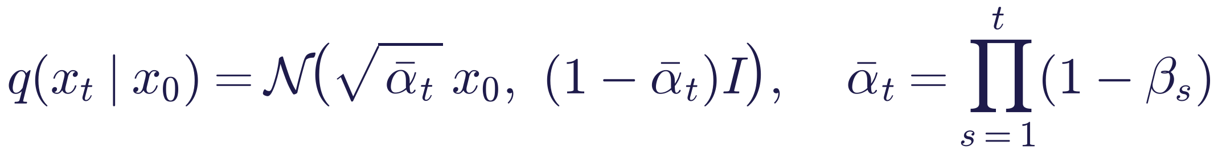
WEEK 04 · DIFFUSION MODELS
The forward (noising) process
Read it as
Symbols
Mix scaled signal and Gaussian noise.
The schedule supplies known coefficients.
Create a selected noise level directly.
x₀
clean image; xₜ noisy image at step t
βₜ
noise added at step t (the schedule)
ᾱ_t
fraction of original signal variance left
ε
standard Gaussian noise
Generative AI · MSc in Artificial Intelligence
12
Notes:
Define the forward process as a Markov chain: each step multiplies the current image by the square root of one minus beta and adds Gaussian noise with variance beta. The scaling preserves unit marginal variance when the input already has unit variance; general data variance tends towards one. Because Gaussians compose, we can jump to any step directly, and the reparameterised form, x t equals root alpha-bar times x nought plus root one minus alpha-bar times epsilon, is the one we implement. Point out the link to week 2: this is exactly the reparameterisation trick. After a thousand steps essentially no signal remains.

Slide 13
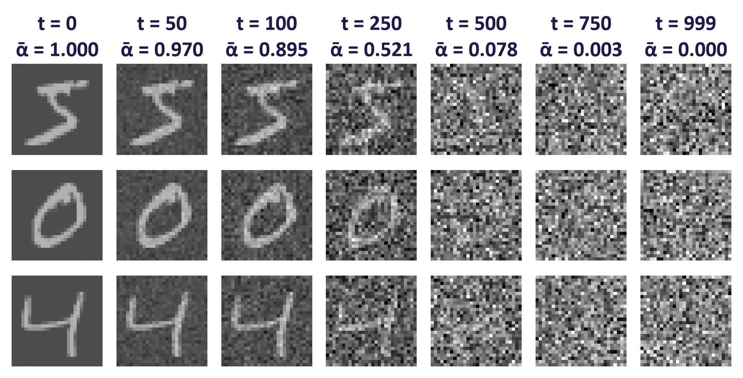
WEEK 04 · DIFFUSION MODELS
The forward process on real digits
Real MNIST digits noised with the DDPM linear schedule (T = 1000). ᾱ shows the fraction of signal variance remaining.
Generative AI · MSc in Artificial Intelligence
13
Notes:
Three real digits at increasing timesteps. At t equals fifty the digit is clearly visible; by five hundred it is barely perceptible; by nine hundred and ninety-nine only noise remains. Ask students: if you were the network and saw the image at t equals seven hundred and fifty, could you predict exactly which noise was added? Not exactly, but you could make a reasonable guess of which digit shape is underneath, and that partial information is what the model learns to exploit. Note that most information is destroyed in the middle timesteps, which motivates better schedules on the next slide.

Slide 14
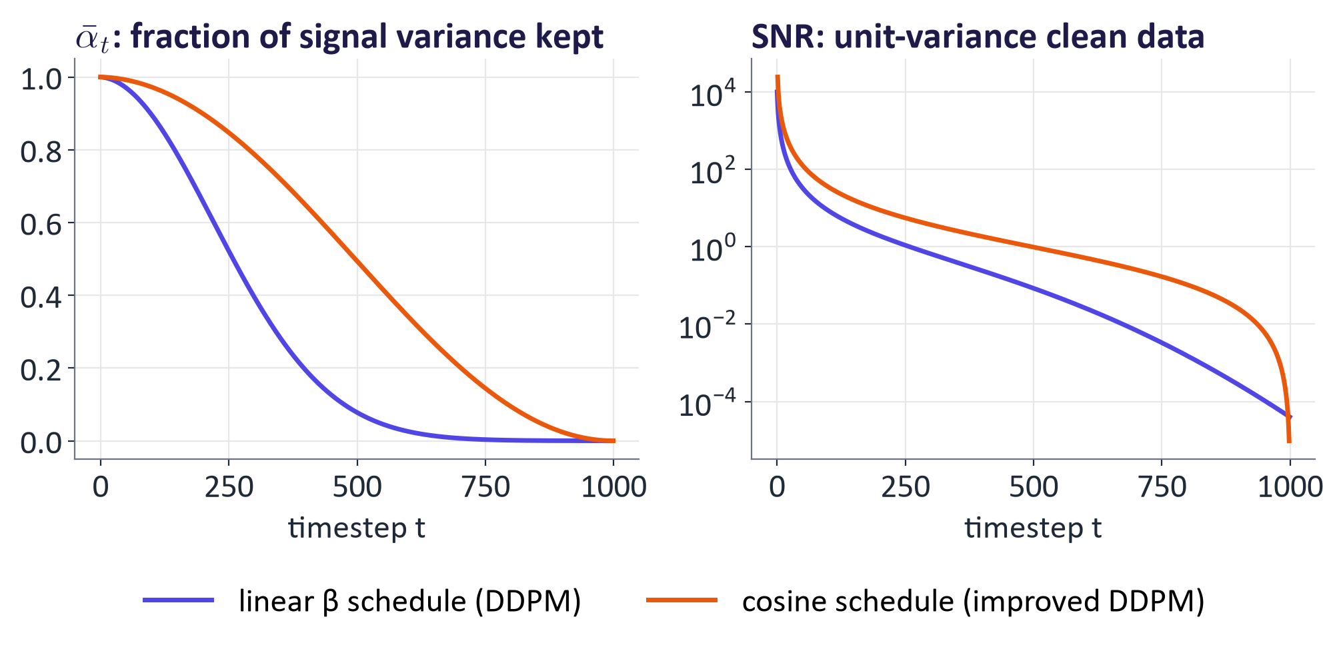
WEEK 04 · DIFFUSION MODELS
Noise schedules decide how fast information is destroyed
Generative AI · MSc in Artificial Intelligence
14
Notes:
The schedule is a design choice. With the original linear schedule, alpha-bar falls to near zero well before the last step, so many training steps are spent on almost pure noise. The cosine schedule keeps more signal for longer. The plot on the right shows the signal-to-noise ratio on a log scale, which is the quantity that later work, such as the EDM framework of Karras and colleagues, identified as the natural way to describe schedules. Students do not need to memorise schedules, but should know that the schedule affects both training quality and how many sampling steps are needed.
Figure discussion prompts: Schedule sets remaining signal. Linear and cosine remove it differently. SNR compares signal and noise power. Check the actual end-of-schedule signal.

Slide 15
WEEK 04 · DIFFUSION MODELS
Generate by repeating reverse steps
One denoiser is reused at every timestep; the sampler decides each update.
The updated x goes back in with the next lower t.
predicted noise +
current x and t
current x
updated x
Start from noise
Predict noise
Take reverse step
Repeat or finish
Random image-shaped x at
Network reads current x
Remove predicted noise;
Next lower t; stop after t =
the last step T.
and timestep t.
add fresh noise if t > 0.
0.
torch.randn
TinyUNet.forward
reverse_step
sample_ddpm
Input data
Model
Output
data flow
feedback / repeat
Check: Does taking 50 DDIM steps mean training 50 separate denoisers?
Generative AI · MSc in Artificial Intelligence
15
Notes:
Generation uses the trained denoiser repeatedly, but it does not train the network again. At the start, the image tensor contains random Gaussian values. A timestep embedding turns the timestep number into features the denoiser can use. TinyUNet processes the image at several resolutions and combines saved features through skip connections, returning a noise prediction with the same shape as the image. The reverse-step formula uses that prediction and the fixed schedule to compute the next state. This lab's DDPM sampler also adds fresh noise except at the final step. Each new state goes back through the same denoiser at a lower timestep until an image is produced. DDIM uses a different update to jump between selected noise levels. Reducing sample_ddpm's steps simply starts at a lower index and truncates its chain; use sample_ddim to study proper timestep skipping across the full schedule.
Worked example:
sample_ddpm starts with shape [n, 1, 28, 28] and begins at index 999 for the full schedule.
TinyUNet predicts an equally shaped noise tensor using the current image and timestep embedding.
reverse_step computes a lower-noise state and adds fresh noise when t is greater than 0.
The next call uses the updated tensor and a smaller timestep, without changing model weights.
sample_ddim instead spans the schedule with 50 selected timesteps and deterministic updates.
Check: Does taking 50 DDIM steps mean training 50 separate denoisers?
Answer: No. The same trained network is called at 50 selected timestep values; only the sampling procedure changes.

Slide 16
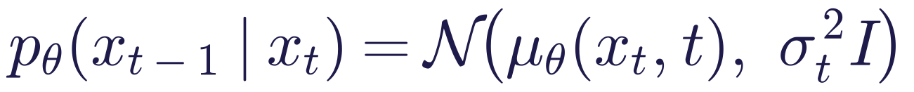
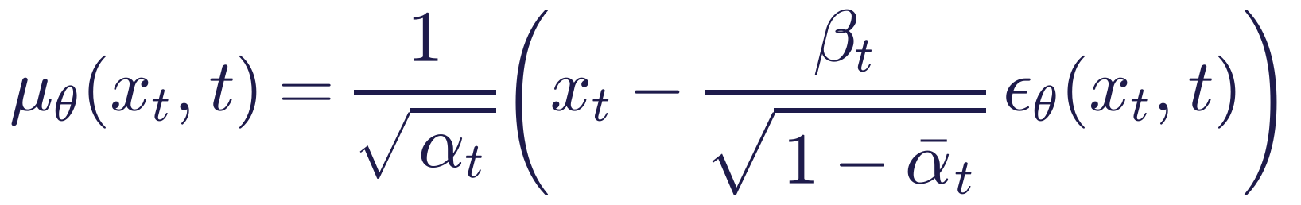
WEEK 04 · DIFFUSION MODELS
The reverse (denoising) process is learned
Read it as
Symbols
One network handles many noise levels.
Use its prediction to calculate a reverse mean.
DDPM adds sampling noise except at the final step.
ε_{θ}(xₜ, t)
the network's noise prediction
αₜ
1 − βₜ
σₜ²
sampling noise, often βₜ
Generative AI · MSc in Artificial Intelligence
16
Notes:
The reverse process runs the chain backwards. When each forward step adds only a small amount of noise, the true reverse step is also approximately Gaussian, so we model it as a Gaussian whose mean is produced by a network. DDPM parameterises that mean through a noise-prediction network: given the noisy image and the timestep, it predicts the noise, and the formula converts that prediction into the mean of the slightly cleaner image. The same network is used at every step and receives the timestep as an extra input, usually through a sinusoidal embedding like the positional encodings we meet next week.

Slide 17
WEEK 04 · DIFFUSION MODELS
Create one noise-prediction training example
Choose a noise level directly. The known added noise is the target.
Repeat with fresh data, timesteps and noise.
clean x, t and
clean x
noise
noisy x and t
predicted noise
Choose clean
Draw t and noise
Mix signal and
Predict added
Compare and
data
noise
noise
update
Choose noise level
Make noisy x
The network receives
Known noise is the
Real point or image.
and noise ε.
directly.
noisy x and t.
MSE target.
diffusion_loss
diffusion_loss
q_sample
EpsMLP / TinyUNet
diffusion_loss / opt
known noise (the target)
Input data
Model
Loss / update
data flow
feedback / repeat
Check: Does training need to run every earlier noising step to create xₜ?
Generative AI · MSc in Artificial Intelligence
17
Notes:
Diffusion training creates its own known targets. For each real example, draw a timestep and Gaussian noise. The q_sample function combines the clean data and noise using the schedule at that timestep. It can jump straight to the selected level. The network sees the noisy data and timestep, and predicts the noise that was added. Squared error compares the prediction with the known noise. Repeated examples at many timesteps train one shared denoiser. The network learns its weights; the chosen noising schedule remains fixed.
Worked example:
For one scalar illustration, let x₀ = 1, ε = −0.5 and ᾱₜ = 0.64.
Then xₜ = √0.64 × 1 + √0.36 × (−0.5) = 0.50.
The denoiser input is xₜ and t. Its target is ε = −0.5.
If it predicts −0.3, this scalar squared error is (−0.5 + 0.3)² = 0.04.
Check: Does training need to run every earlier noising step to create xₜ?
Answer: No. q_sample uses the closed form and the selected schedule coefficient.

Slide 18
WEEK 04 · DIFFUSION MODELS
Training objective: predict the noise
Read it as
Symbols
Draw real x₀, timestep t and noise ε.
Construct xₜ directly; predict ε from xₜ and t.
Minimise squared prediction error.
t
uniform random step in 1…T
ε
the noise we added (the target)
ε_{θ}
the network's guess
Generative AI · MSc in Artificial Intelligence
18
Notes:
Draw a real image, a timestep and fresh noise; construct the noisy input directly and compare the predicted and recorded noise. The loss averages squared errors. Ho et al. derived a weighted objective from an evidence lower bound and found a simpler reweighting useful. Analogy: a learner practices against an answer sheet that the teacher created. Ask: why is a discriminator unnecessary? The recorded noise supplies the target. Common mistake: calling optimisation guaranteed stable or assuming a likelihood connection proves complete sample coverage. Check actual training and outputs.

Slide 19
WEEK 04 · DIFFUSION MODELS
Training and sampling in a few lines
# One training prediction per image
t = torch.randint(0, T, (len(x0),), device=x0.device)
eps = torch.randn_like(x0)
a = abar.to(x0.device)[t].view(-1, 1, 1, 1)
xt = a.sqrt() * x0 + (1 - a).sqrt() * eps
loss = F.mse_loss(model(xt, t), eps)
# Reuse trained weights: reverse_step is in the lab
model.eval()
with torch.no_grad():
x = torch.randn(n, 1, 28, 28, device=x0.device)
for k in reversed(range(T)):
x = reverse_step(model, x, k, betas, alphas, abar)
Training uses one selected noise level.
Sampling repeats the lab reverse_step.
The timestep and coefficients match the image batch.
Generative AI · MSc in Artificial Intelligence
19
Notes:
This is a fragment using the model and schedules defined in the lab. Each training image gets a timestep tensor entry. Reshape its scalar coefficient to one by one by one so it broadcasts across that image. The reverse_step helper forms a timestep tensor for every image in the sampling batch, predicts noise and applies the DDPM mean and optional noise. Analogy: one practice question versus a sequence of refinement passes. Ask: where do weights change? In the training optimiser step, never in this sampling loop. Common mistake: passing a Python integer directly to TinyUNet, which expects a batch of timestep values. The notes retain the expanded update.

Slide 20

WEEK 04 · DIFFUSION MODELS
The score-based view (Song et al., 2021)
Score: the direction in which an image becomes more likely, at one noise level.
A rescaled noise prediction estimates the score: removing noise moves towards likely data.
Continuous view: noise is added smoothly over time, as an SDE (a change with randomness).
Its deterministic twin, the probability-flow ODE, underlies fast samplers such as DDIM and DPM-Solver.
Generative AI · MSc in Artificial Intelligence
20
Notes:
A score is a gradient of log probability, giving a local direction towards more likely data at a noise level. The displayed scale converts noise prediction into a score estimate. Introduce SDE as a continuous equation with random changes and ODE as a deterministic equation for a changing state. Numerical samplers approximate such paths with finite updates. These connections explain related methods. Avoid claiming every discrete DDIM setting is exactly the continuous probability-flow ODE.

Slide 21
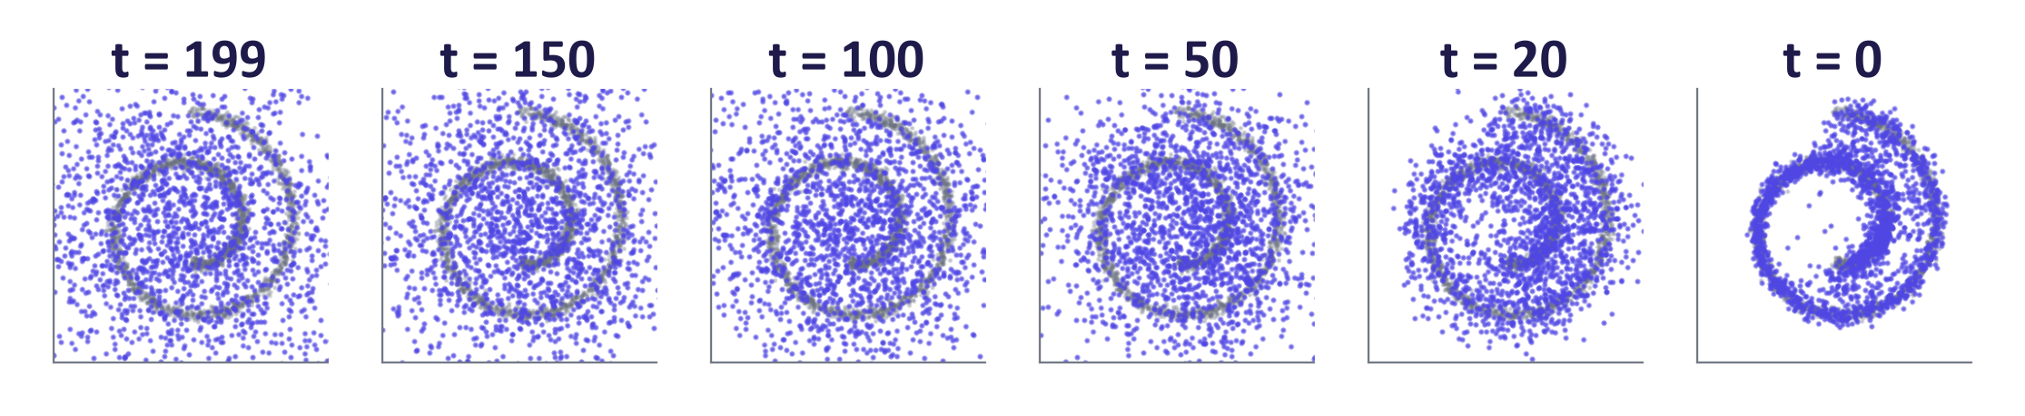
WEEK 04 · DIFFUSION MODELS
A real diffusion model on 2-D data: noise becomes structure
The same 2,000 points are shown at six reverse steps, from t = 199 down to t = 0.
The cloud only settles onto the grey spiral in the last 20 steps.
Most points end on the spiral, but its inner end is covered less well: inspect coverage.
A small MLP trained with the noise-prediction loss on a 2-D swiss roll (grey). Blue: 2,000 samples during the reverse process.
Generative AI · MSc in Artificial Intelligence
21
Notes:
A real result on data we can see. We trained a tiny three-layer network on points from a two-dimensional swiss roll using exactly the loss on the previous slides, then ran the reverse process from pure Gaussian noise. At the first reverse step the points are a shapeless cloud; as the steps proceed, they are pulled onto the spiral, and at the end they lie on the data. No adversary or learned encoder is used. Inspect the observed spiral coverage and deviations; this example does not prove complete coverage. Students train this model in the first part of the lab.

Slide 22
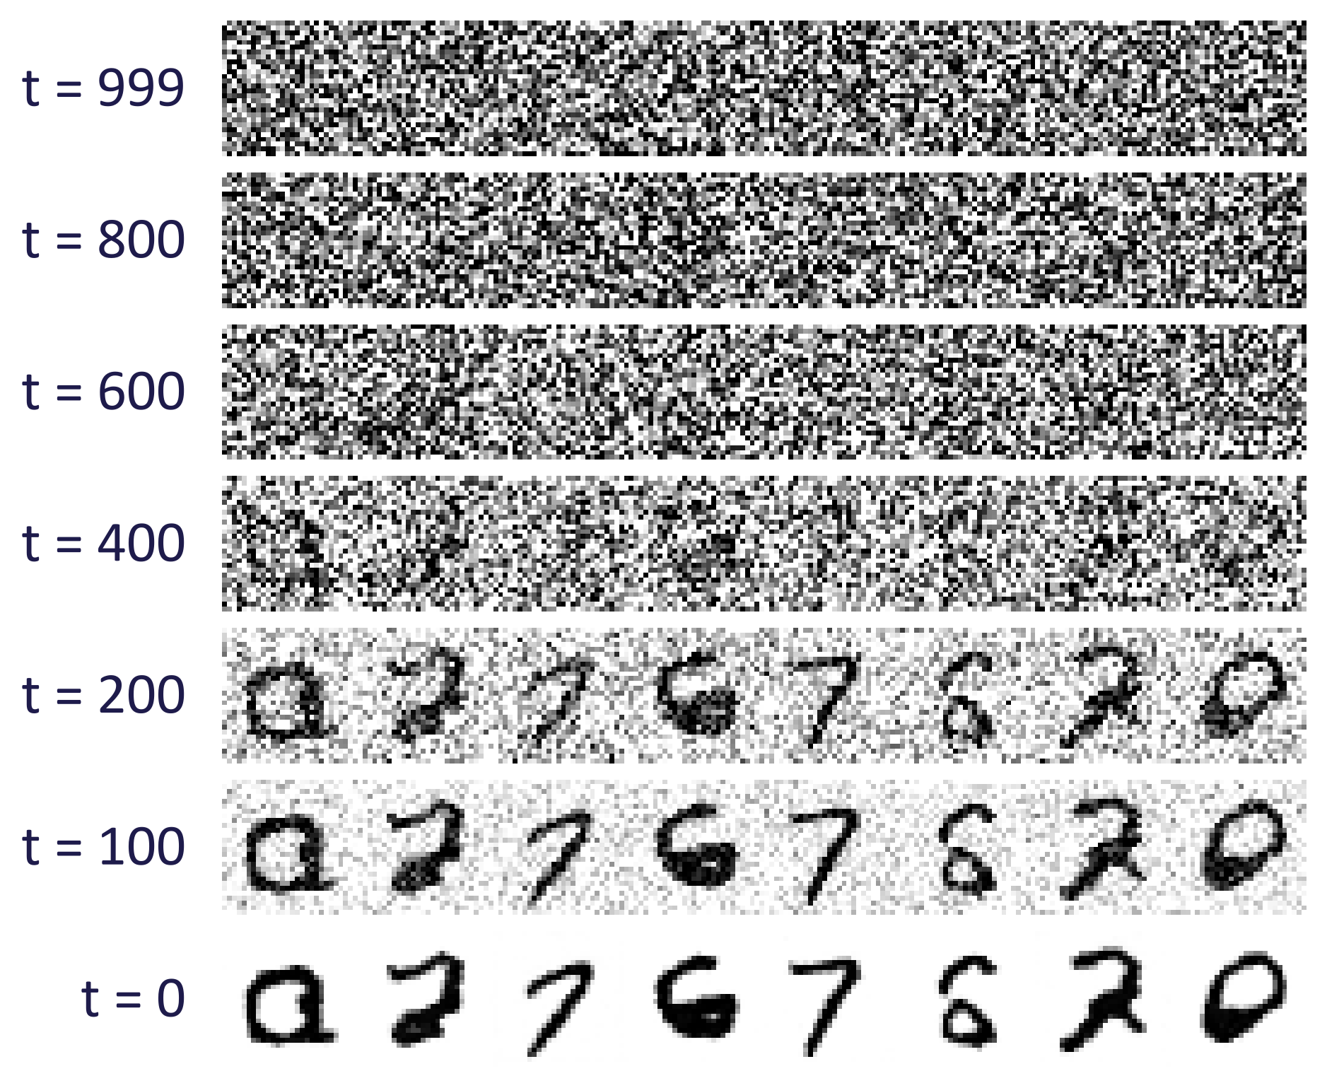
WEEK 04 · DIFFUSION MODELS
A tiny diffusion model on MNIST, trained for this lecture
Rows run from pure noise (t = 999) to finished digits (t = 0).
Digit shapes appear between t = 400 and t = 200; strokes sharpen at the end.
One tiny U-Net (254,337 parameters), trained for about 8 minutes on an NVIDIA GTX 1650 laptop GPU.
Not every sample is a clean digit, so inspect them all.
Generative AI · MSc in Artificial Intelligence
22
Notes:
These digits come from a very small U-Net trained for a few epochs with the same code as the lab. Reading down the rows, the reverse process starts from noise, coarse shapes emerge around the middle timesteps, and fine strokes are refined at the end. This coarse-to-fine behaviour is typical of diffusion: early reverse steps decide the global layout, late steps add detail. It is also why editing methods such as SDEdit start from a partially noised image: they keep the layout decided by the input and let the model repaint details.
Figure discussion prompts: One tiny timestep-aware U-Net. Inspect structure across reverse steps. Judge the recorded samples and failures.

Slide 23

WEEK 04 · DIFFUSION MODELS
Quick check
During DDPM training, what does the network learn to predict?
The clean image, predicted directly from pure noise in a single step
The value of the next pixel, given all the previous pixels in raster order
A
B
The class label of the image, so that sampling can be guided by class
The Gaussian noise that was added to create xₜ, for a randomly chosen step t
C
D
Vote, then convince your neighbour (1 minute).
Generative AI · MSc in Artificial Intelligence
23
Notes:
Answer: D. The network receives a noisy image and its timestep and predicts the noise that was mixed in; the loss is mean squared error against the true noise. A does not describe this training target. Some trained and distilled systems can generate in one step; our model instead learns a conditional noise prediction at each selected level. Some variants do predict the clean image or a velocity, but always at a given noise level, not from pure noise in one shot. C describes a classifier and B an autoregressive model. B is a good distractor because it is how autoregressive image models such as PixelCNN work.

Slide 24

03
Architecture and latent diffusion
What network does the denoising, and how does text get in?
Notes:
Welcome back. Section three moves from maths to engineering. Which network predicts the noise, U-Net or transformer? Why do practical systems run diffusion in the latent space of an autoencoder, connecting back to week 2? And how does a text prompt influence the denoiser? By the end students should be able to explain the full Stable Diffusion pipeline component by component, which is a common exam question.

Slide 25
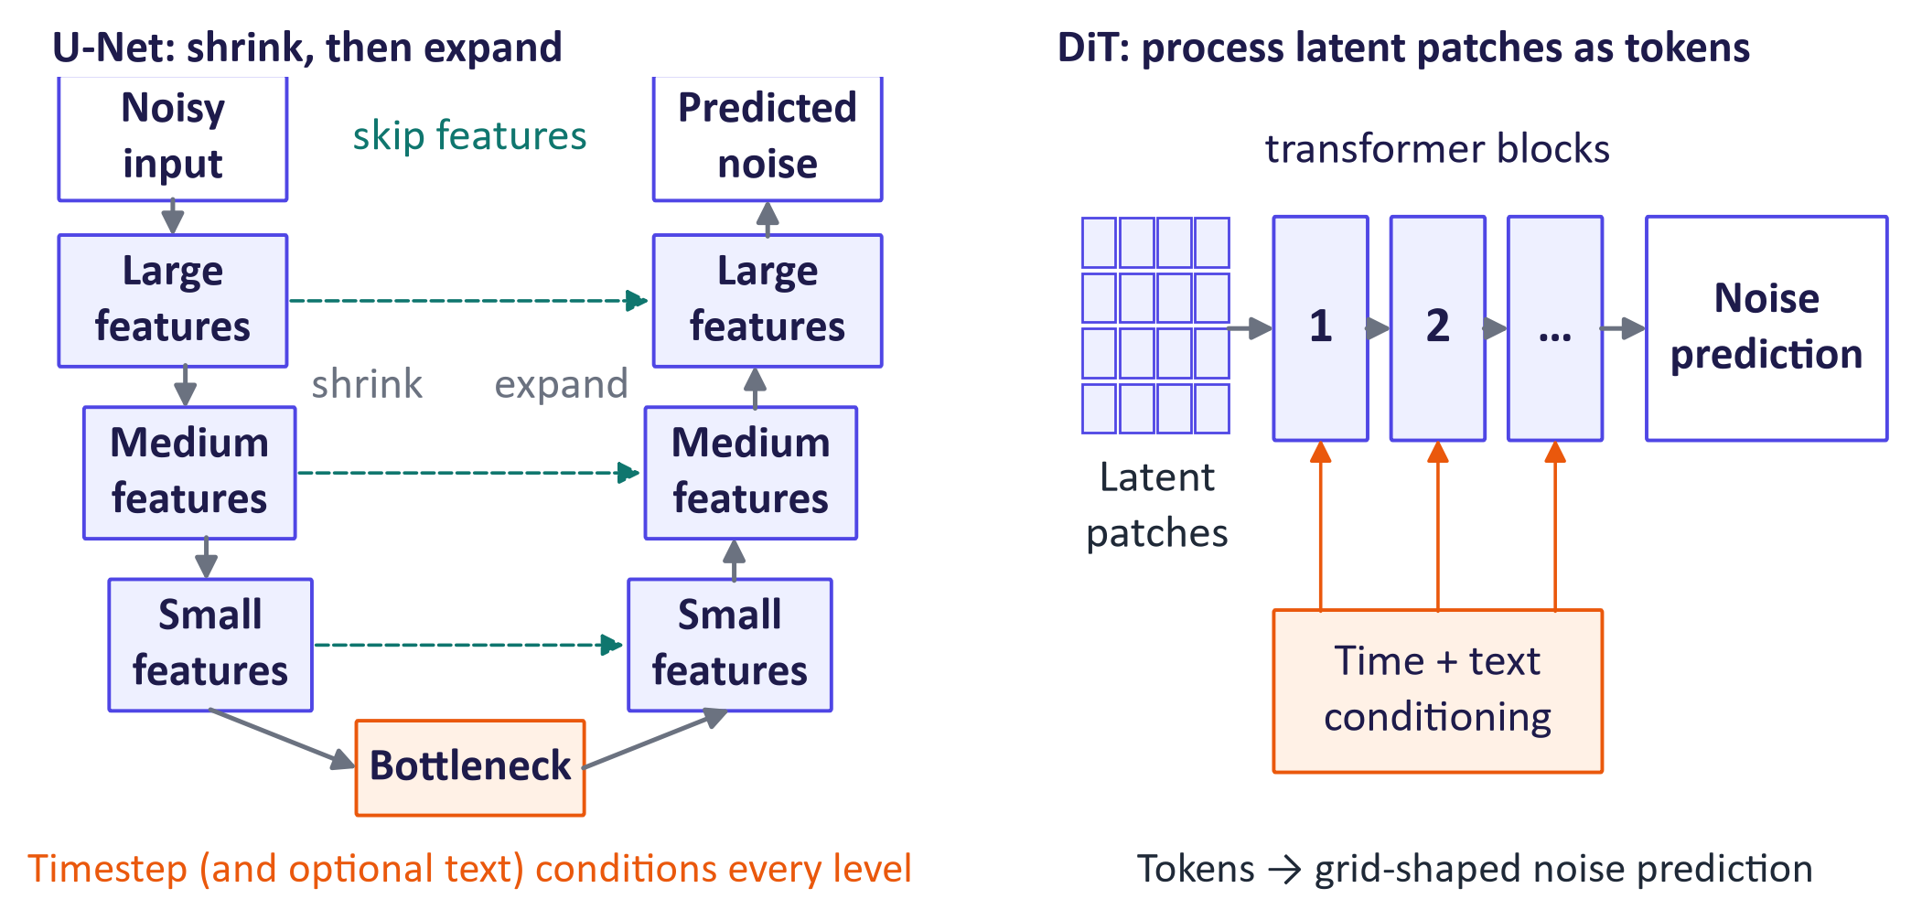
WEEK 04 · DIFFUSION MODELS
Two denoiser architectures: U-Net and diffusion transformer
Generative AI · MSc in Artificial Intelligence
25
Notes:
U-Net combines downsampling, upsampling and saved skip features. A diffusion transformer instead represents image or latent patches as tokens. Both need timestep information. Text-conditioned designs also accept text vectors, while the small MNIST lab model has no text condition. Ask students to trace input and output shapes. In this lab noise prediction has the same shape as the noisy input. The architecture can change while this training target stays the same.
Figure discussion prompts: U-Net: shrink, expand, join saved features. DiT: process image or latent patches. Supply timestep and applicable conditions. Noise output matches the input shape.

Slide 26
WEEK 04 · DIFFUSION MODELS
From a text prompt to image pixels
Text conditions guide repeated latent updates. The VAE decoder produces the final image.
Repeat prediction and update at the next selected timestep.
seeded noisy
latent
noise prediction
final latent
generated image
Encode
Draw starting
Predict latent
Decode final
Inspect and
prompt
noise
noise
Update latent
state
record
Text tokens
Create a seeded
Read latent,
Use compatible
VAE returns
Prompt fit,
become vectors.
latent tensor.
timestep and
sampler rules.
pixels once at
failures and time.
text.
pipe.scheduler
end.
pipe
generate
pipe
pipe.vae
grid / clip_score
text vectors
Input data
Model
Output
data flow
feedback / repeat
Check: Does the VAE encoder need a real image for ordinary text-to-image generation?
Generative AI · MSc in Artificial Intelligence
26
Notes:
A text-to-image pipeline connects several trained components. The text encoder represents the prompt as vectors. Generation draws starting noise in the VAE's smaller latent space. At each step the denoiser reads the current latent, timestep and text information. A sampler updates the latent using its noise prediction. Guidance may combine prompted and unprompted predictions. After the final update, the VAE decoder turns the latent into pixels. The weights stay fixed during this request. Inspect prompt fit directly because a high similarity score can still miss object counts or positions.
Worked example:
Use a prompt such as "two red cubes on a blue table".
Hold prompt, seed, model and sampler fixed while changing the number of steps.
The final latent is decoded once after the repeated denoising updates.
Check the two cubes and their colours by viewing the image. Record time and CLIP score alongside that check.
Check: Does the VAE encoder need a real image for ordinary text-to-image generation?
Answer: No. Generation starts with a noisy latent and finishes with the VAE decoder. Editing an existing image may also use the encoder.

Slide 27
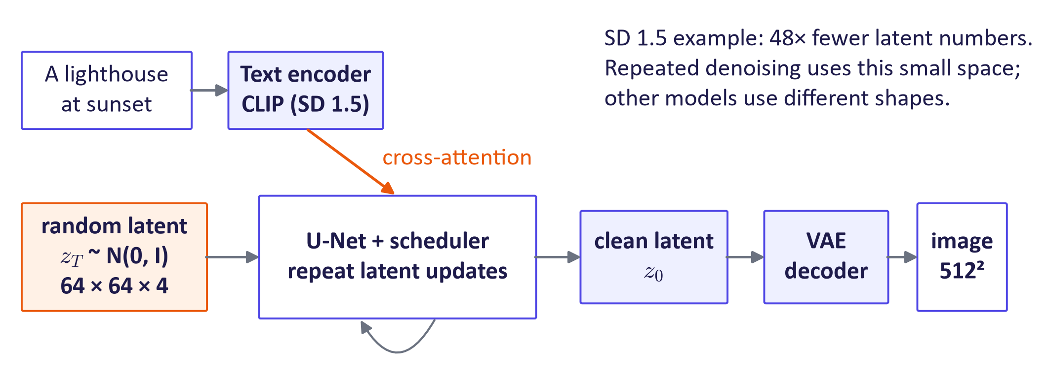
WEEK 04 · DIFFUSION MODELS
Latent diffusion: the Stable Diffusion pipeline
Generative AI · MSc in Artificial Intelligence
27
Notes:
Walk through the pipeline left to right. The prompt is tokenised and encoded by a pretrained text encoder, CLIP's text transformer in Stable Diffusion 1.5, T5 as well in later models. Generation starts from random noise in the latent space, not in pixel space. The denoiser runs for a number of steps, each time attending to the text embeddings through cross-attention, a mechanism explained next week. The final clean latent is decoded to pixels by the VAE decoder. For scale: Stable Diffusion 1.5 has a U-Net of about 860 million parameters, a 123-million-parameter CLIP text encoder and an 84-million-parameter VAE.
Figure discussion prompts: Text encoder: prompt → vectors. Denoiser: repeatedly update a small latent. Scheduler: choose numerical update steps. VAE decoder: final latent → pixels.

Slide 28




WEEK 04 · DIFFUSION MODELS
What each component contributes
Autoencoder (VAE)
Text encoder
Shrinks a 512 × 512 image to a 64 × 64 × 4 latent; decodes the final latent back to pixels.
Turns the prompt into vectors (CLIP's text model in SD 1.5) that guide every step.
Denoiser
Scheduler / sampler
A U-Net or transformer that predicts the noise in the current latent, given t and the text.
Not a network: a formula that turns each noise prediction into the next, cleaner latent.
Generative AI · MSc in Artificial Intelligence
28
Notes:
Summarise the division of labour. The autoencoder is trained first and frozen; it makes the whole system affordable, which is why latent diffusion made open-source image generation possible on consumer GPUs. The text encoder is usually a frozen pretrained model; weaknesses in prompt following, such as counting objects or rendering text, often trace back to it, which is why newer models use larger text encoders. The denoiser is the part trained on hundreds of millions of image-caption pairs. The scheduler is not a network at all; in the Hugging Face Diffusers library you can swap it with one line, which students do in the lab.
This diagram is the Stable Diffusion 1.5 example. Other models can use different autoencoders, text encoders and denoiser architectures. Swap only compatible schedulers whose prediction type and coefficients match the trained model. Ask which component runs repeatedly: the denoiser. Common mistake: treating the scheduler as learned weights or decoding pixels at every latent update.

Slide 29

04
Sampling, guidance and prompts
Why do steps, guidance scale, seeds and negative prompts change the picture?
Notes:
Section four is practical and visual. Every image generator exposes a few controls: number of steps, sampler, guidance scale, seed and negative prompt. Students will use all of them in the lab and in the project. We explain what each one does in terms of the maths from section two, using real Stable Diffusion outputs generated with a fixed seed so that only one setting changes at a time.

Slide 30



WEEK 04 · DIFFUSION MODELS
Samplers: from 1000 steps to a handful
DDPM
DDIM / ODE methods
Distilled models
Follows all 1,000 small steps, adding a little fresh noise each time.
Slow, but the reference baseline.
Visits only selected noise levels, for example 50 of the 1,000.
Same trained network; only the update rule changes.
A student network is trained to make big jumps.
Some generate in 1–4 steps (for example SD-Turbo).
Generative AI · MSc in Artificial Intelligence
30
Notes:
Three groups of samplers. DDPM's ancestral sampler follows a stochastic reverse chain. This lab's DDIM uses deterministic updates over selected timesteps spanning the full schedule; ODE solvers such as DPM-Solver are another route to fewer evaluations. Neither requires retraining the noise predictor. Simply lowering the steps argument in the lab's DDPM function truncates its loop, so use the full DDPM schedule as the baseline and DDIM for timestep skipping. Measure quality and runtime in the actual experiment. Distillation goes further by training a student model for large jumps, giving few-step generation. Consistency models and adversarial diffusion distillation, which connects with last week's GAN discriminator, are examples.

Slide 31
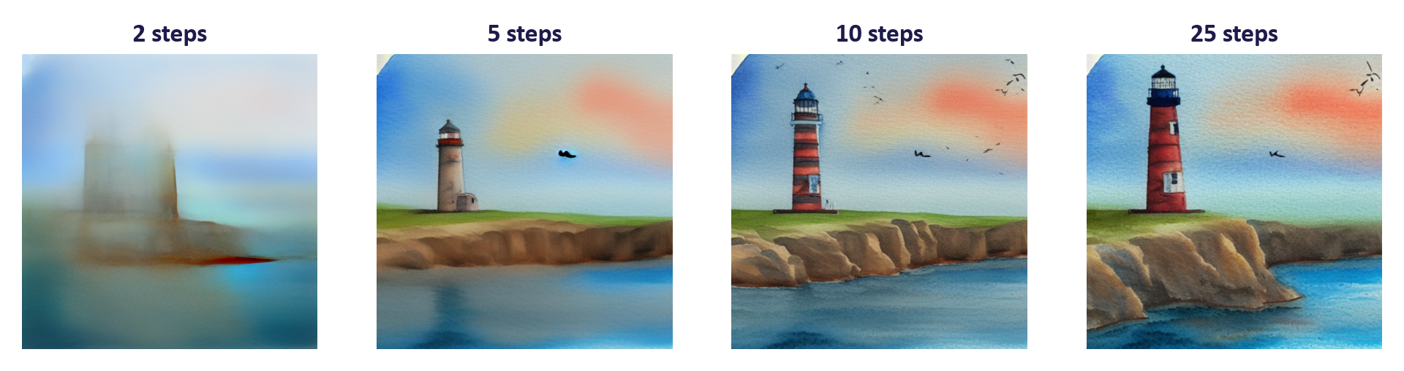
WEEK 04 · DIFFUSION MODELS
Effect of the number of steps (Stable Diffusion 1.5, same seed)
Same prompt, seed and guidance; only the number of denoising steps changes.
2 steps: a blurred colour layout. 5: the scene is recognisable. 10–25: details settle.
Time on the lecture CPU: 45 s for 2 steps, 419 s for 25.
DPM-Solver++ sampler, guidance 7.5, seed 42. Real outputs generated for this lecture.
Generative AI · MSc in Artificial Intelligence
31
Notes:
Real outputs with everything fixed except the number of steps. With two steps the image is a blurry colour layout, showing that the global composition is decided early. By five steps the scene is recognisable; ten steps add most details; twenty-five steps refine textures. Beyond about twenty-five to thirty steps with a good solver, improvements are small, which is why most tools default to twenty to fifty. Ask students to connect this with the coarse-to-fine MNIST figure. With the same model and guidance, more steps usually increase denoiser work; fixed overhead means total runtime need not be exactly linear; the timings are in the teaching notes.

Slide 32
WEEK 04 · DIFFUSION MODELS
Classifier-free guidance (Ho & Salimans, 2022)
Read it as
Symbols
Train with the condition sometimes dropped.
Combine conditional and reference predictions.
Here w = 1 gives the conditional prediction.
c
text condition (prompt embedding)
∅
empty prompt
w
guidance scale
Generative AI · MSc in Artificial Intelligence
32
Notes:
Classifier-free guidance is the single most important trick behind prompt-following image generation. During training, the prompt is replaced by an empty prompt some of the time, so one network learns both conditional and unconditional noise predictions. At sampling time we compute both and extrapolate from the unconditional prediction towards the conditional one. The difference vector points in the direction that makes the image more like the prompt; multiplying it by w greater than one exaggerates that direction. The cost is two network evaluations per step. It replaced classifier guidance, which needed a separate noise-aware classifier.
Here w = 1 gives the conditional prediction; the symbol convention varies across papers. Active guidance requires two predictions, which software can batch into one network call with twice the examples. Pipelines may skip the reference prediction when guidance is disabled. Do not apply an SD1.5 guidance default to every model: SD-Turbo disables guidance. Ask what w = 0 gives in the displayed formula: the reference prediction.

Slide 33
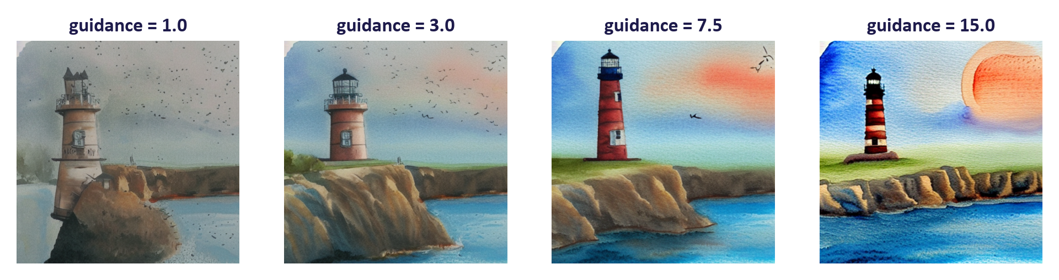
WEEK 04 · DIFFUSION MODELS
Effect of the guidance scale (same seed)
Same prompt, seed and 25 steps; only the guidance scale w changes.
w = 1: washed out, no sunset. 7.5: lighthouse, cliff and sunset all present. 15: harsh, oversaturated colours.
w above 1 runs the denoiser twice per step (with and without the prompt), so it is slower: 164 s at w = 1, 471 s at w = 7.5 on the lecture CPU.
Generative AI · MSc in Artificial Intelligence
33
Notes:
Real outputs with only the guidance scale changing. At one, the model is the plain conditional model and the image often ignores parts of the prompt. Around seven and a half, the default for Stable Diffusion 1.5, the lighthouse, cliff and sunset are all present. At fifteen, colours saturate and contrast becomes harsh, a characteristic artefact of excessive guidance. This is also a diversity trade-off: higher guidance makes different seeds look more alike. Connect to GANs: the truncation trick in BigGAN trades diversity for quality in a similar way. On cost: at a scale of one the pipeline skips the second, prompt-free pass, so each step needs one network call instead of two. Treat single CPU timings as rough: the same 7.5, 25-step setting took 471 seconds here and 419 seconds in the steps experiment.
Figure discussion prompts: Keep prompt and seed fixed. Compare prompt fit and visual artefacts. A useful range depends on the model. Large guidance can reduce variety.

Slide 34
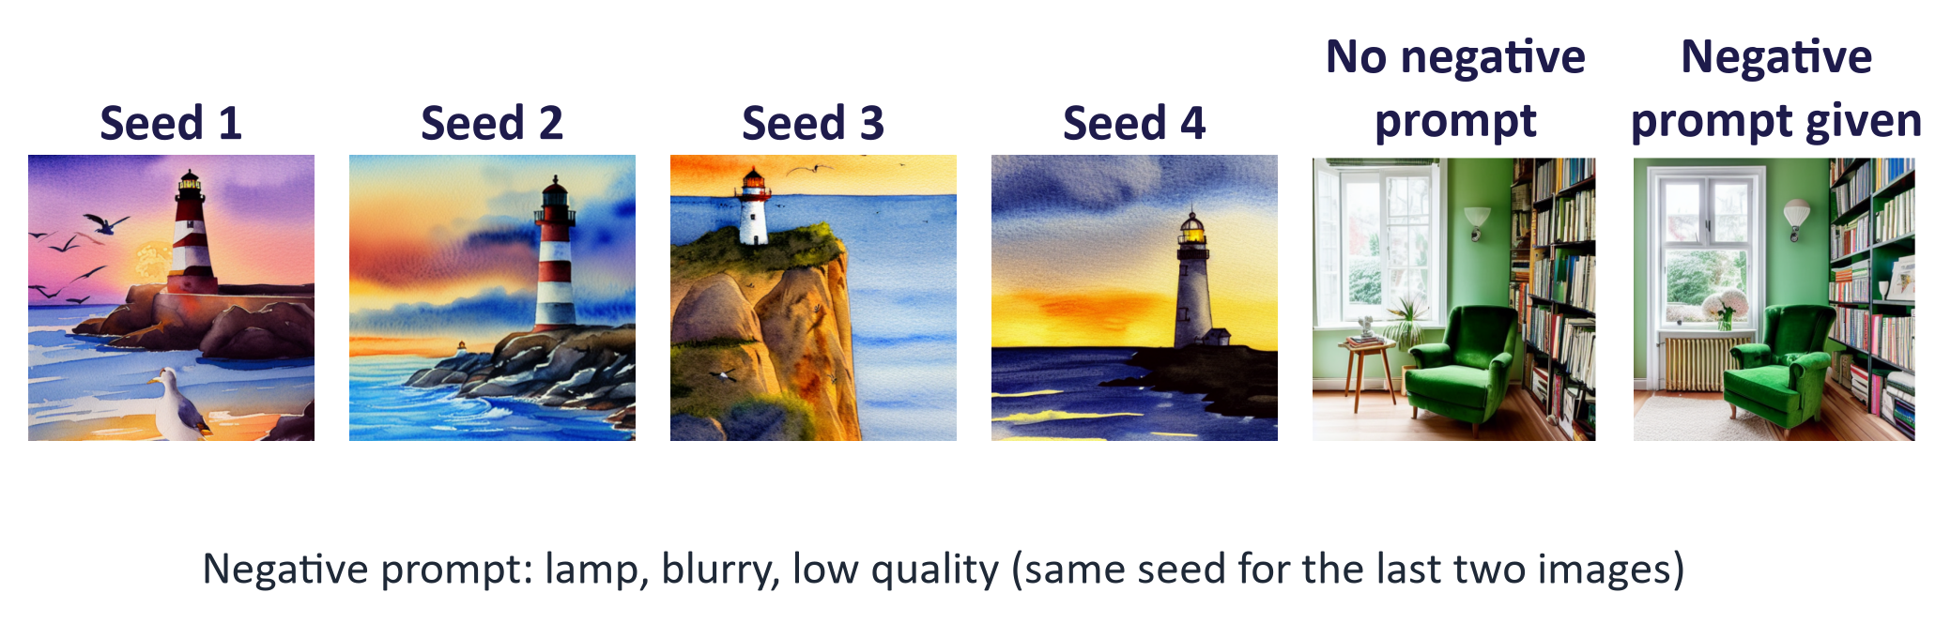
WEEK 04 · DIFFUSION MODELS
Seeds and negative prompts
Seeds 1–4: same prompt and settings, different starting noise, so four different pictures.
Right pair: the same seed, with and without the negative prompt "lamp, blurry, low quality".
The lamp is still there: a negative prompt pushes away from features; it cannot guarantee removal.
Generative AI · MSc in Artificial Intelligence
34
Notes:
A seed sets a random-number sequence, rather than directly naming an image. Holding seed and settings fixed makes controlled comparisons easier within the same setup. Exact results can still vary across hardware, software, model versions or nondeterministic operations. A negative prompt supplies an alternative condition in guidance and encourages movement away from its features. It cannot guarantee removal. Ask students to record all controls and inspect actual images.
Figure discussion prompts: Seed sets the random-number sequence. Record model, sampler, software and settings. Negative prompts supply a guidance reference. Neither control guarantees a correct picture.

Slide 35

05
Variants, evaluation and responsible use
What has changed since Stable Diffusion, and how do we judge the results?
Notes:
The final section brings us to the current state of the field. Flow matching and rectified flow, used by Stable Diffusion 3 and FLUX; few-step distillation, with a real SD-Turbo example; the many variants for editing, control, video and audio; how to evaluate image generators; a comparison of all the generative families so far; and responsible use, including copyright and memorisation, which are live issues for diffusion models.

Slide 36
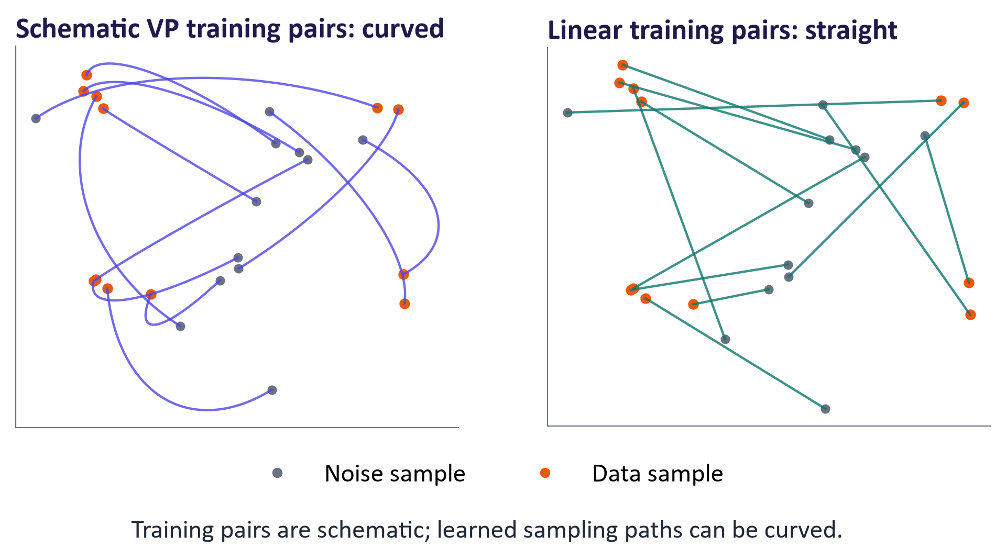
WEEK 04 · DIFFUSION MODELS
Flow matching and rectified flow: straighter paths
Generative AI · MSc in Artificial Intelligence
36
Notes:
Flow matching, introduced by Lipman and colleagues and in rectified flow by Liu and colleagues in 2022, learns a velocity field that transports noise to data along simple paths, usually straight lines between a noise sample and a data sample. The panel compares schematic paired training paths. The learned marginal velocity generally averages possible pairwise targets, so generated trajectories need not follow one straight training pair. Efficiency depends on training, model and numerical solver. Conceptually they are close relatives of diffusion: both learn to turn noise into data gradually with a regression loss.
Ask which paths are shown: paired training interpolations, not measured sample trajectories. The regression fits a marginal field across many possible pairings. The sample solver follows that learned field, which can curve.

Slide 37
WEEK 04 · DIFFUSION MODELS
The flow-matching objective
Read it as
Symbols
Here t = 0 is data; t = 1 is noise.
Train velocity towards ε − x₀.
Generate by integrating backwards from noise.
x₀
data sample
ε
noise sample
v_{θ}
predicted velocity
Generative AI · MSc in Artificial Intelligence
37
Notes:
The objective is as simple as DDPM's. Mix a data point and a noise sample with a linear interpolation, and train the network to predict the constant velocity of that straight path, the noise minus the data. At sampling time, start from noise and integrate the learned velocity field back to the data with a few ODE steps. Warn students that sign and time conventions vary between papers: some write the data at time one. The important ideas are the linear path, the velocity target and the regression loss. In the lab, the optional extension converts the MNIST model to flow matching with a two-line change.

Slide 38
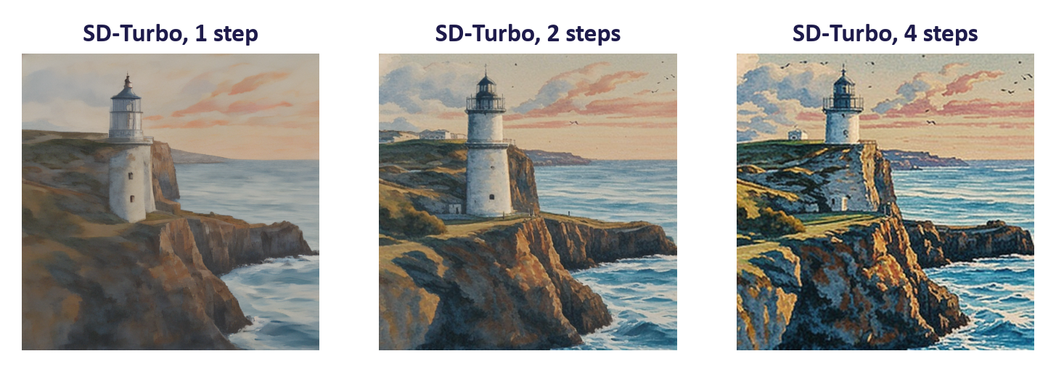
WEEK 04 · DIFFUSION MODELS
Few-step generation with a distilled model (SD-Turbo)
One distilled model at 1, 2 and 4 steps, with no guidance.
Time on the lecture CPU: 25 s for 1 step, 46 s for 4; SD 1.5 with 25 steps took 419 s.
Costs: fixed 512 × 512 size, less variety and weaker control from negative prompts.
Generative AI · MSc in Artificial Intelligence
38
Notes:
A real result from SD-Turbo, released by Stability AI in 2023. It was distilled from Stable Diffusion 2.1 using adversarial diffusion distillation, which combines a distillation loss with a GAN discriminator, connecting last week and this week. With one step it already produces a coherent image, and four steps add detail. Compare with the twenty-five steps and classifier-free guidance, meaning fifty network calls, used on the previous slides. The timings measured on the lecture machine are in the notes. The costs: fixed resolution, somewhat less diversity, and weaker control through negative prompts, since guidance is disabled.
Figure discussion prompts: SD-Turbo distils Stable Diffusion 2.1. Use 1–4 steps; guidance disabled. Negative prompts have no effect in this path. Measure time, detail and prompt fit.

Slide 39






WEEK 04 · DIFFUSION MODELS
Beyond text-to-image: diffusion variants
Editing
Control
Personalisation
Partly noise a photo, then denoise with a new prompt; inpainting repaints only a masked area.
ControlNet makes the image follow an edge map, depth map or body pose.
Teach a new subject from a few images (for example LoRA, week 8), only with consent.
Video
Audio
Science
Denoise many frames together so that objects move consistently.
Generate music or speech as spectrograms or compressed audio codes.
Propose protein structures or molecules for experts to test in the lab.
Generative AI · MSc in Artificial Intelligence
39
Notes:
Diffusion is a general recipe, so it has spread far beyond text-to-image. Editing methods exploit the coarse-to-fine structure: noise an existing image partly, then denoise with a new prompt; inpainting restricts changes to a mask. ControlNet adds a trainable copy of the encoder that reads structural conditions such as edges, depth maps or human pose. Personalisation methods, including LoRA, which we study in week 8, teach a model a new subject from a handful of images. Video models extend diffusion transformers to space and time; audio models diffuse in spectrogram or codec latent spaces. In science, diffusion designs proteins and forecasts weather. Week 10 revisits video and audio.

Slide 40
WEEK 04 · DIFFUSION MODELS
Evaluating image generators
Aspect | How to measure it | Watch out for
Realism and coverage | FID or KID against real images | Depends on the feature network and the number of images
Prompt fit | CLIP similarity of image and prompt | Can miss counts and positions ("three cubes")
Objects and relations | Detector-based tests, such as counting the cubes | The detector makes its own mistakes
Human preference | People rate or rank images | Needs a rubric, several raters and agreement
Cost | Seconds and memory per image | Always state the hardware
Generative AI · MSc in Artificial Intelligence
40
Notes:
Compare several sources of evidence. FID compares feature means and covariances; it depends on the feature network, reference set and sample count. CLIP similarity measures one image-text relationship and can miss counts or spatial errors. Detector-based compositional tests inherit detector errors. Human ratings need a clear rubric, several raters and reported agreement. Analogy: assess a meal by taste, nutrition, cost and consistency rather than one score. Ask which test would catch a request for three objects that produces two. Common mistake: treating one automatic metric or a preference vote as complete validation.

Slide 41
WEEK 04 · DIFFUSION MODELS
Comparing the generative families (weeks 2–4)
 | VAE | GAN | Diffusion | Flow matching
Learns to | Rebuild the input + KL (ELBO) | Fool a learned checker | Predict the added noise | Predict a velocity (direction)
Typical quality | Often blurry | Often sharp | Detailed | Detailed
Typical coverage | Usually broad | Can collapse | Usually broad | Usually broad
Generation cost | One pass | One pass | Many steps; fewer if distilled | Several solver steps
Typical role today | Latent spaces, compression | Fast, sharp outputs | Image, video, audio | Image generation (SD 3, FLUX)
Generative AI · MSc in Artificial Intelligence
41
Notes:
This table completes the comparison with other generative models required by the descriptor and is a strong revision aid. It also shows how the families work together in practice: the VAE provides the latent space, diffusion or flow matching does the generation, and GAN losses keep decoders sharp and help distil fast samplers. Transformers, next week, supply both the text encoder and, increasingly, the denoiser backbone. Encourage students to use this table to structure an exam answer on choosing a model family.

Slide 42

WEEK 04 · DIFFUSION MODELS
Responsible AI lens: diffusion models
Rights: models learned from scraped images; check licences before commercial use.
Memorisation: images repeated in training can be regenerated almost exactly.
Bias: audit who appears for prompts such as "a CEO" or "a nurse".
Disclosure: label generated images and keep provenance (EU AI Act Article 50).
Report the compute and energy of your actual workload.
Generative AI · MSc in Artificial Intelligence
42
Notes:
Each point is a live issue. Copyright: diffusion models were trained on large scraped datasets such as LAION, and courts in several countries are considering claims by artists and image libraries; students should not assume training use is settled law. Memorisation: Carlini and colleagues showed that images duplicated many times in training can be regenerated almost exactly, a privacy and copyright risk. Bias audits of Stable Diffusion found strong occupational and racial stereotypes. Safety filters and source history (provenance) tools help, and Article 50 distinguishes provider marking from deployer disclosure of deepfakes and certain public-interest text, with scope and exceptions; consult the official text. In the lab, the pipeline's safety checker is discussed rather than removed silently.

Slide 43
WEEK 04 · DIFFUSION MODELS
Build diffusion, then inspect a pipeline
Connect the small model's mechanics with a pretrained text-to-image system.
signal/noise
trained point
trained image
images + prompt +
intuition
predictor
denoiser
sampler evidence
settings
Visualise
Learn on
Learn on
Compare
Generate from
noising
points
digits
samplers
text
Evaluate runs
View chosen
Train a 2-D
Train
Full DDPM;
Encode; update
Check time, fit
corruption levels.
noise predictor.
image-shaped
50-step DDIM.
latent; decode.
and failures.
prediction.
grid / clip_score
q_sample / abar
EpsMLP
TinyUNet
sample_ddim
pipe / generate
Model
Output
data flow
Check: Why might changing guidance have no effect in the CPU fallback?
Generative AI · MSc in Artificial Intelligence
43
Notes:
The lab begins with a system small enough to inspect. Noising a digit exposes the meaning of the schedule. A two-dimensional point model then makes the reverse trajectory visible before you train an image network. Both networks use the same noise-prediction loss. Comparing DDPM and DDIM separates the denoiser from the sampler: fixed learned weights can support different generation procedures. The pretrained text-to-image pipeline adds components. A text encoder represents the prompt, a denoiser updates a compact image latent, a scheduler controls the updates, and a VAE decoder turns the result into pixels. The generate wrapper calls these components through pipe; it does not train them. Keep one setting change per comparison and record the active model path, because the CPU fallback uses SD-Turbo with guidance disabled. Finally, CLIP similarity measures prompt-image agreement in one embedding space; combine it with timing and careful visual inspection.
Worked example:
Inspect q_sample at t = 0 and t = 999; index 0 already adds a small amount of noise.
On the 2-D swiss roll, compare reverse snapshots with the real point cloud.
Train TinyUNet with diffusion_loss, then record time and visual results for DDPM and DDIM.
generate fixes a seed while changing steps or guidance; the CPU SD-Turbo fallback forces guidance to zero.
clip_score compares image and prompt embeddings; also inspect object counts and visible artefacts yourself.
Check: Why might changing guidance have no effect in the CPU fallback?
Answer: The generate wrapper forces guidance to 0.0 for the SD-Turbo fallback, so the requested guidance value is not used.

Slide 44


WEEK 04 · DIFFUSION MODELS
Lab 4: train a diffusion model and use Stable Diffusion
1
Create and inspect noisy examples.
Runtime
GPU recommended for images. About 17 min on a laptop CPU (SD-Turbo) after downloads
2
Train point and image denoisers.
3
Compare full DDPM with DDIM.
Time
2-hour lab
4
Load a pretrained latent pipeline.
5
Change one control per comparison.
Hand in
Models, figures, sampler timings, alignment table, three answers
6
Measure time, alignment and failures.
Generative AI · MSc in Artificial Intelligence
44
Notes:
The lab has two halves. First, students implement the forward process and the training and sampling loops themselves, on 2-D data where everything is fast, and then on MNIST with a tiny U-Net (six epochs on a Colab GPU, two on a CPU). Second, they use the Hugging Face Diffusers library with Stable Diffusion 1.5 and SD-Turbo, sweeping the controls we discussed and measuring time. They finish with a small evaluation using CLIP score, which previews week 9, and a failure case. Remind students that Stable Diffusion's licence has use restrictions, and that generated images of real people are not permitted in the lab.

Slide 45





WEEK 04 · DIFFUSION MODELS
Read, watch, practise
Foster (2023) Generative Deep Learning, 2nd ed., ch. 8 'Diffusion Models'
Core module text
Lilian Weng: What are diffusion models?
Derivations, samplers, guidance
Ho, Jain & Abbeel (2020) Denoising Diffusion Probabilistic Models
The DDPM paper
Jay Alammar: The Illustrated Stable Diffusion
Pipeline explained visually
Hugging Face Diffusion Models Course
Free units with notebooks (Diffusers)
MIT 6.S184: Flow Matching and Diffusion Models
Lecture notes for flow matching
3Blue1Brown / Welch Labs: But how do AI images and videos actually work?
Visual explanation including CLIP and guidance
Rombach et al. (2022) Latent Diffusion Models
Stable Diffusion's architecture
Generative AI · MSc in Artificial Intelligence
45
Notes:
Foster chapter 8 builds a diffusion model step by step in Keras. The DDPM paper is short and readable after today. The Hugging Face Diffusion Models Course is the best hands-on follow-up and uses the same Diffusers library as the lab. The Welch Labs video on the 3Blue1Brown channel is an excellent visual explanation, including classifier-free guidance. Lilian Weng's post covers the maths in depth; Jay Alammar's illustrated guide explains the pipeline; the MIT course notes are the reference for flow matching. All links were checked in September 2026.

Slide 46
WEEK 04 · DIFFUSION MODELS
Week 4: what we learned
Fixed forward process
Learned noise predictor
Repeated generation
Create noisy examples directly
Train one denoiser using squared
Start from fresh noise; reuse fixed
from clean data, a timestep and
error against the noise you added.
weights at decreasing noise
known noise.
levels.
Latent image pipeline
Controls and speed
Evaluate and record
Text encoder, denoiser, sampler
Use compatible samplers; test
Check prompt fit, realism, variety,
and VAE decoder have separate
guidance, seeds and distilled step
time, rights and visible failures.
jobs.
counts.
Example to explain aloud
Illustrative noising: x₀ = 1, ᾱₜ = 0.64, ε = −0.5 gives xₜ = 0.8 − 0.3 = 0.5.
Next: in Week 5 we see how attention lets transformers combine information from tokens.
Exit question: Does 50-step DDIM require 50 separately trained denoisers?
Generative AI · MSc in Artificial Intelligence
46
Notes:
Use the arithmetic strip to ask students to separate clean data, noisy input and known target noise. The denoiser sees the noisy value and timestep, not the target. Then ask for the generation path, where there is no known original image. Point to the separate pipeline jobs and ask when pixels appear: after the VAE decoder. Ask the exit question before revealing its answer. Revisit the difference between valid DDIM schedule jumps and truncating the DDPM loop. Close by asking what CLIP similarity can miss, such as object counts, and which settings must accompany an experiment for useful comparison.
Exit question: Does 50-step DDIM require 50 separately trained denoisers?
Answer: No. One denoiser is reused at 50 selected noise levels; the sampling rule changes.
Recap the six points. The key equation is the noise-prediction loss with the closed-form forward process; the key system is the latent diffusion pipeline; the key controls are steps, guidance, seed and negative prompt. Next week we open the black box that appears everywhere in today's pipeline: the transformer and its attention mechanism, which powers the text encoder, the diffusion transformer and, in week 6, large language models. Ask students to finish the lab and read Foster chapter 8.

