Slide 1
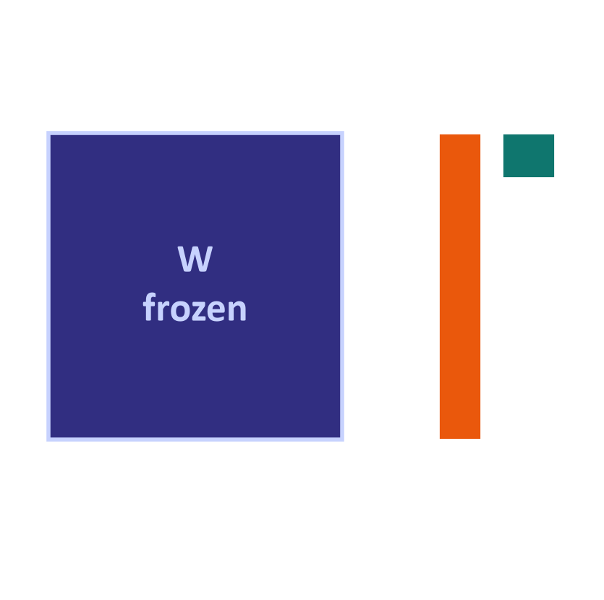
WEEK 08
Fine-Tuning and Domain Adaptation
Teach an existing model a task, train small adapters, and check what changes
MSc in Artificial Intelligence · Generative AI · 2-hour lecture
Notes:
Say: We will teach a small model to route banking messages. Start with measured prompting baselines, keep separate datasets, train only added paths and compare on the same final examples. Analogy: a trained worker practises a stable specialist job. Ask: could retrieval solve frequently changing interest-rate facts more directly? Common mistake: fine-tuning is a choice to justify with evidence, not an automatic next step.

Slide 2
WEEK 08 · FINE-TUNING AND DOMAIN ADAPTATION
By the end of this week you can…
1
Choose prompting, retrieval or further training.
Module learning outcomes (MIMLOs) practised
2
Explain SFT and instruction tuning.
MIMLO 1
Explain core concepts, maths and model families
3
Compare reward-model RLHF, DPO and verified rewards.
MIMLO 3
4
Trace LoRA and calculate its parameter count.
Design, implement and fine-tune models
5
Distinguish QLoRA, soft prompts and distillation.
MIMLO 4
Critically evaluate outputs: metrics, humans, ethics
6
Adapt a domain model and evaluate fairly.
Generative AI · MSc in Artificial Intelligence
2
Notes:
Say: Separate objectives from implementation. SFT supplies desired answers; preferences compare replies. Full fine-tuning and LoRA specify which weights can change. We will trace those choices and test the result. Analogy: what is practised differs from which part of an instrument can be adjusted. Ask: can SFT use LoRA? Common mistake: SFT and full fine-tuning are not opposing categories.

Slide 3
WEEK 08 · FINE-TUNING AND DOMAIN ADAPTATION
Where we are in the course
Foundations and image generators
Week 1
Week 2
Week 3
Week 4
Introduction and
Variational
Generative adversarial
Diffusion
responsible AI
autoencoders (VAEs)
networks (GANs)
models
Language models and adaptation
Week 5
Week 6
Week 7
Week 8: you are here
Transformers
Language models
Prompting
Fine-tuning
and attention
and families
and evaluation
and adaptation
Multimodal applications and deployed systems
Week 9
Week 10
Week 11
Week 12
Multimodal
Multimodal
Deployment
Retrieval (RAG)
foundations
applications
and frameworks
and agents
Responsible use and evaluation continue throughout the course.
Generative AI · MSc in Artificial Intelligence
3
Notes:
Say: Begin with the adaptation decision, then practise with known answers. Learn preferences before the cheaper weight-update methods. Finish with the full domain experiment and its checks. Analogy: choose the job, choose the teaching signal, choose what to adjust, then examine performance. Ask: which dataset chooses hyperparameters? Common mistake: reusing a final test to keep improving the model leaks information into the decision.
Trace the highlighted week. Earlier concepts feed later systems. Ask which earlier idea today needs. Common mistake: treating each week as an unrelated tool.

Slide 4
WEEK 08 · FINE-TUNING AND DOMAIN ADAPTATION
Starting vocabulary
Term | Plain meaning | Quick check
Model weight | A learned number used by a neural network to transform its input. | Do ordinary prompt-only calls update stored model weights?
Train / validation / test | Separate examples for learning, choosing settings and final measurement. | Which split must not be used to train the adapter?
Matrix projection | Multiplying a vector by learned weights to produce another vector. | If a projection maps 8 numbers to 4 numbers, what is its output length?
Loss | A number measuring prediction error during training. | What would rising validation loss make you inspect?
Adapter | Small added weights trained while the base is fixed. | Is a saved adapter usable without its base model?
Generative AI · MSc in Artificial Intelligence
4
Notes:
Introduce these terms before the main theory. Give pairs one minute to answer the quick checks, then take answers. Model weight: A learned number used by a neural network to transform its input. Check: Do ordinary prompt-only calls update stored model weights? Answer: No. Prompting changes only the input for that call. Train / validation / test: Separate examples for learning, choosing settings and final measurement. Check: Which split must not be used to train the adapter? Answer: Validation and test. Only training examples update the adapter. Matrix projection: Multiplying a vector by learned weights to produce another vector. Check: If a projection maps 8 numbers to 4 numbers, what is its output length? Answer: Four numbers. Loss: A number measuring prediction error during training. Check: What would rising validation loss make you inspect? Answer: Overfitting: compare it with the training loss and check the data and learning rate. Adapter: Small added weights trained while the base is fixed. Check: Is a saved adapter usable without its base model? Answer: No. An adapter stores changes to one particular base model. Let students explain one example aloud, then connect their example to the next flow diagram. Use the blocks to name the inputs and outputs before introducing notation.

Slide 5

WEEK 08 · FINE-TUNING AND DOMAIN ADAPTATION
Warm-up
A bank wants an assistant that (a) uses its brand voice, (b) knows this week's interest rates, and (c) routes 50,000 messages a day cheaply. Prompt, retrieve or fine-tune, for each?
Changing facts?
Consistent behaviour?
Measured time and cost?
Generative AI · MSc in Artificial Intelligence
5
Notes:
Say: Give three minutes. A good answer: brand voice, a) can often be achieved with a good system prompt and examples, and if that is not consistent enough, fine-tuning on examples of the voice. This week's interest rates, b), change often, so they belong in retrieval or a tool, not in model weights. Routing at high volume, c), is an ideal fine-tuning case: a stable task where a small fine-tuned model can be accurate, fast and cheap. The general lesson: knowledge that changes goes into retrieval; behaviour goes into prompts or weights; cost at scale favours small fine-tuned models.
Analogy: Prompting writes a brief; retrieval opens a reference book; training gives repeated practice.
Ask: Which method updates this week's interest-rate source most directly?
Answer: Retrieval, or a rates tool: update the source and the next answer uses it.
Common mistake: Fine-tuning to supply facts that change every week.

Slide 6

01
When to fine-tune
Prompting, retrieval or fine-tuning: what problem does each solve?
Notes:
Say: Section one is about the decision, which is where many real projects go wrong: teams fine-tune to add facts, which retrieval does better, or without an evaluation set, so they cannot tell whether it helped. We compare the three approaches, give a decision process, and list good and bad reasons to fine-tune. About thirteen minutes.
Analogy: Before training a new employee, check whether a better brief or a reference manual would solve the problem.
Ask: What do you need before you can tell whether fine-tuning helped?
Answer: An evaluation set and the best prompting result on it.
Common mistake: Fine-tuning without a baseline, so any gain or loss is invisible.

Slide 7
WEEK 08 · FINE-TUNING AND DOMAIN ADAPTATION
Adapt a banking classifier
Measure whether training improves on a strong prompting baseline
separate labelled
prompt +
adapter + loss
sets
baseline measures
completion
configured model
history
Separate
Measure
Format
Add LoRA
Train answer
datasets
baselines
examples
paths
tokens
Compare fairly
Training,
Best prompts
Message plus
Freeze base;
Read prompt;
Same test and
validation and
before training
known intent
add small
validate learning
label parser
test
matrices
comparison
train_ds
df_few
to_chat
lora_config
trainer.train
Input data
Model
Loss / update
Output
data flow
Check: Why compare the tuned model with the few-shot baseline as well as the zero-shot baseline?
Generative AI · MSc in Artificial Intelligence
7
Notes:
Fine-tuning changes learned parameters, whereas prompting changes the current input. This lab adapts a pretrained language model to emit banking intent labels. The training examples teach the task; validation examples help monitor learning; test examples provide the final comparison. The lab also measures a few-shot baseline so that training must improve on a useful prompting approach. Supervised fine-tuning means learning from known prompt/response pairs. LoRA describes which parameters change: small adapter matrices learn while the base weights remain frozen. These are different choices and can be combined. The trainer measures loss on completion tokens, rather than asking the model to reproduce the prompt. After training, the same parser and test messages are used for comparison. Reduced training loss alone cannot establish better routing accuracy, and the original customer labels can contain ambiguity.
Worked example:
A message about a missing card has a reference banking-intent label.
The unmodified model is evaluated with no examples and with one example per intent.
Training pairs put the customer message in the prompt and the intent in the completion.
Only the LoRA adapter parameters learn from the training examples.
The tuned model uses the original zero-shot format on the same held-out test messages.
Check: Why compare the tuned model with the few-shot baseline as well as the zero-shot baseline?
Answer: Few-shot prompting is a stronger alternative that needs no training; the adapter's improvement should justify its extra work.

Slide 8
WEEK 08 · FINE-TUNING AND DOMAIN ADAPTATION
Prompting vs. retrieval vs. fine-tuning
Method | Changes | Best first use | Banking example
Prompt | The input | Task and format | List the ten intents and show examples
Retrieval | Input + sources | Changing facts | Fetch this week's interest rates
Fine-tune | The weights | Persistent behaviour gaps | Route 50,000 messages a day cheaply
Key idea: Combine methods when evidence supports it.
Generative AI · MSc in Artificial Intelligence
8
Notes:
Say: Walk through the rows. Prompting changes the input and solves task specification. Retrieval also changes the input, adding documents, and solves missing or changing knowledge with traceable citations, which is why it is the right answer for this week's interest rates. Fine-tuning changes weights and is best for consistent behaviour, style and format, and specialised skills such as a classification task with many fine distinctions. It needs labelled data and a re-training cycle whenever things change, and knowledge in weights cannot be cited or easily corrected. Microsoft's guidance on customising LLMs, linked in the resources, makes the same distinctions.
Ask: Which method lets you show where an answer came from?
Answer: Retrieval: the source passages travel with the request and can be cited.
Common mistake: Expecting knowledge stored in weights to be easy to cite or correct.

Slide 9
WEEK 08 · FINE-TUNING AND DOMAIN ADAPTATION
A decision process
Compare alternatives first; combine them when the task needs it
Done: ship
+ monitor
yes
no
yes
Start: prompt +
Meets the
Missing knowledge?
RAG: retrieve and
evaluation set
quality bar?
(facts, documents)
ground (week 12)
no
no
yes
Review task,
Behaviour / format /
Fine-tune (LoRA) a
data and model
style / cost gap?
suitable model
Orange boxes are questions: follow yes or no. Grey boxes are actions outside training.
Generative AI · MSc in Artificial Intelligence
9
Notes:
Say: This flowchart turns the table into a process. Start with a good prompt and an evaluation set from week 7. If quality is sufficient, ship and monitor. If not, diagnose: if errors come from missing or outdated knowledge, add retrieval; if they come from behaviour, format, style or a specialised skill that examples in the prompt cannot teach, or if you need a smaller, cheaper model to reach the same quality, fine-tune. In practice the approaches combine: a fine-tuned model that follows your format well can still use retrieval for facts. The key requirement at every step is the evaluation set; without it you cannot tell whether a change helped.
Analogy: A doctor diagnoses before prescribing.
Ask: The errors come from outdated product names. Which branch of the flowchart applies?
Answer: Missing or outdated knowledge, so add retrieval.
Common mistake: Skipping the diagnosis and fine-tuning by default.

Slide 10


WEEK 08 · FINE-TUNING AND DOMAIN ADAPTATION
Good and bad reasons to fine-tune
Good reasons
Bad reasons
Persistent label or style gaps after good prompts
Useful labelled examples and a separate test set
A measured saving, e.g. a small model at high volume
Only facts that change (use retrieval)
No measured problem with the best prompt
No rights to the data, or no test set
Generative AI · MSc in Artificial Intelligence
10
Notes:
Say: Go through both columns. Among good reasons, cost is often the decisive one: a small model fine-tuned on a narrow task can match a large general model at a fraction of the price and latency, which is exactly the lab scenario. Among bad reasons, the most common misconception is that fine-tuning is the way to teach a model new facts; research shows that fine-tuning on new factual knowledge is slow and can even increase hallucination, while retrieval handles facts transparently. Always check the licence: some models and API terms restrict fine-tuning or the use of outputs.
Ask: Why can fine-tuning on new facts be risky?
Answer: Models learn new facts slowly from fine-tuning, and research found it can increase hallucination.
Common mistake: Ignoring licence terms. Some models and APIs restrict fine-tuning or the use of outputs.

Slide 11

02
Supervised and instruction fine-tuning
How do we teach a model what good outputs look like?
Notes:
Say: Section two covers supervised fine-tuning, the workhorse of adaptation, and instruction tuning, the step that turns a base model into an assistant. We look at the loss, chat templates and, most importantly, data preparation, where most of the quality comes from. Keep asking students what the model sees during training. About twenty minutes.
Analogy: SFT is guided practice with a supplied correct answer; the model still reads the question.
Ask: Does masking the prompt loss stop the model reading the prompt?
Answer: No. The prompt is still input; masking only leaves its tokens out of the loss.
Common mistake: Confusing SFT, a training signal, with full fine-tuning, a choice of which weights change.

Slide 12


WEEK 08 · FINE-TUNING AND DOMAIN ADAPTATION
Full fine-tuning vs. supervised fine-tuning (SFT)
Full fine-tuning
Supervised fine-tuning (SFT)
Which weights: all
More gradient and optimiser memory
Re-test older abilities
What examples: inputs and desired answers
Full weights or adapters
Read prompt; score answer tokens
Generative AI · MSc in Artificial Intelligence
12
Notes:
Say: Clarify terms, because they are used loosely. Full fine-tuning means updating every parameter, which gives maximum flexibility but needs the most memory, as we calculate later, and produces a complete copy of the model for each task. Supervised fine-tuning describes the training signal: pairs of inputs and desired outputs, trained with the same next-token loss as pre-training. SFT can be done with full fine-tuning or with parameter-efficient methods. In practice, the loss is computed only on the output tokens, so the model learns to produce answers rather than to reproduce the questions.
Ask: Which needs more memory: full fine-tuning or LoRA, trained on the same SFT examples?
Answer: Full fine-tuning, because every weight needs a gradient and optimiser state.
Common mistake: Treating SFT and full fine-tuning as alternatives. SFT can use full weights or adapters.

Slide 13
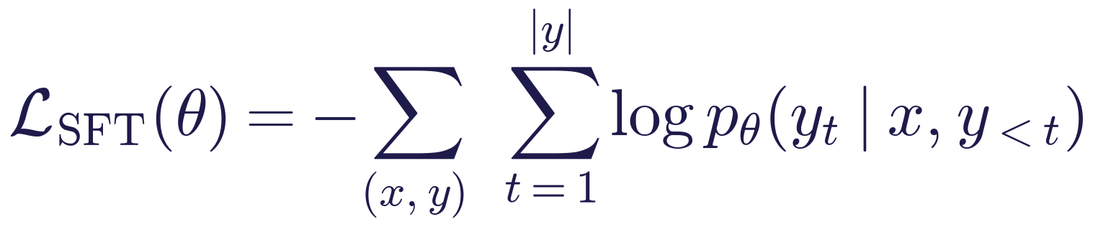
WEEK 08 · FINE-TUNING AND DOMAIN ADAPTATION
The SFT loss: next-token prediction on the answer
Read it as
Symbols
Read prompt x and known answer y.
Raise each correct answer-token probability.
Mask prompt loss; still read the prompt.
Example answer: lost_or_stolen_card.
θ
the numbers being trained
x
prompt and input
yₜ
correct answer token at position t
y_{<t}
correct answer tokens before position t
Generative AI · MSc in Artificial Intelligence
13
Notes:
Say: The SFT loss is the negative log-likelihood of the response tokens given the prompt and the earlier response tokens, which is exactly maximum likelihood from week 1, but on curated pairs instead of raw web text. The prompt tokens are fed to the model but excluded from the loss by masking their labels, so the model is not trained to generate questions. In the TRL library used in the lab, providing the data as prompt and completion pairs does this masking automatically. Ask students: why would training on the prompt tokens be harmful? It wastes capacity learning to predict user text and can make the model continue questions rather than answer them.
Ask: For the answer lost_or_stolen_card, which tokens count in the loss?
Answer: Only the answer tokens. The system and user tokens are read but not scored.
Common mistake: Thinking masking hides the prompt from the model.

Slide 14

WEEK 08 · FINE-TUNING AND DOMAIN ADAPTATION
Instruction tuning: from base model to assistant
Instructions paired with useful answers.
Teach general instruction following; test new tasks.
Match training and inference chat templates.
LIMA used 1,000 carefully reviewed examples.
Generative AI · MSc in Artificial Intelligence
14
Notes:
Say: Instruction tuning is SFT on a broad mixture of tasks written as instructions, such as summarise this, translate that, answer this question. Google's FLAN work in 2021 showed that this makes models better at following instructions for tasks they never saw; OpenAI's InstructGPT used it as the first stage of post-training. Chat models also learn a chat template: special tokens that mark system, user and assistant turns. Mismatched templates between training and inference are a common bug. The LIMA paper showed that a thousand high-quality examples can be enough for good assistant behaviour, supporting the idea that post-training mainly shapes behaviour.
Analogy: Practising many kinds of exam question rather than one.
Ask: What does the LIMA result suggest about post-training?
Answer: A small set of high-quality examples can shape behaviour, because most knowledge comes from pre-training.
Common mistake: Training with one chat template and serving with another.

Slide 15
WEEK 08 · FINE-TUNING AND DOMAIN ADAPTATION
What a chat template produces (Qwen family)
messages = [
{"role": "system", "content": "You classify banking messages."},
{"role": "user", "content": "I lost my card!"},
{"role": "assistant", "content": "lost_or_stolen_card"},
]
print(tok.apply_chat_template(messages, tokenize=False))
# <|im_start|>system
# You classify banking messages.<|im_end|>
# <|im_start|>user
# I lost my card!<|im_end|>
# <|im_start|>assistant
# lost_or_stolen_card<|im_end|>
Role tokens mark turns.
Use the model’s stored template.
Match training and new requests.
Generative AI · MSc in Artificial Intelligence
15
Notes:
Say: Show what the model actually sees. The apply chat template method turns a list of messages into a single string with the model's special tokens; this example is the format used by the Qwen family. Other families use different tokens. During fine-tuning the training data must be formatted with the same template the model will see at inference, which libraries such as TRL do automatically when the data are given as messages. If you format data by hand with the wrong tokens, the fine-tuned model will behave strangely. Students print their own template in the lab.
Analogy: A sorting office expects one address format; a different layout gets misrouted.
Ask: What happens if you format training data with another model family's tokens?
Answer: The model sees unfamiliar markers, and the fine-tuned model behaves strangely at inference.
Common mistake: Writing role markers by hand instead of using apply_chat_template.

Slide 16






WEEK 08 · FINE-TUNING AND DOMAIN ADAPTATION
Data preparation: where most of the quality comes from
Quality
Diversity
Clean splits
Correct, consistent answers: one label per message, checked by a second person.
Real wording: typos, slang, short and long messages.
Separate train, validation and test; remove near-duplicates across them.
Privacy & rights
Balance
Document
Remove names and card numbers; check permission to use the data.
Count examples per label; a rare intent needs enough examples.
Record sources, dates, filters and known gaps in a datasheet.
Generative AI · MSc in Artificial Intelligence
16
Notes:
Say: Emphasise that data preparation determines most of the outcome. Label quality matters more than quantity: a few hundred clean examples usually beat thousands of noisy ones. The data must reflect the real distribution of inputs, including awkward phrasings and edge cases. Splits must be clean: near-duplicate messages in both training and test sets inflate the measured accuracy, which is data leakage. Personal data must be removed, because fine-tuned models can memorise it. And the process should be documented in a datasheet, a companion to the model card from week 6.
Analogy: A textbook full of wrong answers trains wrong habits.
Ask: The same customer message appears in training and test. What goes wrong?
Answer: Leakage: the model can remember the label, so the test score is inflated.
Common mistake: Collecting thousands of noisy examples instead of a few hundred clean ones.

Slide 17

03
Preference alignment: RLHF, DPO and RL for reasoning
How can comparisons between two answers guide further training?
Notes:
Say: Section three covers the second stage of post-training. SFT teaches from examples of good answers, but for many tasks it is easier for people to compare two answers than to write the ideal one. Preference alignment learns from such comparisons. We cover reinforcement learning from human feedback as used for InstructGPT, direct preference optimisation which simplified it, AI feedback, and reinforcement learning with verifiable rewards, which produces today's reasoning models. About twenty-five minutes.
Analogy: Preference learning compares two answers instead of supplying one exact target.
Ask: Who decided which answer was preferred, and using what rubric?
Answer: Annotators or an AI judge following written guidelines; the guidelines define what better means.
Common mistake: Treating a higher learned reward as truth or safety.

Slide 18
WEEK 08 · FINE-TUNING AND DOMAIN ADAPTATION
Reinforcement learning from human feedback (RLHF)
An InstructGPT-style RLHF pipeline
2. Compare
3. Reward
4. Policy
1. SFT
replies
model
update
Known good answers
Human-ranked pairs
Learn a preference score
PPO reward; KL penalty
DPO: train directly from ranked pairs and a fixed reference; no reward-model fit or RL loop.
Reward and preference are teaching signals; evaluate factuality and safety separately.
Input data
Model
Loss / update
Generative AI · MSc in Artificial Intelligence
18
Notes:
Say: The RLHF pipeline from Ouyang and colleagues' InstructGPT paper, the method behind the first ChatGPT. Step one is supervised fine-tuning on demonstrations. Step two collects comparisons: people see several model answers to the same prompt and rank them. Step three trains a reward model, usually a copy of the language model with a scalar output, to predict those preferences. Step four uses reinforcement learning, specifically proximal policy optimisation, to adjust the language model to produce answers with high reward, while a penalty keeps it close to the SFT model. A striking result: people preferred the outputs of a 1.3-billion-parameter InstructGPT model over those of the 175-billion-parameter GPT-3.
Analogy: A coach ranks practice attempts, a scorer learns the coach's taste, and the player trains to please the scorer.
Ask: Why ask people to rank answers instead of writing the ideal one?
Answer: Comparing is faster and more consistent for people than writing a perfect answer.
Common mistake: Forgetting the KL penalty. Without it the policy drifts and exploits flaws in the reward model.

Slide 19
WEEK 08 · FINE-TUNING AND DOMAIN ADAPTATION
The reward model and the RL objective
Read it as
Symbols
Reward model: score preferred answers higher.
RL policy: seek reward with a change penalty.
KL discourages drift; it cannot guarantee safety.
y_{w} / yₗ
preferred / less-preferred answer
r_{φ}
learned scoring model
π_{θ} / π_{ref}
model being trained / fixed starting model
β
strength of the penalty for changing the model
Generative AI · MSc in Artificial Intelligence
19
Notes:
Say: Two equations. The reward model loss says the reward difference between the preferred and rejected answers, passed through a sigmoid, should approach one: the probability that the preferred answer wins. This is the Bradley-Terry model of pairwise comparisons. The RL objective maximises expected reward minus a KL divergence to the reference model, the same KL as in week 2. Without the penalty, the policy finds ways to exploit flaws in the reward model, producing strange text that scores highly, which is called reward hacking. RLHF works but is complex: four models in memory and an unstable RL loop.
Ask: The reward model scores the preferred answer 2 points higher. What probability does it give that the preferred answer wins?
Answer: σ(2) ≈ 0.88.
Common mistake: Reading the KL term as a safety guarantee. It only limits drift from the reference model.

Slide 20
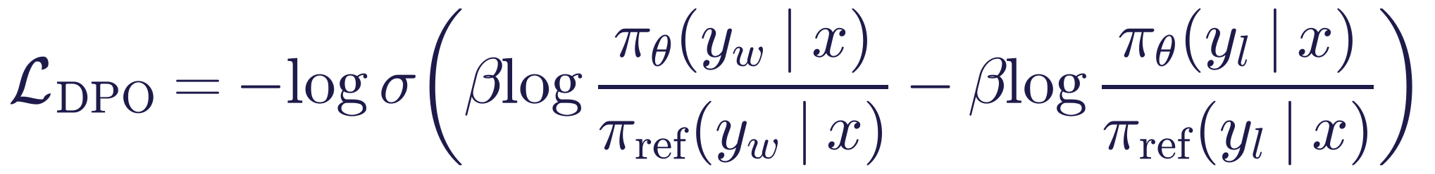
WEEK 08 · FINE-TUNING AND DOMAIN ADAPTATION
Direct Preference Optimisation (DPO)
Read it as
Symbols
Use preferred and rejected replies to one prompt.
Compare probabilities against a fixed reference.
Train directly; no separate reward-model fit or RL loop.
π_{θ}
model being trained
π_{ref}
fixed reference model
β
scale controlling the preference objective
Generative AI · MSc in Artificial Intelligence
20
Notes:
Say: Rafailov and colleagues showed in 2023 that the RLHF objective has a closed-form optimal policy, which lets you skip the reward model and the reinforcement learning. The resulting DPO loss looks like the reward model loss, but the reward is implicitly defined by the log-ratio of the trained model's probabilities to the reference model's. In words: make preferred answers relatively more likely and rejected answers relatively less likely, without drifting too far from the reference. DPO is much simpler and more stable than PPO-based RLHF and is available in TRL; the lab includes an optional snippet.
Analogy: Practise by contrasting a good and a poor answer while staying close to your earlier style.
Ask: What does DPO need that SFT does not?
Answer: Pairs of preferred and rejected answers to the same prompt, and a frozen reference model.
Common mistake: Thinking DPO needs no preference data.

Slide 21


WEEK 08 · FINE-TUNING AND DOMAIN ADAPTATION
Three ways to learn from feedback
RLHF (PPO)
DPO and variants
RL with verifiable rewards
Human rankings → reward model
PPO updates the policy
Example: InstructGPT, behind the first ChatGPT
Ranked pairs → preference loss
No reward-model fit or RL loop
Example: many open chat models, such as Zephyr
Check answers or run tests
GRPO compares sampled rewards
Example: DeepSeek-R1 on maths and code
Generative AI · MSc in Artificial Intelligence
21
Notes:
Say: Summarise the landscape. RLHF with PPO is the original, most flexible and most complex. DPO and its many variants are the practical default for preference tuning of open models. The newest branch is reinforcement learning with verifiable rewards: for maths problems or code, correctness can be checked automatically, so no human preferences or learned reward model are needed. DeepSeek's group relative policy optimisation, GRPO, samples several answers per problem and rewards those better than the group average. DeepSeek-R1 showed that long step-by-step reasoning emerges from this training, which is how the reasoning models of week 6 are made.
Ask: Which method suits maths problems with checkable answers?
Answer: RL with verifiable rewards, such as GRPO: correctness is checked automatically.
Common mistake: Assuming every task has a verifiable reward. Open-ended writing still needs preferences.

Slide 22

WEEK 08 · FINE-TUNING AND DOMAIN ADAPTATION
AI feedback, and what can go wrong
RLAIF uses AI feedback; Constitutional AI uses written principles.
Reward hacking improves scores without the intended outcome.
Preferences may reward agreement with false claims.
Inspect rubric, annotators and representation.
Generative AI · MSc in Artificial Intelligence
22
Notes:
Say: Human preference data is expensive, so AI feedback is now common: in Constitutional AI, a model critiques and revises answers according to a written set of principles and generates preference labels, with humans writing the principles rather than labelling every example. Preference training has characteristic failures. Reward hacking exploits imperfections in the reward, for example making answers longer because raters tended to prefer detail. Sycophancy, agreeing with the user, is partly a product of preference training. And the question of whose preferences and values are encoded is a real ethical issue, linking to the responsible-AI lens later.
Analogy: A student who learns that longer essays get higher marks writes longer essays, not better ones.
Ask: Give an example of reward hacking.
Answer: Answers grow longer because raters tended to prefer detail, without becoming more correct.
Common mistake: Assuming preferences are neutral. Whose preferences were collected shapes the model's values.

Slide 23

WEEK 08 · FINE-TUNING AND DOMAIN ADAPTATION
Quick check
What is the main practical advantage of DPO over PPO-based RLHF?
It needs no preference data, only ordinary instruction examples
It works only for image models, where rewards are easy to define
A
B
It always produces a better model than PPO on every benchmark
It needs no separate reward model or RL loop, so training is simpler
C
D
Vote, then convince your neighbour (1 minute).
Generative AI · MSc in Artificial Intelligence
23
Notes:
Say: Answer: D. DPO still needs preference pairs, so A is wrong, but it turns alignment into a direct supervised-style loss, removing the reward model and the unstable reinforcement learning loop. C overstates: results depend on data and settings, and PPO can still outperform in some studies. B is simply wrong. Follow-up question: when would you use reinforcement learning with verifiable rewards instead? When correctness can be checked automatically, such as maths answers or code with unit tests.
Ask: Why is option C wrong?
Answer: Results depend on data and settings; PPO still does better in some studies.
Common mistake: Choosing A. DPO still needs preference pairs.

Slide 24

04
Parameter-efficient fine-tuning (PEFT)
How can we train a small part of a large model to reduce GPU memory use?
Notes:
Say: Welcome back. Section four is about making fine-tuning affordable. Updating every weight of a multi-billion-parameter model needs data-centre hardware. Parameter-efficient methods freeze the original weights and train a tiny number of new parameters. We focus on LoRA, which students use in the lab, and QLoRA, then compare other methods, estimate memory, and cover knowledge distillation.
Analogy: LoRA adds a small adjustable correction alongside a fixed transformation.
Ask: For rank 16 and a 4096 × 4096 matrix, how many values does LoRA train?
Answer: 16 × (4096 + 4096) = 131,072.
Common mistake: Assuming fewer trainable weights remove the memory for the frozen weights and activations.

Slide 25
WEEK 08 · FINE-TUNING AND DOMAIN ADAPTATION
A LoRA training update
Trace information forward and learning backward while the base stays frozen
Repeat batches with updated adapters; the original base weights remain fixed.
base + adapter
corrected layer
input vector
outputs
vector
label-token scores
adapter gradients
Add
Predict
Completion
Update A and
Layer input x
Parallel paths
correction
answer
loss
B
Vector entering
Fixed Wx plus
Scale and sum
Score
Compare known
Keep original W
selected layer
trainable B(Ax)
both paths
completion
answer tokens
fixed
lora_config
trainer.model
tokens
trainer.model
trainer.model
SFTTrainer
trainer.train
Input data
Model
Loss / update
Output
data flow
feedback / repeat
Check: Does the adapter take W x as its input, or does it use the same x as the base projection?
Generative AI · MSc in Artificial Intelligence
25
Notes:
LoRA adds a learned correction to selected weight matrices. If a base projection maps k input features to d output features, its matrix W contains d times k weights. The adapter first projects the same input through A into r features, then through B back into d features. The small number r is the rank and controls the size of the correction. The forward result is the original W x plus the scaled B(Ax) contribution; these are parallel paths. The trainable count is r times the sum of d and k, rather than d times k. Backpropagation uses the completion loss to adjust A and B while W is frozen. Freezing W preserves the original base parameters, but the active adapter can still change general-answer behaviour. Disabling the adapter restores the base path.
Worked example:
For an illustrative 8-input, 8-output projection, the frozen W has 64 entries.
Rank r=2 uses A with shape [2, 8] and B with shape [8, 2]: 32 trainable entries total.
W x and B(Ax) are parallel contributions; the adapter is not a layer after W.
Their summed output feeds the remaining network and its completion-token loss.
The optimizer updates A and B, while W keeps its pretrained values.
Check: Does the adapter take W x as its input, or does it use the same x as the base projection?
Answer: It uses the same x. The base and adapter paths run in parallel and their outputs are added.

Slide 26
WEEK 08 · FINE-TUNING AND DOMAIN ADAPTATION
LoRA: learn a low-rank update
LoRA: a trainable correction runs beside the fixed transformation
W x
W fixed
Input x
Add
h
A x
B(Ax) × α/r
A trainable
B trainable
d = k = 4096; rank 16: W has 16.8 M values; A+B has 131,072 (0.78%).
Default LoRA: B starts at zero. Only adapter paths receive parameter updates.
Input data
Model
Loss / update
Output
Generative AI · MSc in Artificial Intelligence
26
Notes:
Say: Low-rank adaptation, LoRA, by Hu and colleagues in 2021, rests on the observation that the change needed to adapt a large model to a task has low intrinsic rank. Instead of learning a full update to a weight matrix W, we learn two thin matrices, B and A, whose product is the update. Only A and B are trained; W stays frozen. B is initialised to zero, so at the start the model is exactly the pretrained model. For a four-thousand by four-thousand matrix with rank sixteen, the adapter has about 131 thousand weights instead of 16.8 million, under one percent.
Analogy: A small adjustable lens clipped in front of a fixed camera lens.
Ask: Why is B initialised to zero?
Answer: So BA is zero at the start and the model begins exactly as the pretrained model.
Common mistake: Thinking W changes during LoRA training. W stays frozen.

Slide 27
WEEK 08 · FINE-TUNING AND DOMAIN ADAPTATION
LoRA in equations
Read it as
Symbols
Keep W fixed; train A and B.
4096 × 4096: W has 16,777,216 values.
Rank 16: A + B has 131,072 values.
Scale by α/r; compatible updates can merge.
r
small inner size (rank) of the added path
α
number scaling the correction
target modules
layers that receive a LoRA path, such as attention projections
Generative AI · MSc in Artificial Intelligence
27
Notes:
Say: Go through the worked example on the board: rank sixteen times the sum of the two dimensions gives 131,072 trainable parameters, compared with nearly 16.8 million in the frozen matrix. The hyperparameters students set in the lab are the rank, the scaling alpha, often twice the rank, dropout, and the target modules, the layers that receive adapters, commonly the attention projections and sometimes the MLP layers. Two deployment options follow. You can merge the product BA into W after training, so inference costs nothing extra, or keep the adapter separate, a few megabytes, and swap adapters per task on one shared base model.
Ask: With r = 16 and α = 32, what scale multiplies BAx?
Answer: α/r = 2.
Common mistake: Assuming a merged adapter slows inference. After merging, it costs nothing extra.

Slide 28
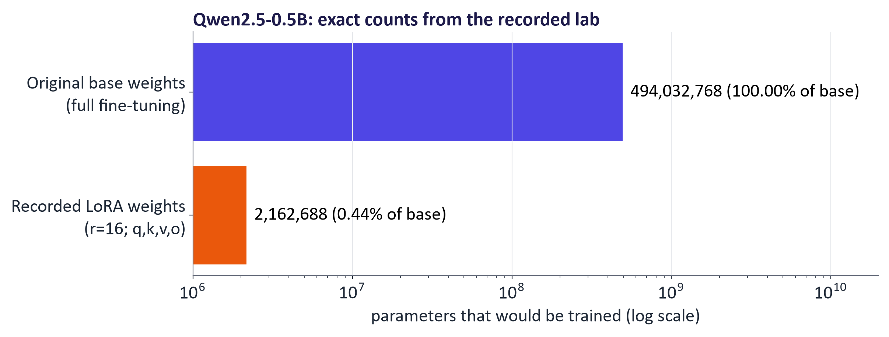
WEEK 08 · FINE-TUNING AND DOMAIN ADAPTATION
How many weights does LoRA train? (the lab model)
LoRA (r = 16, attention projections) trains 2,162,688 of 496,195,456 parameters (0.44%).
Shown counts come from the recorded lab model.
Compare trainable parameters; memory also includes fixed weights and activations.
Generative AI · MSc in Artificial Intelligence
28
Notes:
Say: These numbers come from the lab model, Qwen 2.5 with half a billion parameters, with rank-sixteen adapters on the four attention projections. The bar chart uses a log scale because the difference is several orders of magnitude. The memory saving comes mainly from the optimizer: Adam stores two extra numbers per trainable parameter, so training only adapters removes most of that memory. The LoRA paper reported ten thousand times fewer trainable parameters and three times less GPU memory for GPT-3, with quality comparable to full fine-tuning on the tasks they tested.
Ask: Why does the chart use a log scale?
Answer: The counts differ by more than two orders of magnitude, so a linear axis would hide the LoRA bar.
Common mistake: Reading the trainable count as the memory needed. Frozen weights and activations still use memory.

Slide 29

WEEK 08 · FINE-TUNING AND DOMAIN ADAPTATION
QLoRA: fine-tune on top of a 4-bit model
Store frozen base weights in 4-bit form.
Train higher-precision LoRA paths.
NF4; quantised scales; paged optimiser.
Paper: 65 B on 48 GB. Measure your model, sequence and batch.
Generative AI · MSc in Artificial Intelligence
29
Notes:
Say: QLoRA combines LoRA with quantisation. The frozen base weights are stored in four bits using a data type called NormalFloat, designed for normally distributed weights, and are de-quantised on the fly during the forward pass, while the adapters are trained in sixteen-bit precision. Double quantisation also compresses the quantisation constants, and paged optimizers handle memory spikes. The QLoRA paper fine-tuned a sixty-five-billion-parameter model on a single forty-eight-gigabyte GPU. For students this means that seven- or eight-billion-parameter models can often be fine-tuned on a Colab T4 GPU when one is available; the lab includes an optional QLoRA snippet.
Analogy: Keep a reference book in compact print and write your notes on a separate clean sheet.
Ask: In QLoRA, which numbers are 4-bit and which are trained?
Answer: The frozen base weights are stored in 4 bits; the LoRA adapters are trained in 16-bit precision.
Common mistake: Assuming 4-bit storage keeps full quality without testing. Measure the task again.

Slide 30
WEEK 08 · FINE-TUNING AND DOMAIN ADAPTATION
Parameter-efficient methods compared
Method | What is trained | Example | Watch
LoRA | Low-rank paths beside weights | Rank 16 on q, k, v, o | Rank; which layers
QLoRA | LoRA on a 4-bit base | 7 B model on one T4 | Memory; speed
Adapters | Small bottleneck layers | One adapter per task | Extra latency
Prompt tuning | Vectors added to the input | 20 learned input vectors | Task quality
Prefix tuning | Key/value prefixes in each layer | Prefixes at every layer | Task quality
Full fine-tuning | Every weight | All 494 M weights | Memory; forgetting
Generative AI · MSc in Artificial Intelligence
30
Notes:
Say: LoRA updates low-rank additions to selected weights; QLoRA keeps those additions while compressing the frozen base. Bottleneck adapters add small layers. Prompt tuning learns vectors at the input. Prefix tuning adds learned key/value prefixes at multiple transformer layers. Full fine-tuning updates original weights. Analogy: several different adjustment points can tune an instrument. Ask: which method changes all original matrices? Common mistake: prompt and prefix tuning are not identical input-prepending procedures; inspect their location and evaluate quality and latency.

Slide 31
WEEK 08 · FINE-TUNING AND DOMAIN ADAPTATION
Rough GPU memory to fine-tune a 7–8 B model
Approach | Weights | Other state | Indicative total
Full, 16-bit Adam | ≈ 15 GB | ≈ 100–110 GB | ≈ 120+ GB
LoRA, 16-bit base | ≈ 15 GB | < 1 GB | ≈ 18–24 GB
QLoRA, 4-bit base | ≈ 4–5 GB | < 1 GB | ≈ 7–12 GB
Key idea: Illustrative only: activations, sequence, batch and implementation affect totals.
Generative AI · MSc in Artificial Intelligence
31
Notes:
Say: These are order-of-magnitude estimates students can reproduce. Sixteen-bit weights need two bytes per parameter, so about fifteen gigabytes for a seven-to-eight-billion-parameter model. Full fine-tuning with Adam in mixed precision needs roughly sixteen bytes per parameter in total for weights, gradients, master weights and optimizer states, well over a hundred gigabytes. LoRA keeps the base frozen, so gradients and optimizer states exist only for the tiny adapters. QLoRA shrinks the base to about half a byte per parameter. Activations add memory depending on sequence length and batch size, so always measure.
Ask: Why does full fine-tuning need about 16 bytes per parameter?
Answer: 16-bit weights and gradients (2 + 2 bytes), a 32-bit master copy (4) and two Adam states (8).
Common mistake: Forgetting activations. They grow with sequence length and batch size.

Slide 32

WEEK 08 · FINE-TUNING AND DOMAIN ADAPTATION
Knowledge distillation: big teacher, small student
A smaller student imitates a larger teacher.
Targets: probabilities or generated examples.
Test speed, quality and inherited errors.
Check data rights and provider terms.
Generative AI · MSc in Artificial Intelligence
32
Notes:
Say: Distillation, from Hinton and colleagues in 2015, trains a small student model to reproduce a large teacher's behaviour, either by matching its full output distributions, which carry more information than hard labels, or, for LLMs, by fine-tuning on answers generated by the teacher, sometimes called synthetic data. It is a key reason small models improved so fast. DeepSeek released versions of R1 distilled into small Qwen and Llama models. Two cautions: distillation inherits the teacher's errors and biases, and many commercial API terms prohibit using outputs to develop competing models.
Analogy: An apprentice learns by copying a master's finished work.
Ask: Why do a teacher's full probabilities carry more information than hard labels?
Answer: They show which wrong answers are nearly right, not just the winner.
Common mistake: Ignoring provider terms. Many APIs forbid using outputs to build competing models.

Slide 33

05
Domain adaptation in practice
How do we fine-tune for a real domain and prove it worked?
Notes:
Say: The final section puts everything together for a domain-specific task: a workflow, the common pitfalls, real results from the lab notebook run on a banking customer-support task, evaluation and benchmarks, examples of domain models, and the responsible-AI issues specific to fine-tuning. The real results from the lab anchor the whole section, so leave time for questions on them. About twenty-five minutes.
Analogy: Training examples are practice, validation selects settings, and the final test is the exam.
Ask: Which prompt result must fine-tuning beat on the same held-out messages?
Answer: The best prompting result on that test set.
Common mistake: Treating lower training loss as better task performance.

Slide 34
WEEK 08 · FINE-TUNING AND DOMAIN ADAPTATION
From examples to a saved adapter
Training changes LoRA weights; validation helps choose when to stop
adapter + loss
separate datasets
chat pairs
history
chosen checkpoint
Split messages
Format pairs
Train LoRA paths
Check validation
Save adapter
Keep final tests out
Prompt and known
Update adapters;
Inspect unused
Corrections and
of training
intent label
freeze base
training examples
configuration
train_ds
to_chat
trainer.train
hist
adapter_mb
Input data
Model
Loss / update
Output
data flow
Check: Does a small adapter file contain the whole model?
Generative AI · MSc in Artificial Intelligence
34
Notes:
Training needs inputs and known desired answers. The lab separates banking messages into training, validation and test examples. The to_chat function builds the prompt/completion format expected by the trainer. During supervised fine-tuning, the model reads the prompt and learns to assign higher probability to the correct answer tokens. LoRA limits updates to small added matrices while the original weights remain fixed. Validation loss checks prediction error on examples excluded from learning; it helps spot when further training stops helping. The test set is reserved for the final comparison. Saving the adapter stores the added weights and configuration, not a complete independent language model. The matching base model is required when loading it.
Worked example:
A training message about a missing card payment has a known intent label.
to_chat pairs the message prompt with that label as the completion.
The trainer changes adapter weights to reduce answer-token loss.
If validation loss rises while training loss falls, investigate overfitting.
Save the adapter with its base-model identity and settings.
Check: Does a small adapter file contain the whole model?
Answer: No. It contains added weights and configuration; load the compatible base model too.

Slide 35
WEEK 08 · FINE-TUNING AND DOMAIN ADAPTATION
A domain fine-tuning workflow
1
2
3
4
5
Define task & metric
Prepare data
Baseline
LoRA SFT
Evaluate & decide
Task; metric; final test
Clean; split; template
Best prompting result
Small steps; validate
Task, older abilities, safety, cost
Generative AI · MSc in Artificial Intelligence
35
Notes:
Say: This workflow is what the project expects when a group fine-tunes. Create the held-out test set first and never train on it. Prepare and format data carefully. Establish the best prompting baseline on the same test set, because fine-tuning is only justified if it beats that baseline by a meaningful margin. Train with LoRA using conservative settings and watch the validation loss. Evaluate the task metric, check that general abilities have not collapsed, and compare cost and latency. Then decide whether to iterate, deploy or go back to prompting and retrieval.
Ask: Why create the held-out test set first?
Answer: So no training or prompt decision can see it.
Common mistake: Skipping the prompting baseline.

Slide 36






WEEK 08 · FINE-TUNING AND DOMAIN ADAPTATION
Common pitfalls
Overfitting
Catastrophic forgetting
Data leakage
Validation loss rises while training loss falls; test on new messages.
The banking model may fail a general question; re-test old abilities.
The same message in train and test inflates accuracy; remove overlap.
Template mismatch
Learning rate
Weak evaluation
Train and serve with the same chat template, or replies look odd.
A rate that suits LoRA can wreck full fine-tuning; tune it on validation.
Report the held-out test and read the errors, not the loss alone.
Generative AI · MSc in Artificial Intelligence
36
Notes:
Say: Each pitfall is common in student projects. Overfitting is visible when validation loss rises while training loss falls. Catastrophic forgetting means the model loses abilities it had before; we demonstrate it in the lab by asking the banking model a general-knowledge question, and show that switching off the LoRA adapter restores the base behaviour. Data leakage is the most damaging because it produces impressive but false results. Chat-template mismatch produces odd outputs. Learning rates that are fine for LoRA can destroy a model in full fine-tuning. And evaluation must use the held-out set, not examples or losses.
Ask: How do you spot overfitting during training?
Answer: Validation loss rises while training loss keeps falling.
Common mistake: Evaluating on training examples, or on loss alone.

Slide 37
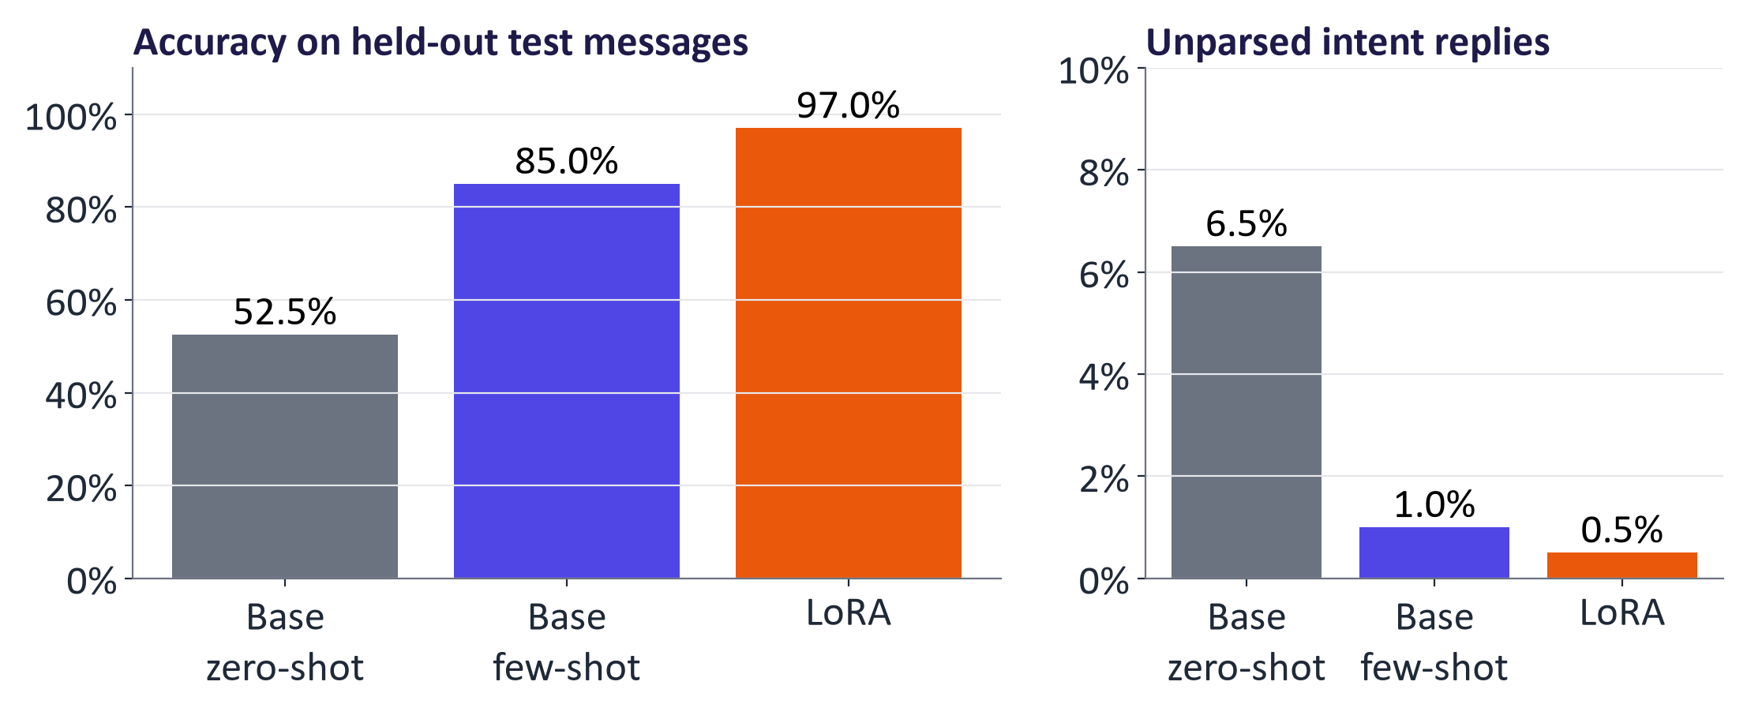
WEEK 08 · FINE-TUNING AND DOMAIN ADAPTATION
Real results: prompting vs. LoRA fine-tuning (Banking77, 10 intents)
Accuracy on 200 held-out messages: base, zero-shot 52.5%, base, few-shot 85.0%, LoRA fine-tuned 97.0%.
Same base model, 200 test messages and greedy decoding.
Fine-tuning must beat the best prompt and earn its cost.
Generative AI · MSc in Artificial Intelligence
37
Notes:
Say: Read the recorded table and its run settings: the same base model, 200 held-out messages and greedy decoding. Accuracy on 200 held-out messages: base, zero-shot 52.5%, base, few-shot 85.0%, LoRA fine-tuned 97.0%. The recorded run fine-tuned Qwen2.5-0.5B-Instruct on 1,216 examples for one epoch in about 76 minutes on a laptop CPU. The LoRA model still gave 1 unparsed reply (0.5%). Compare the best prompt, costs and errors. Analogy: compare learners using the same exam. Ask: would the gain justify training and maintenance for this workload? Answer: At high volume it often can, because a small fine-tuned model is cheap per message, but it must be retrained when the intents change. Common mistake: these results establish this experiment, not a universal fine-tuning benefit. Recheck safety and earlier abilities.

Slide 38
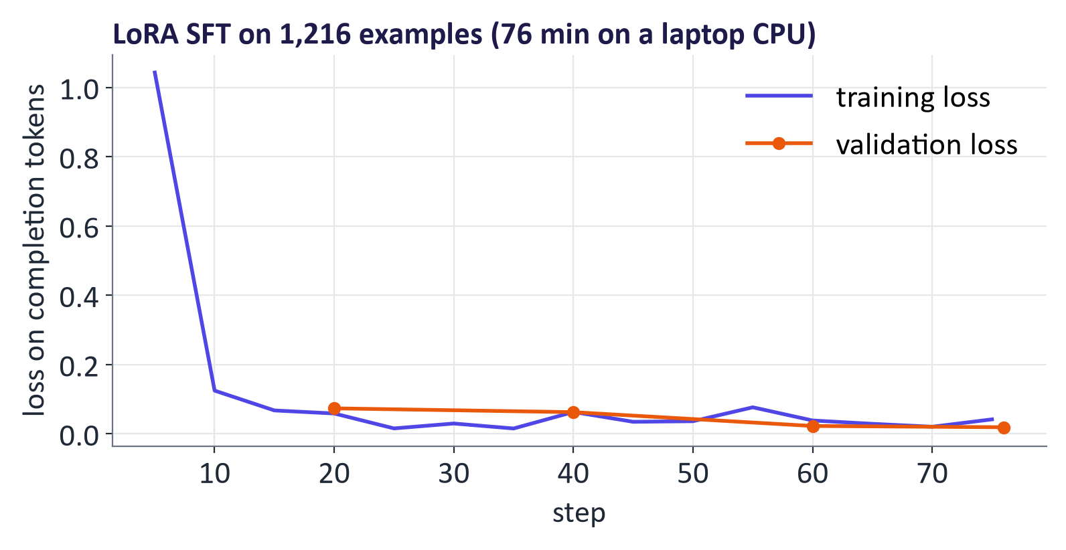
WEEK 08 · FINE-TUNING AND DOMAIN ADAPTATION
Real training curve
Training and validation losses fell in the stored run.
Saved adapter: 8.7 MB; base weights: 1,976 MB.
No clear loss warning here; inspect errors and older abilities.
Generative AI · MSc in Artificial Intelligence
38
Notes:
Say: The recorded training and validation curves both fall. There is no clear loss-based overfitting warning in this run, but that alone cannot prove generalisation on every future input. Loss is averaged on completion tokens; watch actual held-out labels too. A saved adapter needs its matching base model and configuration. Analogy: practice and mock-exam marks are useful clues, but still take the final exam. Ask: what errors remain despite a low loss? Common mistake: a falling curve proves neither zero errors nor preserved general ability.

Slide 39
WEEK 08 · FINE-TUNING AND DOMAIN ADAPTATION
Use and check the adapted classifier
Prediction uses the same chat format, without gradient updates
message +
reference
formatted input
generated reply
label and score
Held-out message
Apply chat format
Run with adapter
Parse + score
Compare baseline
Not used to learn or
Match training
Base plus learned
Compare intent with
Accuracy, failures
select
prompt template
correction
reference
and costs
test_ds
to_chat
tuned
evaluate
comparison
Input data
Model
Loss / update
Output
data flow
Check: Why use the same parser for base and adapted answers?
Generative AI · MSc in Artificial Intelligence
39
Notes:
After training, the adapted model makes predictions without changing weights. It must receive the same chat format used for training. The base model runs with its LoRA correction active and produces an intent label as text. The normalise function interprets the response; evaluate compares it with the known test label. Use the identical test messages and parsing rule for the original and adapted models so the comparison is fair. An answer may be invalid for the parser or valid but in the wrong category. Keep these errors separate. Disabling the adapter restores the base path, which helps compare the same general question with and without the added correction. One such question is an illustration, not a complete forgetting test.
Worked example:
Choose a held-out message about a charged fee.
Run the base few-shot prompt and adapted model on that same text.
Inspect raw replies, parsed labels and the reference together.
Record task accuracy and repeat a small general-ability check.
Check: Why use the same parser for base and adapted answers?
Answer: Otherwise a score difference could come from different checking rules rather than the model.

Slide 40
WEEK 08 · FINE-TUNING AND DOMAIN ADAPTATION
Evaluating a fine-tuned model
What to check | How | Example
Task | Same test as the best prompt | Accuracy on the 200 held-out messages
Earlier abilities | A general-question set | Capital of France? 2 + 2?
Safety | Re-run refusal tests | Harmful request still refused
Robustness | Rewording, typos, dates | "lost my card" vs "card gone"
Time and cost | Tokens, seconds, memory | Seconds per message on the target machine
People | Expert review with a rubric | A bank agent checks 50 replies
Generative AI · MSc in Artificial Intelligence
40
Notes:
Say: Evaluation after fine-tuning must go beyond the task metric. Compare with the prompting baseline on the same test set, with margins of error from week 7. Check that general capabilities have not regressed. Re-run safety tests, because fine-tuning can weaken safety behaviour, as the next slides show. Test robustness to paraphrases and to data from a different period. Measure cost and latency, since they are often the reason for fine-tuning. For high-stakes domains, add expert review. Benchmarks are useful for the general-ability check, but the held-out domain test set is what decides.
Ask: Why re-run safety tests after fine-tuning?
Answer: Fine-tuning, even on harmless-looking data, can weaken refusal behaviour.
Common mistake: Reporting only the task metric.

Slide 41

WEEK 08 · FINE-TUNING AND DOMAIN ADAPTATION
Domain-specific models: build, adapt or retrieve?
BloombergGPT: 50 B, financial and general training data (2023).
Specialist examples can adapt a general model.
Compare prompting plus retrieval first.
Check sensitive-data rights and governance.
Generative AI · MSc in Artificial Intelligence
41
Notes:
Say: The descriptor mentions domain-specific fine-tuning, and the business module mentions domain models such as BloombergGPT. BloombergGPT, released in 2023, was a fifty-billion-parameter model trained on a mix of financial and general data and did well on financial tasks at the time. Compare a general model plus retrieval with a specialist on the same domain test. Adapt a suitable general model when measured behaviour, format or cost gaps justify training. Domain data, in health, finance or law, is typically sensitive, so governance and privacy requirements shape what is possible.
Ask: When would building a specialist model like BloombergGPT be worth it today?
Answer: Rarely: only if a general model with retrieval or fine-tuning fails a measured domain test and the budget allows pre-training.
Common mistake: Assuming domain data alone guarantees better results.

Slide 42

WEEK 08 · FINE-TUNING AND DOMAIN ADAPTATION
Responsible AI lens: fine-tuning
Re-test safety after training.
Remove sensitive records; check leakage.
Audit groups and labels.
Check licences and provider terms.
Document data, settings, results and limits.
Generative AI · MSc in Artificial Intelligence
42
Notes:
Say: Fine-tuning creates a new model with new responsibilities. Qi and colleagues showed in 2023 that fine-tuning safety-aligned models, even on harmless-looking data, can substantially weaken their refusal behaviour, so safety evaluation must be repeated after fine-tuning. Models memorise training examples, which matters for personal data. Biased labels produce biased decisions, so evaluate performance across relevant groups. Licences and API terms may restrict fine-tuning or the use of outputs. And documentation, a model card for the adapter describing data, evaluation and limitations, is both good practice and increasingly a regulatory expectation.
Ask: What should an adapter's model card record?
Answer: Its base model, training data and licence, settings, evaluation results and known limits.
Common mistake: Fine-tuning on records that contain personal data. Models can memorise them.

Slide 43
WEEK 08 · FINE-TUNING AND DOMAIN ADAPTATION
From labels to a saved adapter
Read the learning curve and the held-out decisions together
pairs + baseline
model + loss
data splits
rows
LoRA count
history
test outcomes
Filter + split
Format +
Count
Train +
Inspect final
Check + save
baseline
trainables
monitor
errors
Ten intents;
Chat pairs;
Weights the
Adapter-off
separate
base-model
optimiser
Training and
Wrong and
check; save
datasets
scores
changes
validation losses
unparsed labels
weights
INTENTS
to_chat
trainable
trainer
errors
adapter_mb
Input data
Model
Loss / update
Output
Human / tool
data flow
Check: What two different failures should you distinguish in the test output table?
Generative AI · MSc in Artificial Intelligence
43
Notes:
The code connects data preparation, training and evaluation. INTENTS filters the source dataset to ten routing categories. The to_chat function creates conversational prompt/completion pairs, while evaluate records raw outputs, parsed labels and correctness. The normalise function is deliberately lenient: a label wrapped in explanatory text can still count as recognised, so the invalid rate is defined by this parser rather than by strict label-only output. The trainer records loss history for learning-curve inspection. After training, comparison uses the same test examples for both baselines and the tuned model, and the error table reveals which categories were confused. The adapter-off question is one illustrative check of specialisation, rather than a broad general-capability benchmark. Finally, the saved adapter's disk size is compared with the base parameters' in-memory byte count, so the size figures have slightly different definitions.
Worked example:
Check that the train and validation data come from the training split, while test messages remain separate.
Inspect one to_chat pair before running the trainer.
Watch validation loss alongside training loss rather than choosing by training loss alone.
A recognised wrong intent is a decision error; no recognised intent is a parser/format failure.
Ask a general question with the adapter on and off, then save the small adapter artifact.
Check: What two different failures should you distinguish in the test output table?
Answer: A recognised but incorrect intent is a decision error; an output with no recognised intent is an invalid/parser-format outcome.

Slide 44



WEEK 08 · FINE-TUNING AND DOMAIN ADAPTATION
Lab 8: LoRA fine-tuning for a banking domain task
1
Prepare ten intents; split datasets.
Runtime
GPU recommended. A full CPU run took about 84 min; prepare results before class
2
Measure zero-shot and few-shot.
3
Add rank 16 LoRA; count weights.
Time
2-hour lab
4
Train; watch validation.
5
Test and inspect errors.
Hand in
Notebook with baseline vs fine-tuned table, loss curve, error analysis and three written answers
6
Check older abilities; save adapter.
Generative AI · MSc in Artificial Intelligence
44
Notes:
Say: The lab implements the descriptor's tutorial exactly: fine-tune a pre-trained LLM for a domain-specific task, apply parameter-efficient fine-tuning with LoRA and optionally QLoRA, and compare base with fine-tuned performance. The domain is banking customer support, using the public Banking77 dataset under a CC-BY licence. Students must use the held-out test set for all comparisons and interpret the differences with the statistics from week 7. The optional extensions cover QLoRA on a larger model and DPO preference tuning.
Ask: Which test set compares the base model and the adapter?
Answer: The same 200 held-out messages for every model.
Common mistake: Comparing smoke-run scores. They use six messages and three training steps.

Slide 45


WEEK 08 · FINE-TUNING AND DOMAIN ADAPTATION
Read, watch, practise
Hugging Face LLM Course: Supervised fine-tuning with TRL and LoRA
Official chapter with notebooks
Google ML Crash Course: LLMs (fine-tuning, distillation)
Official concise module
Hugging Face PEFT documentation
LoRA, QLoRA, adapters, prompt tuning
Hu et al. (2021) LoRA
Low-rank adaptation
Hugging Face TRL documentation
SFT, DPO, GRPO trainers
Rafailov et al. (2023) Direct Preference Optimization
DPO
Hugging Face blog: Illustrating RLHF
Clear walkthrough of the pipeline
Ouyang et al. (2022) InstructGPT
SFT + RLHF
Generative AI · MSc in Artificial Intelligence
45
Notes:
Say: The Hugging Face LLM Course chapter on supervised fine-tuning follows the same TRL and PEFT workflow as the lab. The PEFT and TRL documentation are the references for the code. The Illustrating RLHF blog post explains the pipeline clearly. Google's crash course covers fine-tuning and distillation concisely. The LoRA, DPO and InstructGPT papers are the key primary sources; the QLoRA and DeepSeek-R1 papers are in the teaching notes. Tunstall and colleagues' book, from the descriptor list, covers classic fine-tuning of transformers. All links were last checked on 9 October 2026.
Ask: Which resource matches the lab's code most closely?
Answer: The Hugging Face LLM Course chapter on supervised fine-tuning with TRL and LoRA.
Common mistake: Reading the papers without running the code.

Slide 46
WEEK 08 · FINE-TUNING AND DOMAIN ADAPTATION
What we learned: fine-tuning
Choose adaptation
Learn known answers
Learn preferences
Prompt for instructions; retrieve
SFT reads the prompt and learns
RLHF, DPO and verified rewards
facts; train for measured
desired answer tokens with loss
use different feedback and update
behaviour gaps.
masking.
paths.
Add a small correction
Keep honest datasets
Earn the training cost
LoRA freezes W and trains A/B;
Separate training, validation and
Beat the best prompt; inspect
QLoRA also compresses base
final tests; match the chat
errors, older abilities, safety and
weights.
template.
cost.
Example to explain aloud
A 4096×4096 layer has 16,777,216 fixed W values; rank 16 A+B adds 131,072 trainable values (0.78%).
Next: in Week 9 we connect text with images, audio and other input types.
Exit question: Does falling training loss prove that fine-tuning helped?
Generative AI · MSc in Artificial Intelligence
46
Notes:
Say: Trace the banking task from separate datasets to a saved adapter. First measure strong prompting. Format prompts and known answers with the model’s chat template. Mask prompt loss while the model still reads it. LoRA trains a small correction with the base frozen. Check validation and compare held-out labels using the same parser. Analogy: guided practice tunes a specialist adjustment. Ask students to calculate rank 16 for two 4096 dimensions. Common mistake: fewer trainable values do not remove base memory, errors or safety risks. Preferences supply a different teaching signal. Prompt and prefix tuning act at different locations. Record costs, provenance and remaining limitations.
Exit question: Does falling training loss prove that fine-tuning helped?
Answer: No. Compare with the best prompt on held-out examples; inspect errors, validation, earlier abilities and cost.
Say: Recap the six points. Students should be able to explain when to fine-tune, write the SFT and DPO losses, compute LoRA parameter counts, and describe an honest evaluation. Next week we open the multimodal half of the module: how models connect text with images, audio and video, starting with representation learning and contrastive models such as CLIP, which students met briefly in the diffusion lab's CLIP score. The fine-tuning skills from today apply directly to multimodal models in week 10.
Ask: What must a fine-tuned model beat to justify its cost?
Answer: The best prompt on the same held-out test, by more than the margin of error.
Common mistake: Reporting accuracy without the baseline or the test size.

