Slide 1
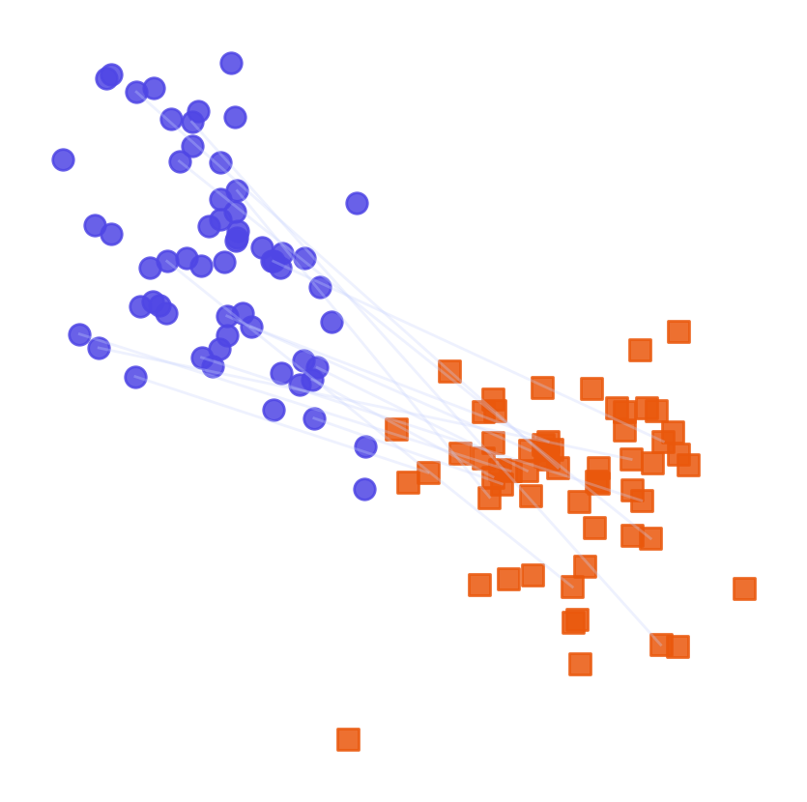
WEEK 09
Foundations of Multimodal Generative AI
Connect words, images and speech through vectors, matching scores and careful checks
MSc in Artificial Intelligence · Generative AI · 2-hour lecture
Notes:
Welcome to week 9, the start of the multimodal part of the module. So far our models have handled one kind of data at a time: images in weeks 2 to 4, text in weeks 5 to 8. Real-world information mixes text, images, audio and video, and the most capable systems of 2026 handle them together.
Analogy: A photo library whose search box accepts words needs a numerical description of every picture.
Ask students: Which earlier week already joined an image model and a text model?
Expected answer: Week 4: Stable Diffusion's CLIP text encoder conditioned the image generator, and the lab's CLIP score measured prompt alignment.
Common mistake: Thinking multimodal always means one giant model. Many systems join separate encoders.

Slide 2
WEEK 09 · FOUNDATIONS OF MULTIMODAL GENERATIVE AI
By the end of this week you can…
1
Define modality (a data type), representation, alignment, fusion and grounding with concrete examples.
Module learning outcomes (MIMLOs) practised
2
Explain how image, text and audio encoders turn inputs into vectors: lists of numbers.
MIMLO 1
Explain core concepts, maths and model families
3
Trace CLIP training on matching image-caption pairs and read its contrastive loss; compare SigLIP.
MIMLO 2
4
Use a frozen model for image classification and text-to-image search; measure accuracy and precision@k.
Analyse and apply multimodal generative AI
5
Compare multimodal architectures, including the vision-encoder-to-LLM design used by LLaVA.
MIMLO 4
Critically evaluate outputs: metrics, humans, ethics
6
Use Whisper for speech recognition; calculate word error rate and discuss data rights, bias and attacks.
Generative AI · MSc in Artificial Intelligence
2
Notes:
Six outcomes, matching the descriptor's week 9 and MIMLO 2, which asks students to analyse and apply multimodal techniques including alignment and cross-modal reasoning. The first two are vocabulary and representations. The third, contrastive learning with CLIP, is the technical core and includes a loss students should be able to write and compute. The fourth surveys architectures and vision-language transformers. The fifth adds audio with Whisper and evaluation metrics, touching MIMLO 4.
Ask students: Which outcome includes a loss you should be able to compute by hand?
Expected answer: Contrastive learning with CLIP.
Common mistake: Treating alignment and fusion as synonyms.

Slide 3
WEEK 09 · FOUNDATIONS OF MULTIMODAL GENERATIVE AI
Where we are in the course
Foundations and image generators
Week 1
Week 2
Week 3
Week 4
Introduction and
Variational
Generative adversarial
Diffusion
responsible AI
autoencoders (VAEs)
networks (GANs)
models
Language models and adaptation
Week 5
Week 6
Week 7
Week 8
Transformers
Language models
Prompting
Fine-tuning
and attention
and families
and evaluation
and adaptation
Multimodal applications and deployed systems
Week 9: you are here
Week 10
Week 11
Week 12
Multimodal
Multimodal
Deployment
Retrieval (RAG)
foundations
applications
and frameworks
and agents
Responsible use and evaluation continue throughout the course.
Generative AI · MSc in Artificial Intelligence
3
Notes:
The plan follows the descriptor: definition of modalities; key concepts and terminology; representation learning across modalities; key multimodal architectures and models; contrastive learning with CLIP; and vision-language transformers. Section three is the longest because it contains the maths and the real results from the lab, run in advance on CIFAR-10. Take the break after section three.
Ask students: Why does section three take the longest?
Expected answer: It contains the contrastive loss, its maths and the real lab results.
Common mistake: Skipping the maths and remembering only model names.
Trace the highlighted week. Earlier concepts feed later systems. Ask which earlier idea today needs. Common mistake: treating each week as an unrelated tool.

Slide 4
WEEK 09 · FOUNDATIONS OF MULTIMODAL GENERATIVE AI
Starting vocabulary
Term | Plain meaning | Quick check
Vector | An ordered list of numbers used to represent an item. | What is the length of the vector [0.2, 0.4, 0.1]?
Encoder | A network that converts input data into numerical representations or distribution parameters. | Does an image encoder return a photograph or numerical features?
Similarity | A score comparing two representations; larger means more similar here. | Which candidate ranks first when scores are 0.2, 0.7 and 0.4?
Pair | Two examples marked as describing the same content. | Which caption should match a dog photo?
Inference | Using a trained model to predict or generate without updating its learned weights. | Does searching a gallery train CLIP again?
Generative AI · MSc in Artificial Intelligence
4
Notes:
Introduce these terms before the main theory. Give pairs one minute to answer the quick checks, then take answers. Vector: An ordered list of numbers used to represent an item. Check: What is the length of the vector [0.2, 0.4, 0.1]? Answer: Three. Encoder: A network that converts input data into numerical representations or distribution parameters. Check: Does an image encoder return a photograph or numerical features? Answer: Numerical features: a vector, not a picture. Similarity: A score comparing two representations; larger means more similar here. Check: Which candidate ranks first when scores are 0.2, 0.7 and 0.4? Answer: The candidate scoring 0.7. Pair: Two examples marked as describing the same content. Check: Which caption should match a dog photo? Answer: The caption that describes the dog photo, such as 'a photo of a dog'. Inference: Using a trained model to predict or generate without updating its learned weights. Check: Does searching a gallery train CLIP again? Answer: No. Search uses the trained weights without changing them. Let students explain one example aloud, then connect their example to the next flow diagram. Use the blocks to name the inputs and outputs before introducing notation.

Slide 5

WEEK 09 · FOUNDATIONS OF MULTIMODAL GENERATIVE AI
Warm-up
Find “a dog on a beach” among uncaptioned holiday photos. What must the system compare?
Try a second query: “red umbrella”.
Name the input and desired output.
Generative AI · MSc in Artificial Intelligence
5
Notes:
Give two minutes. Students usually propose training a classifier, then realise that they would need a class for every possible query and labelled data for each. The key insight to draw out is the last point: if text and images can be turned into vectors in the same space, where a matching image and description land close together, then any query can be compared with any image by a similarity score, with no task-specific training.
Analogy: Think of a photo library whose search box accepts words. The stored pictures need a comparable numerical description.
Ask students: What goes into image search, and what comes out?
Expected answer: A text query goes in; a ranked set of gallery images comes out.
Common mistake: A search result is a model match, not proof that every requested detail is present.

Slide 6

01
Modalities and terminology
What exactly does 'multimodal' mean?
Notes:
Section one establishes the vocabulary: modalities and how each is represented, the precise meanings of cross-modal, multimodal, alignment and fusion, the difference between multimodal understanding and generation, and the three ways of fusing modalities. These terms appear in the exam and in every multimodal paper. About fifteen minutes.
Analogy: Two languages can describe the same scene. Encoders supply comparable numerical descriptions; fusion combines information.
Ask students: How are alignment and fusion different?
Expected answer: Alignment learns correspondence; fusion combines information inside a system.
Common mistake: Sharing vector dimensions alone does not teach matching meanings.

Slide 7
WEEK 09 · FOUNDATIONS OF MULTIMODAL GENERATIVE AI
Find an image using words
Separate image and text encoders meet at a similarity score
one score per
raw inputs
prepared inputs
normalised vectors
image
Query + gallery
Prepare inputs
Encode each type
Compare
Rank images
directions
Text and stored
Pixels and query
Comparable
Query against stored
Display highest
pictures
tokens
normalised vectors
images
scores
query
proc
embed_texts
scores
top
Input data
Model
Output
data flow
Check: When a new text query arrives, must every gallery image be encoded again?
Generative AI · MSc in Artificial Intelligence
7
Notes:
A modality is a kind of data, such as text or an image. CLIP connects these two modalities through an embedding: a vector describing an input. The image branch prepares photographs and passes them through the image encoder; the text branch tokenizes the query and passes it through the text encoder. Projection layers put both outputs into one shared vector space. Normalisation makes vector length consistent so the dot product measures cosine similarity. Each image receives one score against the query, then ranking selects the highest scores. The gallery can be encoded before a query arrives, which avoids repeating image processing for each search. This lab uses a pretrained, frozen CLIP model. Retrieval changes the query and ranking, rather than training new model weights.
Worked example:
Use the typed query 'a red sports car on a road'.
CIFAR-10 photographs already have image vectors stored in img_emb.
Encode the query once and compare it with every image vector.
Display the six highest-ranked images; inspect whether they match the words.
Check: When a new text query arrives, must every gallery image be encoded again?
Answer: No. Reuse stored image embeddings, encode the new query and compare its vector with them.

Slide 8
WEEK 09 · FOUNDATIONS OF MULTIMODAL GENERATIVE AI
Four main modalities, one idea: turn everything into vectors
Different input units; learned numerical representations
Text
Subword tokens
Text embeddings
Image
Image patches
Vision encoder
Learned vectors
combined or
Audio
Spectrogram frames
Audio encoder
compared
or codec tokens
Video
Frames and patches
Video encoder
(+ audio)
Input data
Model
Output
Generative AI · MSc in Artificial Intelligence
8
Notes:
A modality is a type of data with its own structure: text is a sequence of discrete symbols; images are two-dimensional grids of pixels; audio is a one-dimensional waveform, usually converted to a time-frequency spectrogram; video is a sequence of images with time and often audio. Each modality is split into units: sub-word tokens, image patches, spectrogram frames or codec tokens, and video frames with patches. A modality-specific encoder turns those units into vectors.
Analogy: Different instruments can be written in the same musical notation.
Ask students: What unit does each modality become before its encoder?
Expected answer: Text becomes sub-word tokens, images become patches, audio becomes spectrogram frames or codec tokens, and video becomes frames split into patches.
Common mistake: Thinking Whisper reads raw audio samples. It uses log-mel spectrogram features.

Slide 9
WEEK 09 · FOUNDATIONS OF MULTIMODAL GENERATIVE AI
Key terms
Term | Meaning | Example
Modality | A type of data | A photo; a voice recording
Unimodal | One type only | A text-only chatbot
Cross-modal | From one type to another | Search photos with words
Multimodal | Several types together | Ask a question about a photo
Alignment | Learn which items correspond | A photo lands near its caption
Fusion | Combine information in a model | LLaVA joins image and question
Grounding | Link a claim to evidence | Box the dog the caption names
Generative AI · MSc in Artificial Intelligence
9
Notes:
These definitions come straight from the descriptor's list: modality, cross-modal, multimodal, alignment and fusion; grounding is added because it appears in many vision-language papers. The distinction between cross-modal and multimodal is subtle: cross-modal emphasises going from one modality to another, for example text-to-image search, while multimodal means processing several together. Alignment is about correspondence between modalities; fusion is about how information is combined inside a model. Encourage students to use these terms precisely in their reports.
Ask students: Is text-to-image search cross-modal or multimodal?
Expected answer: Cross-modal: the query is text and the results are images. A model that reads an image and a question together is multimodal.
Common mistake: Using alignment and fusion interchangeably. Alignment learns correspondence; fusion combines information.

Slide 10


WEEK 09 · FOUNDATIONS OF MULTIMODAL GENERATIVE AI
Multimodal understanding vs. multimodal generation
Understanding
Generation
Media → text, labels or vectors
Whisper: lecture audio → transcript
CLIP: query → matching photos
Text → images, speech or video
SD-Turbo: prompt → picture
MMS-TTS: sentence → speech
Key idea: Check the exact model’s supported inputs and outputs.
Generative AI · MSc in Artificial Intelligence
10
Notes:
Separate the two directions. Understanding maps non-text inputs to text, labels or vectors; generation maps text to non-text outputs. They are closely linked: the text encoder inside Stable Diffusion from week 4 is CLIP's text transformer, and we measured prompt alignment with CLIP score in the week 4 lab. This week focuses on understanding and alignment; next week covers multimodal LLMs and generation across modalities, including audio and video.
Ask students: Is Whisper an understanding model or a generation model?
Expected answer: Understanding: it maps audio to text.
Common mistake: Assuming a model can produce every modality it can read. Check its supported outputs.

Slide 11
WEEK 09 · FOUNDATIONS OF MULTIMODAL GENERATIVE AI
Three ways to fuse modalities
Early fusion
Late fusion
Cross-attention
Image tokens
Text tokens
Image encoder
Text encoder
Image K / V
Text queries
Joint model
Compare outputs
Attention inside model
Input data
Model
Early fusion: combine inputs first.
Late fusion: compare separately encoded outputs.
Cross-attention: one modality queries another.
Generative AI · MSc in Artificial Intelligence
11
Notes:
Fusion is about where information is combined. Early fusion puts all modalities into one model from the start, allowing rich interactions, at higher cost; natively multimodal models such as those in the Gemini family process interleaved text and image tokens. Late fusion keeps separate encoders and combines only their outputs, as CLIP does with a similarity score; it is efficient because each item is encoded once, which is ideal for search over millions of images.
Analogy: Early fusion is a joint meeting; late fusion compares two separate reports; cross-attention lets one team question the other.
Ask students: Why is late fusion efficient for searching millions of images?
Expected answer: Each image is encoded once and stored; a new query needs one text encoding and a similarity lookup.
Common mistake: Assuming early fusion is always better. Every pair must pass through the model together, which costs more.

Slide 12

WEEK 09 · FOUNDATIONS OF MULTIMODAL GENERATIVE AI
Quick check
CLIP encodes images and texts separately and compares them with cosine similarity. Which fusion strategy is this?
Late fusion
Early fusion
A
B
Cross-attention fusion
No fusion: CLIP is unimodal
C
D
Vote, then convince your neighbour (1 minute).
Generative AI · MSc in Artificial Intelligence
12
Notes:
Answer: A, late fusion. CLIP's image and text encoders never see each other's inputs; the modalities meet only at the end, in the similarity score between two embeddings. This is what makes CLIP so efficient for retrieval: you can encode a million images once, store the vectors, and compare any new text query against them. B and C describe designs where modalities interact inside the network. D is wrong: CLIP is multimodal because it aligns two modalities in one space.
Ask students: Why is option D wrong?
Expected answer: CLIP aligns two modalities in one space, so it is multimodal.
Common mistake: Thinking CLIP's encoders see each other's inputs. They meet only in the similarity score.

Slide 13

02
Representation learning across modalities
How does each modality become vectors that can be compared?
Notes:
Section two covers representation learning: how images, audio and video are turned into sequences of vectors that transformers can process, and the idea of a shared embedding space in which different modalities can be compared directly. It links back to tokens and embeddings from weeks 5 and 6. About seventeen minutes.
Analogy: A map can record coordinates for different places. An embedding stores learned features, rather than a literal address.
Ask students: Can we directly compare arbitrary image and text vectors of equal length?
Expected answer: No. Encoders need a learned shared representation and compatible preprocessing.
Common mistake: A two-dimensional plot discards information from the full vectors.

Slide 14

WEEK 09 · FOUNDATIONS OF MULTIMODAL GENERATIVE AI
Representation learning: vectors that capture meaning
A representation describes useful input features with numbers.
Alignment learns correspondence from paired examples.
Noisy captions can teach wrong matches; more data does not remove the problem.
Generative AI · MSc in Artificial Intelligence
14
Notes:
Representation learning is the thread connecting this whole module: VAE latents, transformer embeddings and now multimodal embeddings are all vectors that capture meaning. Unimodal models learn good representations within one modality by self-supervision. Multimodal alignment needs paired data, where two modalities describe the same thing, and the web provides it at enormous scale: images with alt-text captions, videos with subtitles, podcasts with transcripts. This data is noisy, since captions often do not describe the image well, and scale does not remove misleading or missing labels.
Ask students: What makes web image-caption pairs noisy?
Expected answer: Alt text often describes the page or the product, not what the picture shows.
Common mistake: Assuming more pairs remove the noise. Wrong captions still teach wrong matches.

Slide 15




WEEK 09 · FOUNDATIONS OF MULTIMODAL GENERATIVE AI
Every modality as a sequence of tokens
Images
Audio
A 224 × 224 photo becomes 49 patches of 32 × 32 pixels, each with a position.
Spectrogram frames become vectors, as in Whisper; or a codec turns sound into IDs.
Video
Discrete tokens
Frames sampled a few times a second, cut into patches with time positions.
A learned codebook maps image or audio pieces to IDs a model can predict.
Generative AI · MSc in Artificial Intelligence
15
Notes:
The unifying trick of modern multimodal AI is to turn every modality into a sequence of tokens, so the same transformer machinery applies. Images become patches, as in the Vision Transformer from week 5. Audio is first converted into a spectrogram, a picture of frequency content over time; its frames become tokens, as in Whisper, or audio can be compressed into discrete codec tokens for generation.
Analogy: Cutting a photo into numbered tiles before describing each tile.
Ask students: A 224 × 224 image is cut into 32 × 32 patches. How many patch tokens is that?
Expected answer: 7 × 7 = 49.
Common mistake: Forgetting positions. Patch vectors need position information, as words do.

Slide 16
WEEK 09 · FOUNDATIONS OF MULTIMODAL GENERATIVE AI
Audio as input: the Whisper pipeline
Waveform
Log-mel
Audio
Text decoder
Transcript
16 kHz
features
encoder
cross-attention
Input data
Model
Output
Waveform → log-mel features → audio encoder.
Text decoder attends to audio and predicts words.
Check transcription against a reference.
Generative AI · MSc in Artificial Intelligence
16
Notes:
Whisper, released by OpenAI in 2022 and available as open weights, is our audio representation example. The waveform, sampled at sixteen kilohertz, becomes a log-mel spectrogram. The encoder processes these time-frequency features. The decoder generates transcript tokens while attending to the audio, using the encoder-decoder design from week 5. It was trained on 680,000 hours of weakly supervised audio with web transcripts. Large datasets still require data-quality checks and evaluation across accents and recording conditions. Students transcribe real speech with Whisper in the lab.
Analogy: A stenographer listens to the recording, then types the transcript word by word.
Ask students: Which part of Whisper attends to the audio while writing?
Expected answer: The decoder, through cross-attention to the encoder's outputs.
Common mistake: Assuming 680,000 hours of training removes accent and noise errors. Evaluate on your own recordings.

Slide 17

WEEK 09 · FOUNDATIONS OF MULTIMODAL GENERATIVE AI
Shared embedding spaces
Learn comparable image and text vectors from matching pairs.
Normalised dot products give cosine similarity.
Rank candidates; a high score does not prove every detail matches.
Generative AI · MSc in Artificial Intelligence
17
Notes:
A shared embedding space is the direct answer to the warm-up. If a photo of a dog on a beach and the text a dog on a beach at sunset map to nearby vectors, search becomes a nearest-neighbour lookup. The space enables many applications without retraining: retrieval in both directions, zero-shot classification by comparing an image with class descriptions, deduplication and clustering of image collections. CLAP does this for audio and text.
Analogy: A shared map on which a place and its description land at the same spot.
Ask students: Name two uses of a shared space that need no retraining.
Expected answer: Retrieval in either direction and zero-shot classification; also deduplication and clustering.
Common mistake: Reading a high similarity score as proof that every detail matches.

Slide 18

03
Contrastive learning: CLIP and SigLIP
How do you teach a model that a picture and a sentence mean the same thing?
Notes:
Section three is the technical core. We describe CLIP, its training data and objective, write the contrastive loss, and then look at what CLIP can do without further training, zero-shot classification and retrieval, using real results from the lab run on CIFAR-10. We then introduce SigLIP's sigmoid loss and the modality gap. About thirty minutes; take the break afterwards.
Analogy: Matching photo cards with caption cards is a batch-wide identification game. Read one row, then one column.
Ask students: Three pairs have equal choice probabilities. What is their loss?
Expected answer: Each correct choice has probability 1/3, so the uniform-choice loss is ln 3, about 1.10.
Common mistake: Calculating loss does not train a model; training also updates weights with gradients.

Slide 19

WEEK 09 · FOUNDATIONS OF MULTIMODAL GENERATIVE AI
CLIP: Contrastive Language–Image Pre-training (OpenAI, 2021)
Two encoders; one shared comparison space.
Train by identifying each image’s caption and each caption’s image.
CLIP used 400 million web pairs and batches of 32,768.
Use class descriptions without task-specific training.
Generative AI · MSc in Artificial Intelligence
19
Notes:
CLIP, by Radford and colleagues in 2021, is one of the most influential models in generative AI. Its data was four hundred million image-text pairs collected from the internet. Its architecture is a dual encoder: an image encoder, a Vision Transformer in the model we use, and a text transformer, each projecting into a shared five-hundred-and-twelve-dimensional space. The training objective is contrastive: within each batch, every image must pick out its own caption from all the captions, and every caption its own image.
Ask students: In a batch of 32,768 pairs, how many wrong captions does each image compete against?
Expected answer: 32,767.
Common mistake: Thinking CLIP was trained on class labels. It learned from captions.

Slide 20
WEEK 09 · FOUNDATIONS OF MULTIMODAL GENERATIVE AI
How matching pairs teach CLIP
Learn which caption belongs to each image, and vice versa
In training, loss gradients update encoders; the lab only measures loss.
two matching
ordered pairs
model inputs
normalised vectors
score matrix
losses
Paired inputs
Prepare
Encode +
Score all pairs
Match both
Average loss
Keep
branches
project
ways
image-caption
Pixels and
Normalise both
One row and
Diagonal is the
Combine both
order
caption tokens
vector batches
column per pair
target
errors
batch_imgs
proc
embed_images
clip_loss
clip_loss
clip_loss
Input data
Model
Loss / update
data flow
feedback / repeat
Check: For three matching pairs, how many comparisons are made, and where are the three target pairs?
Generative AI · MSc in Artificial Intelligence
20
Notes:
Contrastive learning learns a representation by comparing matching and non-matching examples. A batch is a small group of image-caption pairs processed together. After both encoders produce vectors, every image is compared with every caption. If the input lists retain their original pairing, the correct comparisons lie on the diagonal of the matrix. Each row asks which caption belongs to an image; each column asks which image belongs to a caption. Temperature changes how sharply score differences affect the matching probabilities. Cross-entropy measures the error in these choices, and CLIP averages the two directions. In training, backpropagation uses that error to change encoder weights. In this lab the embeddings are frozen: clip_loss demonstrates the objective by comparing correct and shuffled pairs, without performing a training step.
Worked example:
Imagine three pairs: car with car caption, bird with bird caption, ship with ship caption.
All comparisons form a 3 by 3 score matrix; the correct pairs occupy its diagonal.
The car row should prefer the car caption over the bird and ship captions.
The car-caption column should prefer the car image over the other images.
Compare correct versus shuffled captions in the lab; no optimiser runs here.
Check: For three matching pairs, how many comparisons are made, and where are the three target pairs?
Answer: Nine comparisons form a 3 by 3 matrix. The three target pairs are on the diagonal.

Slide 21
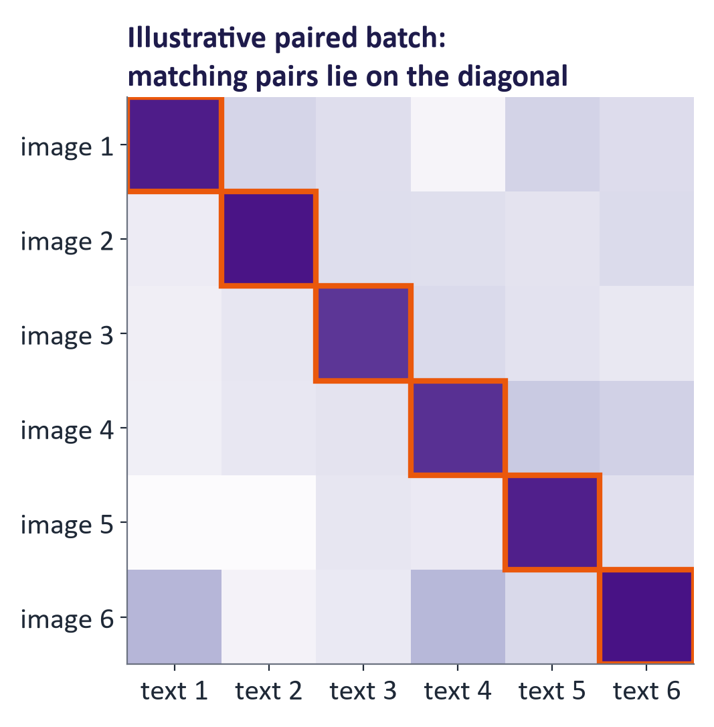
WEEK 09 · FOUNDATIONS OF MULTIMODAL GENERATIVE AI
The contrastive objective as a matrix
Generative AI · MSc in Artificial Intelligence
21
Notes:
Picture a batch of N image-caption pairs as an N by N matrix of similarities: row i is image i, column j is caption j. The correct pairs are on the diagonal. Training increases the diagonal similarities and decreases the off-diagonal ones, treating each row as a classification problem, which caption belongs to this image, and each column as a classification problem, which image belongs to this caption.
Analogy: Matching photo cards with caption cards: read one row, then one column.
Ask students: In a 4 × 4 similarity matrix, how many cells are correct pairs?
Expected answer: Four, on the diagonal; the other twelve are negatives.
Common mistake: Training only one direction. CLIP averages the image-to-text and text-to-image losses.

Slide 22
WEEK 09 · FOUNDATIONS OF MULTIMODAL GENERATIVE AI
One contrastive learning step
CLIP training is explained here; the lab uses fixed encoders
Training gradients update encoders; this lab only measures loss.
paired examples
normalised vectors
all-pair scores
average loss
Matching pairs
Encode both
Compare all pairs
Measure error
types
Update in training
Preserve each
Image and caption
Square similarity
Diagonal matches
Conceptual; no
pairing
vectors
matrix
both ways
optimiser here
batch_imgs
embed_images
clip_loss
clip_loss
Input data
Model
Loss / update
data flow
feedback / repeat
Check: Is calculating a loss the same as training the model?
Generative AI · MSc in Artificial Intelligence
22
Notes:
Contrastive training teaches encoders to distinguish matching pairs from non-matching pairs. Each row of a batch contains an image and its own caption. The encoders produce vectors, and every image is compared with every caption to make a square score matrix. The labelled matches lie on the diagonal when the pairing order is preserved. One loss asks each image to choose its caption; another asks each caption to choose its image. Their average supplies the learning signal. In a training system, gradients from this loss update encoder weights. This lab deliberately does not run that update: it uses a pretrained CLIP model and compares the loss for correct and shuffled pairs.
Worked example:
Take three pairs: dog, car and ship, each with its own caption.
There are 3 × 3 = 9 comparisons, with 3 diagonal matches.
If every caption choice has probability 1/3, one loss is −ln(1/3) = ln 3, about 1.10.
A confident correct choice gives lower loss; no training step is performed in the lab.
Check: Is calculating a loss the same as training the model?
Answer: No. Training also needs gradients and an optimiser step to update weights.

Slide 23
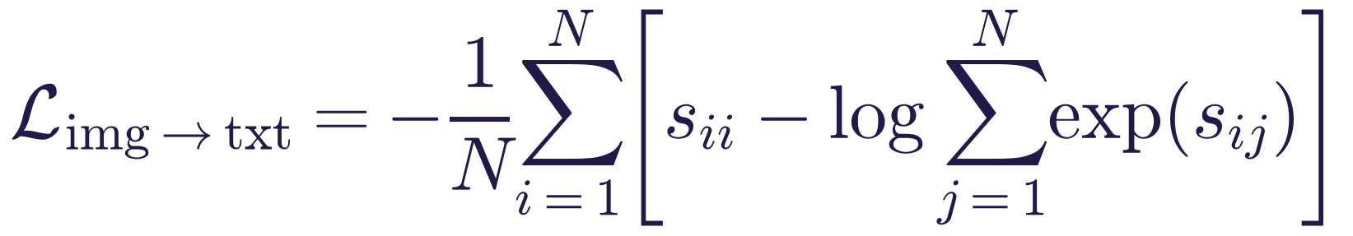
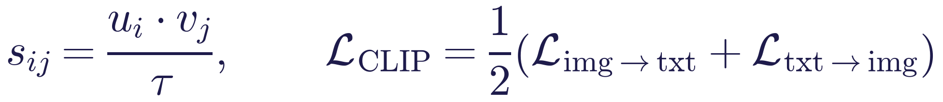
WEEK 09 · FOUNDATIONS OF MULTIMODAL GENERATIVE AI
The contrastive (InfoNCE) loss
Read it as
Symbols
Normalise vectors; divide dot products by temperature τ.
Softmax turns scores into caption-choice probabilities.
Cross-entropy penalises wrong choices; average both directions.
u / v
Image / text vectors
τ
Temperature
N
Pairs in this batch
Generative AI · MSc in Artificial Intelligence
23
Notes:
Write the loss on the board. The similarity s i j is the cosine similarity between image i and text j, divided by a temperature; CLIP learns the temperature and it ends up around one hundredth, which sharpens the softmax, the same temperature idea as in week 1. For each image, the softmax over all captions should put its probability on the matching caption; the loss is the negative log of that probability, a cross-entropy with the diagonal as the target.
Ask students: What does a temperature of 0.01 do to the scores?
Expected answer: It multiplies them by 100, which sharpens the softmax so the best match dominates.
Common mistake: Forgetting to normalise the vectors. Without it the dot product is not a cosine similarity.

Slide 24

WEEK 09 · FOUNDATIONS OF MULTIMODAL GENERATIVE AI
The loss in numbers (from the lab)
Batch of N = 6 image–caption pairs: correct pairs 1.14; captions shuffled 1.99; uniform-choice baseline ln N = 1.79.
Compare measured loss with uniform choice: ln N.
Frozen embeddings illustrate the objective; no optimiser runs.
Generative AI · MSc in Artificial Intelligence
24
Notes:
These numbers come from the lab run: six CIFAR-10 images from different classes and six matching captions, embedded with the pretrained CLIP. With the correct pairing the loss is far below the uniform-choice baseline of the log of six, about 1.79, because each image is most similar to its own caption. When the captions are shuffled the loss rises above that baseline, because the model is now confidently wrong. Students compute exactly this in part four of the lab, which makes the abstract equation concrete.
Ask students: Why does shuffling the captions raise the loss above ln 6?
Expected answer: The model is confidently wrong: each image still prefers its true caption, which is now in the wrong position.
Common mistake: Thinking this calculation trains CLIP. No optimiser runs; the embeddings stay frozen.

Slide 25
WEEK 09 · FOUNDATIONS OF MULTIMODAL GENERATIVE AI
Zero-shot classification: describe the classes, then compare
Class prompts
Text encoder
'a photo of a cat'
Compare vectors
Choose highest score
cosine similarity
from given classes
New image
Image encoder
Input data
Model
Output
Generative AI · MSc in Artificial Intelligence
25
Notes:
Zero-shot classification with CLIP takes no training. Write each class name into a caption template such as a photo of a cat, embed all the captions with the text encoder, embed the image with the image encoder, and predict the class whose caption is most similar. The classifier is defined entirely by text, so changing the classes means changing a list of words. This is also why prompt engineering matters for CLIP, as the next slide shows.
Analogy: A matching game in which you write the label cards yourself.
Ask students: How do you add an eleventh class to a zero-shot classifier?
Expected answer: Write one more caption, such as a photo of a bicycle, and embed it. No training is needed.
Common mistake: Assuming any wording works equally well. The caption template changes accuracy.

Slide 26
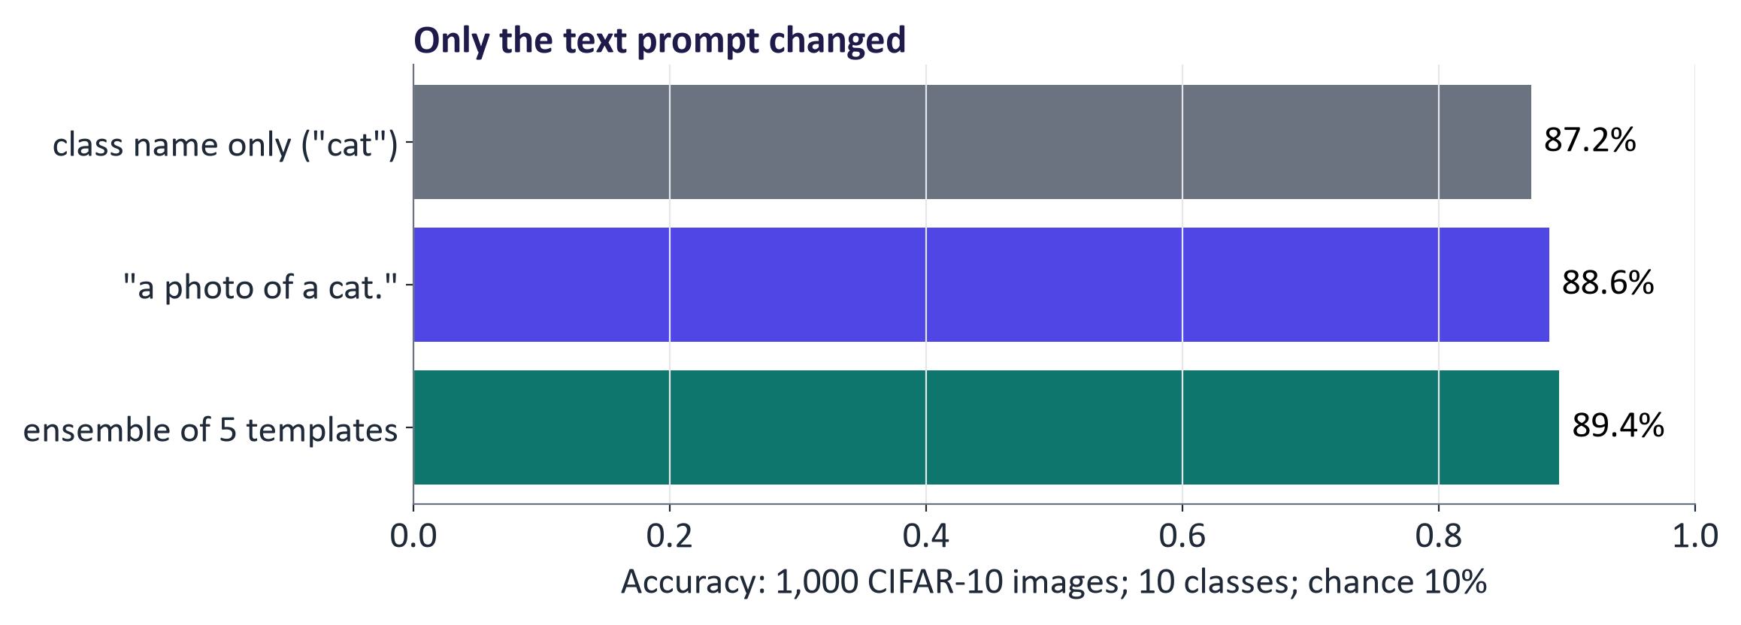
WEEK 09 · FOUNDATIONS OF MULTIMODAL GENERATIVE AI
Real results: prompt templates matter for CLIP too
Zero-shot accuracy on 1,000 CIFAR-10 test images: class name only (“cat”) 87.2%; “a photo of a cat.” 88.6%; ensemble of 5 templates 89.4%.
Describe classes in caption-like templates.
Average template vectors, then measure whether ensembling helps.
Generative AI · MSc in Artificial Intelligence
26
Notes:
Real results from the lab: CLIP ViT-B/32 classifying CIFAR-10 test images zero-shot, with only the text prompt changing. Here the bare class name did slightly worse than the template a photo of a, because CLIP's text encoder was trained on natural captions. Averaging several templates, including ones that mention blur and low resolution, which suits CIFAR's tiny images, helped a little more. On 1,000 images a one-point difference is ten images, so check whether such gaps hold on other data. The lesson from week 7 transfers: prompts are part of the model and must be evaluated.
Ask students: Why can a photo of a cat beat the bare word cat?
Expected answer: CLIP's text encoder was trained on caption-like sentences, not single words.
Common mistake: Choosing the best template on the test images. Choose it on separate data.

Slide 27
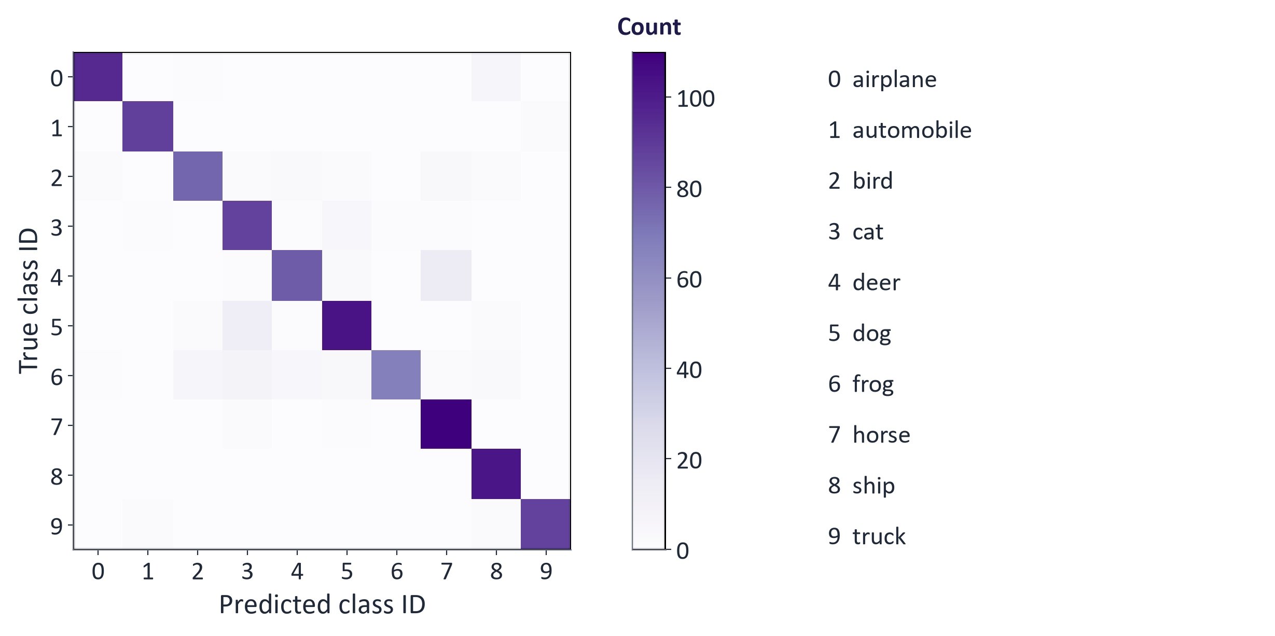
WEEK 09 · FOUNDATIONS OF MULTIMODAL GENERATIVE AI
Where zero-shot CLIP goes wrong (real confusion matrix)
Measured heatmap: each row is a true class; each column is a prediction. Dark diagonal cells are correct.
Generative AI · MSc in Artificial Intelligence
27
Notes:
The confusion matrix from the lab run shows where the zero-shot classifier fails. The diagonal is strong, and the largest off-diagonal counts are between classes that look alike at low resolution: deer predicted as horses, dogs and frogs predicted as cats, and airplanes predicted as ships. CIFAR's thirty-two by thirty-two images are upscaled to CLIP's input size, which is a distribution shift from the web photos it was trained on.
Ask students: Which classes does the model confuse most, and why?
Expected answer: Look-alike classes at low resolution: deer with horses, dogs and frogs with cats, airplanes with ships.
Common mistake: Reporting overall accuracy without looking at which classes fail.

Slide 28
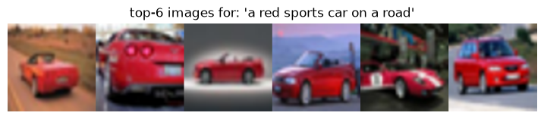
WEEK 09 · FOUNDATIONS OF MULTIMODAL GENERATIVE AI
Text-to-image retrieval (real)
Encode each query once; reuse gallery vectors.
Text→image retrieval precision @1 1.00, @5 0.96, @10 0.98 (fraction of top-k images of the queried class).
Generative AI · MSc in Artificial Intelligence
28
Notes:
Retrieval uses the same embeddings in the other direction. The query text is embedded once and compared with the stored embeddings of all images; the top results are returned. The strip shows the top six CIFAR images for a free-text query about a red sports car, and the bullet gives the measured precision at k for class-name queries.
Ask students: Precision@5 is 0.8. How many of the five results were relevant?
Expected answer: Four.
Common mistake: Reading precision@k as recall. It says nothing about relevant images that were not returned.

Slide 29
WEEK 09 · FOUNDATIONS OF MULTIMODAL GENERATIVE AI
SigLIP: a sigmoid loss instead of softmax (Zhai et al., 2023)
Read it as
Symbols
Each pair asks: match or non-match?
Sigmoid scores pairs independently, without row-wide softmax.
This changes the training objective and batch requirements.
σ
Sigmoid
t / b
Learned scale / offset
zᵢⱼ
+1 match; −1 non-match
Generative AI · MSc in Artificial Intelligence
29
Notes:
SigLIP, from Google in 2023, replaces the softmax over the batch with an independent sigmoid, a logistic regression, for every image-text pair: matching pairs should score high, all others low. Because each pair is scored separately, there is no need to normalise over the whole batch, which reduces communication between devices and works well even with smaller batches. SigLIP image encoders are widely used as the vision backbone of recent open vision-language models. The lab's optional extension compares SigLIP's zero-shot accuracy with CLIP's.
Ask students: Why does SigLIP work with smaller batches?
Expected answer: Each pair is scored on its own, so no softmax over the whole batch is needed.
Common mistake: Thinking the sigmoid and softmax losses give the same training signal.

Slide 30
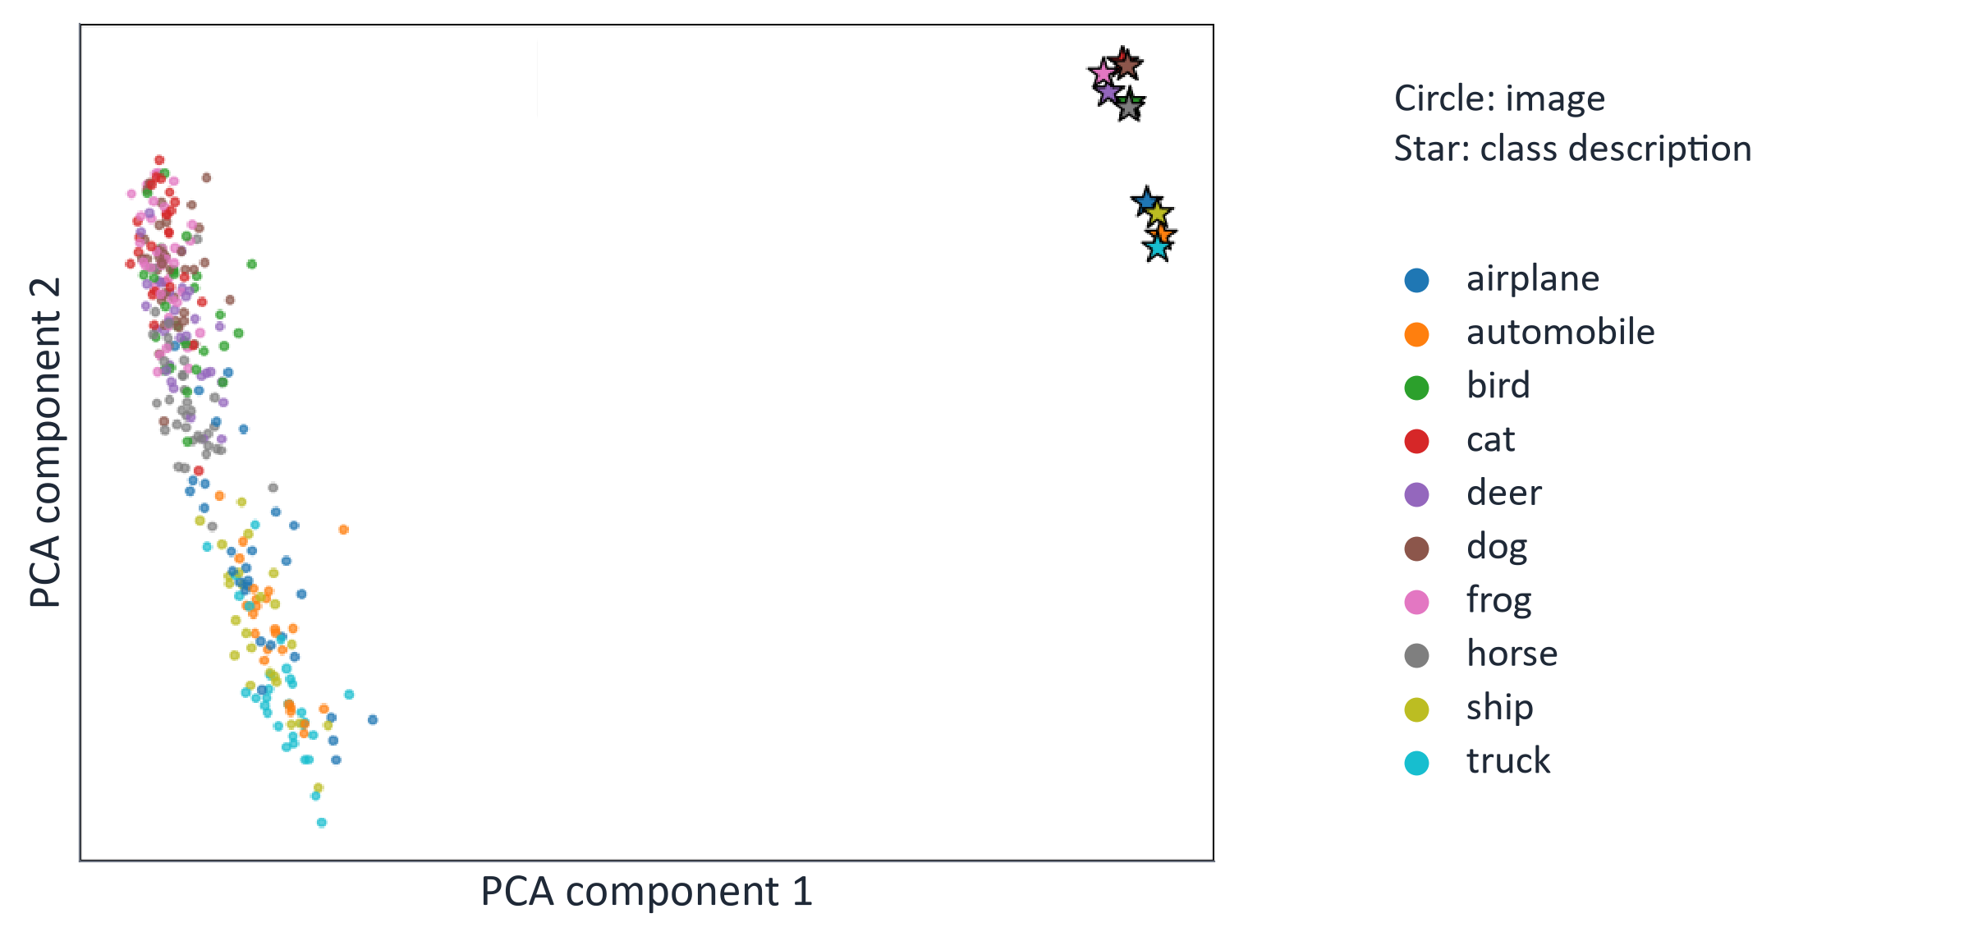
WEEK 09 · FOUNDATIONS OF MULTIMODAL GENERATIVE AI
The modality gap (real embeddings from the lab)
Real saved projection: circles are images; stars are class descriptions. PCA compresses 512 dimensions into two.
Generative AI · MSc in Artificial Intelligence
30
Notes:
A surprising property of CLIP-style spaces is visible when we project real embeddings to two dimensions with PCA: images and texts form two separate clouds. This modality gap, studied by Liang and colleagues in 2022, arises from initialisation and the contrastive objective. It does not break retrieval, because what matters is which caption is closest to an image relative to the others. But it has practical consequences: image-to-image similarities are typically much higher than image-to-text similarities, so thresholds must be set separately for each comparison type.
Analogy: A flat map of a mountain preserves some relationships and loses height. A PCA plot similarly loses information from the original 512-dimensional vectors.
Ask students: Does a point pair being nearby in this plot prove it is nearby in all 512 dimensions?
Expected answer: No. Check the original-vector similarities as well as this compressed picture.
Common mistake: Separate clouds do not mean retrieval is broken. Ranking compares an image with the given text candidates in the original space.

Slide 31
WEEK 09 · FOUNDATIONS OF MULTIMODAL GENERATIVE AI
Quick check
Why did CLIP use very large batches (32,768 pairs)?
Fewer model parameters are then needed
More negative pair comparisons per step
A
B
Large image files must be loaded together
Batch size has no effect on what is learned
C
D
Vote, then convince your neighbour (1 minute).
Generative AI · MSc in Artificial Intelligence
31
Notes:
Answer: B. In the contrastive loss, every other caption in the batch is a negative for a given image. With a larger batch, each image must be distinguished from more, and more similar, captions, which forces the embeddings to capture finer distinctions. A and C are irrelevant. D is wrong for softmax-based contrastive learning, although SigLIP's sigmoid loss reduces the dependence on batch size, which is one of its selling points.
Ask students: What makes a negative caption hard?
Expected answer: It is close to the true caption, such as a photo of a truck for an automobile, so the model must learn finer distinctions.
Common mistake: Choosing A. Batch size does not change the number of parameters.

Slide 32

04
Multimodal architectures and vision-language transformers
How can a language model use visual features to answer an image question?
Notes:
Welcome back. Section four surveys the architectures named in the descriptor: dual encoders like CLIP, fusion encoders, encoder-decoders, and a common design connecting a vision encoder to a language model. We trace the history of vision-language transformers and finish with a map of important models.
Analogy: A bridge lets visual features enter a language model in a useful format. Its learned mapping connects representation spaces.
Ask students: Why does LLaVA need a projector?
Expected answer: The projector maps vision features to vectors usable by the language component.
Common mistake: A CLIP similarity score alone cannot answer a detailed visual question.

Slide 33
WEEK 09 · FOUNDATIONS OF MULTIMODAL GENERATIVE AI
Four families of multimodal architecture
Dual encoder
Fusion encoder
CLIP / SigLIP: compare image and text vectors
VisualBERT: read image and text jointly
Image
Compare
Text
Image tokens
encoder
vectors
encoder
Joint encoder
Text tokens
Encoder-decoder
Vision encoder + LLM
BLIP / Whisper: read one modality; write text
LLaVA: bridge image features into a language model
Input encoder
Text decoder
Vision
Bridge
LLM
Input data
Model
Generative AI · MSc in Artificial Intelligence
33
Notes:
Four families. Dual encoders, like CLIP and SigLIP, encode inputs separately and compare their vectors. They support fast retrieval and zero-shot classification; a similarity score alone cannot answer a detailed visual question. Fusion encoders read image and text jointly with attention. Encoder-decoders read one modality and generate another, as in captioning and speech recognition. The fourth family connects a vision encoder to an LLM through a bridge. It is a common multimodal assistant design and the focus of next week.
Ask students: Which family would you choose to search a million product photos with text?
Expected answer: A dual encoder such as CLIP: encode the photos once, then compare each query.
Common mistake: Using a dual encoder to answer detailed visual questions. A similarity score cannot describe an image.

Slide 34

WEEK 09 · FOUNDATIONS OF MULTIMODAL GENERATIVE AI
Vision-language transformers: a short history
2019: joint image-region and text models.
2021: CLIP/ALIGN dual encoders.
2022: Flamingo cross-attention; BLIP.
2023: BLIP-2 Q-Former; LLaVA projector.
Week 10: applications using several modalities.
Generative AI · MSc in Artificial Intelligence
34
Notes:
The history shows a convergence. Early vision-language transformers in 2019 extended BERT to image regions detected by an object detector, with either one shared stream or two streams linked by cross-attention. CLIP and Google's ALIGN in 2021 showed the power of contrastive learning at web scale. DeepMind's Flamingo in 2022 connected a frozen language model to image features with gated cross-attention, enabling few-shot visual tasks.
Ask students: What did Flamingo add in 2022?
Expected answer: Gated cross-attention that lets a frozen language model read image features, enabling few-shot visual tasks.
Common mistake: Thinking each new design replaced the old ones. Dual encoders are still the standard for search.

Slide 35
WEEK 09 · FOUNDATIONS OF MULTIMODAL GENERATIVE AI
The LLaVA recipe: connect a vision encoder to an LLM
1
2
3
4
Image
Vision encoder
Projector
LLM
Pixels
Patch features
Map features for LLM
Visual + text → answer
Train the bridge, then visual instruction examples.
Resolution limits readable detail.
Generative AI · MSc in Artificial Intelligence
35
Notes:
LLaVA, by Liu and colleagues in 2023, made this design popular because it is remarkably simple. A pretrained CLIP vision encoder turns the image into a grid of patch features; a small projection network maps each patch feature into the LLM's token-embedding space, producing visual tokens; the LLM reads them followed by the text prompt and generates an answer.
Analogy: An interpreter turns visual features into vectors the language model can read.
Ask students: Which part does LLaVA train first?
Expected answer: The projector, on image-caption pairs; then the projector and the language model together on visual instruction examples.
Common mistake: Assuming the model sees every detail. Image resolution limits small text and objects.

Slide 36
WEEK 09 · FOUNDATIONS OF MULTIMODAL GENERATIVE AI
A map of important multimodal models
Model (year) | Modalities | Type | Typical use
CLIP / SigLIP | Image–text | Dual encoder | Search
ALIGN | Image–text | Dual encoder | Search
Flamingo | Image/video–text | Cross-attention | VQA
BLIP-2 | Image–text | Q-Former | Captioning
LLaVA | Image–text | Projector | Visual chat
Whisper | Audio–text | Encoder–decoder | Transcription
CLAP | Audio–text | Dual encoder | Audio search
ImageBind | Six types | Image alignment | Retrieval
Generative AI · MSc in Artificial Intelligence
36
Notes:
This table is a map for revision and for choosing components in the project. Dual encoders for search and zero-shot tasks; bridge-to-LLM models for question answering and chat about images; encoder-decoders for converting speech to text; audio-text contrastive models such as CLAP for sound search; and ImageBind for experiments across many modalities. Most are available as open weights on Hugging Face. Next week adds the natively multimodal assistants and generators.
Ask students: Which model in the table would you pick to search a sound library with text?
Expected answer: CLAP, the audio-text dual encoder.
Common mistake: Choosing a model without checking its licence and supported modalities.

Slide 37

05
Audio, evaluation and responsible AI
How well does it work, and at what cost to whom?
Notes:
The final section returns to audio with real Whisper results, defines word error rate, summarises how multimodal models are evaluated, and discusses the responsible-AI issues of multimodal data, which are serious: consent, harmful content in scraped datasets, bias in zero-shot classification, and surveillance. About twenty minutes.
Analogy: A transcription is an intermediate message passed to search. A wrong word can change every later result.
Ask students: Four of five search results match the query class. What is precision@5?
Expected answer: It is 4/5 = 0.8. This does not say how many of all relevant gallery images were retrieved.
Common mistake: WER, image accuracy and retrieval precision use different denominators and answer different questions.

Slide 38
WEEK 09 · FOUNDATIONS OF MULTIMODAL GENERATIVE AI
Search a gallery using speech
A speech transcript becomes the text query for CLIP
audio waveform
transcript text
checked query
image scores
Spoken request
Transcribe
Check transcript
Encode text query
Rank + display
Audio plus sampling
Whisper generates
Use reference when
Compare with stored
Inspect returned
rate
words
available
images
pictures
load_audio
asr
wer
embed_texts
top
Input data
Model
Loss / update
Output
data flow
Check: Which stage should you inspect first if the text query does not match the spoken words?
Generative AI · MSc in Artificial Intelligence
38
Notes:
This inference chain joins two existing models without training either one. Whisper converts the spoken request into text. A wrong transcription can change what is searched, so read the transcript before interpreting retrieval results. Where a reference transcript is available, WER counts changed, missing and extra words. CLIP then encodes the text query and compares it with gallery image vectors that have already been stored. Ranking returns the highest-scoring pictures. A failed result can come from the audio, transcription, text encoding or image ranking. Inspecting each intermediate output helps identify the cause instead of treating the whole chain as one unexplained error.
Worked example:
The speaker says "a red car on a road".
If the transcript says "a red cart", search may change before CLIP runs.
Correct the query for a controlled comparison, then encode it once.
Compare the query with the stored gallery vectors and inspect the returned images.
Check: Which stage should you inspect first if the text query does not match the spoken words?
Answer: The speech transcript; CLIP is receiving the wrong query before image search begins.

Slide 39
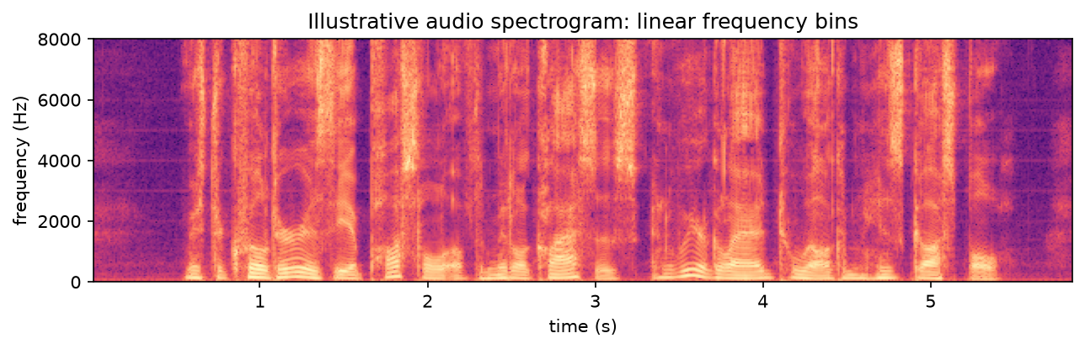
WEEK 09 · FOUNDATIONS OF MULTIMODAL GENERATIVE AI
Speech recognition with Whisper (real)
Whisper on LibriSpeech sample clips: mean WER 9.1%. Example: “mister quilter is the apostle of the middle…” → “Mr. Quilter is the apostle of the middle…” (“mister” vs “Mr.” counts as an error unless text is normalised).
This plot uses linear frequency bins; Whisper uses log-mel features.
Generative AI · MSc in Artificial Intelligence
39
Notes:
An illustrative spectrogram of the first LibriSpeech clip from the lab, with time on the horizontal axis and linear frequency bins on the vertical. This plot is not Whisper's exact preprocessing, which uses log-mel features. Bright bands show harmonics of the speaker's voice. Whisper transcribed ten clips in the lab run with the word error rate reported in the bullet. LibriSpeech is clean read audiobook speech, one of the easier benchmarks.
Analogy: A transcription is an intermediate message passed to search; a wrong word can change every later result.
Ask students: Why might Whisper do worse on a recorded lecture than on LibriSpeech?
Expected answer: LibriSpeech is clean read speech; lectures add noise, accents, technical terms and overlapping speakers.
Common mistake: Treating this spectrogram plot as Whisper's input. Whisper uses log-mel features.

Slide 40
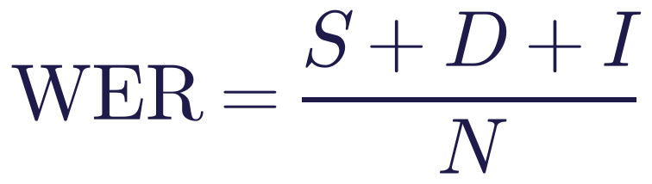
WEEK 09 · FOUNDATIONS OF MULTIMODAL GENERATIVE AI
Word error rate (WER)
Read it as
Symbols
Count substitutions S, deletions D and insertions I.
Divide their sum by the reference word count N.
One missing word among six gives WER = 1/6.
S / D / I
Changed / missing / extra words
N
Reference words
Generative AI · MSc in Artificial Intelligence
40
Notes:
Word error rate is the standard metric for speech recognition. The hypothesis is aligned to the reference with the minimum number of word edits, the edit or Levenshtein distance used in the lab's TODO, and the errors are divided by the number of reference words. Work through the example. Note that WER can exceed one hundred percent if the system inserts many words, and that it treats all errors equally, so a wrong name costs the same as a wrong article.
Ask students: A reference has 10 words; the output has 2 substitutions and 1 insertion. What is the WER?
Expected answer: (2 + 0 + 1) / 10 = 0.3.
Common mistake: Assuming WER cannot exceed 100%. Many inserted words can push it higher.

Slide 41
WEEK 09 · FOUNDATIONS OF MULTIMODAL GENERATIVE AI
How multimodal models are evaluated
Capability | Metric | Common benchmark
Classification | Accuracy | CIFAR / ImageNet
Retrieval | Recall@k | COCO / Flickr30k
Captioning | CIDEr / CLIPScore | COCO
VQA | Accuracy | ChartQA / DocVQA
Speech | WER | LibriSpeech
Fairness | Group comparisons | Task audit
Generative AI · MSc in Artificial Intelligence
41
Notes:
Each capability has standard metrics and benchmarks. Retrieval uses recall at k in both directions, typically on MS-COCO and Flickr30k. Captioning uses reference-based metrics such as CIDEr plus CLIPScore and human rating. Visual question answering has many benchmarks, including ones for charts and documents that matter for business applications. Speech recognition uses word error rate on benchmarks such as LibriSpeech and the multilingual FLEURS.
Ask students: Which metric would you report for text-to-image search?
Expected answer: Recall@k, in both directions if both are used.
Common mistake: Comparing WER, accuracy and precision as if they shared a denominator.

Slide 42

WEEK 09 · FOUNDATIONS OF MULTIMODAL GENERATIVE AI
Responsible AI lens: multimodal data and models
Check image, audio and video rights.
Audit harmful errors across relevant groups.
Printed text and altered audio can mislead models.
Protect privacy; review dataset curation and consent.
Generative AI · MSc in Artificial Intelligence
42
Notes:
Multimodal data raises the sharpest responsible-AI issues of the module. Scraped images, voices and videos rarely come with consent. In December 2023 the Stanford Internet Observatory reported child sexual abuse material in LAION-5B, a dataset used to train open image models; LAION withdrew it and released a cleaned version in 2024. CLIP's own paper and follow-up audits reported biased misclassification of people into offensive categories. OpenAI showed that writing a word on an object can fool CLIP.
Ask students: How can a word written on an object fool CLIP?
Expected answer: CLIP learned to read text in images, so a handwritten label can outweigh the visual evidence.
Common mistake: Assuming scraped images and voices were collected with consent.

Slide 43
WEEK 09 · FOUNDATIONS OF MULTIMODAL GENERATIVE AI
Follow the multimodal lab
Inspect representations before judging search and speech outputs
same frozen
text-query
images + labels
stored vectors
vectors
paired vectors
interface
Classify
Inspect
Load gallery
Build vectors
images
Search gallery
objective
Add speech
Pictures with
Inspect pair
Compare class
Measure class
Loss and
Transcript, WER
evaluation labels
similarity
descriptions
precision@k
compressed
and search
images
img_emb
recall_at_k
PCA view
asr
pred
clip_loss
Input data
Model
Loss / update
Output
data flow
Check: Four of five returned images match the query class. What does 4/5 measure in this lab?
Generative AI · MSc in Artificial Intelligence
43
Notes:
The notebook first loads labelled photographs; the labels are used to evaluate outputs, rather than train CLIP. The embed_images and embed_texts functions prepare the shared representations reused throughout the lab. The zero_shot_accuracy function compares each image with descriptions of all classes and measures how often the selected class is correct. Retrieval reverses that perspective: a text query ranks the gallery. Despite its historical name, recall_at_k measures the fraction of returned images belonging to the requested class, averaged across class queries: precision at k. The clip_loss function then illustrates the training objective, while PCA compresses vectors into a two-dimensional view for inspection. Finally, Whisper converts speech into words. The wer function evaluates transcription errors before the transcript becomes a text query. Each intermediate output helps locate which stage caused a failure.
Worked example:
Inspect img_emb.shape: one row represents one gallery image.
Compare classification accuracy for a class name and for caption-like templates.
If four of five returned pictures have the queried class, precision@5 is 0.8.
Look at both loss values and the PCA plot; neither changes CLIP's weights.
Inspect a Whisper transcript before using it as a CLIP search query.
Check: Four of five returned images match the query class. What does 4/5 measure in this lab?
Answer: Precision@5: the fraction of returned results that are relevant, rather than the fraction of all relevant gallery images retrieved.

Slide 44



WEEK 09 · FOUNDATIONS OF MULTIMODAL GENERATIVE AI
Lab 9: CLIP embeddings, zero-shot classification and Whisper
1
Encode image/text pairs; inspect similarity.
Runtime
Colab T4 GPU or CPU (slower). About 1 min on a 4 GB laptop GPU after downloads
2
Compare class prompts and classification errors.
3
Search images; measure precision@k.
Time
2-hour lab
4
Compare paired/shuffled contrastive loss.
Hand in
5
Inspect PCA; transcribe and measure WER.
Notebook with similarity plots, accuracy table, retrieval metrics, loss values, WER table and three answers
Generative AI · MSc in Artificial Intelligence
44
Notes:
The lab implements the descriptor's tutorial: understand modalities and embeddings; explore text-image embeddings, alignment and retrieval with pretrained models like CLIP. It adds the contrastive loss, so students connect the equation to real embeddings, and a speech part with Whisper and word error rate, so that audio is covered as the descriptor's modality list requires. The slide results came from this notebook. The chained speech-to-image retrieval previews the cross-modal systems of week 10.
Ask students: Which lab part chains two modalities?
Expected answer: The speech-to-image search: Whisper's transcript becomes a CLIP text query.
Common mistake: Comparing your scores with the slides without noting hardware and library versions.

Slide 45





WEEK 09 · FOUNDATIONS OF MULTIMODAL GENERATIVE AI
Read, watch, practise
Radford et al. (2021) CLIP
Learning Transferable Visual Models from Natural Language Supervision
Hugging Face Community Computer Vision Course
Multimodal units (CLIP, VLMs)
Zhai et al. (2023) SigLIP
Sigmoid loss for language-image pre-training
Hugging Face Audio Course
Spectrograms, Whisper, speech models
Radford et al. (2022) Whisper
Robust speech recognition via large-scale weak supervision
3Blue1Brown / Welch Labs: How AI images and videos work
Includes a clear CLIP explanation
Hugging Face blog: Vision language models explained
Architectures and training
Foster (2023) Generative Deep Learning, ch. 13 'Multimodal Models'
Core module text
Generative AI · MSc in Artificial Intelligence
45
Notes:
The CLIP paper is long, but its first sections are very readable and its bias analysis is worth reading. SigLIP and Whisper are the other two primary sources for today. Hugging Face's blog post on vision language models is an excellent, current overview of architectures. The computer vision and audio courses from Hugging Face have hands-on units on exactly today's models. The Welch Labs video explains CLIP visually. Foster's chapter 13 covers multimodal models including DALL-E and Flamingo. All links were last checked on 9 October 2026.
Ask students: Which resource explains CLIP visually?
Expected answer: The Welch Labs video.
Common mistake: Reading only summaries. The CLIP paper's bias analysis is worth reading in the original.

Slide 46
WEEK 09 · FOUNDATIONS OF MULTIMODAL GENERATIVE AI
Week 9: connect modalities
Represent
Align
Learn CLIP
Encoders turn images, text and
Paired examples teach
Match each image and caption
audio into useful vectors.
cross-modal correspondence.
both ways; average their losses.
Use frozen encoders
Add speech
Check the result
Describe classes or rank gallery
Whisper produces words; WER
Inspect scores, errors, group
images without weight updates.
checks them against reference
differences and data rights.
words.
Example to explain aloud
“A red car” → text vector → compare stored image vectors → ranked gallery.
Next: in Week 10 we connect multimodal models to generation and checked applications.
Exit question: Four of five returned images match. What is precision@5?
Generative AI · MSc in Artificial Intelligence
46
Notes:
Ask students to reconstruct the gallery search without reading the slide. Start with the text query and stored image vectors. Explain why the same learned comparison supports class-description matching and retrieval. Then ask which operations update weights: contrastive training can, but this lab uses frozen encoders. Revisit the three-pair matrix and the uniform-choice loss ln 3. Finish with the speech chain: an incorrect transcript gives CLIP an incorrect query. Use the exit question to distinguish precision from recall. A strong similarity score is one check, so students still inspect actual images, speech errors, data rights and performance across groups.
Exit question: Four of five returned images match. What is precision@5?
Answer: 4/5 = 0.8. The denominator is returned results, not all relevant images.
Recap the six points. Students should be able to define the key terms, write and explain the contrastive loss, and describe how zero-shot classification and retrieval work. Next week we build on these foundations: multimodal LLMs that chat about images and documents, generation across modalities including speech and video, how multimodal generation is evaluated, and responsible use including deepfakes and content provenance.
Ask students: In one sentence, how does CLIP label an image class it was never trained to label?
Expected answer: It compares the image vector with vectors of class descriptions and picks the most similar.
Common mistake: Calling zero-shot training-free in every sense. CLIP itself was trained on 400 million pairs.

