Slide 1
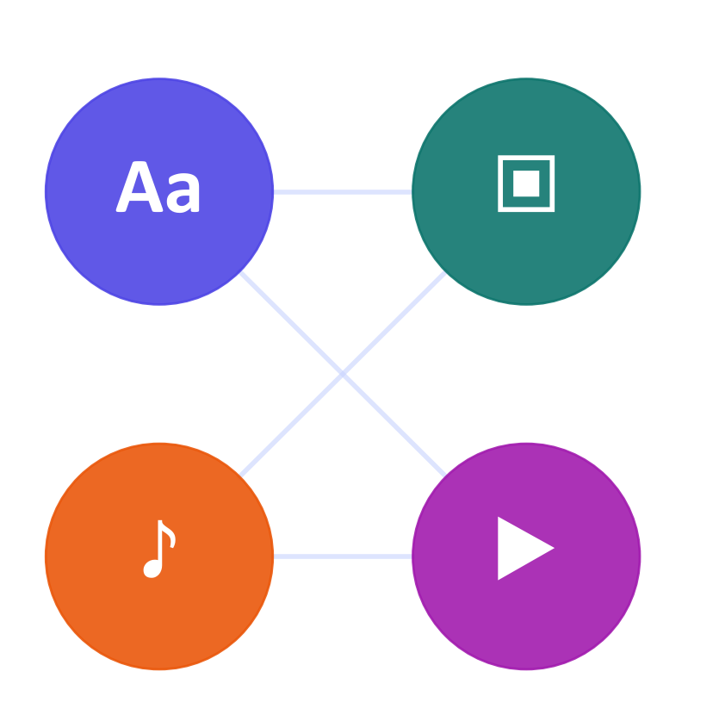
WEEK 10
Multimodal Generative AI Applications
Read and generate media, inspect each stage, and verify what the model claims
MSc in Artificial Intelligence · Generative AI · 2-hour lecture
Notes:
Welcome to week 10, multimodal generative AI applications. Last week we learned how models align modalities in a shared space. This week we look at the systems built on those foundations: multimodal LLMs that read photos, documents, charts and audio and answer in text or speech; generators that turn text into images, speech, music and video; and how to evaluate them and use them responsibly.
Ask students: Name one multimodal tool you used this week. What went in, and what came out?
Expected answer: For example, a phone app that reads a photo of a menu and answers in text: an image in, text out.
Common mistake: Assuming a model that reads images can also generate them.

Slide 2
WEEK 10 · MULTIMODAL GENERATIVE AI APPLICATIONS
By the end of this week you can…
1
Trace how a vision-language model (VLM) uses image features with a language model; compare modular and native designs.
Module learning outcomes (MIMLOs) practised
2
Explain the data and training stages used to align images with text and teach visual tasks.
MIMLO 2
Analyse and apply multimodal generative AI
3
Use models for captions, chart and invoice questions, image generation and editing, and speech generation.
MIMLO 3
4
Check factual answers with known values; use image-text scores, speech word errors and human scoring appropriately.
Design, implement and fine-tune models
5
Identify hallucination: invented objects, text or numbers; separate reading errors from calculation errors.
MIMLO 4
Critically evaluate outputs: metrics, humans, ethics
6
Design responsible applications with consent, privacy, verification and clear media labels; explain limits of provenance methods.
Generative AI · MSc in Artificial Intelligence
2
Notes:
Six outcomes matching the descriptor's week 10: multimodal LLMs; training and fine-tuning multimodal models; evaluation of multimodal generative AI; and applications, extended with generation across modalities and responsible use, which the revised 7.3 adds explicitly because deepfakes and content provenance are now regulated. The practical outcome is designing an application that combines a multimodal model with verification and labelling, which feeds directly into projects that process images, documents or speech. This week practises MIMLO 2, 3 and 4.
Ask students: Which outcome comes from the revised 7.3 descriptor?
Expected answer: Responsible use of synthetic media: deepfakes, labelling and content provenance.
Common mistake: Treating output quality as the only outcome. Verification and labelling are part of the design.

Slide 3
WEEK 10 · MULTIMODAL GENERATIVE AI APPLICATIONS
Where we are in the course
Foundations and image generators
Week 1
Week 2
Week 3
Week 4
Introduction and
Variational
Generative adversarial
Diffusion
responsible AI
autoencoders (VAEs)
networks (GANs)
models
Language models and adaptation
Week 5
Week 6
Week 7
Week 8
Transformers
Language models
Prompting
Fine-tuning
and attention
and families
and evaluation
and adaptation
Multimodal applications and deployed systems
Week 9
Week 10: you are here
Week 11
Week 12
Multimodal
Multimodal
Deployment
Retrieval (RAG)
foundations
applications
and frameworks
and agents
Responsible use and evaluation continue throughout the course.
Generative AI · MSc in Artificial Intelligence
3
Notes:
The plan follows the revised descriptor. Sections one and three contain the real outputs from the lab run: captions, chart and document question answering, text-to-image, image editing and speech round trips. Take the break after section three. Section five covers deepfakes, provenance and applications, and ends with a design pattern that students can reuse in their projects.
Ask students: Which sections show real outputs from the lab run?
Expected answer: Sections one and three.
Common mistake: Reading one run of one model as typical of every model.
Trace the highlighted week. Earlier concepts feed later systems. Ask which earlier idea today needs. Common mistake: treating each week as an unrelated tool.

Slide 4
WEEK 10 · MULTIMODAL GENERATIVE AI APPLICATIONS
Starting vocabulary
Term | Plain meaning | Quick check
Modality | A type of data, such as text, images or audio, with its own structure. | What are the input and output modalities of image captioning?
Autoregressive generation | Generate a next token from the input and previously generated tokens. | What information is available when generating the third output token?
Ground truth | A reference answer or observation used to check a model output. | How can a chart we create ourselves provide known answers?
VLM | A vision-language model that processes images together with text. | What two inputs are supplied for an invoice question?
Generative AI · MSc in Artificial Intelligence
4
Notes:
Introduce these terms before the main theory. Give pairs one minute to answer the quick checks, then take answers. Modality: A type of data, such as text, images or audio, with its own structure. Check: What are the input and output modalities of image captioning? Answer: Input: an image. Output: text. Autoregressive generation: Generate a next token from the input and previously generated tokens. Check: What information is available when generating the third output token? Answer: The input plus the first two generated tokens. Ground truth: A reference answer or observation used to check a model output. Check: How can a chart we create ourselves provide known answers? Answer: We know the values we plotted, so every reading can be checked exactly. VLM: A vision-language model that processes images together with text. Check: What two inputs are supplied for an invoice question? Answer: The invoice image and the text question. Let students explain one example aloud, then connect their example to the next flow diagram. Use the blocks to name the inputs and outputs before introducing notation.

Slide 5

WEEK 10 · MULTIMODAL GENERATIVE AI APPLICATIONS
Warm-up
A receipt photo must be split between four people. Which stage could fail?
Read amounts accurately.
Calculate and cross-check totals.
Protect personal details.
Generative AI · MSc in Artificial Intelligence
5
Notes:
Two minutes in pairs. Students usually identify reading errors first, then arithmetic errors, and some notice privacy: receipts can contain partial card numbers, locations and times. Add a fourth risk: the model may confidently report numbers that are not on the receipt, which is multimodal hallucination. This warm-up maps onto the lecture: section one shows that current models read and reason well but not perfectly; section four measures hallucination; section five covers privacy. The design lesson, extract then verify with code, appears at the end.
Analogy: A receipt reader has two jobs: read the printed amounts, then calculate with those amounts. Each job needs its own check.
Ask students: Can a fluent invoice answer contain a wrong total?
Expected answer: Yes. The model can misread values or calculate incorrectly; verify extracted fields and sums.
Common mistake: A valid output format does not establish that its values match the image.

Slide 6

01
Multimodal LLMs
How do chat models see, read and listen?
Notes:
Section one covers multimodal large language models, also called vision-language models or MLLMs. We compare the two main designs, list their capabilities, survey the model families, and look at real outputs from open models on photos, a chart and a document, including errors. About twenty-five minutes.
Analogy: A visual bridge acts like an adapter between two devices: it maps vision features into vectors the language model can use.
Ask students: Besides text, what kinds of input can a multimodal LLM take?
Expected answer: Images (including documents and charts), audio, and video as sampled frames, depending on the model.
Common mistake: Assuming a multimodal family name guarantees every input and output type.

Slide 7
WEEK 10 · MULTIMODAL GENERATIVE AI APPLICATIONS
Choose a multimodal task
The input, desired output and evaluation determine the route
input + task
selected route
model input
task output
checked media
Start with data
Prepare input
Generate
Check task
Label media
Choose route
output
Use a
Input and
VLM, diffusion or
Use expected
Text, image or
task-specific
Inspect re-saved
desired task
speech
pixels or tokens
waveform
measure
metadata
photos
vlm_proc
gen
score
meta
Input data
Model
Loss / update
Output
data flow
Check: Can a good CLIP score demonstrate that generated speech sounds natural?
Generative AI · MSc in Artificial Intelligence
7
Notes:
Multimodal generation covers several different tasks, so one score cannot evaluate every output. The input and desired output define the route. A vision-language model reads an image together with a question and generates answer text. A diffusion pipeline converts a description, or an image plus an editing request, into a new image. Text-to-speech converts a sentence into an audio waveform. Each route uses preprocessing suited to that model. Evaluation then asks a specific question: does the answer match a known chart value, does the image align with its prompt, or can speech recognition recover the words? These checks cover only part of quality. Finally, the lab adds metadata to a generated image and resaves it as JPEG, demonstrating that a provenance label can disappear during ordinary file processing.
Worked example:
A help-desk chart plus 'Which day had the most tickets?' routes to the VLM.
A lighthouse description routes to the text-to-image pipeline instead.
A sentence routes to TTS; Whisper converts its generated waveform back to words.
Check each output with its own metric, then inspect metadata on the generated image.
Check: Can a good CLIP score demonstrate that generated speech sounds natural?
Answer: No. This lab's CLIP score measures image-text alignment; speech naturalness needs a speech-appropriate evaluation.

Slide 8
WEEK 10 · MULTIMODAL GENERATIVE AI APPLICATIONS
Two designs: modular bridge vs. natively multimodal
Modular bridge
Joint multimodal training
Image
Encoder
Bridge
LLM
Supported
Multimodal model
input types
LLaVA joins pretrained vision and language parts.
Inputs and outputs depend on the checkpoint.
Input data
Model
Modular: pretrained encoder → bridge → language model.
Native multimodal: training mixes supported data types.
Trace the exact model’s inputs and outputs.
Generative AI · MSc in Artificial Intelligence
8
Notes:
There are two broad designs. Modular models connect separately pretrained encoders to a language model through a projector, as in LLaVA from last week; they are cheap to build and common among open models, and usually output text. Natively multimodal, sometimes called omni, models are trained from the start on interleaved sequences of text, image and audio tokens, so they can process and often generate several modalities in one model, which enables low-latency voice conversations and reasoning over audio and video.
Ask students: Which design is easier to build from existing open models?
Expected answer: The modular design: connect a pretrained encoder to a language model through a trained bridge.
Common mistake: Assuming a modular model can reply in speech. Most output text only.

Slide 9






WEEK 10 · MULTIMODAL GENERATIVE AI APPLICATIONS
What multimodal LLMs can do
Describe / answer
Documents / OCR
Charts / tables
Write alt text for a photo. Check that every named object is really there.
Read an invoice number and total. Validate each field in code.
Read one bar's value; check the axis and units. Add values in code.
Video
Speech
Screens / GUI
Summarise a lecture clip from sampled frames. A brief event can fall between frames.
Transcribe a spoken question and reply aloud. Check names and numbers.
Find the Submit button and propose a click. Code or a person approves it.
Generative AI · MSc in Artificial Intelligence
9
Notes:
Multimodal LLMs have a wide range of capabilities. Describing and answering questions about images supports accessibility, for example generating alt text. Document understanding, reading invoices, forms and PDFs, is one of the most valuable business uses. Chart and table reading supports analytics. Video understanding samples frames and sometimes audio. Speech models understand and produce voice. Screen understanding lets agents operate graphical interfaces, previewed in week 12. For every capability, accuracy varies with image quality, resolution and domain, so evaluation is essential.
Ask students: Why can a video model miss a short event?
Expected answer: It samples a few frames per second, so an event between samples may never be seen.
Common mistake: Trusting chart readings without checking the axes and units.

Slide 10
WEEK 10 · MULTIMODAL GENERATIVE AI APPLICATIONS
Multimodal model families (examples, 2026)
Family | Access | Inputs | Notes
GPT (OpenAI) | Hosted | Text and images; audio on some models | Live voice on some endpoints
Gemini (Google) | Hosted | Text, images, audio, video | Long video and document inputs
Claude (Anthropic) | Hosted | Text, images, PDF pages | Reads charts, tables and scans
Qwen-VL / Qwen-Omni | Open weights | Images and video; Omni adds audio | Lab GPU route: Qwen3-VL-2B
LLaVA | Research | Images + text | Reference modular design
SmolVLM | Open weights | Images + text | Lab CPU route: 256 M parameters
Key idea: Family examples: verify exact capabilities and licence.
Generative AI · MSc in Artificial Intelligence
10
Notes:
A snapshot of families, without version numbers, which change monthly. The proprietary families from OpenAI, Google and Anthropic all accept images and documents; OpenAI and Google also handle audio natively, and Gemini is notable for very long video and document contexts. Among open-weight models, the Qwen vision-language and omni families are strong on documents and charts; LLaVA is the research reference; small models such as SmolVLM run on laptops. In the lab we use Qwen3-VL-2B on a GPU and SmolVLM on a CPU, both Apache-licensed.
Ask students: Which model does the lab use on a CPU, and why?
Expected answer: SmolVLM-256M, because it is small enough for a laptop; the GPU path uses Qwen3-VL-2B.
Common mistake: Assuming every member of a family accepts the same inputs. Check the exact endpoint or model card.

Slide 11
WEEK 10 · MULTIMODAL GENERATIVE AI APPLICATIONS
From picture and question to words
A vision-language model connects visual features to text generation
New tokens extend the answer prefix for the next prediction.
raw inputs
pixels + tokens
visual features
visual + text input
new token IDs
Image +
Vision
Bridge
Predict next
Decode
question
Prepare inputs
features
features
token
answer
Pixels and
Pixels plus
Encode the
Map for
Use input and
Read only the
requested
question tokens
visible input
language
answer prefix
continuation
answer
vlm_proc
component
ask
vlm
vlm
vlm.generate
vlm_proc.decode
Input data
Model
Output
data flow
feedback / repeat
Check: Why does ask remove the input token prefix before decoding?
Generative AI · MSc in Artificial Intelligence
11
Notes:
A vision-language model, or VLM, combines visual understanding with language generation. The lab's processor prepares the image and formats a chat message containing the question. Inside the selected model, a vision component encodes pixels into features; a connection to the language component makes those features usable alongside question tokens. The precise bridge depends on the model architecture, while the lab calls the same high-level generation interface. Generation is autoregressive: every new token is predicted using the input and the answer prefix generated so far. A decoder then converts token IDs into readable words. The ask function slices away the input token prefix before decoding the output. The model can produce confident text even when it misreads a chart, so the known chart values provide evidence for checking rather than trusting fluency.
Worked example:
Pass the help-desk chart and 'How many tickets were there on Thursday?' to ask.
The processor prepares the chart and formats the question as model inputs.
Visual features provide evidence; the decoder generates an answer token by token.
ask decodes only the new answer tokens, leaving the input prompt out.
Compare the answer with the known value 25; a fluent answer may still be wrong.
Check: Why does ask remove the input token prefix before decoding?
Answer: To return the newly generated answer rather than repeat the question and chat prompt.

Slide 12
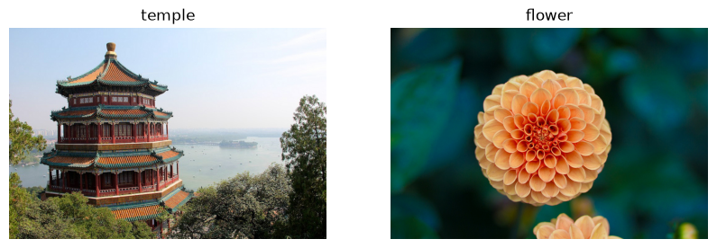
WEEK 10 · MULTIMODAL GENERATIVE AI APPLICATIONS
Real captions from an open VLM
temple: “A traditional Chinese pagoda with red walls and orange-tiled roofs stands majestically on a hill overlooking…”; flower: “A close-up of a vibrant, peach-colored dahlia flower with a soft, blurred green background.”
Compare every claimed detail with the photographs.
Generative AI · MSc in Artificial Intelligence
12
Notes:
These are the two sample photographs from scikit-learn's standard image set, a temple in China and a flower, captioned by the open vision-language model in the lab run; the captions are quoted in the bullet. Generally such captions are accurate at the level of objects and scenes, but can add details that are not there, such as a time of day or a location.
Analogy: A witness who describes a scene well but adds a confident guess about its surroundings.
Ask students: Which caption details can you check in the photograph, and which might be invented?
Expected answer: Objects, colours and the flower type can be checked; surroundings and weather need checking, because models add plausible settings.
Common mistake: Accepting a fluent caption as a complete and accurate description.

Slide 13
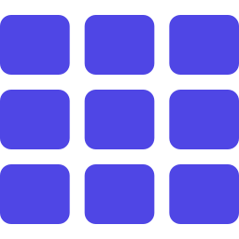
WEEK 10 · MULTIMODAL GENERATIVE AI APPLICATIONS
How images become tokens, and why resolution matters
Example: (336/14)² = 576 image patches.
Higher resolution can retain small text, at greater cost.
Tiles and sampled video frames change the token load.
Check the exact model and billing rules.
Generative AI · MSc in Artificial Intelligence
13
Notes:
Connect to weeks 5 and 9. A vision encoder cuts the image into patches; a three-hundred-and-thirty-six-pixel image with fourteen-pixel patches gives twenty-four by twenty-four, which is 576 visual tokens, each passed to the LLM. Reading small text in documents requires high resolution, so models tile large images or process them at their native resolution, which multiplies the token count. Video is sampled at a few frames per second, so long videos consume enormous numbers of tokens.
Ask students: A 448-pixel square image with 14-pixel patches: how many patches?
Expected answer: (448/14)² = 32² = 1,024.
Common mistake: Assuming higher resolution is free. More patches mean more tokens, time and cost.

Slide 14
WEEK 10 · MULTIMODAL GENERATIVE AI APPLICATIONS
Read an invoice and verify the numbers
Separate visual extraction from arithmetic and factual checking
checked value or
invoice pixels
image + question
candidate answer
error
Known invoice
Ask for a field
Read image
Check source
Compute + review
Render fictional
Give image and
Generate candidate
Compare with known
Design: validate
fields
precise question
values
answer
values and sums
document
ask
vlm.generate
score
Input data
Model
Loss / update
Output
data flow
Check: Can a correct addition still produce a wrong invoice total?
Generative AI · MSc in Artificial Intelligence
14
Notes:
The invoice example distinguishes seeing a number from calculating with it. The lab creates a fictional invoice from known strings and values, so there is a reference to check. The ask function supplies the image and question to a vision-language model, which returns a candidate answer. The score function gives a small automatic check, but its substring or first-number rule can miss some errors. Read the full reply alongside the source. For a real invoice application, extract fields into a validated structure and sum them in ordinary code; compare that result with the printed total. The final block describes that application design, rather than a complete invoice-processing service supplied by the notebook.
Worked example:
Suppose visible lines show EUR 10 and EUR 20, with printed total EUR 30.
Ask for each amount separately before computing the total.
If one extracted amount is EUR 200, valid numeric format still hides a reading error.
Code computes 10 + 20 = 30; review a mismatch with the image.
Check: Can a correct addition still produce a wrong invoice total?
Answer: Yes. Code can add incorrectly extracted numbers perfectly; check the input values too.

Slide 15
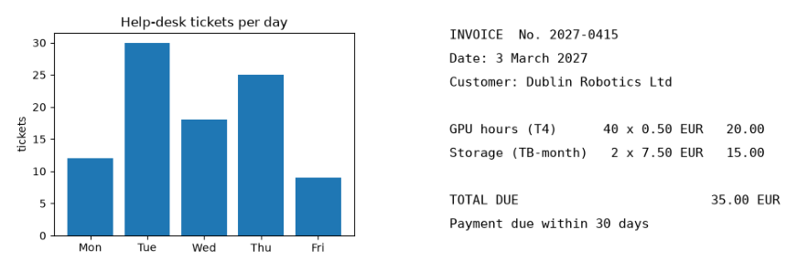
WEEK 10 · MULTIMODAL GENERATIVE AI APPLICATIONS
Cross-modal reasoning over a chart and a document (real)
Qwen3-VL-2B-Instruct answered 5 of 6 questions correctly: missed “What is the total number of tickets from Monday to…” (said “60”, gold 94).
Known chart and invoice values provide reference answers.
Generative AI · MSc in Artificial Intelligence
15
Notes:
This is the lab's evaluation design: we generated a bar chart and an invoice-style document, so the correct answers are known exactly: which day had the most tickets, a single value, a total that requires adding five numbers, the invoice number, the total due and the customer name. The bullet reports the measured accuracy of the open VLM. Typically single values and text fields are read correctly, while aggregation, adding up the bars, is less reliable because the model estimates rather than computes.
Ask students: Why can the model read single values but get the total wrong?
Expected answer: Reading a value is perception; adding five values needs exact arithmetic, which the model only estimates.
Common mistake: Accepting a model's sum without computing it in code.

Slide 16

WEEK 10 · MULTIMODAL GENERATIVE AI APPLICATIONS
Quick check
How should 200 invoice line items be totalled?
Ask the model once for the grand total of all items
Increase the temperature so the model reads more carefully
A
B
Extract checked fields, sum in code, compare printed totals
Trust the total if the model states high confidence
C
D
Vote, then convince your neighbour (1 minute).
Generative AI · MSc in Artificial Intelligence
16
Notes:
Answer: C. Separate perception from computation: use the model for what it is good at, reading fields into a schema validated in code, as in week 7, then compute totals with code and cross-check them against the totals printed on the invoices to detect reading errors automatically. A relies on the model's arithmetic across many images, which is error-prone and unverifiable. B adds randomness. D is unreliable: models' self-reported confidence is poorly calibrated. Add human review for invoices where the checks disagree.
Ask students: How would code detect a misread line item?
Expected answer: The sum of the extracted line items would not match the printed total.
Common mistake: Trusting the model's stated confidence.

Slide 17

02
Training and fine-tuning multimodal models
How are these models built, and how can you adapt one?
Notes:
Section two briefly explains how multimodal LLMs are trained, which the descriptor lists as training and fine-tuning multimodal models, and how you can adapt one to your own domain with the parameter-efficient methods from week 8. Keep it brief: students need the pipeline and the vocabulary, not the details of each stage. About thirteen minutes.
Analogy: First connect the reader to the writer; then practise useful image questions. This mirrors alignment followed by visual instruction tuning.
Ask students: Does loading a pretrained VLM train its bridge?
Expected answer: No. The lab performs inference. Training the bridge needs examples, loss gradients and updates.
Common mistake: The illustrated recipe is a common modular setup, not a universal training history.

Slide 18
WEEK 10 · MULTIMODAL GENERATIVE AI APPLICATIONS
Teach a visual bridge and useful answers
A conceptual training recipe; this lab loads existing models
pretrained
licensed examples
components
aligned features
adapted model
Review paired
Load existing
Test new images
data
parts
Train bridge
Tune visual tasks
Vision and language
Conceptual feature
Conceptual
Evaluate held-out
Images and desired
models
mapping
instruction training
examples
answers
vlm
QA
Input data
Model
Loss / update
data flow
Check: Does the multimodal lab train the illustrated bridge?
Generative AI · MSc in Artificial Intelligence
18
Notes:
A modular vision-language model can start from an existing image encoder and language model. The image encoder produces visual features, but those features are not automatically in the form the language model expects. A learned bridge, often called a projector, maps them into suitable vectors. An alignment stage uses image-caption examples to train that connection. Visual instruction tuning then uses questions and desired answers about images, documents or charts. Different recipes train different components; some keep the image encoder fixed and add LoRA to the language model. Held-out images check whether the system generalises beyond its examples. This is a conceptual recipe: the lab loads pretrained models and measures inference, rather than training a VLM.
Worked example:
An image of a cup is paired with "a blue cup on a desk".
The bridge learns to present the visual features to the language model.
An instruction example asks "What colour is the cup?" with answer "blue".
A new cup photo tests reading accuracy without appearing in training.
Check: Does the multimodal lab train the illustrated bridge?
Answer: No. It loads existing models; the diagram explains how such a model can be built.

Slide 19
WEEK 10 · MULTIMODAL GENERATIVE AI APPLICATIONS
A typical training pipeline for a vision-language model
1. Pretrained
2. Train bridge
3. Instruction
4. Preferences
5. Domain tuning
vision + language
paired captions
image questions
optional
optional
Illustrative recipe: check which components each method trains.
Model
Loss / update
Start with pretrained vision and language parts.
Train their bridge with paired examples.
Tune image-question-answer tasks; test new images.
Different recipes train different components.
Generative AI · MSc in Artificial Intelligence
19
Notes:
Walk through the stages. The vision encoder, typically CLIP or SigLIP, and the LLM are pretrained separately at great cost. Alignment trains the projector on image-caption pairs so that visual features land in the LLM's input space. Visual instruction tuning, introduced by LLaVA, fine-tunes on conversations about images, now including charts, documents, OCR and grounding tasks, often generated synthetically with the help of stronger models. Preference tuning or reinforcement learning, as in week 8, reduces hallucination and improves helpfulness.
Ask students: Which stage teaches the model to answer questions about images?
Expected answer: Visual instruction tuning, on image-question-answer conversations.
Common mistake: Treating this recipe as universal. Other models train different parts or are trained natively from the start.

Slide 20

WEEK 10 · MULTIMODAL GENERATIVE AI APPLICATIONS
Data for multimodal training
Image-caption pairs.
Interleaved image/text documents.
Questions, fields, charts and object locations.
Audio with transcripts or descriptions.
Review labels, licences and consent.
Generative AI · MSc in Artificial Intelligence
20
Notes:
Multimodal training data comes in several forms. Web image-caption pairs are plentiful but noisy, so many teams re-caption images with a strong model to get more detailed descriptions. Interleaved documents teach models to handle mixed sequences. Task-specific data, for OCR, charts, screenshots and video, is often generated synthetically, for example by rendering charts with known values, exactly what we do in the lab for evaluation. Audio data pairs speech with transcripts.
Ask students: Why render charts with known values for training or testing?
Expected answer: The correct answers are known exactly, so the labels are free and accurate.
Common mistake: Using scraped images and captions without checking licences and consent.

Slide 21

WEEK 10 · MULTIMODAL GENERATIVE AI APPLICATIONS
Adapting a multimodal model to your domain
Define a specific visual task.
Try prompting and checked extraction first.
Adapt with labelled examples and a separate test.
LoRA may train language weights; the bridge may also change.
Generative AI · MSc in Artificial Intelligence
21
Notes:
The week 8 approach carries over directly. For a domain such as a company's own forms, industrial inspection images or satellite imagery, you collect image-question-answer examples, freeze the vision encoder and apply LoRA to the language model and possibly the projector, using libraries such as TRL, which supports vision-language fine-tuning. The same decision rule applies: start with prompting and structured extraction; fine-tune when evaluation on your own images shows persistent reading or format errors.
Ask students: Which part would you usually freeze when adapting a VLM to your own forms?
Expected answer: The vision encoder. LoRA then trains the language model and possibly the bridge.
Common mistake: Fine-tuning before trying prompting and checked extraction on your own images.

Slide 22

03
Generation across modalities
From text to images, speech, music and video
Notes:
Section three surveys generation across modalities, the descriptor's list of text to image, image to image, text to audio, text to video and so on. We look at real text-to-image and image-editing outputs from the lab, a speech round trip, and the state of music and video generation. About twenty-five minutes; take the break afterwards.
Analogy: Different workshop tools make different outputs: a diffusion pipeline makes pixels, TTS makes audio samples, ASR makes words.
Ask students: Which generation tasks does the lab run, and which are only discussed?
Expected answer: Text to image, image to image and text to speech run; text to video is discussed because of its cost.
Common mistake: Assuming one model handles every generation task.

Slide 23
WEEK 10 · MULTIMODAL GENERATIVE AI APPLICATIONS
Generation across modalities: a map
Task
How it works
Examples
Text to image
Diffusion / flow models
SD-Turbo, FLUX
Image editing
Noise, denoise, control
SDEdit, ControlNet
Text to speech
Acoustics + waveform
VITS / MMS
Speech to speech
Listen and respond
Voice assistants
Text to audio
Diffusion or codec tokens
MusicGen, Stable Audio
Text to video
Model space and time
Video diffusion models
Generative AI · MSc in Artificial Intelligence
23
Notes:
This map summarises the main generation tasks, how they work and example model families. Images use latent diffusion or flow transformers from week 4. Editing uses partial noising, inpainting and control signals. Speech synthesis uses neural text-to-speech, increasingly language models over audio-codec tokens, which also enable voice cloning from short samples. Speech-to-speech models power real-time voice assistants. Music and sound use diffusion or token language models over audio codecs. Video uses spatio-temporal diffusion transformers.
Ask students: Which method family underlies most image, video and music generators on this map?
Expected answer: Diffusion or flow models, often transformers; some audio generators are language models over codec tokens.
Common mistake: Thinking voice cloning needs hours of recordings. A few seconds can be enough, which is why consent matters.

Slide 24
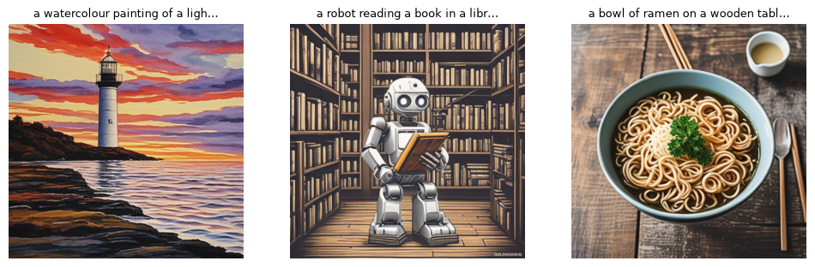
WEEK 10 · MULTIMODAL GENERATIVE AI APPLICATIONS
Text → image with a distilled model (real)
SD-Turbo: 2 denoising steps; guidance_scale = 0.
CLIP score against its own prompt 29.2–36.0 vs other prompts 7.8–11.5: each own-prompt score exceeded the mean score for the other prompts in this run.
Inspect requested details and visual errors too.
Generative AI · MSc in Artificial Intelligence
24
Notes:
Three prompts rendered by SD-Turbo with two steps in the lab run. Quality is good for a distilled model that needs only two denoising steps. The bullet reports the CLIP scores: each image scores higher against its own prompt than the mean score against the other prompts, a simple sanity check of prompt alignment that the lab automates. Remind students that SD-Turbo uses the Stability AI Community License, with conditional commercial use, registration and revenue limits, which matters for projects.
Ask students: Why is guidance_scale set to 0 for SD-Turbo?
Expected answer: SD-Turbo was distilled to work without classifier-free guidance, so one prediction per step is enough.
Common mistake: Reading a higher CLIP score as proof that every requested detail is present.

Slide 25
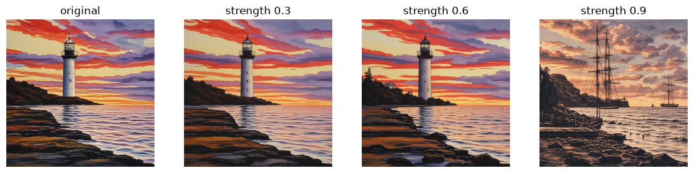
WEEK 10 · MULTIMODAL GENERATIVE AI APPLICATIONS
Image → image: editing with partial noise (real)
Editing strength sets the starting noise level.
Low strength tends to retain more input structure.
High strength permits more change; inspect the actual result.
Generative AI · MSc in Artificial Intelligence
25
Notes:
Image-to-image editing, from week 4's SDEdit idea, adds noise to an existing image and denoises it with a new prompt. The strength parameter sets how far into the noise schedule we go: in the recorded run, 0.3 and 0.6 left the lighthouse painting almost unchanged, while 0.9 replaced most of it with a new coastal scene. None of the three looks like a pencil sketch: strength controls how much may change, not whether the style request is followed, so compare each result with what was asked. Inpainting restricts the change to a mask, and control methods such as ControlNet guide the preservation of edges or pose.
Ask students: With strength 0.6 and 4 inference steps, how many denoising steps run?
Expected answer: 4 × 0.6 = 2.4, so 2 steps in practice.
Common mistake: Thinking higher strength gives sharper images. It permits larger changes.

Slide 26
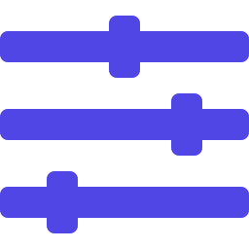
WEEK 10 · MULTIMODAL GENERATIVE AI APPLICATIONS
Editing, control and personalisation
Inpainting/outpainting: edit a region or extend boundaries.
Control guides: edges, depth or pose.
Instruction editing: describe a change.
Personalisation: adapt a subject or style with permission.
Generative AI · MSc in Artificial Intelligence
26
Notes:
Beyond simple image-to-image, four editing families matter in practice. Inpainting and outpainting regenerate or extend regions. Control methods follow structural guides such as edges, depth maps or human pose. Instruction-based editing lets users describe changes in words, and natively multimodal models now support conversational editing. Personalisation with LoRA or DreamBooth teaches a model a specific person, product or artistic style from a handful of images, which is powerful for product photography and dangerous for impersonation and style imitation.
Ask students: Which editing method keeps a person's pose while changing their clothes?
Expected answer: A control method such as ControlNet with a pose guide, or inpainting only the clothing region.
Common mistake: Personalising a model on someone's face or voice without their permission.

Slide 27

WEEK 10 · MULTIMODAL GENERATIVE AI APPLICATIONS
Speech: text-to-speech, cloning and speech-to-speech
TTS: words → sound features → waveform.
Other generators predict audio-codec IDs.
Voice imitation needs permission and misuse controls.
Lab: MMS-TTS → Whisper → WER.
Generative AI · MSc in Artificial Intelligence
27
Notes:
Speech generation has changed quickly. Classic neural text-to-speech converts text into acoustic features and then a waveform with a vocoder; VITS-based models such as Meta's MMS, used in the lab, do this end to end. Newer systems treat audio as codec tokens and use language models, enabling voice cloning from a few seconds of speech, valuable for accessibility and dubbing, but also used in fraud. Speech-to-speech assistants respond aloud; delay depends on the model and application.
Analogy: Different workshop tools make different outputs. A diffusion pipeline makes pixels; TTS makes samples; ASR makes words.
Ask students: Why keep an audio waveform’s sampling rate with its samples?
Expected answer: The rate tells the recogniser how many samples represent a second and preserves playback speed.
Common mistake: A higher editing strength permits larger changes; it does not guarantee sharper images.

Slide 28

WEEK 10 · MULTIMODAL GENERATIVE AI APPLICATIONS
Music, sound and video
Music/sound: diffusion or audio tokens, such as MusicGen.
Video: spatial and temporal patches; sometimes sound.
Inspect changing identity, motion, drift and compute cost.
Check music/film rights and deceptive uses.
Generative AI · MSc in Artificial Intelligence
28
Notes:
Music generation uses the same toolkit: Meta's MusicGen is a language model over audio-codec tokens; Stable Audio is a latent diffusion model. The music industry has sued several music-generation companies over training data, a live copyright issue. Text-to-video models such as OpenAI's Sora and Google's Veo families extend diffusion transformers to space and time, and since 2025 some also generate synchronised sound. The open problems are temporal consistency, realistic physics, long durations and cost.
Ask students: What is the hardest open problem in video generation?
Expected answer: Keeping identities and motion consistent over time; longer videos also cost far more compute.
Common mistake: Assuming generated music is free to use. Rights holders have sued over training data.

Slide 29
WEEK 10 · MULTIMODAL GENERATIVE AI APPLICATIONS
Quick check
In image-to-image editing, what does increasing the 'strength' from 0.3 to 0.9 do?
Sharper output with the same composition
Identical output, but more memory is used
A
B
A higher guidance scale for the prompt
More starting noise; potentially larger changes
C
D
Vote, then convince your neighbour (1 minute).
Generative AI · MSc in Artificial Intelligence
29
Notes:
Answer: D. Strength controls how far along the noise schedule the original image is pushed before the model denoises it with the new prompt. Low strength keeps structure and colours; high strength keeps little of the original. It is related to the number of effective denoising steps, which is why the lab multiplies steps by strength. A, B and C confuse strength with other settings. This is the same forward process from week 4, applied to an existing image instead of pure noise.
Ask students: What does strength 0.3 do?
Expected answer: It adds little noise, so the result keeps most of the input's structure and colours.
Common mistake: Confusing strength with guidance scale (option C).

Slide 30

04
Evaluating multimodal generative AI
How do you measure quality, alignment and truthfulness across modalities?
Notes:
Welcome back. Section four is about evaluation, which the descriptor lists explicitly for multimodal models. We summarise metrics by task, focus on multimodal hallucination with a real probe from the lab, and discuss how to design human evaluation for images and audio. About seventeen minutes.
Analogy: Use a different ruler for each measurement. A caption score, field accuracy and listening rubric answer different questions.
Ask students: Does zero WER prove generated speech sounds natural?
Expected answer: No. One recogniser recovered the words; naturalness needs listening evaluation.
Common mistake: An image-text similarity score is not a calibrated probability of factual correctness.

Slide 31
WEEK 10 · MULTIMODAL GENERATIVE AI APPLICATIONS
Metrics by task
Task | Automatic metrics | Human evaluation
Image generation | FID / CLIP / GenEval | Prompt match, defects
Captioning | CIDEr / CLIPScore | Facts, invented detail
VQA | Known-answer accuracy | Reading / arithmetic
Speech | ASR WER | Naturalness, clarity
Video | FVD / alignment | Motion, continuity
Hallucination | POPE / CHAIR | Supported claims
Generative AI · MSc in Artificial Intelligence
31
Notes:
This table maps each task to its usual metrics. Images reuse FID and CLIP score from week 4, plus compositional benchmarks. Captions use CIDEr and CLIPScore. Question answering uses accuracy, which requires ground truth, which is why generating our own chart and invoice was useful. Speech uses word error rate through a recogniser and human Mean Opinion Scores for naturalness. Video uses Fréchet Video Distance and human rating.
Ask students: Which metric in the table needs known correct answers?
Expected answer: Known-answer accuracy for VQA; that is why the lab generates its own chart and invoice.
Common mistake: Reading a CLIP score as a calibrated probability that an image is correct.

Slide 32

WEEK 10 · MULTIMODAL GENERATIVE AI APPLICATIONS
Multimodal hallucination
An unsupported visual claim is a hallucination.
Test present and absent objects; inspect yes/no bias.
Qwen3-VL-2B-Instruct: 6 of 6 yes/no probes correct; it said “yes” to 0 of 4 absent objects or fields.
Resolution, checked extraction and review support verification.
Generative AI · MSc in Artificial Intelligence
32
Notes:
Hallucination in multimodal models takes specific forms: naming objects that are absent, reading numbers wrongly, inventing text in documents, and answering yes to leading questions. POPE, from Li and colleagues in 2023, measures object hallucination with balanced yes/no questions and reveals a tendency to say yes. Our lab probe asked about present and absent objects in the photos, chart and invoice; the measured result is in the bullet.
Analogy: A leading question can make a witness agree to something they never saw.
Ask students: Why does POPE balance yes and no questions?
Expected answer: Otherwise a model that always answers yes would look accurate.
Common mistake: Treating a perfect score on a small probe as proof that the model never hallucinates.

Slide 33

WEEK 10 · MULTIMODAL GENERATIVE AI APPLICATIONS
Designing human evaluation for images and audio
Randomise side-by-side order.
Use a task-specific scoring rubric.
Vary content, accents, languages and raters.
Report agreement; combine human and automatic checks.
Generative AI · MSc in Artificial Intelligence
33
Notes:
Automated metrics for images and audio are only partial, so human evaluation is usually required, and week 7's principles apply. Pairwise comparisons are more reliable than absolute ratings, and randomising order prevents position bias. Rubrics make criteria explicit. Rater diversity and content diversity matter particularly for multimodal outputs: image generators and speech recognisers have documented disparities across skin tones, accents and languages. Report inter-rater agreement. The project's evaluation of any multimodal component must include such a small human study.
Ask students: Why compare two outputs side by side rather than rate one alone?
Expected answer: Pairwise judgements are more reliable than absolute scores, and randomised order prevents position bias.
Common mistake: Using raters from one group only. Quality can differ across accents, languages and skin tones.

Slide 34

05
Responsible use, applications and trends
What can go wrong, how do we label synthetic media, and where is this useful?
Notes:
The final section covers the harms of realistic synthetic media, the layered approach to provenance and labelling, consent and rights, the most valuable applications, emerging trends for 2026 and 2027, a design pattern for multimodal applications, and a responsible-use checklist. Leave time for the labelling discussion. About twenty-two minutes.
Analogy: A signed edit history resembles a tamper-evident record. It helps check origin and edits, but does not prove the depicted scene happened.
Ask students: What does the PNG-to-JPEG experiment demonstrate?
Expected answer: A simple text metadata label can disappear during ordinary file processing.
Common mistake: Unsigned metadata is not C2PA, and missing provenance is not proof of a fake.

Slide 35




WEEK 10 · MULTIMODAL GENERATIVE AI APPLICATIONS
Harms of realistic synthetic media
Impersonation
Non-consensual imagery
Fake faces or voices can enable fraud.
Fabrications can severely harm people.
Disinformation
Harassment
Fakes mislead; real evidence may be dismissed.
Synthetic identities can enable targeted abuse.
Generative AI · MSc in Artificial Intelligence
35
Notes:
These harms are real and current. In early 2024 an employee of the engineering firm Arup in Hong Kong transferred about twenty-five million US dollars after a video call in which the other participants were deepfakes. Non-consensual sexual deepfakes, including of minors, are one of the most damaging uses, and many jurisdictions have criminalised them. Synthetic media spreads disinformation, and the existence of fakes lets people dismiss genuine evidence, the liar's dividend. Scammers use synthetic personas.
Ask students: What is the liar's dividend?
Expected answer: Because fakes exist, people can dismiss genuine evidence as fake.
Common mistake: Assuming only famous people are targets. Fraud and harassment target ordinary people too.

Slide 36
WEEK 10 · MULTIMODAL GENERATIVE AI APPLICATIONS
Provenance and labelling: no single layer is enough
Layer
What it does
Limit
Visible disclosure
Tells the viewer
May be cropped
Signed C2PA history
Records origin and edits
Does not prove truth
Invisible watermark
Signals synthetic content
May weaken after edits
Detection classifier
Estimates synthetic origin
Can make mistakes
Provenance: origin and edit history; not scene truth.
Use labels, signed C2PA credentials and other appropriate checks.
Article 50 separates provider marking from deployer disclosure; see official scope and exceptions.
Generative AI · MSc in Artificial Intelligence
36
Notes:
Provenance works in layers, each with weaknesses. Visible labels are simple but easy to remove. C2PA content credentials, backed by major technology and media companies, cryptographically sign the history of an asset; some cameras and platforms support them, but credentials can be stripped. Invisible watermarks, such as Google DeepMind's SynthID for images, audio, video and text, survive common edits but exist only if the generator adds them. Detectors predict whether media is synthetic but are in an arms race.
Ask students: Which layer is most likely to survive a screenshot?
Expected answer: An invisible watermark such as SynthID may survive; metadata and C2PA credentials are usually lost.
Common mistake: Treating missing provenance as proof that media is fake.

Slide 37

WEEK 10 · MULTIMODAL GENERATIVE AI APPLICATIONS
Discuss: where should the label go?
An app removes a stranger and brightens a photo. Where should an AI-edit label appear?
Family album, news report, insurance claim.
Consider visible disclosure and edit history.
Generative AI · MSc in Artificial Intelligence
37
Notes:
Three minutes in pairs, then take two or three views. There is no single right answer, which is the point: labelling rules depend on context and harm. Most students agree that a family photo needs no visible label, but a news photograph or an insurance claim does, because people rely on it as evidence.
Ask students: Why might the insurance claim need a label when the family album does not?
Expected answer: People rely on the claim photo as evidence, so an undisclosed edit could deceive and cause harm.
Common mistake: Looking for one labelling rule for every context.

Slide 38

WEEK 10 · MULTIMODAL GENERATIVE AI APPLICATIONS
Consent, likeness and rights
Obtain permission for face or voice imitation.
Check training and output rights and licences.
Use an appropriate lawful basis for personal data.
Collect only what the task needs.
Generative AI · MSc in Artificial Intelligence
38
Notes:
Rights issues are central to multimodal work. Faces and voices identify people, so using them requires consent, and laws protecting voice and likeness are spreading. Training on and imitating living artists' work is ethically and legally contested. Music and film rights holders have brought lawsuits against generative audio and video companies. Under GDPR, images of people and scanned documents are personal data, so processing them through third-party APIs needs a lawful basis and data-protection checks. These points go into the project's responsible-AI section.
Ask students: Is a scanned invoice personal data under GDPR?
Expected answer: Yes, if it identifies a person, for example by name or address.
Common mistake: Sending personal images to a third-party API without a lawful basis.

Slide 39





WEEK 10 · MULTIMODAL GENERATIVE AI APPLICATIONS
Valuable applications
Accessibility
Documents
Voice
Alt text for blind users; live captions for deaf users.
Read invoices and forms, validate the fields, route each to the right team.
Answer phone queries in several languages; hand over to a person when unsure.
Education
Design
Inspection
Explain a diagram or comment on handwritten work, with teacher review.
Draft concept images for a campaign; label them as generated.
Flag possible defects in product photos; a person confirms each alert.
Generative AI · MSc in Artificial Intelligence
39
Notes:
Multimodal AI has many beneficial applications. Accessibility is perhaps the clearest: image descriptions and captions help blind and deaf users. Document processing, reading invoices, forms and contracts, is a major enterprise use. Voice assistants handle customer service in many languages. In education, models explain diagrams and give feedback on handwritten work, with teacher review. Design and marketing use image generation for concepts and localisation. Industrial inspection and robotics use vision-language models, including vision-language-action models that output robot actions.
Ask students: Which application on the slide most directly helps disabled users?
Expected answer: Accessibility: alt text for blind users and live captions for deaf users.
Common mistake: Deploying automated feedback on student work without teacher review.

Slide 40

WEEK 10 · MULTIMODAL GENERATIVE AI APPLICATIONS
Emerging trends (2026–27)
Any-to-any supported media routes.
Live speech and video interaction.
Longer video with sound and control.
Screen actions and world-model research.
Small models on user devices.
Treat capability claims as model-specific.
Generative AI · MSc in Artificial Intelligence
40
Notes:
Looking ahead to the period when students graduate: models are converging on any-to-any designs; voice and video agents are becoming real time; video generation is adding sound, length and control; agents that see and operate computer screens are moving into products, which connects to week 12; world models that simulate environments are being developed for robotics and games; and small multimodal models run on phones. Remind students to verify any product claims when they encounter them: this area changes monthly.
Ask students: Why treat trend claims as model-specific?
Expected answer: Capabilities differ between models and change monthly; check the exact model before relying on a claim.
Common mistake: Planning a project around a product announcement rather than a tested model.

Slide 41
WEEK 10 · MULTIMODAL GENERATIVE AI APPLICATIONS
A design pattern for multimodal applications
1
2
3
4
5
Input
Perceive
Verify
Use output
Review / label
Quality and permission
Extract fields
Check values and sums
Answer or generate
Oversight and provenance
Key idea: Read with the model; calculate and cross-check with code.
Generative AI · MSc in Artificial Intelligence
41
Notes:
This design pattern summarises the lecture and suits most projects. Check input quality and consent. Use a multimodal model to perceive and extract content into a structured schema. Verify with code: totals, formats, cross-references and business rules. Then act, answer or generate. Finally, route risky or uncertain cases to human review and label any generated media with provenance. The callout is the slogan: models perceive, code computes and checks, people decide when the stakes are high.
Ask students: In the receipt example, which step catches a misread amount?
Expected answer: Verify: code compares the extracted line items with the printed total.
Common mistake: Letting the model do the arithmetic.

Slide 42

WEEK 10 · MULTIMODAL GENERATIVE AI APPLICATIONS
Responsible-use checklist for multimodal projects
State purpose and people affected.
Check permission, lawful basis and licences.
Test reading errors and invented detail.
Apply appropriate disclosure and provenance.
Record versions, settings and measured results.
Generative AI · MSc in Artificial Intelligence
42
Notes:
This adapts the five-step checklist from week 1 to multimodal work. Purpose includes asking whether people shown or heard could be harmed. Consent and data protection are central because faces, voices and documents are personal data. Verification must include hallucination and group-wise checks. Labelling synthetic media is now a legal duty in the EU. Recording licences matters because several popular multimodal models, including two in today's lab, restrict commercial use.
Ask students: Which two lab models restrict commercial use?
Expected answer: SD-Turbo (Stability AI Community License, with conditions) and MMS-TTS (non-commercial).
Common mistake: Recording results without model versions and settings.

Slide 43
WEEK 10 · MULTIMODAL GENERATIVE AI APPLICATIONS
Generate, inspect and evaluate
Follow three model routes and a provenance experiment
inputs +
completed visual
references
checks
generated images
alignment results
generated media
Create test
Generate +
Measure
Speech round
inputs
Ask + verify
edit
alignment
trip
Resave image
Known chart and
Inspect facts and
Compare image
Own and
Synthesise,
Inspect
invoice values
hallucination
strength settings
other-prompt
transcribe,
metadata loss
ask
scores
compare
meta
QA
edits
clip_score
wer
Input data
Model
Loss / update
Output
data flow
Check: If WER is zero in the speech round trip, what has been demonstrated?
Generative AI · MSc in Artificial Intelligence
43
Notes:
This lab contains several experiments rather than one model that performs every task. The first route uses ask for captions, chart questions and a fictional invoice. The score helper is a small heuristic: it checks a text substring or the first parsed number, so inspect full answers as well as its score. A separate diffusion route generates images and performs editing at different strengths. The clip_score function checks whether generated images align with their prompts, without establishing factual accuracy or complete visual quality. The speech route synthesises a waveform, transcribes it with Whisper and compares words using WER. That round trip measures recoverability through one recogniser, rather than human listening quality. The final PNG-to-JPEG experiment inspects how an attached AI-generation label can be lost after resharing.
Worked example:
Inspect the chart values and fictional invoice fields before calling the VLM.
Compare model answers with known answers and inspect any incorrect result.
Generate the lighthouse image; compare the original with edits at three strengths.
Compare original sentences with Whisper's recovered text, then listen to the audio.
Print the PNG metadata and compare it with the resaved JPEG's metadata.
Check: If WER is zero in the speech round trip, what has been demonstrated?
Answer: Whisper recovered the reference words after normalisation. Naturalness, emotion and human listening quality still require separate checks.

Slide 44


WEEK 10 · MULTIMODAL GENERATIVE AI APPLICATIONS
Lab 10: multimodal generative tasks, measured
1
Caption and answer image questions.
Runtime
Colab T4 GPU or CPU. About 7 min on a laptop CPU with the 2B model, after downloads
2
Verify chart/invoice facts; probe absent objects.
3
Generate/edit images; compare prompt alignment.
Time
2-hour lab
4
Synthesize/transcribe speech; calculate WER.
Hand in
5
Resave metadata; distinguish it from signed provenance.
Notebook with QA accuracy table, hallucination probe, generated images with CLIP scores, speech WER table and three answers
Generative AI · MSc in Artificial Intelligence
44
Notes:
The lab covers the descriptor's list of multimodal generative tasks: image to text, cross-modal reasoning, text to image, image to image, text to audio and speech to text, with text to video discussed rather than run because of cost. Every part has a measurement, so students practise evaluation as well as generation. The provenance exercise makes the fragility of metadata concrete. Remind students of the licence restrictions of SD-Turbo (conditional Community License) and MMS-TTS (non-commercial).
Ask students: Why does the provenance exercise re-save a PNG as a JPEG?
Expected answer: To show that ordinary re-saving drops a simple text metadata label.
Common mistake: Treating unsigned metadata as C2PA credentials.

Slide 45


WEEK 10 · MULTIMODAL GENERATIVE AI APPLICATIONS
Read, watch, practise
Hugging Face blog: Vision language models explained
Architectures, training, evaluation
C2PA: Content credentials
Provenance standard
Google Gemini API: Image understanding
Official guide to multimodal prompting
Google DeepMind: SynthID
Watermarking for AI content
Hugging Face Diffusers documentation
Text-to-image, img2img, inpainting
EU AI Act, Article 50
Transparency obligations
Hugging Face Audio Course
TTS and speech models
Liu et al. (2023) Visual Instruction Tuning (LLaVA)
The modular MLLM recipe
Generative AI · MSc in Artificial Intelligence
45
Notes:
The Hugging Face blog on vision language models is the best technical overview. Google's image understanding guide shows how a frontier API handles images and documents. The Diffusers documentation covers the generation pipelines used in the lab. The Hugging Face Audio course covers speech synthesis and recognition. For provenance, the C2PA site, Google DeepMind's SynthID page and the text of Article 50 are the primary sources. The LLaVA paper is the key reference for multimodal instruction tuning.
Ask students: Which sources are primary for provenance?
Expected answer: The C2PA site, Google DeepMind's SynthID page and the text of Article 50.
Common mistake: Relying on news summaries of the AI Act instead of its official text.

Slide 46
WEEK 10 · MULTIMODAL GENERATIVE AI APPLICATIONS
Week 10: media with checks
Read images
Understand training
Generate and edit
Image + question → visual
A bridge and visual instruction
Text conditions pixels; editing
features → language-model
examples connect pretrained
perturbs an existing image.
answer.
parts.
Generate speech
Evaluate the task
Review provenance
TTS makes a waveform; ASR
Use known facts, task metrics,
Protect consent and rights; origin
checks recovered words, not
error analysis and human review.
records do not prove scene truth.
naturalness.
Example to explain aloud
Invoice image → extracted fields → checked amounts → code sum → review any mismatch.
Next: in Week 11 we package models into monitored applications.
Exit question: Code sums extracted amounts correctly. Can the final total still be wrong?
Generative AI · MSc in Artificial Intelligence
46
Notes:
Return to the receipt from the warm-up. Ask students to separate reading a value from calculating with it. Reconstruct the VLM path from pixels and question to new answer tokens. Name the bridge as a learned mapping, then distinguish conceptual training from the frozen models used in the lab. Compare the image and speech routes: they create different outputs and require different measures. A CLIP score checks alignment; speech WER checks recovered words through one recogniser. Neither covers all quality. End by explaining why a removable PNG label is not signed provenance and why a correct sum can still use wrongly extracted values.
Exit question: Code sums extracted amounts correctly. Can the final total still be wrong?
Answer: Yes. An extracted amount may have been misread; check values against the image as well.
Recap the six points. Students should be able to explain the two MLLM designs, list generation tasks and their methods, choose evaluation metrics for each, and propose a layered provenance strategy. Next week we move from models to systems: deploying generative AI with frameworks and APIs, local and cloud serving, cost and latency, monitoring and guardrails, which every project will need.
Ask students: What is the one-line rule of the design pattern?
Expected answer: Models perceive, code computes and checks, and people decide when the stakes are high.
Common mistake: Evaluating only output quality, not reading errors and invented detail.

