Slide 1
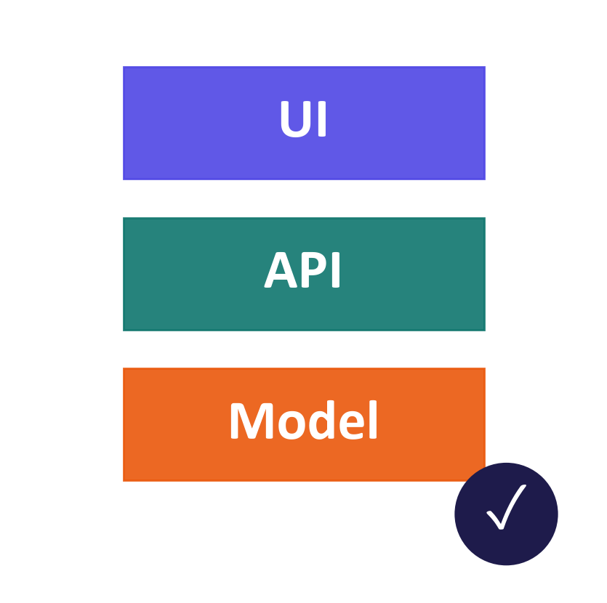
WEEK 11
Deployment and Frameworks
Turn a notebook into an application, measure the cost, and monitor the results
MSc in Artificial Intelligence · Generative AI · 2-hour lecture
Notes:
Welcome to week 11, deployment and frameworks. So far we have used models inside notebooks. This week we turn a model into something other people can use: an application with an interface and an API, running somewhere sensible, at an acceptable cost and speed, with guardrails and monitoring. Every number on the "real" slides was measured by running this week's lab in advance, on a small open model, so students can reproduce them on Colab.
Ask students: What separates a notebook that works from an application other people can use?
Expected answer: An interface or API, a place to run, controlled cost and speed, guardrails and monitoring.
Common mistake: Treating deployment as copying the notebook to a server.

Slide 2
WEEK 11 · DEPLOYMENT AND FRAMEWORKS
By the end of this week you can…
1
Map the layers of an AI application: model, serving, request coordination and user interface.
Module learning outcomes (MIMLOs) practised
2
Explain an API (a way for programs to communicate), protect access keys and handle limits and streaming.
MIMLO 3
Design, implement and fine-tune models
3
Compare provider-hosted, university-hosted and device-local models using quality, privacy, time and cost.
MIMLO 4
4
Explain quantisation (fewer bits), batching (several requests together) and caching (reusing results).
Critically evaluate outputs: metrics, humans, ethics
5
Build interfaces with Gradio and FastAPI; use Docker to package the code and its dependencies.
MIMLO 5
Deploy models; build RAG and agentic systems
6
Record model versions, timings and token counts; test quality, safety checks and deployment choices.
Generative AI · MSc in Artificial Intelligence
2
Notes:
Six outcomes matching the descriptor's week 11: frameworks; API platforms; deployment options; building applications and interfaces; deploying and monitoring with standard tools; and comparison. The final outcome is the one examiners and employers care about: justifying a deployment decision with evidence about latency, cost and quality rather than habit. This week practises MIMLO 5, deploying generative AI with contemporary frameworks, together with MIMLO 3 and 4.
Ask students: Which outcome matters most to employers?
Expected answer: Justifying a deployment decision with evidence about latency, cost and quality.
Common mistake: Choosing a framework out of habit rather than for a specific need.

Slide 3
WEEK 11 · DEPLOYMENT AND FRAMEWORKS
Where we are in the course
Foundations and image generators
Week 1
Week 2
Week 3
Week 4
Introduction and
Variational
Generative adversarial
Diffusion
responsible AI
autoencoders (VAEs)
networks (GANs)
models
Language models and adaptation
Week 5
Week 6
Week 7
Week 8
Transformers
Language models
Prompting
Fine-tuning
and attention
and families
and evaluation
and adaptation
Multimodal applications and deployed systems
Week 9
Week 10
Week 11: you are here
Week 12
Multimodal
Multimodal
Deployment
Retrieval (RAG)
foundations
applications
and frameworks
and agents
Responsible use and evaluation continue throughout the course.
Generative AI · MSc in Artificial Intelligence
3
Notes:
The plan follows the revised descriptor. Sections two and three contain real measurements from the lab: streaming latency, quantisation and batching. Take the break after section three. Sections four and five show the code students will write in the lab and how to monitor and protect the application.
Ask students: Which sections contain real measurements?
Expected answer: Sections two and three: streaming latency, quantisation and batching.
Common mistake: Reading measurements from one laptop GPU as typical of every deployment.
Trace the highlighted week. Earlier concepts feed later systems. Ask which earlier idea today needs. Common mistake: treating each week as an unrelated tool.

Slide 4
WEEK 11 · DEPLOYMENT AND FRAMEWORKS
Starting vocabulary
Term | Plain meaning | Quick check
Token | A unit processed or generated by a model; a text token can be a word, word part or character. | Are character count and token count always the same?
Function | A named piece of code taking inputs and returning an output. | What are the inputs and output of a chat response function?
JSON | A structured text format for exchanging fields and values, including objects and lists. | In {"max_tokens":64}, which part is the field name?
API | An interface through which one program asks another to do work. | Does a browser need the provider's secret key?
Latency | The elapsed time from a request to its result; first-token latency measures the initial wait. | Is first-token wait the same as full-answer wait?
Generative AI · MSc in Artificial Intelligence
4
Notes:
Introduce these terms before the main theory. Give pairs one minute to answer the quick checks, then take answers. Token: A unit processed or generated by a model; a text token can be a word, word part or character. Check: Are character count and token count always the same? Answer: No. A token can be a whole word, part of a word or punctuation. Function: A named piece of code taking inputs and returning an output. Check: What are the inputs and output of a chat response function? Answer: Inputs: the messages and settings such as max_tokens. Output: the generated reply. JSON: A structured text format for exchanging fields and values, including objects and lists. Check: In {"max_tokens":64}, which part is the field name? Answer: max_tokens is the field name; 64 is its value. API: An interface through which one program asks another to do work. Check: Does a browser need the provider's secret key? Answer: No. The secret key stays on the server; the browser talks to your server. Latency: The elapsed time from a request to its result; first-token latency measures the initial wait. Check: Is first-token wait the same as full-answer wait? Answer: No. The first token usually arrives well before the full answer is finished. Let students explain one example aloud, then connect their example to the next flow diagram. Use the blocks to name the inputs and outputs before introducing notation.

Slide 5

WEEK 11 · DEPLOYMENT AND FRAMEWORKS
Warm-up
Your notebook works. Tomorrow 500 students use it. What could fail?
Waiting time and capacity.
Cost and privacy.
Failures and operating responsibility.
Generative AI · MSc in Artificial Intelligence
5
Notes:
Two minutes in pairs. Collect answers under the four headings on the slide; together they are the agenda for today. Students often mention speed first. Push them on cost: a public link to a paid API with no limits can produce a large bill overnight. Push them on keys: API keys pasted into notebooks or GitHub are routinely stolen by automated scanners. And on operations: without logs you do not know that the app is failing until users complain.
Analogy: A classroom tap works for one cup; serving 500 people needs measured flow, capacity and someone watching for leaks.
Ask students: What changes when one notebook serves 500 students?
Expected answer: Concurrent requests, waiting time, cost, failure handling and operating responsibilities all need testing.
Common mistake: A successful single request does not demonstrate capacity for many simultaneous users.

Slide 6

01
Frameworks and the tool stack
Which tools exist, and which do you need?
Notes:
Section one maps the tool landscape into layers, compares the main frameworks named in the descriptor, introduces the OpenAI-compatible API pattern that connects them, and discusses when an orchestration framework helps and when plain code is better. Ask students which of these tools they have already used: most know a chat assistant, few have called an API directly. About twenty minutes.
Analogy: A restaurant separates the menu, kitchen and waiter. Model libraries, servers and application code likewise do different jobs.
Ask students: Does using a workflow framework automatically host the model?
Expected answer: No. Coordination, model execution and hosting are separate choices.
Common mistake: An OpenAI-compatible endpoint may implement only a subset of the client features.

Slide 7
WEEK 11 · DEPLOYMENT AND FRAMEWORKS
A monitored chat application
Follow the actual Gradio path through the lab's respond function
allowed clean
checked answer +
message + history
message
chat messages
answer + counts
metadata
User request
Check current
Build
Generate
Check output
Log + return
Current
input
messages
answer
Metadata and
message and
Block or redact
Rules, history
Return text and
Apply a basic
answer or
history
simple patterns
and cleaned text
token counts
text rule
refusal
demo
check_input
respond
generate
check_output
respond
Input data
Model
Output
Human / tool
data flow
Check: Does a blocked request consume model-generation tokens in respond?
Generative AI · MSc in Artificial Intelligence
7
Notes:
Deployment turns a model into a system that accepts requests and returns usable answers. In this lab, Gradio calls the Python respond function directly. The separate FastAPI exercise offers another route to the same model; the Gradio interface does not call that API. The respond function first applies an input check to the current message. Allowed requests combine a system instruction, recent history and cleaned text, then generate returns answer text and token counts. A basic output check runs before the answer is returned. Blocked requests skip generation and receive a refusal. Both paths write latency, model identity, token counts and the blocking reason to a JSON-lines log. Monitoring summarises those records into percentiles and counts. These simple pattern checks illustrate the flow; they do not guarantee that every injection or personal-data format will be detected.
Worked example:
A student types a question in the Gradio interface.
respond checks the current message before calling the local model.
An allowed message reaches generate; a blocked request skips model generation.
The output is checked and a metadata-only JSON log line is written.
Monitoring aggregates allowed-request latency and all-request block counts.
Check: Does a blocked request consume model-generation tokens in respond?
Answer: No. It skips generate and logs zero prompt and completion token counts for that request.

Slide 8
WEEK 11 · DEPLOYMENT AND FRAMEWORKS
The generative AI stack
Application
Interface and request handling
Orchestration
Connect prompts, retrieval and tools
Access / serving
Hosted API, serving engine or local runner
Model
Weights and generation settings
Hardware
Cloud, server or local device
Monitor quality, latency, errors and cost across every layer.
Generative AI · MSc in Artificial Intelligence
8
Notes:
Think in layers. At the bottom is hardware: cloud GPUs and TPUs, servers, laptops and phones with neural processing units. Models are proprietary, reached only through APIs, or open-weight, downloaded from the Hugging Face Hub. The access and serving layer is how you run a model: cloud APIs, self-hosted serving engines such as vLLM, or local runners such as Ollama. Orchestration frameworks compose prompts, tools, retrieval and agents. At the top are applications and interfaces.
Ask students: In which layer do vLLM and Ollama sit?
Expected answer: Access and serving: they run models; they are neither models nor orchestration frameworks.
Common mistake: Confusing orchestration, such as LangChain, with model hosting.

Slide 9
WEEK 11 · DEPLOYMENT AND FRAMEWORKS
Frameworks and platforms at a glance
Tool | Layer | Use it for (example)
Hugging Face | Models / hosting | Download Qwen2.5-0.5B; host a demo
OpenAI / Azure | Provider API | Call a GPT model with a key
Gemini / Vertex | Provider API | Call Gemini; free tier in AI Studio
vLLM / SGLang / TGI | Server | Serve 50 users from one GPU
Ollama / llama.cpp / LM Studio | Local | Run a small model on a laptop
LangChain / LangGraph | Coordination | Chain retrieval, a model and tools
LlamaIndex | Retrieval | Index a handbook for search
Generative AI · MSc in Artificial Intelligence
9
Notes:
Walk through the table by layer. Hugging Face is the hub for open models and also offers hosted inference through partner providers. OpenAI's API and Microsoft's Azure OpenAI serve GPT models; Azure adds enterprise features such as private networking, regional data residency and compliance certifications, which matter to universities and companies. Google's Gemini API has a free tier through AI Studio, and Gemini Enterprise Agent Platform (formerly Vertex AI) is its enterprise route. vLLM is the most widely used open-source serving engine for GPUs. Ollama makes local models easy.
Ask students: Which tool would you use to run a small model on a laptop without a GPU?
Expected answer: A local runner such as Ollama or llama.cpp.
Common mistake: Choosing a GPU serving engine such as vLLM for one user on a laptop.

Slide 10
WEEK 11 · DEPLOYMENT AND FRAMEWORKS
One client, many back ends: the OpenAI-compatible API
Hosted provider
OpenAI / Azure / Gemini
Inference router
Hugging Face
Chat client
Serving engine
vLLM / SGLang
messages + model
Local runner
Ollama / llama.cpp
Lab endpoint
FastAPI on localhost
Set endpoint, key and model; verify supported fields and behaviour.
Generative AI · MSc in Artificial Intelligence
10
Notes:
Several providers and serving tools accept the basic OpenAI chat-completions format. Examples include compatible endpoints from Gemini, Hugging Face, vLLM and Ollama. The lab builds a small compatible endpoint with FastAPI. Reuse the basic client pattern by changing its base URL, key and model name. Then check supported fields, streaming behaviour and model features: compatibility does not mean every endpoint has identical capabilities. Provider-specific features may need a native SDK.
Ask students: Which three settings change when the client switches to another compatible back end?
Expected answer: The base URL, the key and the model name.
Common mistake: Assuming every compatible endpoint supports every field, such as tools or streaming options.

Slide 11


WEEK 11 · DEPLOYMENT AND FRAMEWORKS
Plain SDK or orchestration framework?
Plain SDK + code
Framework
Call and debug directly
Own prompts, checks and retries
Example: 30 lines that call the API and validate the JSON
Connectors and tracked workflows
Useful abstraction; more dependencies
Example: a LangGraph agent with checkpoints and approval steps
Key idea: Start simple; add a framework for a specific need.
Generative AI · MSc in Artificial Intelligence
11
Notes:
Students often assume they must use LangChain. Frameworks are useful when you need their connectors to data sources, retrievers, state management for multi-step agents, or tracing integrations, and LangGraph in particular is designed for controllable agent workflows. But they add abstraction layers, and their APIs change quickly, which makes debugging harder. Guides from Anthropic and OpenAI on building agents recommend starting with direct API calls and simple code, and adding frameworks only when they solve a real problem.
Ask students: When does an orchestration framework earn its extra dependencies?
Expected answer: When you need its connectors, multi-step state or tracing; otherwise direct API calls are easier to debug.
Common mistake: Starting with a framework before the basic calls work.

Slide 12

WEEK 11 · DEPLOYMENT AND FRAMEWORKS
Quick check
Student data must stay on university servers. What fits the existing compatible client?
Self-host a suitable compatible model; change URL and re-test
Rewrite every component for a new local framework
A
B
Send data to the external API, then request deletion
Switch to a larger external model with better accuracy
C
D
Vote, then convince your neighbour (1 minute).
Generative AI · MSc in Artificial Intelligence
12
Notes:
Answer: A. Because vLLM exposes an OpenAI-compatible API, the application code stays the same; only the base URL, key and model name change. You must then re-evaluate quality, because the open model will behave differently, and plan capacity for the GPUs. B is unnecessary work. C does not satisfy a requirement that data never leaves. D changes nothing about where data goes.
Ask students: After switching to a self-hosted model, what must you re-test?
Expected answer: Answer quality on your test set, and capacity under realistic load.
Common mistake: Choosing C. Asking for deletion after sending data does not meet a rule that data never leaves.

Slide 13

02
API platforms
Keys, tokens, pricing, rate limits and streaming
Notes:
Section two covers what every developer must know about API platforms: authentication and key management, how tokens determine cost, rate limits and error handling, and streaming. We look at real latency measurements and a cost calculation. The same skills apply to OpenAI, Azure, Google and Hugging Face. About twenty-two minutes.
Analogy: A taxi bill records distance and waiting separately. API bills can price input and output tokens separately.
Ask students: With 300,000 requests, how many input tokens arise at 800 per request?
Expected answer: 240 million input tokens; 300 output tokens per request adds 90 million output tokens.
Common mistake: Streaming changes when users can read output; it does not guarantee less model computation.

Slide 14






WEEK 11 · DEPLOYMENT AND FRAMEWORKS
What an API platform gives you, and what it expects
Authentication
Tokens / prices
Rate limits
A secret key or cloud identity says who is calling and who pays.
Priced per million tokens; output usually costs more than input.
Caps on requests and tokens per minute; HTTP 429 means wait and retry.
Streaming
Batch / cache
Schemas / tools
Text arrives chunk by chunk, so users start reading sooner.
Offline batches and repeated prompt prefixes can cost less.
Ask for JSON fields or tool calls in a declared format.
Generative AI · MSc in Artificial Intelligence
14
Notes:
Six concepts cover most API platforms. Authentication uses API keys, or for enterprise clouds, identities such as Microsoft Entra ID, which avoid long-lived secrets. Pricing is per million tokens, with output tokens usually several times more expensive than input, so long answers cost more than long prompts. Rate limits cap requests and tokens per minute. Streaming sends tokens as they are generated. Batch APIs process large offline jobs asynchronously at a discount, and prompt caching discounts repeated prefixes such as long system prompts.
Ask students: Why can long answers cost more than long prompts?
Expected answer: Output tokens are usually priced several times higher than input tokens.
Common mistake: Retrying a 429 error immediately and repeatedly.

Slide 15

WEEK 11 · DEPLOYMENT AND FRAMEWORKS
Keeping API keys safe
Keep keys out of notebooks and Git.
Load server-side secrets; the browser calls your server.
Use restricted credentials and spending controls.
Revoke leaked keys; review usage.
Generative AI · MSc in Artificial Intelligence
15
Notes:
Key security is a practical skill every student needs. Keys committed to public repositories are found by automated scanners very quickly and used to run up bills. Store keys in Colab Secrets, environment variables or a cloud secrets manager. Never embed a key in front-end code, because anyone can read it in the browser; the front end must call your own back end, which holds the key. Use separate keys per project with spending limits and alerts.
Ask students: Where should a web app's API key live?
Expected answer: On your server, loaded from a secrets store; the browser calls your server, never the provider directly.
Common mistake: Putting a key in front-end code or a shared notebook.

Slide 16
WEEK 11 · DEPLOYMENT AND FRAMEWORKS
Anatomy of a request: where the time goes
Network
Queue
Prefill
Decode
and auth
read prompt
generate remaining tokens
Wait to first token (TTFT)
Then continue streaming
TTFT: wait before the first token.
Decoding: generate remaining tokens.
Streaming exposes output sooner; computation can be unchanged.
Generative AI · MSc in Artificial Intelligence
16
Notes:
Break latency into parts. Network and authentication add tens of milliseconds. Under load, requests wait in a queue. Prefill processes the whole prompt in parallel, so it grows with prompt length, which matters for RAG with long contexts. Then decoding generates one token at a time, which is why output length dominates total time. Time to first token is network plus queue plus prefill; total latency is roughly time to first token plus the number of output tokens divided by the decoding speed.
Ask students: Why does a long RAG prompt increase the time to first token?
Expected answer: Prefill must process every prompt token before the first output token appears.
Common mistake: Thinking streaming reduces total computation. It only shows text sooner.

Slide 17
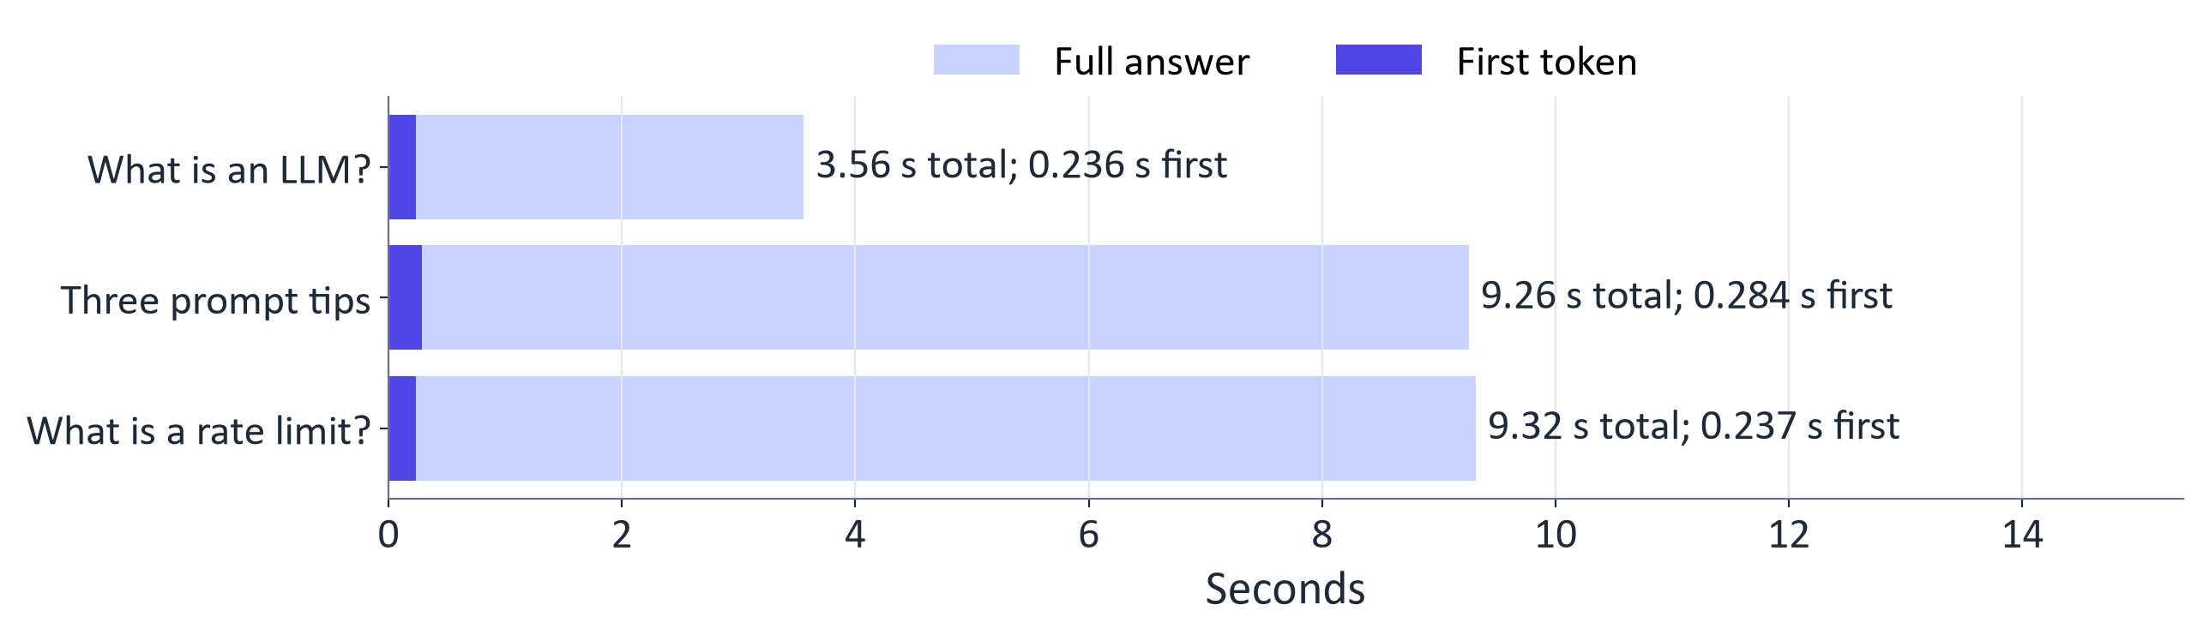
WEEK 11 · DEPLOYMENT AND FRAMEWORKS
Measured: streaming latency of a small open model
Qwen2.5-0.5B-Instruct on an NVIDIA GTX 1650 laptop GPU: TTFT 0.24–0.28 s, full answers 3.6–9.3 s at 14 tokens/s.
This lab times first non-empty decoded text: an approximate TTFT.
Generative AI · MSc in Artificial Intelligence
17
Notes:
This is the lab's measurement for Qwen2.5-0.5B-Instruct. The dark part of each bar is time to first token, the light part the rest of the answer. The numbers are quoted in the bullet. Time to first token is a small fraction of the total, which is why streaming is standard in chat interfaces. Hosted frontier models run on far larger hardware, but they are also much larger, so the same pattern holds.
Ask students: In the measured bars, how large is the first-token wait compared with the whole answer?
Expected answer: A small fraction; most of the time is spent decoding the rest of the answer.
Common mistake: Reporting average latency without the slow cases.

Slide 18
WEEK 11 · DEPLOYMENT AND FRAMEWORKS
Estimating cost: 500 students, 20 requests a day, one month
Option (illustrative prices) | Price per 1M tokens (in / out) | USD per month
Small hosted model | $0.10 / $0.40 | $60
Mid-size hosted model | $0.50 / $2.00 | $300
Frontier hosted model | $2.00 / $10.00 | $1,380
Self-hosted small GPU, always on | $0.60 per hour | $432 + staff time
Method: 300,000 requests × (800 input + 300 output tokens). Illustrative prices; check current provider rates.
Generative AI · MSc in Artificial Intelligence
18
Notes:
Walk through the arithmetic. Five hundred students times twenty requests a day times thirty days is three hundred thousand requests. Each has eight hundred input and three hundred output tokens. For the small model, that is three hundred thousand times eight hundred tokens at ten cents per million, plus three hundred thousand times three hundred tokens at forty cents per million: twenty-four plus thirty-six, sixty dollars. The same formula gives three hundred dollars for the mid-size model and one thousand three hundred and eighty dollars for the frontier model.
Ask students: What would the small-model bill be if answers were 600 tokens instead of 300?
Expected answer: $24 for input plus $72 for output: $96 a month.
Common mistake: Comparing an API bill with GPU rental and forgetting staff time.

Slide 19
WEEK 11 · DEPLOYMENT AND FRAMEWORKS
Streaming and retries in code
from openai import OpenAI
client = OpenAI(base_url=BASE_URL, api_key=API_KEY)
# Read API_KEY from a secrets store.
stream = client.chat.completions.create(
model=MODEL, messages=messages,
stream=True, max_tokens=300)
for chunk in stream:
text = chunk.choices[0].delta.content or ""
print(text, end="")
# Retry 429 with capped backoff and jitter.
Cap output and request time.
Backoff: longer waits; jitter: random variation.
Limit retries and report failure.
Generative AI · MSc in Artificial Intelligence
19
Notes:
Two patterns every application needs. Streaming: set stream to true and print each chunk's delta as it arrives. Retries: when the provider returns HTTP 429, too many requests, wait and retry, doubling the wait each time and adding random jitter so that many clients do not retry at the same moment. Always set a maximum number of output tokens, which caps both cost and latency, and a timeout. The official SDKs have built-in retries for some errors, but you should understand and configure them.
Ask students: Why add random jitter to retry waits?
Expected answer: So that many clients that failed together do not all retry at the same moment.
Common mistake: Retrying forever. Cap the retries and report the failure.

Slide 20

03
Deployment options and efficient serving
Cloud, self-hosted or local, and how to make it cheaper and faster
Notes:
Section three compares the three deployment options, then covers the three main efficiency techniques named in the descriptor: quantisation, batching and caching, with real measurements. The key message: cost and speed are design choices that can be measured, and every efficiency gain must be checked against quality. About twenty-five minutes; take the break afterwards.
Analogy: Sharing a bus trip can move more passengers per hour while making one passenger wait. Batching has the same tradeoff.
Ask students: Does fake_quantize store four-bit tensors in this lab?
Expected answer: No. It rounds then reconstructs floating-point tensors; the displayed storage estimate is hypothetical.
Common mistake: The weight-size estimate omits cache, activations, scales and runtime overhead.

Slide 21
WEEK 11 · DEPLOYMENT AND FRAMEWORKS
Cloud API vs. self-hosted vs. local
 | Cloud API | Self-hosted | Local
Models | Provider's list | Open models you can run | What fits the device
Cost | Pay per token | GPU hire + staff time | Device + electricity
Data | Leaves to the provider | Stays on your servers | Stays on the device
Operations | Provider runs the model | Your team runs it | The device owner
Example | Gemini for a prototype | vLLM for a university | Ollama on a laptop
Generative AI · MSc in Artificial Intelligence
21
Notes:
There is no universally best option. A cloud API provides hosted models and shifts model-server operation to the provider. Check its quality, charges, region and data terms. Self-hosting gives your team control over compatible open models, but you pay for hardware, electricity and staff. High steady use can improve its economics. Local processing can keep data on a configured device; check network features, licences and resource costs. Some applications combine these routes, after testing quality and access requirements.
Ask students: Which option keeps data on a device you configure?
Expected answer: Local, after checking network features and licences.
Common mistake: Assuming self-hosting is always cheaper. Staff time and idle GPUs cost money.

Slide 22

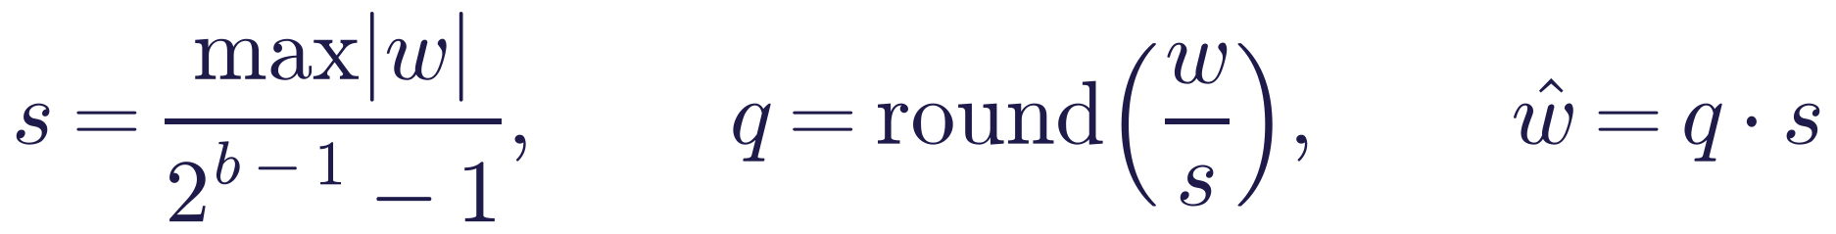
WEEK 11 · DEPLOYMENT AND FRAMEWORKS
Quantisation: fewer bits per weight
Read it as
Symbols
Weights: parameters × bits/8 bytes, before overhead.
Absmax: scale, round, then reconstruct with q × s.
Group scales trade storage for lower error.
b
Bits per weight
s
Group scale
q
Rounded integer
ŵ
Reconstructed value
Generative AI · MSc in Artificial Intelligence
22
Notes:
Quantisation stores weights with fewer bits. Memory is roughly the number of parameters times bits divided by eight: a seven-billion-parameter model needs fourteen gigabytes in sixteen-bit, seven in eight-bit and under four in four-bit, which is the difference between needing a data-centre GPU and running on a laptop. The absmax method scales each group of weights so the largest maps to the largest integer, rounds, and stores the integers plus one scale per group. Smaller groups keep more precision.
Ask students: How much memory do the weights of a 7 B model need at 8-bit?
Expected answer: About 7 GB, before scales and runtime memory.
Common mistake: Forgetting the per-group scales, which add storage.

Slide 23
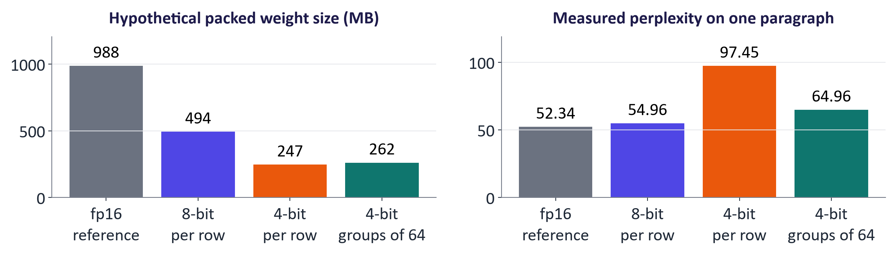
WEEK 11 · DEPLOYMENT AND FRAMEWORKS
Measured: size and quality after quantisation
Perplexity: fp16 52.3 (≈ 988 MB); int8 per row 55.0 (≈ 494 MB); int4 per row 97.5 (≈ 247 MB); int4 groups of 64 65.0 (≈ 262 MB).
The lab simulates rounding in floating-point tensors. Re-check task quality.
Generative AI · MSc in Artificial Intelligence
23
Notes:
The lab rounds weights in linear layers, excluding the output language-model head, then reconstructs floating-point values for inference. It measures perplexity on one paragraph. The displayed storage sizes are estimates of hypothetical packed weights; this demonstration does not store four-bit tensors. Compare the measured quality for eight-bit, row-scaled four-bit and grouped four-bit rounding. Separate group scales can preserve detail at additional storage cost. One paragraph is only a quick check; rerun the actual task evaluation before deployment.
Ask students: Which 4-bit scheme lost less quality in the lab, and why?
Expected answer: Groups of 64: each group has its own scale, so small weights keep more precision.
Common mistake: Judging quality from one paragraph's perplexity. Rerun the task evaluation.

Slide 24
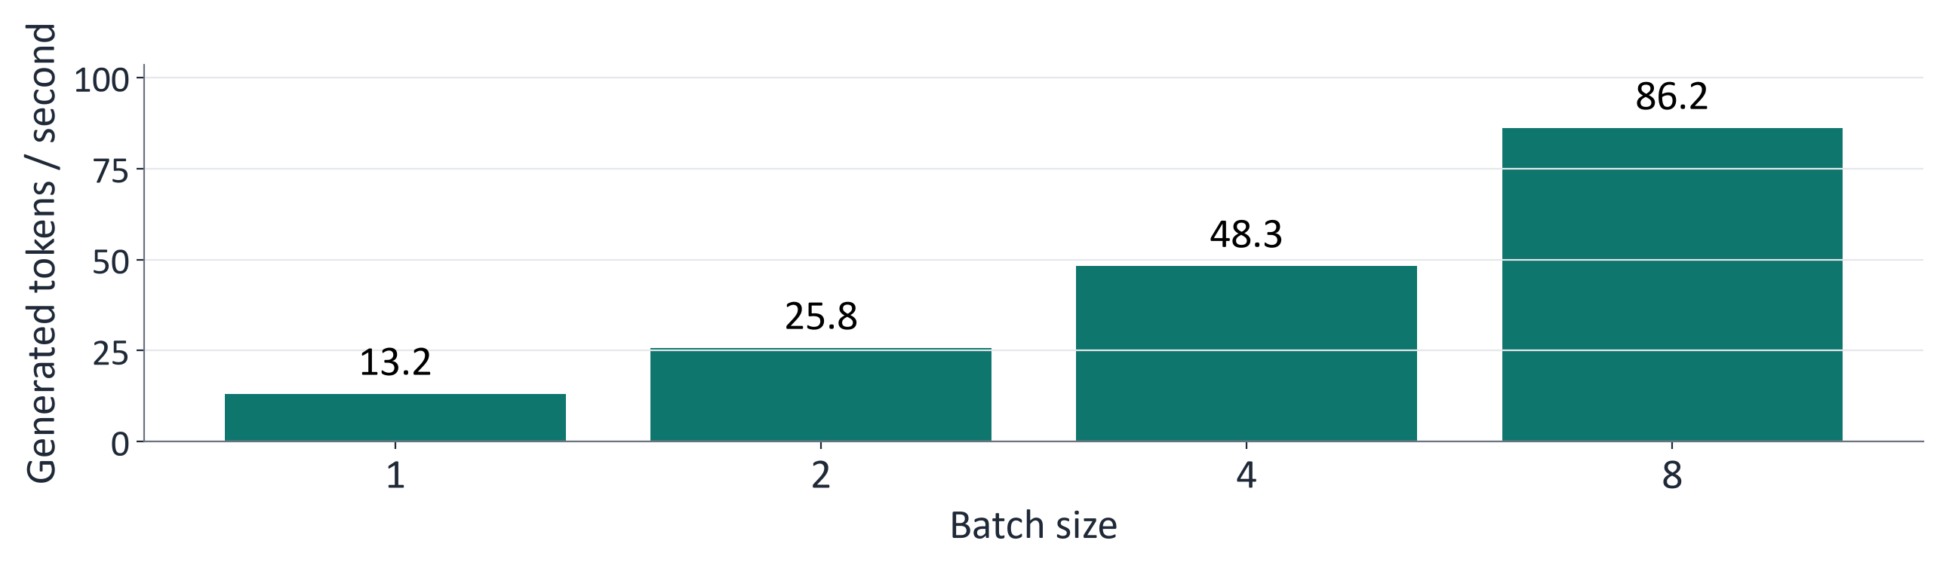
WEEK 11 · DEPLOYMENT AND FRAMEWORKS
Measured: batching raises throughput
13.2 tokens/s at batch 1 → 86.2 tokens/s at batch 8 (6.5× on an NVIDIA GTX 1650 laptop GPU).
Batching raises aggregate throughput; an individual request may wait longer.
Continuous batching admits work as capacity frees.
Generative AI · MSc in Artificial Intelligence
24
Notes:
Generating for one request at a time leaves most of a GPU idle, because decoding is limited by memory bandwidth, not arithmetic. Processing several requests together reuses each weight read for many sequences. The lab measures throughput for batch sizes one to eight; the numbers are in the bullet. Production engines go further with continuous batching, adding and removing requests at every step rather than waiting for a whole batch to finish. The trade-off: larger batches increase throughput but can increase each user's latency.
Ask students: Why does batching raise throughput on a GPU?
Expected answer: Decoding is limited by memory bandwidth, and batching reuses each weight read for several sequences.
Common mistake: Assuming every user gets a faster answer. A request may wait for its batch.

Slide 25

WEEK 11 · DEPLOYMENT AND FRAMEWORKS
Serving engines and caching
KV cache: reuse earlier attention keys/values.
PagedAttention: organise cache pages; batch requests.
Prefix / response cache: reuse input computation / answers.
Speculation: propose then verify tokens.
Test smaller adapted models.
Generative AI · MSc in Artificial Intelligence
25
Notes:
vLLM's key idea, PagedAttention, manages the key-value cache in fixed-size pages, like an operating system's virtual memory, which reduces wasted memory and allows larger batches. Prefix caching reuses the KV cache for shared prompt beginnings, such as a long system prompt, and API providers pass on the saving as discounted cached input tokens. Response caching answers repeated questions instantly. Speculative decoding speeds up generation by letting a small model draft tokens that the large model verifies in parallel.
Ask students: Which technique saves work when every request starts with the same long system prompt?
Expected answer: Prefix caching.
Common mistake: Thinking speculative decoding changes the output. The large model checks every proposed token.

Slide 26
WEEK 11 · DEPLOYMENT AND FRAMEWORKS
What fits where? (weights only)
≈ 1 GB
≈ 4 GB
16 GB
≈ 140 GB
0.5 B weights, 16-bit
7–8 B weights, 4-bit
T4 GPU capacity
70 B weights, 16-bit
Weights only. Add scales, KV caches, activations and runtime memory.
Generative AI · MSc in Artificial Intelligence
26
Notes:
The figures estimate weight storage, not total runtime memory or a guaranteed model fit. A 0.5 B model at 16-bit needs about 1 GB for weights; 7–8 B at 4-bit about 4 GB before scales; 70 B at 16-bit about 140 GB. A T4 has 16 GB total, shared with attention caches, activations and framework overhead. Context length and batch size change the required runtime memory. Measure the actual configuration before recommending hardware.
Ask students: Can a 7 B model at 16-bit run on a T4?
Expected answer: Its weights alone need about 14 GB of the T4's 16 GB, leaving little for caches and activations; 8-bit or 4-bit is safer.
Common mistake: Treating weight size as total memory.

Slide 27
WEEK 11 · DEPLOYMENT AND FRAMEWORKS
Quick check
An accurate self-hosted model struggles with 50 concurrent users. What should you test?
A higher temperature so replies finish sooner
Continuous batching and quantisation; re-check quality
A
B
A longer prompt with more detailed instructions
Disable streaming so each reply is sent whole
C
D
Vote, then convince your neighbour (1 minute).
Generative AI · MSc in Artificial Intelligence
27
Notes:
Answer: B. With many concurrent users, a naive server processes requests one at a time, so queues grow. A serving engine with continuous batching raises throughput dramatically, and quantisation reduces memory so more requests fit in a batch. Quality must be rechecked after quantising. A changes randomness, not speed. C makes prefill slower. D does not change total time and makes perceived latency worse.
Ask students: Why is option D wrong?
Expected answer: Streaming does not change total time; turning it off only makes the wait feel longer.
Common mistake: Quantising without re-checking quality.

Slide 28

04
Building applications and interfaces
Gradio, FastAPI and Docker
Notes:
Welcome back. Section four shows how the pieces fit together into an application: an interface for people, an API for other programs, guardrails and logging around the model, and a container for deployment. The code on these slides is what students write in the lab. About fourteen minutes.
Analogy: An interface is a front door; an API is another entrance. Controls on one door do not automatically protect the other.
Ask students: Does the lab FastAPI route inherit respond input checks?
Expected answer: No. FastAPI calls generate directly, while Gradio calls respond; each route needs its own controls.
Common mistake: The exported Docker files are a smaller scaffold, not the full checked notebook application.

Slide 29
WEEK 11 · DEPLOYMENT AND FRAMEWORKS
Proposed integrated application architecture
Proposed integrated design; the lab tests separate routes.
User
UI
API
Input
Model
Output
Answer
checks
checks
Logs, metrics and versions
Dashboard
latency / tokens / blocks
and alerts
Input data
Model
Output
Human / tool
Generative AI · MSc in Artificial Intelligence
29
Notes:
This is a proposed integrated design. A user interface or other client calls a back-end API, with input checks, model generation, output checks and logs inside that request path. In the lab the routes are separate: Gradio calls respond and generate directly, while the SDK and LangChain call the FastAPI endpoint. That endpoint does not inherit respond's guardrails or logs. The exported app.py is a smaller packaging scaffold without all notebook checks and logging.
Ask students: In the proposed design, where should input checks and logs sit?
Expected answer: Inside the back-end request path, so every client passes through them.
Common mistake: Putting checks only in the user interface, where other clients bypass them.

Slide 30
WEEK 11 · DEPLOYMENT AND FRAMEWORKS
From API request to generated answer
The endpoint translates structured messages into tokens and back
input + new token
HTTP JSON
parsed messages
input token IDs
IDs
answer + counts
Client request
Parse body
Prepare
Generate
Decode new
Return JSON
tokens
tokens
tokens
Messages and
Read declared
Apply expected
Shared model
Remove the
Choices and
output cap
JSON fields
chat format
under lock
input prefix
token usage
client
ChatRequest
inputs
generate
generate
chat_completions
Input data
Model
Output
Human / tool
data flow
Check: Why are prompt and completion token counts returned separately?
Generative AI · MSc in Artificial Intelligence
30
Notes:
An API is an interface through which one program requests work from another. The OpenAI-compatible exercise receives an HTTP request containing JSON fields. FastAPI uses ChatRequest to parse the body, and chat_completions passes its messages to generate. The chat template adds the role markers expected by the model, while the tokenizer converts the formatted text to token IDs. MODEL_LOCK prevents the notebook and server from generating on the shared model simultaneously. The model's output includes the original input prefix plus its continuation. The generate function slices away that prefix, decodes only new tokens and reports input and output counts. The endpoint packages those results into choices and usage fields. Compatibility concerns this response structure; the lab endpoint remains a small demonstration without the authentication, streaming or complete request controls of a deployed service.
Worked example:
The SDK sends 'Name two uses of FastAPI.' to the local endpoint.
ChatRequest parses messages and max_tokens; the endpoint caps output length.
generate formats messages into tokens and waits for the shared model lock.
Only generated continuation tokens are decoded as the assistant answer.
The response includes choices and a usage block for the SDK to read.
Check: Why are prompt and completion token counts returned separately?
Answer: They describe different work: reading the input and producing the answer. They support usage and cost calculations.

Slide 31
WEEK 11 · DEPLOYMENT AND FRAMEWORKS
An OpenAI-compatible endpoint with FastAPI
@api.post("/v1/chat/completions")
def chat(req: ChatRequest):
text, n_in, n_out = generate(
req.messages, req.max_tokens)
return {
"object": "chat.completion",
"choices": [{"index": 0, "finish_reason": "stop",
"message": {"role": "assistant",
"content": text}}],
"usage": {"prompt_tokens": n_in,
"completion_tokens": n_out,
"total_tokens": n_in + n_out}}
FastAPI exposes a Python handler.
Basic compatible JSON; test required features.
This route calls generate directly, separately from checked Gradio.
Generative AI · MSc in Artificial Intelligence
31
Notes:
FastAPI turns a Python function into a web API. Pydantic models validate the request body automatically, rejecting malformed requests, and FastAPI generates interactive documentation. By returning the OpenAI response format, including the usage block with token counts, our server works with the OpenAI SDK and LangChain unchanged, as students verify in the lab. In production you would add authentication, request size limits, timeouts and streaming, and run the server behind a process manager.
Ask students: Why return a usage block with token counts?
Expected answer: Clients such as the OpenAI SDK read it to log usage and estimate cost.
Common mistake: Exposing the endpoint publicly without authentication, size limits and timeouts.

Slide 32
WEEK 11 · DEPLOYMENT AND FRAMEWORKS
A chat interface with Gradio
import gradio as gr
def respond(message, history):
allowed, cleaned, reason = check_input(message) # guardrail
if not allowed:
return f"Sorry, I can't help with that ({reason})."
answer, n_in, n_out = generate(build_messages(cleaned, history))
log_request(n_in, n_out, reason) # metadata only
return check_output(answer)
demo = gr.ChatInterface(respond, title="Course assistant")
demo.launch(share=True) # temporary public link from Colab
Gradio connects a browser to respond.
Spaces hardware, quotas and costs vary.
Public links need appropriate access and request controls.
Generative AI · MSc in Artificial Intelligence
32
Notes:
Gradio builds a web interface from a Python function; ChatInterface provides a complete chat UI in one line. The respond function wraps the model with an input check, logging and an output check. In Colab, share equals true prints a temporary public link, useful for demonstrations but anyone with the link can use it. For longer-lived demos, Hugging Face Spaces hosts Gradio apps, with secrets for API keys. Streamlit is a popular alternative for data-oriented apps.
Ask students: Who can use a share=True link?
Expected answer: Anyone who has the link, until it expires or the session stops.
Common mistake: Leaving the public link running after the demonstration.

Slide 33
WEEK 11 · DEPLOYMENT AND FRAMEWORKS
Prepare a model for a measured release
Deployment changes the running system; it does not train weights
measured
versioned settings
baseline measures
tradeoffs
packaged demo
Choose version
Measure baseline
Try efficiency
Package scaffold
Monitor trial
Model, prompt and
Speed and task
Rounding, batching
Replace ranges with
Inspect logs before
settings
quality
and caches
tested pins
wider use
MODEL_ID
measure
fake_quantize
dockerfile
summary
Input data
Model
Loss / update
Output
Human / tool
data flow
Check: Does a theoretical 4-bit size table show that this notebook stores weights in 4-bit tensors?
Generative AI · MSc in Artificial Intelligence
33
Notes:
Deployment prepares an existing model for use through an application. First record its identity, prompt and generation settings. Measure task quality and speed before making efficiency changes, so later differences have a baseline. The lab illustrates weight rounding, batching and response caching; fake_quantize is a simulation with floating-point tensors, not a genuine low-bit serving engine. Packaging records the environment and start command. The exported app scaffold is smaller than the notebook handler, so inspect which checks it includes. Monitoring a limited trial checks whether real request timing and failures match expectations. None of these steps trains the model weights; they change how the application operates.
Worked example:
Record the selected model name before measuring a fixed question set.
A cache can make a repeated request fast; also measure uncached requests.
Check task answers after an efficiency change.
Inspect the packaging scaffold and compare it with the checked notebook handler.
Check: Does a theoretical 4-bit size table show that this notebook stores weights in 4-bit tensors?
Answer: No. fake_quantize rounds values but keeps floating-point tensors; the storage estimate is theoretical.

Slide 34

WEEK 11 · DEPLOYMENT AND FRAMEWORKS
Packaging and releasing: Docker, versions, CI
Docker records app, dependencies and start command.
Provide secrets at runtime.
Record model, prompt, settings and data versions.
Run CI evaluations before release.
Trial gradually; retain a rollback version.
Generative AI · MSc in Artificial Intelligence
34
Notes:
A Docker image packages code, dependencies and a start command. Record tested exact versions for repeatable deployment; the lab export supplies version ranges as a starting scaffold. A container reduces environment differences but still depends on compatible hardware, platform settings, network access and resources. Pass secrets at run time. Version the model, prompts, decoding settings and retrieval index as well as the code. Re-run evaluations after changes, release gradually and keep a rollback path.
Ask students: Why version prompts and decoding settings as well as code?
Expected answer: Any of them can change answers, so a release must record them all to reproduce a result.
Common mistake: Releasing to everyone at once with no rollback version.

Slide 35

05
Monitoring, guardrails and comparison
How do you know it is working, and safe?
Notes:
The final section covers what to monitor, a real monitoring summary from the lab, layered guardrails, the LLMOps tooling for tracing and evaluation, a comparison of deployment choices, and a responsible deployment checklist. It answers the question every client asks after launch: how do we know it is still working? About twenty-one minutes.
Analogy: A dashboard records several dials because one average can hide a queue. Tail latency, quality and cost need different measurements.
Ask students: If p95 is two seconds, what does that describe?
Expected answer: Approximately 95% of measured allowed requests took at most two seconds; blocked requests are counted separately.
Common mistake: Simple pattern checks can miss attacks and personal-data formats; logs are not a full evaluation.

Slide 36






WEEK 11 · DEPLOYMENT AND FRAMEWORKS
What to monitor
Performance
Cost
Reliability
Time to first text, full answer time, p95 and requests per second.
Tokens and spend per user and per day, with a budget alert.
Errors, timeouts, 429s and provider outages.
Quality
Safety
Versions
A fixed test set re-run weekly, plus sampled human reviews.
Blocked inputs, redactions and attacks that got through.
Which model, prompt and index answered each request.
Generative AI · MSc in Artificial Intelligence
36
Notes:
Monitoring for generative AI extends normal web monitoring. Performance uses percentiles because averages hide slow requests: p95 means ninety-five percent of requests are faster. Cost must be tracked per user and per day, with alerts. Reliability includes rate-limit errors and provider outages. Quality needs signals such as user feedback, sampled reviews and regression tests, because model and data drift can silently degrade answers. Safety metrics track guardrail activity.
Ask students: Which signals would reveal that answer quality is drifting?
Expected answer: Regression tests on a fixed set, sampled human reviews and user feedback.
Common mistake: Monitoring only speed and errors, not answer quality.

Slide 37
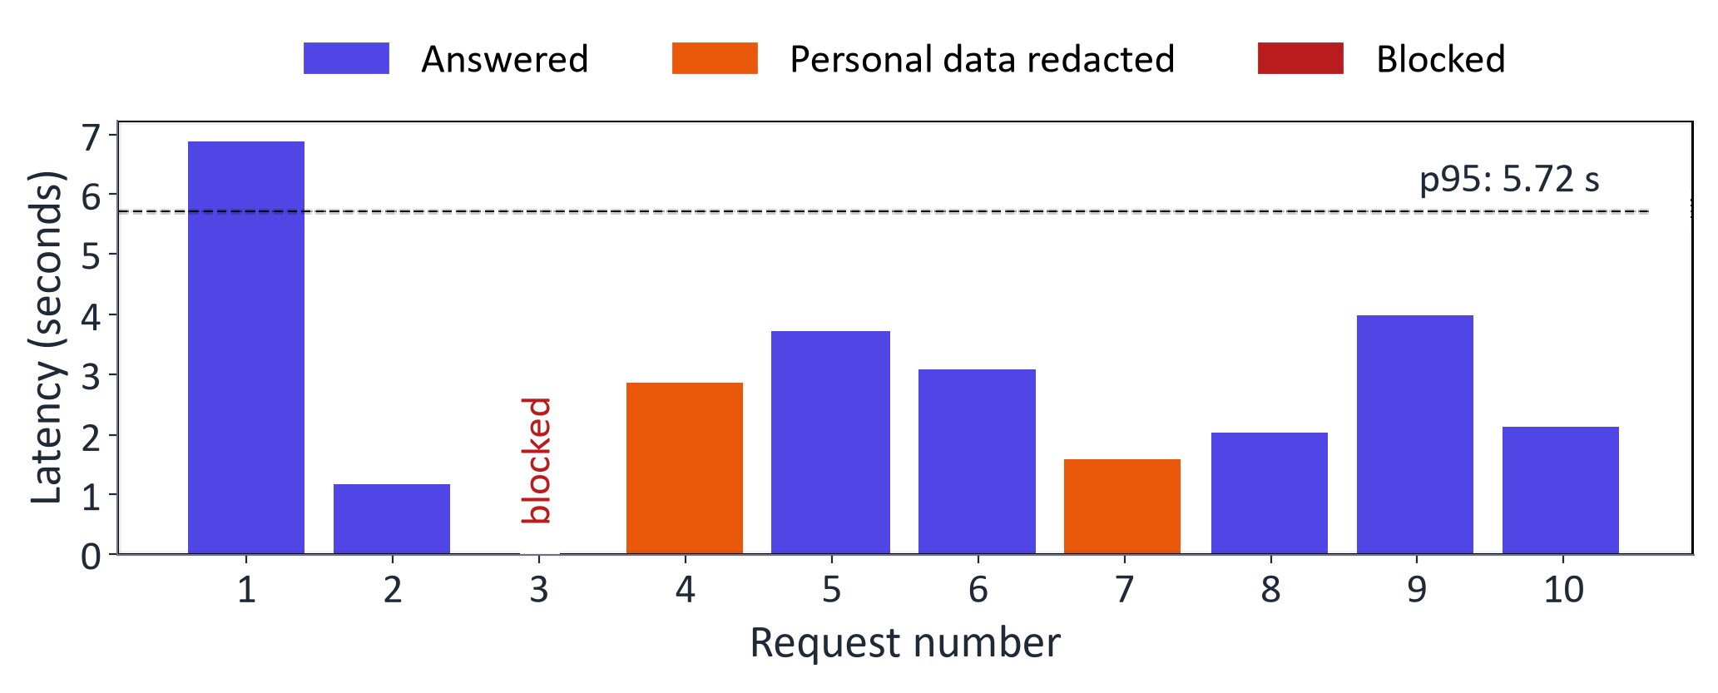
WEEK 11 · DEPLOYMENT AND FRAMEWORKS
Measured: a monitoring summary from the lab app's logs
10 requests: 1 blocked (injection), 2 with personal data redacted; p50 2.85 s, p95 5.72 s.
Handler logs timing, tokens, blocks and versions; no raw prompts.
Generative AI · MSc in Artificial Intelligence
37
Notes:
The lab sends simulated traffic through the app, including a prompt-injection attempt and messages containing an e-mail address and a phone number. Each bar is one request: blue answered, orange answered after redacting personal data, red blocked. The dashed line marks the ninety-fifth percentile latency. The summary in the bullet is computed from the log file. Point out the design choice: logs store metadata, not message text, following GDPR data minimisation; if you need text for quality review, redact it and limit retention and access.
Ask students: Why does the log store metadata rather than message text?
Expected answer: Data minimisation: timings and token counts are enough for monitoring and avoid storing personal data.
Common mistake: Reading ten simulated requests as evidence of production performance.

Slide 38
WEEK 11 · DEPLOYMENT AND FRAMEWORKS
Follow allowed and blocked app requests
Gradio calls respond directly; the FastAPI route is separate
message text
clean text or block
answer + counts
answer or refusal
Browser message
Check current
Generate if
Log + respond
input
allowed
Check answer
Current request and
Block or redact
Fixed model; no
Apply the output rule
Metadata plus
history
simple patterns
weight updates
answer or refusal
demo
check_output
respond
check_input
generate
Input data
Model
Output
Human / tool
data flow
Check: If the API endpoint uses generate directly, does it inherit respond's input checks?
Generative AI · MSc in Artificial Intelligence
38
Notes:
The checked Gradio route begins in respond. It tests the current message for a small set of patterns and may block it or redact matching personal information. If allowed, it builds messages from the cleaned request and recent history, calls generate, then checks the answer. It records metadata such as timing, token counts and block reason without storing raw prompts in this handler's log. A blocked input skips generation but still creates a log record. These rules are examples: they can miss different personal-data forms and attacks. In particular, checking the current message alone does not clean all earlier history. The separate FastAPI exercise does not automatically inherit respond's checks or logging.
Worked example:
A permitted request reaches generation and records input/output token counts.
A blocked current message receives a refusal without running the model.
Both paths add a metadata row that monitoring can count.
Inspect earlier history too; a clean newest message does not make old content safe.
Check: If the API endpoint uses generate directly, does it inherit respond's input checks?
Answer: No. Controls must be applied on each reachable request route.

Slide 39
WEEK 11 · DEPLOYMENT AND FRAMEWORKS
Guardrails in layers
1
2
3
4
5
Input
Model / tools
Output
Oversight
Monitor
Check size, identity, content
Restrict permissions
Check schema and policy
Escalate uncertain cases
Test misses and false alarms
Key idea: Apply controls to every reachable route; pattern rules catch only some cases.
Generative AI · MSc in Artificial Intelligence
39
Notes:
Guardrails work in layers because each layer can be bypassed. Input checks enforce length and rate limits, redact personal data and filter known injection patterns. The model setup limits damage: least-privilege tools mean an injected instruction cannot do much. Output checks run moderation classifiers, validate structured outputs and check for leaked secrets or policy violations. Humans handle sensitive or uncertain cases. Monitoring and red-teaming find new attacks. The lab's regex guardrails are deliberately simple; students discuss how to bypass them in question two.
Ask students: An injected instruction slips past the input filter. Which layer limits the damage?
Expected answer: The model and tools layer: least-privilege tools cannot perform harmful actions.
Common mistake: Relying on regular expressions alone.

Slide 40

WEEK 11 · DEPLOYMENT AND FRAMEWORKS
LLMOps tooling: tracing and evaluation
Tracing: record steps, timing and token use.
Examples: OpenTelemetry, Langfuse, LangSmith, MLflow.
LLMOps: versions, tests, deployment and monitoring.
Repeat evaluations and review sampled answers.
Generative AI · MSc in Artificial Intelligence
40
Notes:
Tracing is essential once an application has several steps, as RAG and agent systems do next week: a trace shows which retrieval, prompt, tool call or model call caused a bad answer or a slow response. OpenTelemetry is the open standard; Langfuse is an open-source LLM observability platform; LangSmith integrates with LangChain; MLflow tracks experiments and traces; and cloud platforms such as Microsoft Foundry (formerly Azure AI Foundry) and Google's Gemini Enterprise Agent Platform (formerly Vertex AI) include monitoring and evaluation dashboards. Guardrail libraries and safety classifiers provide more robust checks than hand-written rules.
Ask students: What does a trace show that a single log line does not?
Expected answer: The chain of steps (retrieval, prompts, tool and model calls) with timings, so you can find the step that caused a slow or bad answer.
Common mistake: Treating tracing as a replacement for evaluation.

Slide 41
WEEK 11 · DEPLOYMENT AND FRAMEWORKS
Comparison: choosing a deployment for a student project
Need | Good choice | Why | Check
Quick prototype | Hosted API + Gradio | Working demo in an hour | Data terms and cost
Private data, no budget | Local model | Data stays on the device | Memory and quality
Demo a fine-tuned model | Hugging Face Spaces / Colab | Free hosted GPU or CPU | Hardware and time limits
Many users | Serving engine (vLLM) | Batches concurrent requests | Load-test waits
Repeatable hand-in | Docker + pinned versions | Same environment for markers | Rebuild from scratch
Generative AI · MSc in Artificial Intelligence
41
Notes:
The descriptor asks for a comparison, so end with a practical decision table for projects. For a quick prototype, compare hosted model quality, permitted data, quotas and cost, then use a Gradio interface where it fits. For private data without a budget, run a local model. To demo your own fine-tuned model, use Hugging Face Spaces or Colab. For many users with steady load, a serving engine on a GPU. For a reproducible hand-in, a Docker image with pinned versions.
Ask students: Which option fits a group demo of its own fine-tuned model?
Expected answer: Hugging Face Spaces or Colab, after checking hardware and session limits.
Common mistake: Choosing a serving engine for a prototype with five users.

Slide 42

WEEK 11 · DEPLOYMENT AND FRAMEWORKS
Responsible deployment checklist
Disclose AI interaction as required.
Minimise data; control access and retention.
Protect keys and cap requests.
Test, monitor and provide human escalation.
Budget for the measured task.
Generative AI · MSc in Artificial Intelligence
42
Notes:
This checklist connects the week to responsible AI. Transparency is now a legal duty in the EU: users must be told they are interacting with an AI system. Data protection requires knowing where prompts go and how long they are kept. Security follows the OWASP Top 10 for LLM applications, which lists prompt injection, sensitive information disclosure and unbounded consumption among the main risks. Oversight and evaluation continue after launch. Finally, cost and energy: smaller, well-chosen models reduce both.
Ask students: Which OWASP risk covers a public app that runs up a large bill?
Expected answer: Unbounded consumption.
Common mistake: Forgetting to tell users they are interacting with an AI system.

Slide 43
WEEK 11 · DEPLOYMENT AND FRAMEWORKS
Measure before deploying
Connect speed, cost, quality and application logs
operating
measured
timed model
usage counts
assumptions
tradeoffs
request logs
Compare
Inspect
Load + time
Serve + call
Estimate cost
efficiency
Build interface
operation
First text and
Exercise local
Illustrative prices
Rounding,
Checked direct
Logs and
full-answer wait
API clients
and retries
batching and
Python route
packaging
measure
chat_completions
monthly_cost
caching
respond
scaffold
fake_quantize
summary
Model
Loss / update
Output
Human / tool
data flow
Check: Does fake_quantize reduce the actual model tensor storage to four bits in this experiment?
Generative AI · MSc in Artificial Intelligence
43
Notes:
The lab begins with streaming measurements before introducing serving. The measure function times the first non-empty decoded text chunk, an approximation of first-token latency because a chunk can contain several tokens. The FastAPI exercise then exposes generation to a client program. The monthly_cost function uses classroom prices, while retry simulation illustrates delayed retries after rate limiting. The efficiency experiments distinguish different tradeoffs: fake_quantize approximates low-bit weights but restores them as floating-point tensors, so the size table is theoretical; batching measures aggregate throughput; caching reuses an answer for a repeated message list. The Gradio application calls respond directly, adding simple checks and log records. Finally, synthetic traffic produces a monitoring summary. The generated Docker files are a smaller packaging scaffold, so compare their features with the notebook before assuming equivalent application behaviour.
Worked example:
Compare first non-empty text time with full-answer time in lat_df.
Inspect the local API answer and its usage counts.
Compare weight approximation error with perplexity after fake quantisation.
Observe batching throughput separately from single-request latency.
Inspect which simulated requests were blocked or redacted and compare p50 with p95.
Check: Does fake_quantize reduce the actual model tensor storage to four bits in this experiment?
Answer: No. It rounds then dequantises weights into floating-point tensors. The size estimate describes hypothetical packed low-bit storage.

Slide 44



WEEK 11 · DEPLOYMENT AND FRAMEWORKS
Lab 11: deploy, measure and monitor a generative AI app
1
Measure first text and full response time.
Runtime
Colab T4 GPU or CPU (slower). About 3 min on a 4 GB laptop GPU after downloads
2
Serve locally; call SDK and framework.
3
Estimate costs; simulate bounded retries.
Time
2-hour lab
4
Compare rounding, batching and cache effects.
Hand in
5
Inspect checked Gradio logs and Docker scaffold.
Notebook with latency, cost, quantisation, batching and monitoring tables, the app link or screenshot, and three answers
Generative AI · MSc in Artificial Intelligence
44
Notes:
The lab covers both descriptor tutorials: exploring tools with local and cloud models, and building and deploying a small application with a web interface, measuring latency and cost and adding logging and guardrails. Cloud API keys are optional; everything else runs without accounts. Remind students to stop the public Gradio link at the end of the session and never to paste keys into the notebook.
Ask students: Which lab parts work without any API key?
Expected answer: All of them except the optional cloud API calls.
Common mistake: Pasting keys into the notebook instead of Colab Secrets.

Slide 45


WEEK 11 · DEPLOYMENT AND FRAMEWORKS
Read, watch, practise
Microsoft: Generative AI for Beginners
Lessons on building and securing apps
Ollama
Run open models locally
Hugging Face Inference Providers
OpenAI-compatible router to open models
Gradio quickstart
Interfaces in Python
Gemini API: OpenAI compatibility
Use Gemini with the OpenAI SDK
FastAPI tutorial
Build APIs with Python
vLLM documentation
High-throughput serving
OWASP Top 10 for LLM Applications
Security risks and mitigations
Generative AI · MSc in Artificial Intelligence
45
Notes:
Microsoft's Generative AI for Beginners has lessons on building and securing applications. The Hugging Face Inference Providers and Gemini compatibility pages show the OpenAI-compatible pattern with free tiers. The vLLM documentation and Ollama cover self-hosted and local serving. Gradio and FastAPI tutorials cover the application layer. The OWASP Top 10 for LLM applications is the standard security reference. The textbook reading is Tunstall and colleagues, chapter 8, on making transformers efficient in production. All links were last checked on 9 October 2026.
Ask students: Which resource is the standard security reference?
Expected answer: The OWASP Top 10 for LLM applications.
Common mistake: Copying deployment code from tutorials without pinning versions.

Slide 46
WEEK 11 · DEPLOYMENT AND FRAMEWORKS
Week 11: operate an application
Choose the layers
Call an API
Measure speed
Separate model libraries, serving,
Send structured requests; protect
First text, full wait and throughput
application code and interfaces.
keys and bound retries.
answer different questions.
Compare efficiency
Package and release
Monitor every route
Measure quality after rounding,
Record tested versions; trial
Track quality, cost, failures and
batching and cache changes.
gradually and retain a rollback.
checks on each entry point.
Example to explain aloud
500 students → expected requests → token/GPU cost → load test → checked interface → monitoring.
Next: in Week 12 we add retrieved evidence and controlled tool use.
Exit question: Batching doubles throughput. Must each student receive an answer sooner?
Generative AI · MSc in Artificial Intelligence
46
Notes:
Return to the 500-student warm-up. Ask students to identify the model, server, interface and monitoring responsibilities. Distinguish the first visible text from the complete response, then use the exit question to separate throughput from individual waiting time. Revisit the illustrative bill: input and output tokens have separate rates. Explain that fake quantisation measures approximation error while keeping floating-point tensors. Follow one allowed and one blocked request through respond. The Gradio route uses that handler, while the separate API route calls generate directly. Finish by asking what must be tested before using the smaller Docker scaffold as a real application.
Exit question: Batching doubles throughput. Must each student receive an answer sooner?
Answer: No. More total tokens per second can coexist with a longer wait for one request.
Recap the six points. Students should be able to draw the architecture of a small application, estimate its cost, explain where latency comes from, choose and justify a deployment option, and list what to monitor. Next week, the final technical week, we connect models to knowledge and tools: retrieval-augmented generation and agents, which use everything from today.
Ask students: Estimate a monthly bill: 100 users, 10 requests a day, 1,000 input and 200 output tokens, small-model prices.
Expected answer: 30,000 requests: 30 M input tokens cost $3 and 6 M output tokens cost $2.40, about $5.40 in total.
Common mistake: Forgetting that output tokens cost more per token.

