Slide 1
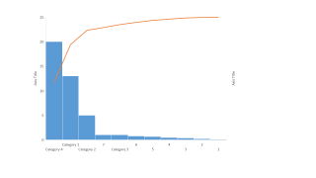
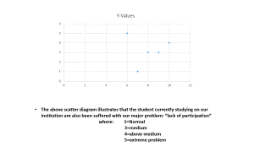
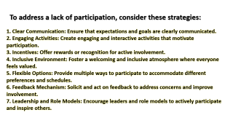
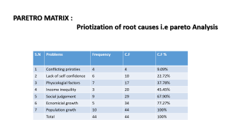
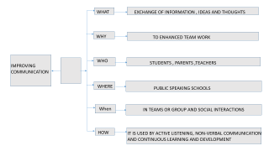
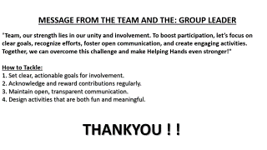
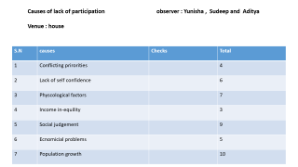
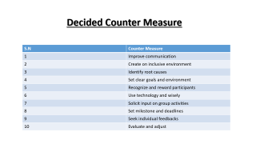
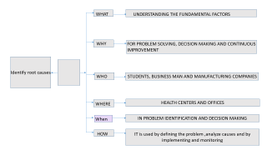




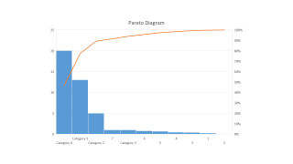





Slide 2
Causes of lack of participation observer : Yunisha , Sudeep and Aditya
Venue : house
S.N | causes | Checks | Total
1 | Conflicting prirorities |  | 4
2 | Lack of self confidence |  | 6
3 | Physcological factors |  | 7
4 | Income in-equility |  | 3
5 | Social judgement |  | 9
6 | Ecnomicial problems |  | 5
7 | Population growth |  | 10

Slide 3
PARETRO MATRIX :
Priotization of root causes i.e pareto Analysis
S.N | Problems | Frequency | C.F | C.F %
1 | Conflicting priroties | 4 | 4 | 9.09%
2 | Lack of self confidence | 6 | 10 | 22.72%
3 | Physcologial factors | 7 | 17 | 37.78%
4 | Income inequility | 3 | 20 | 45.45%
5 | Social judgement | 9 | 29 | 67.90%
6 | Ecnomicial growth | 5 | 34 | 77.27%
7 | Population growth | 10 | 44 | 100%
 | Total | 44 | 44 | 100%

Slide 4
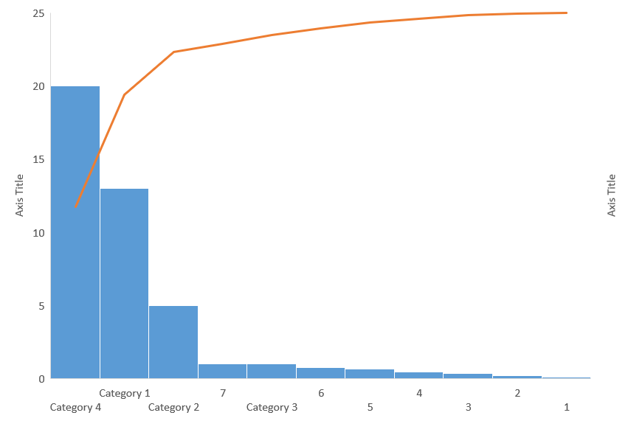

Slide 5
The above scatter diagram illustrates that the student currently studying on our institution are also been suffered with our major problem: “lack of participation”
where: 1=Normal
3=medium
4=above medium
5=extreme problem

Slide 6
Decided Counter Measure
S.N | Counter Measure
1 | Improve communication
2 | Create on inclusive environment
3 | Identify root causes
4 | Set clear goals and environment
5 | Recognize and reward participants
6 | Use technology and wisely
7 | Solicit input on group activities
8 | Set milestone and deadlines
9 | Seek individual feedbacks
10 | Evaluate and adjust

Slide 7
WHAT
EXCHANGE OF INFORMATION , IDEAS AND THOUGHTS
WHY
TO ENHANCED TEAM WORK
WHO
STUDENTS , PARENTS ,TEACHERS
IMPROVING COMMUNICATION
WHERE
PUBLIC SPEAKING SCHOOLS
When
IN TEAMS OR GROUP AND SOCIAL INTERACTIONS
HOW
IT IS USED BY ACTIVE LISTENING, NON-VERBAL COMMUNICATION AND CONTINUOUS LEARNING AND DEVELOPMENT

Slide 8
WHAT
UNDERSTANDING THE FUNDAMENTAL FACTORS
WHY
FOR PROBLEM SOLVING, DECISION MAKING AND CONTINUOUS IMPROVEMENT
Identify root causes
WHO
STUDENTS, BUSINESS MAN AND MANUFACTURING COMPANIES
WHERE
HEALTH CENTERS AND OFFICES
When
IN PROBLEM IDENTIFICATION AND DECISION MAKING
HOW
IT is used by defining the problem ,analyze causes and by implementing and monitoring

Slide 9
IMPLEMENTATION

Slide 10
IMPLEMENTATION
IMPLEMENTATION

Slide 11
IMPLEMENTATION
Check Sheet Innovative Cohort Quality Circle
Topic: Final Observation
Date: 2081-04-2 |  |  | Place: LETS TALK APP
Name: Barsha,Yunisha,Sampada
SN | Causes | Tally bar |  | Total
1 | COMPLEX RISK ASSESMENT | ||| |  | 3
2 | STRESS AND ANXIETY | |||| | |  | 6
3 | INCREASED UNCERTAINITY | |||| |||| | |  | 11
4 | EXCESSIVE SENARIO PLANNING | ||| |  | 3
5 | INCREASED REQUIREMENT | |||| |  | 5
6 | RESOURCE ALLOCATION | || |  | 2
7 | DEPRESSION AND ANXIETY | |||| |||| |  | 9

Slide 12
ANALYSIS
Analysis
COMPARISON
BENEFITS
RESULT
STRATEGIES

Slide 13
COMPARISON

Slide 14
COMPARISION
COMPARISION

Slide 15
COMPARISION

Slide 16
COMPARISION

Slide 17
RESULT

Slide 18
RESULT
RESULT

Slide 19
STRATEGIES

Slide 20
STRATEGIES
STRATEGIES

Slide 21
STRATEGIES
FUTURE STRATEGIES
During the case study various ideas, plans and creativity were implemented. After the case study we have made various future strategies for the study of various kinds of problems in students. The main strategies are listed below:
Organic workshops a seminars for students, parents and teachers to provide information on OVER THINKING and have Encourage open communication and create a safe space for students to discuss their concerns and seek support.
Implement regular and assessment of the effectiveness of strategies implemented.
Emphasizes the importance of having a healthy mind.

Slide 22
BENEFITS

Slide 23
BENEFITS
BENEFITS

Slide 24
BENEFITS
BENEFITS BY CASE STUDY
Tangible :
Allows students to apply theoretical knowledge to practical situations
Improve and enhance communication skills
Improve research skills
The particular skills obtained can be beneficial for our future careers
Helps in realizing the importance of time
Intangible :
Encourages student to think critically
Enhance the ability to solve complex problems
It improves the ability of student to make decision in critical situation
It builds up confidence
It builds the ability to evaluate multiple alternatives and make informed choices

Slide 25
CONCLUSIONS
Conclusions
REPORT
THANK YOU
SPECIAL THANKS
QUERIES

Slide 26
REPORT

Slide 27
REPORT
REPORT

Slide 28
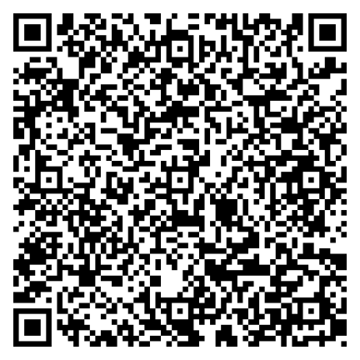
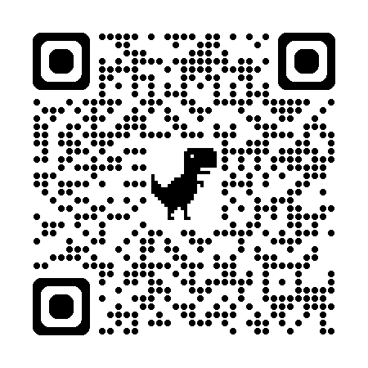
REPORT
APP WEBSITE
LET'S TALK (AI Integrated)
lethelp.dorik.io

Slide 29
MESSAGE FROM THE TEAM AND THE: GROUP LEADER
"Team, our strength lies in our unity and involvement. To boost participation, let’s focus on clear goals, recognize efforts, foster open communication, and create engaging activities. Together, we can overcome this challenge and make Helping Hands even stronger!"
How to Tackle:
1. Set clear, actionable goals for involvement.
2. Acknowledge and reward contributions regularly.
3. Maintain open, transparent communication.
4. Design activities that are both fun and meaningful.
THANKYOU ! !

Slide 30
To address a lack of participation, consider these strategies:
1. Clear Communication: Ensure that expectations and goals are clearly communicated.
2. Engaging Activities: Create engaging and interactive activities that motivate participation.
3. Incentives: Offer rewards or recognition for active involvement.
4. Inclusive Environment: Foster a welcoming and inclusive atmosphere where everyone feels valued.
5. Flexible Options: Provide multiple ways to participate to accommodate different preferences and schedules.
6. Feedback Mechanism: Solicit and act on feedback to address concerns and improve involvement.
7. Leadership and Role Models: Encourage leaders and role models to actively participate and inspire others.

Slide 31
Next Page

