Slide 1
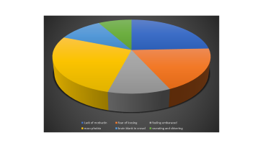
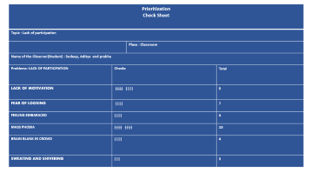
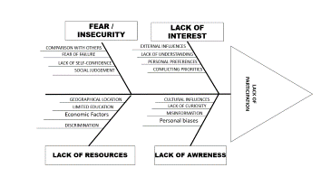
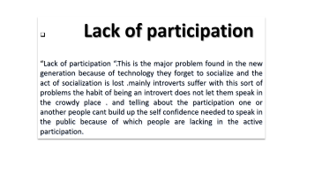

Slide 2
Prioritization Check Sheet
Topic : Lack of participation
 | Place : Classroom | Place : Classroom
Name of the Observer(Student) : Sudeep, Aditya and prabhu
Problems: LACK OF PARTICIPATION | Checks |  | Total
LACK OF MOTIVATION | |||| |||| |  | 9
FEAR OF LOOSING | |||| |  | 7
FEELING EMBARACED | |||| |  | 4
MASS PHOBIA | |||| |||| |  | 10
BRAIN BLANK IN CROWD | |||| |  | 4
SWEATING AND SHIVERING | ||| |  | 3

Slide 4
Lack of participation
“Lack of participation “.This is the major problem found in the new generation because of technology they forget to socialize and the act of socialization is lost .mainly introverts suffer with this sort of problems the habit of being an introvert does not let them speak in the crowdy place . and telling about the participation one or another people cant build up the self confidence needed to speak in the public because of which people are lacking in the active participation.

Slide 5
FEAR / INSECURITY
LACK OF INTEREST
COMPARISON WITH OTHERS
EXTERNAL INFLUENCES
FEAR OF FAILURE
LACK OF UNDERSTANDING
LACK OF PARTICIPATION
LACK OF SELF-CONFIDENCE
PERSONAL PREFERENCES
SOCIAL JUDGEMENT
CONFLICTING PRIORITIES
GEOGRAPHICAL LOCATION
CULTURAL INFLUENCES
LIMITED EDUCATION
LACK OF CURIOSITY
Economic Factors
MISINFORMATION
Personal biases
DISCRIMINATION
LACK OF RESOURCES
LACK OF AWRENESS

Slide 6
Next Page

