Slide 1
Unified Mentor Internship

Slide 2
AtliQ Hospitality Analysis
By – Sudeep Kumar Lakra
ID : UMIP9740

Slide 3
TABLE OF CONTENTS
01
Problem vs. solution
03
Our products
02
Dataset
04
Business model

Slide 4
INTRODUCTION
AtliQ Grands, a 20-year veteran in India's luxury hotel industry, owns multiple five-star properties. Facing market share and revenue losses due to competitor strategies and management issues, they aim to regain their position by incorporating Business and Data Intelligence, outsourcing to a third-party service provider for insights.

Slide 5
01
Problem vs. solution

Slide 6
Problem Statement
Atliq Grands owns multiple five-star hotels across India. They have been in the hospitality industry for the past 20 years. Due to strategic moves from other competitors and ineffective decision-making in management, Atliq Grands are losing its market share and revenue in the luxury/business hotels category. As a strategic move, the managing director of Atliq Grands wanted to incorporate “Business and Data Intelligence” in order to regain their market share and revenue. However, they do not have an in-house data analytics team to provide them with these insights. Their revenue management team had decided to hire a 3rd party service provider to provide them with insights from their historical data.

Slide 7
02
Dataset

Slide 8
Tables
02
03
01
Dim Dates
Dim Hotels
Dim Rooms
04
05
Fact Aggregated Bookings
Dim Dates

Slide 9
Dim Dates
Date
Mmmm yy
Week No
Day of Week
This column contains the date
This column contains month and year
Contains the week number of the year
Name of the weekday for example Monday,Tuesday etc.

Slide 10
Dim Hotels
Property ID
Property Name
Category
City
This column contains unique property id
This column contains name of the AtliQ Hotel Properties
Type of rooms available in hotel like Luxury or Business
It cotains name of city where hotel is located

Slide 11
Dim Rooms
Room ID
Room Class
This column contains unique room id
This column contains different classes of rooms like elite, premium etc

Slide 12
Fact Aggregated Bookings
Property ID
Check In Date
Room Category
Successful Bookings
This column contains unique property id
Date when the guests have arrive to the hotel and checked in.
Type of rooms available in hotel like RT1,RT2 etc
Capacity
This column contains the detail of rooms that were booked successfully
This column has the total capacity of hotel

Slide 13
Fact Bookings
Property ID
Checkout Date
Check In Date
No of Guests
Booking Platform
Booking ID
Ratings Given
Room Category
Booking Status
Revenue Generated
Revenue Realized

Slide 14
03
KPI

Slide 15
KPI
Revenue
Total Bookings
Average Ratings
Total Capacity
Total Successful Bookings
Occupancy %
Total Cancelled Bookings
Cancellation Rate

Slide 16
04
Dashboard

Slide 17
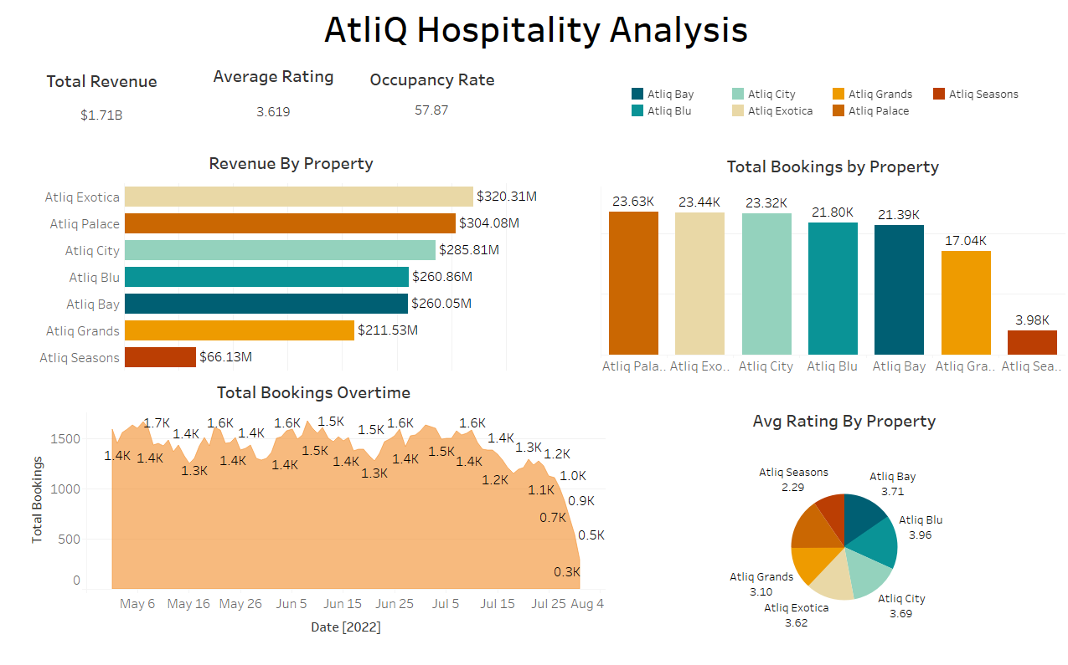
Tableau Dashboard

Slide 18
05
Conclusion

Slide 19
Conclusion
AtliQ Hospitality's analysis reveals that while the total revenue stands at $1.71B, AtliQ Exotica and AtliQ Palace are the top revenue generators. The average rating across properties is 3.619, with AtliQ Blu leading in guest satisfaction. The overall occupancy rate is 57.87%, indicating room for improvement. AtliQ Grands and AtliQ Seasons underperform in both revenue and bookings, suggesting the need for targeted strategies to enhance performance. Total bookings show a downward trend towards the end of the period, highlighting potential issues in attracting guests consistently. To regain market share, AtliQ should focus on improving underperforming properties and maintaining high standards in guest experience.

Slide 20


Thank You

