Slide 1

Unified Mentor Internship

Slide 2
Entertainer Data Analysis
By Sudeep Kumar Lakra ID : UMIP9740

Slide 3
Table of contents
01
02
03
04
05
Statement
Dataset Overview
KPI
This sections describe the problem statement
This section gives us the brief intro about the dataset
This section shows details about the tasks that has to performed
Dashboarding
Conclusions
Tableau Dashboard
The final Verdict

Slide 4
01
Statement
This sections describe the problem statement.

Slide 5
Purpose statement
What is the data about
Normal life can be stressful, and people need to relax. Being entertained by others is a wonderful way to take some time out of life. It can reduce stress and make life's issues easier to face. The media and entertainment industry consists of film, television, radio and print. These segments include movies, TV shows, radio shows, news, music, newspapers, magazines, and books. The entertainment industry is a group of sub-industries devoted to entertainment. The entertainment industry is used to describe the mass media companies that control the distribution and manufacture of mass media entertainment.

Slide 6
02
Dataset Overview
This section gives us the brief intro about the dataset

Slide 7
There are three different tables given to us.
01
02
03
Last Work
Basic Info
Breakthrough Info
This table contains data about the last movies done by the actors.
This tables give detail about the basic information like place of birth,birth year, name etc.
This table gives us information about the first movie and the first big achievenment of the actors

Slide 8
Last Work
Entertainer
It has the name of the actors/actressess.
Year of Last Major Work
It shows the last year the actors have worked
Year of Death
It shows the death year of actor/actresses.

Slide 9
Basic Info
Entertainer
It has the name of the actors/actressess.
Gender
Male/Female
Birth Year
It shows the birth year of actor/actresses.

Slide 10
Breakthrough Info
Entertainer
It has the name of the actors/actressess.
Year of Breakthrough/Award Nomination
The year when the first movie of the actors were released
This column shows the name of the first movie done by the actors
Breakthrough Name
This column shows the first big achievement of the actors
Year of first Oscar/Grammy/Emmy

Slide 11
03
KPI
This section shows details about the tasks that has to performed

Slide 12
KPI
Age of Death
Average age of Death
Total Entertainer
Years Active

Slide 13
04
Dashboarding
Tableau Dashboard

Slide 14
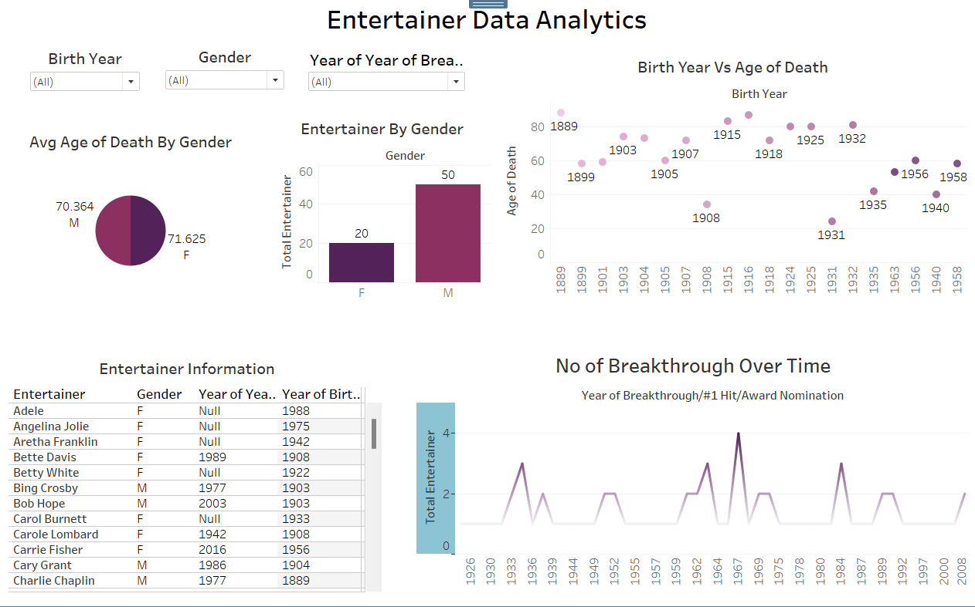
Tableau Dashboard

Slide 15
05
Conclusion
Final Verdict

Slide 16
Conclusion
In summary, the media and entertainment sector is vital in offering much-needed respite from the demands of daily life. It accommodates a wide range of interests and inclinations by providing a vast selection of content for print, radio, television, and film, guaranteeing that everyone may find something to amuse and unwind. The entertainment business is an important source of relaxation and escape, allowing individuals to relax and approach life's issues with a renewed perspective, whether through movies, TV shows, music, or literature. In addition to enhancing our lives, entertainment as a conglomeration of sub-industries focused on its production and dissemination also promotes a feeling of community and shared experiences.

Slide 17


Thank You
https://public.tableau.com/app/profile/sudeep.lakra/viz/Entertainer_17219945737060/Overview
https://www.linkedin.com/in/sudeep-lakra/

