Slide 1
Unified Mentor Internship

Slide 2
Foreign Direct Investment
By Sudeep Kumar Lakra
ID : UMIP9740

Slide 3
Table of contents
01
03
02
04
KPI
Introduction
Dashboard
Dataset Overview
Conclusion
05

Slide 4
01
Introduction

Slide 5
Introduction
Investment is a game of understanding historic data of investment objects under different events but it is still a game of chances to minimize the risk we apply analytics to find the equilibrium investment.
To understand the Foreign direct investment in India for the last 17 years from 2000-01 to 2016-17. This dataset contains sector and financial year-wise data of FDI in India Sector-wise investment analysis Year-wise investment analysis.

Slide 6
02
Dataset Overview

Slide 7
FDI Table
Sectors
This column contains the name of the different sectors
This column contains the detail of the years
Year
This column contains the details of the total amount invested in different sectors
Amount

Slide 8
03
KPI

Slide 9
KPIs
FDI Amount in Rupees
FDI Amount in USD
Rank by FDI
Total Amount in Rupees
Total Amount in USD

Slide 10
04
Dashboard

Slide 11
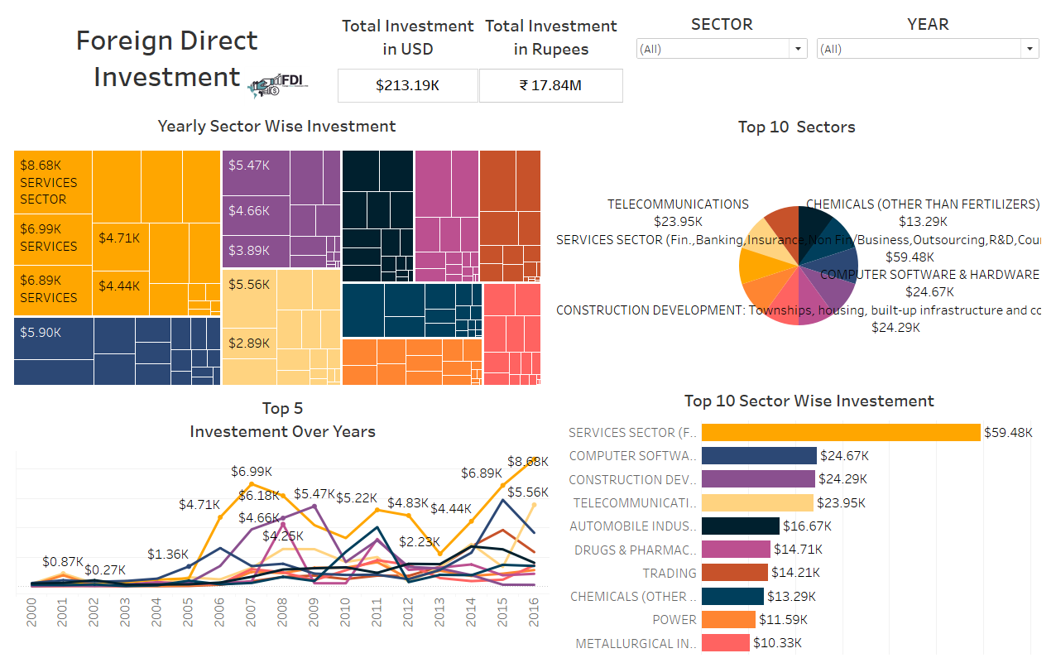
Tableau Dashboard

Slide 12
05
Conclusion

Slide 13
Conclusion
From 2000–01 to 2016–17, Foreign Direct Investment (FDI) in India shown growth, with major industries such as Telecommunications and Services drawing steady investment. Important elements are market potential, economic stability, and policy changes. Government measures supporting a strategic emphasis on high-growth and developing industries can maximize investment possibilities and reduce risks.

Slide 14
Continuation
Services
Telecommunications
Computer Software and Hardware
Construction Development
Top Performing Sectors
Automobile Industry
Pharmaceuticals
Emerging Sectors
Positive growth trajectory over 17 years
Spikes in FDI due to favorable policies
Resilience and recovery post-global economic events
Impactful Trends:

Slide 15


Thank You

