Slide 1

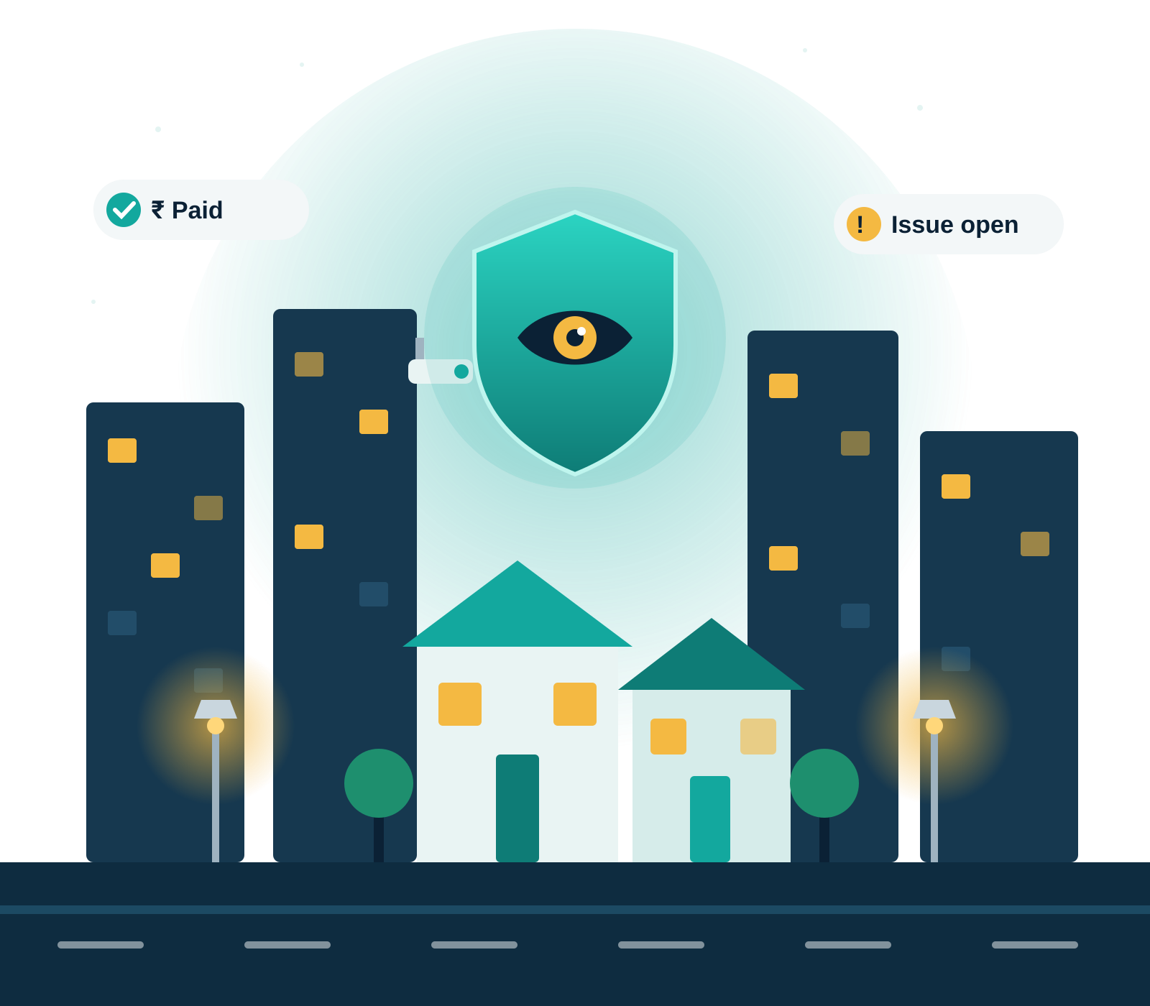
SecureComm
One transparent window into your residential community
A detailed, module-by-module walkthrough of how residents, volunteers, security guards and the super admin share one source of truth.
Prototype walkthrough · Sudeep · October 2026
Notes:
This deck walks through every module of the SecureComm prototype in detail: what it is for, who uses it, what it records and how records move from one status to the next.

Slide 2




Residents are often the last to know
THE PROBLEM
“
Where does my maintenance money go?
Did anyone act on my complaint?
Trust breaks down when information sits with only a few people.
Collections and expenses are shared once a year, if at all.
Issues get lost in WhatsApp groups with no owner or status.
Are the cameras and lights working?
Who came through the gate today?
SecureComm puts the same facts in front of every role.
Nobody knows how many CCTVs or street lights are faulty.
Paper registers at the gate are hard to check or audit.
Notes:
Four everyday questions residents ask that today have no clear answer. The root cause is the same: information is held by a few people and shared informally.

Slide 3

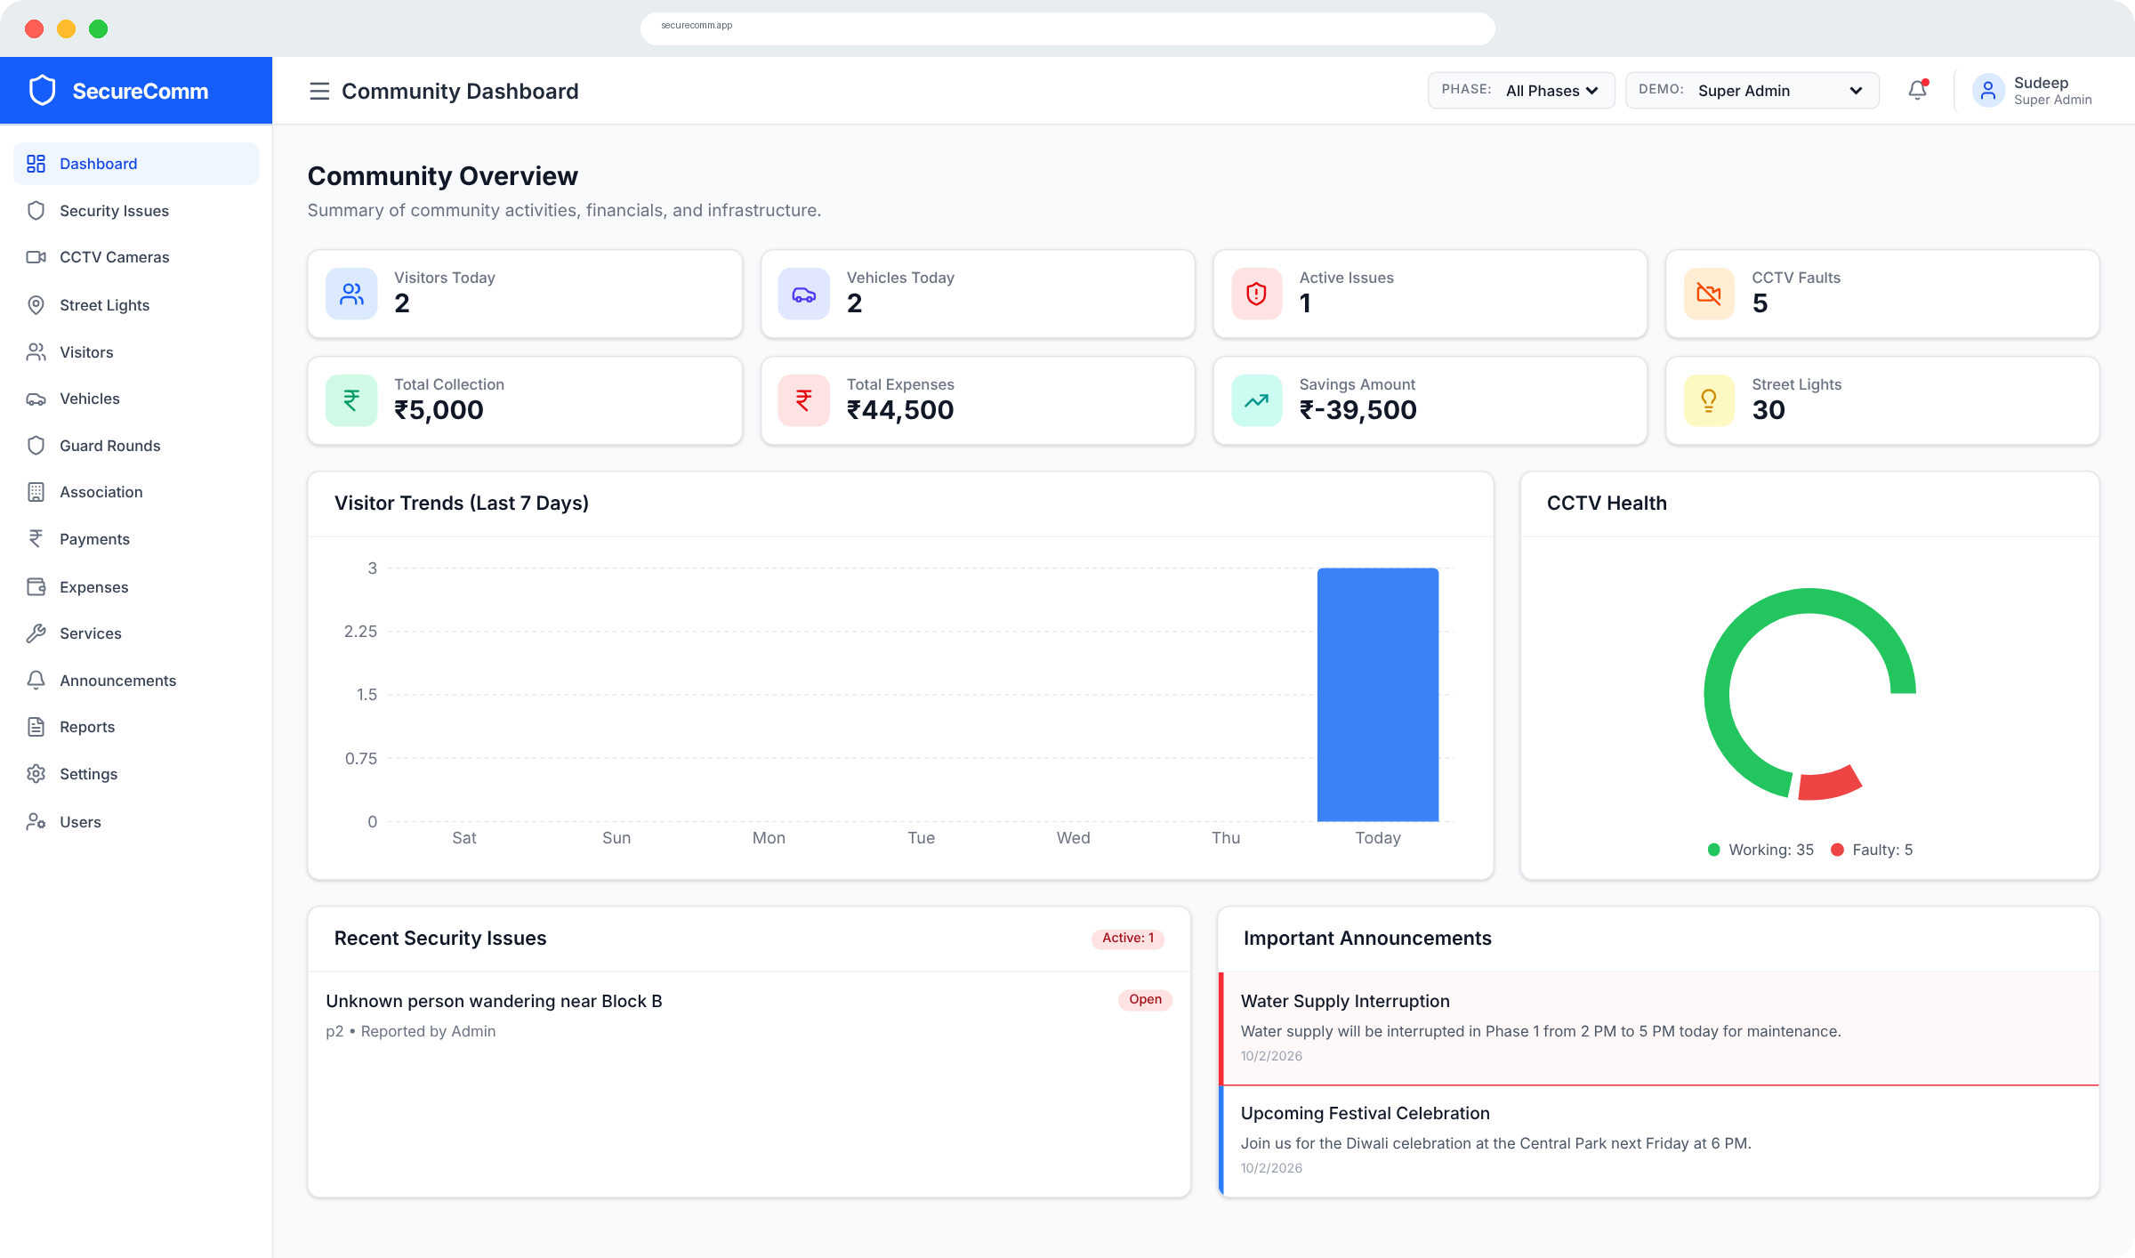


One shared source of truth
THE SOLUTION
See it
Live status of security issues, CCTV, street lights, finances and notices — for every role.
Own it
Every issue, patrol round, payment and expense is logged with status, date and who recorded it.
Act on it
Residents report issues, check dues and find verified service providers themselves.
The community dashboard, as seen by the Super Admin
Notes:
Three ideas drive the product: make information visible, make every action accountable, and let residents take part directly.

Slide 4




Four roles, one platform
WHO USES IT
Super Admin
Volunteer / Superintendent
Security Guard
Community Member
Owns the whole community
Runs day-to-day operations
Looks after the gate
Sees everything that matters
Configures community settings and gate access rules
Adds volunteers, guards and residents
Sees all 6 phases and 2 sectors
Records payments and logs expenses
Broadcasts announcements
Manages CCTV, street lights and committee
Registers visitor entry and exit
Tracks vehicles at the gate
Logs patrol rounds on Day, Night or Reliever shift
Reports security issues
Views CCTV health and payment status
Reads notices and finds service providers
Notes:
There are four roles. In the prototype a 'Demo' switcher in the header lets you change role live, so you can show how the sidebar and permissions change for each person.

Slide 5
Each role sees exactly what it needs
ROLE-BASED ACCESS
Module | Super Admin | Volunteer | Guard | Resident
Dashboard | ✓ | ✓ | ✓ | ✓
Security Issues | ✓ | ✓ | ✓ | ✓
CCTV Cameras | ✓ | ✓ | – | ✓
Street Lights | ✓ | ✓ | – | –
Visitors | ✓ | ✓ | ✓ | –
Vehicles | ✓ | ✓ | ✓ | –
Guard Rounds | ✓ | ✓ | ✓ | –
Association | ✓ | ✓ | – | –
Payments | ✓ | ✓ | – | ✓
Expenses | ✓ | ✓ | – | –
Services | ✓ | ✓ | ✓ | ✓
Announcements | ✓ | ✓ | ✓ | ✓
Reports | ✓ | ✓ | – | –
Settings | ✓ | – | – | –
Users | ✓ | – | – | –
Modules visible in the sidebar
15
13
Super Admin
Volunteer
7
6
Security Guard
Resident
Residents get read-only views. They see CCTV health, security issues and payments, but edit and delete actions are hidden for them.
Notes:
This matrix comes straight from the role list on each sidebar item. A tick means the module appears in that role's menu. Inside a module, residents still get view-only screens.

Slide 6



15 modules in five groups
MODULE MAP
Safety
Gate
Money
Community
Control
Security Issues
Visitors
Payments
Announcements
Dashboard
CCTV Cameras
Vehicles
Expenses
Association
Users
Street Lights & Assets
Reports
Service Providers
Settings
Guard Rounds
The next slides take each module in turn: what it is for, who uses it, what it records, and how its records move from one status to the next.
Notes:
Use this as the agenda for the deep dive. The groups follow how a community actually runs: keep it safe, control the gate, account for money, keep people informed, and administer the platform.

Slide 7






Learn one screen, and you know them all
HOW EVERY MODULE WORKS
01
02
03
Summary cards
Search & filter
Add a record
Live counts at the top: totals, open items, faults, amounts.
Find records by name, house or ID; filter by status or priority.
A short form opens in a pop-up; required fields are starred.
04
05
06
Update status
Phase & sector
Role-aware actions
Change status in one click; counters and dashboard update.
Every record is tagged, so the phase switcher filters it.
Edit and delete buttons appear only for roles allowed to use them.
Notes:
Every module page follows the same six-part pattern, which makes the app easy to learn for non-technical residents and volunteers.

Slide 8









Dashboard: the pulse of the community
MODULE 01 · CONTROL · DASHBOARD
The landing page for every role. It pulls live numbers from all other modules, so everyone starts the day with the same picture.
EIGHT TILES — CLICK ANY TO OPEN ITS MODULE
Visitors today
→ Visitors
Vehicles today
→ Vehicles
Active issues
→ Security
CCTV faults
→ CCTV
Total collection
→ Payments
Total expenses
→ Expenses
Savings amount
→ Reports
Street lights
→ Street lights
BELOW THE TILES
Visitor trend for the last 7 days
CCTV health donut (working vs faulty)
Recent security issues and important notices
Phase switcher for admins and volunteers
Notes:
Savings is calculated as total paid collections minus total paid expenses. When an admin or volunteer picks a phase, every tile recalculates for that phase only. Residents and guards always see the whole community.

Slide 9
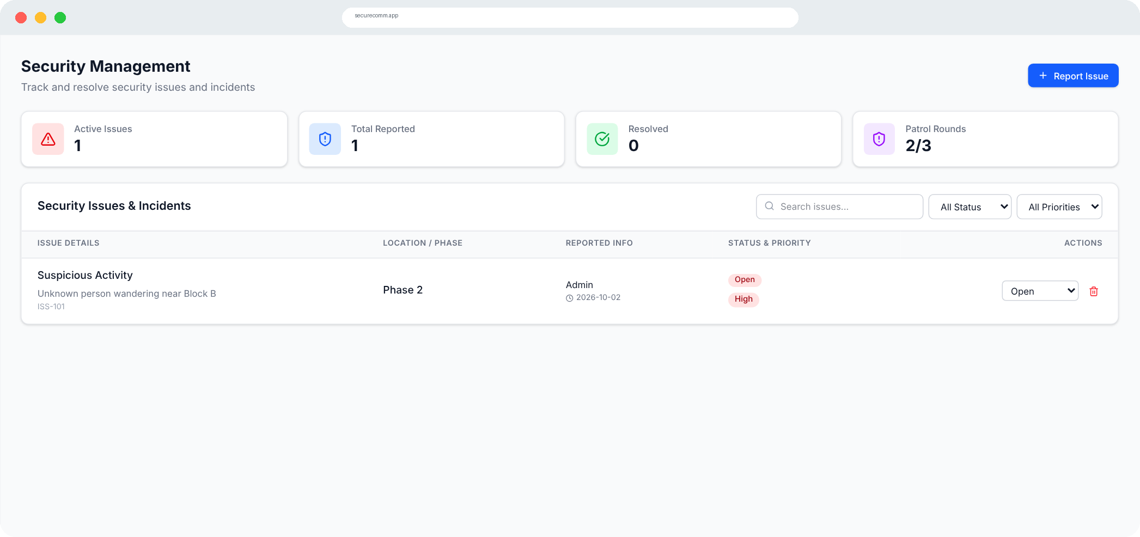
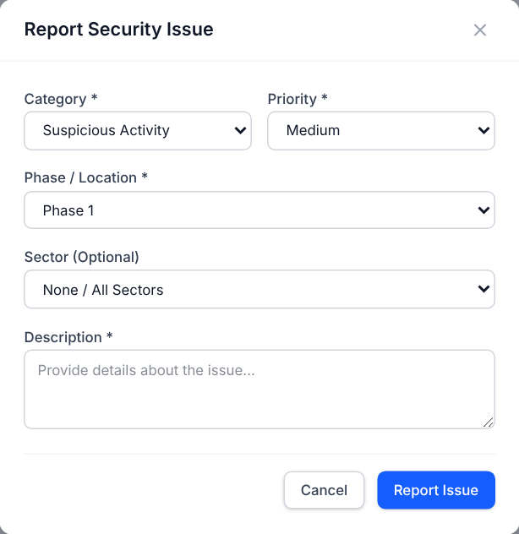


Security Issues: every incident, tracked to closure
MODULE 02 · SAFETY · SECURITY ISSUES
The community's incident register. Anyone, including residents, can raise an issue, and everyone can follow it until it is resolved.
WHO USES IT
Super Admin
Volunteer
Guard
Resident · report & view
WHAT GETS RECORDED
Category (5 incident types)
Priority: Low / Medium / High
Phase / location
Sector (optional)
Description of what happened
Reported by, date, ID (auto)
SUMMARY CARDS ON THIS PAGE
STATUS FLOW
Active issues (Open + In Progress)
Open
In Progress
Resolved
Total reported
Categories: suspicious activity, trespassing, vandalism, infrastructure damage, CCTV / camera fault.
Resolved
Patrol rounds completed (e.g. 2/3)
Notes:
Residents can press Report Issue, but only admins, volunteers and guards can change the status or delete an issue. Search works on category and description; filters work on status and priority.

Slide 10
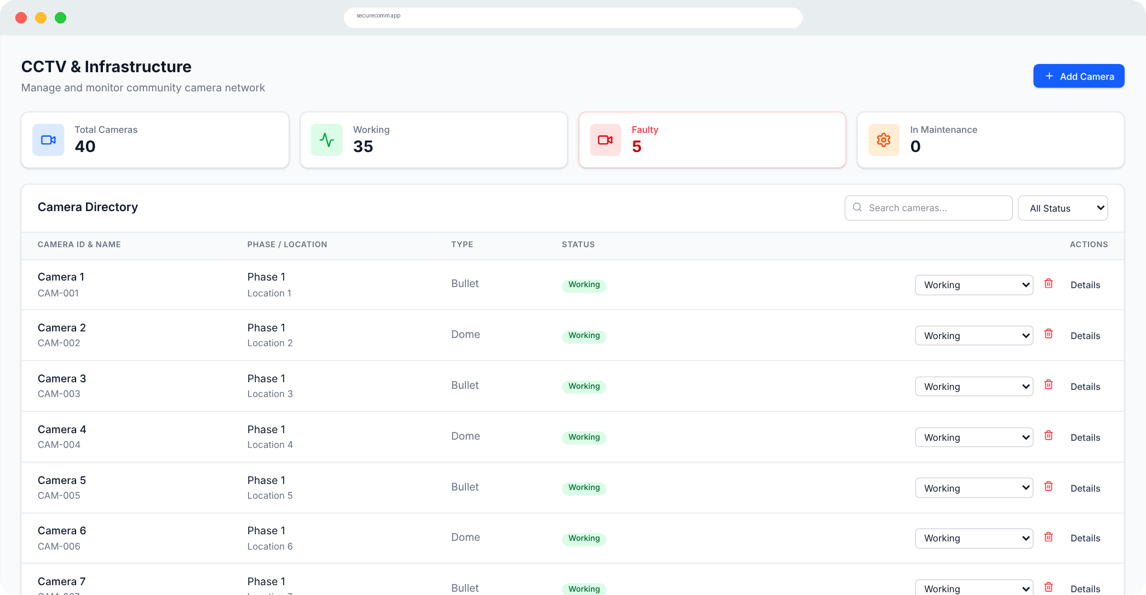
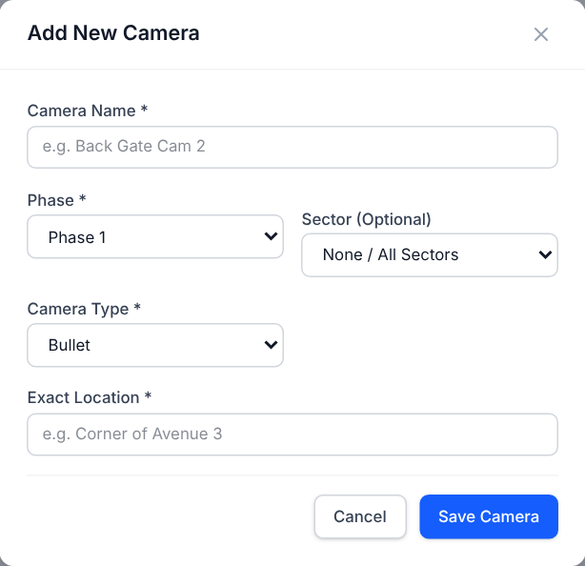

CCTV Cameras: is every camera actually working?
MODULE 03 · SAFETY · CCTV CAMERAS
A live directory of every camera in the community and its health, so a dead camera is noticed the same day — not after an incident.
WHO USES IT
Super Admin
Volunteer
Resident · view
WHAT GETS RECORDED
Camera name
Camera ID (auto, CAM-001…)
Type: Bullet / Dome / PTZ
Phase and sector
Exact location
Last maintenance date
CAMERA STATUS (CHANGE ANY TIME)
SUMMARY CARDS ON THIS PAGE
Working
Not Working
Under Maintenance
Total cameras
Working
Faulty count feeds the dashboard's CCTV Faults tile and the health donut.
Faulty
In maintenance
Notes:
Admins and volunteers add cameras and switch status from a dropdown in each row. Residents see the same list and counts, without the action column. Demo data: 40 cameras, 35 working, 5 faulty.

Slide 11
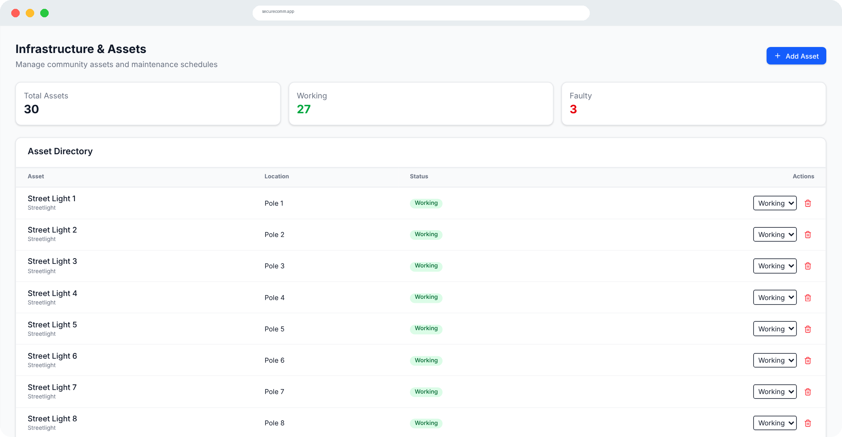

Street Lights & Assets: shared infrastructure
MODULE 04 · SAFETY · STREET LIGHTS & ASSETS
Tracks the shared equipment a community depends on — street lights, water pumps, generators and lifts — so faults are visible and get fixed.
WHO USES IT
Super Admin
Volunteer
WHAT GETS RECORDED
Asset name
Type: Streetlight / Water Pump / Generator / Lift
Phase and sector
Location (e.g. Pole 12)
ASSET STATUS
Working
Faulty
Summary cards show total, working and faulty assets for the selected phase. Demo data: 30 street lights, 3 faulty.
Notes:
New assets start as Working. Admins and volunteers flip status to Faulty when a complaint comes in and back to Working after repair. The dashboard's Street Lights tile links here.

Slide 12
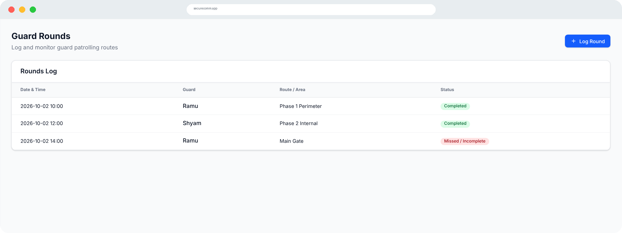

Guard Rounds: proof the perimeter is patrolled
MODULE 05 · SAFETY · GUARD ROUNDS
A log of every patrol round, so the committee and residents can see that guards actually walked their routes — and which rounds were missed.
WHO USES IT
Super Admin
Volunteer
Guard
WHAT GETS RECORDED
Date and time (pre-filled to now)
Guard name
Route / area (e.g. Peripheral)
Phase and sector
Notes (optional)
Round result
ROUND RESULT
Completed
Missed / Incomplete
Completed rounds also appear on the Security page as a 'Patrol Rounds 2/3' card.
Notes:
Guards log a round as soon as they finish it. Missed rounds are shown in red, which makes gaps in coverage obvious during committee reviews.

Slide 13
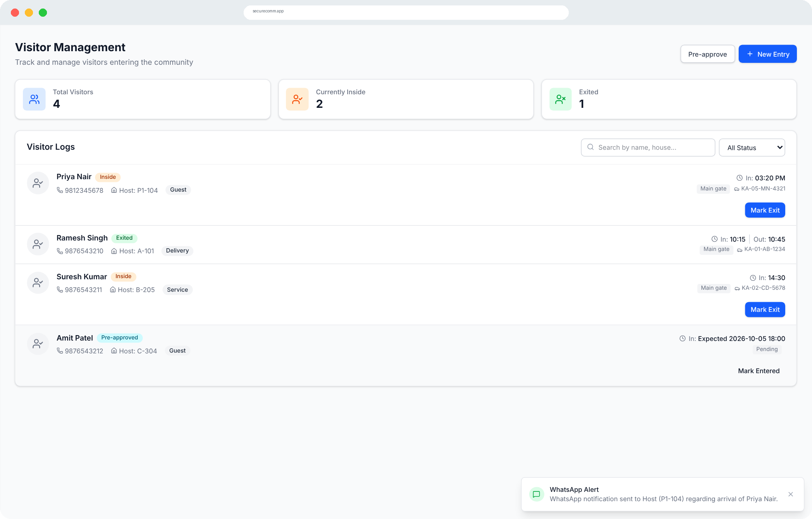
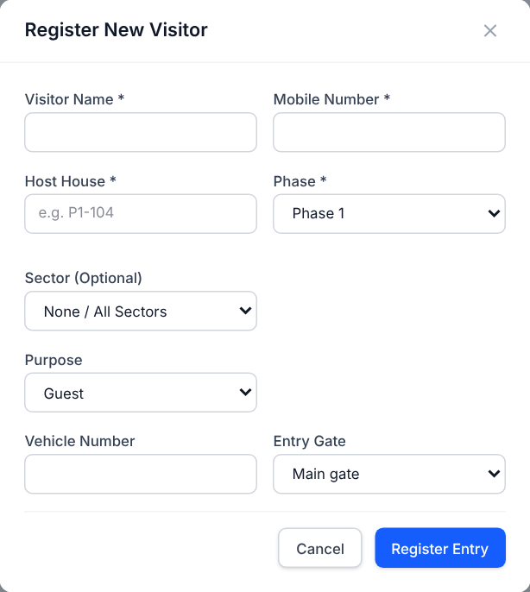
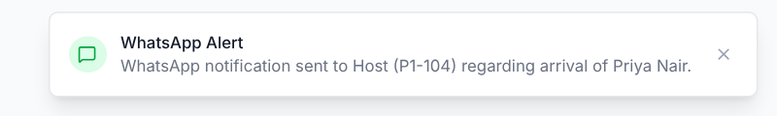

Visitors: a digital gate register
MODULE 06 · GATE · VISITORS (WALK-IN)
Replaces the paper book at the gate. The guard records each walk-in visitor in seconds, and the host is alerted straight away.
WHO USES IT
Super Admin
Volunteer
Guard
WHAT GETS RECORDED
Visitor name
Mobile number
Host house (e.g. P1-104)
Phase and sector
Purpose: Guest / Delivery / Service / Other
Vehicle number
Entry gate (5 gates)
Entry time (auto)
VISITOR STATUS
Inside
Exited
HOST ALERT ON ENTRY
On entry, the host gets a WhatsApp alert (simulated in the prototype — see the pop-up on the right).
Notes:
Gates in the prototype: Main gate, 4th phase entry gate, 3rd phase entry gate, and two sector gates. The guard presses Mark Exit when the visitor leaves, which records the exit time.

Slide 14





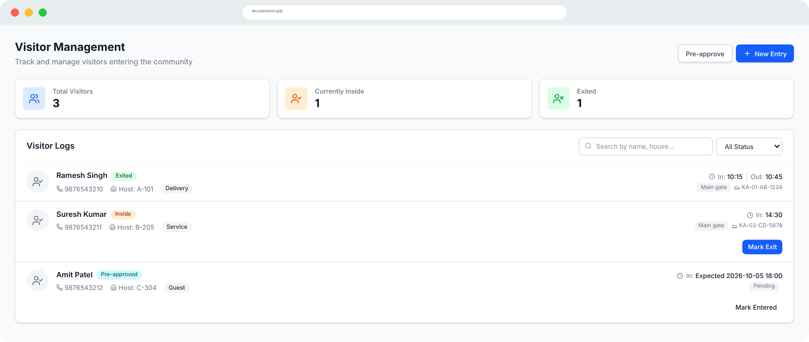
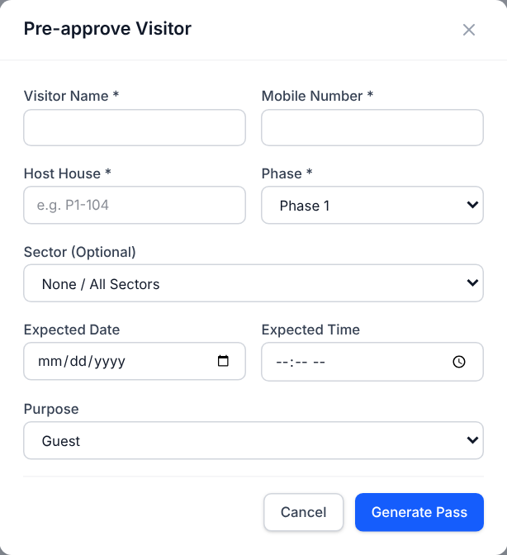
Pre-approval: expected guests walk straight in
MODULE 06 · GATE · VISITORS (PRE-APPROVED)
1. Pre-approve
2. Pass sent
3. Mark Entered
4. Mark Exit
Host or admin enters the visitor's name, mobile, host house and expected date and time.
A pass is generated and sent to the visitor's mobile. Status: Pre-approved, gate: Pending.
At the gate the guard finds the name and taps Mark Entered. Status becomes Inside.
When the visitor leaves, the exit time is stamped. Status becomes Exited.
ALL VISITOR STATUSES
Pre-approved
Inside
Exited
Denied
Notes:
Pre-approval removes waiting at the gate for expected guests, while still leaving a complete record. The visitor log can be searched by name or house and filtered by status.

Slide 15
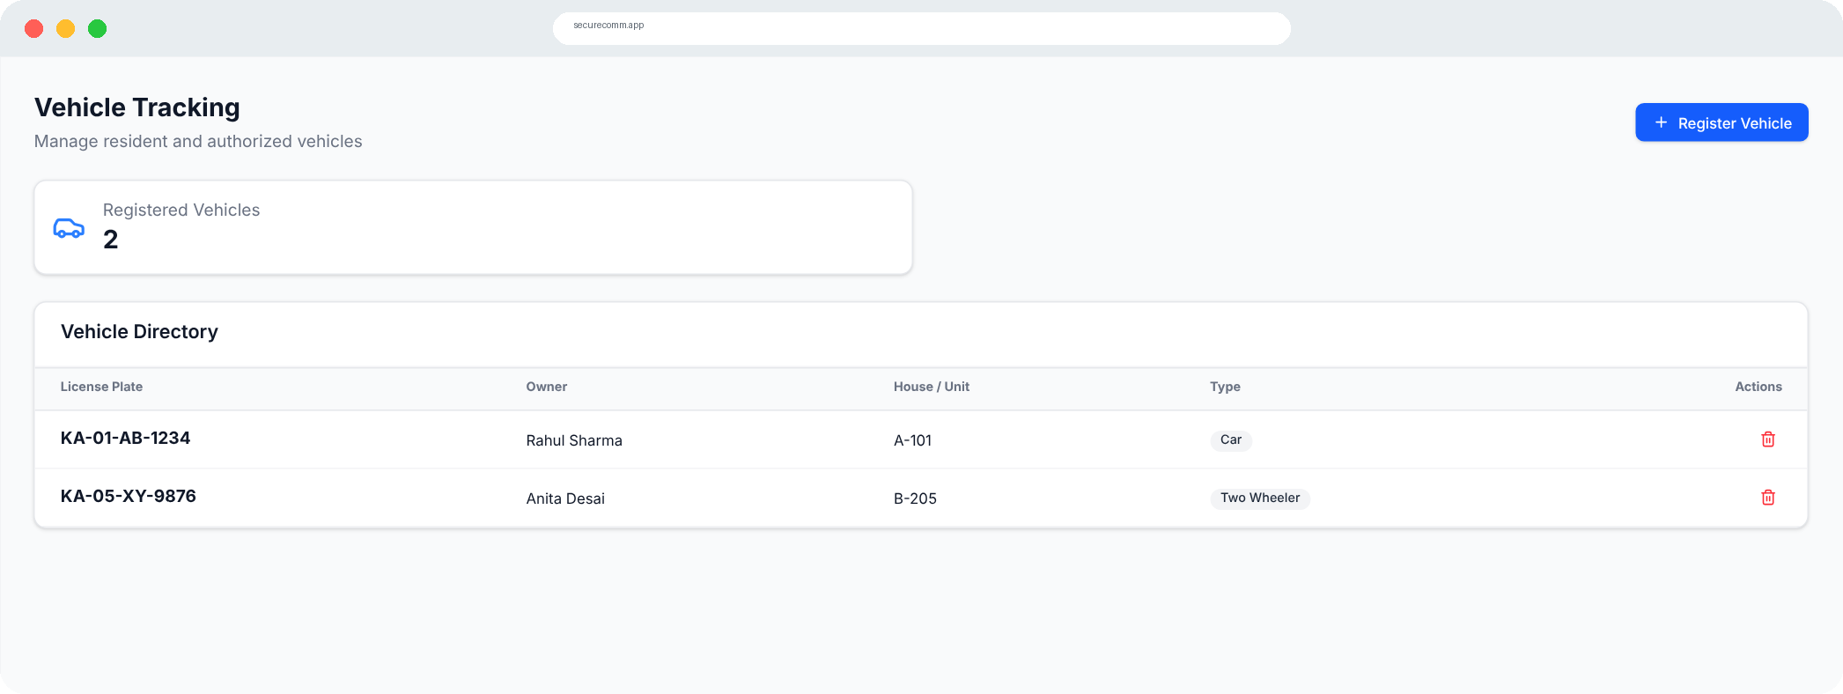

Vehicles: know a resident's car from a stranger's
MODULE 07 · GATE · VEHICLES
A register of resident and authorised vehicles, linked to houses, so guards can check a number plate at the gate in seconds.
WHO USES IT
Super Admin
Volunteer
Guard
WHAT GETS RECORDED
License plate (e.g. MH12AB1234)
Owner name
House / unit ID
Type: Car / Two-Wheeler / Commercial
Phase and sector
Registration date (auto)
LIFECYCLE
Register
Listed in directory
Remove when sold
Visitor entries also capture vehicle numbers, and the dashboard counts Vehicles Today.
Notes:
The directory shows owner, house, plate and type, with a count of registered vehicles for the selected phase.

Slide 16
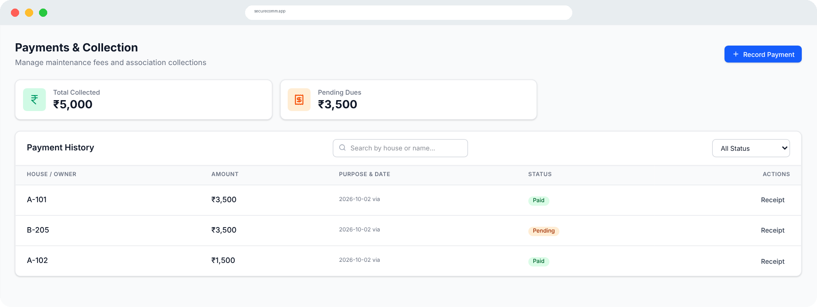
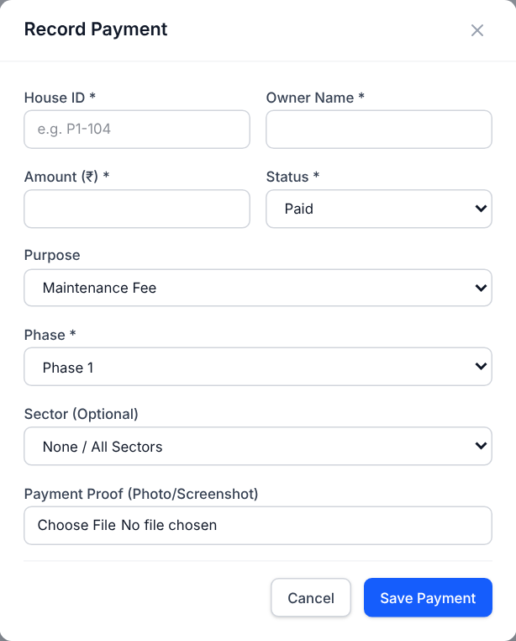

Payments: every rupee collected, with proof
MODULE 08 · MONEY · PAYMENTS
Every maintenance fee and contribution is recorded against a house, with a proof screenshot, so dues are never a matter of memory.
WHO USES IT
Super Admin
Volunteer
Resident · view
WHAT GETS RECORDED
House ID and owner name
Amount (₹)
Purpose: Maintenance / Event / Fine
Payment method (UPI default)
SUMMARY CARDS ON THIS PAGE
Payment proof photo
Phase and sector
Total collected (Paid only)
Pending dues (everything not Paid)
PAYMENT STATUS (ALSO: OVERDUE)
Pending
Paid
Saving a payment sends the owner a WhatsApp receipt (simulated); the proof can be opened from the list.
Notes:
Payment history can be searched by house or name and filtered by Paid or Unpaid. Residents can see the list, which is what makes collections transparent.

Slide 17
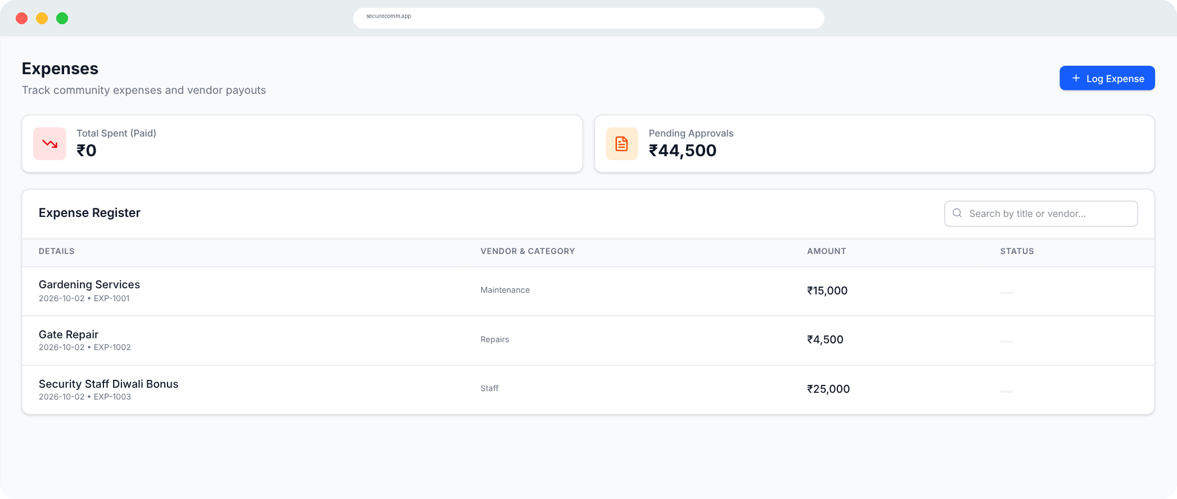
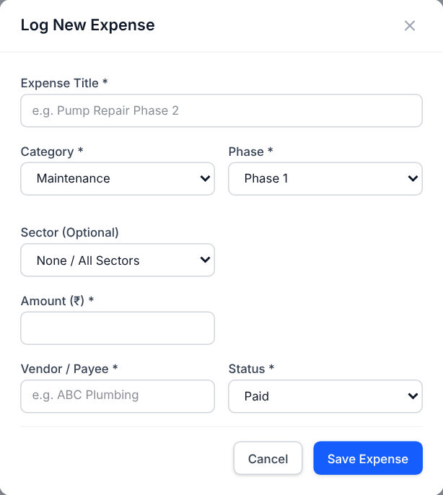
Expenses: where the money goes
MODULE 09 · MONEY · EXPENSES
The other half of the ledger: every rupee spent, what it was for, and who was paid — with a separate stage for spends awaiting approval.
WHO USES IT
Super Admin
Volunteer
WHAT GETS RECORDED
Expense title
Category (5 types)
Amount (₹)
Vendor / payee
Phase and sector
Date (auto)
SUMMARY CARDS ON THIS PAGE
Total spent (Paid only)
EXPENSE STATUS
Pending approvals
Pending Approval
Paid
Categories: maintenance, security services, utilities (water / electricity), events, other.
Notes:
The expense register can be searched by title or vendor. Paid expenses feed the dashboard's Total Expenses tile and the savings figure.

Slide 18
Collections − Expenses = Savings, for everyone to see
MONEY · HOW IT ADDS UP
−
=
Collections
Expenses
Savings
₹5,000
₹44,500
−₹39,500
Paid payments
Paid expenses
Shown on the dashboard
Why this matters
A deficit like this one is visible the moment it happens — not at the year-end meeting. Residents can see the same collection and spending figures the committee sees, and the phase filter shows which part of the community each rupee came from or went to.
Notes:
All amounts are prototype demo data. Only records marked Paid count towards collections and expenses; pending items are shown separately.

Slide 19
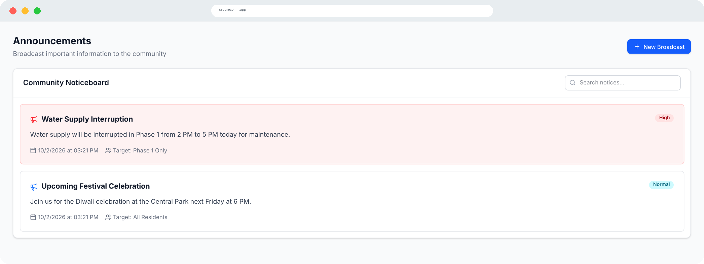
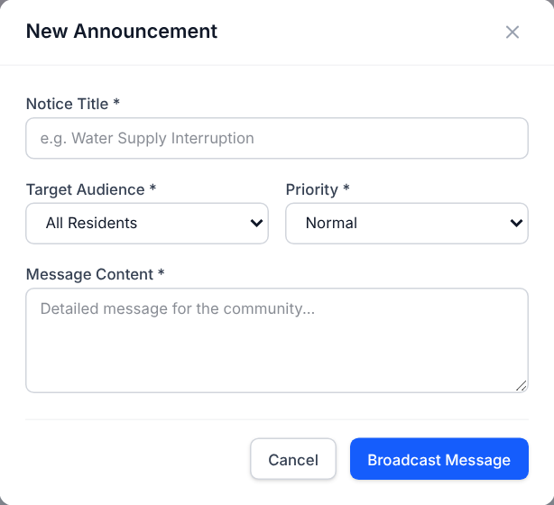

Announcements: one official noticeboard
MODULE 10 · COMMUNITY · ANNOUNCEMENTS
One place for every official notice — water cuts, events, emergencies — instead of messages scattered across WhatsApp groups.
WHO USES IT
Super Admin
Volunteer
Guard · view
Resident · view
WHAT GETS RECORDED
Notice title
Message content
Target: All Residents / Phase 1 / Phase 2 / Security Team
Priority: High (Emergency) / Normal / Low
SUMMARY CARDS ON THIS PAGE
Date and time (auto)
Searchable noticeboard
Priority badge on each notice
WHAT HAPPENS ON BROADCAST
Write
Broadcast
WhatsApp alert
Noticeboard
Target audience shown
High-priority notices are highlighted in red and also appear on the dashboard.
Notes:
Only admins and volunteers see the New Broadcast button. Guards and residents read the noticeboard and can search it.

Slide 20
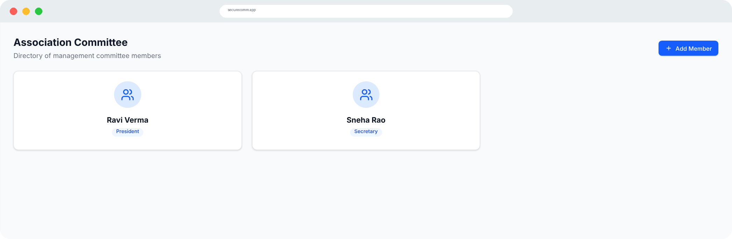

Association: who runs the community
MODULE 11 · COMMUNITY · ASSOCIATION
A public directory of the management committee — names, roles and contacts — so residents always know whom to approach.
WHO USES IT
Super Admin
Volunteer
WHAT GETS RECORDED
Member name
Role: President / Secretary / Treasurer / Member
Phase and sector they represent
Contact number
LIFECYCLE
Add member
Directory card
Remove when term ends
Each member appears as a card with a role badge; the phase switcher shows each phase's representatives.
Notes:
Demo data has Ravi Verma as President for Phase 1 and Sneha Rao as Secretary for Phase 2.

Slide 21
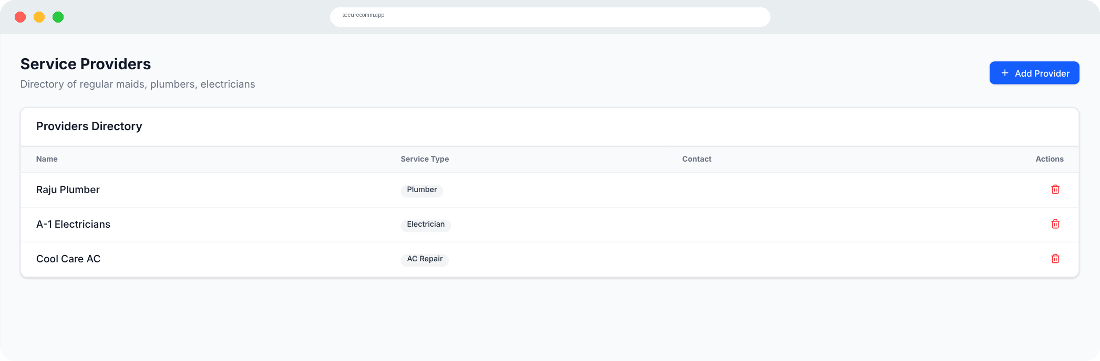

Service Providers: a trusted directory
MODULE 12 · COMMUNITY · SERVICE PROVIDERS
A shared list of the people who work in homes, with a verified badge, so residents can hire with confidence and guards know who to expect.
WHO USES IT
Super Admin
Volunteer
Guard · view
Resident · view
WHAT GETS RECORDED
Name
Service type (13 types)
Contact number
Phase, or all phases
Sector (optional)
Verified by association
LIFECYCLE
Add provider
Verify
Residents call directly
Types: maid, cook, driver, plumber, electrician, carpenter, painter, gardener, AC and fridge repair, deep cleaning, pest control, other.
Notes:
Admins and volunteers add or remove providers; everyone else sees the directory. Settings can auto-approve known service providers at the gate.

Slide 22

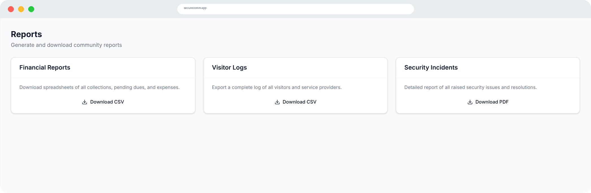
Reports: records ready for any meeting
MODULE 13 · MONEY · REPORTS
One-click exports for annual meetings, audits and disputes. Available to the Super Admin and volunteers.
CSV
CSV
PDF
Financial reports
Visitor logs
Security incidents
All collections, pending dues and expenses in a spreadsheet.
A complete log of all visitors and service providers.
Every issue raised and how it was resolved.
Use: Treasurer's statement at the AGM
Use: Checking who entered on a given day
Use: Reviewing security agency performance
In the prototype the download buttons are placeholders that show the intended experience.
Notes:
Reports turn the day-to-day records into documents the committee can share. Download buttons currently show a demo message.

Slide 23
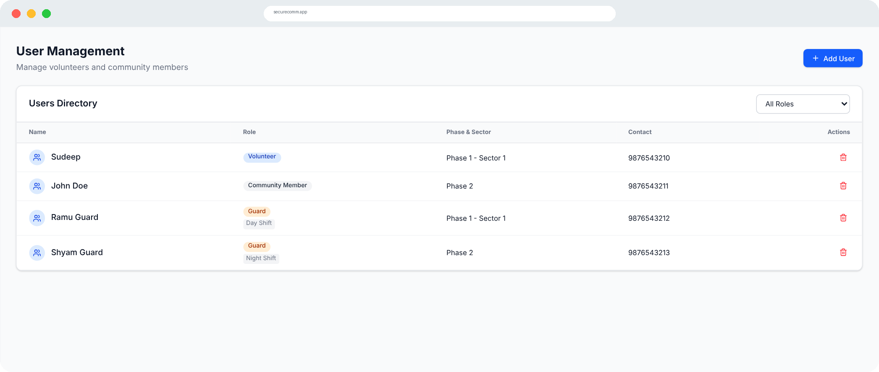
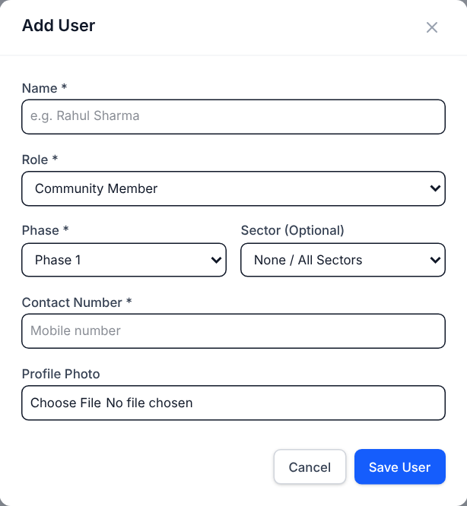

Users: who is on the platform, in what role
MODULE 14 · CONTROL · USER MANAGEMENT
The Super Admin's control room for people. Every resident, volunteer and guard is added here with a role, phase and contact.
WHO USES IT
Super Admin
WHAT GETS RECORDED
Full name
Role: Community Member / Volunteer / Guard
Guard shift: Day / Night / Reliever
Phase and sector
Contact number
Profile photo
SUMMARY CARDS ON THIS PAGE
Role badge on every user
LIFECYCLE
Shift tag for guards
Add user
Role badge
Filter
Remove
Anyone else who opens this page sees: 'You do not have permission to view this page.'
Notes:
The shift field only appears when the role is Guard. A confirmation message appears when a user is added or removed.

Slide 24
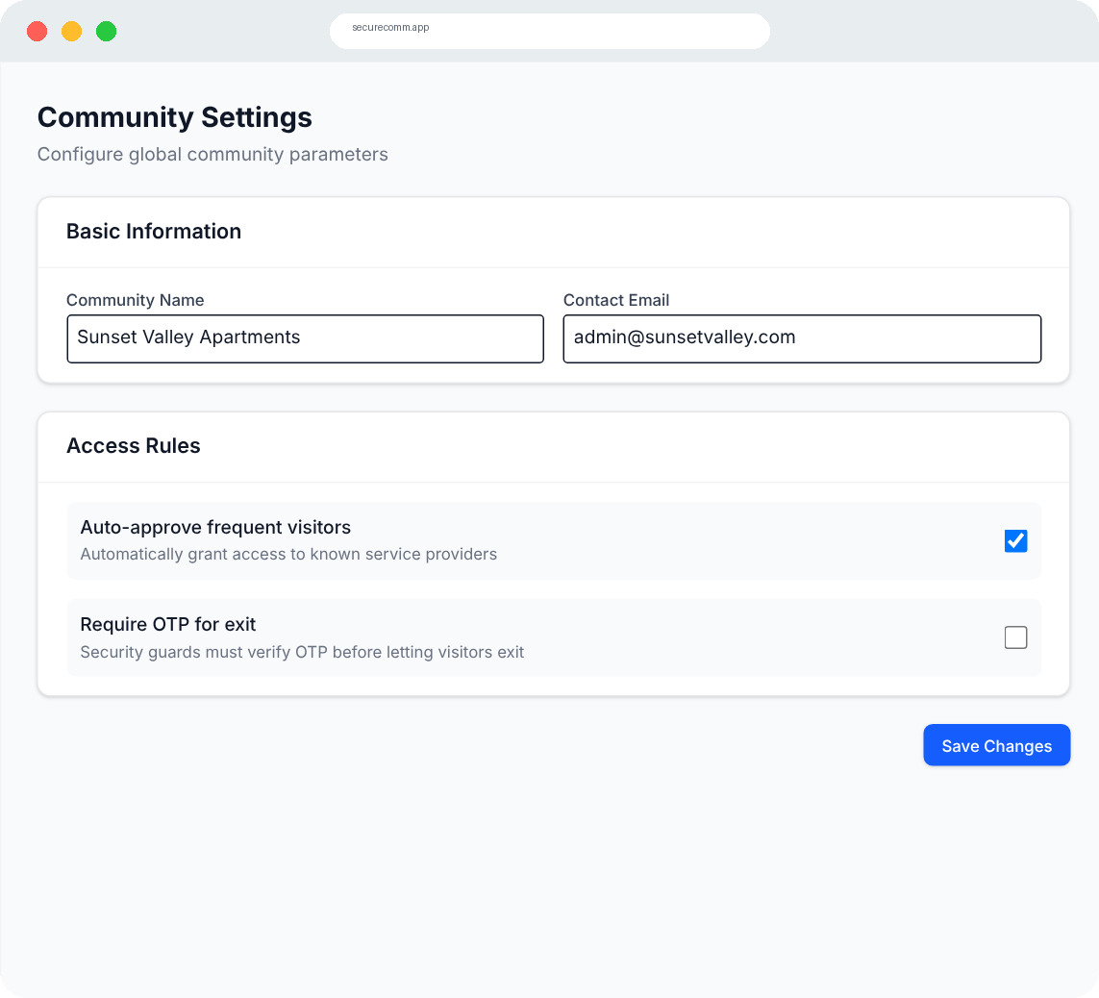



Settings: community-wide rules, set once
MODULE 15 · CONTROL · COMMUNITY SETTINGS
Only the Super Admin can open Settings. These choices apply to everyone in the community.
Basic information
Community name (e.g. Sunset Valley Apartments) and the official contact email.
Auto-approve frequent visitors
Known service providers are let in automatically, so maids and drivers don't wait at the gate every day.
Require OTP for exit
Guards must verify a one-time code before a visitor leaves — a stronger check for sensitive layouts.
Notes:
Settings are a demo in the prototype (saving shows a confirmation). They show how gate rules would be controlled centrally.

Slide 25
Built for large, multi-phase layouts
PHASES & SECTORS
6 + 2
phases and sectors
755
houses
2,170
residents
Every record carries a phase and an optional sector. Admins and volunteers use the phase switcher in the header to filter every module to one phase.
Notes:
Sample phase data from the prototype. Phase-level filtering lets each phase's volunteers focus on their own area while the Super Admin sees everything.

Slide 26

Your profile shows your own footprint
PERSONAL ACCOUNTABILITY
Click your name in the top-right corner to open User Profile & Activity. It summarises what you have done on the platform.
Issues reported
Why it builds trust
Every incident you raised and its current status
Residents can prove what they paid and when.
Volunteers' and guards' work is visible, not invisible.
Disagreements are settled by records, not by memory.
Visitors hosted
Guests, deliveries and services that came to your house
Payments made
Your dues, contributions and fines, with dates
Notes:
In the prototype the activity panel uses the demo data for everyone; with real logins it would filter to the signed-in person.

Slide 27
A day in the community, through SecureComm
PUTTING IT TOGETHER
06:00
Guard
Guard Ramu logs the Phase 1 perimeter round as Completed.
Guard Rounds
10:15
Guard
A delivery arrives at the Main gate. Entry is logged; the host gets a WhatsApp alert.
Visitors
11:30
Resident
A resident reports a broken street light near Block B as Medium priority.
Security Issues
12:00
Volunteer
A volunteer marks the issue In Progress and the light as Faulty.
Street Lights
15:00
Volunteer
Repair is paid; the volunteer logs a ₹4,500 expense and marks the issue Resolved.
Expenses
18:00
Super Admin
The admin broadcasts a water-cut notice to Phase 1 only.
Announcements
21:00
Resident
Residents open the dashboard: issue resolved, money spent, notice received.
Dashboard
Notes:
This scenario shows how the modules connect: a single street-light complaint moves through Security Issues, Street Lights and Expenses, and ends up visible to everyone on the dashboard.

Slide 28
Transparency builds trust.
15 modules, 4 roles, one shared record. When residents, volunteers, guards and admins all see the same facts, communities run safer and fairer.
Thank you · Questions?
Notes:
Close with the core message and offer a live demo using the role switcher.

